Slide 1
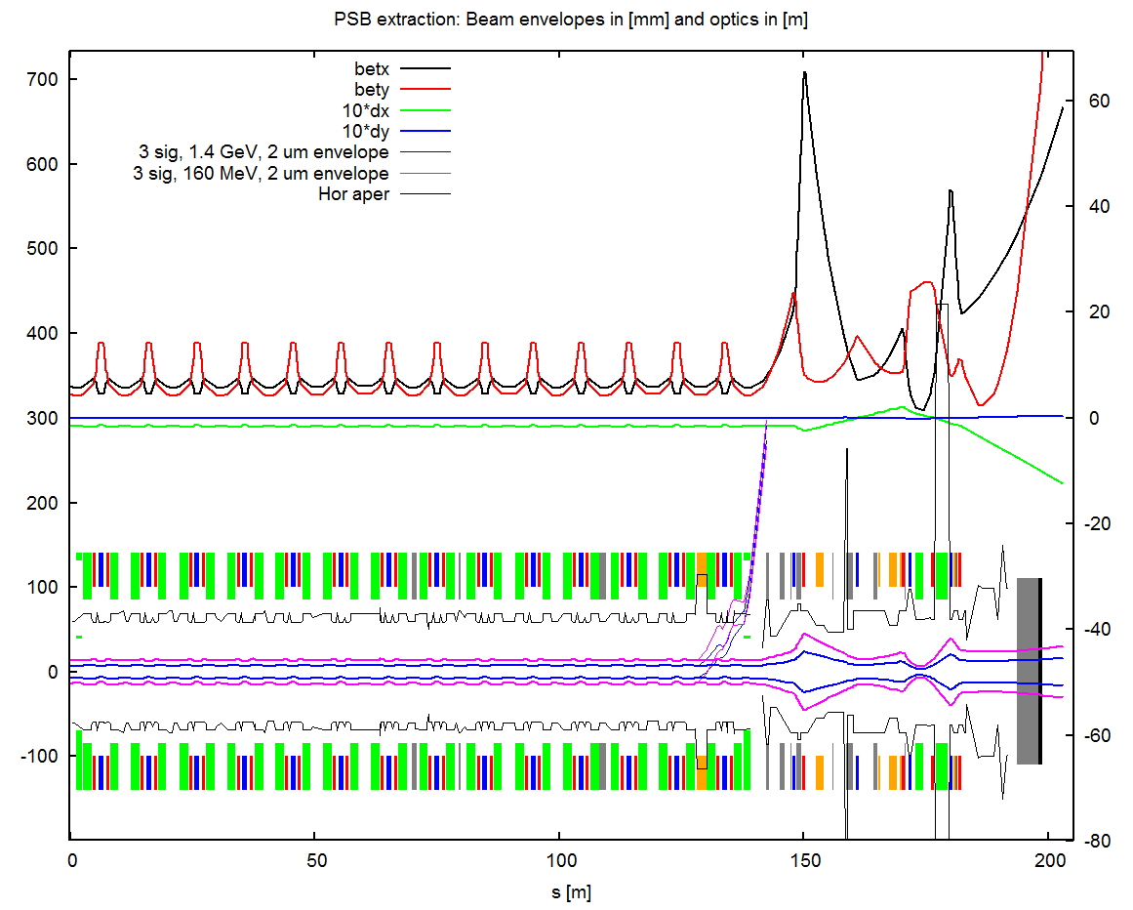
PSB extraction @160 MeV, 2 um, HOR
betx,y, dx,y in [m]
Envelope, aperture in [mm]
PSB ring up to SMH15
BT
BTM+dump
Notes:
Pos. and angle at septum (nominal values) → bumper off → rematch to get the same position/angle

Slide 2
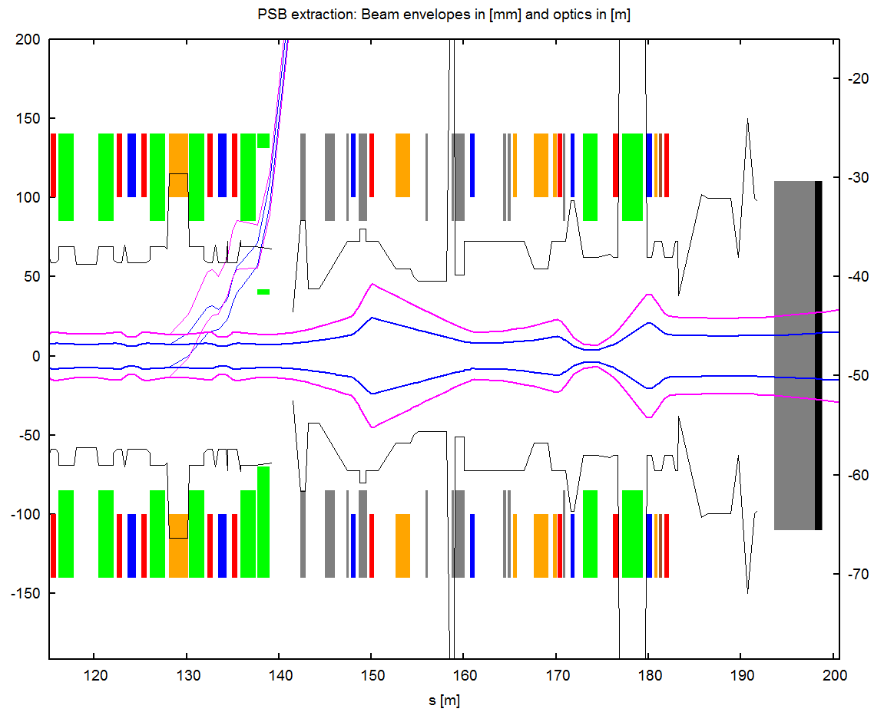
PSB extraction @160 MeV, 2 um, HOR
Extraction envelopes (thin):
blue:
with operation values for BSW14L4, KFA14 and SMH15
magenta:
bumper is off,
matched kicker and septum strength to same angle and position at septum exit
thick envelopes show beam vs aperture in the ring and in the lines for 1.4 GeV and 160 MeV
Aperture is tight at upstream bend of SMH15 (BR.BHZ142)
Envelope, aperture in [mm]

Slide 3
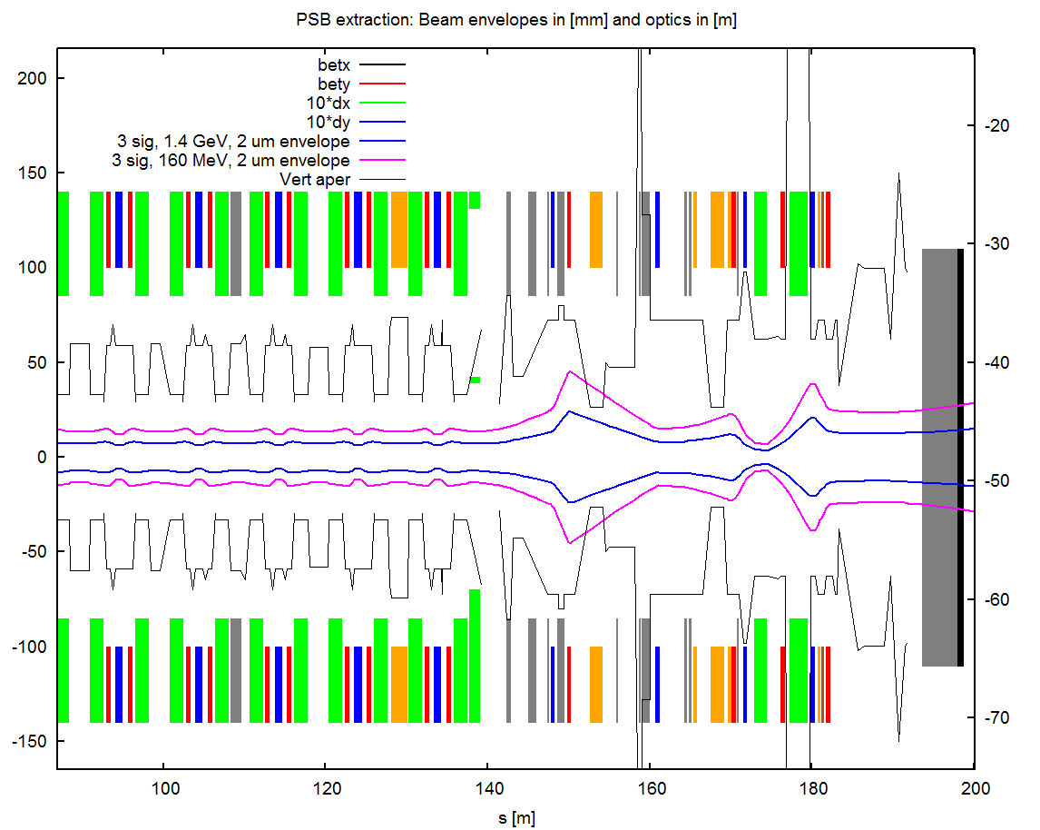
PSB extraction @160 MeV, 2 um, VERT
Vertical plane:
no problem at the extraction septum but KFA10 in the BT line cuts the 160 MeV beam at ±2 sigma
Envelope, aperture in [mm]

Slide 4
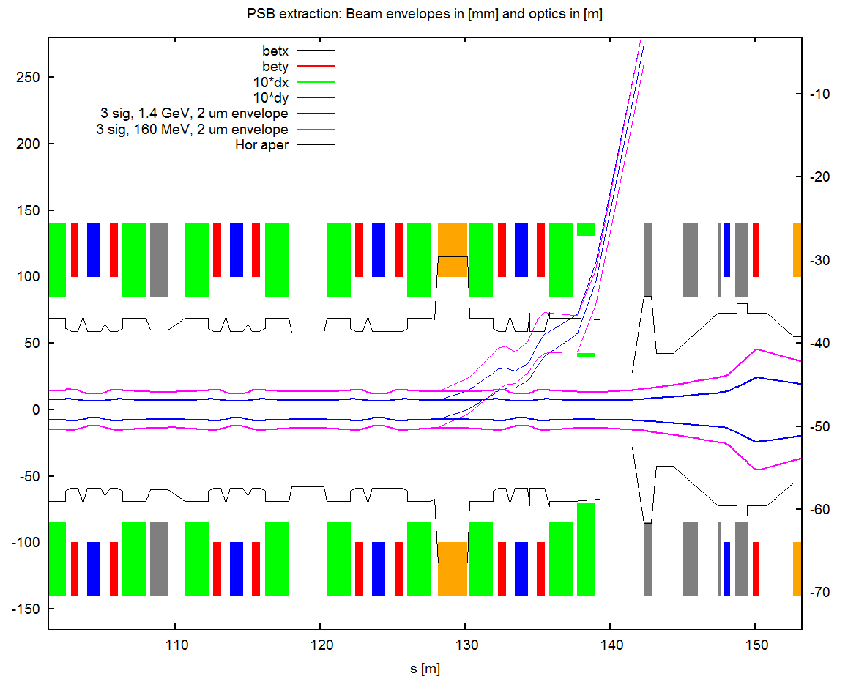
PSB extraction @160 MeV, 2 um, HOR
Limiting the kicker to 10 mrad improves the aperture, not perfectly matched in pos/angle but probably good enough to thread the beam through BT
Envelope, aperture in [mm]

Slide 5
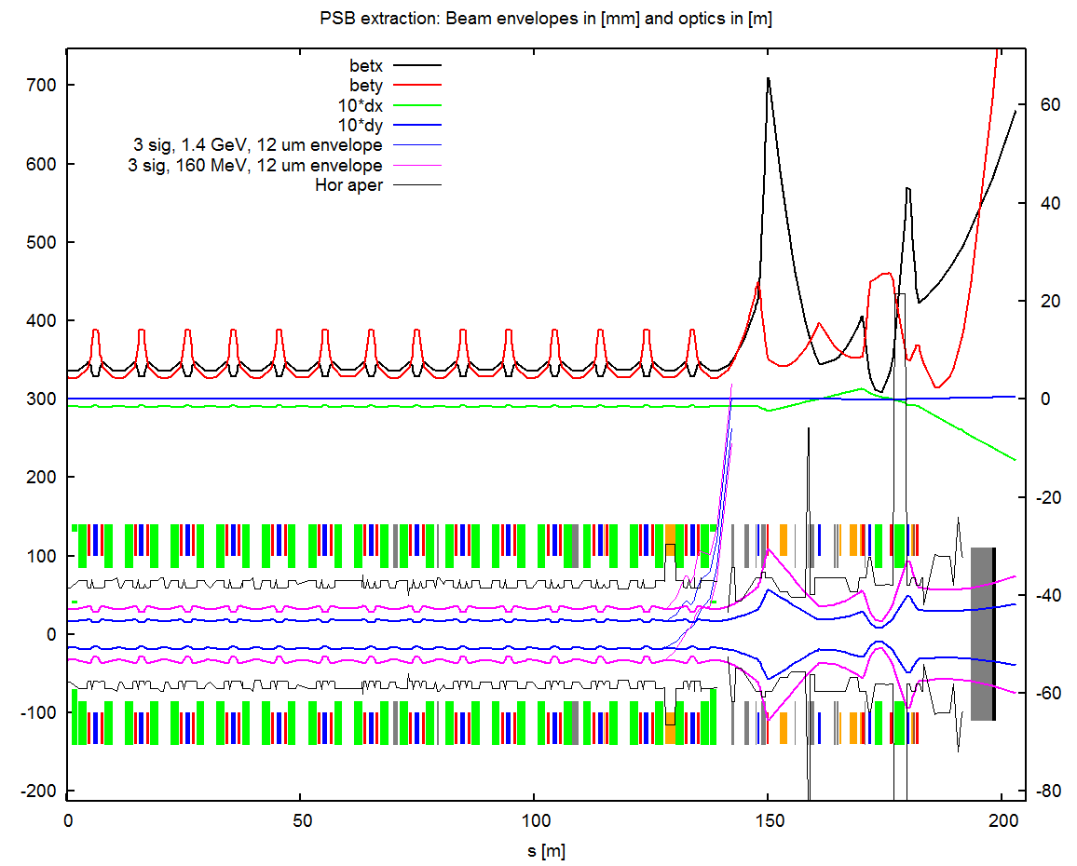
PSB extraction @160 MeV, 12 um
betx,y, dx,y in [m]
Envelope, aperture in [mm]

Slide 6
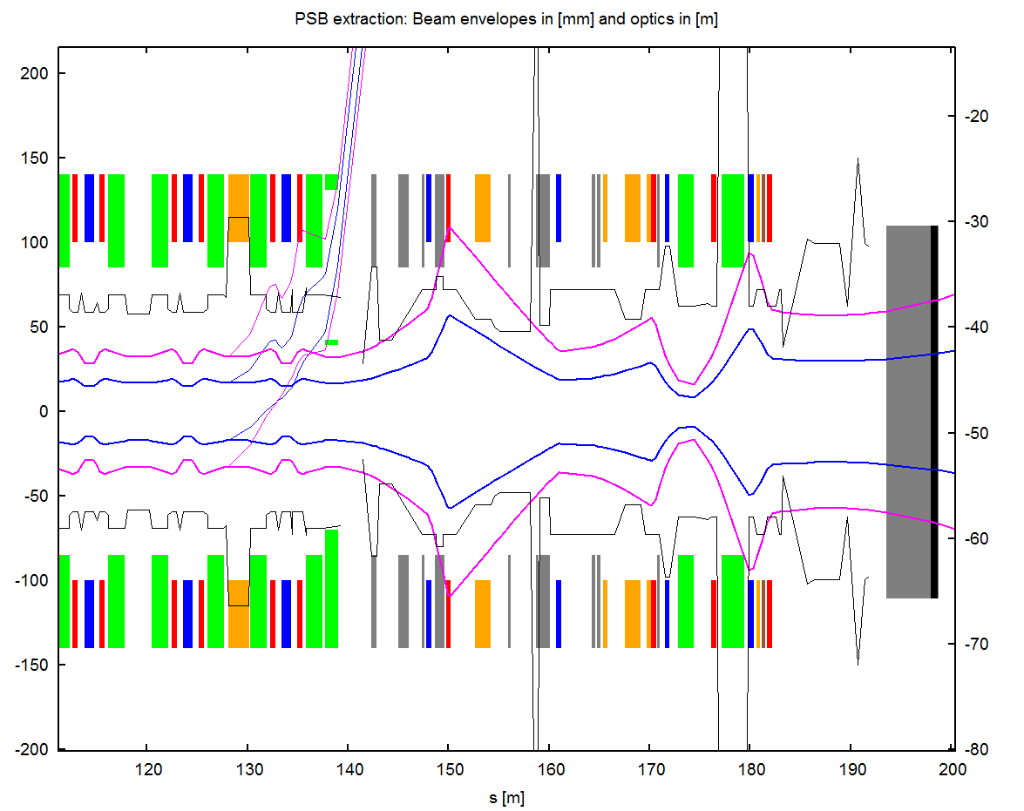
PSB extraction @160 MeV, 12 um
The big emittance beams at 160 MeV would cause losses all over the place...
Envelope, aperture in [mm]

Slide 7
Magnet strenghts
Present extraction: Ekin: 1.4 GeV, Brho: 7.14 T.m
Magnet | Kick [mrad] | U/I | B.dl [T.m] | B.dl NOM [T.m] | U/I NOM
BSW14L4 | 9.1 |  | 0.065 | 0.095 | 765 A
KFA14L1 | 7.2 | 41 kV | 0.051 | 0.073 | 58 kV
SMH15L1 | 46.8 | 7000 A | 0.334 | 0.336 | 7038 A
Extraction at Linac4 inj energy: Ekin: 160 MeV, Brho: 1.9 T.m
Magnet | Kick [mrad] |  | B.dl [T.m] | B.dl NOM [T.m]
BSW14L4 | 0 |  | 0 | 0.095 | 765
KFA14L1 | 12.1 | 18 kV* | 0.023 | 0.073 | 58 kV
SMH15L1 | 54.3 | 2161 A | 0.103 | 0.336 | 7038 A
*min = 10 kV

Slide 8
Summary
160 MeV extraction (with current 1.4 GeV transfer line settings) looks OK with:
  Small emittance beams (~2um)
  Potential losses:
    horizontal plane at region of BR.BHZ142 (PSB ring)
    vertical plane at BT.KFA10 (BT line)
  Slightly wrong angle/pos at SMH15 exit
Magnet strengths
  OK for BE.KFA14 and BE.SMH15
Bigger emittances NOT OK aperture-wise at extraction and in the lines

Slide 9
Possible further steps
Optimised BT line optics might be able to reduce losses at BT.KFA10
Slow extraction bump ON (at reduced value) at injection might improve losses in the ring (bump closure might interfere with measurement of chicane and painting bump closure during Linac4 injection commissioning)
An MD could be organised next year to check the feasibility of the scheme and measure the extraction bump closure

