Slide 1
Considerations for a
Lepton Factory in the LHC tunnel
November 11th, 2025
Pantaleo Raimondi
Fermilab/CERN

Slide 2
Outline
Considerations on high energy lepton super-factory
ARC scaling laws
Optics beyond FODO
Final Focus system
Hardware requirements
Performances
Conclusions

Slide 3
High energy superfactory (1)
Factory-era based on the idea of increasing the collision frequency by having as many bunches as possible tightly packed => 2 rings
Superfactory-era based on large piwinsky angle and crab waist (LPA&CW):
- Much simpler to separate/recombine the 2 beams/rings
- Longitudinal collision area not dependent by bunchlength
- Small vertical betafunctions
- “Small vertical tuneshift” & “Negligible horizontal tuneshift”
- Luminosity increases indefinitely by lowering horizontal (and vertical) emittance
- Luminosity increases indefinitely by lowering betay* (and betax*)
Challenges fall on the optics: low emittance & low betas*

Slide 4
High energy superfactory (3)
LPA&CW at high energy
- Difficult to achieve small emittances at high energy
- Difficult to make small betay*
Need a local chromatic correction attached to the FD
Upstream dipoles have to be weak (and long)
SR in the FD impairs the Quantum SR Lifetime
- Luminosity lifetime is very short: need a booster
- SR power limits the number of bunches:
@Z only 10% of the ring (buckets) is full
@ttbar ~0% of the ring is full => hardly a ‘factory”

Slide 5
LEP3 vs FCC Superfactory
LEP3/FFC length ratio ARC about 0.31 =>
- 3 times lower current (constant SR/RF power), @Z 97% of the ring is empty
- 2 vs 4 IPs
LEP3 potential should assume:
- ARC lattice that delivers same FCC emittance
- FF that delivers same betas*
- sqrt(2) larger vertical tune shift (because 2 IPs)
Luminosity could be around 50% wrt FCC (per IP)
If the y-tuneshift is only limited by the half-integer (FCC assumption @Z), the luminosity could be around 70% wrt FCC @Z.
Since at ZH the half-integer is crossed for FCC, L@LEP3 can’t easily exceed 50% of the L@FCC

Slide 6
LEP3 challenges
Not a green field:
Cons: Limits to performances and options
Pros: Reuse existing infrastructure
Conceive an ARC lattice that delivers an FCC-like horizontal emittance
Conceive a Final-Focus system with FCC characteristics that can be implemented with minimum impact on the existing layout
Optimize parameters for optimal performances specific to LEP3
Optimize hardware for cost and power consumption
Optimize the RF system for LEP3
Optimize LEP3 for the RF system
Scaling from other machines and scaling laws might mislead us
Specificity of the requirements should drive the choice of technical solutions

Slide 7
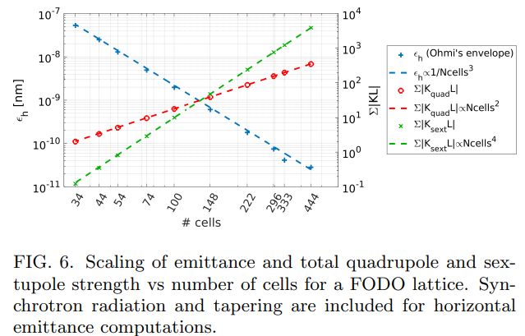
Lattice parameters scaling with the number of cells
Doubling the number of cells:
- makes the emittance 8 times smaller
- requires 2 times more quads with
2 times more integrated gradient
- requires 2 times more sexts with
8 times more integrated gradient
When the required fractional space for quads
and sexts becomes increases (>10%) all the
scaling laws worsen
DA roughly scales with 1/n^3
MA roughly scales with 1/n
P. Raimondi and S. M. Liuzzo, Toward a diffraction limited light source,
Phys. Rev. Accel. Beams 26, 021601 (2023)
To reduce the DA&MA shrinking, deviations from a pure a FODO can help
- “Second generation” factories based on LPA&CW do require very small emittances
- Most powerful emittance-knob for a FODO lattice is the number of cells
- Higher Horizontal phase advance helps (optimum around 120deg, Ex ~30% lower wrt 90deg lattice)
- Maintain satisfying DA&MA becomes harder
- Issues to be addressed are very similar to the ones faced by fourth gen Synchrotron Light Sources

Slide 8
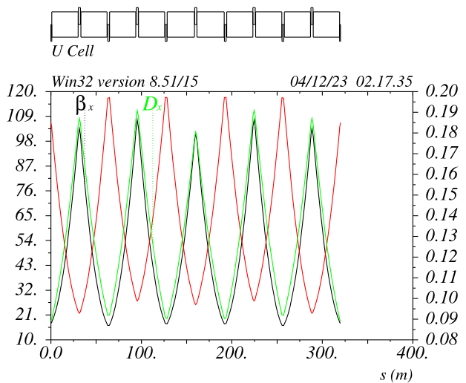
HFD-100/74 with 4 sextupole families FCC ttbar mode
SF1 SF2
SD1 SD2
The cell structure is quasi-periodic:
2 quads families: QF&QD
The dipoles have all same length
Sextupoles are placed left-right symmetric.
Their position wrt the nearby quad (before or after) has been chosen to minimize aberration
Given the fact that only 2 sextupoles out of 10 possible are missing the second order chromaticities do remain very small
4 sextupole families are indeed very effective to cancel the first order detunings of a FODO lattice for a large range of the horizontal phase advance

Slide 9
HFD FCC-ttbar scaling to LEP3
HFD 100/80 for ttbar is composed of about 240 cells
Each cell, about 300mt long consists of:
10 dipoles 28.4mt
5 QFs 2.9mt
5 QDs 1.9mt
4 SFs 0.32mt
4 SDs 0.50mt
HFD intrinsic emittance of about 1.75nm@182.5GeV
HFD intrinsic emittance of about 0.71nm@116GeV
HFD @LEP3 will require about 216 cells to deliver 1nm@116GeV
Cell length shrinks by about 2.8*216/240 => ~2.5
Quadrupole integrated gradients do increase by about: 2.5
Sextupole integrated gradients do increase by about: 6.25

Slide 10
Low emittance lattice for smaller ring: FCC=>LEP3
Number of cells/magnet density uncomfortable
Quads/Sexts/Drifts are a significant fraction of the cell length,
further degrading its characteristics
Solutions based on concepts developed for Light Sources might
help to improve performances and reduce criticalities
EBS (small ring & small emittance) has effectively addressed these issues,
similar solutions can be studied for LEP3

Slide 11
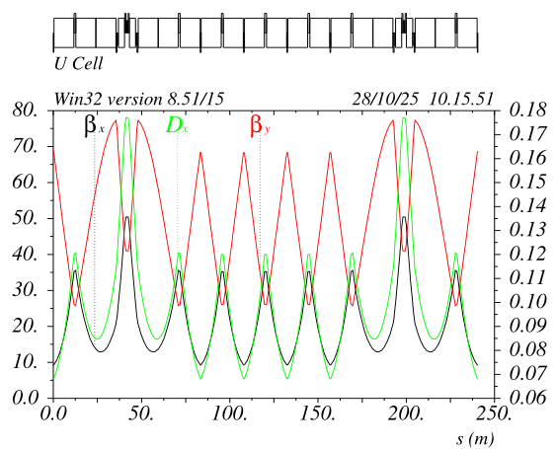
EBS Achromat cell adapted for LEP3 Z/W/ZH mode
SD1 SD2
SF1
Sextupoles are grouped in
an high beta/dispersion region
Phase advance between the sextupoles:
dmux ~ 3pi
dmuy ~ pi
Given the phase relations all the detunings are intrinsically small, effective dmux and dmuy are slightly adjiusted (few %) to compensate for the interleaved sextupoles sheme.
Betas and dispersion at sextupoles and dispersion are optimized for best performance

Slide 12
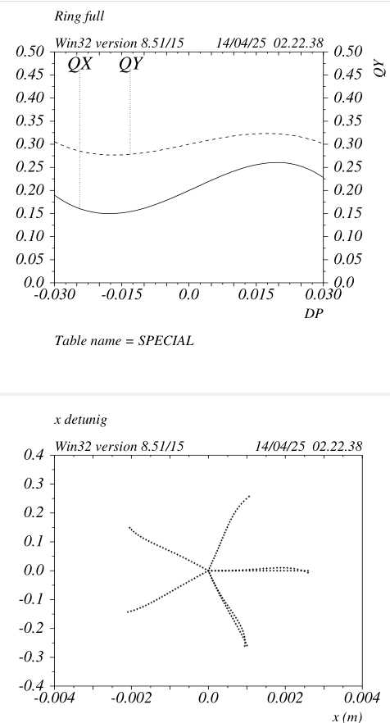
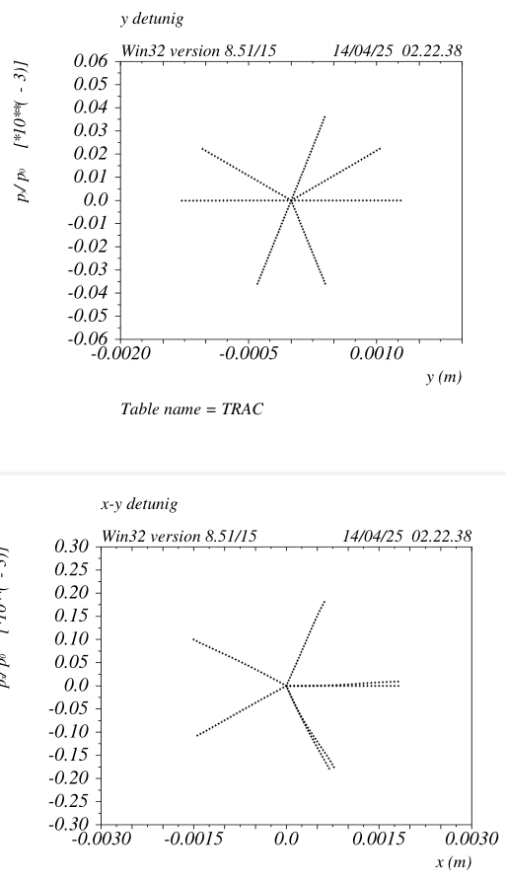
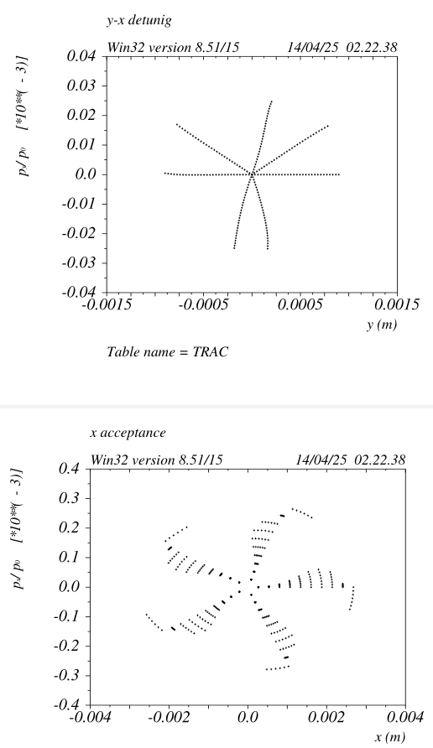
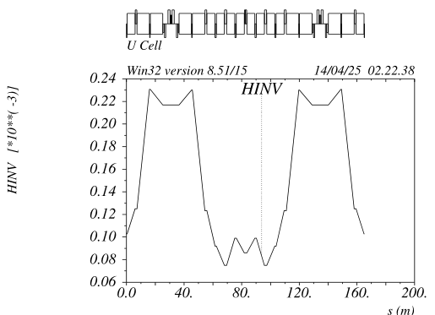
Chromatic and DA properties LEP3 HFD ZH mode
High order chromaticities
are small, MA>+/-3%
No visible high order x detuning
Energy dependent detuning is very small as well (not shown)
(Repeat) All the studies are based on
cell designs with vanishing RDTs up to the second order

Slide 13
HFD: EBS Achromat cell adapted for LEP3 Z/W/ZH modes
SD1 SD2
SF1
Lattice layout:
88 Cells ~240mt long
Each cell consists of:
- 18 dipoles ~12mt long
- 25 quadrupoles with gradients ~ 22T/m
- 6 sextupoles with gradients ~ 900T/m2
@45.6GeV
Ex = 0.25nm
U0 = 0.13GeV/turn
@ 115 GeV:
Ex = 1.6nm
U0 = 5.2GeV/turn

Slide 14
HFD gains wrt LCC-FODO
About 70% total number of dipoles and quadrupoles
Sextupoles are about 4 times weaker (2 times large dispersion and 2 times larger betas wrt FODO) =>
Only about 528 sextupoles are needed with about a factor 4 less integrated K2L
The vertical phase advance is about 1/3 of the horizontal, this makes the QDs much weaker and correspondingly weakens the QFs as well.
Therefore the quads are shorter with more separated beta functions resulting in about a
factor 2 less integrated KL
Given the shorter sextupoles and quadrupoles the dipole filling ratio is larger resulting in about a
15% less SR

Slide 15
LEP3 ARC vacuum chamber diameter
Chamber diameter is crucial
Daphne has about 90mm: 0.5GeV 2.0amps colliding
EBS has about 20mm 6.0GeV 0.2amps circulating (10mAmps single bunch)
MAX4 has about 20mm 3.0GeV 0.5Amps circulating
LEP3 will operate in the 45/120GeV range with ~0.01-0.3Amps colliding beams,
most likely up to 30% of the FCC current
Impedance is a strong parameter that limits the minimum chamber dia,
for the transverse part we should consider that (ARC only part):
- impedance effect decreases linearly with circumference => factor 4 wrt FCCee
- impedance effect decreases linearly with betas => factor 2 wrt FCCee
- impedance effect decreases with current
- impedance is affected by bunchlength
- impedance increases with 1/dia^3
- same overall impedance effect is achieved by decreasing the dia by 8^1/3 => factor 2.0
FCCee has dia= 60mm => LEP3 could adopt dia=30mm
LEP3 inner chamber diameter can be very confortably set to 30mm
Magnets gaps (opposite poles) should be around 38mm

Slide 16
LEP3 quadrupoles and sextupoles requirements wrt FCC @115GeV
FCC-LCC needs:
2240 quads/beam
QFs about 2.9mt long
QDs about 2.1mt long
Gradients about 7.5 T/m
Total magnet length for the 2 rings (QFs + QDs)= 1120*(2.9+2.1)=5600mt @7.5T/m
LEP3 needs:
1584 quads/beam
QFs about 2.0mt long
QDs about 1.0mt long
Gradients about 22T/m
Total magnet length for the LEP3 ring (QFs+QDs)=792*(2.0+1.0)=2376mt @22T/m
Quadrupole length ratio: about 2.5 times less quads are needed
Power consumption scaling (LEP3/FCC) @115GeV:
Power goes with Lmag*G^2*gap^2
Power ratio=2376/5600*(22/7.5)^2*(1/2)^2 = 0.91 (the 1/2^2 is due to the ratio of Lep3 vs FCC magnet gaps)
For the sextupoles there is about another factor 2 reduction wrt to FCC

Slide 17
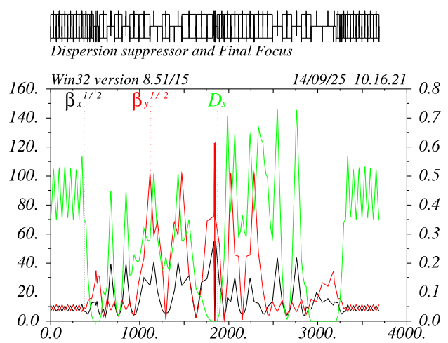
LEP3 Final Focus system
FCC LCC-FF can be rescaled to match the LEP3 layout and meet all the optics and geometric requirements
LCC-FF is 3KM long and has about 0.11mrad total bend angle (and 30mrad IP crossing angle)
LEP3: FF is scaled down to about 1.2KM and the total bend angle is increased to about 0.22mrad
FCC-LCC Final Focus system

Slide 18
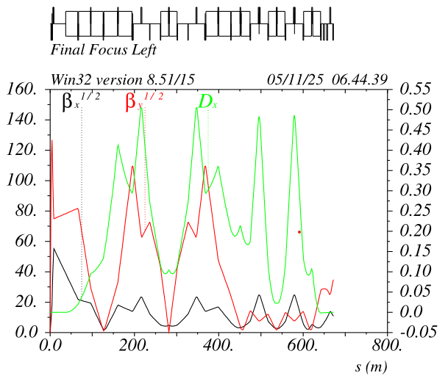
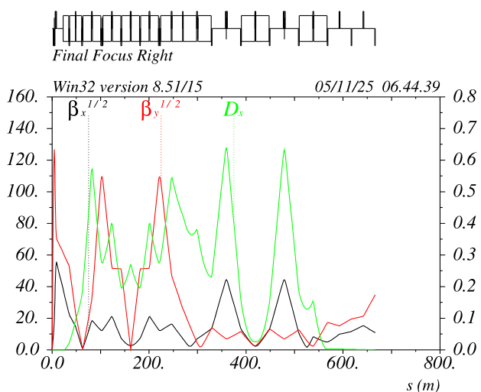
LEP3 left and right Final Focus systems
FF Dipoles complement is adjusted to have the two lines
about 35cm apart @600mt from the IP and tangent to the ARC at that location
The FF shrinkage (wrt FCC) and the total FF angle is chosen in order to:
- preserve good optics properties (betas, etas etc)
- have dipole fields compatible with SR requirements (detector and ARC)
- Have a seemless merging with the ARC
About 1.2km of the tunnel around the IP has to be enlarged. Civil work is unavoidable because of the large crossing angle
In progress

Slide 19
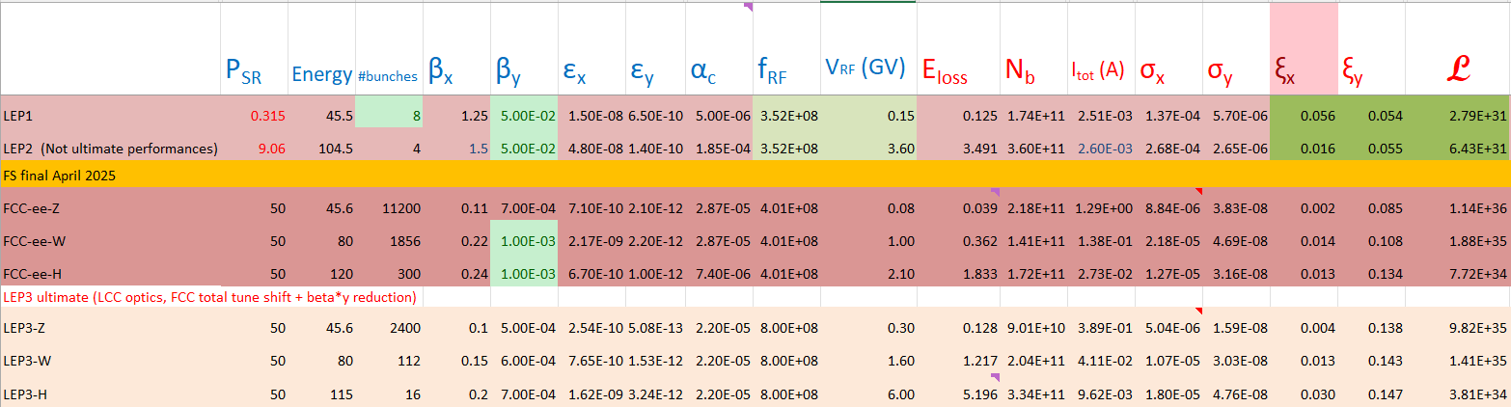
0-iteration parameters comparisons
M Koratzinos
LEP3 parameters dimensioned considering:
- 50MW SR per beam
- Best “reasonable” vertical tune_shift
- Beam parameters consistency and most consistent with FCC ones
Arc optic identical for all modes => Favors Z-mode, that approaches the FCC performances
LEP2 vs LEP3-H shows the effective gain from LPA&CW scheme (~50)

Slide 20
SuperPretzel scheme
For Z mode just about 1000-2000 bunches are needed (In fact LEP3 is hardly a factory, in the sense that the two rings are only 3% full)
In principle we could conceive to have just one bunch train/beam about 1km long
FF systems are naturally separated for the 2 beams and are about 1.2km long
Ideally the ARCs and all the SSs could be common for the two beams. The beams will overlap only in the (separated) FF sections.
The separation optics and hardware could be simpler to make as well.
An RF system and an RF power source that can cope with the resulting time structure is extremely challenging (at least). Given the possible bonus of reducing by a factor two the cost of the Ring (magnets, vacuum chambers, PS, diagnostic, power consuption etc…) it might be worth to be looked at.

Slide 21
Conclusions
An optic optimized for LEP3 is possible and could be realized with the same strategy and techniques developed for FCC
The resulting lattice can be used for easy performance comparison, considering that the IP parameters are similar to the FCC
Layout compatibility with LHC tunnel seems possible
First look at hardware requirements/solutions/options (magnets, vacuum chamber etc) could be done consequently

