Slide 1

Cryogenic CsI for Accelerator-based Dark Matter Search
Jing Liu
DAMSA Bi-weekly Meeting
Nov. 18, 2025

Slide 2
CsI(Tl/Na) VS Pure CsI
Doped CsI
Pure CsI
Light yield: 50~80% of NaI(Tl)
Emission: ~ 550/420 nm
R index: ~1.8 @ 500 nm
Radiation hardness: weak
Decay time: slow (~us)
Light yield: ~2% of NaI(Tl)
Emission: ~ 315 nm
R index: 1.95 @ 315 nm
Radiation hardness: no damage up to 10e5 rads
Decay time: fast (16 ns)

Slide 3
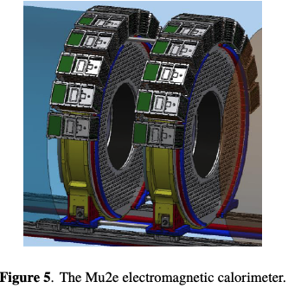
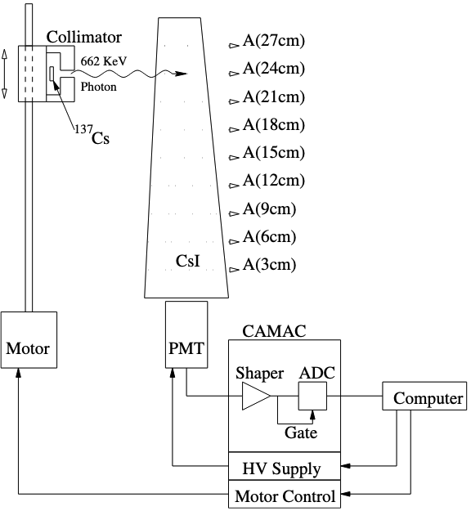
Pure CsI as electromagnetic calorimeter
Density: 4.51 g/cm3
Hygroscopic: slightly
Cleavage plane: none
Study of radiation hardness of pure CsI crystals for Belle-II calorimeter, JINST 11 P03013
JINST 12 C01061

Slide 4
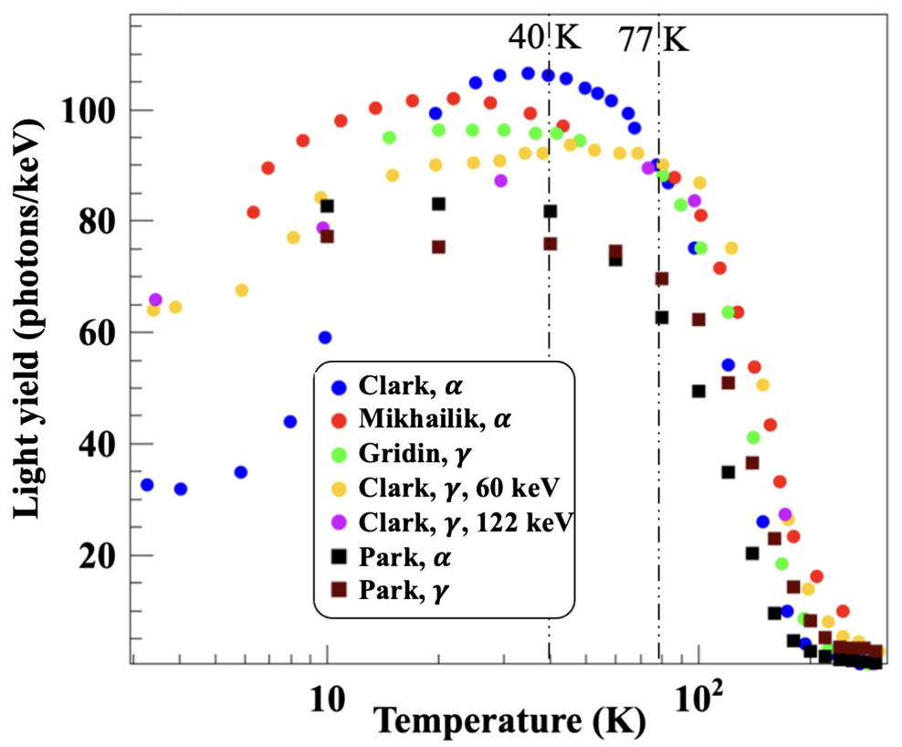
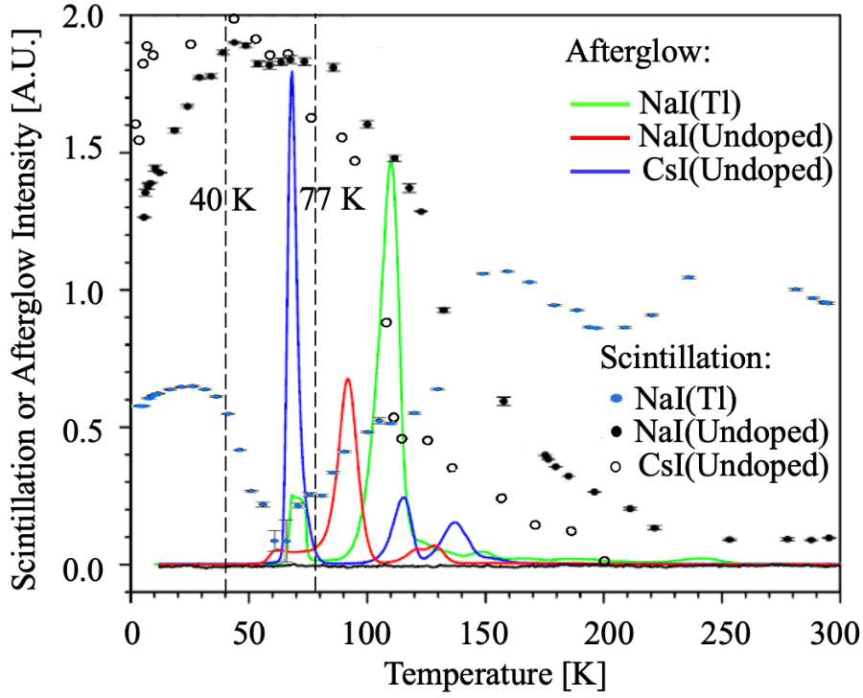
Pure CsI @ different temperatures
PRD 109, 092005 (2024)
https://doi.org/10.1140/epjc/s10052-020-8111-7

Slide 5
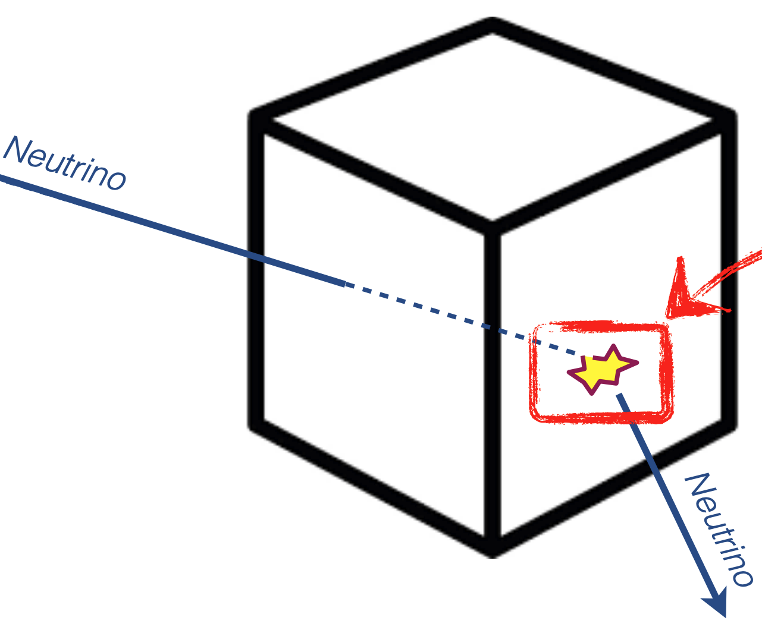
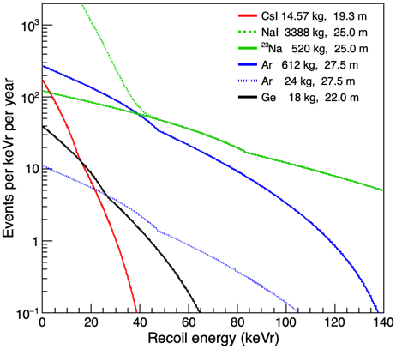
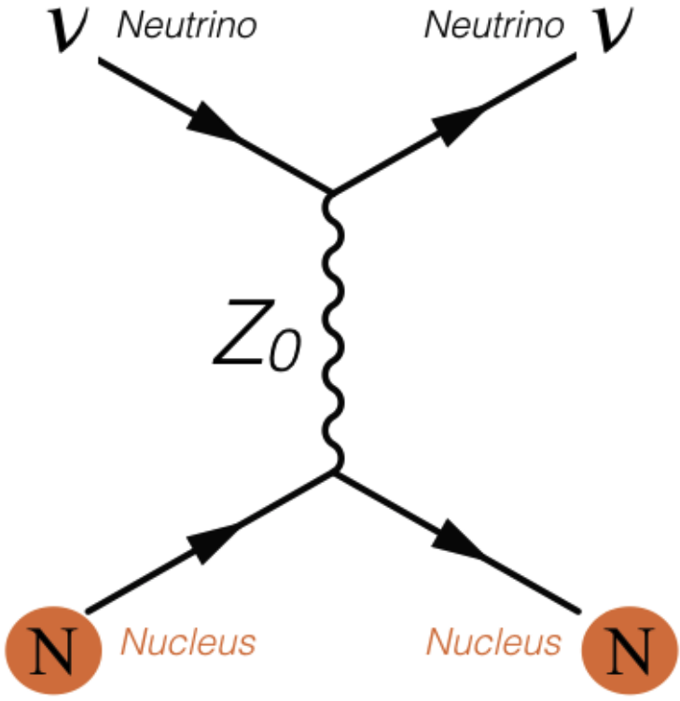
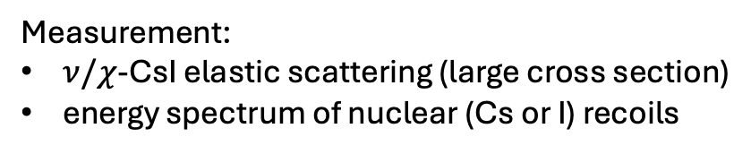
Pure CsI for Dark Matter & Neutrino Detection
Could be Dark Matter
Small recoil energy
Could be new physics
Measurement:
$ν/χ$-CsI elastic scattering (large cross section)
energy spectrum of nuclear (Cs or I) recoils

Slide 6
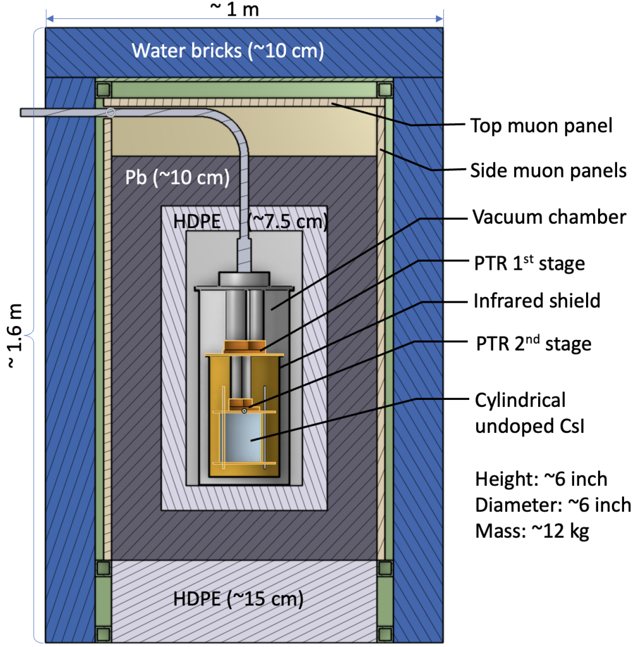
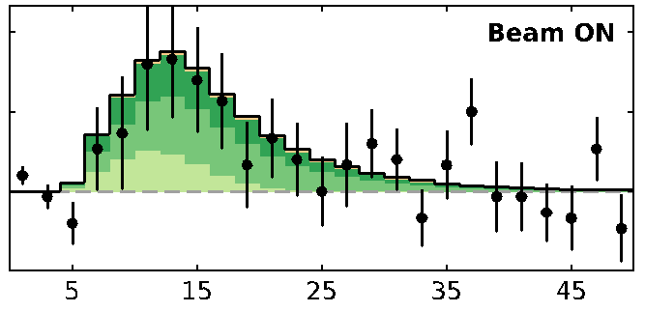

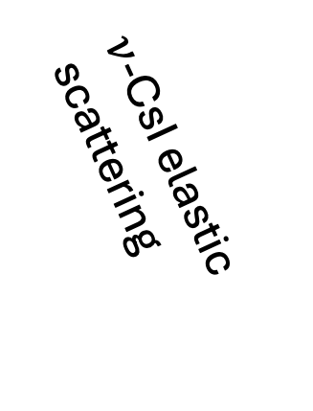
Cryogenic operation of pure CsI
https://sites.duke.edu/coherent/detectors
Efficiency of CsI(Na)
$ν$-CsI elastic scattering
10.1126/science.aao0990
$∝$ Energy

Slide 7
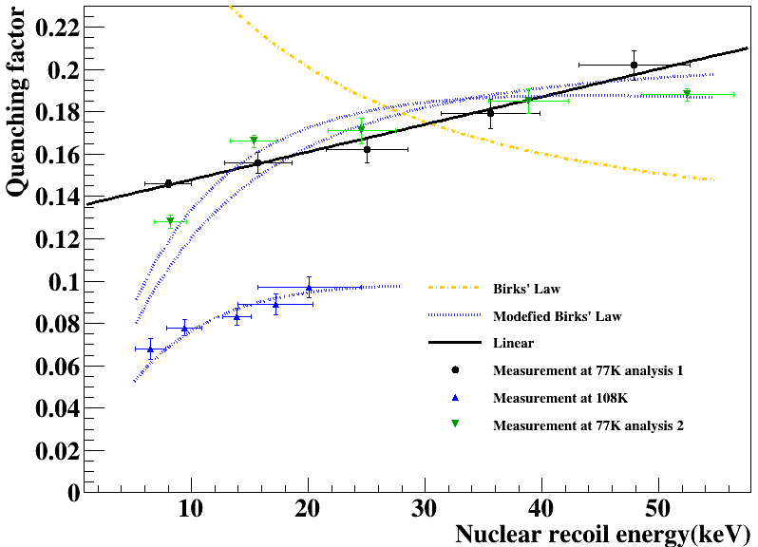
Visible energy
LY(Nuclear)/LY(electronic)
Obtained from electronic recoils:
Our measurement @ TUNL

Slide 8
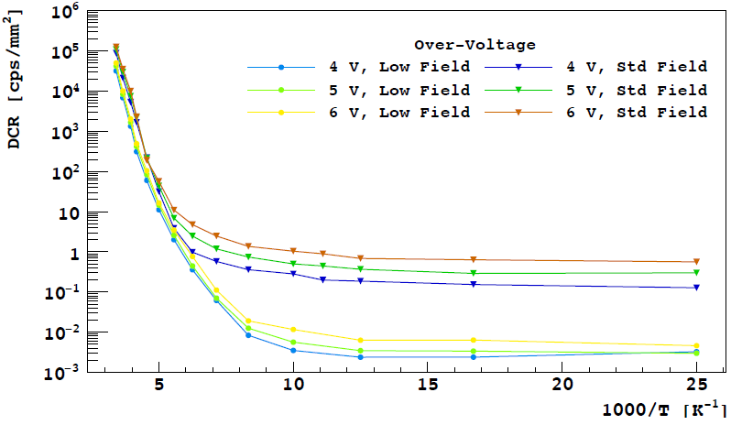
Cooling options
Cryocooler (down to ~ 40 K):
A bit more LY, a bit less afterglow, less SiPM DCR
In liquid nitrogen ( ~ 77 K): PMTs work just fine, less R&D
SiPM dark noise
77 K
40 K

Slide 9
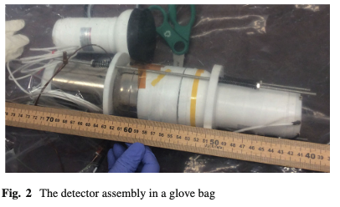
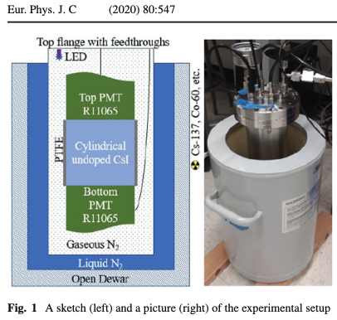
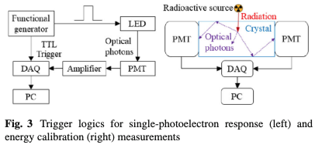
Pure CsI + PMT @ 77 K

Slide 10
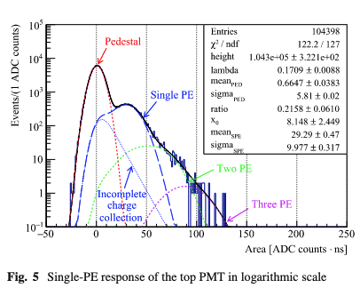
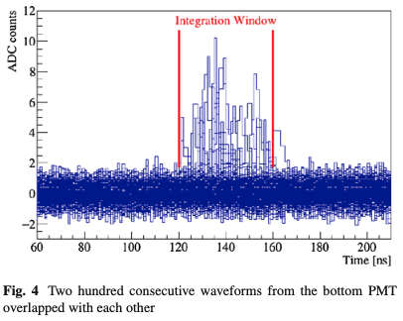
Single PE spectrum

Slide 11
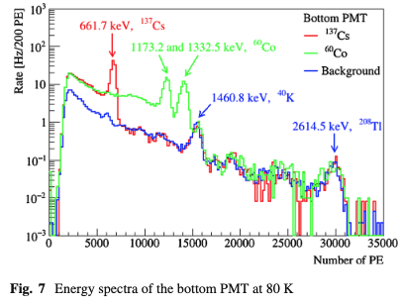
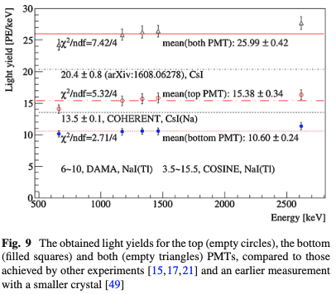
Light yield with PMT @ 77 K

Slide 12
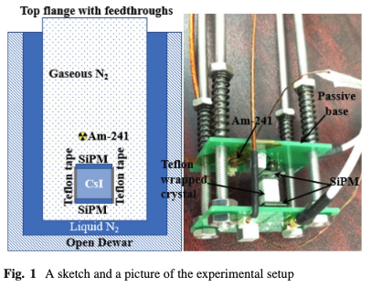
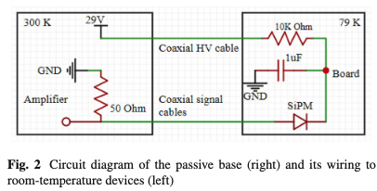
Pure CsI + SiPM @ 77 K
Eur. Phys. J. C (2022) 82:344 https://doi.org/10.1140/epjc/s10052-022-10289-x

Slide 13
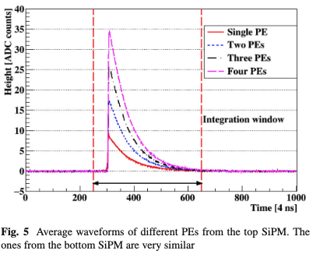
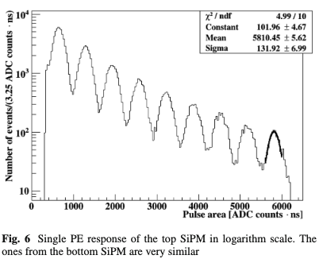
SPE spectrum

Slide 14
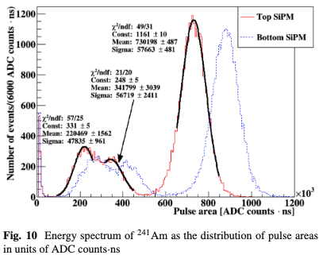
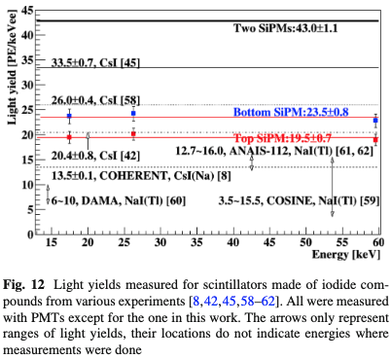
Light yield

Slide 15
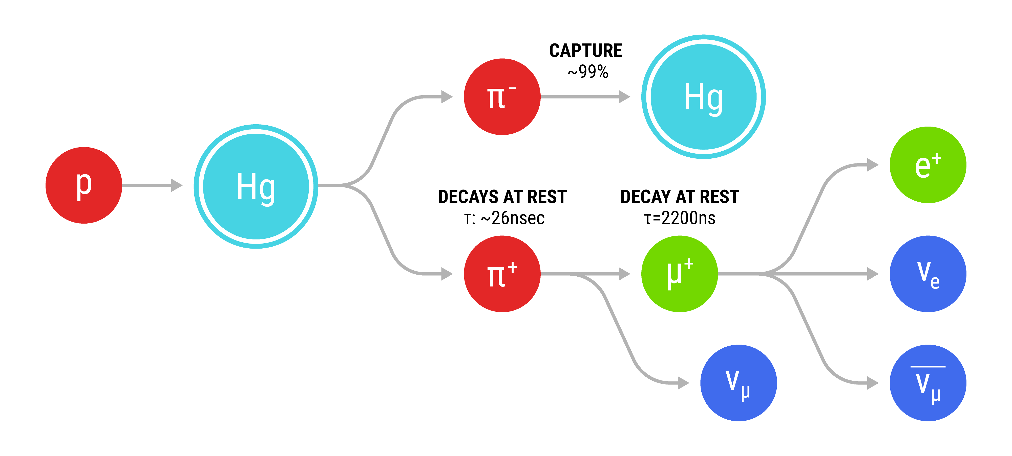
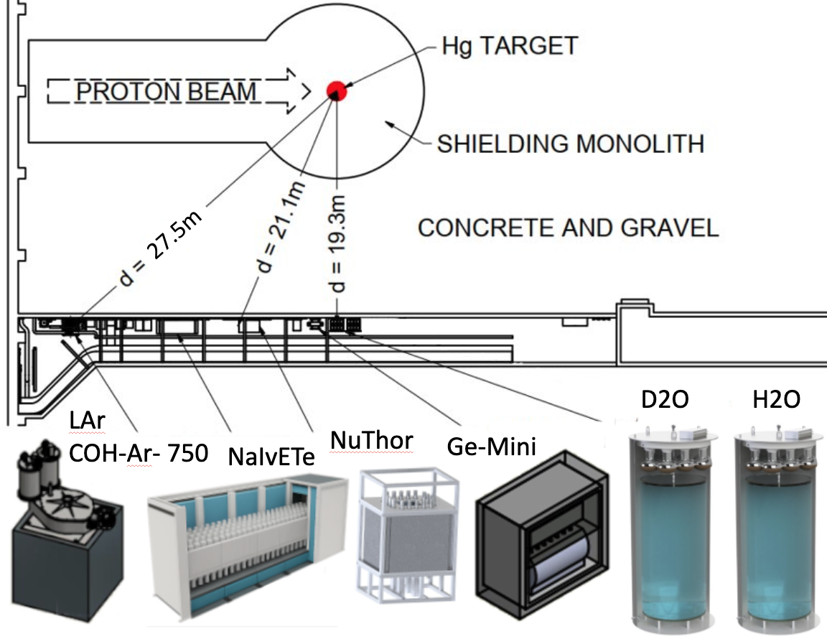



COHERENT @ the SNS
Neutrinos
$$π^{0}/η^{0}$$
$$→Vγ$$
$$↳χ^{′}χ$$
Low-mass dark matter particles

Slide 16
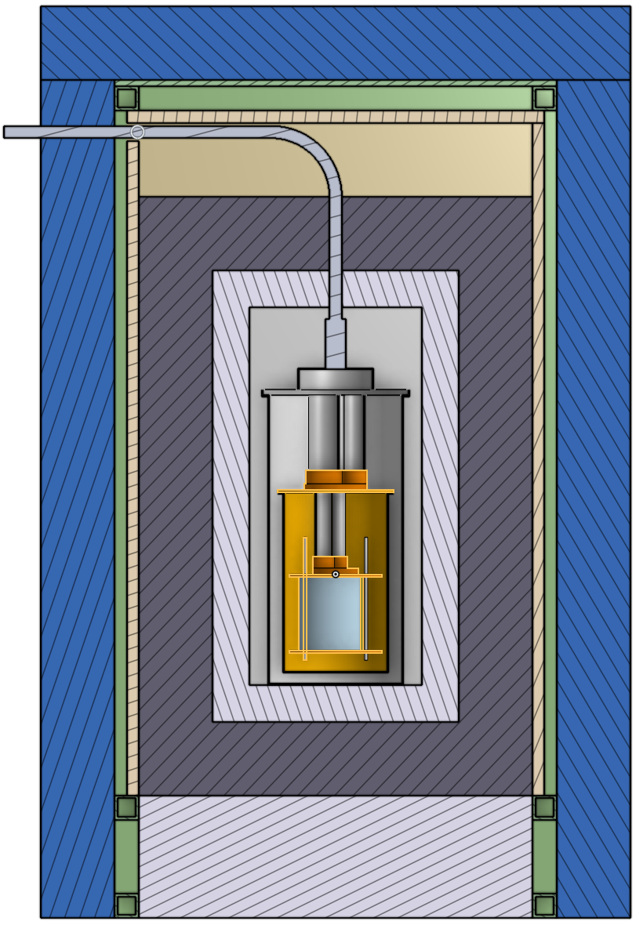
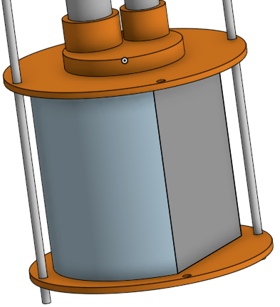
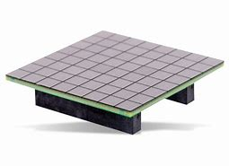


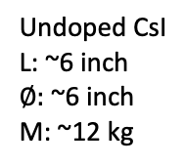
40 K cryostat
~ 1 m
Water bricks (~10 cm)
Top muon panel (~1”)
Pb (~10 cm)
Side muon panels (~1”)
6x6 mm2 single SiPM
300 ~ 800 SiPM channels
Cold FPGA to reduce cables
Or combining channels
HDPE (~7.5 cm)
Vacuum chamber
PTR 1st stage
Infrared shield
~ 1.6 m
PTR 2nd stage
Undoped CsI
L: ~6 inch
$∅:$ ~6 inch
M: ~12 kg
$2×3 50×50 mm^{2}$ SiPM arrays
or
HDPE (~15 cm)
$4×6 25×25 mm^{2}$ SiPM arrays
Notes:
Explain mac (measure center position, large halfz, neutrino color) and tg files (include, parameter, color)

Slide 17
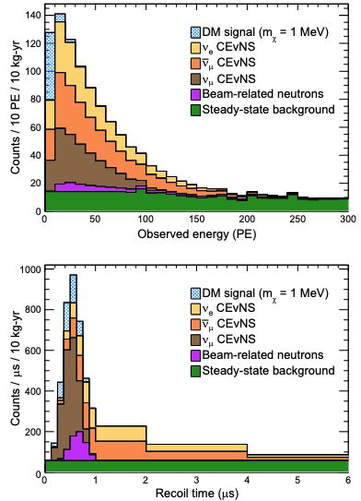
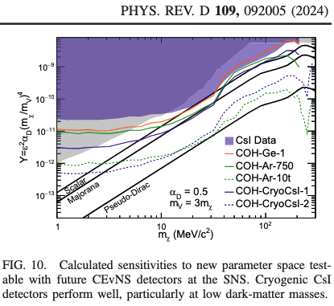
Sensitivity

Slide 18
Summary
Pure CsI VS Doped CsI
Different pro’s & con’s
Pure CsI is perfect as electromagnetic calorimeter
Pure CsI @ different T
Twice brighter than doped CsI @ 40 ~ 77 K
Physics
Probe accelerator-produced low-mass dark matter elastically scattered with CsI
CsI + SiPM offers best light yield

