Slide 1
LHC BWS – Card positioning change, impedance impact
Harry Sullivan
11.112025

Slide 2
Proposed change
Reason for change
To utilise the same control system as existing scanners for operation in the LHC, the parking position needs to be at the opposite side to the motor.
Solution
Possible solution is to rotate the instrument tank 180 degrees, with respect to the motion system and vacuum tank – assuming there is no negative impact to impedance
This solution mitigates:
Leaving the conductive tracks on the card close to the beam in parked position
Having multiple software packages for operation in parallel
Purchasing a new ball screw with opposite screw direction (4 weeks lead time)

Slide 3
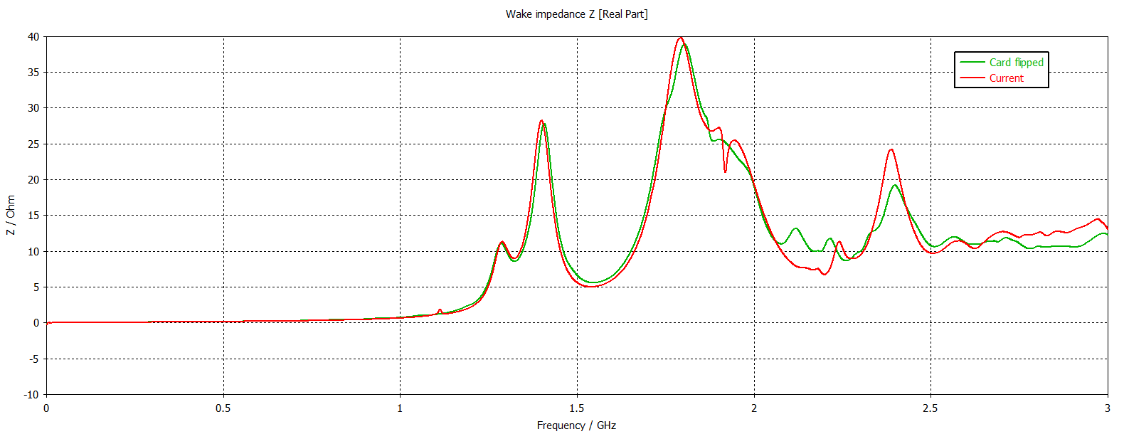
Impact
Rotated card
Conductive tracks now face the beam (assumed negligible impact)
Opposite parking position
DN40 not usable during motion (not planned to be used for prototype)
Impedance
Negligible change to impedance based on a swapped parked position

