Slide 1
MoEDAL/MAPP status 11/2025
Richard Soluk – MoEDAL Collaboration (Technical Coordinator) University of Alberta

Slide 2

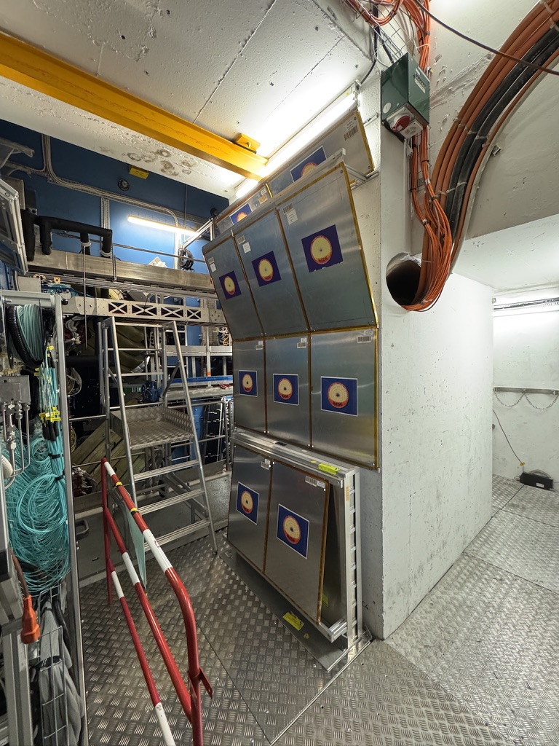
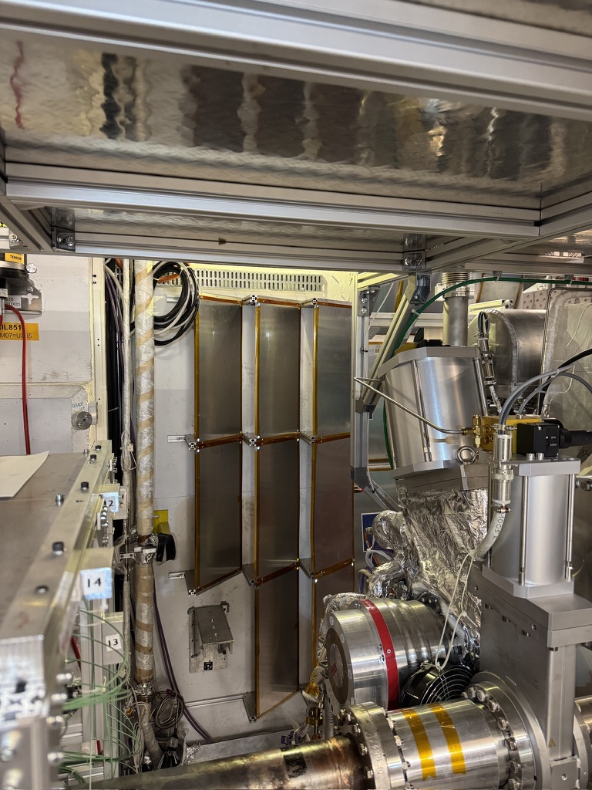
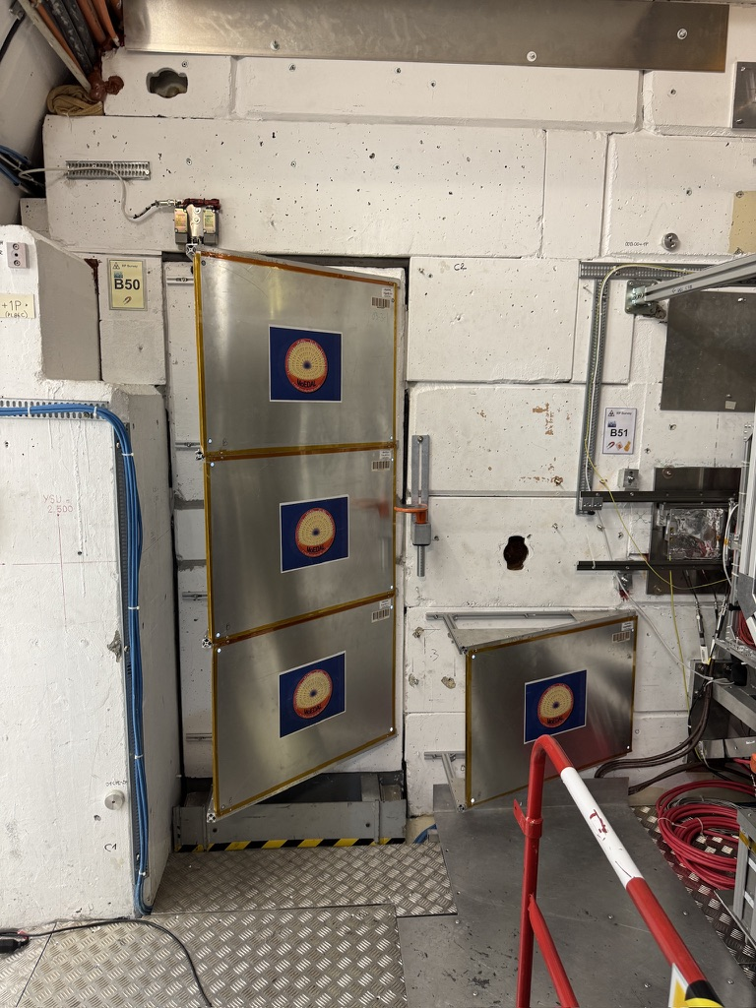
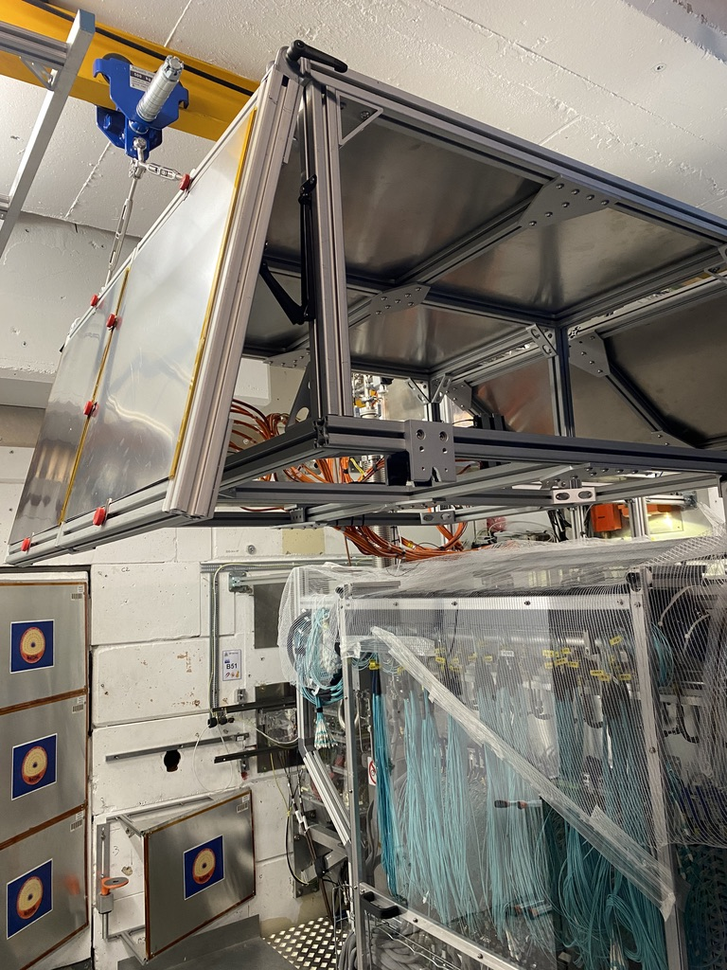
MoEDAL 2025
MoEDAL
Since last report no access (until this week)
TPX group replaced LV power supply Tuesday due to radiation issues
No other hardware changes

Slide 3
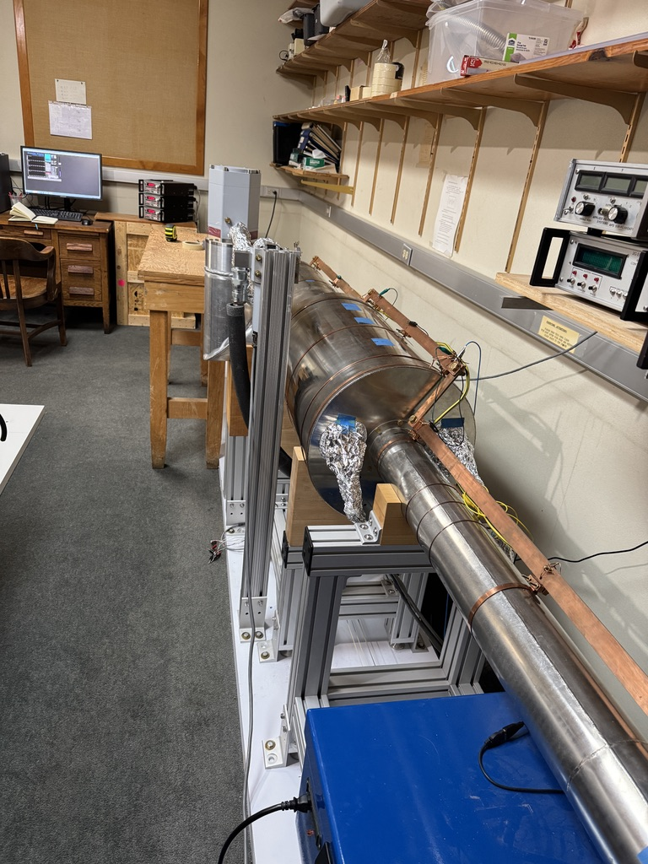
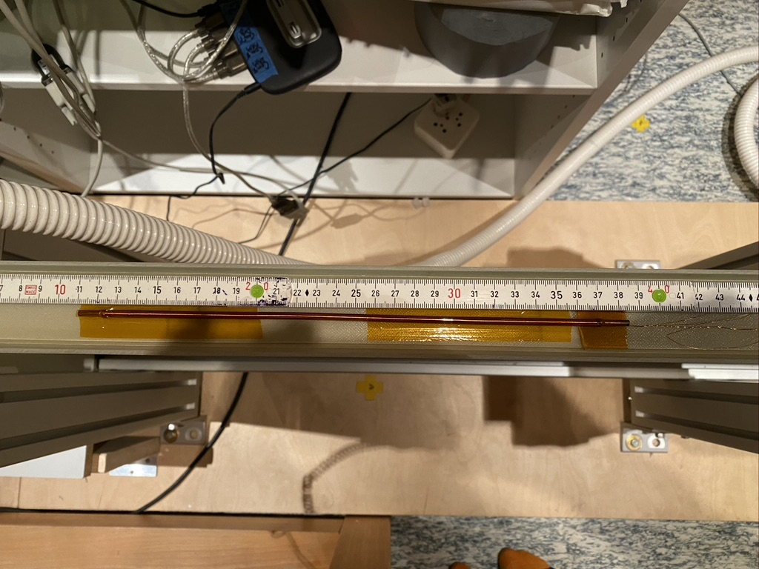
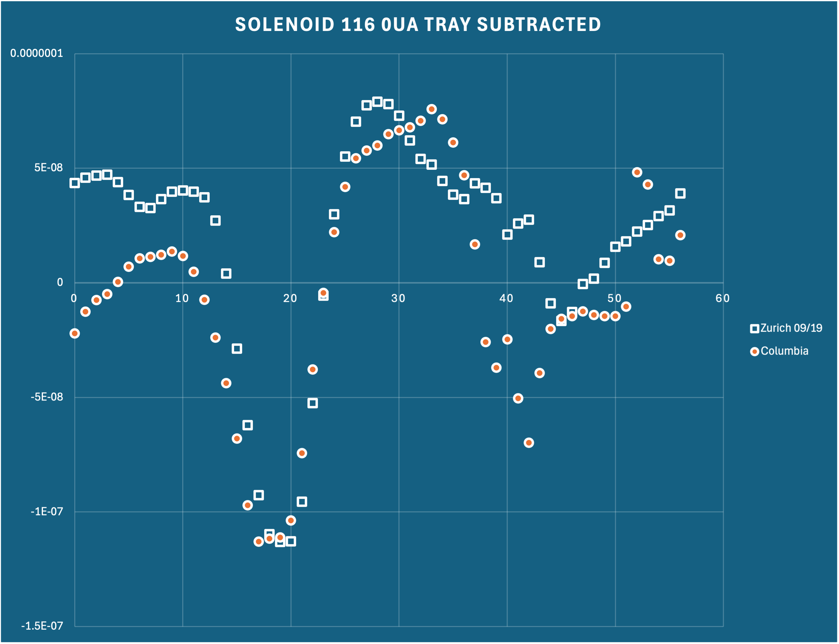
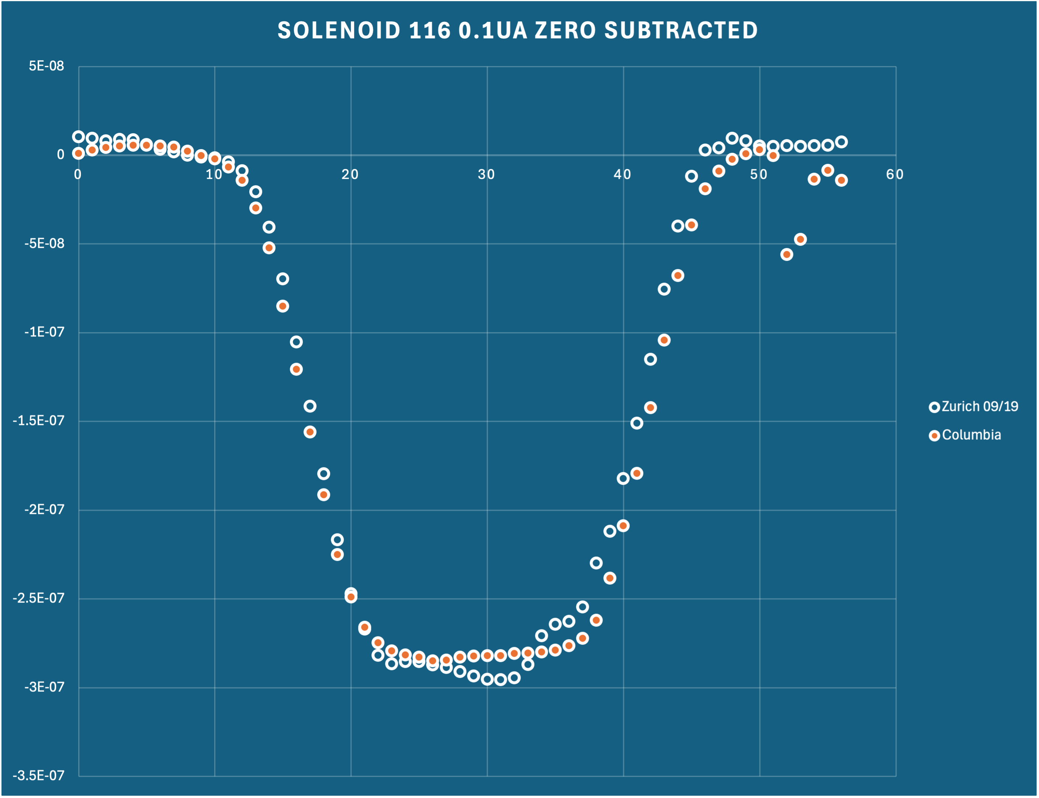
MoEDAL MMT Magnetometer
MoEDAL
ETH Zurich magnetometer running at Columbia University
Conducted tests in October
Minor changes to device
Sensitivity excellent
Noise level good
Stability possibly better
Similar model available in Barcelona through the IFIC Valencia group still to be evaluated

Slide 4
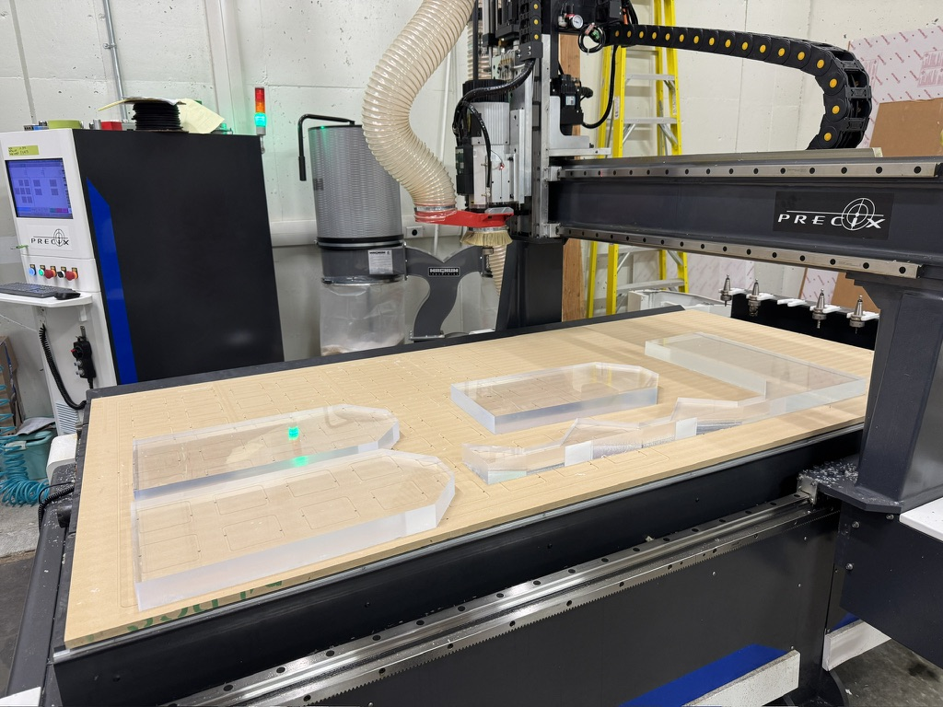
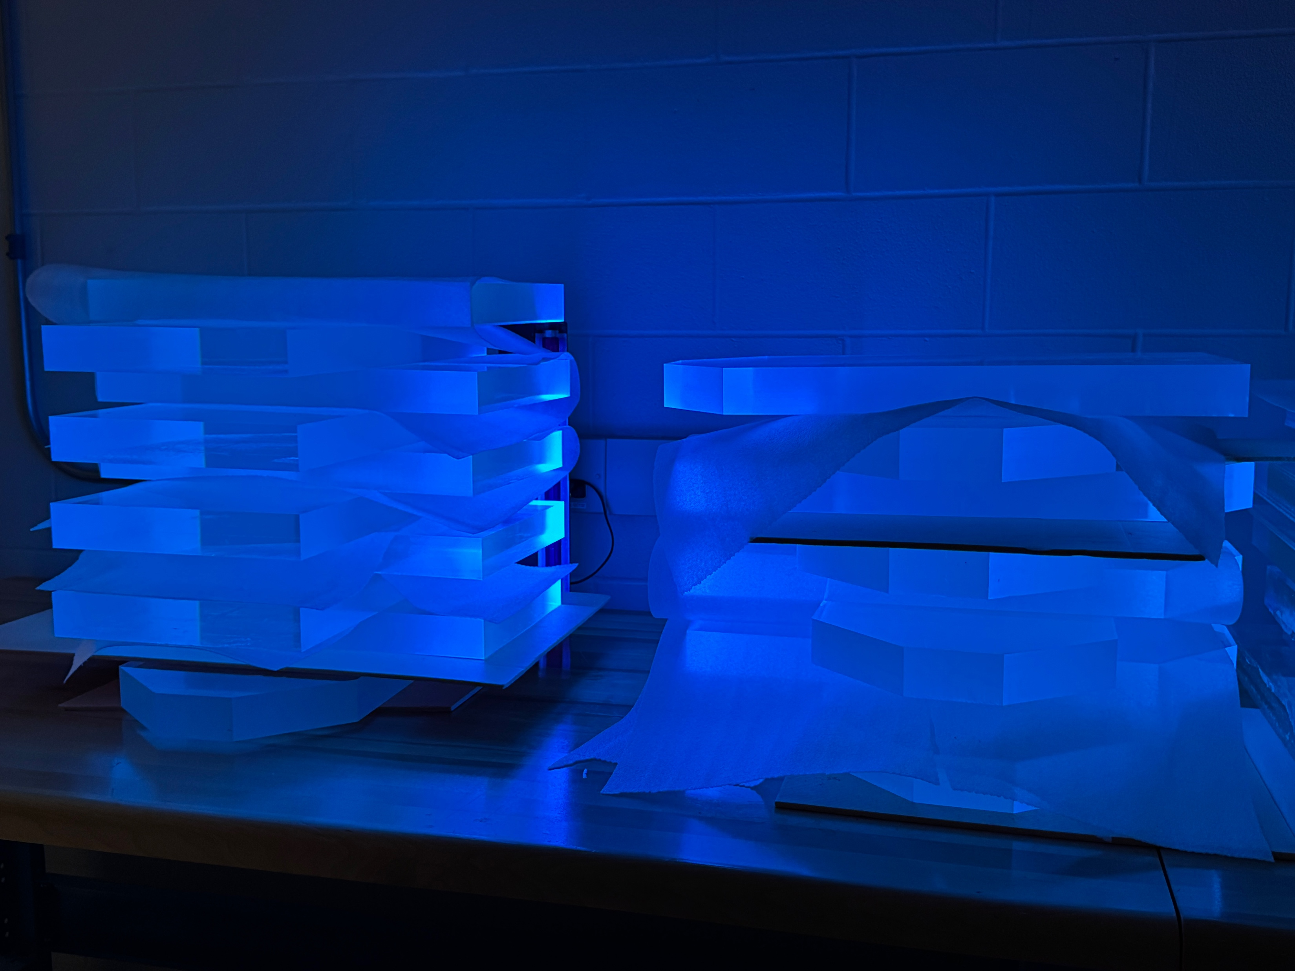
MAPP Outrigger
MoEDAL
CNC router to Alberta now installed and running
Used scintillator lent by the Alabama group cut into 20 pieces for the 4th layer of the outrigger
Now being polished before wrapping

Slide 5
YETS 2025-2026
MoEDAL
YETS 2025-2026
MAPP
Install 7th ADC board
Finish cabling calibration LEDs
Install calibration boards
Install front veto panels
MoEDAL
Remove 2025 NTDs
Remove some NTD infrastructure and forward MMT
Required for normal VELO alcove work
Hopefully don’t need to remove VELO TOP
Install new NTDs at end of YETS
Move TPX low voltage power supply to electronics barrack
Requires pulling a new cable (if possible)

Slide 6
Extra slides
MoEDAL

Slide 7
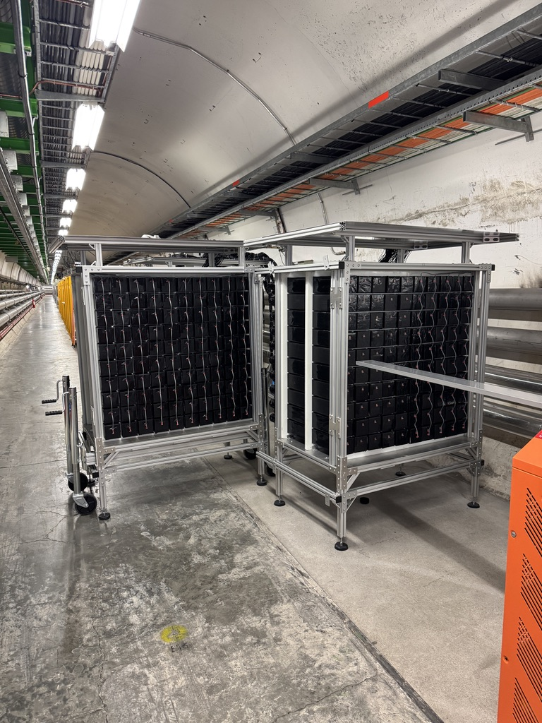
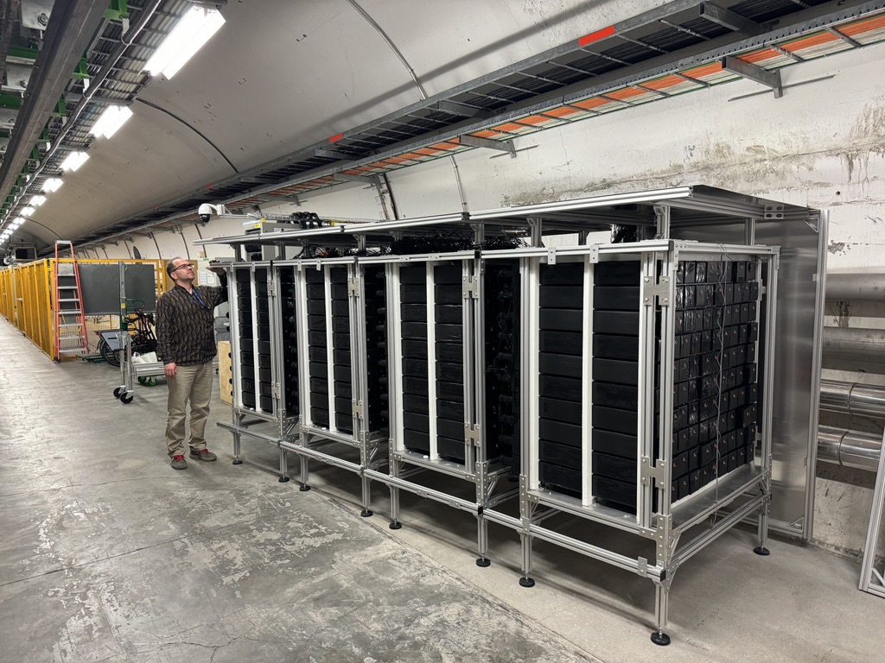
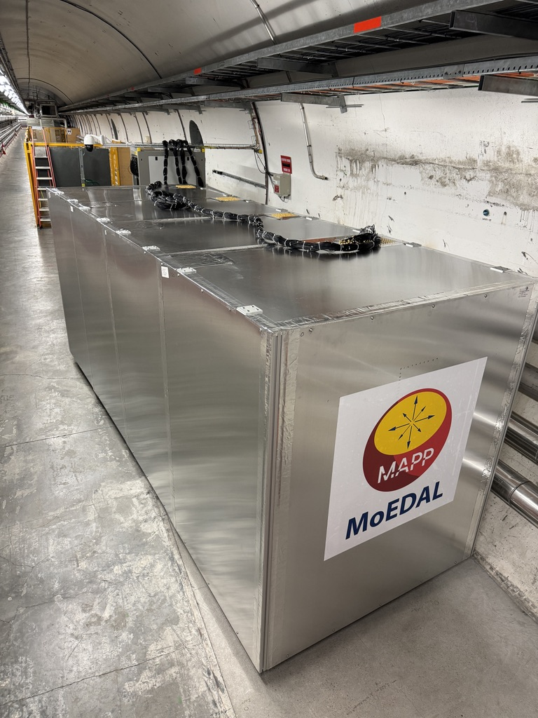
MAPP TS1 2025
MoEDAL
MAPP detector composed of 10 x 10 x 75 cm PS scintillator bars
Read out by either 75mm or 90mm diameter PMTs
398 of 400 bars installed and cabled
Last 2 planned for TS1 but access was very limited
Flame shield not opened

Slide 8
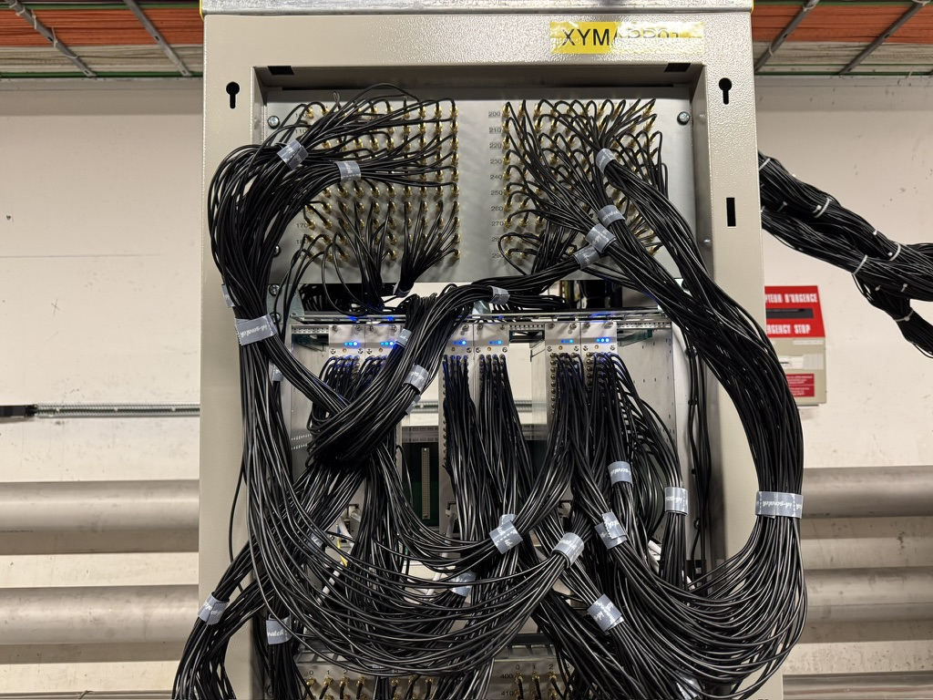
MAPP Electronics TS1 2025
MoEDAL
Minor adjustments to electronics setup
Cabled 6 of the 7 ADC boards
7th board only reads a small number of channels
Each boards reads a horizontal slice through the 4 detector stations (64 channels/board)
Each row of inputs being 4 colinear detectors
View from IP
Channel assignment of each of the MAPP ADC boards

