Slide 1

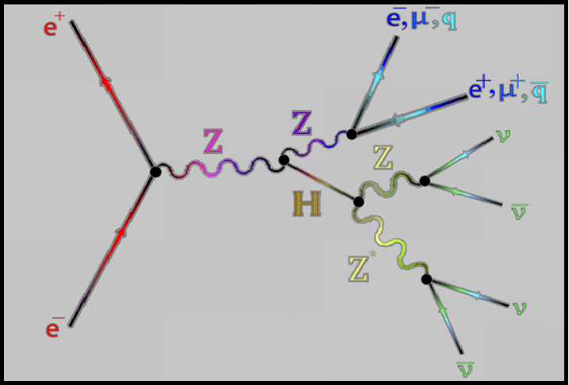
FCC-ee H→ invisible
MVA Analysis
SUNY Old Westbury
Adrian Taveras
Brookhaven National Lab
Kétévi A. Assamagan
Diallo Boye
Ang Li
Andrea Sciandra
Scott Synder

Slide 2
Overview of Experiment
The Future Circular Collider-ee (FCC-ee) will carry out electron-positron collisions at CERN.
In these collisions, we will search for the Higgs boson produced in association with a Z-boson, ee -> ZH.
In this study, we focus on the Higgs boson decaying into invisible particles while the Z-boson decaying into pairs of fermions (ee, μμ, or qq)—as shown in the diagram on the right.
We use the SM H -> ZZ -> 4ν to simulate H -> invisible

Slide 3
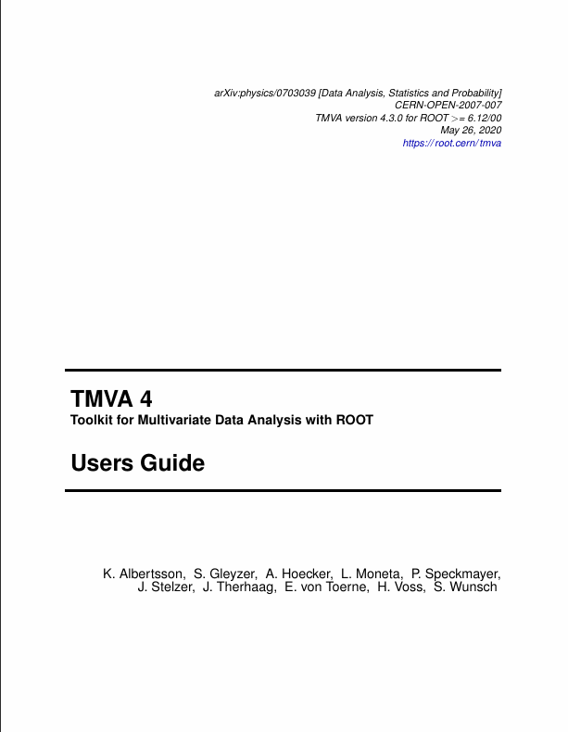
Overview of TMVA
This analysis will utilize the toolkit for multivariate analysis (TMVA), a root-integrated software package for multivariate analysis (MVA).
Using TMVA, multiple methods of classification can be executed simultaneously; testing, training, and evaluations are performed and displayed for the user.
This analysis utilizes TMVA version 4. Most of the information is taken from the TMVA 4 user guide.
What are the goals?
In what ways does TMVA evaluate MVA methods?
How can TMVA be used to improve signal efficiency and background rejection using multivariate analysis?

Slide 4
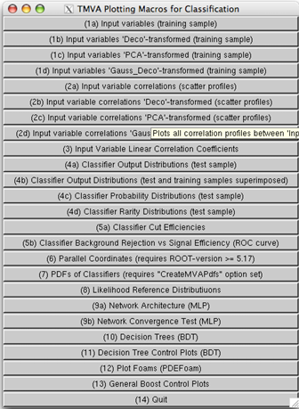
TMVA Test
What is being tested?
What are the tests?
13 input variables for the leptonic channel and the hadronic channel.
Various signal and background samples.
5 MVA methods: boosted decision trees (BDT), k-Nearest Neighbor algorithms (kNN), linear discriminant analysis (LD), multilayer perception (MLP), and likelihood.
Reducing number of input variables based on linear correlation and separation power.
Comparing performance of classifiers through analyzing the area under the ROC curve (AUROCC) and the testing vs. training efficiency overtraining check.

Slide 5
ZH → Z(ee) H(Inv)
ZH → Z(μμ) H(Inv)
ZH → Z(qq) H(Inv)
Signal
The Samples
To test Higgs-to-invisible decay detection, fast and full simulation were utilized. The signal in this case is SM H -> ZZ -> 4ν .
Provided is the list of signal and background samples used in the analysis.
ZH → Z(νν) H[Z(ee)Z(νν)]
ZH → Z(νν) H[Z(μμ)Z(νν)]
ZZ → Z(ee) Z(νν)
ZZ → Z(μμ) Z(νν)
ZZ → Z(μμ) Z(qq)
ZH → Z(νν) H(qq)
ZH → Z(νν) H[Z(qq)Z(νν)]
ZZ → Z(qq) Z(νν)
ZZ → Z(qq) Z(qq)
WW → W(munu) W(munu)
WW → W(qq) W(lnu)
WW→ W(lnu) W(qq)
WW →W(enu) W(enu)
Ztau →Z(tautau)
Background

Slide 6
The Input Variables
Leptonic (ll) channel
input variables
Hadronic (qq) channel
input variables
These are the input variables used to train the BDT, MLP, Likelihood, kNN, and LD classifiers.
There are two sets of variables, one for the leptonic (ll) channel and one for the hadronic (qq) channel.
"ll_m"
"ll_p"
"ll_theta"
"ll_phi"
"vis_m"
"vis_p"
"vis_theta"
"vis_phi"
"visrecoil_theta"
"visrecoil_pt"
"visrecoil_m"
"visrecoil_phi“
"mjj"
“charged_had_m"
" charged_had _pt"
" charged_had _theta"
" charged_had _phi"
"vis_m"
"vis_p"
"vis_theta"
"vis_phi"
"visrecoil_theta"
"visrecoil_pt"
"visrecoil_m"
"visrecoil_phi“
"mjj"

Slide 7
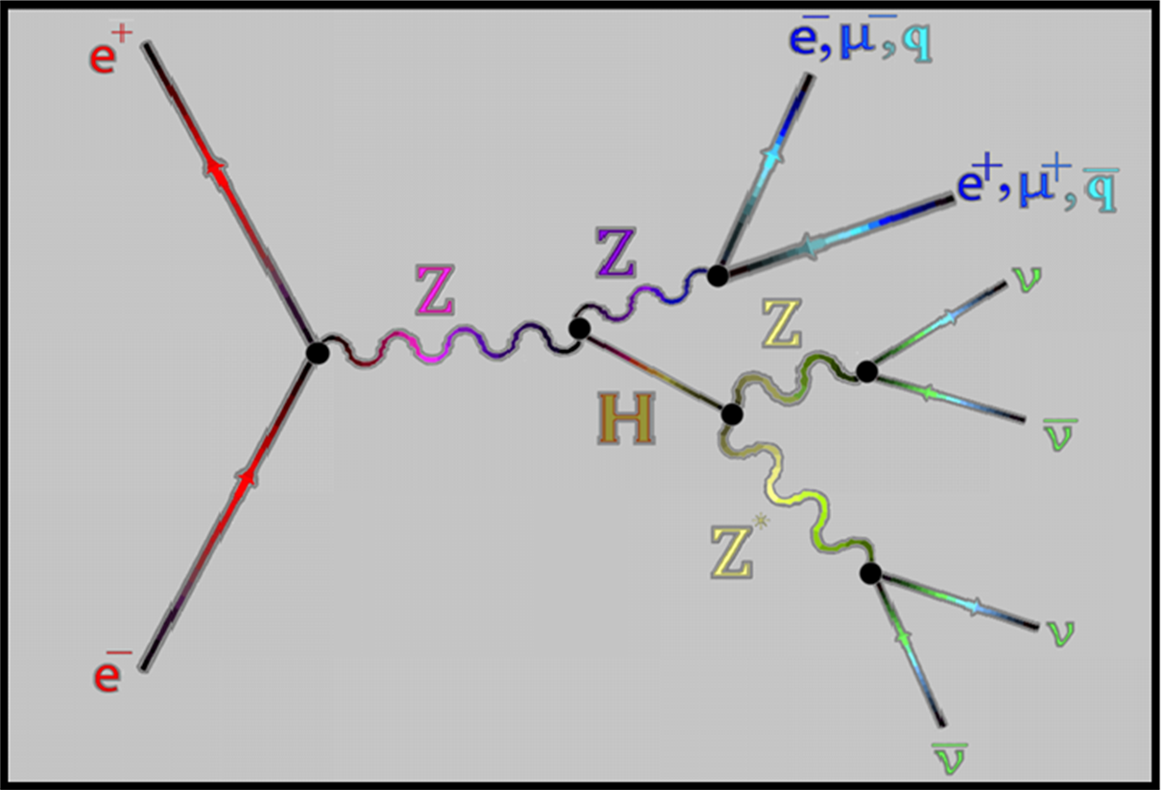
Input Variable
ll:
Leptonic (ll) channel
input variables
Description:
In the ee -> ZH, Z boson can decay into pairs of leptons (muons or electrons).
These variables are the kinematics of di-lepton system.
ll = electrons and muons
"ll_m"
"ll_p"
"ll_theta"
"ll_phi"
"vis_m"
"vis_p"
"vis_theta"
"vis_phi"
"visrecoil_theta"
"visrecoil_pt"
"visrecoil_m"
"visrecoil_phi“
"mjj"

Slide 8
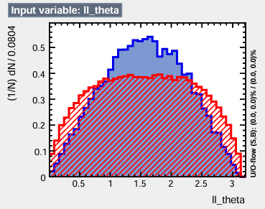
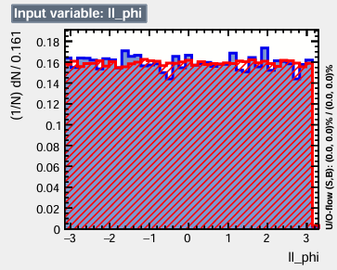
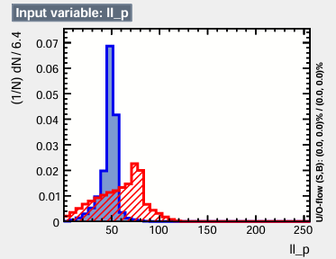
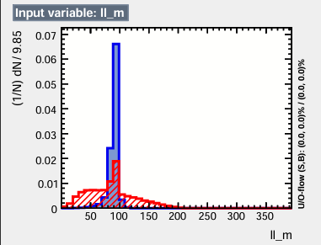
Leptonic (ll) channel input variables

Slide 9
Input Variable Vis:
Leptonic (ll) channel
input variables
Hadronic (qq) channel
input variables
Description
The ee -> ZH products can be classified into two categories, the visible system (can be detected) and invisible system (cannot be detected).
These variables represent the kinematics of the visible system which are the particles caught by the detector (same as the ll variables).
Vis = visible system
"ll_m"
"ll_p"
"ll_theta"
"ll_phi"
"vis_m"
"vis_p"
"vis_theta"
"vis_phi"
"visrecoil_theta"
"visrecoil_pt"
"visrecoil_m"
"visrecoil_phi“
"mjj"
“charged_had_m"
" charged_had _pt"
" charged_had _theta"
" charged_had _phi"
"vis_m"
"vis_p"
"vis_theta"
"vis_phi"
"visrecoil_theta"
"visrecoil_pt"
"visrecoil_m"
"visrecoil_phi“
"mjj"

Slide 10
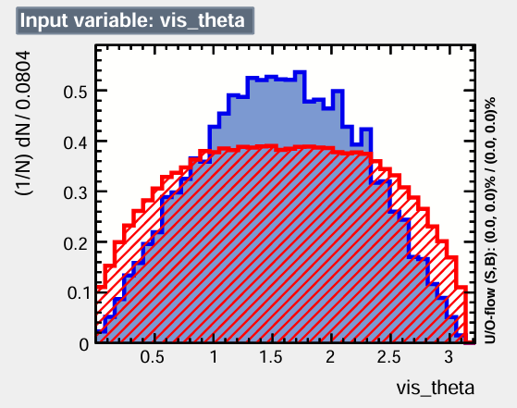
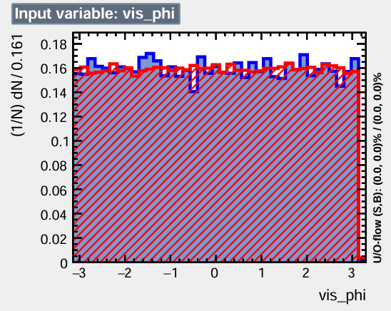
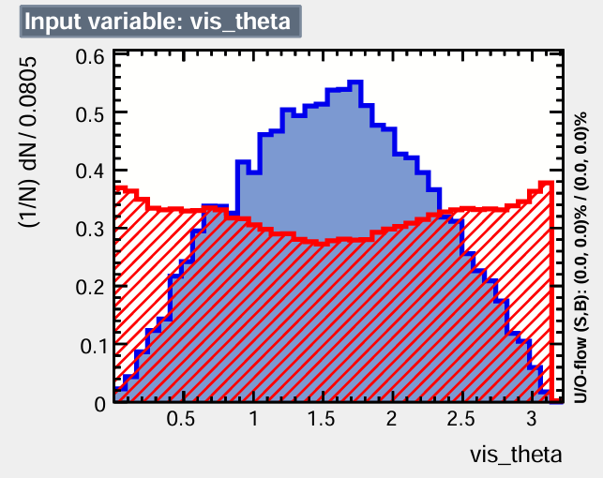
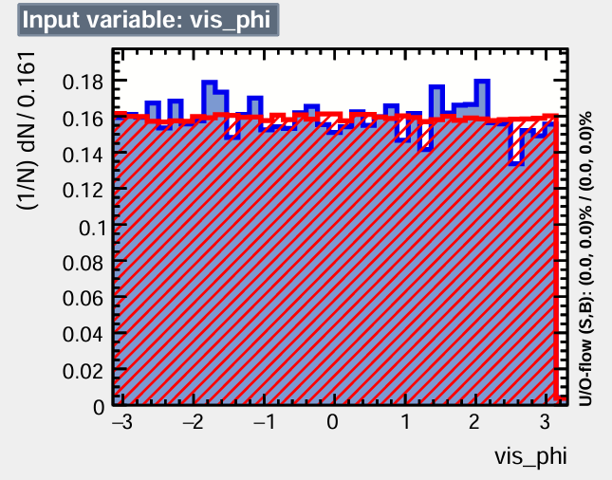
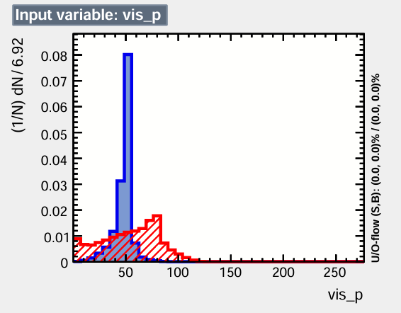
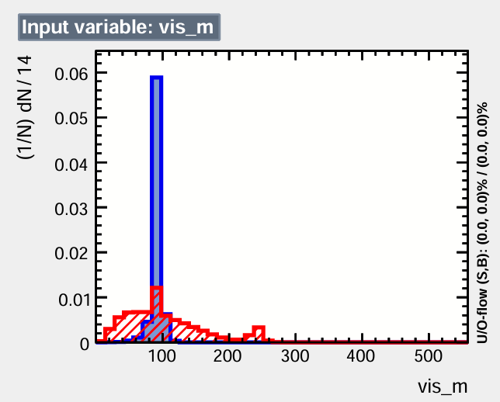
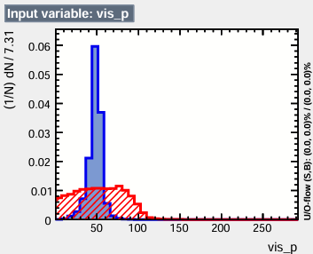
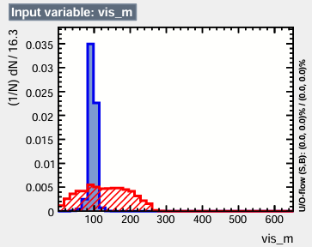
Leptonic (ll) channel
input variables
Hadronic (qq) channel
input variables

Slide 11
Input Variable
Visrecoil:
Leptonic (ll) channel
input variables
Hadronic (qq) channel
input variables
Description
Using energy/momentum conservation laws, we can infer the invisible products.
As the Higgs boson recoils against the Z boson in the center of mass, the visible part’s recoil can be used to estimate the Higgs boson and its decay products kinematics.
"ll_m"
"ll_p"
"ll_theta"
"ll_phi"
"vis_m"
"vis_p"
"vis_theta"
"vis_phi"
"visrecoil_theta"
"visrecoil_pt"
"visrecoil_m"
"visrecoil_phi“
"mjj"
“charged_had_m"
" charged_had _pt"
" charged_had _theta"
" charged_had _phi"
"vis_m"
"vis_p"
"vis_theta"
"vis_phi"
"visrecoil_theta"
"visrecoil_pt"
"visrecoil_m"
"visrecoil_phi“
"mjj"
We use the SM H -> ZZ -> 4ν to simulate H -> invisible

Slide 12
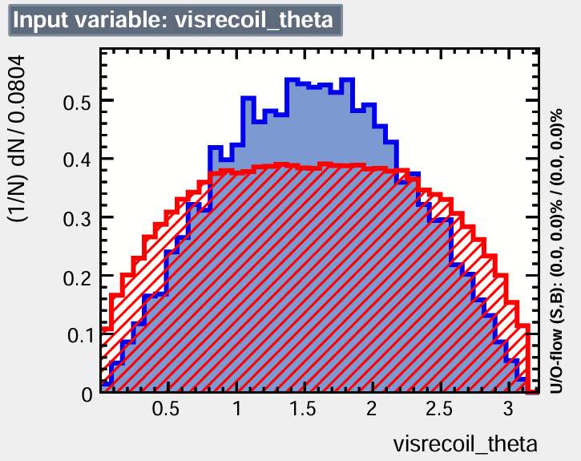
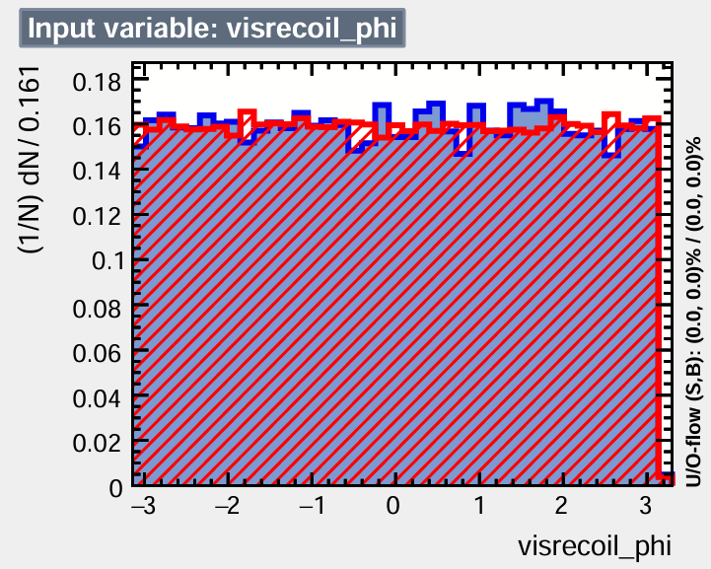
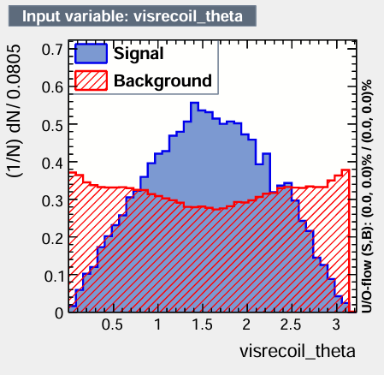
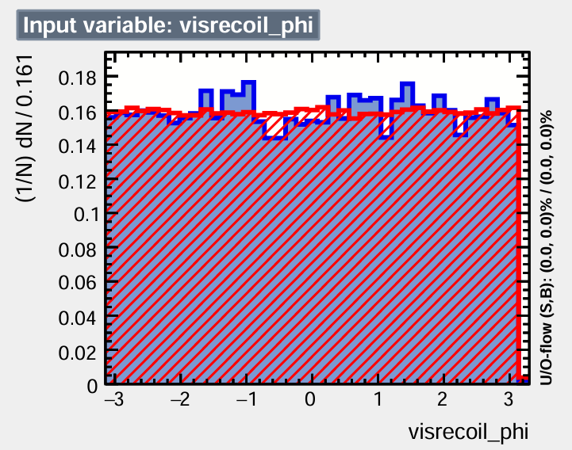
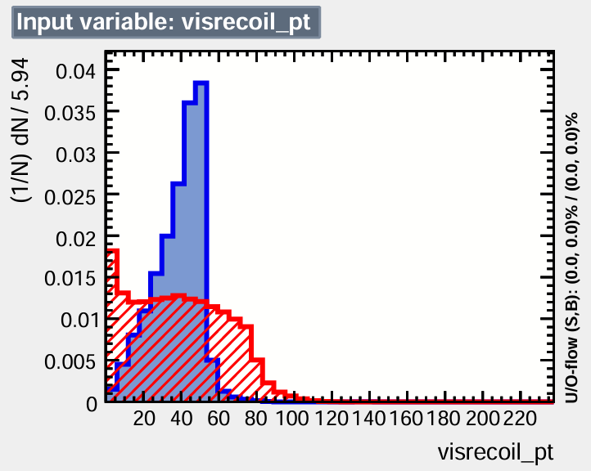
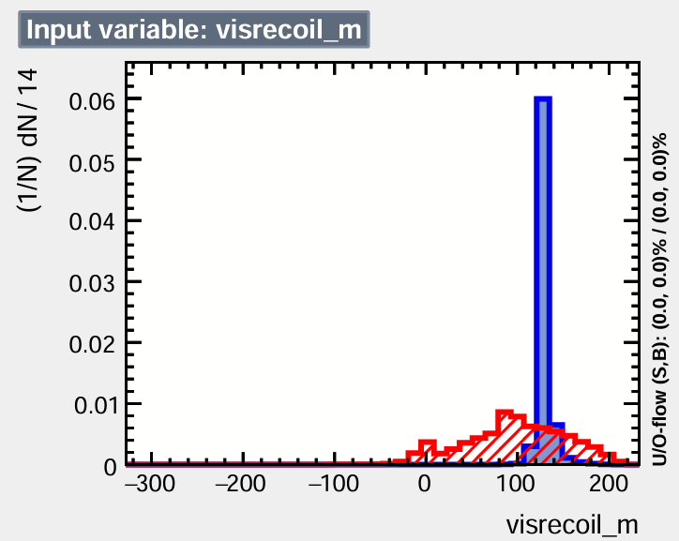
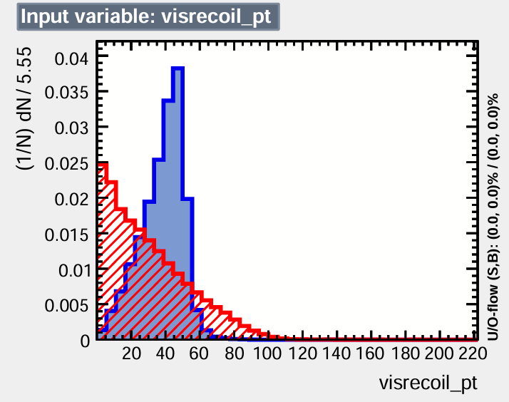
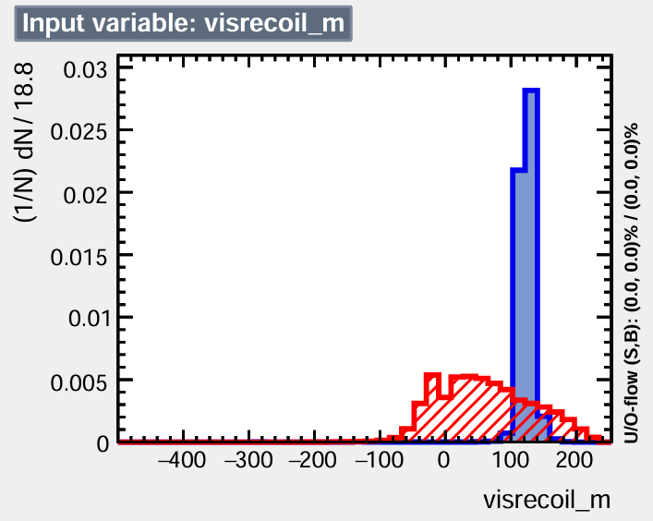
Leptonic (ll) channel
input variables
Hadronic (qq) channel
input variables

Slide 13
Input Variable
Charged_had:
Hadronic (qq) channel
input variables
Charged_had = di-jet system
Description
In the ee -> ZH, the Z boson can decay into two jets.
These variables are the kinematics of the di-jet system.
“charged_had_p"
" charged_had _pt"
" charged_had _theta"
" charged_had _phi"
"vis_m"
"vis_p"
"vis_theta"
"vis_phi"
"visrecoil_theta"
"visrecoil_pt"
"visrecoil_m"
"visrecoil_phi“
"mjj"

Slide 14
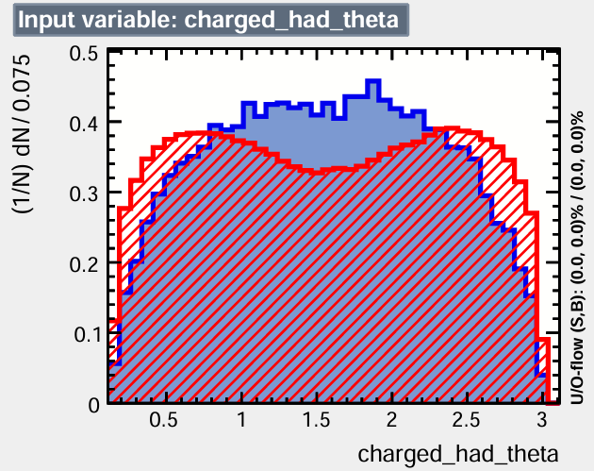
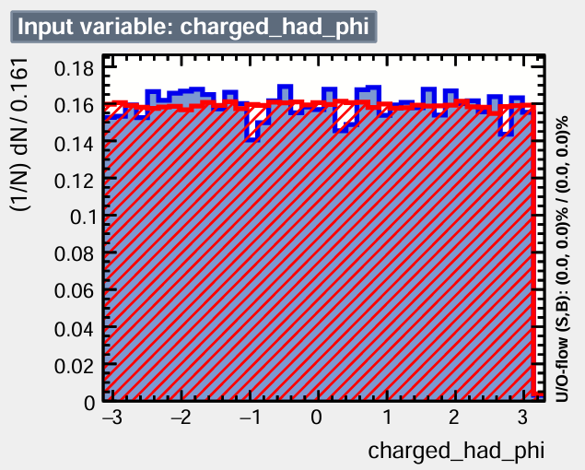
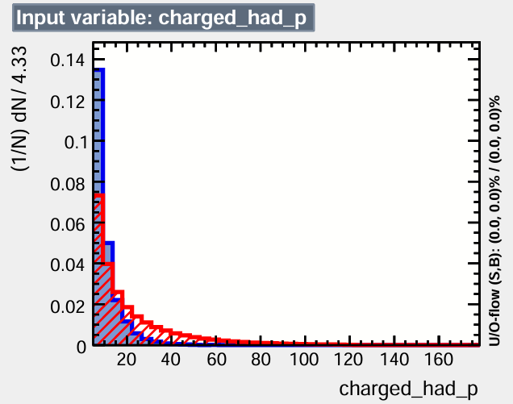
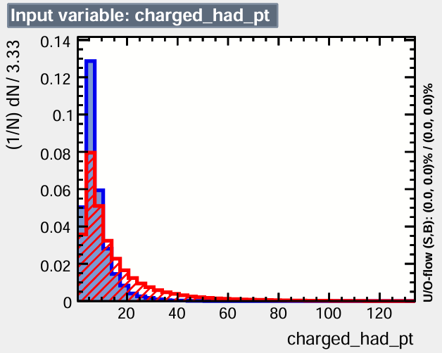
Input Variable
Charged_had:

Slide 15
Input Variable
mjj:
Leptonic (ll) channel
input variables
Hadronic (qq) channel
input variables
Description
This variable represents the di-jet invariant mass.
"ll_m"
"ll_p"
"ll_theta"
"ll_phi"
"vis_m"
"vis_p"
"vis_theta"
"vis_phi"
"visrecoil_theta"
"visrecoil_pt"
"visrecoil_m"
"visrecoil_phi“
"mjj"
“charged_had_m"
" charged_had _pt"
" charged_had _theta"
" charged_had _phi"
"vis_m"
"vis_p"
"vis_theta"
"vis_phi"
"visrecoil_theta"
"visrecoil_pt"
"visrecoil_m"
"visrecoil_phi“
"mjj"

Slide 16
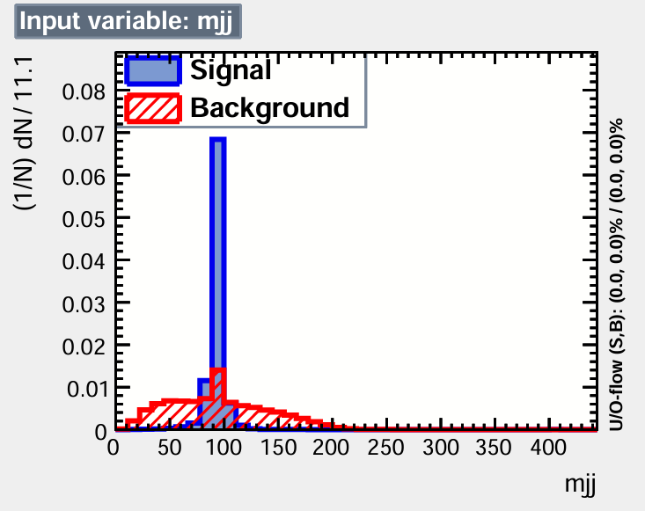
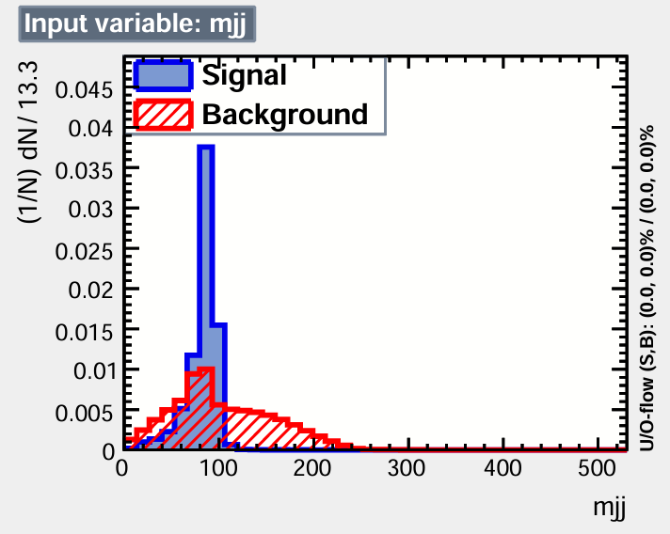
Leptonic (ll) channel
input variables
Hadronic (qq) channel
input variables

Slide 17
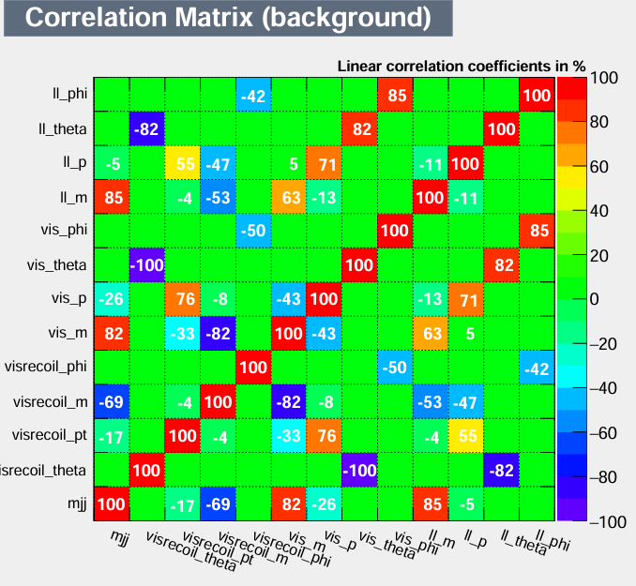
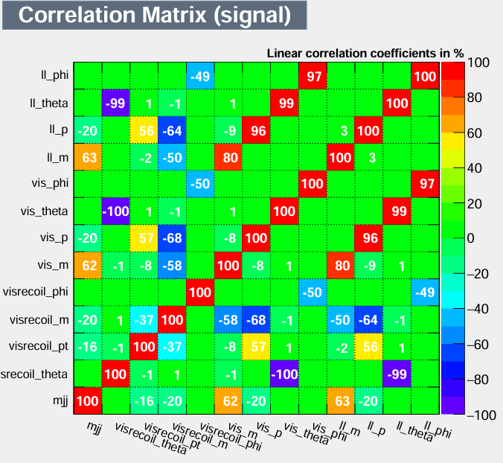
13 variables for Leptonic channel

Slide 18
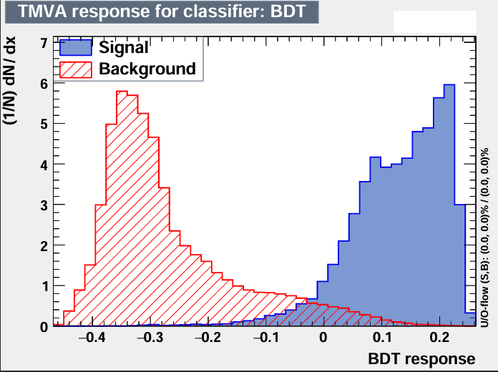
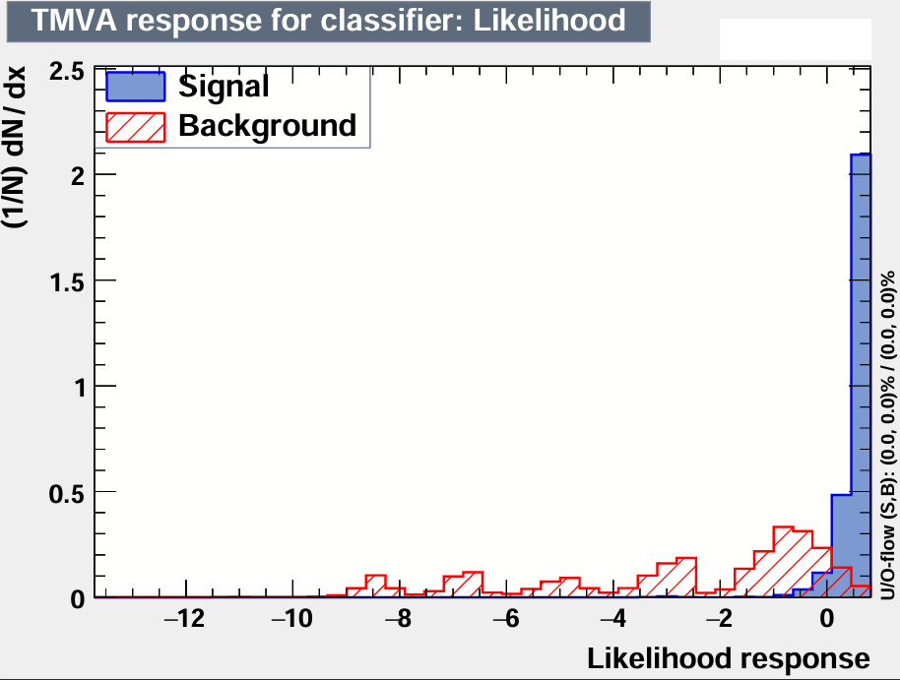
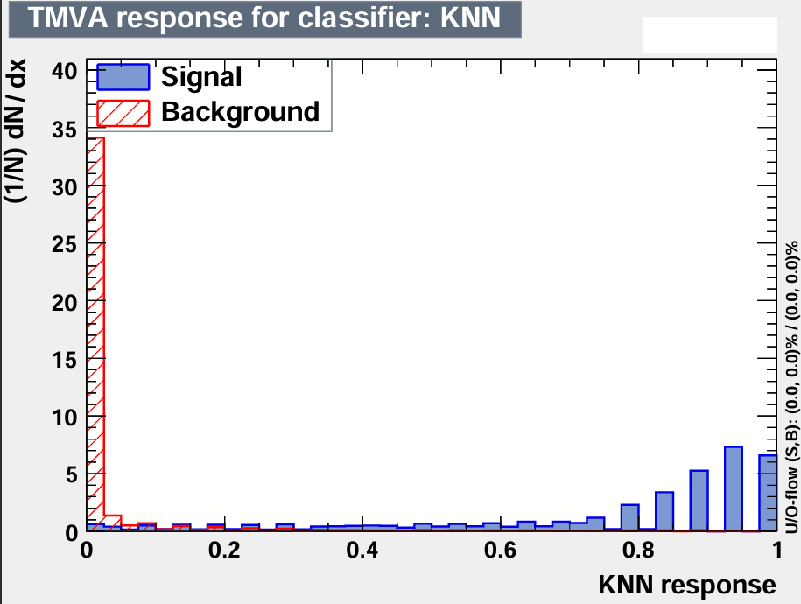
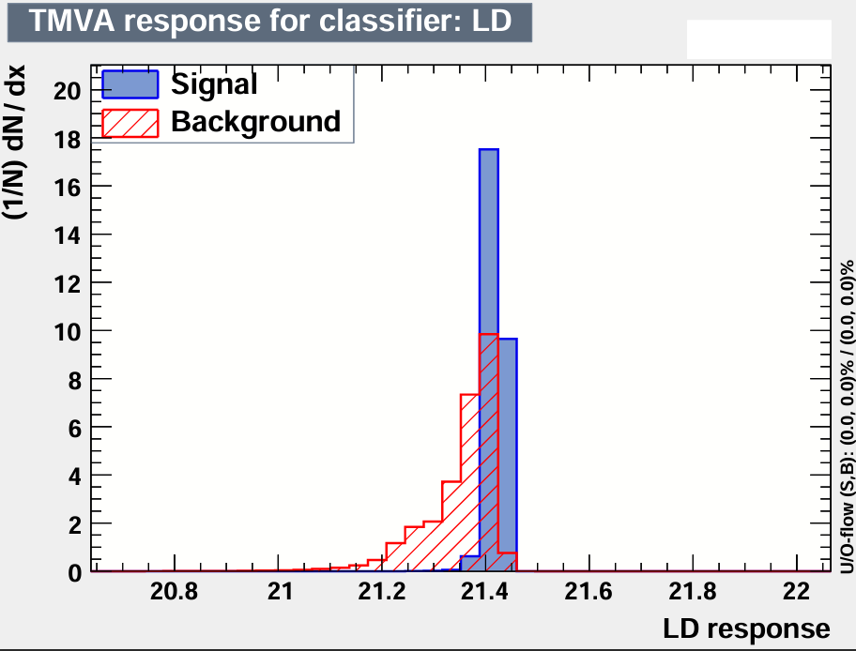
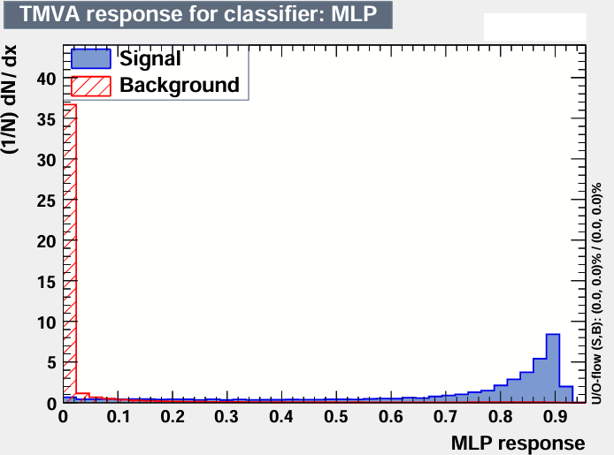
Signal and Background Overlay Graphs
13 input variables for leptonic (ll) channel
: Rank : Variable : Separation
----------------------------------------------------
: 1 : visrecoil_m : 6.611e-01
: 2 : vis_m : 5.096e-01
: 3 : mjj : 4.978e-01
: 4 : vis_p : 4.767e-01
: 5 : ll_p : 4.544e-01
: 6 : ll_m : 4.079e-01
: 7 : visrecoil_pt : 2.583e-01
: 8 : visrecoil_theta : 2.997e-02
: 9 : vis_theta : 2.983e-02
: 10 : ll_theta : 2.793e-02
: 11 : vis_phi : 6.155e-04
: 12 : visrecoil_phi : 5.398e-04
: 13 : ll_phi : 4.821e-04

Slide 19
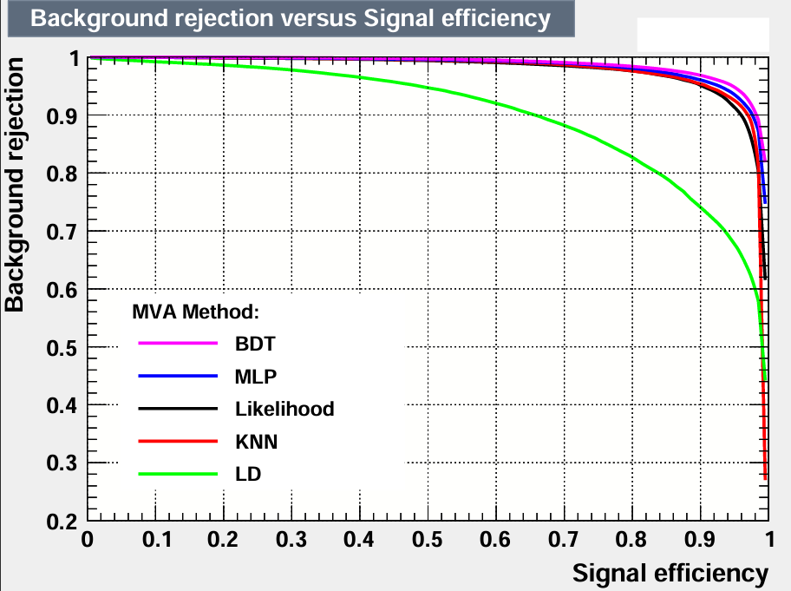
13 Variables Leptonic Channel
 | Signal Efficacy and Purity (area) | Testing vs. Training Efficiency Overtraining Check Using Signal Efficiency from Test Sample (Training Sample)…
MVA Method | AUROCC | At 99% B. Rejection | At 90% B. Rejection | At 70% B. Rejection
BDT | 0.987 | 0.710 (0.713) | 0.982 (0.982) | 1.000 (1.000)
MLP | 0.984 | 0.688 (0.607) | 0.976 (0.976) | 0.999 (0.999)
kNN | 0.979 | 0.610 (0.607) | 0.959 (0.960) | 0.990 (0.991)
Likelihood | 0.977 | 0.645 (0.669) | 0.968 (0.970) | 0.987 (0.987)
LD | 0.902 | 0.136 (0.133) | 0.657 (0.657) | 0.936 (0.937)

Slide 20
Principles for Reducing Variables:
vis_phi and ll_phi are highly correlated.
First, remove highly correlated variables based on signal and background correlation matrix.
vis_theta and visrecoil_theta are highly correlated

Slide 21
Principle for Reducing Variables cont.:
: Rank : Variable : Separation
----------------------------------------------------
: 1 : visrecoil_m : 6.611e-01
: 2 : vis_m : 5.096e-01
: 3 : mjj : 4.978e-01
: 4 : vis_p : 4.767e-01
: 5 : ll_p : 4.544e-01
: 6 : ll_m : 4.079e-01
: 7 : visrecoil_pt : 2.583e-01
: 8 : visrecoil_theta : 2.997e-02
: 9 : vis_theta : 2.983e-02
: 10 : ll_theta : 2.793e-02
: 11 : vis_phi : 6.155e-04
: 12 : visrecoil_phi : 5.398e-04
: 13 : ll_phi : 4.821e-04
Second, remove variables with low rankings based on variable separation power.

Slide 22
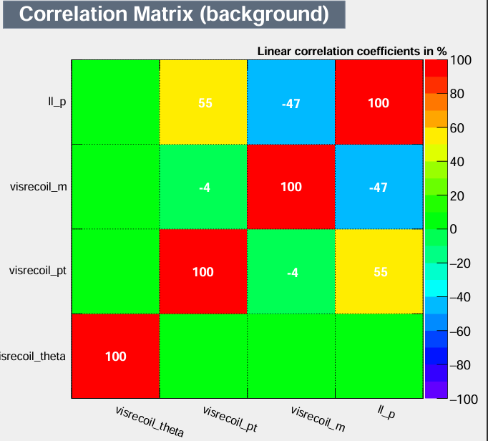
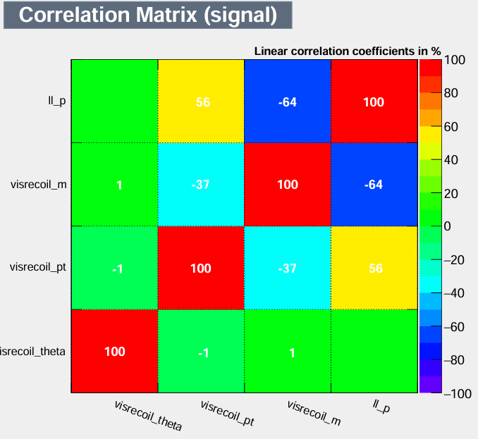
4 variable for Leptonic channel

Slide 23
4 variables for Leptonic channel

Slide 24
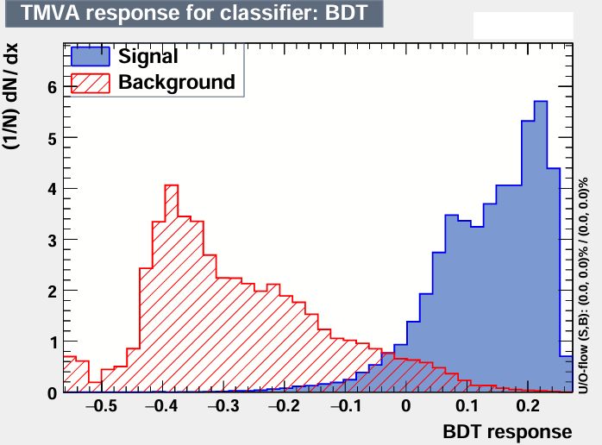
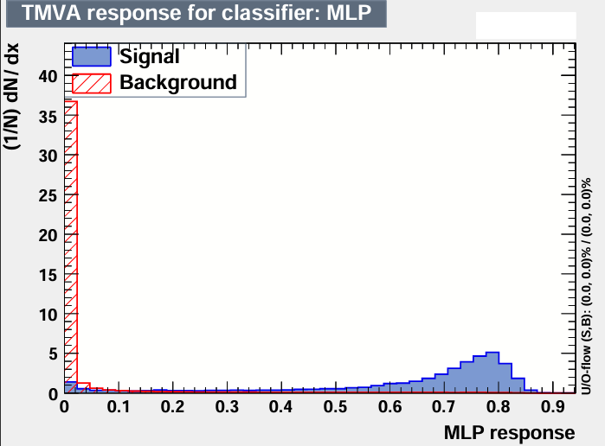
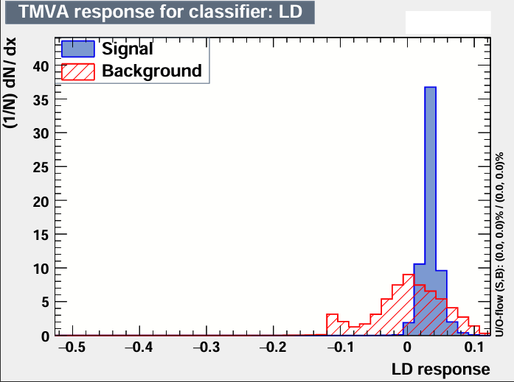
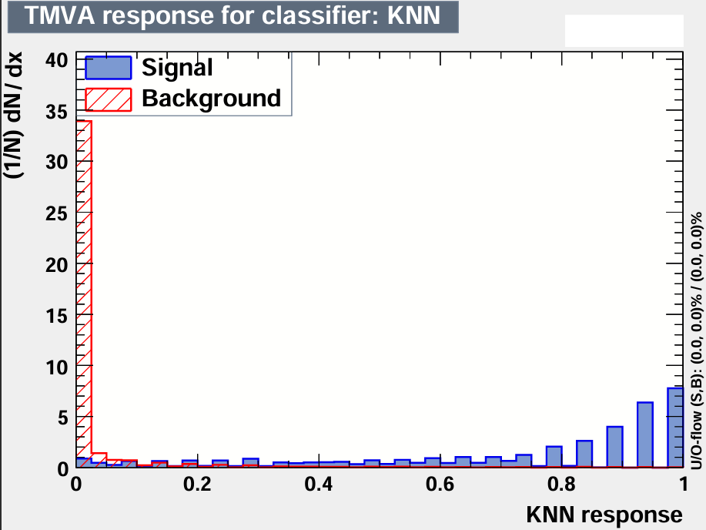
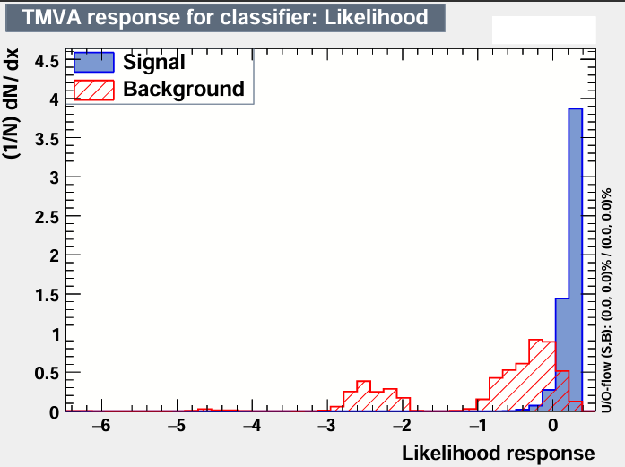
4 input variables for leptonic (ll) channel
Signal and Background Overlay Graphs
Rank : Variable : Separation
: ----------------------------------------
: 1 : visrecoil_m : 6.611e-01
: 2 : ll_p : 4.544e-01
: 3 : visrecoil_pt : 2.583e-01
: 4 : visrecoil_theta : 2.997e-02

Slide 25
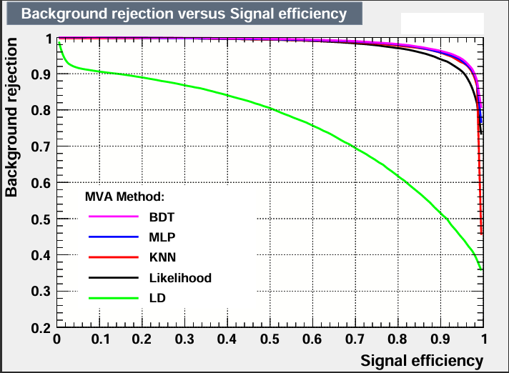
4 Variables Leptonic Channel
 | Signal Efficacy and Purity (area) | Testing vs. Training Efficiency Overtraining Check Using Signal Efficiency from Test Sample (Training Sample)
MVA Method | AUROCC | At 99% B. Rejection | At 90% B. Rejection | At 70% B. Rejection
BDT | 0.982 | 0.656 (0.652) | 0.966 (0.966) | 0.997 (0.997)
MLP | 0.974 | 0.558 (0.543) | 0.951 (0.951) | 0.987 (0.987)
kNN | 0.973 | 0.642 (0.661) | 0.959 (0.960) | 0.981 (0.981)
Likelihood | 0.968 | 0.504 (0.504) | 0.926 (0.926) | 0.986 (0.986)
LD | 0.720 | 0.000 (0.000) | 0.0017 (0.017) | 0.683 (0.685)

Slide 26
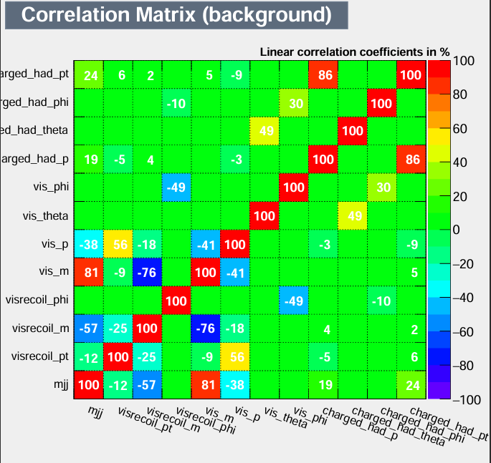
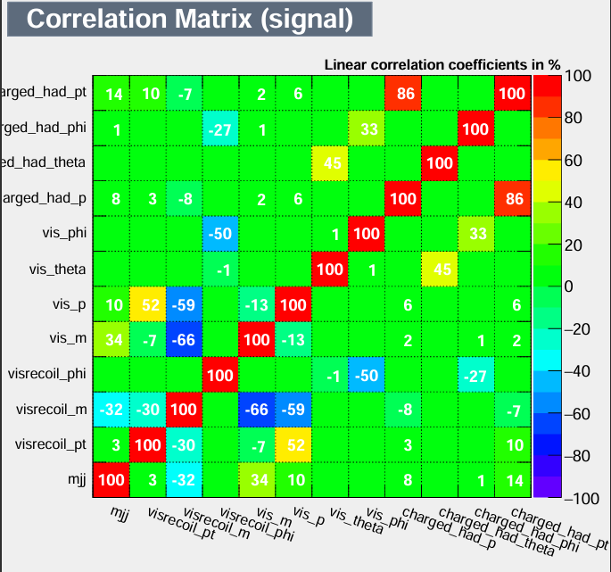
12 variables for Hadronic Channel (excluding visrecoil_theta)

Slide 27
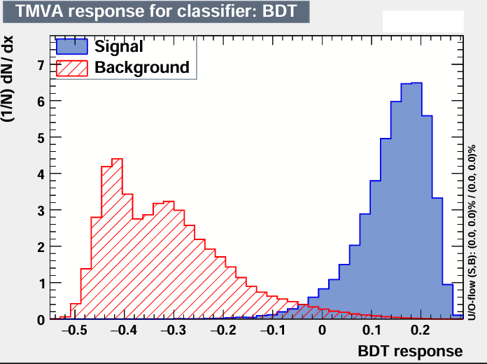
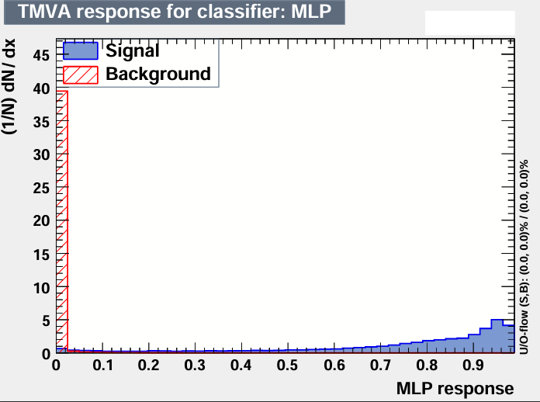



: Rank : Variable : Separation
-----------------------------------------------------
: 1 : visrecoil_m : 7.028e-01 : 2 : vis_m : 6.216e-01 : 3 : vis_p : 4.480e-01 : 4 : mjj : 3.606e-01 : 5 : visrecoil_pt : 2.693e-01 : 6 : charged_had_p : 1.468e-01 : 7 : vis_theta : 1.060e-01 : 8 : charged_had_pt : 9.693e-02 : 9 : charged_had_theta : 1.384e-02 : 10 : vis_phi : 8.970e-04 : 11 : visrecoil_phi : 7.312e-04 : 12 : charged_had_phi : 5.926e-04
12 input variables for hadronic (qq) channel
Signal and Background Overlay Graphs

Slide 28

12 Variables Hadronic Channel
 | Signal Efficacy and Purity (area) | Testing vs. Training Efficiency Overtraining Check Using Signal Efficiency from Test Sample (Training Sample)…
MVA Method | AUROCC | At 99% B. Rejection | At 90% B. Rejection | At 70% B. Rejection
BDT | 0.995 | 0.932 (0.933) | 1.000 (1.000) | 1.000 (1.000)
MLP | 0.996 | 0.932 (0.933) | 1.000 (1.000) | 1.000 (1.000)
kNN | 0.984 | 0.821 (0.835) | 0.977 (0.977) | 0.985 (0.985)
Likelihood | 0.991 | 0.794 (0.796) | 0.987 (0.987) | 1.000 (1.000)
LD | 0.918 | 0.084 (0.084) | 0.719 (0.719) | 0.969 (0.970)

Slide 29


4 variables for Hadronic Channel

Slide 30





4 input variables for hadronic (qq) channel
Signal and Background Overlay Graphs
: Rank : Variable : Separation
: ----------------------------------------------------
: 1 : visrecoil_m : 7.028e-01 : 2 : visrecoil_pt : 2.693e-01 : 3 : charged_had_p : 1.468e-01 : 4 : vis_theta : 1.060e-01

Slide 31

4 Variables Hadronic Channel
 | Signal Efficacy and Purity (area) | Testing vs. Training Efficiency Overtraining Check Using Signal Efficiency from Test Sample (Training Sample)…
MVA Method | AUROCC | At 99% B. Rejection | At 90% B. Rejection | At 70% B. Rejection
BDT | 0.989 | 0.760 (0.760) | 0.985 (0.985) | 1.000 (1.000)
MLP | 0.989 | 0.793 (0.797) | 0.985 (0.985) | 1.000 (1.000)
kNN | 0.976 | 0.817 (0.832) | 0.975 (0.975) | 0.981 (0.981)
Likelihood | 0.984 | 0.652 (0.652) | 0.970 (0.970) | 1.000 (1.000)
LD | 0.863 | 0.000 (0.000) | 0.362 (0.361) | 0.970 (0.970)

Slide 32
4 variables for Hadronic channel

Slide 33
Total Elapsed Time for Leptonic channel
Total Elapsed Time [13 var.-ll]
Methods | Total (sec) | Total (min)
BDT | 68.7 | 1.1
MLP | 555.7 | 9.25
kNN | 272.48 | 4.54
Likelihood | 0.83 | 0.014
LD | 0.34 | 0.0057
Abroximate run time = 15 min
Total Elapsed Time [4 var.-ll]
Methods | Total (sec) | Total (min)
BDT | 43.82 | 0.73
MLP | 195.28 | 3.25
kNN | 13.79 | 0.23
Likelihood | 0.33 | 0.0055
LD | 0.15 | 0.0025
Abroximate run time = 4.2 min

Slide 34
Total Elapsed Time for Hadronic channel
Total Elapsed Time [12 var.-qq]
Methods | Total (sec) | Total (min)
BDT | 454.1 | 7.57
MLP | 2,933.8 | 48.9
kNN | 16,974.1 | 282.9
Likelihood | 3.8 | 0.06
LD | 1.9 | 0.03
Abroximate run time = 5.7 hrs
Total Elapsed Time [4 var.-qq]
Methods | Total (sec) | Total (min)
BDT | 320.6 | 5.3
MLP | 1221.6 | 20.4
kNN | 261.3 | 4.4
Likelihood | 1.6 | 0.03
LD | 0.8 | 0.01
Abroximate run time = 30.1 min

Slide 35
TMVA Number of Variables and Classifier Analysis of Leptonic and Hadronic Channels
# of variables | Channel | Largest ROC-integ (area) | Smallest ROC-integ (area) excluding LD | Highest Signal Efficiency from Training (Testing) Sample at 90% Background Rejection | Lowest Signal Efficiency from Training (Testing) Sample at 90% Background Rejection excluding LD | Shortest Time for Training and Testing excluding LD | Longest Time for Training and Testing
13 | Leptonic | 0.987 [BDT] | 0.977 [Likelihood] | 0.982 (0.982) [BDT] | 0.959 (0.960) [kNN] | 0.83 sec [Likelihood] | 9.3 min [MLP]
4 | Leptonic | 0.982 [BDT] | 0.968 [Likelihood] | 0.966 (0.966) [BDT] | 0.926 (0.926) [Likelihood] | 0.33 sec [Likelihood] | 3.3 min [MLP]
12 | Hadronic | 0.982 [BDT] | 0.984 [kNN] | 0.966 (0.966) [MLP] | 0.977 (0.977) [kNN] | 3.8 sec [Likelihood] | 5.7 hrs [KNN]
4 | Hadronic | 0.989 [MLP, BDT] | 0.976 [kNN] | 0.985 (0.985) [MLP, BDT] | 0.970 (0.970) [Likelihood] | 1.6 sec [Likelihood] | 20 min [MLP]

Slide 36


Muon - MVA
Electron - MVA
At the optimal cut value of -0.05:
Signal Efficiency (Purity) = 0.9
Background Efficiency (Purity) = 0.1
At the optimal cut value of -0.05:
Signal Efficiency (Purity) = 0.95
Background Efficiency (Purity) = 0.05

Slide 37


MVA – Hadron
Electron + Muon - MVA
At the optimal cut value of -0.02:
Signal Efficiency (Purity) = 0.95
Background Efficiency (Purity) = 0.05
At the optimal cut value of -0.03:
Signal Efficiency (Purity) = 0.95
Background Efficiency (Purity) = 0.08

Slide 38


How does TMVA compare to cut-based analysis?
Preliminary tests were done by adding cuts to TMVA in order to compare signal efficiencies of cuts and the MVA method BDT .
The cuts implemented were taken from this analysis.

Slide 39
How does TMVA compare to cut-based analysis?
More rigorous tests still need to be done to conclusively compare the two analyses.
Signal and Background Percentages for the Different Channels of the Cut-Based Analysis and the MVA Based Analysis
Cut-Based Analysis
MVA (BDT) Analysis
Channels | Signal Efficiency % | Background Rejection %
Electron | 58% | 92%
Muon | 76% | 90%
Electron + Muon | 27% | 95%
Hadronic | 76% | 94%
Signal Efficiency % | Background Rejection %
58% | 99%
76% | 99%
27% | 100%
76% | 99%

Slide 40
Conclusion:
For AUROCC and signal efficiency / background rejection, the BDT and MLP methods performed the greatest with subtle differences in their value.
Although all MVA methods performed well (except for LD) the poorest performing methods were Likelihood and k-NN with the smallest AUROCC and signal efficiency/ background rejection.
Removing highly correlated and low ranking variables had a slight decrease in signal effeiceny for the leptonic channel and a slight increase for the hadronic channel.
Future tests include adding more MVA classfiers and adjusting classifier configurations.
Overall, TMVA provides a quick and efficient way to test MVA methods that has the potential to be used for FCC-ee Higgs→ invisible analysis.

Slide 41
Why not all 13 variables?
Run-time error when using both vis_theta and visrecoil_theta.
Both variables are highly correlated with each other but uncorrelated with other variables.
Variable vis_theta was selected due to higher separation ranking.

