Slide 1
p-Pb MD – 31st Oct. 2011
Preliminary analysis of B2 (Pb) emittance measurements
Reine Versteegen

Slide 2
Wire scans of Pb beam B2, 2nd and 3rd fills
γε_{x}(Pb)
b1,b2,b3,b4 = bunches of B2
Dampers ON
time
2nd fill
3rd fill
1st injection of protons (pilot)
Dump of B1
Injections of proton batches: 1b+18b+72b+72b+72b+72b
γε_{y}(Pb)
time

Slide 3
Evolution of bunches emittances, 2nd and 3rd fills
γε_{x}(Pb)
b1,b2,b3,b4 = bunches of B2
0 1:10 2:20 3:30 4:40 5:50 time
γε_{y}(Pb)
0 1:10 2:20 3:30 4:40 5:50 time

Slide 4
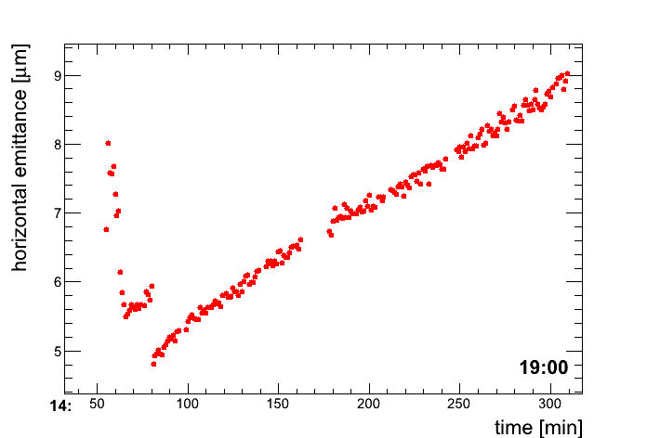
Compare BGI and wire scans data during 3rd fill (x-plane only):
<γε_{x}(Pb)>
<γε_{x}(Pb)>
slope = 0.008 μm/min
3.2
2.8
2.4
2
slope = 0.008 μm/min
slope = 0.010 μm/min
=15:40 =16:30 =17:20
time
BGI with rough calibration (Mariusz Gracjan Sapinski)
Wire Scanner
WS gives larger emittances than BGI…

Slide 5
Wire scans of Pb beam B2 in the presence of proton beam, 4th fill
γε_{x}(Pb)
b1,b2 = bunches of B2
4th fill :
B1 identical: ≈ 300 bunches
B2 = 2 new Pb bunches
Horizontal emittance reaches nominal value after 25 min
IBS will be calculated and compared with these data
time
4th fill
γε_{y}(Pb)
time

Slide 6
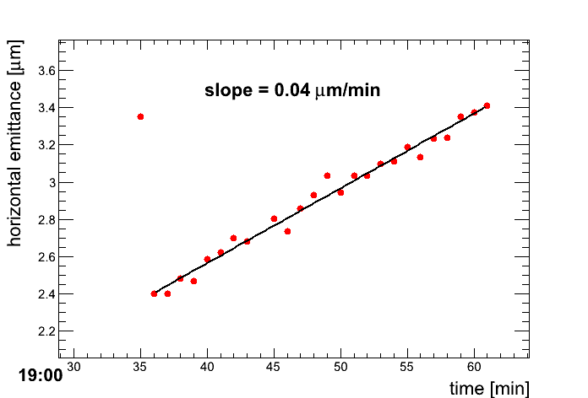
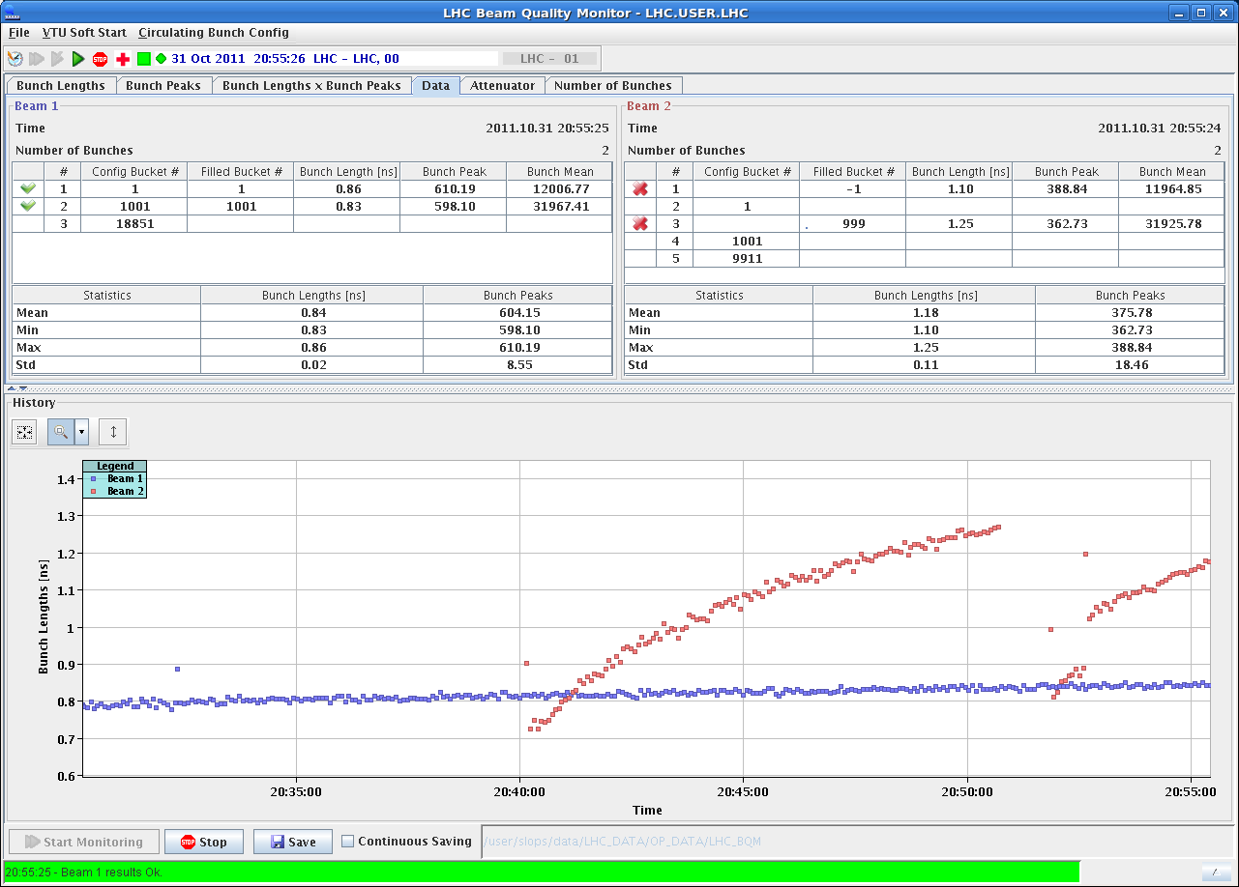
Compare BGI and wire scans data
during 4th fill (x-plane only):
<γε_{x}(Pb)>
<γε_{x}(Pb)>
* γ(p)/γ(Pb)
1.44
1.36
1.28
1.2
1.12
1.04
0.96
0.88
= 0.016 μm/min
BGI with rough calibration (Mariusz Gracjan Sapinski)
Wire Scanner
WS vs. BGI: Same order of magnitude at the beginning of the fill, but different values for the slope
Slope is bigger than before because of shorter bunches

Slide 7
Wire scans of Pb beam B2, 5th fill
γε_{x}(Pb)
b1,b2 = bunches of B2
5th fill :
B1 = 2 new p bunches B2 = 2 new Pb bunches
E = 3.5 Z TeV
time
No data before or during the ramp,
No significant emittance growth during frequency trimms and cogging
End of ramp
γε_{y}(Pb)
time

Slide 8
Thank you

