Slide 1
Highlights of the ATS MD part III
(Achromatic Telescopic Squeeze)
Participants: R. Assmann, R. Bruce, S. Fartoukh, B. Goddard, W. Hofle, D. Jacquet, G. Kruk, M. Lamont, E. Maclean, R. de Maria, R. Miyamoto, G. Mueller, M. Pojer, L. Ponce, S. Redaelli, N. Ryckx, R. Steinhagen, M. Strzelczyk, R. Tomas, G. Vanbavinckhove, J. Wenninger, and many others
Initial Goal:
→ Demonstrate β*=10 cm at IP1 and IP5 (w/o X-angle but with parallel separation)
Initial Plan & Results:
Dry run (3h) → Successful in 2.5 h (no trips, all knobs tested)
Pre-squeeze to 40 cm (4.5 h) → Cancelled
Squeeze to 10 cm (6 h) → beam lost after 4.5 h when starting the telescopic part at β*=40 cm … but 40 cm reached nevertheless at IP1&5 !

Slide 2
What is the ATS scheme? … A small recap.
A squeeze procedure in two steps
1) An “almost” standard squeeze, the Pre-squeeze, acting on the IPQs of IR1 and IR5.
2) A continuation of the squeeze, called Squeeze, acting on the IPQs of IR2/8 for
squeezing IR1 and IR4/6 for IR5 and inducing β-beating bumps in s81/12/45/56.
→
With additional features to warrant the correction of the chromatic aberrations (Q’’, Q’’’, off-momentum β-beat, and more!)
For the July MD, the pre-squeezed β* was chosen to 1.2 m, and the telescopic part was activated to squeeze IR1 only and successfully reach 30 cm (with 400% β-mismatch generated on purpose in arc 81 and 12).
For this MD, the pre-squeezed β* was pushed to its limit of 40 cm, and the plan was to activate the telescopic part both for IR1 and IR5 in order to reach 10 cm.

Slide 3
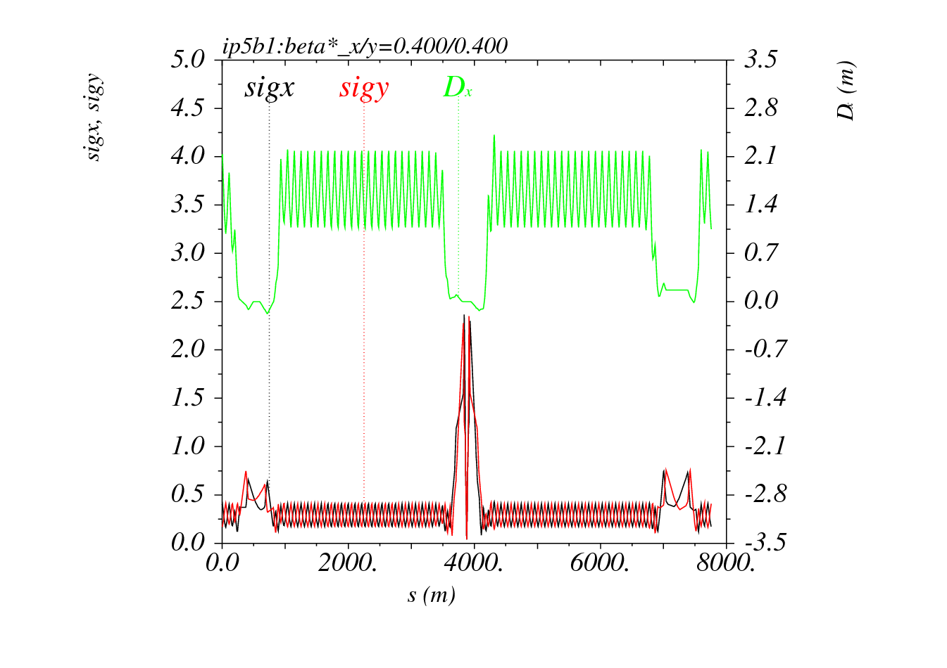
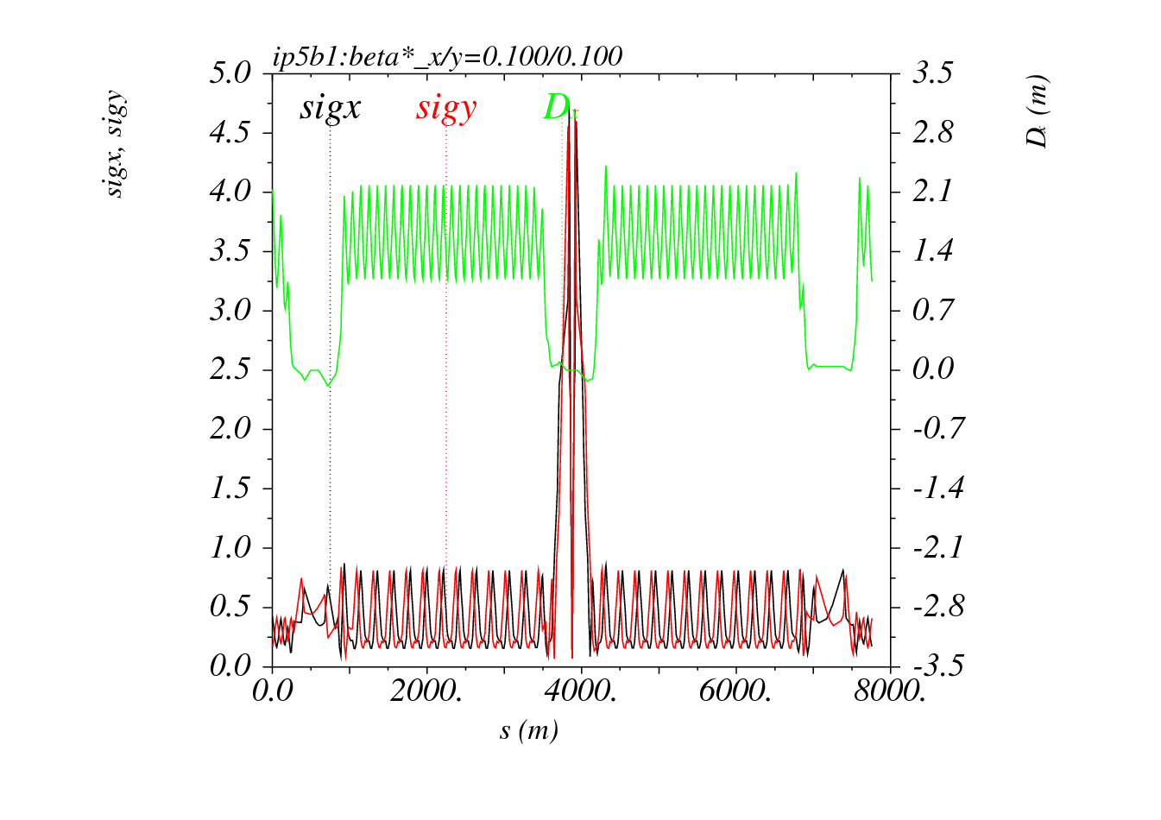
The IR5 pre-squeeze at β*=40 cm
β_{max}=6 km in the triplet
(σ ~2.5 mm @3.5 TeV, γε=3.5 μm)
FODO β’s in arcs 45 & 56
FODO dispersion
The IR5 squeeze at β*=10 cm
β_{max}=24 km in the triplet
(σ ~5 mm @3.5 TeV, γε=3.5 μm)
400% β-mismatch in arcs 45 & 56
FODO dispersion

Slide 4
The Dry Run (2.5h on 30th of October)
A tedious preparation work: the key for success
Optics work : compared to last MD, pre-squeeze pushed down to 40 cm, squeeze transition calculated for IR4 and IR6 (taking into account Brennan’s constraints)
Full ATS hyper-cycle & sequence using the already commissioned ATS ramp and the new ATS squeeze beam process.
→ Some modifications needed & implemented in LSA Pro version and other software with statements like if beam-process-name contains “_ATS_” do it differently
PLP procedure also applied for the setting generation and trims of sextupoles.
Artificially doubling the MQY decay time to avoid trip at low current during the squeeze (affect the duration of the few last segments only).
Two sets of knobs (Q, Q’, coupling) to be used above and below the pre-squeeze β*, and the possibility to switch the QFB from one knob to the other … at least we thought … unfortunately this functionality was not tested during the dry run!

Slide 5
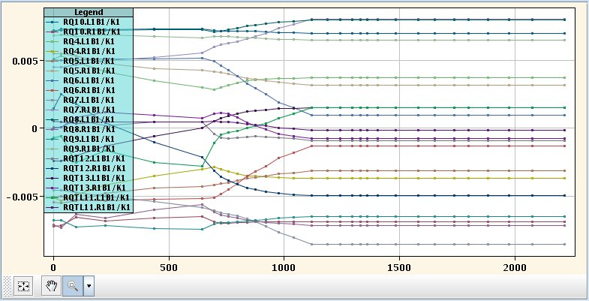
How does it look like in practice (IR1/5)
β*> 40 cm
β*< 40 cm
→ The IPQ settings are changing in IR1 and IR5 down to the pre-squeezed β*, then stay constant.
→ IPQ settings are constant in IR8/2/4/6 down the pre-squeezed β*, then start to move

Slide 6
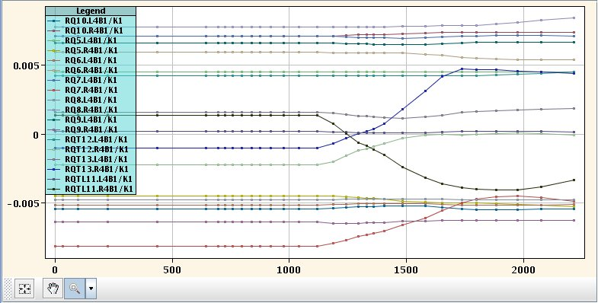
How does it look like in practice (IR8/2/4/6)
β*> 40 cm
β*< 40 cm
→ The IPQ settings are constant in IR8/2/4/6 down to the pre-squeezed β*, then start to move.

Slide 7
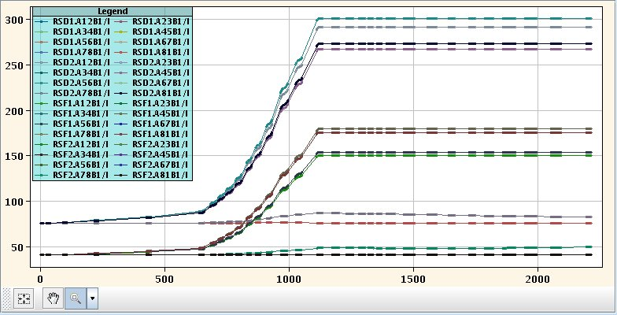
How does it look like in practice (sextupole)
PLP at each
stop point
β*> 40 cm
β*< 40 cm
(at this stage the chromatic correction
is achieved by the β-beating!)
Only 25% of the RS circuits actively participates to the chromatic correction.
They are the limiting circuits during the pre-squeeze (except for the last segment)
→ Note that 300A is reached for some RSDs at 3.5 TeV/beam (i.e. max current reached at 7TeV).

Slide 8
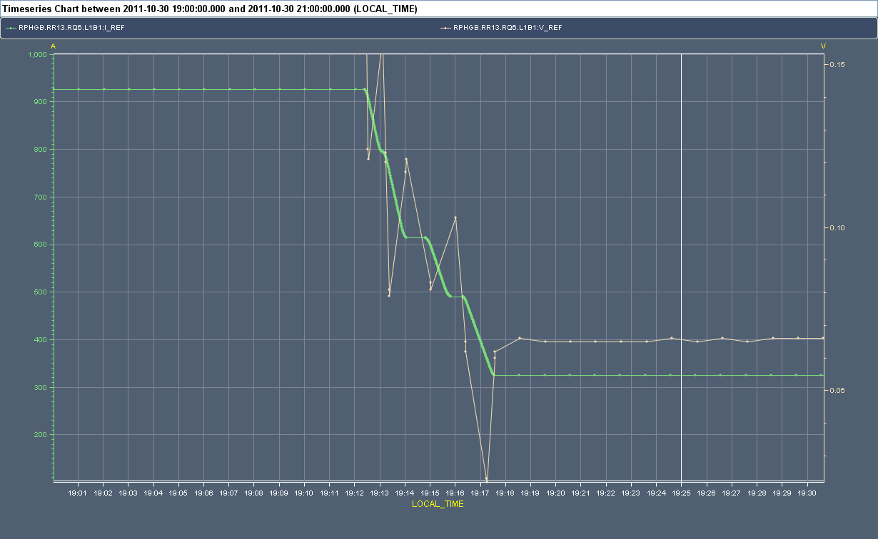
How does it looks like in practice (Q6 in IR1/5)
300 A for the Q6’s in IR1/5 @ 3.5 TeV
(would be 180A for the nominal collision optics at 55cm)
Only 20 mV margin at the end of the pre-squeeze (β*=40 cm)
The only big uncertainty was the RQ6 circuits (MQML) in IR1 and IR5, reaching very
low current (~300A) at the end of the pre-squeeze.
→ However these circuits did not trip … with only 20 mV margin left in Vref

Slide 9
The MD with beam (5th of November)
Easy injection (c.o., tune, coupling, chroma,..).
Excellent transmission during the ramp.
Smooth “pre-squeeze” down to 40 cm (6.2 km β_{max} in the triplet) reached in 2h:
“3 km/h in terms of β_{max} ” including a pause at β*=1m for optics measurement!
→ Successful on-line β-beating measurement and correction at 40 cm (<20%).
Beam lost due to trips of several 600A circuits, triggered by QPS, when preparing the telescopic part towards 10 cm.
When switching the QFB to the new tune knobs, the real time trims of the RQT & RS were sent to zero in S45/56/81/12 (the 4 sectors where the β’s are supposed to increase), and trying to redistribute them in S23/34/67/78 (the 4 sectors where the β’s are always kept nominal).

Slide 10
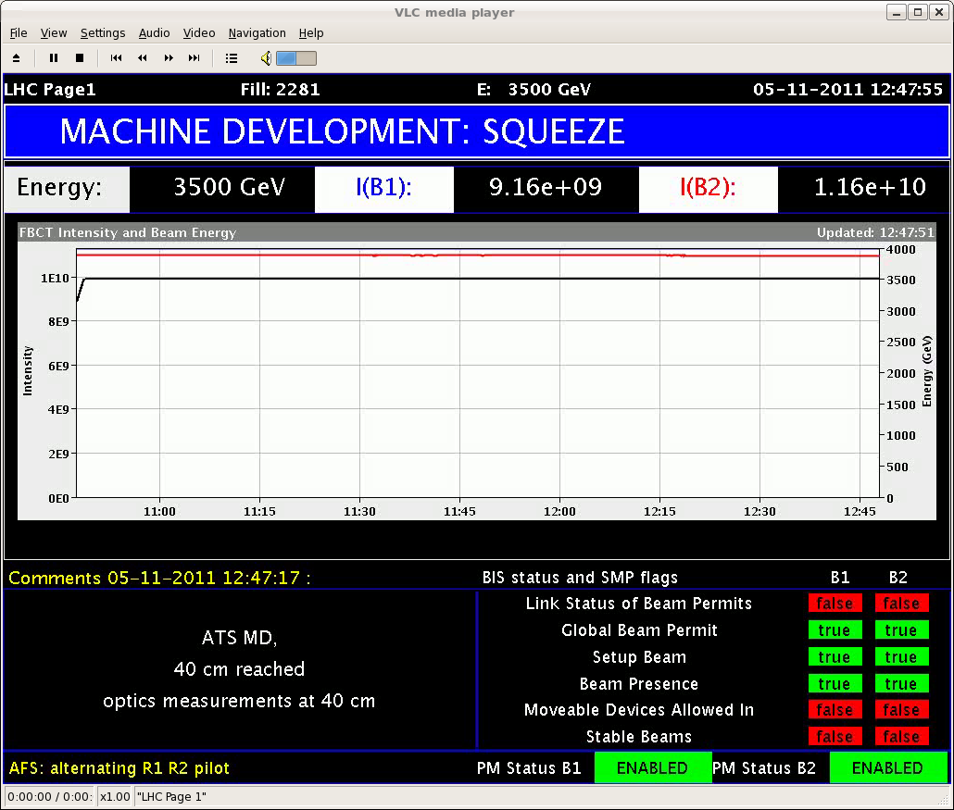
Highlights of the MD with beam
Excellent transmission during ramp and fast pre-squeeze “mini-commissioning”.
Only 2h for 40 cm

Slide 11
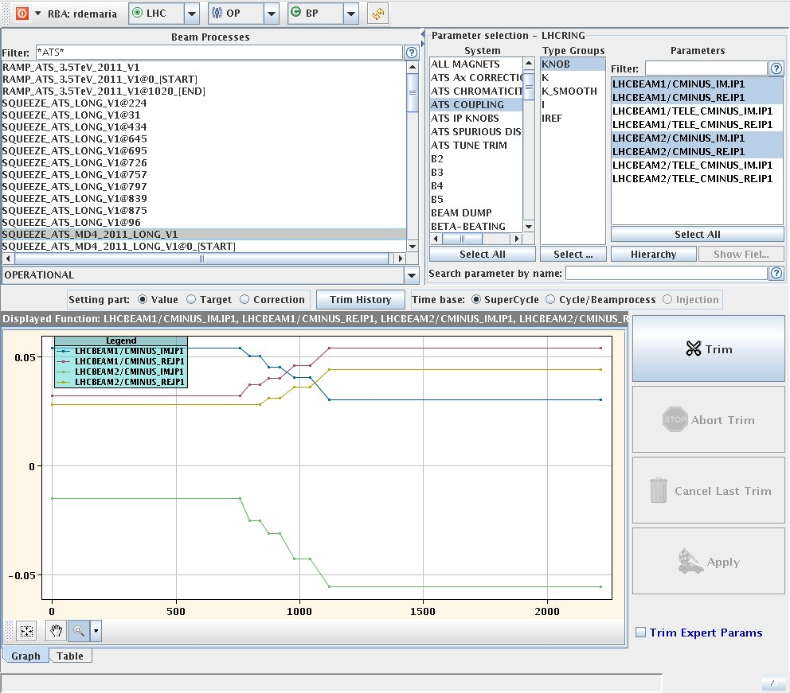
Highlights of the MD with beam
Rather constant Q’ during the pre-squeeze (with stop points possible w/o tripping the RS circuits thank to the “If ATS” in the control softs).
Coupling easily corrected with global knobs, but some trend visible → Fine tuning of the RQSX’s needed in IR1/5 and rebalancing the arc a2 correction (see next slides).

Slide 12
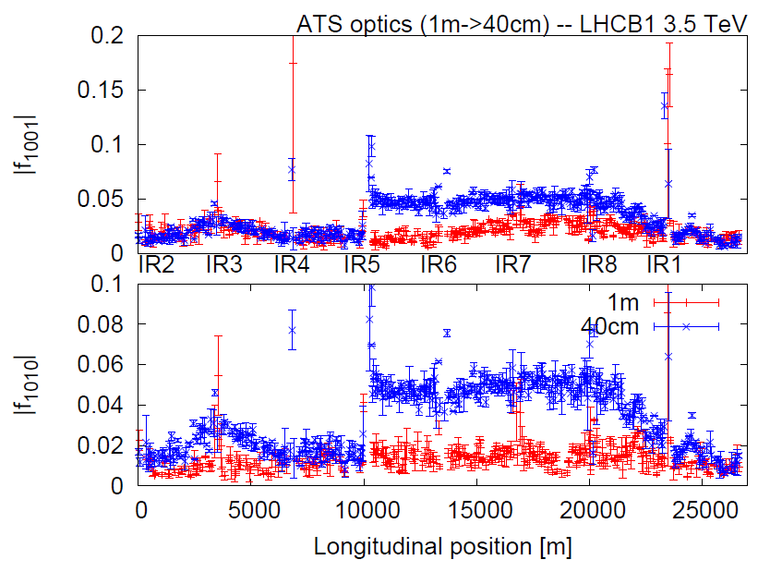
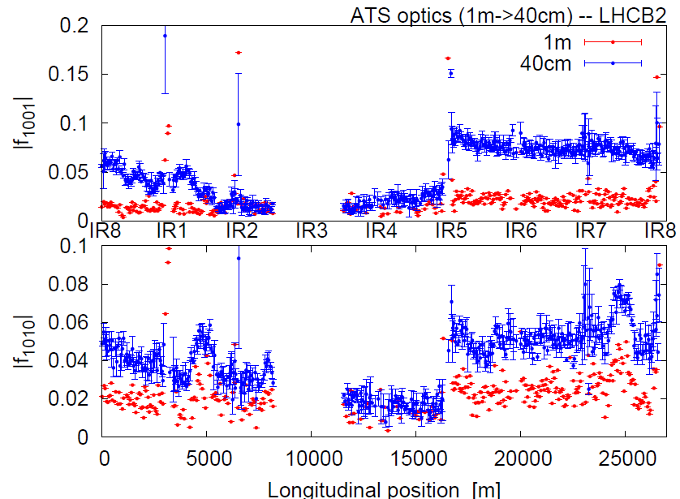
Highlights of the MD with beam
Beam1
Beam2
Clear source of coupling errors in IR5 while IR1 looks OK … but at 10 cm who knows?
→ Certainly, RQSX pre-settings to be re-adjusted in IR5.
Sector by sector a2 correction to be re-optimized accordingly, mainly in S81/12/45/56 to already prepare the telescopic part of the ATS. Idem for the arc by arc b2 correction (not showed here).

Slide 13
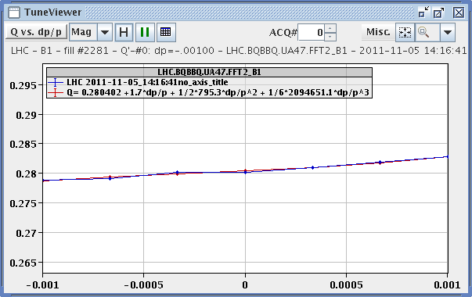
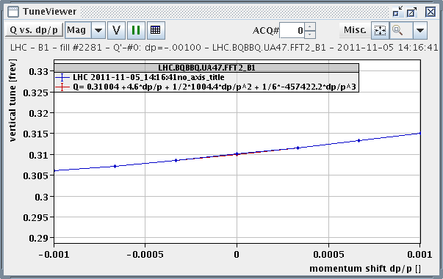
Highlights of the MD with beam
Linear chromatic variations of the tunes at β*=40 cm
→ No or small Q’’ & Q’’’ which is a signature of a well-controlled off-momentum β-beating (.. unfortunately no time for measuring the W’s for a direct confirmation).
Qx(δ) at β*=40 cm
Qy(δ) at β*=40 cm

Slide 14
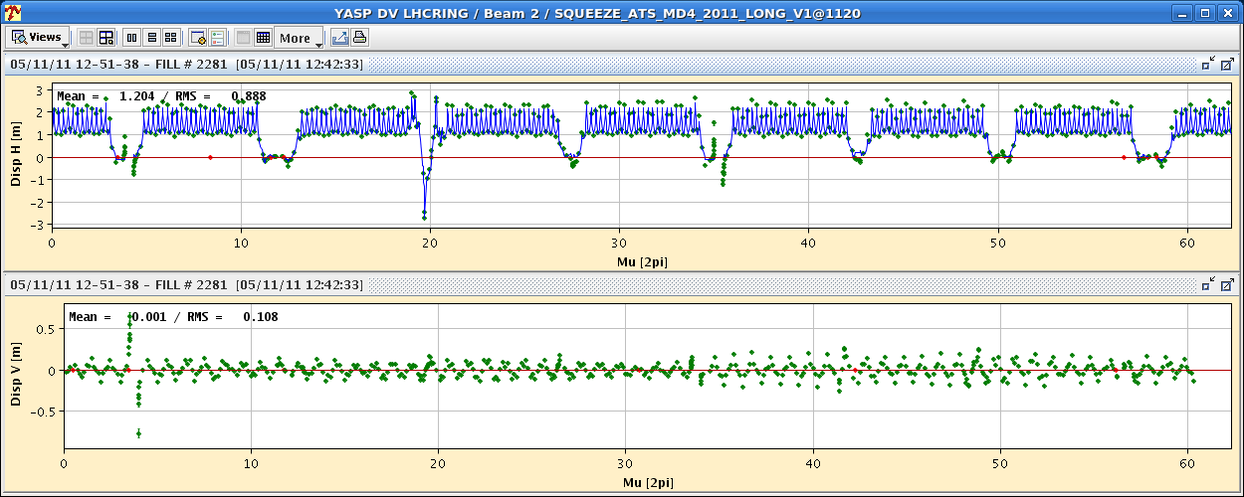
Highlights of the MD with beam
The linear imperfections coming from the arcs start to show up!
Dy still more than acceptable: sorting on random a2 for the MBs.
Dx starts to be worrying, but a priori correctable: the MQ sorting was optimized for β-beating only (too many SSS types)
1.5m at 6km β_{max}
1m at 6km β_{max}
Dx at β*= 40 cm for beam2 (worst case)
Dy at β*= 40 cm for beam2 (worst case)
50 cm at 6km β_{max}

Slide 15
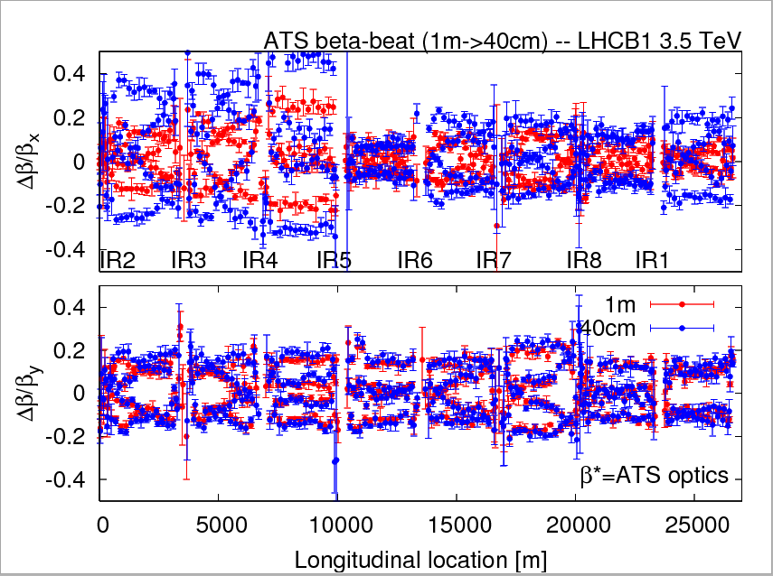
Highlights of the MD with beam
20 → 50% level achieved for the β-beating at β*=1 m→ 40 cm with only 3 empirical trims applied for 3 Q2’s (around ±10 units)
→ mostly generated in IR5: longitudinal alignment of the triplet??

Slide 16
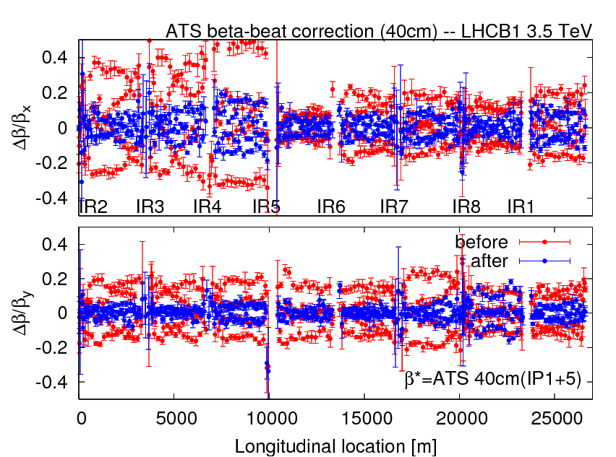
Highlights of the MD with beam
15-20% level reached (for beam1) after one single correction iteration (using only the IPQs of IR1 and IR5).

Slide 17
Conclusions
Certainly a BIG success for the LHC: 40 < 55!
Certainly a BIG success for the “A” of the ATS (Achromatic).
Let us wait for some MD time next year in order to validate the “T” (Telescopic)
… even if already demonstrated with the last MD but only for one IP (the easiest one IP1) and starting from a less aggressive pre-squeezed optics (1.2 m).

