Slide 1
TDI impedance MD
V. Baglin, H. Bartosik, C. Bracco, J. Esteban Mueller, E. Métral,
N. Mounet, G. Papotti, S. Redaelli, B. Salvant, J. Uythoven
Acknowledgments:
OP crew, G. Arduini, T. Baer, P. Baudrenghien, G. Bregliozzi, M. Gasior,
A. Grudiev, B. Goddard, G. Lanza, T. Mastoridis, E. Shaposhnikova,
R. Steinhagen, M. Timmins

Slide 2
Preliminary conclusions
Very good beam conditions. Thanks to everyone!
Clean measurements of B1 and B2 tune shifts with changing TDI gap for single bunch
Not much could be seen with physics beam
Total effective vertical impedances of TDI.2 and TDI.8 are very similar and there could be signs of degradation since last year.
It seems that it is confirmed that the corresponding total effective vertical impedance is larger than predictions
Phase error shift with TDI jaw movement was recorded and longitudinal impedance could be inferred (J. E. Mueller)

Slide 3
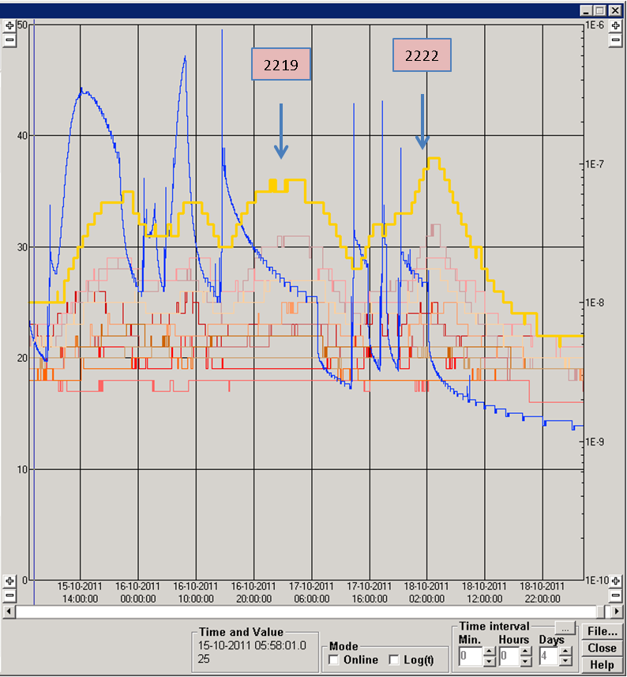
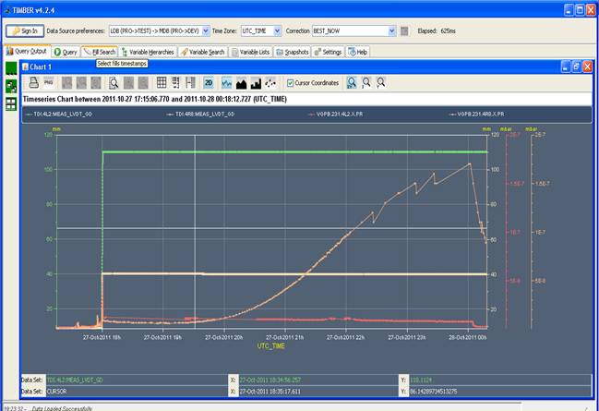
Context
Pressure and temperature increase in both TDIs during physics fills → beam induced
TDI8
temperature
TDI2 gap
TDI8 pressure
TDI8 gap
TDI8 pressure
TDI2 pressure
Vincent Baglin and TE/VSC colleagues
Increasing the gap of the TDI from +/-20mm to +/-55mm from fill 2219 damped the pressure increase, but not the temperature increase.
Decreasing the gap on B2 back to +/-20mm for fill 2261 generated pressure again. Clear correlation with the gap.
For the last fills, TDI gap was put to +/-37.5mm for B2 but no significant difference with +/-55mm was observed

Slide 4
Objectives
Since most of heating and pressure issues had been dealt with during physics fills, it was decided to concentrate on TDI impedance measurements.
Previous TDI measurements had been performed last year (see here and here),
but the noise levels were very high. TDI+TCLIs impedance was larger than expected (a factor 2 to 3)
Degradation of the pressure during the year could also be explained by degradation of the 3 micron Ti coating on the hBN blocks.
Measure the TDI impedance alone with more accuracy
Compare with available predictions
Has the impedance gone worse?

Slide 5
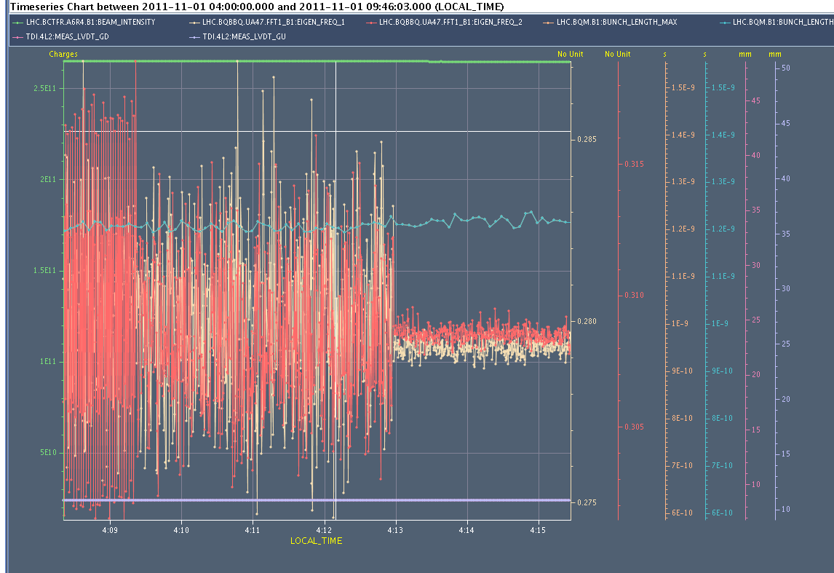
Methods to improve the signal:
- Reducing the noise by switching off dampers and abort gap cleaning
- Increasing intensity to 2.6e11 p/b (by the way bunch is stable with Q’y~4)
intensity
Bunch length
Vtune
Htune
Abort gap cleaning off
Transverse damper off

Slide 6
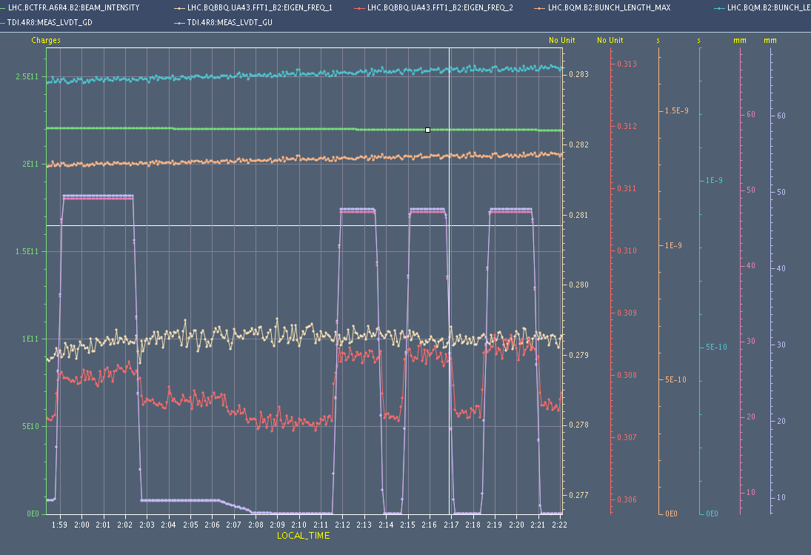
MD results with single bunch B2
Bunch length
intensity
TDI full gap
Htune
Vtune
Clean vertical tune change. No horizontal tune change observed.

Slide 7
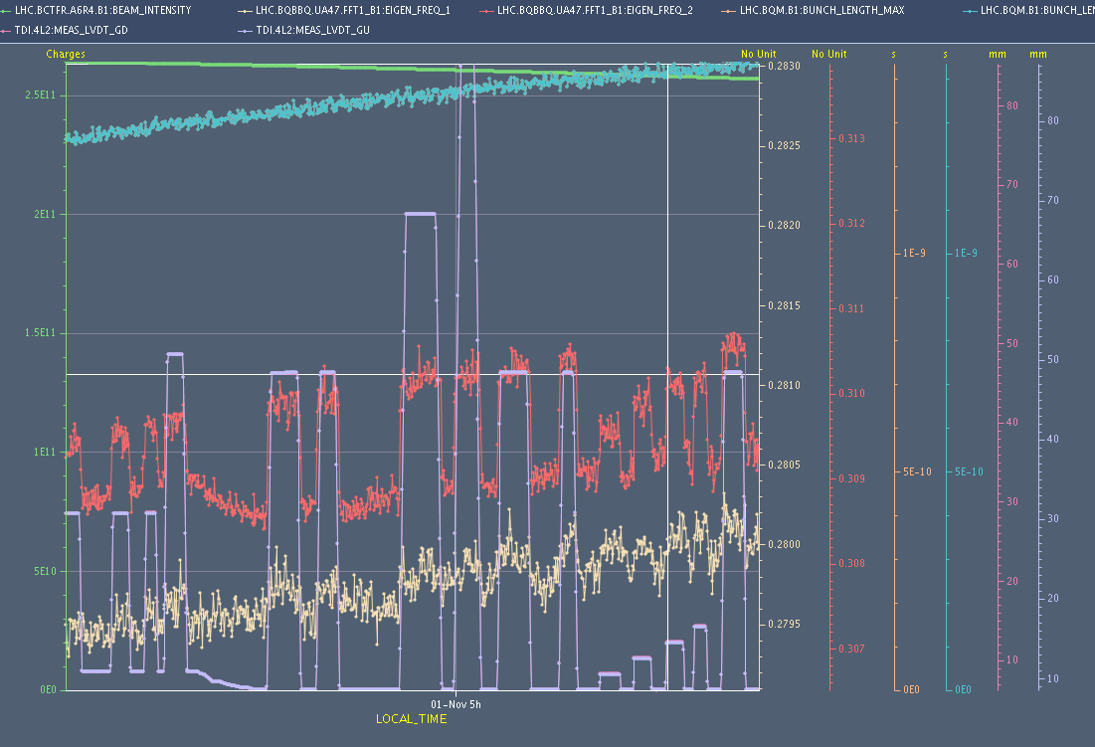
MD results with single bunch B1
intensity
Bunch length
TDI full gap
Vtune
Htune
Clean vertical tune change. Small horizontal tune change also observed.

Slide 8
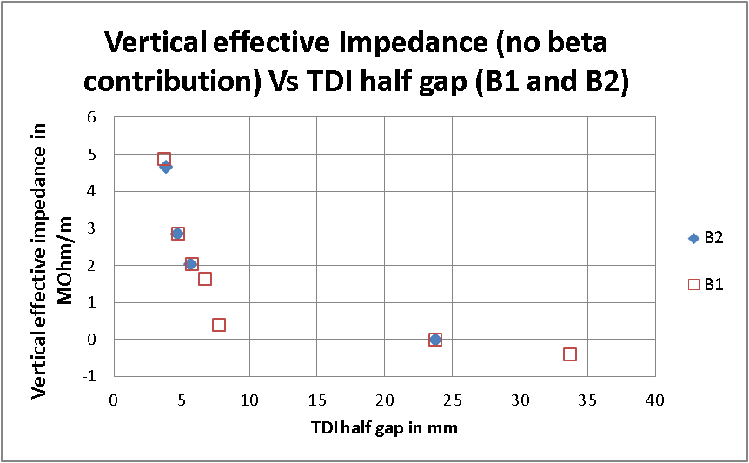
Total effective impedance for B1 and B2

Slide 9
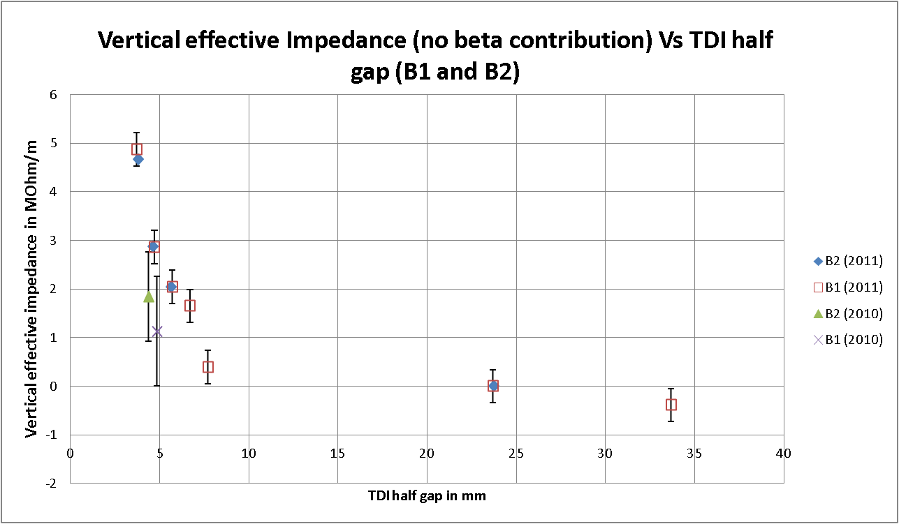
Comparison with 2010 measurements

Slide 10
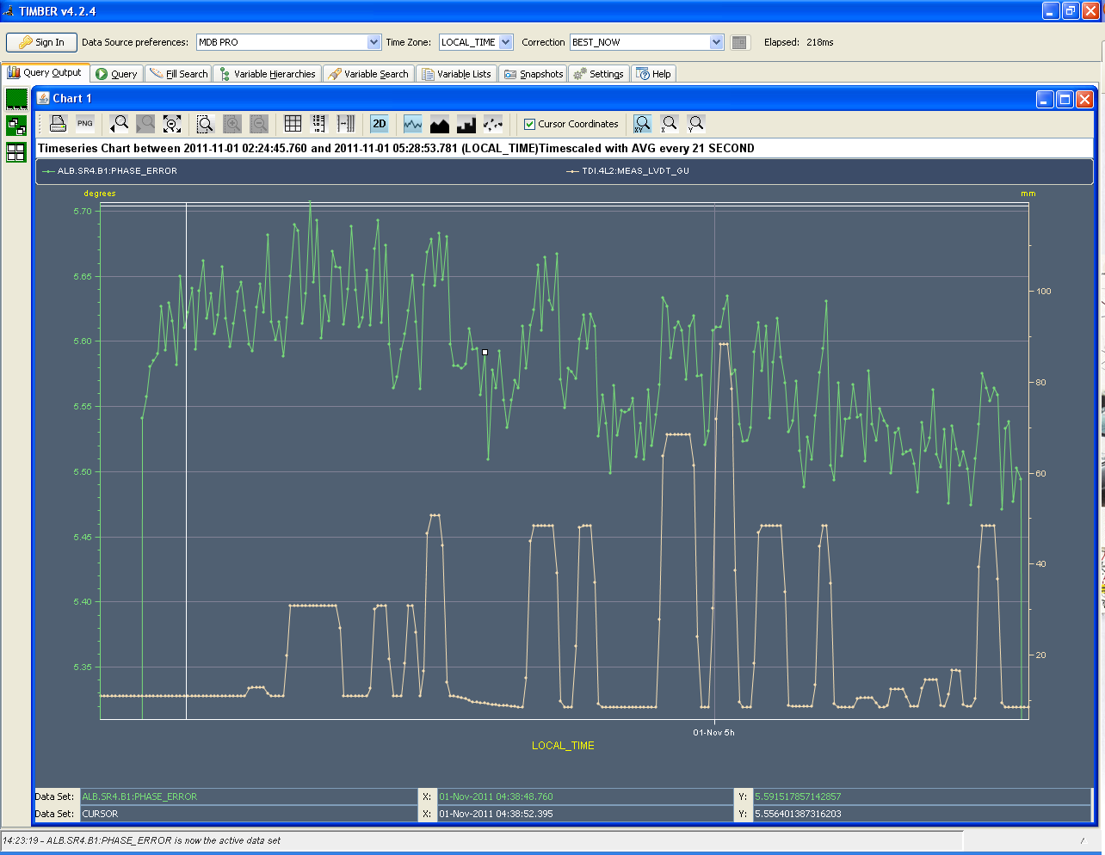
To be compared with phase error measurements
(J. Esteban Mueller and E. Shaposhnikova)
Phase error
TDI gap
Possibility to also compute energy loss and longitudinal impedance due to the TDI gap change

Slide 11
Measurement Vs predictions for transverse impedance?
TDI half gap (mm) | Measured total Zeff (MOhm/m) | Theoretical Resistive Wall total Zeff 3 layers flat chamber (MOhm/m) Coating=3mic | Theoretical Resistive Wall total Zeff 3 layers flat chamber (MOhm/m) Coating=1mic | Theoretical Resistive wall total Zeff 2 layer round chamber (MOhm/m) No coating | Simulated geometrical Zeff (dipolar) with ferrite (MOhm/m)
3.7 | 4.9 | 0.53 | 1.5 | 7.4 | 0.84
4.7 | 2.9 | 0.26 |  | 4.6
5.7 | 2.0 | 0.15 |  | 3.1
6.7 | 1.6 | 0.09
50 | reference | 0.0001 |  |  | ~0
- The measurements are probably larger than expectations by a factor 3 to 4 at 3.7 mm half gap
- Coating degraded?

Slide 12
Preliminary conclusions
Very good beam conditions. Thanks to everyone!
Clean measurements of B1 and B2 tune shifts with changing TDI gap for single bunch
Not much could be seen with physics beam
Total effective vertical impedances of TDI.2 and TDI.8 are very similar and there could be signs of degradation since last year.
It seems that it is confirmed that the corresponding total effective vertical impedance is larger than predictions
Phase error shift with TDI jaw movement was recorded and longitudinal impedance could be inferred (J. E. Mueller)

Slide 13
To do next
Use overinjection as the pilot is generating noise
Use different bunch lengths (as suggested by Elena S.)
Temperature sensors will be taken out. Do we need some sensors closer to the jaw?
Opening the TDI to check the Ti coating?

Slide 14
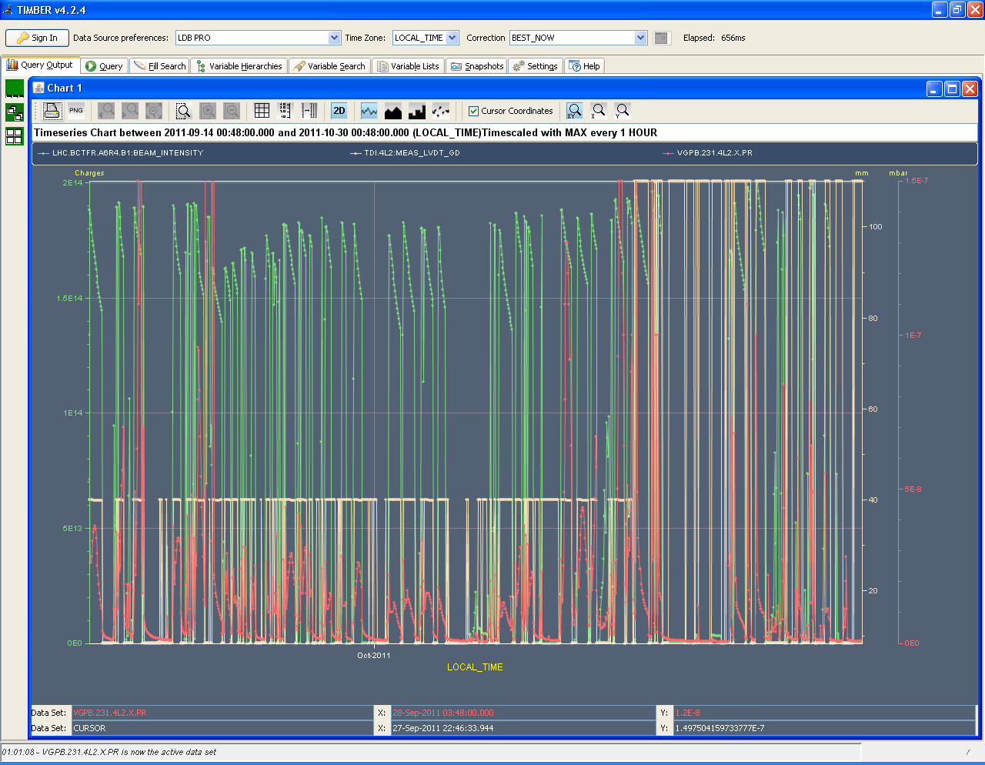

Slide 15
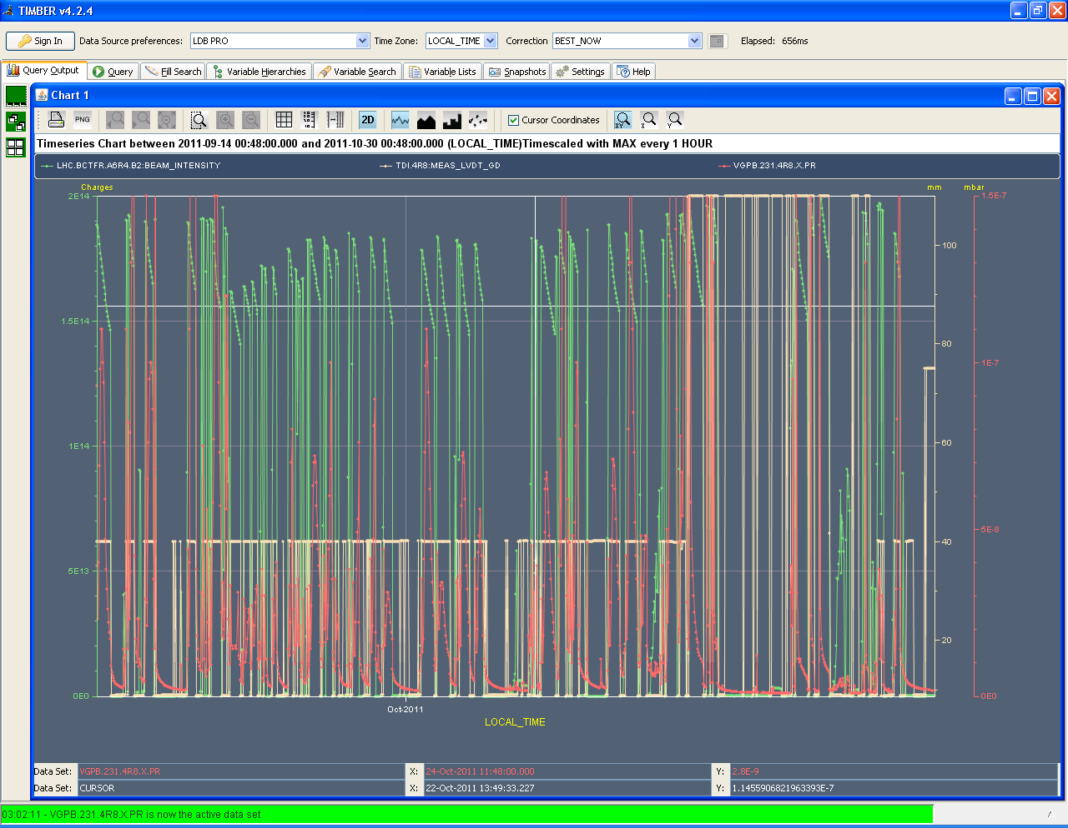

Slide 16
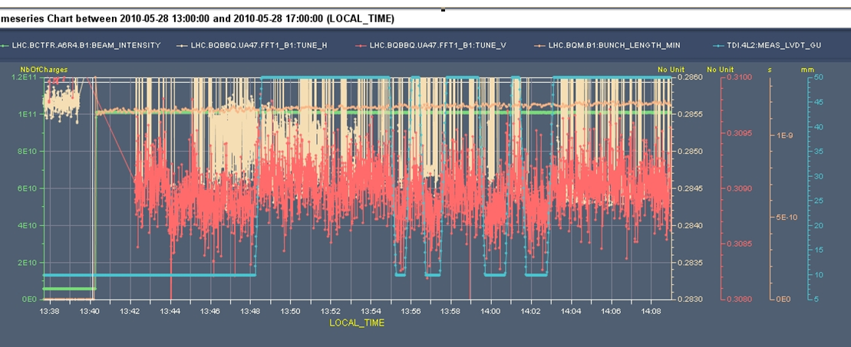
B1: Moving injection protection collimators
Moving TDI collimators from 5 sigma to 15 sigma leads to a tune increase of:
2e-4 in vertical plane (first guess)
? in horizontal plane (the tune jump to +1 sideband shadows the graph... to be filtered)

Slide 17
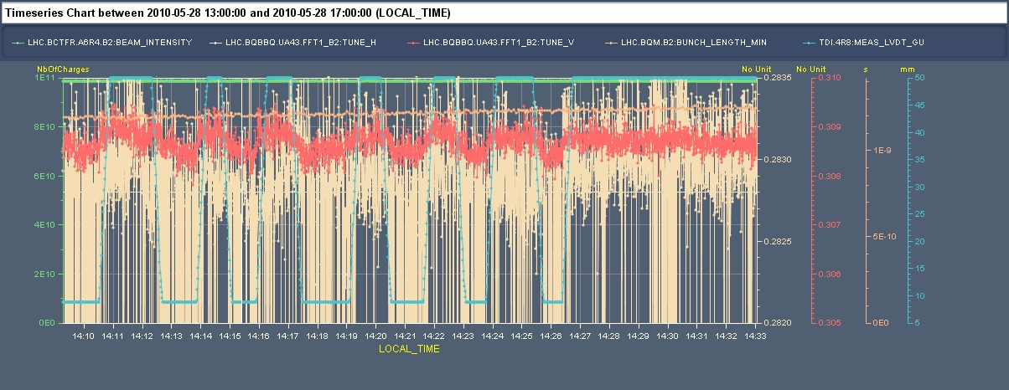
B2: effect on horizontal tune shift of moving injection protection collimators (TDI+TCLIs)
ΔQx~0
ΔQy~-3 10⁻⁴
TDI Collimator gap
→ Correlation between the collimator gap and the vertical tune shift
→ The horizontal tune switches to another peak when collimators are in. To be investigated in more detail.
Tune shift due to injection protection collimators from B2 measurements: ΔQy~ -3 10⁻⁴ and ΔQx~0
Coarse extrapolation from nominal model (only TDI): ΔQy~ -1.2 10⁻⁴ and ΔQx~0

