Slide 1
MKI UFO MD
LHC Study Working Group
  Tobias Baer for the UFO MD Team
  November, 8th 2011
M. Barnes, B. Goddard, C. Bracco, E. Carlier, S. Jackson, V. Kain, M. Misiowiec, A. Nordt,
G. Papotti, J. Uythoven, J. Wenninger, C. Zamantzas.

Slide 2

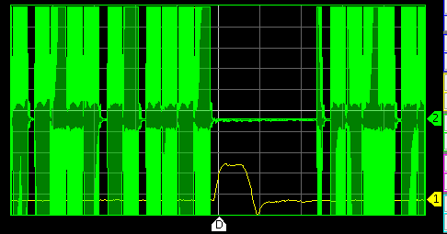
MD Plan
Plan: Study four main aspects:
  Study UFOs at MKQ.
  Study delay of UFO occurence w.r.t. MKI kick (UFO dynamics).
  Study influence of e-cloud solenoids.
  Study UFO asymmetry between kickers (pulsing individual kickers).
What was done:
  01:45 – start verification procedure with pilots, both beams. 3.5h
  05:20 – injecting 1236b, problem with PS cavity. 2.75h
  08:05 – 1236b circulating, start data taking. 2h
  08:43 – start pulsing MKI.05R8.
  08:55 – start pulsing MKI.05L2.
  09:13 – start pulsing all MKQs inbetween MKI pulses.
  09:44 – switch off e-cloud solenoids around MKI.05R8.
  09:56 – beams dumped (injection cleaning problem), MD recovery. 0.5h
MKQ pulse in abort gap

Slide 3
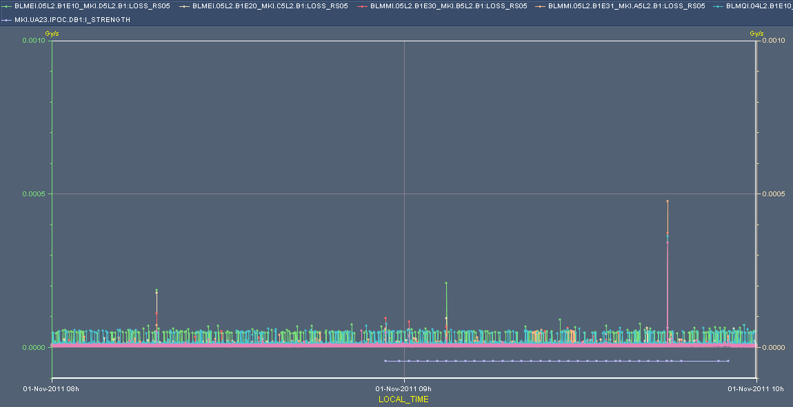
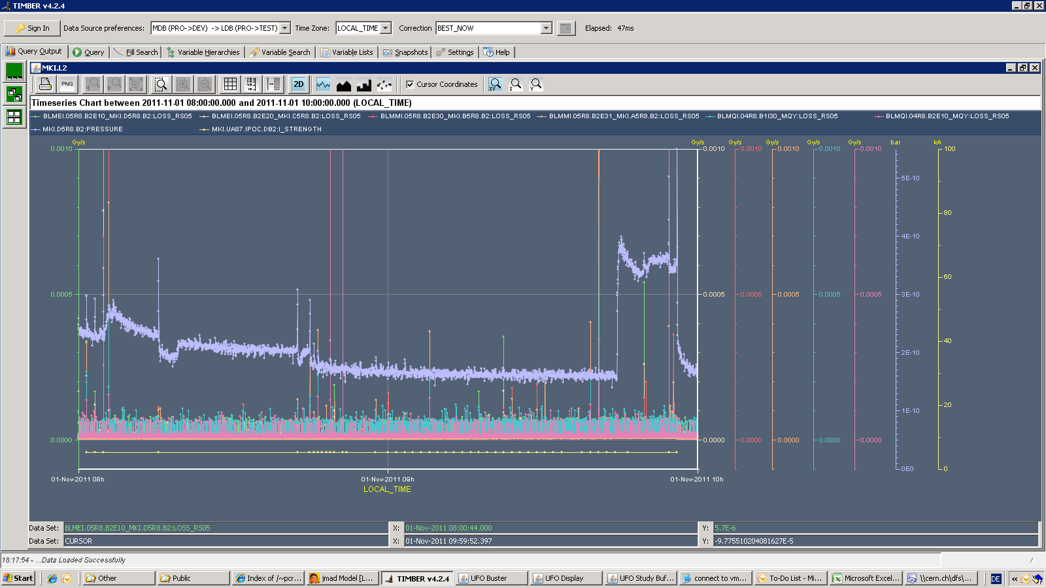
UFOs at MKIs
Losses and MKI pulses
at MKI.5L2.
3 UFOs in 2 hours.
Losses and MKI pulses
at MKI.5R8.
Many UFOs, especially after
MKI pulse.
Sometimes vacuum spike
after MKI pulse.
2 UFOs after MKI pulse
uncorrelated UFO
MKI pulses
Vacuum at MKI.D
Switch off
e-cloud solenoids
Injection
Dump
MKI pulses

Slide 4
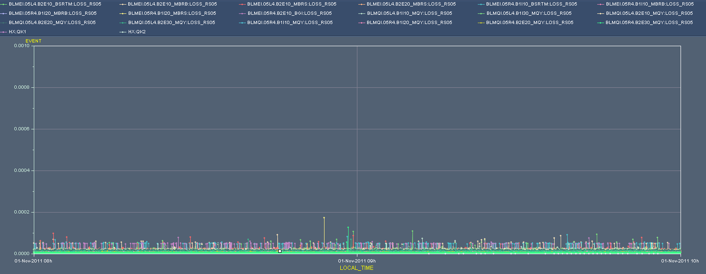
No UFOs at MKQ
No UFOs around MKQs observed.
Pulsing the MKQs 34 times, mostly both planes and beams together.
Pulsing of MKQs

Slide 5
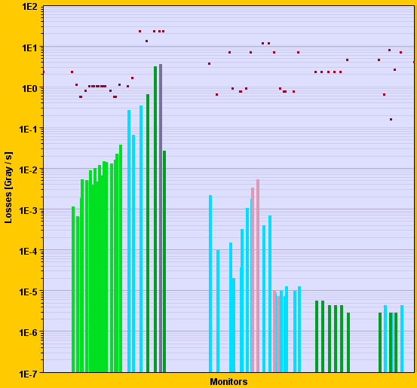
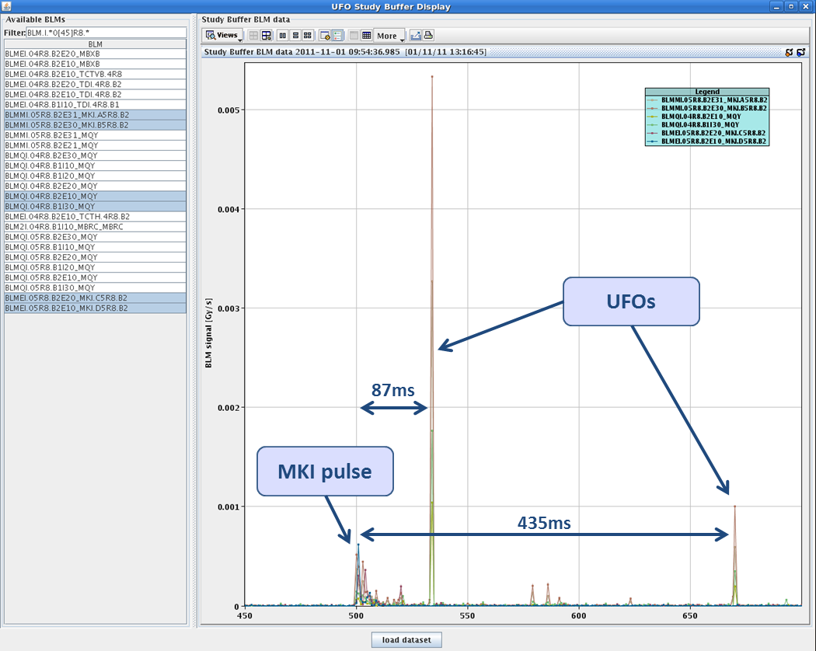
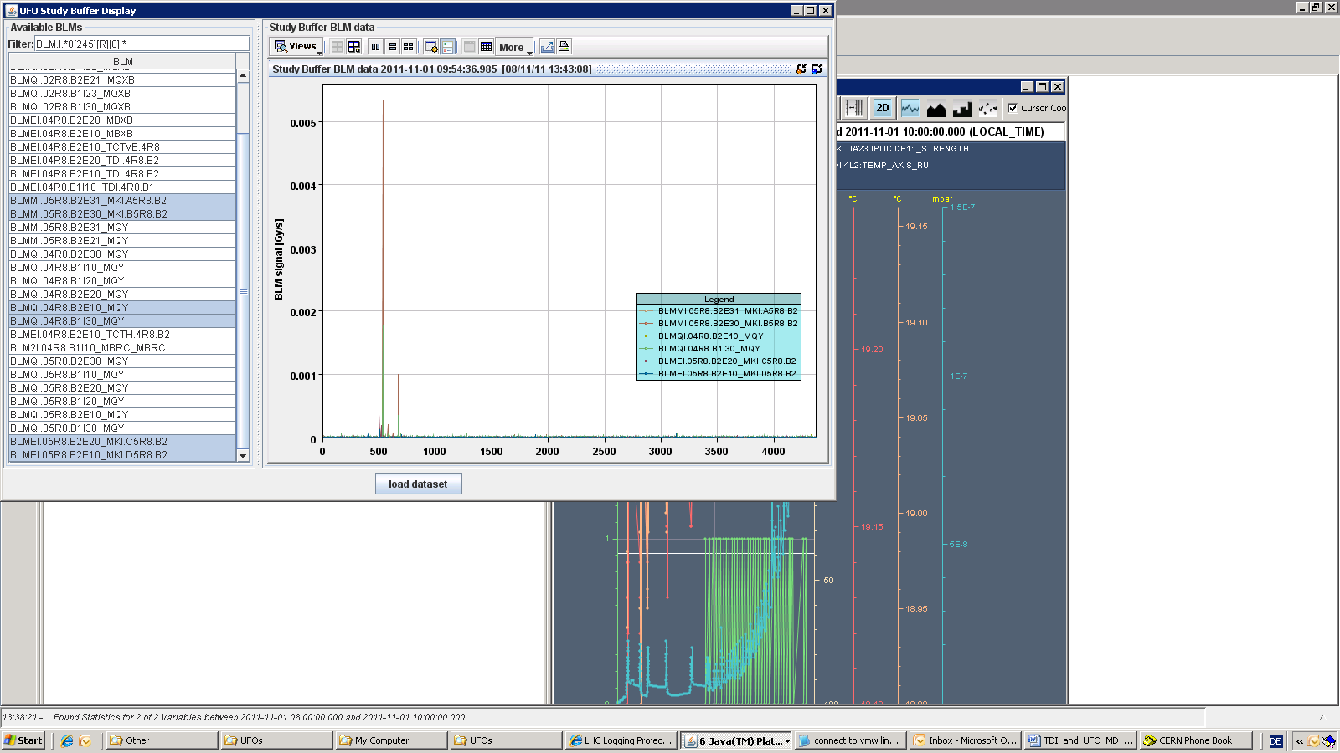
UFO at 09:54:28
Study buffer provides information about temporal and spatial distribution as well as amplitude of UFOs after MKI pulse.
beam
Losses of unbuched beam at TDI
11.2s
2.56ms resolution
UFOs

Slide 6
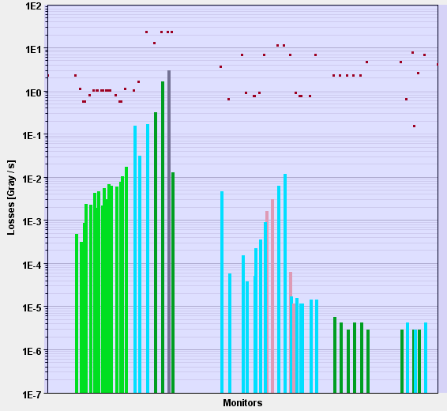
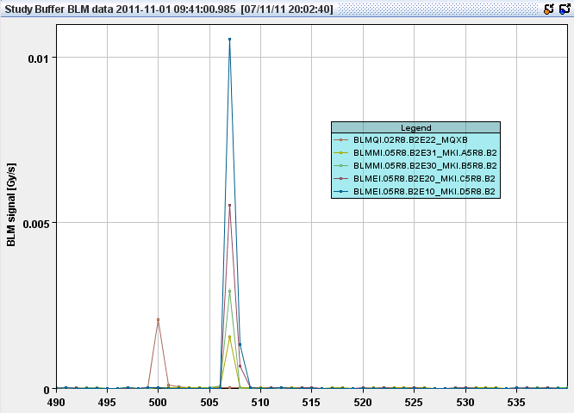
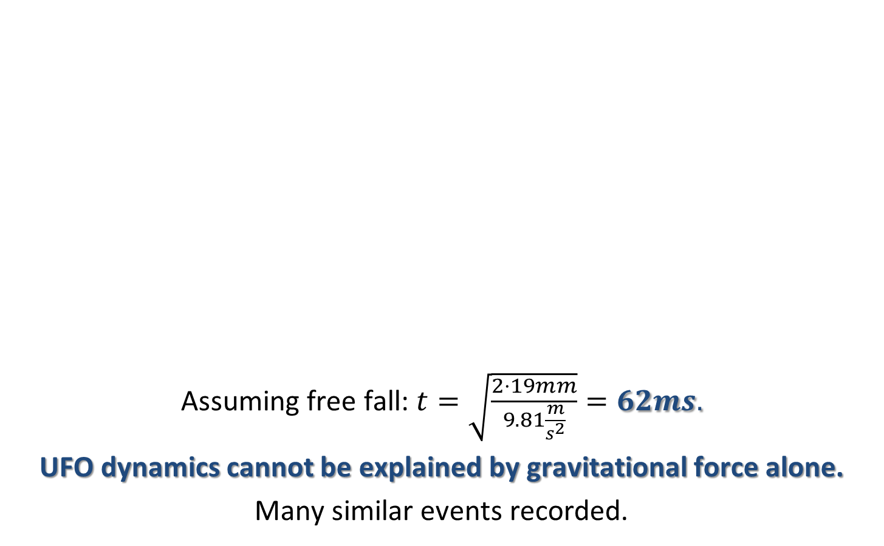
UFO at 09:40:52
Assuming free fall: $t=\sqrt{\frac{2⋅19mm}{9.81\frac{m}{s^{2}}}}=62ms.$
UFO dynamics cannot be explained by gravitational force alone.
Many similar events recorded.
18ms
MKI Pulse
UFO

Slide 7
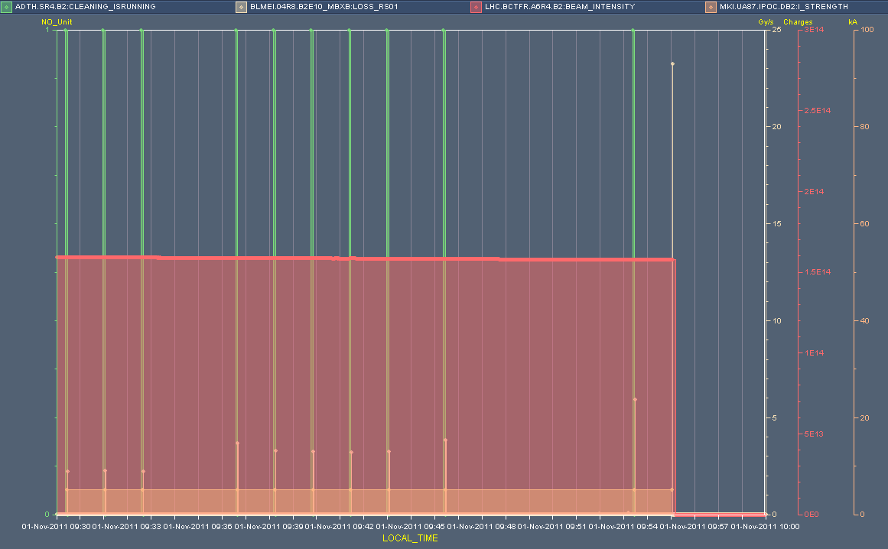
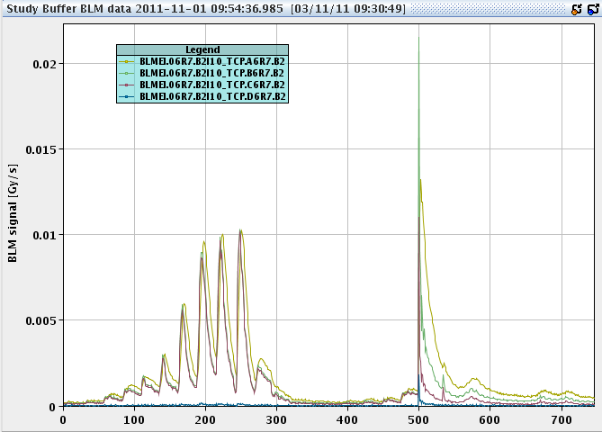
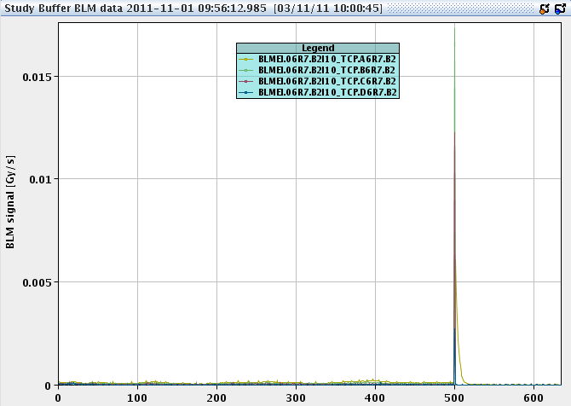
Beam Dump
Injection cleaning was switched off prior to last MKI pulse due to server communication problem.
Losses were a factor 2.5 higher.
Injection interlock if injection cleaning off?
Last pulse: No injection cleaning.
Injection cleaning
x 2.5
No injection cleaning

Slide 8
Conclusion
Took data for 120 pulses of MKIs and MKQs in effectively 2 hours.
Preliminary results:
  No UFOs at MKQ found
  Often candidate UFOs after MKI found, especially in Pt.8. Sometimes even several events.
  Delay of first event to MKI pulse between 12.8ms and 128ms, expectation from gravitational force: 62ms.
Beams dumped before individual MKI kicks could be performed.
Detailed analysis will follow
  UFO rates.
  Correlation with e-cloud solenoids and vacuum activity.
  UFO distribution between individual MKIs.
  etc.

Slide 9
Thank you for
your attention!
Tobias Baer
CERN BE/OP
Tobias.Baer@cern.ch
Office: +41 22 76 75379
Further information:
T. Baer et al., “UFOs in the LHC”, IPAC’11, TUPC137, September 2011.
C. Bracco et al., “UFOs at MKIs”, 9th LSWG meeting, August 2011.
T. Baer et al., “MKI UFOs at Injection”, CERN-ATS-Note-2011-065 MD, August 2011.

