Slide 1
Report on P-Pb MD, Oct 31, 2011
RF gymnastics
R. Alemany Fernandez, P. Baudrenghien, J. Jowett, J. Noirjean

Slide 2
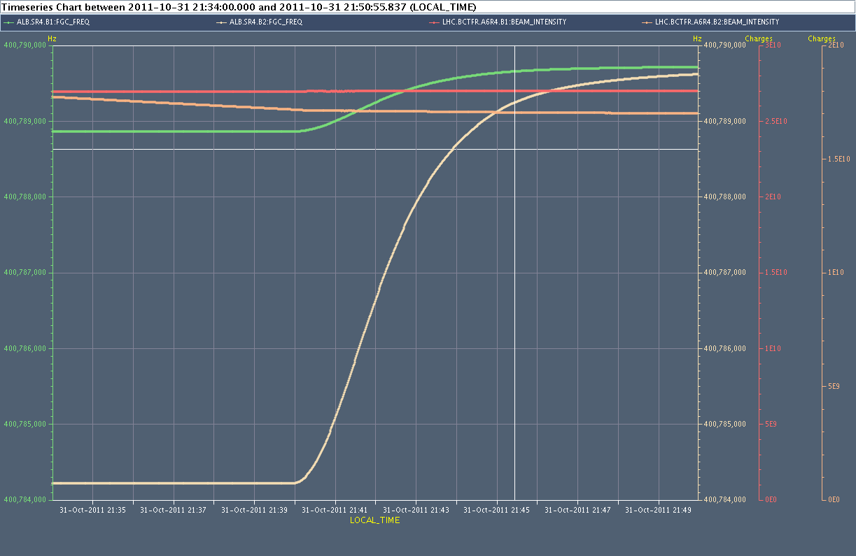
Frequency ramps
Fast BCT p
RF p
Fast BCT Pb
@ 3.5 Z TeV/c
we have 76 Hz difference @ 400.8 MHz
RF Pb
400.788860 MHz -> 400.789715 MHz (p in ring 1)
400.784216 MHz -> 400.789639 MHz (Pb in ring 2)
Individual radial loops (final corrections, -2 Hz ring 1, 4 Hz ring2)

Slide 3
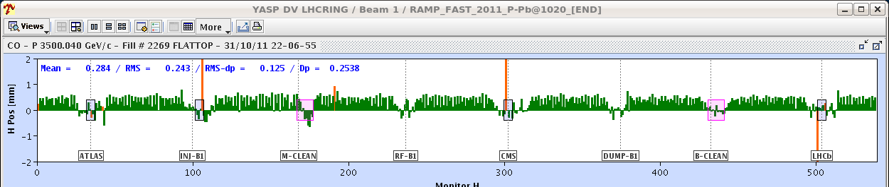
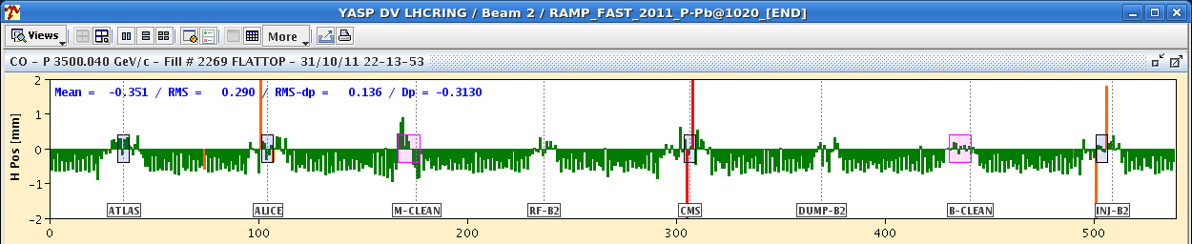
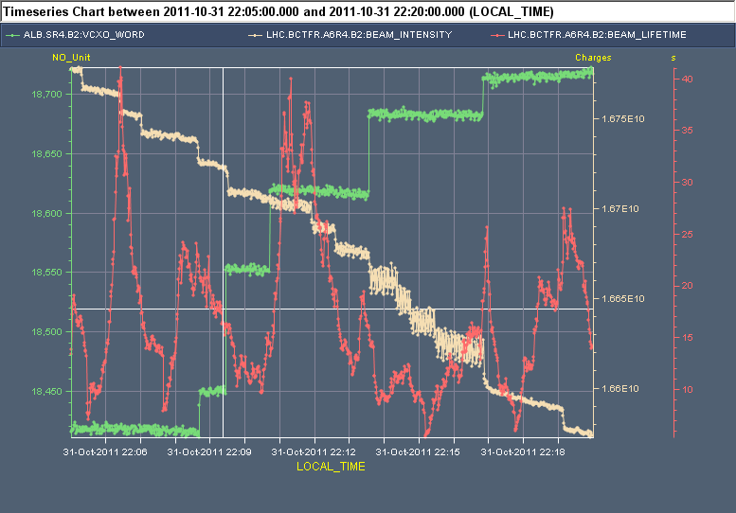
Cogging step 1:Bringing the two rings to a common frequency
p (ring 1) displaced by ~ +0.4 mm
At 3.5 Z TeV/c we first switch the radial loops off as they would try to keep beams centered
We then move the two rings to a common 400.789685 MHz (avg ring1-2)
The trim (38 Hz/ring) corresponds to 3E-4 Dp/p
The p frequency is decreased by 38 Hz, moving the beam 0.4 mm outer
The Pb frequency is increased by 38 Hz, resulting in an inner displacement of 0.4 mm
For each ring we made 4-5 steps (10 Hz max per step). No clear effect observed on lifetime
Pb (ring 2) displaced by ~ -0.4 mm
Frequency
FastBCT
40 h
Lifetime
20 h
Observations during the frequency trims Pb

Slide 4
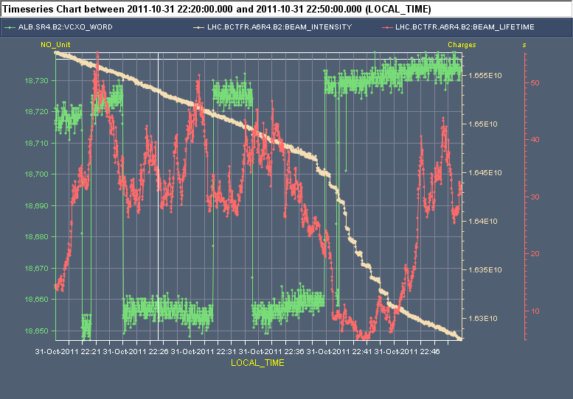
Cogging step 2: Make beams collide in the detectors
After step 1, the 2 beams have equal revolution frequency, but they do not cross in the detector
During the MD the crossing point was ~ 30 μs off (1/3 turn). It can be anywhere in the circumference (89 μs max).
We apply a series of frequency bumps to a ring (Pb during the MD) to rotate it with respect to the other ring
No evident correlation between lifetime and rephasing
With a maximum frequency offset of 10 Hz, we rotate one ring by 1.5 μs per minute.
Δf max = 10 Hz corresponding to Dp/p = -8E-5 or -0.1 mm
The rate df/dt is limited to 9 Hz/s resulting in 179.9 degrees stable phase with 12 MV
FastBCT
50 h
Frequency
Lifetime
10 h
Observations during the frequency bumps Pb

Slide 5
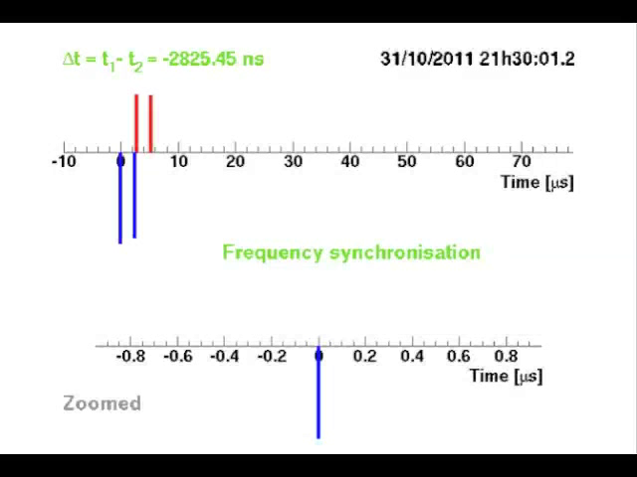
Measured by Atlas
2 p bunches in ring 1
2 Pb bunches in ring 2
Triggered on the p
Top trace shows a full turn (89 μs)
Bottom trace zooms on 1.6 μs on bucket one p
From 21:30 to 22:00, acceleration ramp (slide 2)
From 22:00 to 22:22, move to a common frequency (slide 3)
From 22:22 to 22:40, get beams to cross in the detector (slide 4)
Courtesy of Thilo Pauly and Gabriel Anders (Atlas)

Slide 6
Ready for collision…
22:49 Observations in IP1
Courtesy of T. Pauly (Atlas)

Slide 7
Pending RF issues
Zeroing of the radial loops corrections before starting the rephasing
Automate the frequency trims: Insert a sequencer task to ramp Pb and p frequencies to 400.789685 MHz
Write an application that drives the series of frequency bumps from RF measurements (interval between bucket 1s of both rings plus RF phase difference). We have used the Atlas BPTX during the MD. The application will be developed by the LHC RF during the shutdown.
Improve the frequency bumps (higher amplitude and appropriate direction).
Re-enable radial loops in physics? Sequencer task.

Slide 8
Thank you for your attention
Special thanks to
Markus Albert, Delphine Jacquet and Mirko Pojer
for their contributions before and during the MD,
and to
Thilo Pauly and Gabriel Anders
for the measurements done in Atlas during the ramping and cogging.

