Slide 1
Tight collimator settings MD
R. Assmann, R. Bruce, F. Burkart, M. Cauchi, D. Deboy, L. Lari, S. Redaelli, A. Rossi, B. Salvachua, G. Valentino, D. Wollmann, S. Fartoukh et al.

Slide 2
Motivation and goal of MD
Benefits with tight settings (IR7 @ 4-6-8 sigma, TCT @ 9.3):
  Smaller β* possible
  Better efficiency => Higher stored intensities
  Tight settings (in mm) needed for nominal 7 TeV operation
Tight settings tested successfully in previous MDs in May and August
Goal of MD:
  Investigate the long-term stability of the cleaning performance with tight settings
  Qualify cleaning with ATS-squeeze β*=40cm (see S. Fartoukh et al) to establish reference for pile-up studies
DONE
NOT DONE

Slide 3
MD program
1 nominal bunch per beam
Ramped using functions driving the collimators to tight settings
Squeezed to β*=1m (fall-back since ATS MD not yet done at that time)
Performed loss maps (hor., ver. and off-momentum)

Slide 4
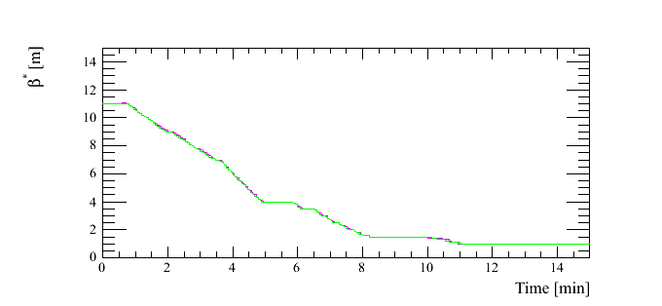
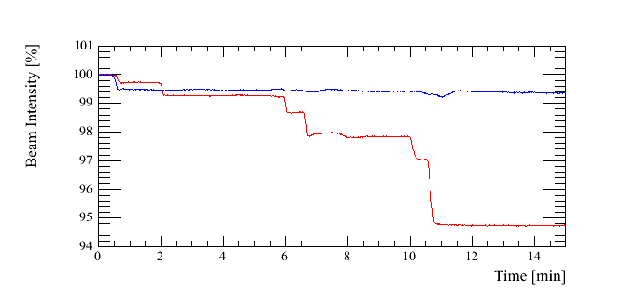
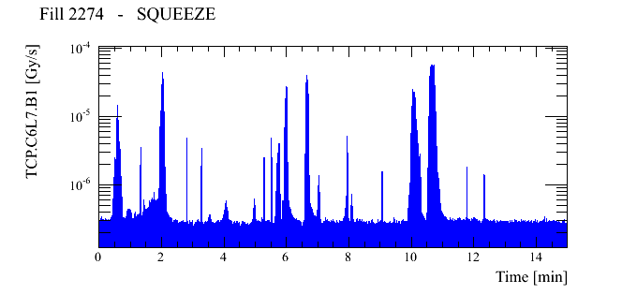
Losses in ramp and squeeze
B. Salvachua

Slide 5
Losses in ramp and squeeze
Because of orbit oscillations, unintentional beam scraping at primary collimators
  Some losses seen during ramp (~1% of beam)
  Larger losses in B1 during squeeze (~5% of beam)
Losses not acceptable for high-intensity operation

Slide 6
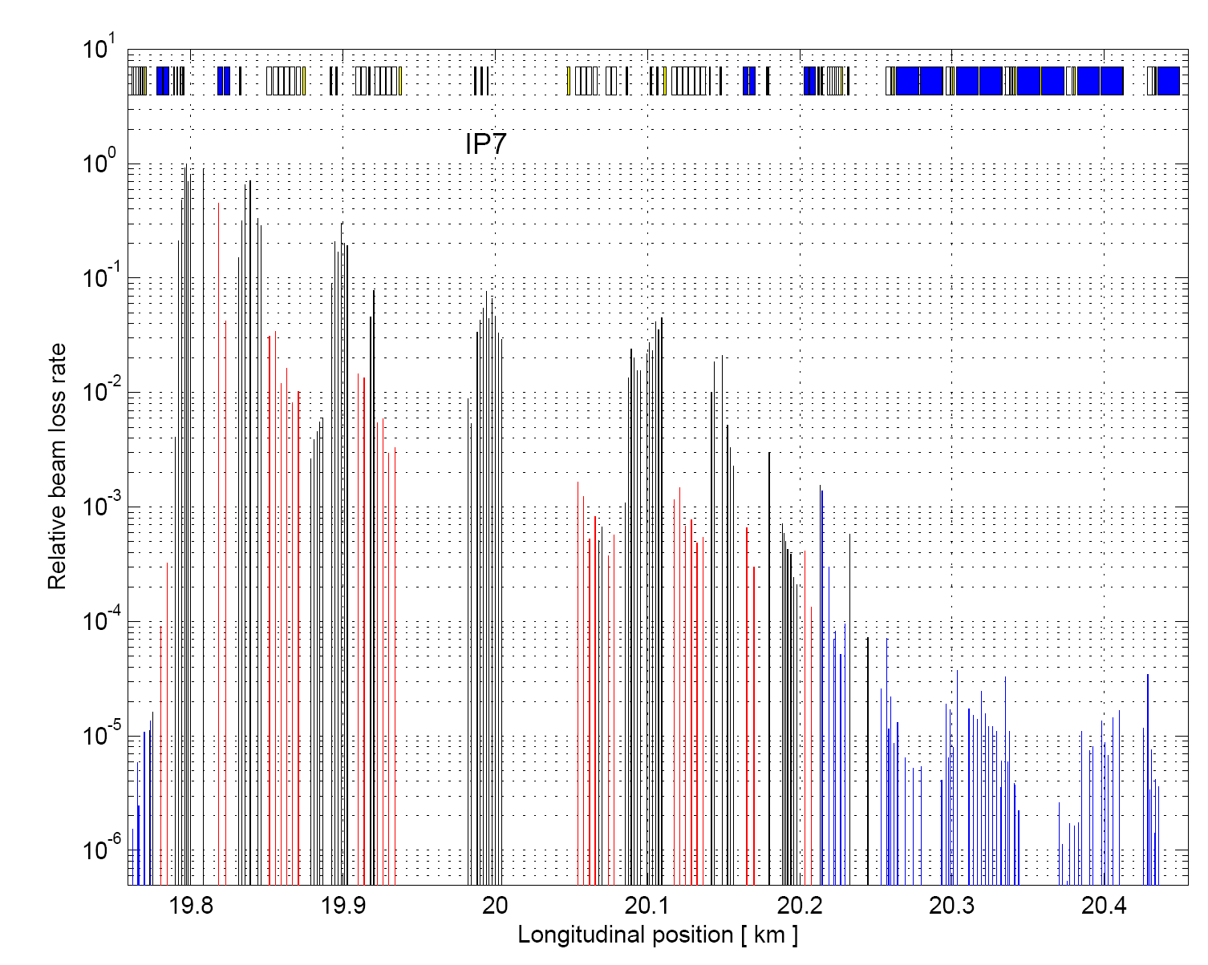
Example: loss map, B1H
S. Redaelli

Slide 7
Results: loss maps
Hierarchy well preserved – excellent long-term stability. Using centers from setup in March!
Cleaning inefficiency consistent with previous MDs (significant improvement wrt intermediate)
Including Q7 to be on the safe side (same dump threshold as downstream BLMs)
Inefficiency | B1 | B2
Horizontal | Q7R7: 7.2e-5 | Q8L7: 1.3e-4
Vertical | Q7R7: 6.9e-5 | Q8L7: 5.7e-5

Slide 8
Conclusions
Excellent long-term stability of cleaning performance. Tight settings still valid 8 months after collimation setup
5% of B1 lost during squeeze, 0.5% lost during ramp
  Promising concept for 2012 but better control of orbit oscillations in squeeze needed.
  Ongoing work (J. Wenninger, S. Redaelli, R. Steinhagen). See LBOC 2011.11.29
We still hope to test tight collimator settings with ATS optics and beta*=40cm in the future

