Slide 1


Observations On High Pile-Up Fills
2201-2252
LSWG- December 8, 2011
G. Trad in collaboration with G. Papotti, on the behalf of the LHC Beam-Beam Working Group
G.Trad – LSWG December 8, 2011

Slide 2
OUTLINE
Fill 2201 (10 October 2011)
    Filling scheme
    Emittances and Intensity Measurements.
    Recomputed Luminosity from measured inputs.
    Beam Losses Analysis.
    Comparison with the simulations.
Fill 2252 (25 October 2011)
    Filling Scheme.
    Beam Losses Observation.
    Beams Separation and its effects on intensity and emittances.
Conclusions
CERN-ATS-Notes
Beam parameters observations during the high pile-up collisions fill
Beam parameters observations during the high pile-up collisions fill- 2
G.Trad – LSWG December 8, 2011

Slide 3
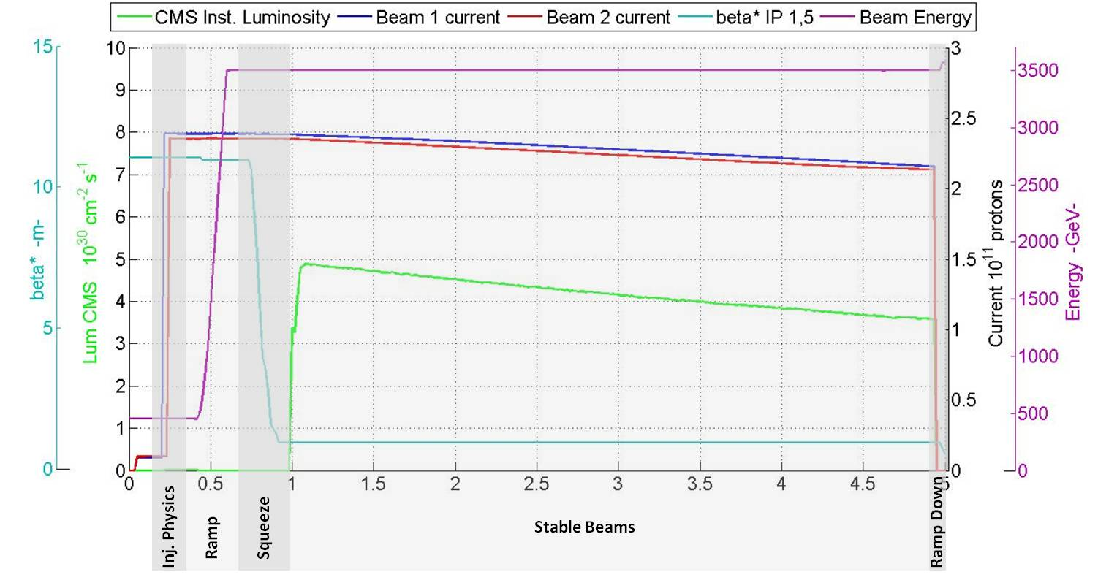
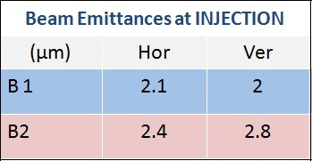
FILL 2201
Filling - Emitt. Int. Meas. - Computed Lumi - Beam Losses - Simulation
G.Trad – LSWG December 8, 2011

Slide 4
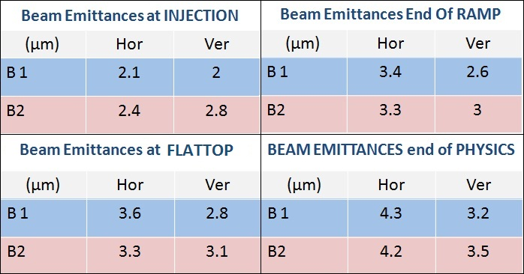
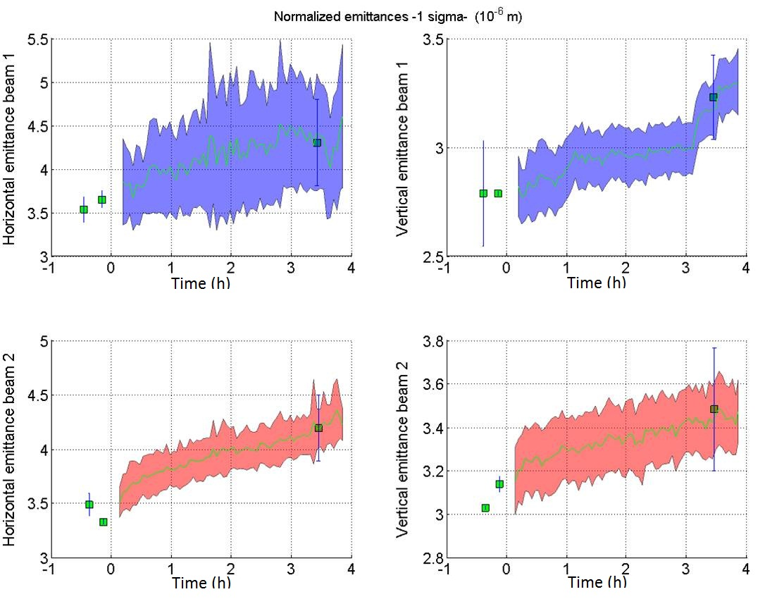
FILL 2201
Filling - Emitt. Int. Meas. - Computed Lumi - Beam Losses - Simulation
Growth @ Inj :
B1 ~ 12%
B2 ~ 8%
Growth @ Ramp:
B1H ~ 44%
B1V ~ 30%
B2H ~ 30%
B2V ~ 7 %
G.Trad – LSWG December 8, 2011

Slide 5


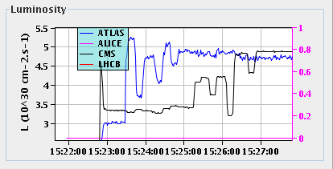
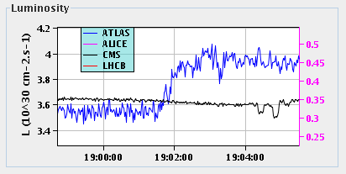
FILL 2201
Filling - Emitt. Int. Meas. - Computed Lumi - Beam Losses - Simulation
Instantaneous Luminosity
Reduction Factors:
HourGlass
Crossing Angle
Offset
~7% (mainly CA since H ~4‰)
Where
~23 %
Start Of Collisions
End Of Collisions
~15% extra
Measured by fBCT
Measured by BSRT
G.Trad – LSWG December 8, 2011

Slide 6
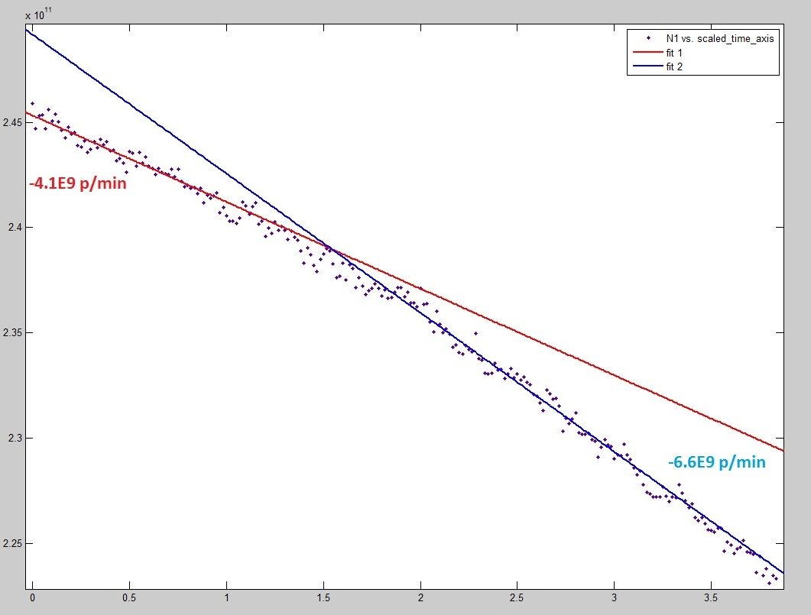
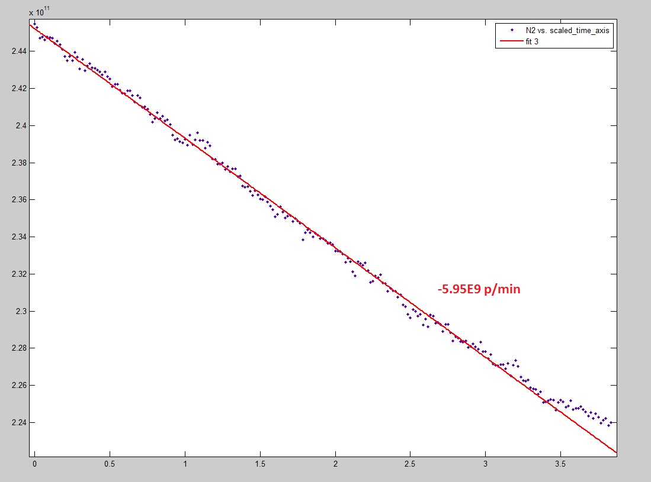
FILL 2201
Filling - Emitt. Int. Meas. - Computed Lumi - Beam Losses - Simulation
BEAM 1
BEAM 2
Burn-off/Total losses
≈40%
BETTER LIFETIME AFTER TUNE SCAN??
Burn-off/Total losses
≈75%
Burn-off/Total losses
≈43%
Burn-off/Total losses
≈75%
G.Trad – LSWG December 8, 2011

Slide 7
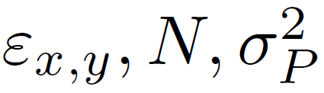
FILL 2201
Filling - Emitt. Int. Meas. - Computed Lumi - Beam Losses - Simulation
Tevatron Luminosity Model
Beam 1
Beam 2
Bunch Intensity
Green = Simulation
Bunch Length
G.Trad – LSWG December 8, 2011

Slide 8
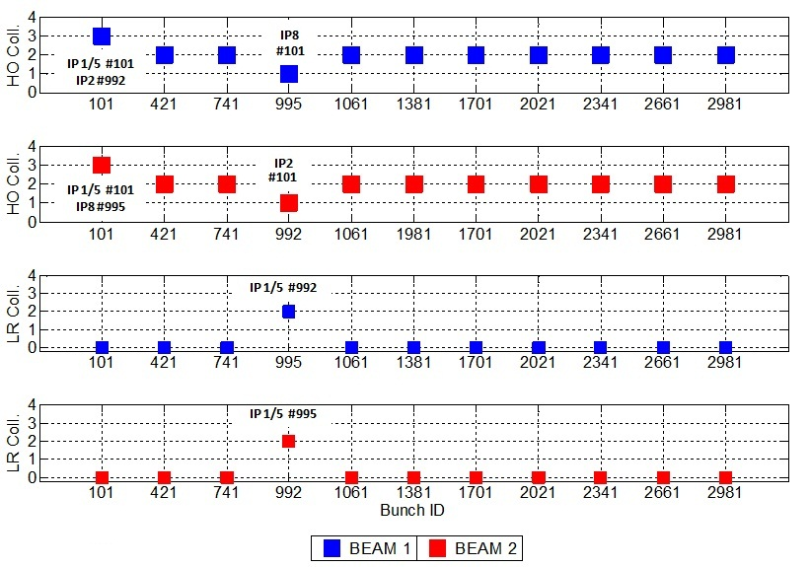
FILL 2252
Filling - Losses Observation - Separation Steps - Emitt. Observation
Separation
Phase
1
2
3
N ≈ 2.3*10^11 pbb
ε ≈ 2.5 μm
G.Trad – LSWG December 8, 2011

Slide 9
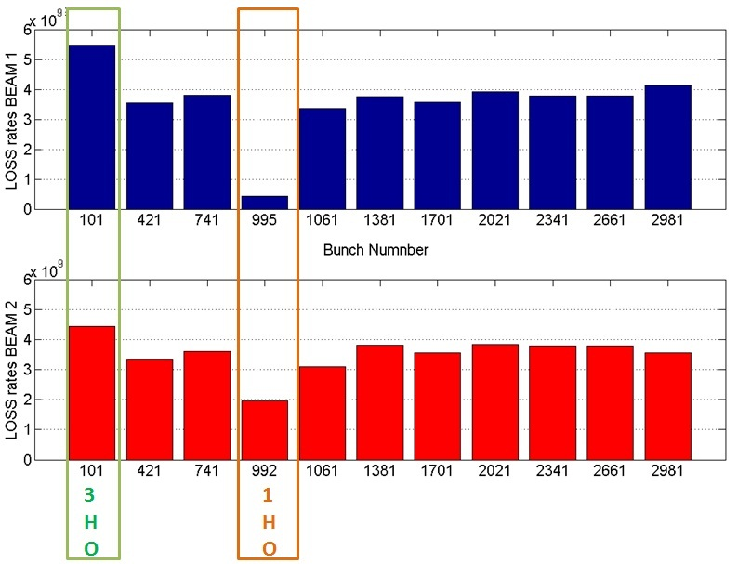
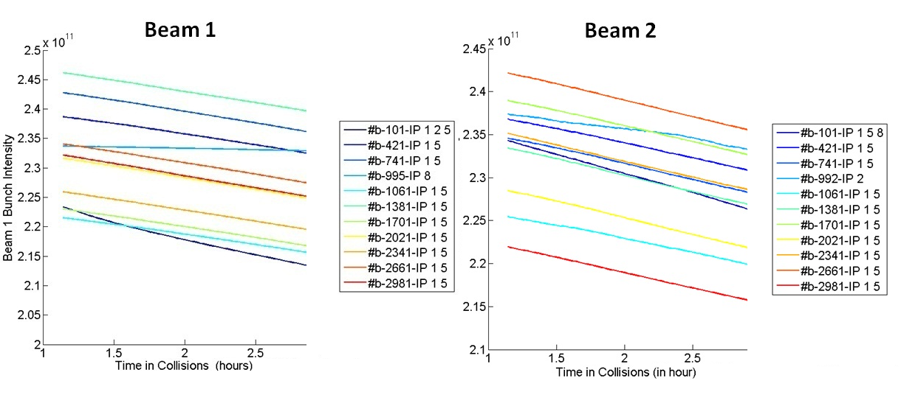
FILL 2252
Filling - Losses Observation - Separation Steps - Emitt. Observation
BEAM 1
BEAM 2
G.Trad – LSWG December 8, 2011

Slide 10
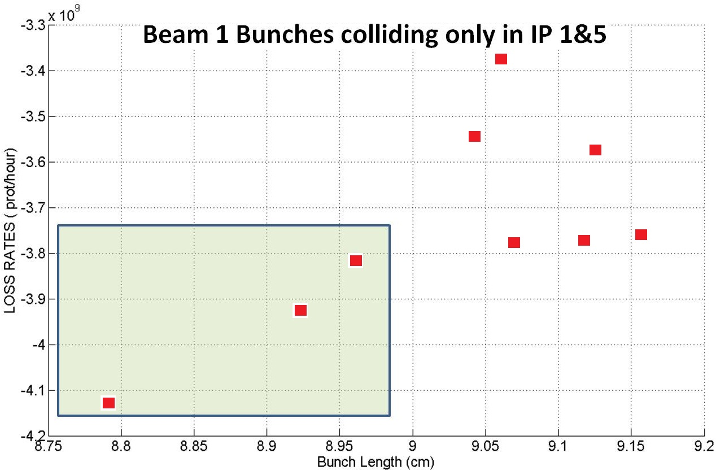
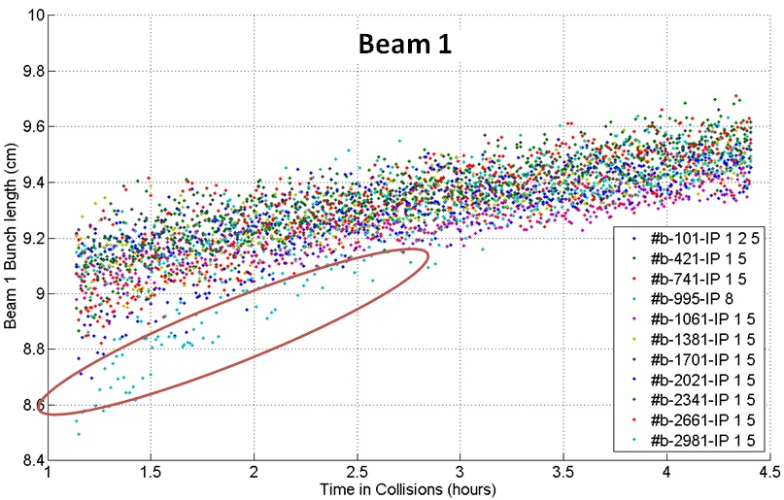
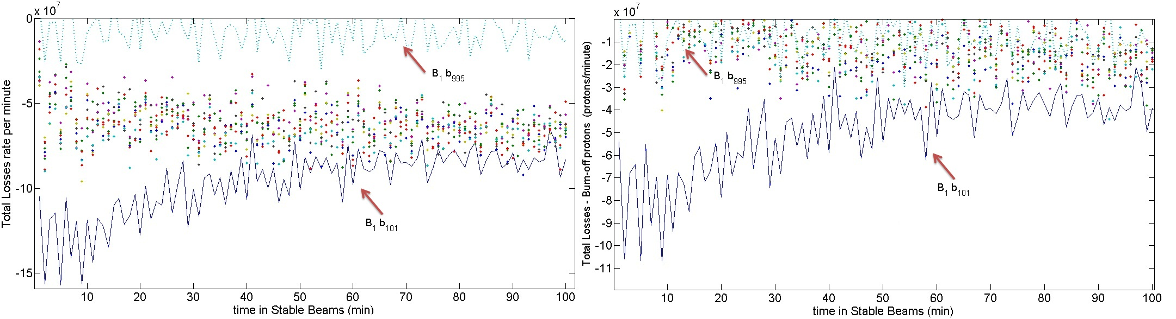
FILL 2252
Filling - Losses Observation - Separation Steps - Emitt. Observation
3 HO Collisions
2 HO Collisions (beam 1)
G.Trad – LSWG December 8, 2011

Slide 11
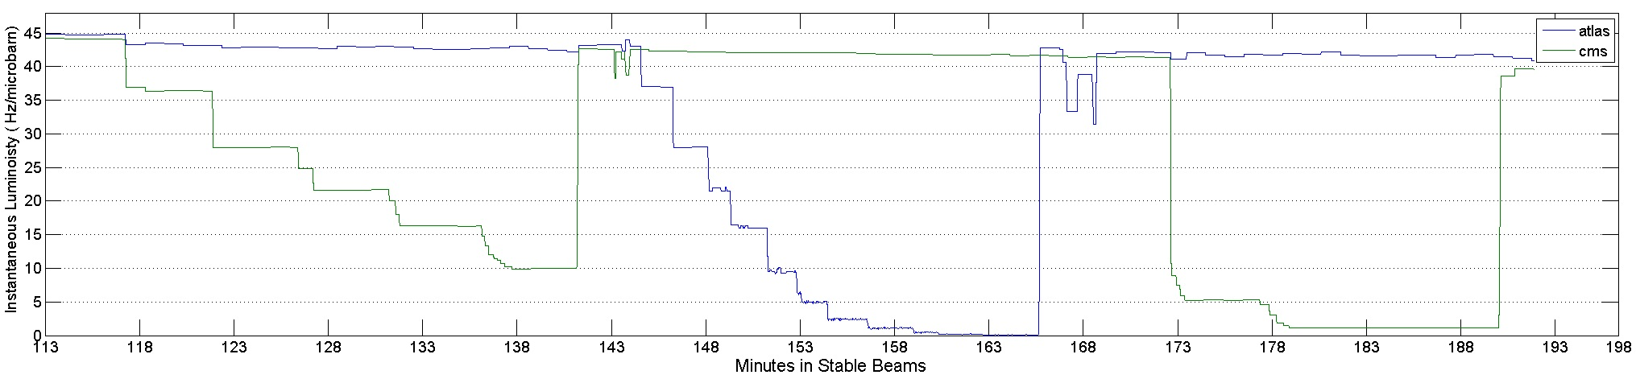
FILL 2252
Filling - Losses Observation - Separation Steps - Emitt. Observation
G.Trad – LSWG December 8, 2011

Slide 12
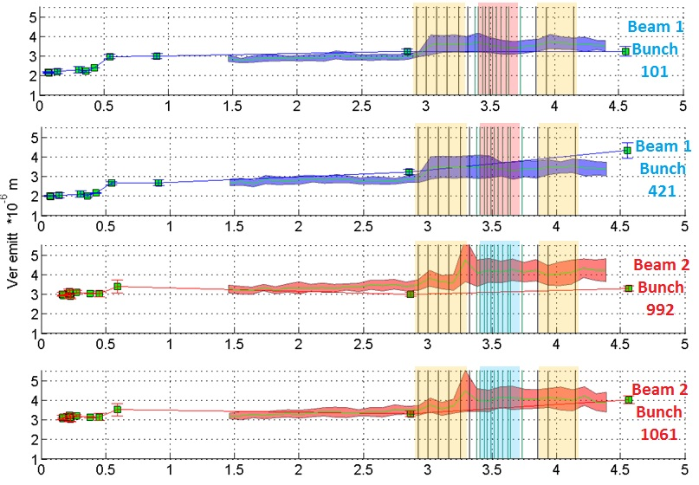
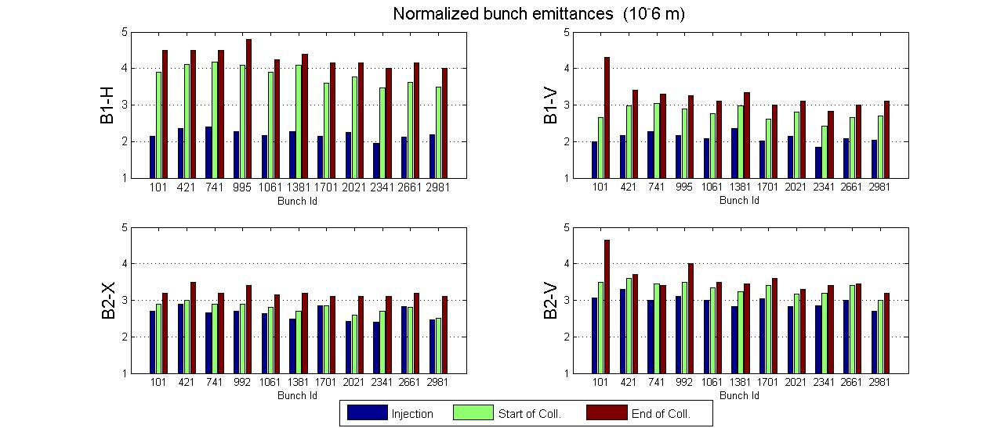
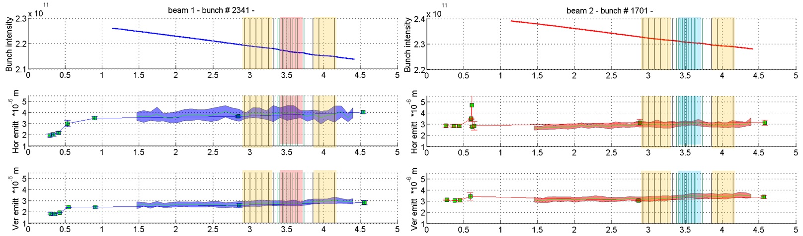
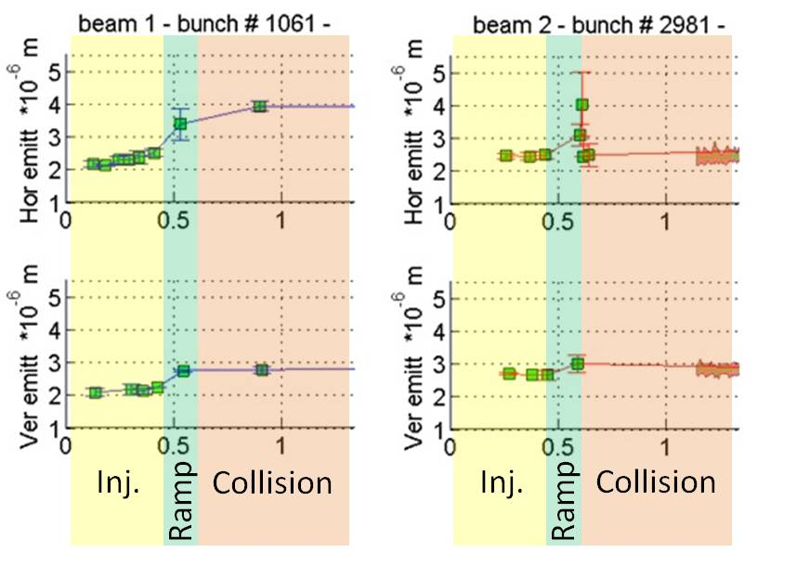
FILL 2252
Filling - Losses Observation - Separation Steps - Emitt. Observation
G.Trad – LSWG December 8, 2011

Slide 13
Conclusions
These two physics fills were successful and very helpful for the experiments who requested it, to probe new working point above their designed values.
Nevertheless some interesting observations are noted :
Observed emittance growth at injection energy and more through the ramp.
Vertical emittance growth observed twice in the vertical plane in beam 1 still under investigations for fill 1, since for fill 2 it corresponds to the separation of the beams.
Incongruity between the measured and calculated instantaneous luminosity (if explained only in terms of β*=1.2-1.3m ! ? )
Missing losses contribution to the Luminosity evolution model ( beam-beam losses ?)
Long Range effects in fill 2 or just losses from tune resonances?
G.Trad – LSWG December 8, 2011

Slide 14
Backup Slides
Parametric Ordinary Differential Equations (ODEs) in :
Rms Momentum Spread
Beam Emittance
Beam Intensity
• the emittance growth and the particle loss due to scattering on the residual gas;
• the particle loss and the emittance growth due to scattering in IPs;
• the transverse and longitudinal emittance growth due to intrabeam scattering;
• the bunch lengthening due to RF noise;
• The emittance growth predicted from the Transverse Feedback Systems (ADT) noise
• synchrotron radiation damping.
G.Trad – LSWG December 8, 2011

Slide 15
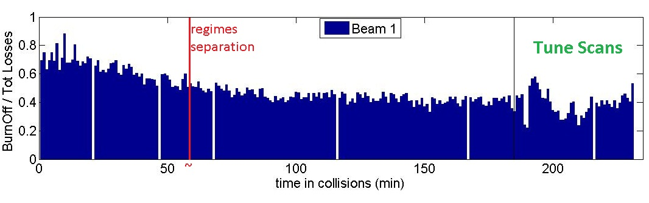
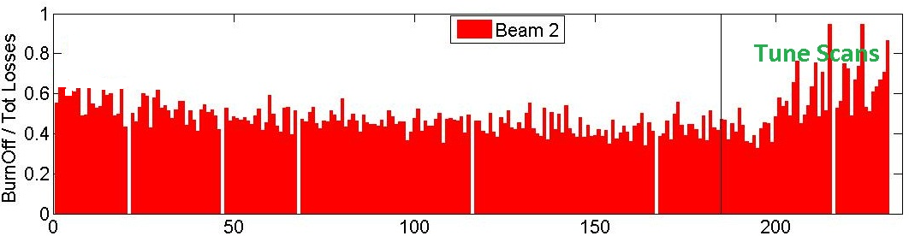
Backup Slides
BEAM 1
BEAM 2
G.Trad – LSWG December 8, 2011

Slide 16
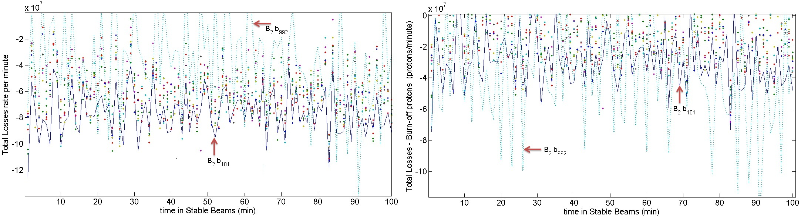
Backup Slides
G.Trad – LSWG December 8, 2011

Slide 17
Backup Slides
G.Trad – LSWG December 8, 2011

