Slide 1
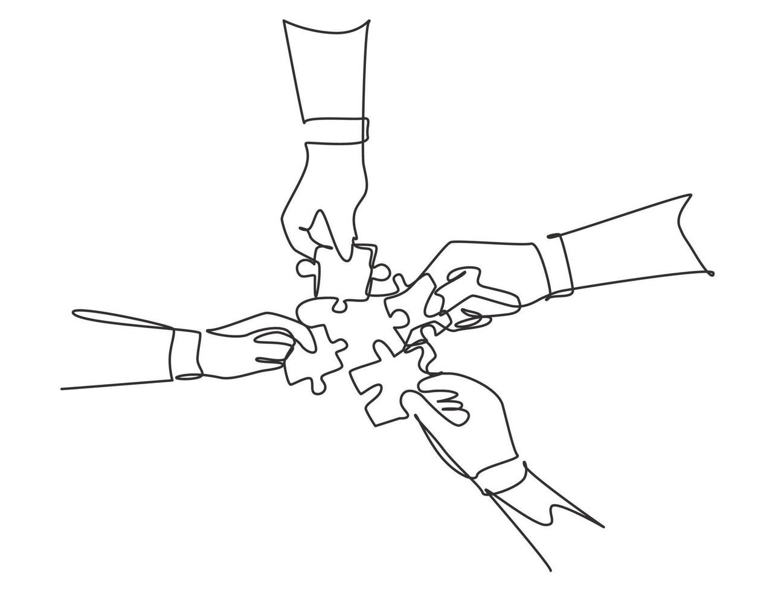
November LHCb Vilnius Team building

Slide 2
Dates
Adam is in Lithuania on Nov 17– 28th
Possible dates to have a meeting:
M | T | W | T | F | S | S
17 | 18 | 19 | 20 | 21 | 22 | 23
24 | 25 | 26 | 27 | 28 | 29 | 30

Slide 3
Activities
Bowling
Escape Rooms
VR Games
Mafia
Bouldering
Dinner and Bar
Mini Golf

Slide 4

Scan and choose by November 12th

