Slide 1

ESPP 2026 update: comms products
Politicians
Scientists & policymakers
General public
Global HEP community
CERN’s next flagship collider
Impact on society / other fields
Physics case
ESPP 2026 Recommendations
Deliberation document
THINKING
BIGGER
RETURN ON
INVESTMENT
DECODING THE
UNIVERSE
4pp
4pp
4pp
~12pp
~36pp

Slide 2
Spark a sense of strategic urgency by conveying the scientific, technological and socioeconomic importance of an unprecedented global research infrastructure for the 21st century
THINKING
BIGGER
What is the FCC?
A marvel of technology and engineering
An engine of knowledge & innovation
Guaranteed science deliverables & socioeconomic benefits
Global leadership in the heart of Europe
An exemplar of sustainable research
CERN’s success in realising large projects
Open science
Bridging nations
ESPP context

Slide 3
RETURN ON INVESTMENT
FCC will push the limits of technology & innovation and inspire & train new generations, yielding a positive socioeconomic cost-benefit ratio
Pursuit of basic knowledge => delivery of modern world
Funding for a flagship collider is an investment for science and society
Core technology & innovation (SC, vacuum, cryo, electronics, big data, AI, …)
Health (cancer therapy, imaging, radioisotopes); energy/environment (fusion, power transmission); ICT (Web, Grid, networking), …
Cosmology & astroparticle, nuclear science, condensed matter, AMO, quantum technologies, life sciences & others via synchrotron X-ray facilities, …
Synergistic relationship between national labs and CERN
Attracting young minds to STEM
Training and capacity building in participating countries
High-tech industry ecosystem (partnership, series production, company premiums, MS return on investment ...)
€440M EC projects, most linked to ESPP 2020 recommendations, 85% for MS

Slide 4

DECODING THE UNIVERSE
(Most) people are innately fascinated by the big questions in physics. Engage them on their own terms with the current turning point in our understanding of nature’s governing laws
Connect particle physics with the world today
Link particle physics with the evolution of the universe
Higgs boson as a new tool for discovery
Understanding “nothingness”
The open questions and a future collider
Forensic physics: discovery via precision
A bigger bang: direct exploration into unknown realms
‘Self-coupling’, ‘electroweak symmetry’, ‘new physics’,..

Slide 5
The Future Circular Collider will not only be the most
extraordinary microscope ever built to advance our
understanding of the fundamental laws of nature
It will be a crucible of technology and innovation – a global research infrastructure with a positive benefit-cost cost ratio that provides society with a stream of STEM talent throughout the 21st century and inspires new generations
We are not selling a collider.
We are selling “fascination”, “wonder”, “curiosity”,
“awe”, “genius”, “truth”, “progress”, “dreams”, “hope”, ...

Slide 10
Status / Next steps:
Policy brief
Internal review by management this/next week
Draft document -> Council delegates 1st week Dec
Final product 19 Dec
EPPCN input welcomed!
ESPP brochures
Confirm publication timeline with ESG (today)
Brochure 1 (strategy): draft complete end Nov
Brochure 2 (impact): draft complete end-Jan
Brochure 3 (physics): draft complete mid-Jan
Review (FCC, ESG, CERN): mid-Feb
Final versions: end-Mar
Website / templates: end-Apr
Public release: May
EPPCN input welcomed!

Slide 11
Extra

Slide 12
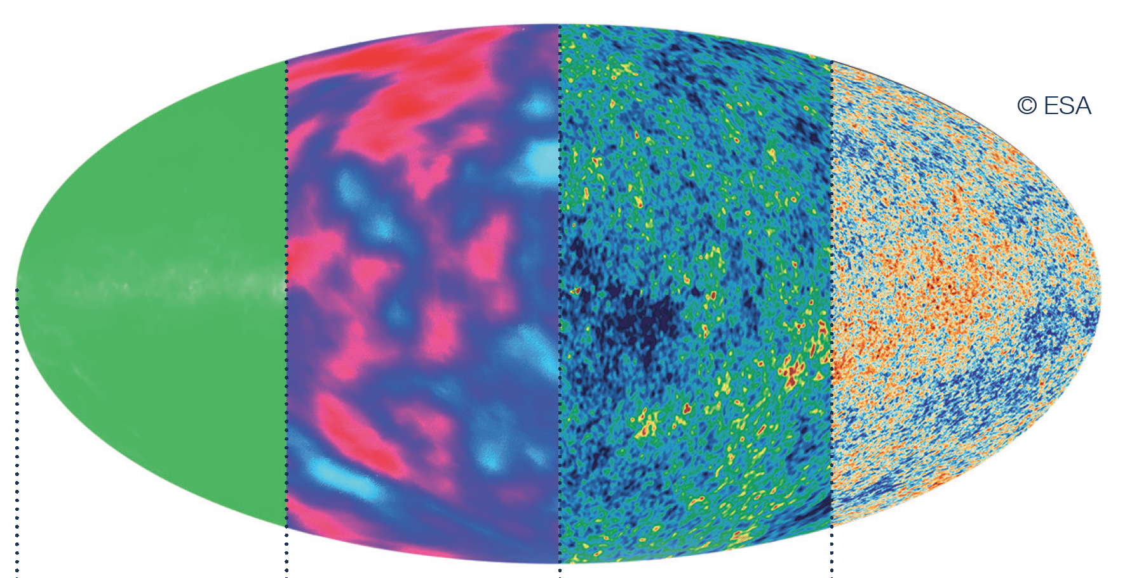
Discovery through precision
Besides direct searches for elusive phenomena, FCC-ee
will map the subatomic world like never before

Slide 13
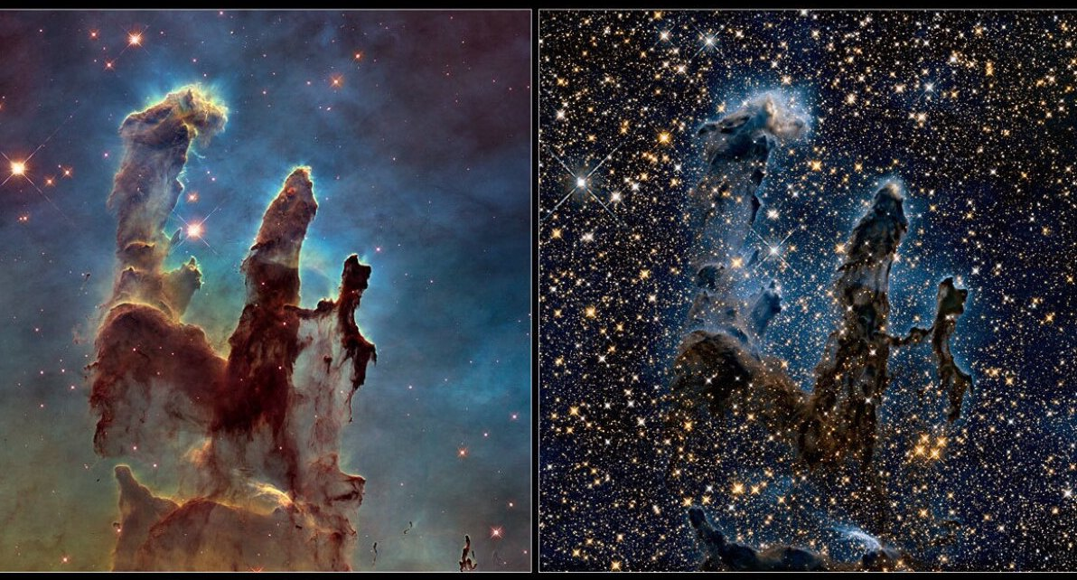
Discovery through exploration
Besides precise measurements of the Higgs boson, FCC-hh
will voyage into unknown realms of matter, space and time

Slide 14
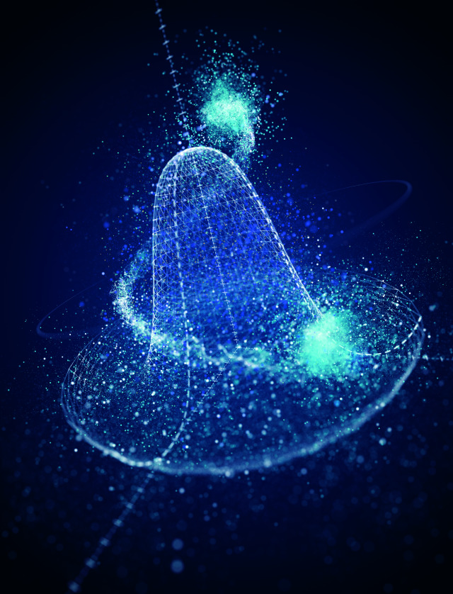
What are space and time? What is nothingness made of?
How did our vast universe begin, and what is its fate?
The discovery of the Higgs boson marked a milestone in
our knowledge of nature’s fundamental constituents
But we are missing something much bigger in our
understanding of the universe
Sell the sequel:
The LHC cemented 20th century understanding in
fundamental physics
The FCC seeks to shatter it

