Slide 1
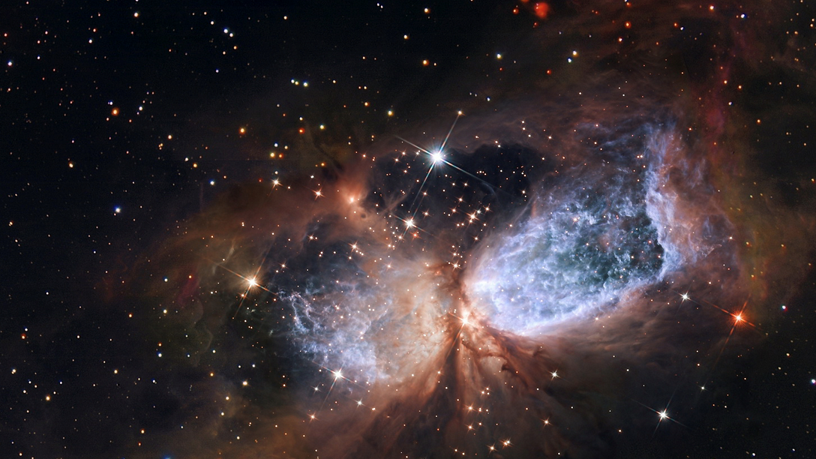
Germany.
Thomas Zoufal
DESY
21.11.2025

Slide 2
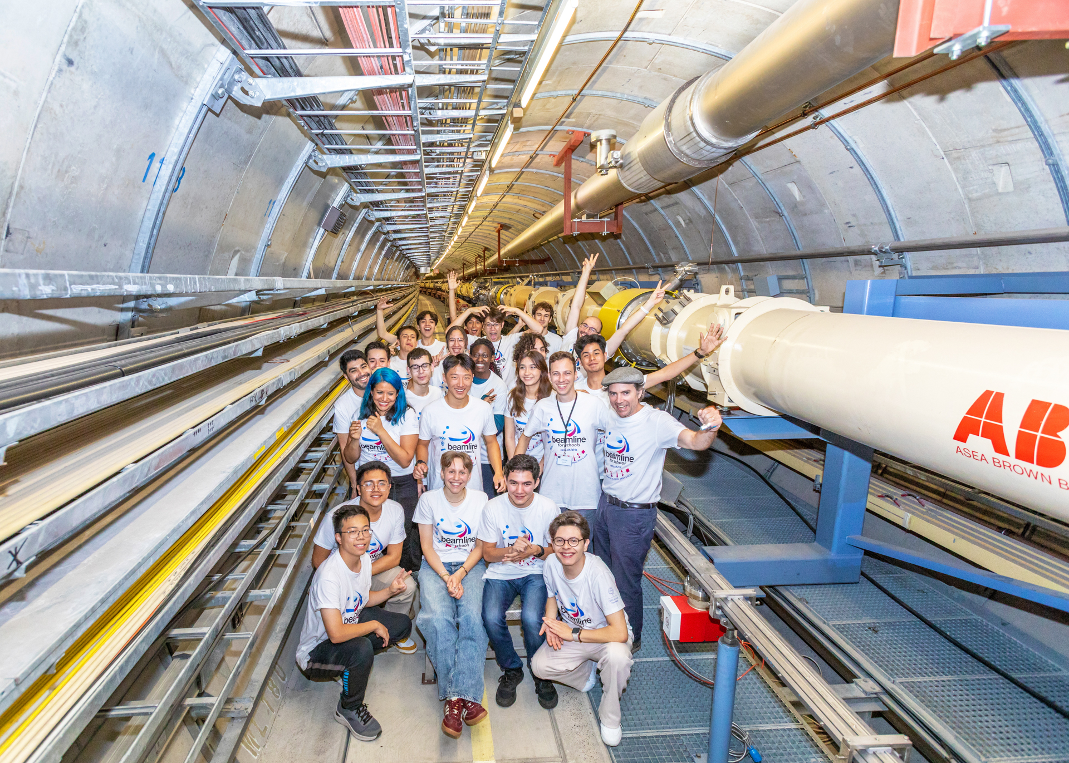
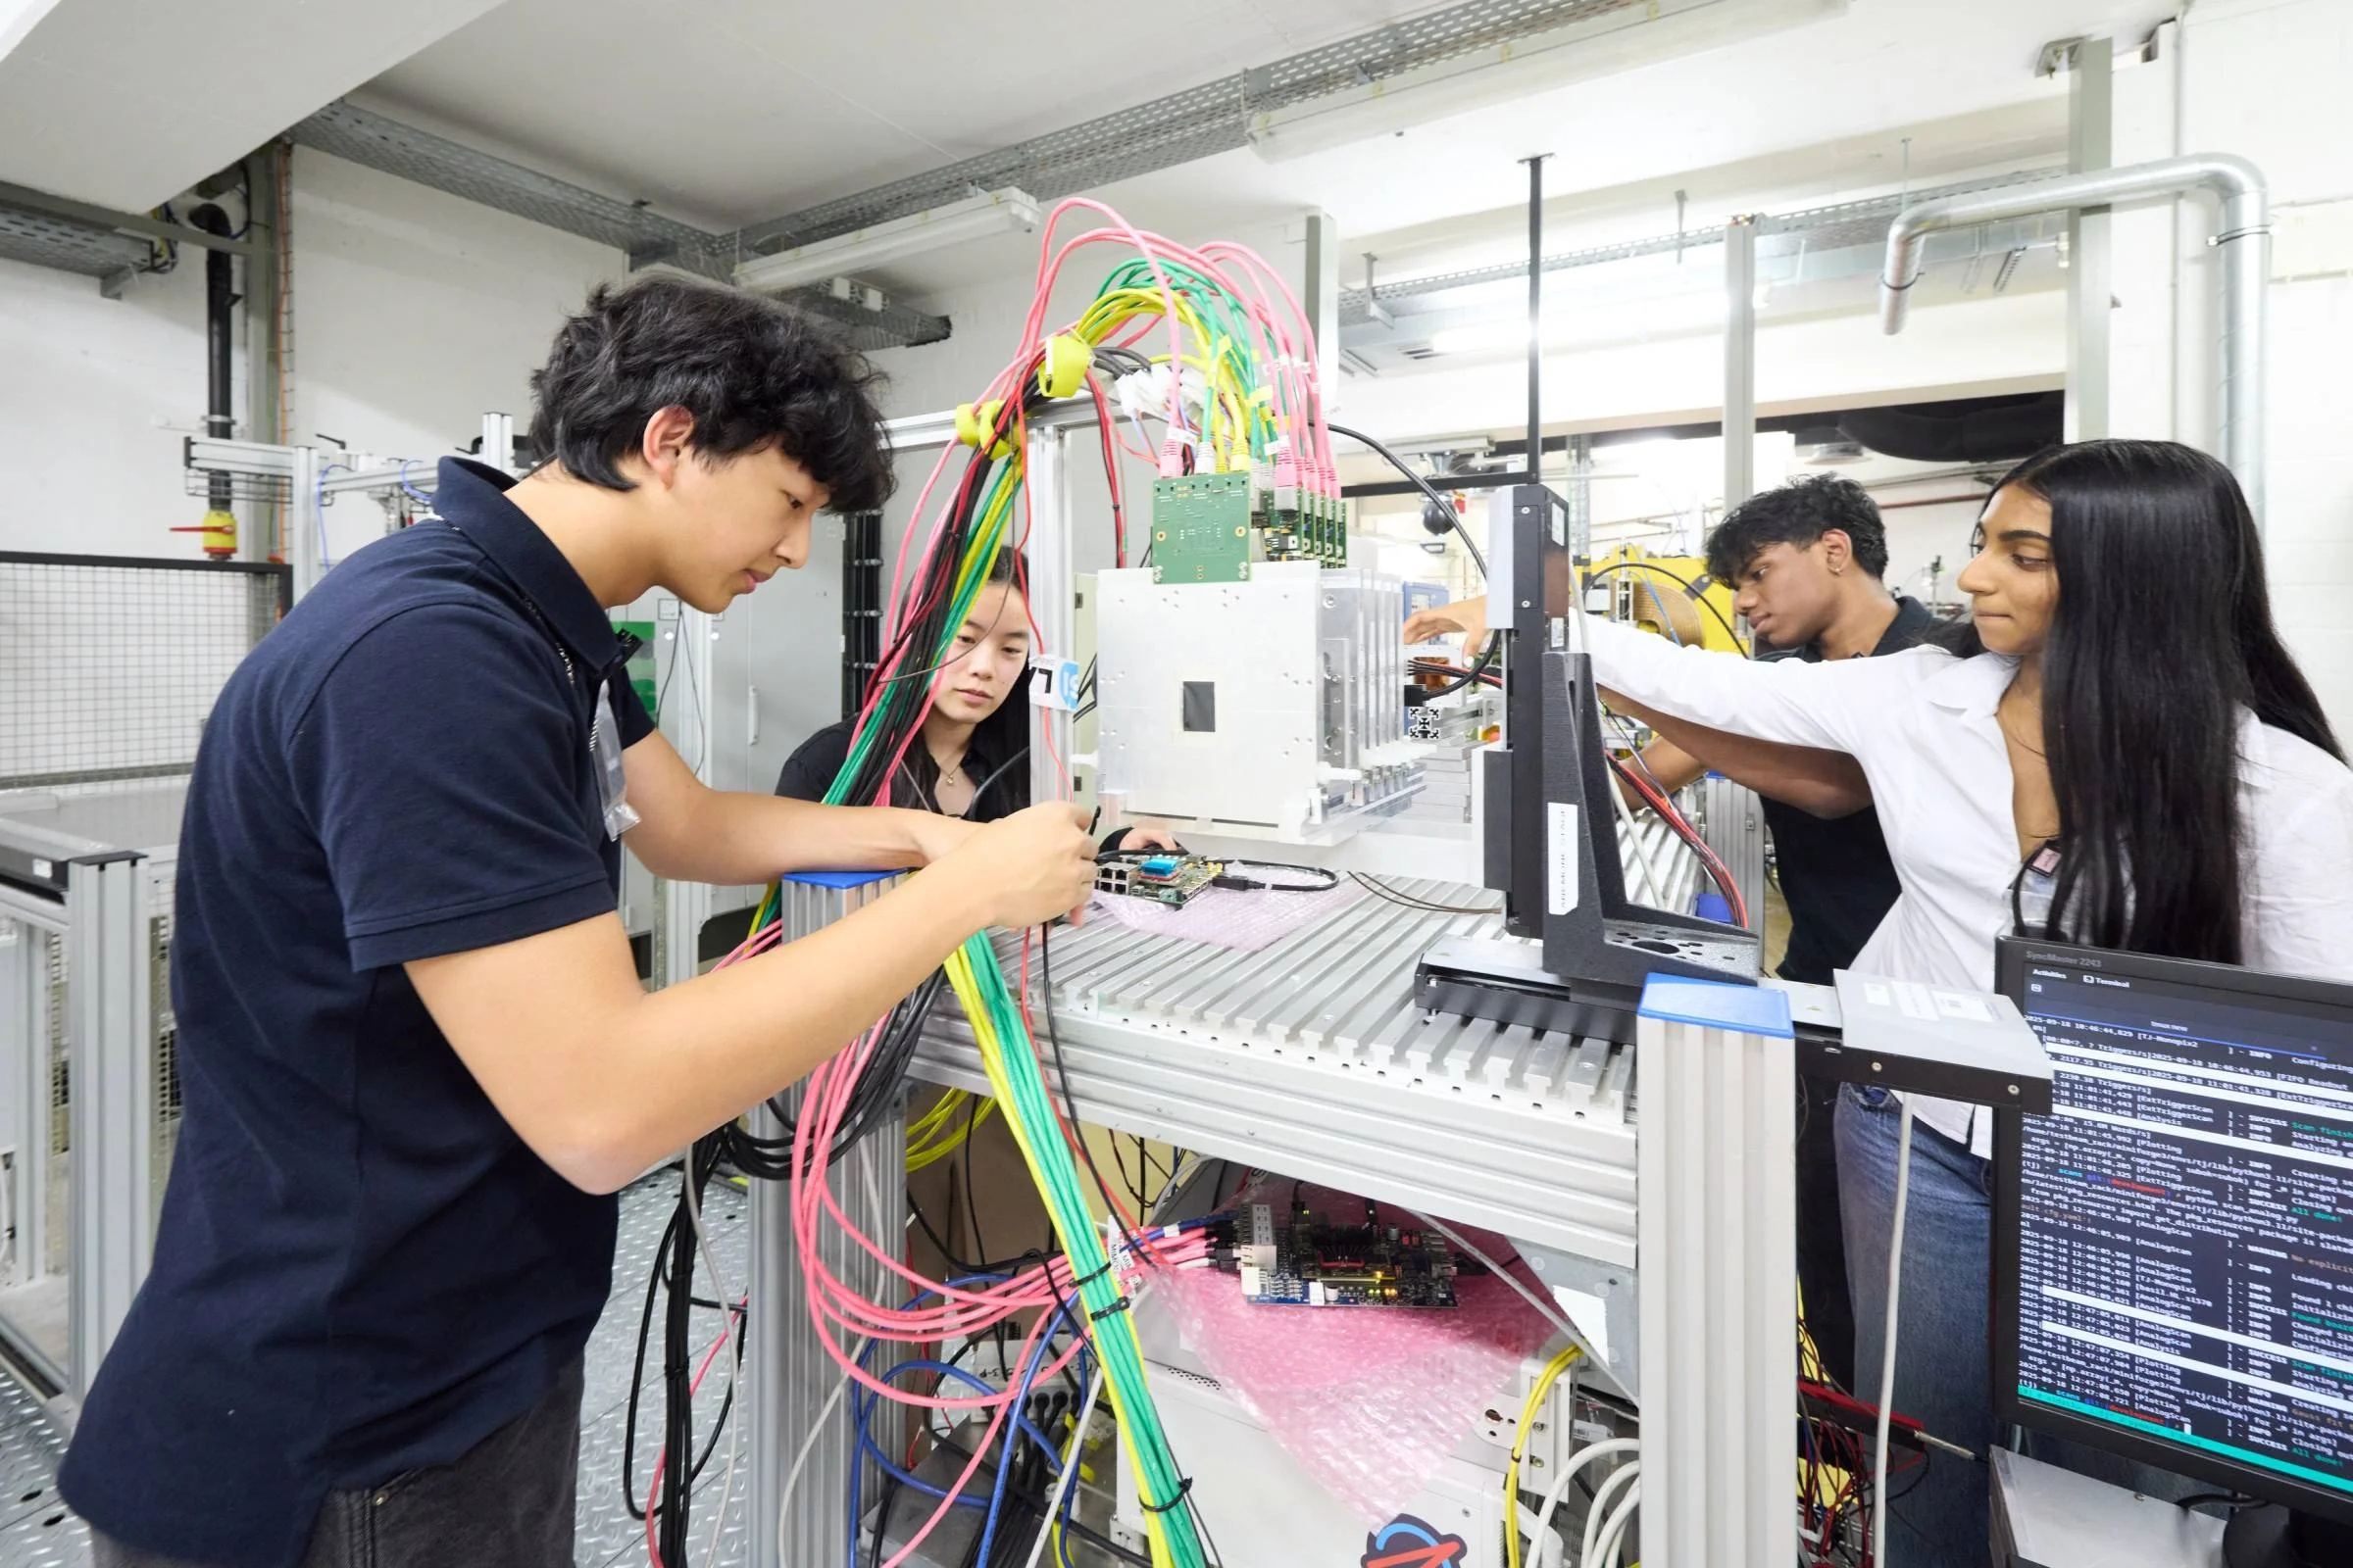
Beamline4Schools
2 Teams from Canada and Mexico at DESY, one Team from USA in Bonn
Photo: DESY, Marta Mayer
Photo: Volker Lannert, Uni Bonn

Slide 3
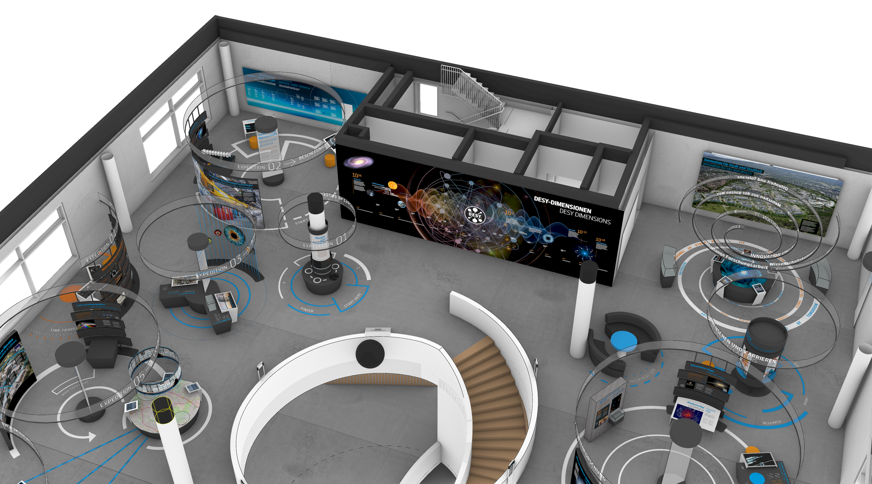
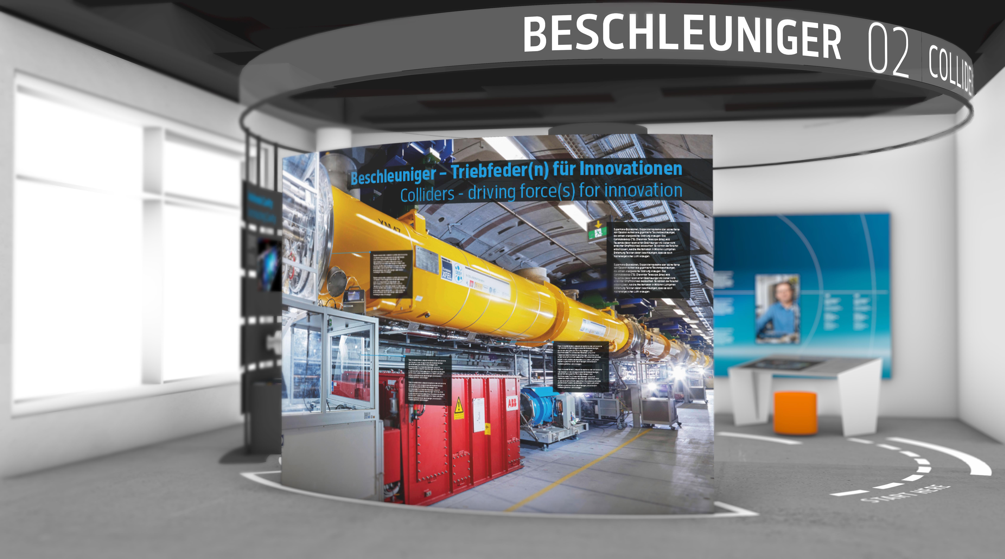
DESYUM
New Visitor Centre at DESY to be opened in Spring

Slide 4
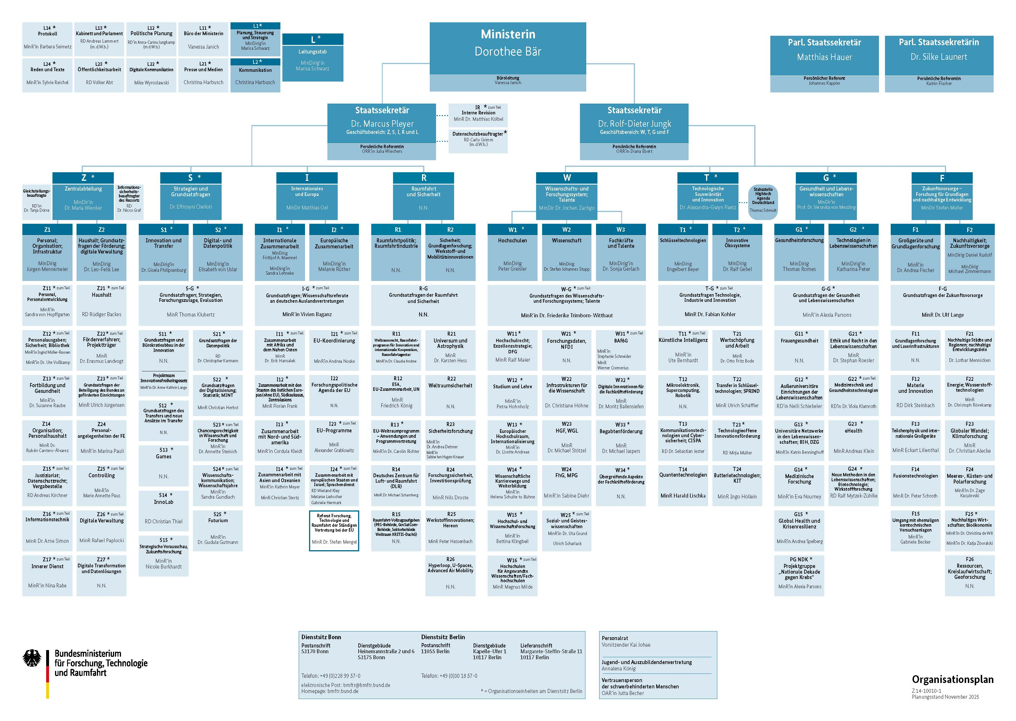
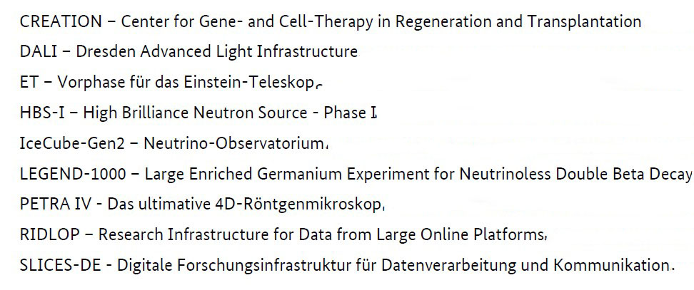
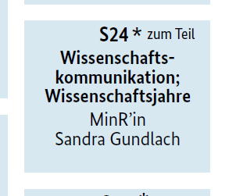
Politics
A new Federal Ministry for Research, Technology and Space
            Short list of research infrastructures
National prioritisation procedure for new, large-scale research infrastructures
            A dedicated department for
            Science Communication

