Slide 1
CRAB DQW M7 test
12/11/2025

Slide 2
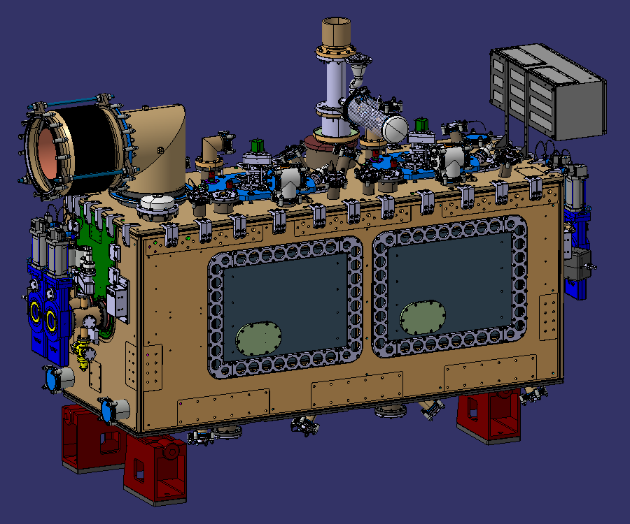
Generalities
Drawing : LHCACF_A0085
Poster CRAB DQW : 2873730
Drawing folder : 3351941

Slide 3
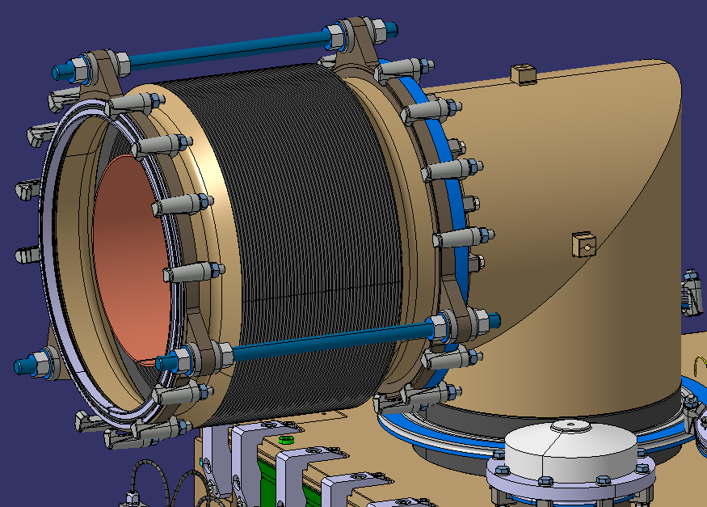
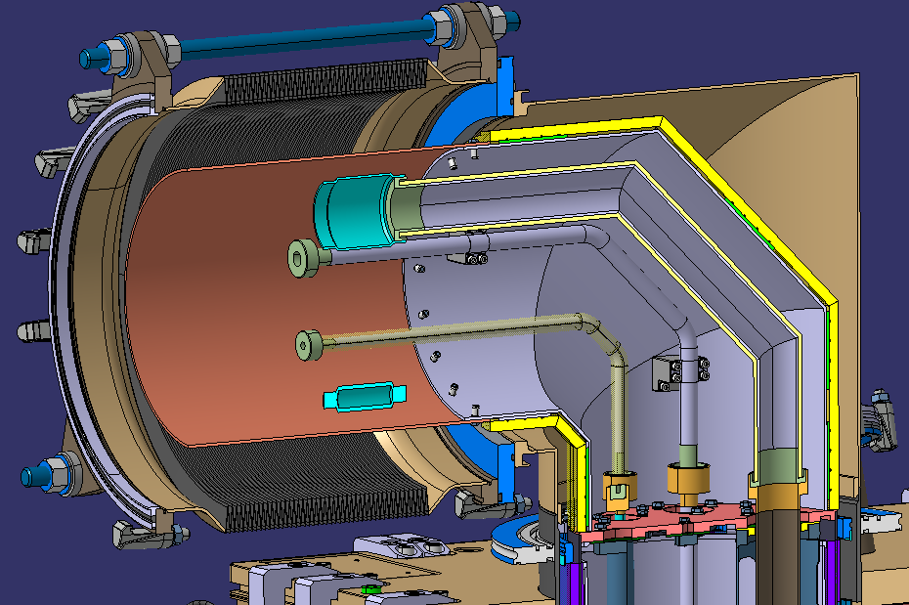
Jumper
Jumper + Bellows : drawing ready
M7 service module : need modification as LHCACFQC0727 (drawing folder : 3359831)

Slide 4
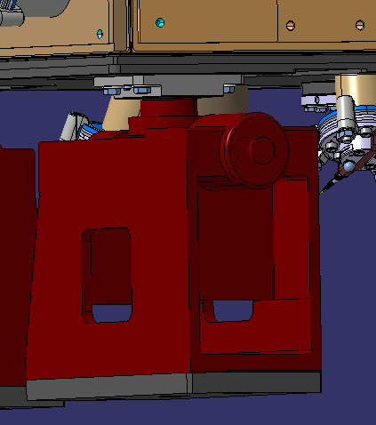
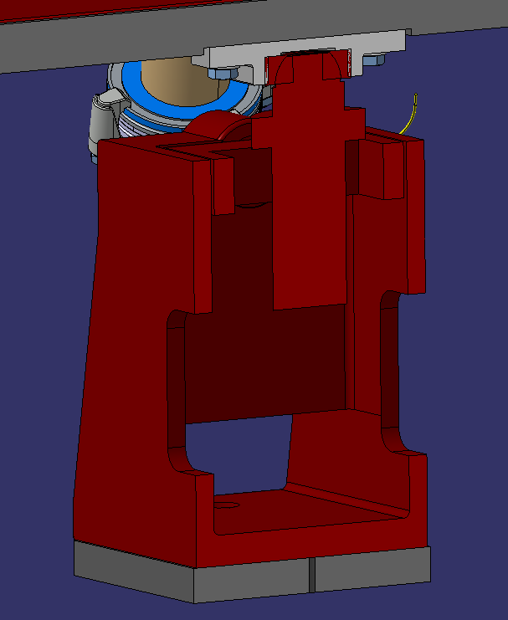
Jacks
Re-use the same as RFD-SPS, positions on floor are not de same + Need a spacing plate LHCACFAH0115 under each jack

Slide 5
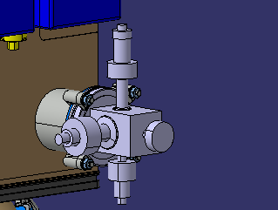
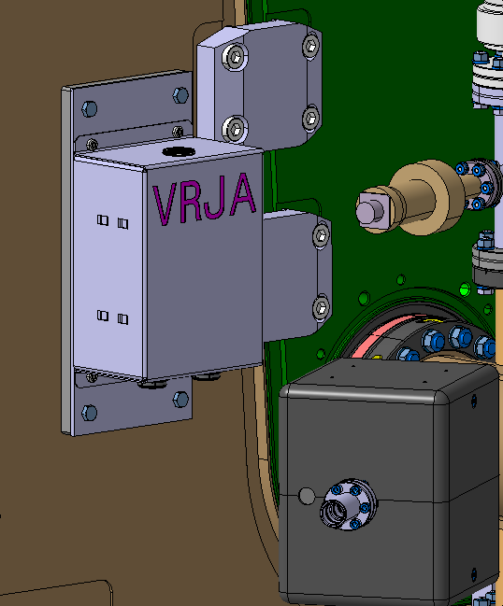
Vacuum instrumentation
A VAZAC sensors assembly is added
2x VPI junction boxes are foreseen (to be confirmed), an interface plate LHCACFVT0148 is needed for each box

Slide 6
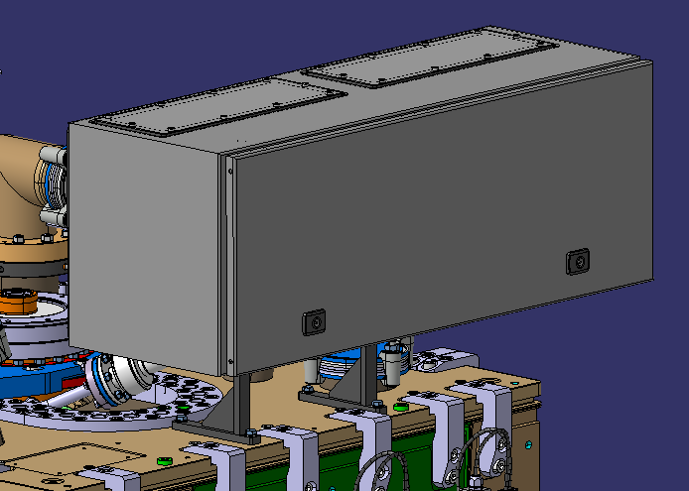
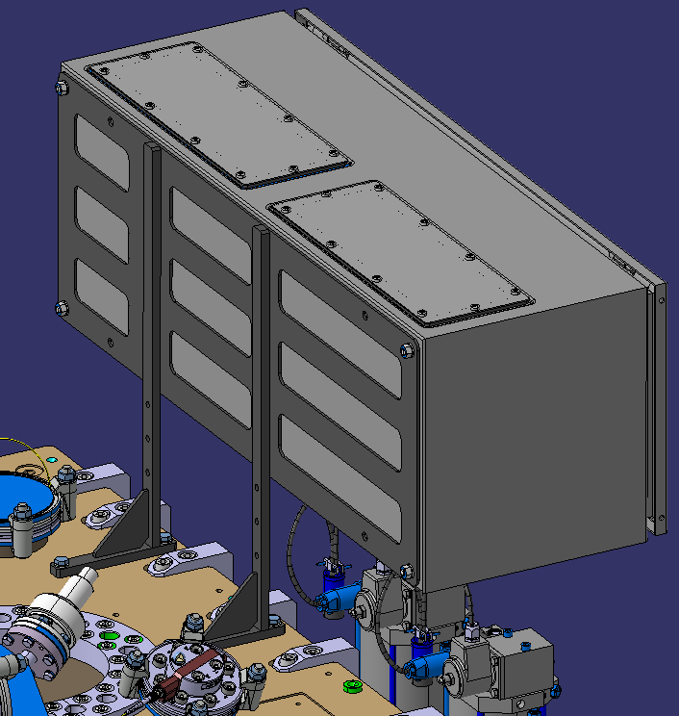
External instrumentation
Instrumentation cabinet to be confirmed, this information is needed for the design of the support LHCACFIS0089

Slide 7
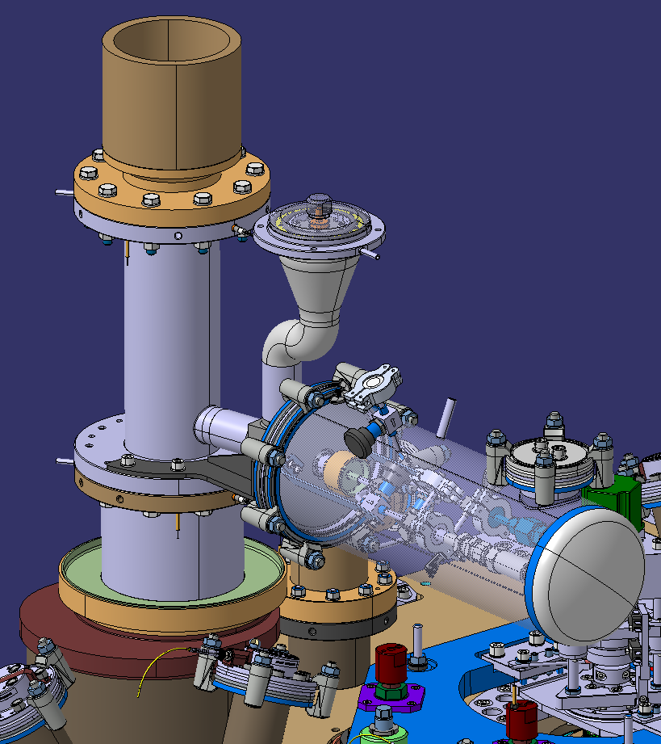
Helium guard + burst disc
Helium Guard assembly LHCACFQC0711 is foreseen for all M7 test, safety blow-up valve last information still missing
Same burst disc as RFD-SPS

