Slide 1
Linear Collider layout & Placement Study
25.11.25
Edward MacTavish
SCE-SAM-FS

Slide 2
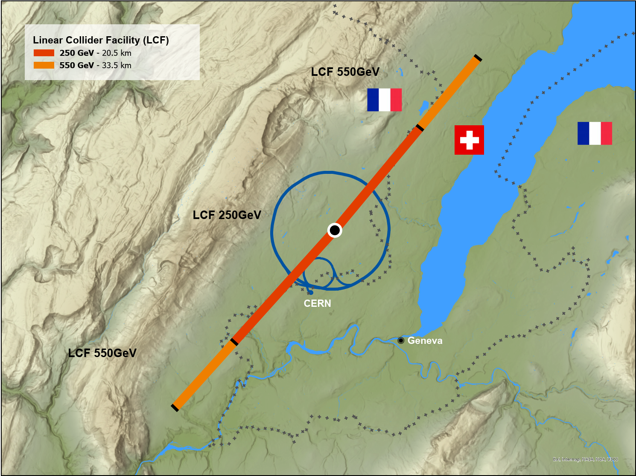
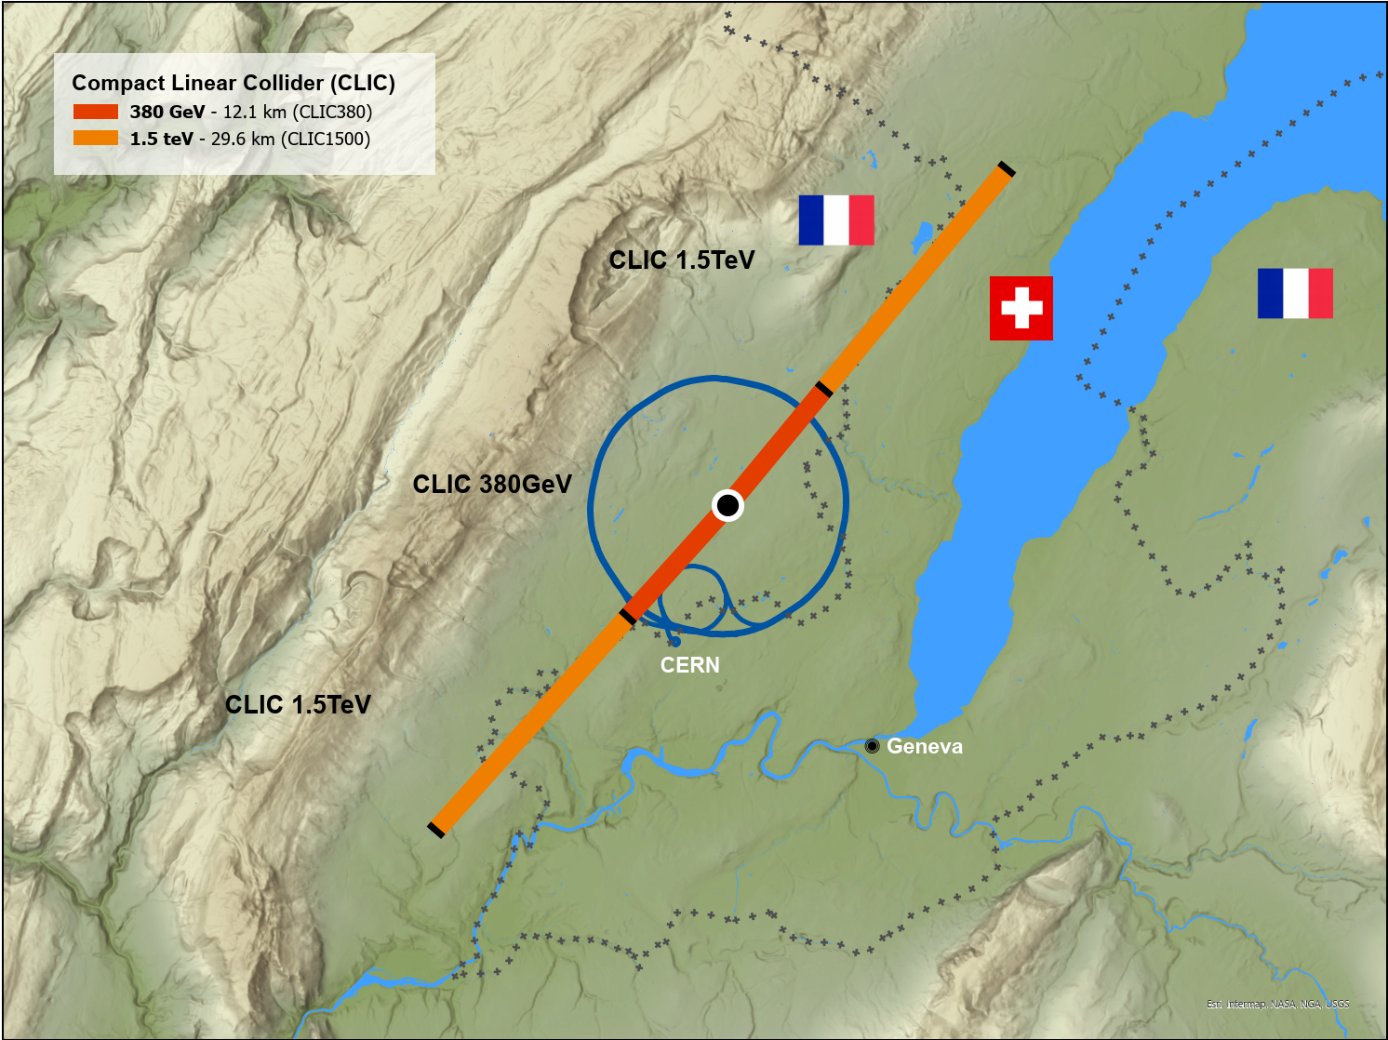
Overview of Studies
The Civil Engineering studies for CLIC and LCF are being developed in tandem at CERN.
The alignment and placement is shared for both studies with Interaction Region located on CERN land.
CLIC:
  380GeV at 12.1km
  1.5TeV at 29.6km
LCF:
  250GeV at 20.5km
  550GeV at 33.5km

Slide 3
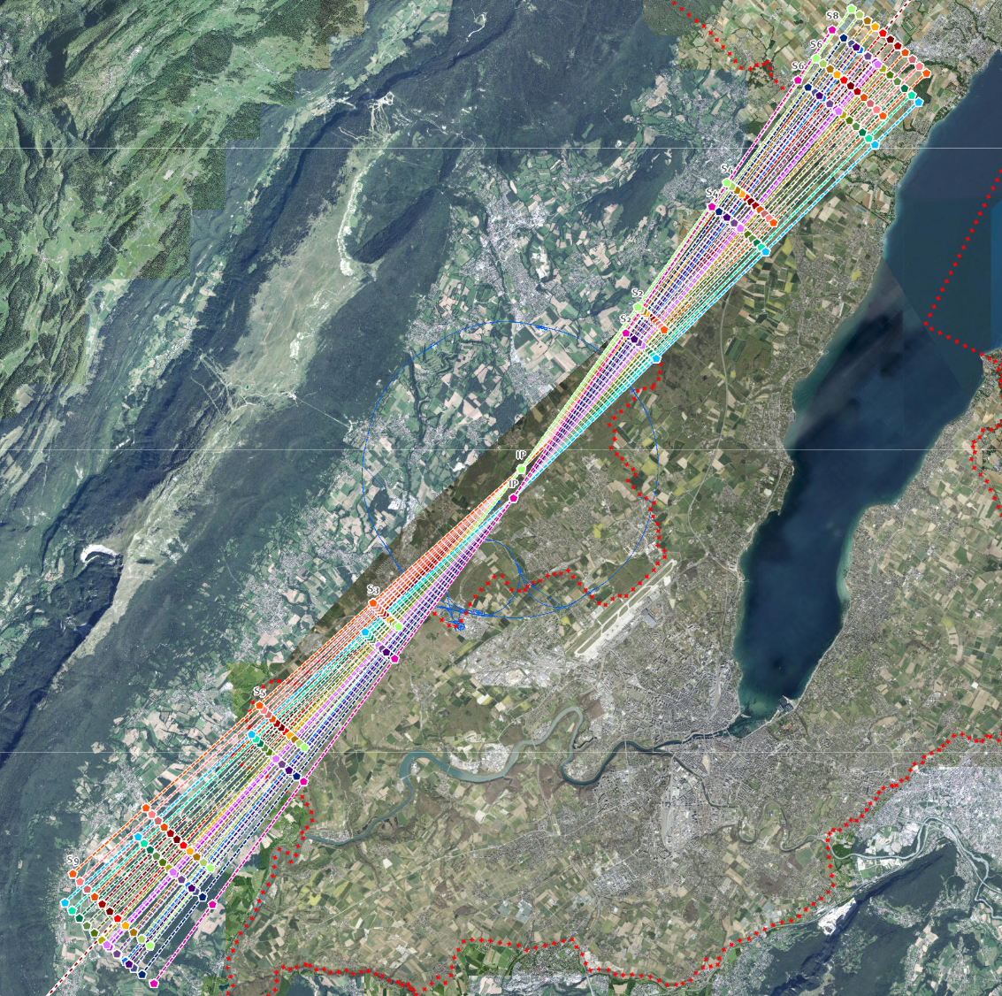
Layout and Placement Study
CERN is developing a placement optimisation tool with several scenarios under evaluation.
The collider may be rotated to determine the most practical alignment.
Assessment Criteria:
  Feasibility of land acquisition based on land classification.
  Accessibility for construction.
  Accessibility for long term operation.
  Suitability of local geology for Shaft & Cavern construction.
Two IP locations possible for LCF.

Slide 4
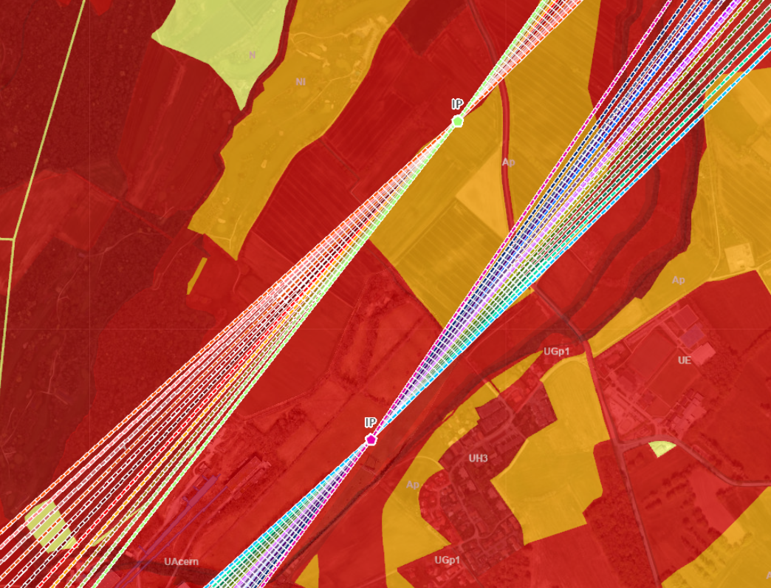
Shaft 1 (IP)

Slide 5
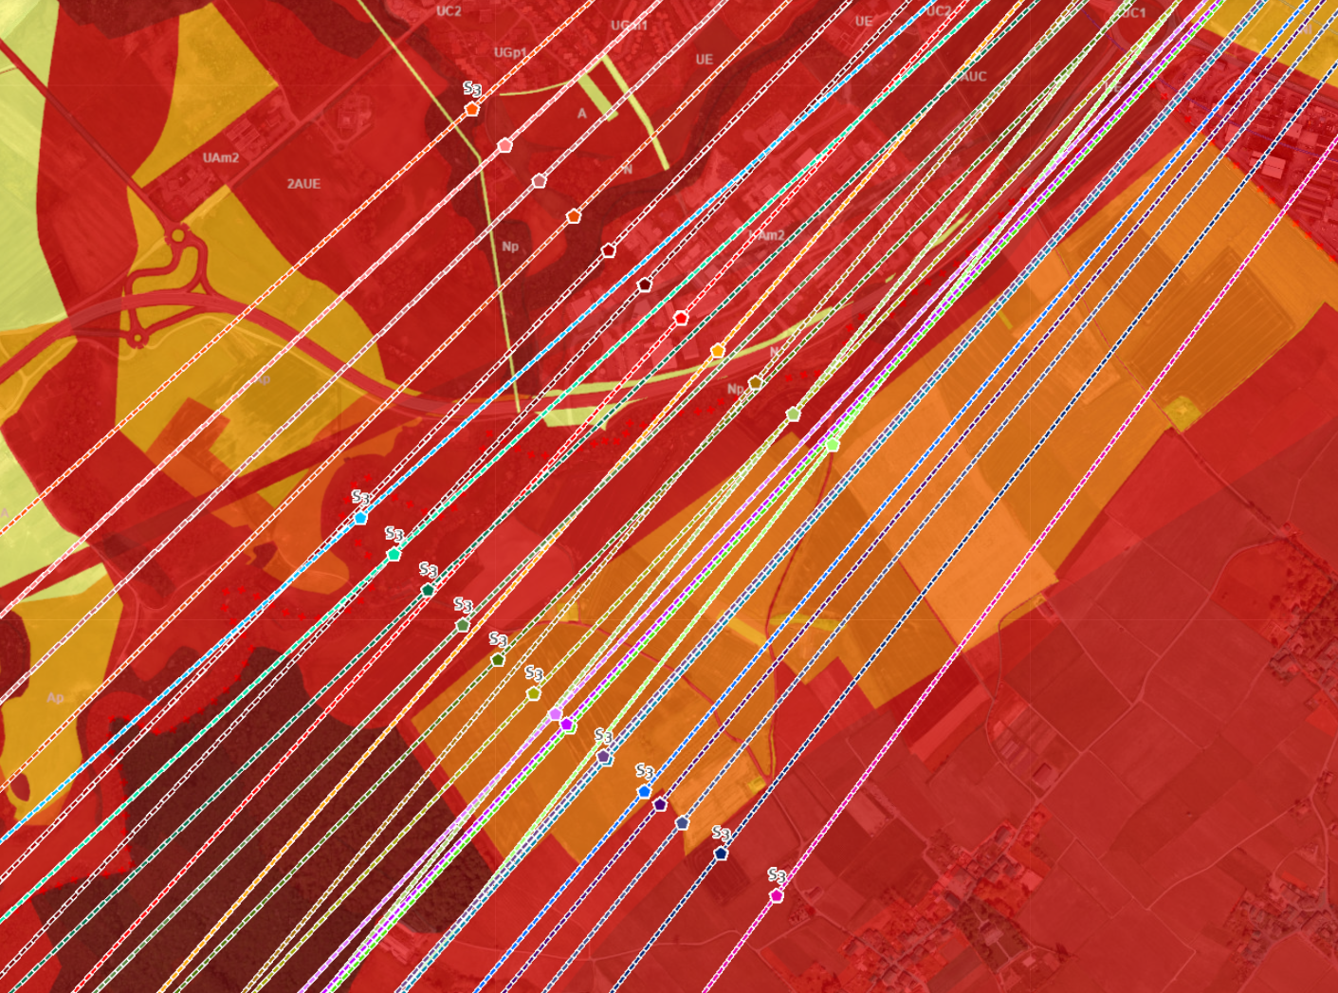
Shaft 3

Slide 6
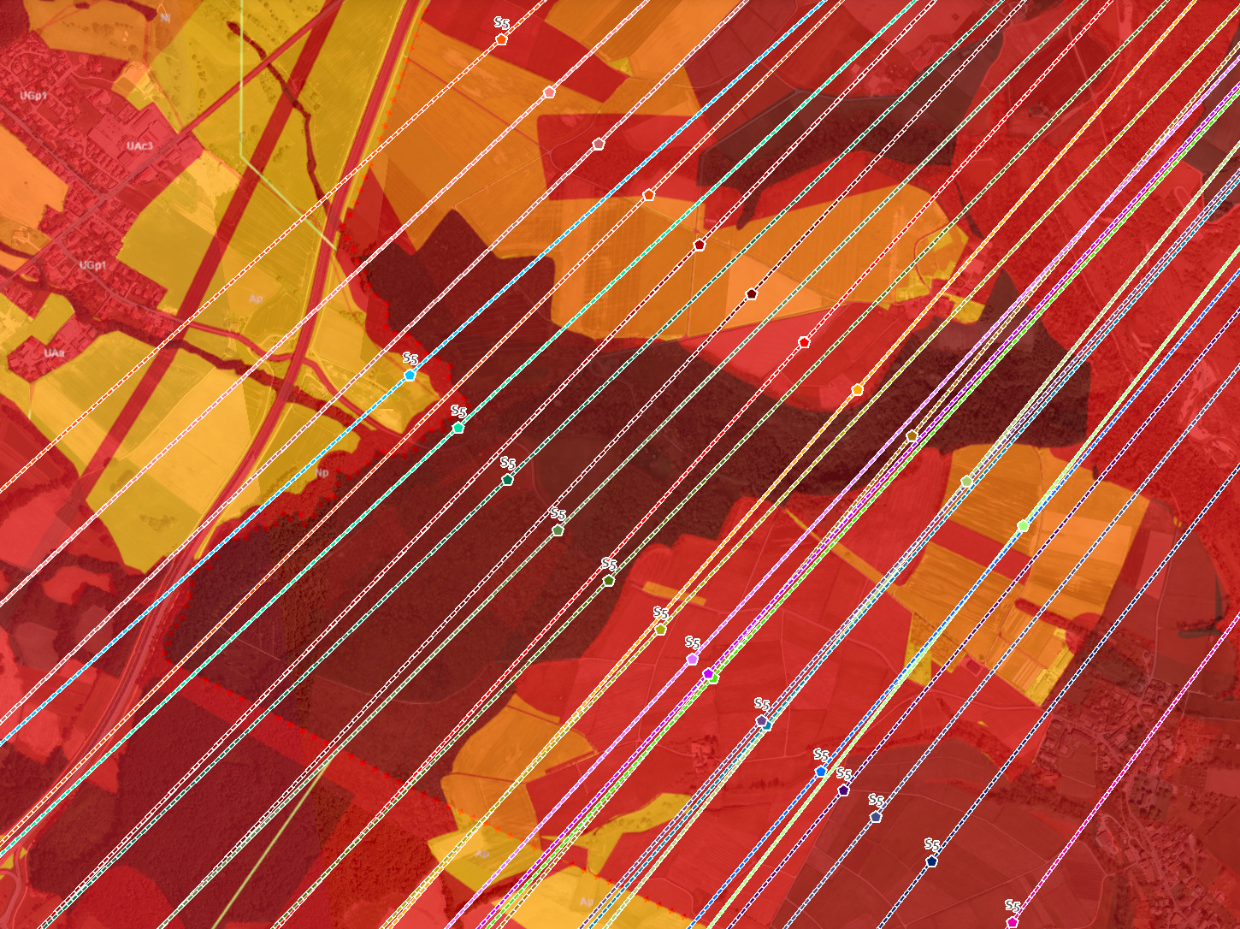
Shaft 5

Slide 7
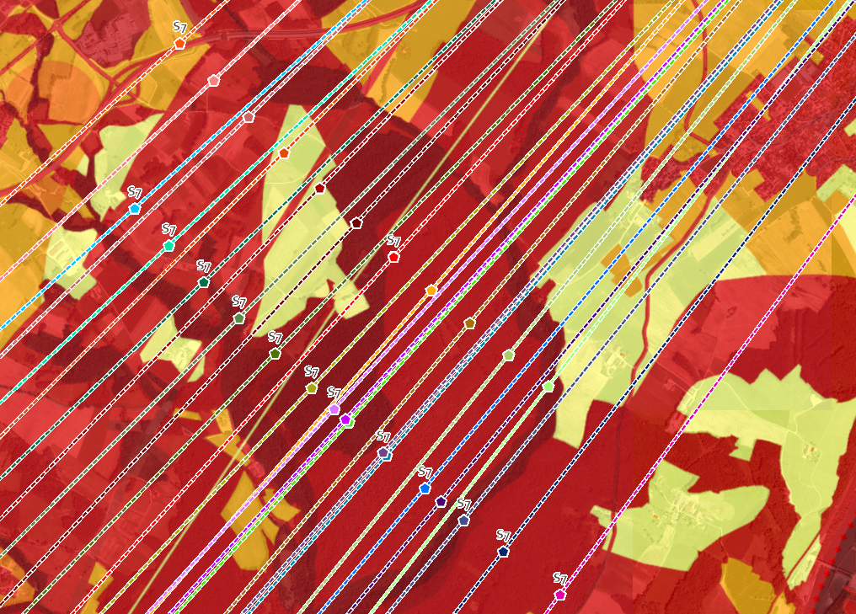
Shaft 7

Slide 8
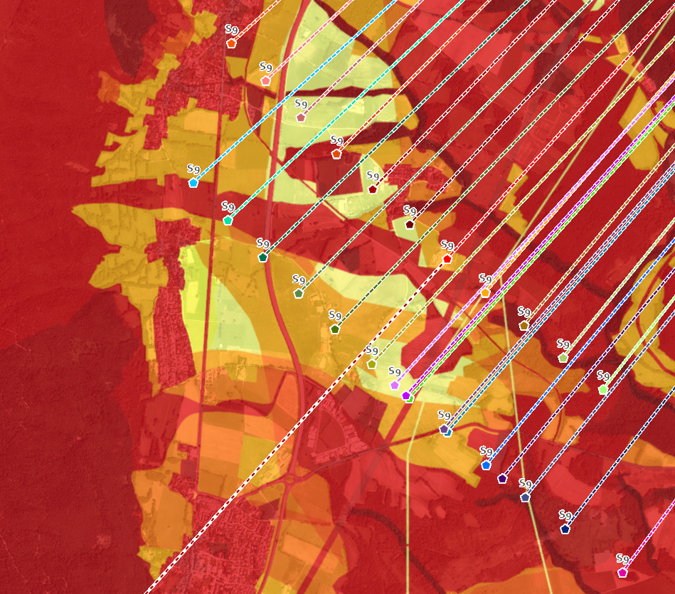
Shaft 9

Slide 9
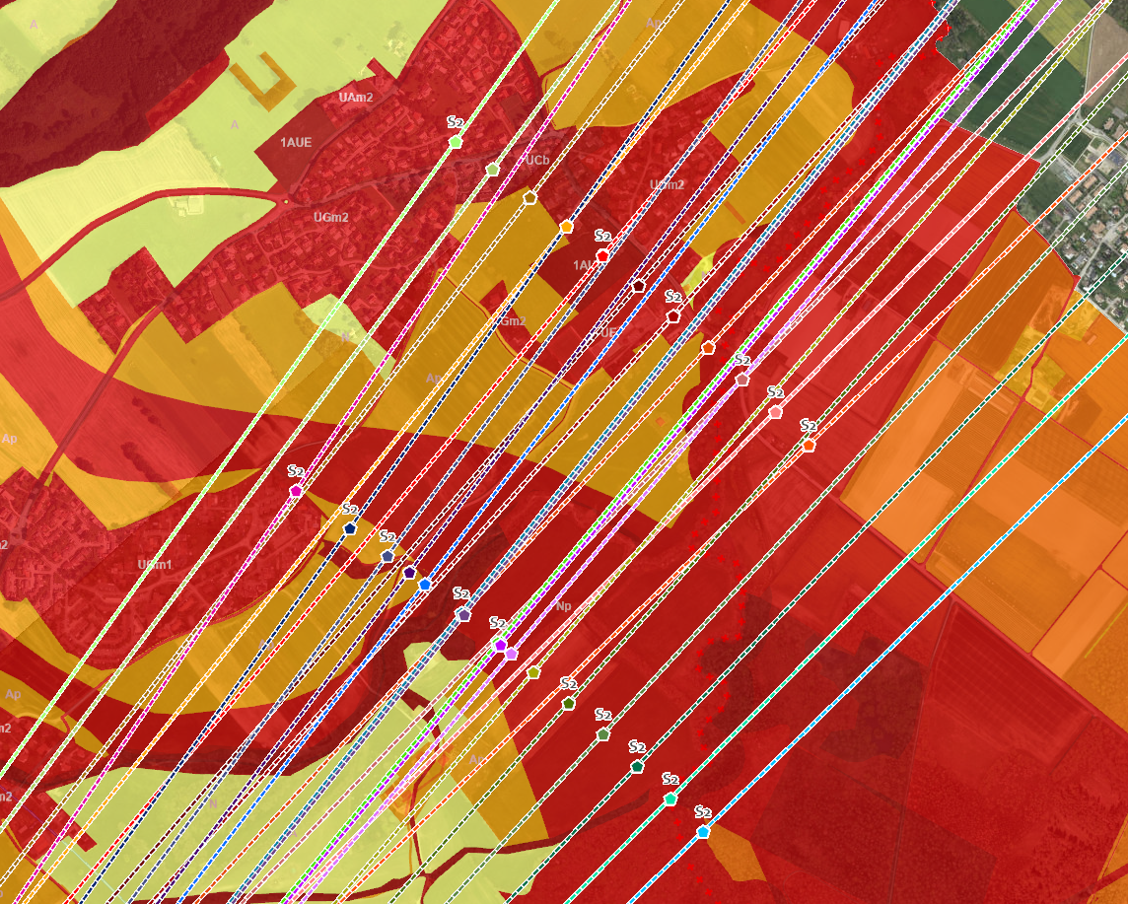
Shaft 2

Slide 10
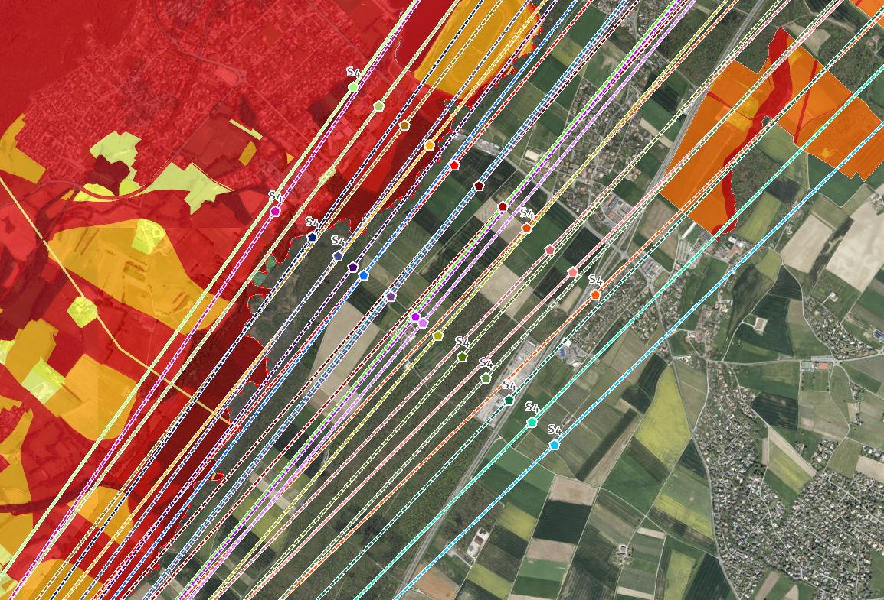
Shaft 4

Slide 11
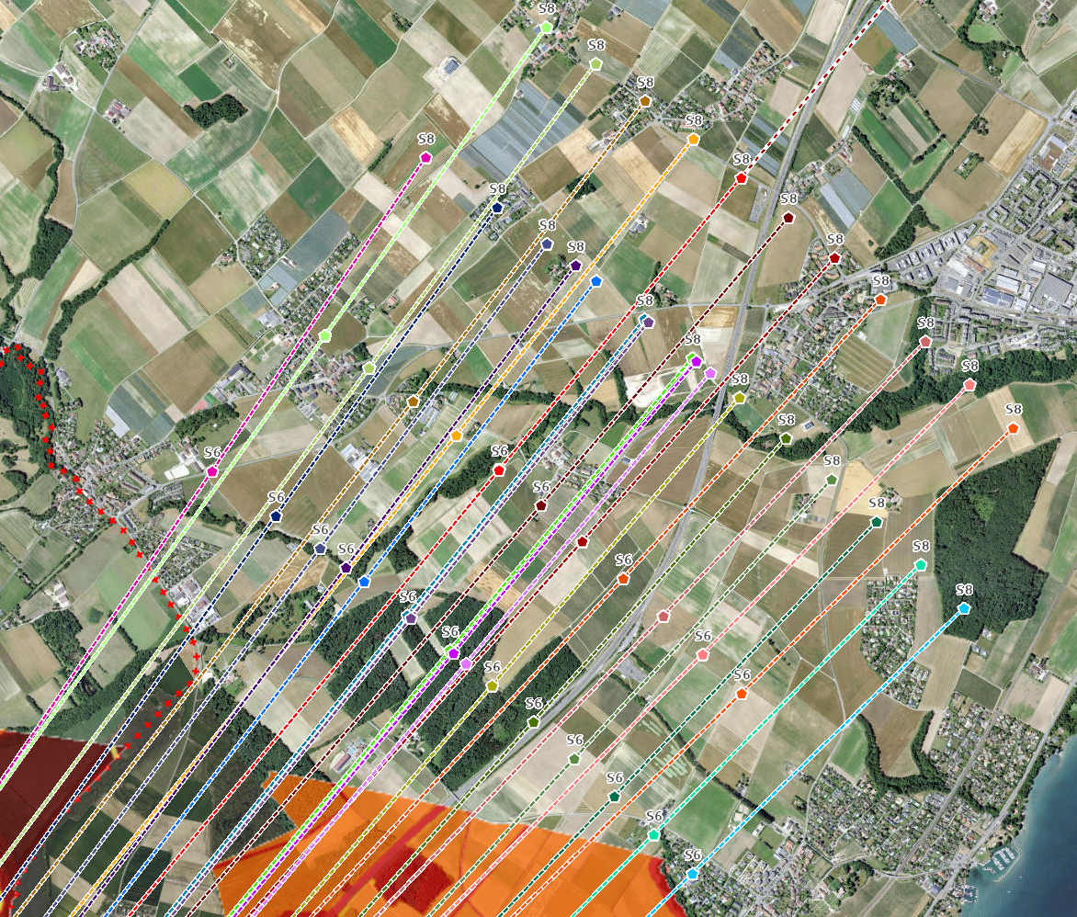
Shafts 6 & 8

Slide 12
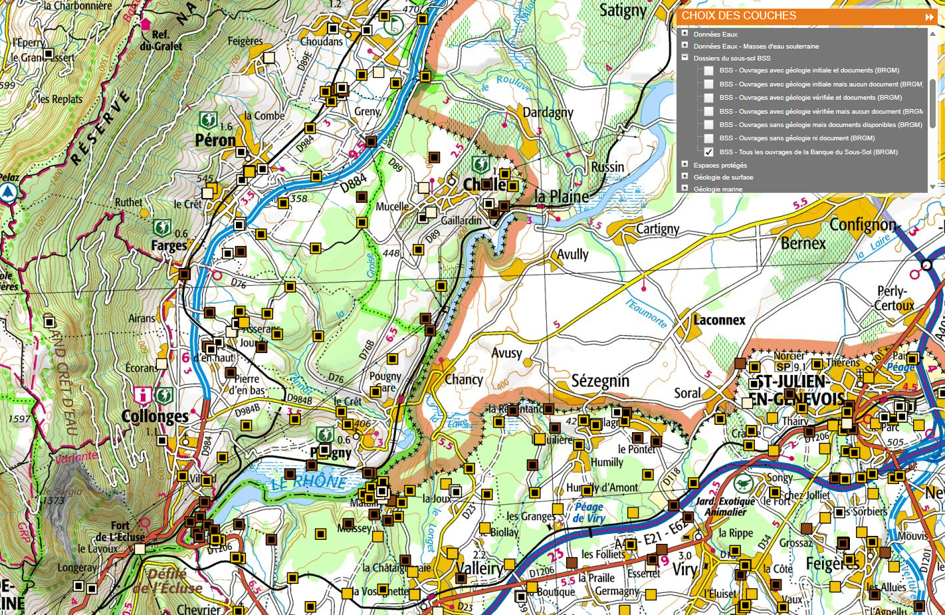
Boreholes 7-9
Visualiseur InfoTerre

Slide 13
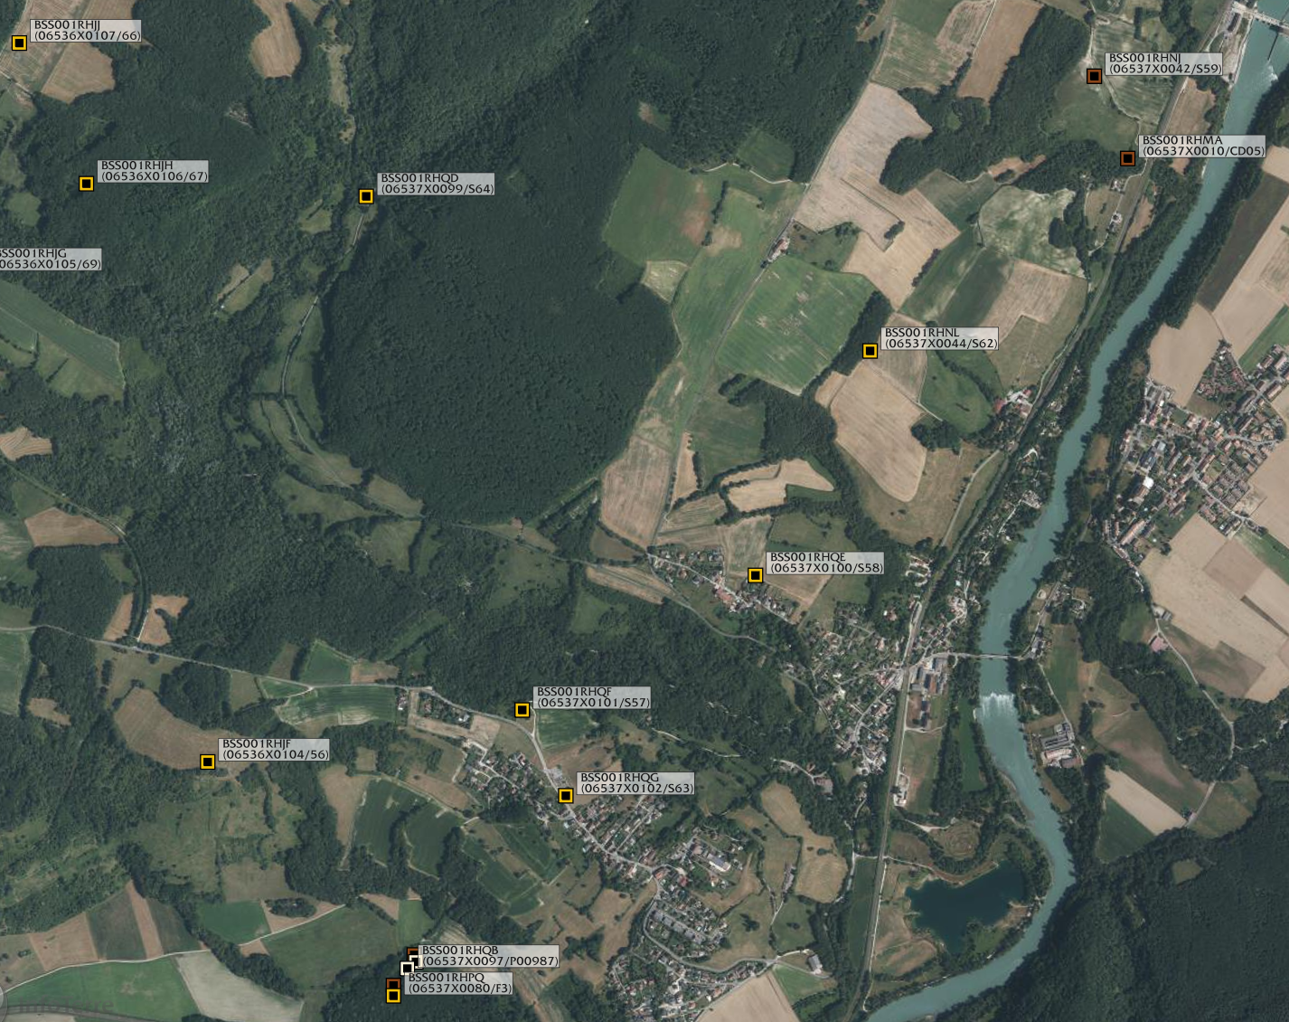
5m
560m
5m
11m
8m
River (Depression)
5m
14m
3m
8m

Slide 14
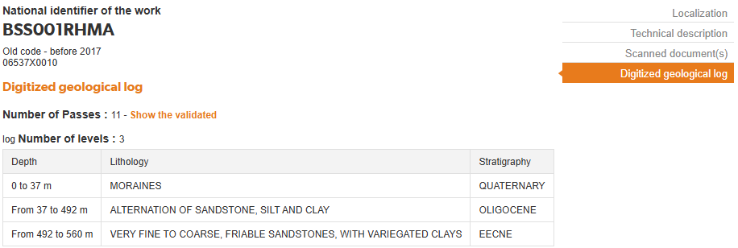
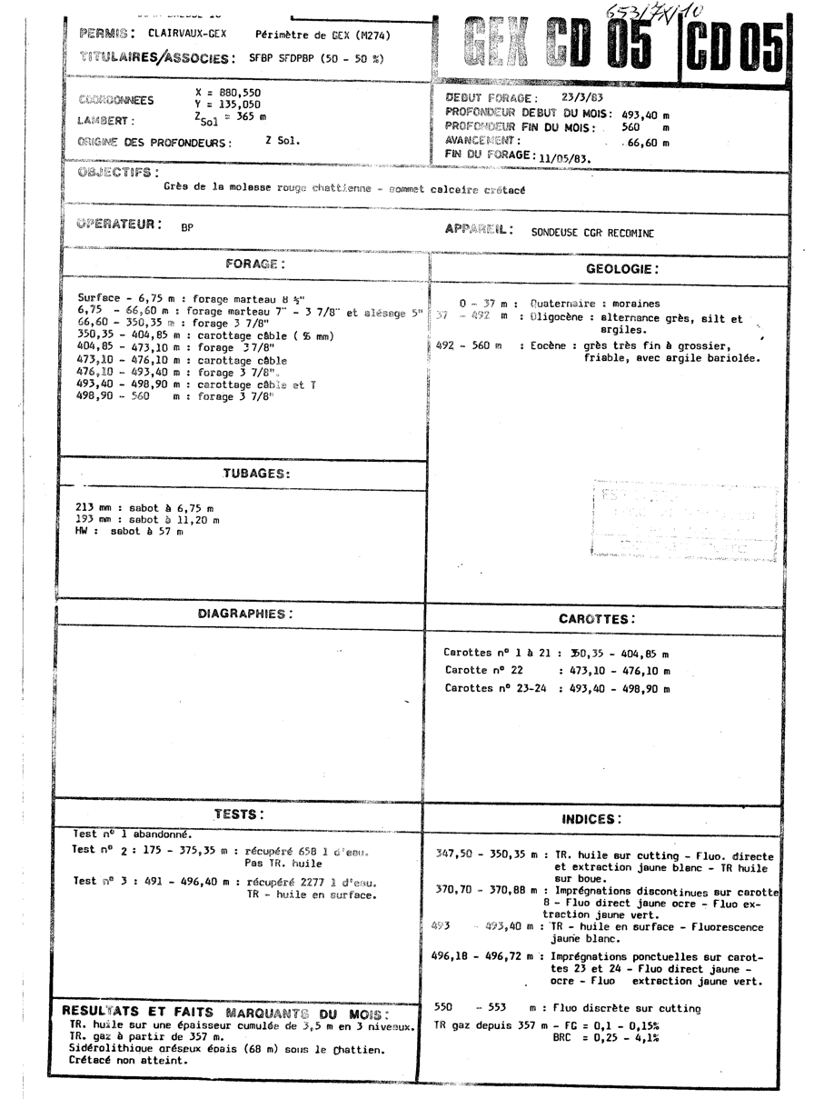
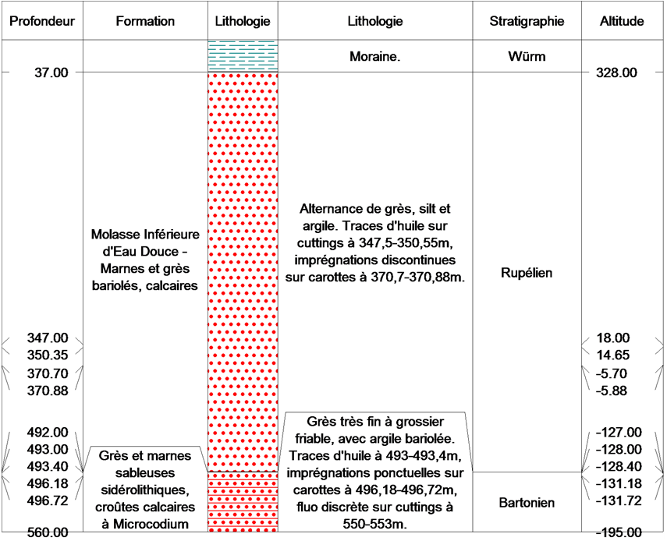

Slide 15
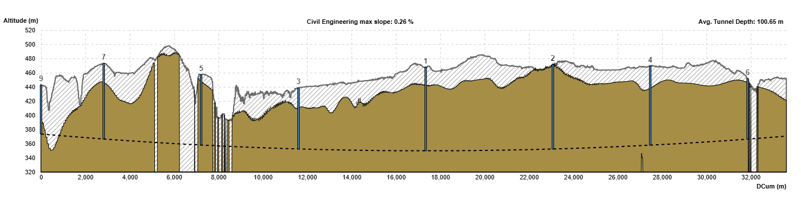

Slide 16
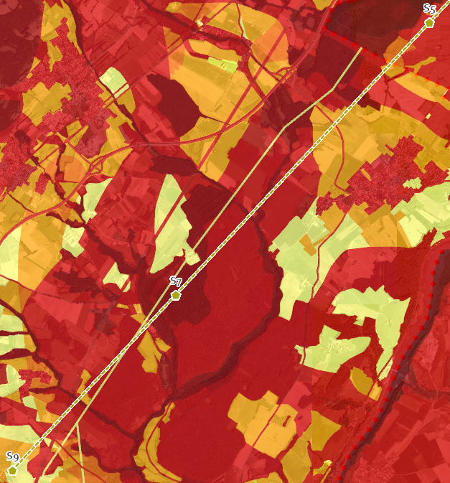
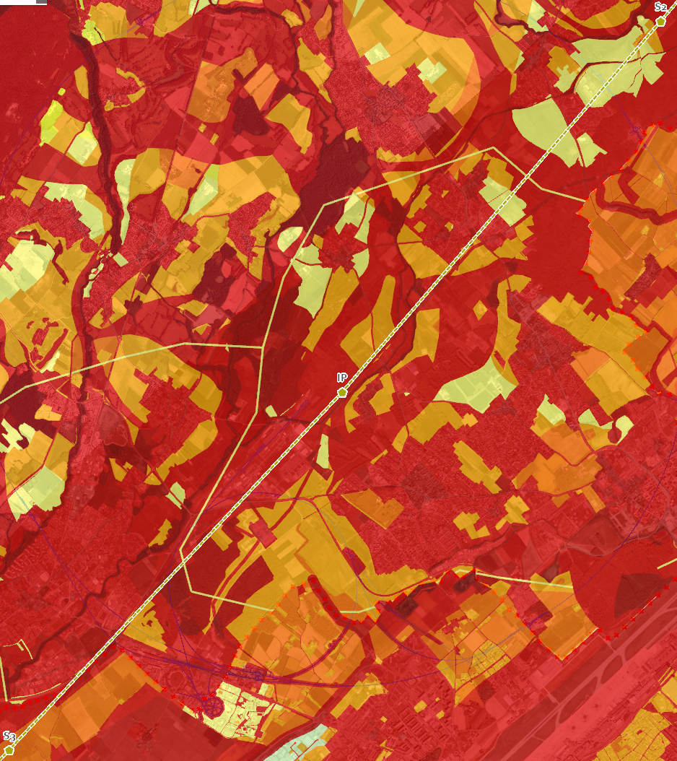
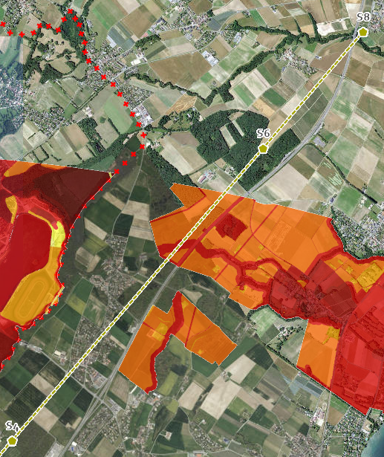
LCF v.13

