Slide 1

ECR/Documents for Information and Approval
Giulia Romagnoli and Natalya Kahn for BE-EA, 2025-11-18
EA Documents - Agile Board - CERN Central Jira

Slide 2
LIST OF DOCUMENTS for Info
FOR INFORMATION EATM
Summary | Reporter | EA Projects | EDMS number | EDMS Status
WIC and Power Converter Connections to the BIS | Antoine Colinet | North Area, NA-CONS | 2887843 - SPSX-CIB-LST-0001 | Under approval
NA-CONS XBPF Installation strategy | Inaki Ortega Ruiz | North Area, NA-CONS | 2802203 - SPSX-B-NOT-0001 | Engineering check
MBSA Magnet - Design Report | Philip Schwarz | North Area, NA-CONS | 3238176 - SPSX-M-RPT-0001 | Released
North Area Baseline Plan for YETS2025-26 | Xavier Palle Lopez | North Area | 3306246 - SPSX-PM-MS-0010 | Under approval
East Area Plan for YETS 25/26 | Aboubakr Ebn Rahmoun | East Area | 3380937 - PSZ-PM-MS-0002 | Under approval
MISE HORS TENSION PARTIELLE DE LA ZONE EST | Denis Ribiollet | East Area | 3171657 - PSZ-E-PRD-0003 | Released
Spill Optimisation for Experiments | Dipanwita Banerjee | Experimental Areas | 3348121 - SPSX-O-EN-0001 | Released
Specification of the measurement campaign for the new AD electron cooler magnet system | Adriana Rossi | AD | 3127404 - AD-LNT-SPC-0003 | Under approval
HiRadMat Patch Panels and Cabling Configuration for Experimental Users | Philippe Boisseaux-Bourgeois | HiRadMat | 3322635 - HRM-E-ES-0001 | Under approval
Preparatory steps to take before accessing HiRadMat underground areas | Paraskevi Alexaki | HiRadMat | 1154948 | Engineering check

Slide 3
Experimental Areas – Operation 2025
PERIOD | ZONE | TITLE | AUTHOR | ECR EDMS link | ECR STATUS | Integration Status
Run 2025 | East Area | MDX Magnet Installation for User Set-Up in T10 | Maarten Van Dijk | 3212841 - PSZ-M-EC-0002 | Released | Completed
Run 2025 | East Area | AMS Installation on T09 Beamline | Dipanwita Banerjee | 3286847 - PSZ-X-EC-0001 | CANCELLED | Completed
Run 2025 | East Area | Re-installation of Modified Vacuum Chamber in East Area F61.MBXHD025 during TS 2025 | Giulia Romagnoli | 3305038 - PSZ-V-EC-0003 | Released | Completed
Run 2025 | Operation/user | GIF++ Metallic Platform for Gas Area Extension | Sylvain Girod | 3214920 - SPSX-J-EC-0010 | Released | Completed
Run 2025 | Operation/user | Installation of a New Hydrogen Buffer outside EHN1 for the NA61/SHINE Experiment | Bartosz Maksiak | 3197663 - SPSX-J-EC-0009 | Released | Completed
Run 2025 | Operation/user | Small Modifications to the Instrumentation in PPE134 | Nikolaos Charitonidis | 3252972 - SPSX-L-EC-0011 | Released | Completed
Run 2025 | Operation/user | Displacement of Beam Instrumentation from H4 to H2 Beamline for Neutrino Platform Operation in 2025 | Nikolaos Charitonidis | 3252924 - SPSX-B-EC-0017 | Released | Completed
Run 2025 | Operation/user | DRD1 Test Facility | Eraldo Oliveri |  | CANCELLED | No need
Run 2025 | Operation/user | Temporary Installation of Two XBPFs in M2 for Beam Divergence Measurement | Inaki Ortega Ruiz | 3313838 - SPSX-B-EC-0020 | Released | Completed
Run 2025 | Operation/user | Re-installation of XCED Detector on H6 Beamline in PPE136 | Miguel Santos | 3286149 - SPSX-B-EC-0018 | Released | Completed
Run 2025 | NA-CONS | Ventilation for the BA81 Extension | Jani Lehtinen | 3156846 - SPSX-U-EC-0002 | Released | Completed
Run 2025 | HI-ECN3 | Creation of New Lorry and Personnel Doors in Building 911 | Jean-Louis Grenard | 3173295 - SPSX-J-EC-0008 | Released | Completed
Run 2025 | HI-ECN3 | New Trench on the Edge of the Budker Road Extension | Ixone Angulo Vaquero | 3252302 - SPSX-J-EC-0012 | Released | Completed
Run 2025 | HI-ECN3 | Recovery of Iron Shielding from TT7 | Tamara Bud | 3277719 - SPSX-J-EC-0013 | Released | No need
Run 2025 | AD | Additional Platform above ALPHA Local Control Room in AD Hall | Francois Butin | 2897943 - AD-LJ-EC-0023 | Released | Completed
Run 2025 | AD | Removal of Four Power Converters | Sven De Man | 3316808 - AD-R-EC-0007 | CANCELLED | No need
Run 2025 | HiRadMat | Recovery of Iron Shielding for Isolde | Karen Ledanois | 3357094 - HRM-J-EC-0001 | Engineering check | No need
Run 2025 | HI-ECN3 | Temporary Installation of P42-Induced Background Test Stand at TCC8 | Florian Stummer | 3368611 - SPSX-B-EC-0021 | Under Approval | Completed

Slide 4
Experimental Areas – YETS 25-26
ECRs
PERIOD | ZONE | TITLE | AUTHOR | ECR EDMS link | ECR STATUS | Integration Status
YETS 25-26 | NA-CONS | Fire doors 9-10-11-12-13-14-17-33 | Adem Kaymak | 3286649 - SPSX-SF-EC-0017 | Under approval | Completed
YETS 25-26 | Operation/user | H6 Additional Quadrupoles for Smaller Beam Sizes in PPE156 | Laurie Nevay | 3371599 - SPSX-M-EC-0008 | In work | Stand-by
YETS 25-26 | Operation/user | PPE118/128 Shielding Modification for Better Crane Access to TT82 | Sylvain Girod | 3317569 - SPSX-J-EC-0014 | Under approval | Completed
YETS 25-26 | HI-ECN3 | HI-ECN3 Transfer Trolley | Roberto Rinaldesi | 3237347 - SPSX-H-EC-0002 | Released | Completed
YETS 25-26 | NA-CONS | CAFS installation (2x TDC8,2x R-270 EHN1, 2x R-290 EHN1, 2x EHN2, 2x bottom of 911, 2x bottom of 912 2 x PA80) | HSE-FRS | 3329416 - SPSX-SF-EC-0019 | Engineering check | Completed
YETS 25-26 | AD | Production/Installation of a New Access Gangway to TELMAX/ASACUSA Platforms | Francois Butin | 3307640 - AD-LJ-EC-0028 | Released | Completed
YETS 25-26 | AD | Production/Installation of the Horizontal Beamline Section in TELMAX (AD/ELENA) | Francois Butin | 3284097 - AD-LJ-EC-0027 | Approval Accepted | Completed
ARRs
PERIOD | ZONE | TITLE | AUTHOR | ECR EDMS link | ECR STATUS | Integration Status
YETS 25-26 | NA-CONS | Starpoint Installation in BA80 – IT-CS | Christian Burlet | 3314109 - SPSX-ED-EC-0001 | Engineering check | Not needed
YETS 25-26 | NA-CONS | Starpoint Installation in BA80 – EN-EL | Jeremy Blanc | 3318127 - SPSX-ED-EC-0002 | Approval Accepted | Not needed

Slide 5
Experimental Areas – 2026
PERIOD | ZONE | TITLE | AUTHOR | ECR EDMS link | ECR STATUS | Integration Status
2026 | Operation/user | GIF++ Bunker Extension in Phase 2 | Martin Jaekel | 3223563 - SPSX-J-EC-0011 | Approval Accepted | Completed
2026 | Operation/user | Lifting Table for GIF Pre-Dump (XTDVs in PPE144) | Sylvain Girod | 3370529 - SPSX-J-EC-0015 | In work | Completed
2026 | NA-CONS | Ventilation for the Fire Safety Technical Room in BA80 | Yannic Body | 3234771 - SPSX-U-EC-0004 | Released | Completed

Slide 6
Experimental Areas – LS3 – TCC2 Renovation
PERIOD | ZONE | TITLE | GROUP | ECR EDMS link | ECR STATUS | Integration Status
LS3 | NA-CONS | TCC2 RENOVATION GLOBAL ECR | BE-EA |  | In work | n/a
LS3 | NA-CONS | New Layout TCC2 (shielding blocks, CV manifolds, new cable trays routing) | BE-EA |  | In work | In progress
LS3 | HI-ECN3 | Installation XTAX, VXSS and magnet change for P4 line | BE-EA | 3163148 - SPSX-L-EC-0010 | In work | In progress
LS3 | NA-CONS | T4 target head offset towards Salève + other target offsets | SY-STI | 3190016 - SPSX-T-EC-0004 | In work | n/a
LS3 | NA-CONS | T4 TBIU, including adapting BSG grid to see BDF/SHiP | SY-BI | 3164015 - SPSX-B-EC-0010 | In work | n/a
LS3 | HI-ECN3 | P4 beam stoppers in TCC2 and integration with the access system | SY-STI | 3164001 - SPSX-B-EC-0008 | In work | Completed
LS3 | NA-CONS | Removal of P4 XTCX 043.042 in TCC2 and XCHV in P42 TT83 | BE-EA | 3164099 - SPSX-TC-EC-0003 | Under Approval | n/a
LS3 | NA-CONS | Removal of the P4/P6 XTAX | BE-EA | 3164017 - SPSX-T-EC-0002 | In work | n/a
LS3 | NA-CONS | Removal and installation XTAX New Design (T2 and T6) in TCC2 | BE-EA |  | In work | In progress
LS3 | NA-CONS | Removal and installation collimators in TCC2 | BE-EA |  | In work | completed
LS3 | NA-CONS | Removal and ?? XSPL | BE-EA |  | TBC | in progress
LS3 | NA-CONS | TCC2 Civil engineering works | SCE-PPM |  | To do | in progress

Slide 7
Experimental Areas – Beginning LS3 – Priority 1
PERIOD | ZONE | TITLE | GROUP | ECR EDMS link | ECR STATUS | Integration Status
LS3 | HI-ECN3 | NA62 Dismantling from ECN3 | EP-DT | 3350600 - SPSX-X-EC-0002 | In work | n/a
LS3 | HI-ECN3 | TCC8 dismantling | BE-EA |  | In work | n/a
LS3 | HI-ECN3 | TCC8: Overhead crane replacement | EN-HE | 3380632 - SPSX-H-EC-0003 | Engineering check | input needed
LS3 | NA-CONS | Fire doors 9-10-11-12-13-14-17-33 | SCE-SAM | 3286649 - SPSX-SF-EC-0017 | Under approval | Completed
LS3 | NA-CONS | BA80 Power Converters for NA-CONS and the HI-ECN3 Bump Magnets | SY-EPC | 3164018 - SPSX-R-EC-0001 | Approval Accepted | Completed
LS3 | NA-CONS | BA80 Cooling Station Consolidation | EN-CV | 3324280 - SPSX-F-EC-0006 | In work | In progress
LS3 | NACONS | Removal of the P42 4-Block Collimators in LS3 | BE-EA | 3340706 - SPSX-TC-EC-0005 | Engineering check | n/a
LS3 | NA-CONS | BIS implementation (including racks) | TE-MPE | 3324656 - SPSX-CIB-EC-0001 | Under approval | Completed
LS3 | NA-CONS | WIC implementation (including racks) | TE-MPE | 3337994 - SPSX-CIW-EC-0001 | In work | Completed
LS3 | NA-CONS | Pulsed/stable network renovation BA80 | EN-EL |  | To do | In progress
LS3 | NACONS | BA2 Cooling Station | EN-CV |  | In work | input needed
LS3 | NA-CONS | SCADA/UPS/AUG | EN-EL |  | To do | In progress
LS3 | NA-CONS | CT2 5th Cell Design Changes | EN-CV |  | In work | Not started
LS3 | NA-CONS | Changes in BA80 - EN-EL | EN-EL | 3324278 - SPSX-E-EC-0006 | In work | In progress
LS3 | NA-CONS | Decabling and cabling TCC2 and BA80 | EN-EL |  | To do | In progress

Slide 8
Experimental Areas – Mid LS3 – Priority 2
PERIOD | ZONE | TITLE | AUTHOR | ECR EDMS link | ECR STATUS | Integration Status
LS3 | NA-CONS | XPBF Installation instead of FISC in all beamlines | SY-BI |  | To do | In progress
LS3 | NA-CONS | Protection against accidental contacts for normal conducting magnets (141/290) | TE-MSC |  | To do | n/a
LS3 | NA-CONS | Dry risers, fire damper and duct modification | EN-CV | 3329418 - SPSX-SF-EC-0020 | In work | Input needed
LS3 | NA-CONS | Renovation of TT20, TDC2 and TCC2 general services | EN-EL |  | To do | In progress
LS3 | HI-ECN3 | P42 Dump installation in TT83 | SY-STI | 3161130 - SPSX-T-EC-0001 | In work | Completed
LS3 | HI-ECN3 | P4 vacuum - vacuum up to P42 dump after LS3 (and to TCC8, if possible) | BE-EA | 3163803 - SPSX-V-EC-0002 | In work | In progress
LS3 | NA-CONS | Consolidation of SEM devices in P42 transfer line | SY-BI | 3164014 - SPSX-B-EC-0009 | In work | Input needed
LS3 | NA-CONS | Changes to sector doors in relation to fire-resistant partitions | EN-AA | 3321299 - SPSX-SF-EC-0018 | In work | In progress
LS3 | NA-CONS | Fire door 6 | SCE-SAM |  | To do | in progress
LS3 | North Area | H6B and H6C reconfiguration | BE-EA | 3371607 - SPSX-L-EC-0012 | In work | In progress

Slide 9
Experimental Areas – End of LS3 – Priority 3
PERIOD | ZONE | TITLE | AUTHOR | ECR EDMS link | ECR STATUS | Integration Status
LS3 | NA-CONS | Fire Detection BA80 Surface | EN-AA | 3128278 - SPSX-SF-EC-0014 | In work | Completed
LS3 | NA-CONS | Collimator replacement renovated micro-collimators TT82 | BE-EA | 2961759 - SPSX-TC-EC-0001 | Engineering check | n/a
LS3 | NA-CONS | Optical fibre installation EHN1, EHN2, BA82 (IT), BX83 918 (IT) ECN3 | EN-EL |  | To do | n/a
LS3 | NA-CONS | Removal of orphan wire in TTs | BE-EA | 3380774 - SPSX-LJ-EC-0002 | Engineering check | n/a
LS3 | NA-CONS | Removal of Hydrostatic Levelling System Network | BE-GM | 3327862 - SPSX-G-EC-0002 | Released | n/a
LS3 | NACONS | New 45deg. Mirrors, cables and vacuum pumps installation in NA XCET Detectors in LS3 | BE-EA |  | In work | n/a
LS3 | NA-CONS | XCET gas racks, N2 flushing and GHG gas lines installation | BE-EA |  | In work | Not started
LS3 | HI-ECN3 | BA82: Installation of power converters and new equipment | SY-EPC |  | To do | not started
LS3 | North Area | BA81 and BA82 Arc Flash Protection | EN-EL | 3380690 - SPSX-E-EC-0007 | Engineering check | n/a
LS3 | NA-CONS | Renovation of BB81 3.3kV switchgears | EN-EL |  | To do | In progress
LS3 | HI-ECN3 | H6, H8, P4 beamline realignment | BE-EA | 3167659 - SPSX-G-EC-0001 | To do | n/a
LS3 | NA-CONS | Fire Detection ECN3 | EN-AA | 3126099 - SPSX-SF-EC-0013 | In work | Input Needed
LS3 | NACONS | Fire doors no. 39, 54, 25, 15 | SCE-SAM |  | To do | in progress

Slide 10
Experimental Areas – LS3 – Pending Approval
PERIOD | ZONE | TITLE | AUTHOR | ECR EDMS link | ECR STATUS | Integration Status
LS3 | North Area | PPE211 changes for NA64 and muone | BE-EA |  | In work | in progress
LS3 | North Area | NA60+ experimental area | BE-EA |  | TBC | In progress
LS3 | North Area | H4 reconfiguration (CEDAR/XCETs, magnet and overall instrumentation requirement) | BE-EA |  | TBC | input needed
LS3 | Operation/user | Consolidation of XCM collimators in M2 beamline | BE-EA |  | In work | In progress
LS3 | Operation/user | M2 Vacuum Upgrade | BE-EA |  | In work | In progress
LS3 | Operation/user | Shielding Improvement for the High Intensity Hadron Operation of M2 | BE-EA | 2868386 - SPSX-J-EC-0002 | Engineering check | Completed
LS3 | Operation/user | Installation of Three XCETs after LS3 in H4 Beamline in PPE124 - PPE134 for NA62 Experiment | BE-EA | 3287034 - SPSX-B-EC-0019 | In work | Not started

Slide 11
Experimental Areas – LS3
PERIOD | ZONE | TITLE | AUTHOR | ECR EDMS link | ECR STATUS | Integration Status
LS3 | East Area | XCET body exchange | Giulia Romagnoli |  | In work | Not started
LS3 | East Area | Renovation HVAC of the building | Francesco Dragoni |  | To do | Input needed
LS3 | East Area | Electron beam in T10 Beamline of the East Area | Maarten Van Dijk |  | TBC | Input needed
LS3 | AD | New AD e-cooler installation | Adriana Rossi |  | In work | In progress
LS3 | AD | Power converters and magnet to be changed on line DI | SY-EPC |  | To do | n/a
LS3 | AD | Equipment BCCCA | SY-BI |  | TBC | Input needed
LS3 | AD | Exchange vacuum valve in position 1008 | TE-VSC | 3365332 - AD-V-EC-0002 | Under approval | In progress
LS3 | AD | Removal of Fire-Hose Reels in Building 193 (AD Facility) | EN-CV | 3365175 - AD-S-EC-0001 | In work | n/a
SRRs
PERIOD | ZONE | TITLE | AUTHOR | ECR EDMS link | ECR STATUS | Integration Status
LS3 | North Area – HI-ECN3 | SRR - P42 Collimators | SY-STI | 3252794 - SPSX-TC-EC-0004 | Engineering Check | Completed
LS3 | North Area - NACONS | SRR - Fire-Resistant Partitions #25 and #38 | SCE-SAM | 3349065 - SPSX-SF-EC-0021 | Under approval | In progress

Slide 12
LIST OF DOCs for APPROVAL
ECR APPROVAL EATM
Summary | Reporter | EA Projects | EDMS number | EDMS Status
NA-CONS Fire-Resistant Partitions 3 - Partitions #09, #10, #11, #12, #13, #14, #17 and #33 | Adem Kaymak | North Area, NA-CONS | 3286649 - SPSX-SF-EC-0017 | Under approval
PPE118/128 Shielding Modification for Better Crane Access to TT82 | Sylvain Girod | North Area | 3317569 – SPSX-J-EC-0014 | Under approval

Slide 13
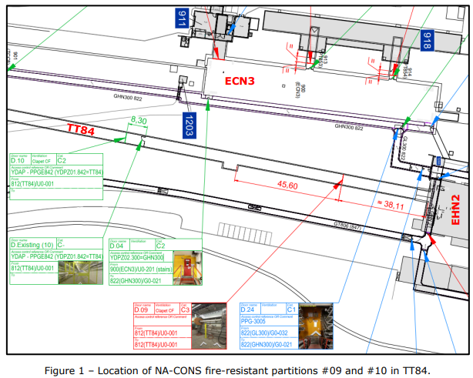
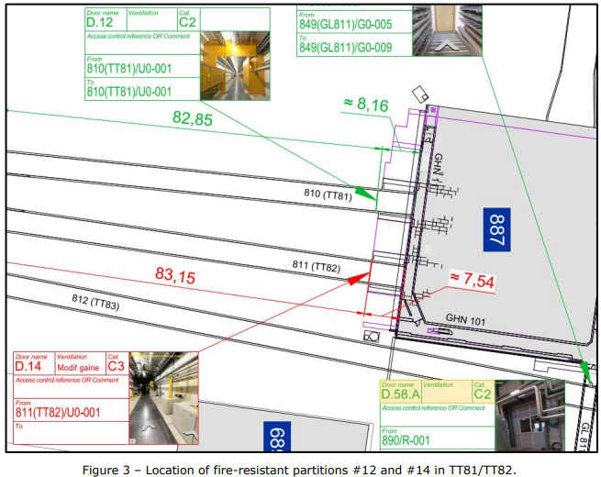
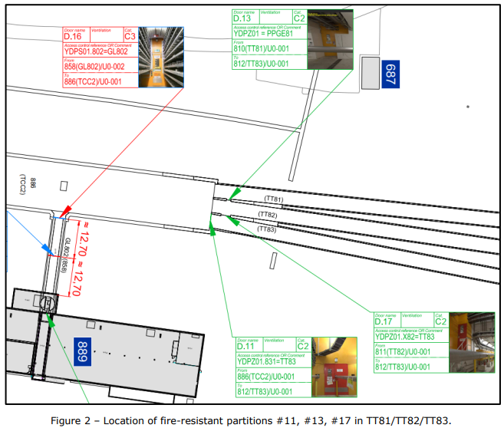
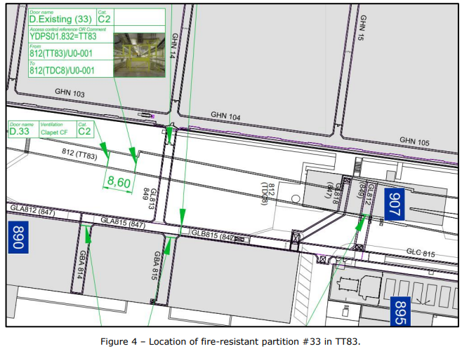
ECR Under Approval
SPSX-SF-EC-0017
Version 0.3
NA-CONS Fire-Resistant Partitions 3 - Partitions #09, #10, #12, #13, #14, #17 and #33
By Adem Kaymak
This ECR describes the installation of 8/39 NA-CONS fire-resistant partitions #09, #10, #12, #13, #14, #17 and #33, together with the necessary frames and ancillaries.
YETS 25/26:
Fire-resistant partition #10
Fire-resistant partition #12
Fire-resistant partition #14
Fire-resistant Partition #33
LS3:
Fire-resistant partition #09
Fire-resistant partition #11
Fire-resistant partition #13
Fire-resistant Partition #17
Door 11
New position approved 10 October
Transport volumes in accordance with EN-HE and survey constraints
Normally open

Slide 14
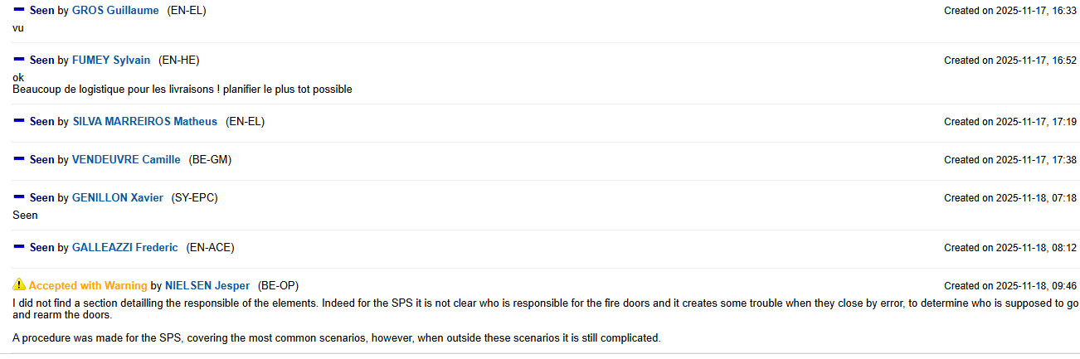
ECR Under Approval
SPSX-SF-EC-0017
Version 0.3
NA-CONS Fire-Resistant Partitions 3 - Partitions #09, #10, #12, #13, #14, #17 and #33
By Adem Kaymak
Seeking approval from EATM

Slide 15
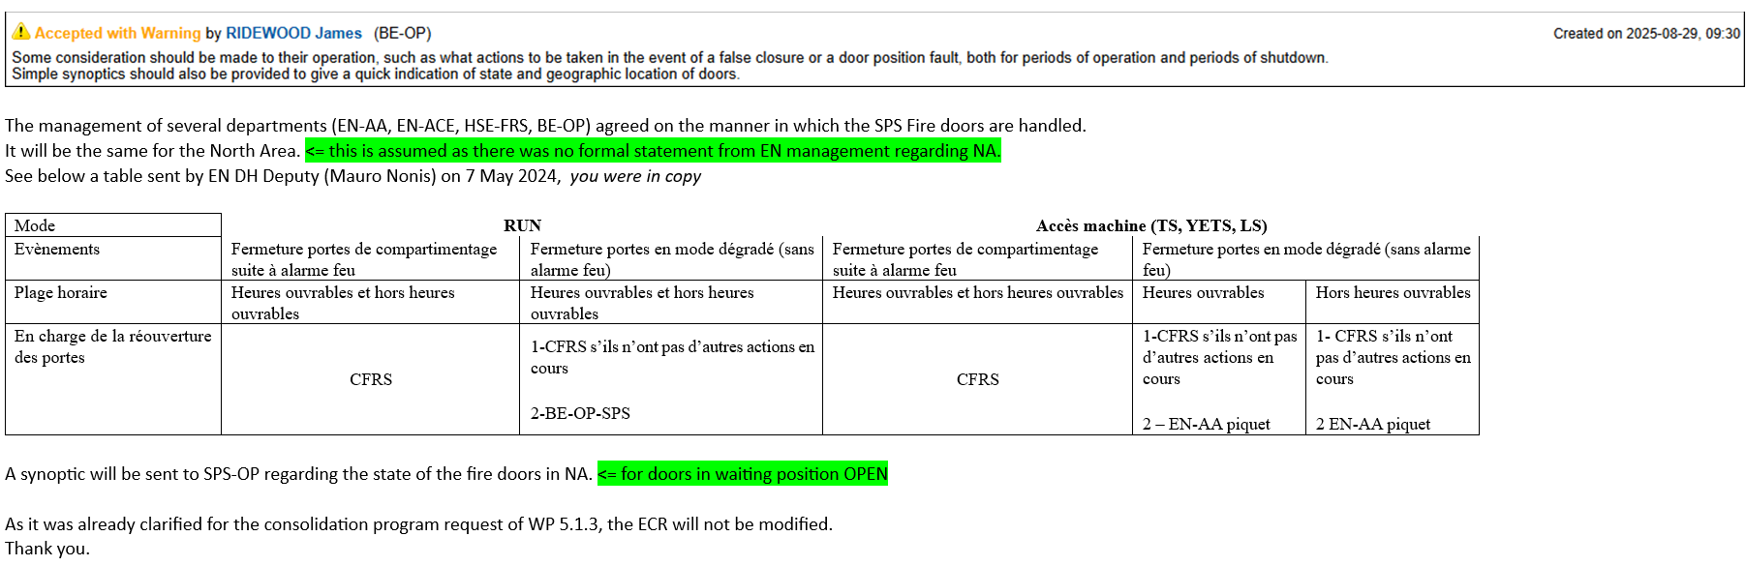
ECR Under Approval
SPSX-SF-EC-0017
Version 0.3
NA-CONS Fire-Resistant Partitions 3 - Partitions #09, #10, #12, #13, #14, #17 and #33
By Adem Kaymak
Seeking approval from EATM

Slide 16
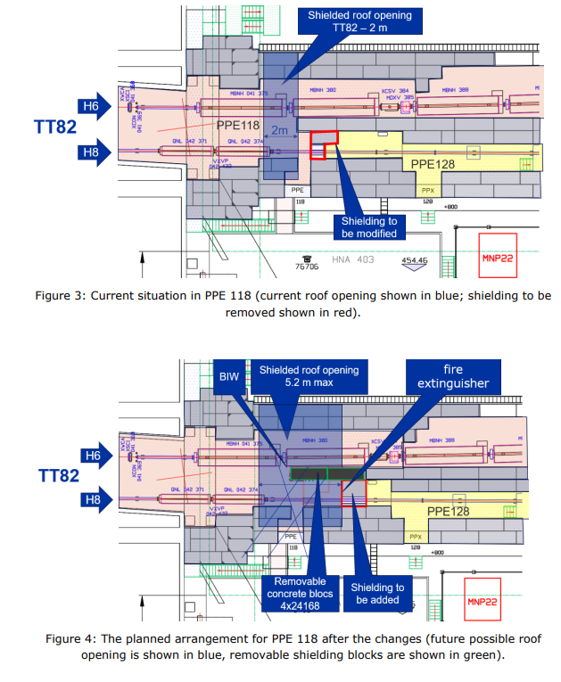
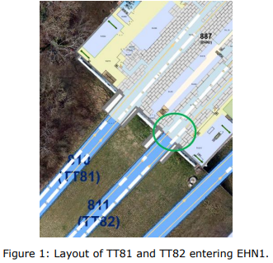
ECR Under Approval
SPSX-J-EC-0014
Version 0.2
PPE118/128 Shielding Modification for Better Crane Access to TT82
By Sylvain Girod
This ECR describes the proposed changes to the shielding in PPE118 and PPE128 in order to improve crane access to TT82.
PPE 118
Separation shielding shifted downstream by 2.4 m
Fire extinguisher and sign moved 3 m away
Emergency exit sign added
BIW alarm mounted on independent steel support
PPE 128
Separation shielding shifted downstream by 2.4 m
Crome monitor moved by 50 cm

Slide 17
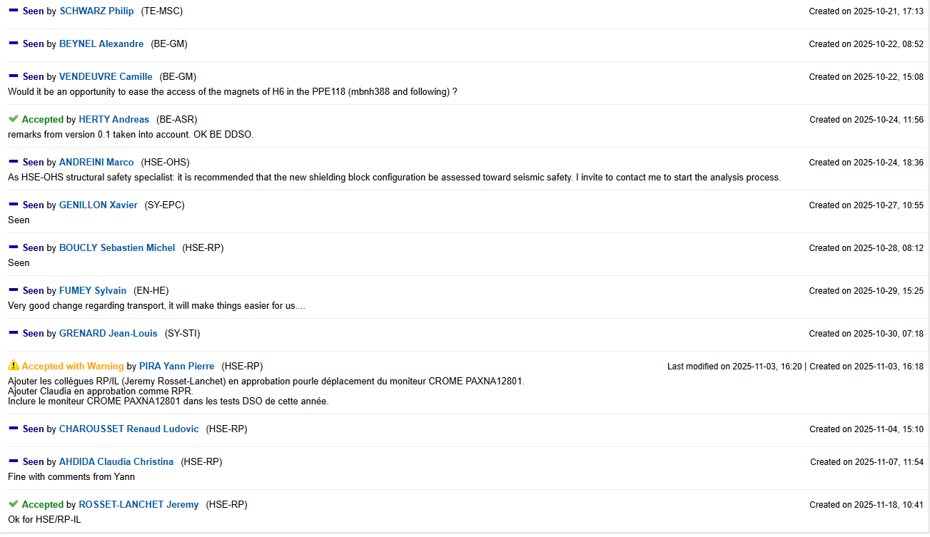
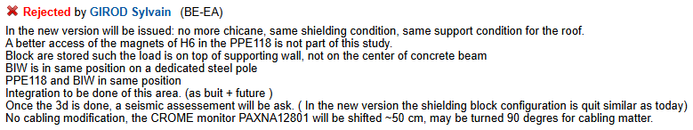
ECR Under Approval
SPSX-J-EC-0014
Version 0.2
PPE118/128 Shielding Modification for Better Crane Access to TT82
By Sylvain Girod
EN-AA approval requested
Seeking approval from EATM

Slide 18
Thank you!

