Slide 1
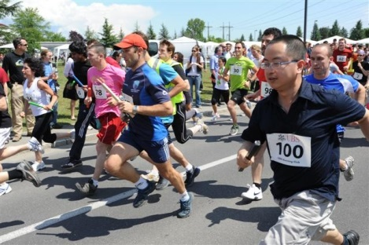
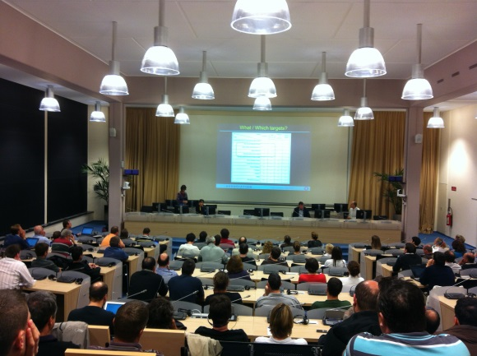
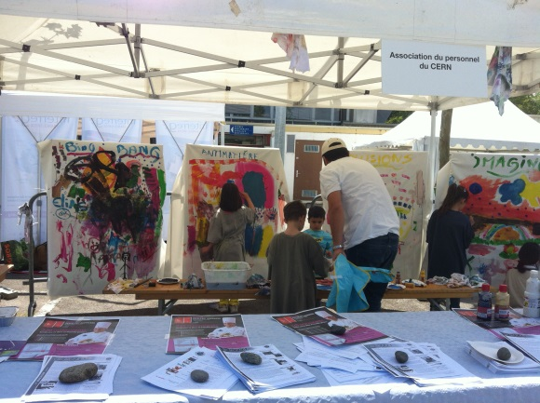
Welcome!
Staff Association

Slide 2
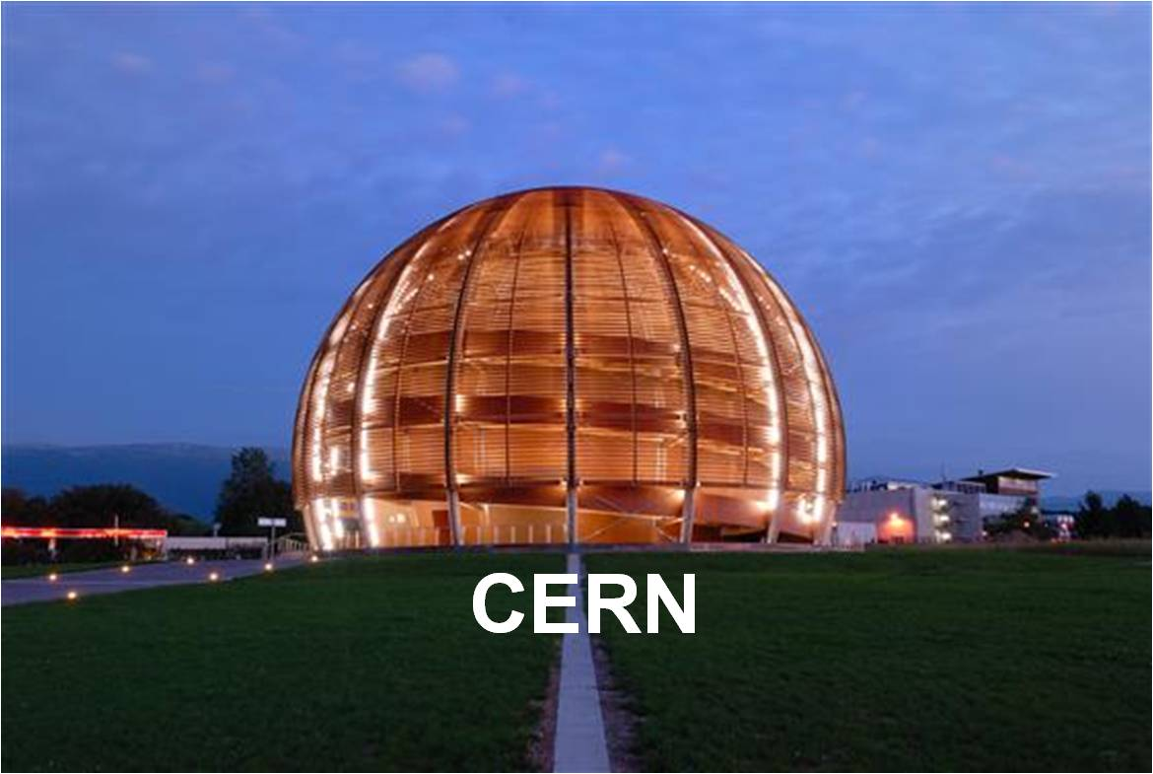
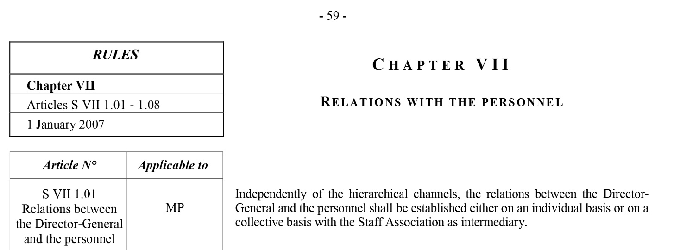
Specific legal framework
Member States
DG
Staff Association

Slide 3
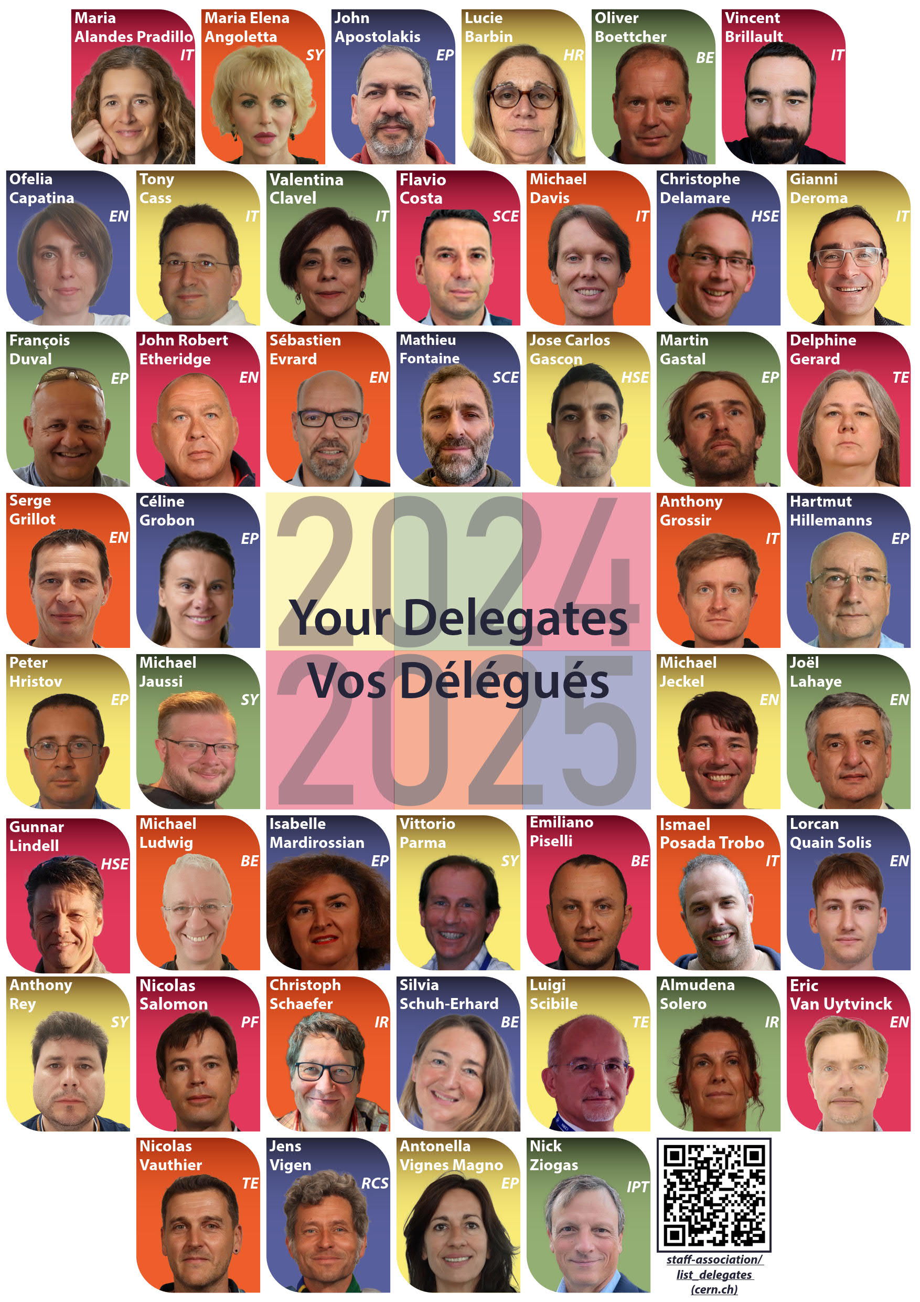
Your delegates
More information on your staff representatives:
https://staff-association.web.cern.ch/fr/list_delegates

Slide 4
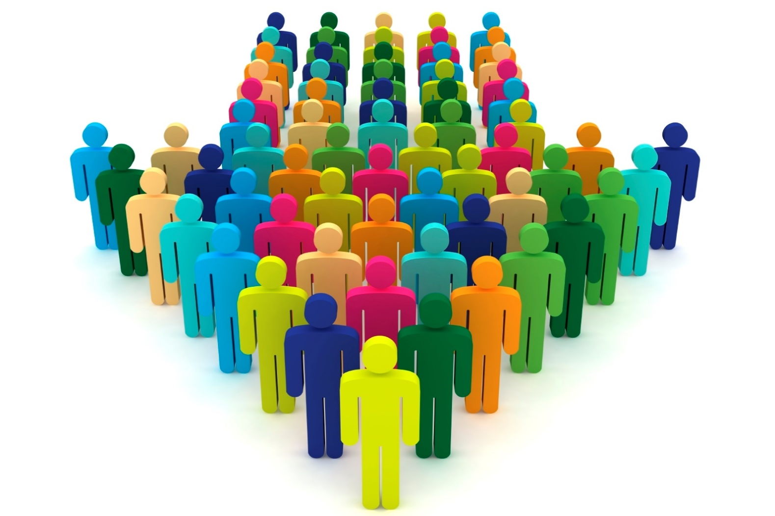
Represent you
The Staff Association, via its delegates, represents collectively all members of personnel of the Organization before the Director-General and Member States. No other body can represent personnel at CERN in the sense of the Staff Rules and Regulations.
To do this, staff representatives actively take part in the different committees, commissions, and joint bodies. Thus the Staff Association takes part in all types of discussions and always acts in the interest of the staff.
https://staff-association.web.cern.ch/you-association/represent-and-defend

Slide 5
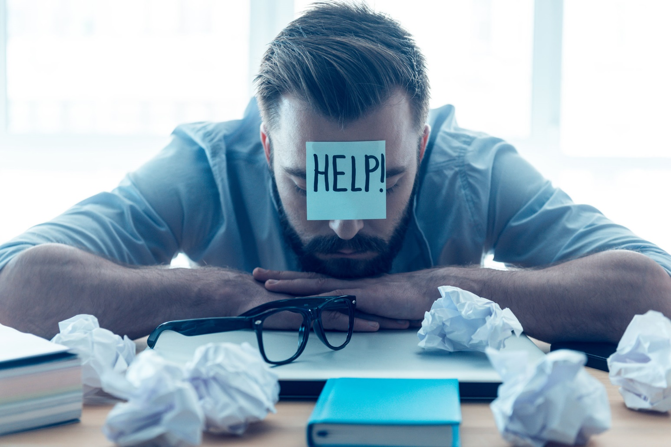
Defend you
The Staff Association can provide individual advice and assistance to its members in their disputes the Organization. A professional career is not always a bed of roses and, in certain situations, assistance is welcome.
https://staff-association.web.cern.ch/represent-and-defend/assistance-and-advice

Slide 6

Facilitate your integration
More than 40 clubs…
https://staff-association.web.cern.ch/unite/clubs

Slide 7

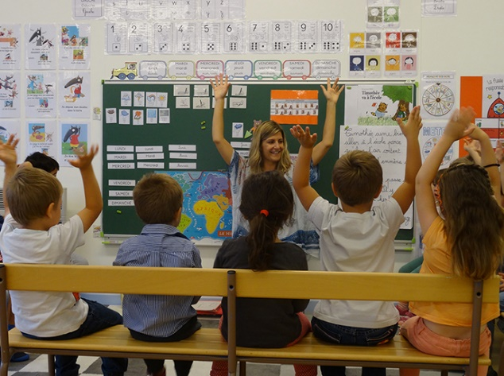
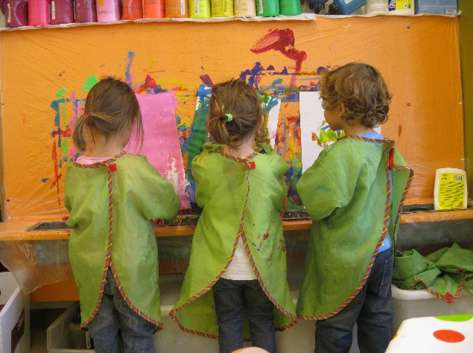
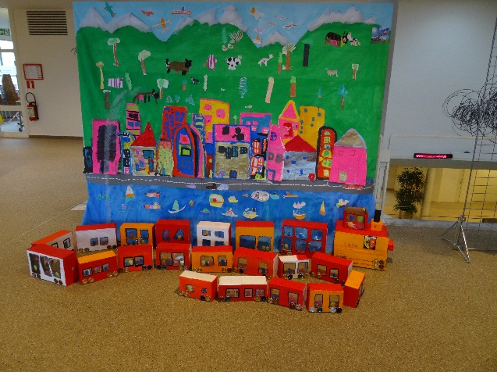
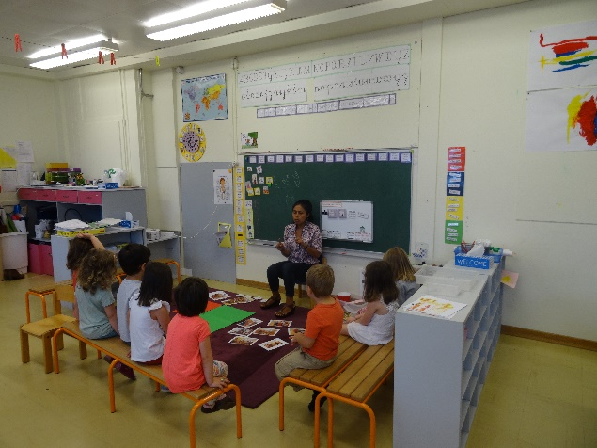
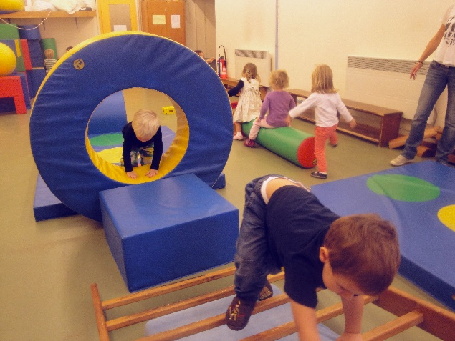
Facilitate your integration
Le Jardin des Particules
for children from 4 months to 7 years old
https://nurseryschool.web.cern.ch/

Slide 8
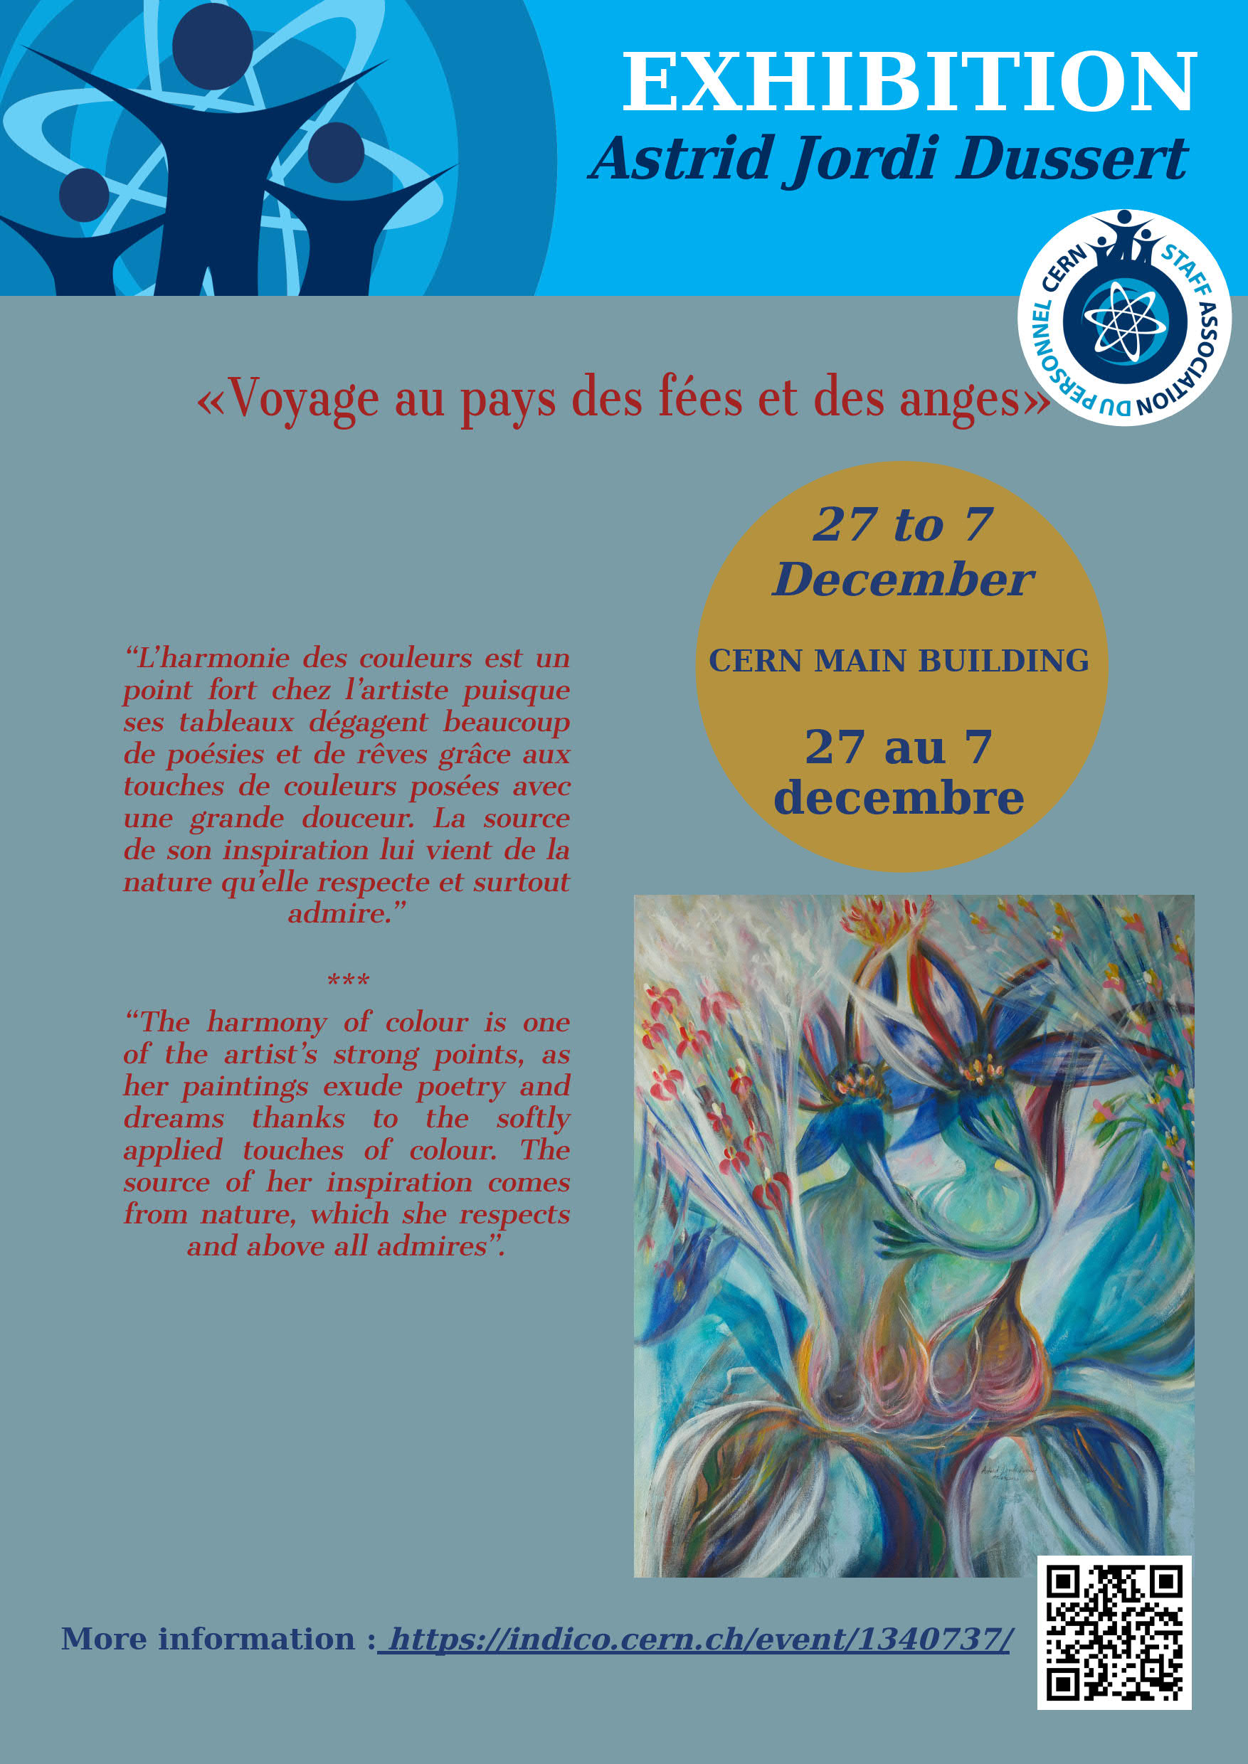


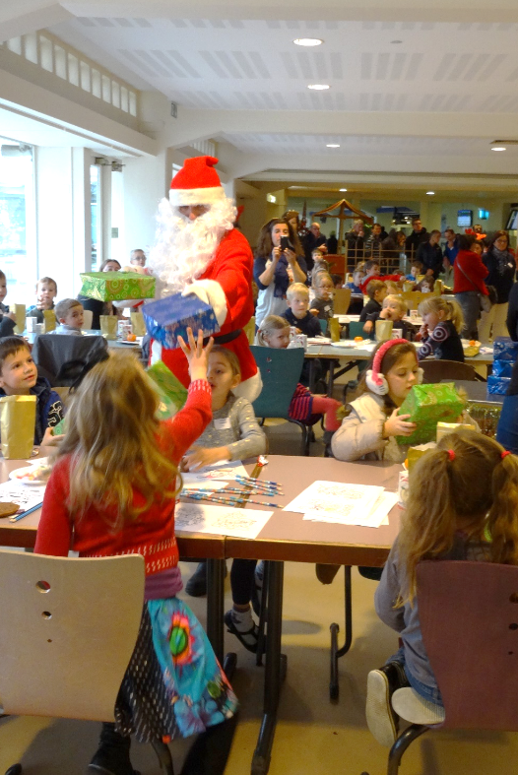
Facilitate your integration
Socio-cultural activities

Slide 9

Keeping you informed
Our bimonthly bulletin
Our public meetings
Our website: http://staff-association.web.cern.ch/
Your delegates in each Department: https://staff-association.web.cern.ch/fr/list_delegates
Mattermost: https://mattermost.web.cern.ch/staff-association
Secretariat :  Staff.Association@cern.ch
   74224
  Building 64-R-010

Slide 10





Join us!
  Membership on a voluntary basis
  Annual contribution fee LD, Fellow, Graduates, MPA:
  50 CHF/year
  Opportunity to subscribe to the Insurance against loss of salary
  Many discounts from our partners:
http://staff-association.web.cern.ch/

Slide 11
Come and
meet us!

