Slide 1
CERN Croquet Club & Lawn Bowls
Not Just Croquet but THREE Ball Games offered by One Club
Croquet, Gateball, Lawn Bowls
All played on one field with one Club House
https://cerncroquetclubgeneva.com/
Many of you will probably have played Croquet as a garden game but here in CERN we play on a large (32 * 25.6 meters) ‘Wimbledon type lawn’ with the grass cut very low, and level, enabling the balls to run without hindrance.
Similar requirements are necessary for Lawn Bowls and Gateball although not over such a large surface area.
Basic skill requirement in all three sports is the ability to hit or throw a ball at a target which is at varying positions and distances each time.
The rules and tactics however are very different.

Slide 2
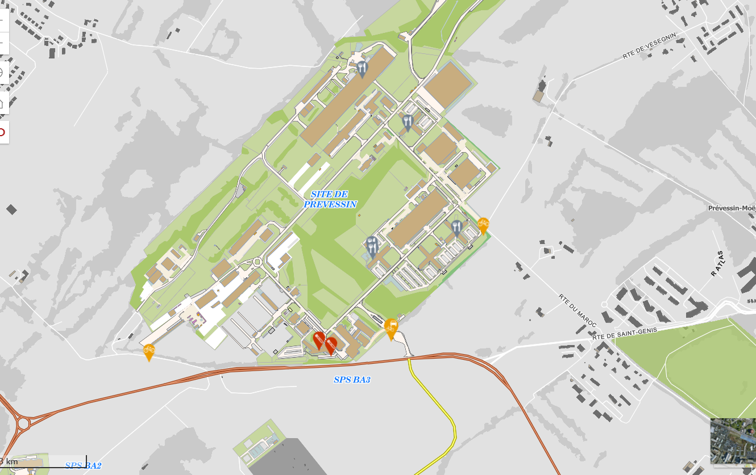
CERN Croquet Club
CERN Prevessin Site

Slide 3
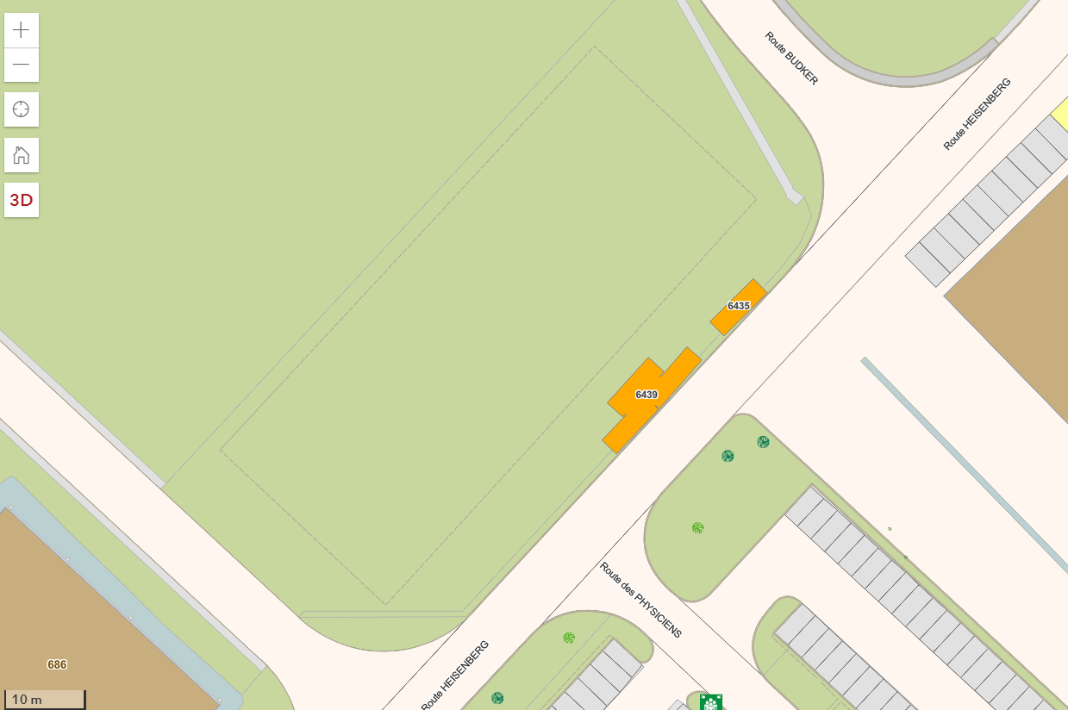
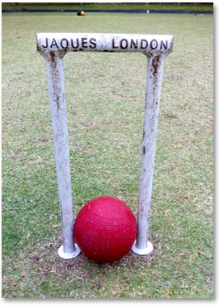
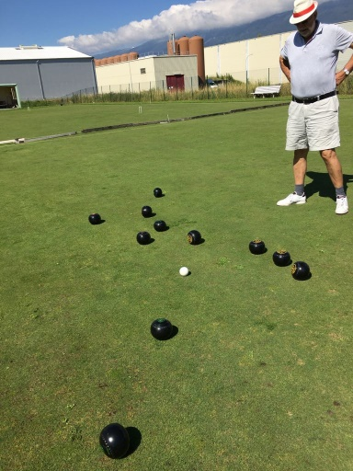
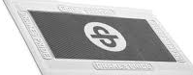
CERN Croquet Club
28m
35m
Croquet Lawn
Lawn Bowls
Club House
Gateball

Slide 4
The Lawns
Created in the Nineties when ordered to stop playing in front of Restaurant 1, a new site was offered on the Prevessin site, where we have stayed ever since.
Ensured that the playing surface and was sown with strong hardy sports grass.
Automatic watering system ensures that the grass is kept in good condition.
Unfortunately CERN access restrictions during Covid has resulted in a deterioration but with the assistance of professionals, is now close to complete restoration.
We look forward to accessing them next week and playing once more.
Hopefully welcoming many of you to our lawns

Slide 5
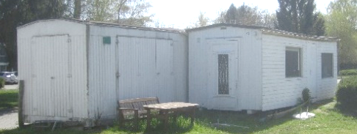
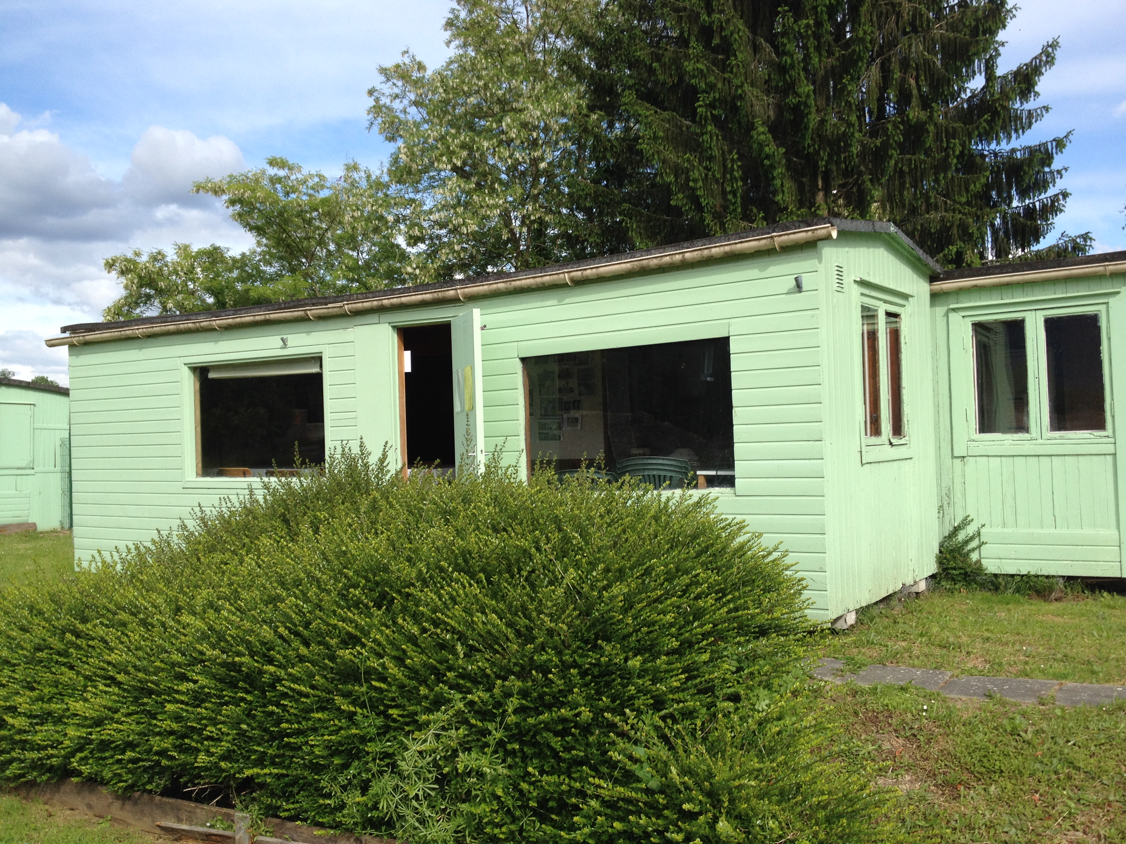
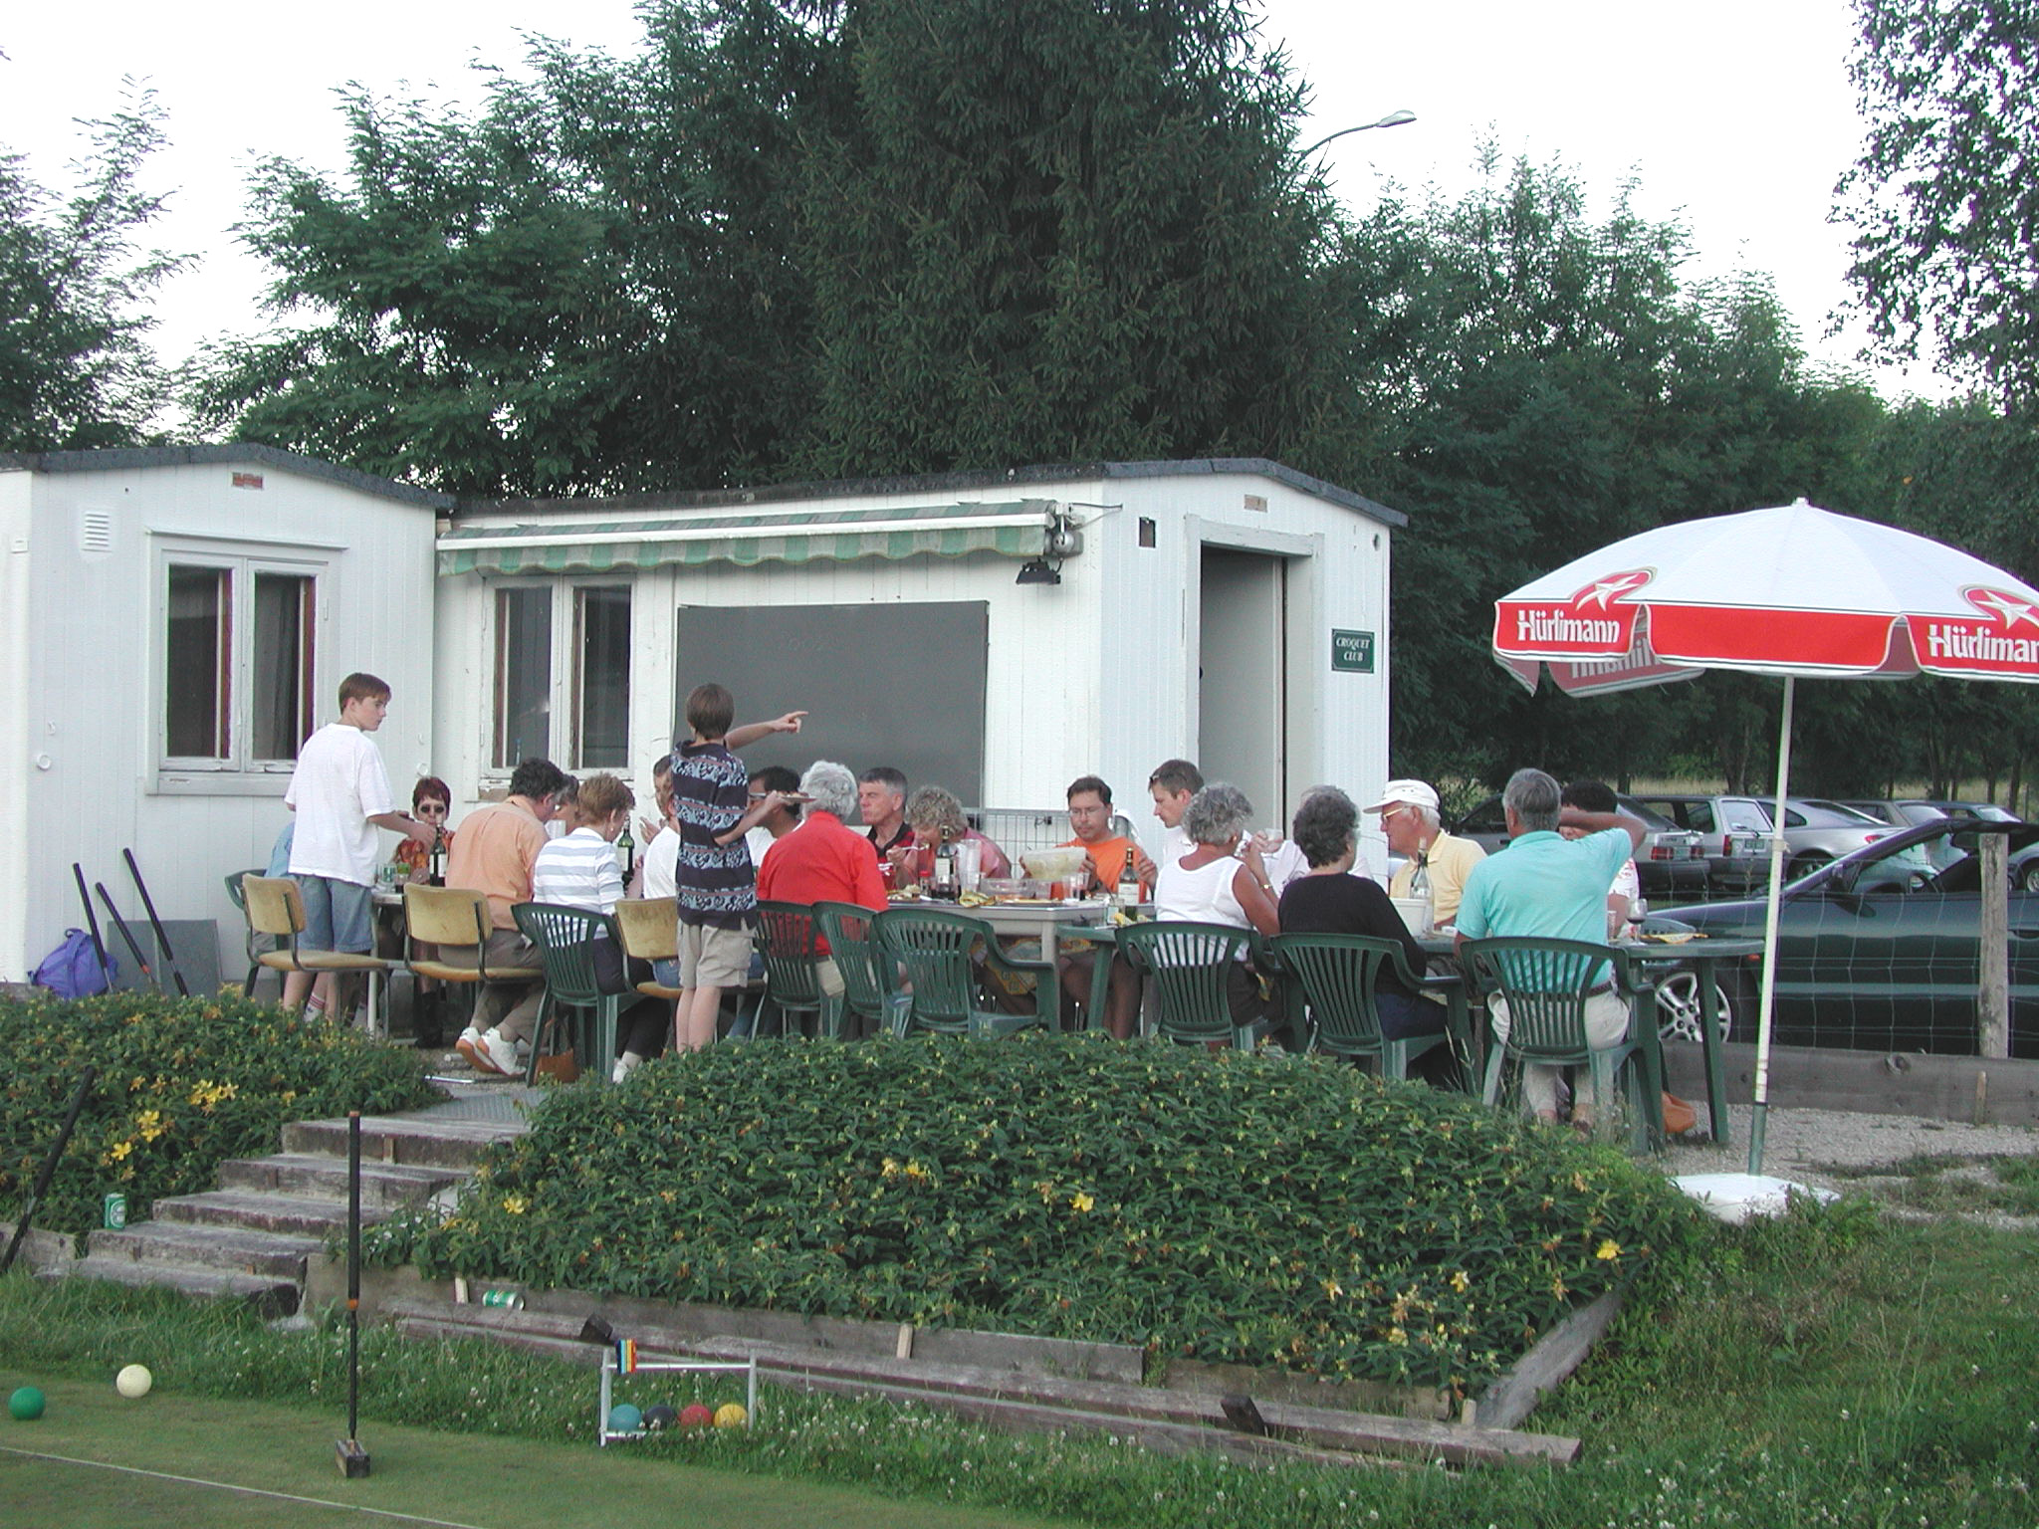
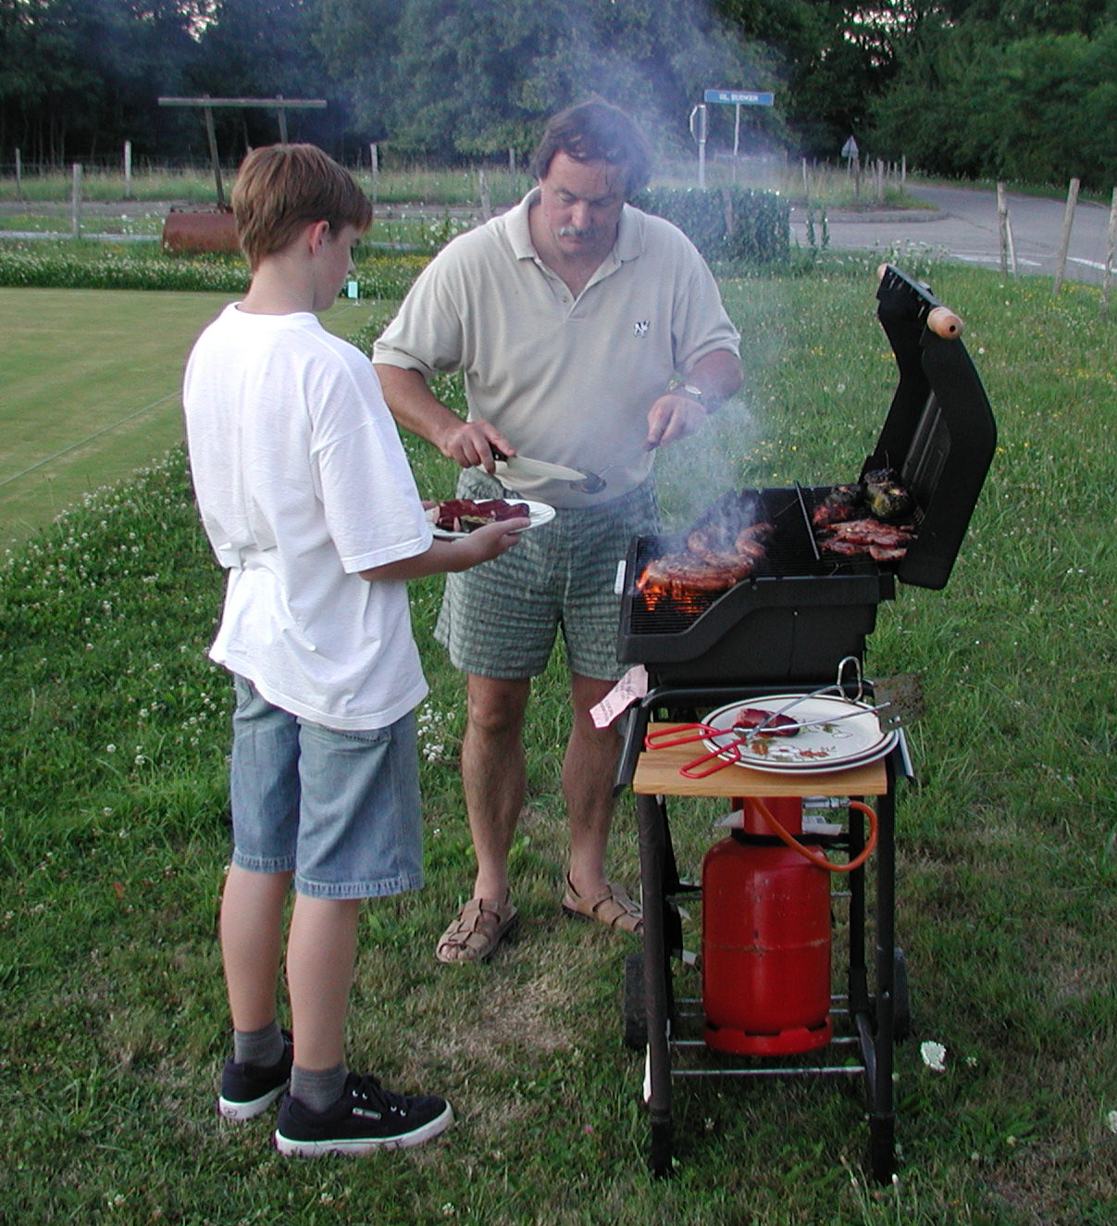
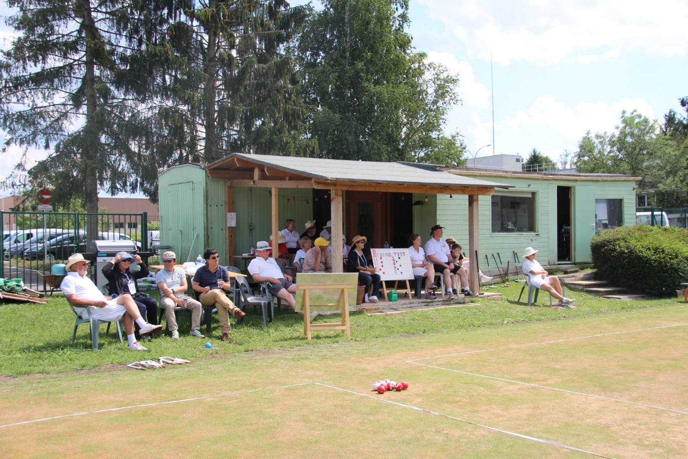
The Club House
Saved from destruction in the nineties, three cabins were converted into the Club House.
Now in need of repair but still functional and appreciated by members and visiting players.
Fully equipped with two fridges, washing facilities, changing room and BBQ area.
Ideal for ‘Team Building’ activities, please mention to your Section Leaders.
We can provide assistance at such events.

Slide 6
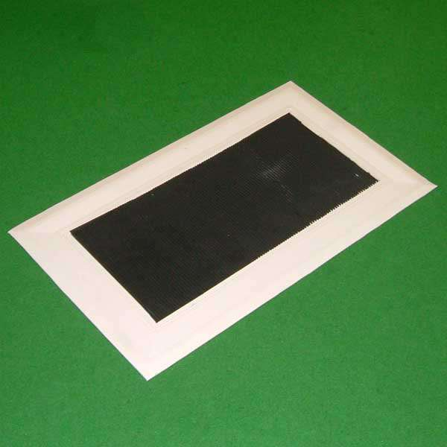
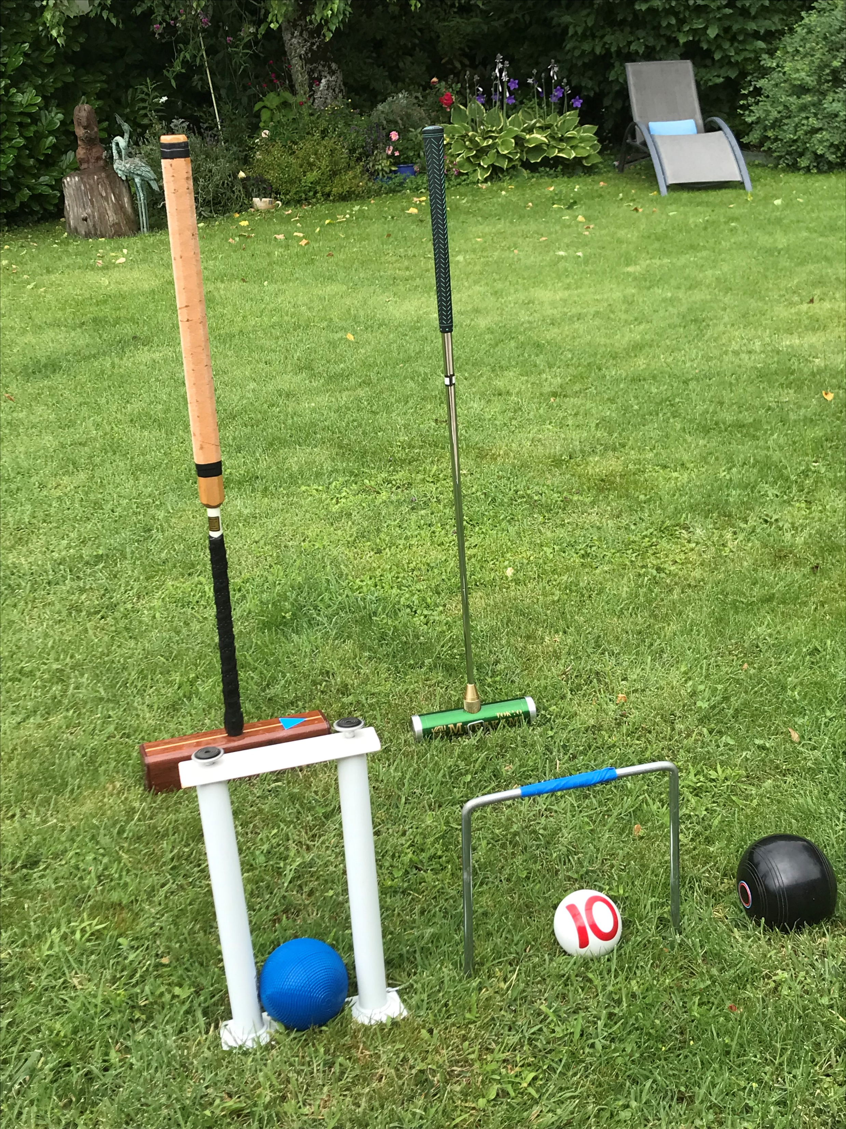
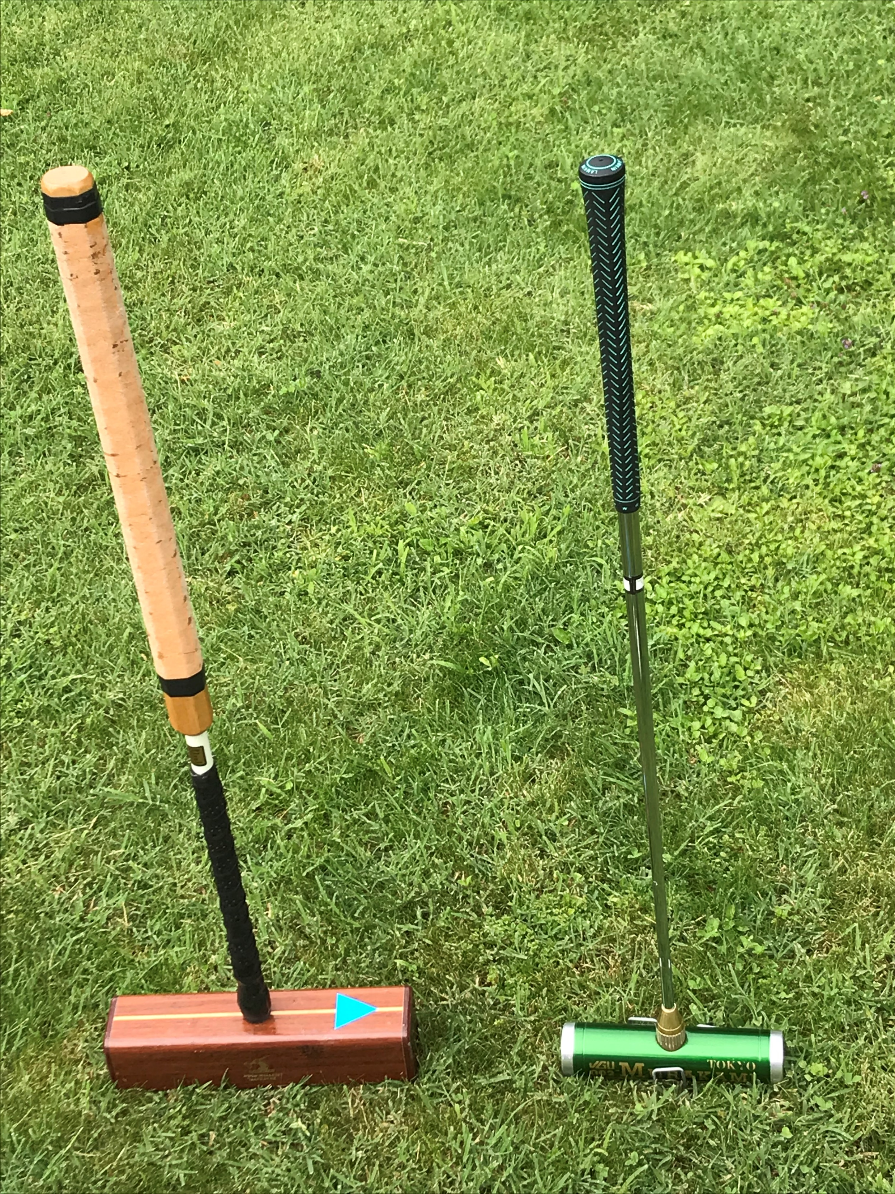
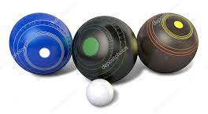
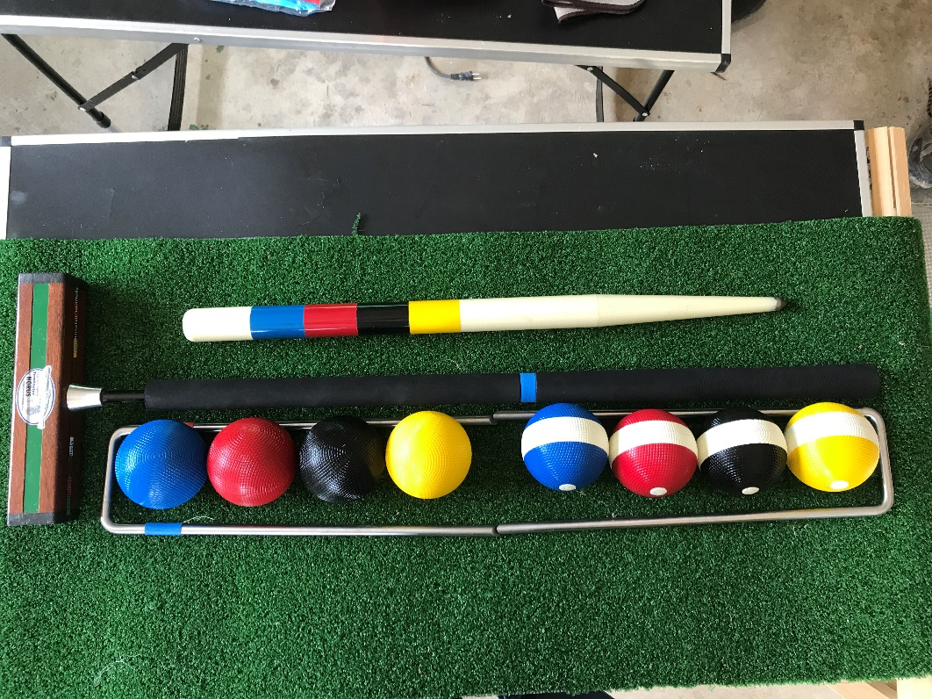
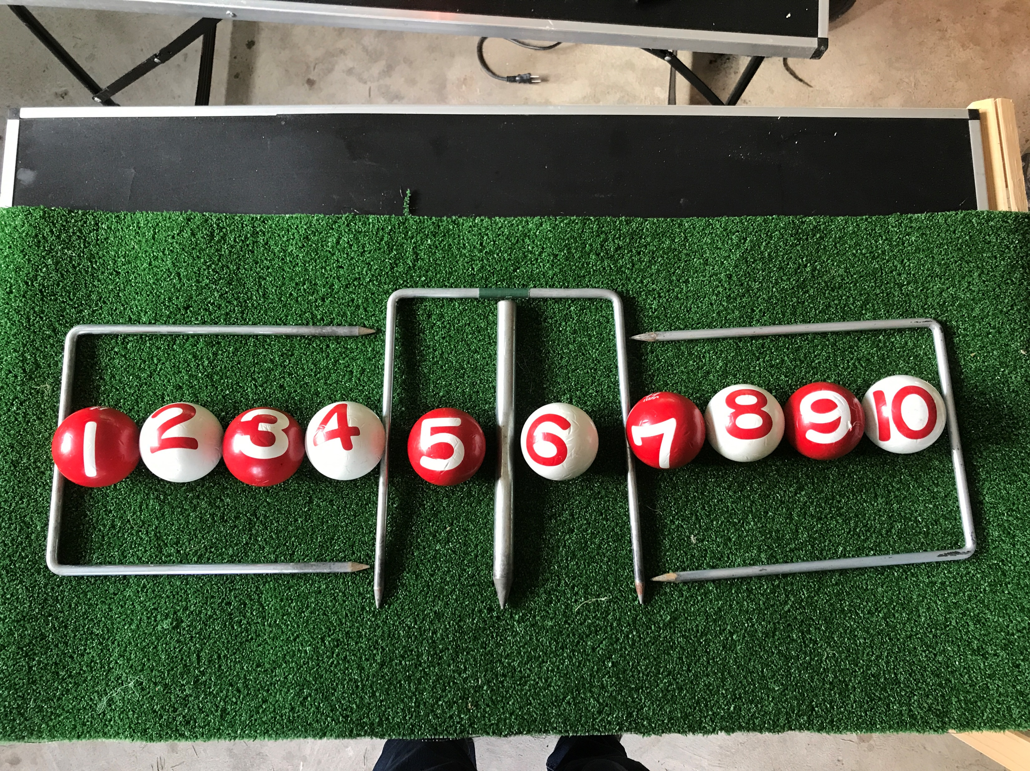
Croquet Gateball Lawn Bowls
Equipment
All equipment required to play the three sports is available at the Club House
You are only required to wear flat soled shoes

Slide 7
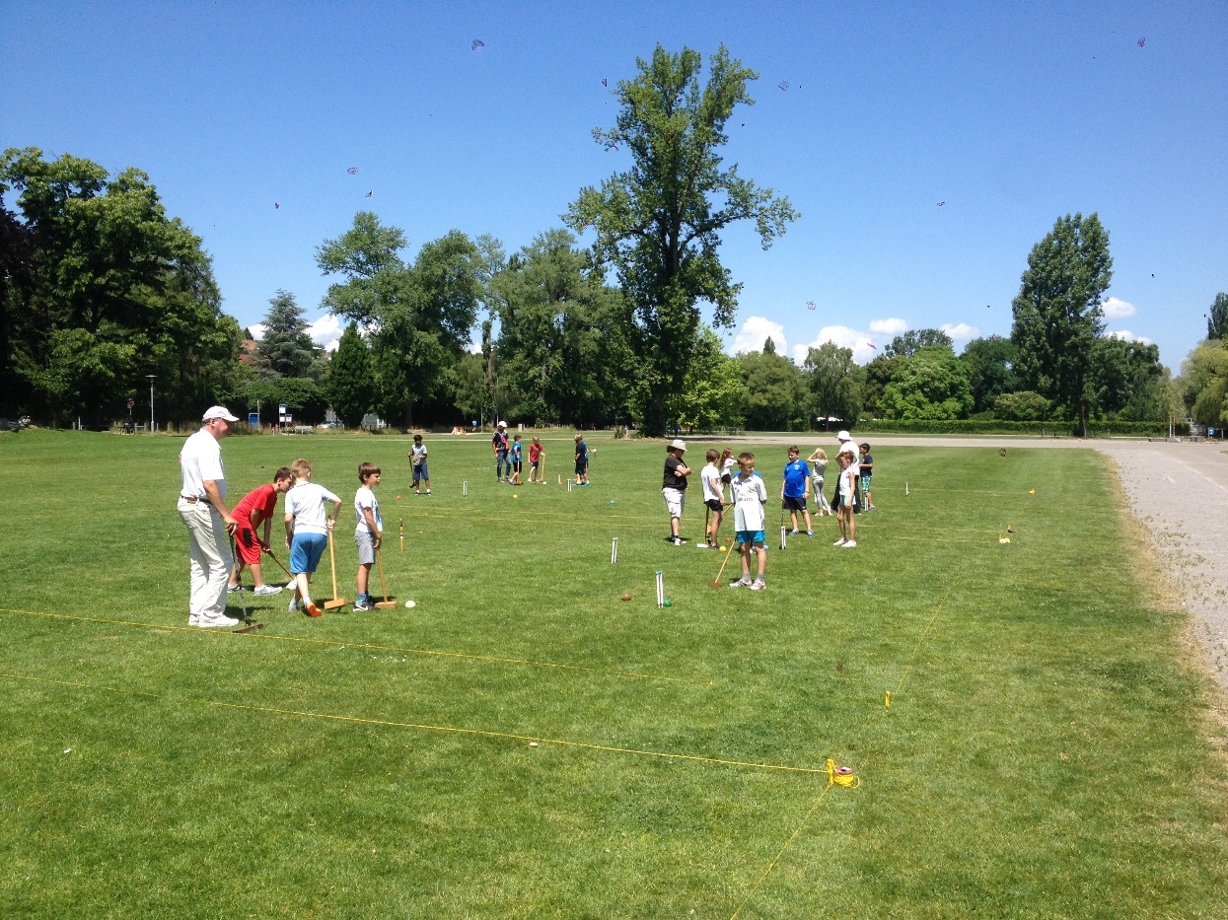
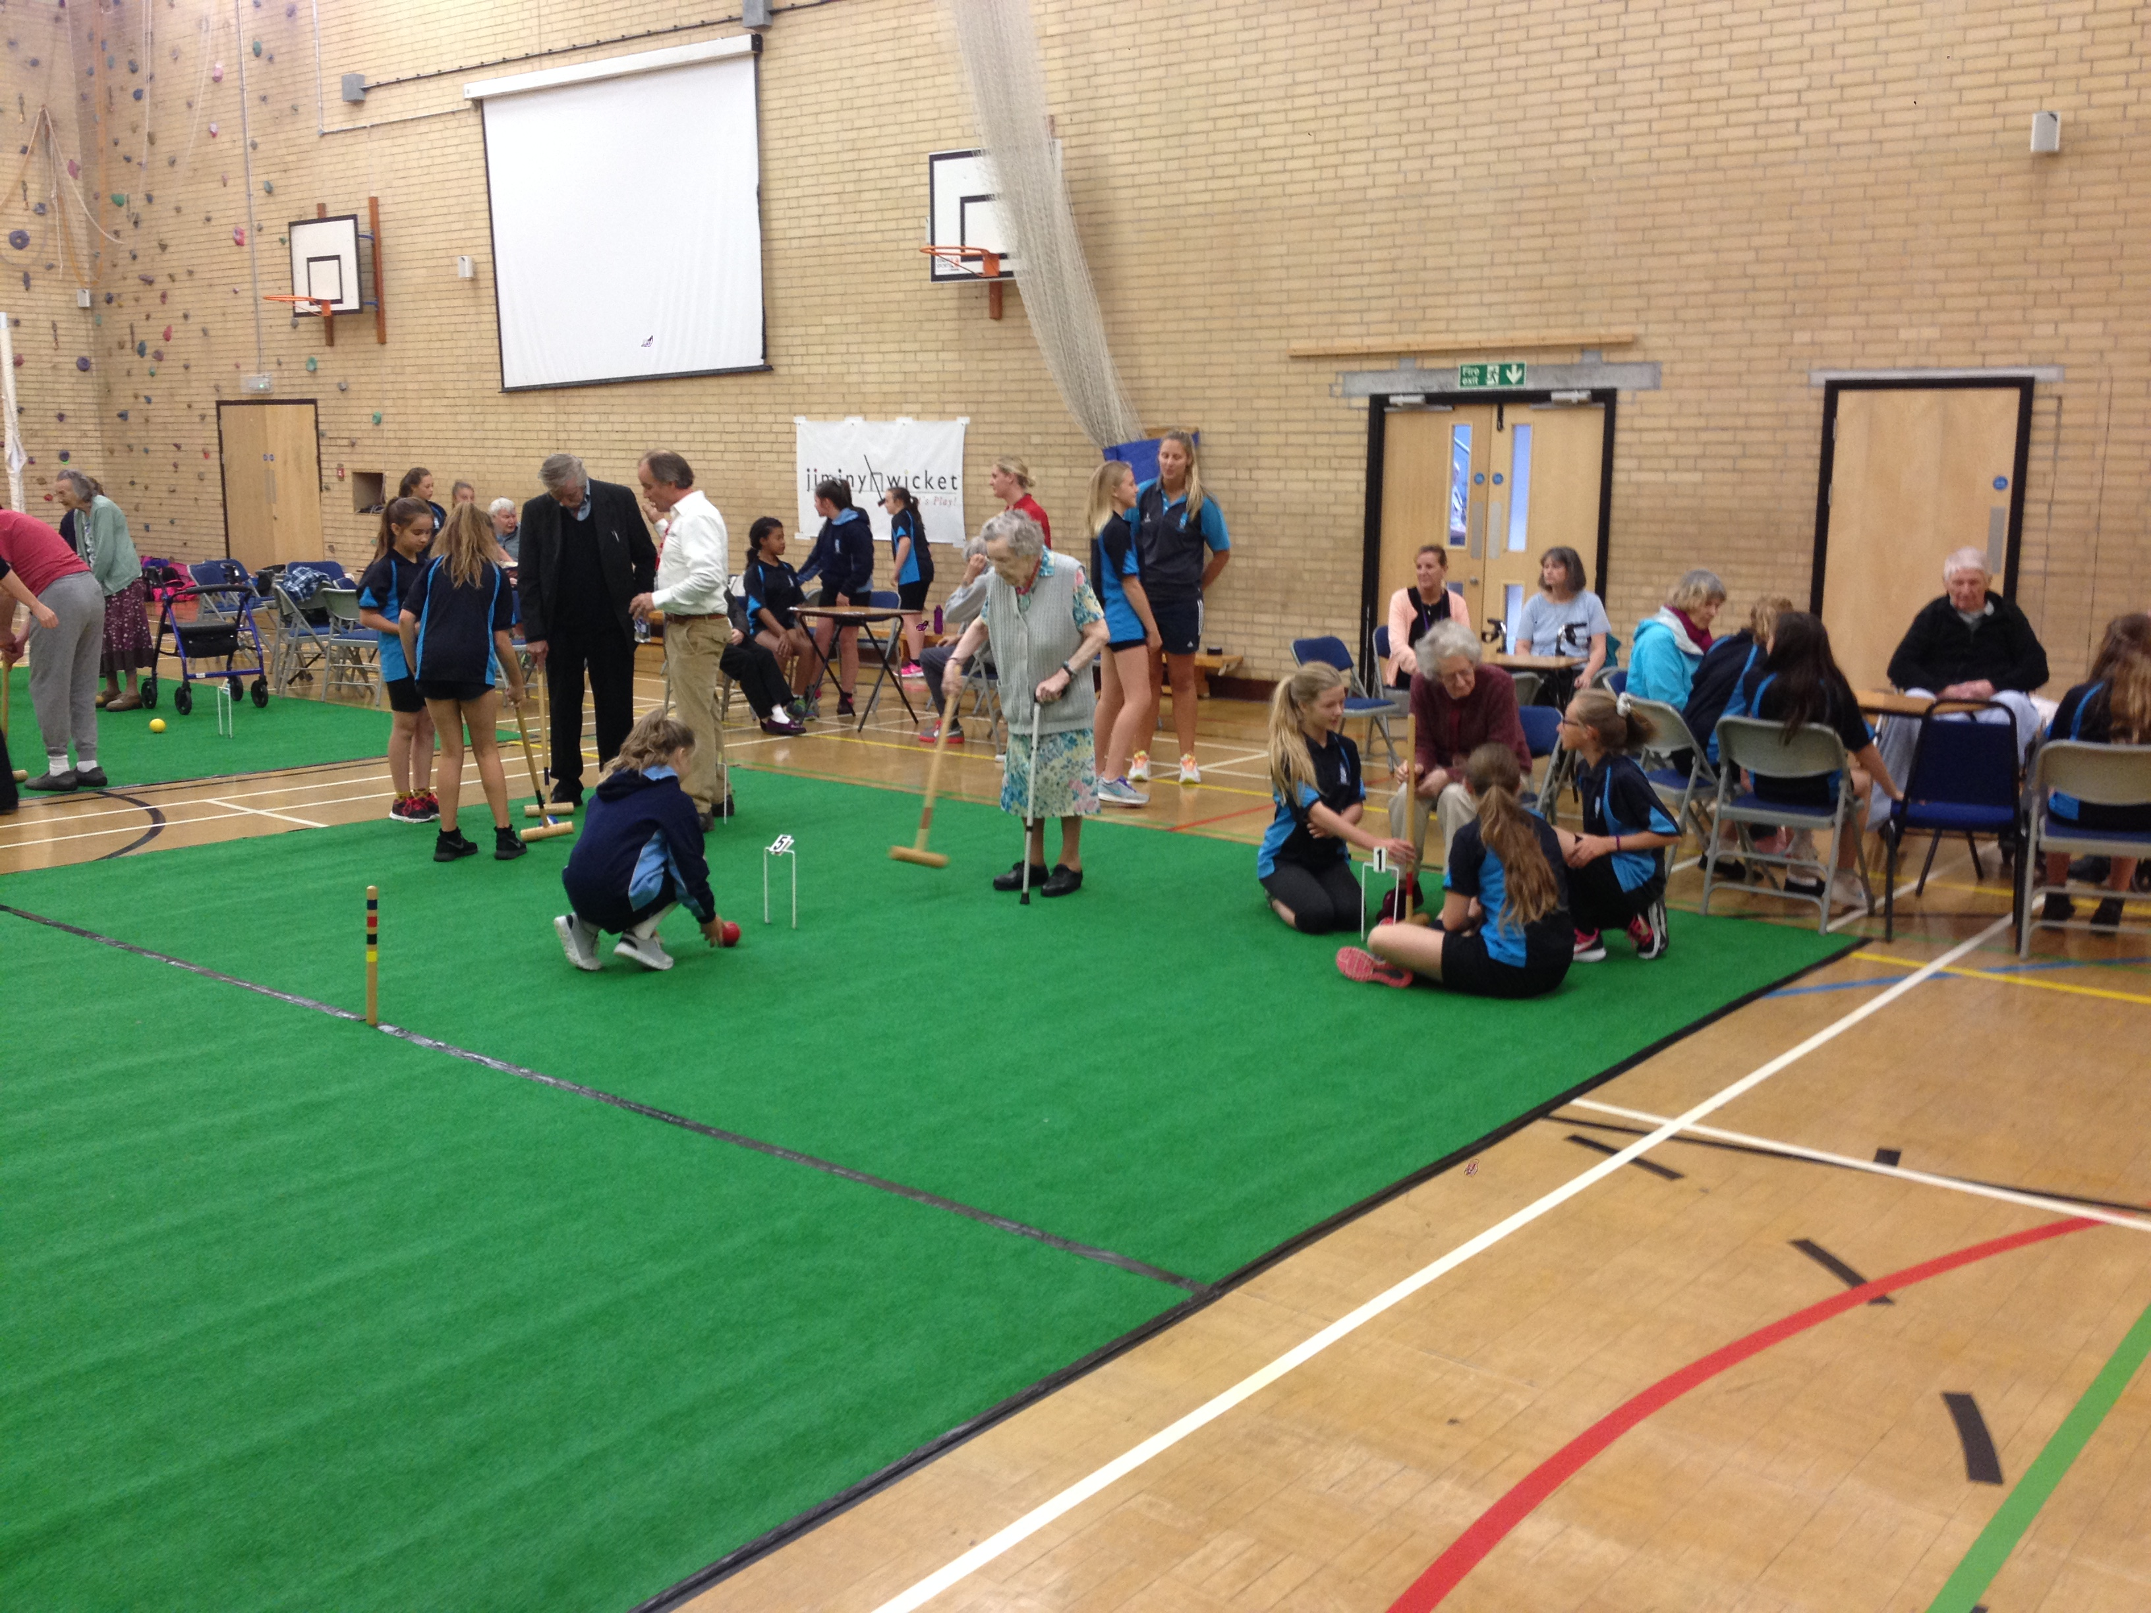
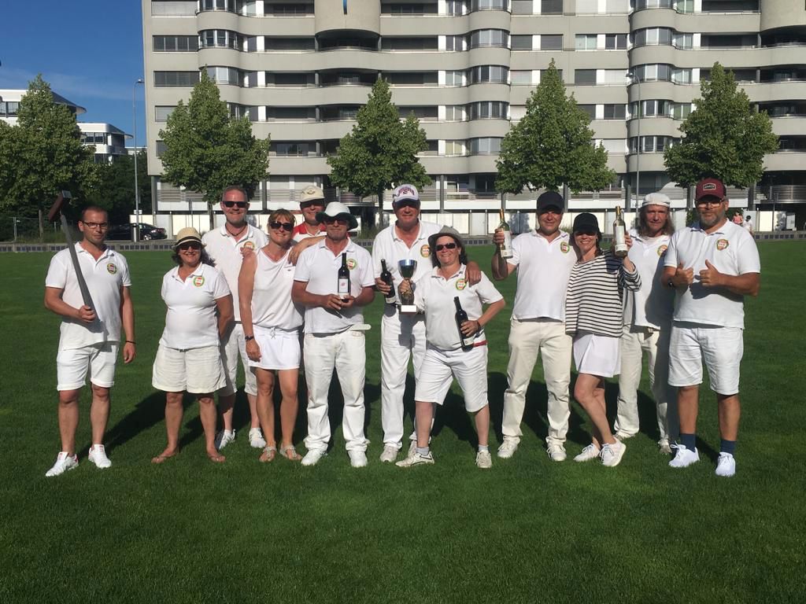
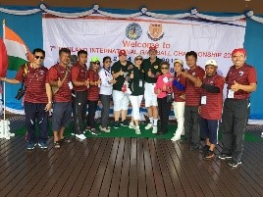
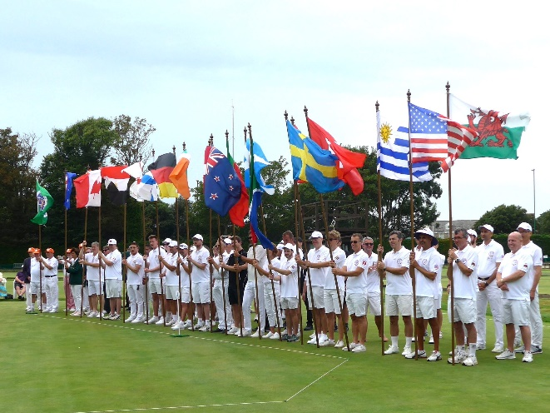
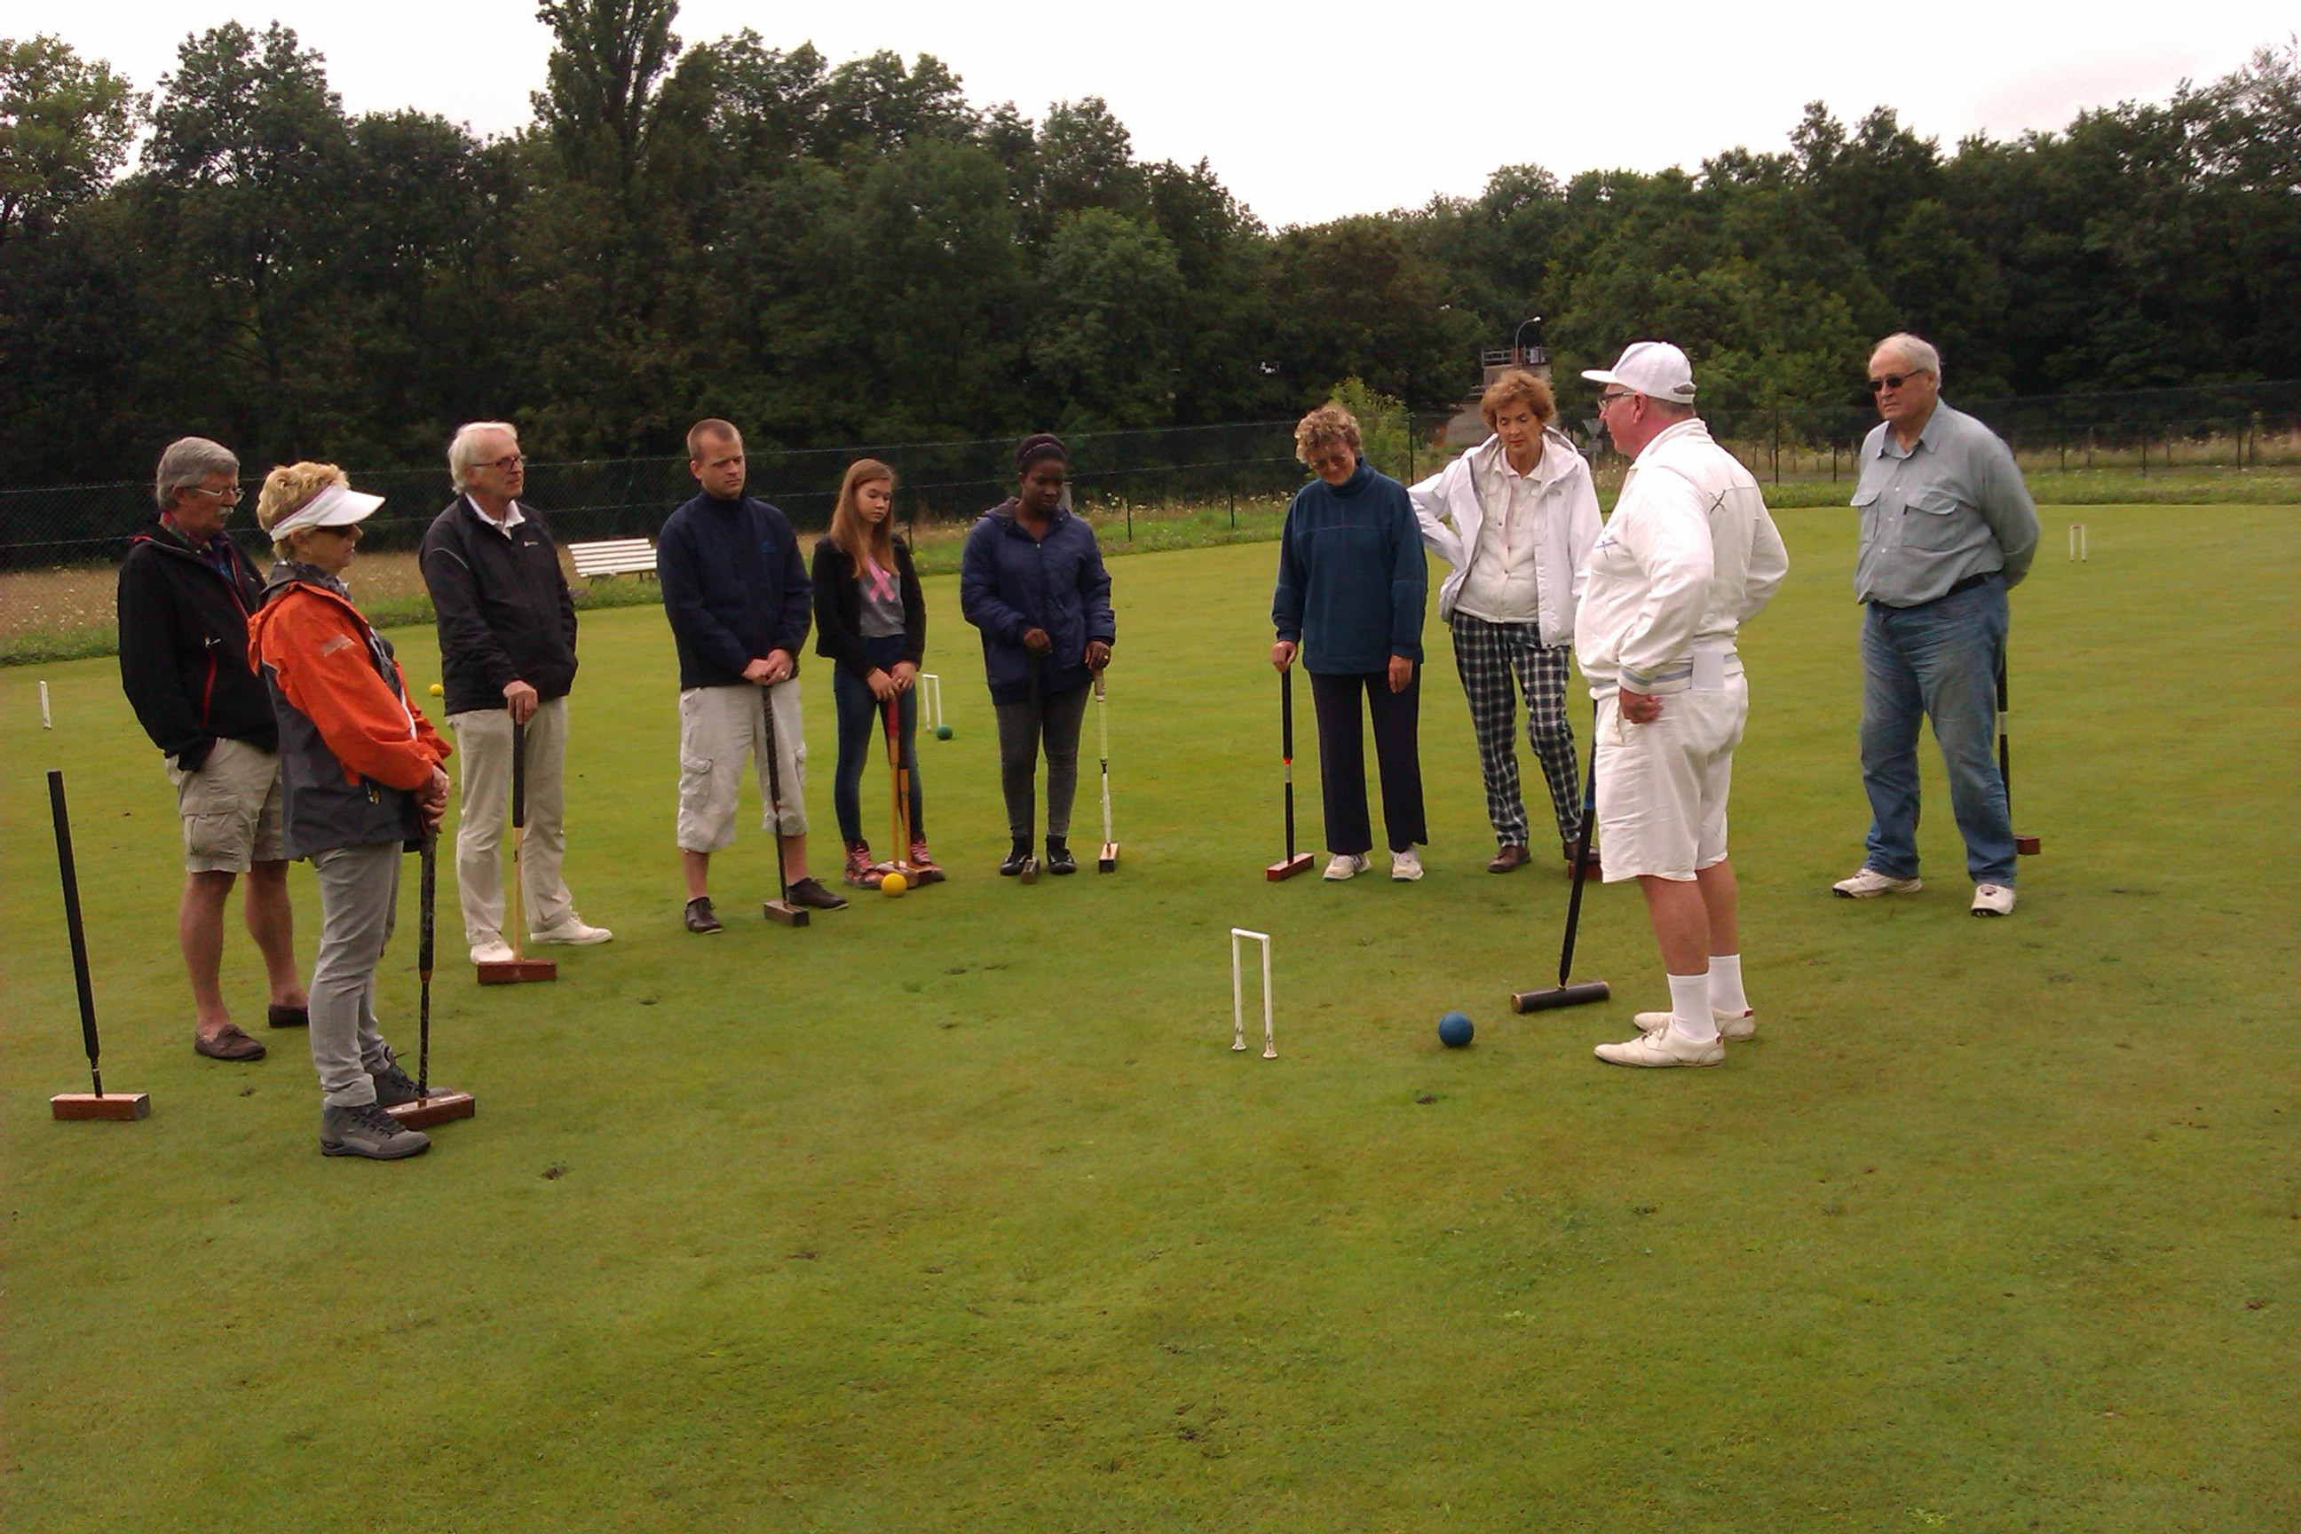
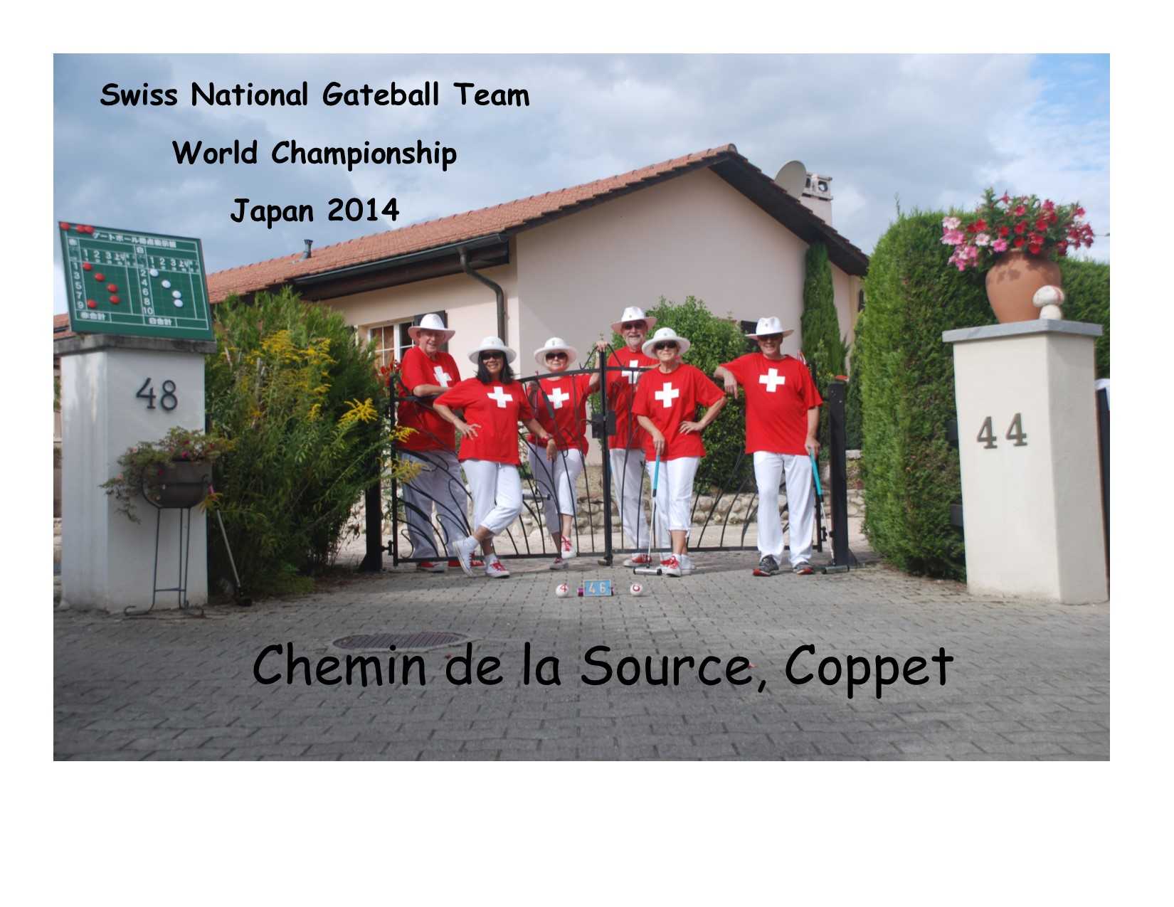
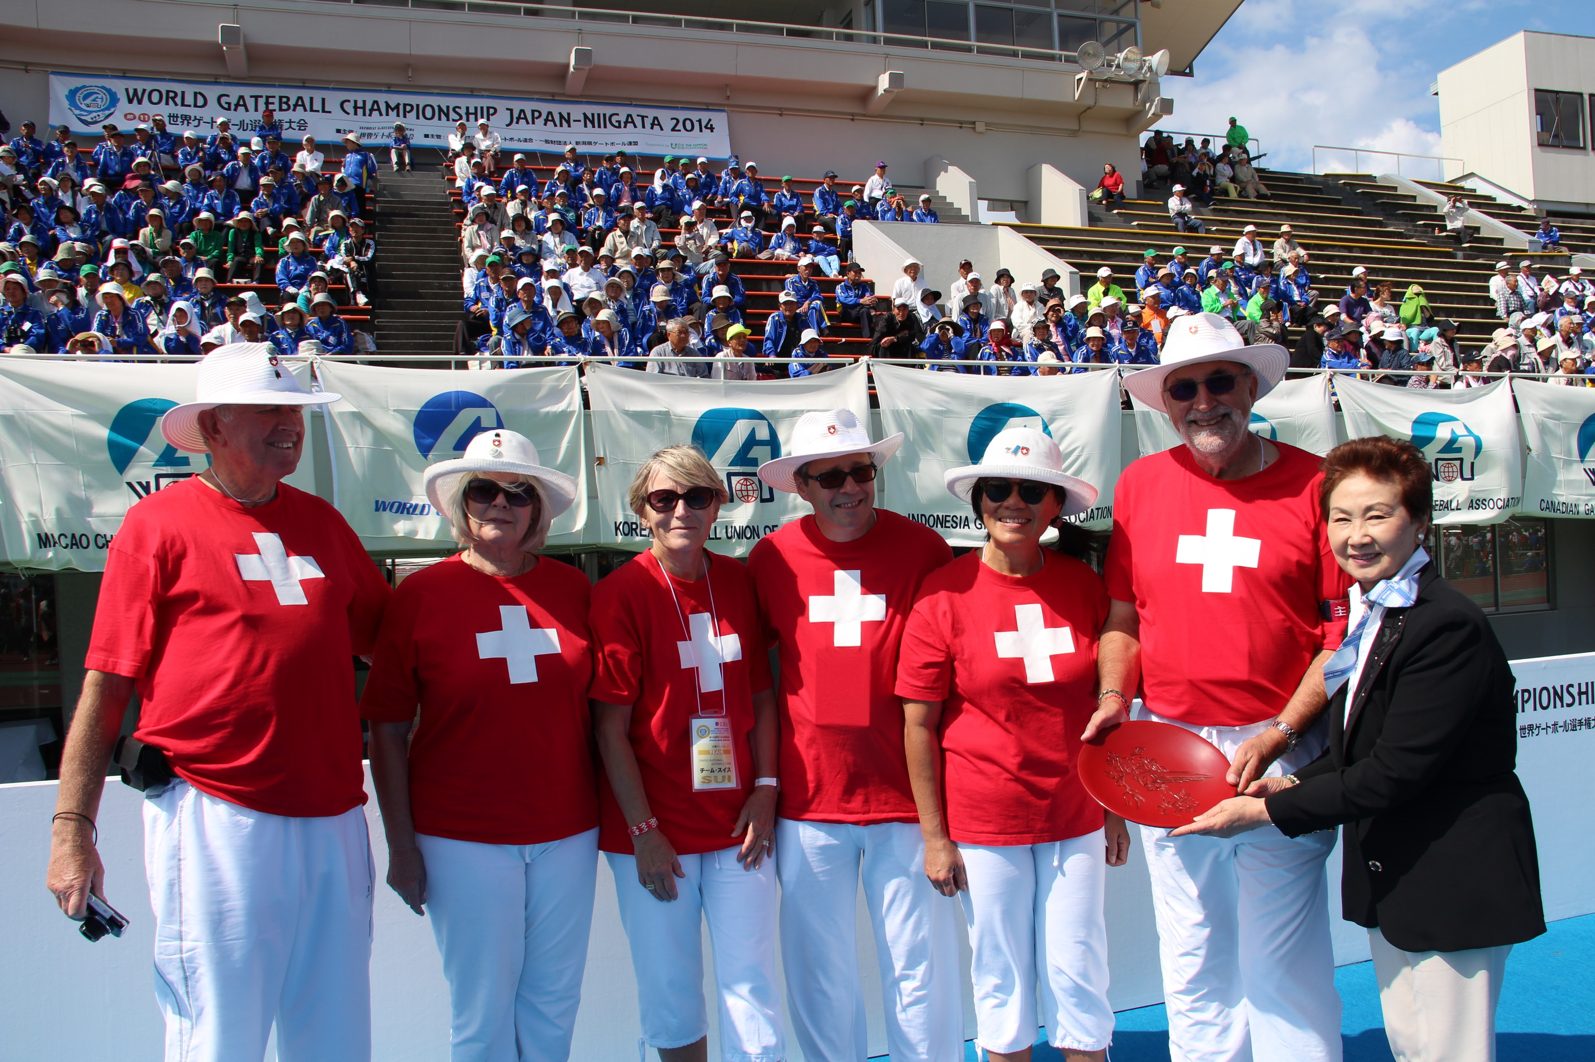
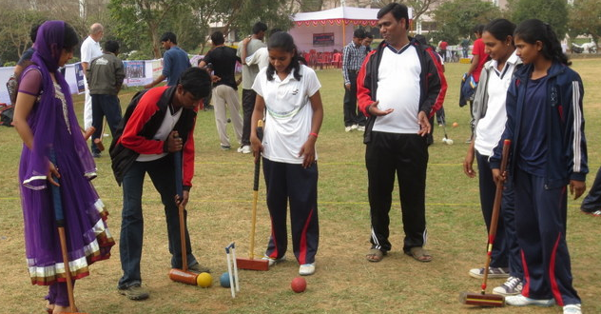
These Sports are for All
Ages:
Abilities:
Sexes:
Nationalities:
Levels:
Coaching :

Slide 8
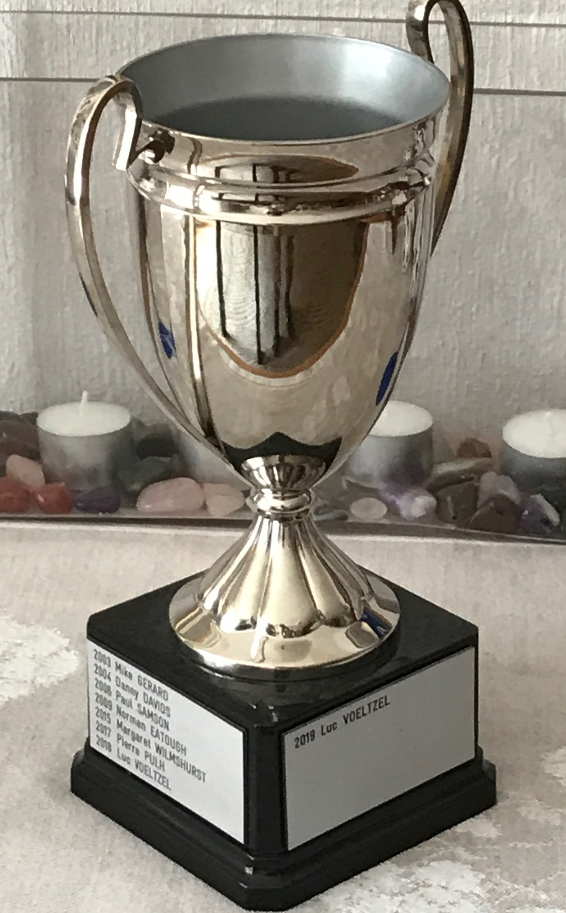
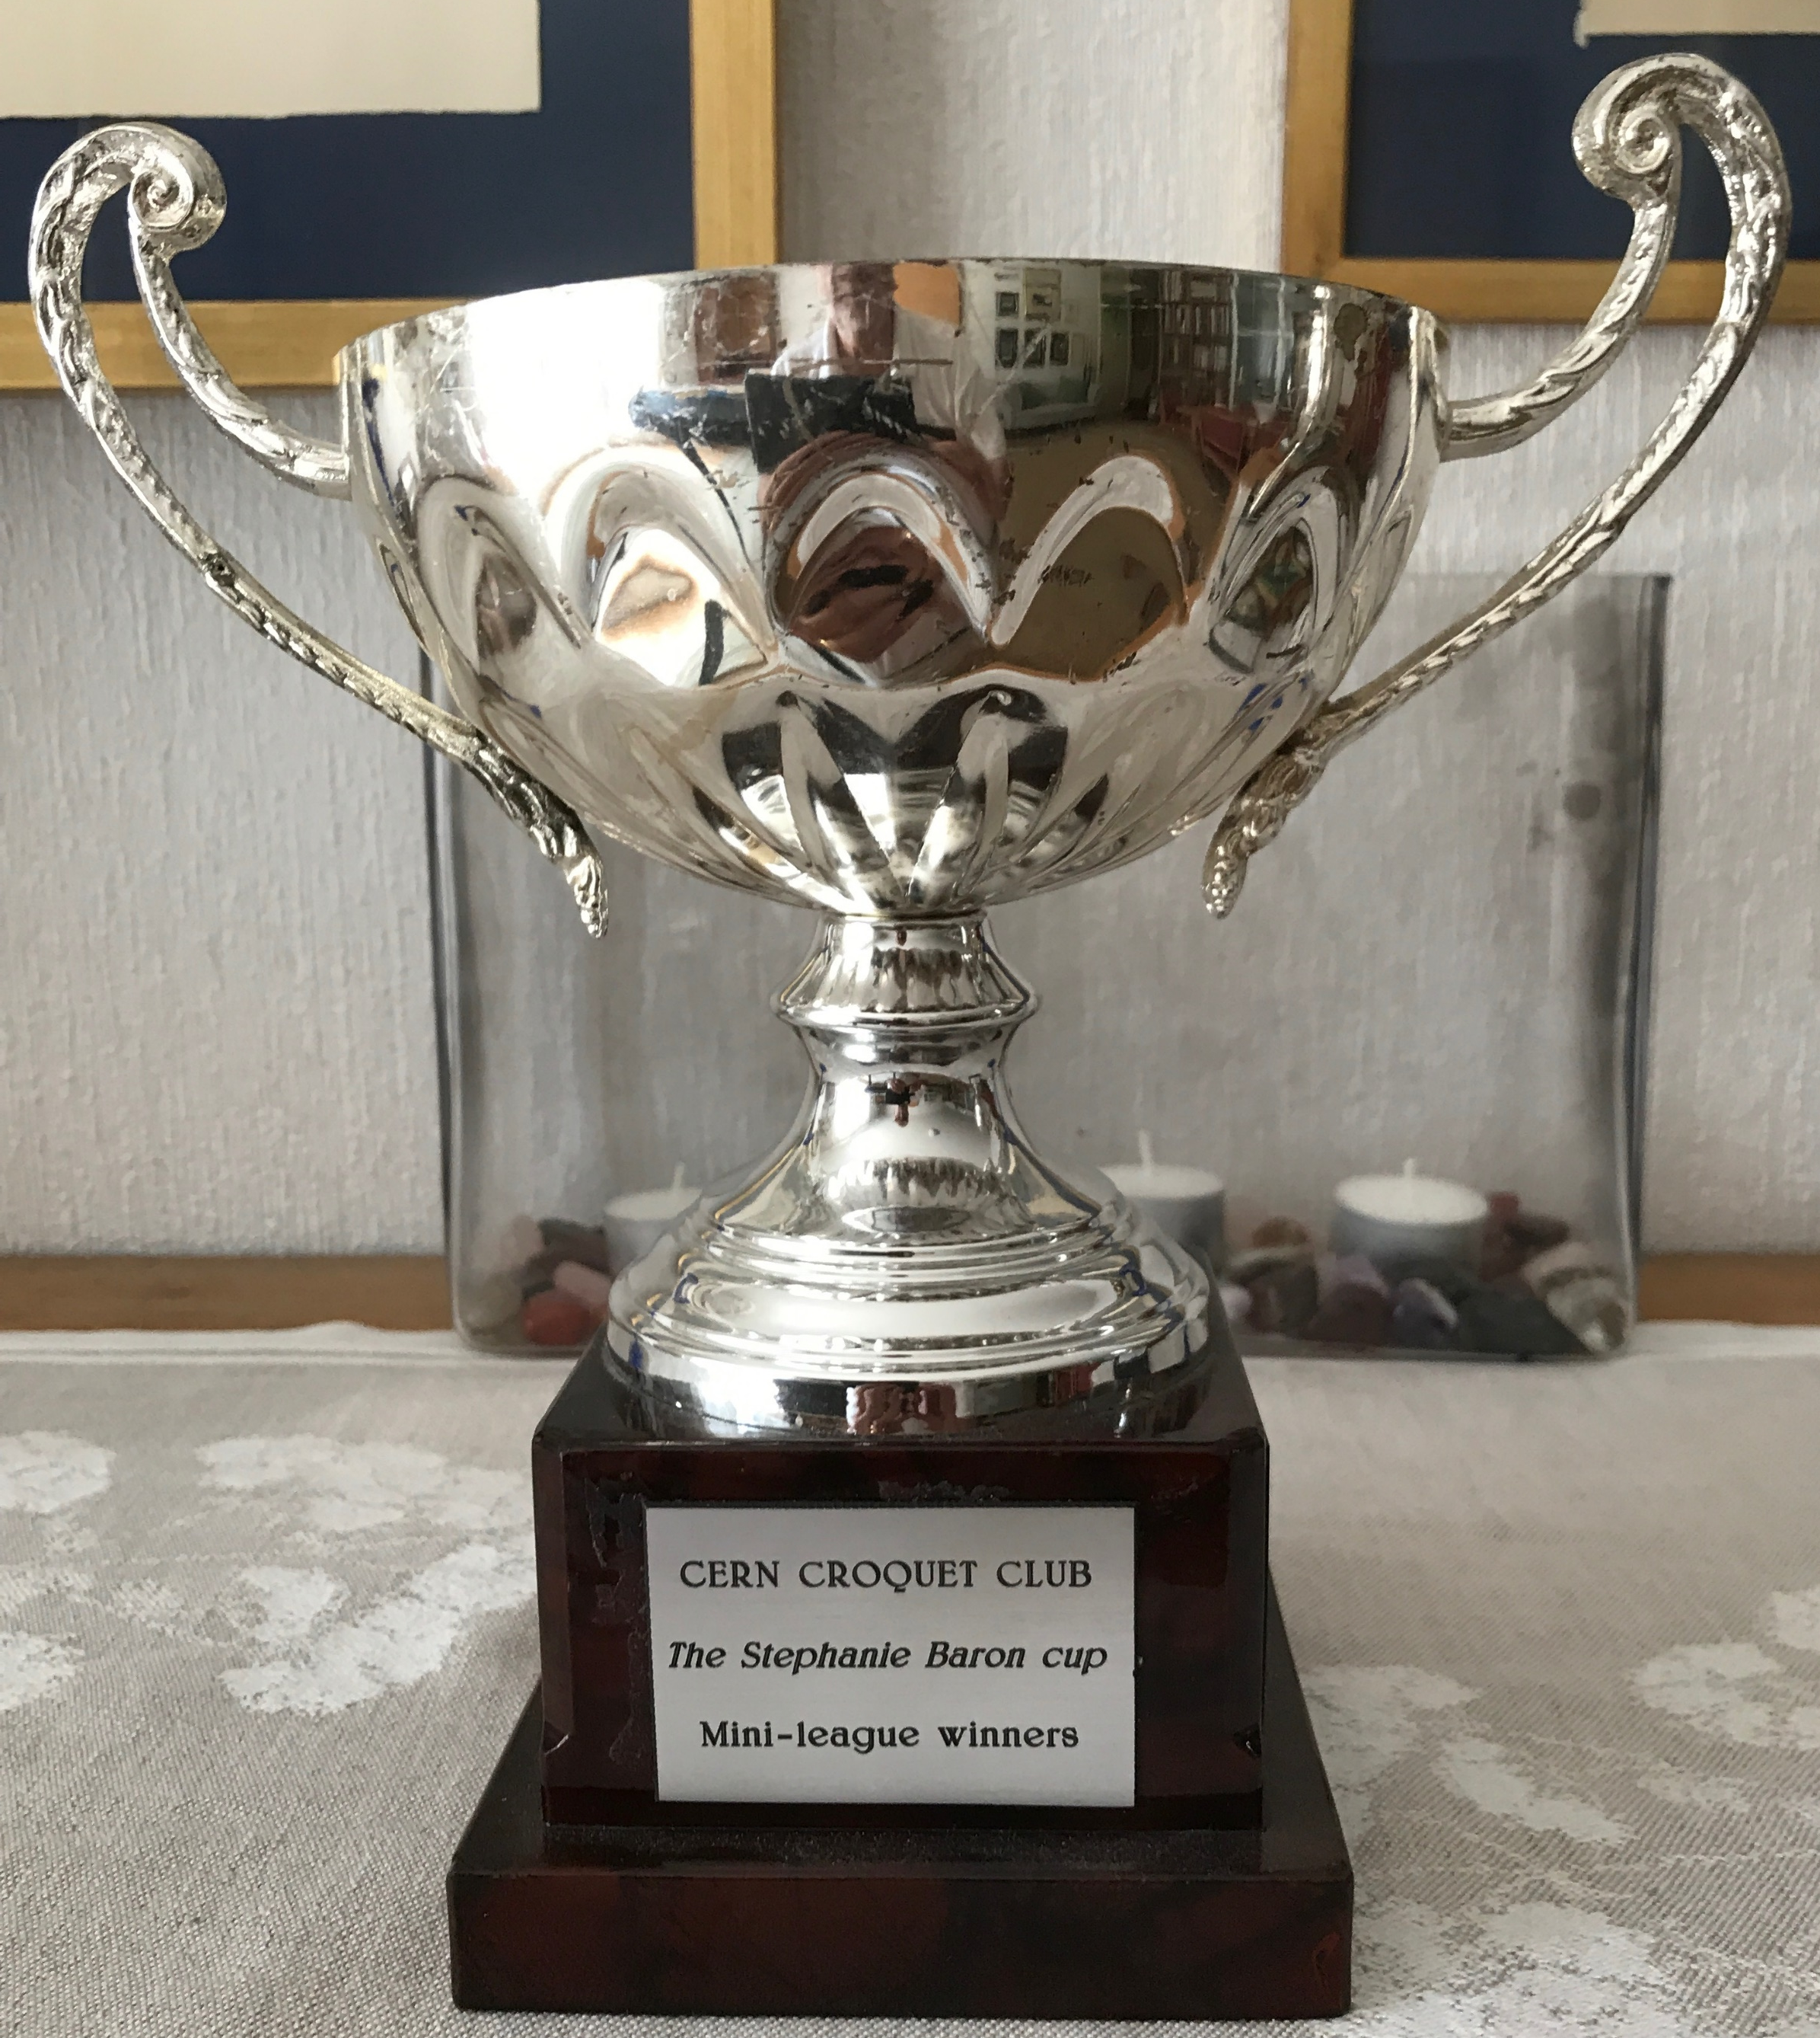
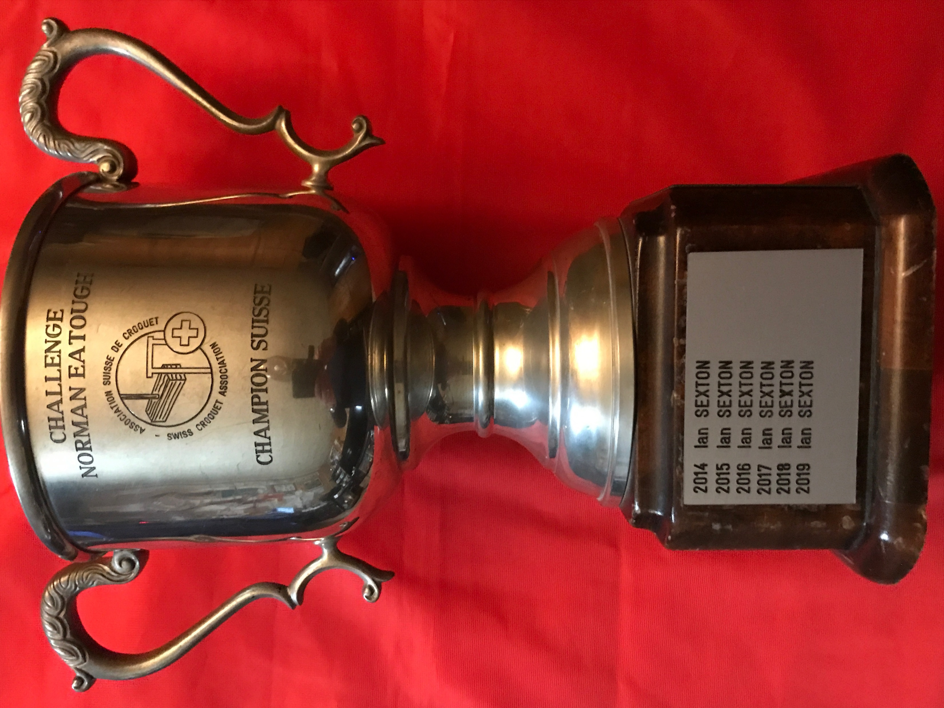
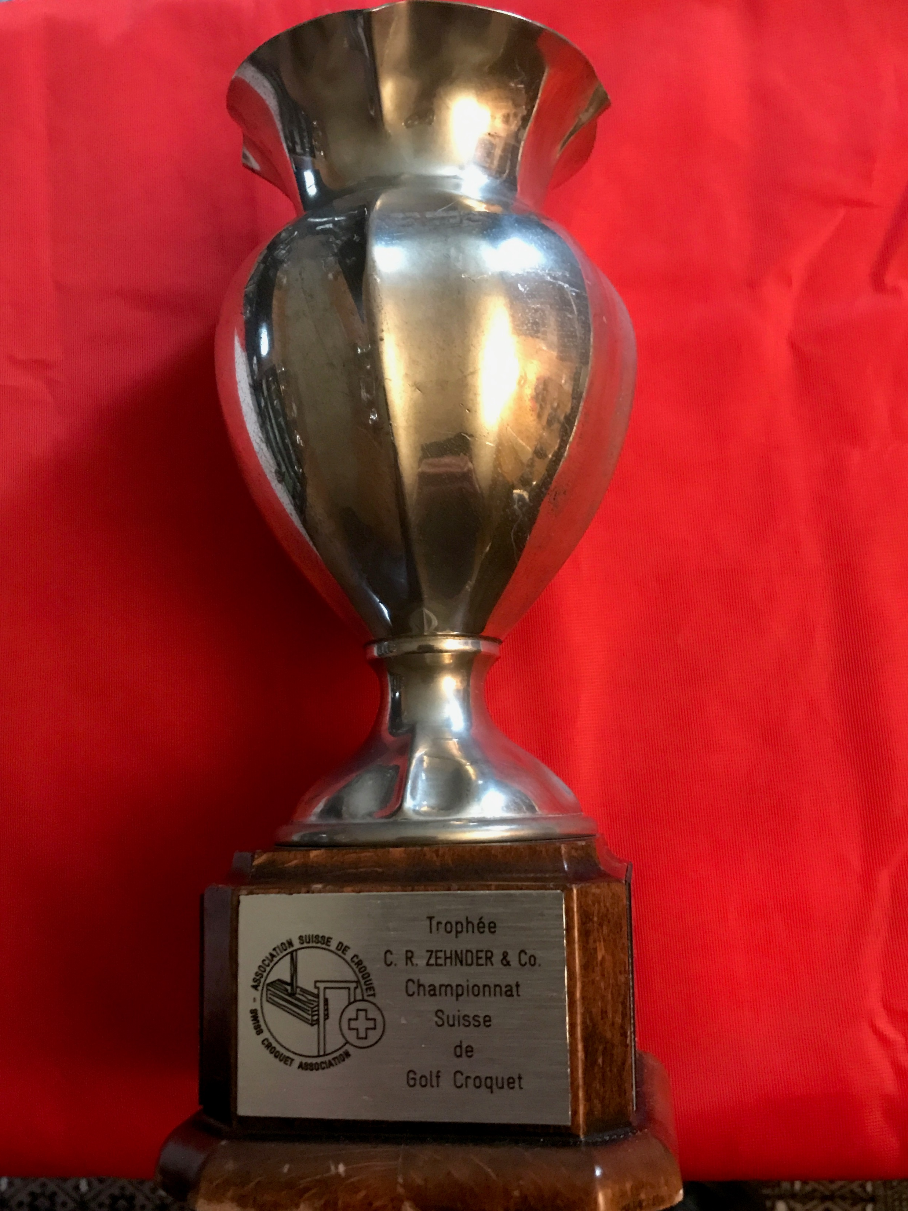
Croquet & Gateball
Tournaments
Both sports are affiliated to their associated world Governing Bodies (WCF and WGU) and as such Club members participate in the World Championships.
With its affiliation to the Swiss Croquet and Gateball Associations, its members also participate in European Championships and Swiss National Championships.
Open tournaments are held on the CERN lawns, at which many International players participate.
There are not so many players in Switzerland and only in recent years have the numbers grown, with clubs now in, Zurich, Rheinfelden and more recently Sion.
Even less playing Gateball, so the opportunities for any new club members participating in some of these championships is very high.

Slide 9
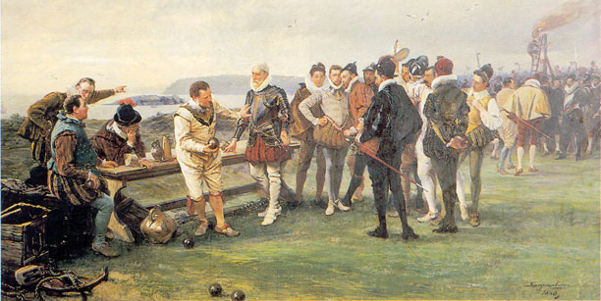
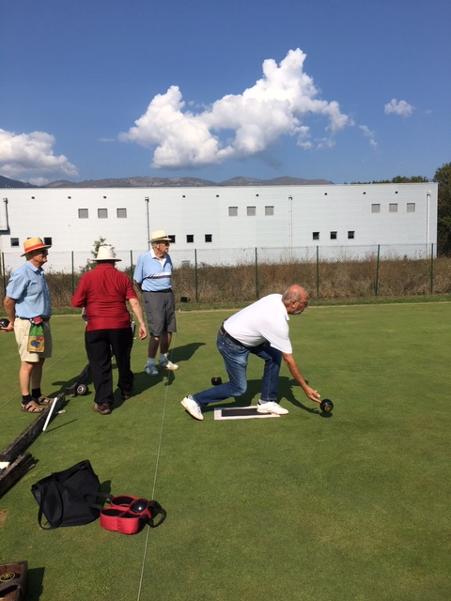
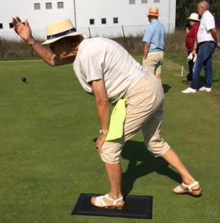
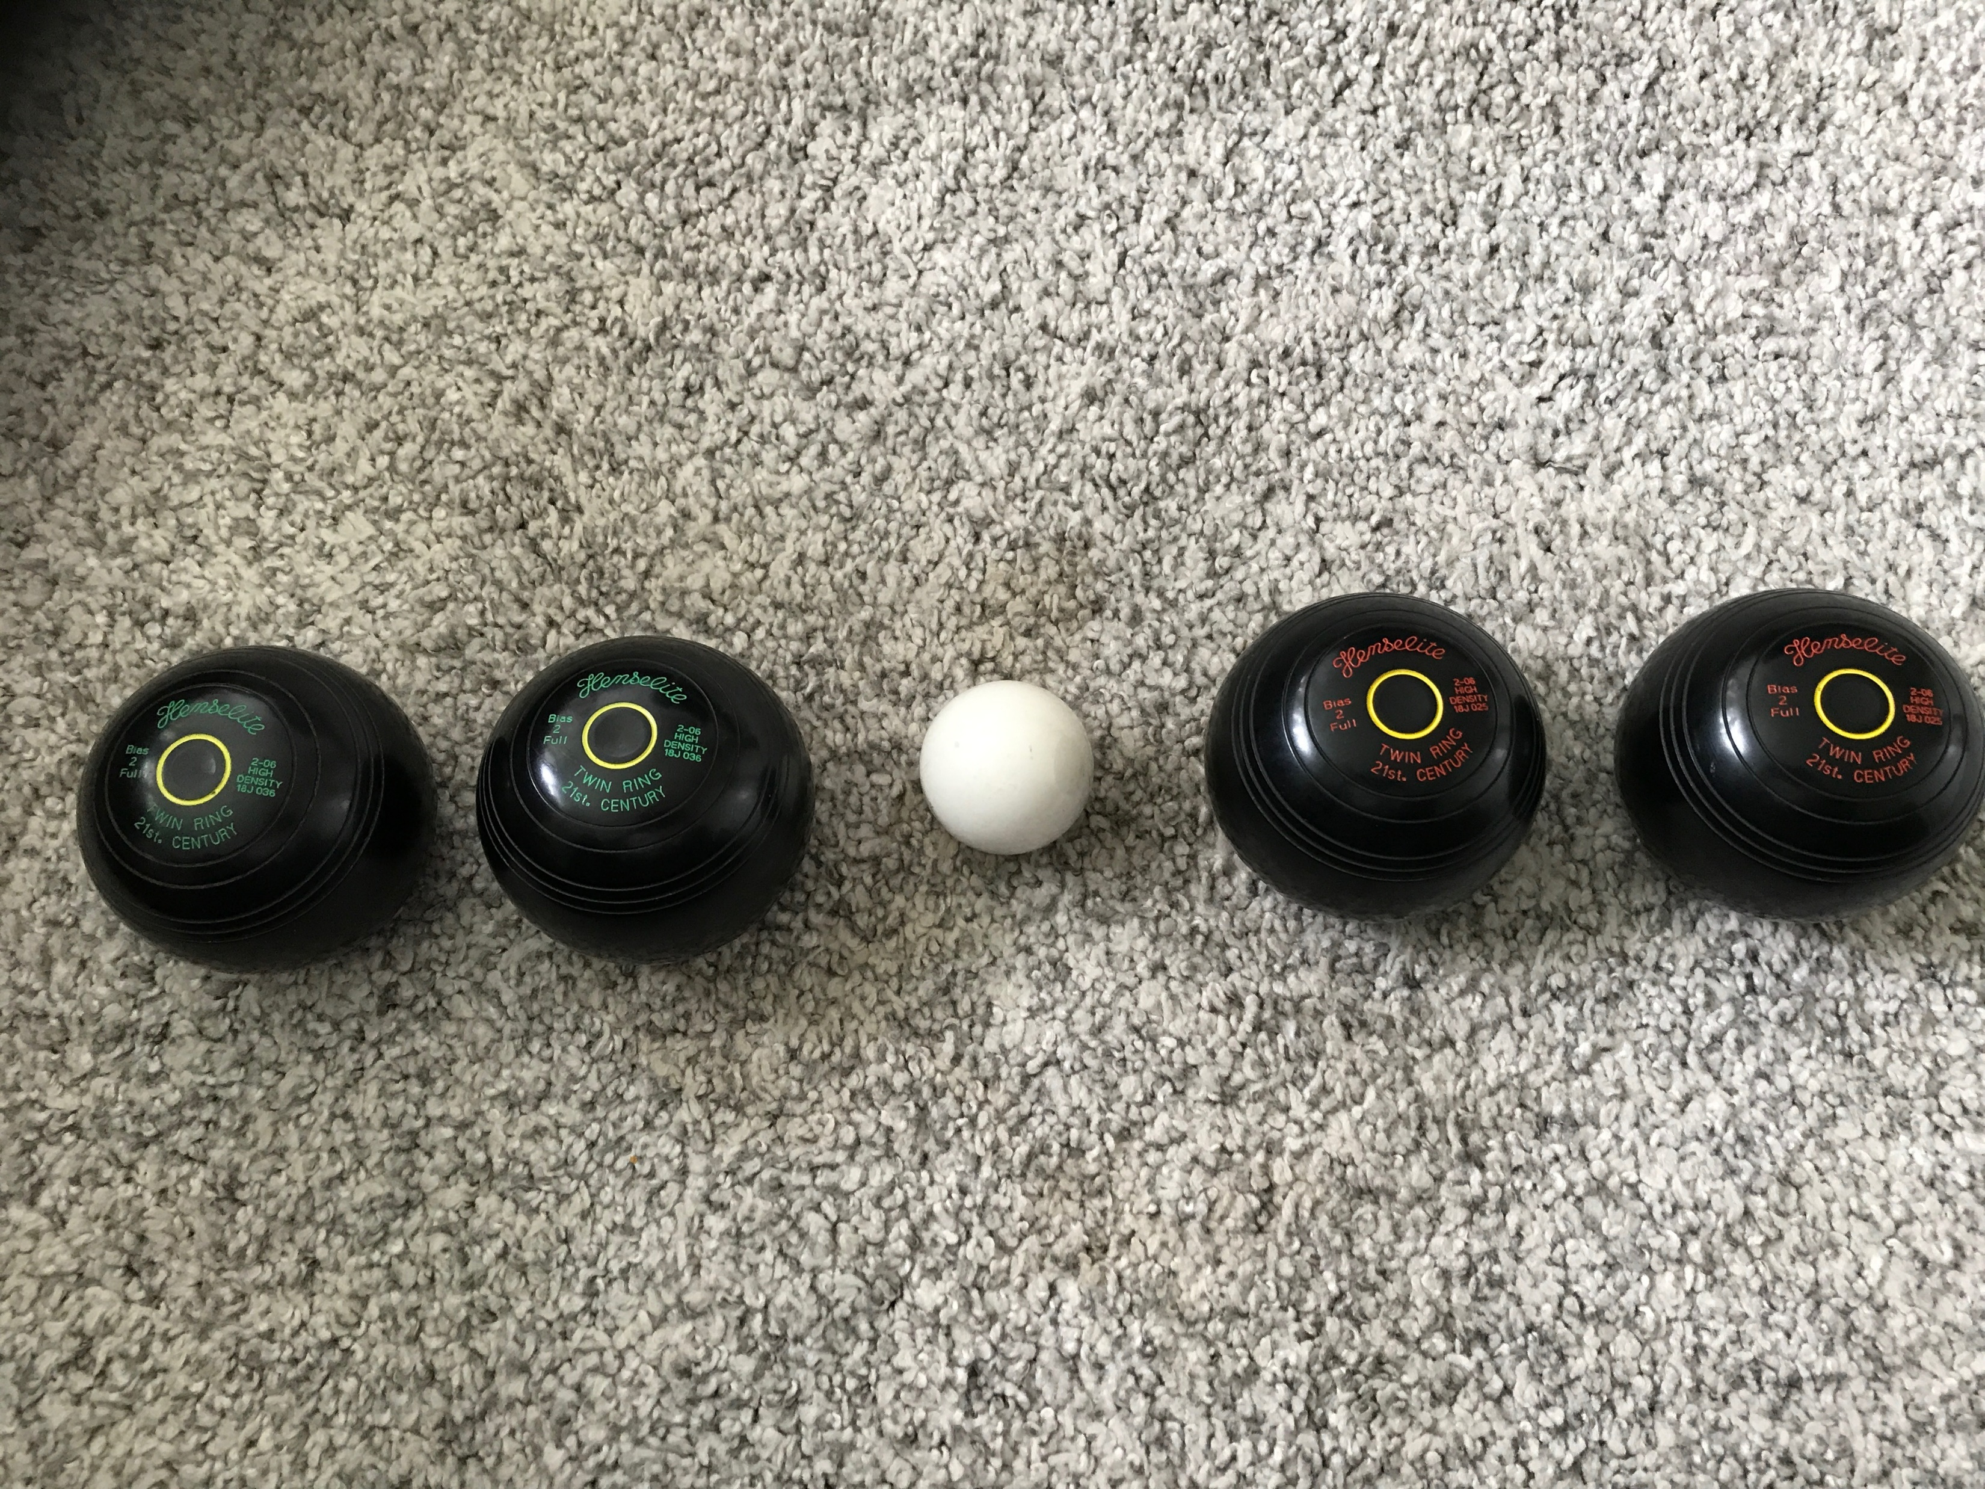
Lawn Bowls
For those not acquainted with Lawn Bowls, it is very similar to Boules, which maybe more familiar around these parts. Like for croquet its origins and history are hotly disputed, like was Sir Francis Drake really playing Bowls as the Spanish Armada advanced on GB ?
Unlike Boules however the ball is rolled underarm along the ground towards the target ball and not thrown in any other way. During the restricted access to CERN Club activities we have been playing Boules at the Bouledrome in Meyrin close by the Swimming pool on Wednesday mornings.
The bowls themselves come in a variety of sizes but are generally around 1.5kg in weight and possess a bias in weight so they roll in a curved path, the precise judgement of which is where much of the challenge of the game lies.
Not such a competitive edge, played socially and enjoyably.

Slide 10
Contacts and Suggested Links
Club Web Site: https://cerncroquetclubgeneva.com/
Dave Underhill: David.Underhill@CERN.ch
World Croquet Fed.: https://worldcroquet.org/
World Gateball Union: http://gateball.or.jp/wgu/
How to play Lawn Bowls: https://www.youtube.com/watch?v=PonGXrse4MU
How to play Gateball: https://www.youtube.com/watch?v=R9p01PnChIQ&t=369s
When can you play? The lawns are available at all times to Club Members
Interested in trying ? Give me a call or send an email ….. See above
Want to join the club ? FREE membership in 2021 for new members
Once we have access to the lawns (next week) there will be Beginner Sessions every Wednesday as of 12:30. We will offer you sandwiches and soft drinks free.
Look forward to seeing you there …… bring your friends
Dave Underhill TEl: =+41 798543264

