Slide 1
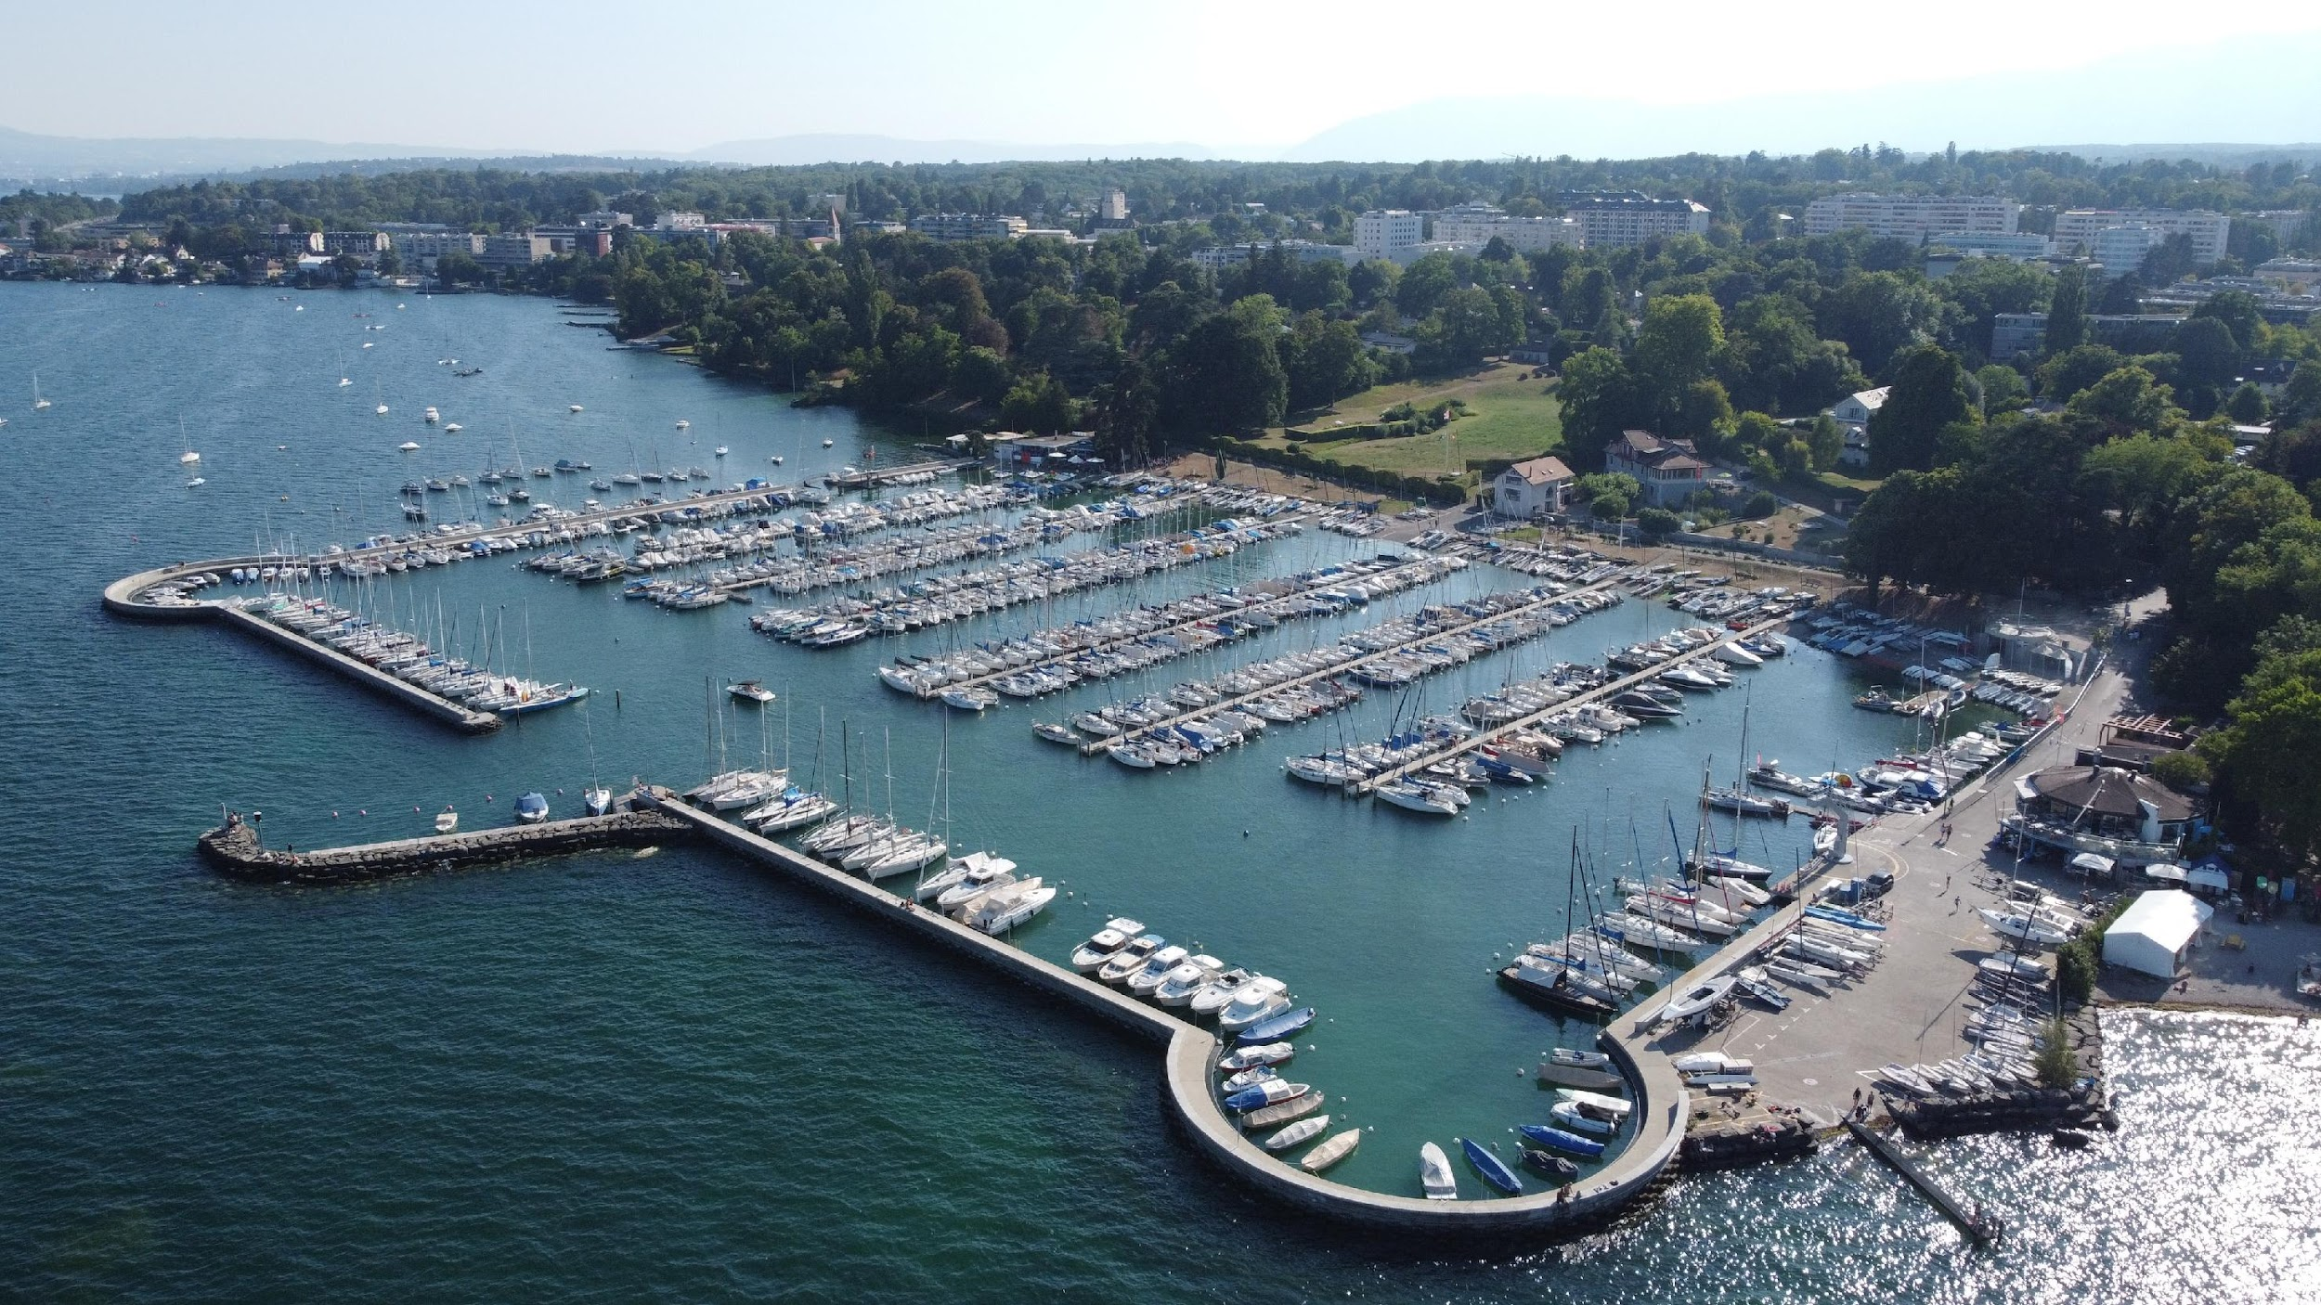
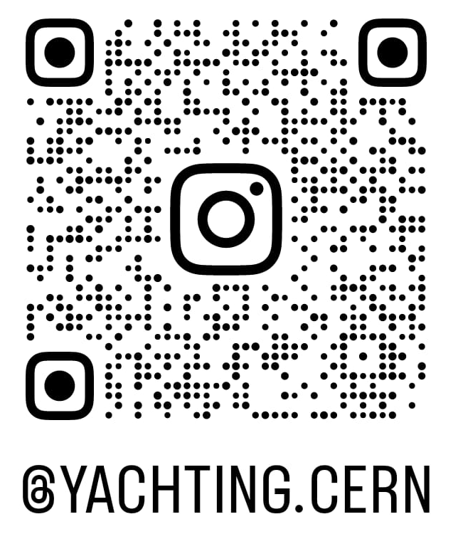
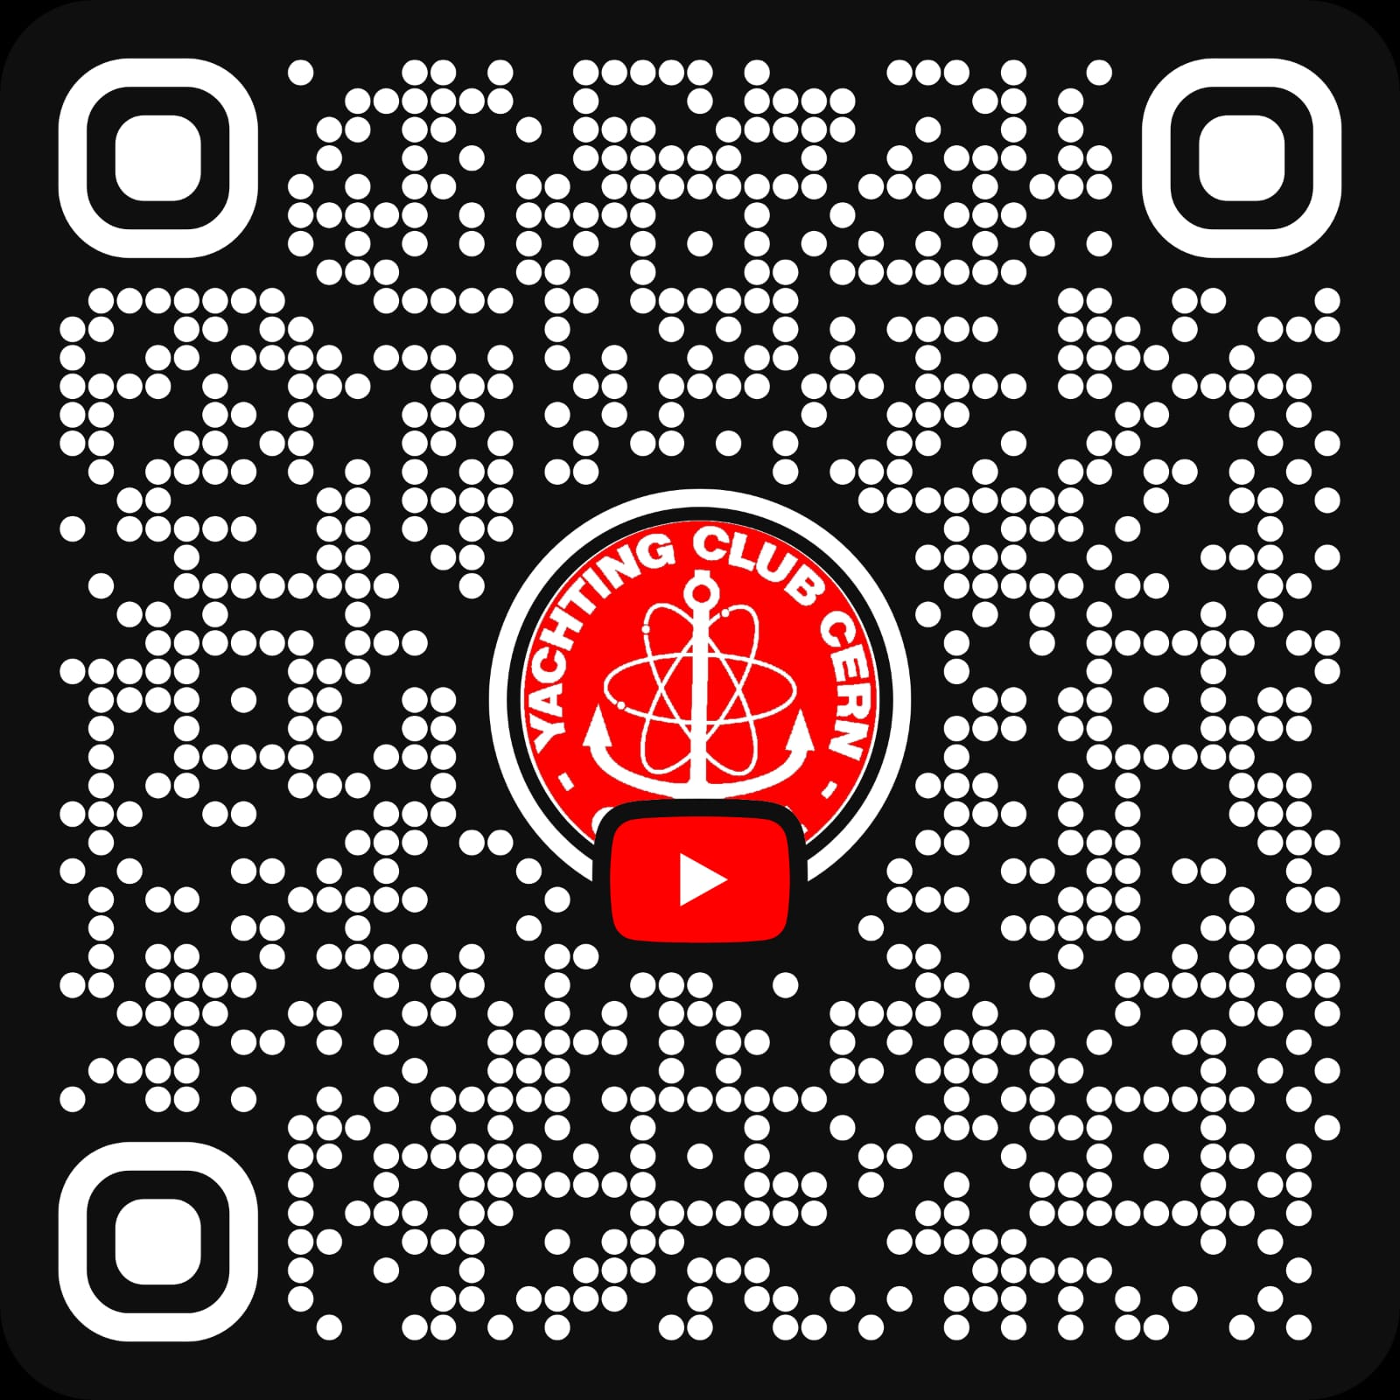

Welcome to the Yachting Club of CERN
https://yachting.web.cern.ch/
Season 2025
Notes:
A F
We will try to show you the club and our main activities, but we will try to be quick, as all the important information have been said to the AGM meeting, so refer to the website or ask around tonight if you are curious on specific topics.

Slide 2
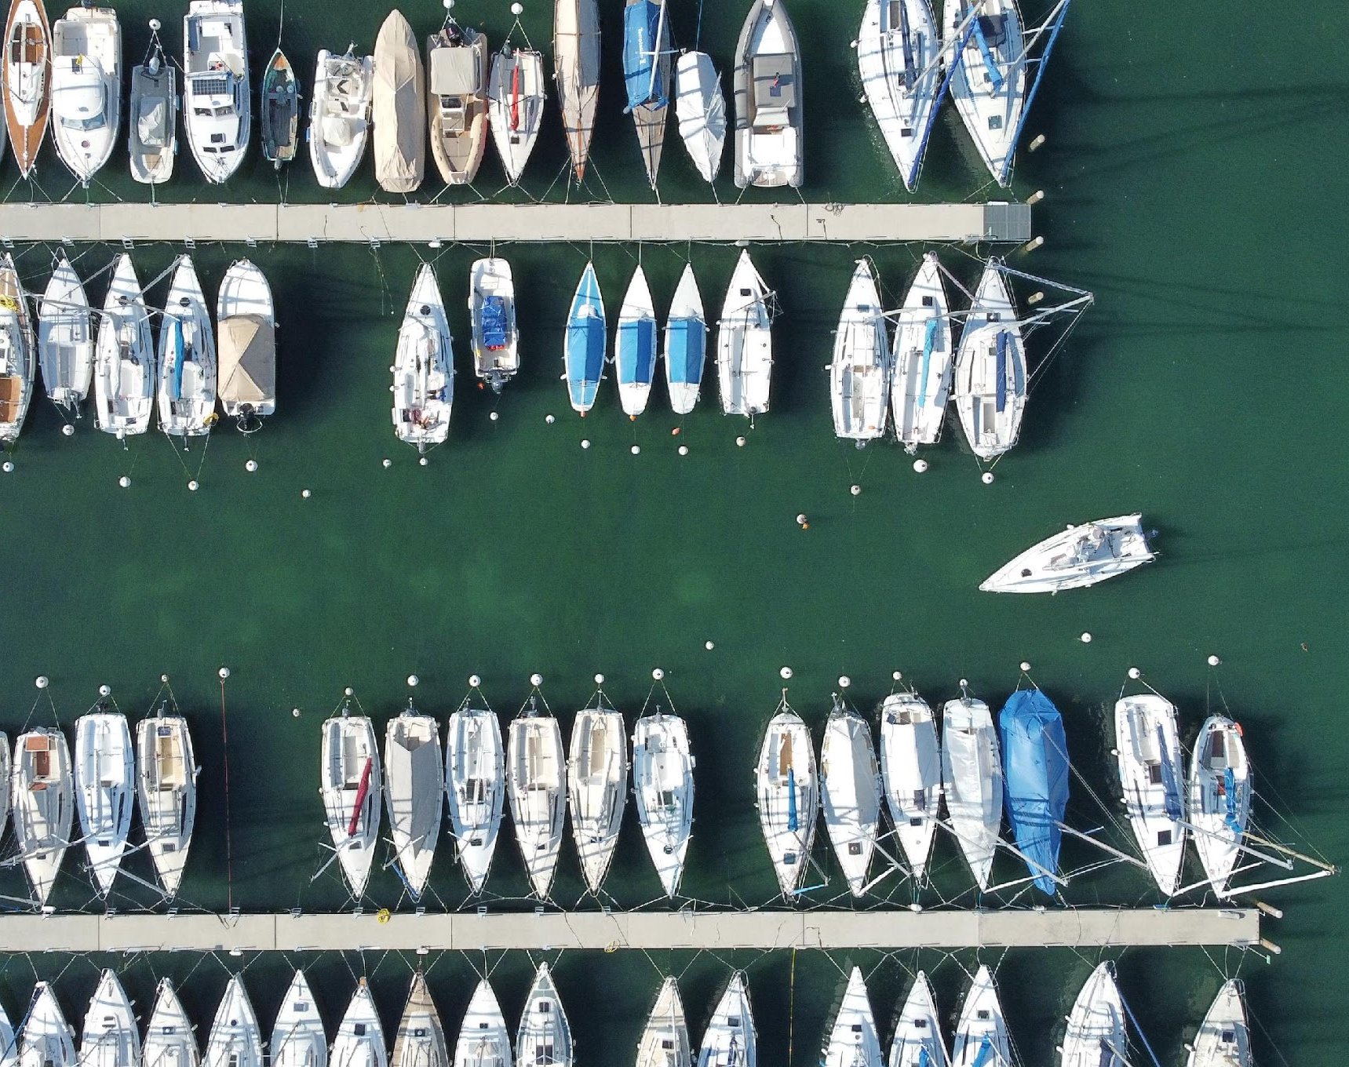
What being part of the YCC is about?
Not a rental club
Spirit of Community
Making Memories
Finding new friends
Sharing knowledges
Learning
Looking after the others
Notes:
F
ask to old members

Slide 3
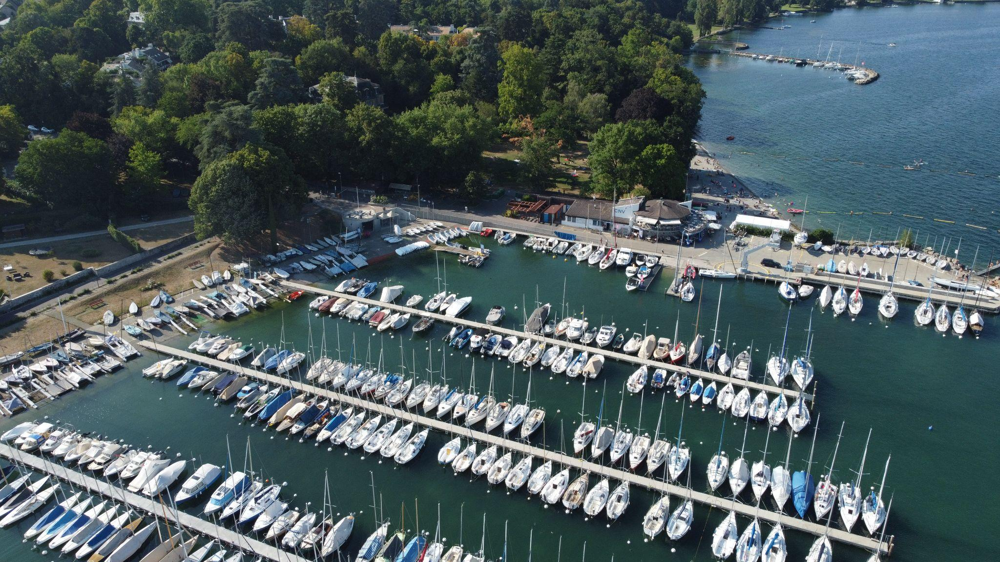

MELTING POTS
YCC Regatta Box
CNV school
The CNV Resto
Notes:
F
Melting pots, For the Practices and than for the Apero after sailing, CNV stays open.

Slide 4
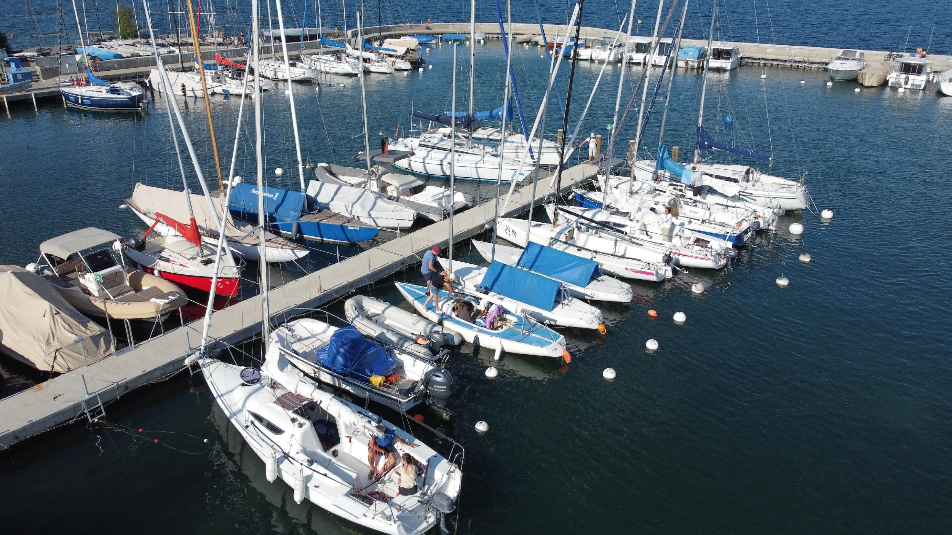
The Fleet
Notes:
A
We own a large fleet of 29 units: 10 Dinghies, 4 Catamarans, 12 Keel boats, 3 Motorboats.

Slide 5
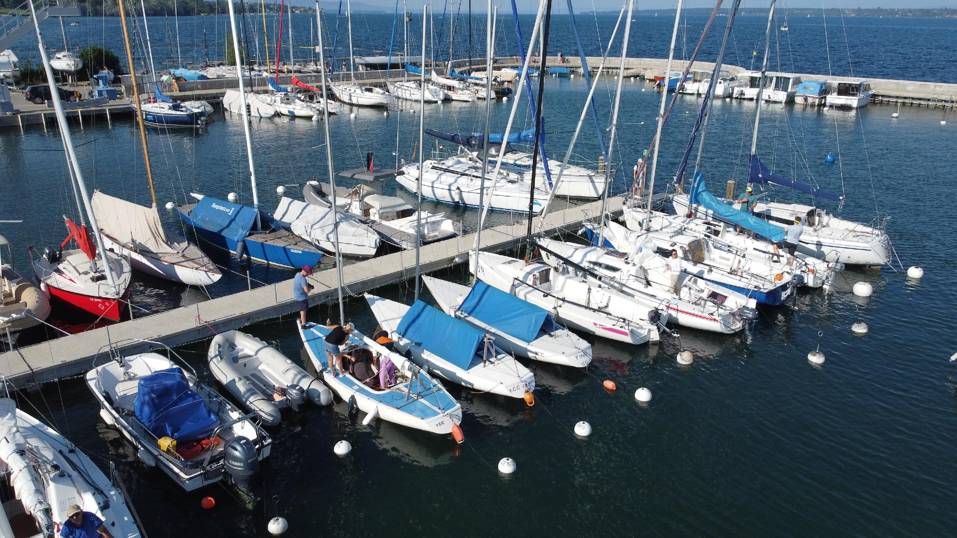
Keel Boats
Notes:
A
12 Keel boats + 3 motorboat
We have a large number of modern keel-boats, some of them very small and open deck like the Yngling, and are the most user boat in the club
Surprises, are multi-purpose classical boat design, and are most used sailing boat in the Leman lake.
J80 and J70 , are modern keel-boat designed mainly for performance sport and racing. They have like our dinghy a Gennaker instead of a Spinnaker, and they have a surfing hull profile. The space of the cabin is minimal, and most of the deck is available for a crew that need to fast maneuver.
The Gibsea and Dynamic 3k are classical cabin boat designed for the sea, for general purpose comfort sailing and cruising.
No Licence
5 Yngling
Sailing Licence
2 Surprise
2 J70
1 J80
Sailing and Motor Licence
1 Gibsea
1 Dynamic 300 – 10 m
3 Motor Boat

Slide 6
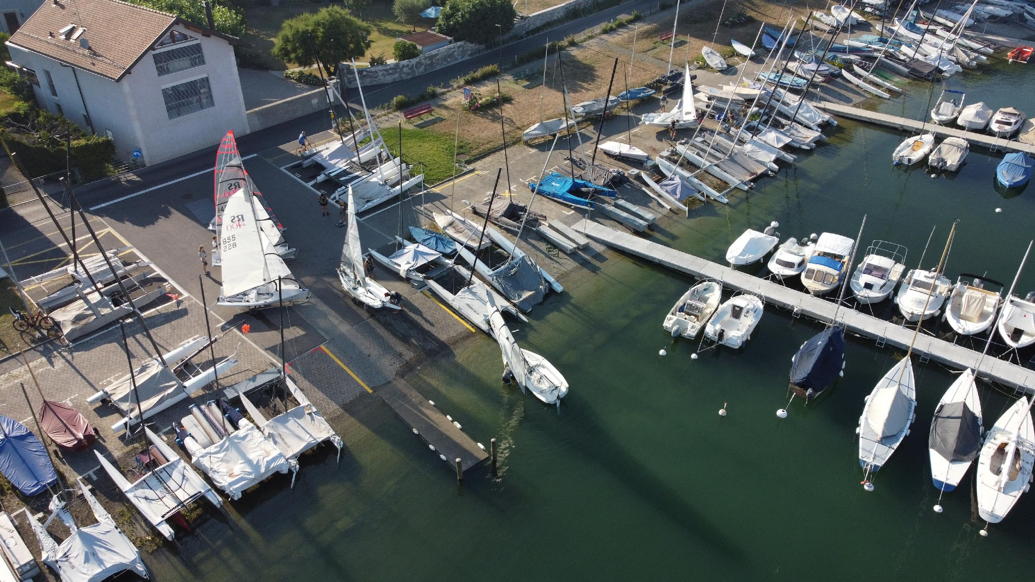
Dinghies and CAT
(toolbox)
Notes:
A
10 Dinghies
We have a fleet of Modern and high performance dinghy. Dinghy are small and light sailing boats, designed for sport, fun and sail - learning. Dinghy have a retractable centerboard that allows an easy mooring on a trailer, and have NOT a weighted keel, that means their stability is granted by the weight of the crew on board, that has to move according to the wind to keep the balance. Dinghy are today very safe boat, the capsize and recovery is a pure fun event, that you will for sure enjoy. On dinghy, crew is in direct contact with the water, therefore a proper wet-suit is needed.
3 Laser
3 RS
3 Melges
1 29er
4 Catamarans
We have 4 Modern Catamarans. All of them are designed for sport and high performance sailing.
Catamarans are very powerful machines, and their big sail area and the very fast speed requires a very good and fast sailing skills. Similar to the dinghy, sport catamarans also need the weight of the crew and the usage of the trapeze to keep balance.
SL16
2 Hobie tiger
Nacra

Slide 7
Meeting Point
YCC Metal container
Dinghy and Catamarans
Key System
CNV
Pizzaaaa
Gibsea
Janisico
Miss R
Mamma Mia
Keel Boats
Event Tent
Notes:
A
Explain the new Key place

Slide 8
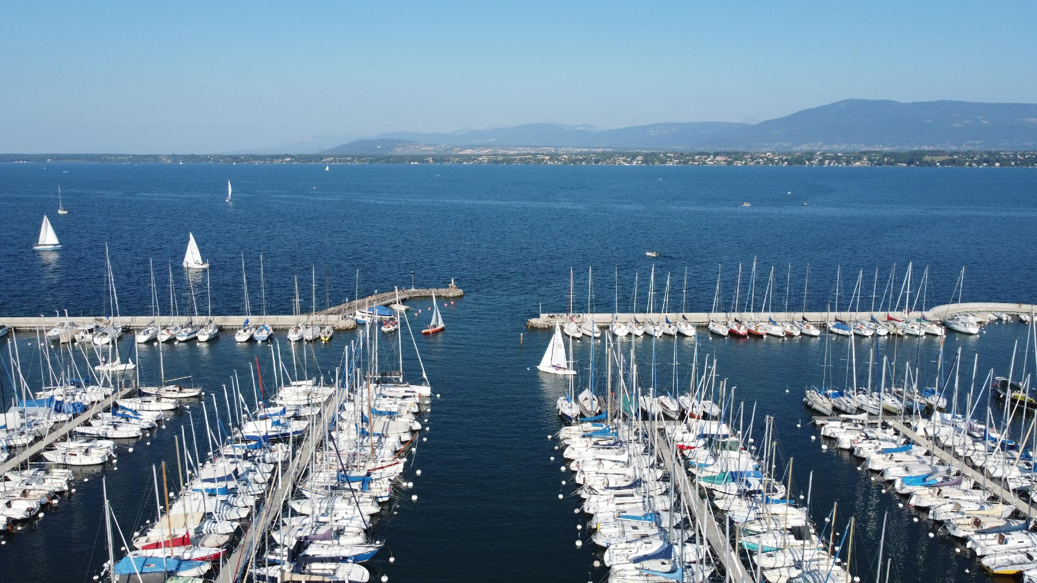
How to Learn and Sail in the club
Notes:
A

Slide 9
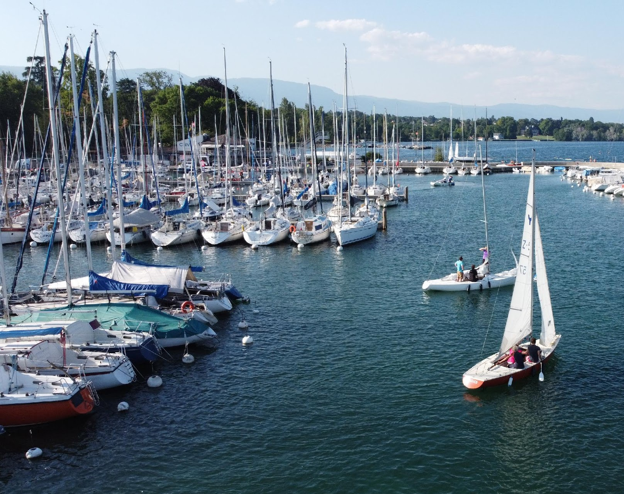
Club Activities
YCC courses
CNV courses (630 - 510 CHF)
Dinghy Training
Yngling Training
Regatta Training
External Regattas
Internal Regattas
Level 0
Thursday Practice
Private Outings
Social Activities (Flotilla)
Notes:
A
All information are on the website:
Official communications by email. So please read them ;)
YCC courses
given by lottery between feb and march
CNV courses
The Club Nautique de Versoix (CNV) is offering special conditions to the YCC members taking its dinghy courses: 510 CHF instead of the regular 630 CHF
Dinghy Training - Paul Smith
July and August
Held over 9 Tuesdays
Open to all skill levels
Focused on improving rigging including the new melges :-D
Mini-regattas for hands-on practice
Yngling Training - Silvia C.
On Friday evenings in July and August
Open to all members
Always doubly booked
Nice training opportunity, also for the Y test
Possibility to enjoy mini regattas
Regatta Training
This season, YCC will organize some regatta training sessions for members. These sessions are aimed at intermediate and advanced sailors to improve and practice their technique, boat handling skills and application of the rules in regatta settings. The trainings are scheduled ahead of the internal YCC regattas.
The events will be announced to all members, teams will be able to sign up together to train as a team. Participation is foreseen for both dinghies and keelboats.
External Regattas
swiss sailing ligue championship
Internal Regattas
Private Outings
whatsapp community, participating to social activities etc
Social Activities (Flotilla, Lunching and berthing of the fleet End of the year dinner, Helpers Evening)

Slide 10
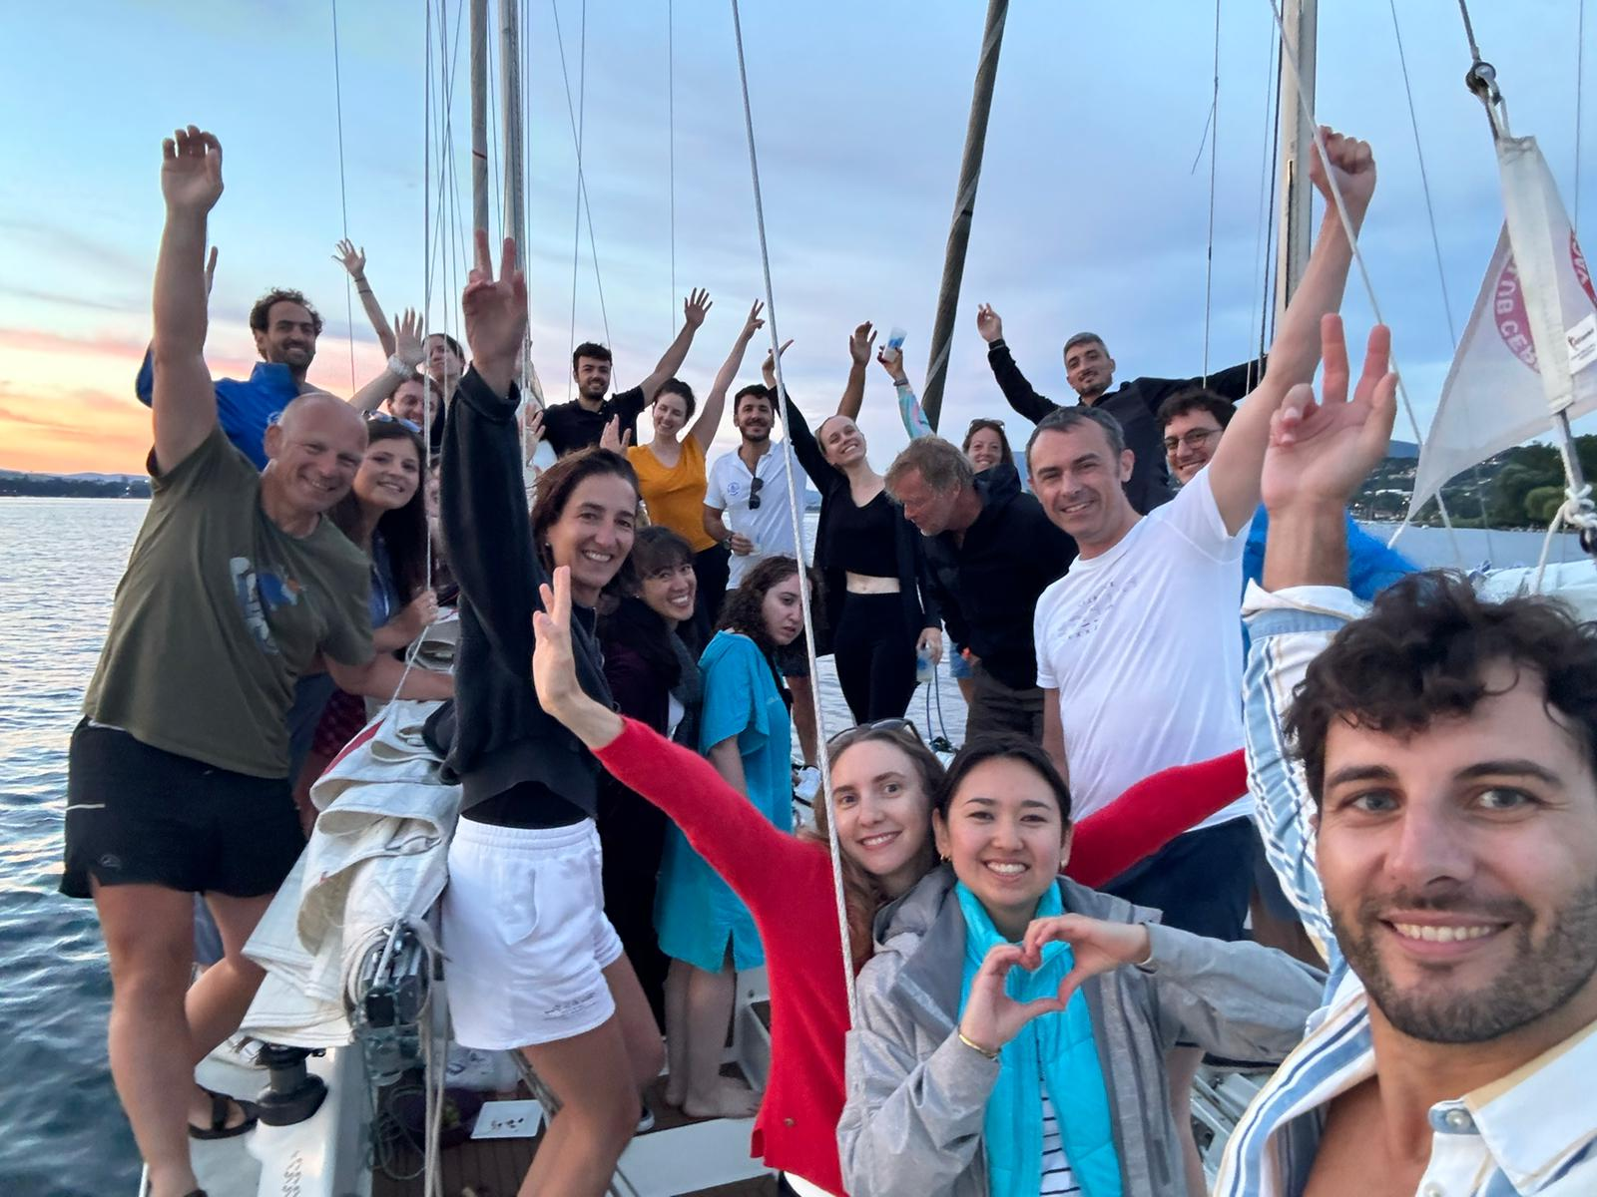
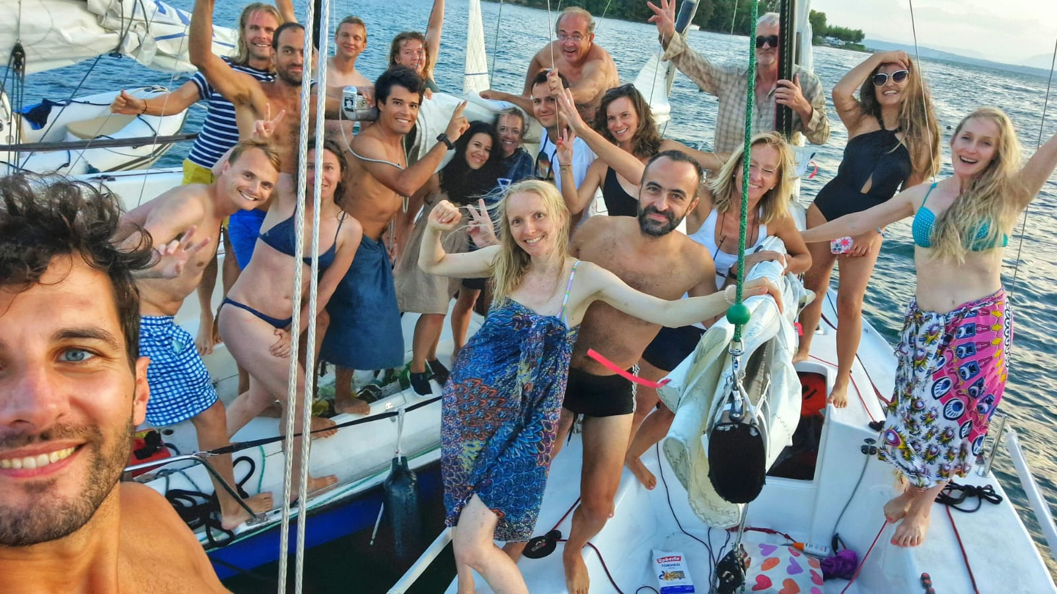
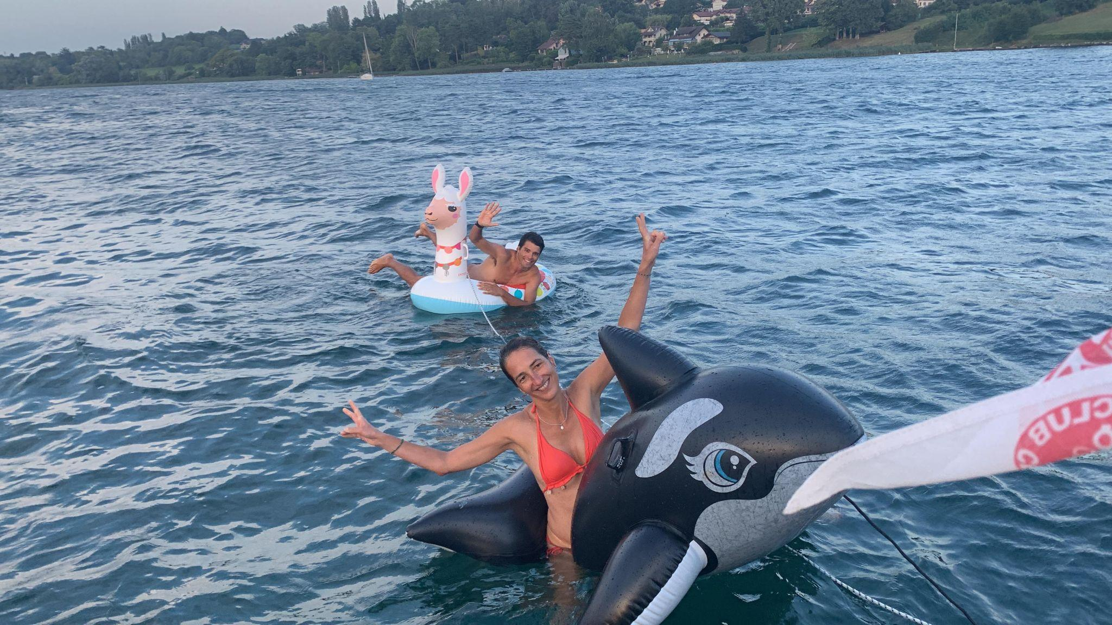
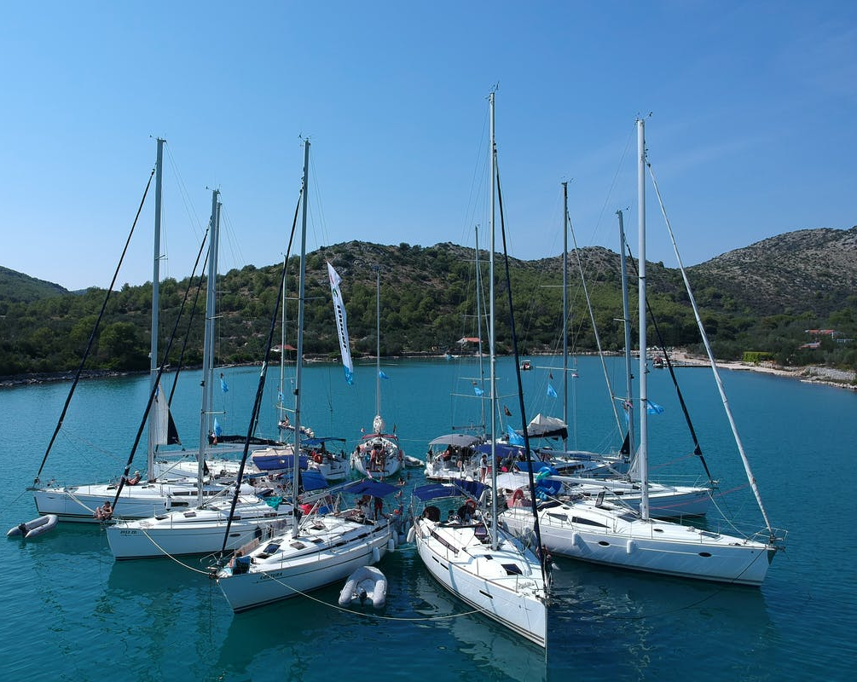
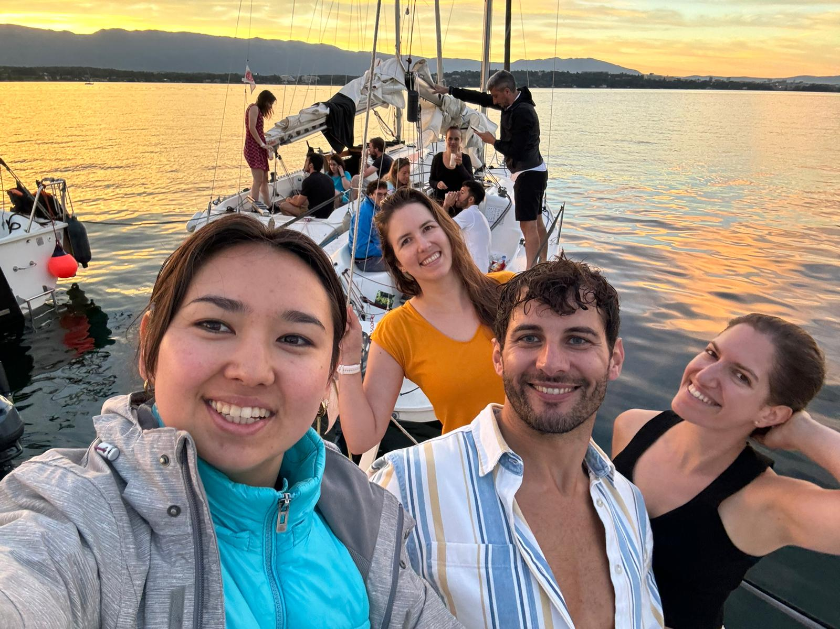
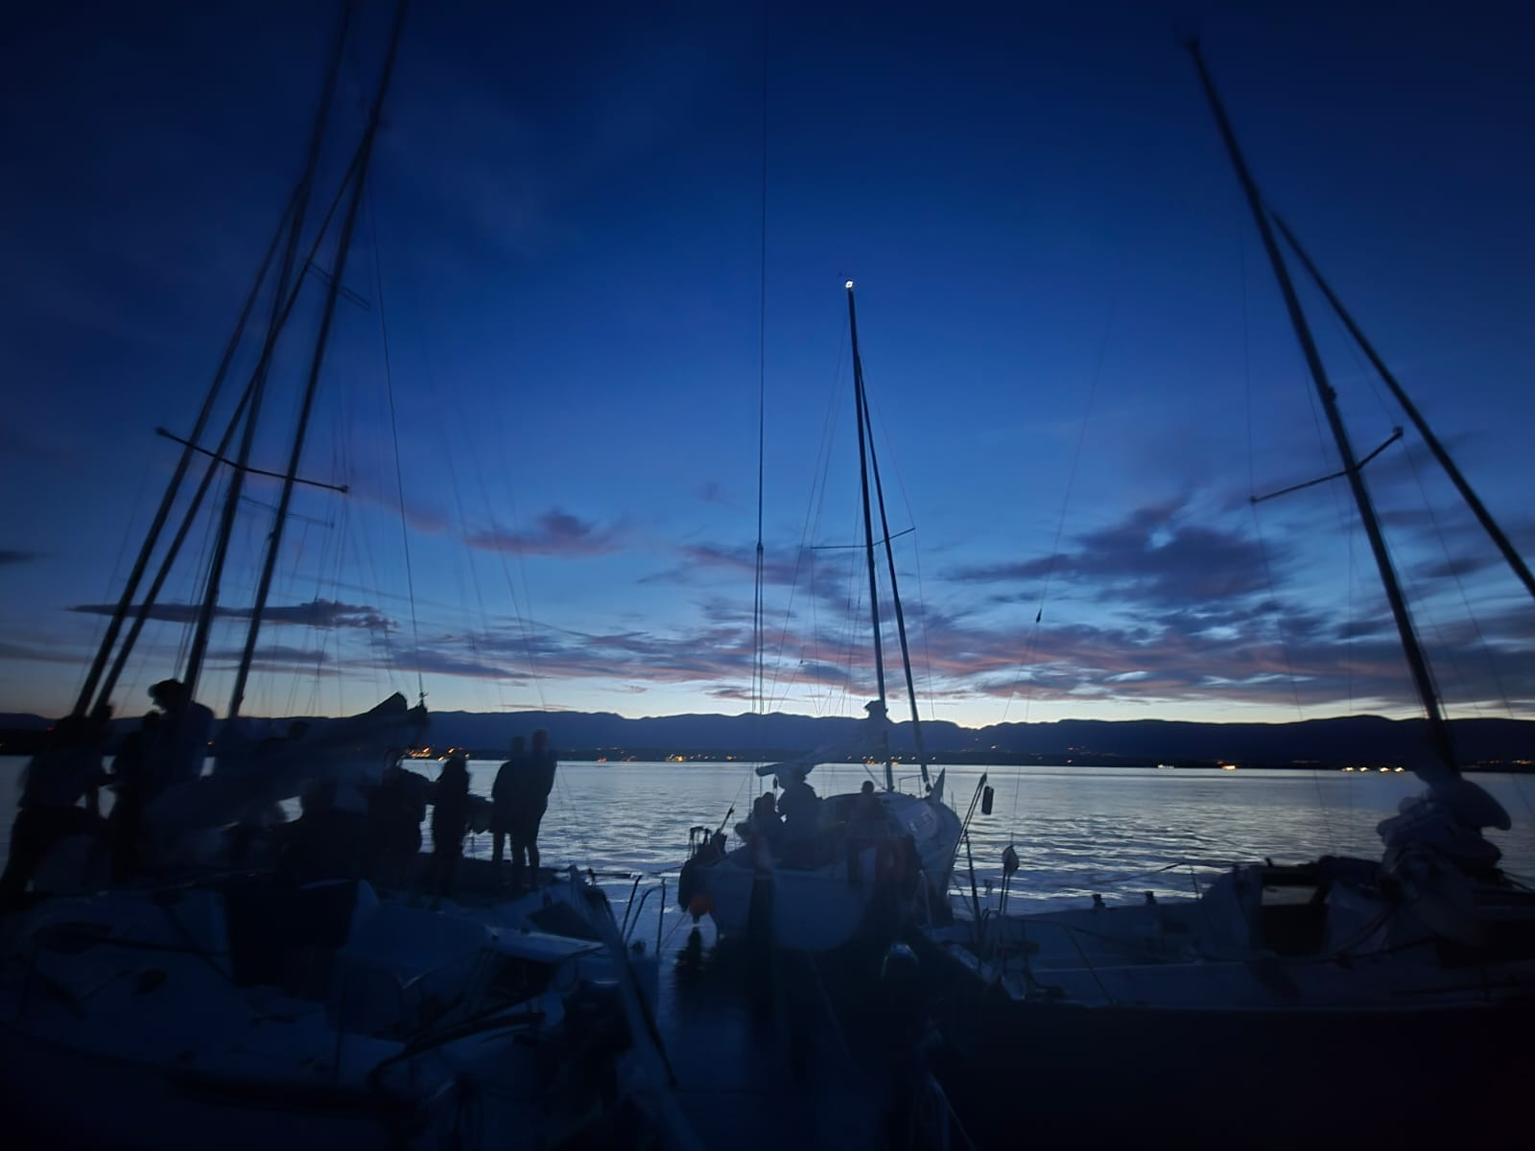
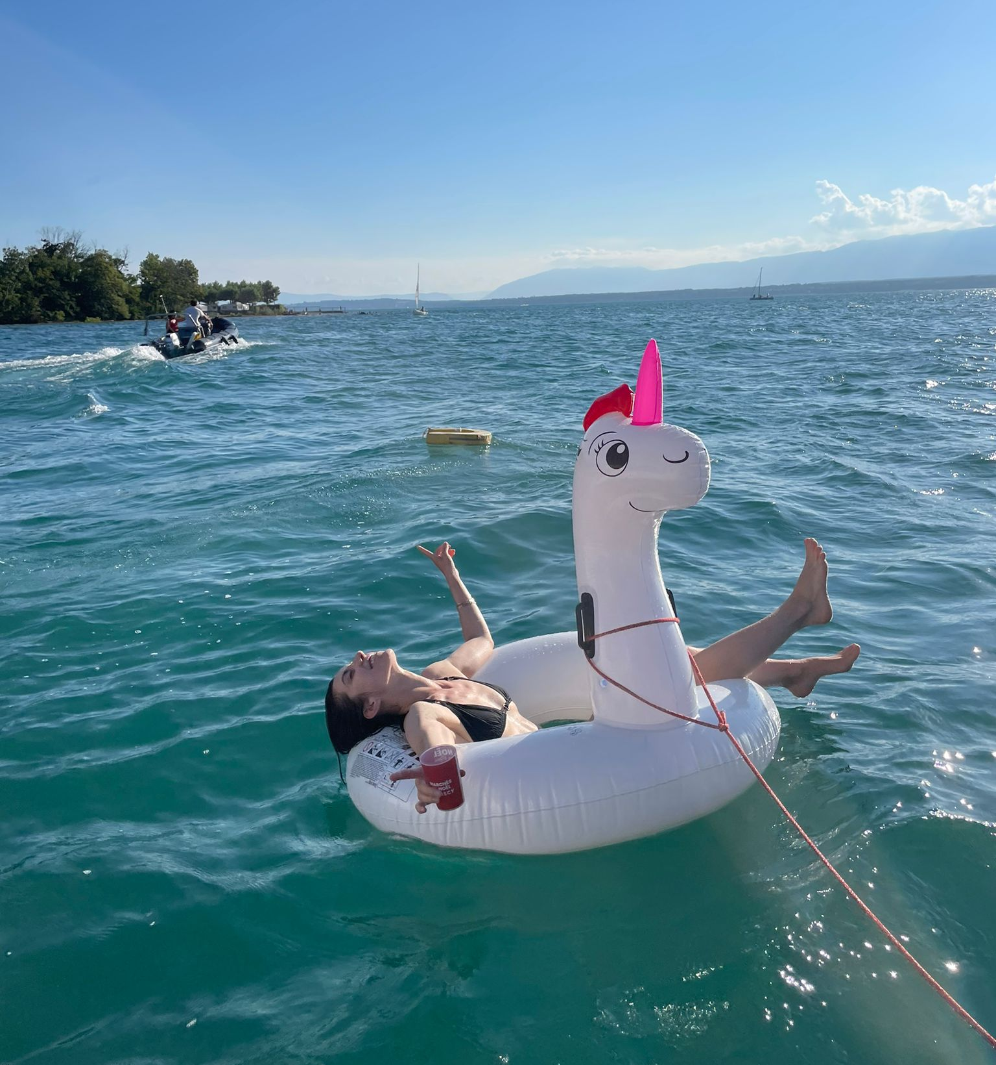
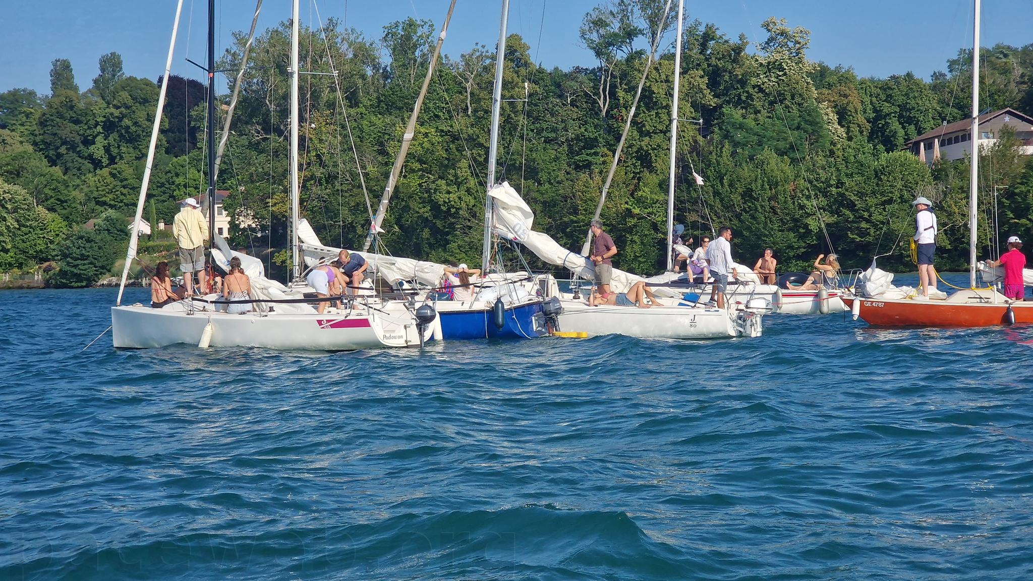
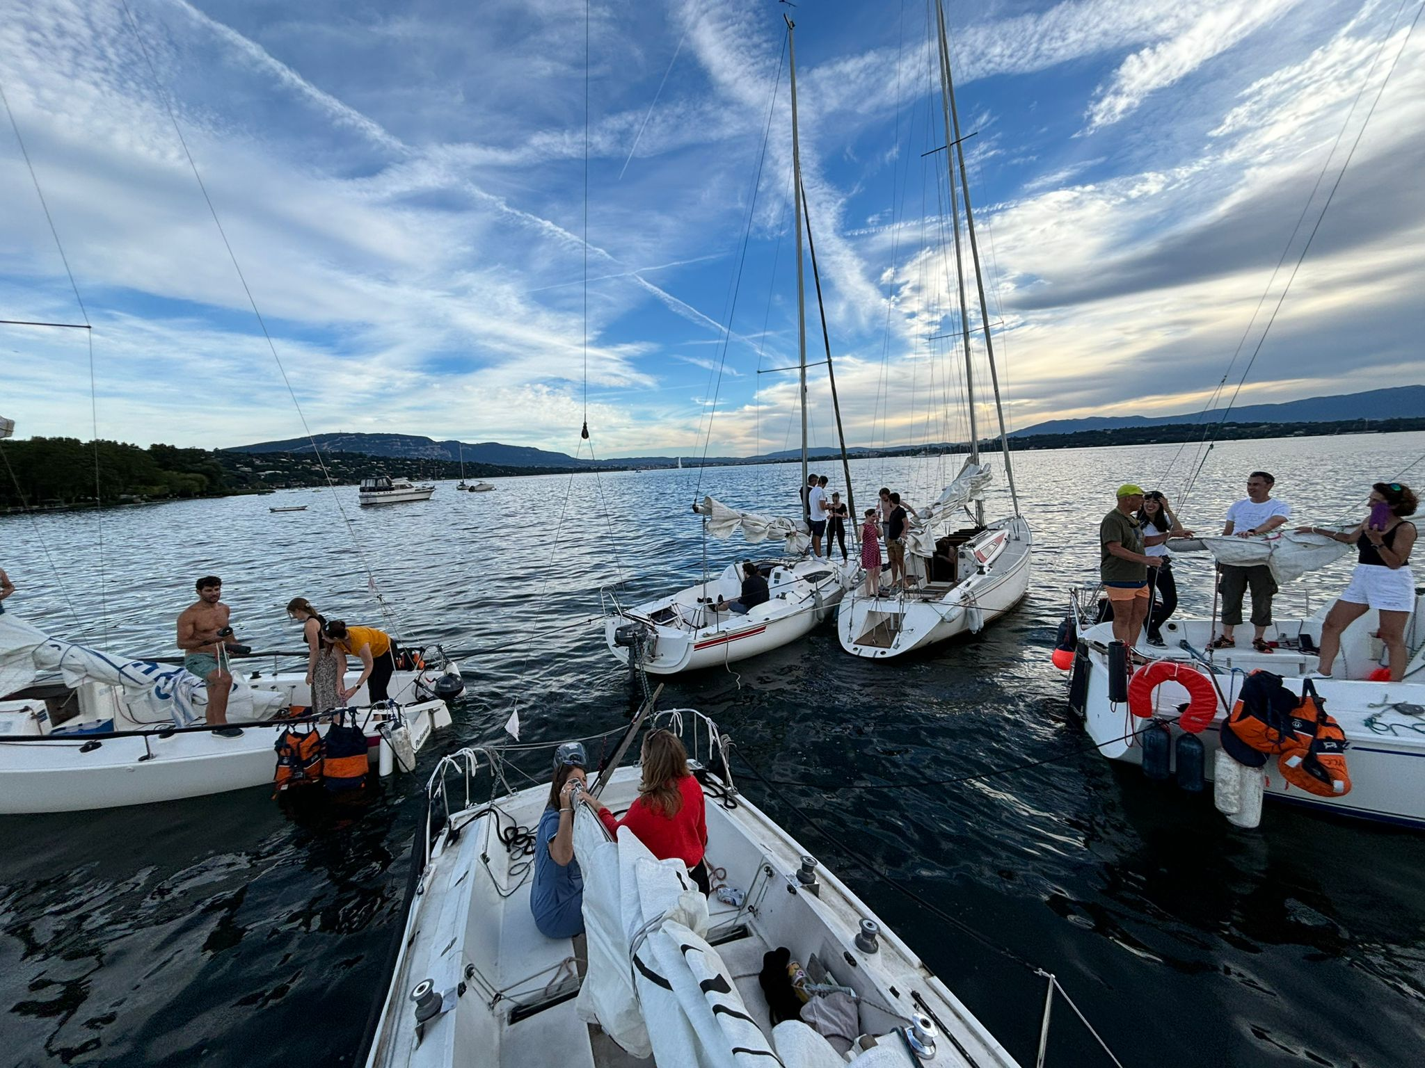
The Flottilla event and Apero
11th and 27th of July
Sailing to a defined spot, one way race.
Anchoring and rafting up
Celebrate until sunset and beyond
music , food, drinks and community spirit
July / Aug - warm weather and longer days
Organising training for skippers in June to raft up - contact Fede and Ale
Notes:
A
to follow tonight spirit let’s start with the newest social activity

Slide 11
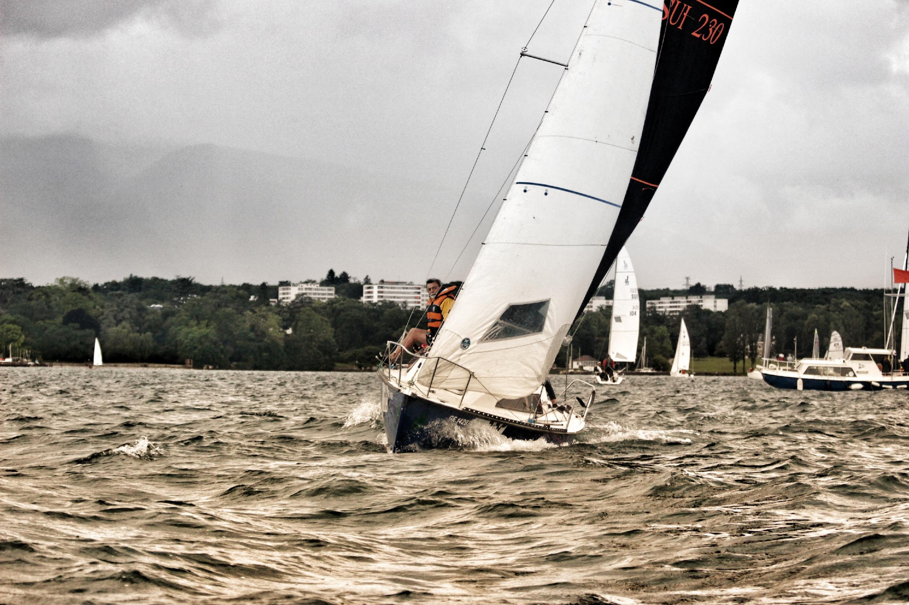
Internal Regattas
SAVE THE DATES !!
22 June | CERN Cup
13 July | Match Race Melges15
30 July | Evening Themed Regatta
10 August | Match Race J70 - SU
31 August | Family & friends
28 Sept | Closing Regatta
Notes:
A
Quite a consolidated format:
Open to everyone, social and fun event
CERN CUP a bit more competitive Sunday event
Evening regatta often themed Wednesday
Family and friends very chill Sunday
Closing on the last Sunday of September

Slide 12
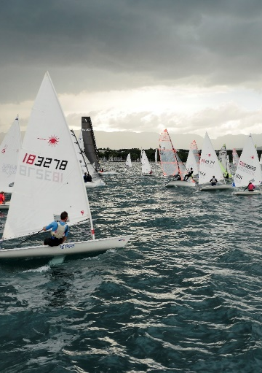

30th June to 4th of July
Part of championnat
du Petit Lac
Local beer, wine,
catering.
Music and
animations
every evening.
Notes:
AL

Slide 13
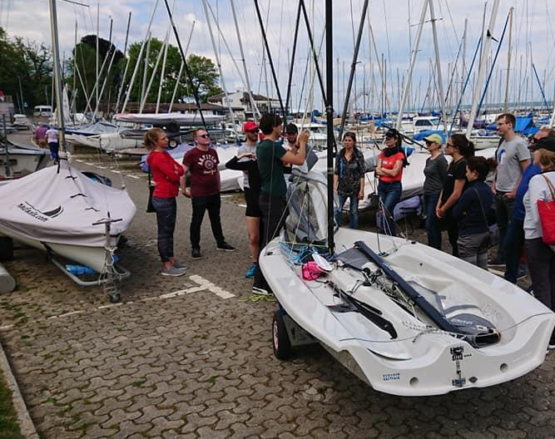
Level 0
Theoretical Introduction
On the Water
Dates TBC :
12th April (Sat)
13th April (Sun)
11th May (Sun)
  no sailing experience, and would like to get your first introduction to the world of sailing.
Level 0 is not mandatory but recommended for:
Recommended before Competent Crew course (CC).
  have sailing experience and would like to meet other enthusiasts while getting a great introduction to the Club.
Notes:
Ana
The course is free of charge.
During 1 day in Versoix you will:
go sailing on a big keelboat (2h)*
learn how to rigg the dinghies (1h30)
learn basic and necessary knots (1h30)
have a safety briefing
have some social activity and general information about the Club and the Port.
Course Prerequisites:
You are a new YCC member for the current year, have no previous sailing experience, and would like to get your first introduction to the world of sailing.
You are a new YCC member who already has some sailing experience and would like to meet other enthusiasts while getting a great introduction to the Club.
One of the core concepts of YCC is sharing, so feel free to come, meet new people, and share your knowledge!
"Level 0 course scope is 3 lessons: 1h knots, 1h rigging and 3h sailing outing - all done in 1 day.
The subscription to Level0 course is possible by filling the Level 0 registration form.
there is a whatsapp group for the participants, contact the coordinator.
Meeting point: la Bouvette
Course Coordinator: Anastazja

Slide 14
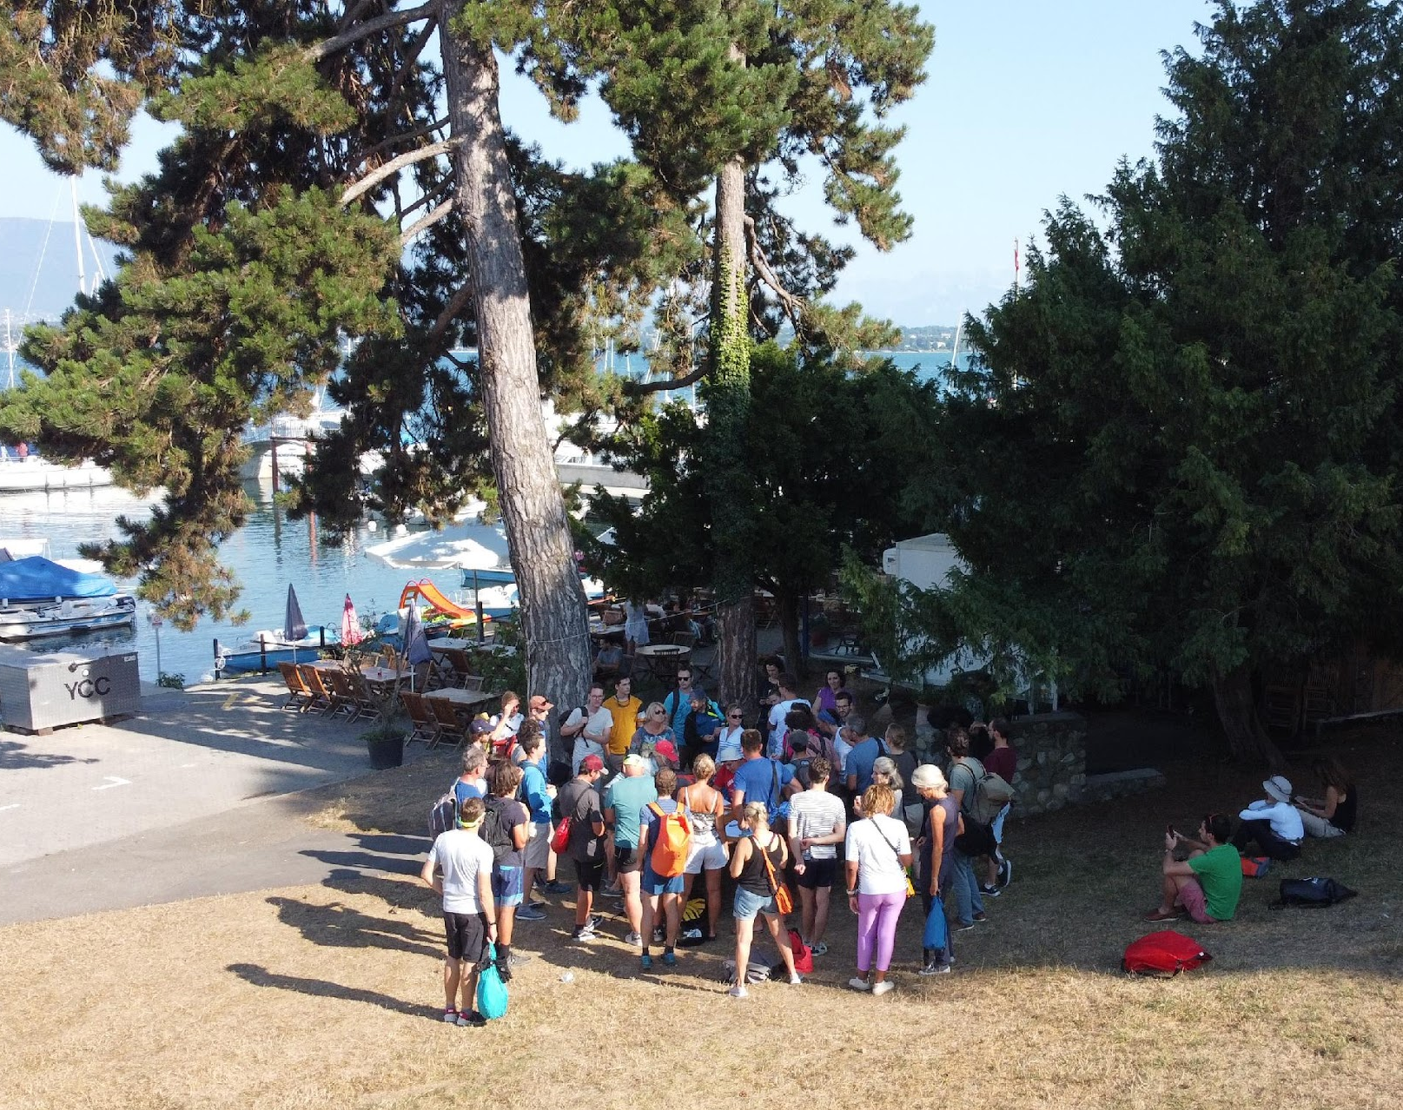
Thursday Practice
Why so important?
What is it?
How to attend?
Notes:
F
Ask to a new comer, when is it? We do not need to tell you that Thursday practice is on Thursday right?
During the sailing season (April-October), the YCC runs practice sessions every Thursday night except on public/CERN holidays. The idea is that all members of the YCC can gain experience, both on boats for which they hold a license and on those for which they intend to get one.
Allocation of places on the boats starts at 18h00 in front of the Regatta box, next to the CNV sailing school.
Registration is mandatory, go on the website to register,
link is updated every week
allocation is made on a lottery bases if the outing is overbooked, you can chrome to the port as often there are no shows.
Sailing lasts in general from 18h00 to 20h00 or sunset, whichever is earlier.
During these practice sessions, there is always surveillance. That is why we count on all our members to volunteer at least once per season to participate during one of he Thursday night practices. If you didn't sign up for this year yet, please have a look at the surveillance pages.

Slide 15
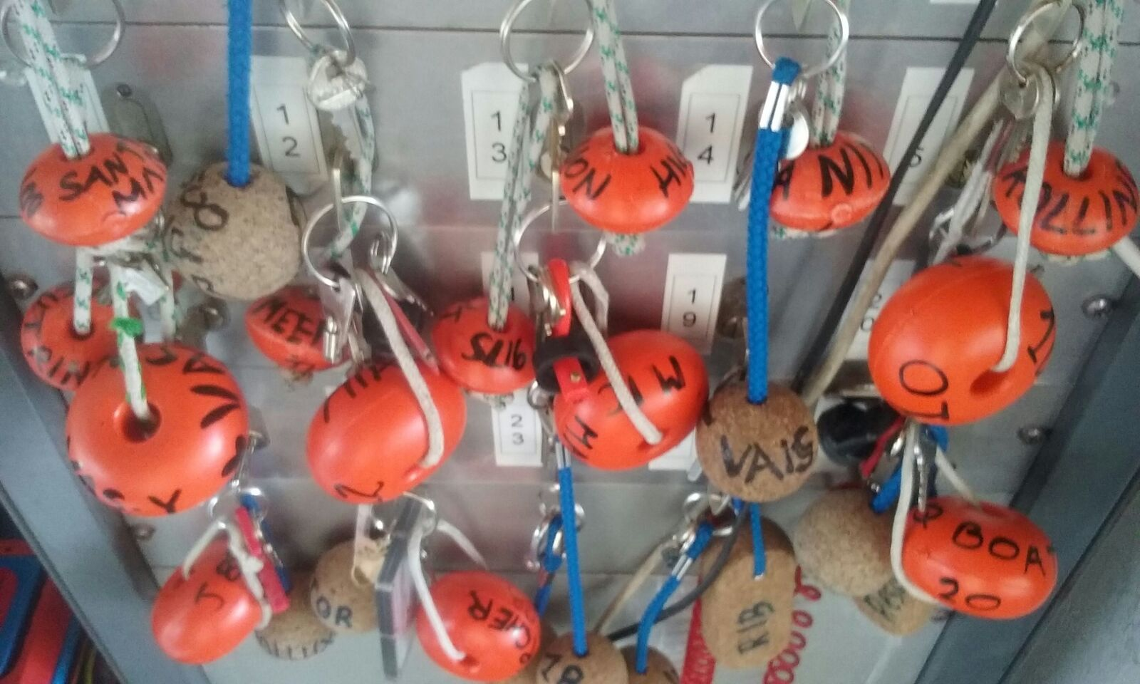
The Key System
How to become a skipper
Notes:
F
How to become a skipper and enjoy beers on the boat with friends?
You do not need to take a course to request a test and get a key.
3 Helping session: 1 maintenance and 2 sourveillance (or 1 sourveillance and 1 helpers)
Tests requisites are on line
some keys have a test card
Reservation rules and How to reserve a boat will be explained by your skipper.
Licences Requisite for french and swiss people differences, so plan it in advance. Chekc it on the SU page.
Theory can be passed before the SU test – swiss theory test is accepted - Rob venoff responsible for exams
Weather forecasts limits for sailing.

Slide 16
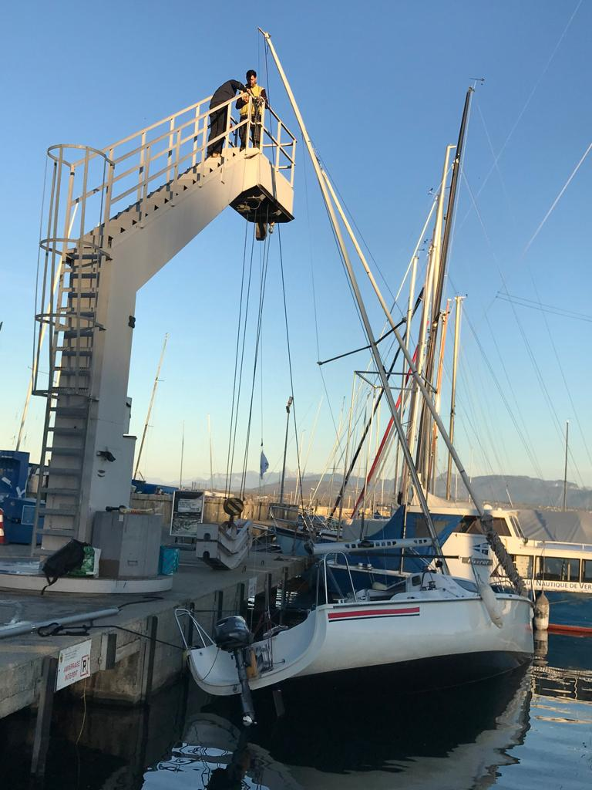
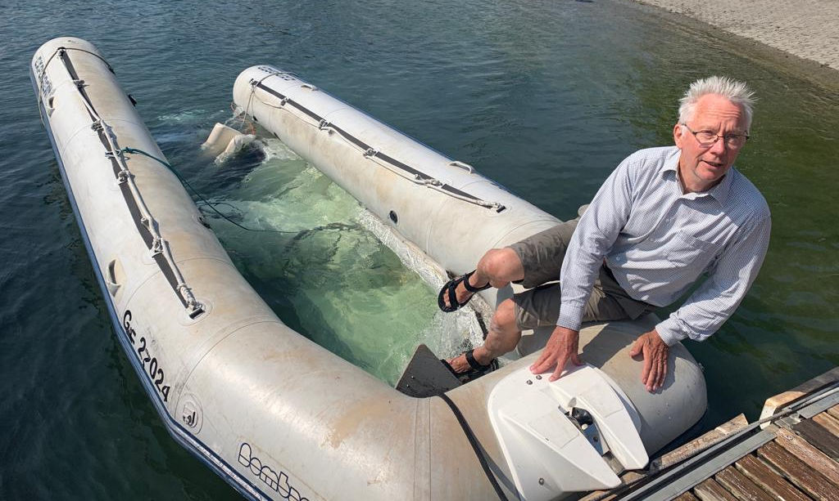
Maintenance and accidents :
I break,
I must repair
I see,
I repair
Why is so important?
How to do it?
Reporting System
Notes:
F
low annual membership fees.
Sail repair kit
Mobydick ans SUI 46,16 Mies Signing or reimbursement for less than 200 CHF
detailed logbooks
Boat logbook
Take Photos
Maintenance documentation and coordinatoors
We are covered, it is like driving a car, you are abliged to act as a driver do not hide.

Slide 17
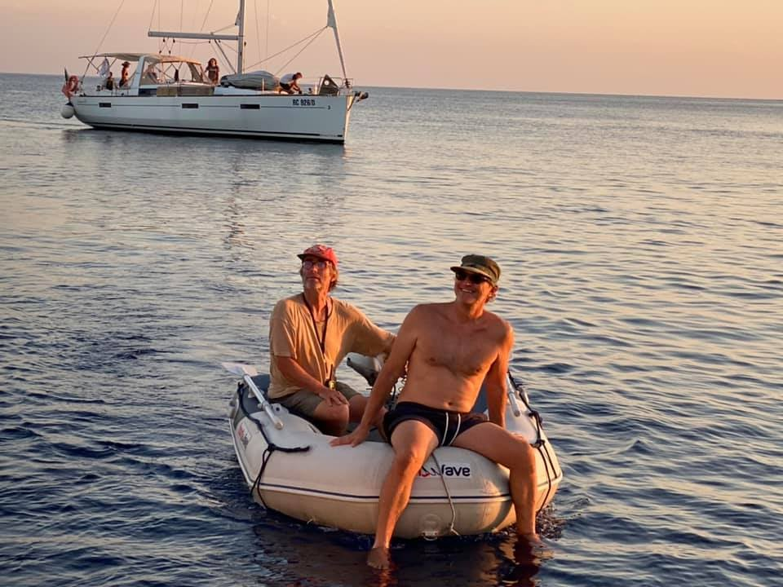
YCC Cruise
What is it.
When.
September 6th to 13th
Where.
Alimos Marina, near Athens, Greece
Notes:
F
Dear YCC Sailors,
The 2025 edition of our traditional Jeûne Genevois Cruise will happen from Saturday, September 6th to Saturday, September 13th, in Alimos Marina, near Athens, Greece.
The YCC has secured the reservation of 8 boats for this voyage
If you wish to alert friends who are not currently YCC members he need to become a member

Slide 18
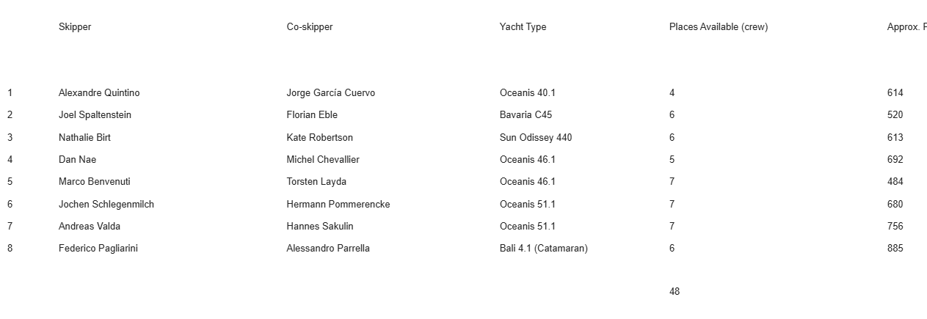
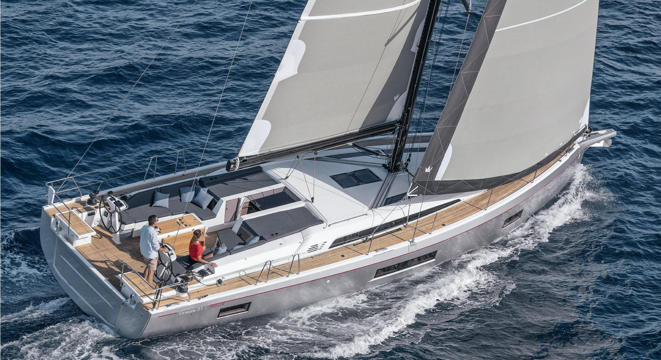
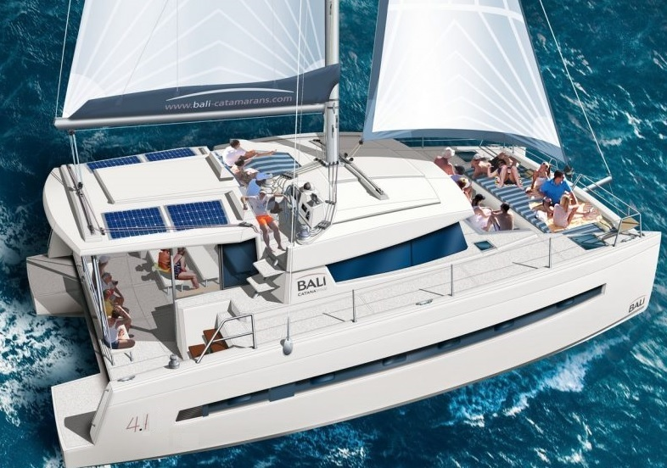
Notes:
F
name the skippers and the two types of boats

Slide 19
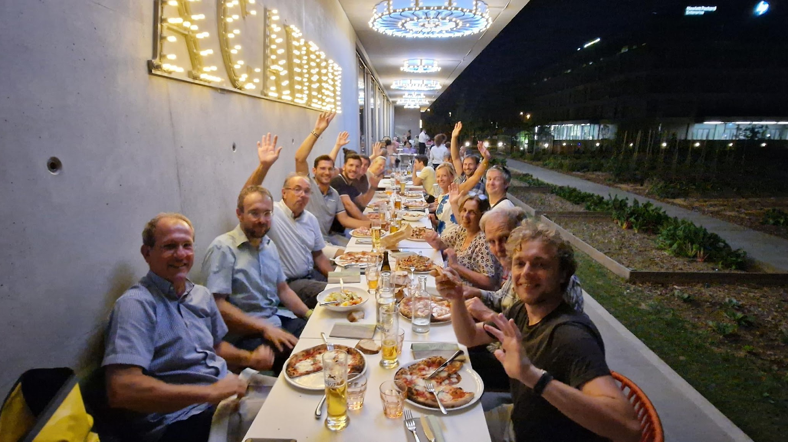
The Committee
Notes:
A
Federico, myself and …
Call all the committee members to show up

Slide 20
Alberto Pace
President, Legal matters
Torsten Layda
Vice-President, Keelboat (SU,J, GS, D3) course coordinator
Marine Pace
Secretary, Newletters
Diogo Monteiro
Treasurer
Michel Chevallier
Courses and tests coordinator
Bartlomiej Urbaniec
Computing infrastructure, Motor boat maintenance
Yazan Savoy
Yngling Maintenance Coordinator. D3 maintenance
Stefan Biereigel
Dinghy Course Coordinator
Michael Van Eck
Motorboat maintenance coordinator, 'Carte Grise' LIbrarian
Gonzalo Fernandez Penacoba
Catamaran courses, catamaran maintenance coordinator
Gijs De Rijk
GS maintenance coordinator, launching/berthing fleet coordinator, moorings, GS courses
Anne-laure Lamure
Semaine du Soir coordinator, catamaran maintenance
Hermann Winrich Pommerenke
Dinghy maintenance coordinator
Mario Campanelli
Spinnaker Course Coordinator
Francesco Monti
Surprise and J keelboats maintenance coordinator, Webmaster, SdS helper
Haude Morel
Insurances
Timothy Foster
Versoix moorings, General maintenance coordinator, maintenance tests
Mariarosaria D'alfonso
Internal Regattas
Marcel Arditi
M tests coordinator
Lajos Cseppento
Surveillance shifts coordinator, surveillance software
Vittorio Parma
BA5 access and safety officer, crane coordinator, D3 maintenance coordinator
Silvia Costantini
Yngling course coordinator
Michal Kwiatek
Trailers maintenance coordinator, RIB maintenance, Data privacy
Nathalie Birt
External regattas, regatta training, Link with Swiss Sailing League
Alessandro Parrella
Social activities
Federico Pagliarini
Club contact person, Thursday Outing coordinator
Marco Benvenuti
YCC Cruises

Slide 21
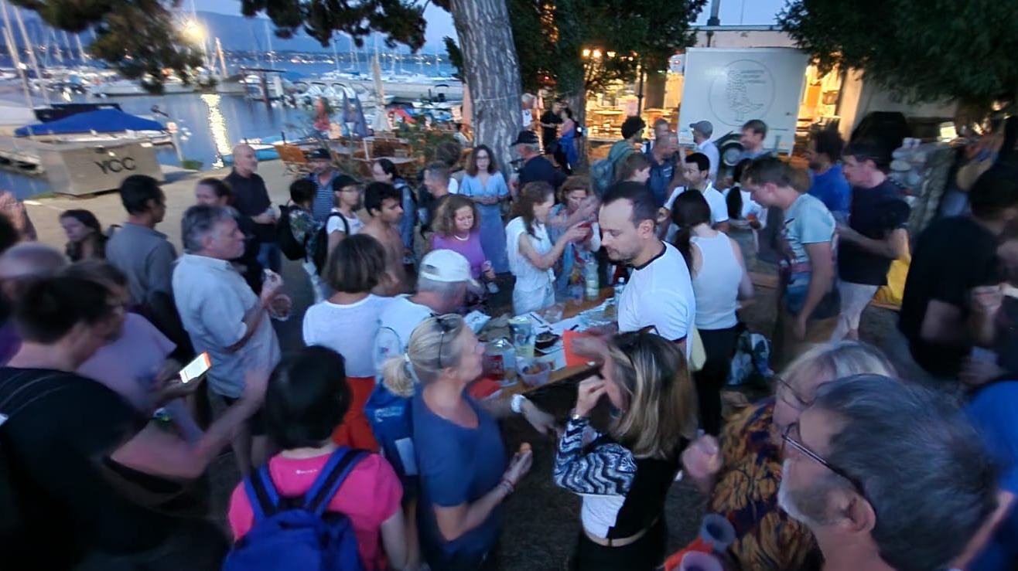
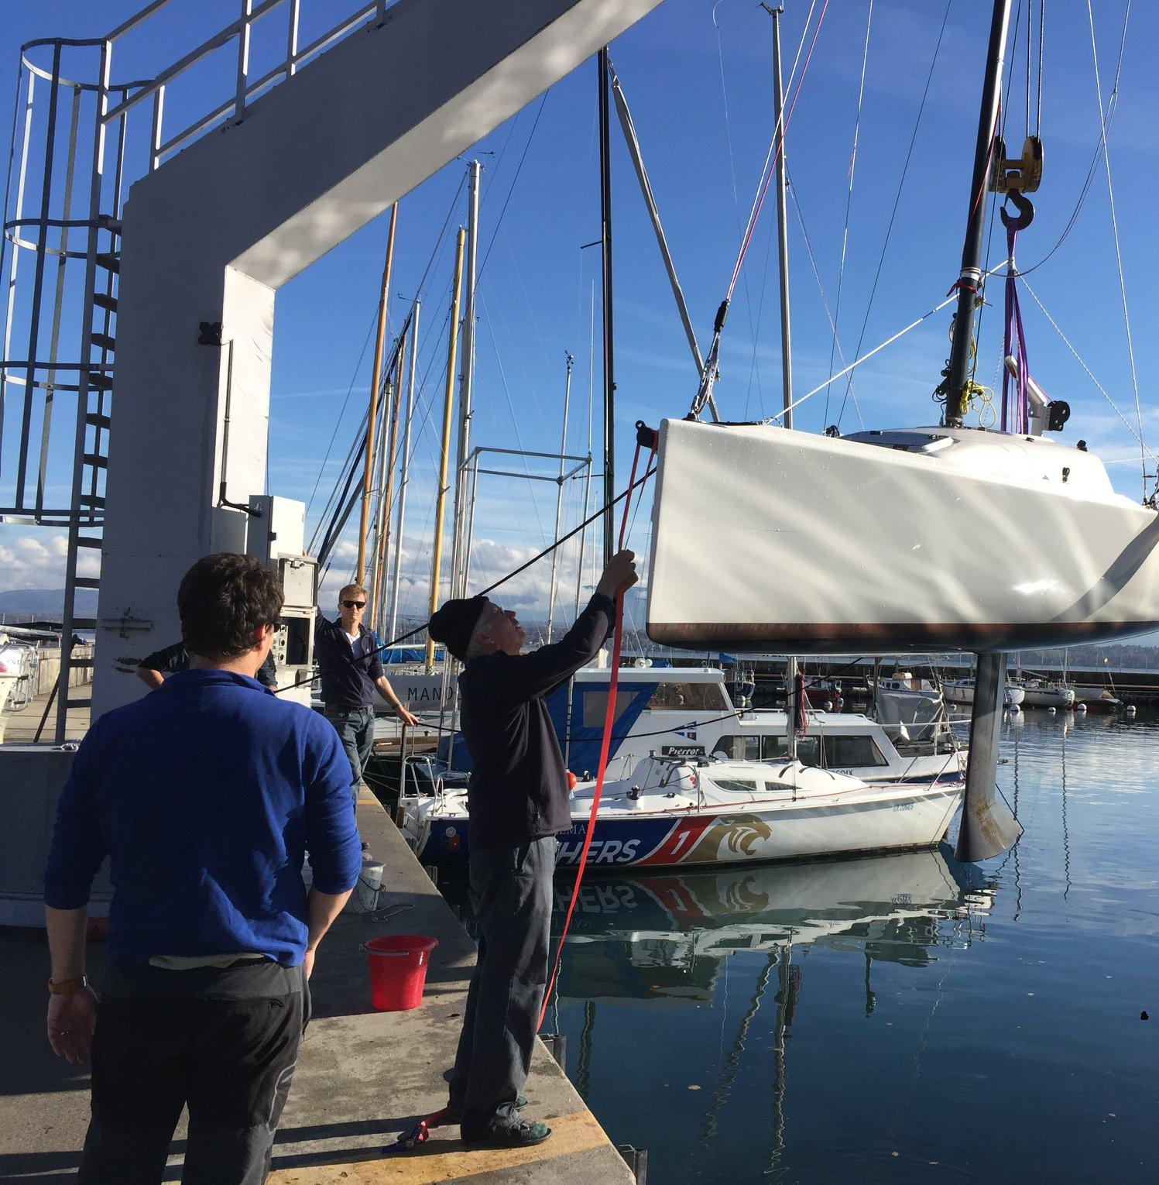
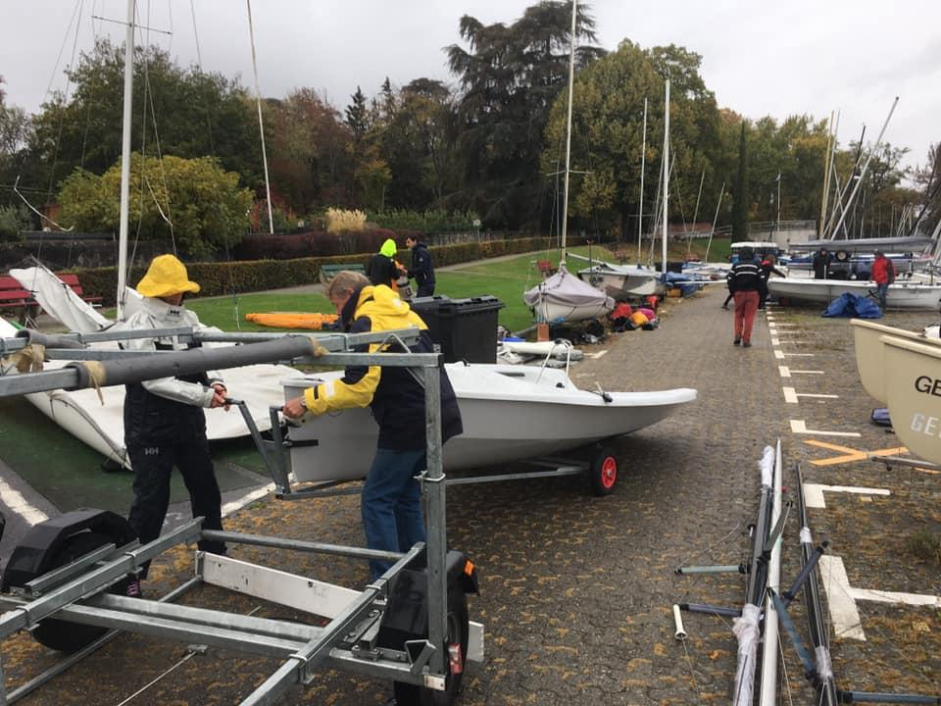
Launching of the fleet
it starts with you
SATURDAY, 5th April, from 8 am !!
Notes:
A
Gijs is coordinating
Fede and I will try to caffeinate and restore the volunteers with fresh brewed coffee and fresh Pan chocolate..
The more we are the easier it will be..
Great opportunity to get to know our boats, their main parts and mostly the veteran club members that know how to sail them, but also to rig and repair them when needed…

Slide 22
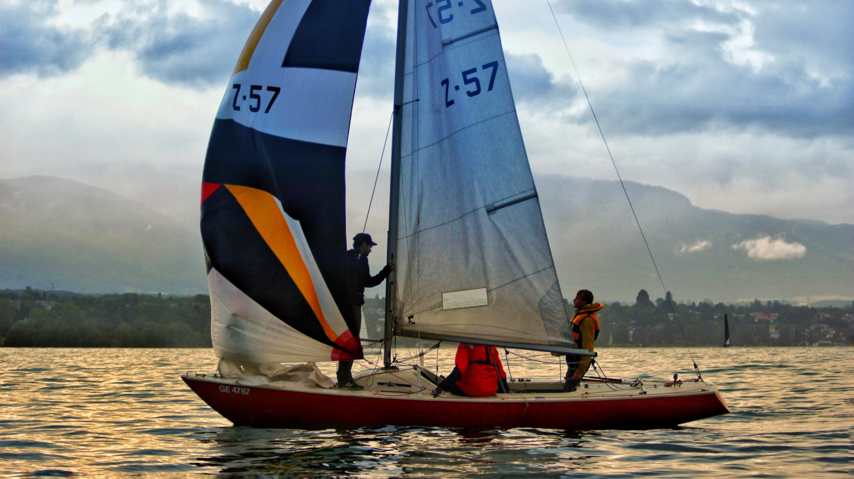
How to join and stay in contact with YCC?
Website:
https://yachting.web.cern.ch/
Instagram
youtube
Whatsapp

Slide 23
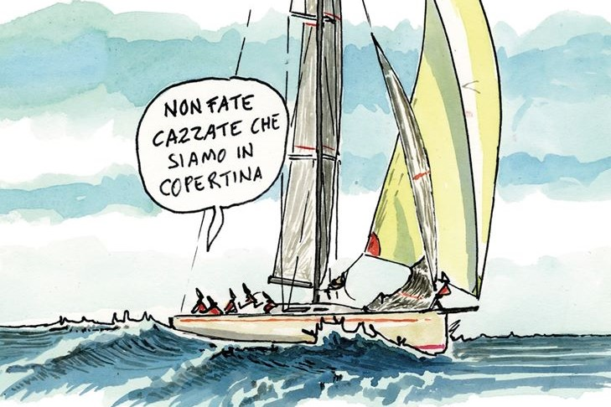
Questions?
Notes:
For any doubt go on the documentation page of the YCC

