Slide 1

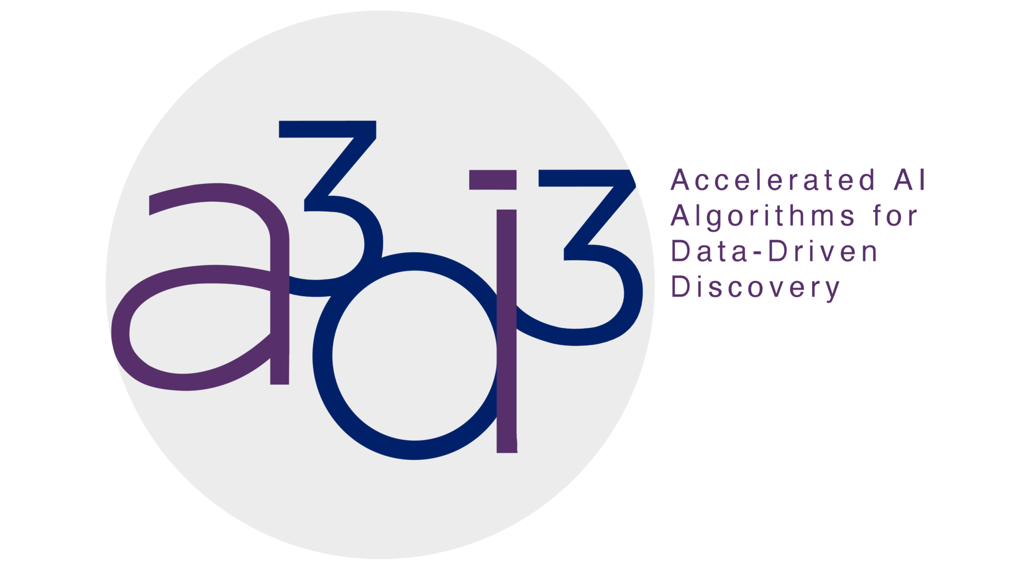

Closed-Loop Brain-Computer Interfaces for the Treatment of Brain Disease and Brain Disorders
Presenter: Dr. Hao Fang
Nov 19, 2025
Notes:
25’

Slide 2
Overview
Introduction of Brain-Computer Interfaces
Neural Transformer for Intracortical Motor Decoding (Afternoon session by Trung Le)
Robust Adaptive Brain-Computer Interfaces for Treating Brain Diseases and Disorders
Conclusions and Q&A
1
Notes:
25’

Slide 3
Overview
Introduction of Brain-Computer Interfaces
Brain decoding: read from the brain
Neuromodulation: write to the brain
Neural Transformer for Intracortical Motor Decoding (Afternoon session by Trung Le)
Robust Adaptive Brain-Computer Interfaces for Treating Brain Diseases and Disorders
Conclusions and Q&A
21
Notes:
25’

Slide 4
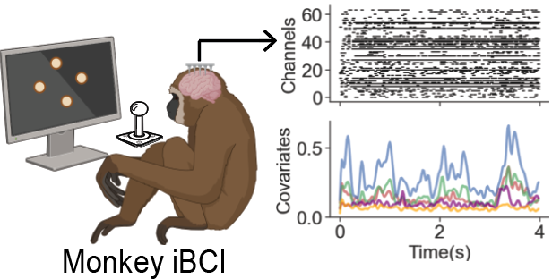
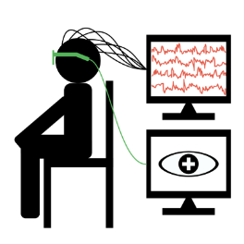
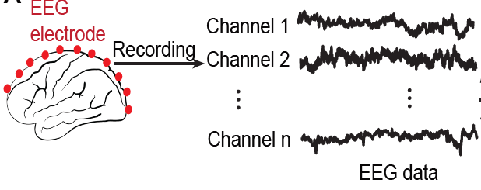
Introduction: read from the brain
Intracortical and non-invasive BCI decoding
Non-invasive BCI
Example 1: decode cursor/joystick movement^{1,2}
Example 2: decode human emotion activity^{3,4}
[1] Nason et al., Neuron., 2021;
[2] Rouse et al., Cell Report,2019;.
[3] Drevets, Curr Opin Neurobiol, 2001;
[4] Mayberg, Br Med Bull, 2003
3
Notes:
25’

Slide 5
Overview
Introduction of Brain-Computer Interfaces
Brain decoding: read from the brain
Neuromodulation: write to the brain
Neural Transformer for Intracortical Motor Decoding (Afternoon session by Trung Le)
Robust Adaptive Brain-Computer Interfaces for Treating Brain Diseases and Disorders
Conclusions and Q&A
21
Notes:
25’

Slide 6
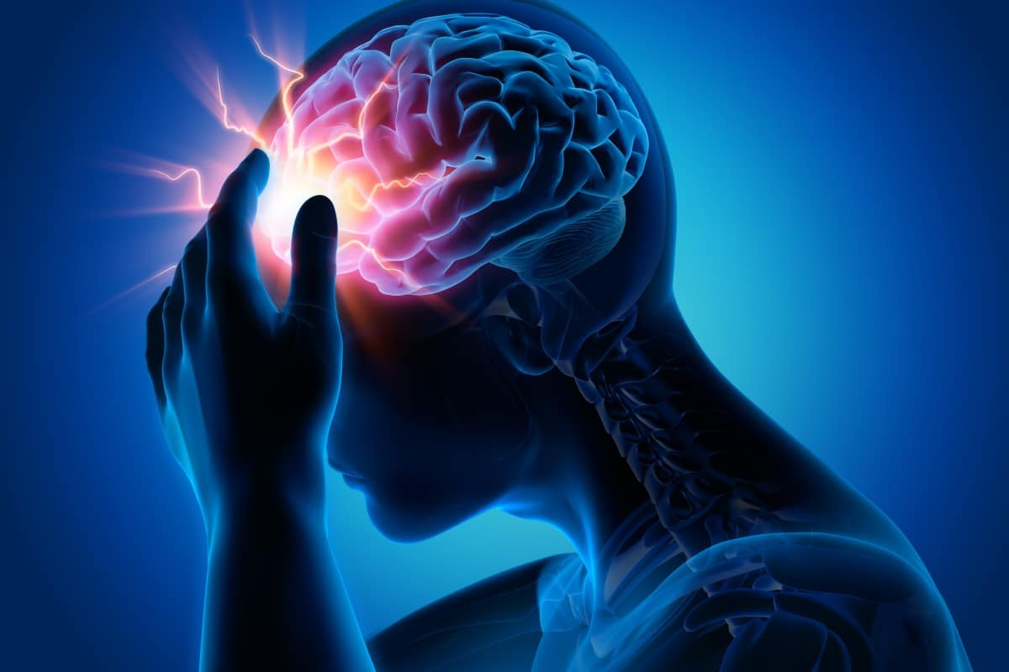
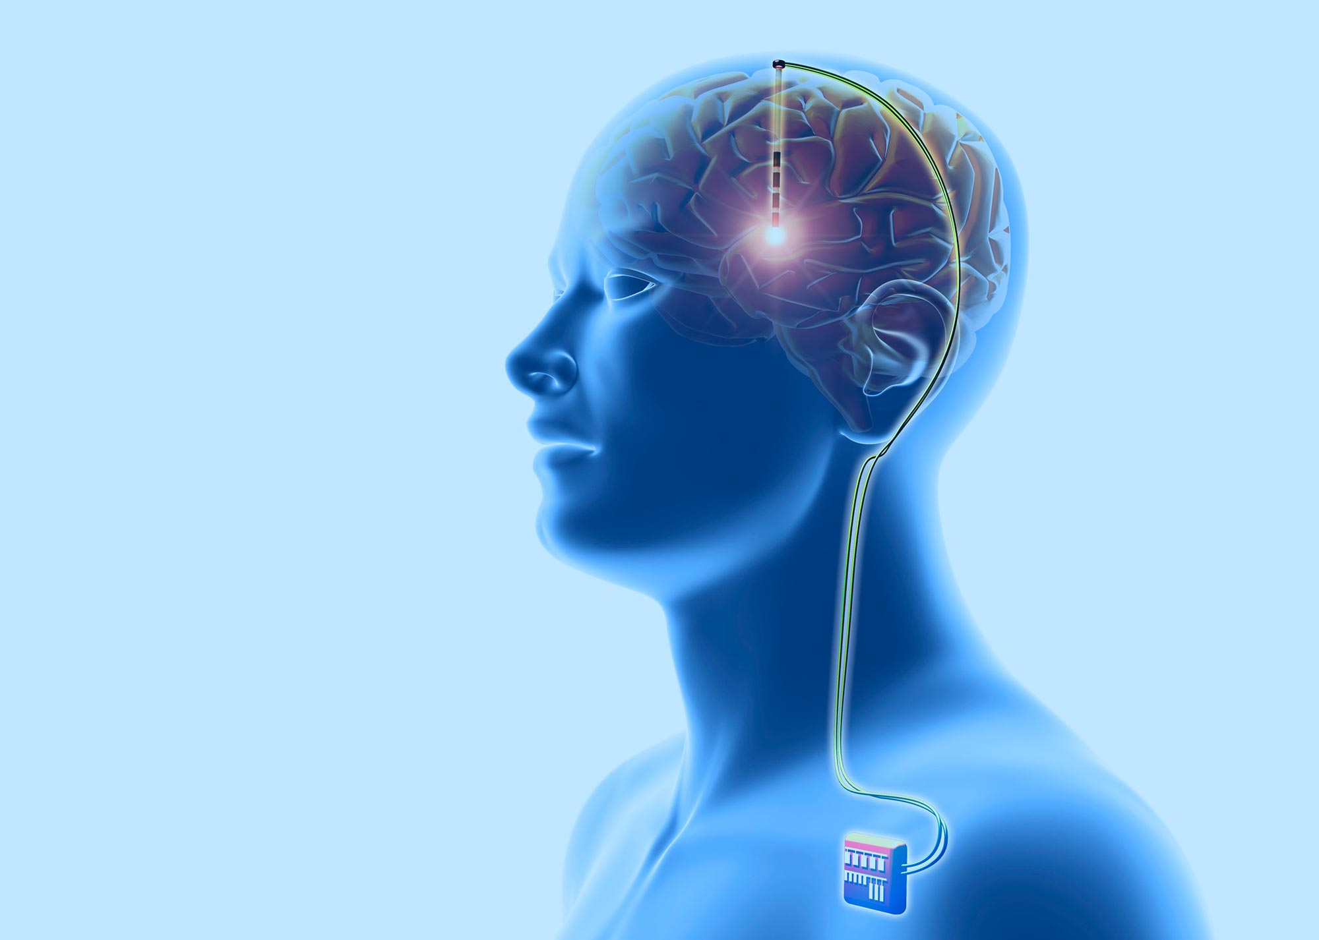
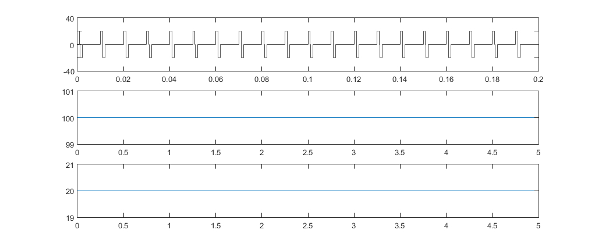
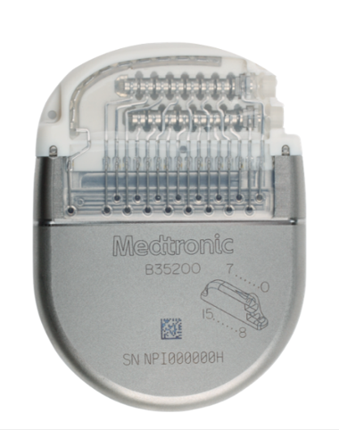
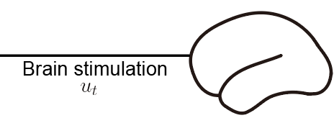
Introduction: write to the brain
Neurological and neuropsychiatric disorders
Parkinson’s disease
Alzheimer disease
Epilepsy
Major depressive disorder
Seizure
Reports from Global Health Metrics
Prevalence > 1 billion¹
> 30% MDD and epilepsy patients are drug-resistant^{2,3}
Annual economic burden > 1 trillion $
Neuromodulation technology
[1] James et al., Lancet., 2018;
[2] Rush et al., Am. J. Psychiatry., 2006;
[3] Kwan et al., NEJM., 2000;
4
Notes:
25’

Slide 7
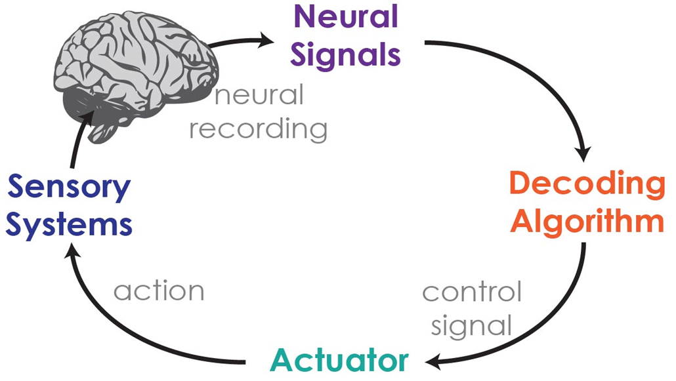
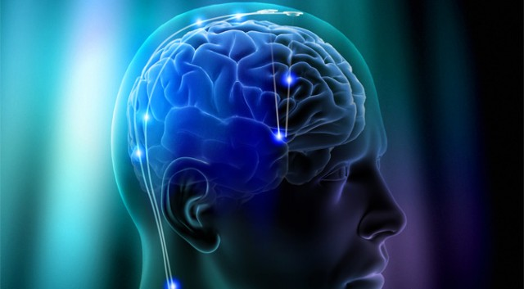

Introduction: next-generation of BCIs
Closed-loop BCIs
Systems and control theory
Machine learning
Neuroscience
Write to the brain
Read from the brain
Treatment of brain dysfunctions
Modulation of brain states and functions
Scientific discovery
5
Notes:
25’s

Slide 8
Overview
Introduction of Brain-Computer Interfaces
Brain decoding: read from the brain
Neuromodulation: write to the brain
Neural Transformer for Intracortical Motor Decoding (Afternoon session by Trung Le)
Robust Adaptive Brain-Computer Interfaces for Treating Brain Diseases and Disorders
Conclusions and Q&A
21
Notes:
25’

Slide 9
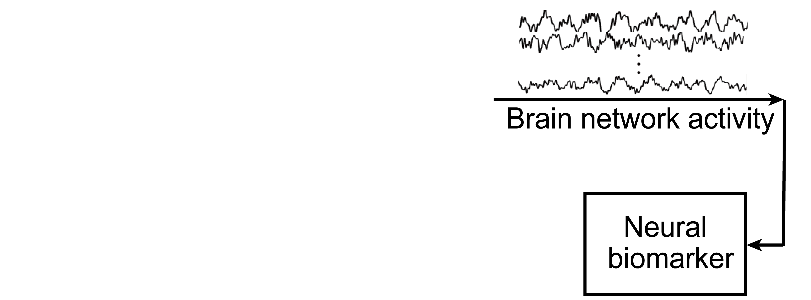
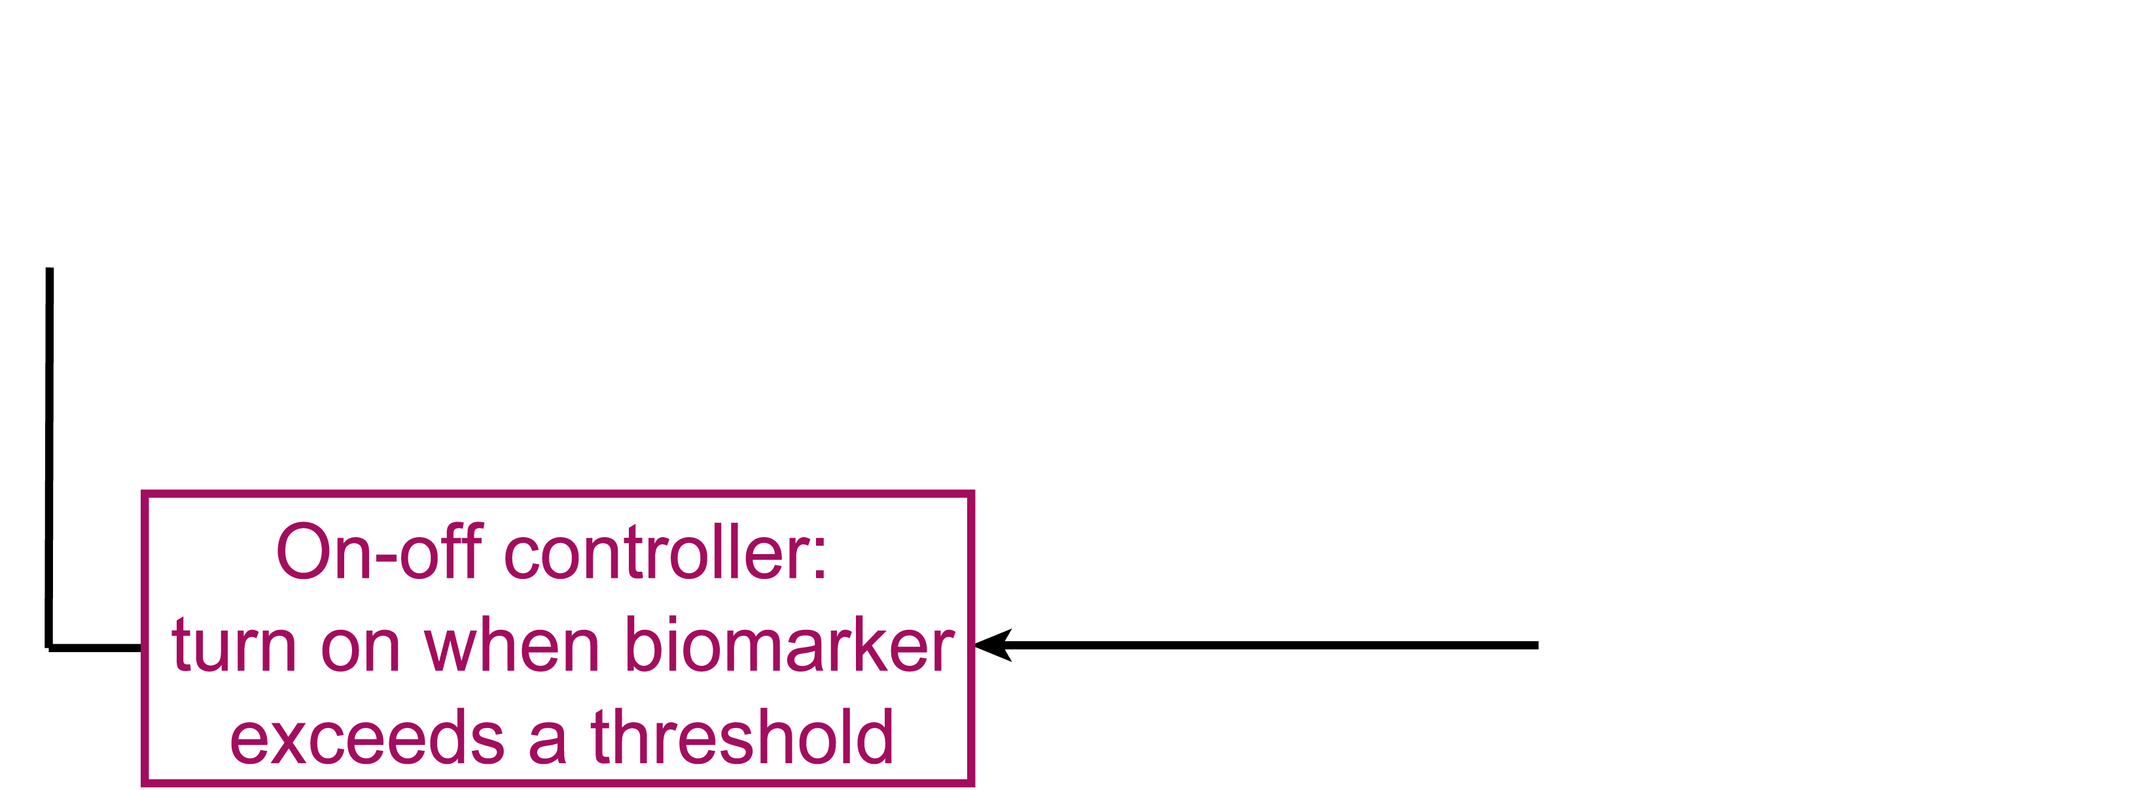
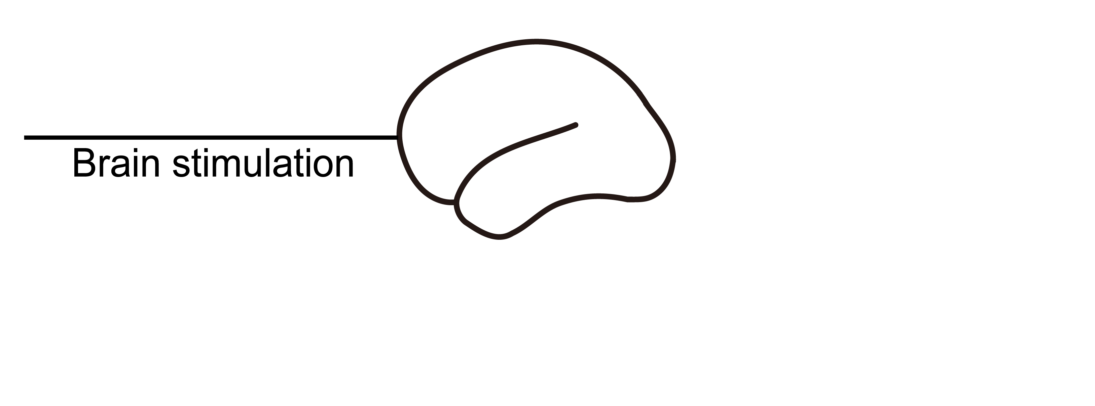
From brain decoding to brain stimulation
Open-loop deep brain stimulation^{1,2} (DBS)
Uncontrolled symptom variations
Variable efficacy
Consider the dynamics of brain network and build a model-based closed-loop controller
Prototype closed-loop deep brain stimulation^{3,4} (DBS)
Model-less, on-off control
Efficacy needs improving
[1] Mayberg et al., Neuron., 2005;
[2] Vissani et al., J. Neural Eng.,2020;
[3] Swann et al., J. Neural Eng., 2018.
[4] Ben-Menachem and Krauss, Nat. Rev. Neurol., 2014.
17
Notes:
60’
A promising treatment for these drug-resistant patients is to use neuromodulation technology. Today, the electrical brain stimulation is one of the most successful neuromodulation technology. In our work, we focus on one type of invasive neuromodulation method that is deep brain stimulation. Here an electrode is implanted into a certain brain region, and it generates tiny electrical pulses to stimulate that brain region to alleviate the disorder symptoms. However, studies showed that the treatment results based on the open-loop design of neuromodulation technology has suffered from several issues, such as uncontrolled symptom variations, unpleasant side effects, and variable efficacy. More recently, the closed-loop neuromodulation design has been proposed where it simply use on-off controller design: it automatically turns on when the neural biomarker exceeds the threshold. However, this prototype closed-loop DBS is model-less. We claim that we need to model the brain network dynamics and build model-based controller.

Slide 10
Overview
Introduction of Brain-Computer Interfaces
Brain decoding: read from the brain
Neuromodulation: write to the brain
Neural Transformer for Intracortical Motor Decoding (Afternoon session by Trung Le)
Robust Adaptive Brain-Computer Interfaces for Treating Brain Diseases and Disorders
Model brain dynamics based on the decoding results
Robust adaptive modeling and neuromodulation design
Conclusions and Q&A
21
Notes:
25’

Slide 11
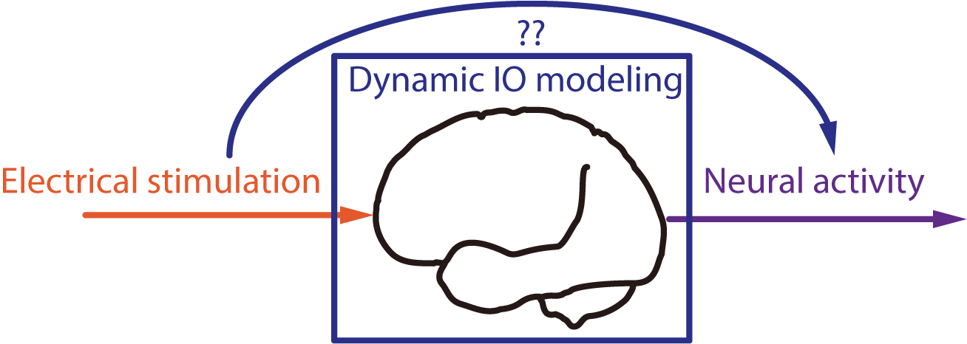
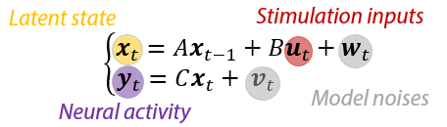
Modeling Brain Response to Stimulation
From brain output to stimulation input
Input
Output
What do we need to model?
Response of Neural activity to Electrical stimulation
IO model structure:
1) Dynamic linear state-space model
2) Amenable for controller design
Fit model parameters
A, B, C, W, V?
Control Theory: system identification
11
18
Notes:
60’
The first question is, what exactly do we need to model?
we need to model the response of neural activity to the electrical stimulation.
For effective modeling, we need the model structure to be dynamic and prefer a linear model that is amenable for controller design.
Therefore, we build a multiple-input-multiple-output linear state-space model. In this model, the brain network activity is modeled as output, and the stimulation is modeled as input. The stimulation effect on brain network activity is modeled through a dynamic latent state. The dynamics of the latent state are described by the difference equation, where the current value of the latent state is recursively related to its past value in time as well as the current input.
Once we have the model, the next step is to fit the model parameters.

Slide 12
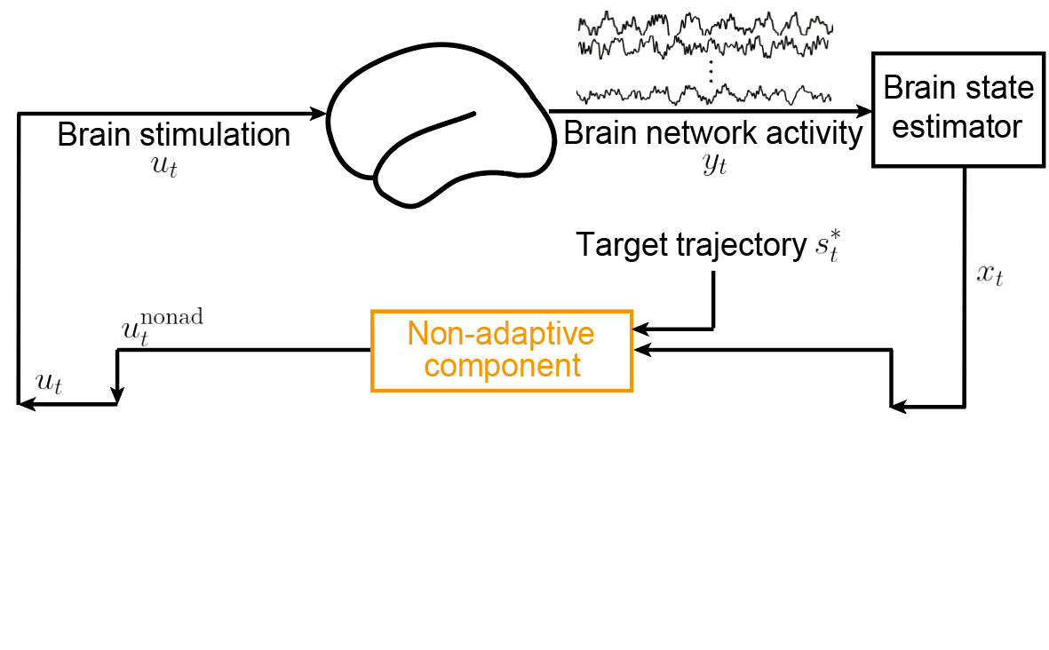
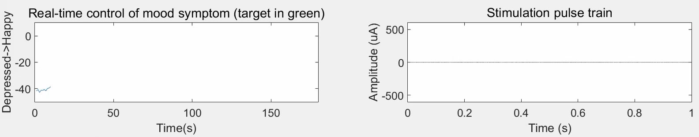



From Dynamic IO model to controller
Dynamic IO brain network model
$$x_{t+1}=Ax_{t}+Bu_{t}+w_{t}$$
$$y_{t}=Cx_{t}+v_{t}$$
Latent brain state estimator: Kalman filter
Linear controller, e.g., linear quadratic regulator (LQR)
$u_{t}^{nonad}=−K_{x}$ $x_{t}+K_{g}s_{t}^{∗}$
19
Notes:
40’
Assuming that we have already fitted an IO model offline, then a typical online closed-loop system consists of
a Kalman filter to estimate the hidden brain state and a linear controller such as LQR
Here is an example of computer simulation to regulate the brain state to follow a given therapeutic target.
We note that we term this linear controller as non-adaptive controller because once we obtain the IO model offline, its parameters are fixed and do not change or adapt during the stimulation.

Slide 13
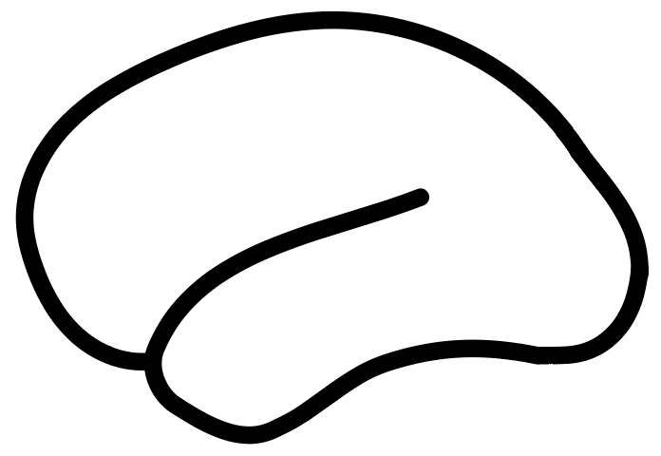
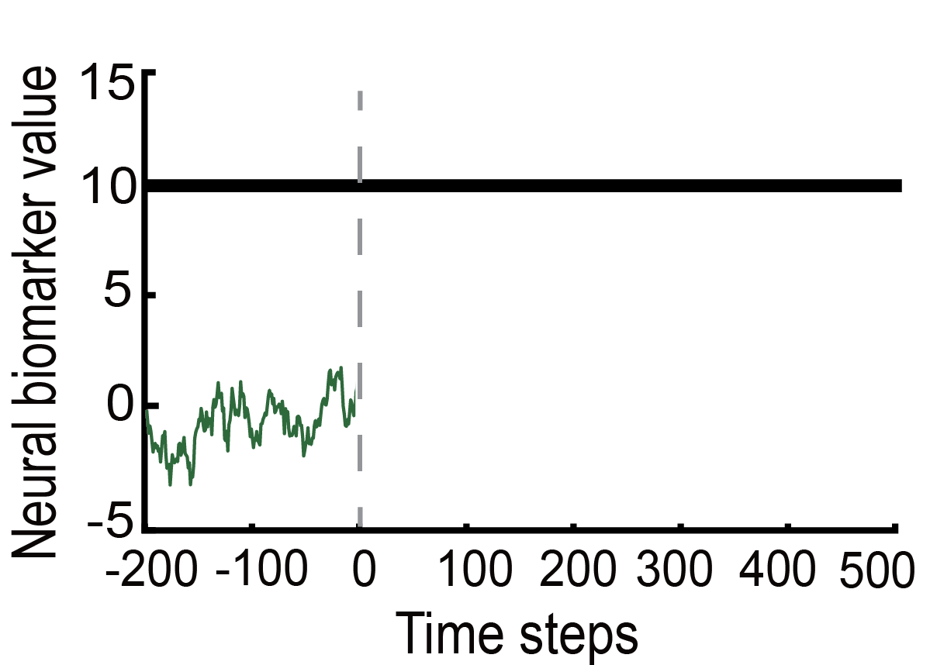
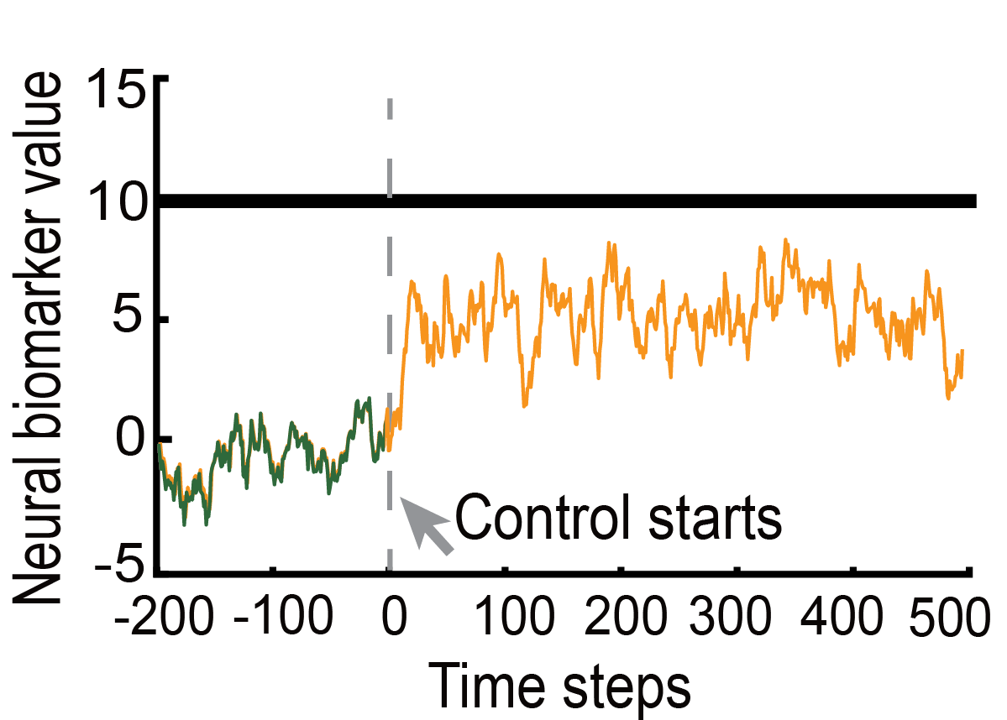



Model mismatch issues
Brain dynamics
Model used in controller design
Nonlinearity
Non-stationary
Disturbances
$$x_{t+1}=Ax_{t}+Bu_{t}+w_{t}$$
$$y_{t}=Cx_{t}+v_{t}$$
$$y_{t}=F(u_{t},t,v_{t})+w_{t}$$
Consider nonlinear modelling and
construct robust adaptive controllers
20
Notes:
80’
In the previous example, we achieve good control performance because the simulated brain is taken as the same model used in controller resign. However, this is not the case. The real brain dynamics have nonlinearity, time-variations, and disturbances that can happen DURING real-time stimulation, for example due to stimulation-induced plasticity, or unpredicted movements of recording electrodes. Since the nonlinearity, time-variations, and disturbances happen in real-time, they cannot be captured by the off-line fitted linear IO model a priori.
This means that there exists a mismatch between the real brain network dynamics and our model during real-time control.
Such a mismatch can greatly degrade the non-adaptive control performance as seen in the following example, where we add model mismatch in our simulation and now non-adaptive control results in a large control error.
So how can we close the gap introduced by this model mismatch?

Slide 14
Overview
Introduction of Brain-Computer Interfaces
Brain decoding: read from the brain
Neuromodulation: write to the brain
Neural Transformer for Intracortical Motor Decoding (Afternoon session by Trung Le)
Robust Adaptive Brain-Computer Interfaces for Treating Brain Diseases and Disorders
Model brain dynamics based on the decoding results
Robust adaptive modeling and neuromodulation design
Conclusions and Q&A
21
Notes:
25’

Slide 15
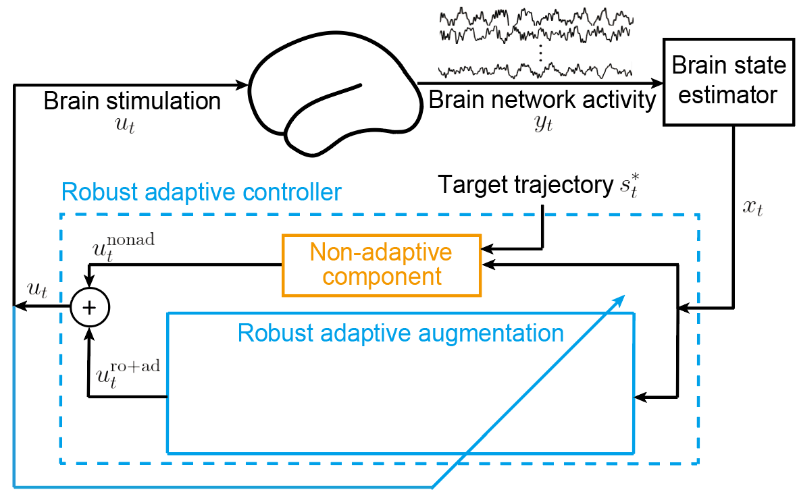

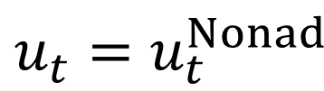

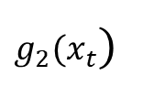
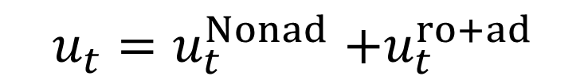


Nonlinear modeling and controller design
Orthogonal to $B, i.e.,{B′B}_{n}\text{ = 0}$
Nonlinear dynamic IO model with uncertainty
Dynamic IO model
$$x_{t+1}=Ax_{t}+B{(u}_{t}+∆ωu_{t}+g_{1}(x_{t}))+ { w}_{t}$$
$$x_{t+1}=Ax_{t}+B{(u}_{t}+∆ωu_{t}+g_{1}(x_{t}))+{{B_{n}g}_{2}\left(x_{t}\right)+w}_{t}$$
$$x_{t+1}=Ax_{t}+Bu_{t}+w_{t}$$
Range space uncertainty
Null space uncertainty
$$y_{t}=Cx_{t}+v_{t}$$
$∆ωu_{t}$: time-varying synaptic filtering gain
$g_{1}(x_{t}$): unknown current inputs
$g_{2}(x_{t}$): plasticity, movement of electrodes
Controller architecture
$$u_{t}{=u}_{t}^{Nonad}+u_{t}^{ro+ad}$$
$${u_{t}=u}_{t}^{Nonad}$$
directly cancel
partially cancel
$∆ωu_{t}+$ $g_{1}(x_{t}$)
$g_{2}(x_{t}$)
22
Notes:
120’
Our solution is to characterize the model mismatch as real-time model uncertainty and then develop a robust adaptive control method to deal with the model uncertainty in real time.
Specifically, instead of assuming that the brain dynamics is exactly linear, we build a nonlinear dynamic IO model with model uncertainty. We consider two types of model uncertainty. The first type is range space uncertainty because they are in the range space of the control input matrix B.
Delta omega is an unknown term and represents uncertainty in the control gain. In practice, it could represent the time-varying synaptic filtering gain at the stimulation side. G1 (x_t) is a nonlinear state-dependent term, it is again modeled as unknown, and could represent the unknown current inputs to the stimulation site from unrecorded brain regions. Both delta omega and g1 are in the range space of control, so theoretically, if they were known, they can be completely canceled by the stimulation.
The second type of uncertainty is null space uncertainty, it is in the null space of control because Bn is orthogonal to B. The nonlinear null space uncertainty g_2 can represent more complicated dynamics that cannot be directly canceled by stimulation, for example dynamics introduced by plasticity and unpredicted movements of electrodes.
Based on this model, we can then design a robust adaptive controller to deal with the real-time model uncertainty. The robust adaptive controller adds a robust adaptive augmentation term on top of the nonadaptive control term. The newly added robust adaptive augmentation aims to estimate and directly cancel the range space uncertainty and partially cancel the null space uncertainty at steady-state.

Slide 16
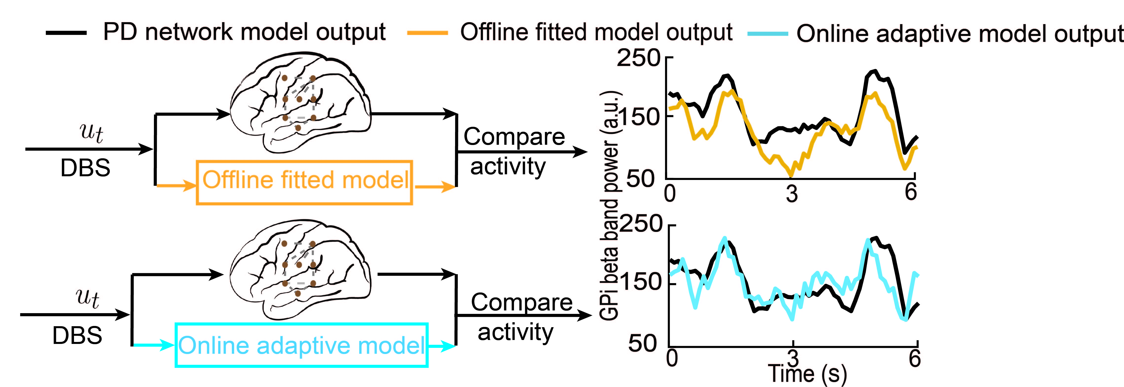
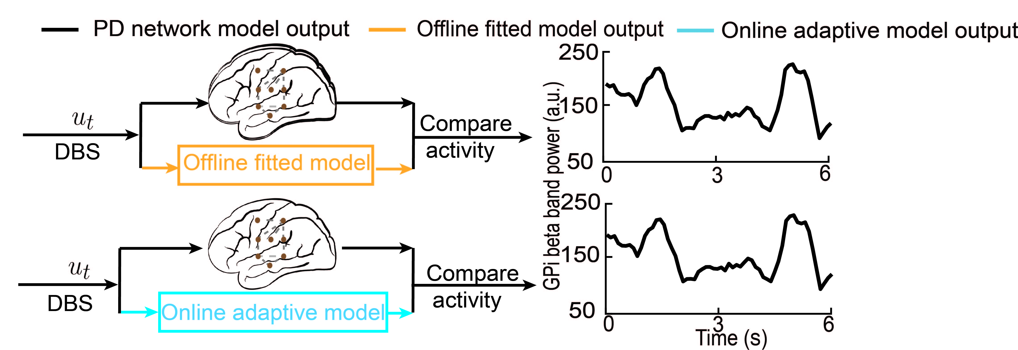
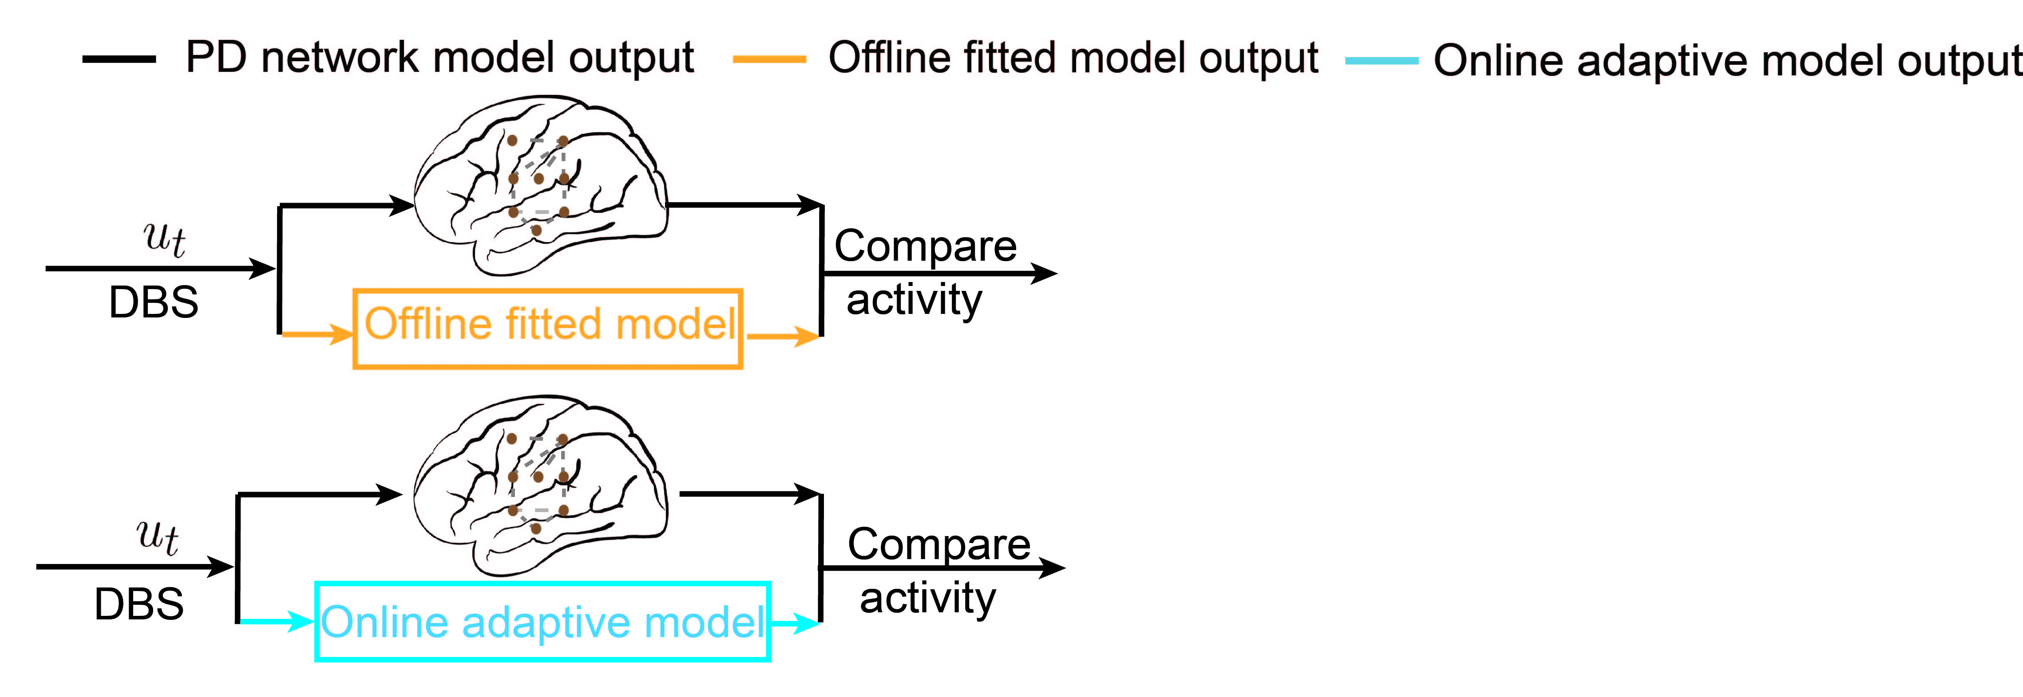
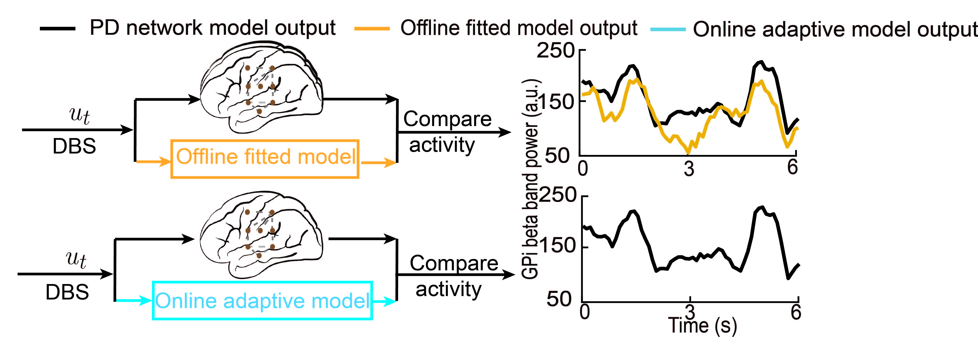
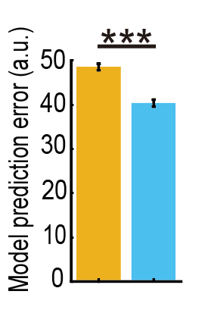


Evaluation of nonlinear framework
Evaluation of Nonlinear Modeling Framework in PD
$$x_{t+1}=Ax_{t}+B{(u}_{t}+∆ωu_{t}+g_{1}(x_{t}))+{{B_{n}g}_{2}\left(x_{t}\right)+w}_{t}$$
$$x_{t+1}=Ax_{t}+Bu_{t}+w_{t}$$
$$y_{t}=Cx_{t}+v_{t}$$
Comparison between offline and online model
23
Notes:
120’
Before we discuss about the detailed controller design. Let us first look the proposed nonlinear modeling framework. Here, we compare the prediction results with the prior proposed offline linear IO model.

Slide 17
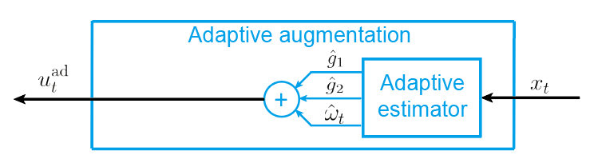
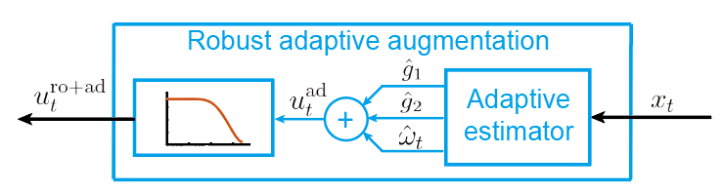
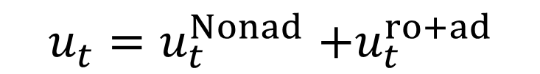

Controller design
Nonlinear dynamic IO model with uncertainty
$$x_{t+1}=Ax_{t}+B{(u}_{t}+∆ωu_{t}+g_{1}(x_{t}))+{{B_{n}g}_{2}\left(x_{t}\right)+w}_{t}$$
$$y_{t}=Cx_{t}+v_{t}$$
Controller architecture
$$u_{t}{=u}_{t}^{Nonad}+u_{t}^{ro+ad}$$
Low-pass filter
Recursive least squares
24
Notes:
50’
To design the robust adaptive augmentation, we first design an adaptive estimator to estimate the model uncertainties using recursive least squares and then construct an adaptive augmentation to cancel the uncertainties.
However, the adaptive augmentation term alone is not robust to disturbances and estimation errors which may lead to instability issues. Therefore, we further apply a low-pass filter to filter out high-frequency control signals. The low pass filter ensures that the controller cancels model uncertainty only within the bandwidth of the closed-loop system, which improves the robustness to high-frequency noise and disturbances.
With the adaptive estimator and the low-pass filter, we finish the design of the robust adaptive controller.

Slide 18
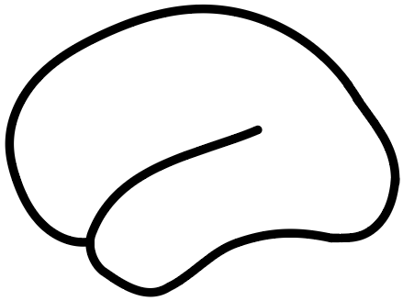
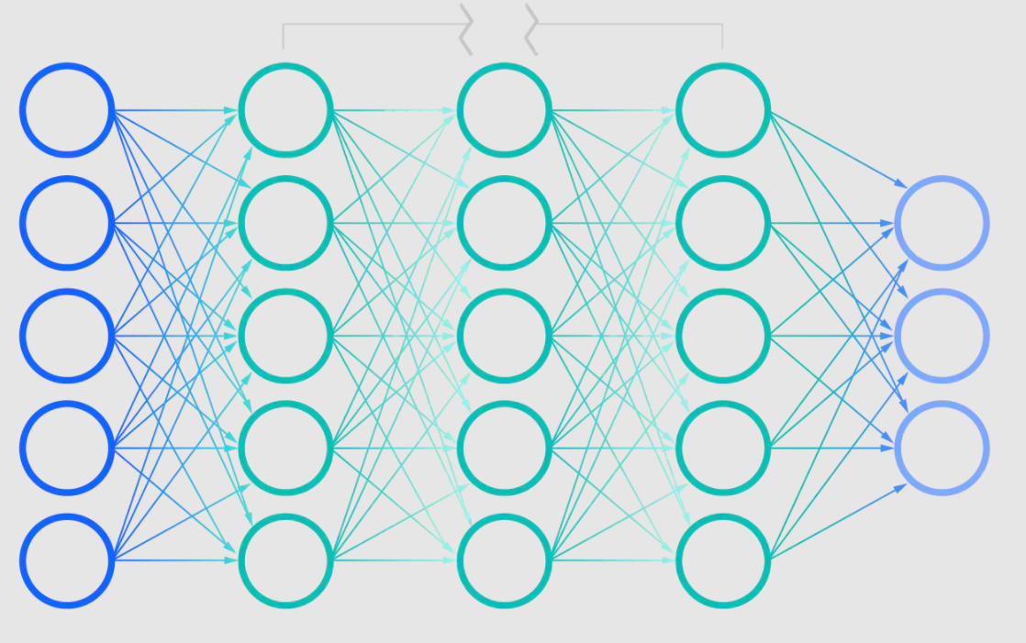
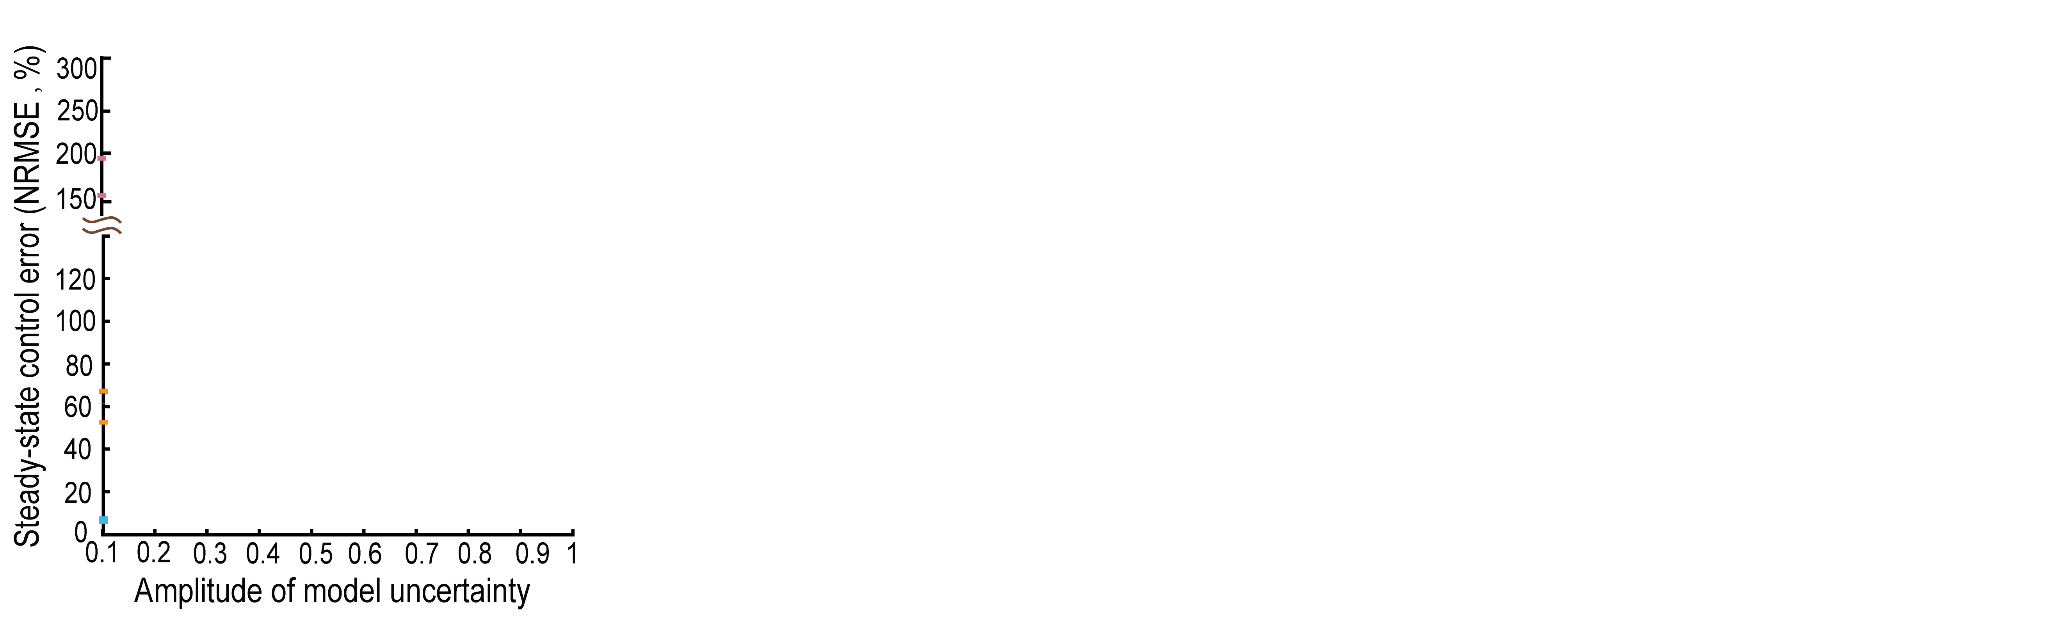


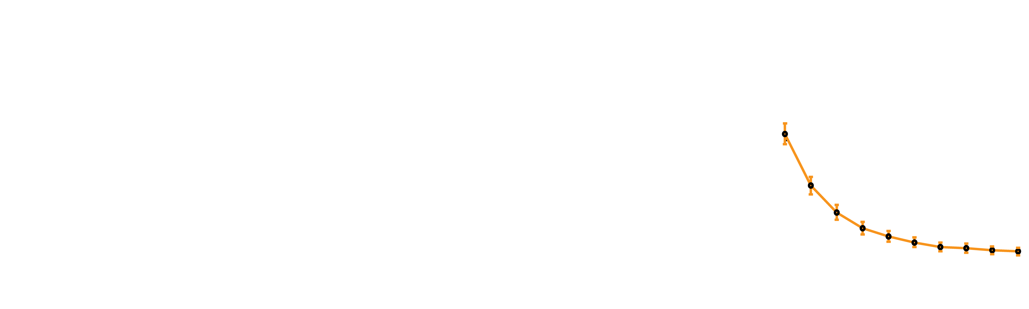
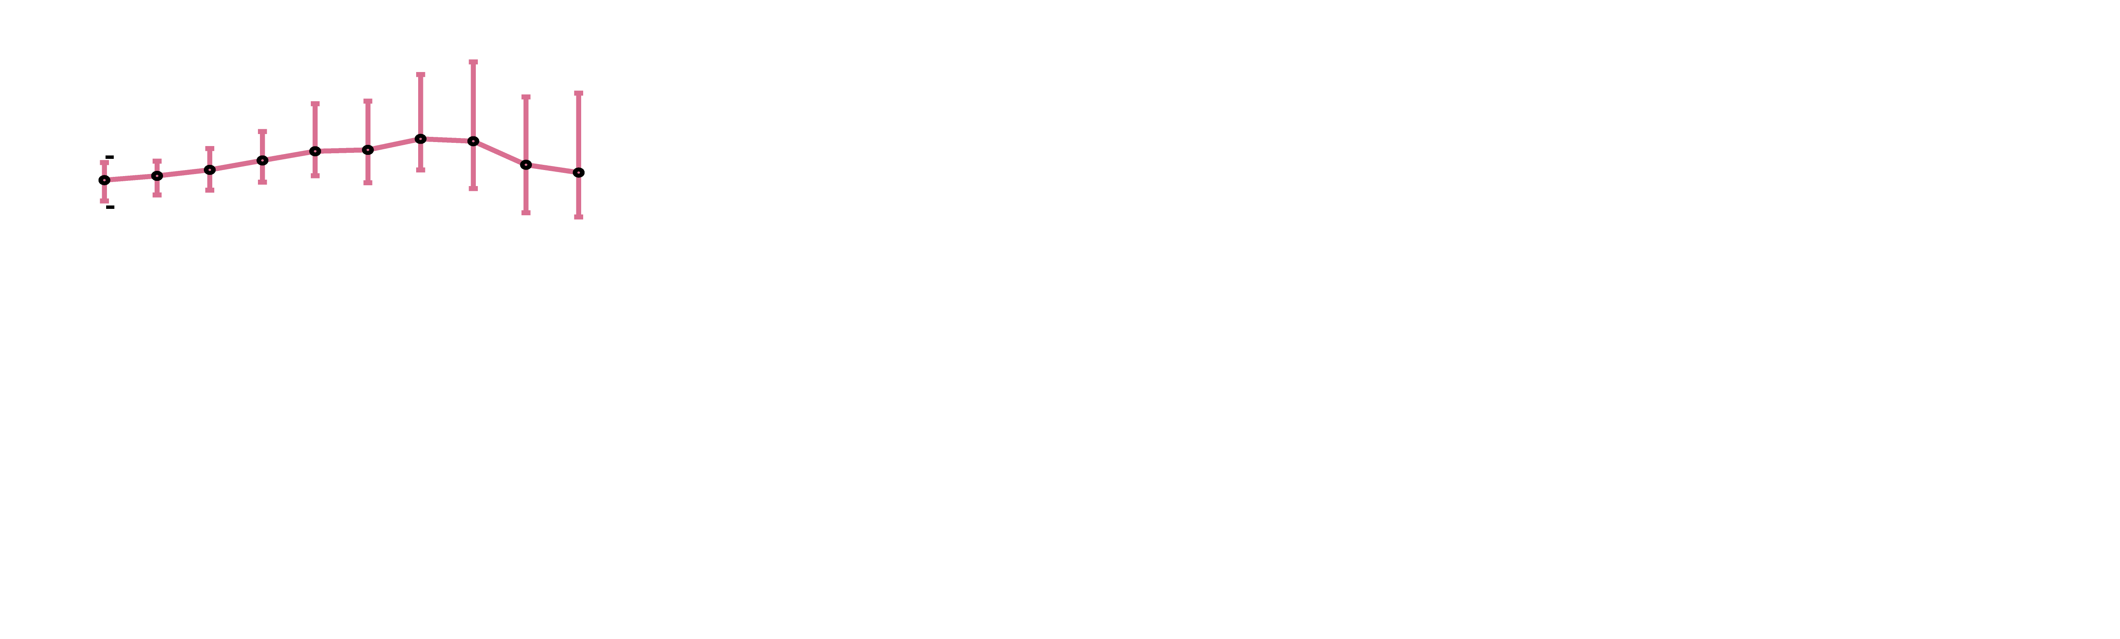
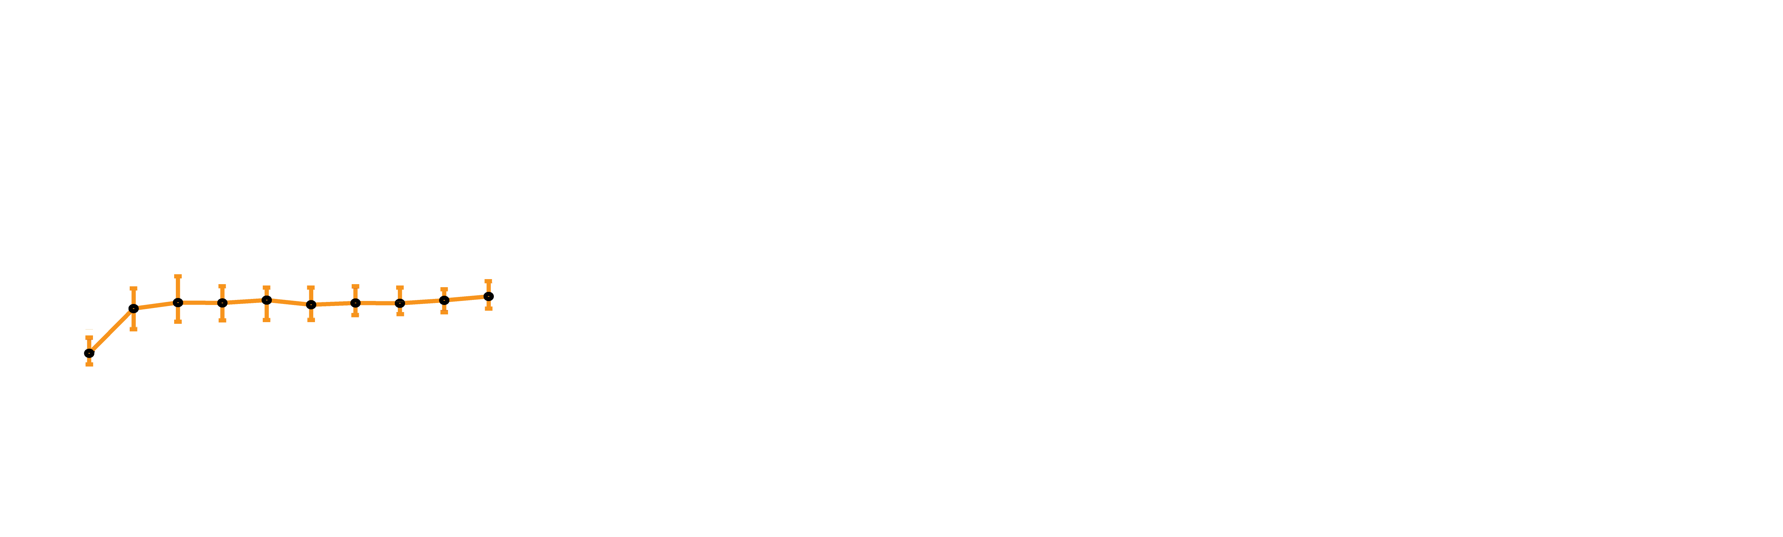



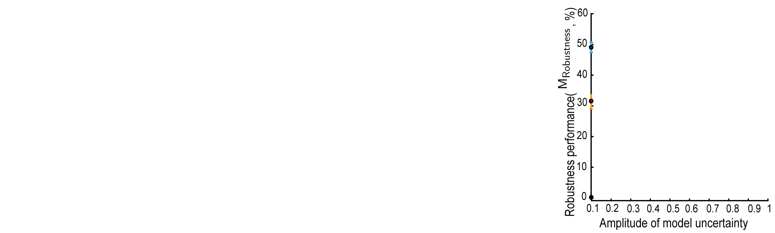
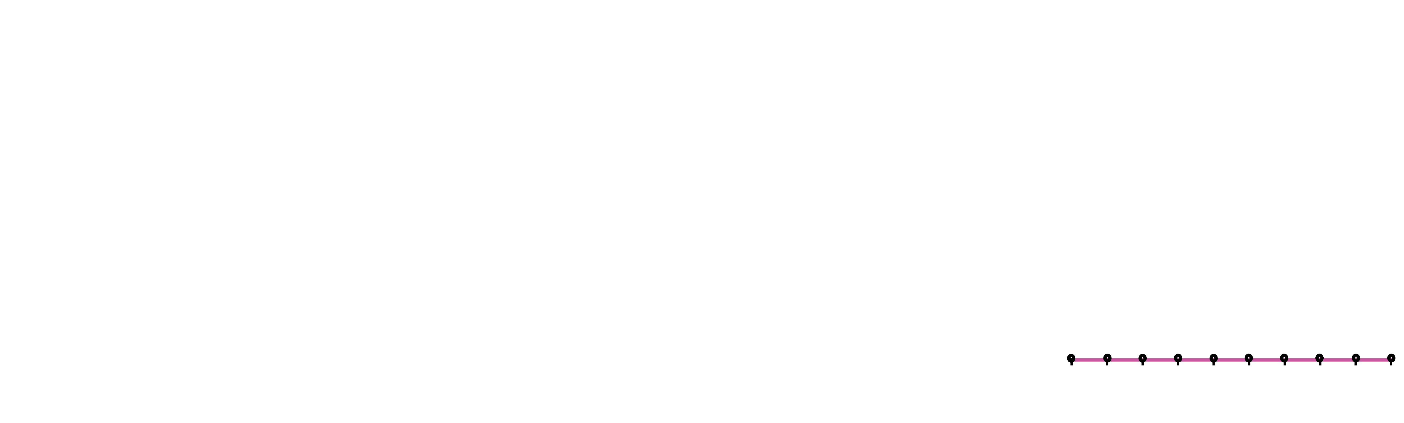
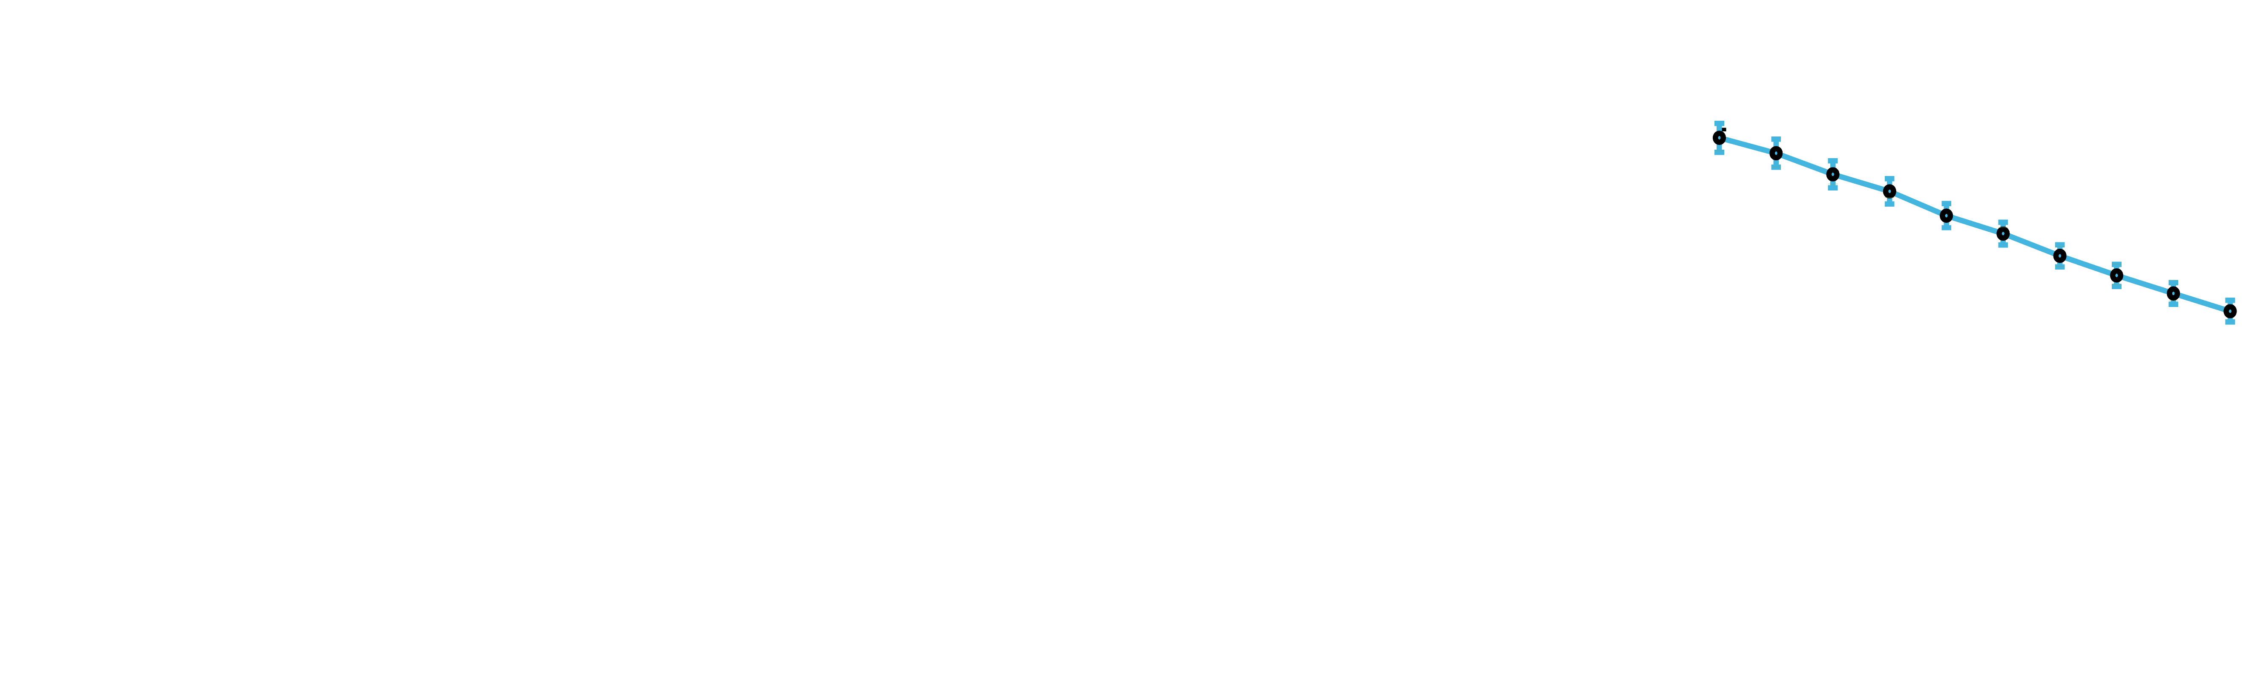

Simulation validation using deep neural networks
$$x_{t+1}=Ax_{t}+B{(u}_{t}+∆ωu_{t}+{δ_{1}g}_{1}(x_{t}))+{{B_{n}δ_{2}g}_{2}\left(x_{t}\right)+w}_{t}$$
$$y_{t}=Cx_{t}+v_{t}$$
Reduce control error
Increase stability
Increase robustness
Open-loop
Non-adaptive
Robust adaptive
25
Notes:
70’
We use deep neural networks to generate nonlinear uncertainties and conducted Monte-Carlo simulations to systematically study the performance when we vary the amplitude of model uncertainty.
In terms of control error, as we increase the amplitude of model uncertainty,
the open-loop control error stays high
the non-adaptive control error reduces, but it is still large.
In contrast, the robust adaptive controller significantly reduces the error to a small value.
In terms of stability, as the amplitude of model uncertainty is increased, the probability of the closed-loop being stable shapely reduced for both the open-loop and non-adaptive controller while the stability of the robust adaptive controller stayed high.
In terms of robustness, which we quantify as the time-delay margin of the closed-loop system, the robustness performance for both the open-loop and non-adaptive controller shapely reduced while the robustness performance of the robust adaptive controller is significantly better.

Slide 19
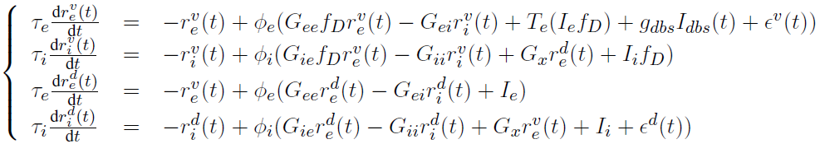
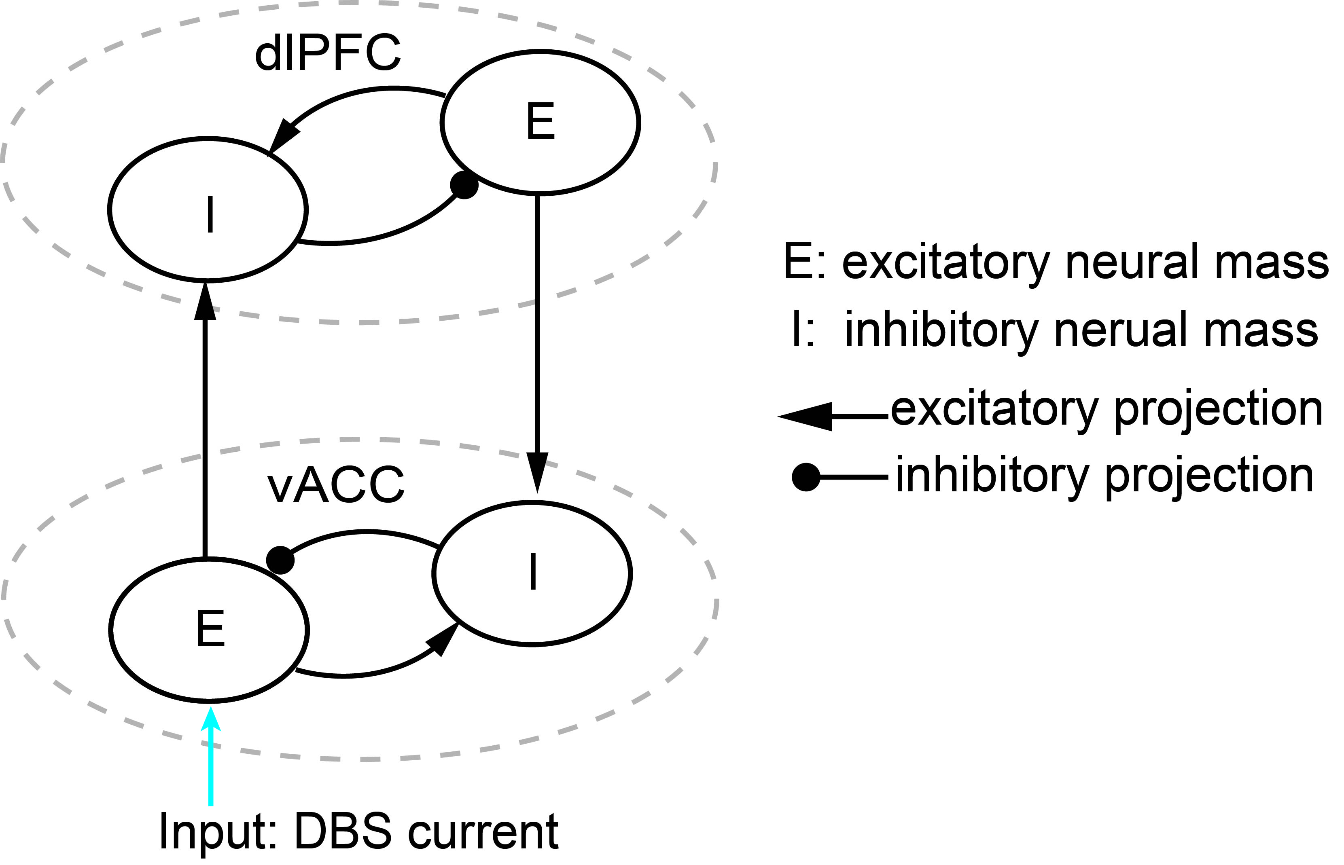
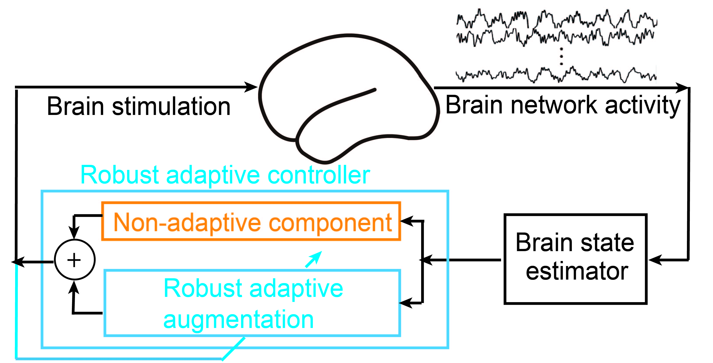
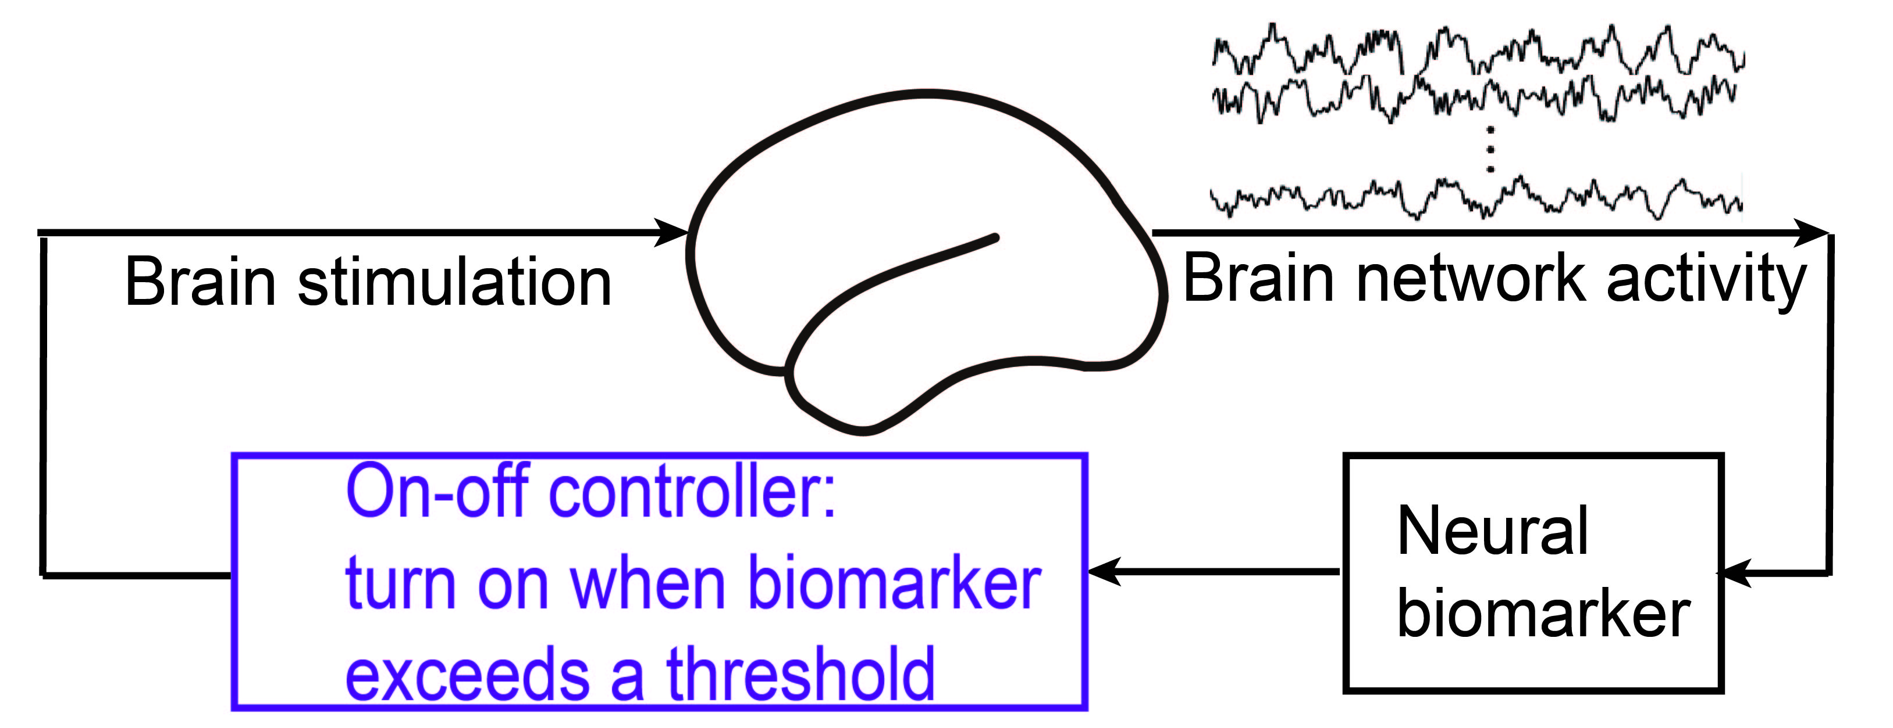
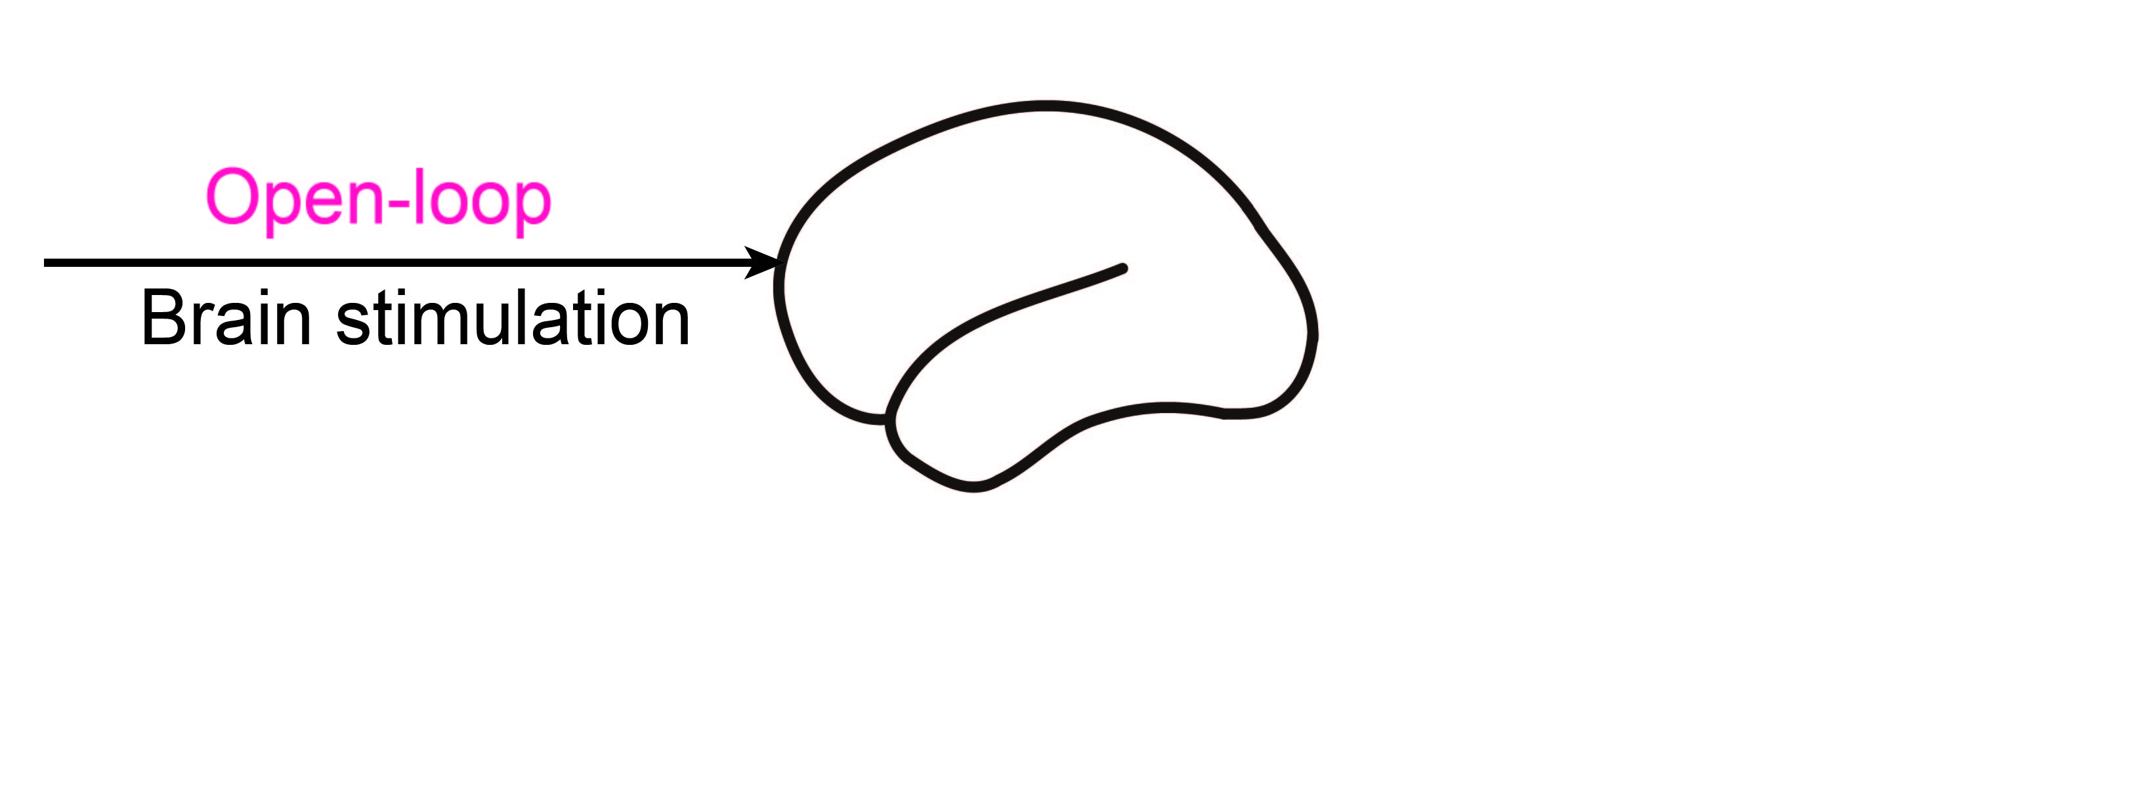
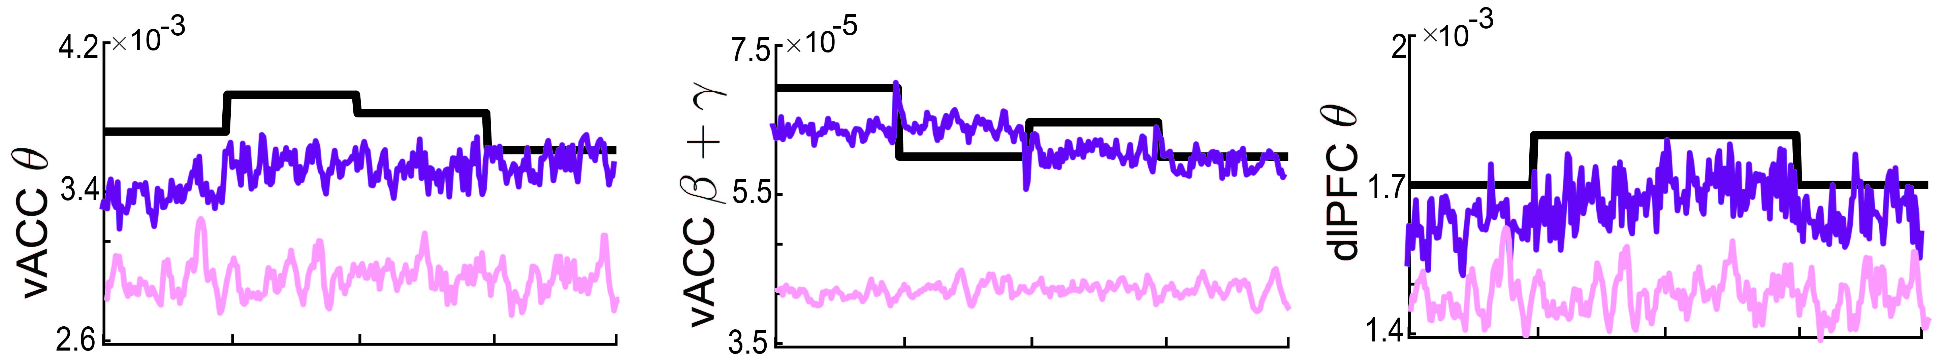
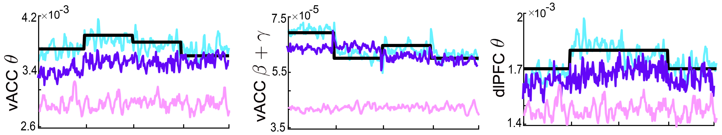
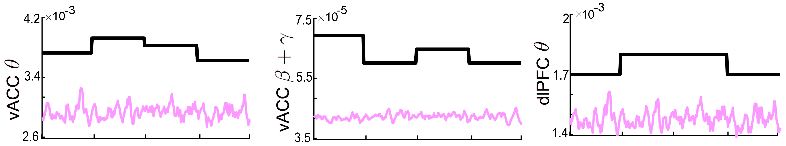

Validation on computational models
vACC-dlPFC neural mass model¹
[1] Ramirez-Mahaluf K et al., Cereb. Cortex. (2017).
Open-loop DBS
Responsive DBS
Robust adaptive DBS
26
Notes:
90’
ventral anterior cingulate cortex (vACC)
dorso-lateral prefrontal cortex (dlPFC)
Finally, we evaluate our methods on another neuropsychiatric disorder. While the underlying mechism of MDD is still under investigation, the recent neuroscience evidence shows that the interaction between vACC-dlPFC regions play important roles in resulting MDD. Therefore, we use a vACC-dlPFC neural mass models to simulate the MDD brain. The depression state is assumed to be related to the multiband powers in both areas. Here, the time varying therapeutic targets in black line represents the healthy state.
We see that the open-loop DBS can not track the targets with large error. The responsive DBS improved the tracking performance but still with some errors. In contrast, the robust adaptive controller accurately follows the target for different bands of vACC and dlPFC regions.
The above simulation results on biophysical models collectively show the future potentials of clinical applications to the treatment of neurological and neuropsychiatric disorders.

Slide 20

Conclusion + Q&A
Construct linear dynamic IO models and a closed-loop controller
Controller evaluation on biophysical models
Extend linear models to include nonlinear uncertainties
Construct a robust adaptive controller
20
27
Notes:
40’
In conclusion, we build linear dynamic IO models and linear controller. To address nonlinearity, time variations, we extend the proposed linear model to be a nonlinear model and construct robust adaptive controller, we use computer simulations to validate the model and our results have implications for future clinical applications.
490’ this part 620+440 = 1060’ for this part

