Slide 1
Surface effects in double-sided silicon 3D sensors fabricated
at FBK
Gian-Franco Dalla Bettaª, M. Povoli^{a,} A. Bagolini^{b},
M. Boscardin^{b}, G. Giacomini^{b},F.Mattedi^{b}, E.Vianello^{b}, N. Zorzi^{b}
ª INFN and University of Trento, 38123 Povo di Trento, Italy
^{b} Fondazione Bruno Kessler (FBK-irst), 38123 Povo di Trento, Italy
Work supported by PAT, project MEMS2, INFN CSN V, projects TREDI (2005-2008)
and TRIDEAS (2009-2012), and INFN CSN I, project ATLAS

Slide 2
Outline
Overview of FBK 3D technology
Aim of this work
Devices under test
Experimental results and TCAD simulations
Conclusion

Slide 3
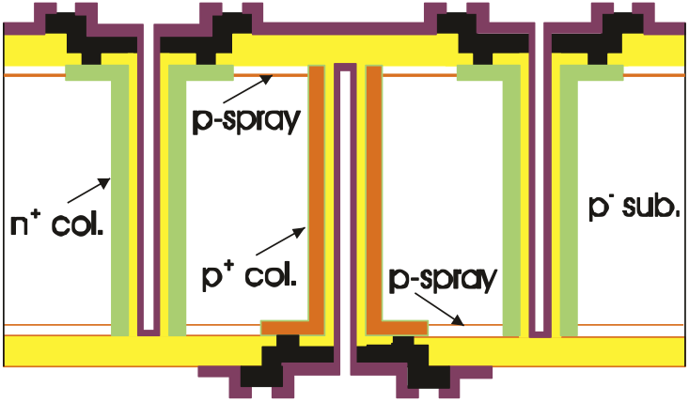
3D sensor technology at FBK
E. Vianello et al., IEEE NSS11, Valencia, Paper N10-6
- Double side process - Passing through columns.
- P-spray on both sides - Contacts on surface implants

Slide 4
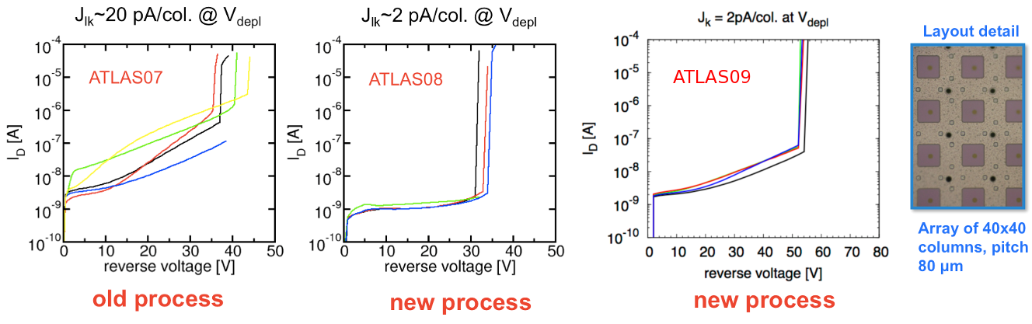
Process evolution
ATLAS07: bad currents and low breakdown (p-spray dose too high)
ATLAS08: better current (less mechanical stress), low breakdown (same p-spray)
ATLAS09: good currents and higher breakdown (p-spray dose adjusted)
With higher breakdown, some layout dependent features have shown up …

Slide 5
Aim of this work
Gain insight into the device electrical behavior using TCAD simulations
Tests performed on 3D diodes:
  two terminal devices, easy to measure
  ~10mm² area, low defect density → intrinsic behavior
Measured technological parameters (lifetimes,…) and doping profiles (SIMS) implemented in the simulations
Attempt to disentangle the effects of each “component” of the device on the electrical characteristics

Slide 6
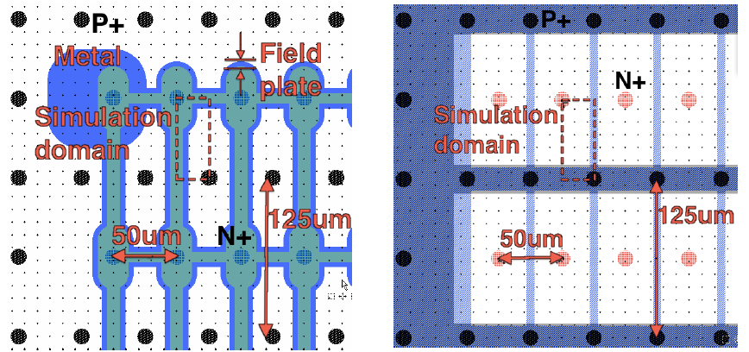
FE-I4 like diode with field plate
Front-side
Back-side

Slide 7
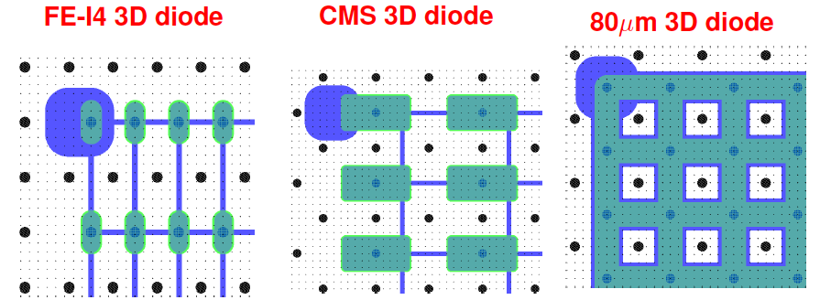
Other available 3D diodes
Different shapes, sizes and column configurations
Different distances between n+ and p+ regions
With and without field-plate

Slide 8
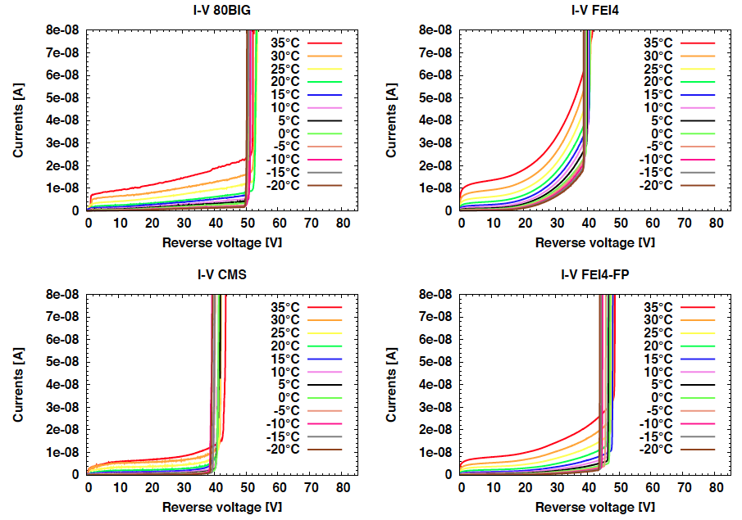
I-V curves at different temperatures

Slide 9
Breakdown voltage vs temperature
T coeff. in good agreement with typical values for avalanche breakdown

Slide 10
Leakage current vs temperature
Avalanche contribution easily distinguished from SRH at 30V

Slide 11
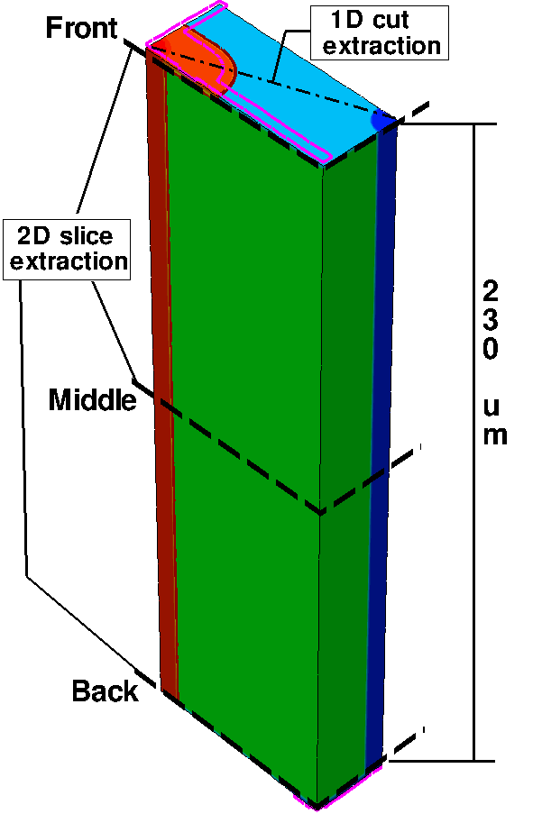
TCAD simulations
Structure parameters
1/4 of elementary cell (exploiting symmetry)
Exact layouts implemented
FBK technology parameters
Measured (SIMS) doping profiles
Models and simulation
Mobility: Doping Dependent, High Field Saturation
Generation/Recombination: SRH, Avalanche
Data analysis
Monitor electrical quantities in different regions
Understand where the breakdown occurs:
2D slices at different depths
1D cut extraction from 2D slices

Slide 12
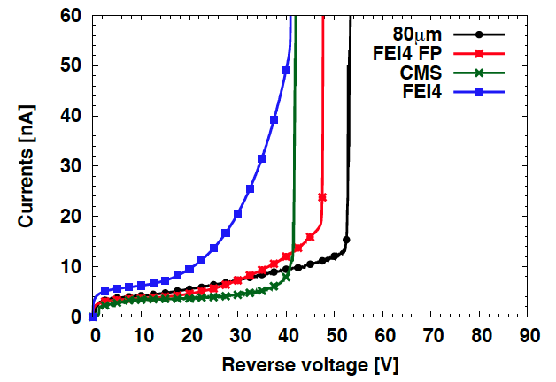
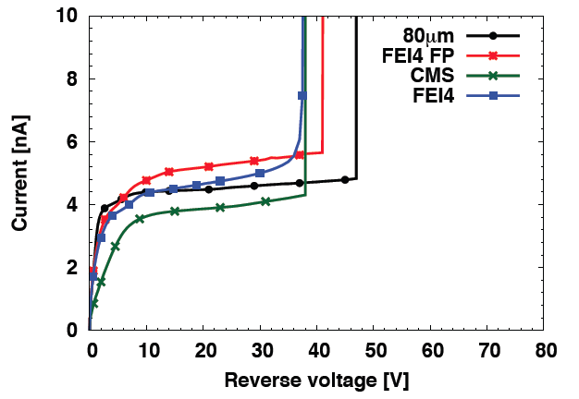
Exp. vs Sim. I-V curves (@RT)
Experimental Simulated
Good agreement on leakage current at low voltage and breakdown voltage values
Agreement not so good as of the curve slope (work in progress)

Slide 13
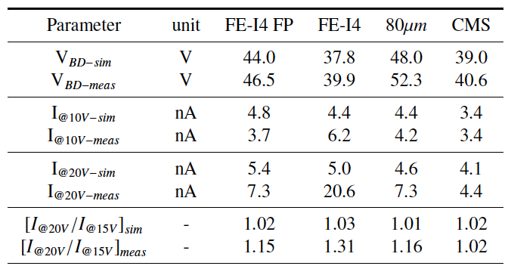
Exp. vs Sim. Comparison
Part 1: static parameters

Slide 14
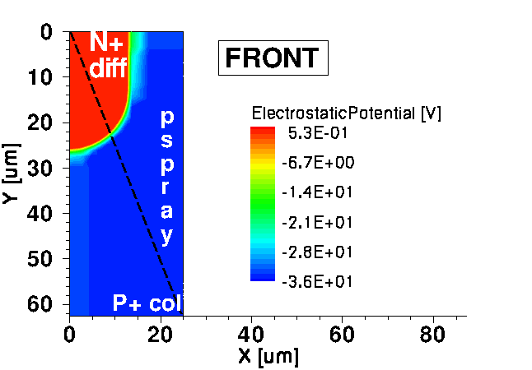
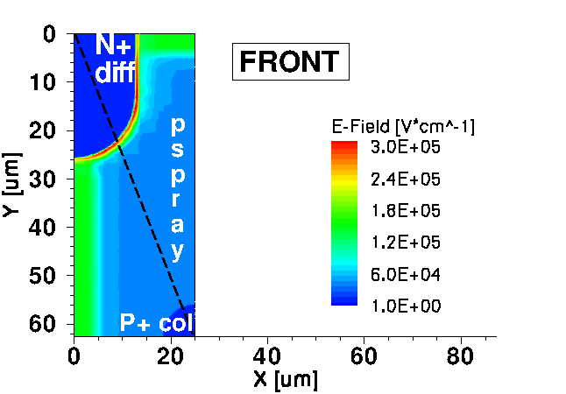
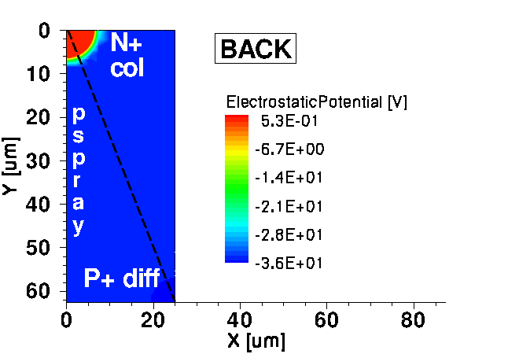
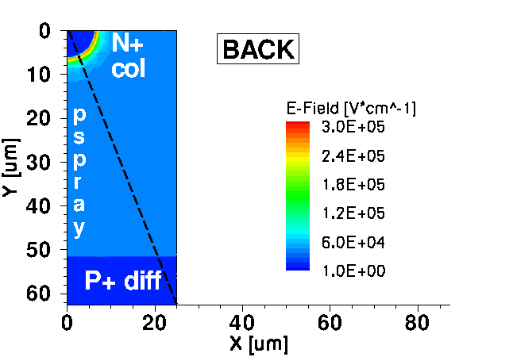
Simulations of FE-I4 diode @ -35V
Electrostatic potential Electric field
Electrostatic potential
P+ column brings the bias
voltage directly on the
p-spray on both sides
Electric Field
Highest fields at the
junctions between
N+ and p-spray:
Front 2.65e5 V/cm
Back 2.48e5 V/cm
High E-field also under
the front side metal
(vertical and horizontal
metal connections)

Slide 15
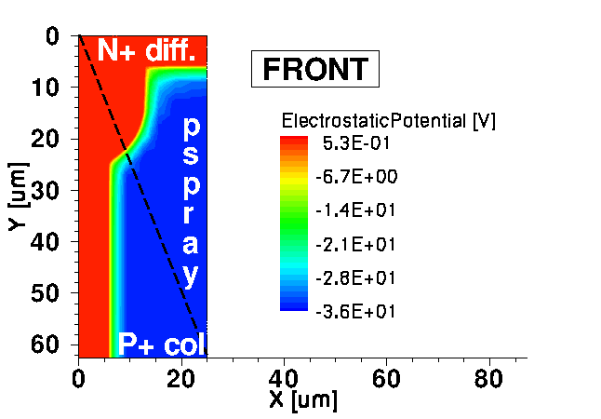
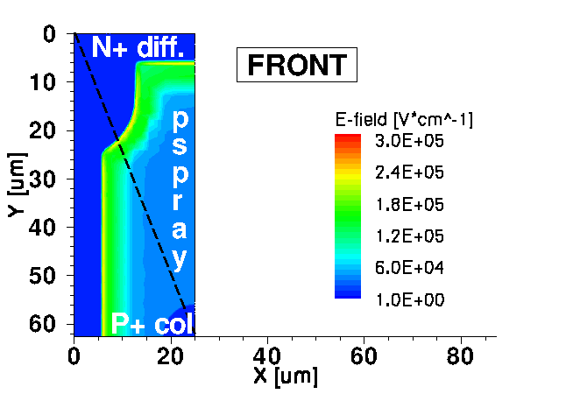
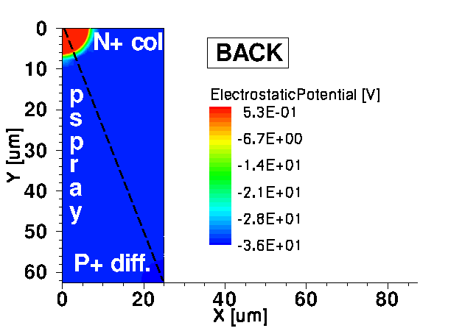
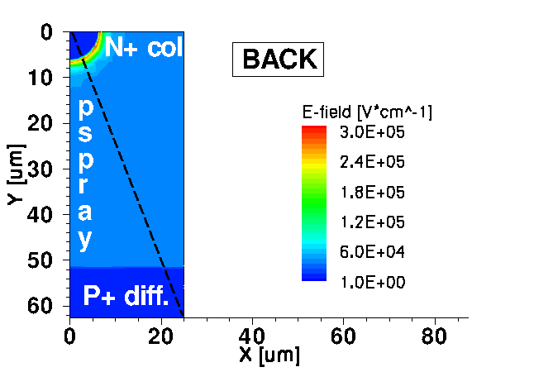
Simulations of FE-I4 FP diode @ -35V
Electrostatic potential Electric field
Electrostatic potential
The field-plate helps depleting the p-spray close to the N+ diffusion
The potential of the p-spray now drops on a wider region
Electric Field
Highest fields at the
junctions between
N+ and p-spray:
Front 2.11e5 V/cm
Back 2.53e5 V/cm
But the field-plate helps in redistributing and lowering
the E-field on the front side (higher breakdown voltage, probably
on the back side)

Slide 16
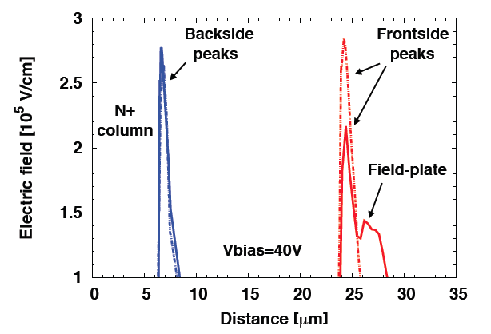
Electric field peak comparison

Slide 17
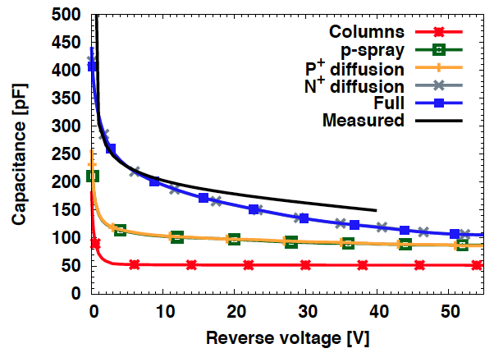
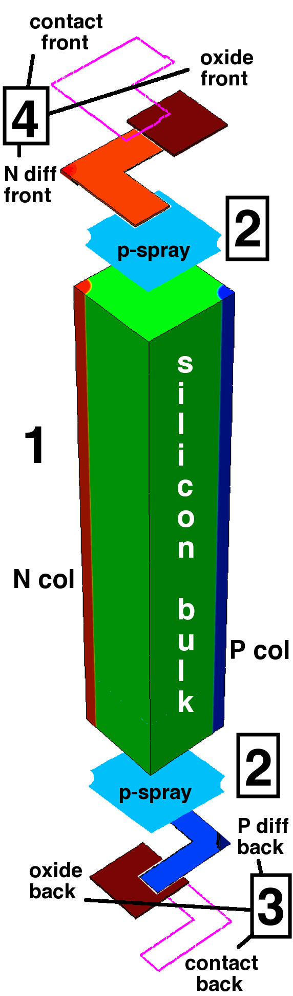
FE-I4 FP diode C-V curves: exp. vs sim.
Column contribution ~50pF (less than 50% …)
Important increase due to p-spray
Back-side layers contribution negligible
Front-side N+ diffusion and field plate cause a large increase at low voltage, then reduced as p-spray is depleted

Slide 18
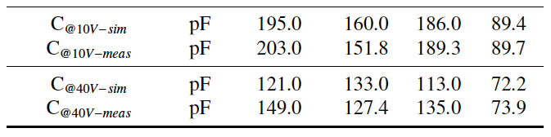
Exp. vs Sim. Comparison
Part 2: capacitance
Discrepancies between experimental and simulated capacitance at high voltage are mainly due to edge effects (not accounted for in the simulations)

Slide 19
Conclusion
We have studied the electrical behavior of different 3D diodes fabricated at FBK
The layout has been found to impact on both the I-V and C-V curves of the devices.
A good agreement was found between measurements and simulations, confirming that TCAD is a reliable tool for device analysis and design (3D simulation compulsory)
This study will then continue with irradiated devices, with the aim of optimizing the layout accounting for both pre-irradiation and post-irradiation conditions.

Slide 20
Acknowledgements
We would like to thank all members of the Processing Group within the ATLAS 3D Sensor Collaboration for many fruitful discussions

Slide 21
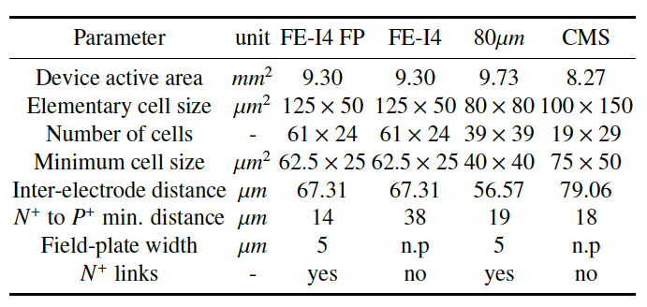
Back-Up: Details of different diodes

