Slide 1
Development of
n-in-p planar pixel sensors
with active edge
for the ATLAS High-Luminosity Upgrade
M.Bomben, G. Calderini,
J. Chauveau, G. Marchiori
LPNHE, Paris, France
A. Bagolini, M. Boscardin ,
G. Giacomini, N. Zorzi
Fondazione Bruno Kessler, Trento, Italy
L. Bosisio*
Università degli Studi di Trieste &
INFN – Trieste, Italy
*visiting professor @ Université
Pierre et Marie Curie
A. La Rosa
DPNC, Université de Genève (CH)
7th “Trento” Workshop on Advanced Silicon Radiation Detectors (3D and p-type Technologies)
Ljubljana, March 1st 2012

Slide 2
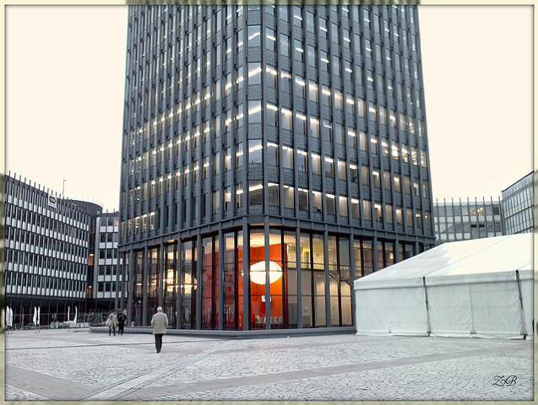

Laboratoire de Physique Nucléaire et des Hautes Energies
(LPNHE)-Paris
Project leader
Simulations
Test
FBK (Trento)
Design
Process

Slide 3
Outline
What is this sensor for?
Trench Tech @ FBK
Layout
Simulations
Test Plans

Slide 4
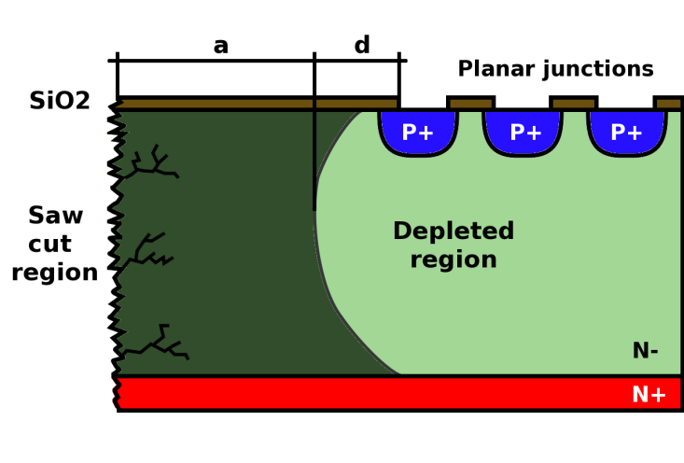
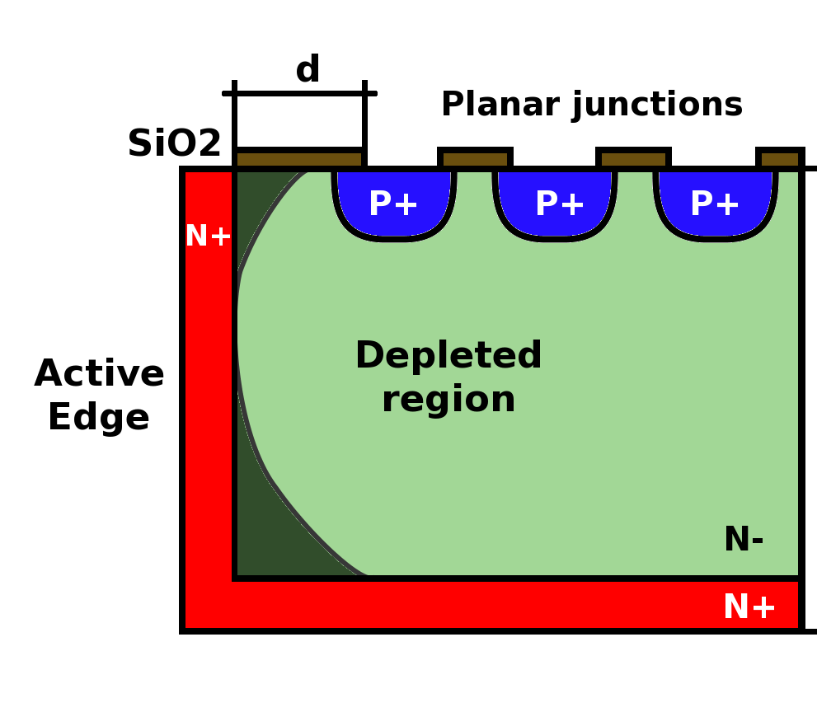
ATLAS Pixel Sensor
R&D for ATLAS upgrade
  a) Rad-hard for ~ 1e16 n_{eq}/cm² (high luminosity LHC)
  b) Highly segmented to cope with high-event rate
  → pixel sensor
  c) Minimize dead area (no z-overlap)
  → Active Edge
  d) Low material budget
  → Thin substrates (200 μm)
  e) Signal mainly due to electrons
  → n-on-p technology
  (n-on-n is double-side, not compatible with Active Edge)
Active edge pixel sensor can be a choice
Dead edge

Slide 5
Active Edge Sensor Structure
Substrate contact
Field plate
Trench
p-stop
n-pixel
p-spray
p-substrate
oxide
Support wafer
oxide

Slide 6
n-on-p needs pixel insulation
We will use both p-spray and p-stop.
Process splittings concern the dose of such implants: e.g.
Splitting # | p-spray dose (cm⁻²) | p-stop dose (cm⁻²)
1 | 0 | 3e12
2 | 1e12 | 5e12
3 | 3e12 | 3e12
4 | 2e12 | 5e12
FBK has experience on planar n-on-p
the edgeless technology is different due to the presence of high temperature steps required for trench doping

Slide 7
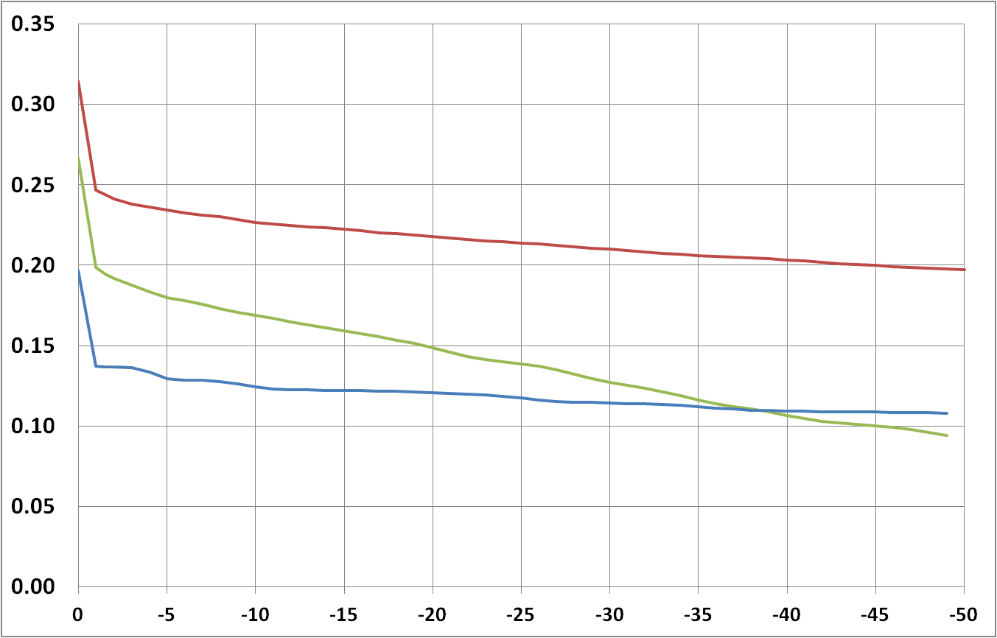
InterPixel Capacitance vs p-spray dose
Pixel capacitance should be minimized.
We want Field Plate (FP) for higher BD Voltage
p-spray must deplete under the FP or there’ll be a large interpixel capacitance
→ Low p-spray dose
fF/μm
Interpixel Capacitance
Field Plate, High dose p-spray
FP, Low dose p-spray
No FP, High dose p-spray
Substrate Voltage (V)

Slide 8
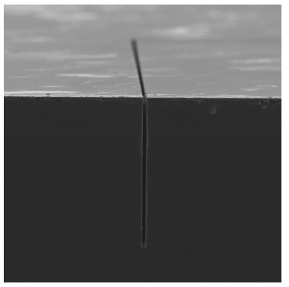

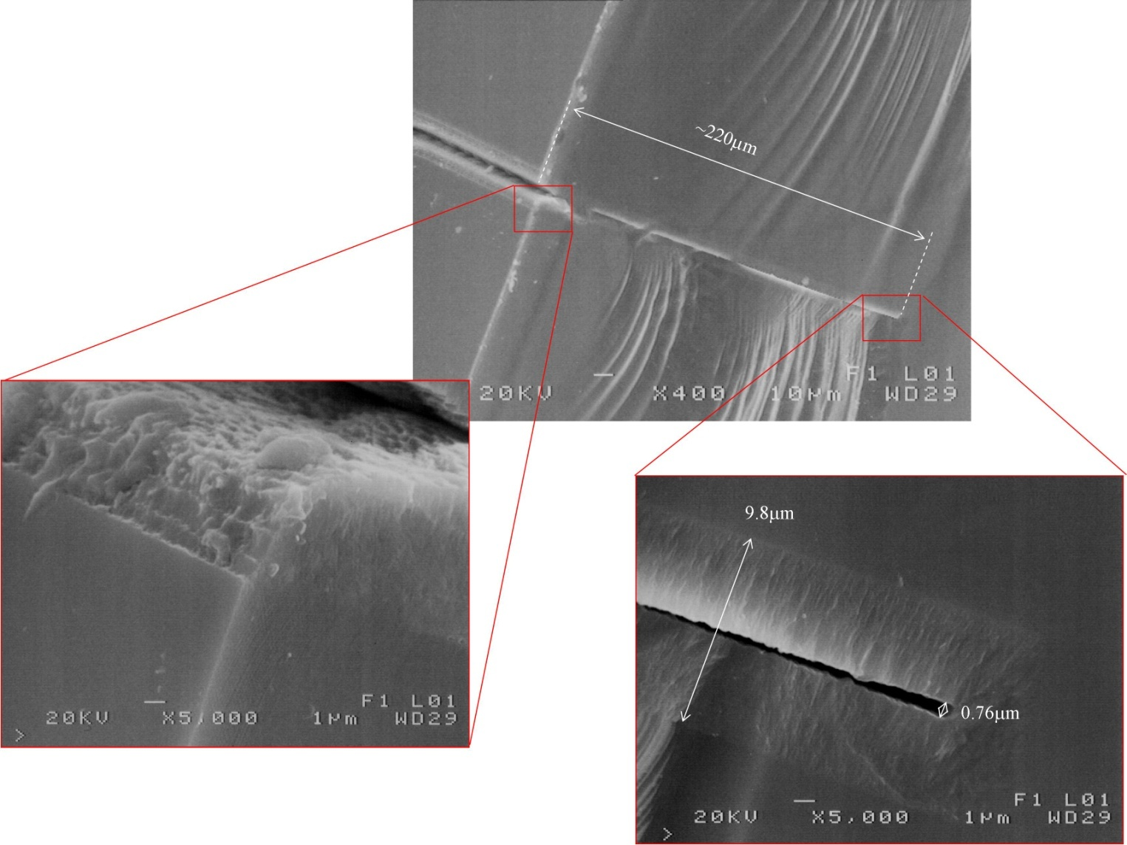
Trench experience @ FBK (1)
10μm wide
220μm deep
polysilicon filled
Clean Si surface
poly
A.Bagolini, “Development of planar active-edge technology at FBK”, 6th Trento workshop 2011

Slide 9
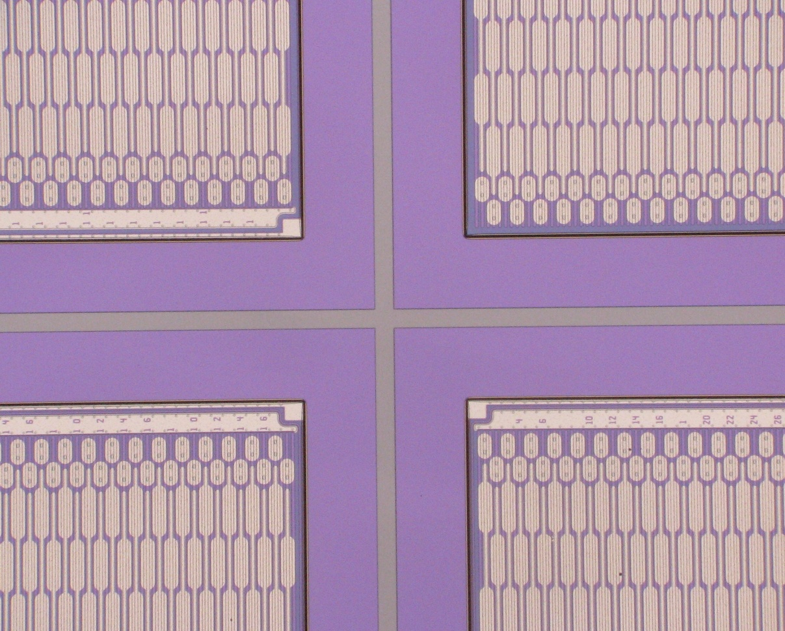
Trench experience @ FBK (2)
Planar strip sensor (p-on-n)
Povoli et al., “Development of planar detectors with active edge” NIM A658 (2011) p. 103

Slide 10
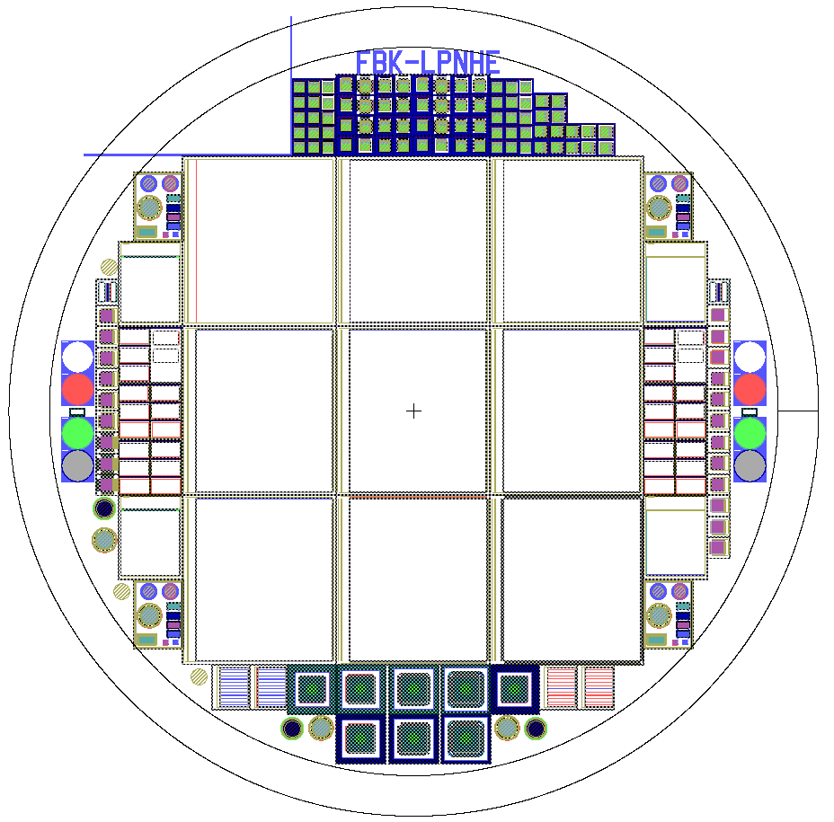
Wafer Layout
9 FE-I4
  0, 1, 2, 3, 5, 10 GRs
  Different n⁺→trench distances
4 FE-I3
  1 or 2 GRs
  2/4 are PT biased
DC Strip Sensors
  0, 1, 2 GRs
  Different n⁺→ trench distances
OmegaPix
  1 or 2 GRs
  2/4 are PT biased
TestPixels/Pad
  0, 1, 2, 3, 5, 10 GRs
  Different n⁺→trench distances
Space for
Hg probe
Test Pad
Planar
Test Strip
FE-I4
FE-I3
OmegaPix
Pro SIMS
n+, p+, p-spray, p-stop

Slide 11
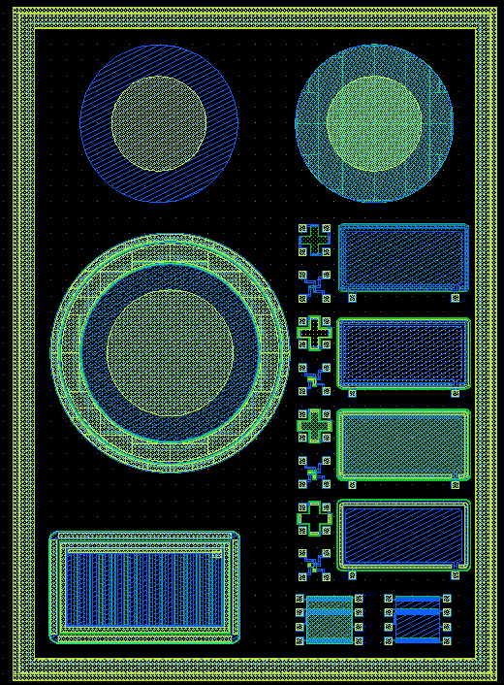
Planar Test Structures
2 MOS (one over p-spray and one over p-spray + p-stop)
Capacitors
1-D Diode
Gated diode
Van der Pauw and contact resistance of every implant

Slide 12
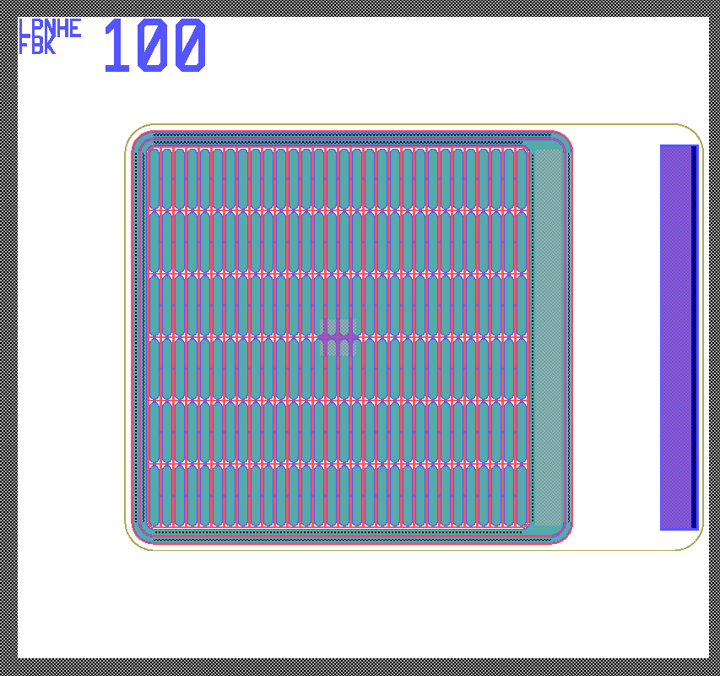
Test Pixel Sensors
IV Measurement: Break-down Voltage vs n⁺→ trench distance
  Layout splittings
  0, 1, 2, 3, 5, 10 GRs
  Different n⁺→trench distances
trench
Bias Tab:
back-side in not accessible until support wafer is removed
→ ohmic (p) contact from front-side
Short-circuited
FE-I4 pixel
  Full-size FE-I4 sensors should behave exactly as these baby sensors
Scribeline:
useful if support wafer is not removed
its position does not affect the electrical characteristics

Slide 13
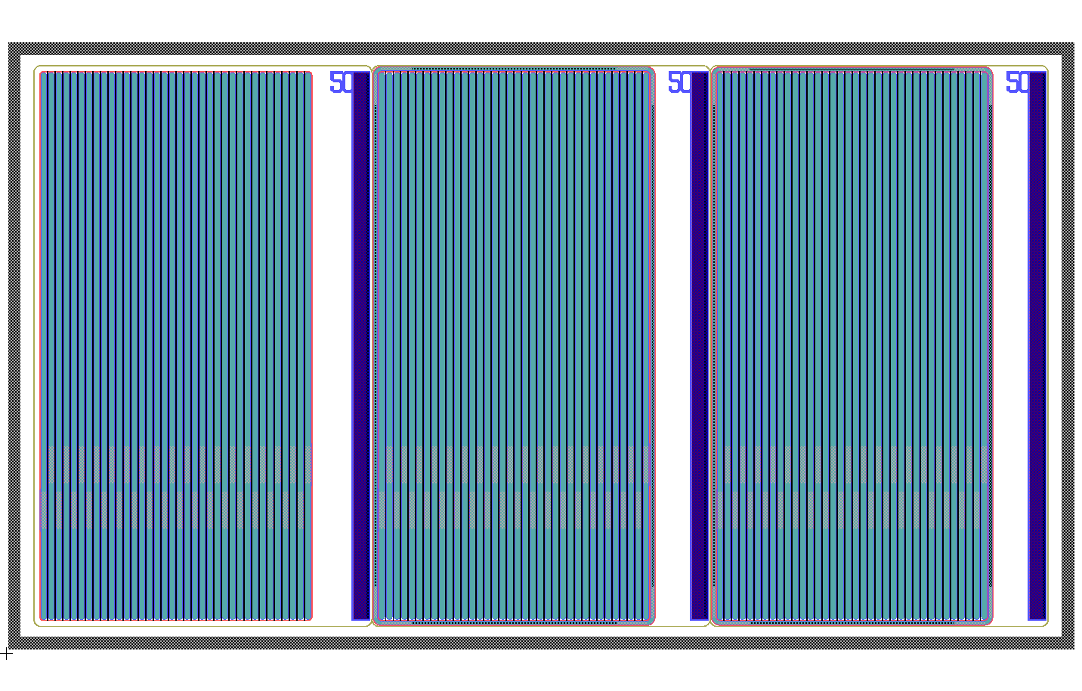
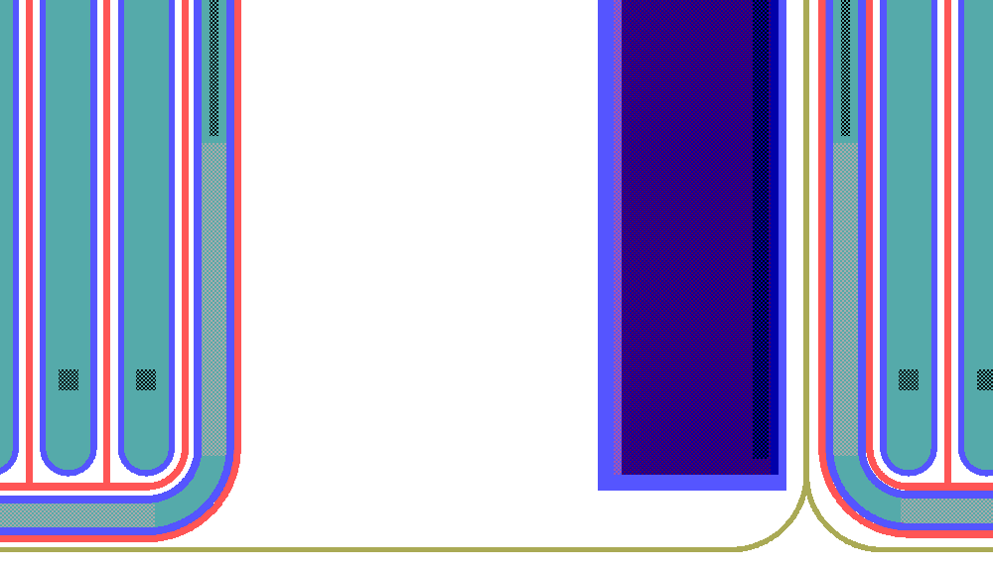
DC-strip sensor
scribeline
3-mm long strips
Same design as pixels, only length
is changed
In a group, 3 design variants
(36 strips each)
(0 GR, 1 GR, 2 GRs)
  wire-bondable to a 128 ch ASIC
Many groups, differing by
strip → trench distance
(50, 75, 100, 150 μm)
0 GR
1 GR
2 GRs
Designed for measuring efficiency and signal collection in the edge region vs. design parameters (distance to trench, # of GRs)
Bias tab
50 μm
trench

Slide 14
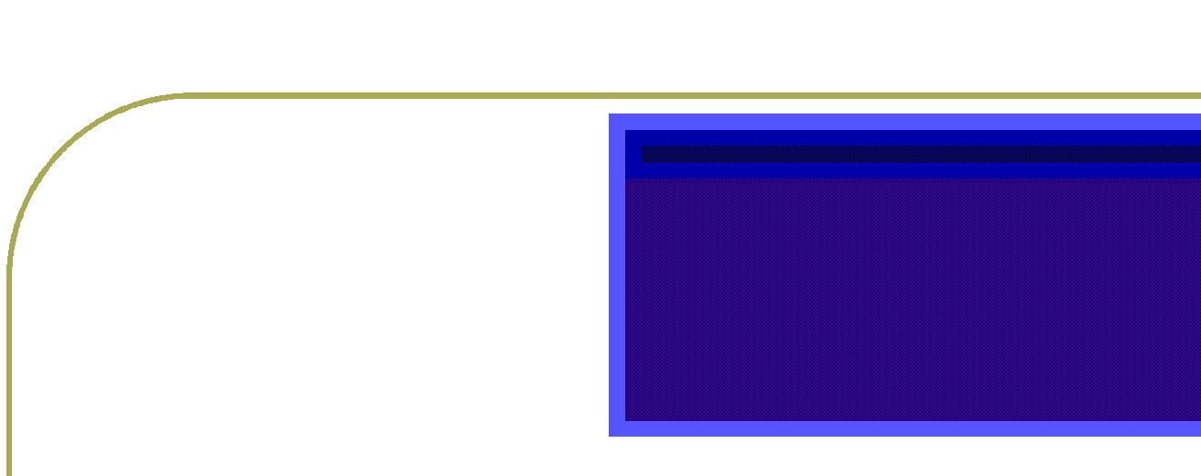
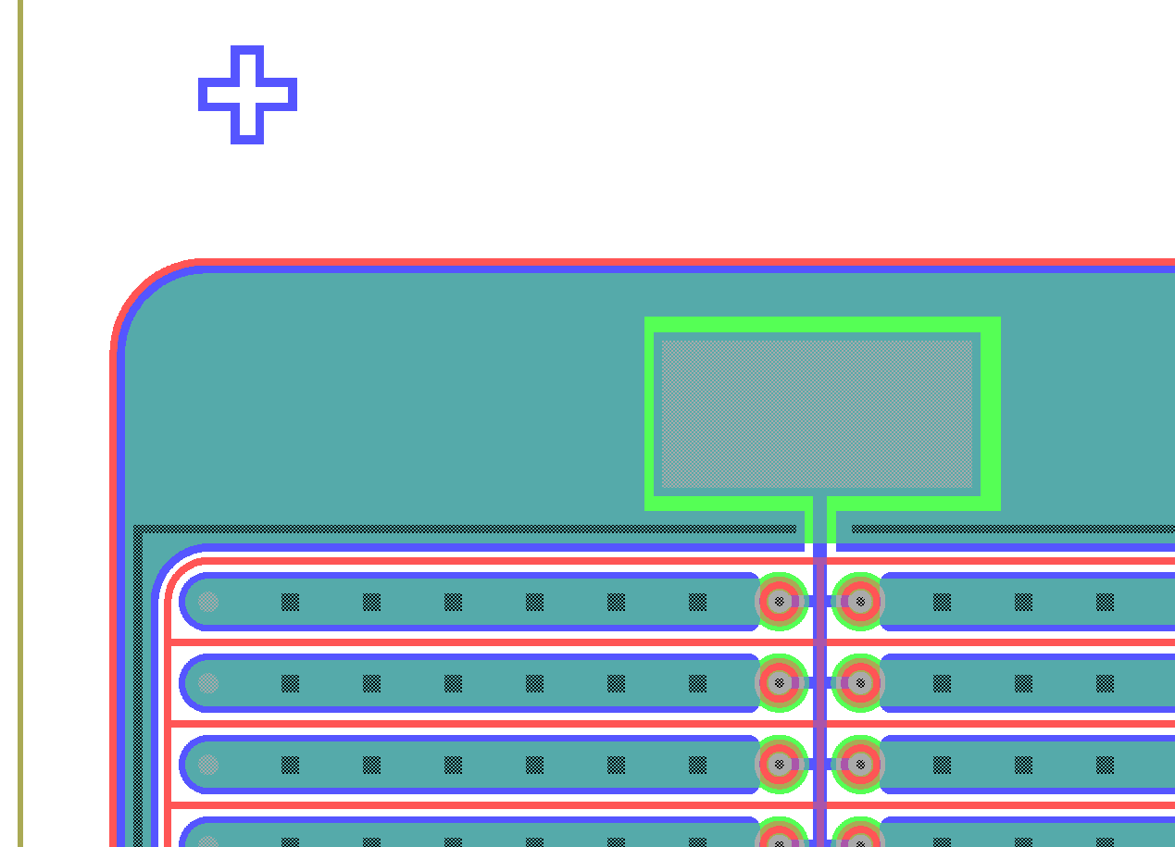
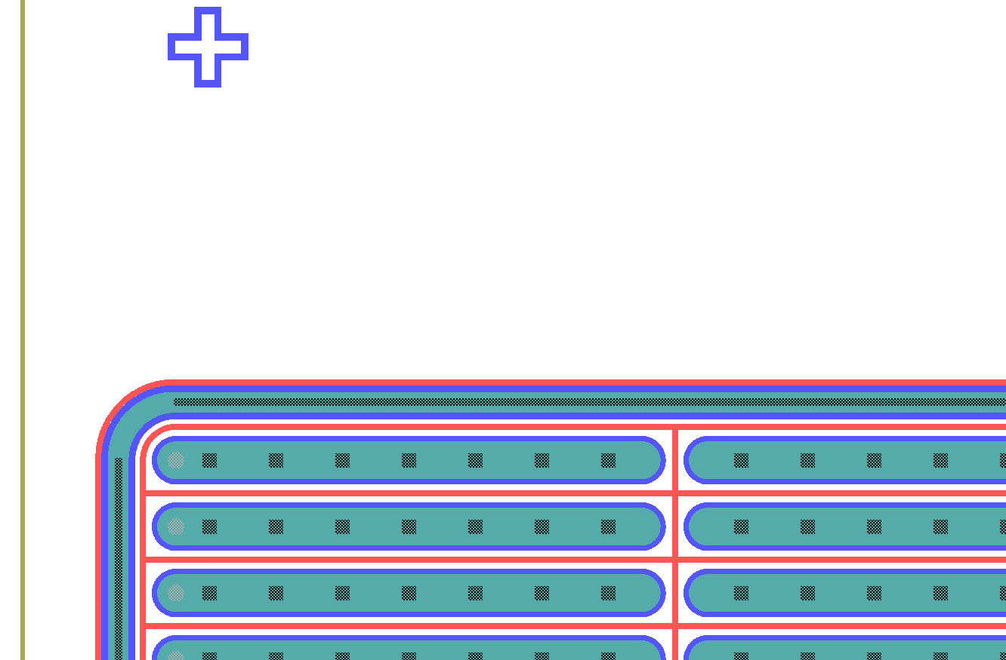
FE-I3 and Omega-Pix
n+ → trench distance = 100 μm
 | PT biased | ROC biased
1 GR | OK | OK
2 GRs | OK | OK
trench
Bias Tab
~ 1.7 mm
PT-biased
Biased only by ROC
100 μm
100 μm

Slide 15
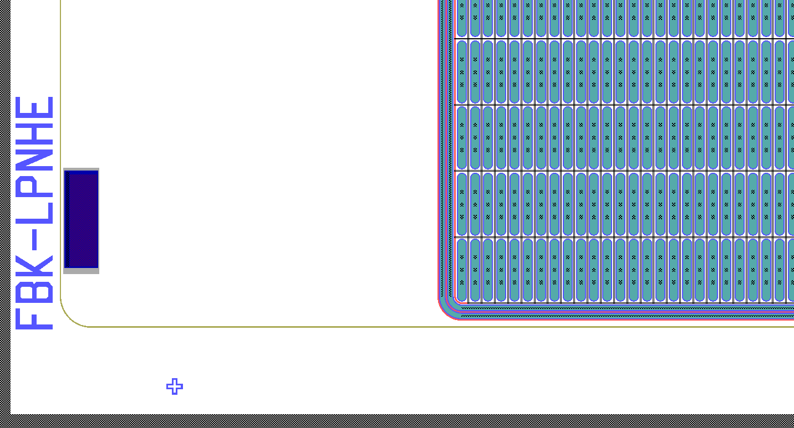
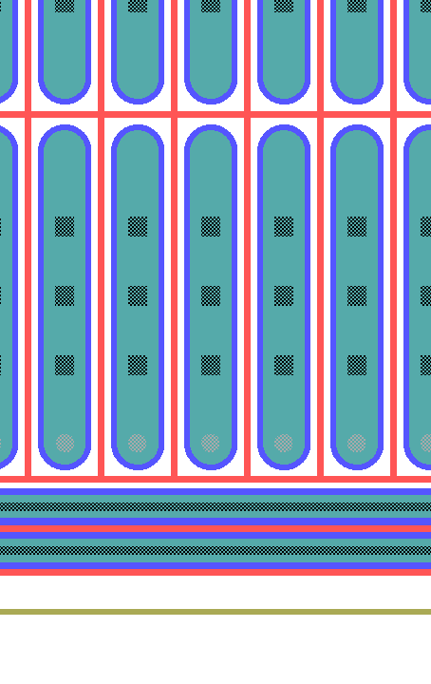
Sensors with FE-I4 Layout
1 X 0 GR (100 μm)
1 X 1 GR (100 μm)
1 X 2 GR (100 μm)
2 X 3 GR (200 μm)
2 X 3 GR (bis) (200 μm)
1 X 5 GR (300 μm)
1 X 10 GR (400 μm)
FE-I4 ROC is the newest of ATLAS and is available.
We can profit from the large experience on 3D and n-on-n read-out by FE-I4.
50μm
Bias tab
100 μm
250μm
trench

Slide 16
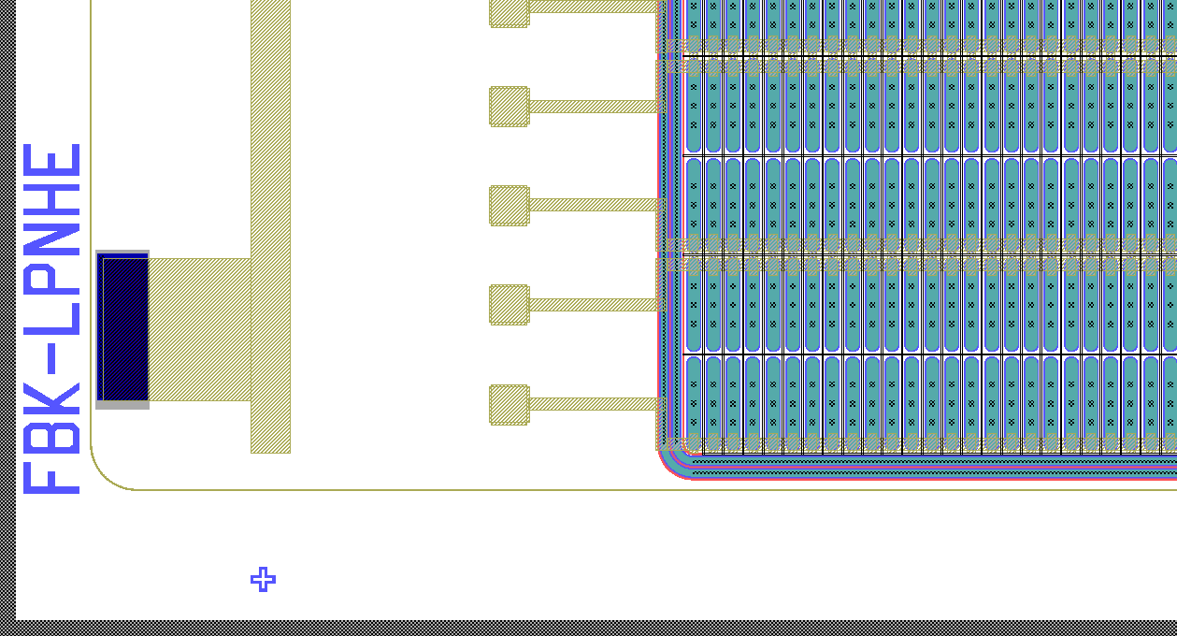
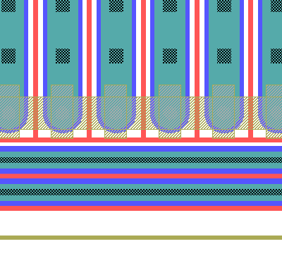
FE-I4 sensors: temporary metal
An additional metal contacts the pixel in the regions of passivation openings.
Automatic measurements on pixel sensors are possible.
Temporary metal is removed after measurements.
100 μm
trench
Temporary metal stripes (over the passivation), connecting all pixels in one row

Slide 17
Simulations
Mainly dedicated to BreakDown Voltage (BDV) analysis.
Varied parameters are:
# of GRs
distance n+ → trench
Design covers many layout options
→ BDV can be measured on test diodes and compared with simulations
After validation with measured data, simulations can be used to improve the design,
Simulations/measurements done before & after irradiation

Slide 18
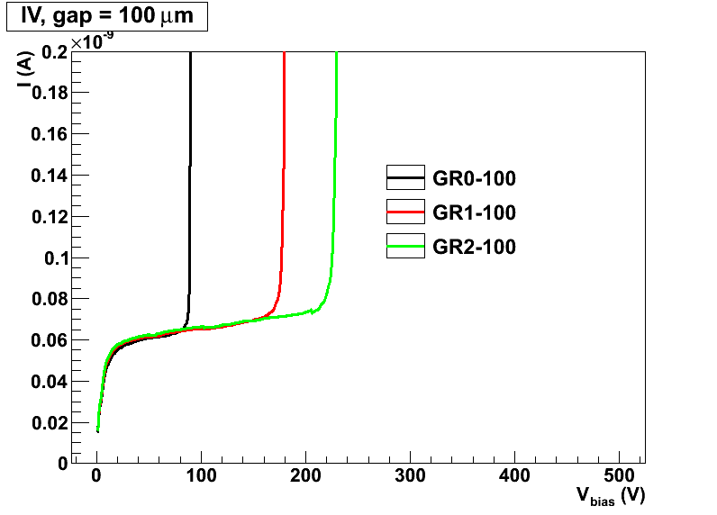
Simulation Example (n+ → trench distance = 100 μm)
BDV >> V_{depl}, also for short n+→ trench distance
BEFORE IRRADIATION
O GR
1 GR
2 GRs
Vdepletion

Slide 19
Outlook
ready to start the fabrication:
  4-inch p-type 200-μm thick wafers have been bond-annealed at SINTEF
  Final layout done! masks ready
  ~ 4 months for processing
Electrical characterization
  pixel sensors, at wafer level, making use of temporary metal (automatic measurements)
  test structures ( diode, strip,..) before and after irradiations (manual measurements)
Late 2012: bump bonding
2013: beam tests

Slide 20
Back-up

Slide 21
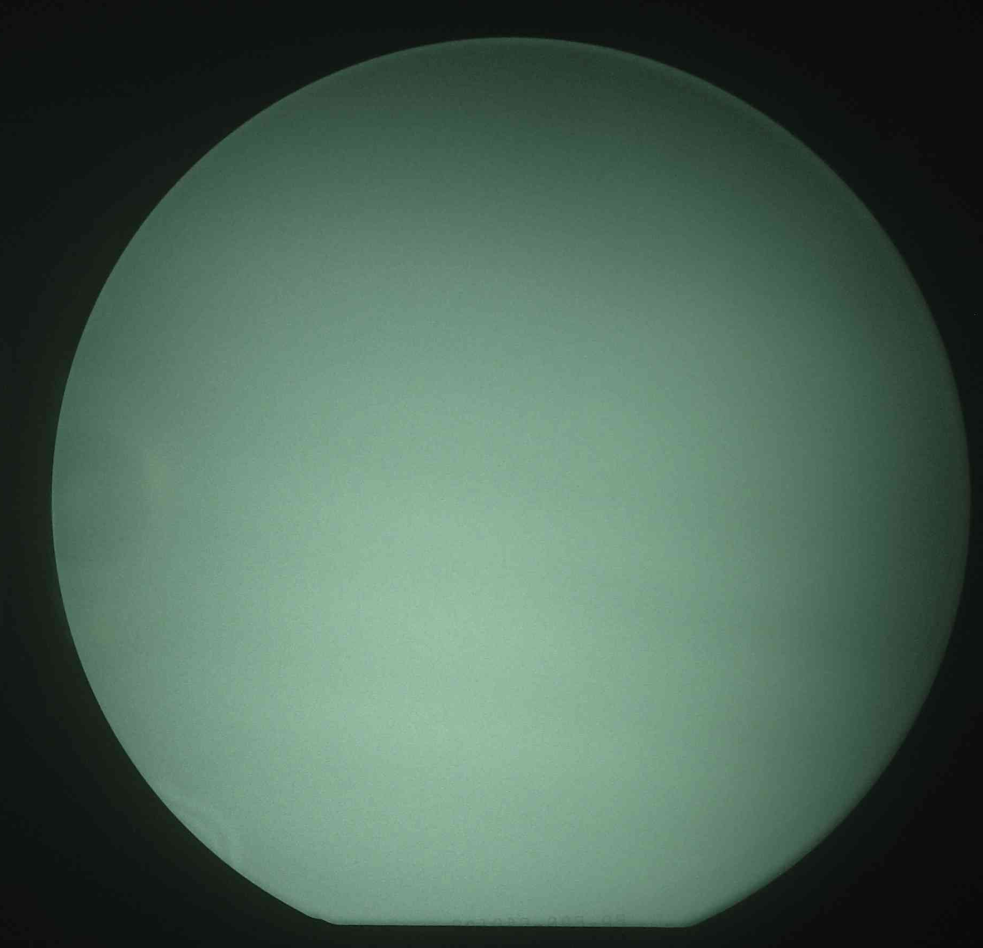
Status
20 p-type 4” 200-μm thick wafers have been bond-annealed at SINTEF
Microscope inspection and IR images show no particular problems
4”

Slide 22
Read-out chip FE-I4
sensor

