Slide 1

Trench detectors for enhanced charge multiplication
G. Casse, D. Forshaw, M. Lozano, G. Pellegrini

Slide 2
Outline
Radiation hardness for the innermost layer: charge multiplication (CM)
Enhancing/optimising CM ?
Planar pixel for the HL-LHC
Possible different geometries in the forward
region
Large area devices for the outer layers

Slide 3
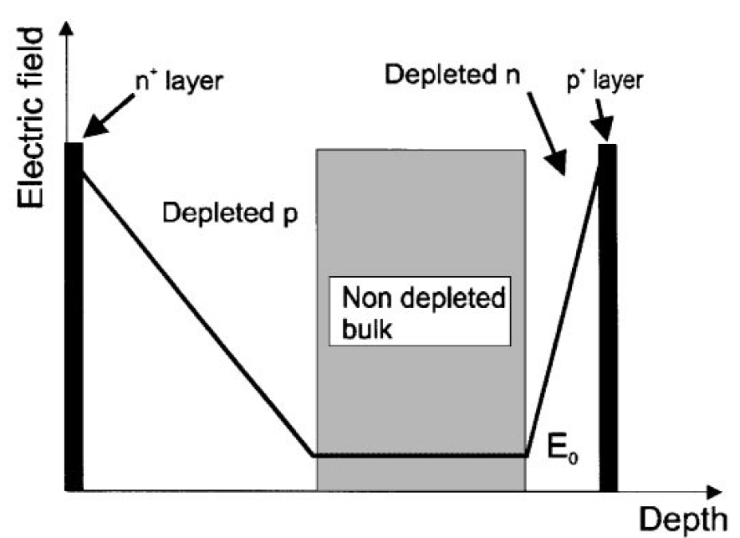
N-side read-out can make planar segmented Si detectors suitable for tracking in extreme (SLHC levels: 1x10¹⁶ cm⁻²) radiation environments.
Schematic changes of Electric field after irradiation
Effect of trapping on the Charge Collection Efficiency (CCE)
Q_{tc} ≅ Q₀exp(-t_{c}/τ_{tr}), 1/τ_{tr} = βΦ.
Collecting electrons provide a sensitive advantage with respect to holes due to a much shorter t_{c}. P-type detectors are the most natural solution for e collection on the segmented side.
N-side read out to keep lower t_{c}

Slide 4
Effect of trapping on the Charge Collection Distance
Q_{tc} ≅ Q₀exp(-t_{c}/τ_{tr}), 1/τ_{tr} = βΦ.
v_{sat,e} x τ_{tr} = λ_{av}
β_{e} = 4.2Ε−16 cm⁻²/ns
G. Kramberger et al., NIMA 476(2002), 645-651.
After heavy irradiation the charge collection distance (CCD) of thin detectors should have a similar (better?) charge collection efficiency (CCE) as thicker ones.
β_{h} = 6.1Ε−16 cm⁻²/ns
λ_{Max,n} (Φ=1e14) ≅ 2400µm
λ_{Max,n} (Φ=1e16) ≅ 24µm
λ_{Max,p} (Φ=1e14) ≅ 1600µm
λ_{Max,p} (Φ=1e16) ≅ 16µm
The reverse current is proportional to the depleted volume in irradiated detectors. Do thin sensors offer an advantage in term of reduced reverse current compared to thicker ones (this aspect is particularly important for the inner layer detectors of SLHC, where significant contribution to power consuption is expected from the sensors themselves)?

Slide 5
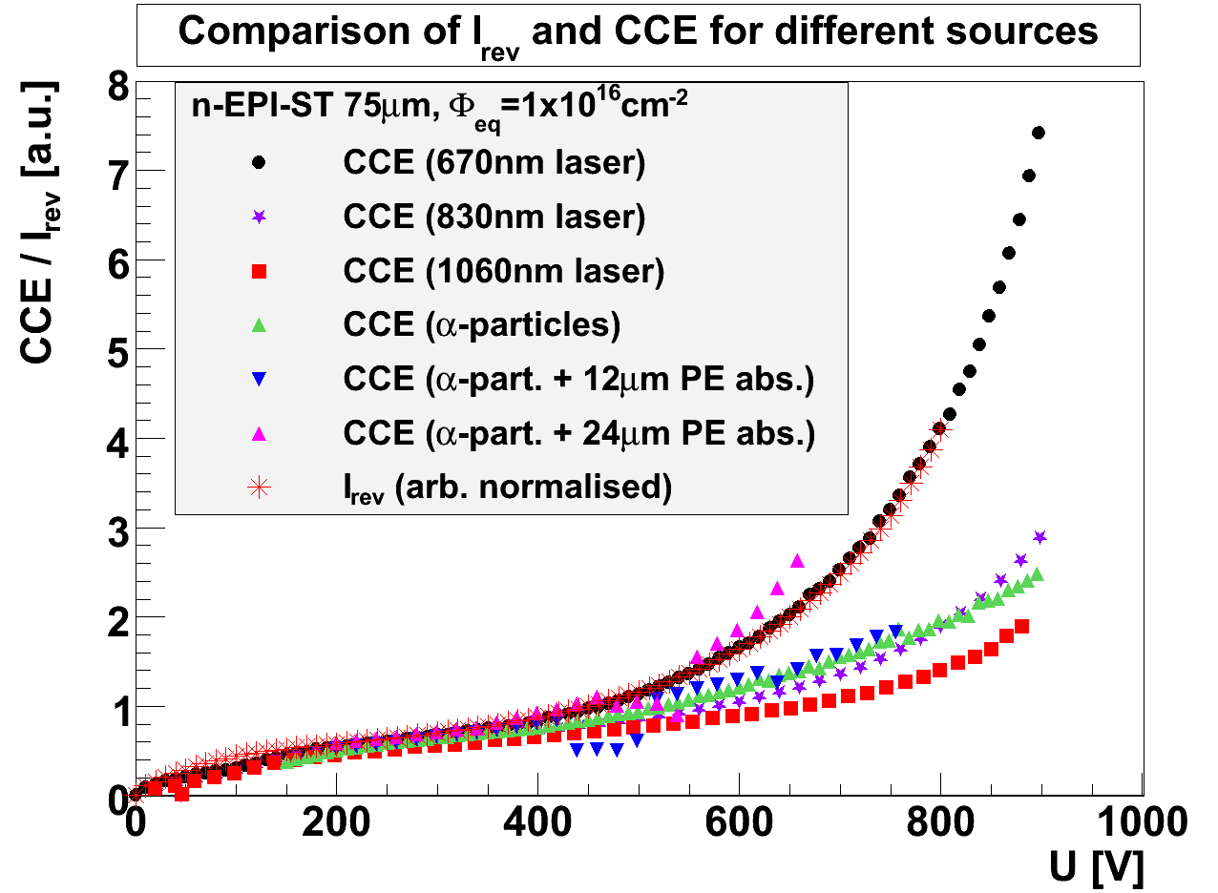
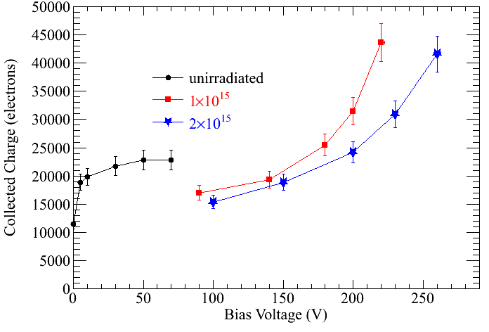
140 and 300 μm n-in-p Micron sensors after 5x10¹⁵ n_{eq} 26MeV p
Evidence of a charge multiplication effect: not only the whole charge is recovered, but increased by f = 1.75
Also CM in diodes (J. Lange, 15th RD50 workshop).
M. Koehler et al., Test Beam and Laser Measurements of Irradiated 3D Silicon Strip Detectors, 16thRD50 Workshop, Barcelona

Slide 6
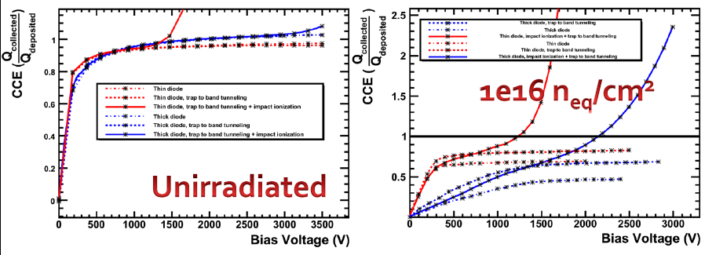
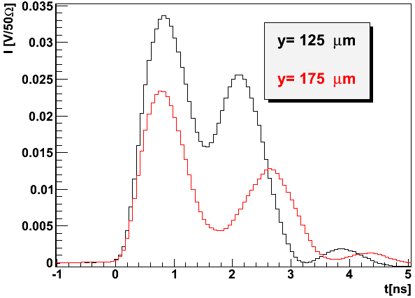
CM is a well documented effect, but we are not mastering it yet
We can qualitatively understand it. We are investigating it from various perspectives.
ISE TCAD, M. Benoit et al., presented at the ATLAS Upgrade meeting, DESY, Hamburg, 19/04/2010
TCT studies
2nd peak due to avalanche multiplication
the difference in peak amplitude for different y is due to electrons trapped
G. Kramberger wt al., 18th RD50 workshop.

Slide 7
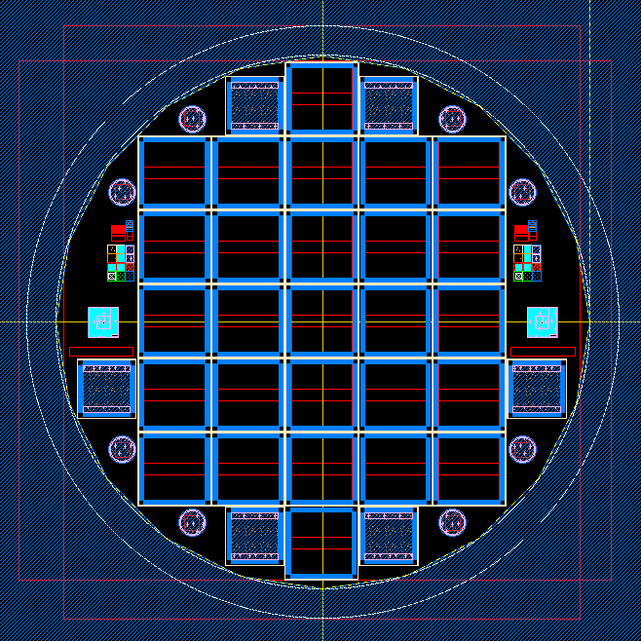
Can we manipulate/optiise CM ?
Charge multiplication after
irradiation
The idea: manipulation of the electric
field
The processing method
Results before and after irradiation
7

Slide 8
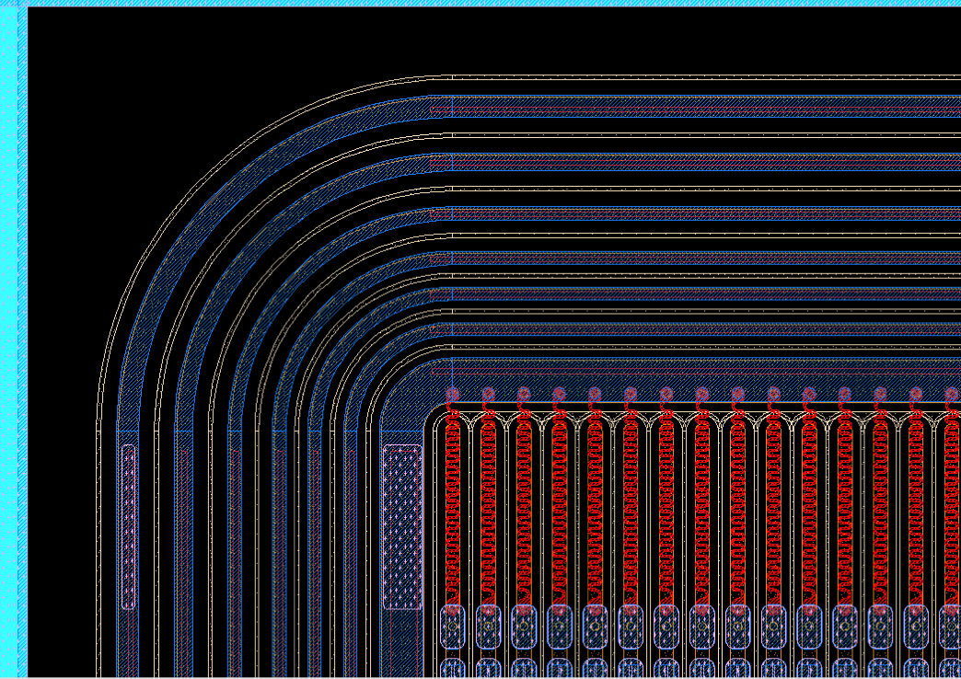
Attempt to manipulate the electric field for inducing CM (RD50 project)
NinP type strip detectors with trenched electrodes
Single chip - 1cm² area
Strip pitch 80um with p-stop isolation structures
Device Simulation and fabricated done by CNM
Well known 6 Guard Ring structure used.
AC coupled
1 standard P-stop design used a reference
5 trench structures simulated → Fabricated → Measured
8

Slide 9
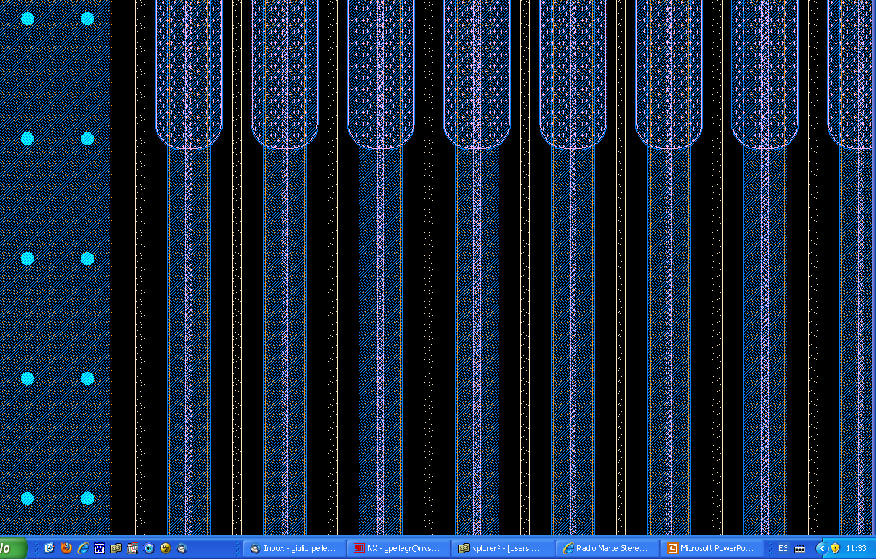
Trenched detector design
Trench 5, 10 50um deep
All 5um wide in center of N+ electrode
Poly trench
P+ implant under N electrode
Centered, 5um wide
Same as P-type diffusion but with trench through N+
P-type diffusion
Oxide trench
n+

Slide 10
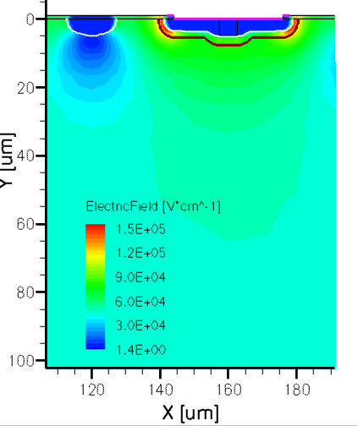
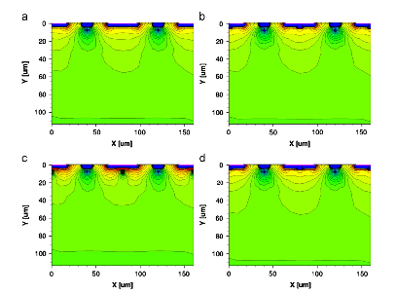
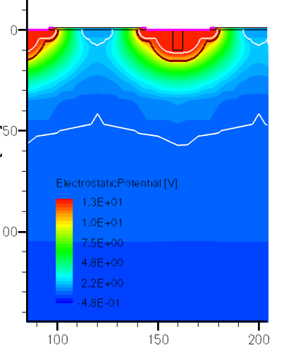
TCAD simulations
Reference
trenched
P+ diffusion
P+ diffusion with oxide filled trench
See NIMA53508 - Simulation of new p-type strip detectors with trench to enhance the charge multiplication effect in the n-type electrodes, P. Ferna ́ndez-Martı ́nez et al.

Slide 11
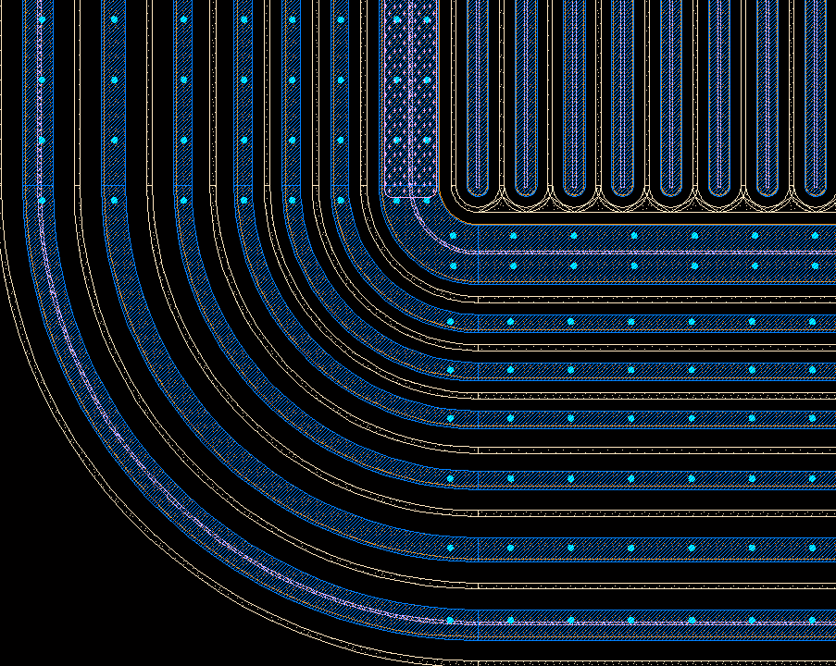
Design Variation’s
Each wafer featured a couple of variations on trench placement
Det A1- trench structure only in active strips
Det A2 – trench structure extended to Bias rail
Det A3 – trench structure extended to Bias rail and last GR
Trench, Bias ring and final GR
Note, Only type A1 dets sent for irradiation

Slide 12
Wafer information/ Irradiation
W2 – 5um trench through centre of electrodes
W3 – 10um trench through centre of electrodes
W5 – 50um trench through centre of electrodes (poor metallisation)
W7 – reference, standard N electrodes with P-stops
W16 – P⁺ implant under N electrode, 5um wide
W18 – W16 structure with wide p⁺ implant
Detectors sent for neutron irradiation to JSI Ljubljana, Doses -
1E15 1MeV neq Measured
5E15 1MeV neq Measured
1E16 1MeV neq Partially Measured
2E16 1MeV neq Measured
3E16 1MeV neq W2/5 No signal at 1000v

Slide 13
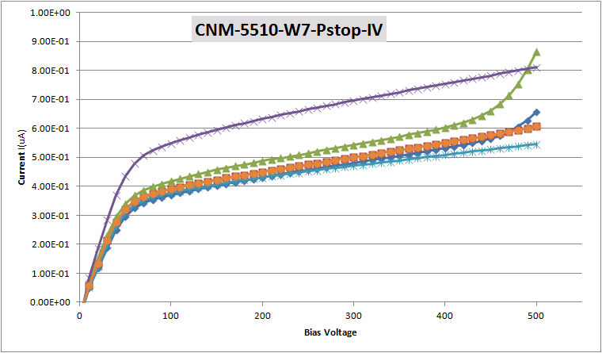
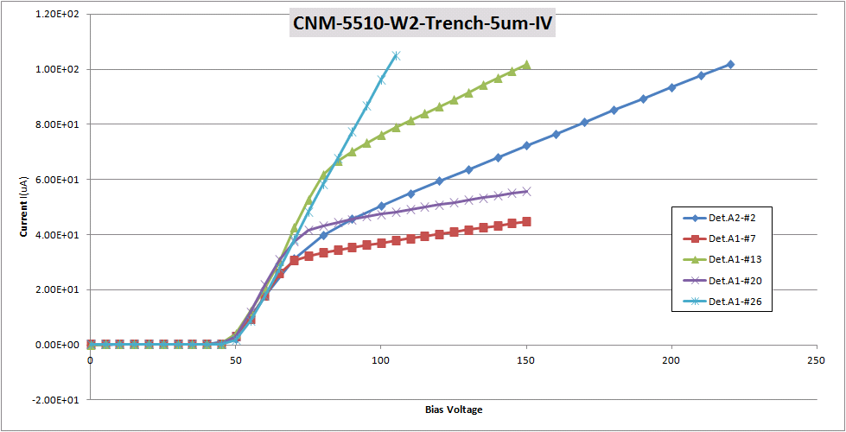
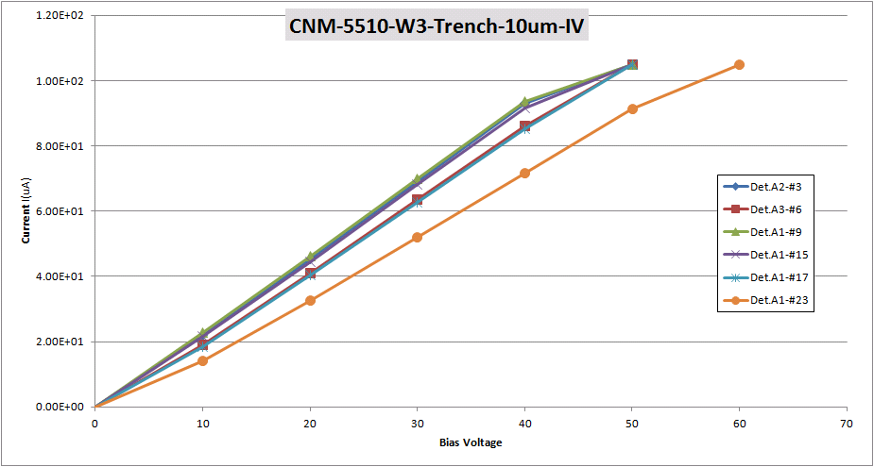
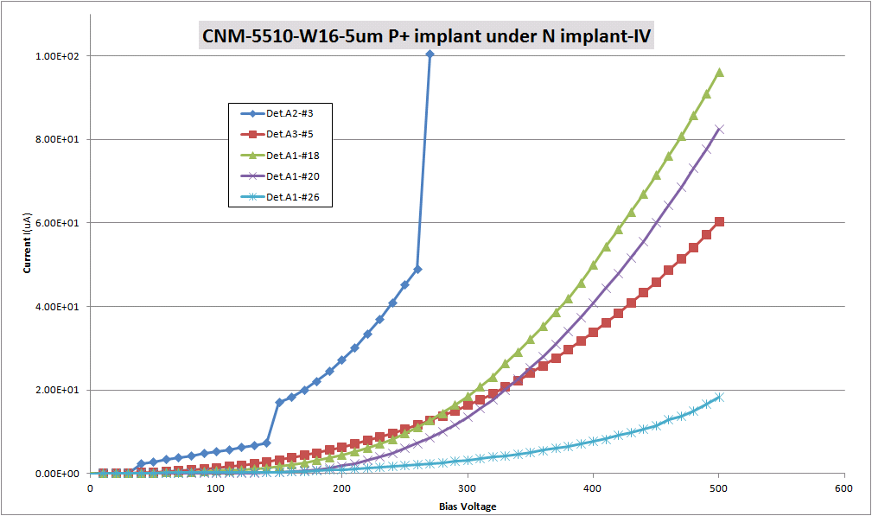
Initial IV from wafers W2,3,7,16

Slide 14
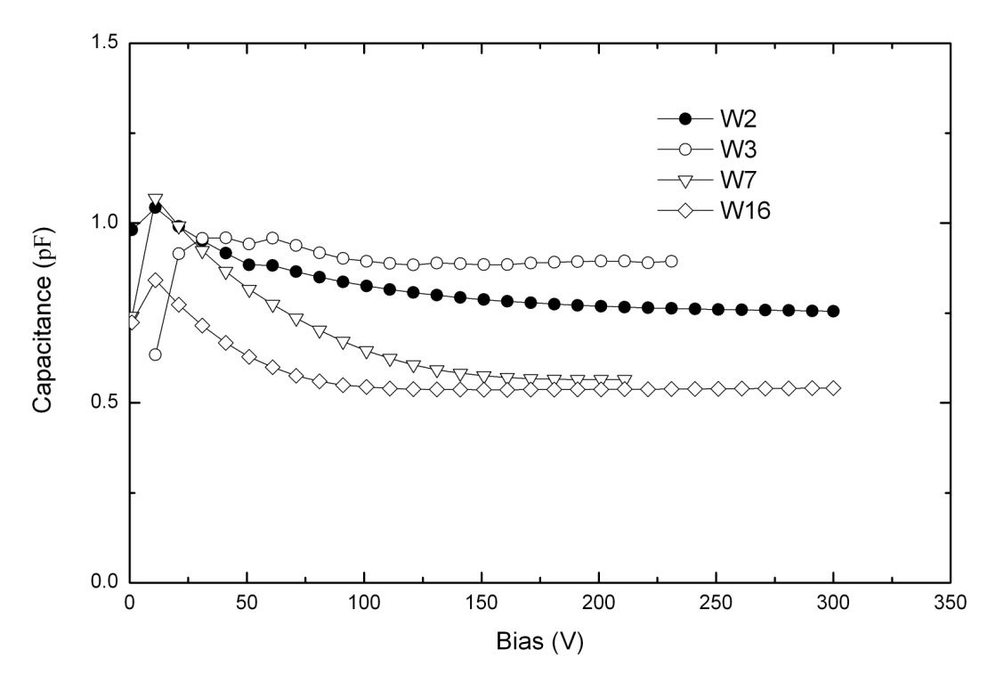
Interstrip capacitance

Slide 15
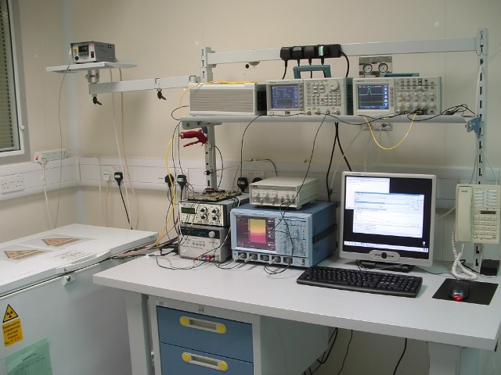
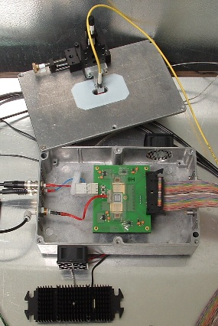
Alibava Setup
Analogue readout based on the Beetle V1.5 chip
(40 MHz readout speed)
Signal generation with 370 Mbq 90Sr fast beta source or IR Laser
(980/1060 nm) for charge collection & sharing studies
Detector attached to aluminium heat sink and cooled using fans to blow cold air over/under detector
Scintilator/s placed under/ontop daughter board for single or coincidence trigger
Cooling down to - 45 deg.C (ElCold EL11LT), 1deg.C hysteresis loop
15

Slide 16
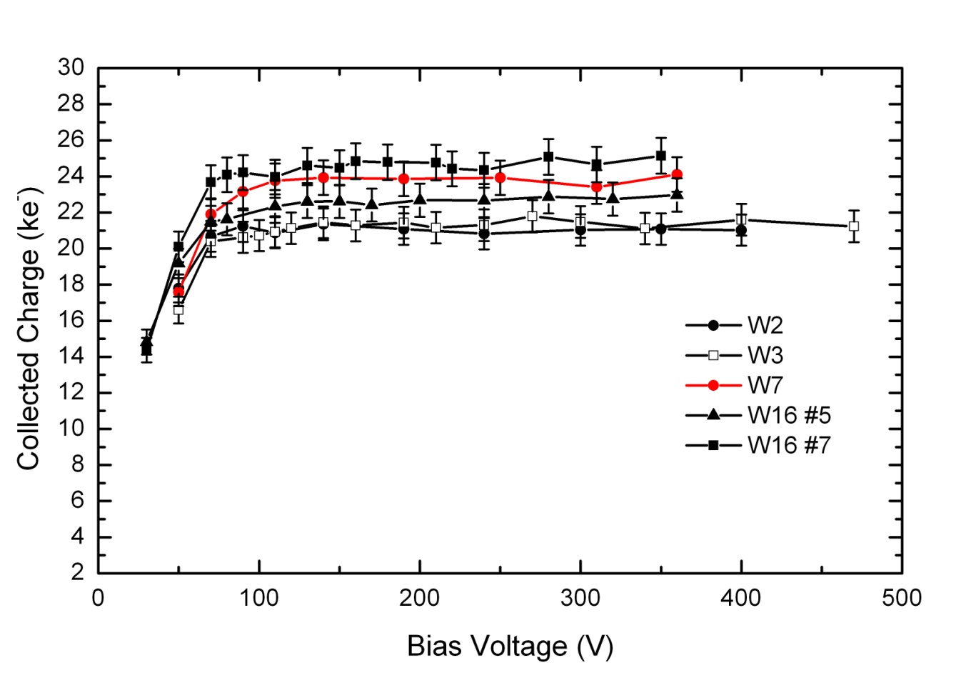
Charge collection as a function of bias voltage – CC(V):
non-irradiated sensors
W5 wouldn't Bias, >1ma at 10V

Slide 17
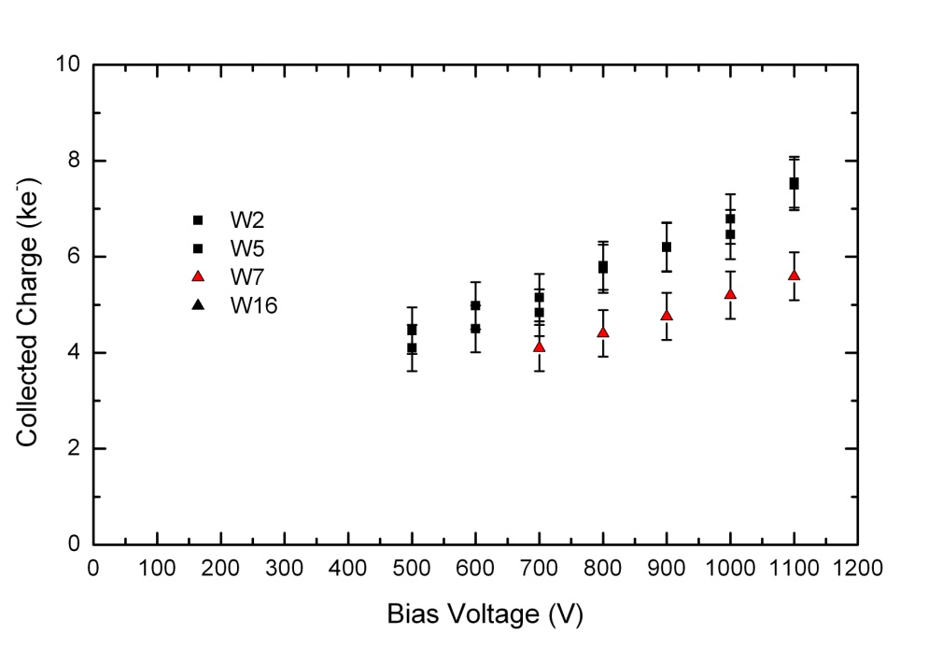
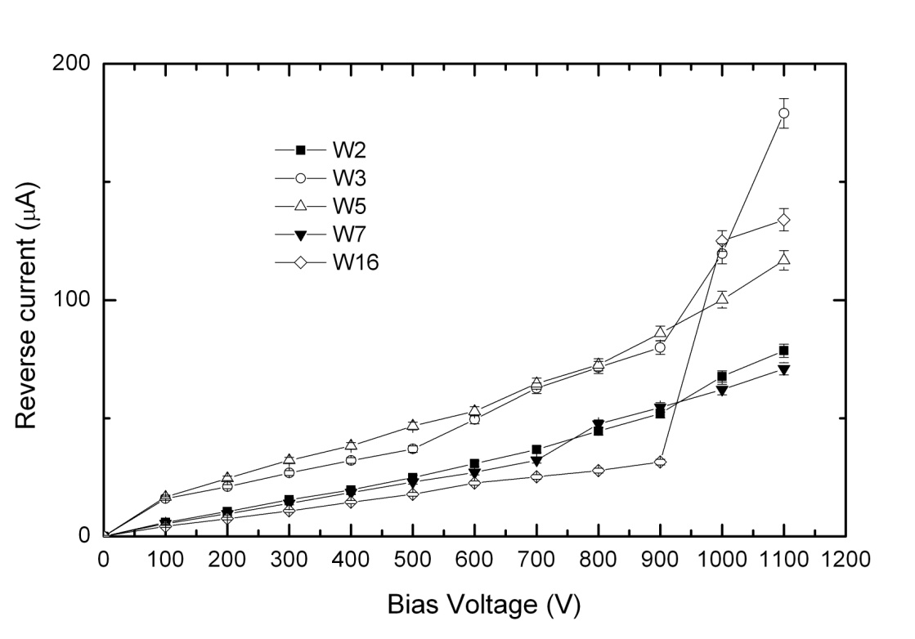
CC(V) and IV after 1E15 n_{eq} cm⁻²

Slide 18
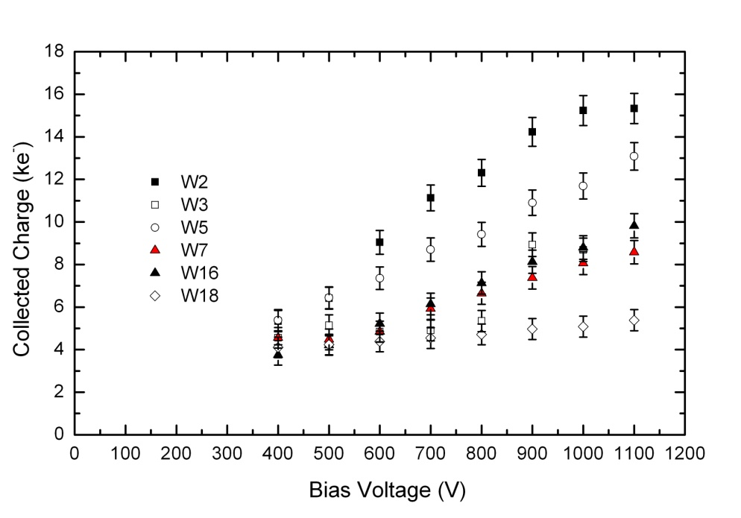
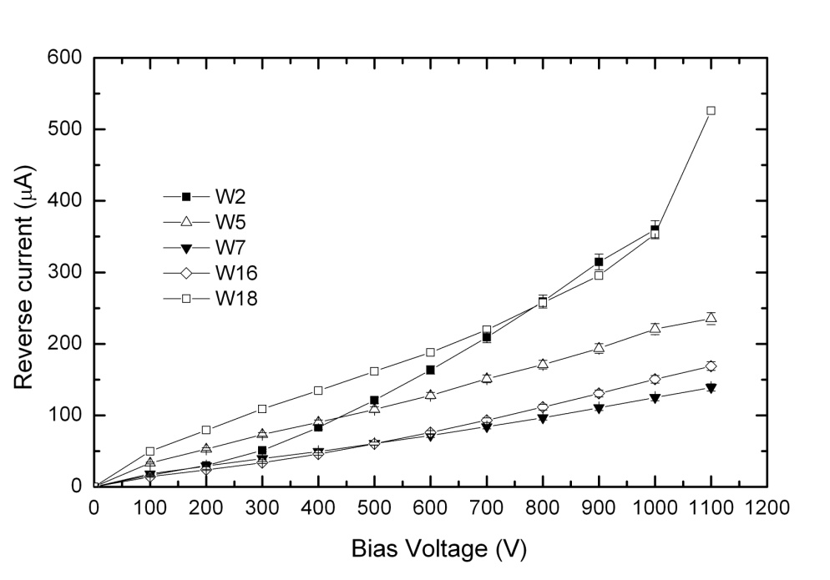
CC(V) and IV after 5E15 n_{eq} cm⁻²
More evidence that trenched detectors have enhanced CC(V) compared to reference
All sensors have higher currents than reference

Slide 19
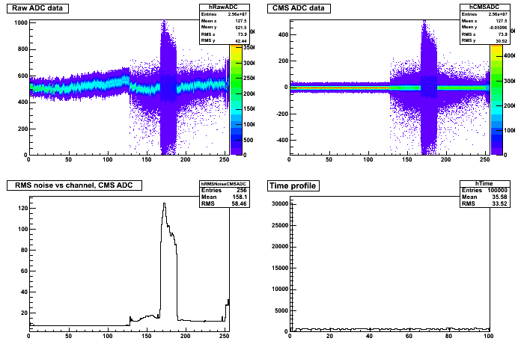
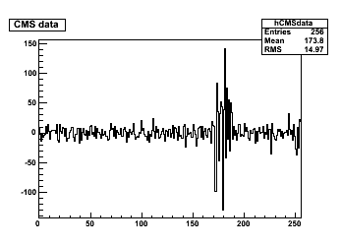
Problems with strip isolation......

Slide 20
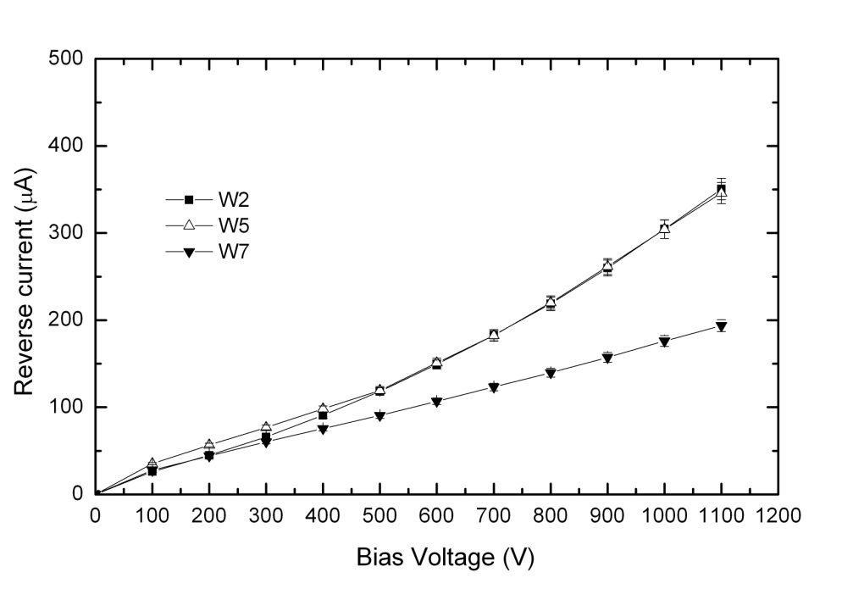
CC(V) and IV after 1E16 n_{eq} cm⁻²
Trenched detectors with higher charge collection than standard.

Slide 21
Further work is required for understanding and controlling this method for charge collection enhancement. This work is being performed with AC coupled microstrip detectors. The relevant application would be pixel devices. Need to test with a pixel geometry (and DC coupled electronics).

Slide 22
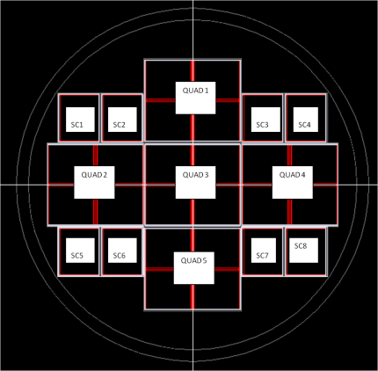
QUAD Mask
Sensor type:
SC1, SC2 – “test” 450 µm edge.
SC3, SC4 – 500x25, 450 µm edge.
SC5 – SC8 “test”, 300 µm edge.
SC6 – SC7 “production”, 300 µm edge.
QUAD1 – “production”, 450 µm edge. QUAD2 – “test”, 300 µm edge.
QUAD3 – “test”, 450 µm edge.
QUAD4 – “test”, 450 µm edge.
QUAD5 – “production” 450 µm.
In pixel layers at higher radii (certainly the 3rd and 4th layers) there will be no need to push the CM for improved signal with respect to standard planar results. Even the second layer will probably need high bias (1000V) with no extra tricks .... Only innermost layer, and possible closer wheel would need a boost ...

Slide 23
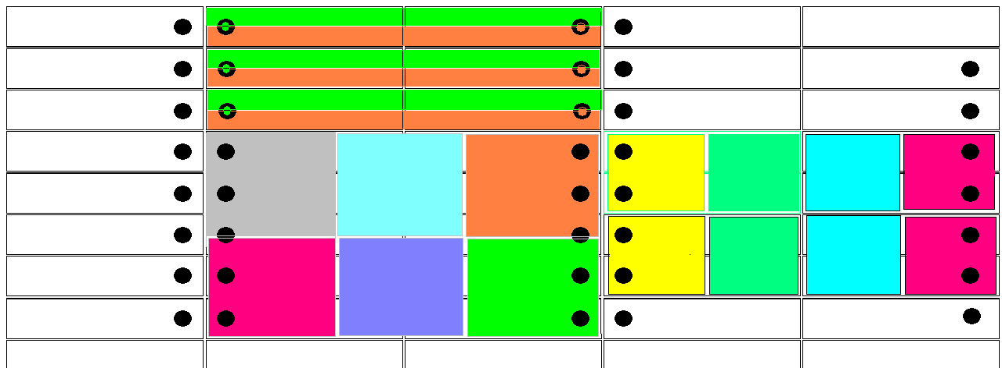
Geometries
Possible pixel geometries based around a FE-I4 footprint. Is it possible to manipulate CM with this geometry and DC coupled devices?
250 μm
50 μm

Slide 24
Conclusions
Enhanced charge multiplication has been achieved with junction engineering. This is a first evidence that this method could be used for reducing the bias voltage required for a given signal (e.g. required for efficient tracking after very high doses). This might be a route to satisfy the radiation tolerance needs of the innermost layers for HL-LHC.
The development has been performed with microstrip AC coupled sensors. More test (topological characterisation, improvement of the processing, tests with pixel geometries ....) are needed to established if this process has practical applications. Nonetheless it can give insight about how the CM works and contribute to developing an effective parameterisation of the effect for practical uses.
Incidentally, work is being carried out within RD50 to see if CM can be influenced by the junction shape/size in a traditional planar processing.

