Slide 1


RFD Crab Cavity Contribution from the U.S. Updates
Leonardo Ristori - FNAL
Dec 12th, 2025 - Global CC Coordination Meeting

Slide 2
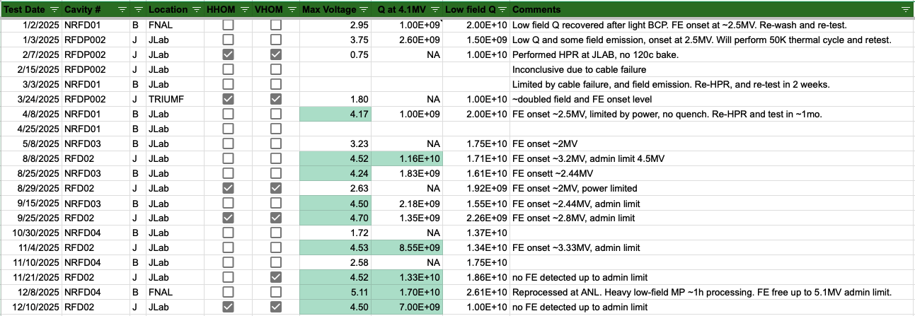
Cold Test Summary: 2025

Slide 3
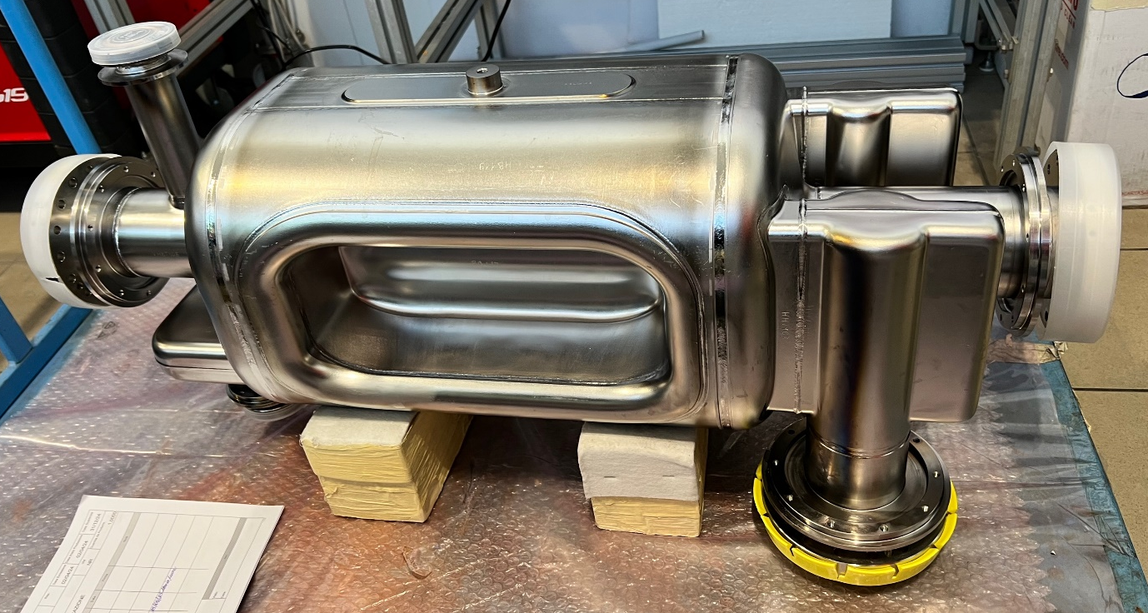
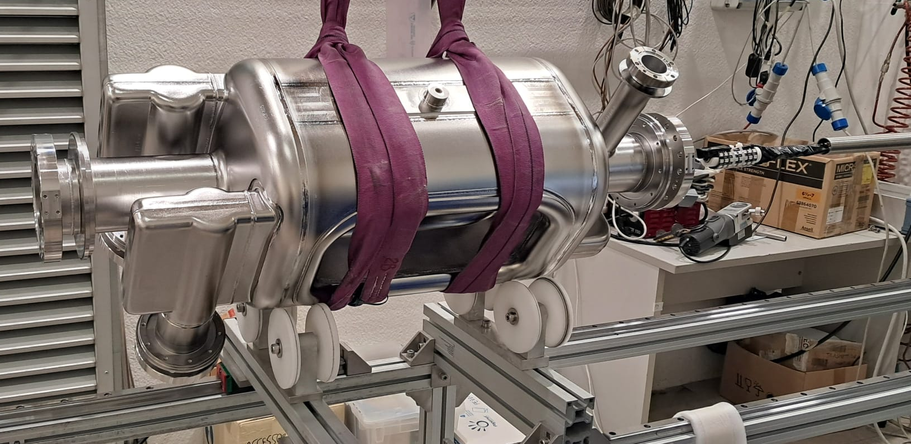
Series Bare Cavities #05 & #06
NRFD05
EB Welding completed. Reshaped to recover frequency.
An acid leak during light BCP damaged Beam Port Brazed joints causing a vacuum leak.
NCR to be prepared by ZRI and AUP and dispositioned by CERN prior to any rework.
ZRI appears confident on the repair although the details still need to be fully understood.
NRFD06
EB Welding: completed in October.
BCP processing: 180µm bulk removal followed by a 40µm light (ZRI)
HPR: used new HPR nozzle, Dec 10th → clean room assembly using AUP advice.
NRFD05 EB Welded.
NRFD06 EB Welded, undergoing optical inspection.

Slide 4
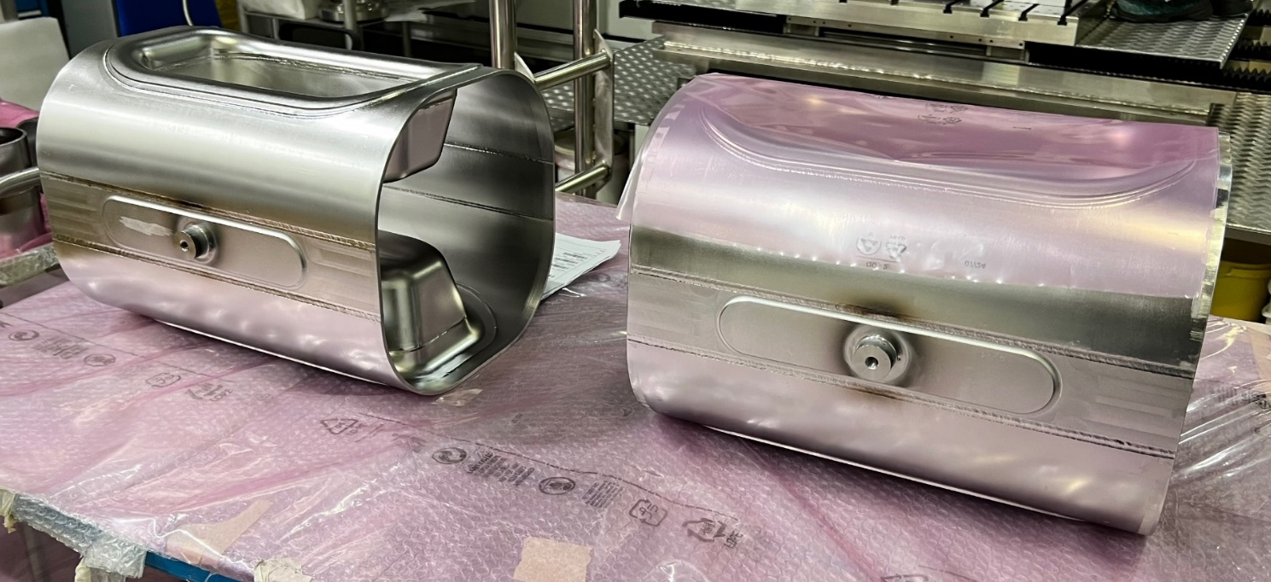
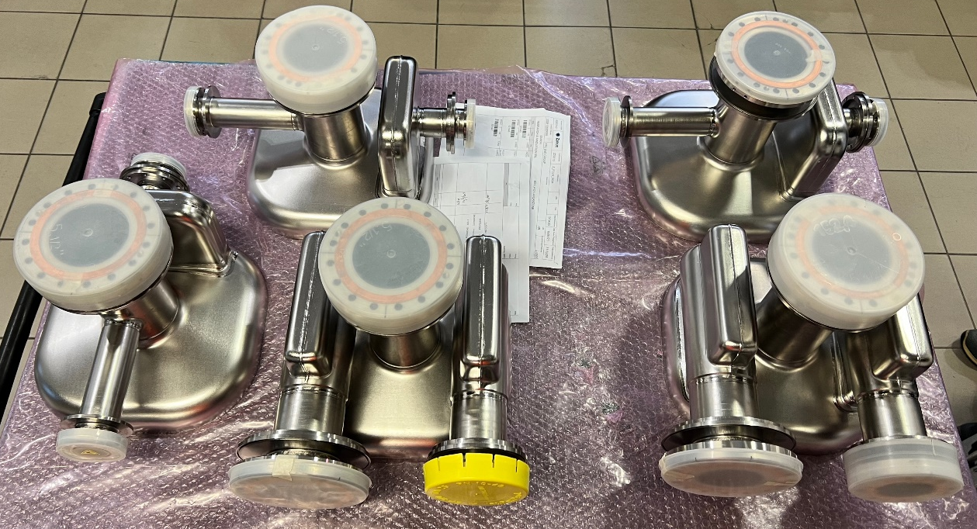
Series Bare Cavities #07 & #08
NRFD07
EB Welding completed.
BCP processing: 180µm bulk started on Dec 9, 2025 (ZRI).
NRFD08
EB Welding completed.
Processing beginning of 2026.
NRFD06 and 07 Main Bodies ready for trim tuning
NRFD06 and 07 End Caps in final CNC machining
Notes:
NRFD07
EB Welding: Scheduled for next week.
NRFD08
Status: In final trim tuning stage; EBW to follow completion of NRFD07.
Preparation: Main bodies EBW includes tuner pin installation. Minor internal defects have been polished prior to final welding.
General Notes
QCRs: To be received by AUP; will be uploaded to EDMS as soon as available.

Slide 5
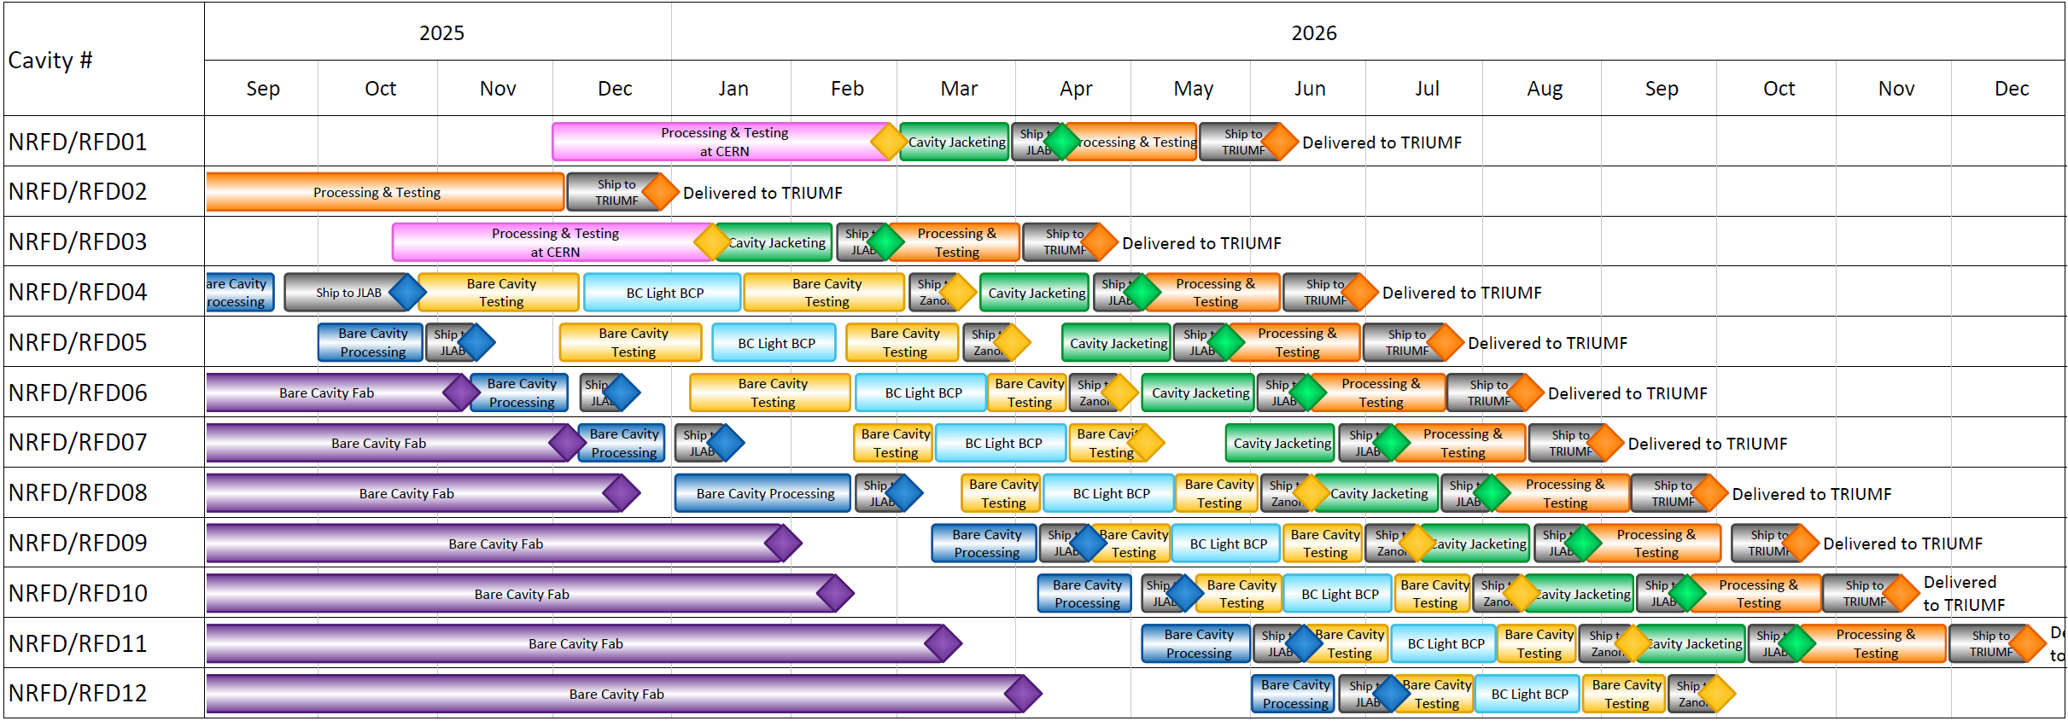

RFD Tests and Delivery Dates
RFD02: qualified & ready for shipment to TRIUMF.
NRFD04: qualified & ready for shipment to Zanon for Jacketing.
NRFD05: failure after light BCP, to be repaired. Quarantined. Behind schedule.
NRFD06: clean room assembly ongoing. Will be shipped to FNAL after holidays. On schedule.
NRFD07, 08: final EBW done. Ahead of schedule.

