Slide 1





Early proton extraction
update
IMCC Target meeting
4th December 2025
J. Mańczak, D. Calzolari, S.Candido R. Franqueira Ximenes, A.Lechner, G. Lerner

Slide 2
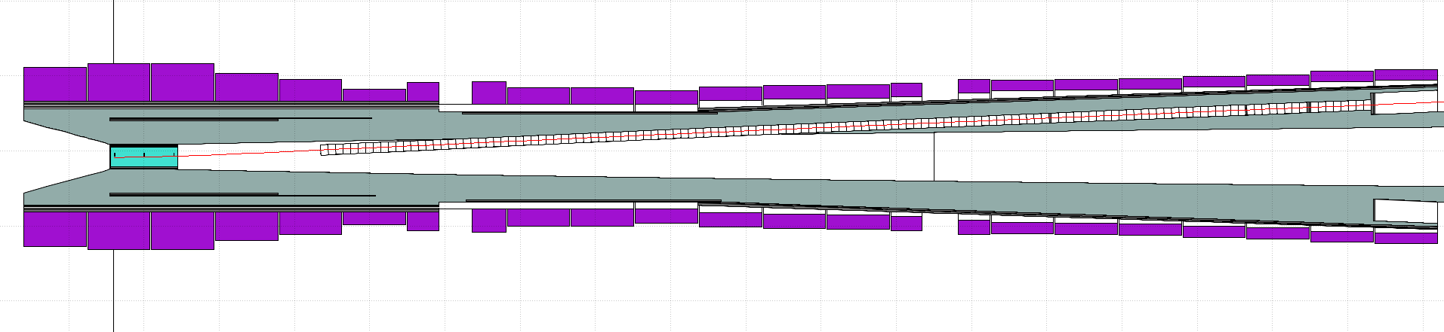
Extraction angle
From the previous studies and discussion, I decided to proceed with 3 degrees target inclination for a flatter extraction. The azimuth angle is fixed at 120 degrees for horizontal extraction.

Slide 3
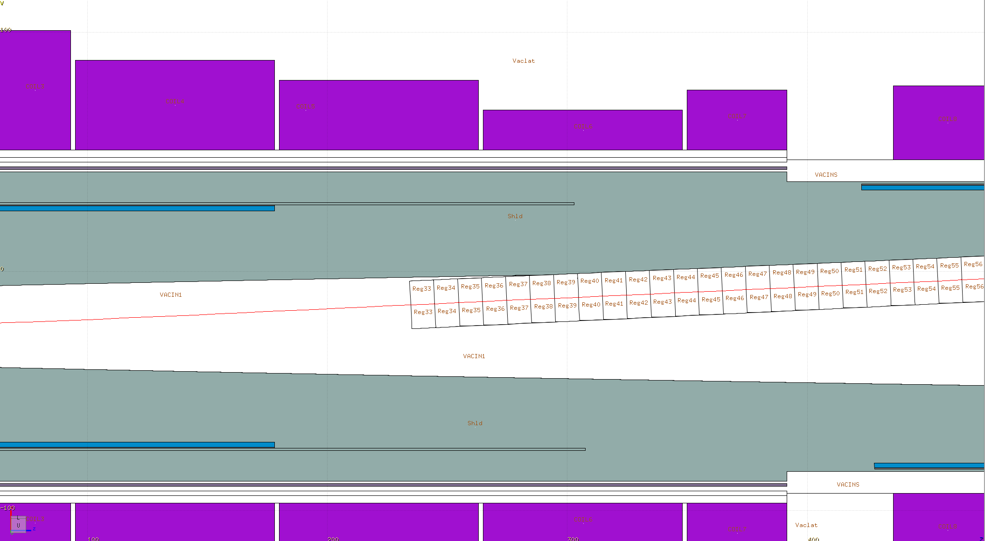
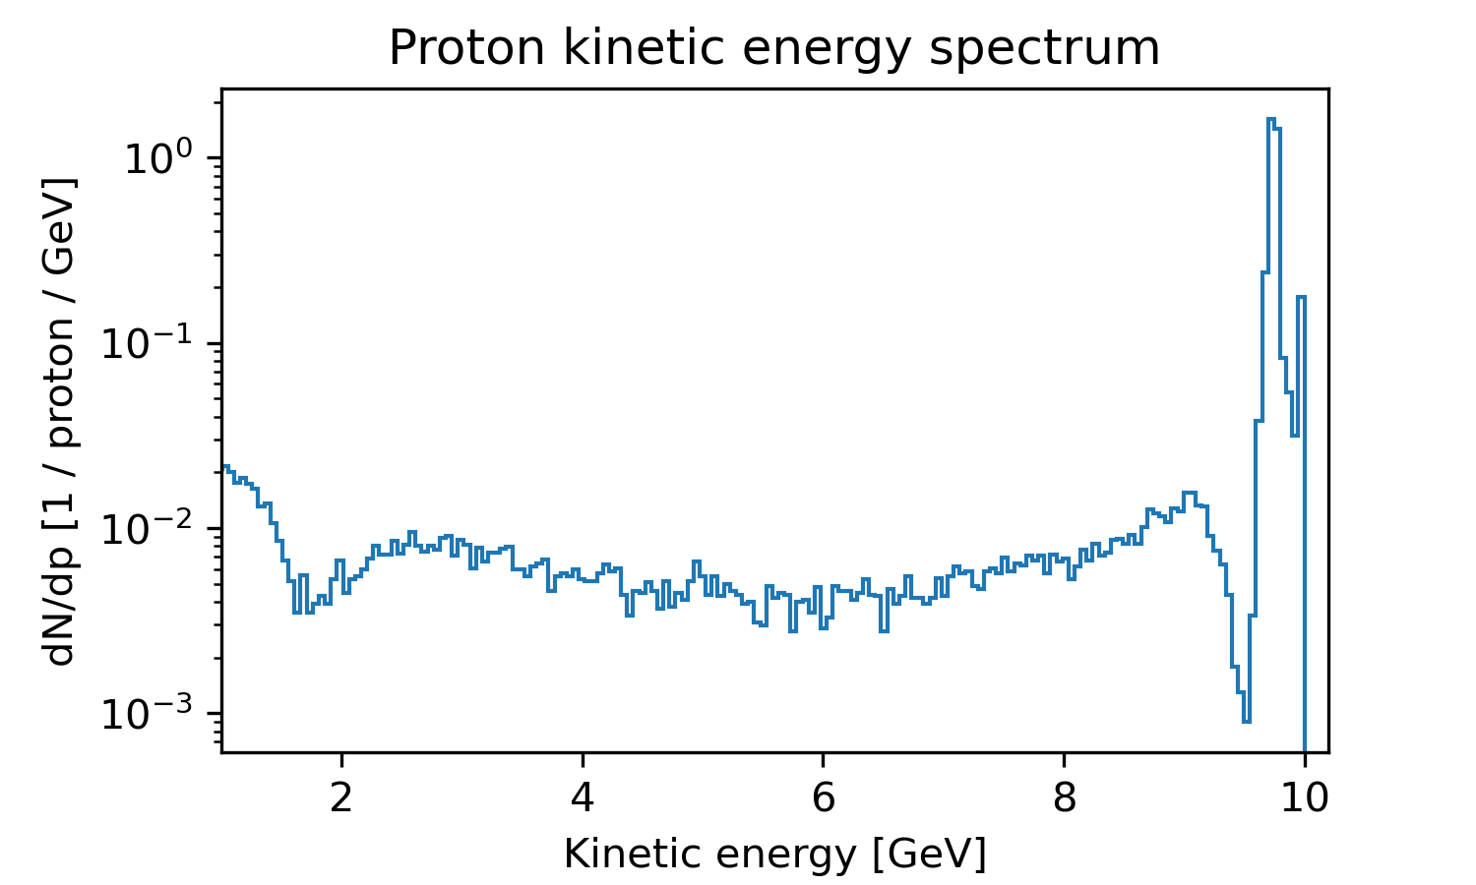
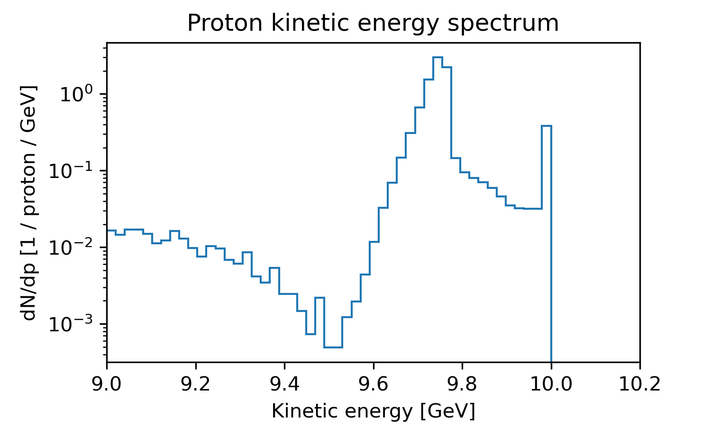
Proton energy to be extracted
These protons cannot be extracted, they will dissipate in the shielding
Proton ditsribution snapshot at this position
Spent protons account for 17% of the beam power, this is the maximum that can be extracted
Elastically scattered component
(<Ekin> = 9.74 GeV) itself carries 16% of the beam power and the channel should be optimized for its extraction

Slide 4
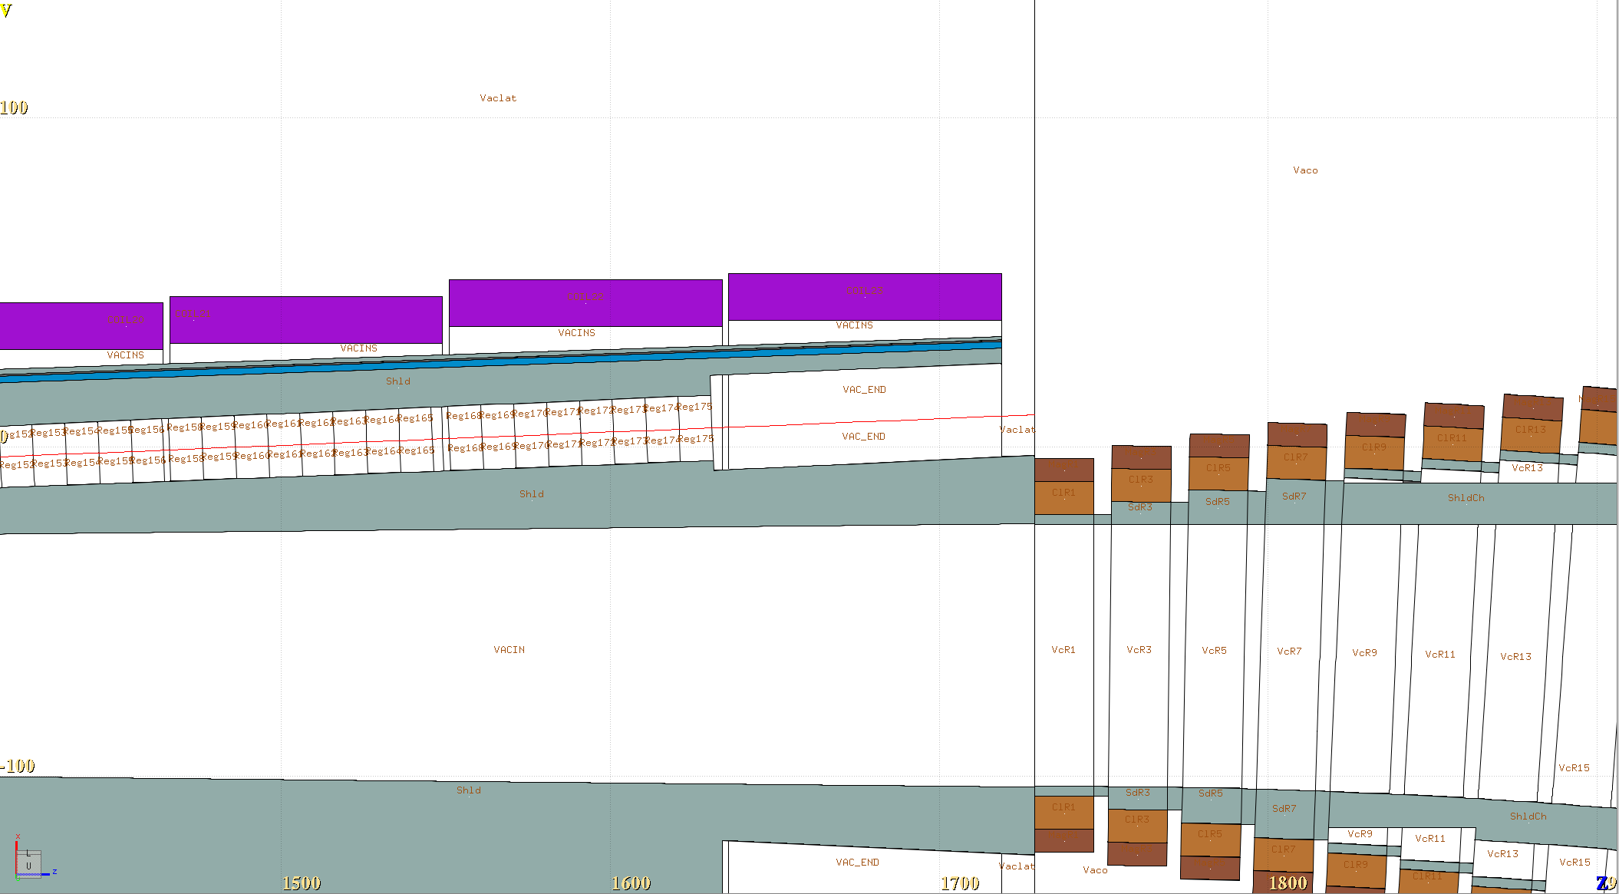
Proton energy actually extracted
Proton ditsribution snapshot at the channel exit
For now, the channel was optimzied for 10 GeV refernece particle
Almost 12% of the primary beam power extracted
At the end of the channel, a small shift of the center with respect to the primary component is present, room for optimziation!

Slide 5
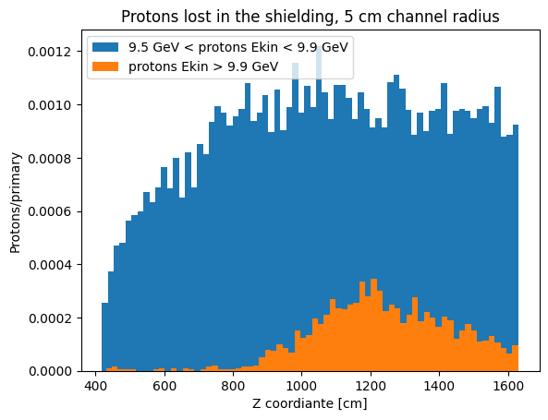
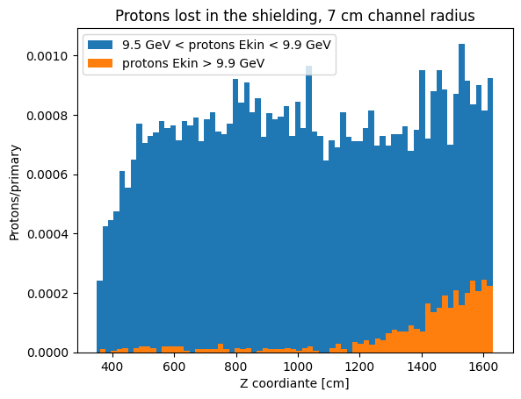
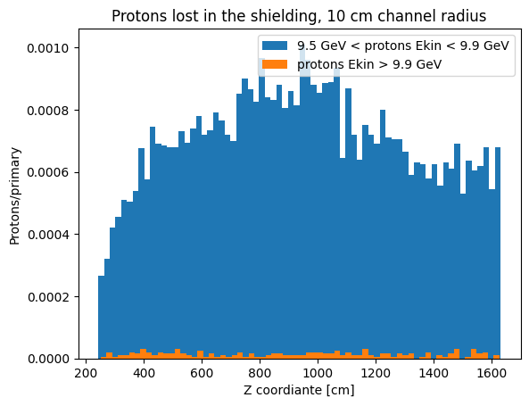
Channel radius
Channel radius must compromise between space for the extraction of the spent protons and shielding from the interaction products of lower energy component.
5 cm was identified as too small, unnecessary losses
7 cm was chosen for the first iteration, pontentially combined with increasing radius from 12 m in Z
10 cm compromises shielding too much

Slide 6
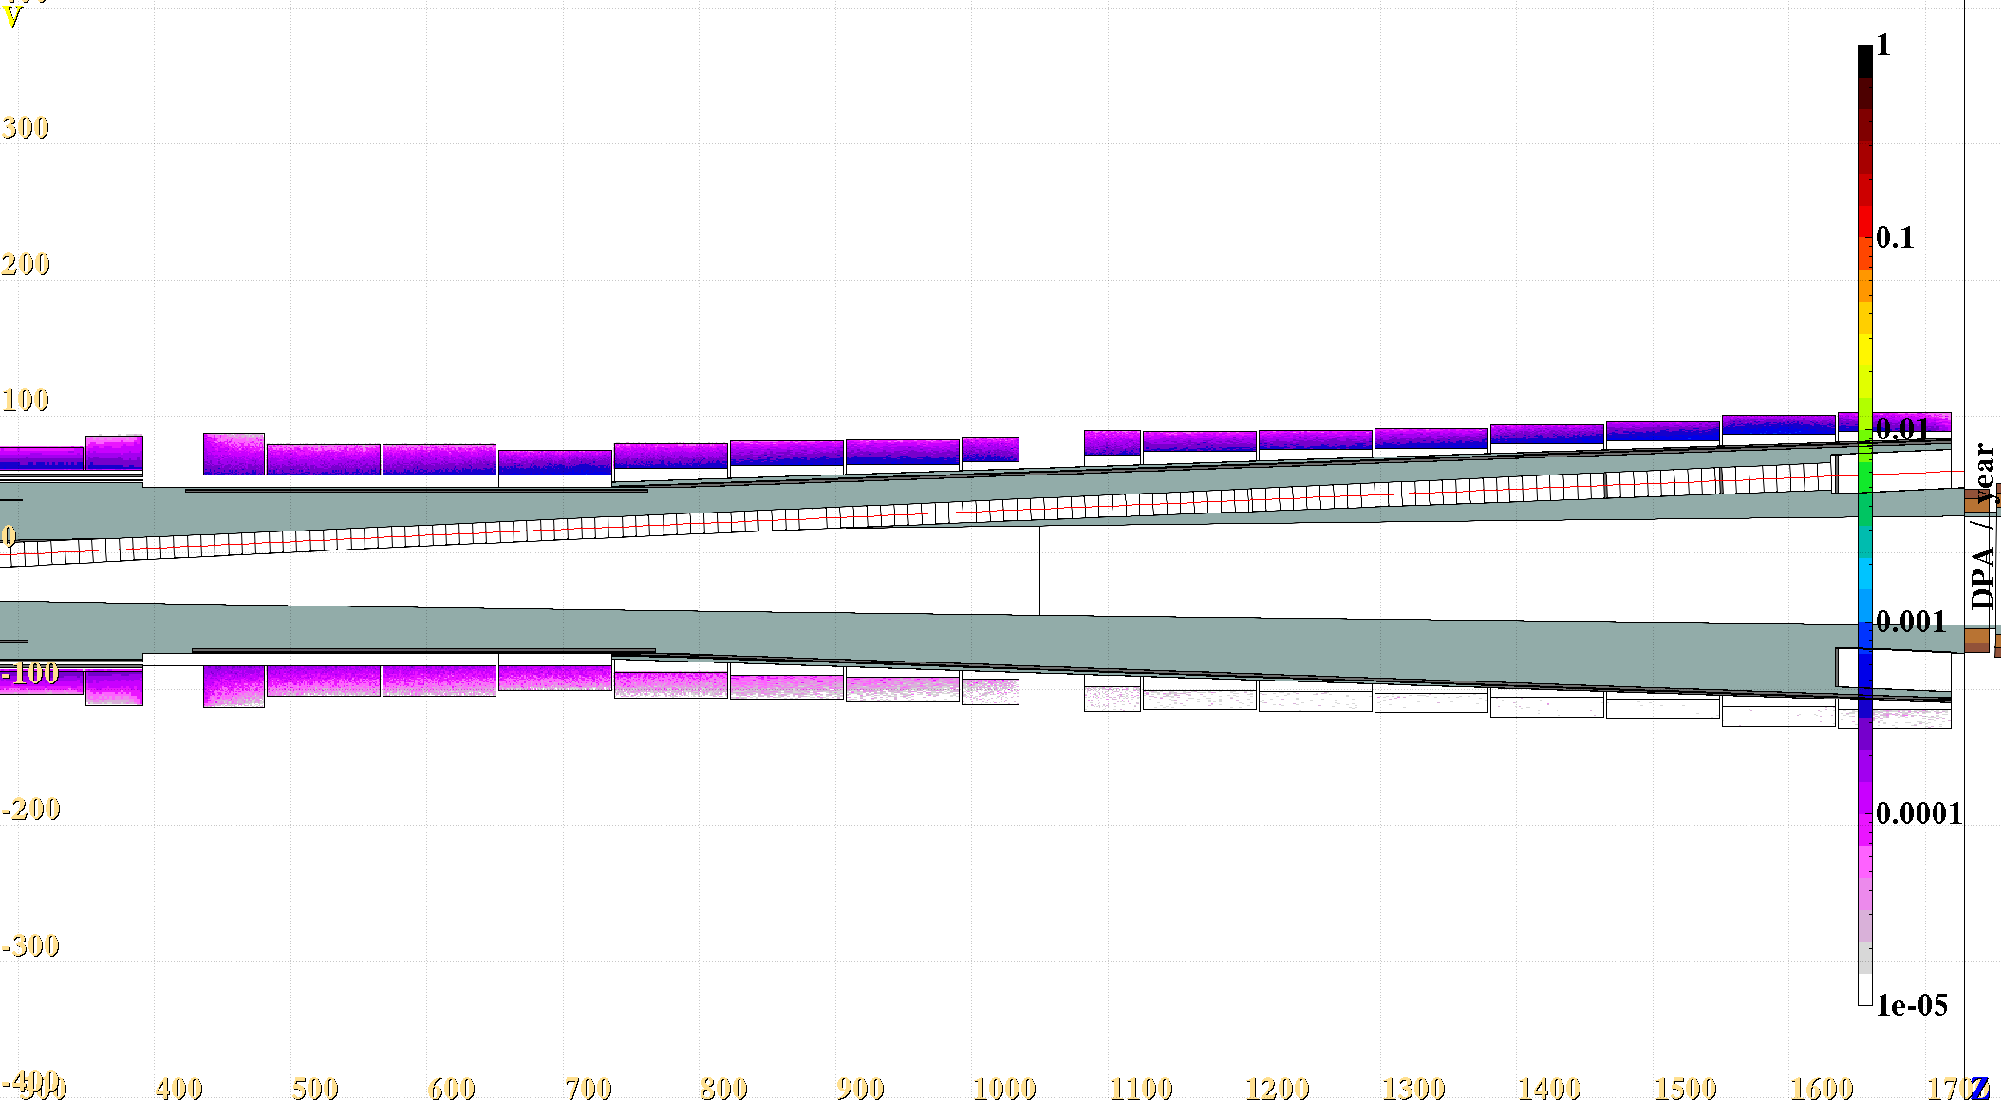
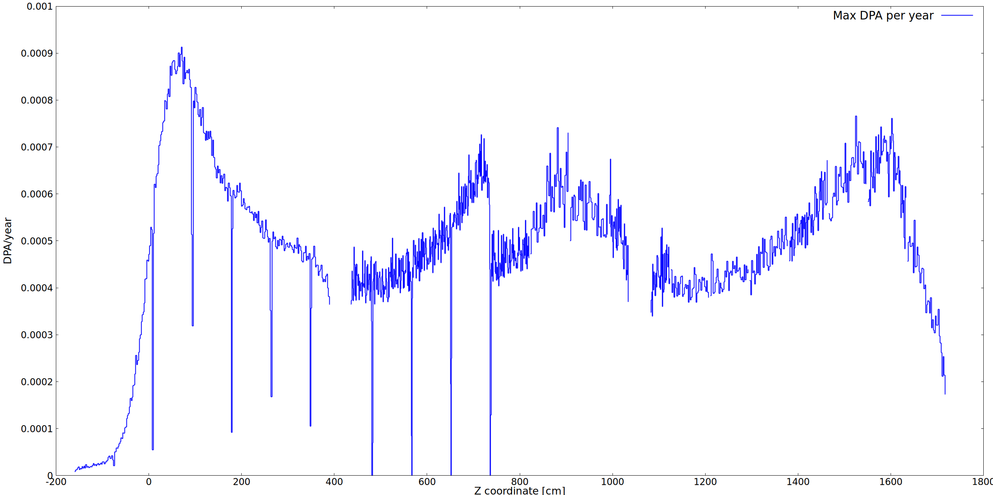
DPA/year, 7 cm radius channel
The DPA/year is consistently below 1e-3, and still we have room for improvement
Additional neutron mitigating layers were added (BC4 + H20

Slide 7
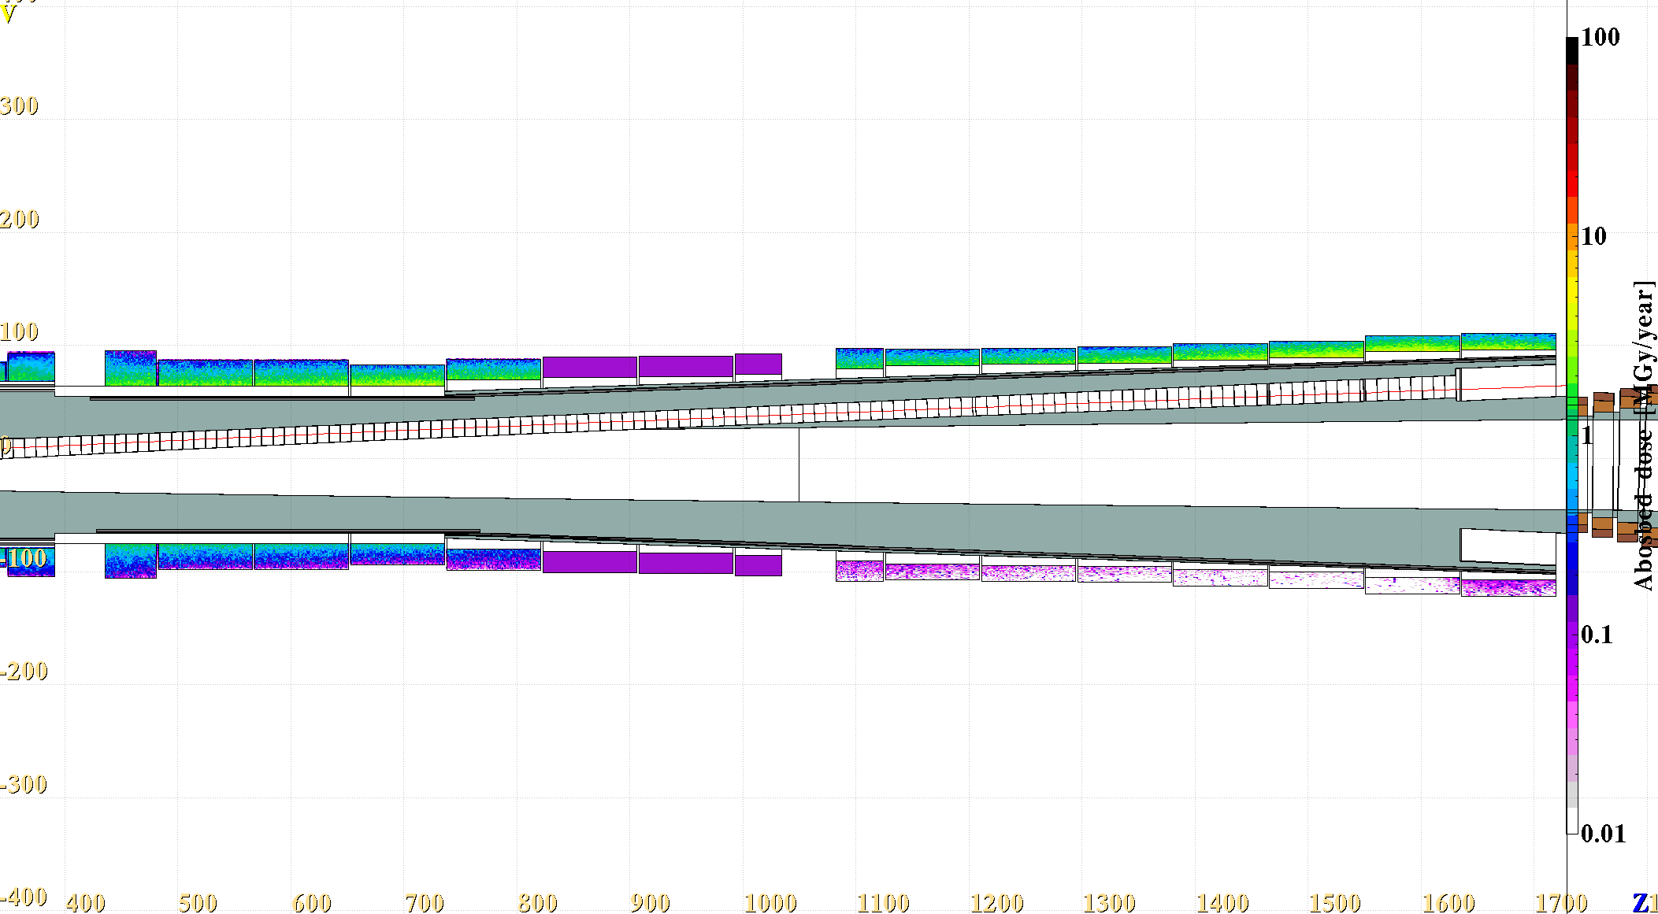
Yearly Dose, 7 cm radius channel
Missing scorings in the simulation, to be fixed!
The yearly dose stays below
5 MGy/year

Slide 8
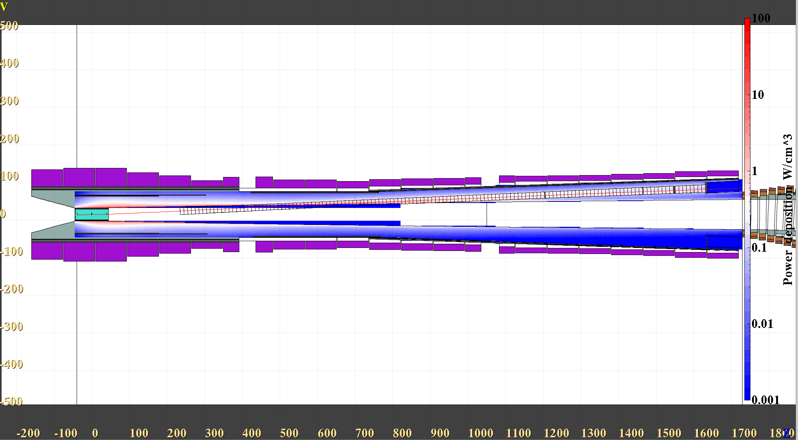
Power deposition, 7cm radius channel
Still to be understood if there are any problematic regions

Slide 9
Magnet apertures
The first 7 coils around the target had to be pushed to 74 cm inner radius (it’s just 1cm more than my IPAC result for a straight target and 4 MW beam)
Starting from here the field is reaches final 1.5 T
148 cm
140 cm
204 cm
Subsequent 4 coils now have 70 cm inner radius (+10 cm with respect to the previous design)

Slide 10
10 GeV vs 5 GeV
5 GeV protons are not rigid enough in the strong magnetic field around the target to guide them for a flat angle extraction.
A steep angle extraction could be possible, but challanging in the context of the tunel shape and high field coil sizes.

Slide 11
Summary
An ideal extraction channel before the chicane is able to extract up to 17% of the primary proton beam power carried by the highest energy component (very beneficial for the chicane design)
A design was proposed that complies with the radiation load restrictions, at the moment it extracts ~10% of the primary power and leaves room for improvement e. g. by shifting the channel center to follow a 9.74 GeV proton instead of original 10 GeV.
Clearance region for the HTS coil sizes is proposed together with the channel design.
The extraction before the chicane can only work for 10 GeV primary beam, in the case of 5 GeV it would have to happen very close to the target and the tunel shape would be more problematic.

