Slide 1

Introduction from ″newcomers″ : Nicholas Lusa
SMT General Meeting
25th November, 2025

Slide 2
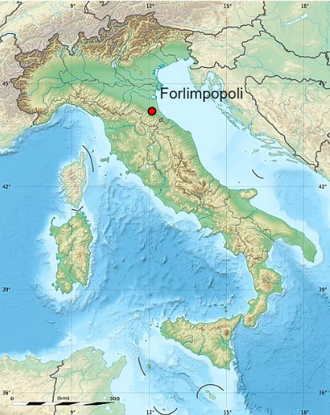
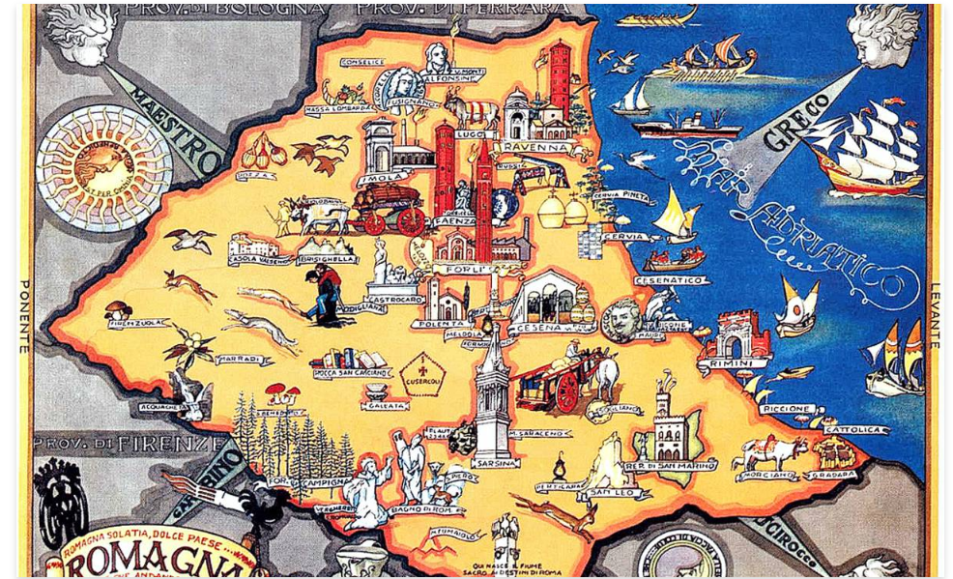
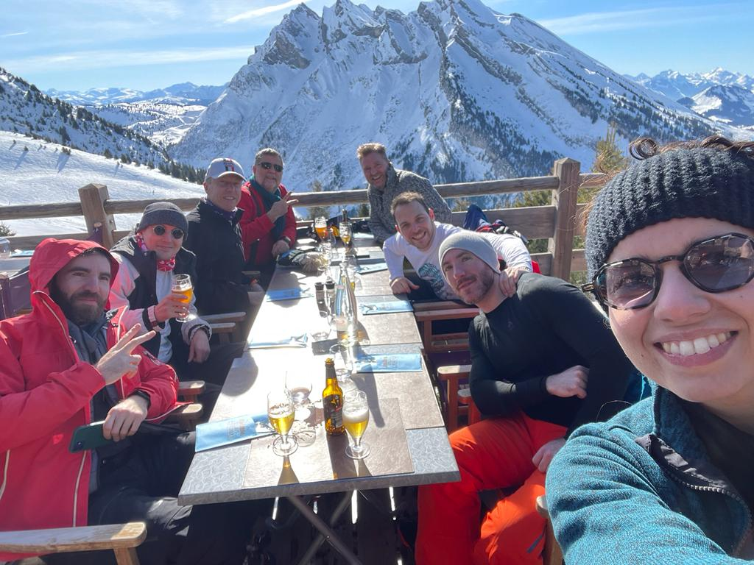
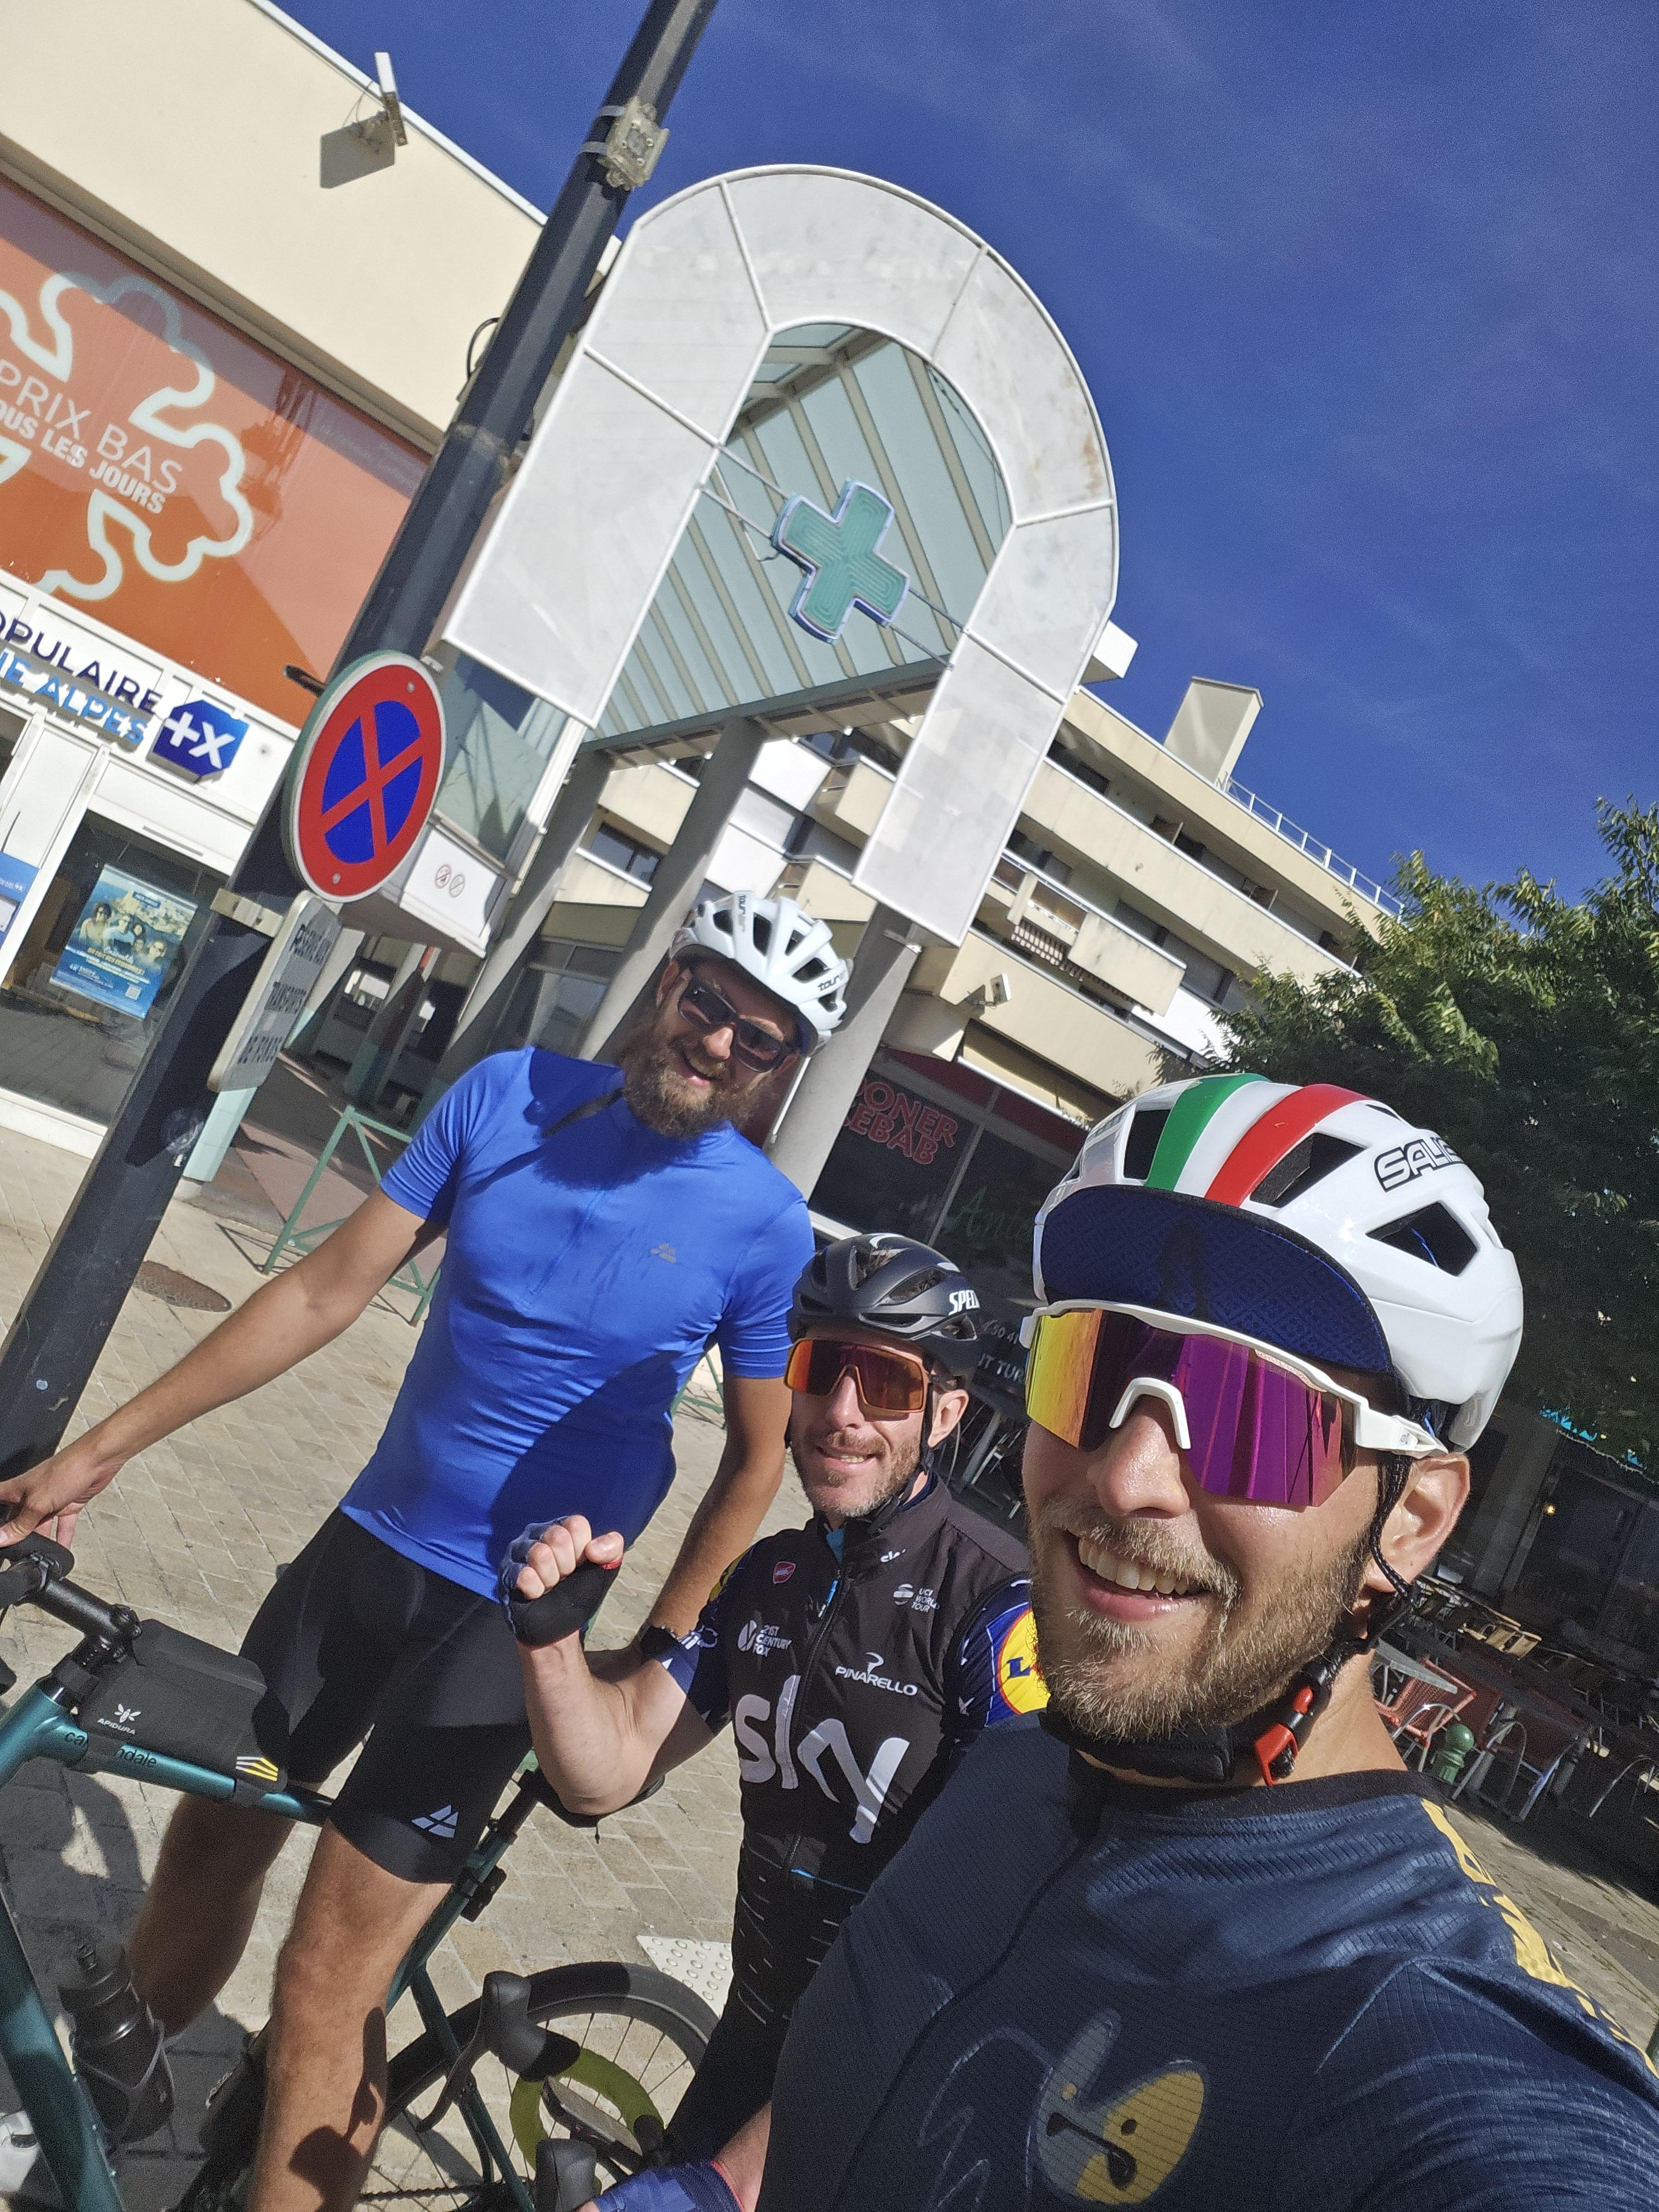
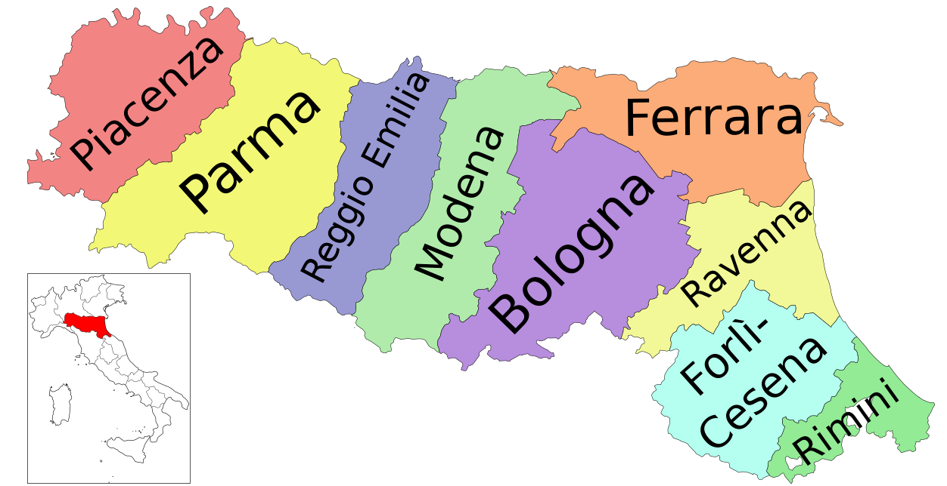
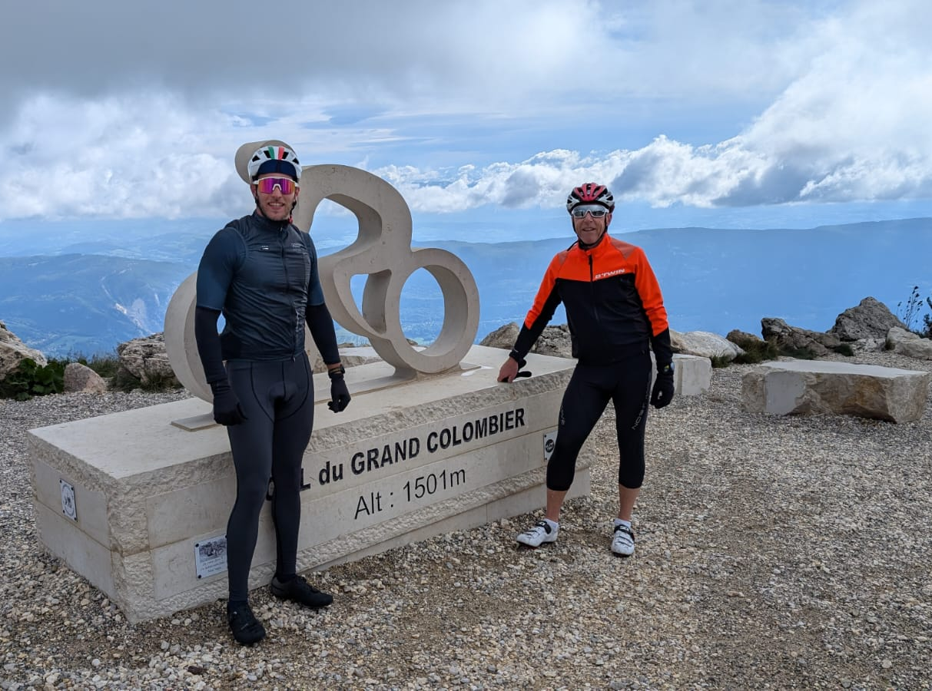
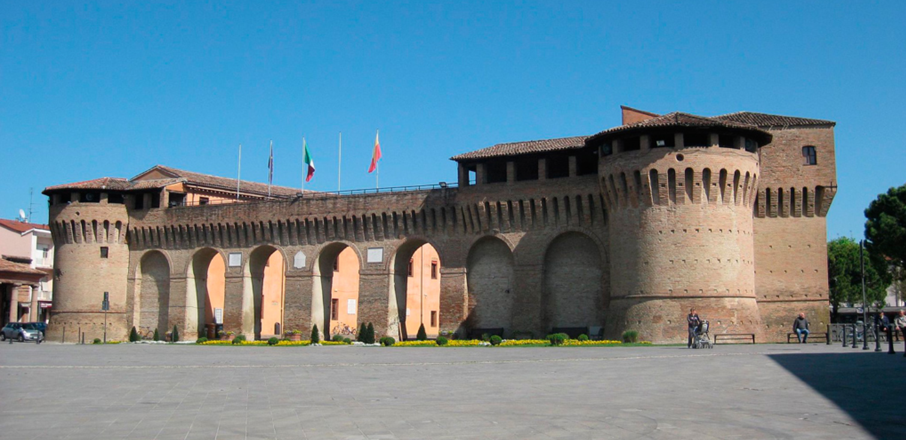
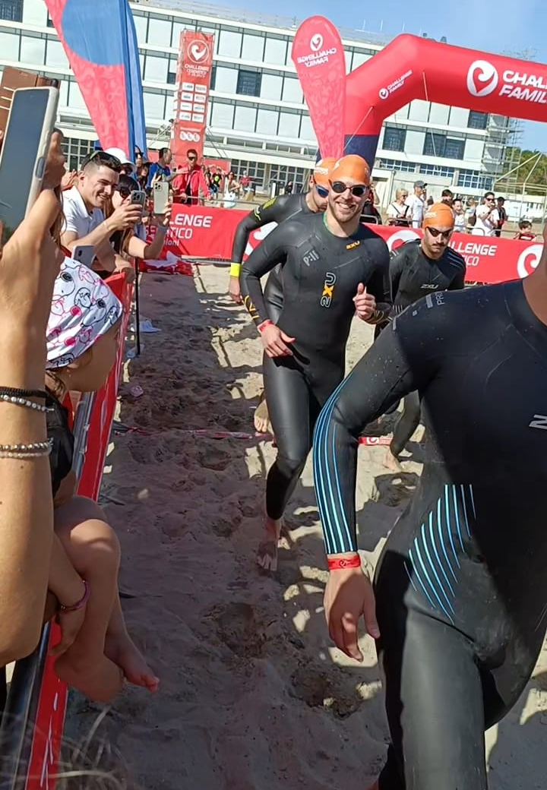
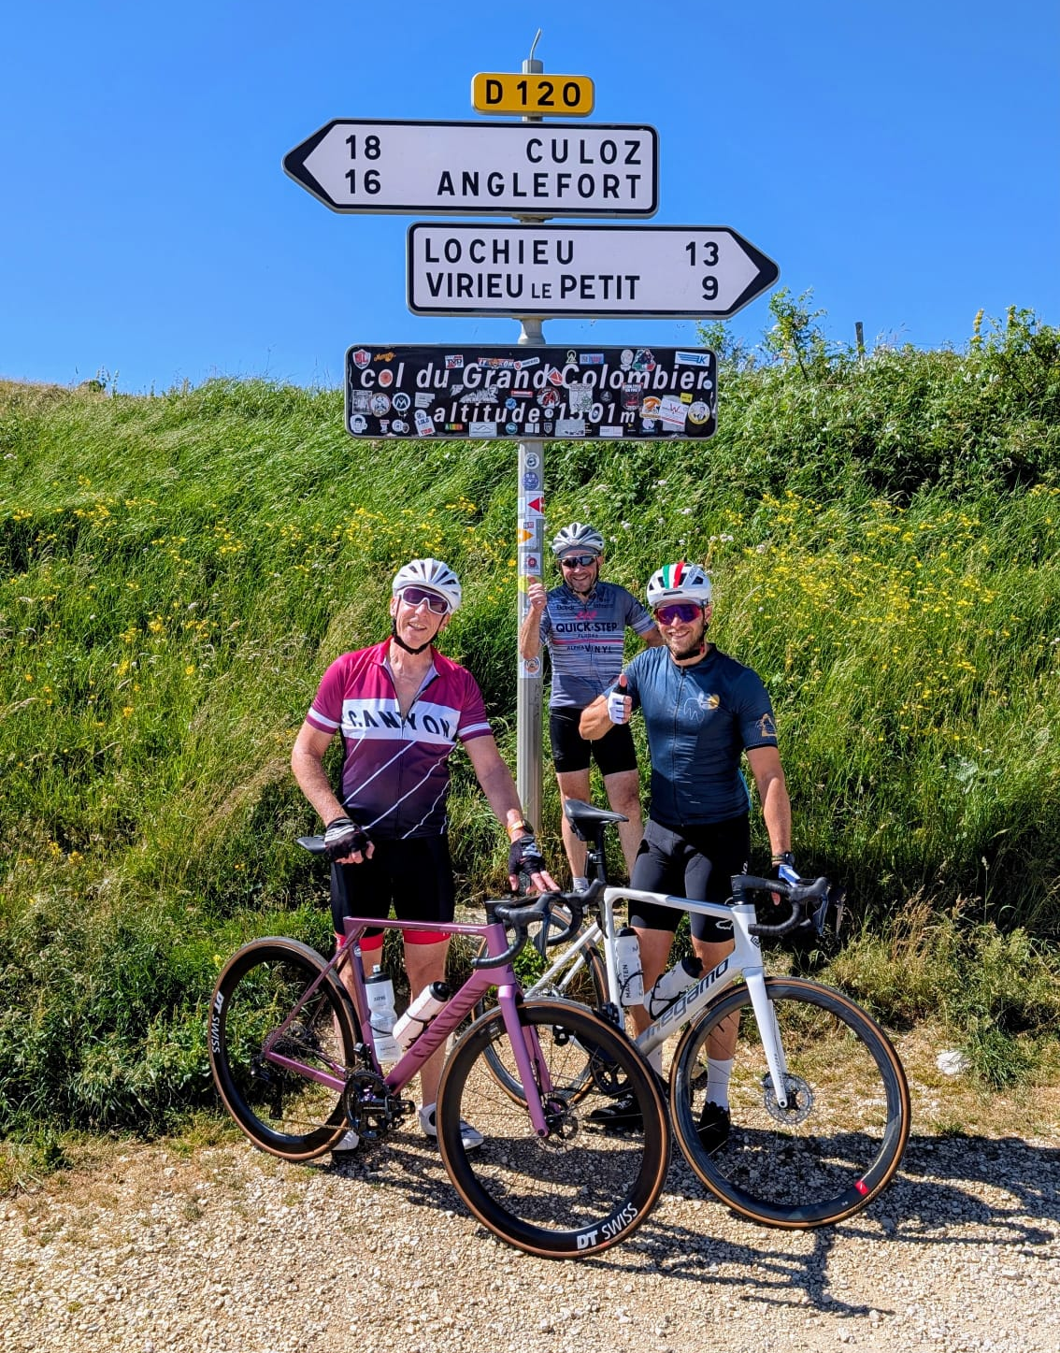
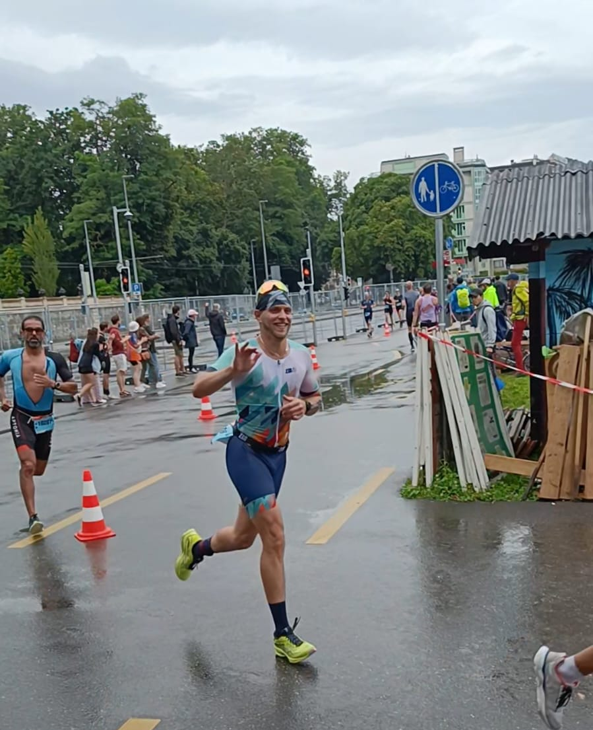
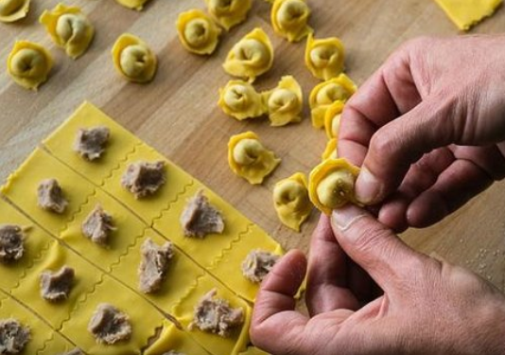
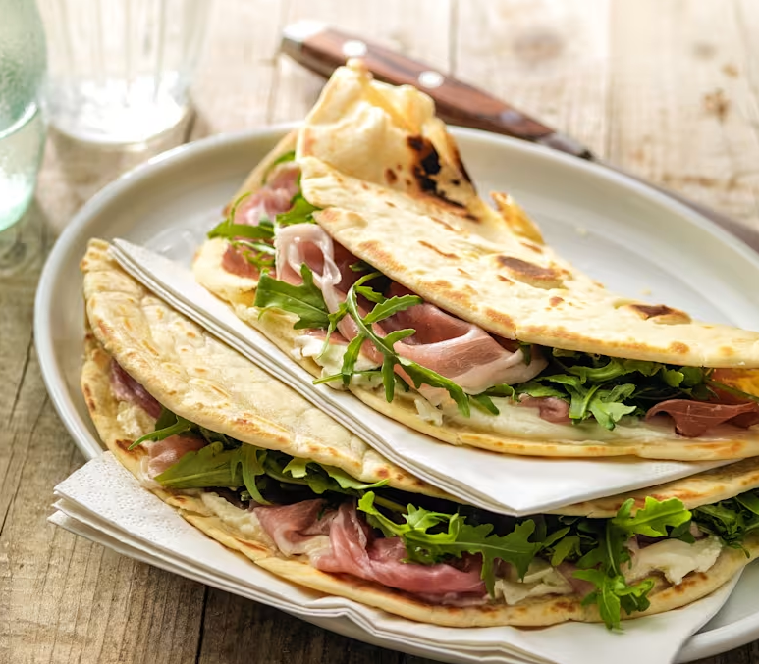
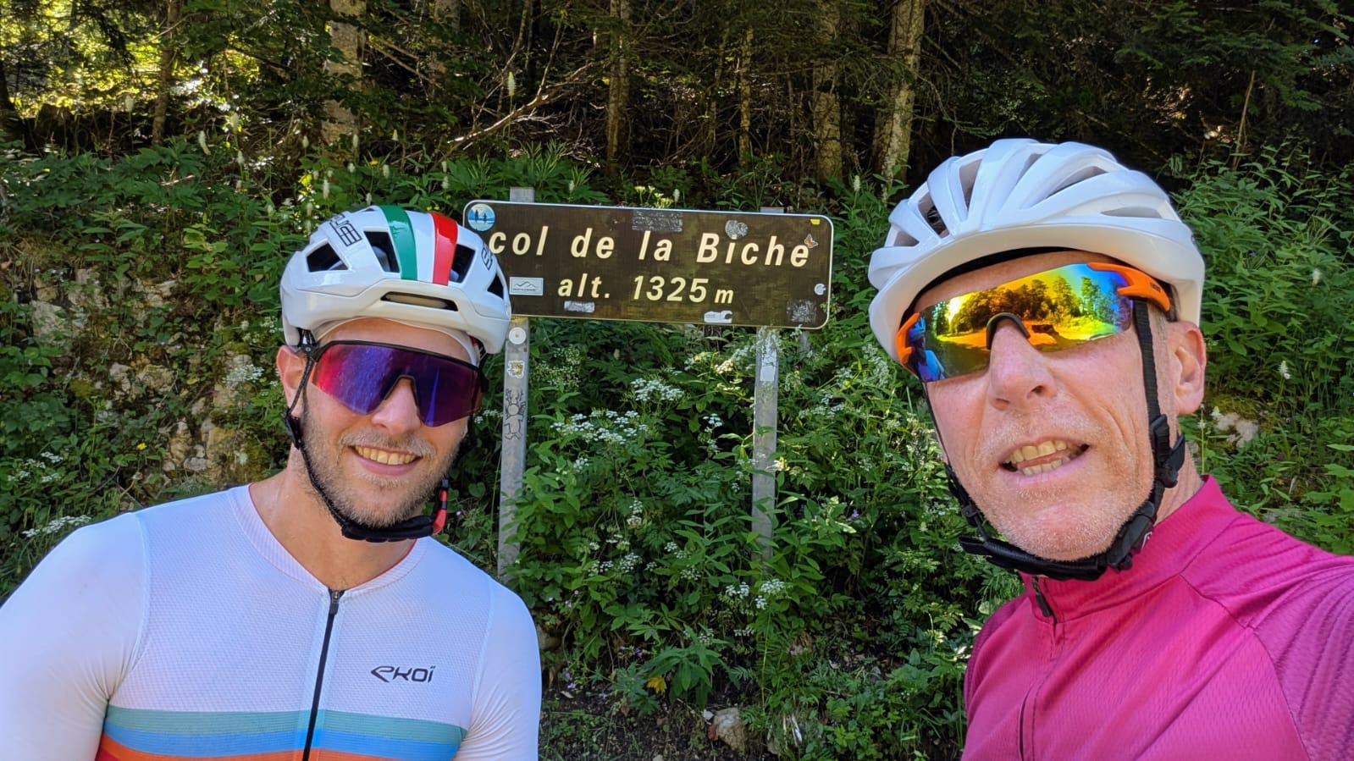
A bit about myself

Slide 3





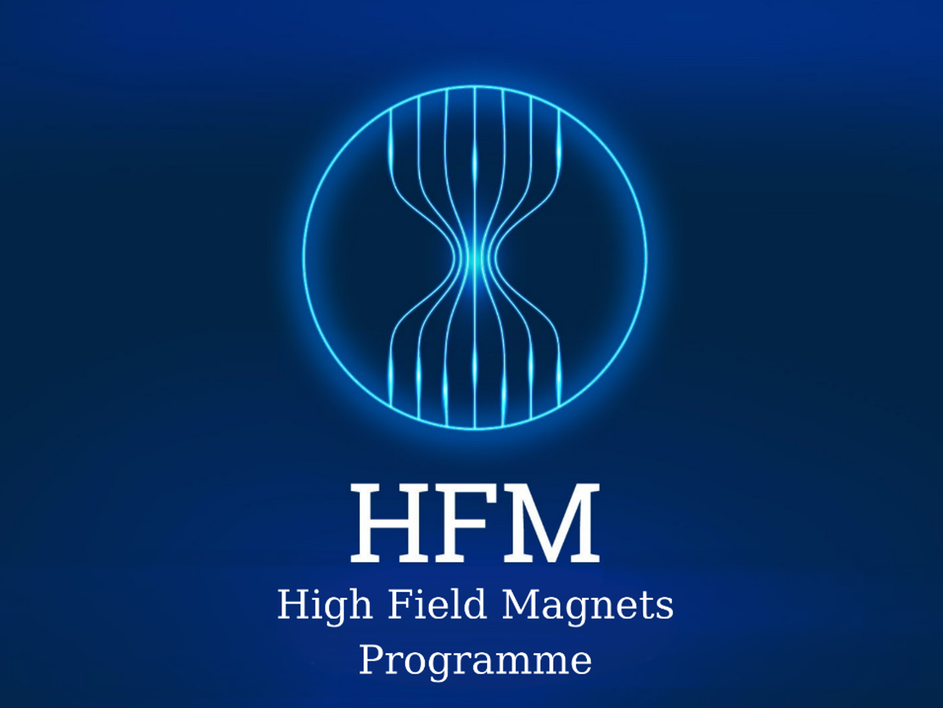

Academic and professional paths
Bachelor in Mechanical Engineering
Certificate on Composite Materials
09/2013
02/2019
09/2020
03/2022
Technical fellow TE-MSC-LMF (Large Magnet Facility)
Staff TE-MSC-LMF
(Large Magnet Facility)
Today
Staff TE-MSC-SMT
(Superconducting Magnet Technology)
05/2014
04/2017
02/2019
10/2019
09/2025
Staff LASA Magnet Group (Laboratory for Accelerators and Applied Superconductivity)

Slide 4
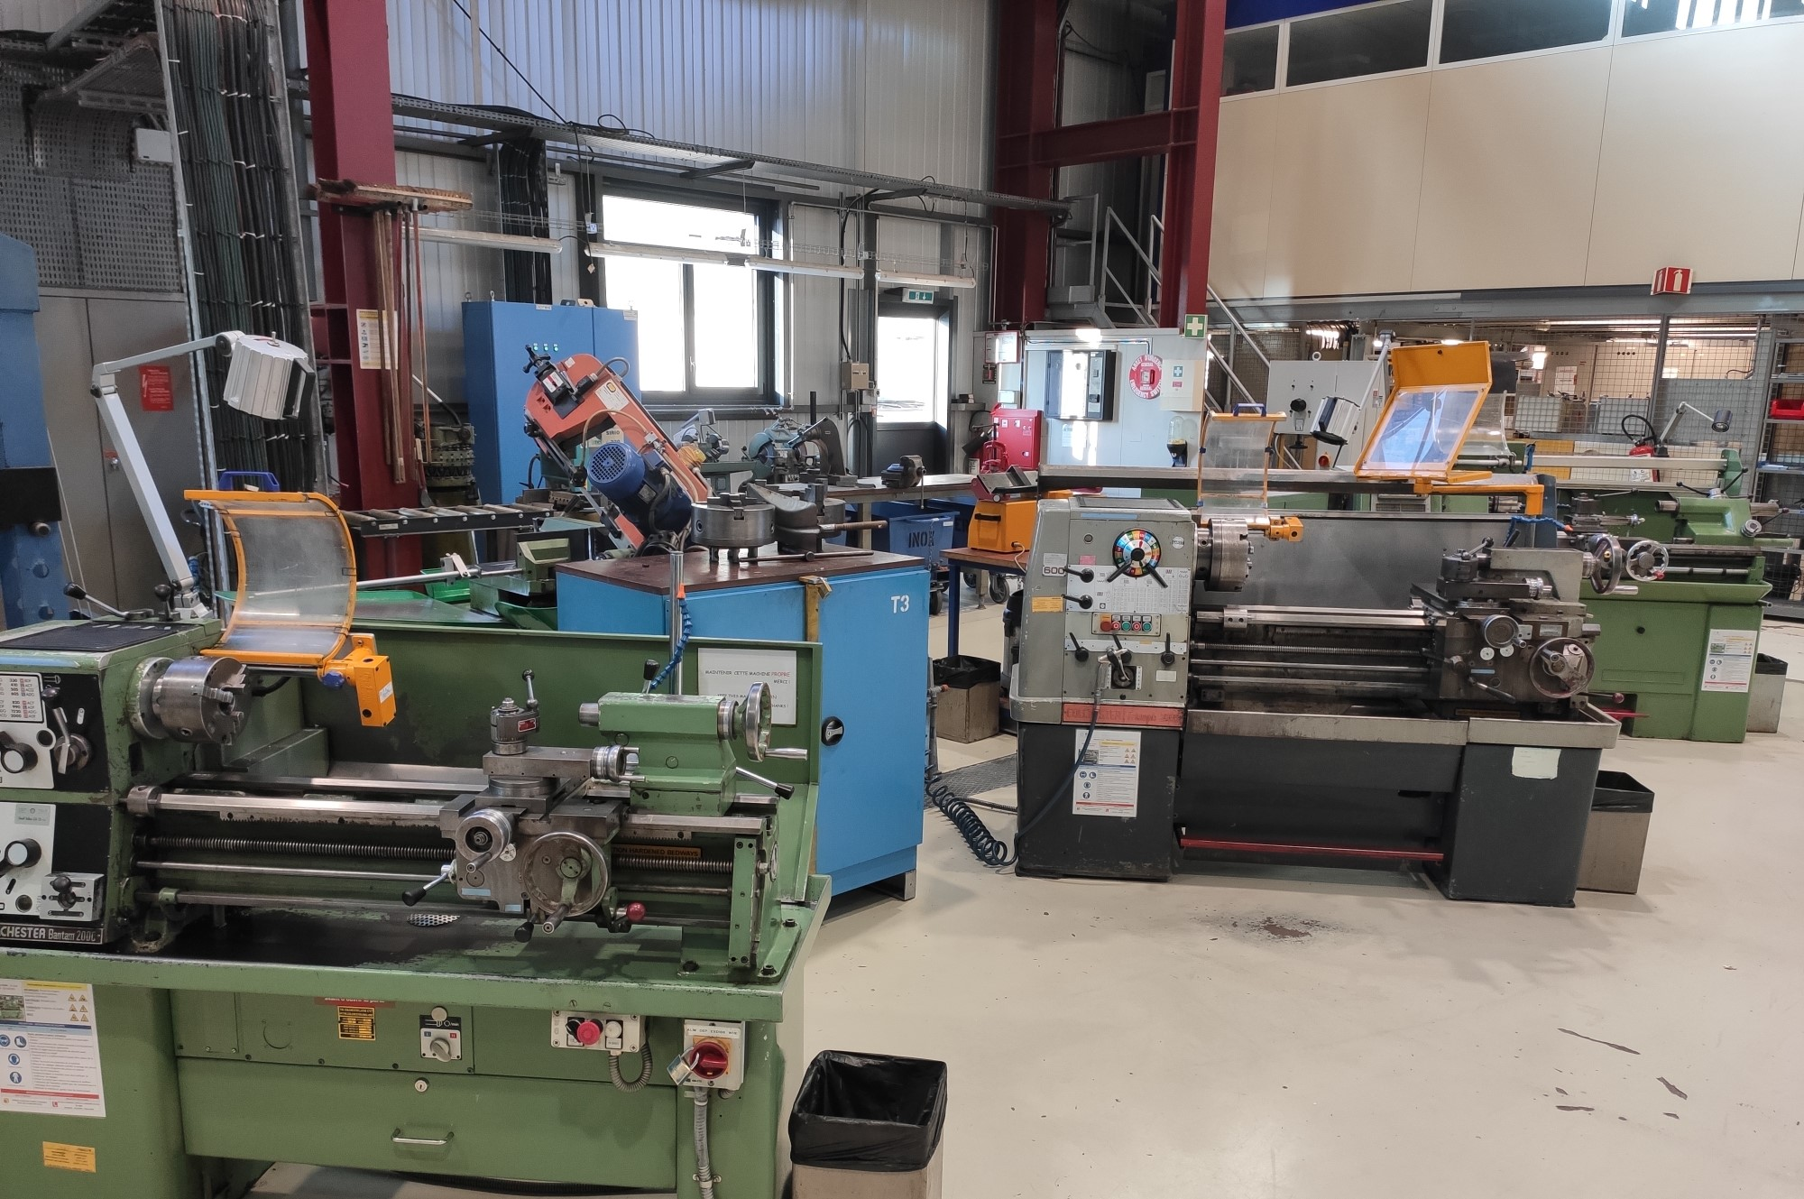
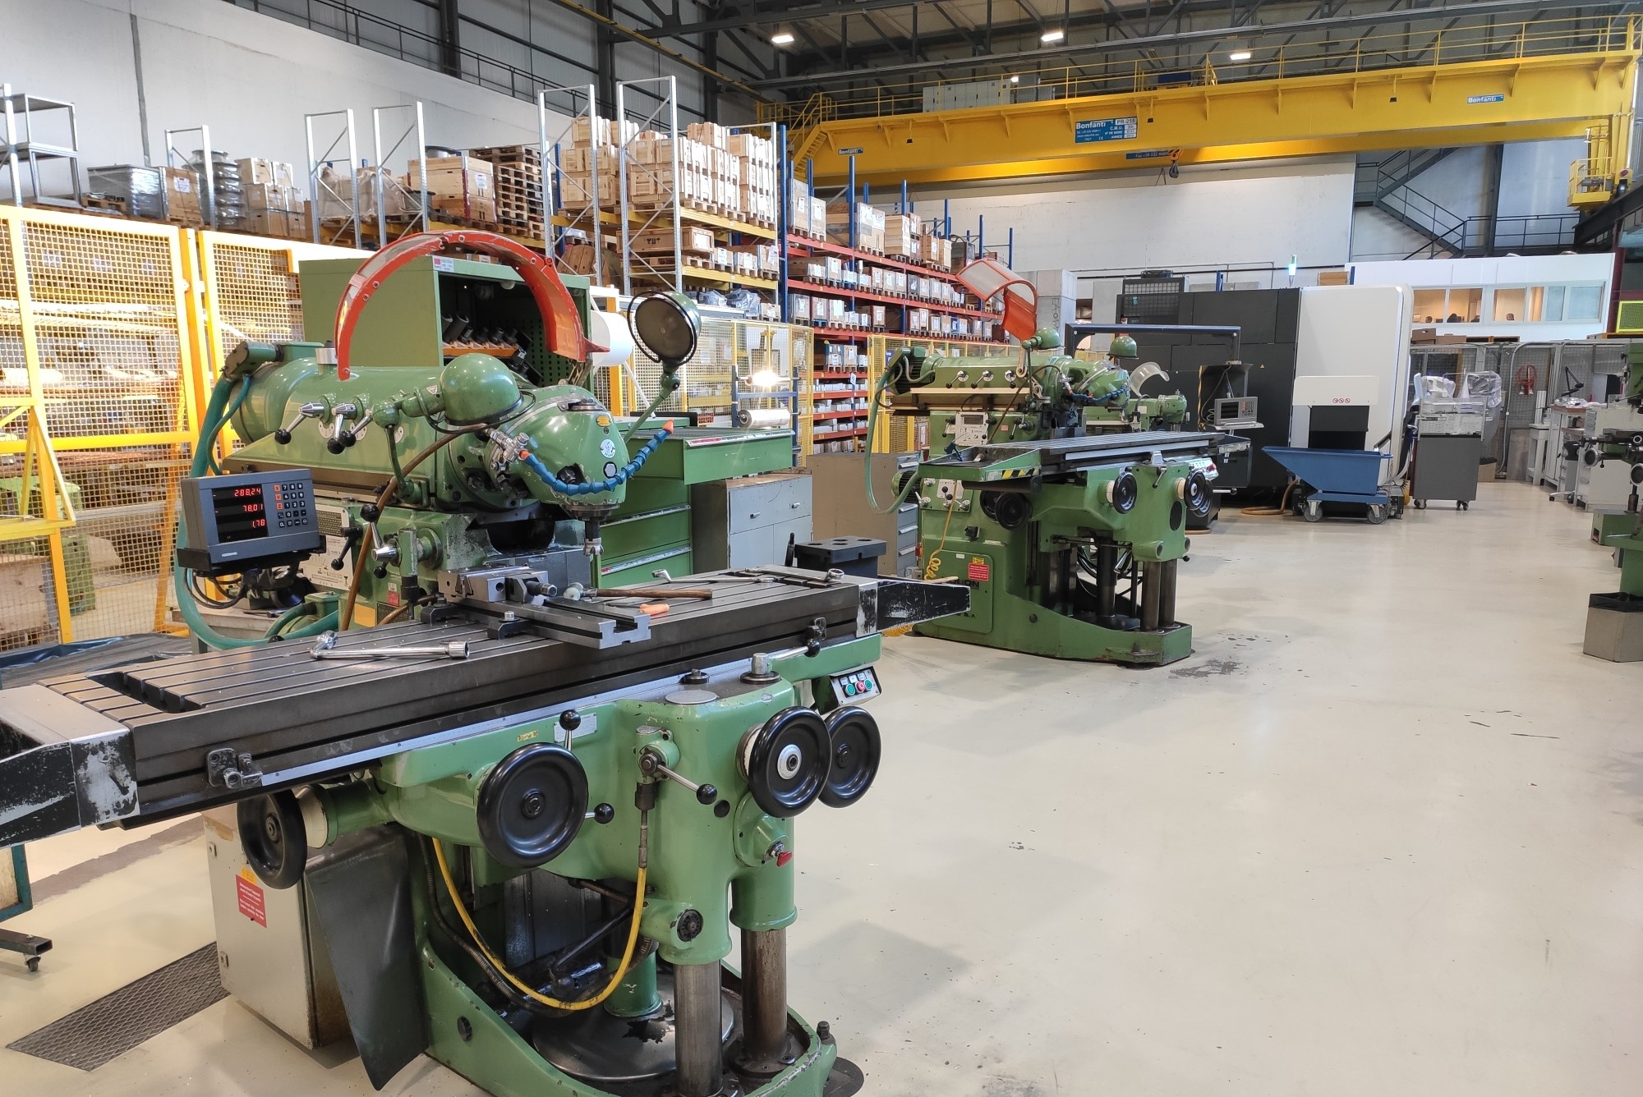
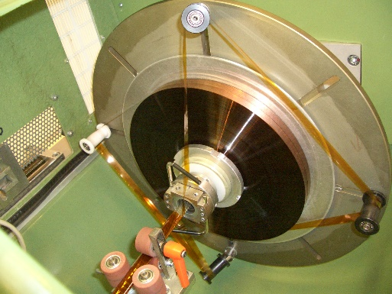
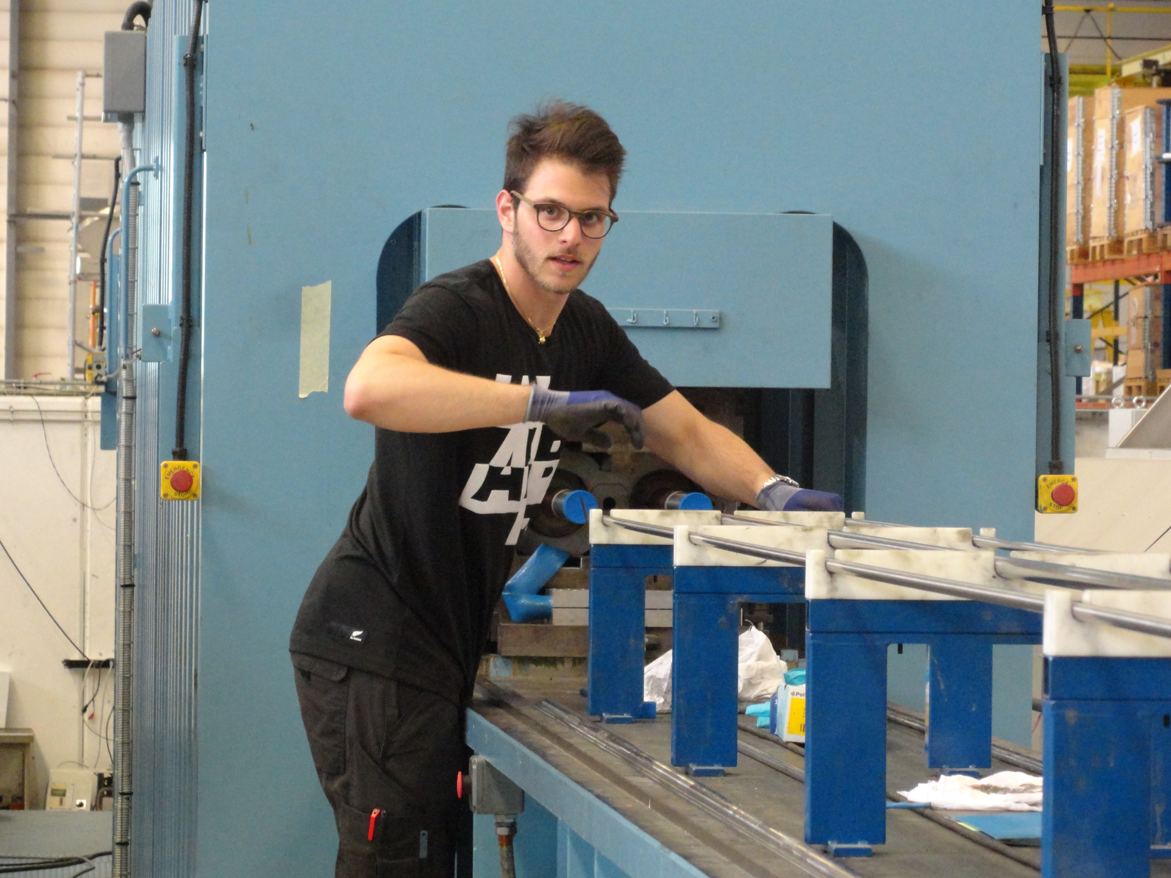
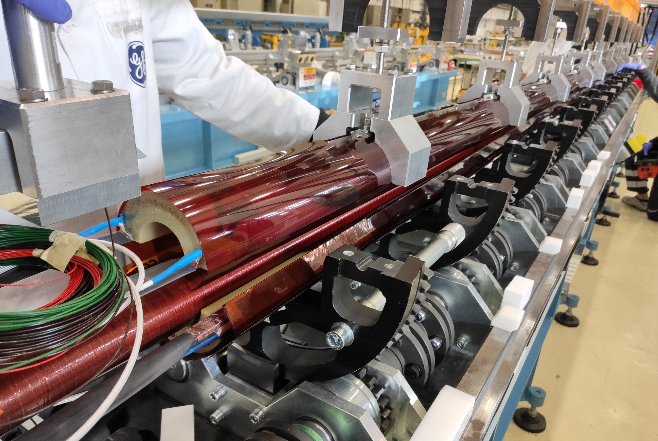
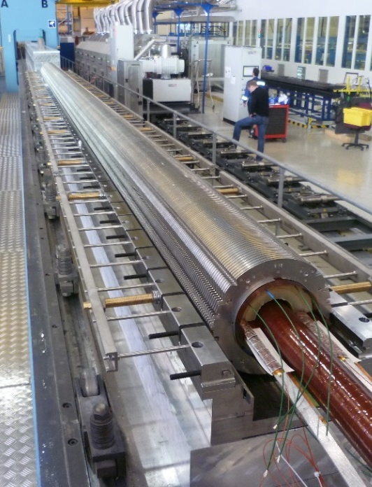
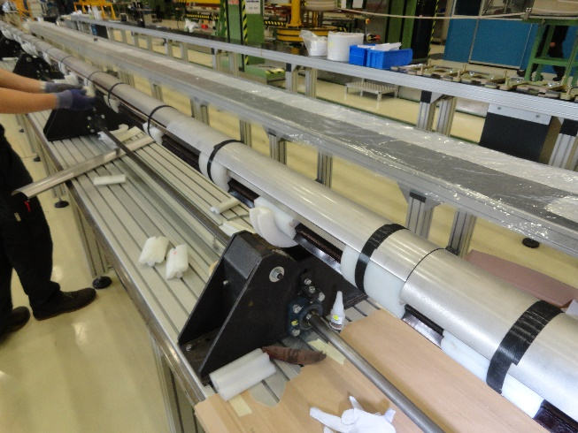
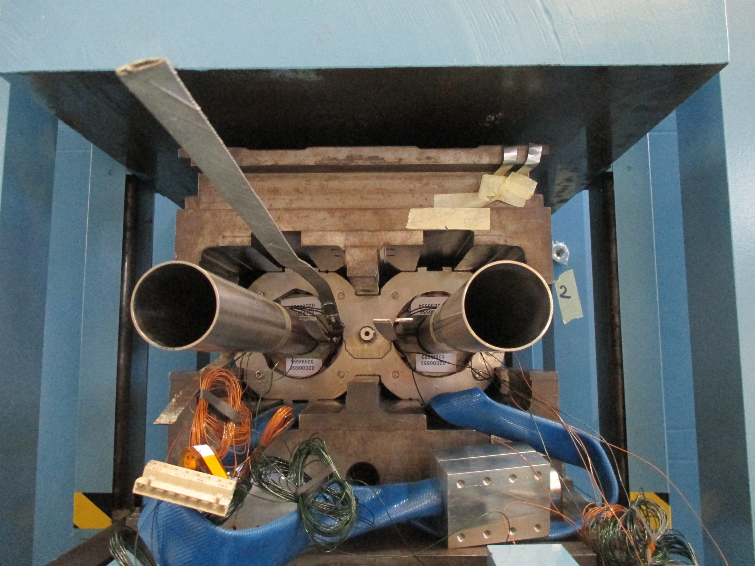
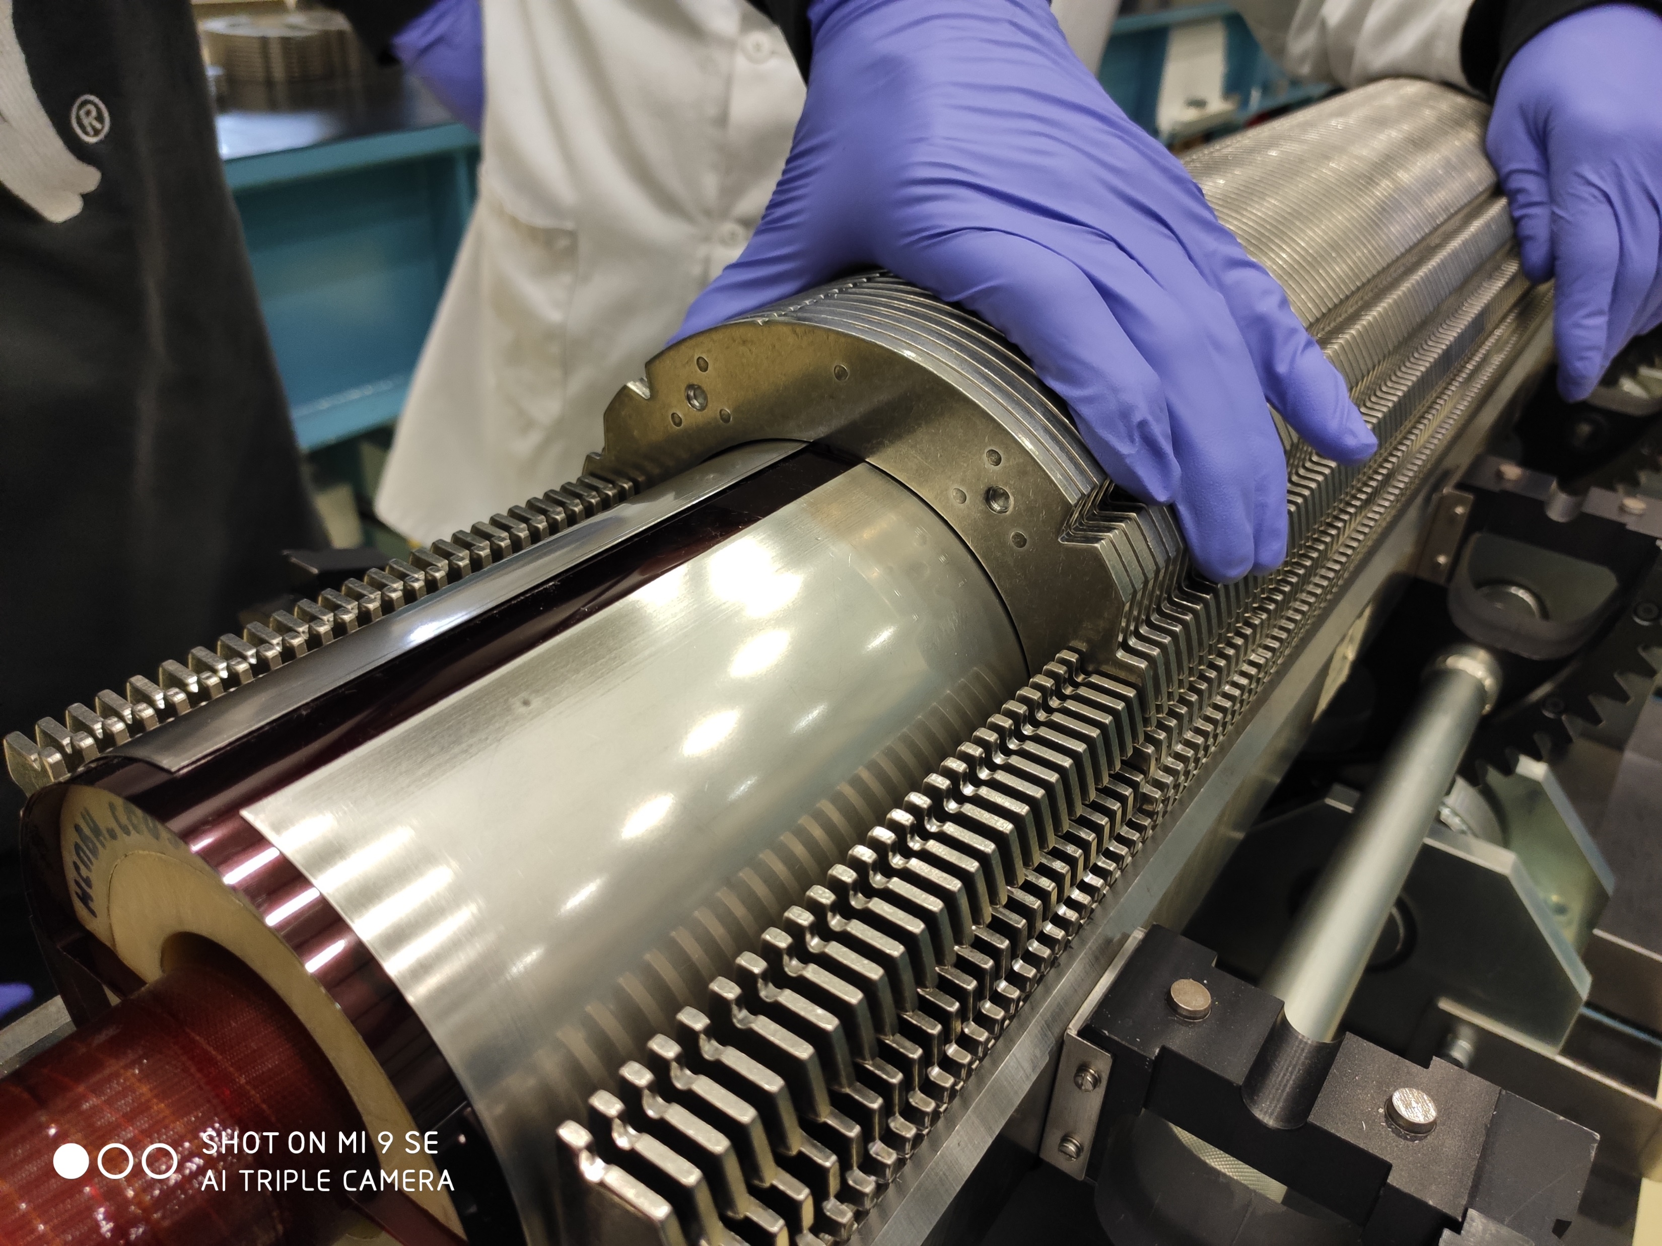
Technical fellow TE-MSC-LMF (2014 – 2017)
Hands-on every single step of the LHC main bending dipole coil fabrication
Polyimide insulation of the cable
Winding and curing of the inner layer and outer layer separately
Impregnation of the coil ends
Coil e-modulus measurement
Coil and magnet assembly
Precollaring and collaring under press
Reparation of LHC main bending dipoles with damaged QHs
Coil and magnet assembly of the first 11T prototypes

Slide 5
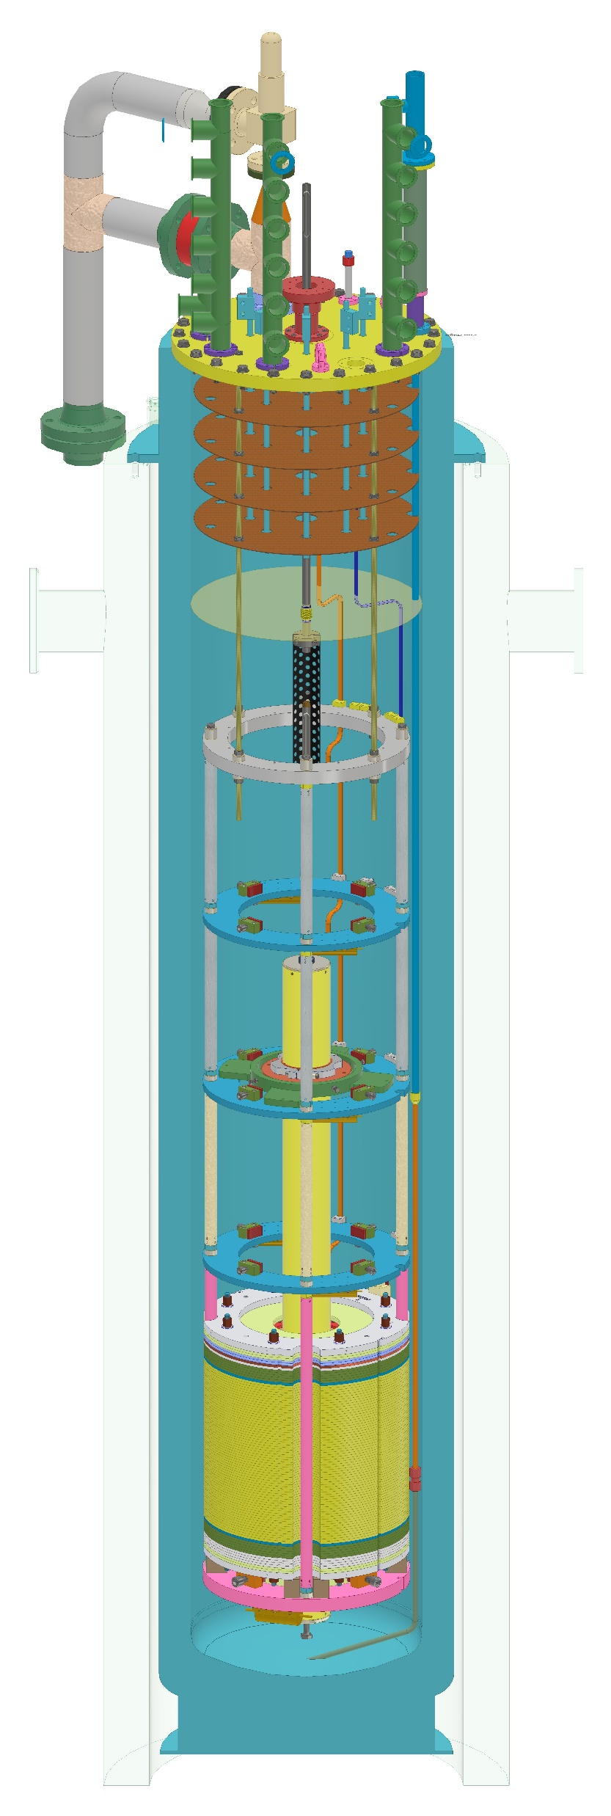
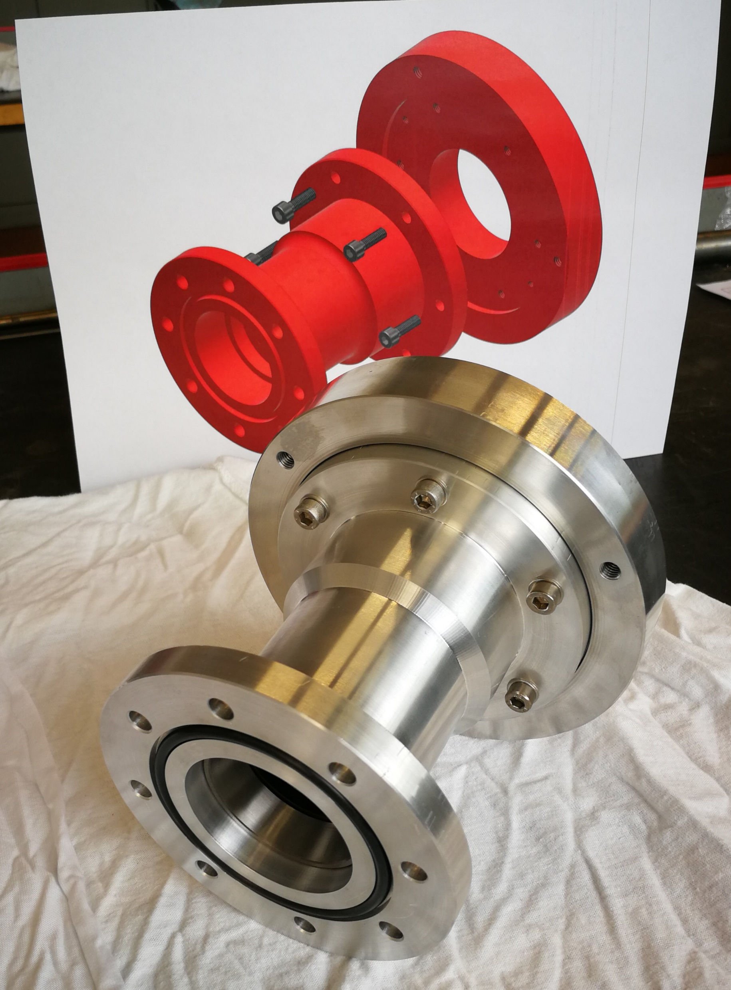
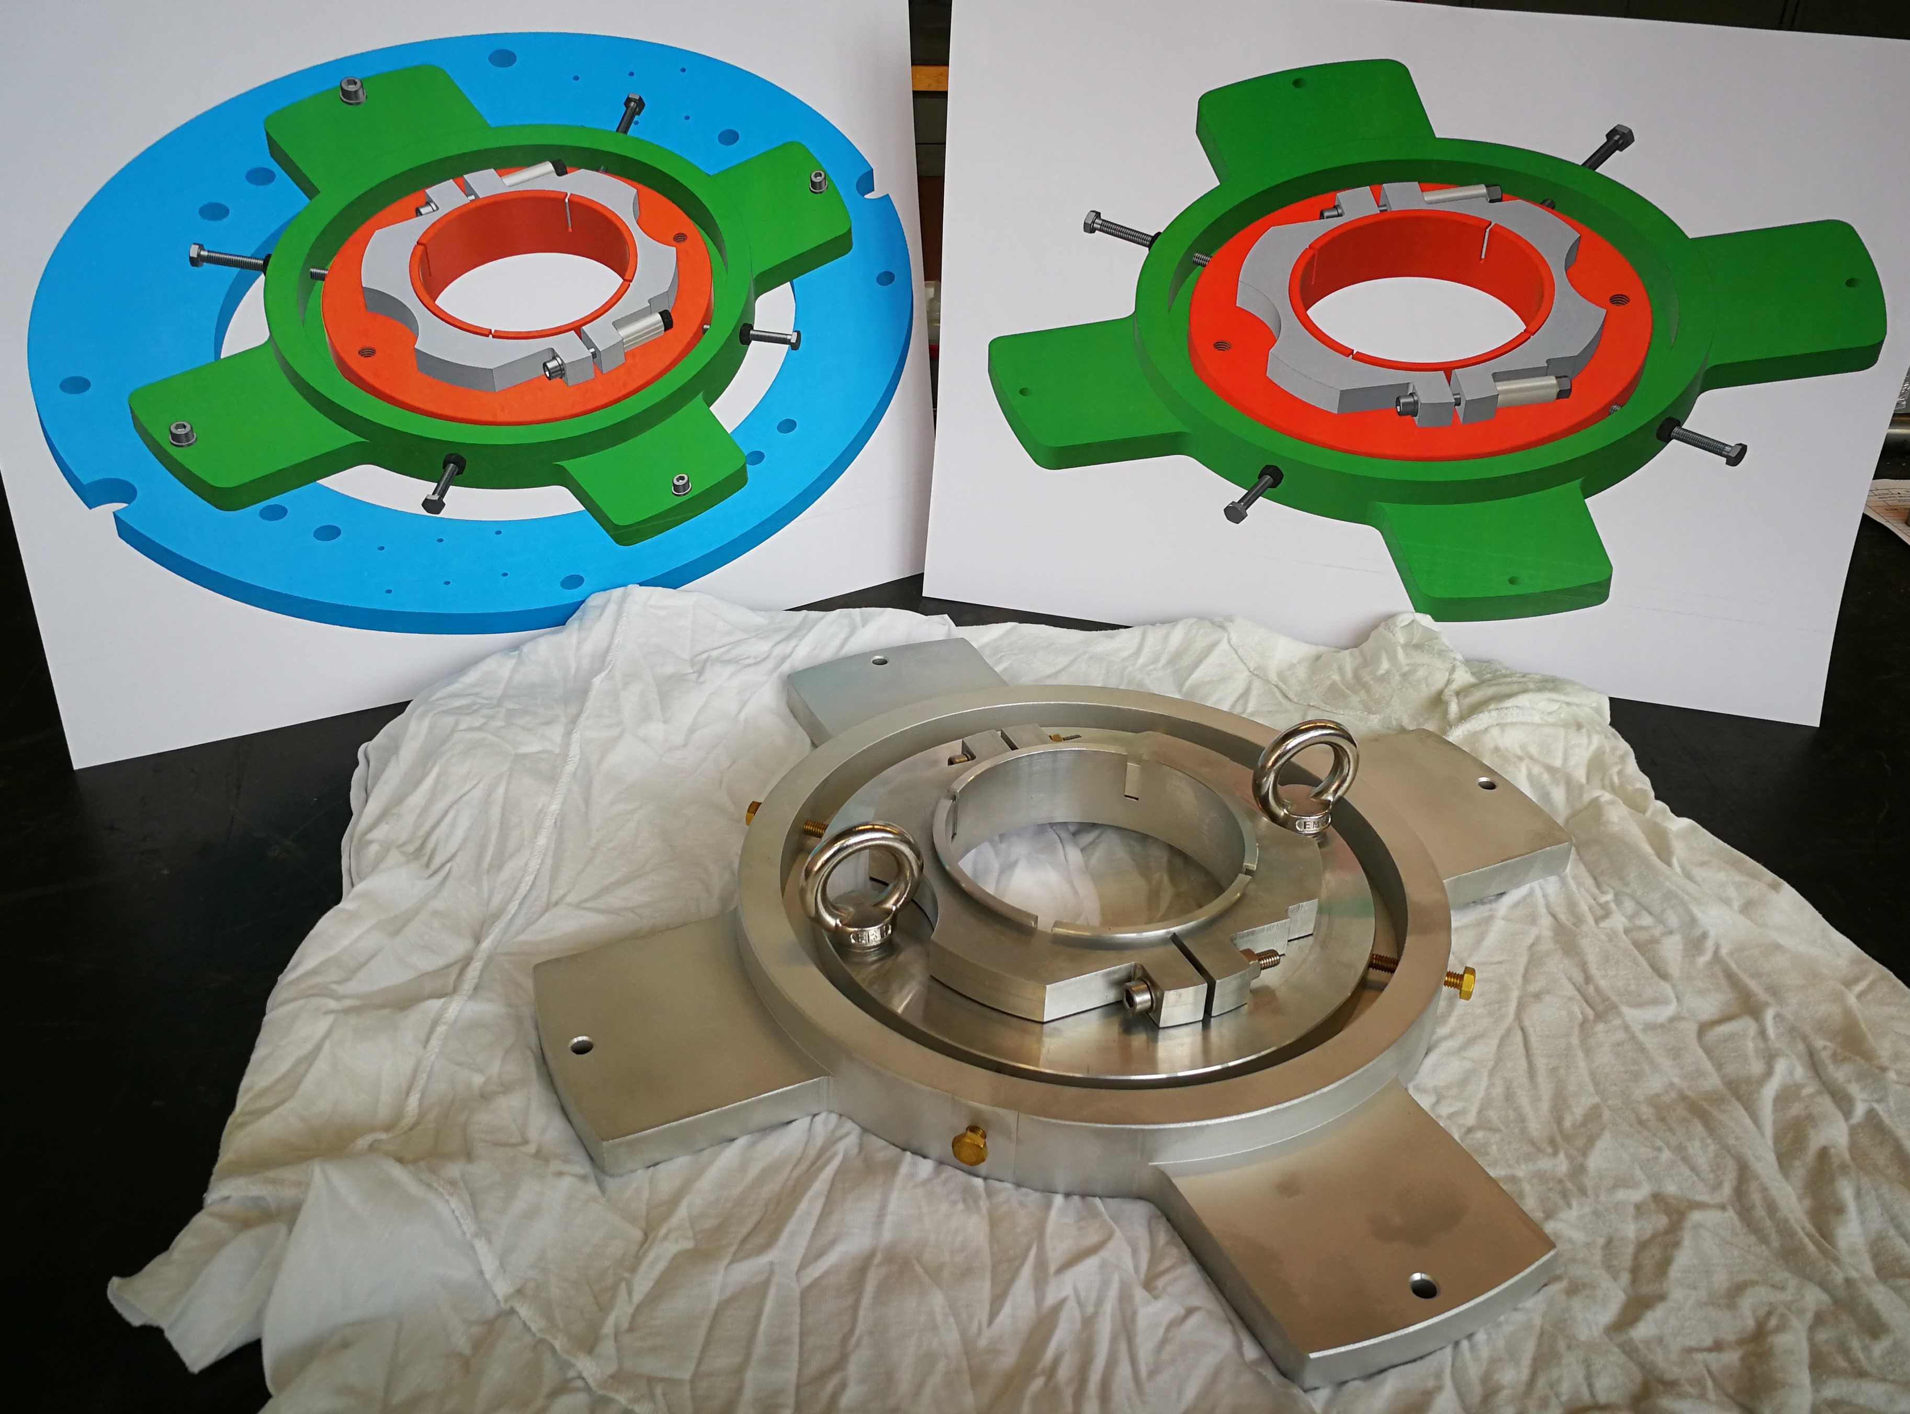
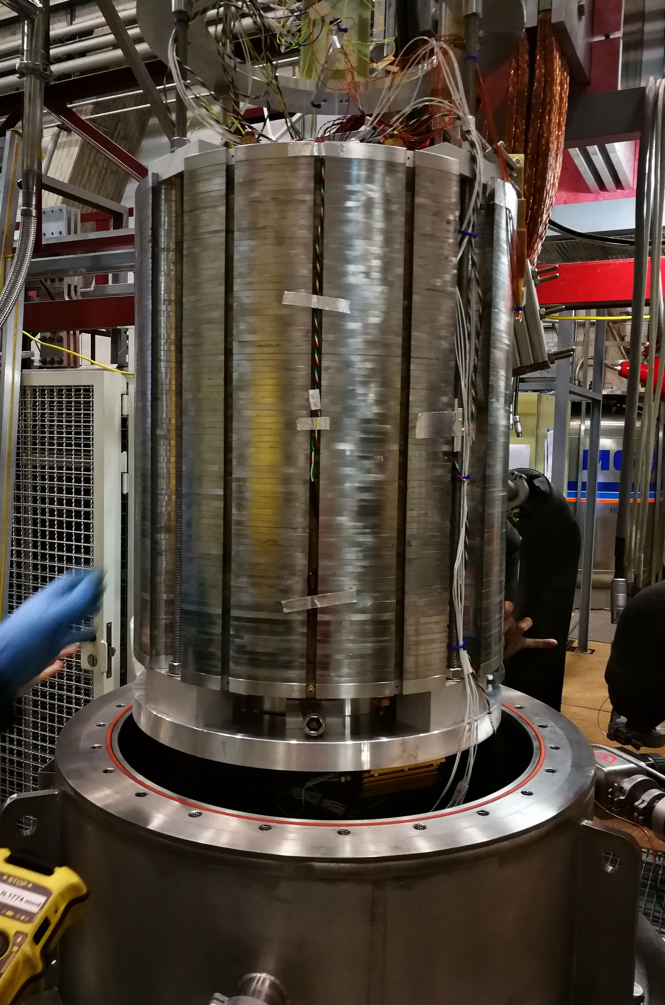
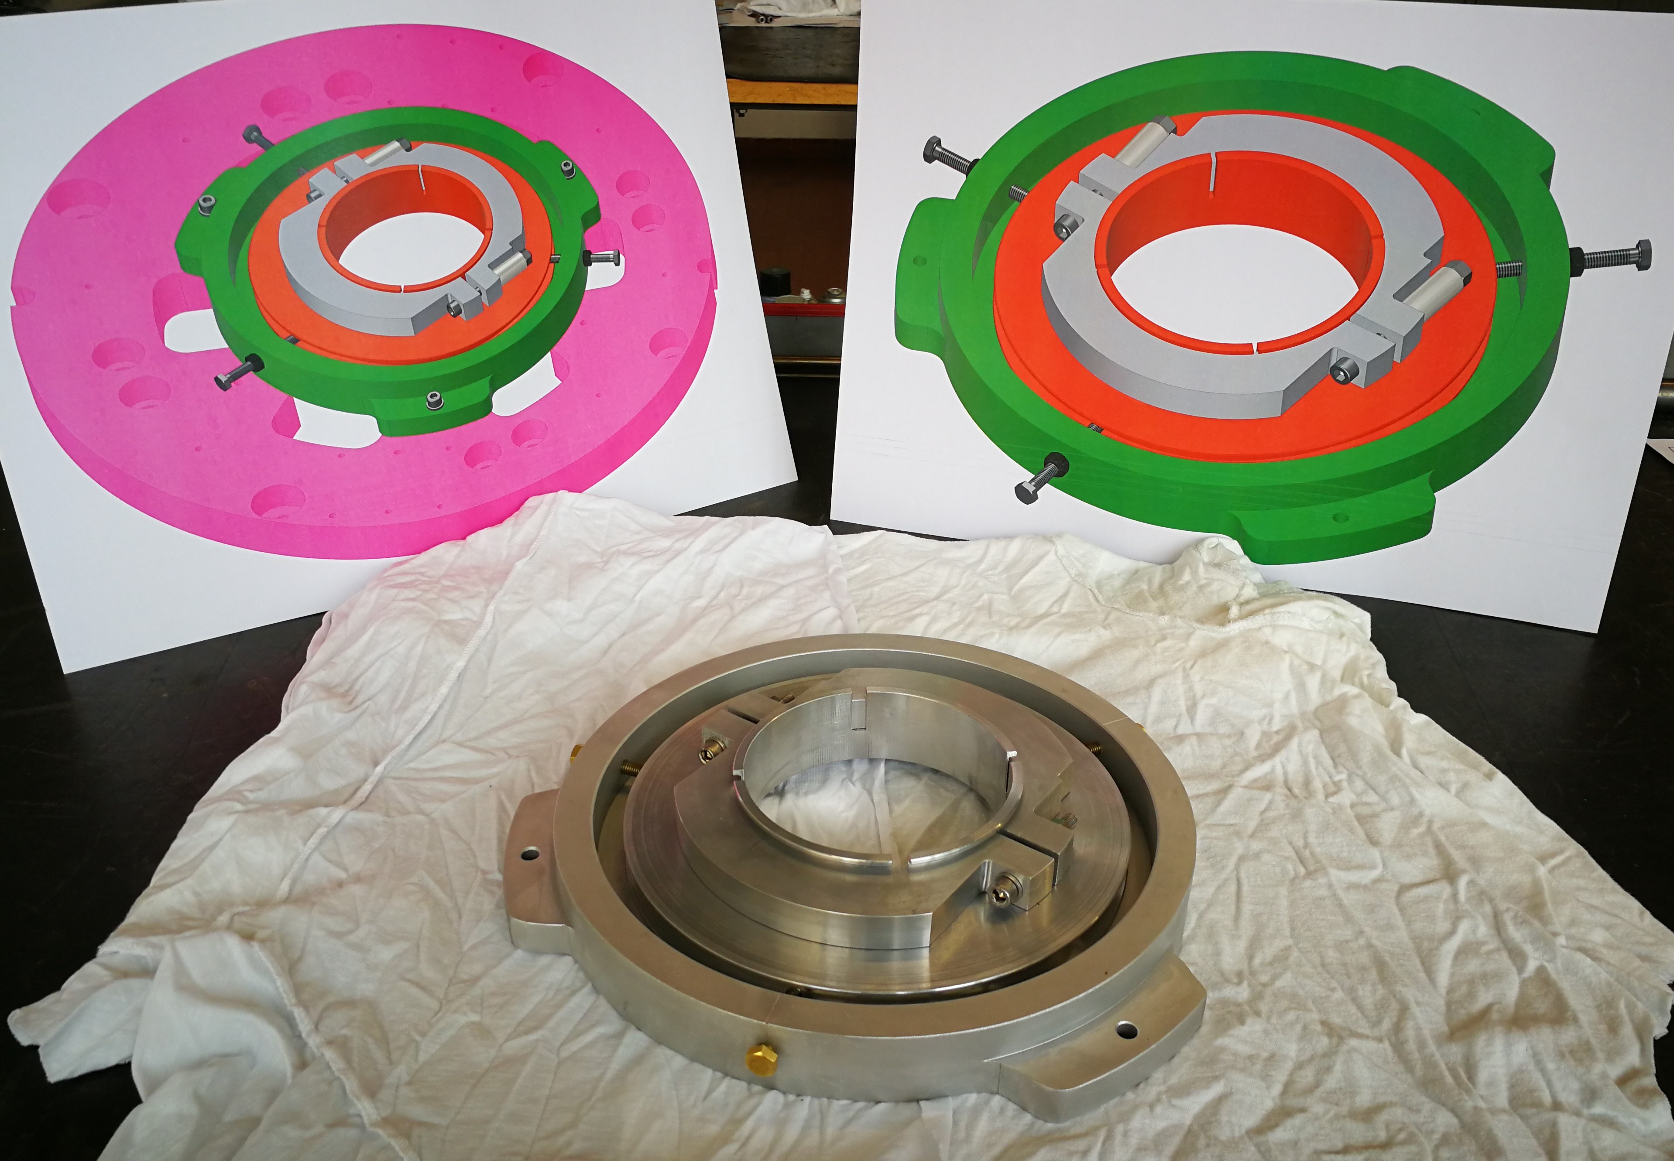
INFN-LASA (2019)
Design and manufacturing of the mechanical interfaces to perform magnetic measurements of the HO correctors in the cryostat
Design of parts for the cold powering test of magnet
5

Slide 6
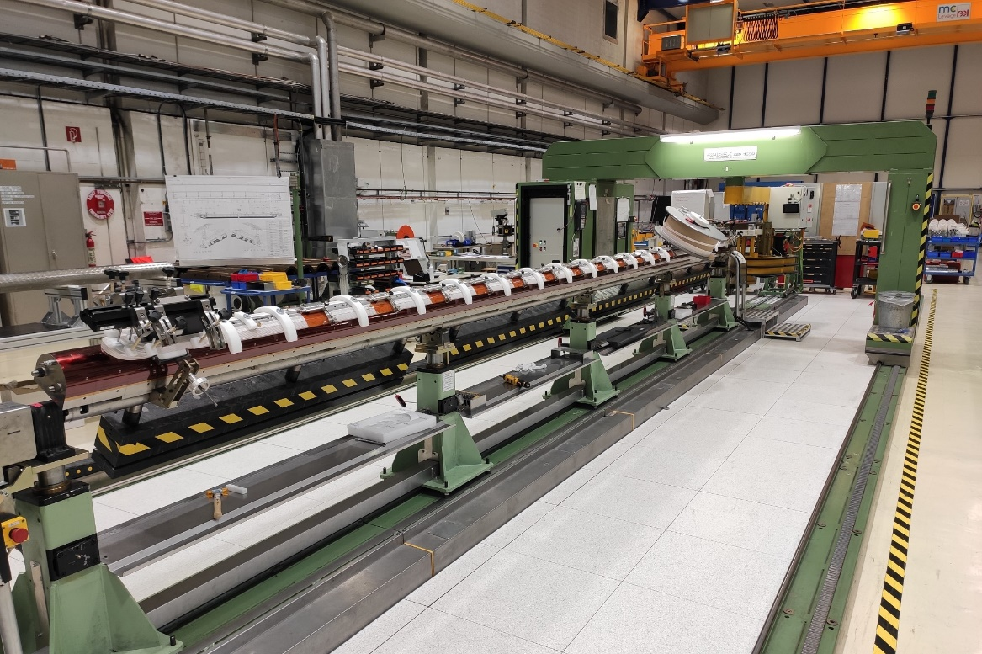
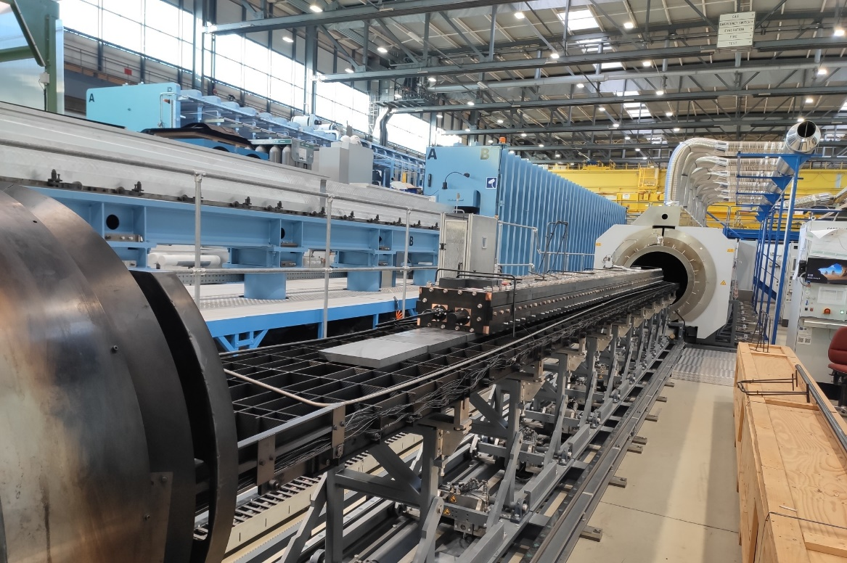
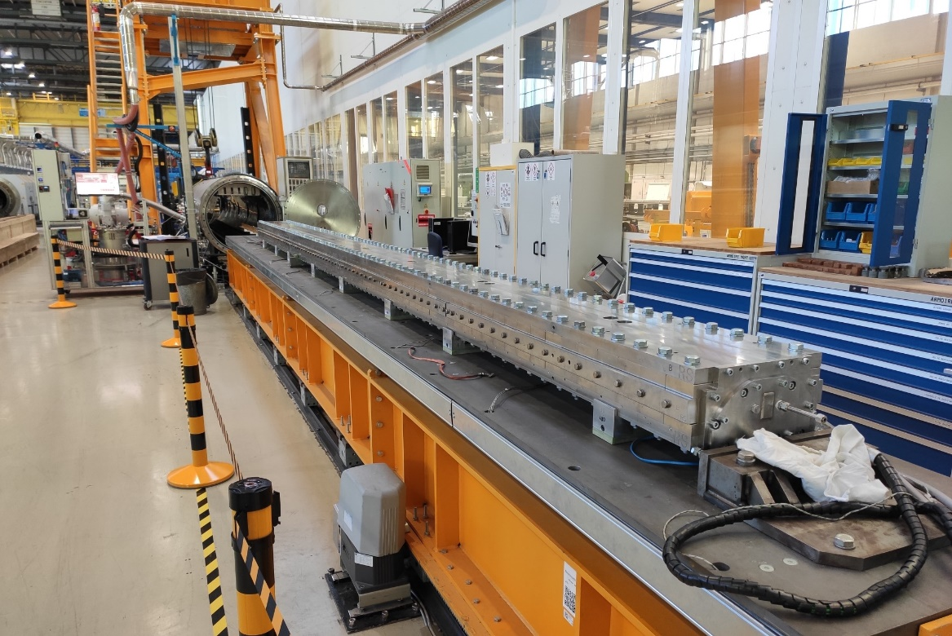
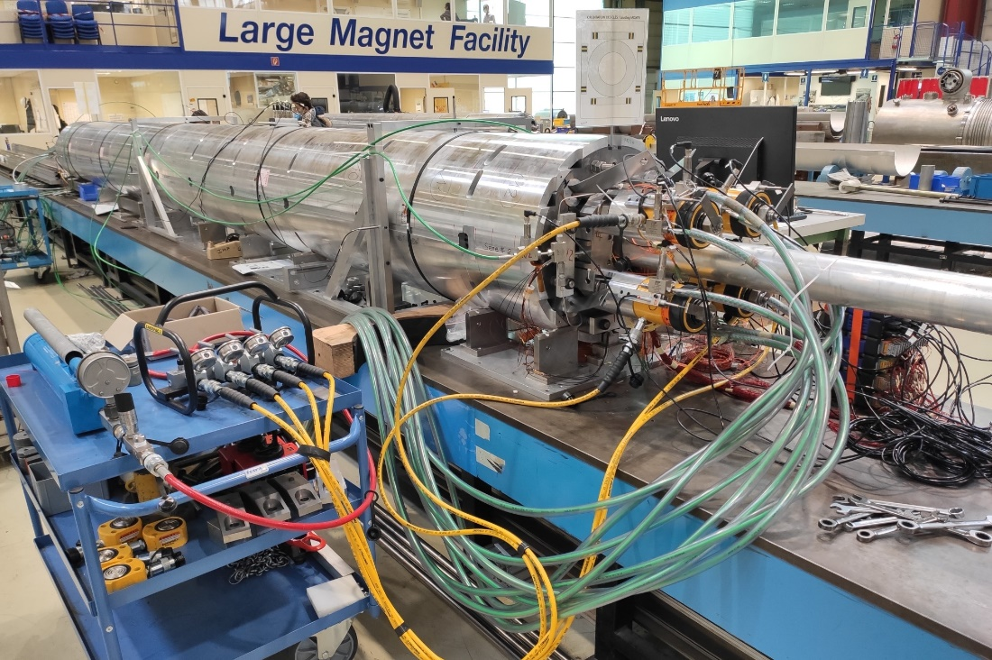
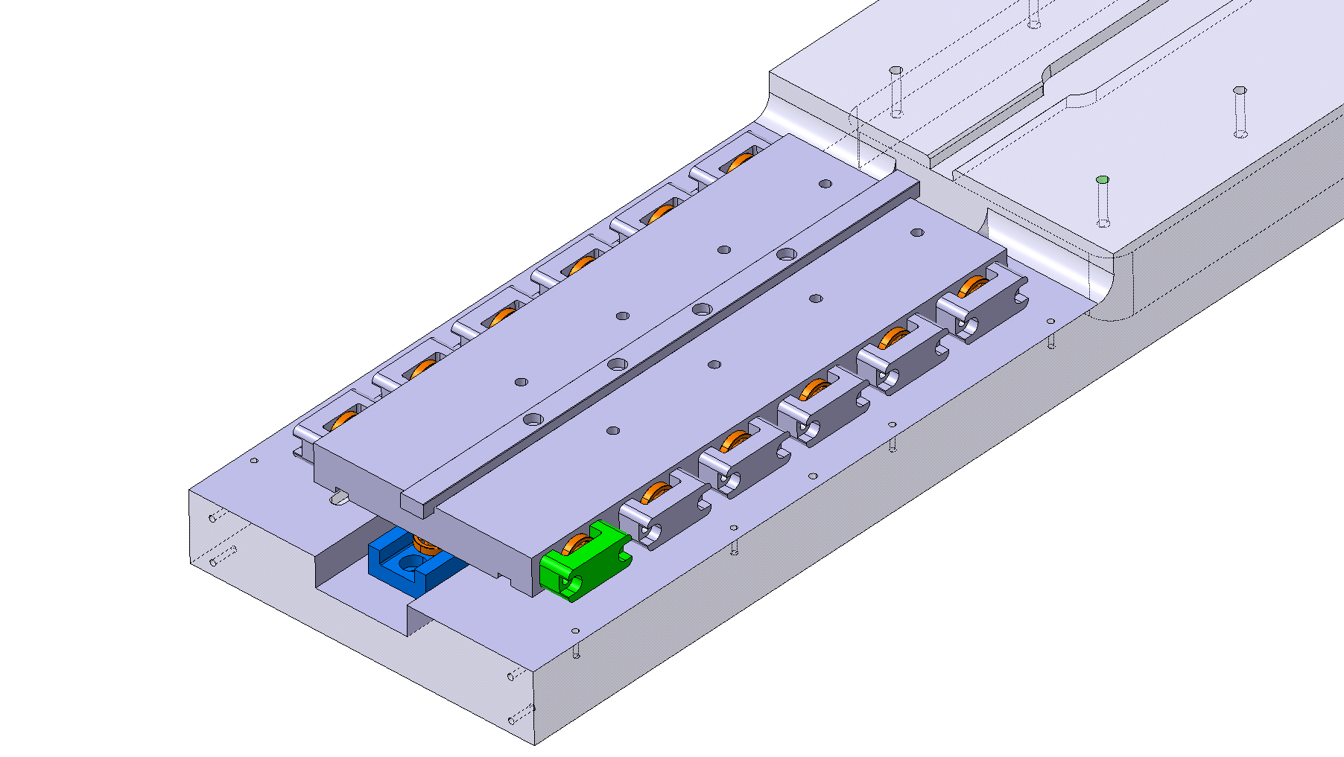
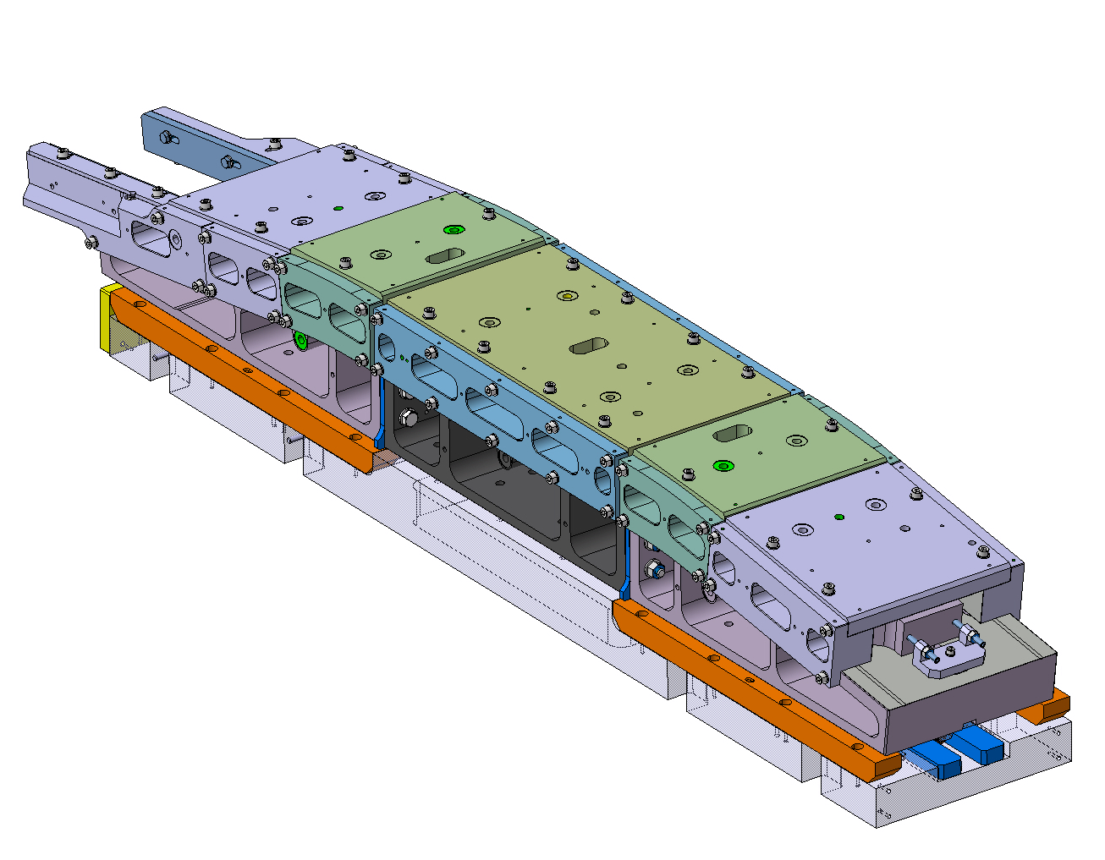
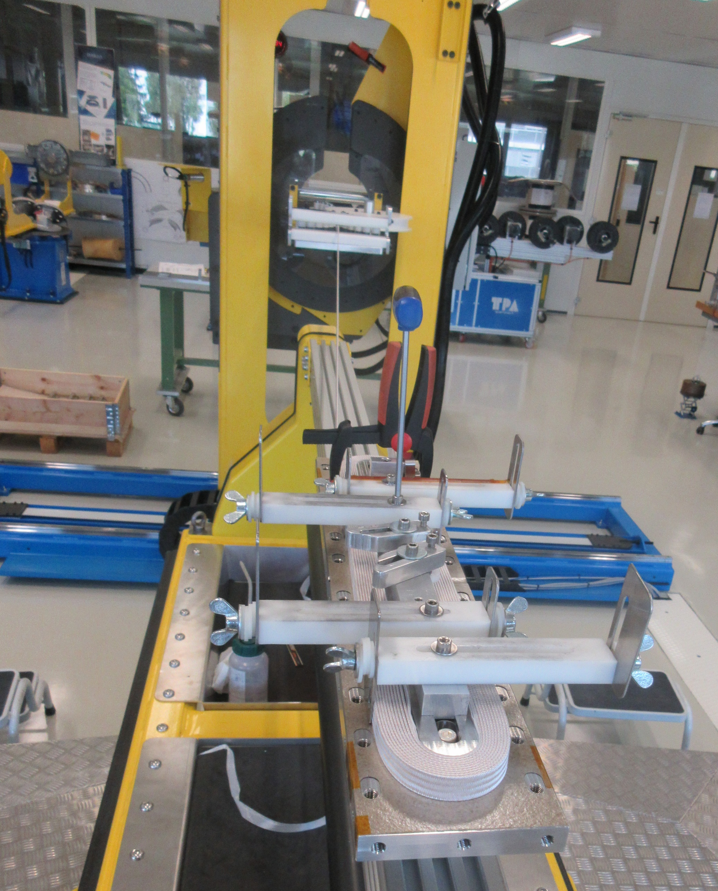
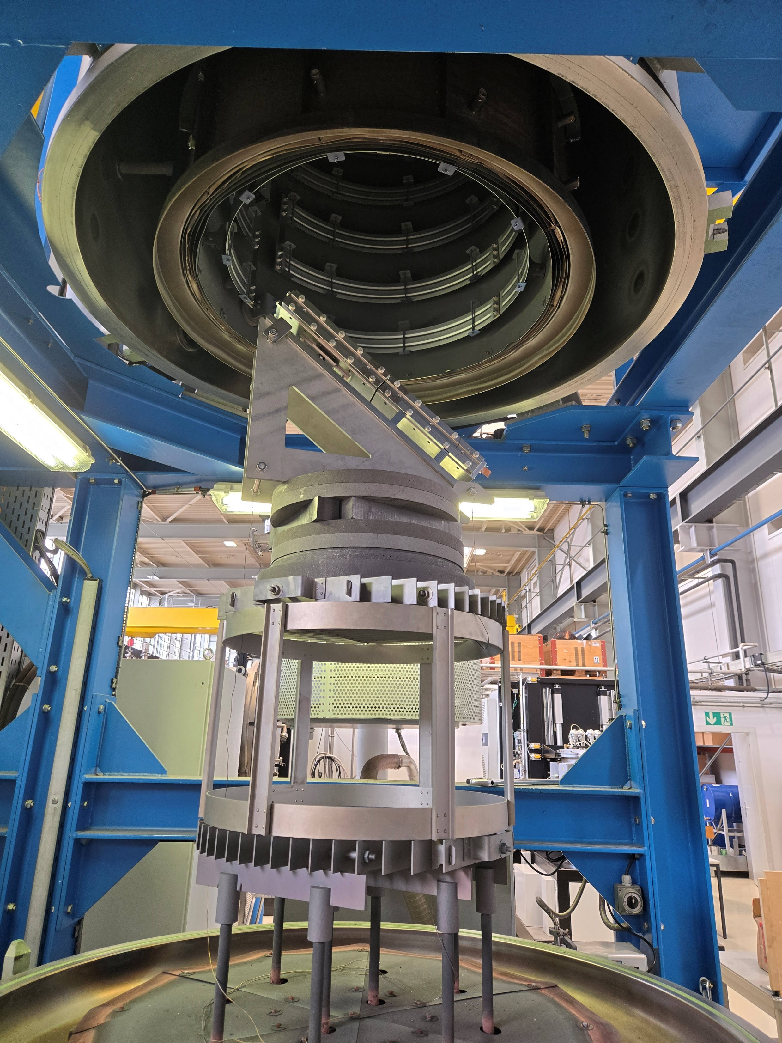
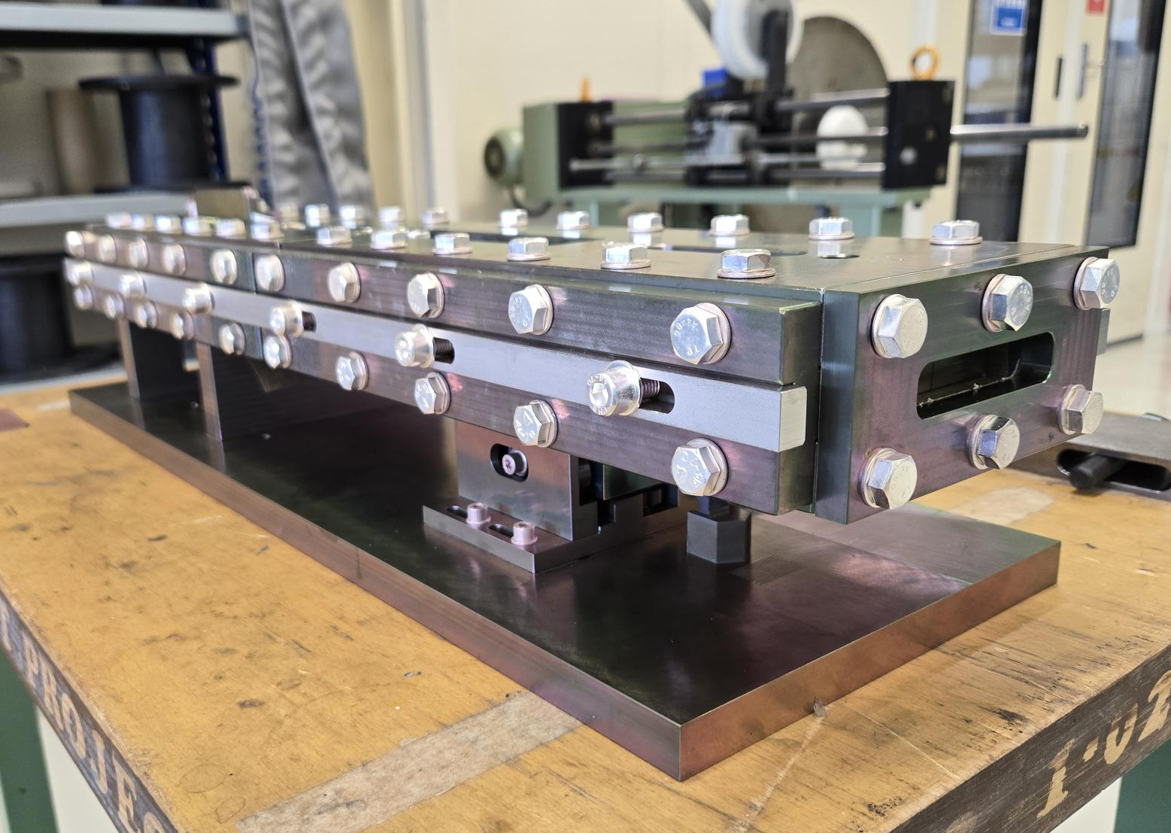
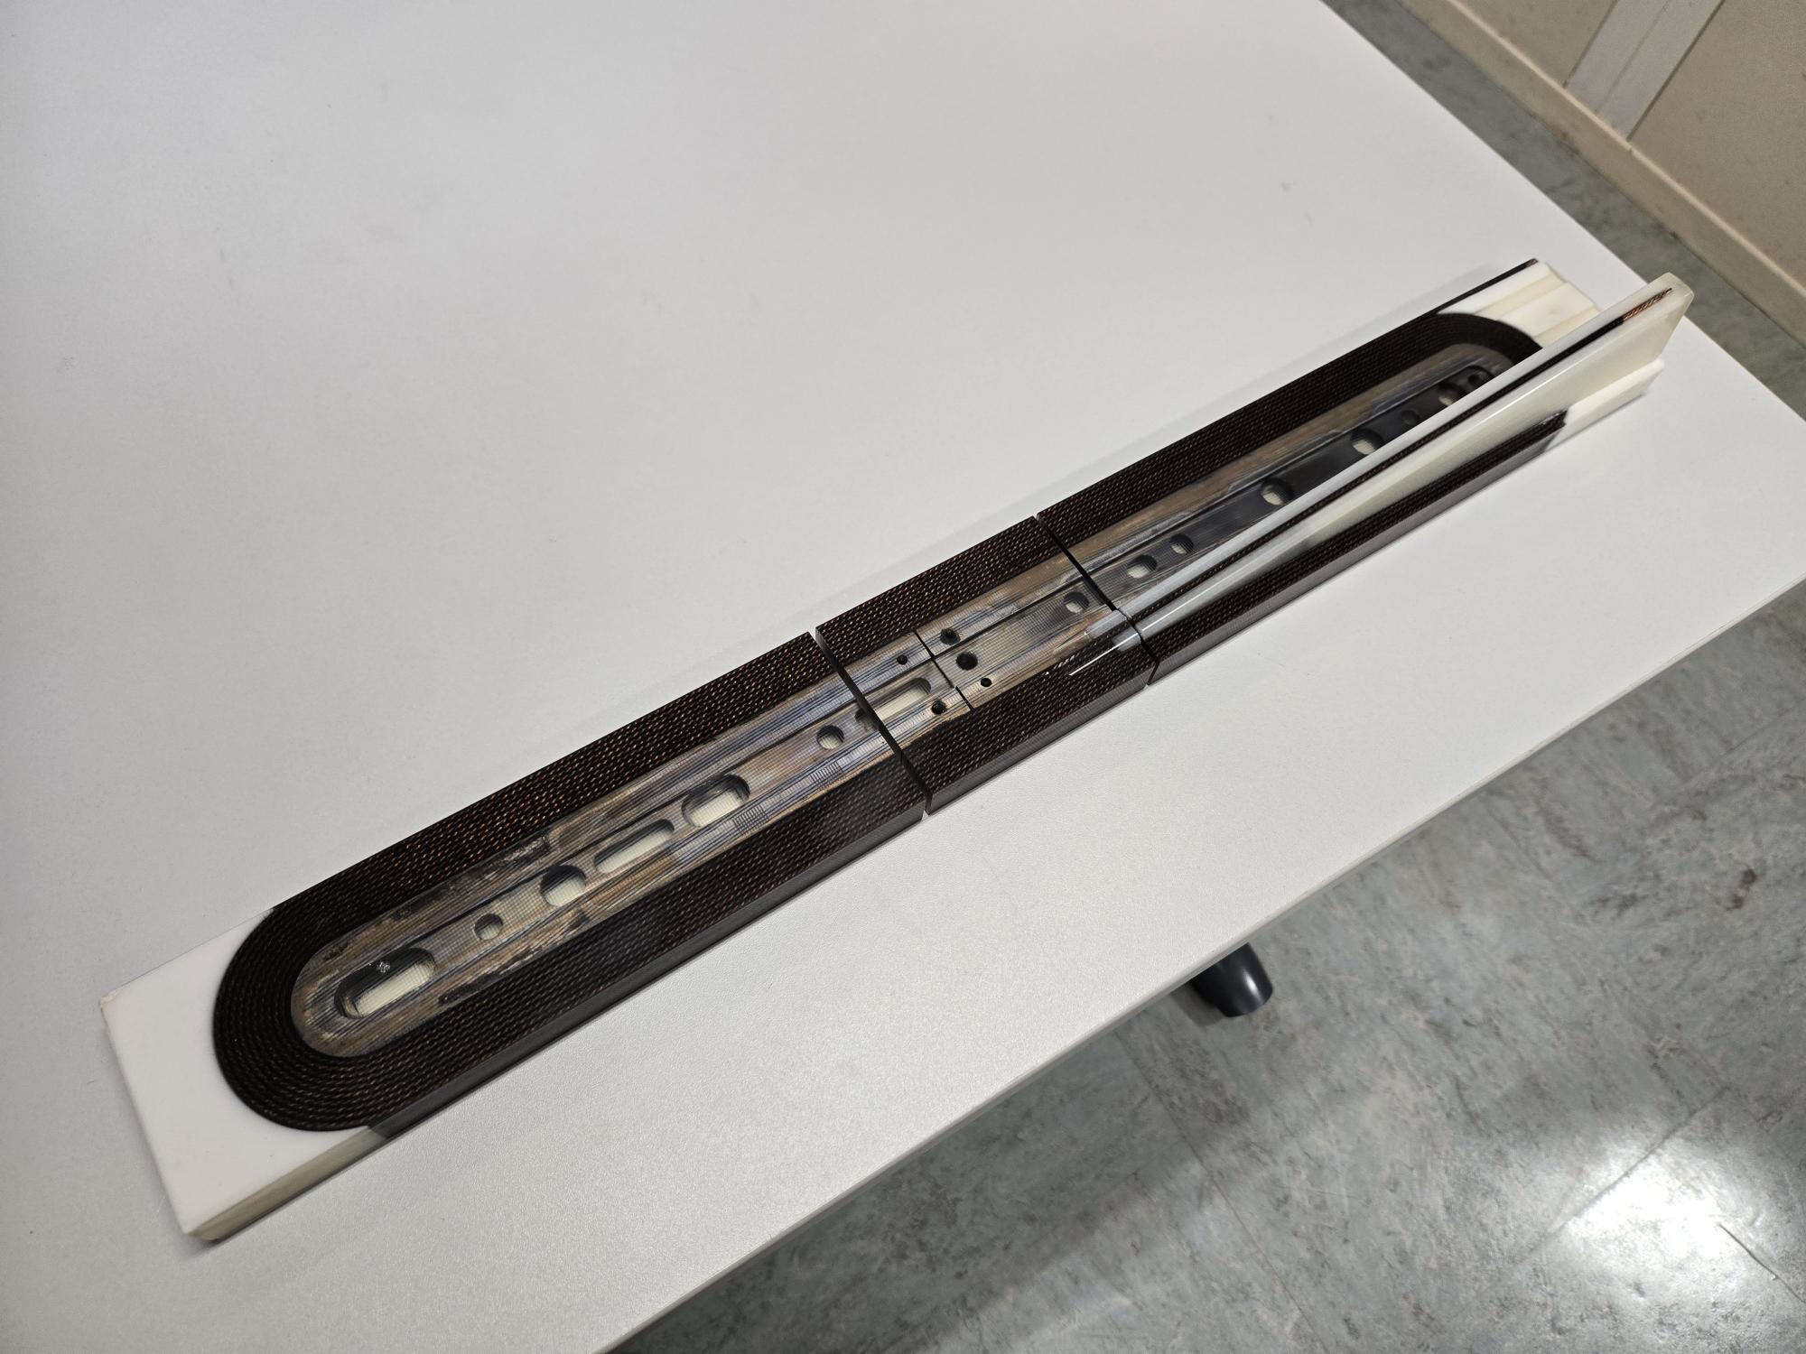
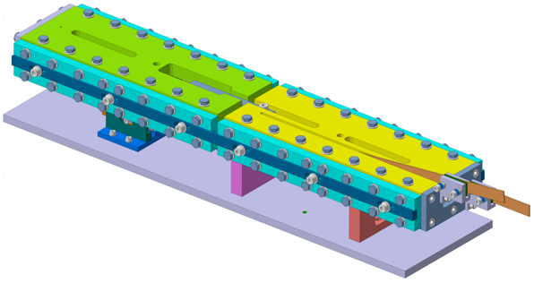
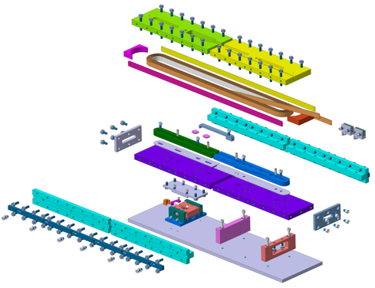
Technical Engineer TE-MSC-LMF (2019 – 2025)
Responsible for MQXFB coil manufacturing
Winding & curing
Reaction heat treatment
Epoxy impregnation
Magnet assembly (collaring and bladder & key)
BOND and BOND-M engineering design working group (development and manufacturing of a 14T block dipole with flared ends)
Novel features in the reaction mold to accomodate for cable expansion and contraction during reaction heat treatment
On purpose mock-ups developed and manufactured to validate and test technical choices
Courtesy of N. Peray and B. Pellet

Slide 7

What’s next?
Internal mobility to SMT section in September 2025
Take the baton from Juan in managing the laboratory activities from January 2026
The main activities planned in the short and medium terms focus on
HFM (High Field Magnet) the 12 T cos-theta (FalconD) and the 14 T block (BOND)
The continuation of the technology development program (SMC, RMC and MQXFS)
Other demonstrators like FUSILLO2, CHiC and FCC-hh MQ
I would sincerely like to thank you all for the warm welcome you have given me in the section, and to wrap up, just a personal thought…
…with a talented and strong team, exceptional expertise and state-of-the-art facility, we have everything we need to achieve our goals and succeed the challenges ahead, all together!
Picture generated by ChatGPT
7

Slide 8
Merci beaucoup de votre attention!
C’est avec plaisir que je répondrai à vos questions…

Slide 9
Additional slides

Slide 10
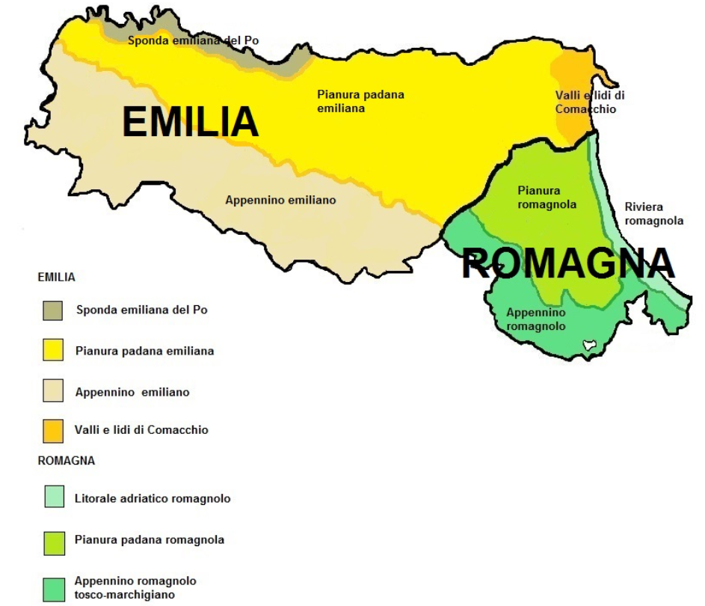
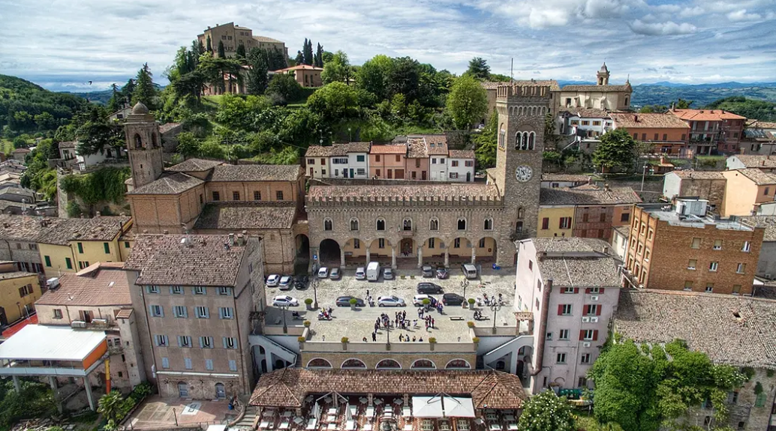
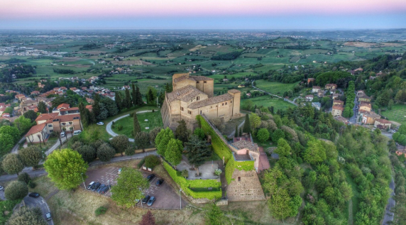
A bit about myself

