Slide 1
Superconducting Magnet Technology latest news
CERN, 25th November 2025
E. Todesco
CERN, Geneva Switzerland

Slide 2
Organigram as of January 2026
18 staffs, 15 fellows and associates (total 33), and 6.5 industrial support [we were 15 staff + 16 fellows and associates in April 2024]
  Total 21 for Magnet Lab and Engineering (plus 5.5 industrial support)
  Total 11 for Polymer and HV lab (plus 2 industrial support)
              Newcomers in red
  A. Foussat replacing E. Todesco as SL in case of absence
  S. Clement replacing R. Piccin in Polylab in case of absence
Engineering
Arnaud Foussat
Ariel Haziot
Mikko Karppinen
Juan Carlos Perez
Jose Luis Rudeiros Fernandez (from April)
Keiran Geiger (FELL, until 1.2026)
Nicola Sala (FELL)
Gonzalo Hernando (GRAP)
Federico Ben el Caid (GRAE)
Dimitriors Tolis (GRAE)
Nicolas Peray (TEMC)
Ignacio Perez (GRAP)
Vendela Roxenborg (GRAE)
Hiba el Sayed (GRAE)
Marika D’Addazio (COAS)
Magnet lab
Nicholas Lusa
Winding & Assembly
Dominique Cote
Carlos Fernandes
Gregory Maury
Benjamin Pellet
Mechanical workshop
Pierre-Olivier Coste
Polymer and HV lab
Roland Piccin
POLAB Operation & Services
Sébastien Clement
Cedric Urscheler
Instrumentation & Electrical Tests
Francois-Olivier Pincot
Pavan Chaganti
Dielectric materials R&D
Christian Scheuerlein
Vincent Schenk (GRAP)
Enrico Lanzoni (TRNE)
Daphne Beaujoint (GRAE)
Filip Louka (TECH)
Simon Sina Nourbakhsh (TECH)

Slide 3
Who’s coming, who’s leaving
Joining the section
  Hiba el Sayed (November 2025)
  Jose Louis Rudeiros (April 2026)
Leaving the section
  Kieran Geiger (end of January)
  Elena Fernandez Mora (end of December)

Slide 4
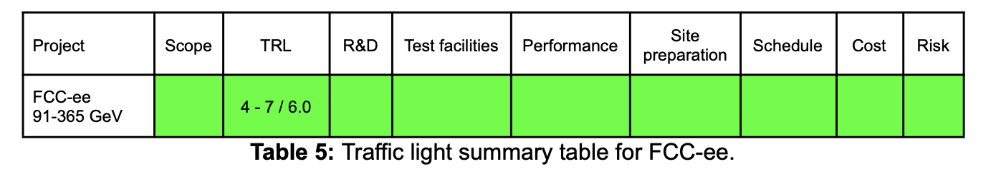
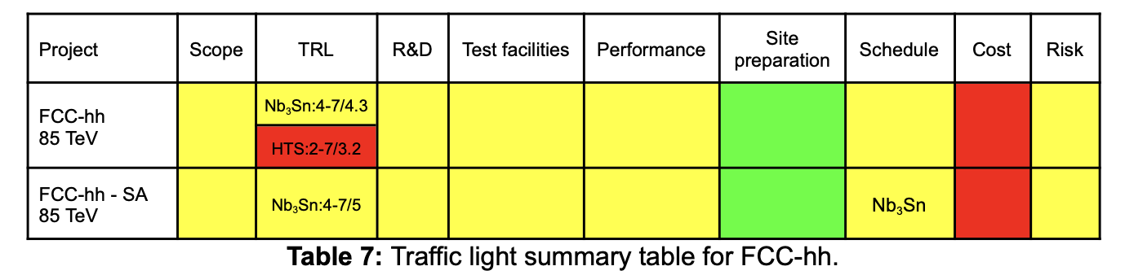
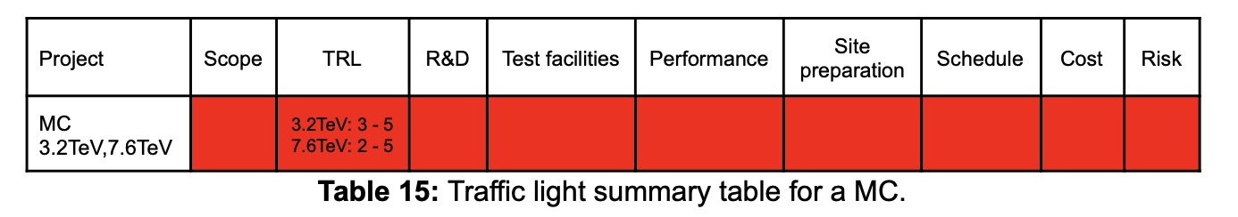
Some news
Evaluation of the different options for future of CERN (European Strategy for Particle Physics)
  https://cds.cern.ch/record/2947728/files/ESG_WG2a_Final.pdf

Slide 5
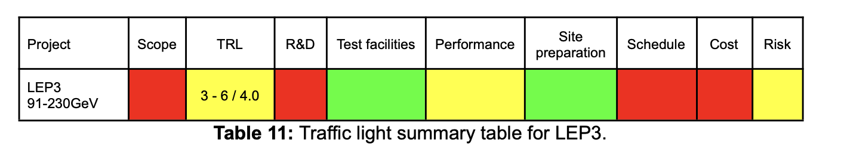
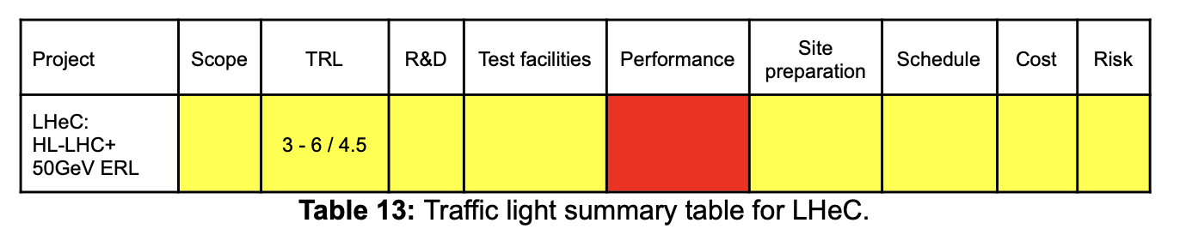
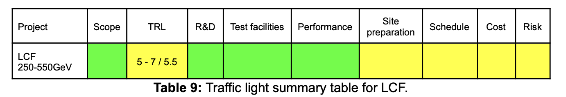
Some news
Other machines:
  LEP3: electron positron in the LHC tunnel as Higgs factory
  LHeC: electrons collinding with LHC protons
  LCF : linear collider as as Higgs factory

Slide 6
HL-LHC, HFM
HL-LHC
  MCBRD11 completed
    Test in January, if everything is conformed this will complete SMT activities for D2 correctors
  MCBXF
    Three more magnets to deliver, activities should be completed in mid 2026
  This will allow redirect resources towards HFM
HFM- FalconD (A. Foussat)
  Winding tests are ongoing – challenging magnet
  Decisions to be taken on 50/56 mm aperture, synergies with INFN, and future activities on four layer cosθ hybrid
HFM – TDP (A. Haziot)
  Very important activity on SMC wax – test should come soon
  Hybrid design ongoing, tests in mid 2026 – fundamental to reduce FCC-hh cost by several billions
  An SMC with Nb-Ti impregnated is planned to prove ability to reach short sample (9 T peak field)
  ESC coils for MQXF
  MQXFS4 preload experiment

Slide 7
HFM
HFM – MQ (M. Karppinen)
  Design completed, cable available, first hardware tests ongoing
HFM – BOND (Juan Carlos Perez)
  Ongoing activities, first coils in 2026, with ambitious target of test at the end of the year
HFM – long (Jose Ferradas)
  Activities ongoing to build 4 m long coils with flared ends
  Strong synergy LMF-SMT
Insulation (R. Piccin)
  Desizing
  Coatings
  Braiding machine
  Radiation resistance

Slide 8
OTHER MAGNETS
LHC MQ spares (M. Karppinen)
  Production ongoing, test in SM18 until mid 2026
CHiC (K. Geiger, M. Karppinen)
  Construction phase ongoing with target of tests in 2026
Fusillo (A. Haziot)
  Third subscale with wax

Slide 9
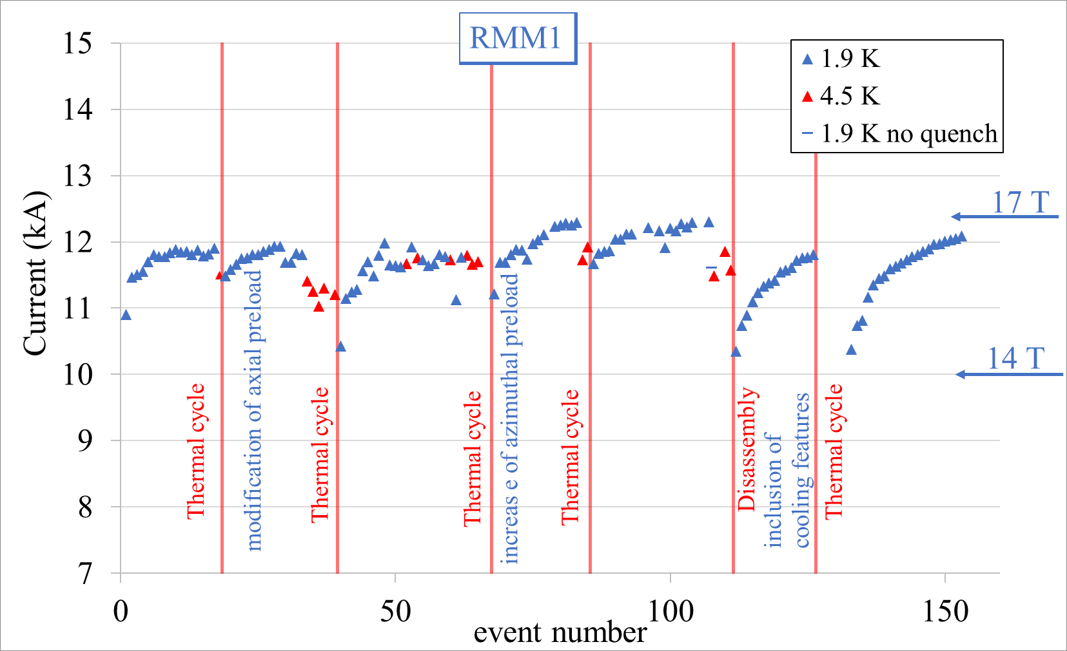
Some news: RMM
RMM1e test is ongoing
  Same coils of RMM1d, but with a fishbone to improve cooling
  Success so far! Magnet reaches target current after totally dissassembly, and does not need anymore a plateau at intermediate current to cool down
  Total loss of memory _ never seen before

Slide 10
Tentative deliveries for 2026
..
Magnet/Demo |  | Origin | Aim | Date in SM18 | Difference
MCBRD11 | HL-LHC | CERN/IHEP | HL-LHC production | December 2025
MCBXFA4 | HL-LHC | CERN/CIEMAT | HL-LHC production | February 2026
MCBXFB10 | HL-LHC | CERN/CIEMAT | HL-LHC production | April 2026
MCBXFA5 | HL-LHC | CERN/CIEMAT | HL-LHC production | June 2026
RMM2 | HFM | CERN | RMM2 with new coils | February 2026
SMC 110 | HFM | CERN | Wax (assembly ongoing) | November 2025
MQ-4 | LHC | Tesla | LHC: 4th MQ spare | December 2025
MQ-5 | LHC | Tesla | LHC: 5th MQ spare | January 2026
MQ-6 | LHC | Tesla | LHC: 6th MQ spare | February 2026
MQ-1 | LHC | Tesla | LHC: 1st MQ spare (repaired) | March 2026
MQ-3 | LHC | Tesla | LHC: 3rd MQ spare (repaired) | TBD
MQXFS4h | HFM | CERN | 3rd increase of preload | March 2026
MQXFS4i | HFM | CERN | 4th increase of preload | May 2026
MQXFS9 | HFM | CERN | MQXFS with ESC | April 2026
Fusillo sub 3 |  | CERN | Other magnets - test of wax | May 2026
CHiC | Other | CERN | First test in LHe | May 2026
MQXFS4j | HFM | CERN | 5th increase of preload | July 2026
ISAAC | HFM | CIEMAT | 12 T common coil demonstrator | February 2026
R2D2 | HFM | CEA | 12 T block with grading demonstrator | January 2026
LMK1 | HFM | CERN | First Falcon D mock up cold test | Nov 2025
SMC 106 | HFM | CERN | Detachable pole | December 2025
SMC 301 | HFM | CERN | SMC MQXF baseline | February 2026
SMC 302 | HFM | CERN | SMC MQXF electrically optimized | March 2026
SMC NbTi 01 | HFM | CERN | SMC Nb-Ti impregnated | April 2026
SMC 303 | HFM | CERN | SMC MQXF 2nd wax impregnated | July 2026
SMC H 01 | HFM | CERN | SMC Hybrid fully impregnated | June 2026
SMC NbTi 02 | HFM | CERN | SMC Nb-Ti non-impregnated | TBD (if needed)
MCBYY | Other | CERN/Uppsala | CCT corrector, wax impregnated | June 2026
BONDmm | HFM | CERN | BOND mechanical model | July 2026
BOND | HFM | CERN | BOND 1st | November 2026

Slide 11
THANKS !
I found an interesting 1 h documentary on the FCC studies preparatory phase of 2015-2020 «Way beyond» by P. Julier
I had the OK from her to make a Xmas projection at 927, for whoever is interested
  https://www.filmingo.ch/fr/play/1349-way-beyond
  https://www.visionsdureel.ch/film/2021/way-beyond/

