Slide 1
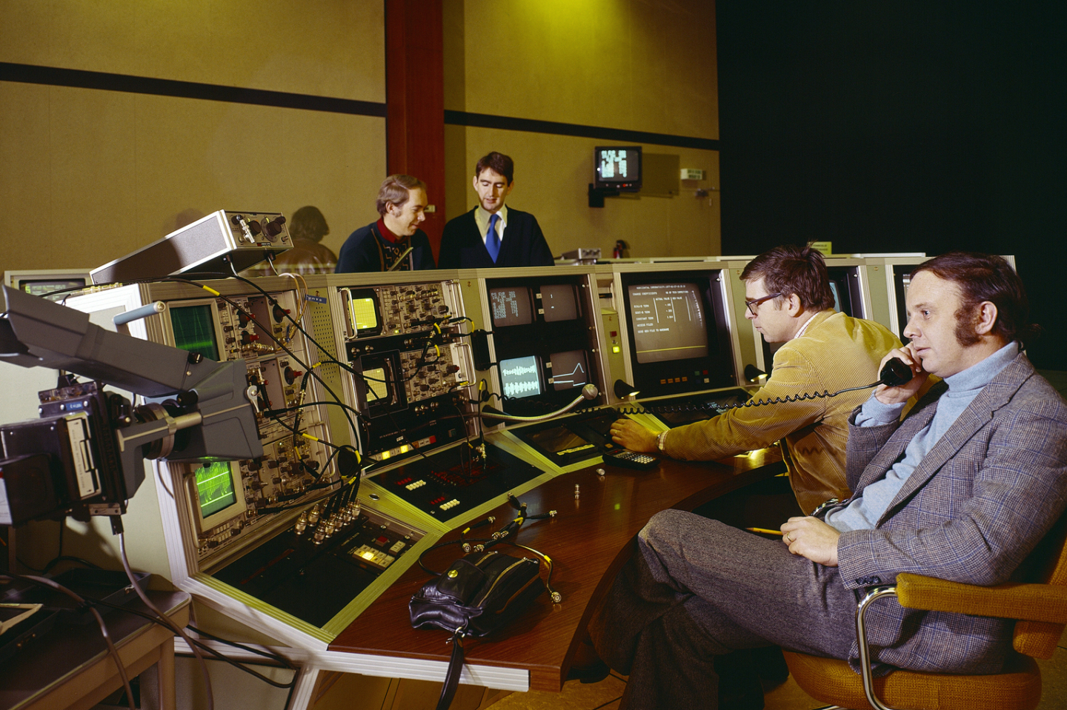

Overview of SPS operation
T. Levens
SY-BI-IQ

Slide 2
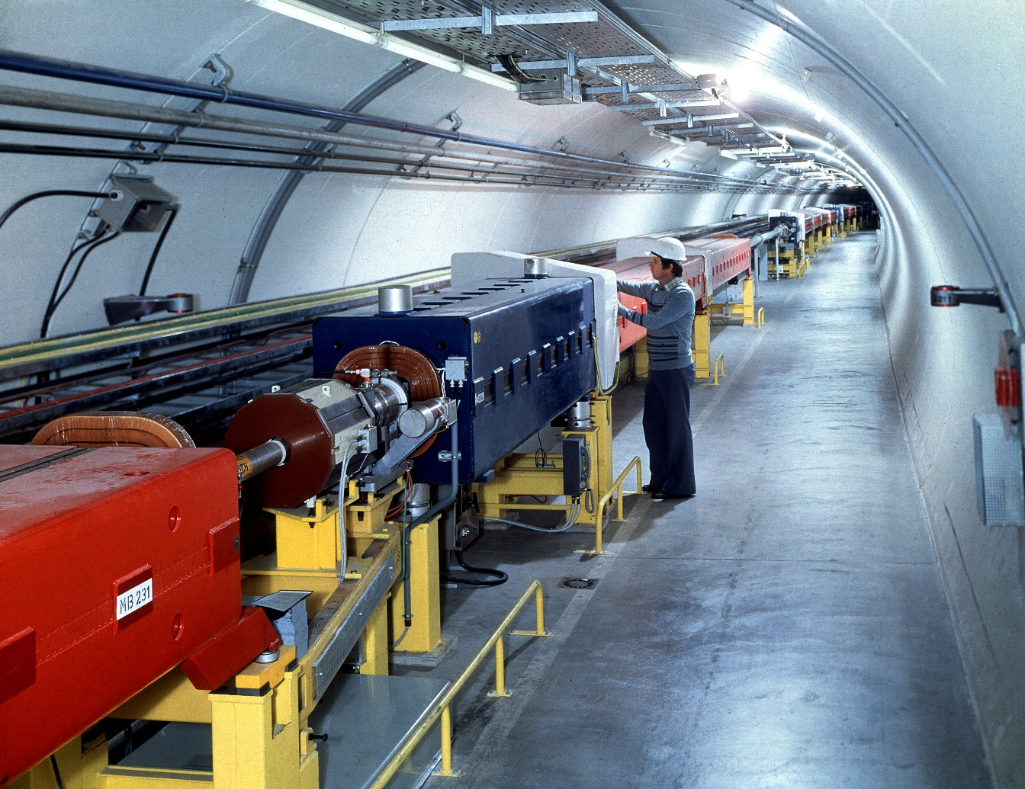
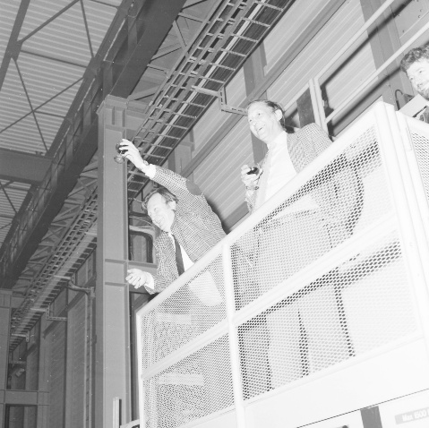

The Super Proton Synchrotron
6.9km 450GeV synchrotron
Second largest accelerator in CERN’s complex
Crossing the border between Meyrin & Prevessin
Commissioned on 17th June 1976
744 dipoles (MBA/MBB) in six arcs
4 dipoles per ½ period
Maximum field 2T at 5.8kA
216 quadrupoles (QF/QD) in a FODO lattice
Short straight section (2m) at each quadrupole
Always BPM, BLM, orbit corrector
Other magnets (sextupoles, octupoles), BI, etc
Six long straight sections (128m) with access point in the BA1 - BA6 surface buildings
LSS1 – injection
LSS2 – slow extraction
LSS3 – acceleration
LSS4 – fast extraction
LSS5 – beam dump
LSS6 – fast extraction
From 1981 to 1991 ran as a proton-antiproton collider
Discovery of the W and Z bosons in 1983
Carlo Rubbia and Simon van der Meer awarded Nobel Prize in 1984
Beam instrumentation
installed in all locations

Slide 3
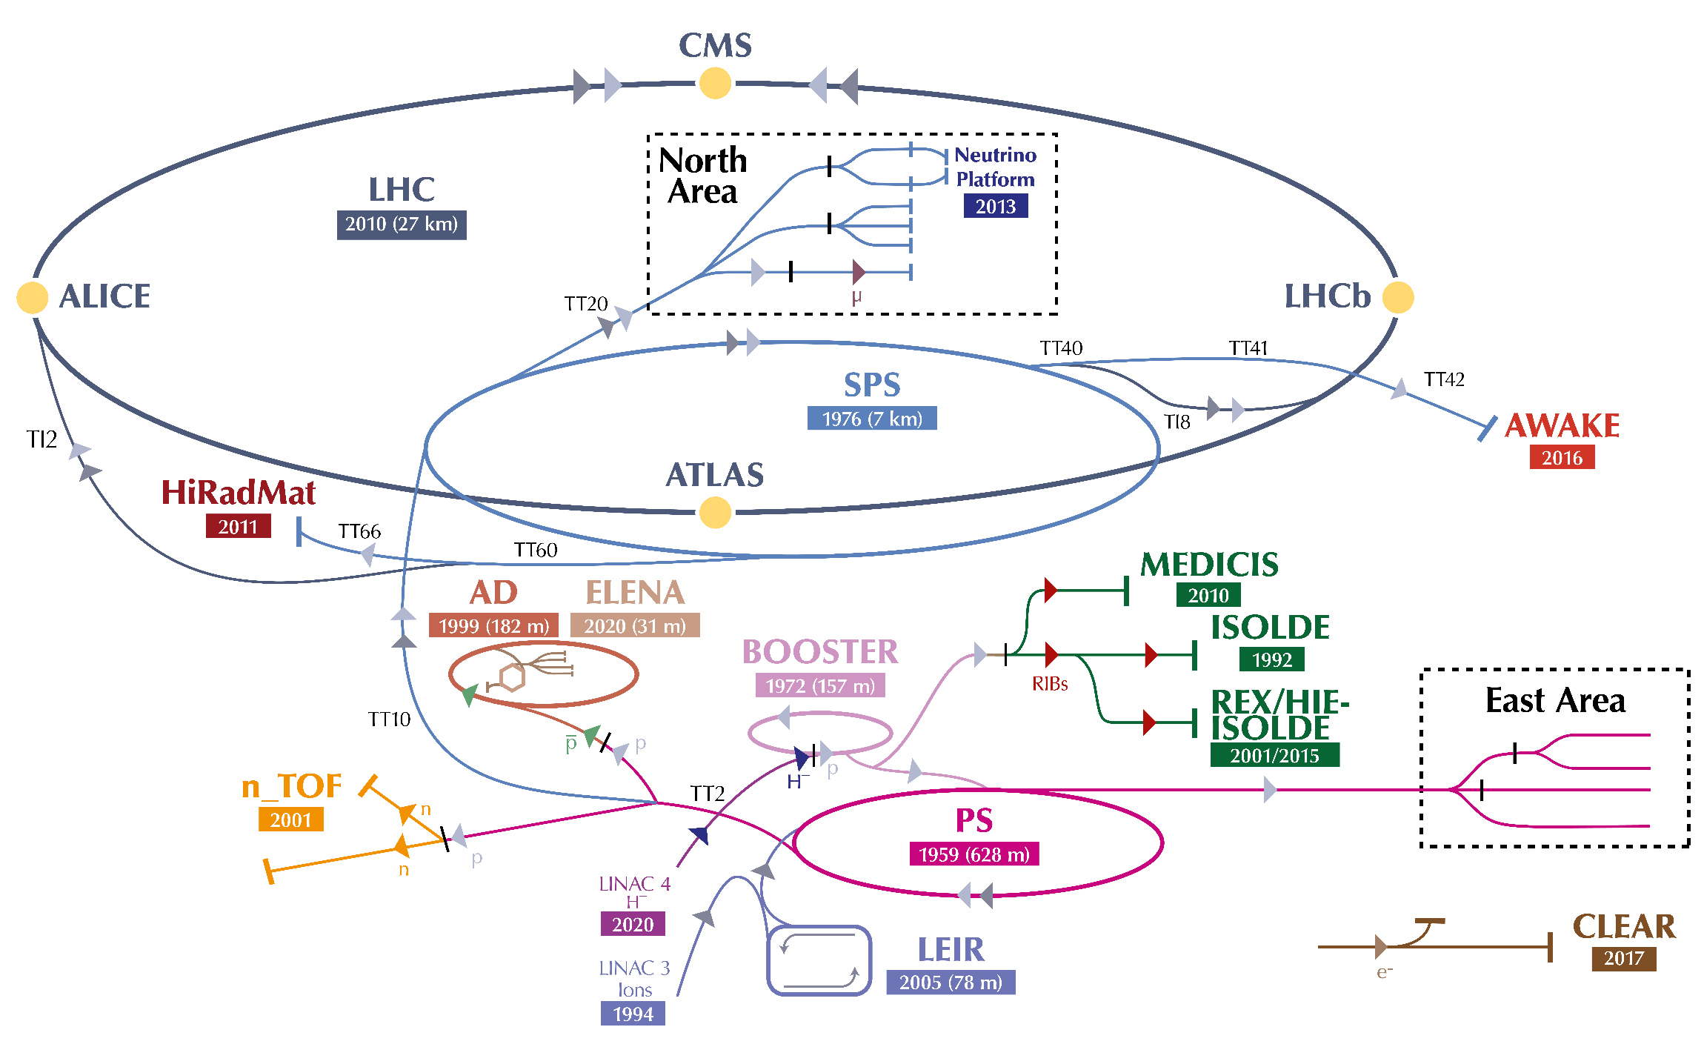
The Super Proton Synchrotron in CERN’s accelerator complex
SPS ring
Injection from PS via TT2/TT10
Slow extraction via TT20
North Area experimental zone
Fast extraction “east” via TT40
LHC Beam 2 via TI8
AWAKE via TT41
Fast extraction “west” via TT60
LHC Beam 1 via TI2
HiRadMat via TT66

Slide 4
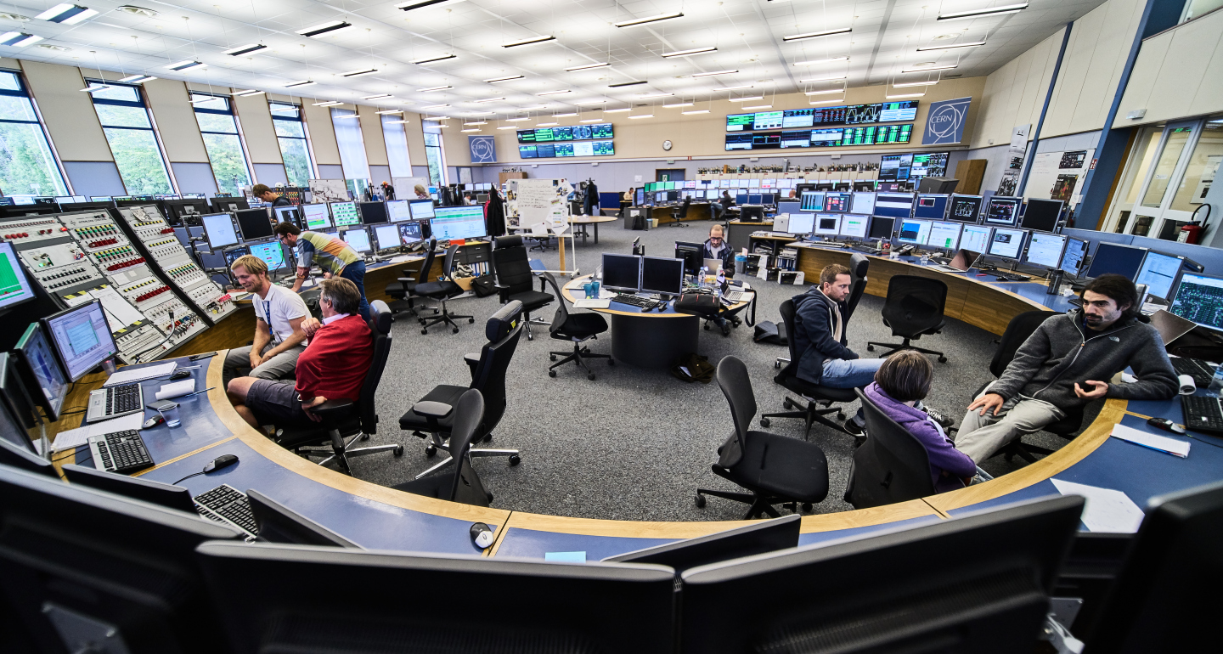
SPS Operation
SPS is operated from the CCC by the BE-OP-SPS section
Two operators on shift 24/7 during operational periods
Three shifts per day
Supported by machine coordinators from various groups
Responsible for following up the planned schedule and activities
Coordinating with other machines and users in case of problems
Following up faults and issues
Reporting of machine status to BEMB/FOM and users meeting
Relying on a team of experts from ABP and all equipment groups (BI, RF, ABT, EPC …)
Weekly coordination meeting (Mon. 9:30am) to discuss the status/plans for the week
Regular SPS Machine Performance Coordination meetings to discuss topics affecting the accelerator operation

Slide 5
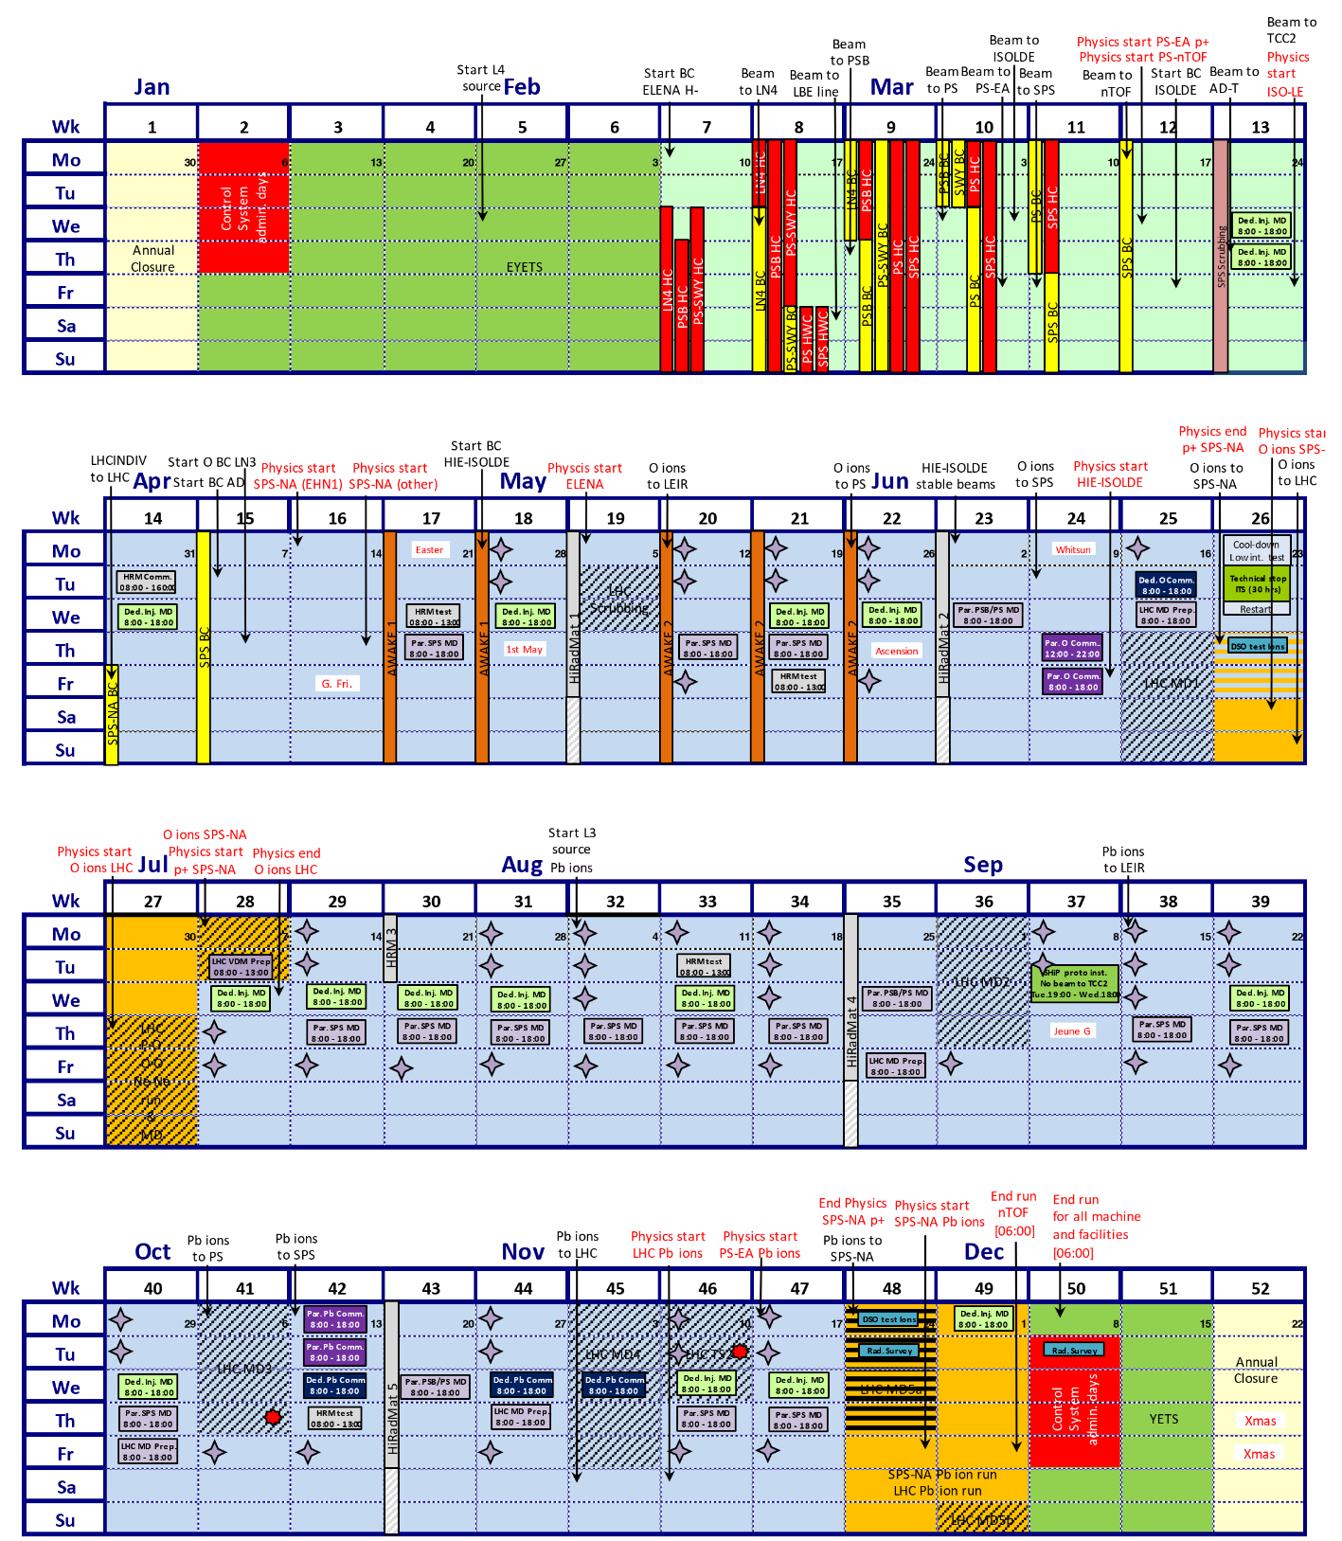
SPS Schedule
Injector Schedule 2025
SPS last injector to start-up
Usually one week after the PS
Beam commissioning for 10 days
Traditionally starting on a Friday morning
Injection, RF capture, ramp, extraction
Perform aperture scans
Perform beam-based alignment
Scrubbing for one week to prepare for high intensity operation
Commissioning of NA extraction with ABT and secondary beam lines with BE-EA
Proton operation for most of the year
Runs for AWAKE/HiRadMat in dedicated blocks throughout the year
Regular Machine Development (MD) slots
LHC & NA ion run at end of year
Mid-year light ion run – new in 2025

Slide 6
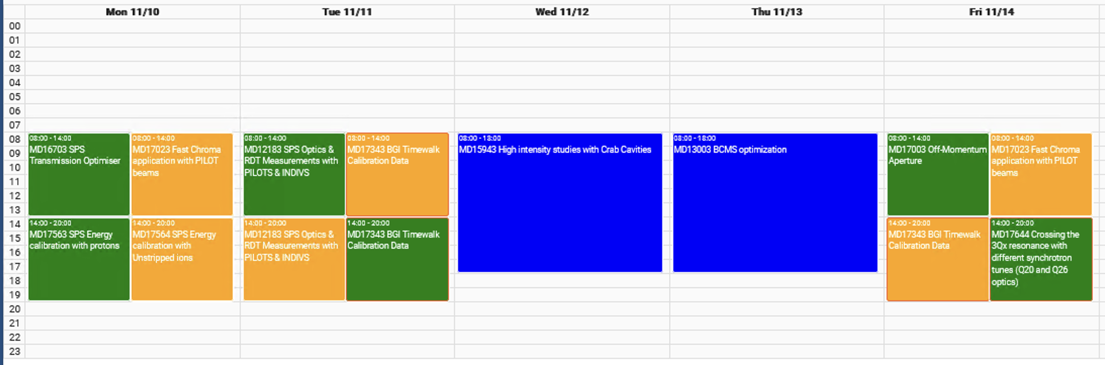
SPS Machine Development
SPS Machine Development (MD) sessions are carried out continuously during the year
Three types of MD are available:
Short parallel MDs
Executed in parallel to fixed target operation, usually on Mon/Tue/Fri, in ½ day blocks
Limited to injection energy on a short cycle
Long parallel MDs
Executed in parallel to fixed target operation, usually on Thu, in full day blocks
Longer cycle allowing acceleration of beam to flat top
Dedicated MDs:
Executed in dedicated mode, usually on Wed (during NA user changeover), in full day blocks
Only option for MDs which cannot be executed in parallel to NA physics (coasts, etc)
Organised by the injector MD coordination team
MD requests and schedule managed by the ASM tool

Slide 7
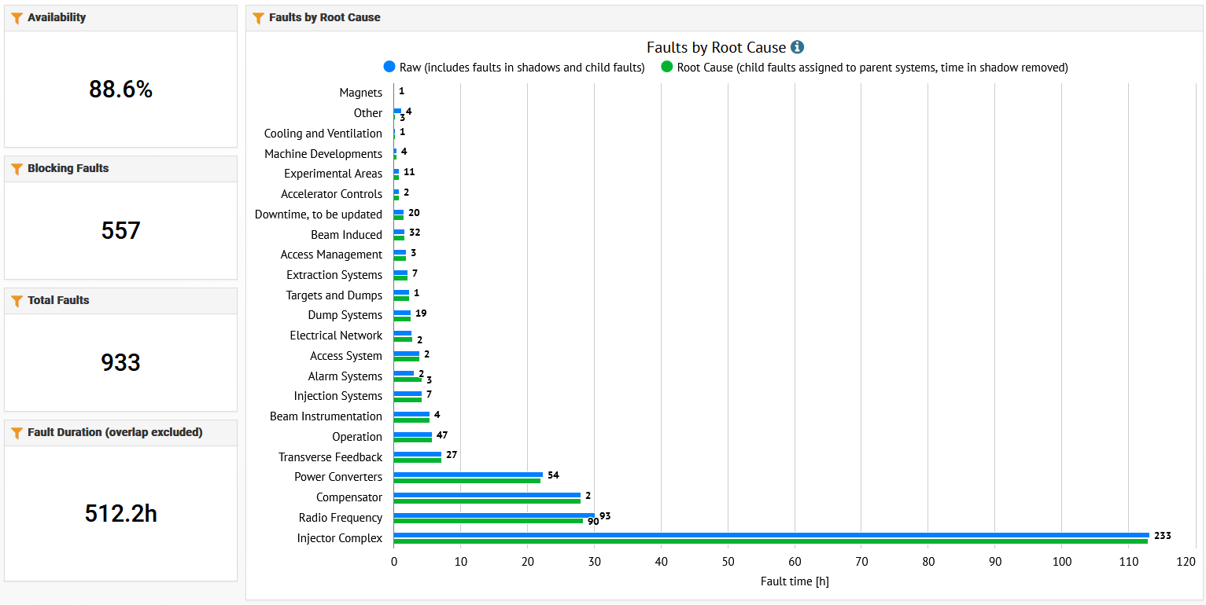
SPS Fault Tracking
Operational faults are tracked in the AFT tool
Statistics used for weekly reports, Chamonix/JAPW presentations… etc
Many SPS faults are automatically opened/closed by the SIS system
For example: if no beam is detected on a certain cycle
Manual clean-up done by SPS-OP and machine coordinators
Weekly review with AFT team
BI typically doing well
But note that non-blocking faults may not be added
Please be sure to review the faults assigned to your system
There is also a BIOP JIRA where issues can be created by OP directly from the e-logbook
Not widely used, unfortunately
SPS AFT faults for last 3 months

Slide 8
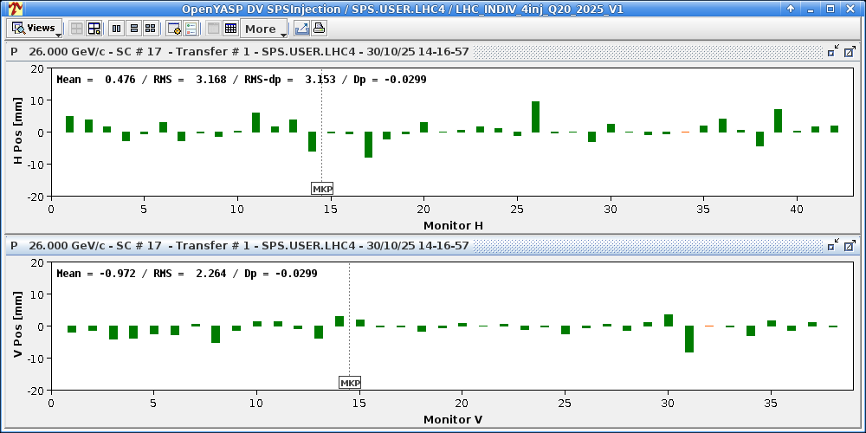
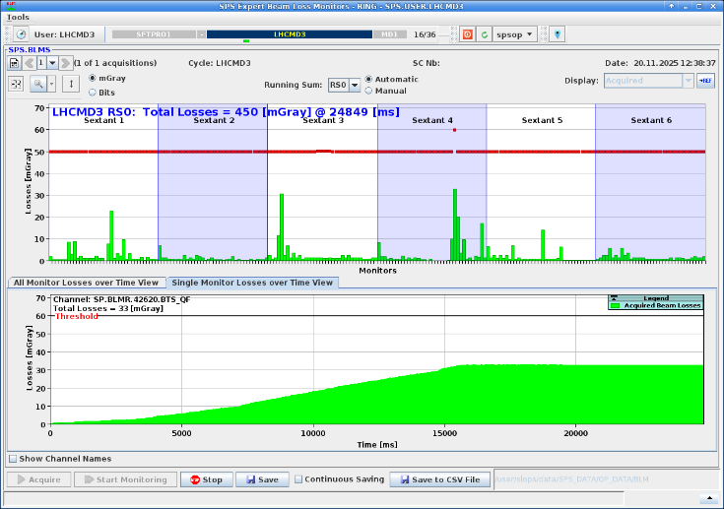
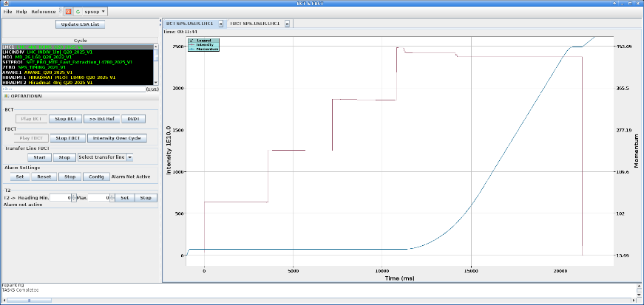
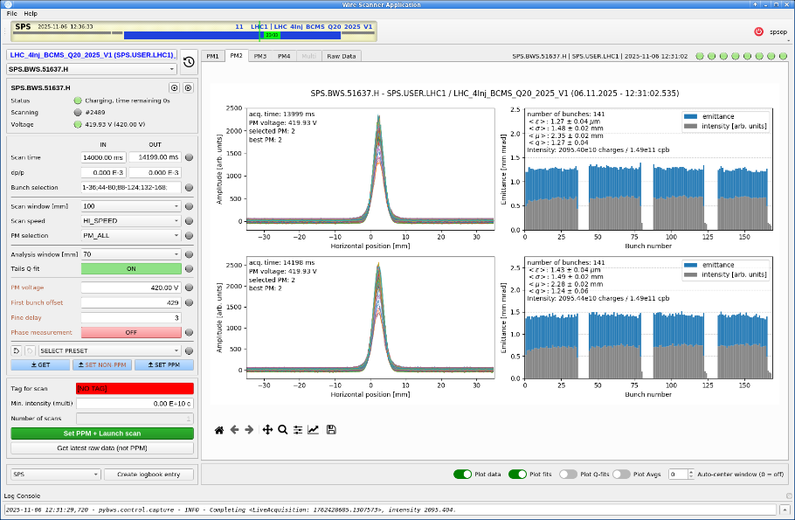
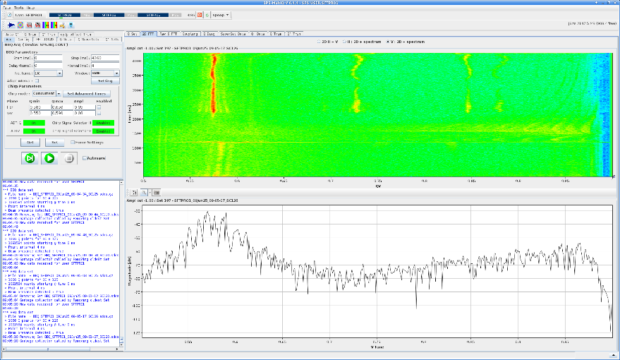
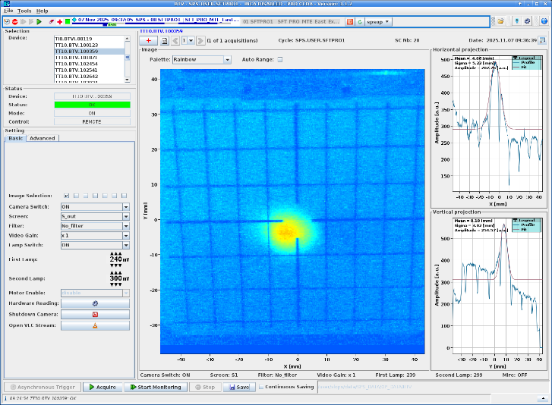
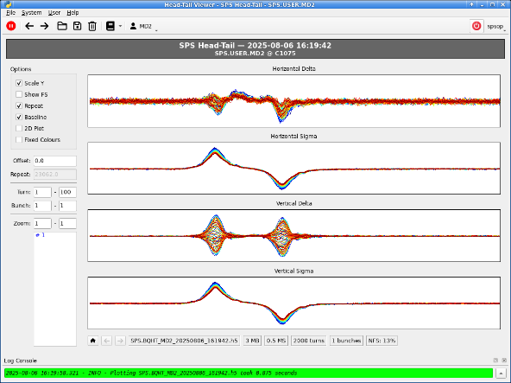
SPS Beam Instrumentation
SPS has a comprehensive suite of beam instrumentation in the ring and transfer lines
BPMs – beam position
BLMs – beam loss
Fast & DC BCTs – intensity
Wire Scanners, BGI, BSRT – profile
BBQ – tune measurement
Head-Tail – instabilities
BTVs, SEM grids, foils – position/profile/intensity
WCMs – longitudinal parameters (RF group)
Typically, all are controlled/viewed with custom applications developed by SPS-OP
Used daily by OP and MD users
Generally: everything is working reliably thanks to consolidation and upgrades over recent years and support of BI experts whenever there are issues - thank you!

Slide 9
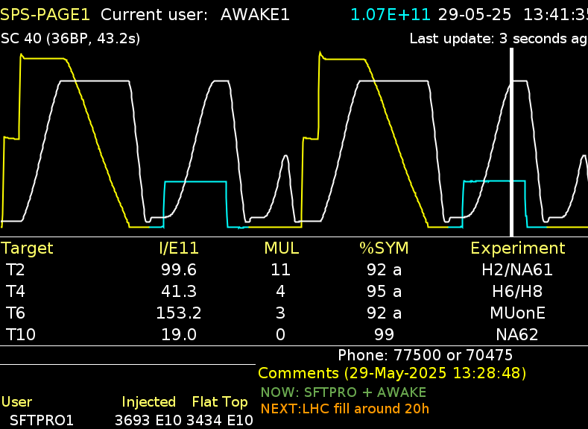
SPS Vistars
PAGE1: primary display of SPS accelerator status
Available online
Scrolling plot showing current super-cycle
White = dipole current
Yellow/blue = beam current
From DC-BCTs
Note arb. scaling per cycle chosen by OP
Information about beam on NA targets
Comments from the operators on the current machine status

Slide 10
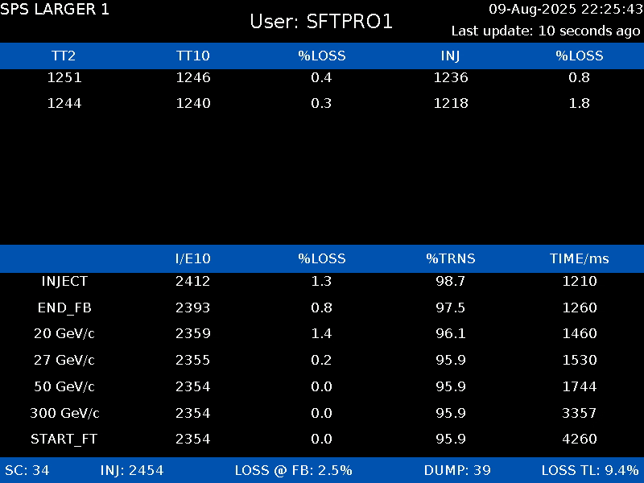
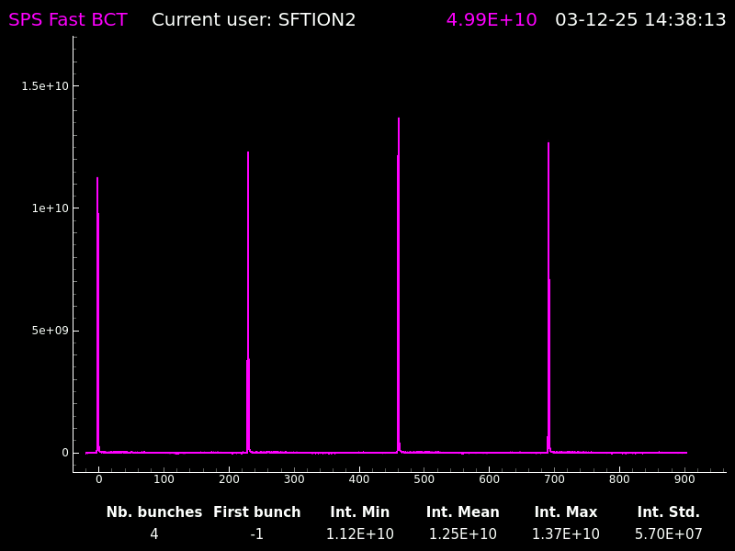
SPS Vistars
LARGER1-4
One screen for each user in the super-cycle
Intensity in TT2/10 and ring at key point in the cycle
Used to view losses and transmission
Fast BCT
Shows one turn of data from the ring FBCT in real-time (integrated in 25ns slots)
Online verification of beam structure

Slide 11

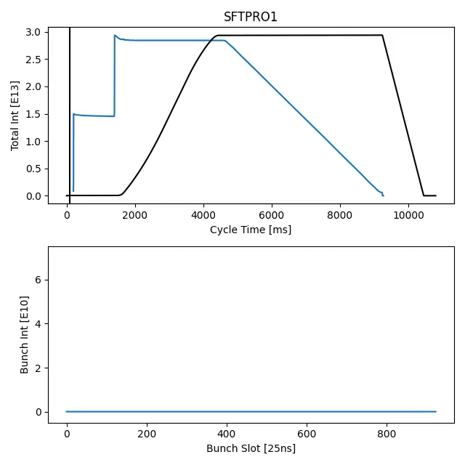
SPS Beams – SFTPRO
SPS Fixed Target PROtons
Two injections from PS at 14GeV
Extracted from PS over 5 turns (2.1us) using multi-turn-extraction (MTE)
Each injection filling 5/11 of the SPS
5ns spaced bunches (200MHz RF)
Accelerated to 400GeV and de-bunched at flat top
Slowly extracted to NA targets using 3rd order resonant extraction (4.8 second)
Quality of spill critical to experiments
Aim to have extracted intensity as close to constant as possible during the spill
Continuous monitoring of 50/100Hz components amplitude and correction

Slide 12
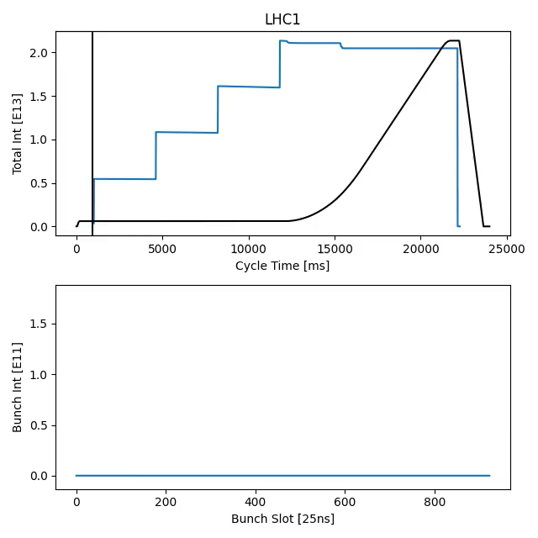
SPS Beams – LHC
LHC requires single bunches and trains with 25ns (or multiple) spacing
Low intensity “pilot” bunches (1e10)
Nominal intensity (1.6-1.8e11)
LIU intensity after LS3 (2.3e11)
Multiple injections from PS at 26GeV
Up to 288 bunches out of 924 bunch slots
Typically 200ns batch spacing
Beam structure defined by PS with different beam types available
Nominal, BCMS, 8b4e …
Accelerated to 450GeV
Fast extraction to LHC B1 or B2
LHC filling requires multiple beam types
Requires coordinate super-cycle switching

Slide 13


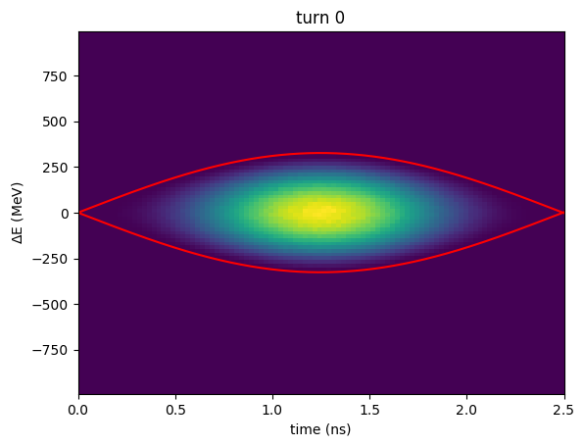
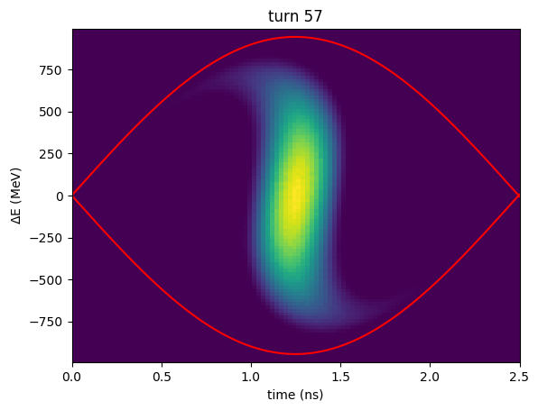
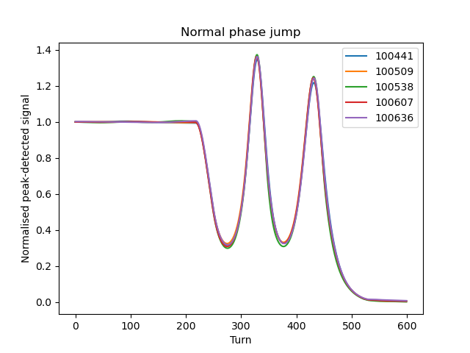
SPS Beams – &
AWAKE take a single bunch up to 3e11
Requested increased up to 5e11 after LS3
Acceleration to 400GeV
Bunch rotation before extraction
Fast extraction via TT40→TT41 to AWAKE
HiRadMat takes full range of LHC-like beams
Depending on experiment requirements
Acceleration to 440GeV
Fast extraction via TT60→TT66 to HiRadMat

Slide 14
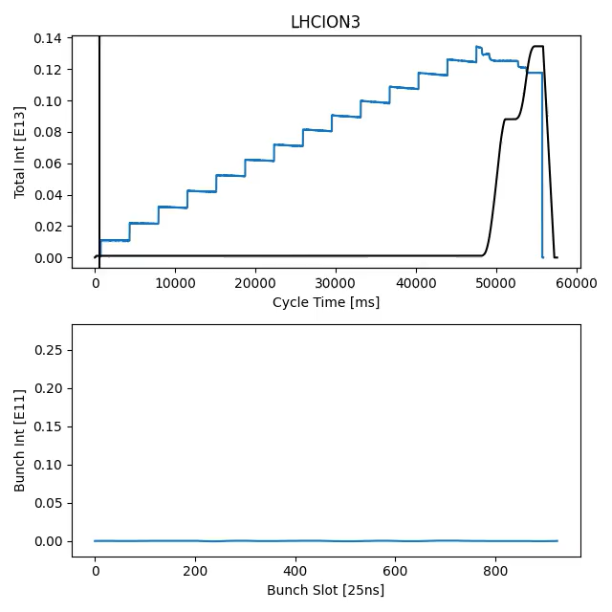
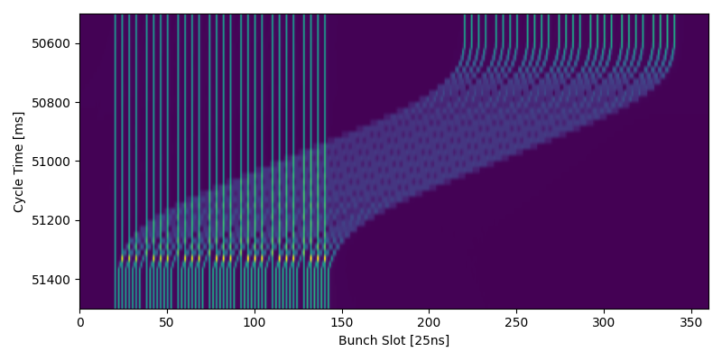
SPS Beams – LHCION
LHC ion physics requires single bunches and trains of 56 bunches
Requires up to 14 injections of 4 bunches from PS each 3.6 seconds
Extremely long cycle – 57.6 seconds!
Slip-stacking on intermediate flat top to interleave the 100ns bunches and achieve 50ns bunch spacing

Slide 15
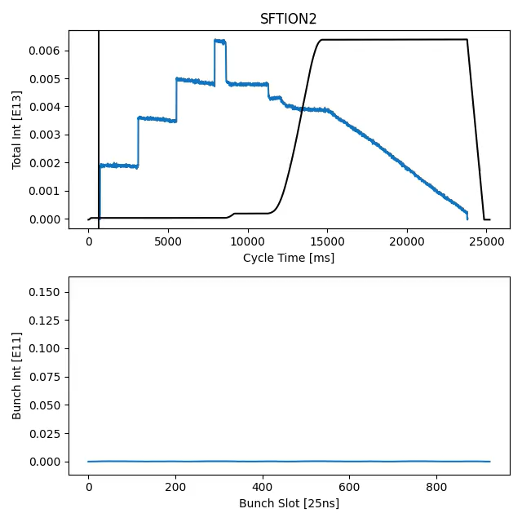
SPS Beams – SFTION
North Area ion physics requires a continuous spill
Injectors provide only bunched beam
4 single bunches injected from PS equally spaced in the ring
Accelerated to an intermediate flat top where they are de-bunched and recaptured in 200MHz RF buckets
Accelerated to 400GeV and de-bunched again at flat top
Slow extracted to NA

Slide 16
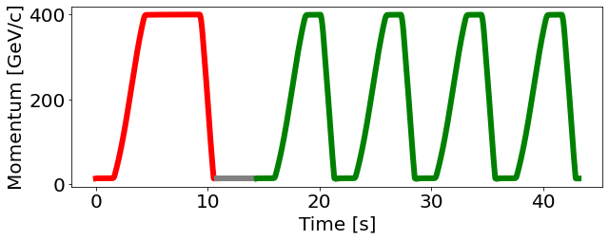
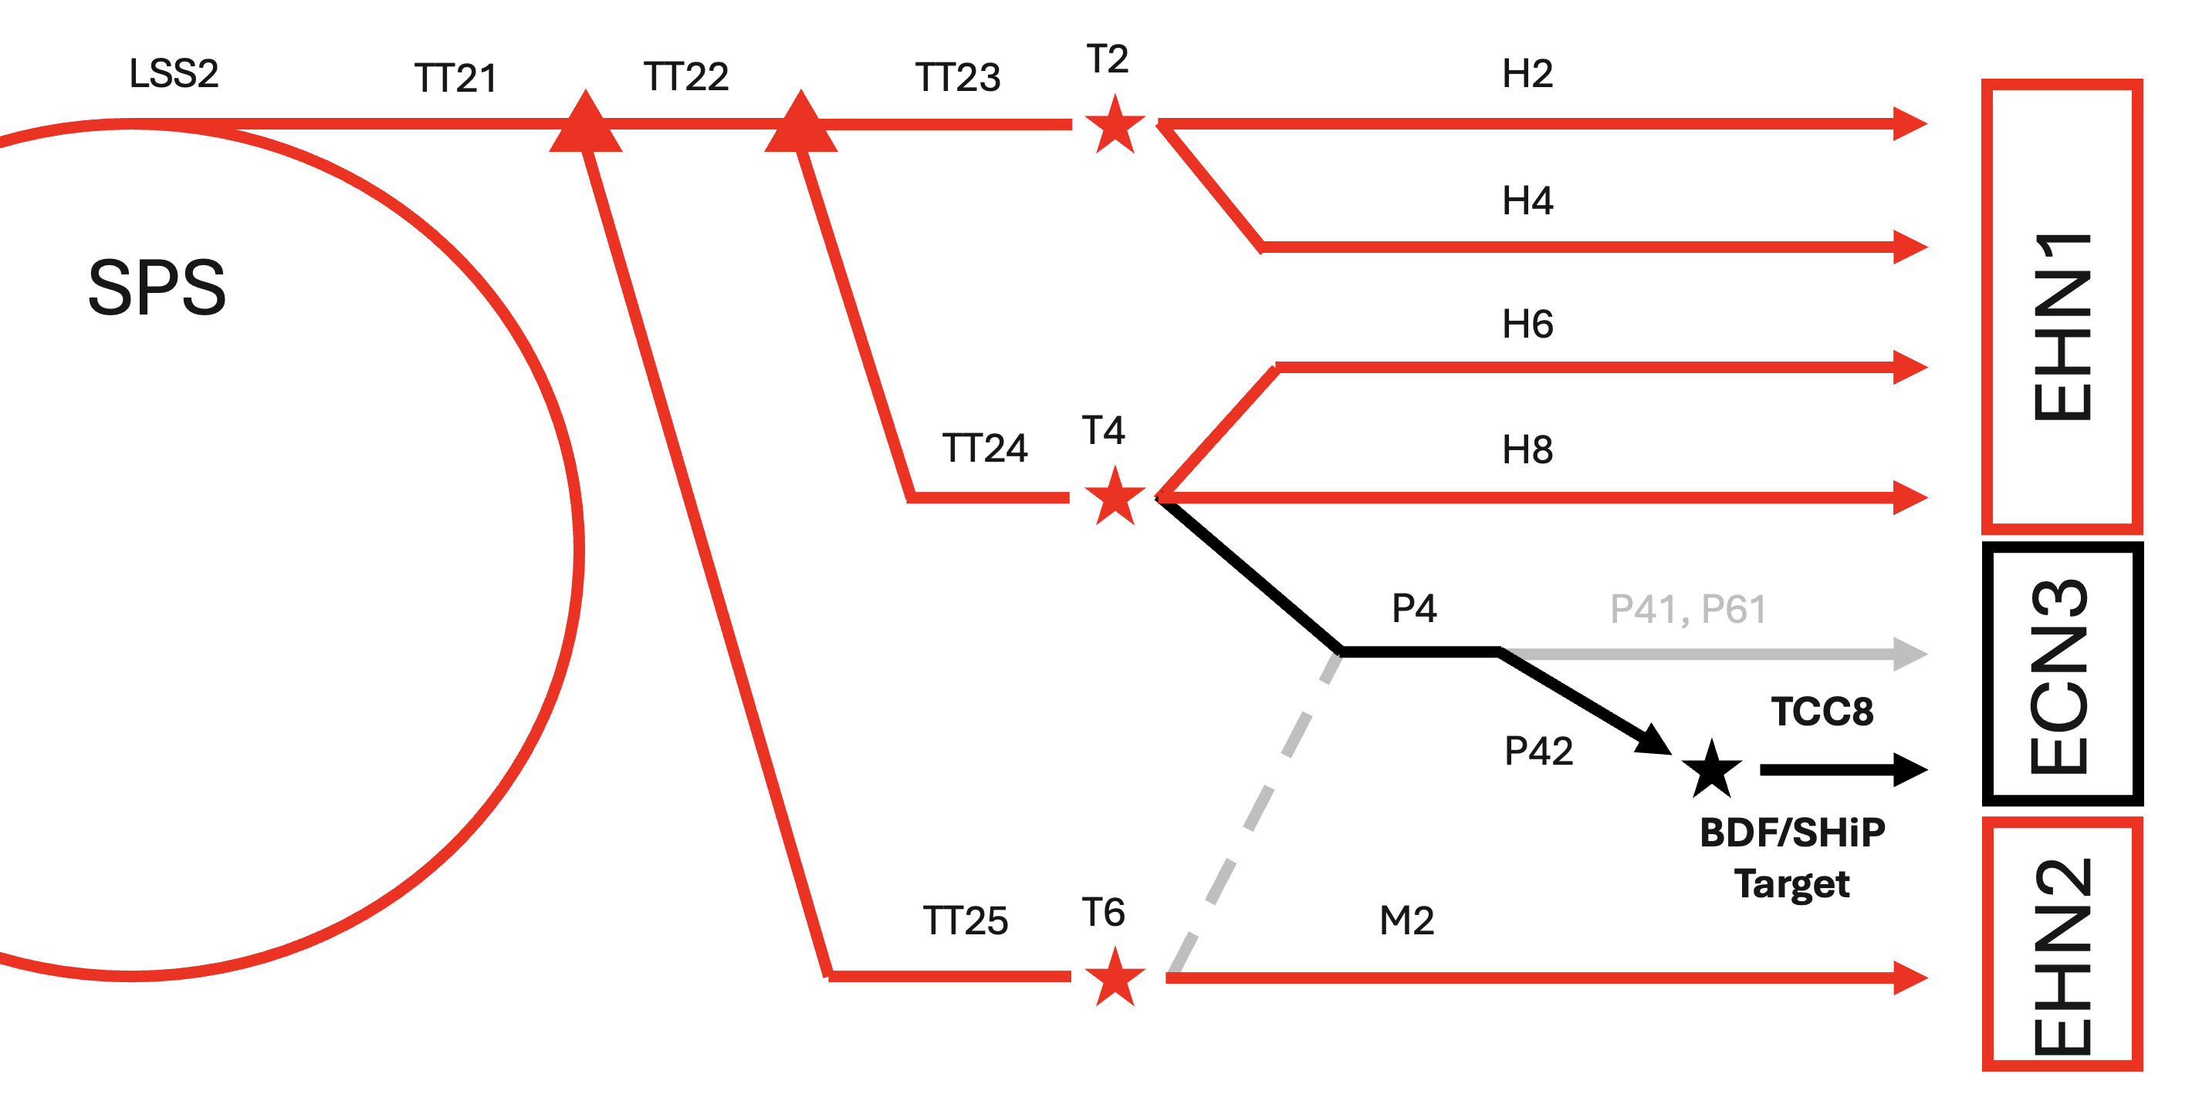
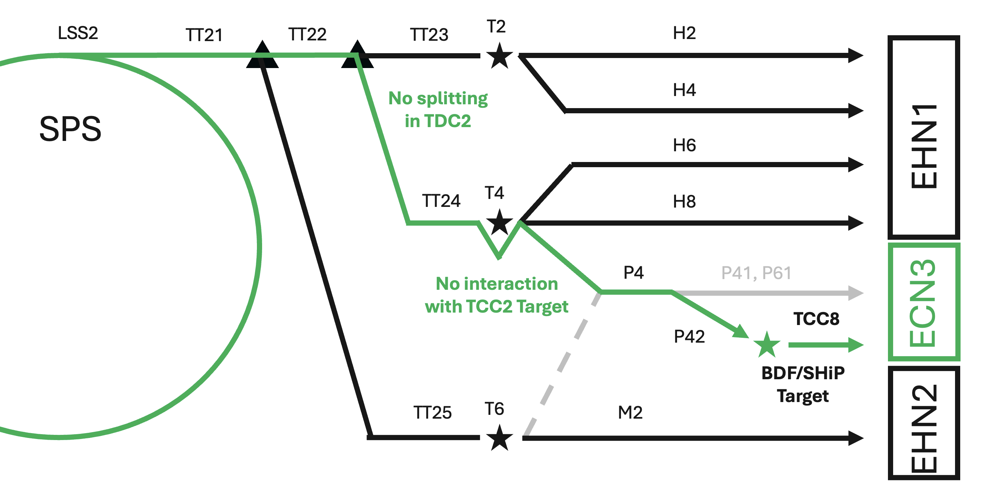
The future – pushing the intensity limits
SFTPRO
4x SHIP
LIU beams for LHC
After LS3, regular operation of LHC with 2.3e11 ppb
Demonstrated at SPS extraction during 2025 !
Only achieved with expert presence and tuning in all machines
Outcome of JAP24 and Chamonix 2025 → LIU reliability run
Already started in PS during 2025
Planned for SPS in 2026
Aim to gain operational experience with these beams and enable their generation without constant expert presence
Short (30m) period after each LHC fill where we will take the LIU intensity beams and check the performance
SHIP at HI-ECN3 – Search for Hidden Particles
Requires high intensity (4.2e13) SFTPRO-like cycles
1.2s slow extraction dedicated to HI-ECN3
4 SHIP cycles per super-cycle plus SFTPRO serving NA users
PPM operation of the NA for the first time

