Slide 1

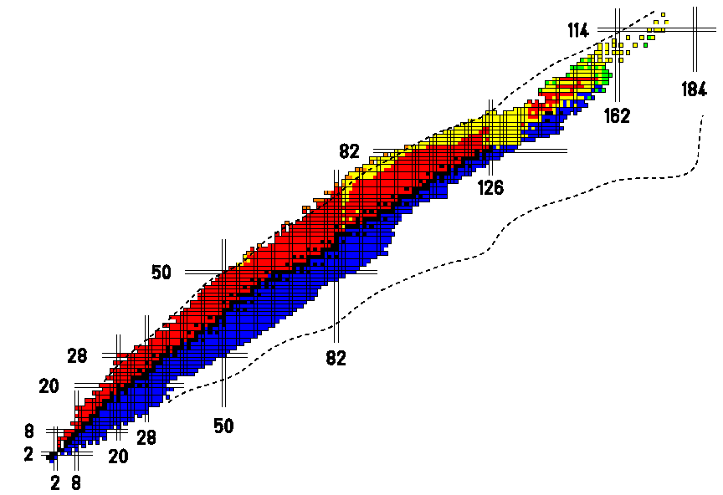
CATHI
Marie Curie Initial Training Network
Cryogenics, Accelerators and Targets at HIE-ISOLDE
Yacine Kadi (EN)
Kick-off Meeting, 23 May 2011

Slide 2
CATHI
Project Structure & Organisation
People and project structure
CATHI Sharepoint site
https://espace.cern.ch/Marie-Curie-CATHI/default.aspx

Slide 3
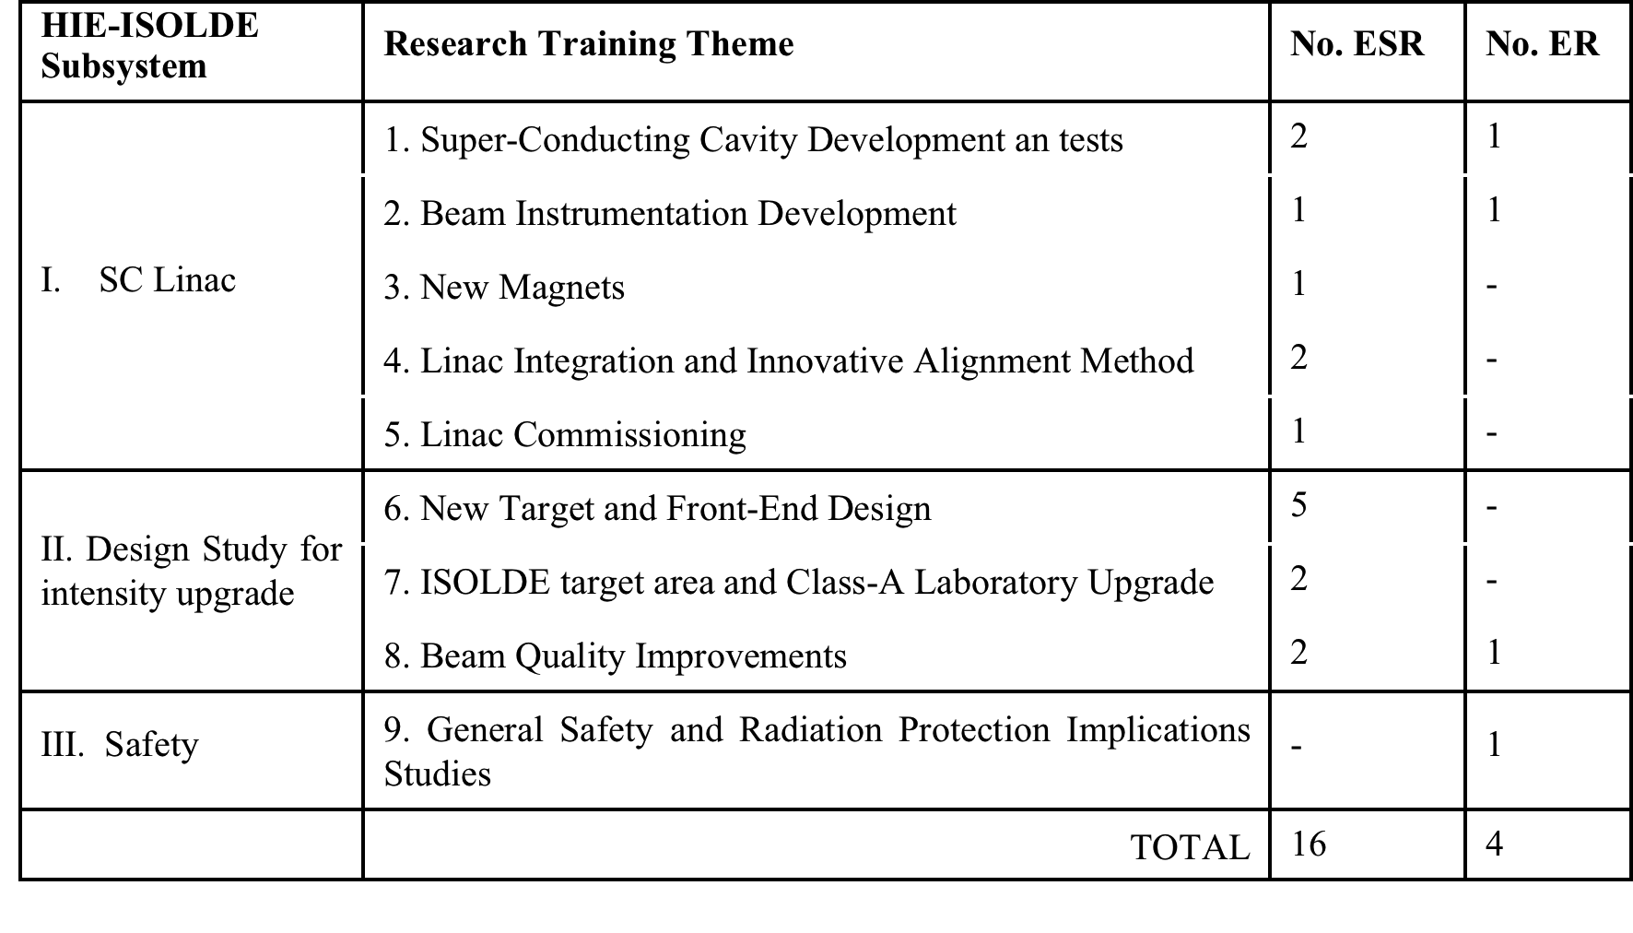
Research Training Themes
(20 Fellows over 4 years)
Y. Kadi HIE-ISOLDE Proposal, IEFC, August 21, 2009

Slide 4
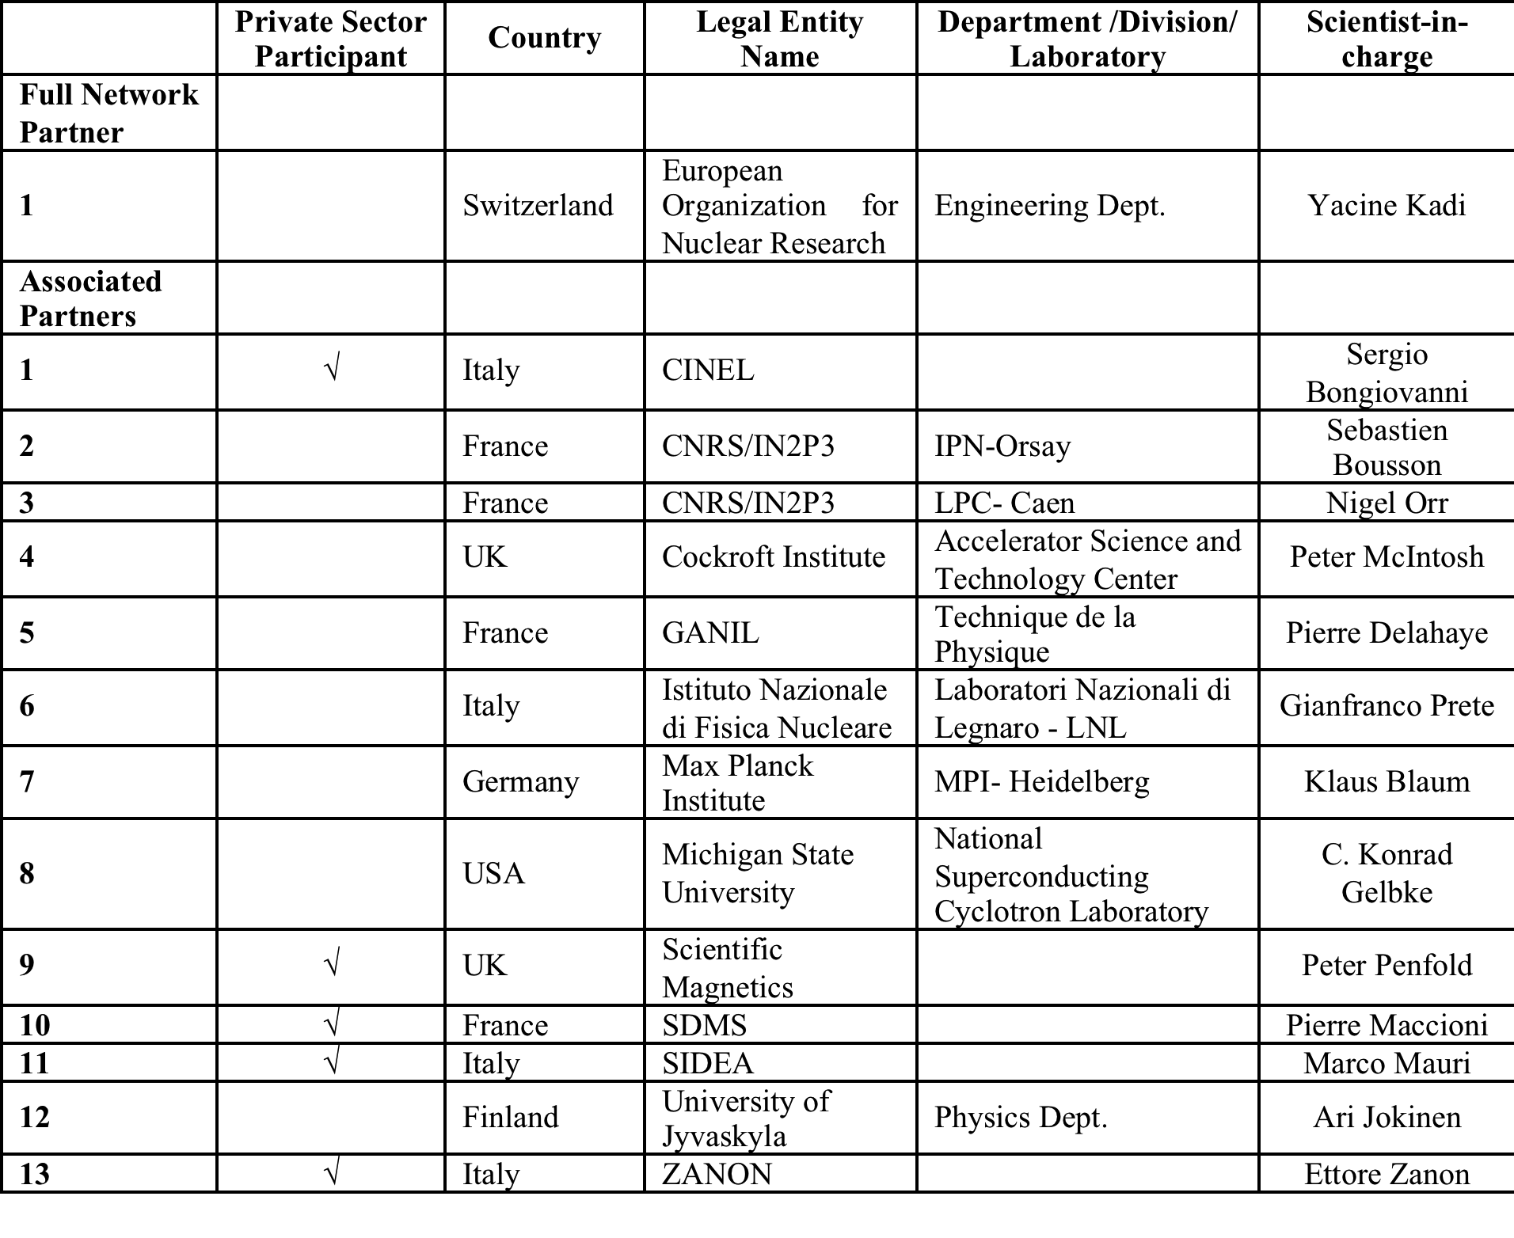
List of Participants
Y. Kadi HIE-ISOLDE Proposal, IEFC, August 21, 2009

Slide 5
WP0
WP9
CATHI Coordinators (Yacine, Richard, Seamus)
Admin
Assist
SC Linac Coordinator (Matteo)
WP1
WP2
WP3
WP4
WP5
s
s
Supervisors
s
s
s
2
ESR
ER
1 ESR
1
ER
ESR
2
ESR
ESR
Secondment

Slide 6
WP0
WP9
CATHI Coordinators (Yacine, Richard, Seamus)
Admin
Assist
Design Study Coordinator (Richard)
WP6
WP7
WP8
s
s
Supervisors
5
ESR
2
ESR
2 ESR
1
ER
Secondment

Slide 7
WP0
WP9
CATHI Coordinators (Yacine, Richard, Seamus)
Admin
Assist
Safety Coordinator (Ana-Paula)
WP9
s
ER
Secondment

Slide 9
CATHI Organisation
Our project is organised around a Sharepoint site https://espace.cern.ch/Marie-Curie-CATHI/default.aspx
  All CATHI members will have access
  Please use it, rather than email attachments, to store and share all information
  There is a good search facility !
  Parts are public (to show the world our results)
  Parts are private to all CATHI members
  Personal information is restricted access

Slide 10
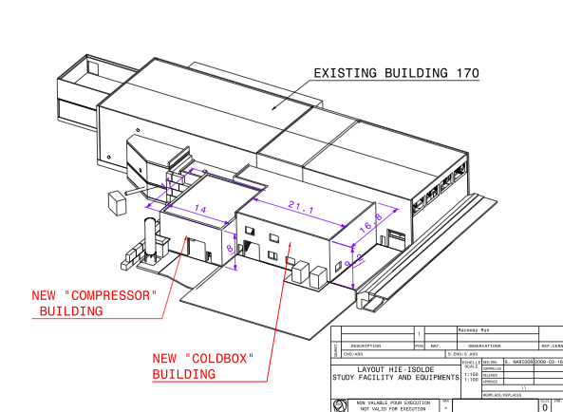

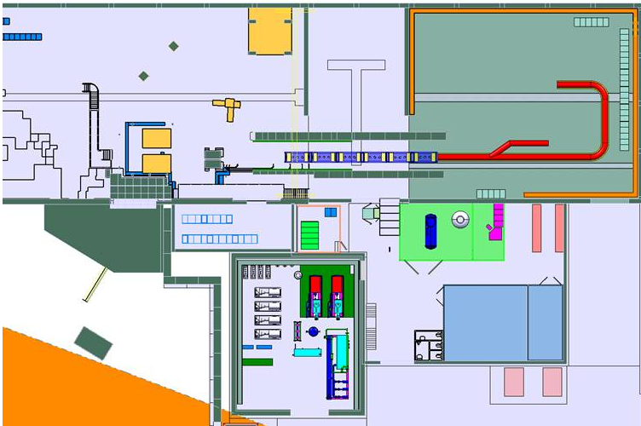
Thank you very much for your attention
HIE-ISOLDE web site -> http://hie-isolde.web.cern.ch/hie-isolde/
CATHI-ITN web site -> https://espace.cern.ch/Marie-Curie-CATHI/default.aspx

