Slide 1
LE-ISOLDE beam optics model and measurements Quentin Vuillemin SY-ABT-BTP Fellowship
Supervisor: Pablo Arrutia
2nd December 2025
Notes:
Good afternoon,
I am Quentin, I started working at CERN in may in BTP. I’ll present the optics for Low Energy … that I stydy during my fellowship under the supervision of Pabl

Slide 2
Outline
Aim: present a simple overview of the work
Context and Motivation
Procedures
Models and survey
Measurements and simulation
quentin.vuillemin@cern.ch 365/1-D09 | Meeting with ISOLDE | Optics for LE-ISOLDE transfer lines
02/12/2025
Notes:
Comparisons with MadX
30’’
50’’

Slide 3
Optics Model
An optics model allows us to predict beam transport. We can:
Check for non-conformities: e.g. miswired power supply
Help operators prepare a stable beam
Steer the beam more efficiently
Control beam size to reduce losses
Facilitate the integration of new experiments
Measure beam characteristics for each target
quentin.vuillemin@cern.ch 365/1-D09 | Meeting with ISOLDE | Optics for LE-ISOLDE transfer lines
02/12/2025
Notes:
What we do in BTP is elaborate an optic model (namely with madX and Xsuite) to predict beam transportation from A to B in ISOLDE

Slide 4
Low energy ISOLDE
Focused on central hall modelling. General approach, can be extended to all other lines
Front ends modelized to characterized beams extracted from target
quentin.vuillemin@cern.ch 365/1-D09 | Meeting with ISOLDE | Optics for LE-ISOLDE transfer lines
02/12/2025
Notes:
1’
7’40

Slide 5
Tasks
To be able to perform quadscans
And use an Xsuite Model

Slide 6
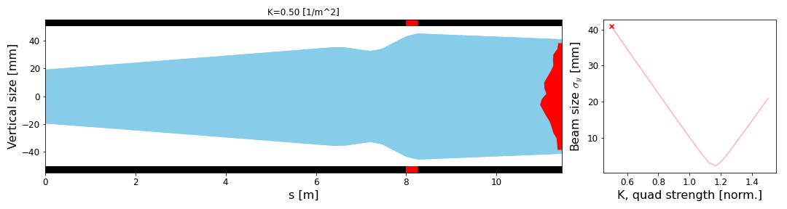
Quad scans
Beam’s initial conditions (emittance, size and divergence) can be reverse-engineered, assuming Gaussian shape via quad scan:
Status of Optics Model for ISOLDE low energy beam lines, Pablo Arrutia, ISOLDE Technical Coordination Meeting 30th April 2024
Notes:
A Quad scan consists in sweeping the voltage for one quadrupole strength and measuring the beam shape right after.
In doing so the beam changes from over-focused to under-focused. And thanks to theses pieces of information Assumuing Gaussian shape, we can reconstruct the beam initial conditions
And that in H and V dimension
Path (description)
50’’
9’10’’

Slide 7
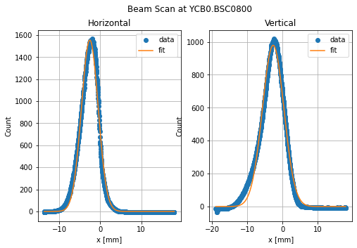
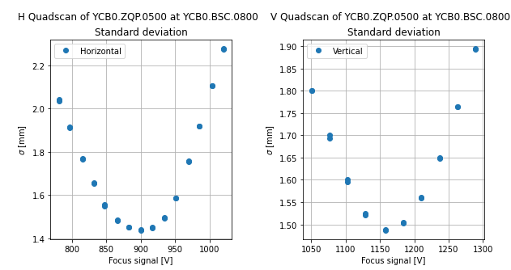
Procedure
Choose one quadrupole and vary voltage.
Gaussian fit on beam scanner profile.
Making sure the “waist” is crossed for both H and V planes.
Notes:
Extract the beam size
each point at the bottom is is from a beam scanner profile for a different Focus signal
1’
10’10’’

Slide 8
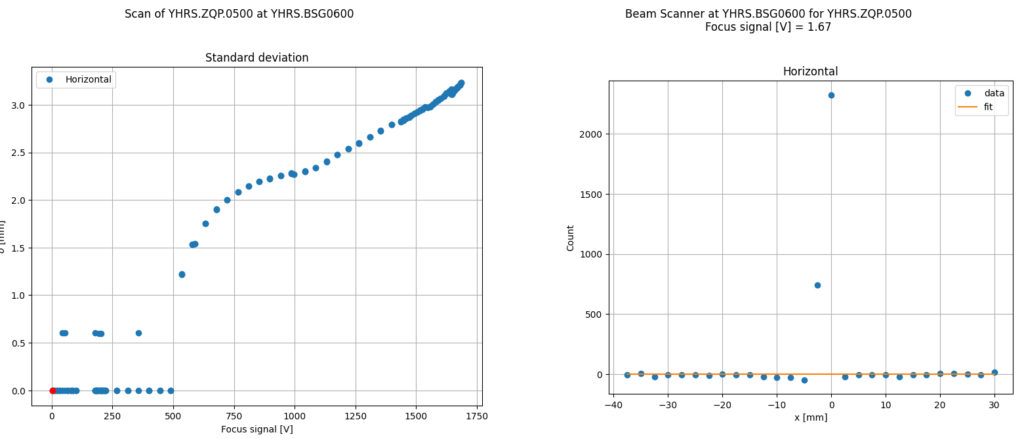
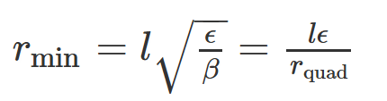
Limitations
Grid mesh: 2 mm
Range of quadrupole do not reach a minimum
Control over two quadrupoles helps
Notes:
LHC Software Architecture

Slide 9
Actions
3D modeling and Layout Database

Slide 10
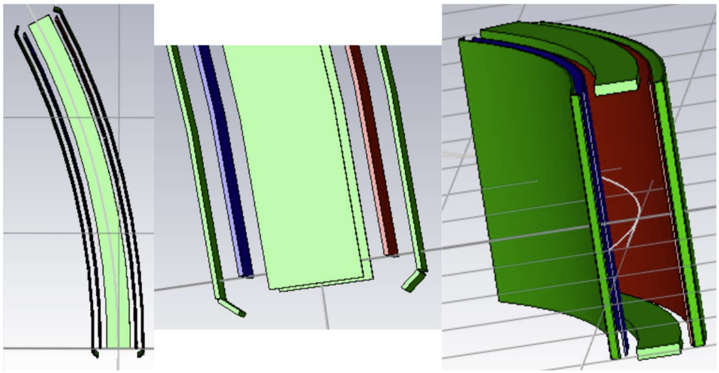
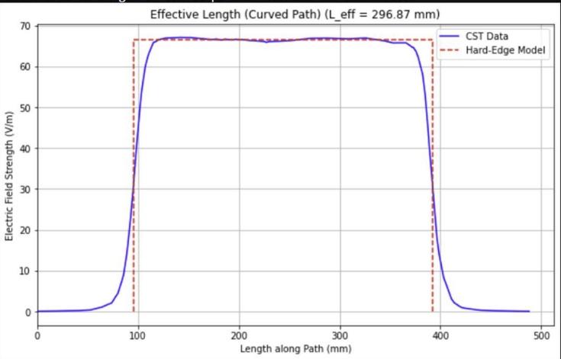
3D models
3D model of the electrostatic bender created in CST Studio Suite, showing the charged electrodes (red and blue) and all grounded supports (green)
Development of a 3D Electrostatic Bender Model for beam simulations at LE-ISOLDE, Aarav Mayu Sindhwad, 12th August 2025

Slide 11
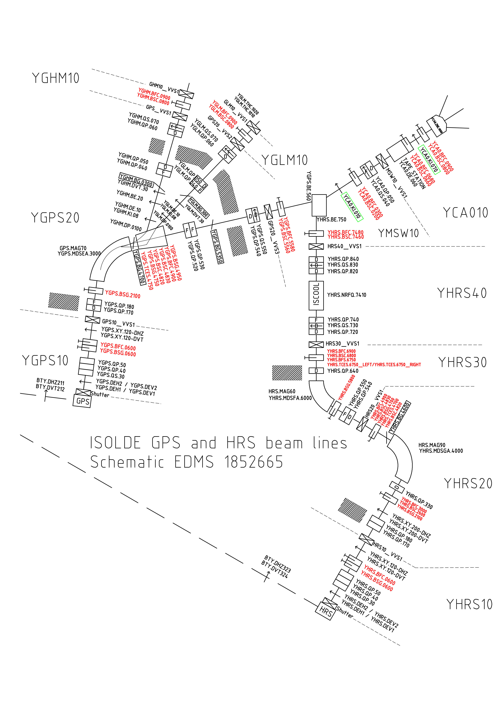
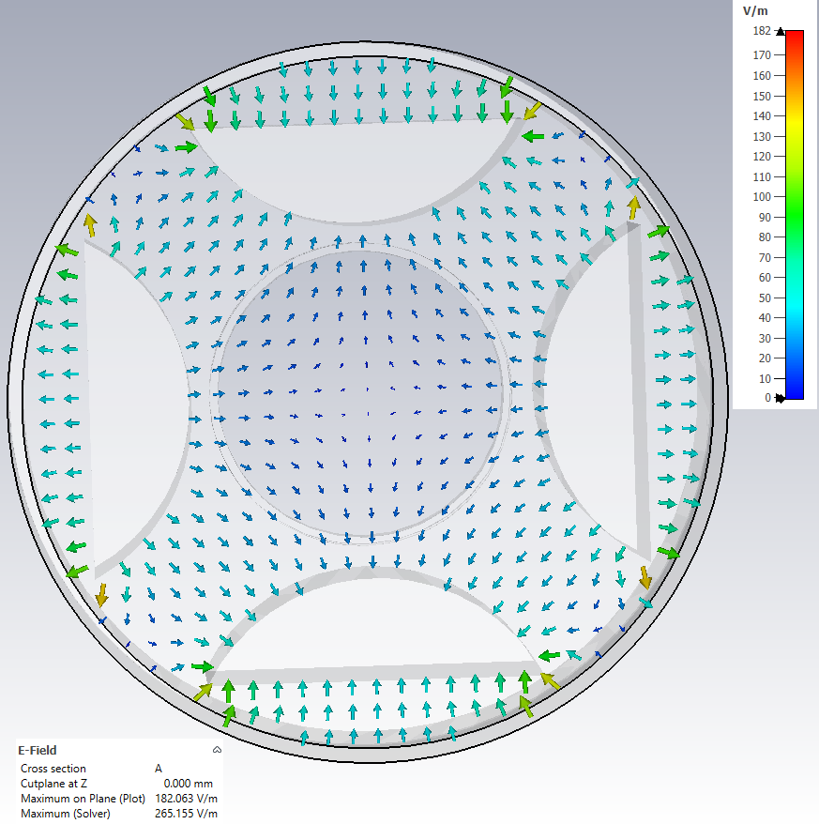
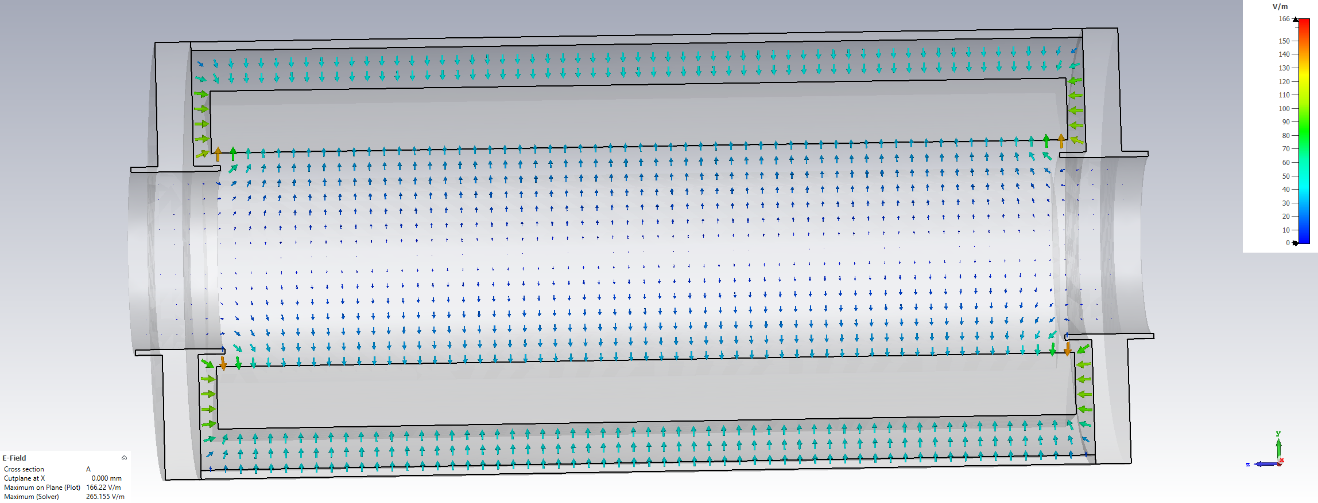
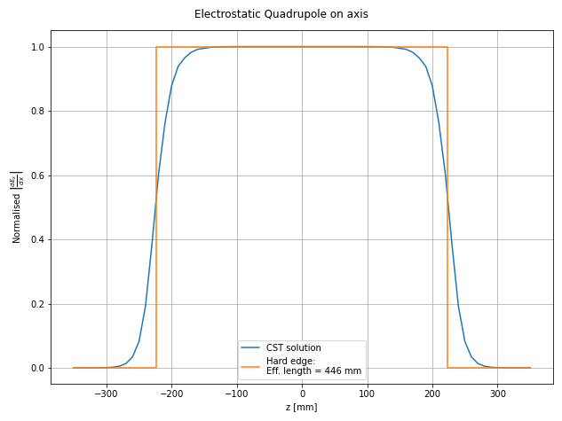
3D models
L_{eff}/L = 86 %
Central quadrupole of Front ends triplet

Slide 12
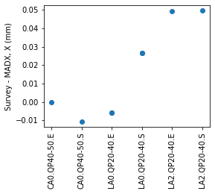
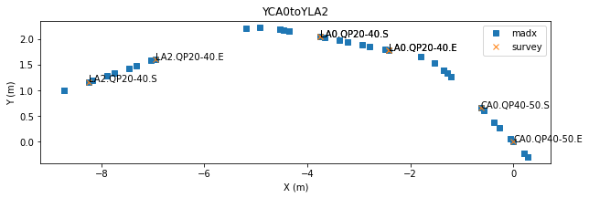
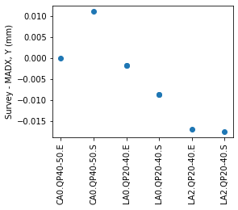
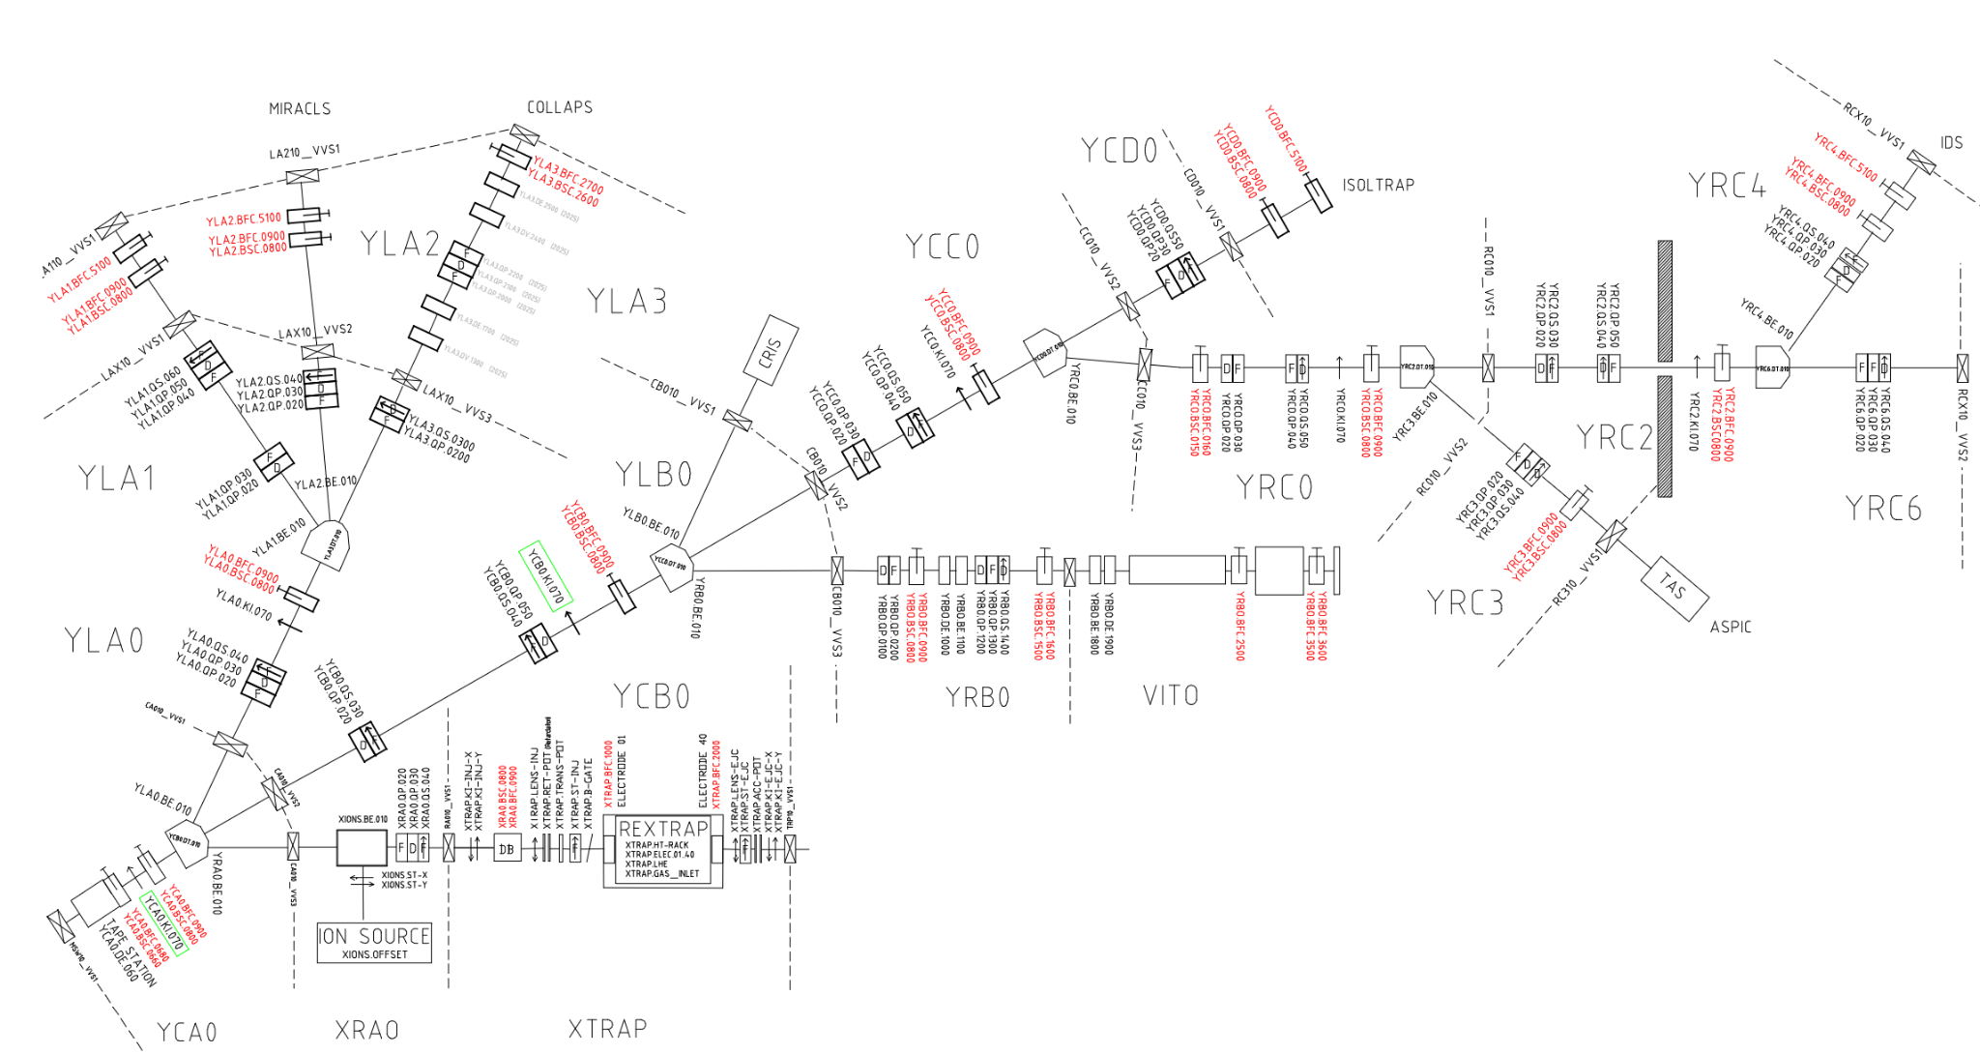
Layout Database Central Hall
Ludmila Temple
Simon Mataguez
Pascal Le Roux
2013 Survey EDMS 1281872
EDMS 2782373

Slide 13
Results
Measurements, model validation
and usable software

Slide 14
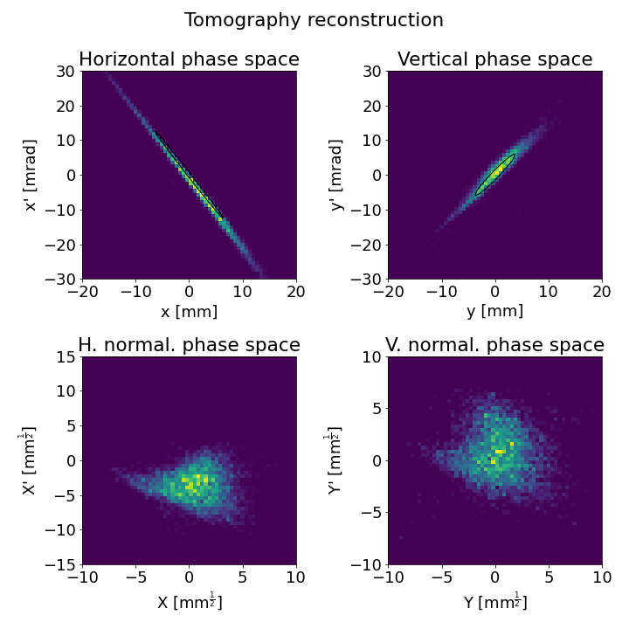
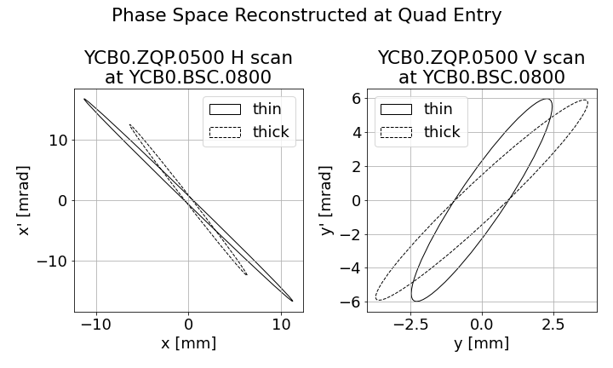
Example of Measurements
Delivering electrons to AWAKE: operational challenges and results , Vittorio Benicci

Slide 15
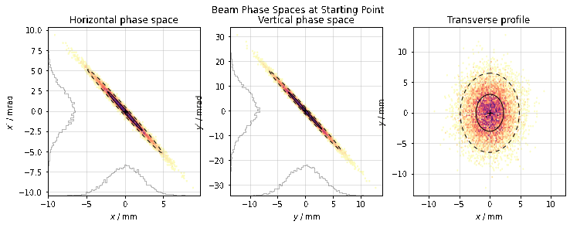
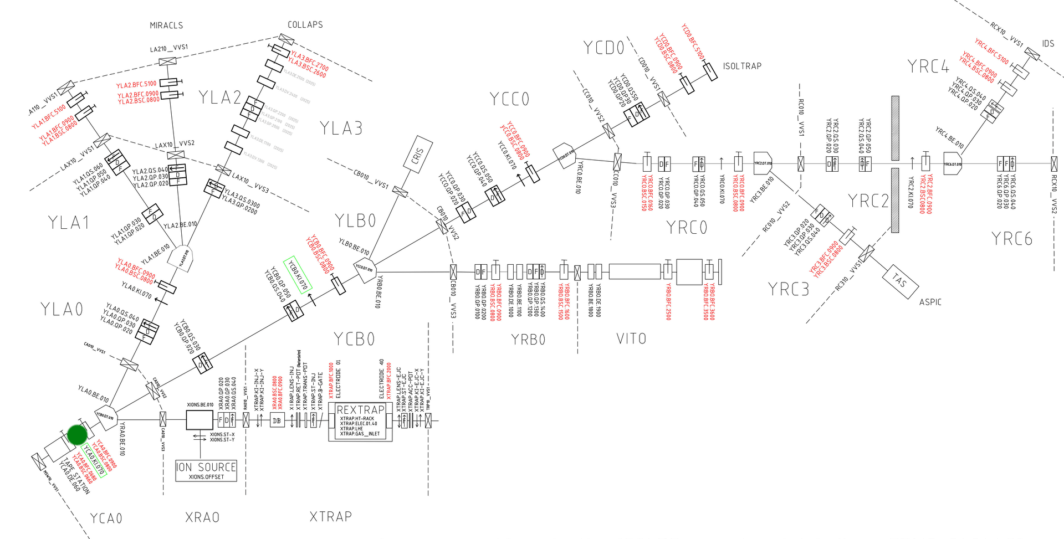
Propagation example from CA0 to VITO

Slide 16
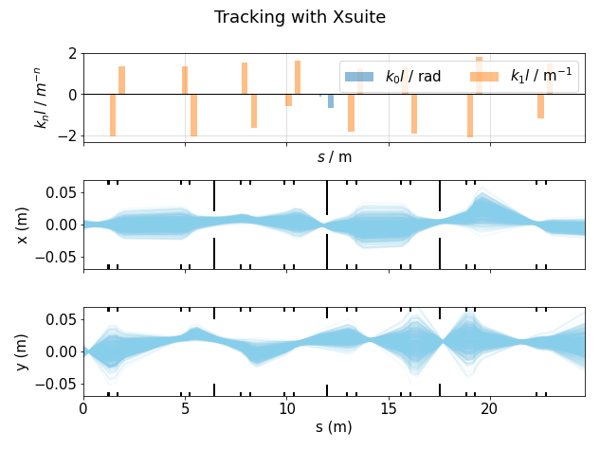
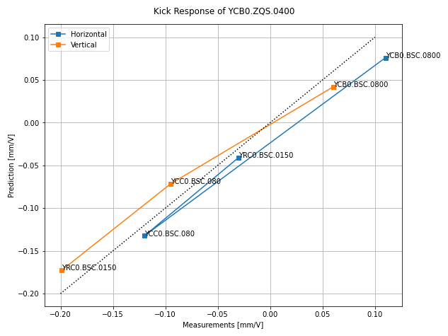
A predictive Xsuite Model

Slide 17
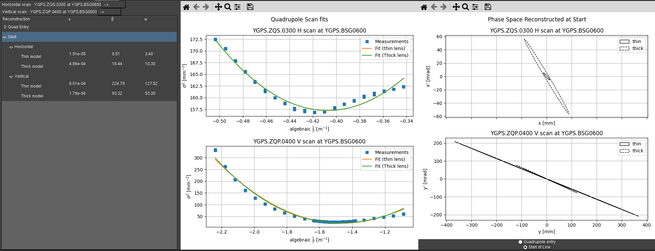
GUI-result for a plasma target at GPS

Slide 18
Conclusion
Developed automatic measurement routine for quadrupole scans
Agreements between model and data.
Use of tomography method
Use of offset and data from survey and operations
3D electrostatic modelling of bender and quadrupoles
Optics is accurate as shown w/ kick response -> LSA beam steering in future
In the five remaining months:
optical models for separators (the missing piece to complete the puzzle)
Simulation multi-species transport through the separators
Documentation for every one to use the GUI and the codes easily
Off-line tests
Groundwork towards an end to end model from target to experiment
Notes:
LHC Software Architecture

Slide 19
Links
Status of Optics Model for ISOLDE low energy beam lines, Low-energy ISOLDE beam lines
Ion optics with electrostatic lenses, Hinterberger, F. 2006 (electrostatic quadrupoles)
Quadrupole Scan Measurements in the Beam Transport Line between DESY II and PETRA III, 2017, Keil, Joachim / Ehrlichmann, Heiko / Sahoo, Gajendra / Wanzenberg, Rainer (thin lens model)
Delivering electrons to AWAKE: operational challenges and results (tomography)
Development of a 3D Electrostatic Bender Model for beam simulations at LE-ISOLDE
Low energy central hall to Isolde to layout database – Ludmila Temple
Beam Optics Model and Characterization for CERN's Low-Energy ISOLDE Transfer Lines IPAC, 2025 IPAC
Bayesian methods and differentiable models for optics studies at the ISOLDE facility, 2025 IPAC

Slide 20
Appendix

Slide 21
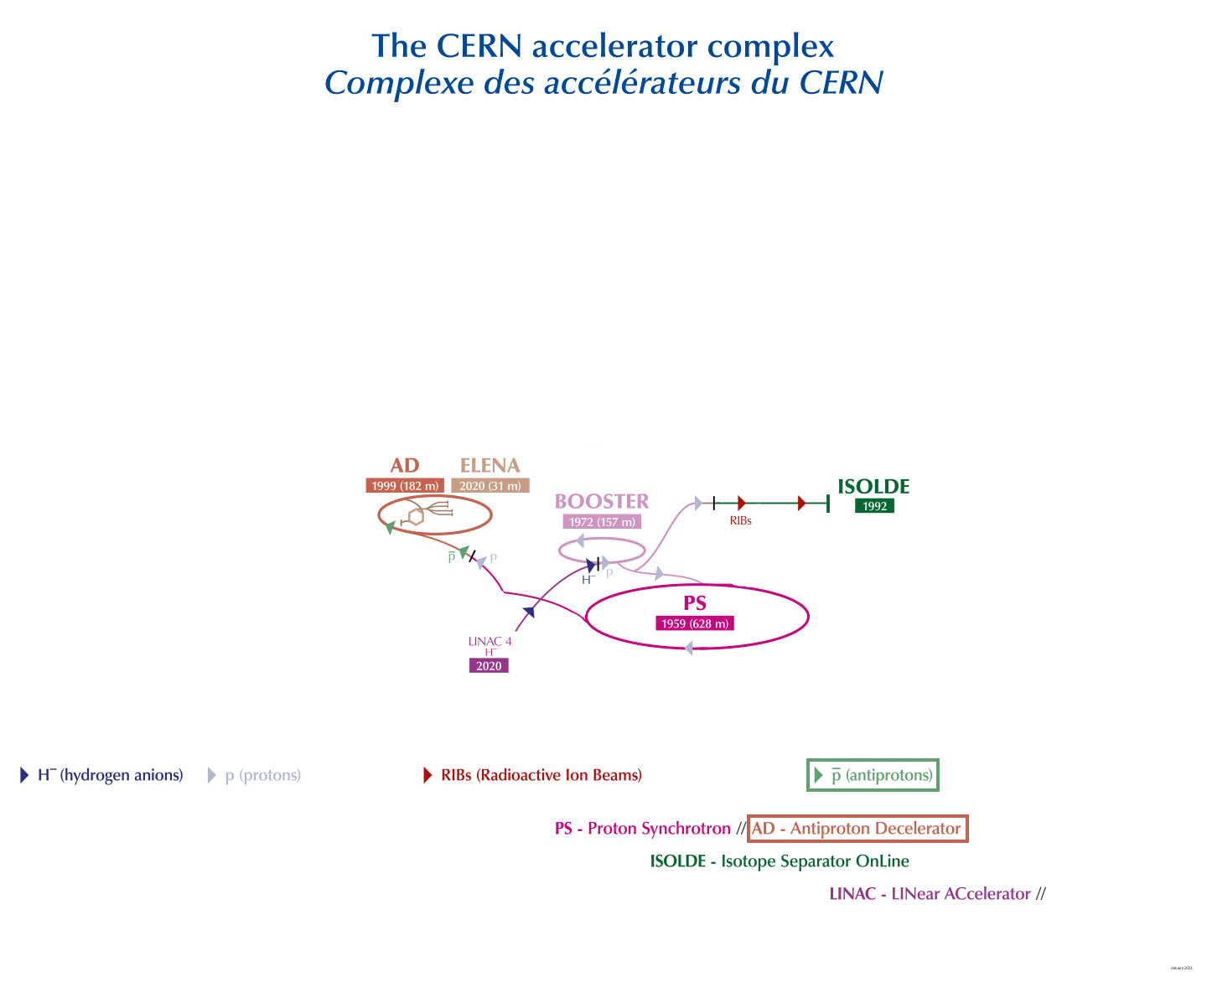

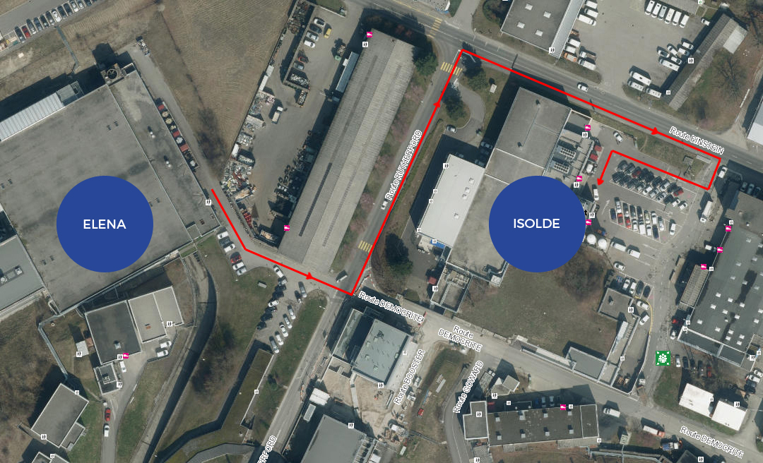
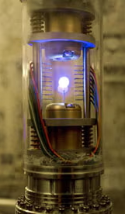
PUMA: antiProton Unstable Matter Annihilation
Trapped anti-matter in a truck
Fictional trapped antimatter from
Angels & Demons (2009)
ELENA Extra Low ENergy Antiproton ring
Notes:
PUMA name
Unique: anti protons interact with unstable nuclei
To do so anti matter from the antimatter factory (AD, ELENA) are going to be transported in a truck to ISOLDE,
Anti matter had never left the facility before, making a sort of real life Dan Brown’s angels and demons,
(that’s whay anti matter transported and not isotopes).
In a nutshell, protons from the PS are used to make anti protons that are then decelerated.
One notable experiment:
ALPHA 27 september 2023 Nature (anti matter falls down like regulat matter)
ELENA Extra Low ENergy Antiproton ring (slowing and cooling anti proton further more)
1’30
6’40’’

