Slide 1


L4-RFQ2 RF conditioning and breakdown localization studies
15.12.2025
Pablo Martinez-Reviriego, Alexej Grudiev, Lee Millar, Suitbert Ramberger, Luca Timeo, Rolf Wegner
pablo.martinez.reviriego@cern.ch

Slide 2
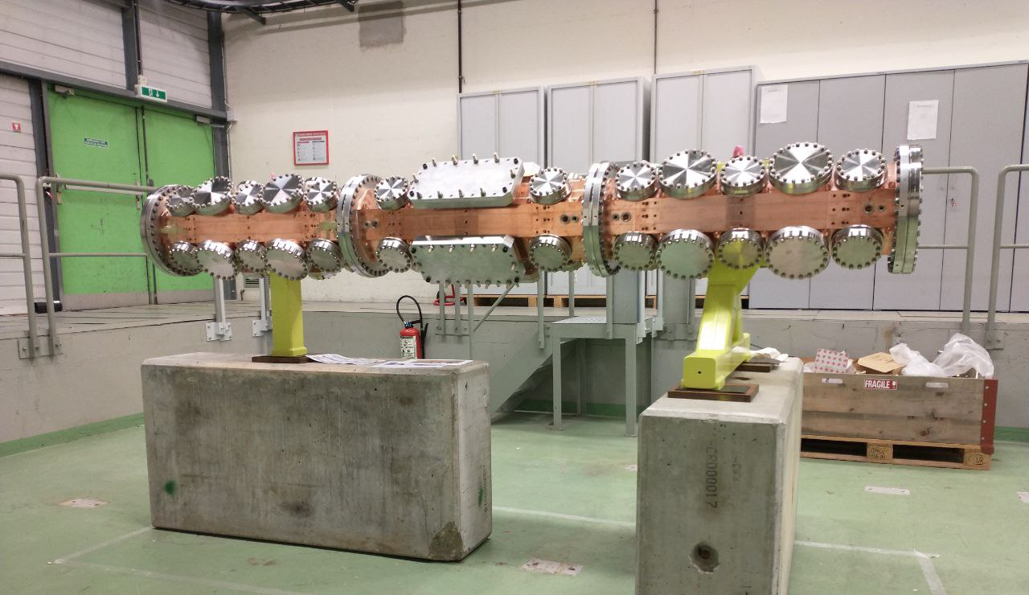
Outline
Introduction
High-power conditioning
BD localization analysis

Slide 3
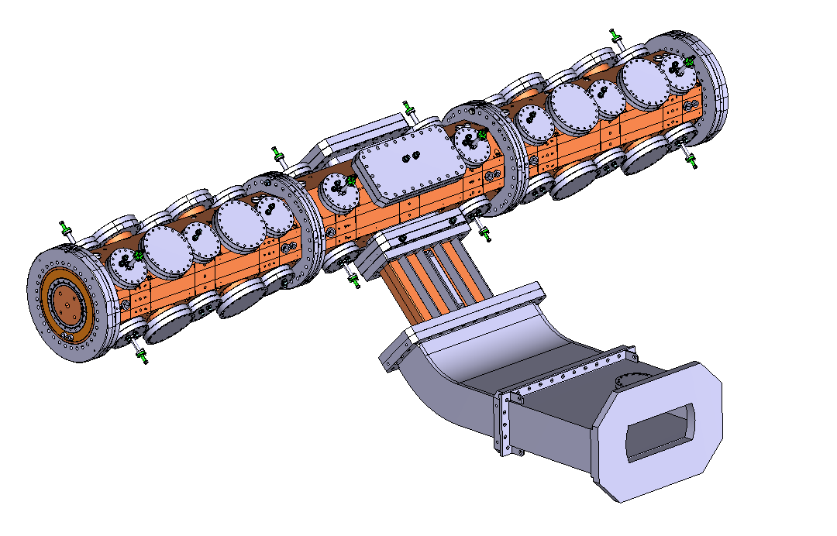
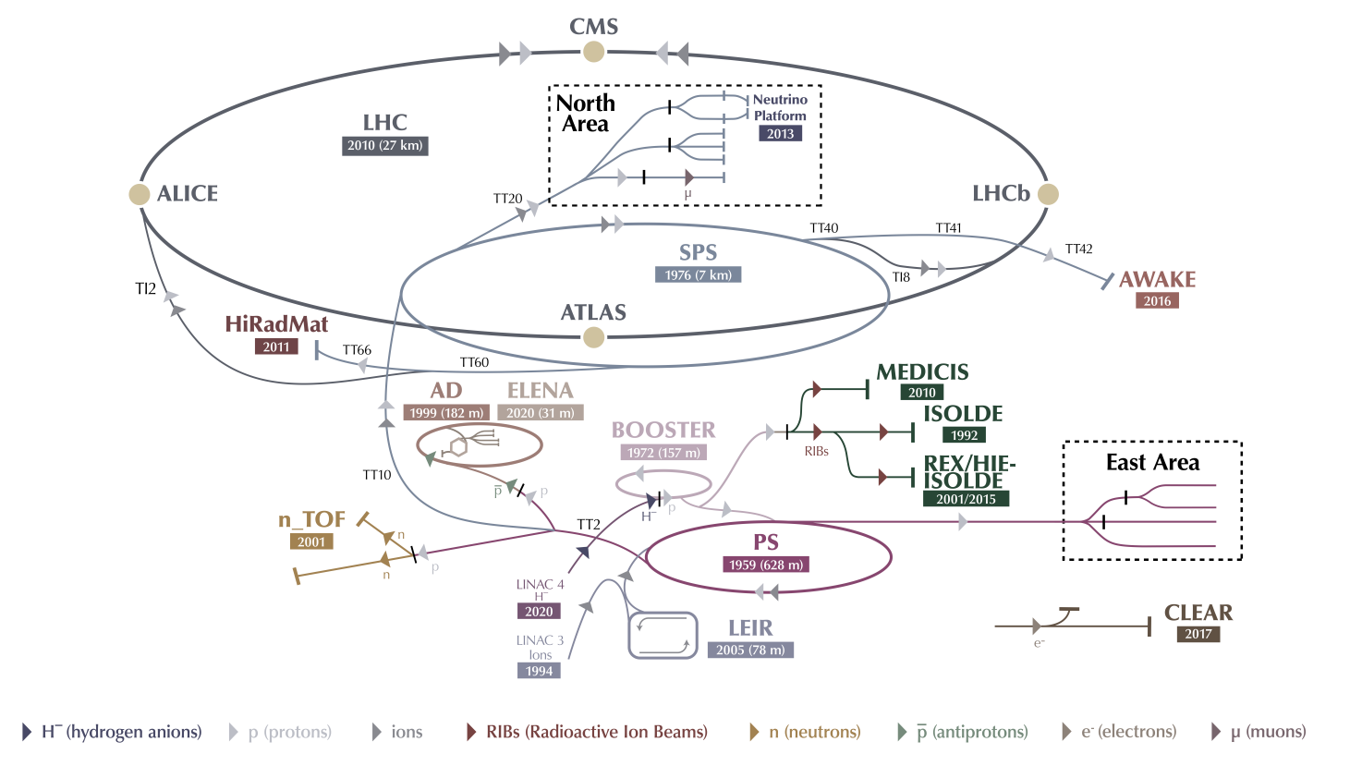
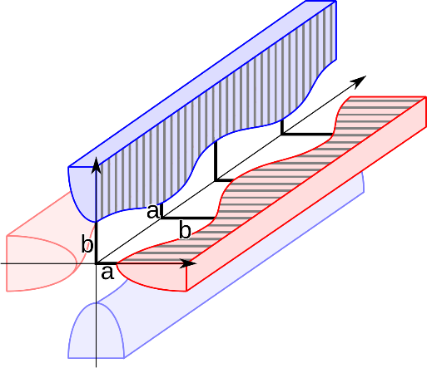
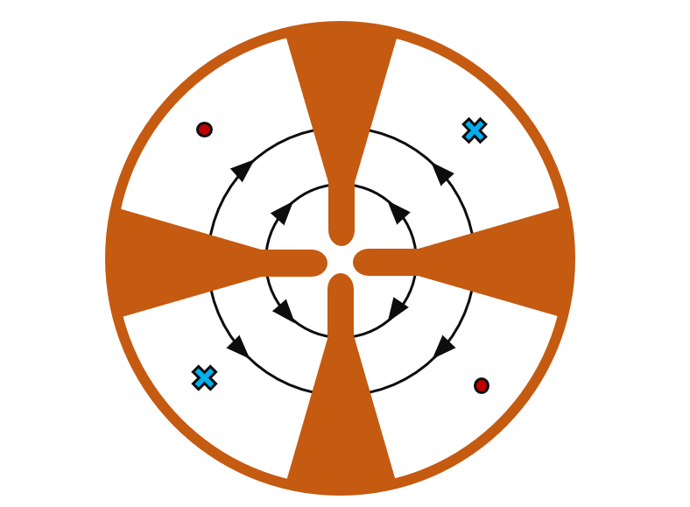
Radio Frequency Quadrupole (RFQ)
$\sim 3$ m structure that focuses, bunches and accelerates continuous beam of low energy hadrons (few MeV)

Slide 4
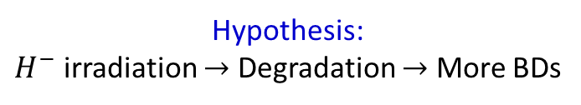
The Linac4 RFQ
Hypothesis:
$H^{−}$ irradiation $→$ Degradation $→$ More BDs
Surface damage observed in Linac4 RFQ
Serafim, C., Calatroni, S., Djurabekova, F., Peacock, R., Bjelland, V., Perez-Fontenla, A. T., ... & Sargsyan, E. (2025). Effects of H− low beam irradiation and high field pulsing tests in different metals. Physical Review Accelerators and Beams, 28(1), 013101.
Critical element in CERN proton chain: No spare
Solution:
New RFQ fabrication and conditioning
Great opportunity for BD studies!
Limitation: New RFQ must survive the conditioning

Slide 5
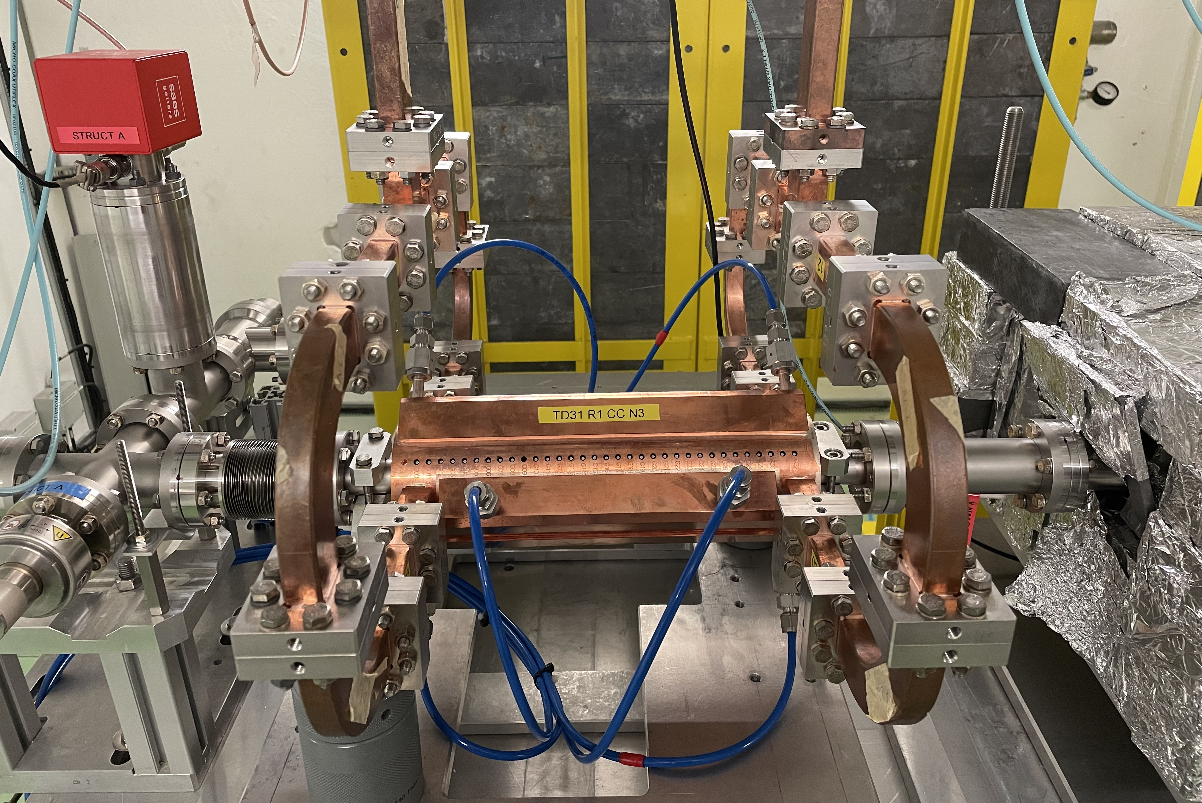
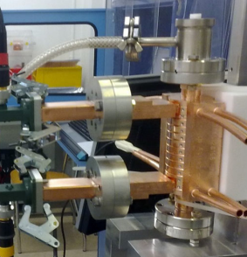
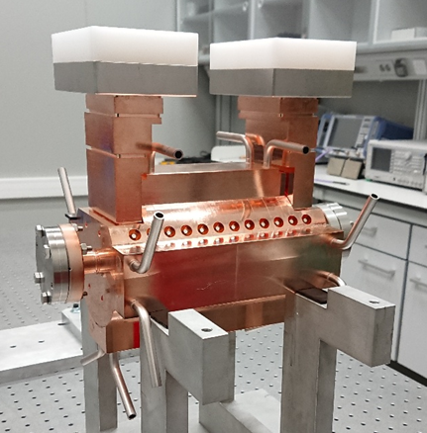
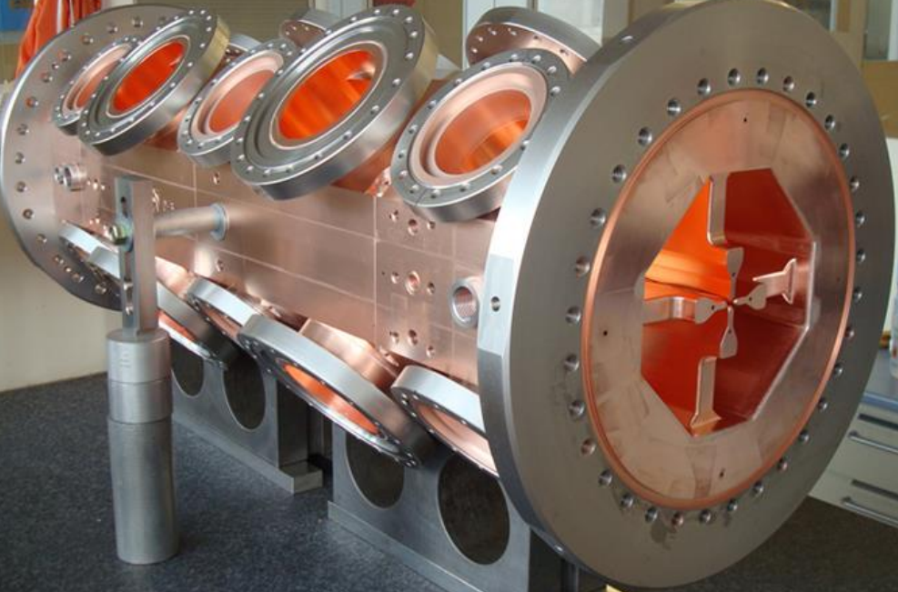
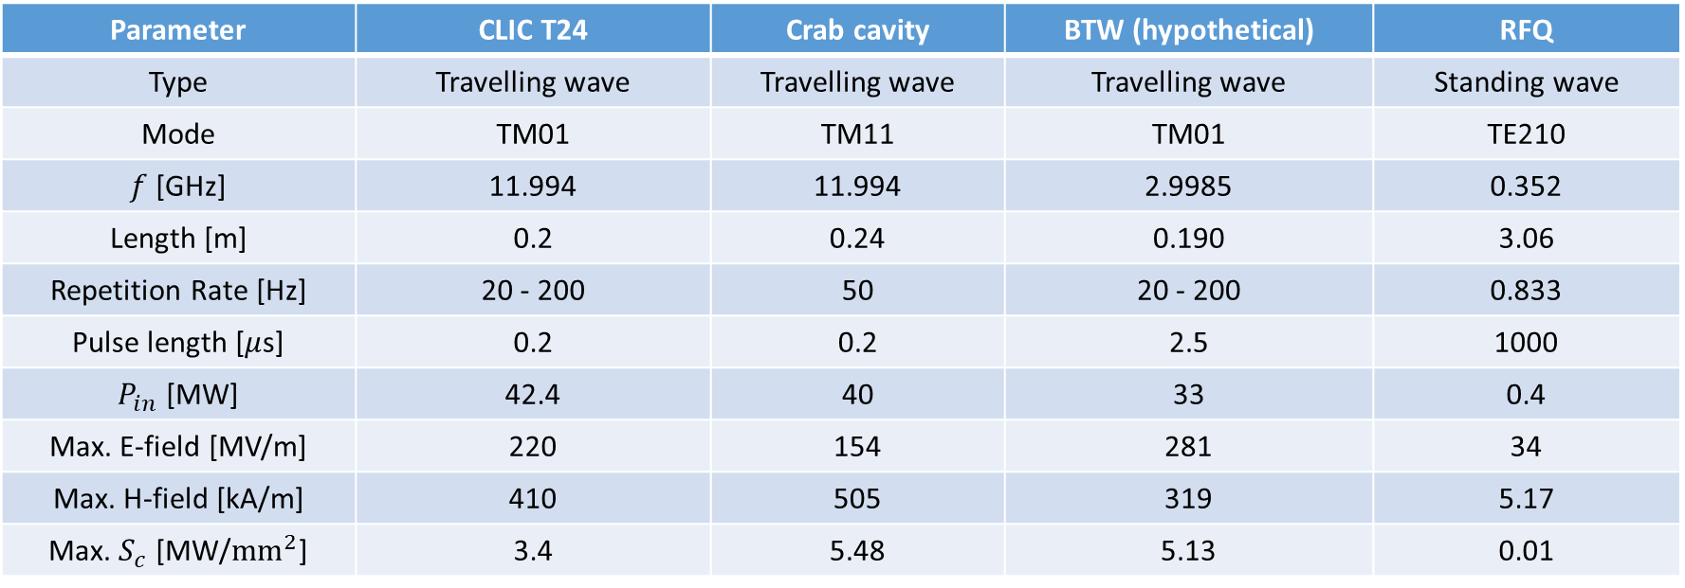
A very different structure
Parameter | CLIC T24 | Crab cavity | BTW (hypothetical) | RFQ
Type | Travelling wave | Travelling wave | Travelling wave | Standing wave
Mode | TM01 | TM11 | TM01 | TE210
$f$[GHz] | 11.994 | 11.994 | 2.9985 | 0.352
Length [m] | 0.2 | 0.24 | 0.190 | 3.06
Repetition Rate [Hz] | 20 - 200 | 50 | 20 - 200 | 0.833
Pulse length [$μ$s] | 0.2 | 0.2 | 2.5 | 1000
$P_{in}$ [MW] | 42.4 | 40 | 33 | 0.4
Max. E-field [MV/m] | 220 | 154 | 281 | 34
Max. H-field [kA/m] | 410 | 505 | 319 | 5.17
Max. $S_{c}$ [MW/${\text{mm}}^{2}$] | 3.4 | 5.48 | 5.13 | 0.01
Paszkiewicz, J. (2020). Studies of breakdown and pre-breakdown phenomena in high-gradient accelerating structures (Doctoral dissertation, University of Oxford).

Slide 6
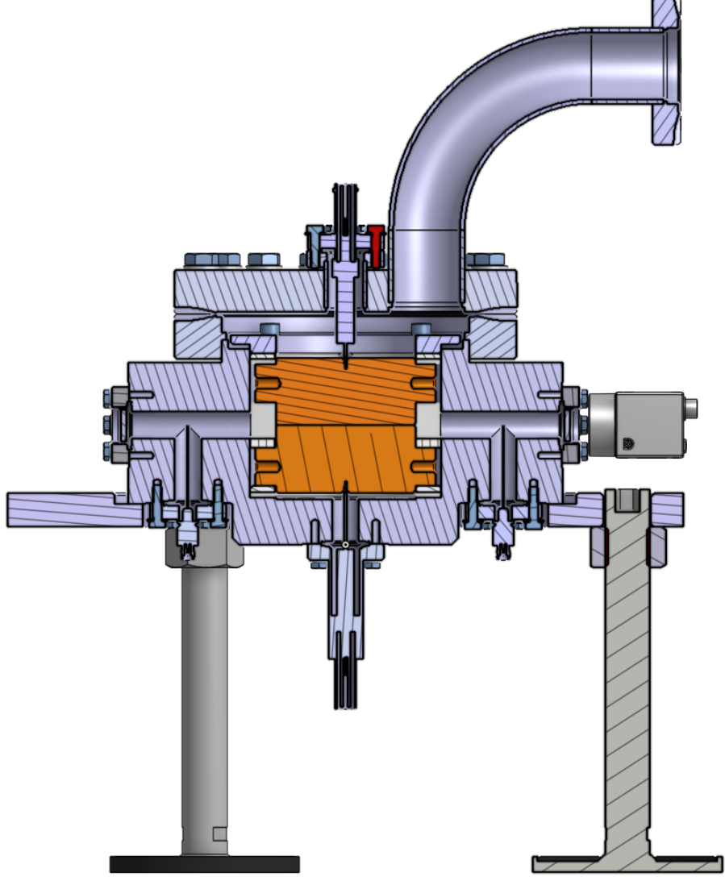
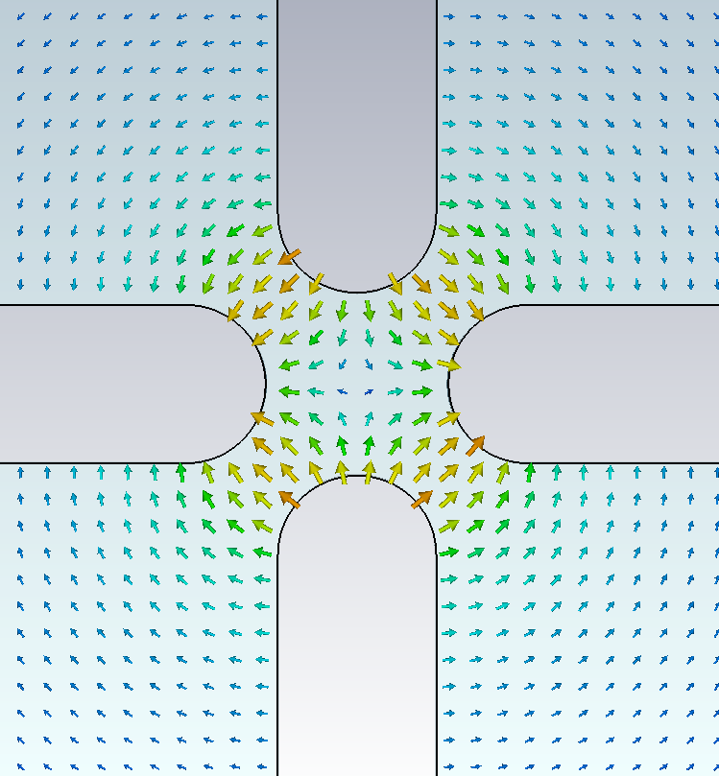
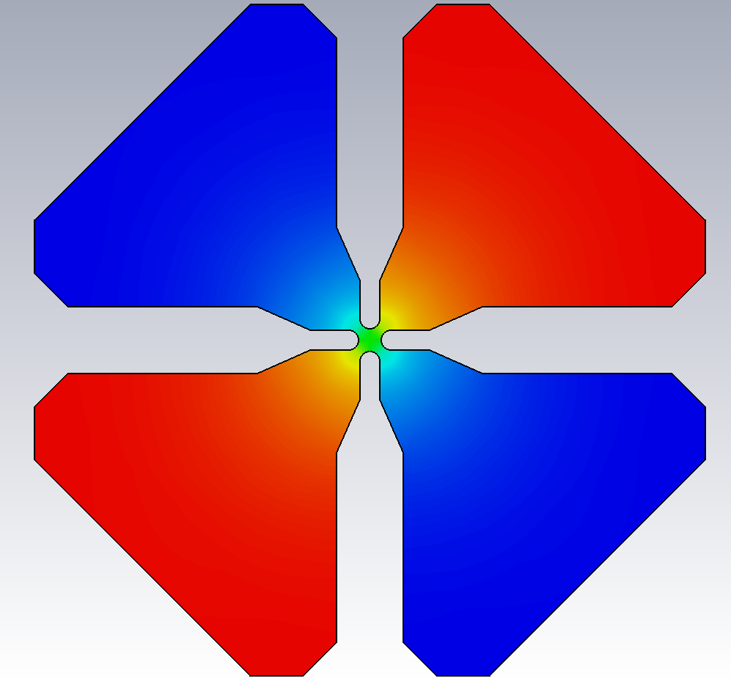
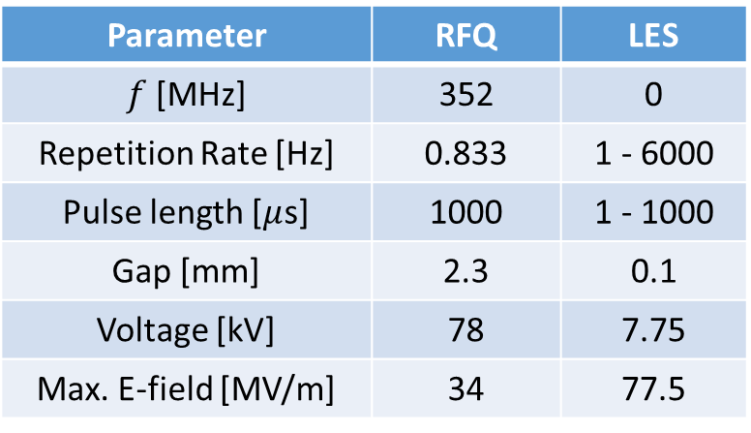
Field distribution
Large Electrode System (LES)
E-field
RFQ cross section:
TE210 mode
I. Profilatova, Recent progress at pulsed dc systems, 8th International Workshop on Mechanism of Vacuum Arcs, 2019.
H-field
Parameter | RFQ | LES
$f$[MHz] | 352 | 0
Repetition Rate [Hz] | 0.833 | 1 - 6000
Pulse length [$μ$s] | 1000 | 1 - 1000
Gap [mm] | 2.3 | 0.1
Voltage [kV] | 78 | 7.75
Max. E-field [MV/m] | 34 | 77.5
Large separation between electric and magnetic field
RFQ might be a key to connect High Frequency and DC

Slide 7
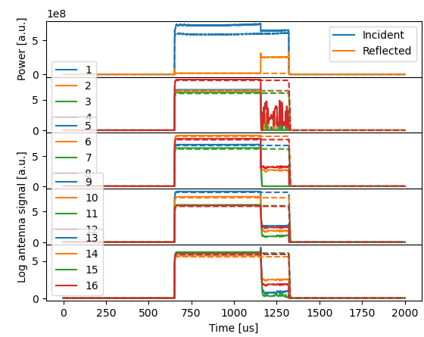
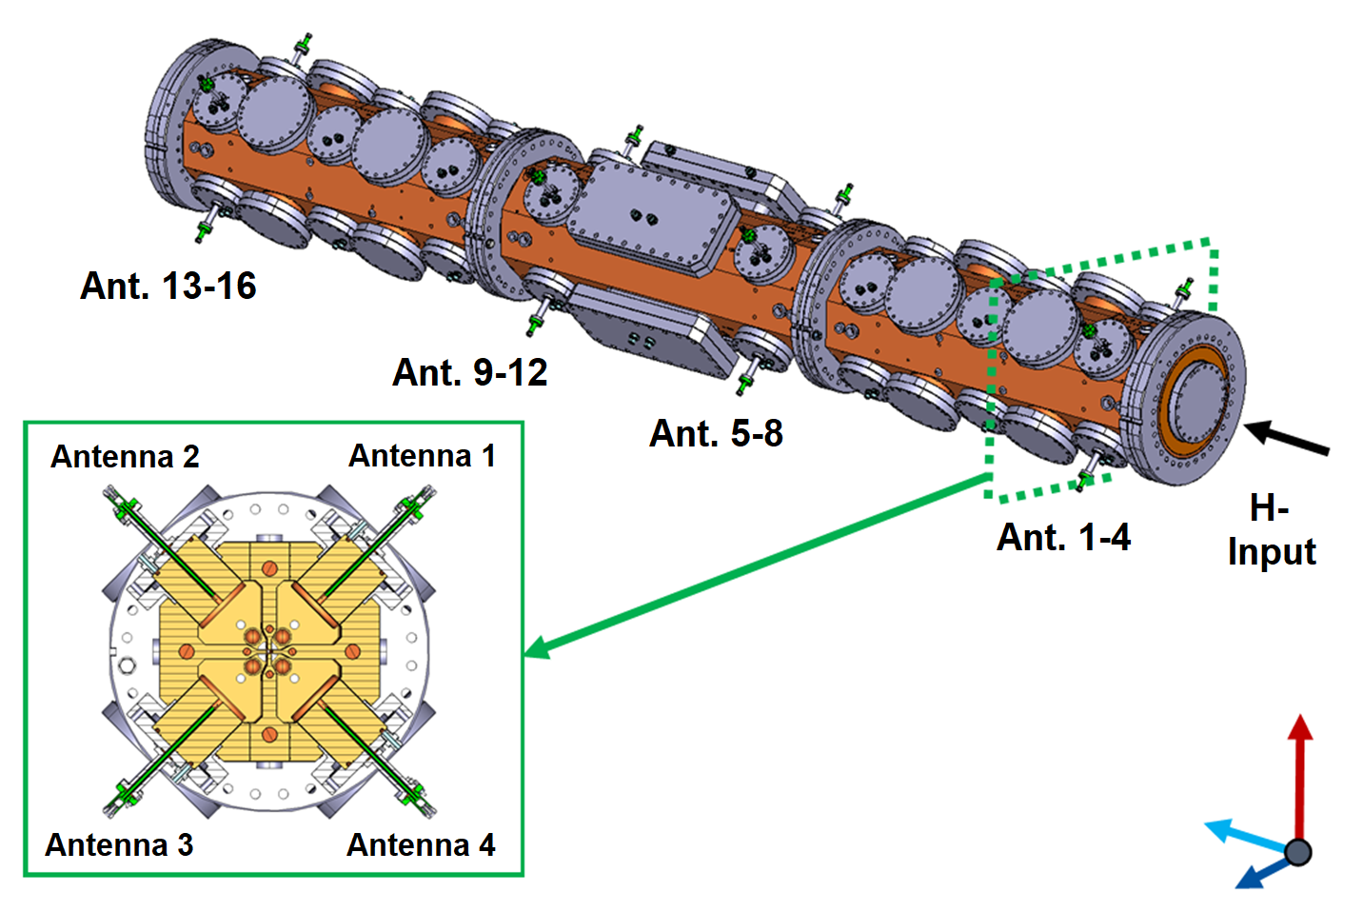
RFQ measurements
Reflected power increases: Different coupling
Antennas show different behavior: BD localization
Vnuchenko, A. (2020). High-gradient issues in S-band RF acceleration structure for hadrontherapy accelerators and radio frequency Quadrupoles

Slide 8
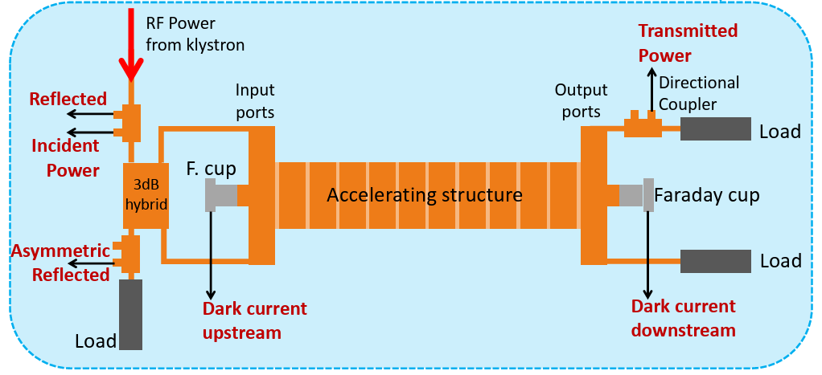
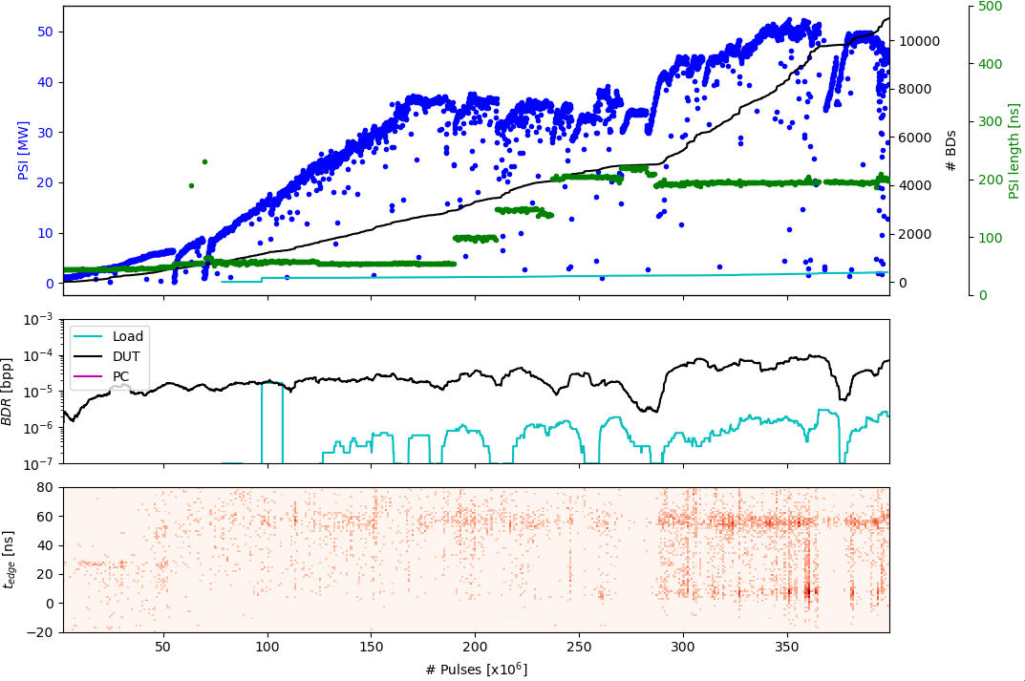
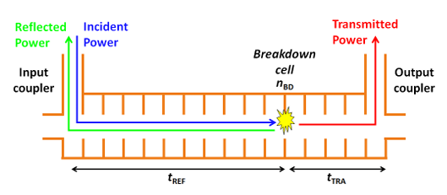

Xbox typical conditioning
TD31 in Xbox2
Giner Navarro, J. (2017). Breakdown studies for high gradient RF warm technology in: CLIC and hadron therapy linacs.
BDs localization
$$t_{edge}=t_{REF}−t_{TRA}+t_{fill}$$

Slide 9
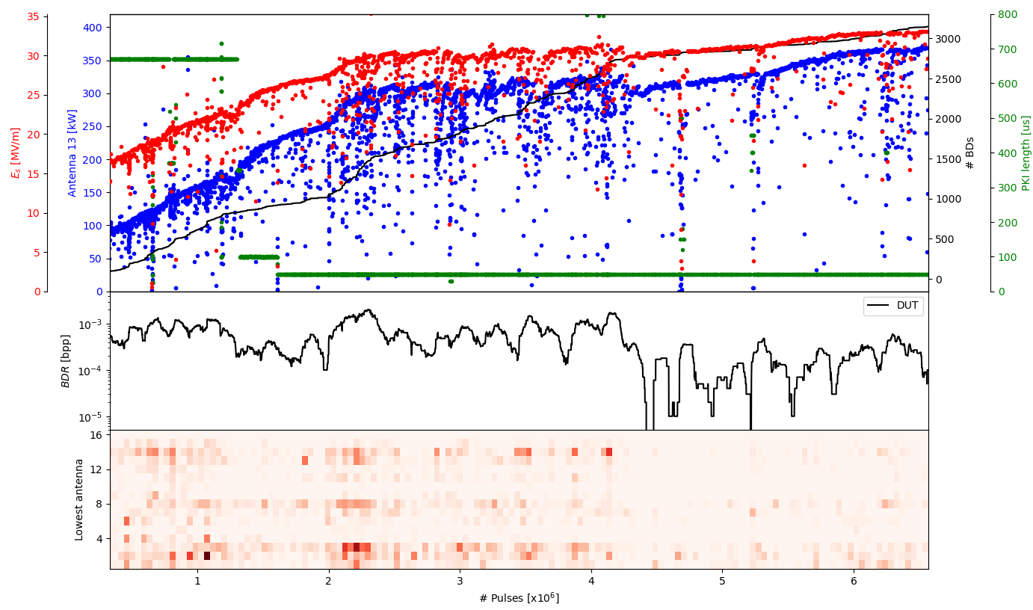
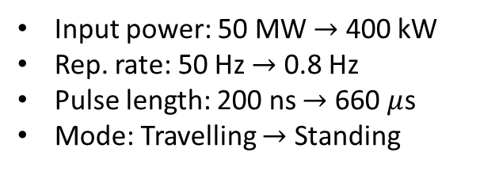
RFQ conditioning (ongoing work)
Forward/reflected
Input power: 50 MW $→$ 400 kW
Rep. rate: 50 Hz $→$ 0.8 Hz
Pulse length: 200 ns $→$ 660 $μ$s
Mode: Travelling $→$ Standing
Which antenna was most affected by the BD?
How can we localize BDs?

Slide 10

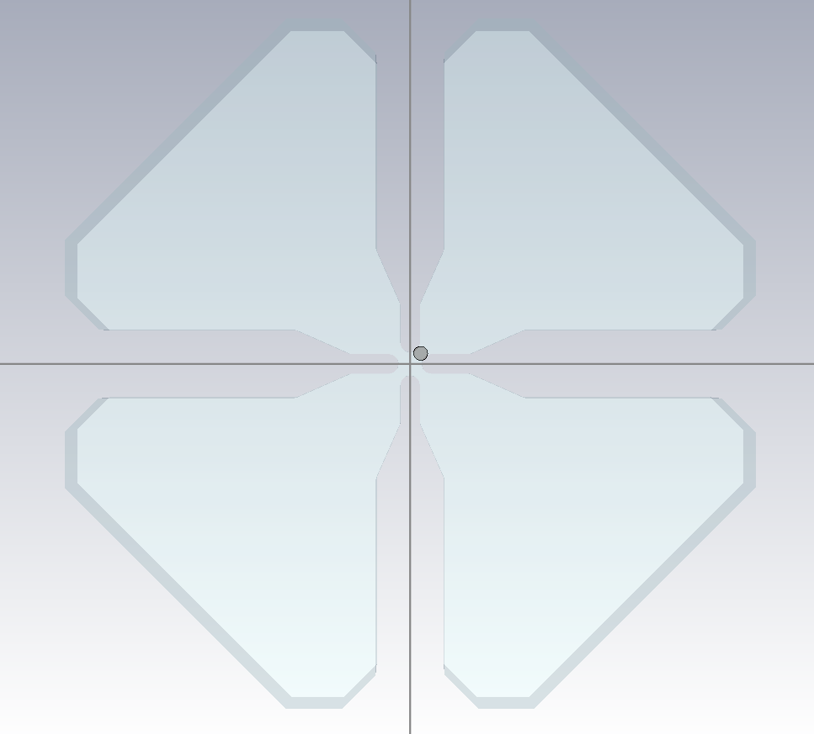
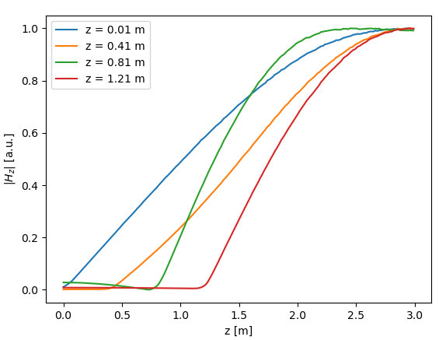
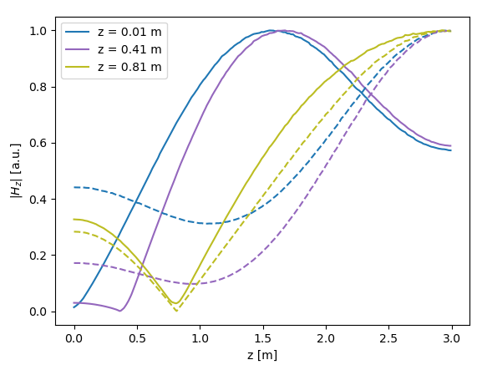
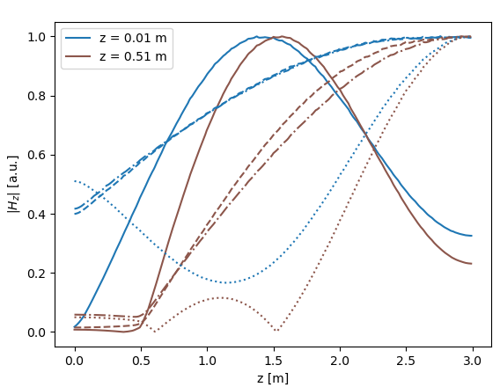
BD simulation
Axial symmetry
Half symmetry
No symmetry
Up right
Down right
Up
Up left
Down
Down left
Wang, F., & Adolphsen, C. (2009). Localization of rf breakdowns in a standing wave cavity. Physical Review Special Topics—Accelerators and Beams, 12(4), 042001

Slide 11
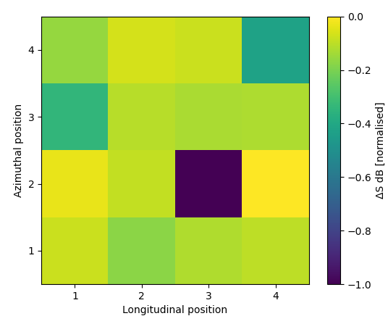
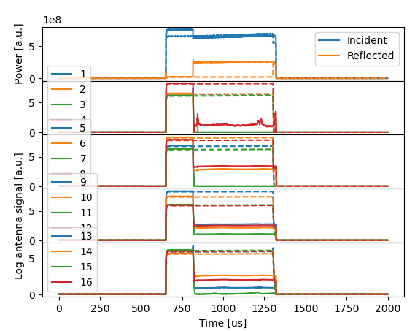
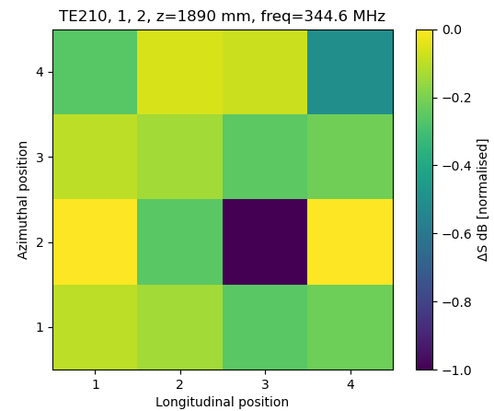
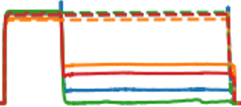


From measurement to simulation
Most similar simulation
Normalization:
$$ΔS_{42}$$
$$ΔS_{ij}=\frac{ΔS_{ij}−ΔS_{min}}{ΔS_{max}−ΔS_{min}}$$
W.L. Millar. Workshop on Breakdown Science and High Gradient Technology 2023, https://agenda.infn.it/event/34253/contributions/210153/

Slide 12
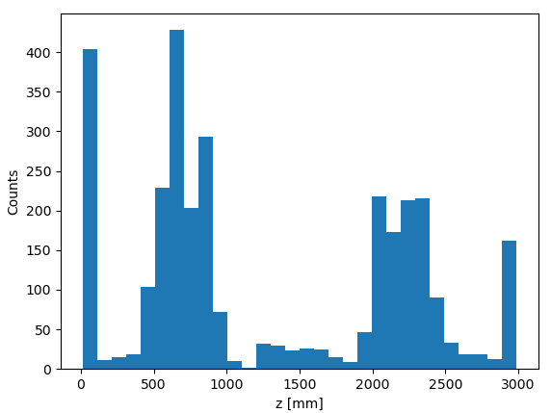
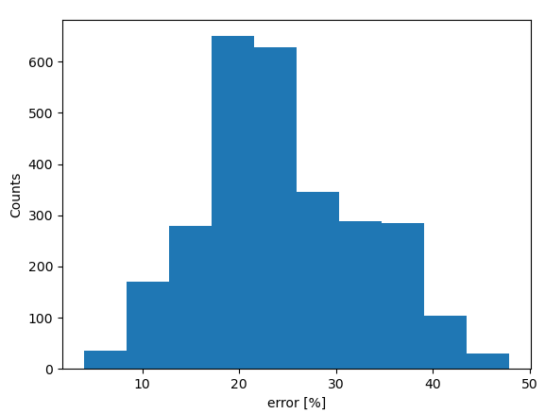
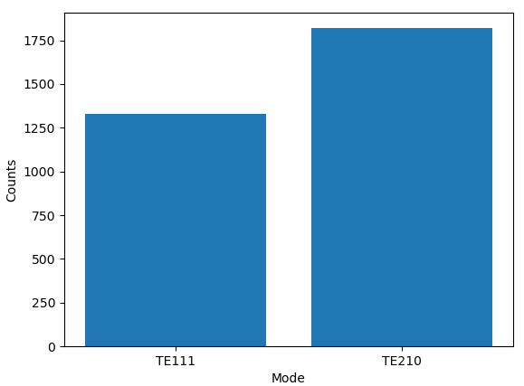
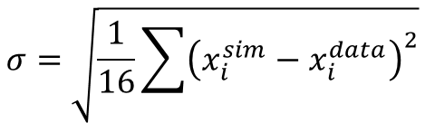
What information can be obtained?
Measurement and simulation agreement
BD longitudinal position
Most similar mode distribution
$$σ=\sqrt{\frac{1}{16}\sum{{\left(x_{i}^{sim}−x_{i}^{data}\right)}^{2}}}$$

Slide 13
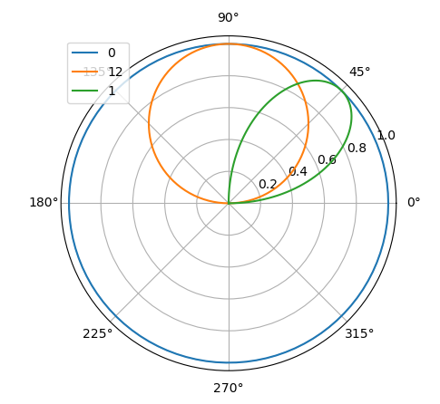
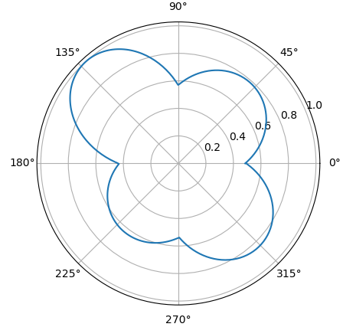
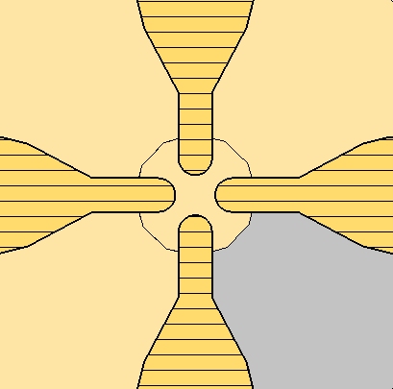
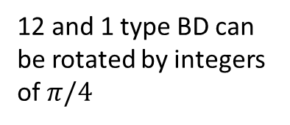
Axial position
12 and 1 type BD can be rotated by integers of $π/4$
0
12
Sum of all BDs
1
V1
V2
V4
Power Coupler
V3

Slide 14
Conclusions
  Surface damage on RFQ1 -> Spare RFQ2 in case replacement is needed.
  First conditioning curve for an RFQ structure (ongoing).
  Testing of method to compare antenna signals and BD localization simulation.
THANK YOU!

Slide 15
Back up

Slide 16
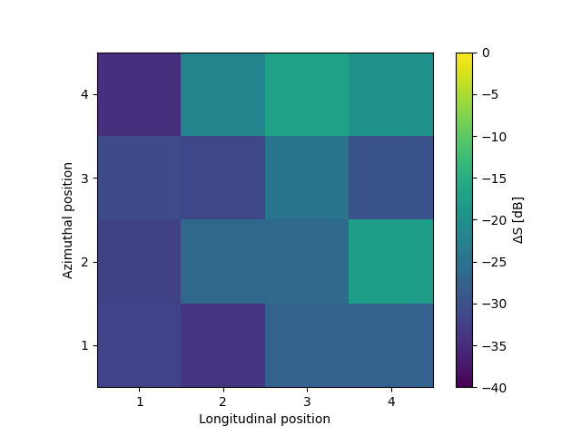
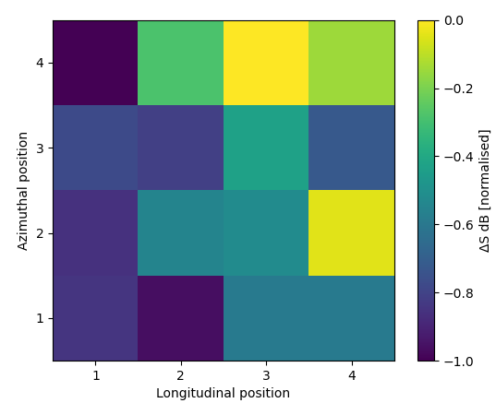
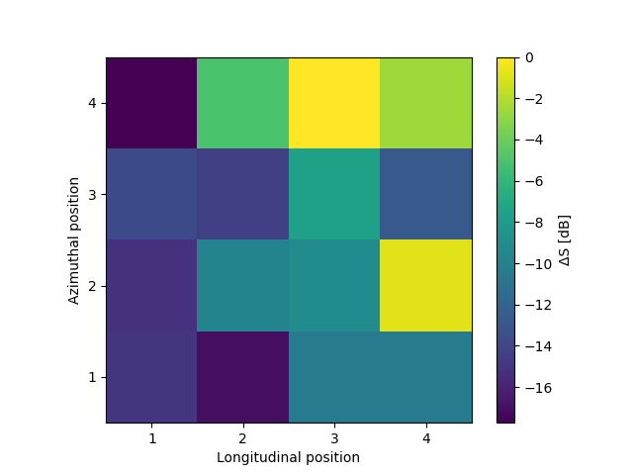
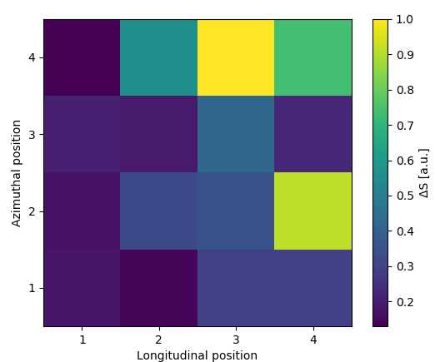



Measurement normalization
$$ΔS_{42}$$
Normalization 1:
Normalization 2:
$$ΔS_{ij}=\frac{ΔS_{ij}−ΔS_{min}}{ΔS_{max}−ΔS_{min}}$$
Normalization 3:
Linear
$$ΔS_{ij}=ΔS_{ij}−ΔS_{min}$$

Slide 17
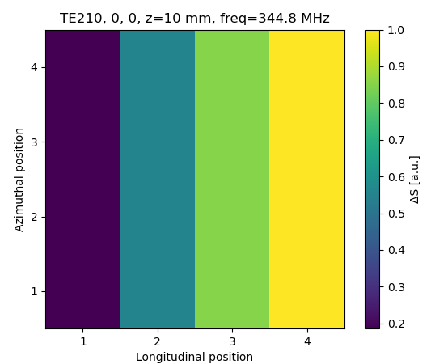
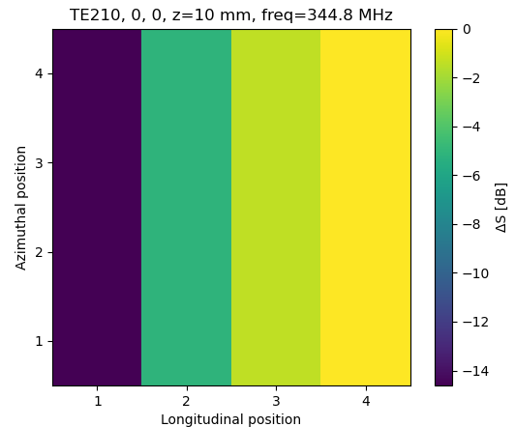
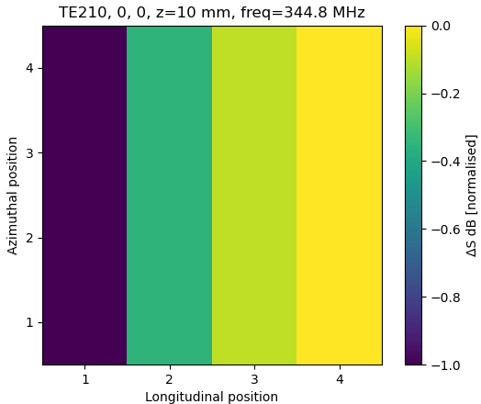

Simulation normalization
Linear (Normalization 3)
To dB (Normalization 2)
Normalization 1:
$$ΔS_{ij}=\frac{ΔS_{ij}−ΔS_{min}}{ΔS_{max}−ΔS_{min}}$$

Slide 18
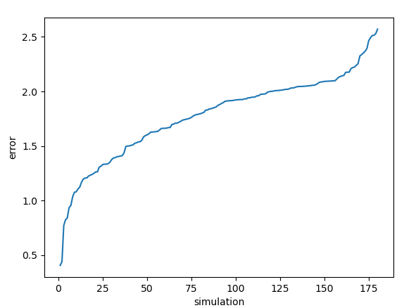
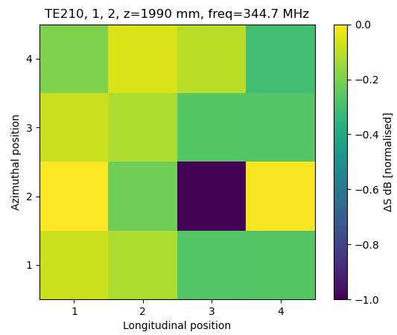
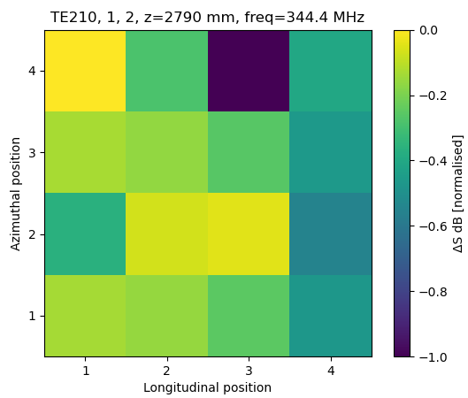
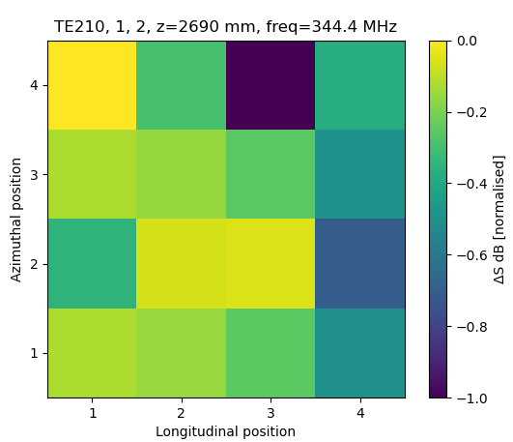
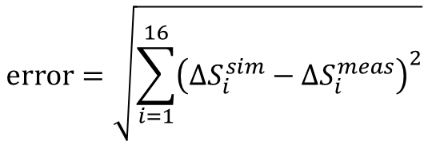
Error minimization
Measurement
$$\text{error}=\sqrt{\sum_{i=1}^{16}{{\left(ΔS_{i}^{sim}−ΔS_{i}^{meas}\right)}^{2}}}$$
1
2
3
4

Slide 19




Normalization 2

Slide 20




Normalization 3

Slide 21


RFQ measurements
BD recovery and soon activation with the same antenna pattern
Reflected power increases: Different coupling
Antennas show different behavior: BD localization
Consecutive BDs (1 s separation) with the same antenna pattern
Vnuchenko, A. (2020). High-gradient issues in S-band RF acceleration structure for hadrontherapy accelerators and radio frequency Quadrupoles

