Slide 1

Flight Simulator
ATF Results
Wiktoria Malek, Pierre Korysko, Andrea Latina
CLIC Project Meeting #48 - 15 Dec 2025 - CERN

Slide 2

Outline
Introducing the Flight Simulator
Description
Applications
System Identification
Beam-Based Alignment
Emittance measurement …
ATF Results
Layout
Linac, Damping Ring, Extraction line and Final Focus
ATF Results - CLIC Project Meeting #48
2

Slide 3
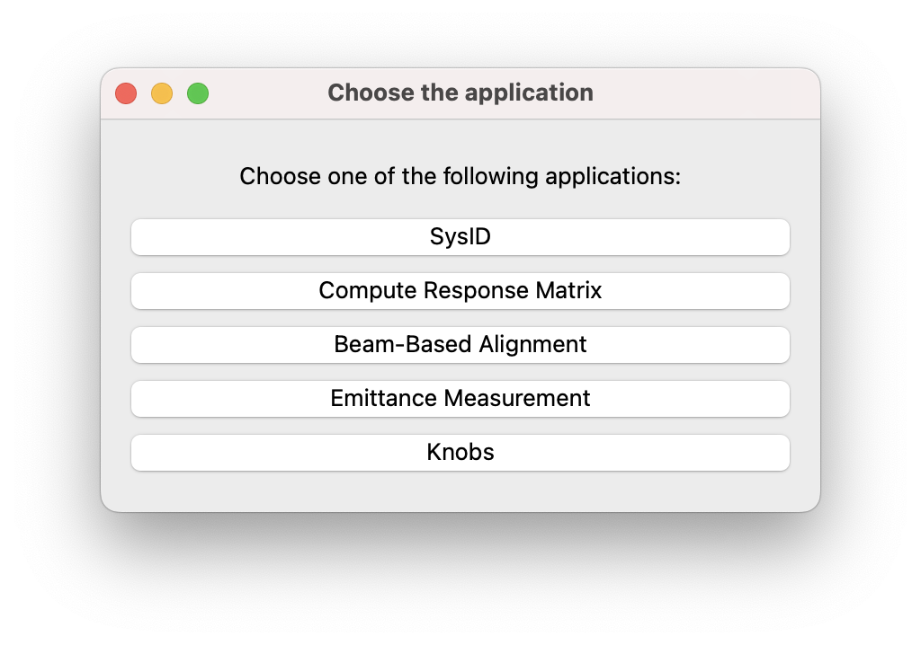
Flight Simulator
Main Panel Dialog:
ATF Results - CLIC Project Meeting #48
3

Slide 4
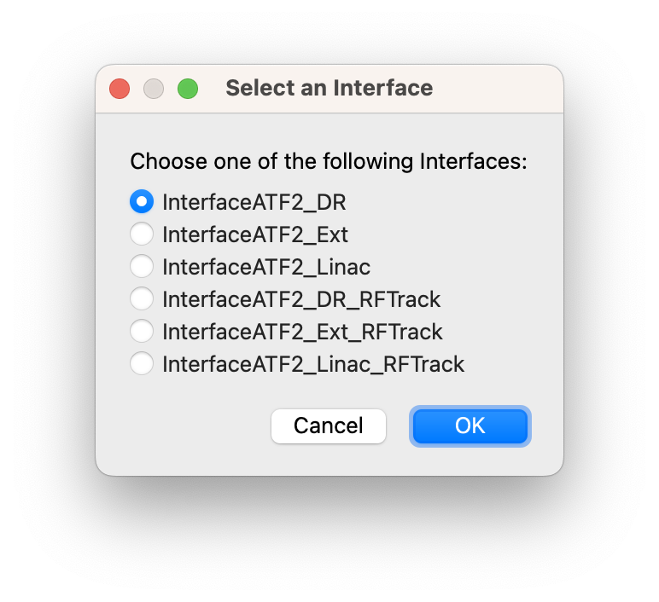
Interfaces
Machine-Independent Framework
Two CLEAR Interfaces also exist
https://gitlab.cern.ch/rf-track
ATF Results - CLIC Project Meeting #48
4

Slide 5
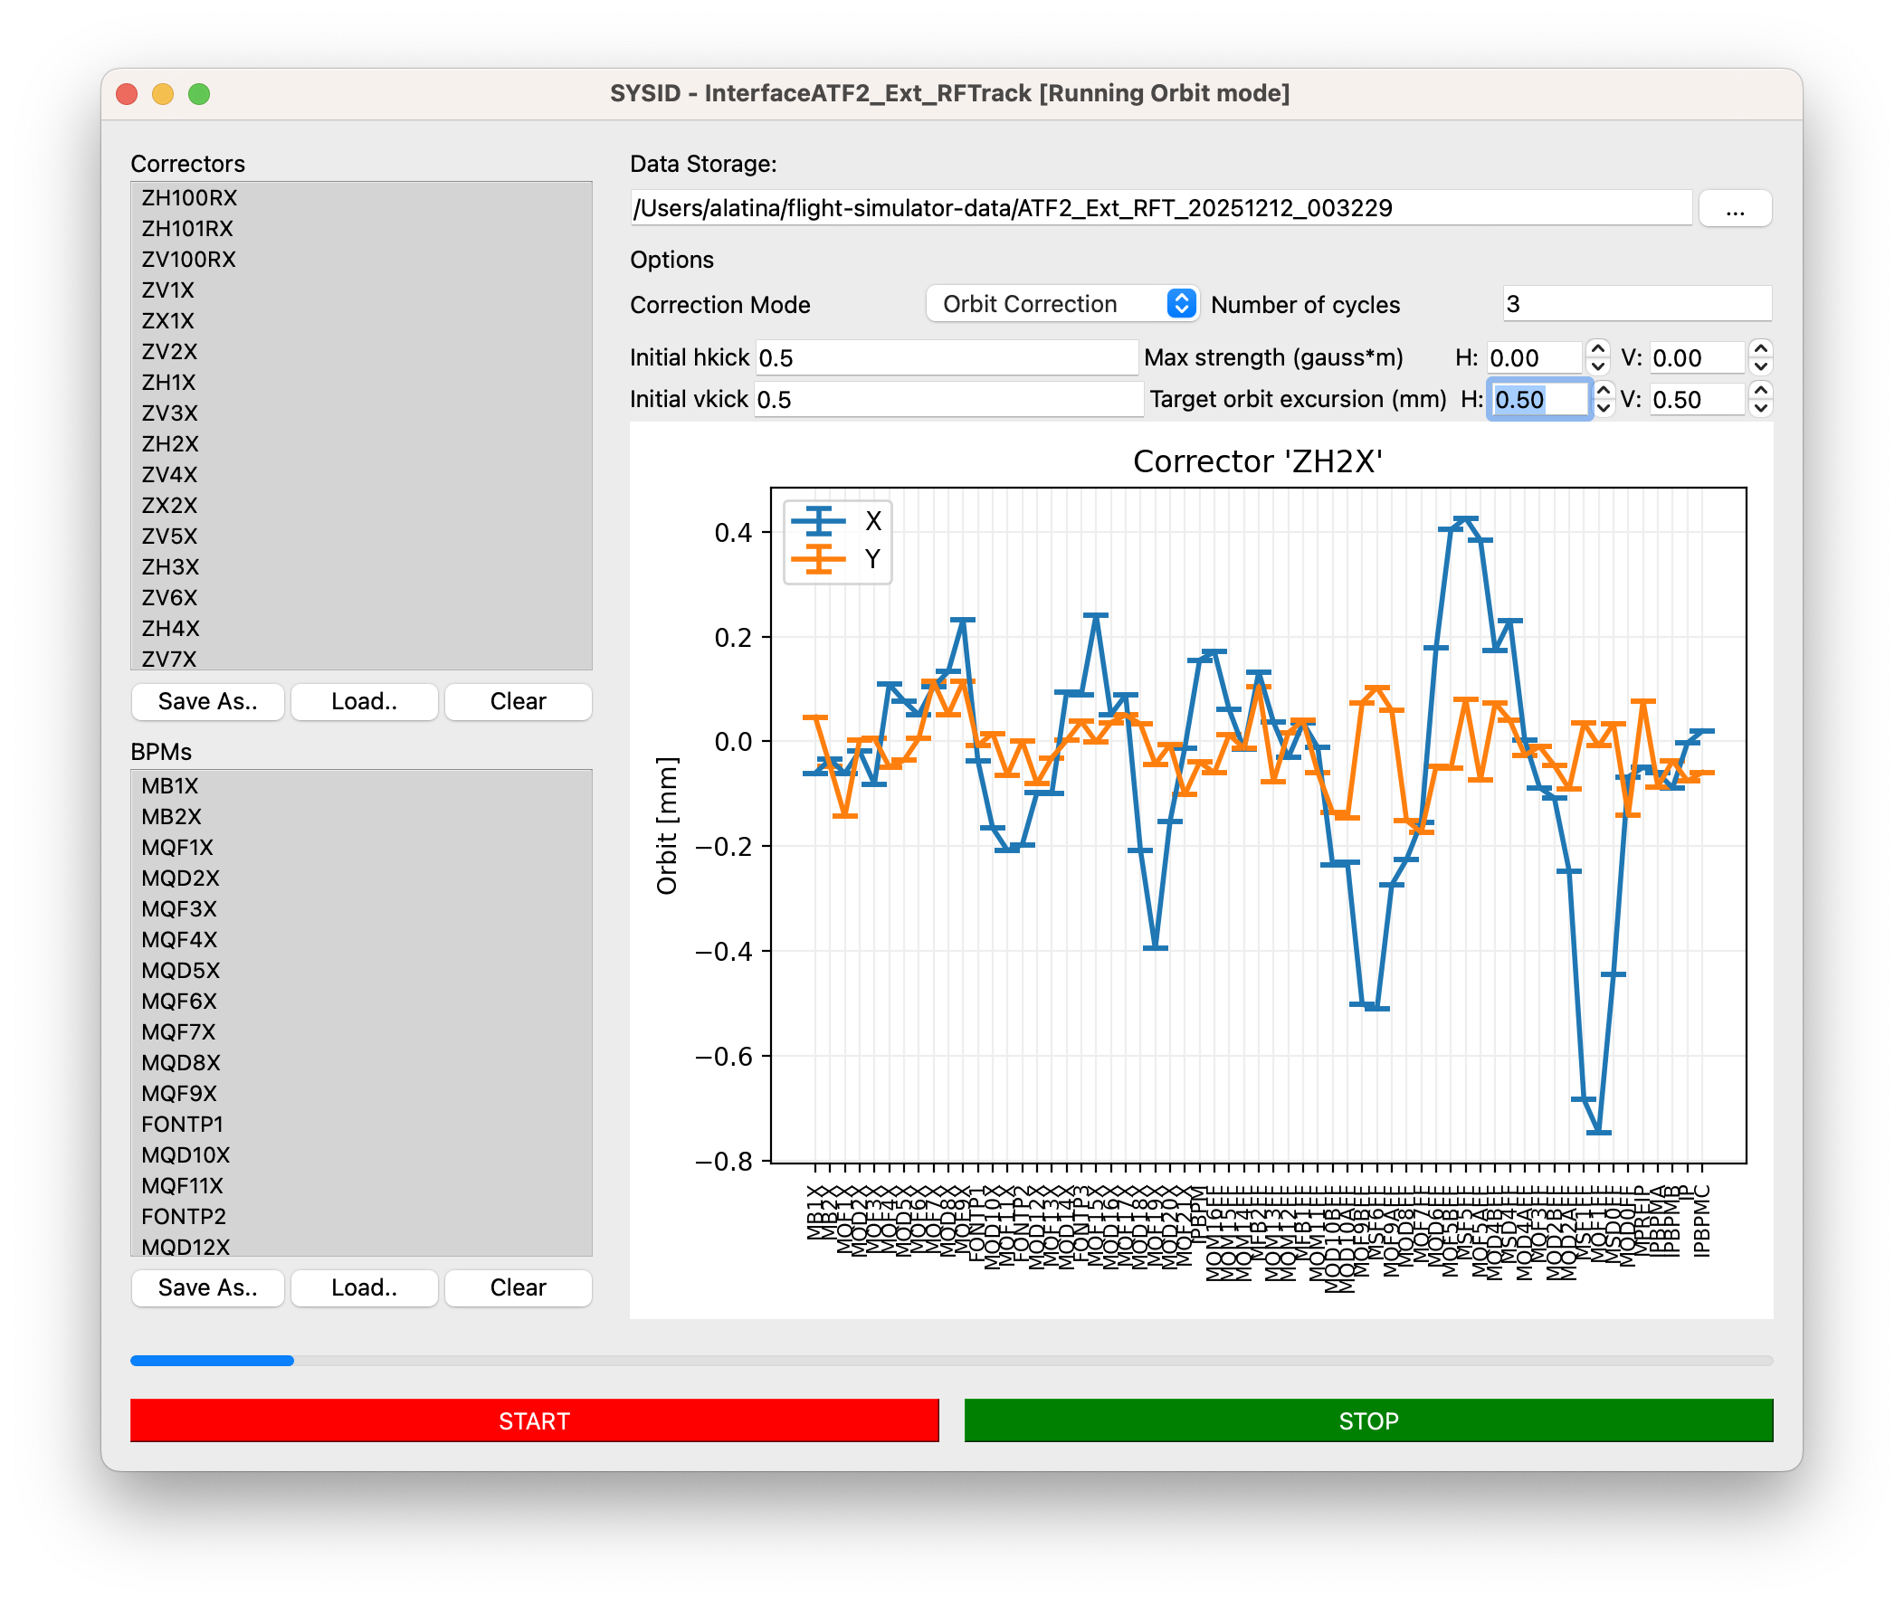
System Identification
Here running on the RF-Track’s ATF2 Extraction line:
Path to storage
List of correctors to use.
Maximum transverse orbit excursion
List of BPMs to use.
ATF Results - CLIC Project Meeting #48
5

Slide 6
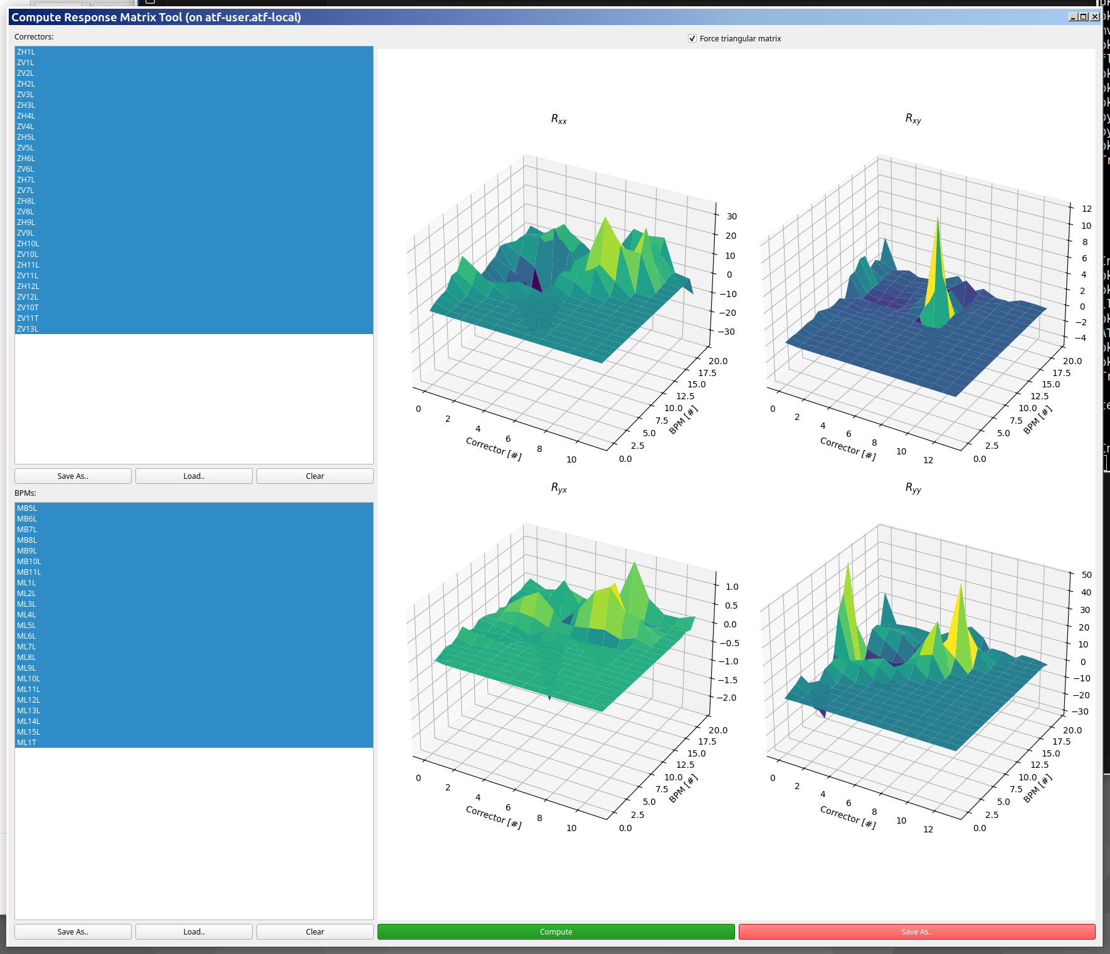
Response Matrix
Applications:
- BBA
- Orbit Bumps
ATF Results - CLIC Project Meeting #48
6

Slide 7
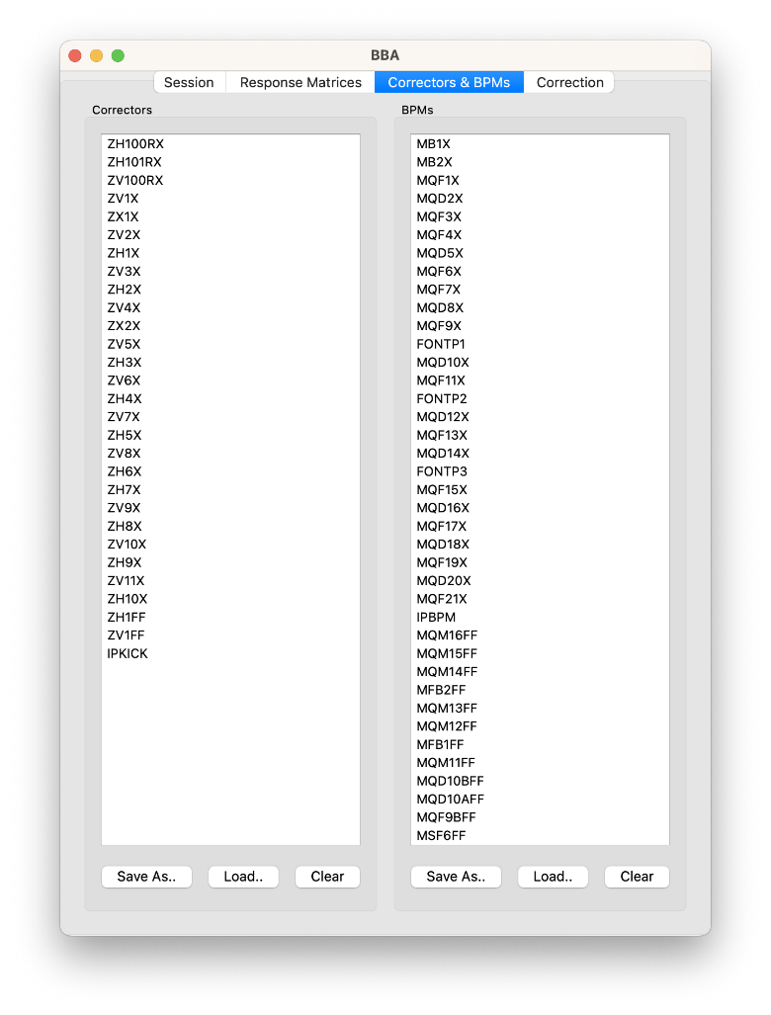
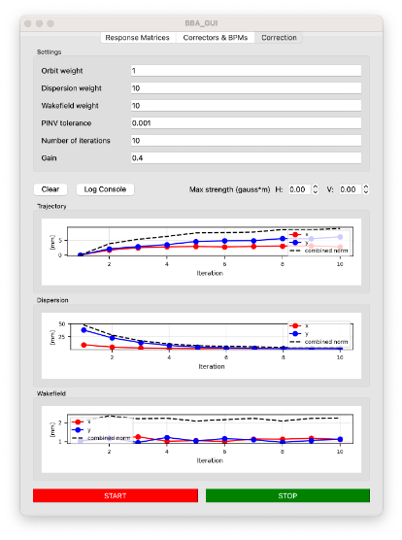
Beam-Based Alignment
Orbit weight Dispersion weight Wakefield weight Nb. of iteration etc
List of correctors to use.
List of BPMs to use.
Orbit being deflected
Dispersion
Wakefield
Simulated Ext Line
ATF Results - CLIC Project Meeting #48
7

Slide 8
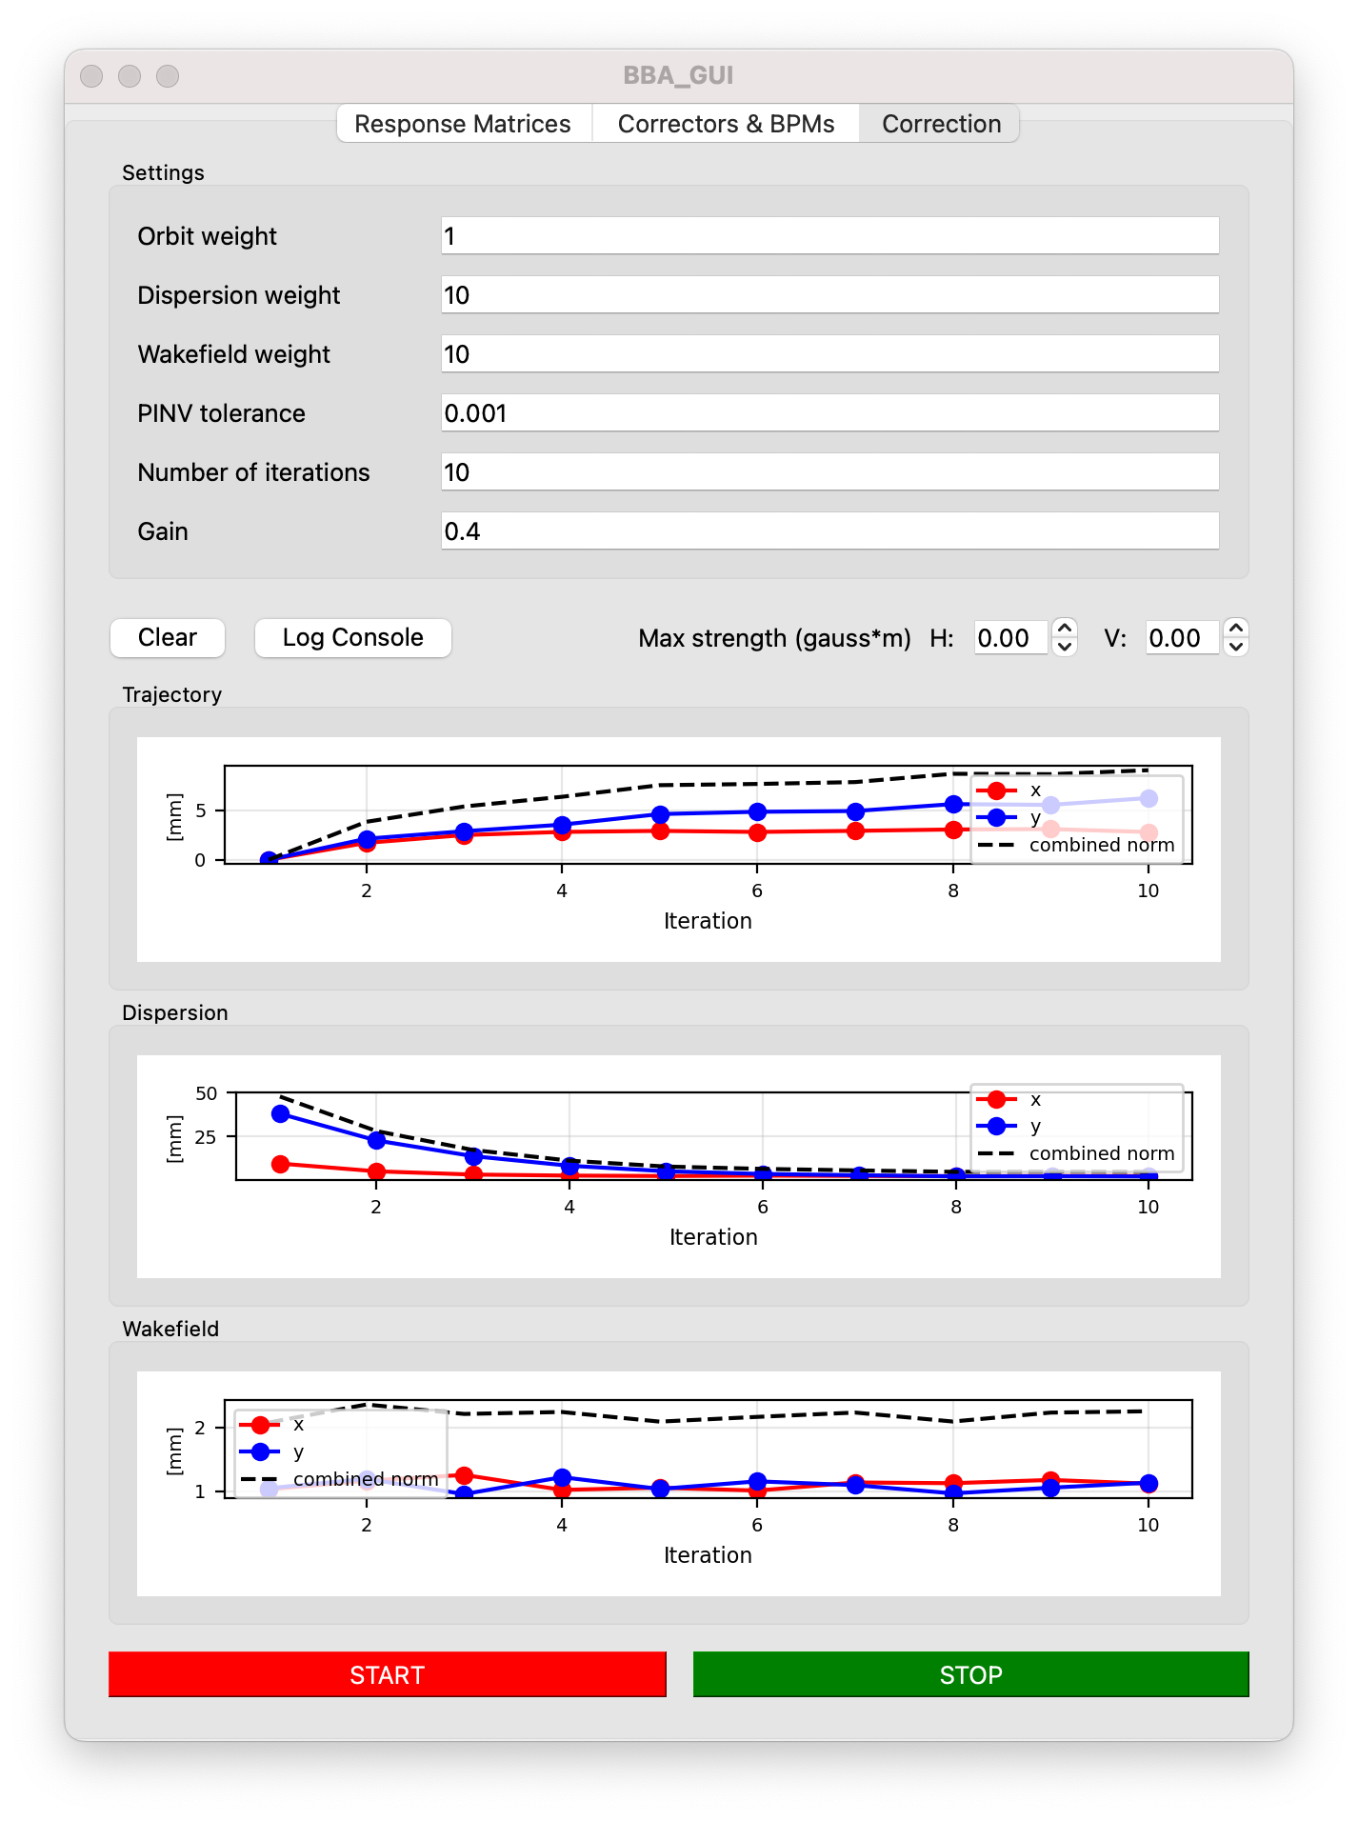
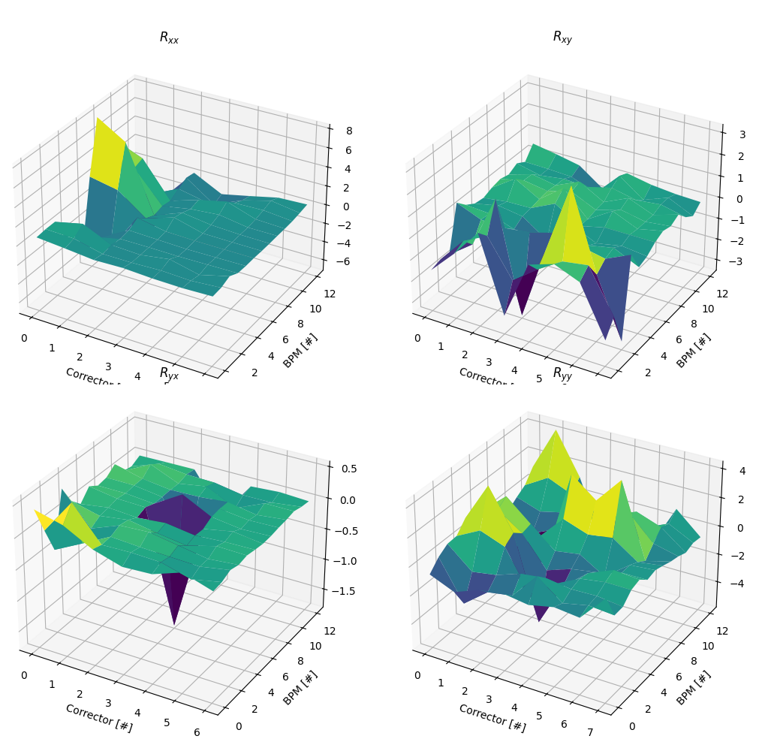
Architecture
Real machines
Simulated Machines
Interface Linac
Interface DR
Interface Ext
Interface Linac
Interface DR
Interface Ext
Machine status
State
… and more
ATF Results - CLIC Project Meeting #48
8

Slide 9
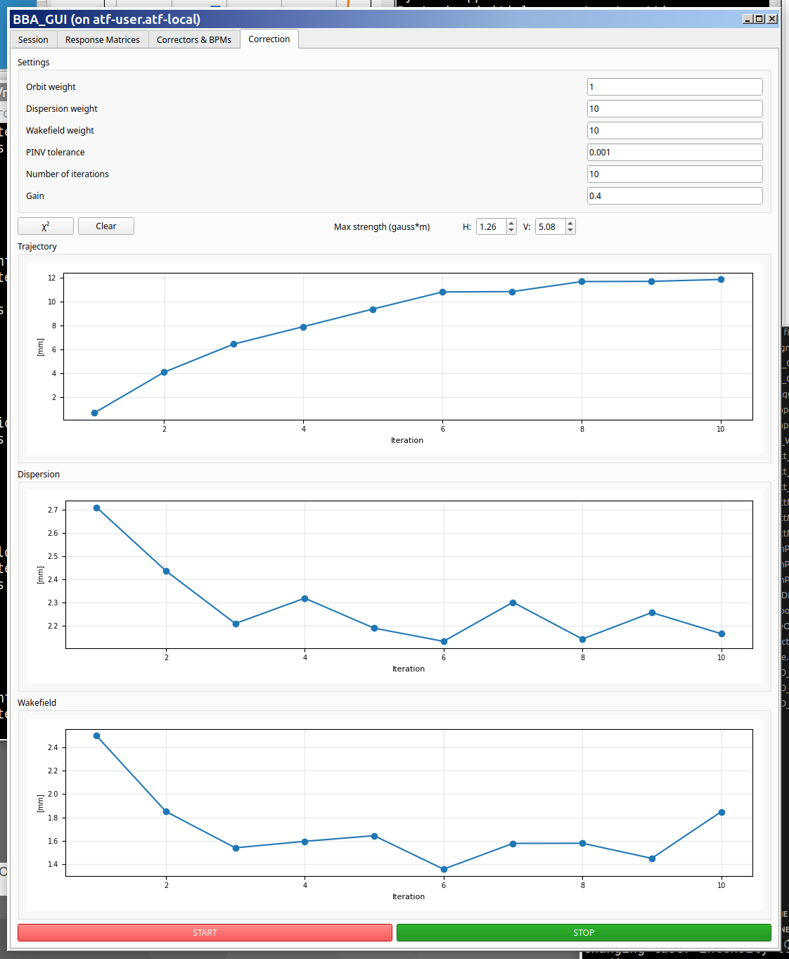
ATF Linac - DFS + WFS
Experimental result
10 iterations
𝜔_{dfs} = 10
𝜔_{wfs} = 10
ATF Results - CLIC Project Meeting #48
9

Slide 10
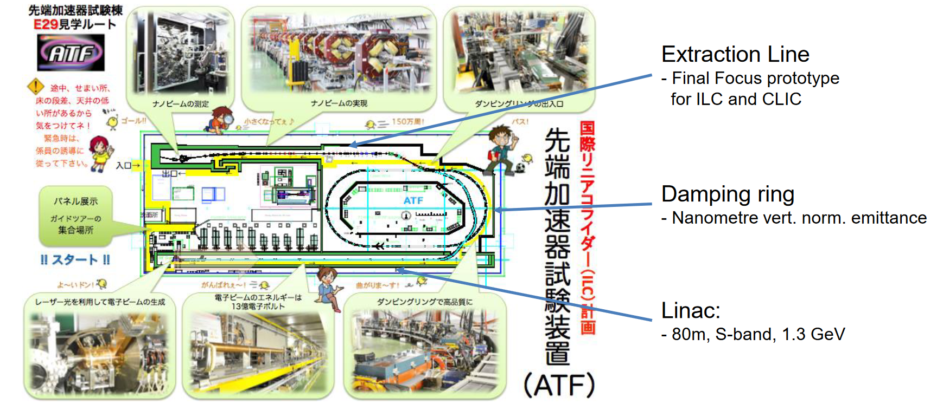
Accelerator Test Facility at KEK (Japan)
ATF Results - CLIC Project Meeting #48
10

Slide 11
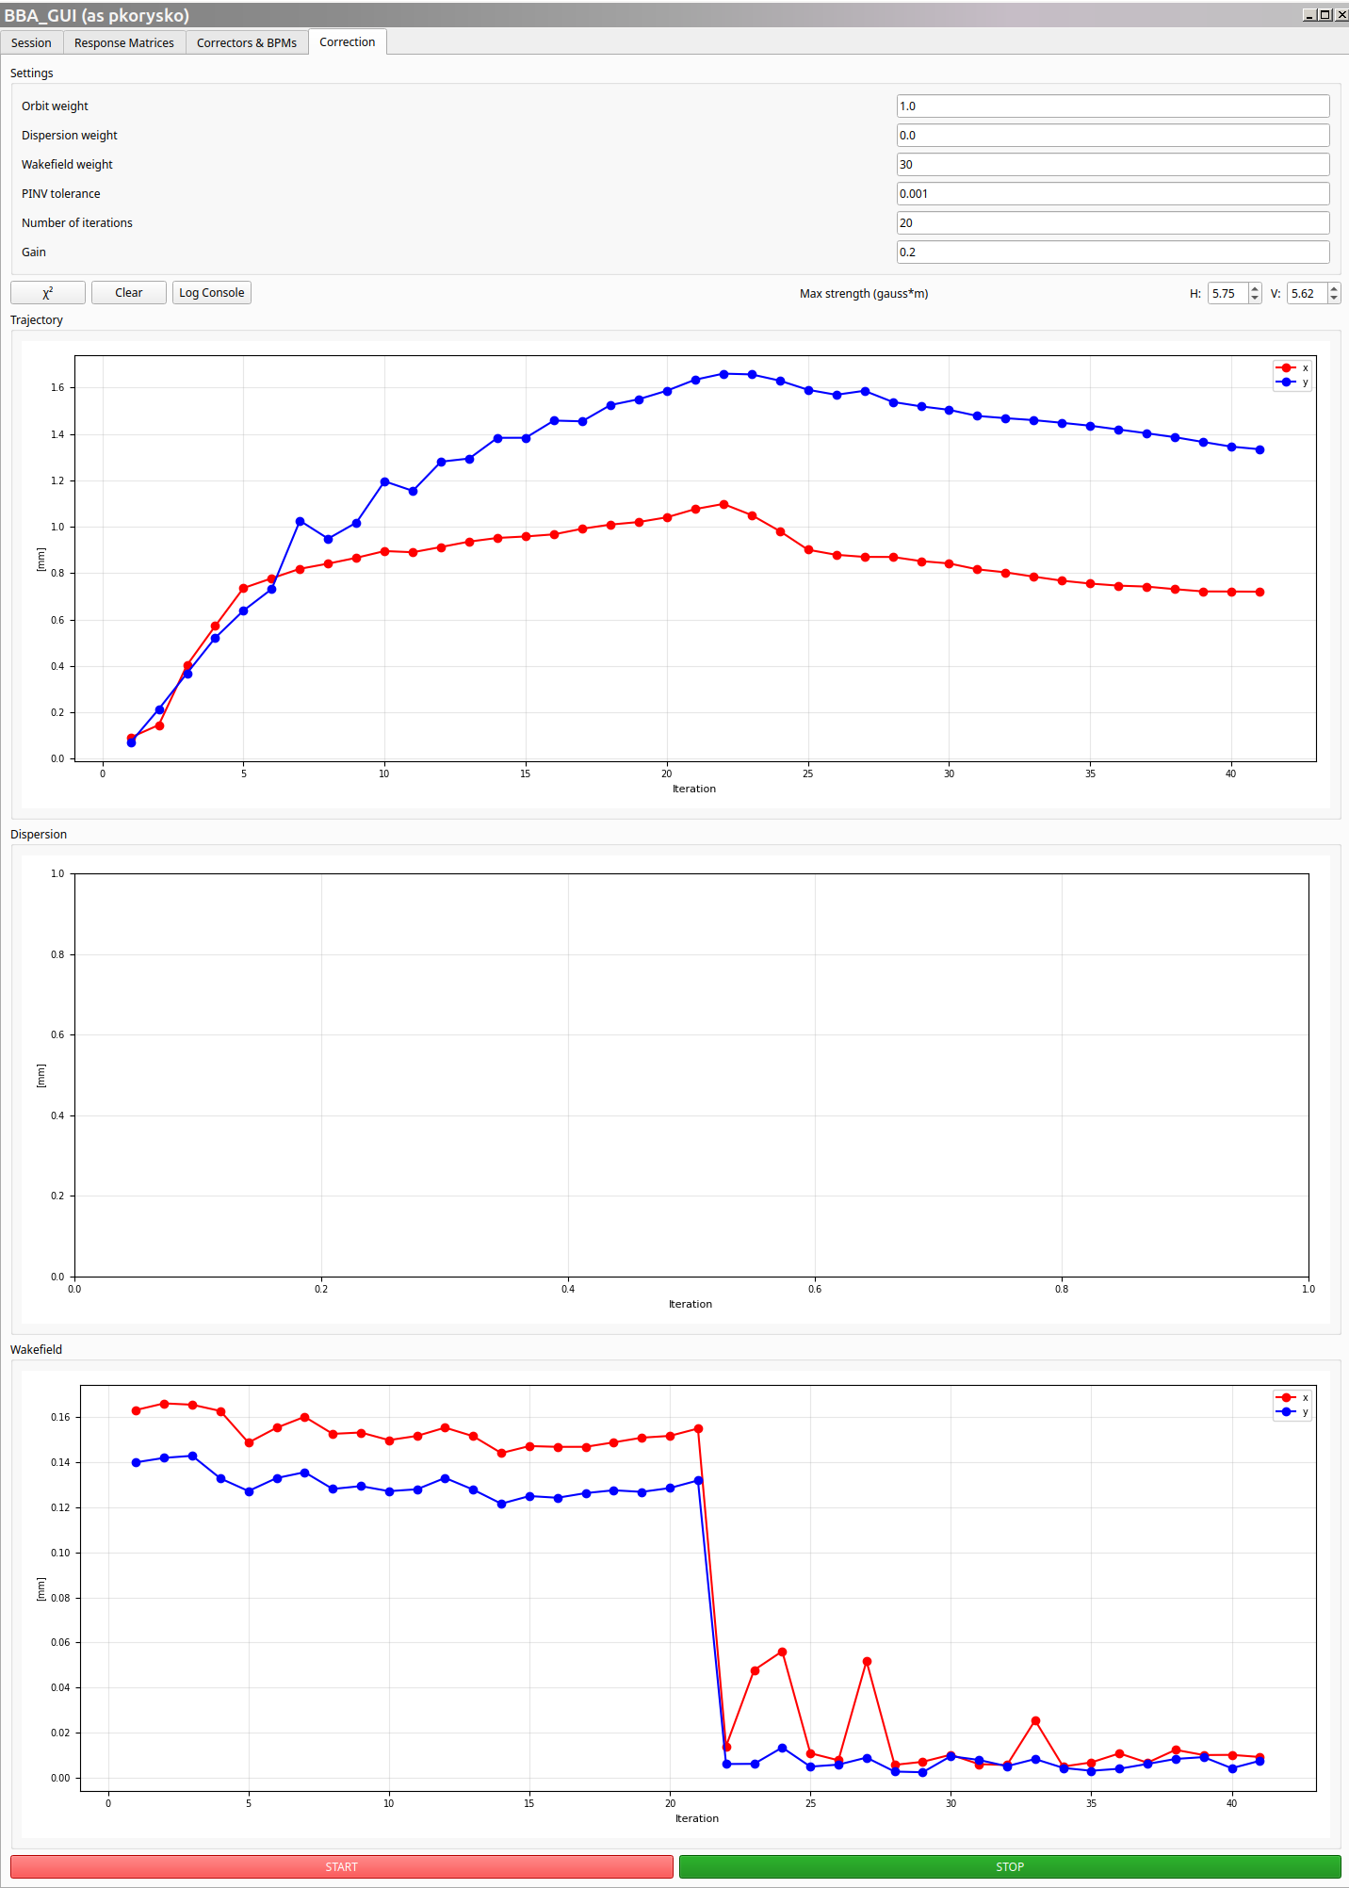
ATF Damping Ring - WFS
Applied WFS:
With weights: 10 and 30
Dramatic improvement with weight 𝜔_{wfs} = 30
Wakefield effect reduced by factor 15.
ATF Results - CLIC Project Meeting #48
11

Slide 12
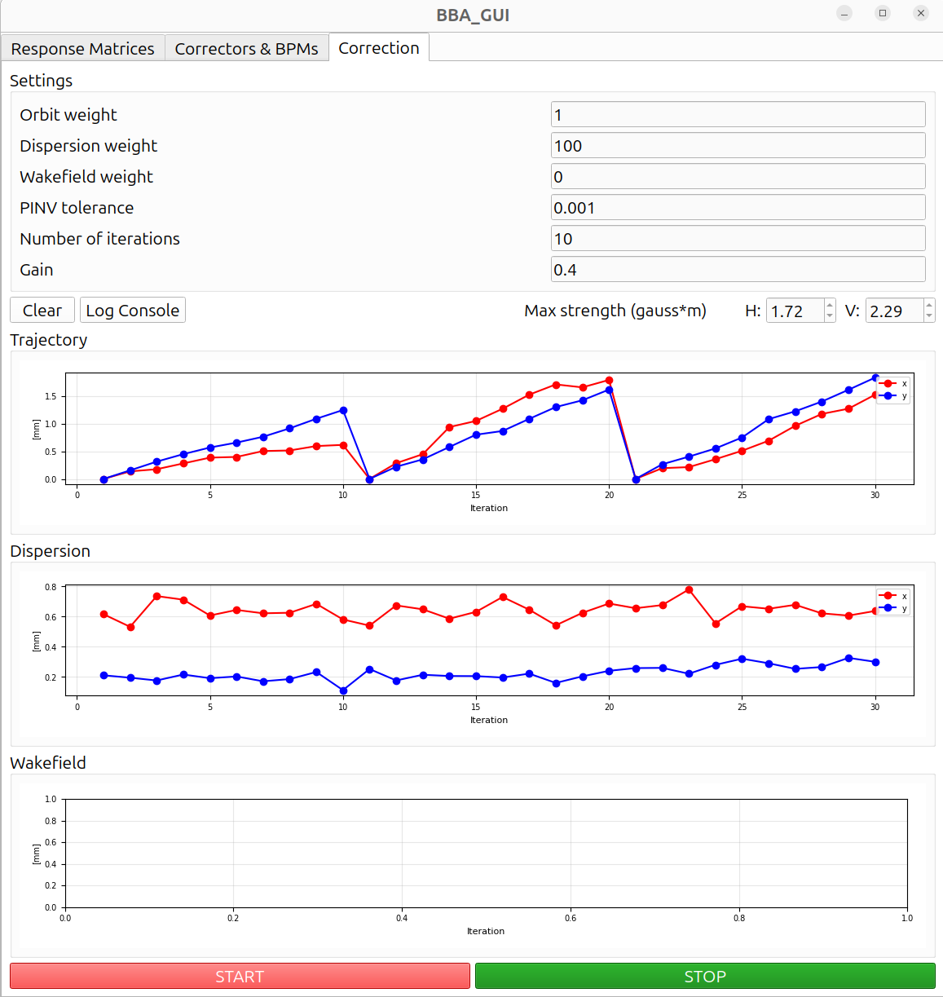
ATF Extraction Line – DFS
Applied DFS:
We tested three DFS weights: 10, 30, 100
Dispersion isn’t reduced
Simulations reproduced the result (we should have used more BPMs)
ATF Results - CLIC Project Meeting #48
12

Slide 13
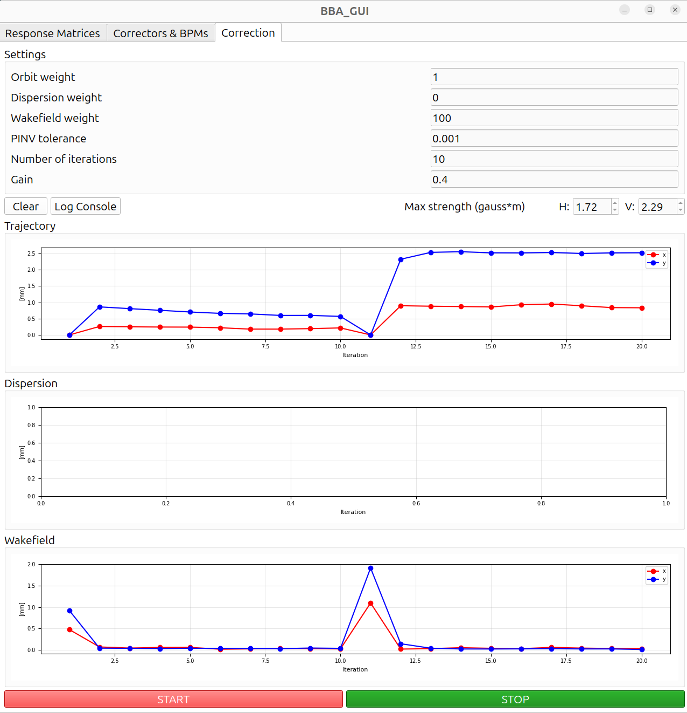
ATF2 Extraction Line - WFS
Applied WFS:
10 iterations: weight = 10 and
10 iterations: weight = 100
Wakefield impact on the orbit is reduced significantly.
ATF Results - CLIC Project Meeting #48
13

Slide 14
Conclusions and Next Steps
A new Flight Simulator in Python is being developed and was tested at ATF with some promising results.
Dedicated tools for Response Matrix calculation, One-to-One correction and Beam – Based Alignment (DFS and WFS) were implemented in the Flight Simulator and give good results.
Deployed the SysID + BBA Applications. We gave a mini—training to ATF staff
Next steps:
Consolidate current applications
Test at CLEAR
Create new applications: Emittance measurement, Bumps, Knobs, ML, …
ATF Results - CLIC Project Meeting #48
14

Slide 15
Example Application: Beam-Based Alignment
Simulation: DFS weight scan
Simulation: WFS weight scan
R, D, W = response matrices
D = R_{E} - R
W = R_{I} – R
R_{E} response of bpms to off-energy beam
R_{I} response of bpms to different intensity
ATF Results - CLIC Project Meeting #48
15

