Slide 1

Largest of the Rings
LHC Past, Present and Future
L. Bottura
CERN Centennial Superconductivity Symposium
The Roots of the LHC Technology
December 8th, 2011

Slide 2
Outline
The LHC pre-history
The making of the LHC
Long live the LHC !
Is there life after the LHC ?

Slide 3
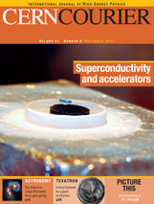
Outline
The LHC pre-history
The making of the LHC
Long live the LHC !
Is there life after the LHC ?
L. Rossi, Superconductivity and the LHC: the early days, CERN Courier, 51(9), November 2011, pp.21-27

Slide 4

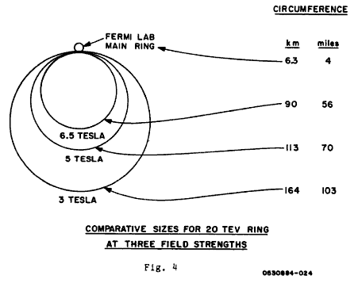
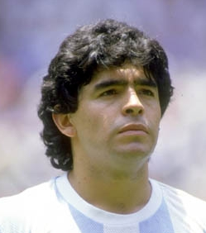
1984…
Big Brother is in full control and rules
The National Reference Design Study (RDS) for a 20 TeV proton machine, hosted by LBNL, DOE recommends proceeding with R&D for a Sine-qua-non Accelerator (the SSC)
Diego Maradona goes to SSC
(Societa’ Sportiva Calcio) Napoli from FC Barcelona for a ridiculous13.5 billions Lire

Slide 5
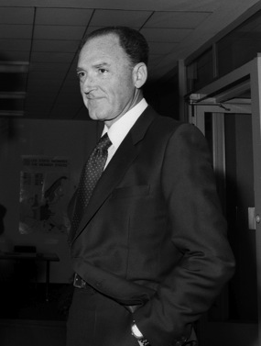

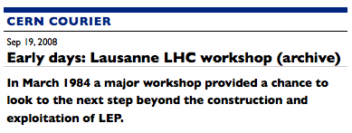
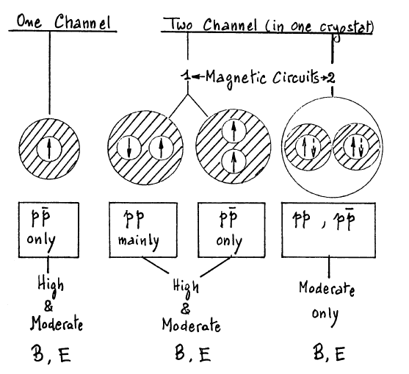
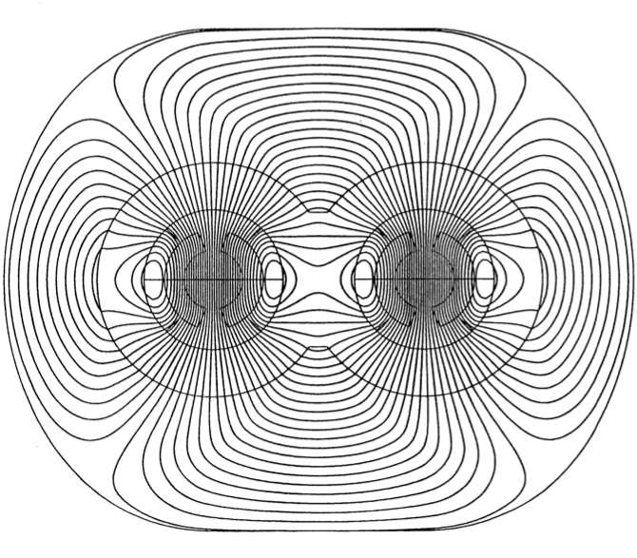
1984 ECFA – Lausanne
G. Brianti
CERN 87-05, G. Brianti and K. Hubner Ed.

Slide 6
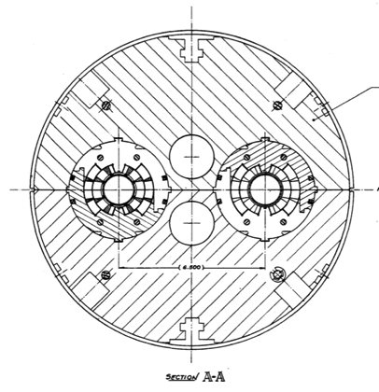
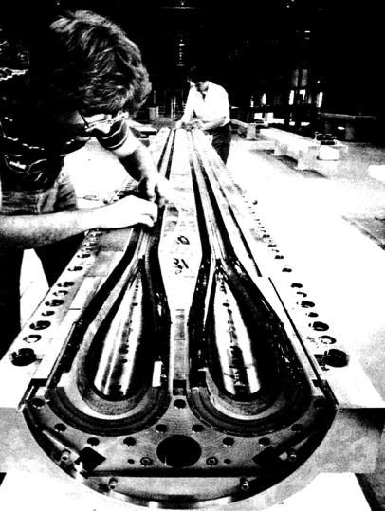
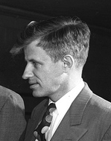
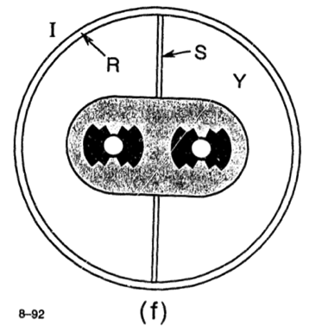
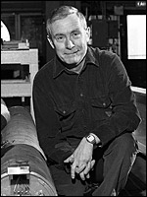
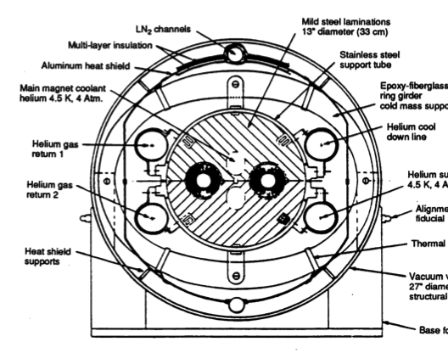
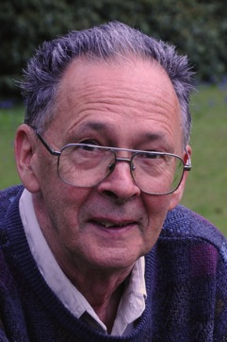
Earlier traces of the two-in-one concept
John P. Blewett, 1971
SSC high field option
Assembly work at BNL
Per F. Dahl, The SSC Dipole: Its Conceptual Origin and Early Design History, SSCL-320, 1990
Robert B. Palmer, Superconducting Accelerator Magnets: A Review of their Design and Training, ICHEP 92, SLAC-PUB-5899, 1992

Slide 7

SSC vs. LHC
G. Brianti had various reasons for headaches in the race of the two projects:
  The existing LEP tunnel imposed a given radius and cross sectional space to the new accelerator – Field !
  The missing factor in energy (8.5+8.5 TeV for LHC vs. 20+20 TeV for SSC) needed to be compensated by a higher luminosity (design value of 10³⁴ 1/cm² s for LHC vs. 10³³ 1/cm² s for SSC) – Aperture and quality !
R&D focus was the key !
  High field: aim at 8 to 10 T bore field
  Two-in-one: to gain space in the crammed tunnel space for the widest possible magnet bore

Slide 8
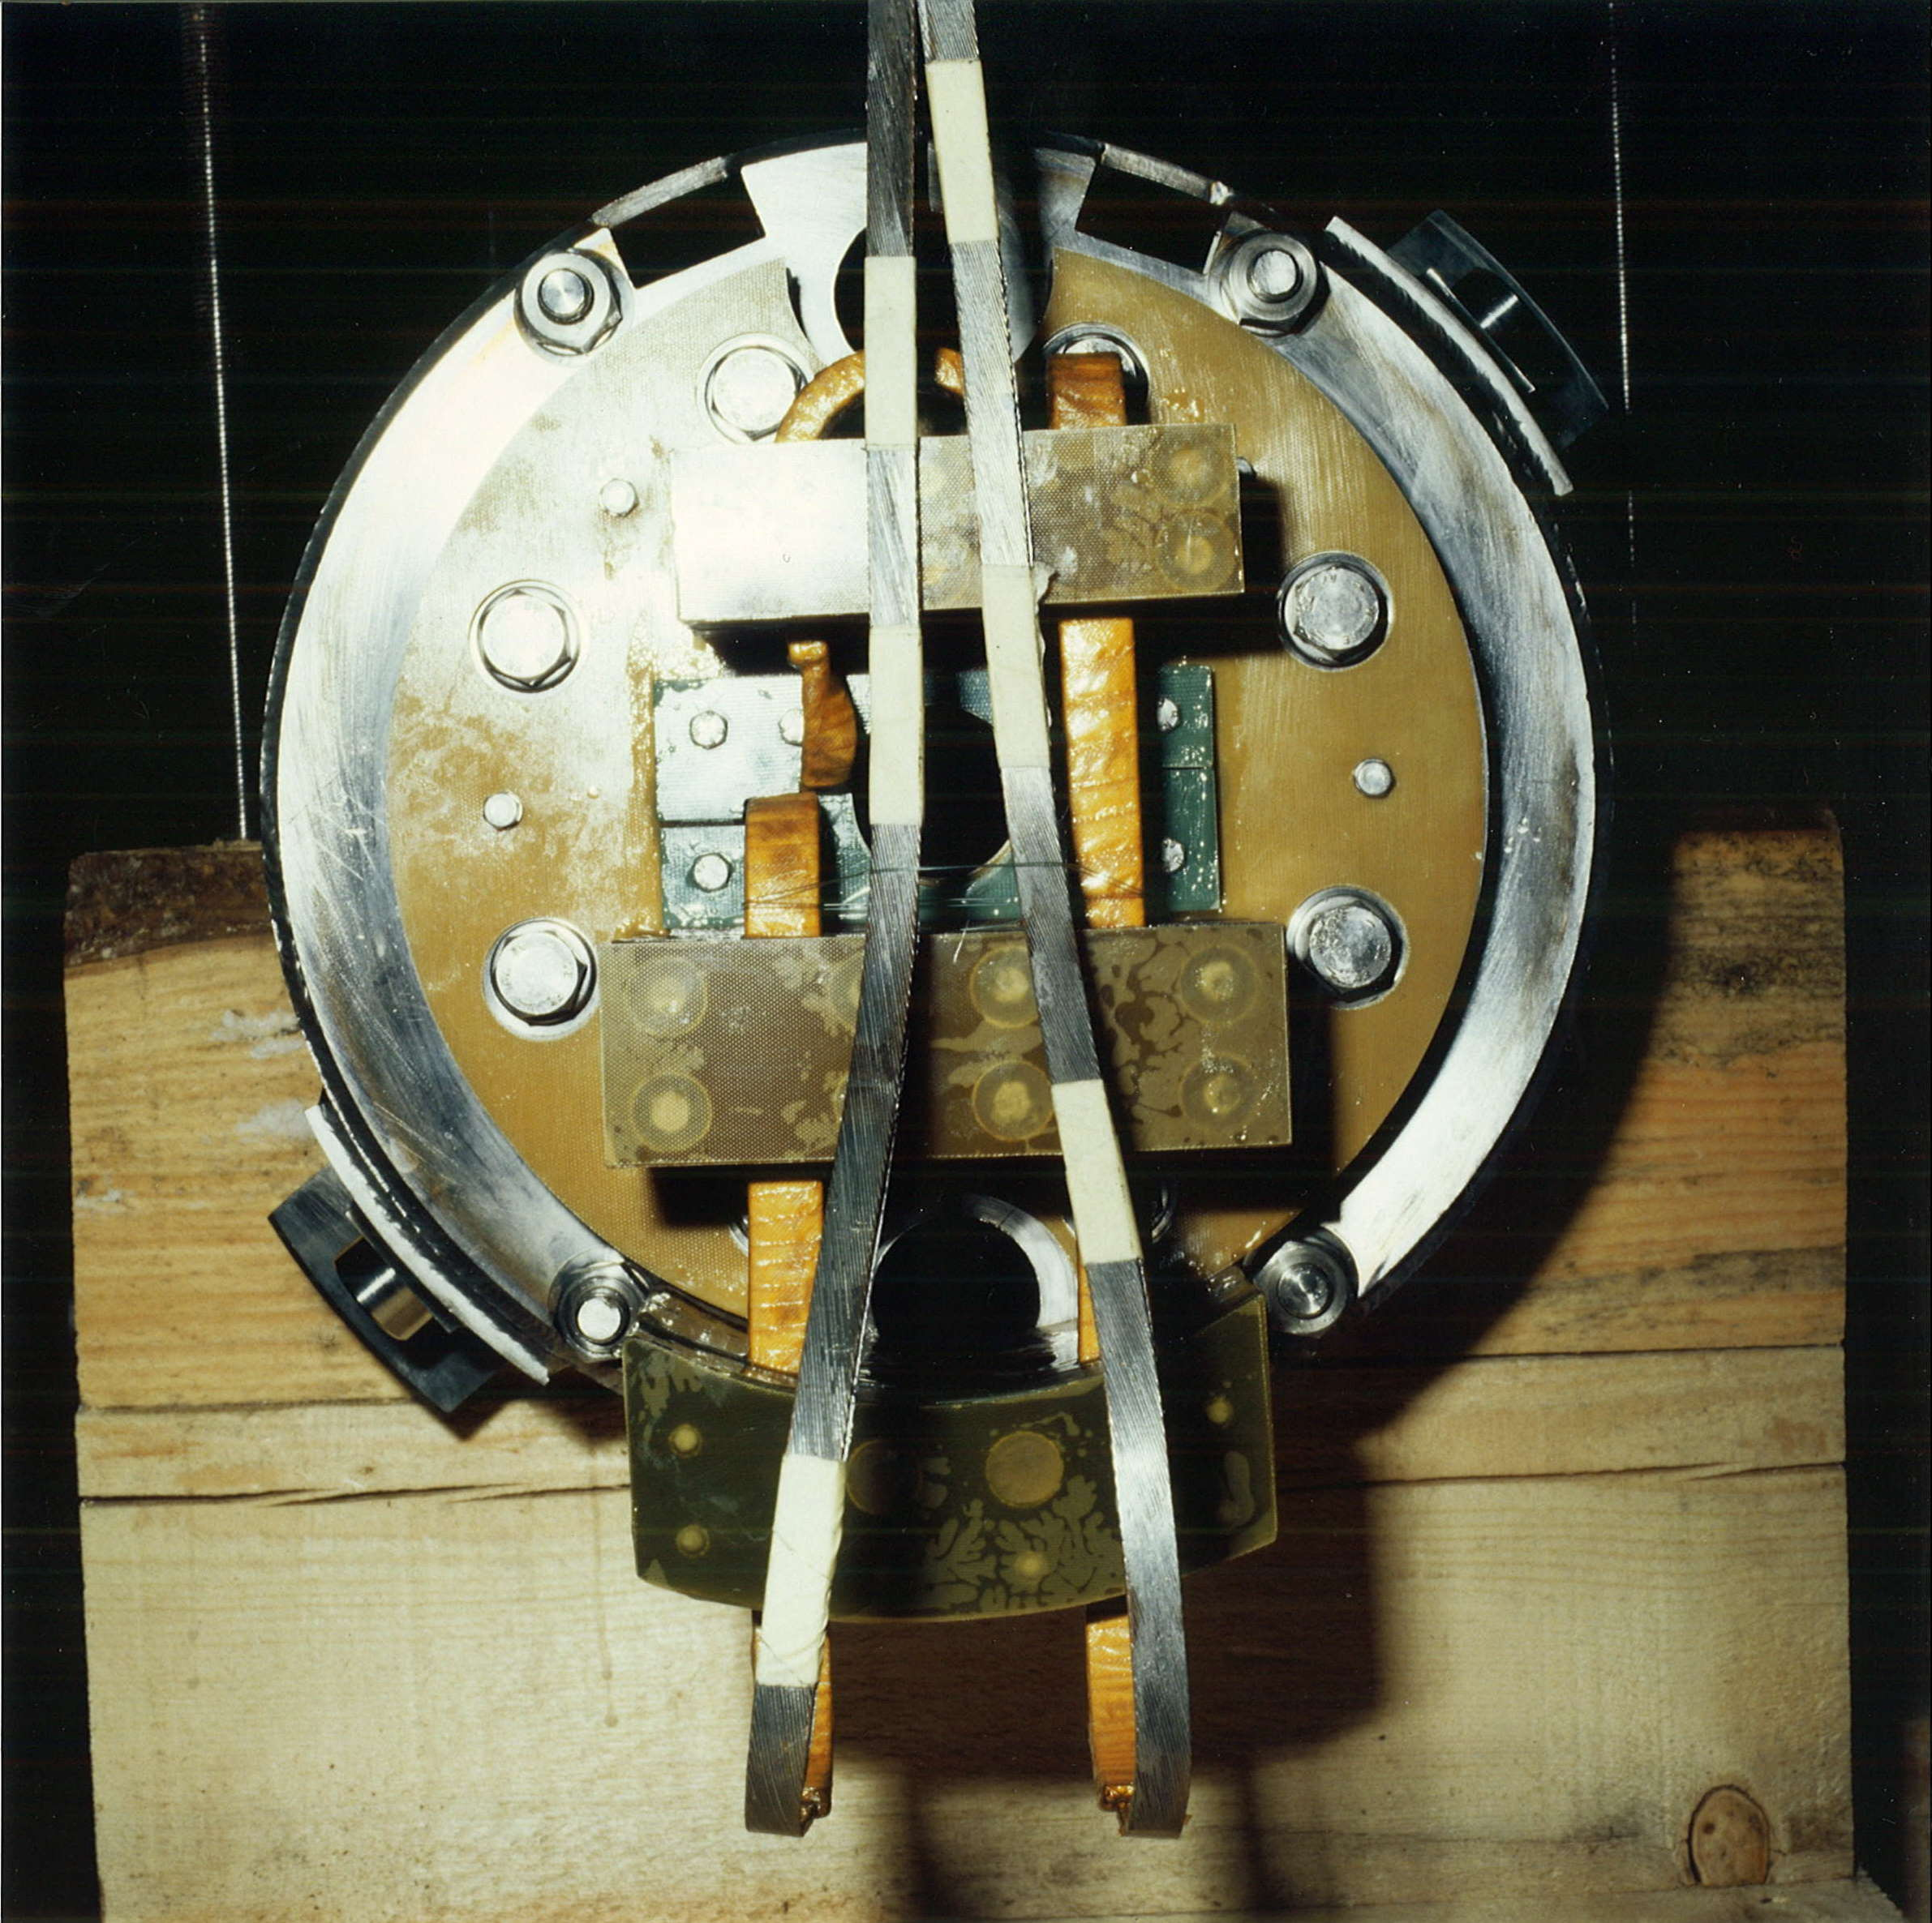
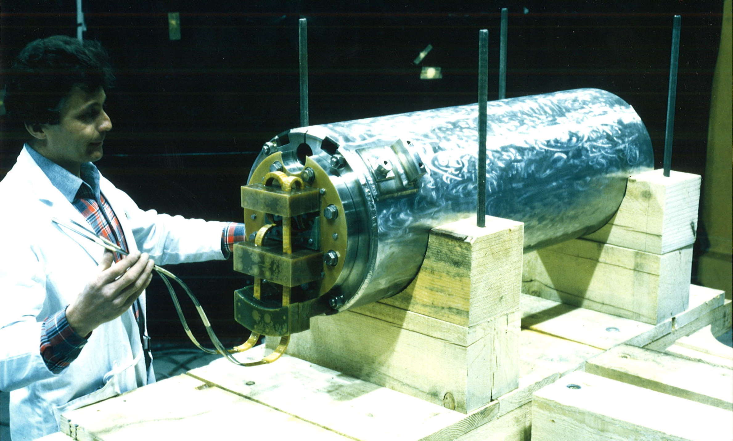
High field – NbTi
1987 – R. Perin and D. Leroy built with Ansaldo Componenti a 1-m single aperture model using a 12.6 mm wide Nb-Ti cable
1988 – The model magnet reached 8.55 T at the first quench and 9.3 T at 1.6 K in 4 quenches

Slide 9
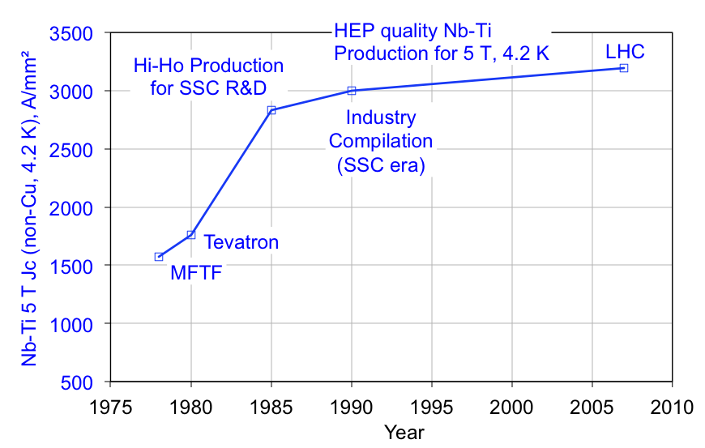
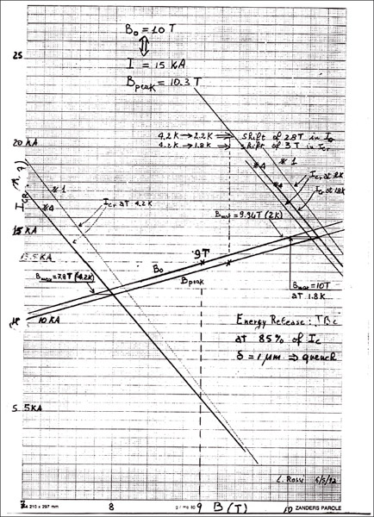
NbTi and superfluid helium
Measurement of Ic of an LHC cable by M. Garber (BNL), 1992
1.8 K
+3 T
LHC largely profited from the SSC R&D on NbTi for both the critical current (3000 A/mm²) and the filament diameter (5 to 10 μm)
Still, superfluid He was a must !
4.2 K

Slide 10
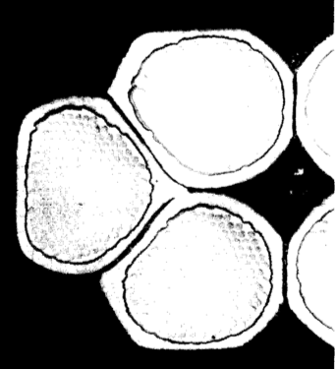
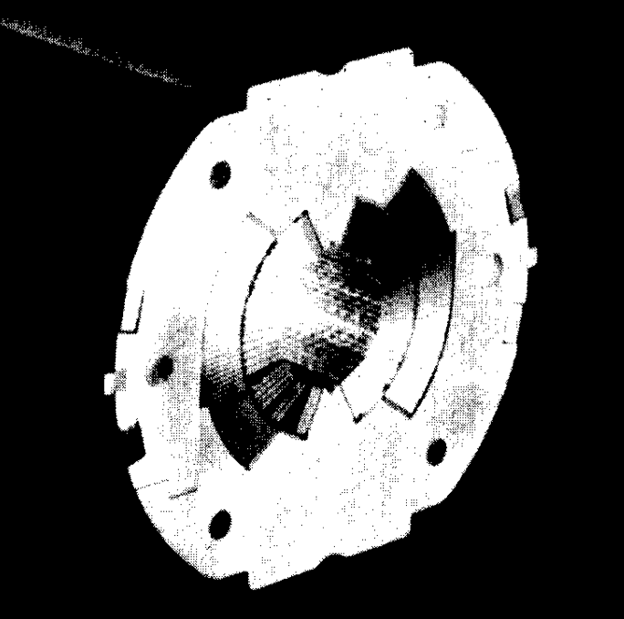
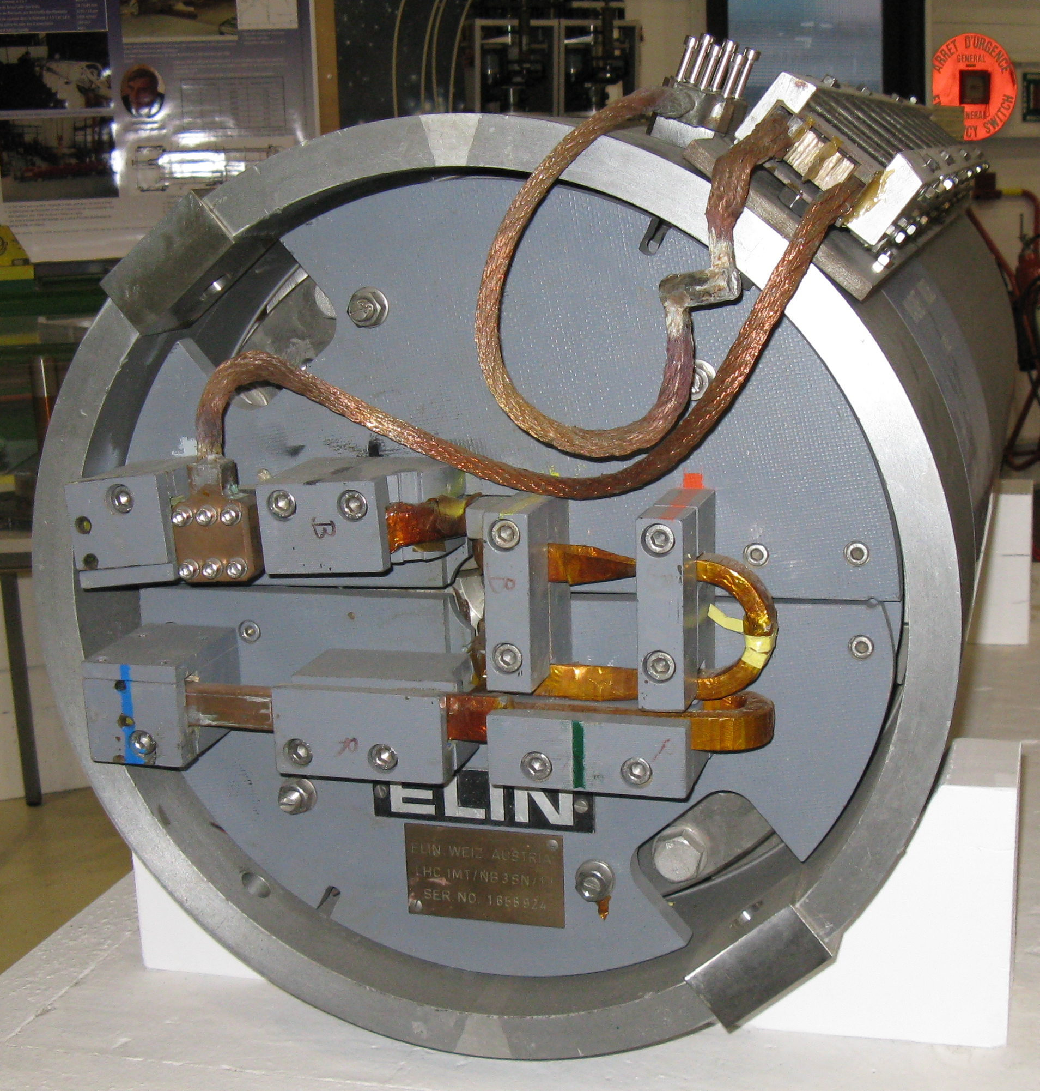
High field – Nb₃Sn
Cable edge
VAC bronze wire
1989 – A. Asner built with Elin (AT) a 1 m single aperture model using a 17 mm cable and the wind-and-react technique
The magnet reached 9.5 T at 4.3 K, and was re-tested after 8 months, reaching 9.5 T after two quenches
A single coil in mirror configuration reached 10.1 T, breaking the barrier of 100 kGauss
S. Wenger, F. Zerobin, A. Asner,, IEEE Trans. Mag. 25(2), 1989, pp. 1636-1639

Slide 11
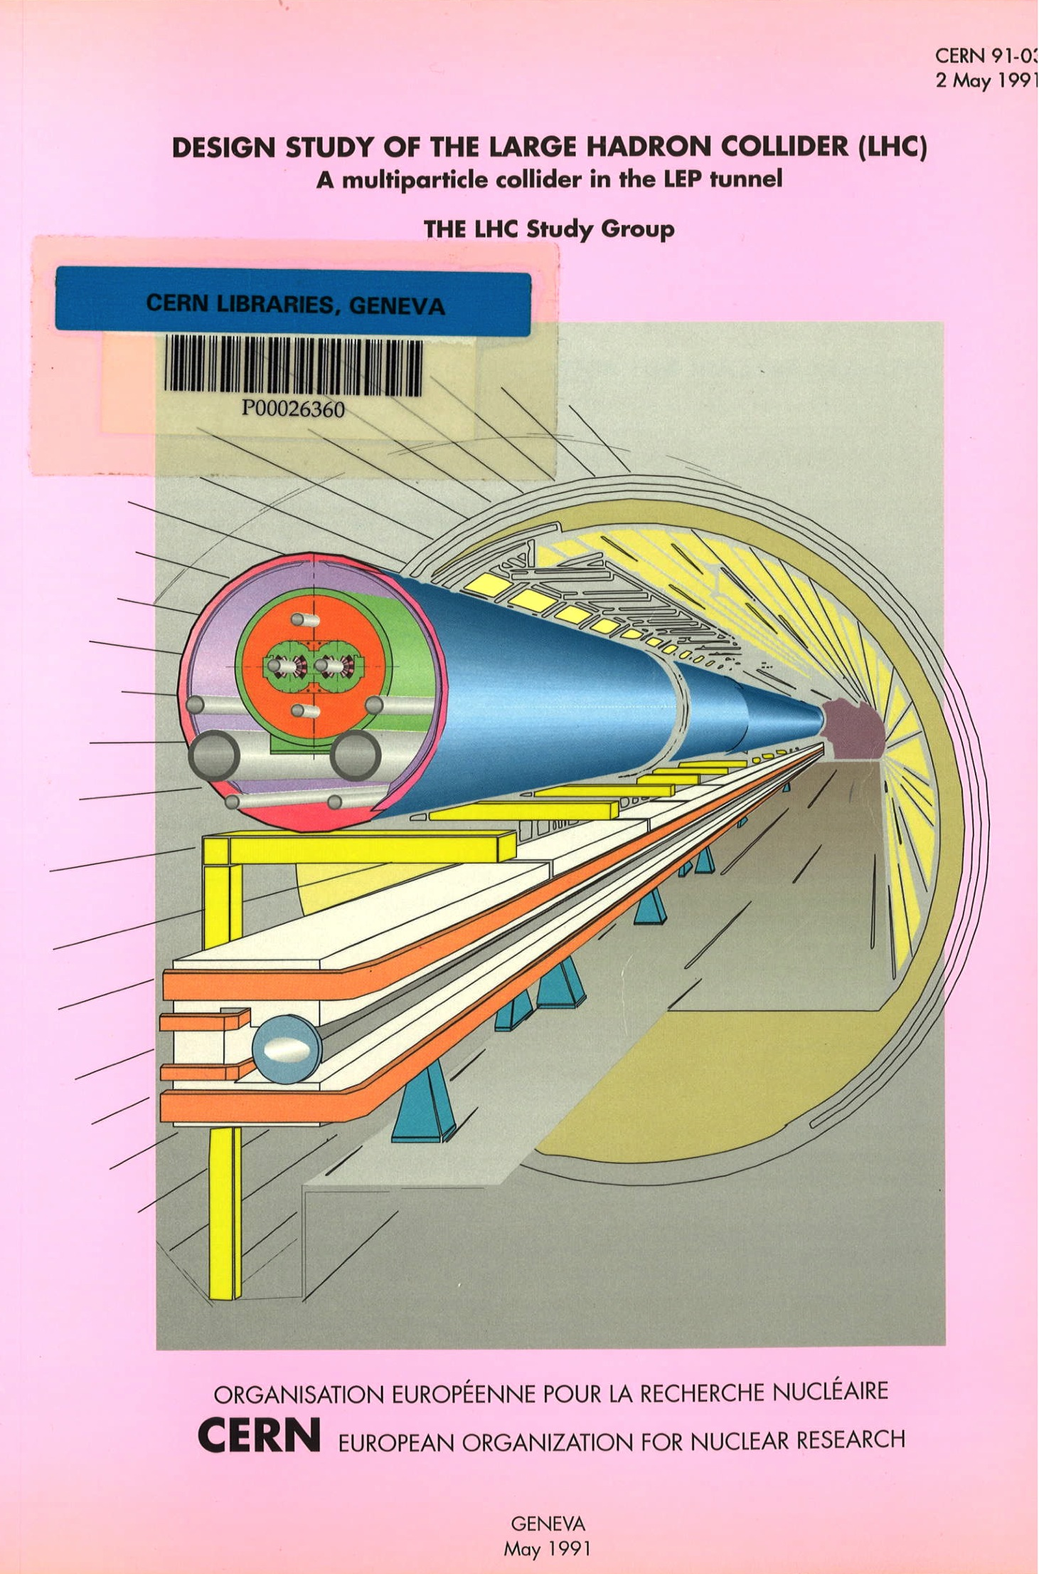
Commit !
1991 – LHC Pink Book the decision was taken to use the more conservative technology:
  NbTi twin aperture, fully coupled magnets
  Cooled over the whole length by superfluid helium at 1.9 K
1-m Models Twin Aperture (MTA) program addressing twin aperture features
Twin Aperture (long) Prototype (TAP) program addressing cooling of long magnets at 1.9 K

Slide 12
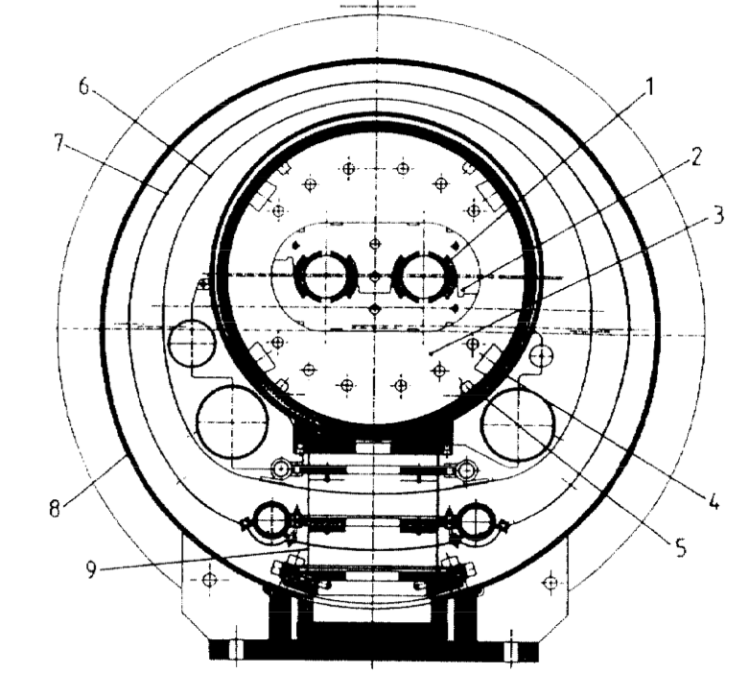
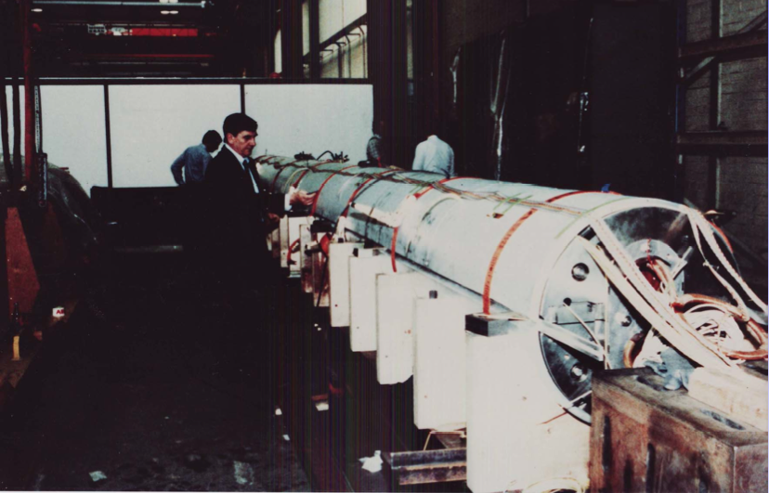
TAP program
Construction at ABB (cold mass) and FBM-Hudson (cryostat) of a twin aperture magnet using HERA-style coils (ABB cable) under the leadership of J. Vlogaert and Ph. Lebrun
1992 – Tests at CEN Saclay, the magnet reaches 5.8 T at 4.3 K and 8.3 T at 1.8 K
D. Granier, et al., Performance of the Twin-Aperture Dipole for the CERN LHC, Proc. EPAC 1992, pp. 1414-1416

Slide 13
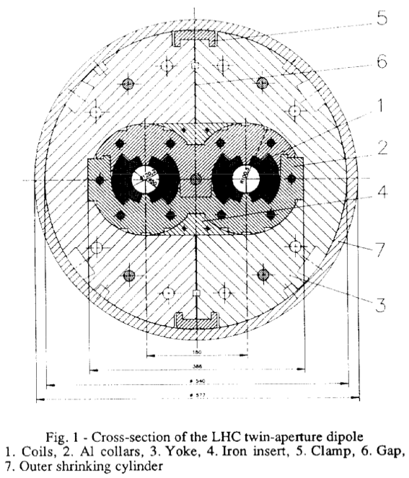
MTA program
1993 – All models (including KEK models) reached rapidly the expected 8 T range at 4.3 K
However, at 1.9 K they fell short of the promised 10 T land, requiring long training to exceed the 9 T mark
In perspective, this was still 90 % to 95 % of the short sample limit, well above the practical operating point of 80 % of short sample, i.e. a badly sold success
D. Leroy and R. Perin, Development of High-Field Superconducting Magnets for the Large Hadron Collider, Proc. EPAC 1990, pp. 326-328

Slide 14
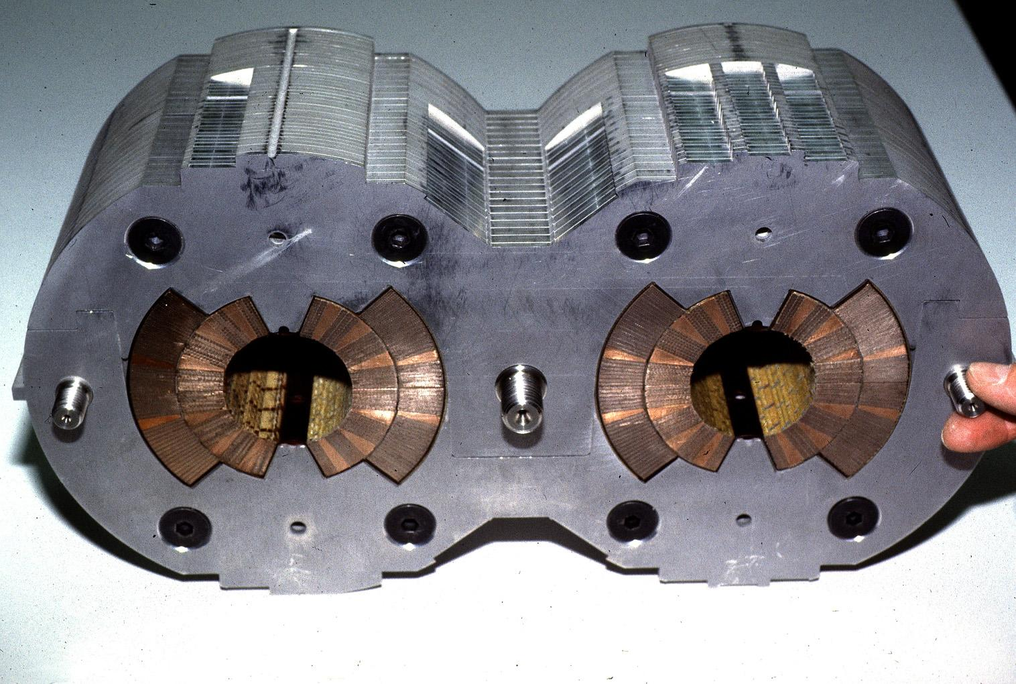




LHC prototypes
17 mm Nb-Ti cable in two grades
6 blocks design
Al collars
1988 – CERN-INFN Agreement for the development of full-size (10 m), twin aperture prototypes (G. Bellini, E. Acerbi, L. Rossi at INFN, M. Bona at CERN)
1989 – Order placed by INFN to Ansaldo Componenti (IT) for the production of two prototypes (MTP1Ax, aka CERN-INFNx), followed by a CERN order for a third prototype (MTP1A3)
1990 – Orders placed by CERN at three more EU producers (Noell, Alstom-Jeumont, Elin-Holec)

Slide 15
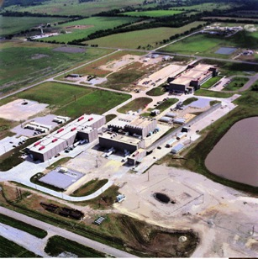
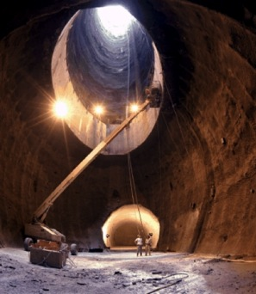
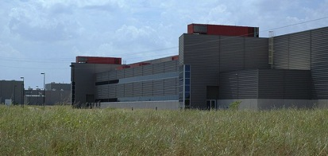

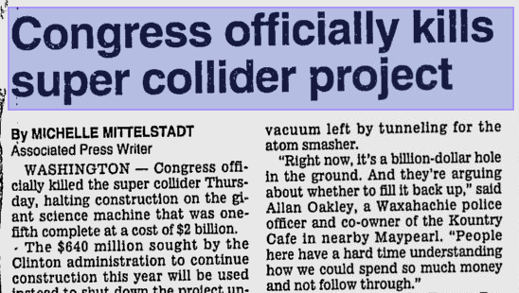
From SSC to Desertron to oblivion
Construction site
1989 – Superconducting Super Collider (SSC) Laboratory established in Texas
1991 – Major construction start. Seventeen shafts sunk and 23.5 km (14.6 mi) of tunnel by late 1993
1987 – Heated debate on cost. Estimate of 4.4 B$ strongly supported by the Texas representative at Congress
1993 – Cost projection reaches 12 B$, similar to the ISS. Strong criticism triggered an audit from DOE
October 1993 – Congress cancels the project, after 2 B$ were spent in the program
Main shaft
SSC buildings

Slide 16
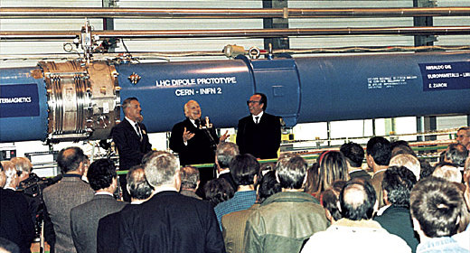
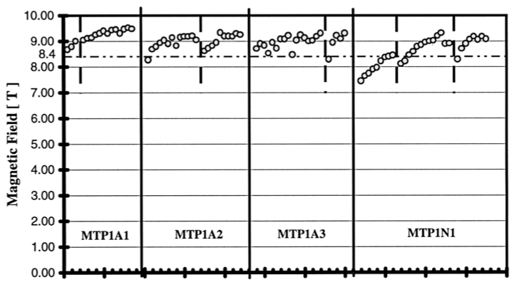
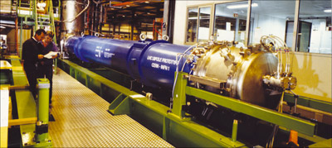
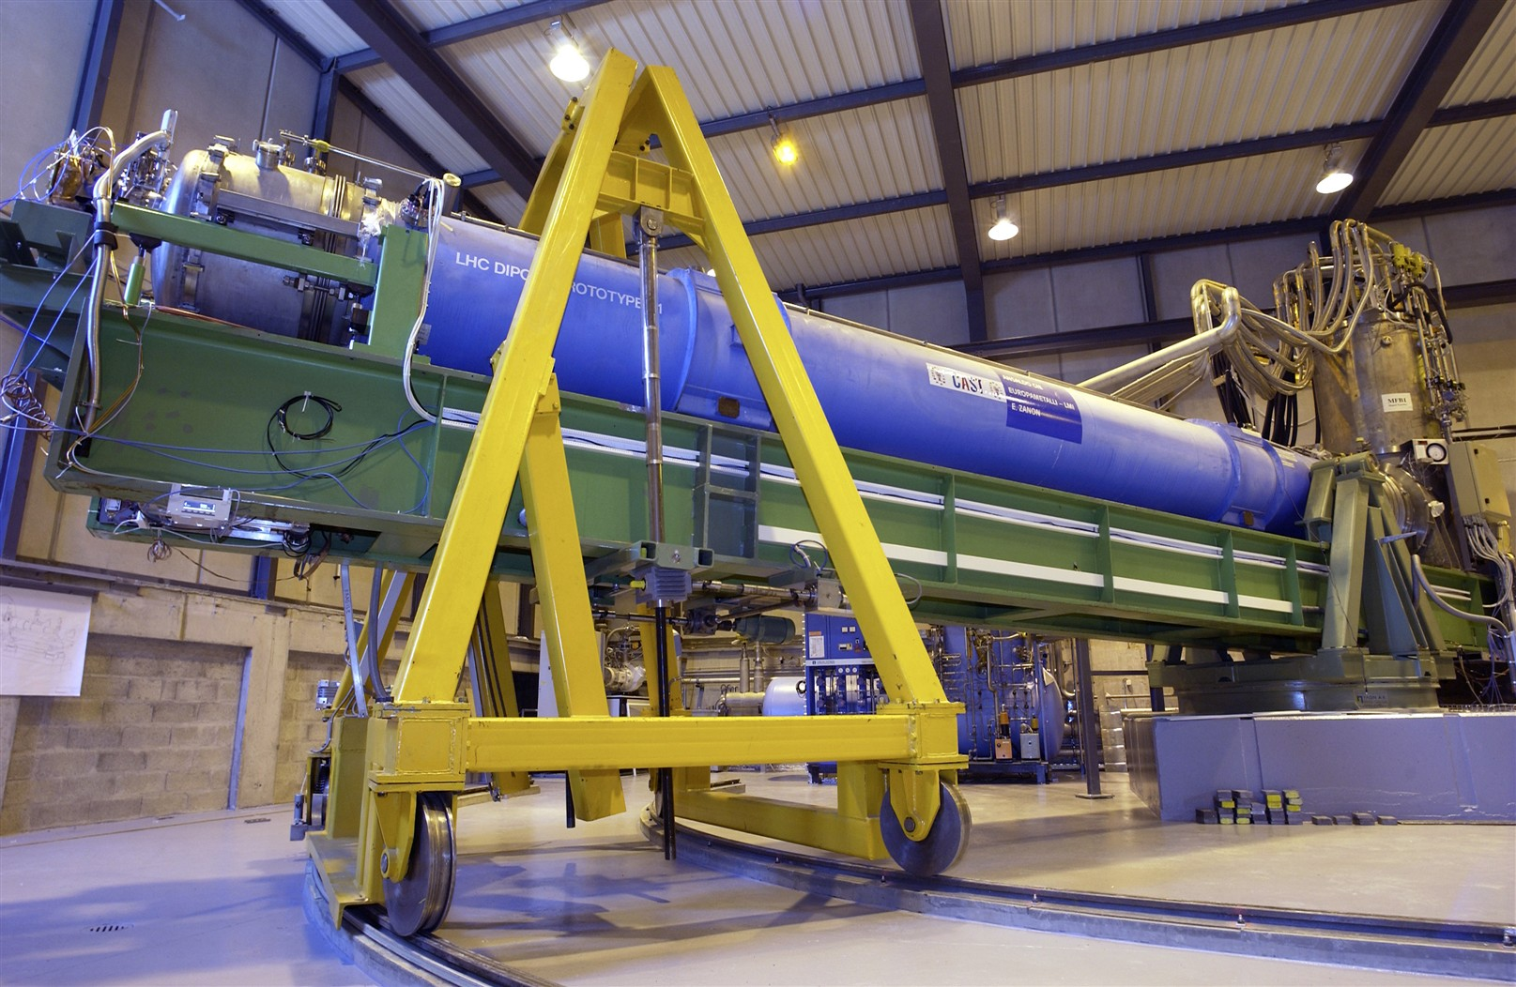
Science, policy and politics
December 1994 – LHC project approved by the CERN Council
1995 – The CERN-INFN 2 in the background (String-1) of Italian president O. Luigi Scalfaro, between R. Perin (left) and L. Maiani (right)
MTP1A1 re-born as CAST
Training of the first MTP prototypes, from: R. Perin, Superconducting Magnets, Proc. PAC 1995, pp. 1282-1287

Slide 17
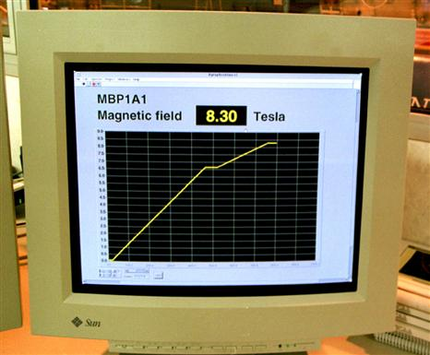
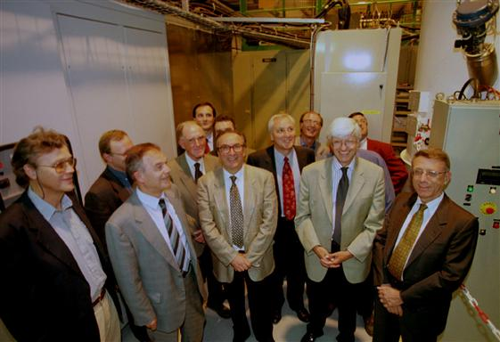
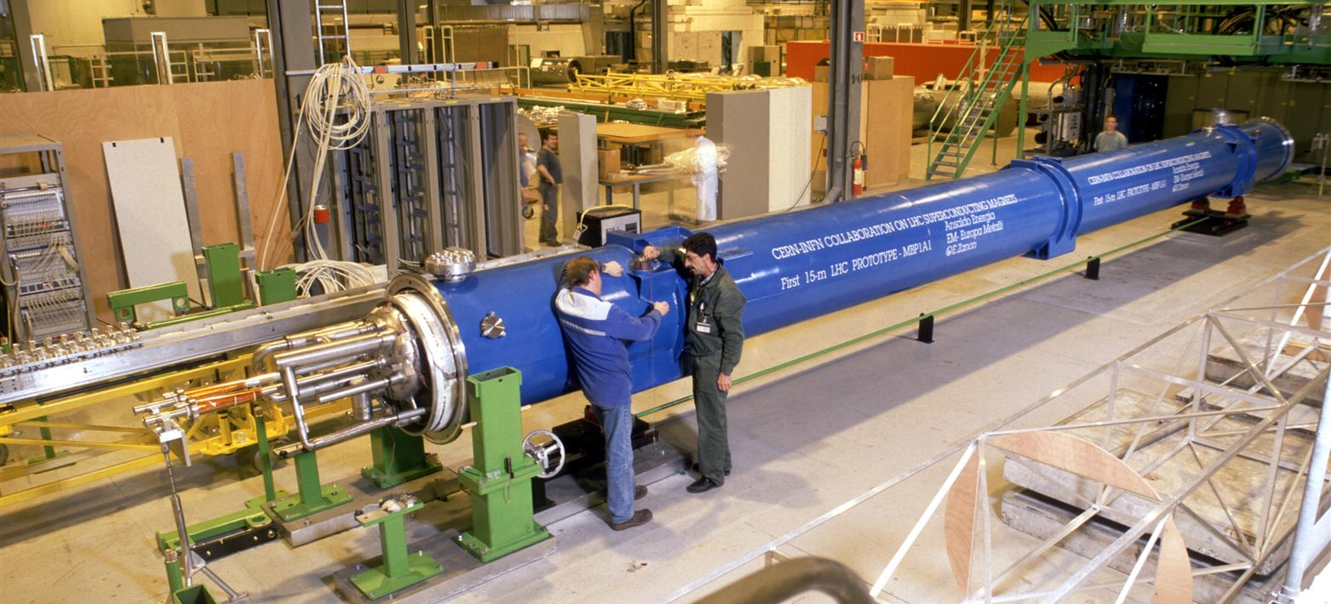
15 m prototypes
1998 – The first 15-m long prototype reaches the LHC nominal operating field

Slide 18
Outline
The LHC pre-history
The making of the LHC
Long live the LHC !
Is there life after the LHC ?

Slide 19
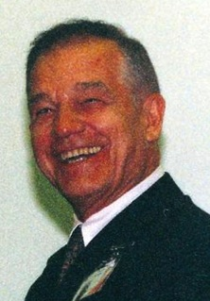
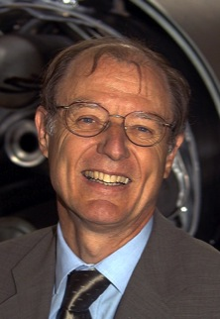
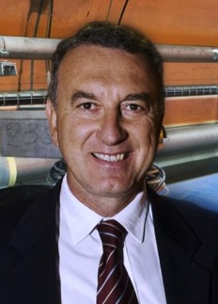
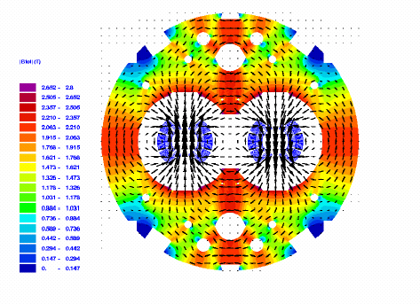
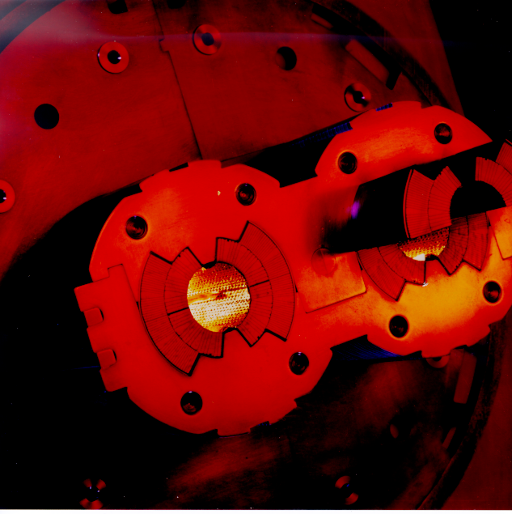
LHC twin-aperture dipole magnets
Concept perfected (design), demonstrated (models and prototypes) and realized on a large industrial scale
R. Perin
C. Wyss
L. Rossi

Slide 20
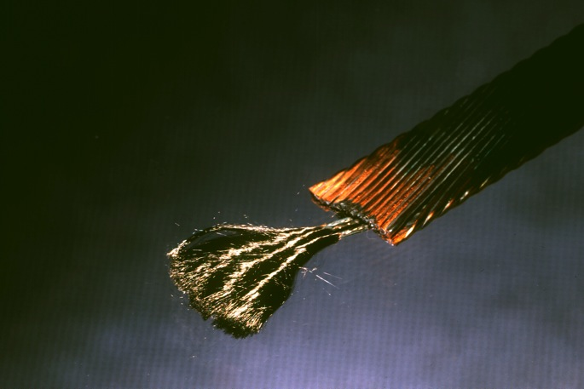
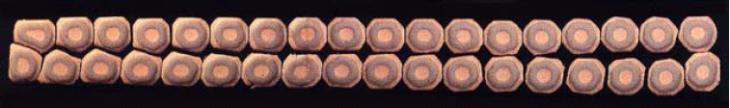
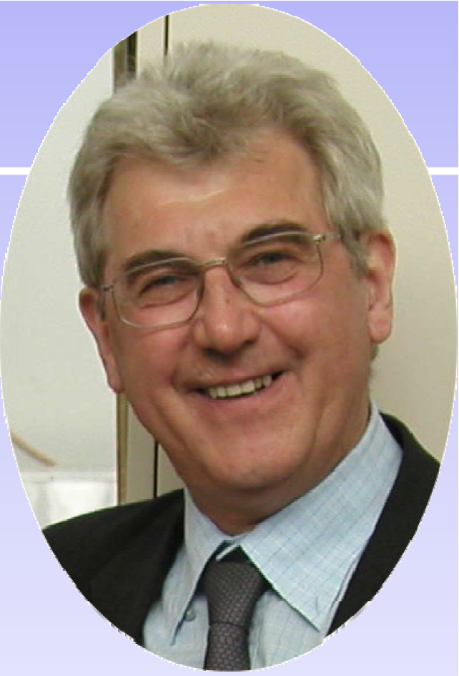
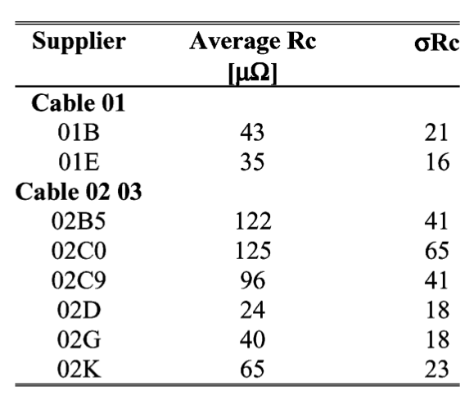
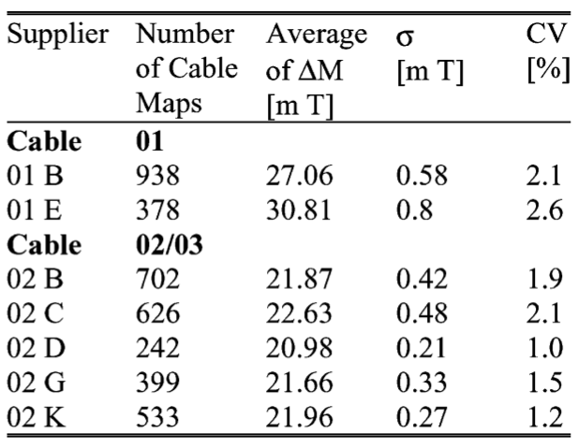
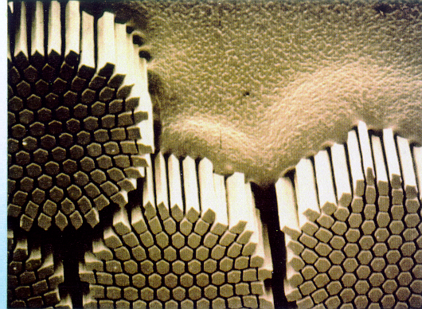
Fine cables
LHC inner cable
LHC outer cable cross section
7 μm filaments
6000 billets, 7500 km of superconducting cables with extremely tight property control
D. Leroy
Stumbling bock for SSC
This is why we can ramp

Slide 21
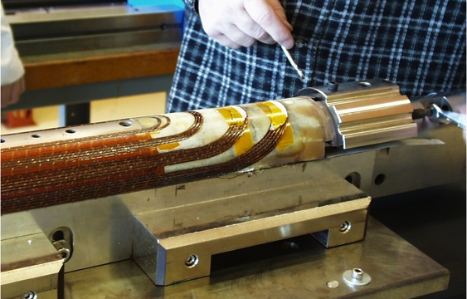
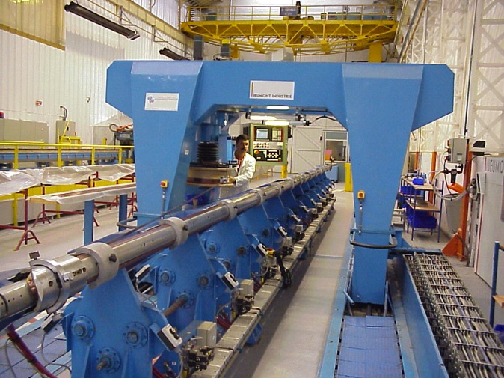


Coil winding
Tight controls on
  Winding quality
  Dimensions (field quality)
Spectacular precision (typical waviness in the range of 20 μm)
By courtesy of E. Todesco (CERN)

Slide 22




Magnet assembly
Geometry of dipoles
Industrial process challenges (e.g. welding)
Tight geometric tolerances
  Sagitta: 1 mm
  IC flanges: 0.7 mm
  Correctors: 0.3 mm

Slide 23


Cryo-magnets and tests
Magnet reception, cryostating, preparation for cold test and “stripping” for installation
Magnet powering tests and magnetic measurements
An industrial approach to the laboratory work

Slide 24


Magnet installation
Logistic and planning
Descent in the tunnel
Magnet transport and installation

Slide 25



Interconnection
65’000 electrical joints
Induction-heated soldering
Ultrasonic welding
Very low resistance
HV electrical insulation
40’000 cryogenic junctions
Orbital TIG welding
Weld quality
Helium leaktightness

Slide 26



Large scale use of HTS
3250 current leads
31 km of BSCCO-2223 tape

Slide 27





The LHC superconducting magnet zoo
By courtesy of S. Russenschuck (CERN)

Slide 28



Short Straight Sections
1994 – CEA short straight sections (SSS) prototypes reach CERN and are assembled in String-I
14 February 1996 – CNRS-CEA-CERN collaboration protocol signed for the procurement of 392 main quadrupoles and assembly in the LHC-SSS
2006 – production completed

Slide 29



High luminosity insertion
LHC point 5

Slide 30



World-Wide Works
World-Wide Works
Approximately 100 contracts and international contributions

Slide 31

LHC !
Injection | (GeV) | 450
Flat-top | (TeV) | 7
Length | (km) | 26.7
Dipole field | (T) | 8.3
Aperture | (mm) | 56
Temperature | (K) | 1.9
Commisioned |  | 2008

Slide 32




Oh, of course, some of the most impressive detectors ever built
CMS
ATLAS

Slide 33








September 10th, 2008…
IR7
IR3
IR6
First turn !

Slide 34





…September 19th, 2008…
Initiated by an unprotected quench of defective joint
NOTE: this is an intentional defect built for testing purposes
Arcing in an interconnection
Over-pressure
Magnet displacement

Slide 35

…back to work in 2009…

Slide 36

…November 30th, 2009…
LHC surpasses a proton beam energy of 1 TeV

Slide 37

… March 30th, 2010
3.5 TeV operation

Slide 38
Outline
The LHC pre-history
The making of the LHC
Long live the LHC !
Is there life after the LHC ?

Slide 39



LHC luminosity in the future
≈ 300 fb⁻¹ by 2020
The target for the projected LHC lifetime is 3000 fb⁻¹
We will need an upgrade by ≈2021:
HL-LHC
M. Lamont (CERN), Private communication
Any reference to existing accelerators and physical quantities is purely accidental

Slide 40










Scope of HL-LHC
Cryoplant for IR’s
IR quadrupoles
Cryoplant for RF cavities
Crab cavities
collimation
SC links

Slide 41

Nb₃Sn knocks at the door

Slide 42








New magnets for HL-LHC
Nb₃Sn
NbTi
Short Model Coil
US-LARP program
FReSCa2
Nb₃Sn Dipole
11 T DS
Nb₃Sn Dipole
HQ/LHQ
Nb₃Sn Quadrupole
MQXC
NbTi Quadrupole

Slide 43








US-LARP magnets
SM
SQ
TQS
LQS-4m
LR
TQC
HQ

Slide 44

Nb₃Sn cables poised to break limits
SMC cable, 1.25 PIT Nb₃Sn wire

Slide 45



SMC-3 at CERN
Thermal cycle
12.6±0.1 T

Slide 46
Outline
The LHC pre-history
The making of the LHC
Long live the LHC !
Is there life after the LHC ?

Slide 47

HE-LHC – (33 TeV cms)
HE-LHC
2030?
SPS+,
1.3 TeV, 2030?
2-GeV Booster
Linac4
By courtesy of R. Heuer

Slide 48

The path to 20 T
By courtesy of P. Lee, Applied Superconductivity Center, NHMFL

Slide 49




Magnets for HE-LHC
Time for a genetic mutation ?!?
For a 17 + 17 TeV collider in the LHC tunnel: 20 T dipoles
Present idea: HTS/Nb₃Sn/Nb-Ti nested coil magnet
Scenario set during the Malta workshop in Oct 2010
high-grade
Nb₃Sn
low-grade
Nb₃Sn
B_{coil}
HTS
Nb-Ti
By courtesy of E. Todesco, CERN

Slide 50

A (maybe) 20 T cable
Roebel cables of punched HTS tapes after an idea of W. Goldacker (KIT)
Manufacturing by IRL Ltd.
First test at liquid helium (4.3 K) and in high field (10 T) show a current carrying capacity of 4 to 10 kA
By courtesy of J. Fleiter, Ph. Denis, G. Peiro, A. Ballarino (CERN)

Slide 51





Conclusions – 1/2
The history of LHC is a history of applied superconductivity.
A history that started 100 years ago…
December 14th: Roald Amundsen reaches the South Pole
May 25th: Pancho Villa raging in Mexico
March 19th – First International Women’s Day
April 8th – K. Onnes discovers supraconductivity
August 22nd: Mona Lisa stolen

Slide 52
Conclusions – 2/2
The history of LHC is also, and foremost, a history of people…
… our supporting sponsors, the DG’s in the period 1984-2010 that defined, defended and did the job
  Herwig Schopper
  Carlo Rubbia
  Christopher Llevellyn Smith
  Luciano Maiani
  Robert Aymar
  Rolf-Dieter Heuer
… two strong project leader of remarkable fiber that navigated very rough seas
  Giorgio Brianti
  Lyn Evans

Slide 53

… and those who made it !

