Slide 1

Welcome to the
SVD-PXD Meeting
Markus Friedl
(HEPHY Vienna)

Slide 2

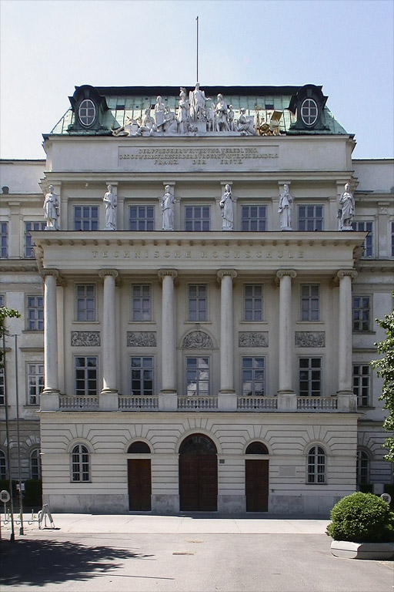
TU Vienna – University of Technology
Location
Founded in 1815
Large university: 26,000 students, 4,000 staff
8 faculties
70 different study courses offered
We are now in the main building constructed 1816-1820

Slide 3
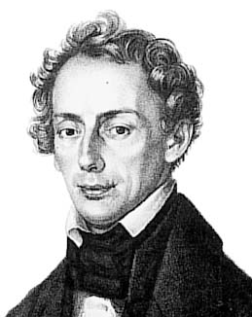
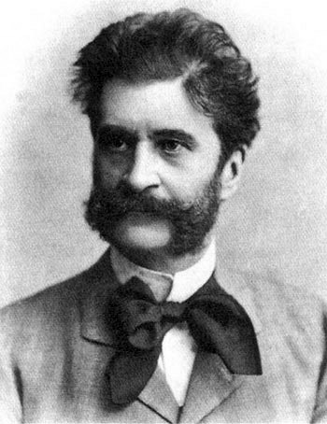
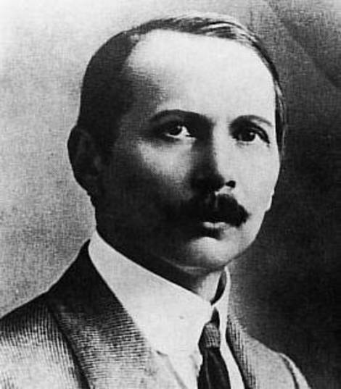
Famous TU Alumni
Location
Christian Doppler (1803-1853), Doppler effect
Johann Strauss jun. (1825-1899),
composer
Viktor Kaplan (1876-1934),
Kaplan turbine

Slide 4
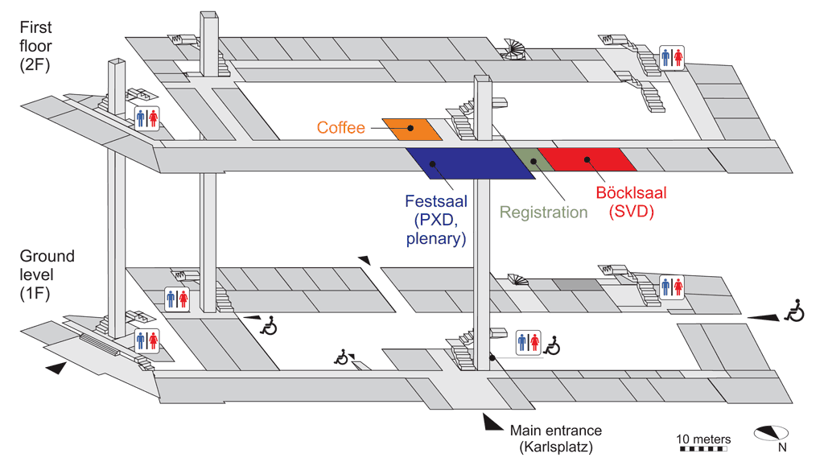
Location

Slide 5
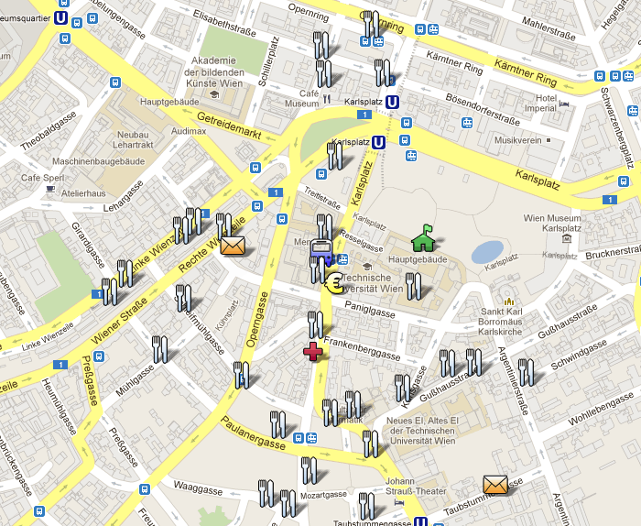

Neighborhood
Location
http://g.co/maps/xktzy or
http://svdpxd.hephy.at
Travel & Hotel → Maps
Lunch
reservation
possible
Mensa
We are here
Nelson’s

Slide 6
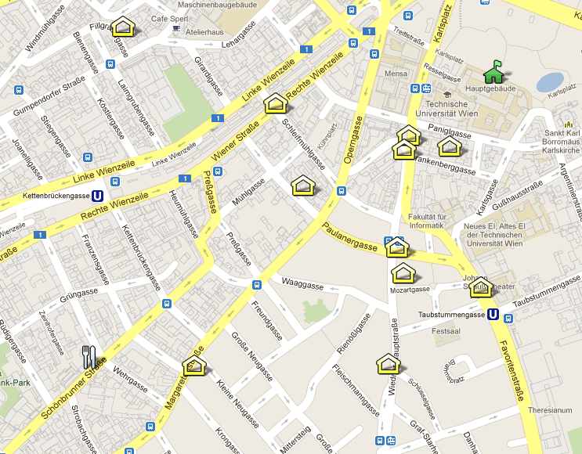
Social Events
Location
Tonight:
Reception & Concert right here
Tomorrow evening: Dinner at Restaurant Waldviert-lerhof
We are here
Schönbrunner Straße 20
A-1050 Wien

Slide 7
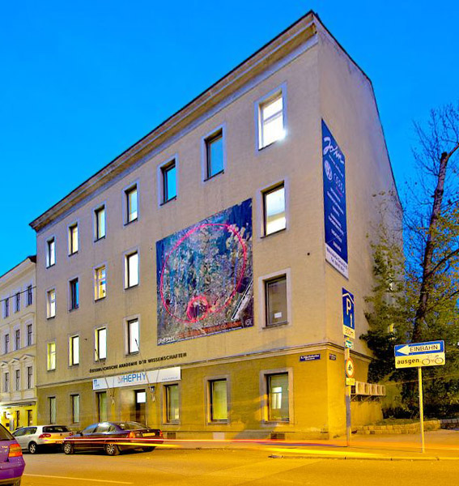

Local Organizer: HEPHY Vienna
Local Organization
Large institute of the Austrian Academy of Sciences
Located at Nikolsdorfer Gasse 18, 1050 Vienna
Staff & students: ~70

Slide 8
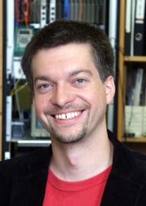
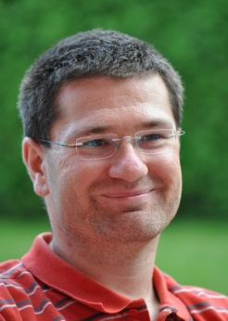
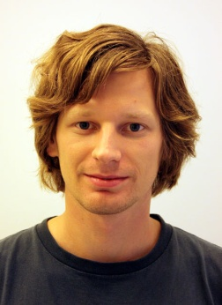
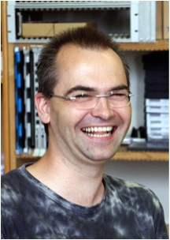
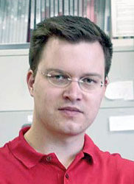
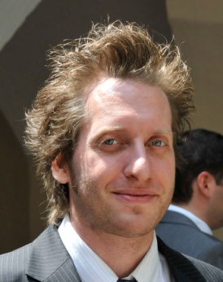
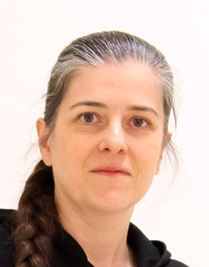
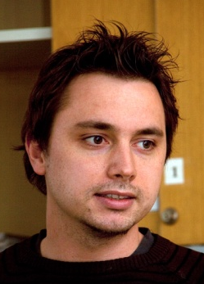
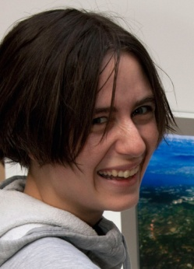
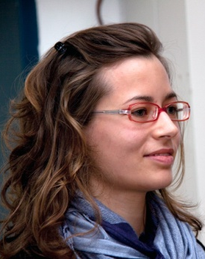
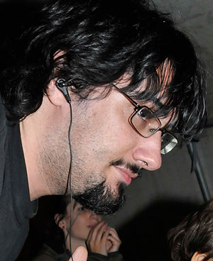
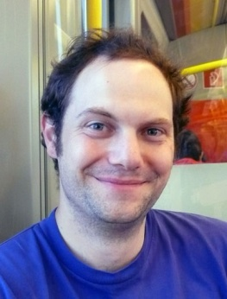
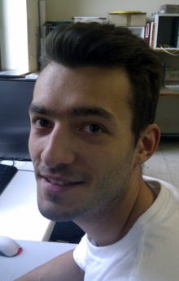
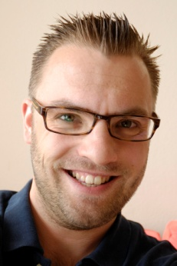
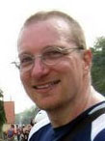
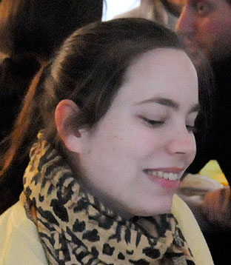
We Are Here to Assist You!
Local Organization
Local Organizing Committee
&
Helping Hands

Slide 9
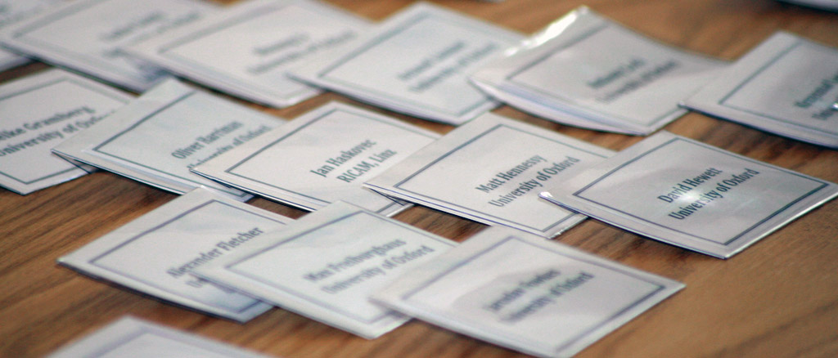
Registration Desk
Local Organization
Open every day from 8:30 until end of scientific program
First address for all kind of organizational issues

Slide 10
Presentations
Schedule
Please upload your talk to Indico well before your session starts
If that fails, you may bring it on a USB stick to the reception

Slide 11
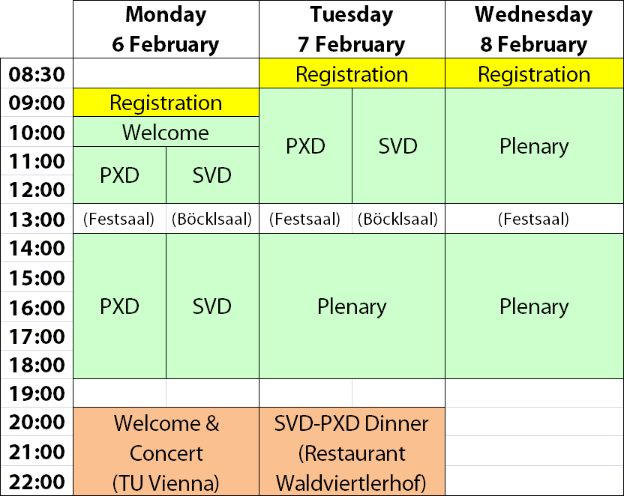
Timetable
Schedule
Please look at the Indico timetable for details: http://indico.cern.ch/event/svdpxd
Group photo taken Tuesday 16:00 (coffee break)

Slide 12
Internet Access
Practical Issues
WLAN
  Use „tunet“ (open)
  Open any website in browser and enter personalized access codes according to the sheet in your folder
  Then you have full internet access (Web, SSH, Mail,…)
  Eduroam is also available

Slide 13
Public Transportation
Practical Issues
Sorry, but we do not provide tickets at the registration desk
Tickets are available from
  Tobacconists
  Vending machines in underground stations
Ticket types:
  Single trip (including changes) € 1.80 (short distance: € 0.90)
  4 strips (each valid for a single trip) € 7.20
  Various tickets valid for one or more days
Please consult http://svdpxd.hephy.at/travel-hotel/public-transportation for additional information
Entering platform of underground requires punched ticket

Slide 14
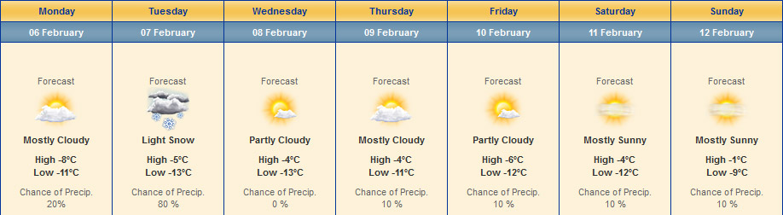
Weather Forecast
Finally…
Beware – it‘s cold in winter… ☹
There might be snow on Tuesday (meeting dinner)
Source: http://uk.weather.com/weather/10day-Vienna-AUXX0025

Slide 15
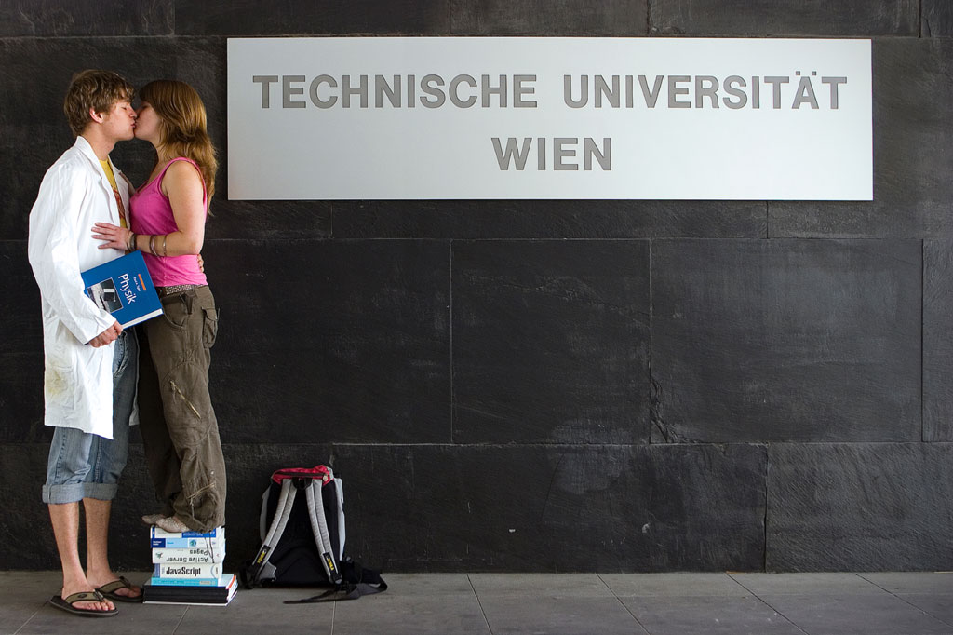
Enjoy the meeting!

