Slide 1
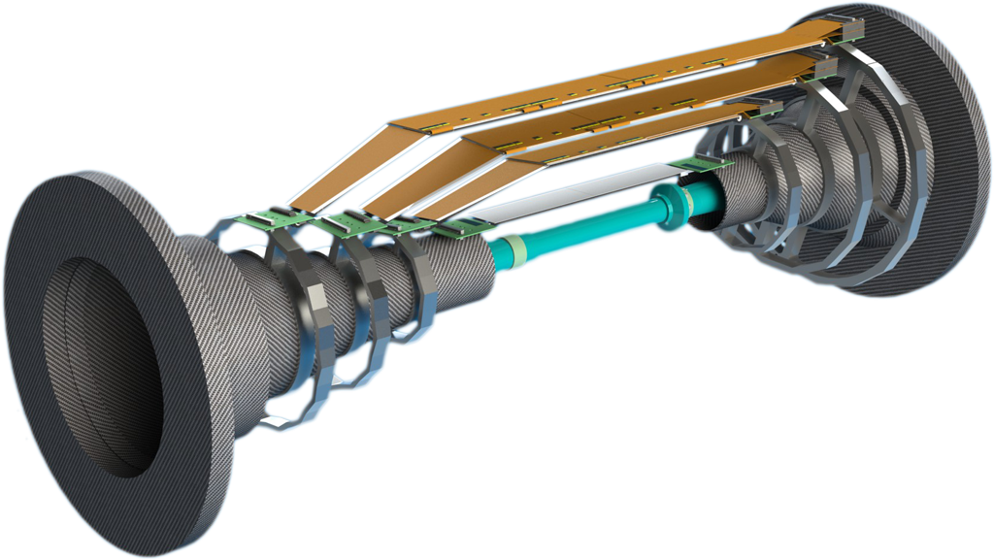
SVD-PXD, 6 February 2012
SVD Schedule
Markus Friedl (HEPHY Vienna)

Slide 2
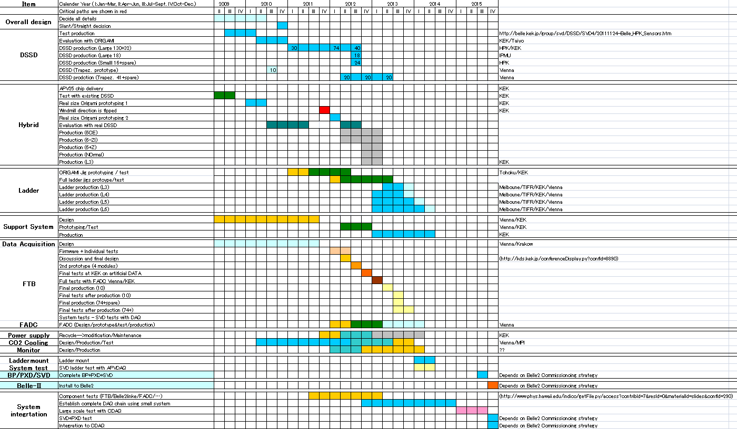
Overall
SVD
Schedule
by Toru

Slide 3
Detailed Schedule with HEPHY focus
Made for HEPHY resource planning
Starting from realistic assumptions, not the overall schedule
Realized important dependencies
Comparison with overall schedule reveals some (minor) differences
Full schedule (10 pages) is available in Indico for download

Slide 4
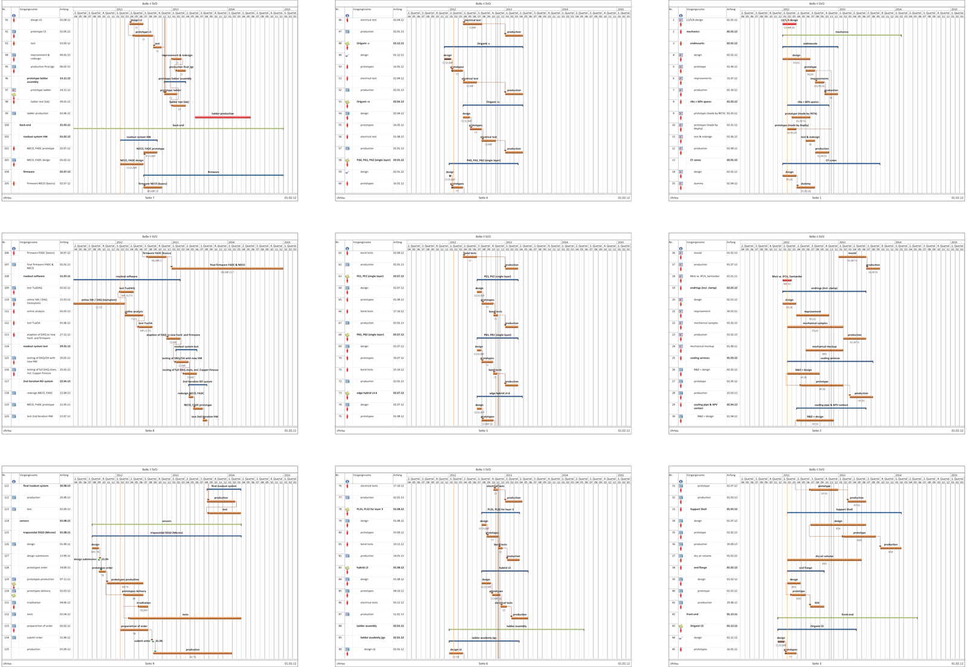
Detailed Schedule with HEPHY focus

Slide 5
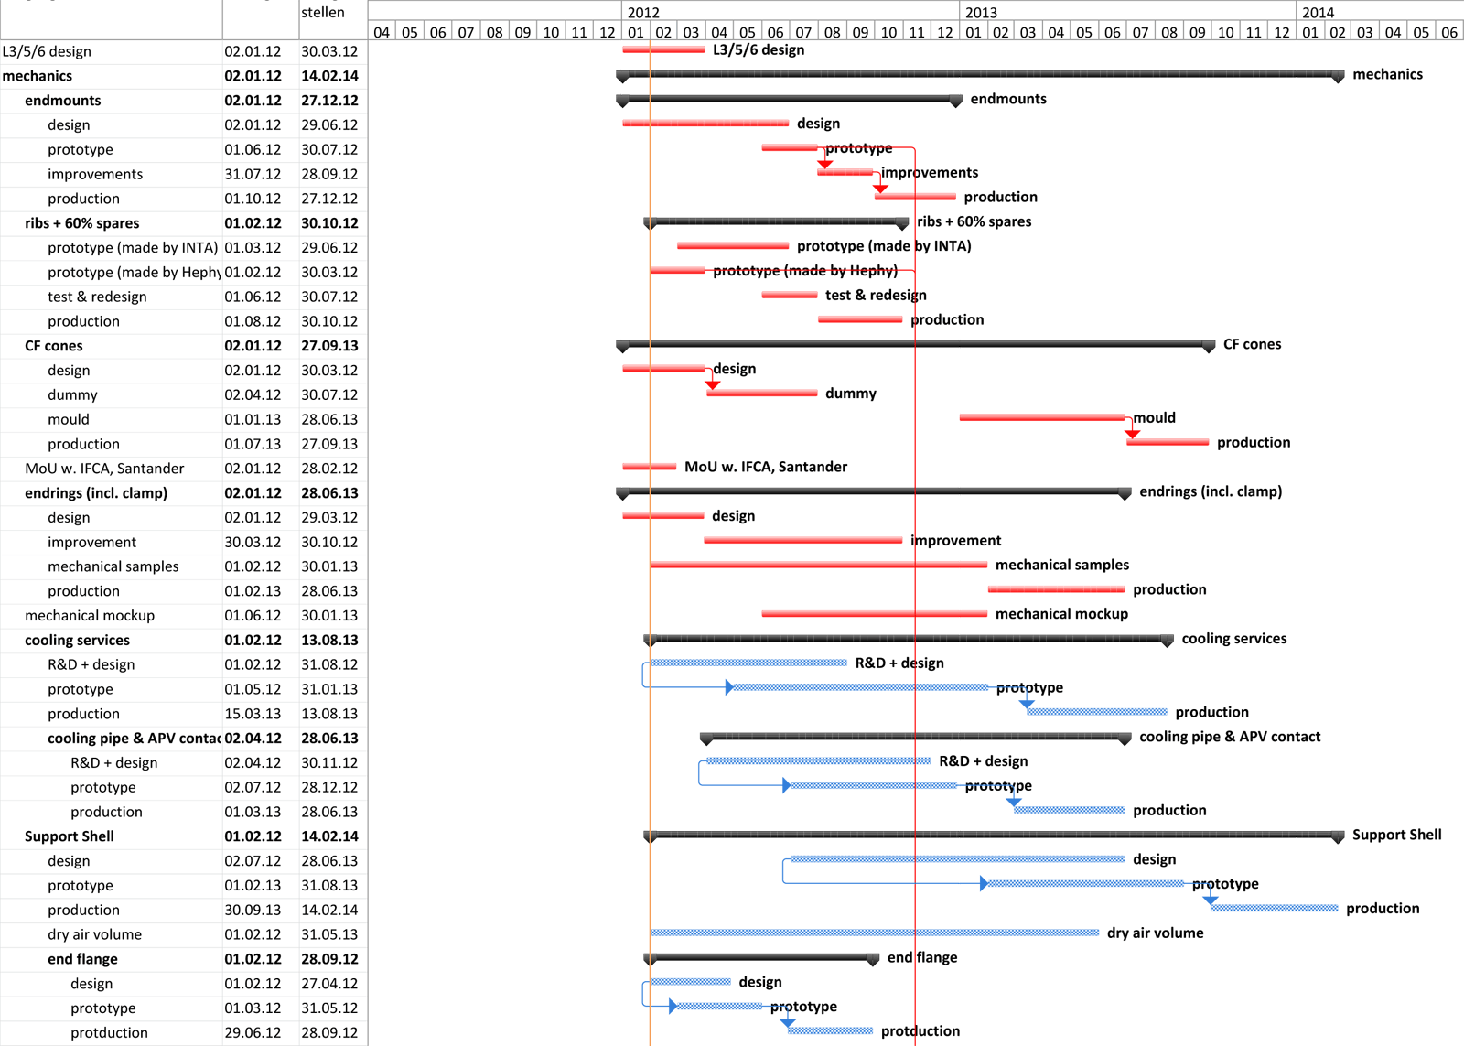
Mechanics
Ladder configuration MUST be frozen by March B2GM,
otherwise many other things will be delayed!

Slide 6
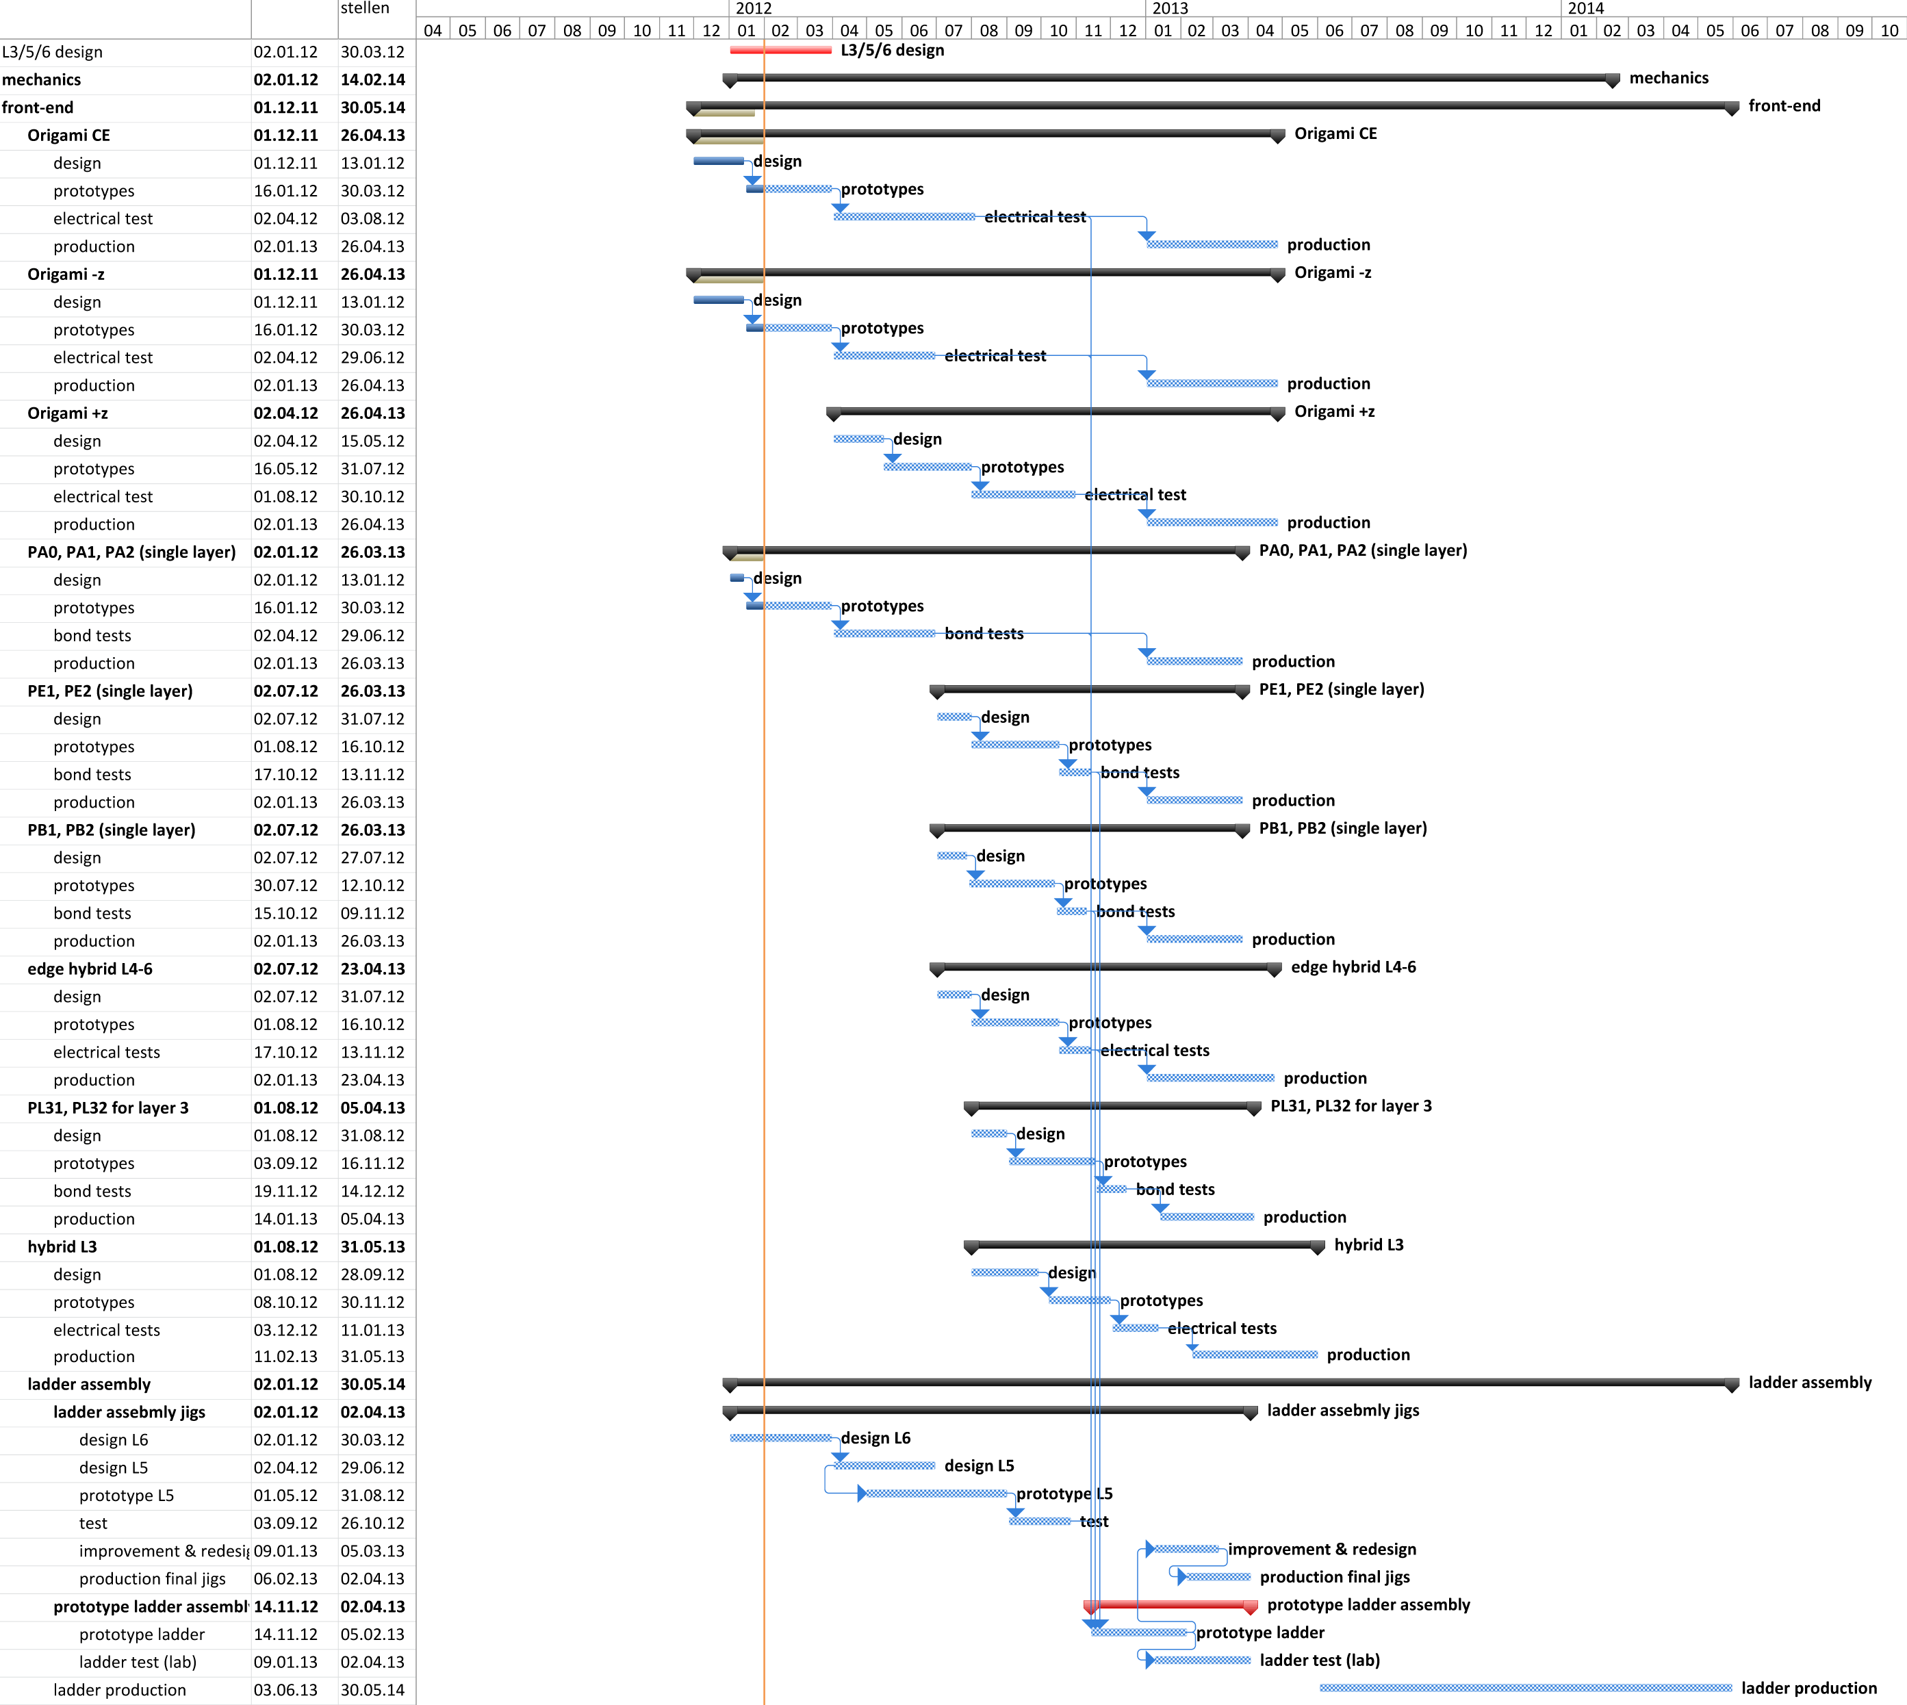
Front-End
Ladder configuration MUST be frozen by March B2GM,
otherwise many other things will be delayed!

Slide 7
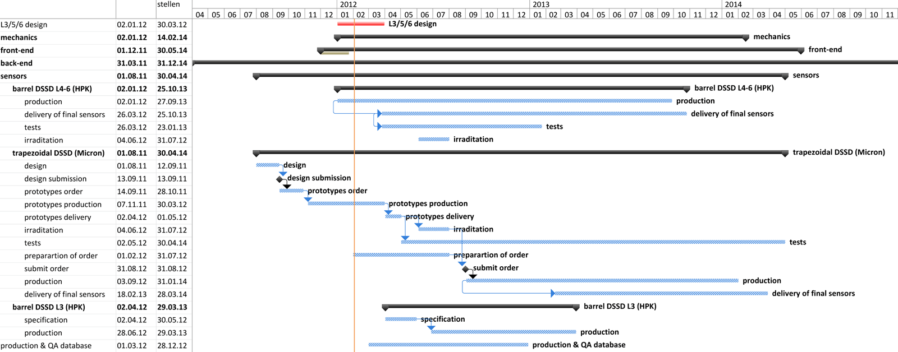
Sensors
Looks less complicated (fewer parts)
Nonetheless: essential input to ladder production
L3 geometry affects sensor specs (size, pitch)
Production & QA database needed → Thomas (Wednesday)

Slide 8
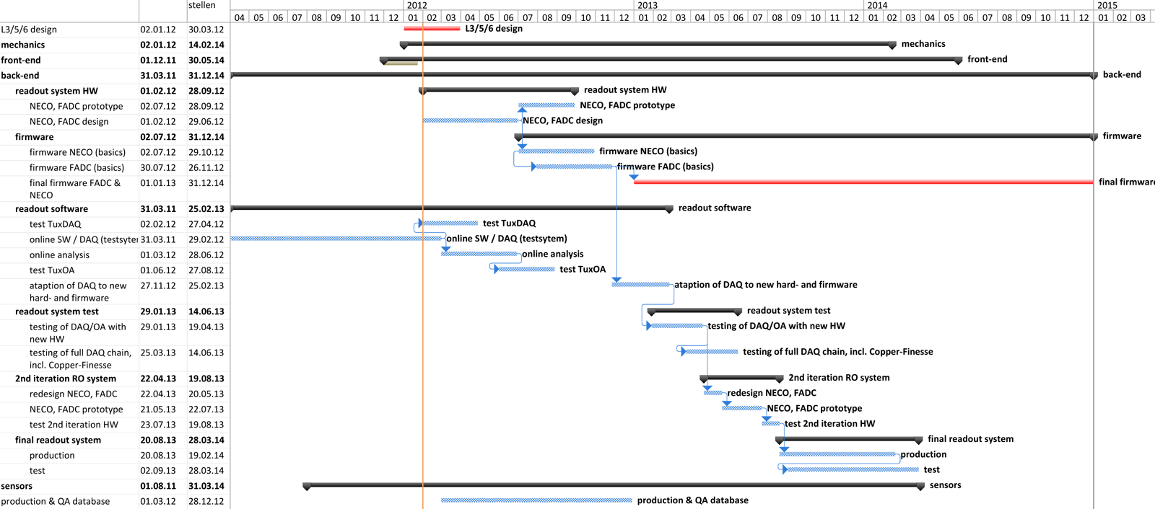
Back-end
Relatively independent from others
Firmware development will likely continue after Belle II start

Slide 9
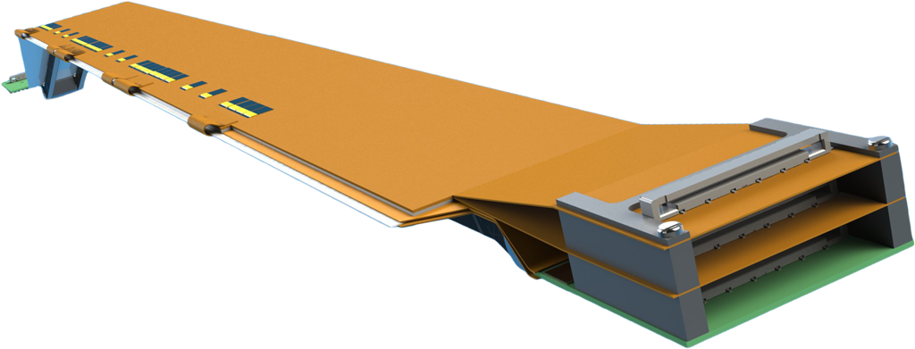
Ladder Assembly
Proposal for share:
  Layer 6 – KEK/Tokyo
  Layer 5 – Vienna
  Layer 4 – Melbourne
  Layer 3 – ?
Other potential sites:
  Seoul – likely (requires bonding station)
  Mumbai – problematic (APV25 export restrictions)
  Karlsruhe – unlikely (other priorities)

Slide 10

Summary
Detailed schedule and resource planning for HEPHY
Most important topic now: SVD ladder geometry
  Hope to converge in this meeting
  Finally freeze by March B2GM at latest
  Otherwise overall schedule will not hold
Proposal for ladder assembly
  Let’s discuss…

