Slide 1
PXD Summary
PXD Sessions:
DEPFET
PXD6 evaluation, irradiations, SOI, PXD9
2) ASICs
DCDB tests, SDS, DHPT 01
3) PXD Characterization
Hybrid tests, in pixel tests, PXD6/DCDB2, ELSA irradiations, gated mode, QC
4) Module Concept/Interconnection/EMCM
Interconnects, EMCM, Tests in Valencia
5) Monitoring Software
DAQ and monitoring, slow control -> monitoring group
6) Testbeam
Results, Plans
7) Services/PS/Grounding
PS, Kapton, PPP, Services, Signal Integrity, Overvoltage Protection, Grounding
8) DAQ/DHH
DHH status, ATCA status (ONSEN)

Slide 2
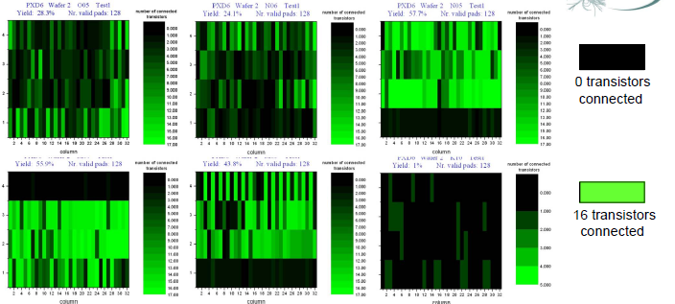
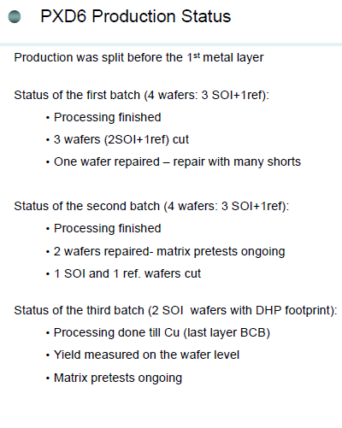
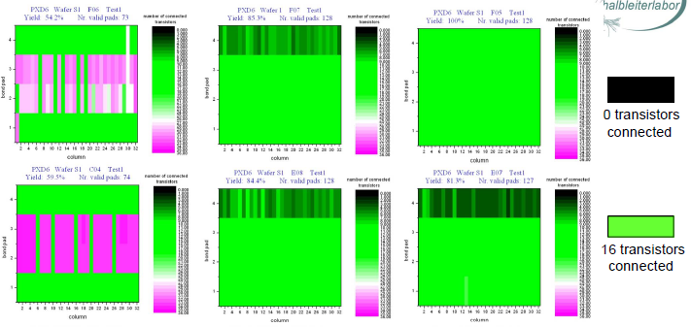
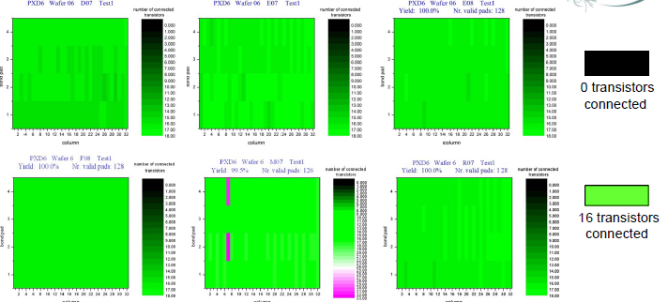
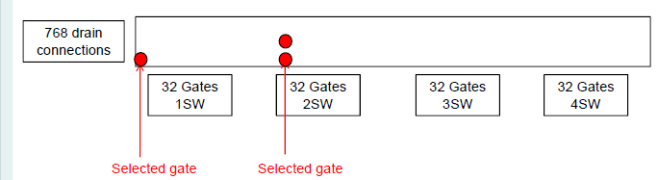
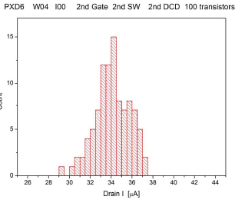
PXD6 tests
Measuremtents of full size matrices started

Slide 3
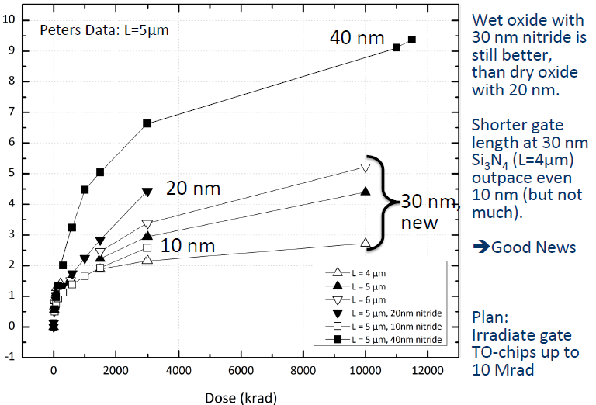
Irradiations
PXD6 has a wet oxide instead the dry oxide of previous versions
Wet oxide turns out to be more radiation hard than dry one
=> We can use nitride with a comfortable thickness !

Slide 4
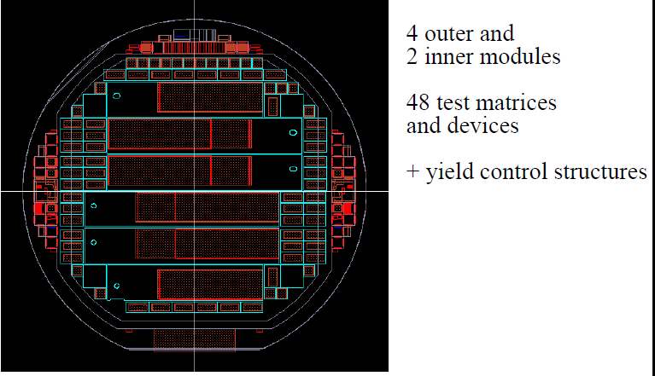
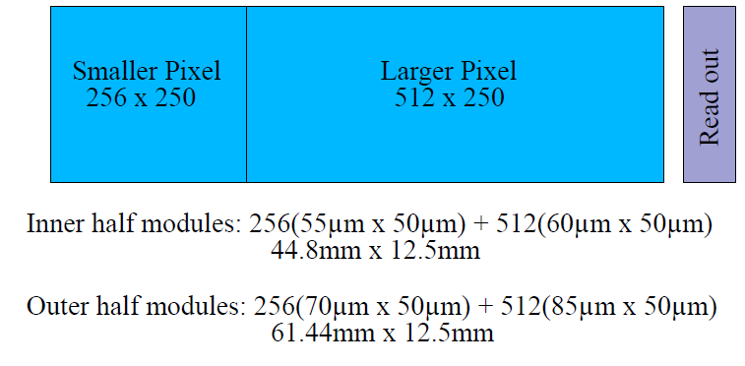
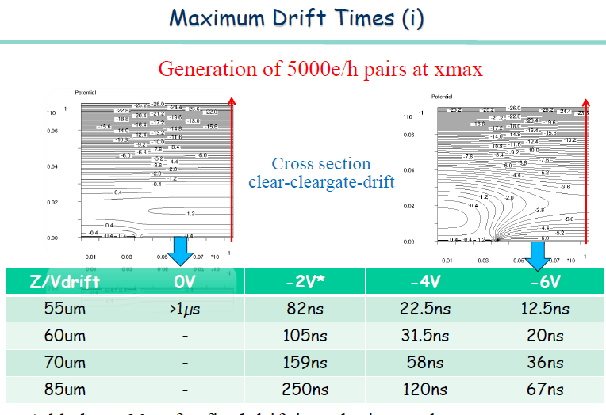
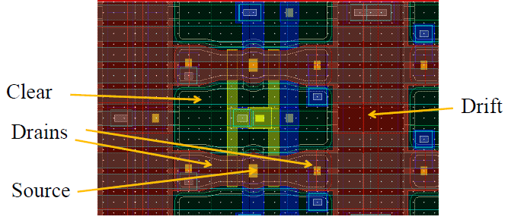
PXD9

Slide 5
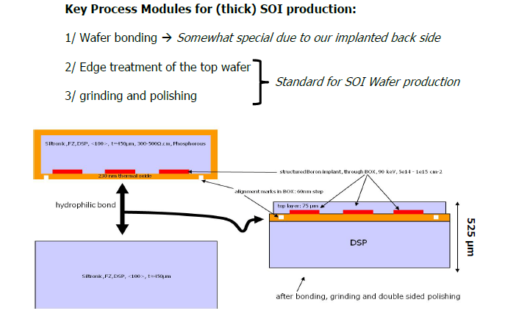
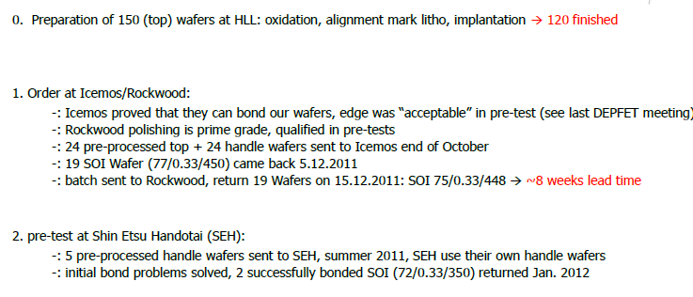
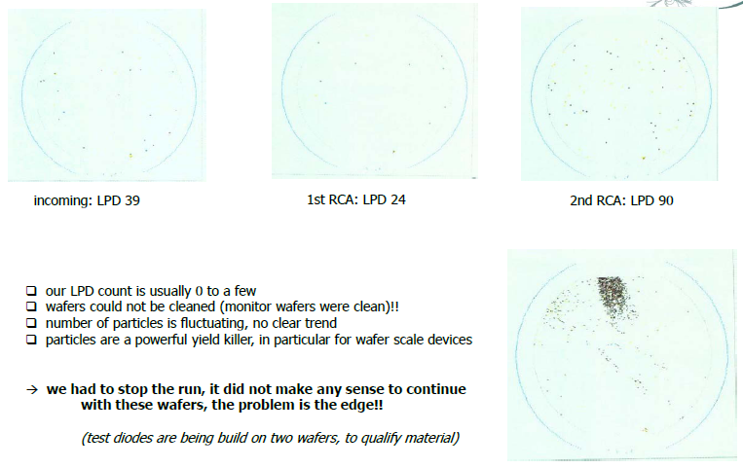
SOI
Processing of PXD9 scheduled
to start February 2012
Had to stop processing
Need to repair wafers or procure
new ones

Slide 6
SOI: next steps
Repair wafers (cover edge with poly, re-polish, inspect) restart in March
ICEMOS will try a new edge treatment
(etching instead of grinding) restart in May
3) Wafers from Shin Etsu
edge quality of standard wafers ok
bonding ok (but not with the edge quality required)
need more R&D restart in August
Need to re-schedule
Plan with prototype run & main production: already late (finish PXD end 2015!)
PXD9 will become main production
Even with 6 months delay (Shin Etsu): PXD ready in time (August 2015)
Backup production still possible if yield low (but with a delay) -> plan B

Slide 7
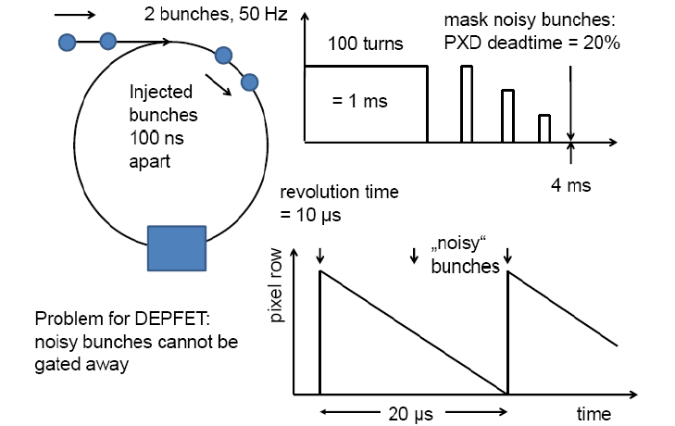
Injection Noise: Gated DEPFET
Injected bunches are noisy and spoil data
Can we gate the DEPFET during the passage of a noisy bunch?
~ 20% loss of data (with some uncertainty about actual damping time)

Slide 8
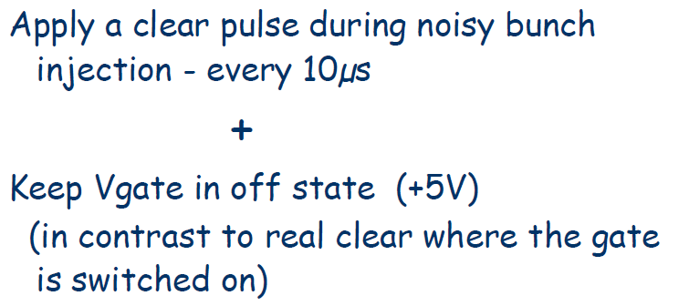
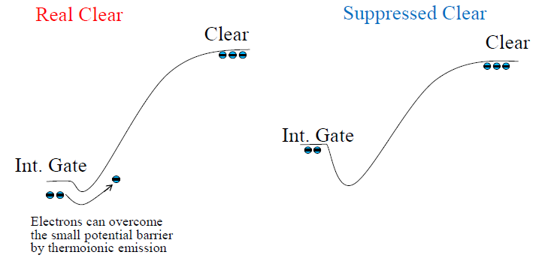
Gated operation
Potential difference controlled by external gate

Slide 9
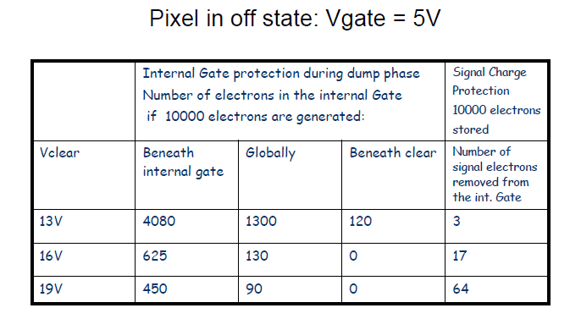
Simulation
Measurements will be done by Felix Müller. stay tuned!
Note: even a slight penalty in performance would outweigh a 20% loss of data!

Slide 10
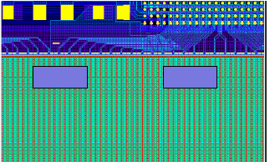
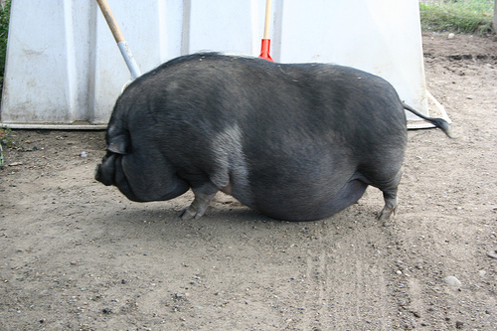
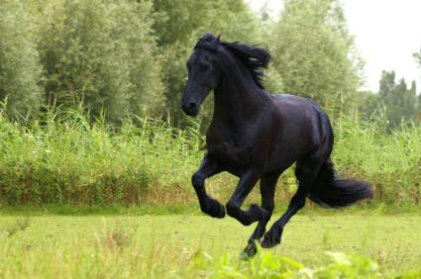
Caveats
Potential problems:
large currents for global clear: 30 mA
more power: 360mW/module
need caps (2 x 200 nF); where?
modifications of switcher, DHP needed
complicated readout cycle

Slide 11
Dynamic Range
We need a certain dynamic range to see a signal of up to 2.5 MIPs (? tbc) with 128 bit resolution
On top of
DEPFET/DCD pedestal spread
Common mode fluctuations (per input line)
Variations due to radiation damage (threshold voltage shift)
Basics:
Max. baseline compensation of DCD-B2: 200µA (common for each DCD)
Input current compensation: up to 0/8/16/24 µA (2 bit DAC)
Option in DCD-B2: input common mode compensation up to 200µA (300 ? tbc, not yet tested)

Slide 12
DEPFET current range
geometry
Threshold voltage: depends on irradiation
Gate voltage: adjustable
Inhomogeneous threshold voltage shift leads to a large pedestal dispersion!
And to a dispersion of the DEPFET gain, too!

Slide 13
Data versus Model
Good agreement till ~ 125 µA (then deviations from the simple model are expected)

Slide 14
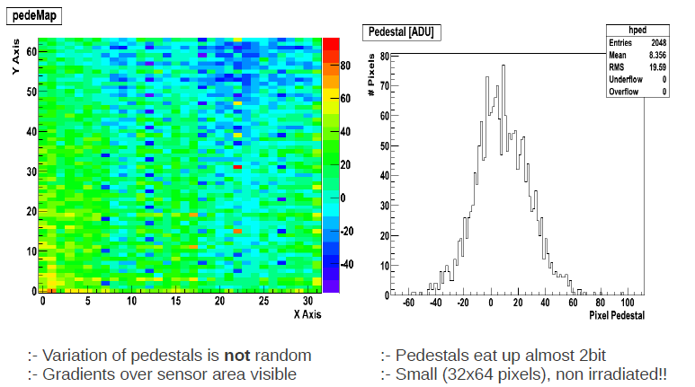
Pedestal Spread
Rather large pedestal spread in
Hybrid 4.1.04
100 ADC counts => 10µA
~ 0.3 volt shift
Some gradient along and across matrix
But, this is a small matrix!
Perhaps, this is a somehow sick matrix
Need more statistics and systematic investigations

Slide 15
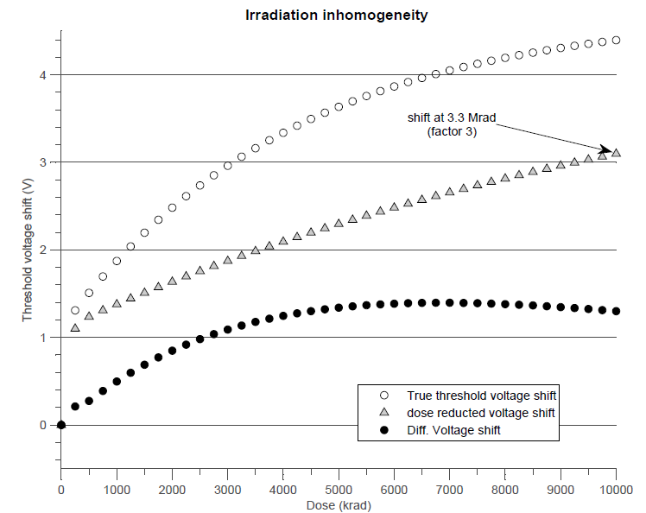
Threshold voltage difference
Thin wet oxide (like in PXD6)
Factor 3 difference
In fact: module divided in three sections
Facto3 3 across 1.1 cm!
Anyway:
Max ΔV < 1.5V
A. Ritter

Slide 16
Pedestal Compensation
Raw pedestals
After baseline comp.
After DAC subtraction.
DAC 11 24 µA
8 µA
DAC 10 16 µA
Min signal range: 8µA
128 steps
Max pedestal spread: 32µA
DAC 01 8 µA
ADC: 16µA
256 steps
DAC 00 0 µA
Input CM compensation <200µA (in steps of <2µA – 7bits?)
Option in DCD-B2: input CM compensation <200µA
ADC step 16µA/256 = 62.5nA

Slide 17
Max allowed pedestal spread of 32µA
Residual dynamic range for signal: 8 µA
MIP ~ 2.7 µA (gq 0.45nA/e): 3 MIPs!
but: common mode!
Input CM compensation should help
may be affected by disconnected or noisy channels:
One noisy channel with 100µA offset would give 0.4µA offset: ok
6/256 channels disconnected: CM wrong by 2%: 2µA for 100µA offset: probably still ok
Real hit: 2.7µA/250 ~ 0.01µA, negligible
Nevertheless: this is a 2nd order effect and will be exactly corrected by the DHP
We just have to make sure that the residual CM does not saturate the dynamic range

Slide 18
Range if we have DAQ only
Lower limit of Id: minimum acceptable qg => minimum signal/noise
Assume: S/N > 20:1
Noise 100 nA
Signal: 2µA for 6000 electrons => gq(min) = 0.33 nA/e
For L=5µm W=20µA we need
Id(min)=34µA @ 1.2V
Upper limit of Id (DAC range) :
Id(max) = Id(min) + 32µA = 66µA
The max voltage shift which keeps Id between 34µA and 66 µA is ~ 0.4 V
gq varies between 0.33 nA/e to 0.44 nA/e

Slide 19
Range with DAQ only

Slide 20
with input CM compensation
Lower limit of Id: minimum acceptable qg => minimum signal/noise
Assume: S/N > 20:1
Noise 100 nA
Signal: 2µA for 6000 electrons => gq(min) = 0.33
For L=5µm W=20µA we need
Id(min)=34µA @ 1.2V
Upper limit of Id: can compensate shifts up to full DCD range (200µA):
Id(max) = 200µA – signal range (8µA) = 192µA
The max voltage shift which keeps Id between 34µA and 192 µA is ~ 1.6 V
gq varies beween 0.33 nA/e to 0.76 nA/e (a MIP is 4.5µA!)
This would be ok, given the expectations!
(and, we still have the segmentation!)

Slide 21
Range with CM compensation

Slide 22
Conclusions
Main worry: availability of SOI material!
Project already delayed!
Rely on improvements at ICEMOS (in work) and/or Shin Etsu
Otherwise, things look pretty good
Noteworthy: gated operation to suppress injection noise seems possible
However: system aspects (power, current)
Need to understand operation parameters:
pedestal spread
dynamic range
max. compensable threshold voltage shift!
Need to change attitude:
from proof of principle => limits of operation
We need to implement “imperfections” in MC
Need guidance what performance parameters are critical!

Slide 23

Thanks to the Vienna team for hosting this great workshop!

