Slide 1

Meeting Dinner
Restaurant
Waldviertlerhof

Slide 2
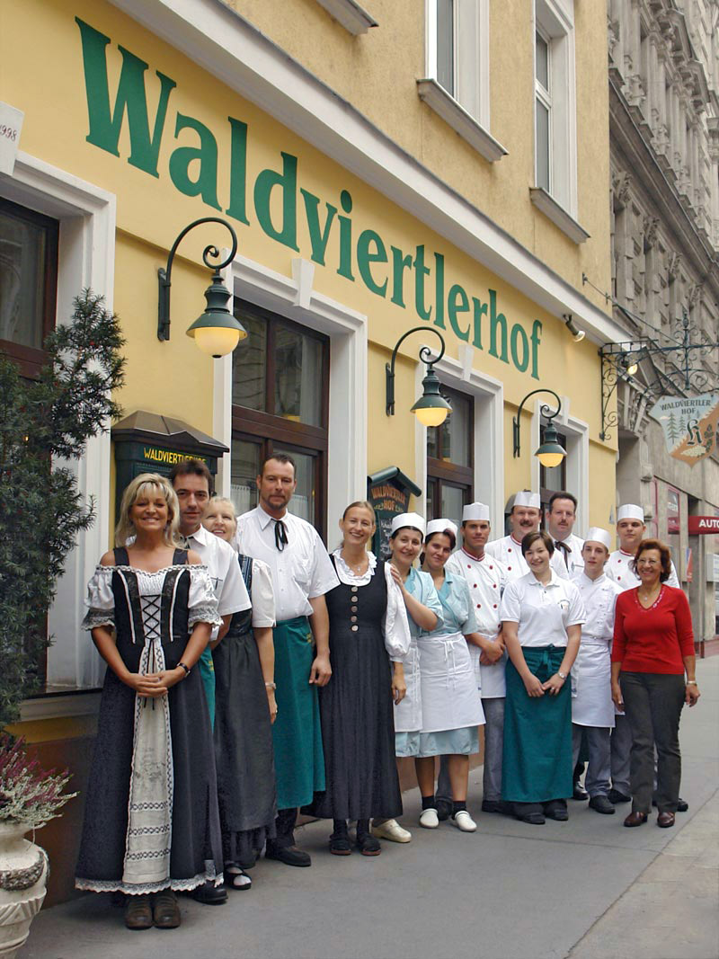
Waldviertlerhof
Traditional Austrian cuisine
Starting time: 20:00
Address:
Schönbrunner Straße 20, 1050 Vienna
Walking distance: 1.2km
Public transportation: bus
Each takes ~15 minutes

Slide 3
Bus Route
MEETING
Public transportation: bus 59A from Bärenmühldurchgang (direction Philadelphia-brücke) to Ziegelofengasse (3 stops)
Short
distance:
Half-price
ticket
(children)
is sufficient!
DINNER

Slide 4
If You Want to Go There With Us
We will guide you there (walking)
We meet here (at the registration desk) at 19:30
Of course you can also go there by yourself
If you take the bus, please note that you need a (half-price) ticket (to be punched inside the bus)
Tickets are sold at vending machines in underground stations or at tobacconists
Please wear your name badge

