Slide 1
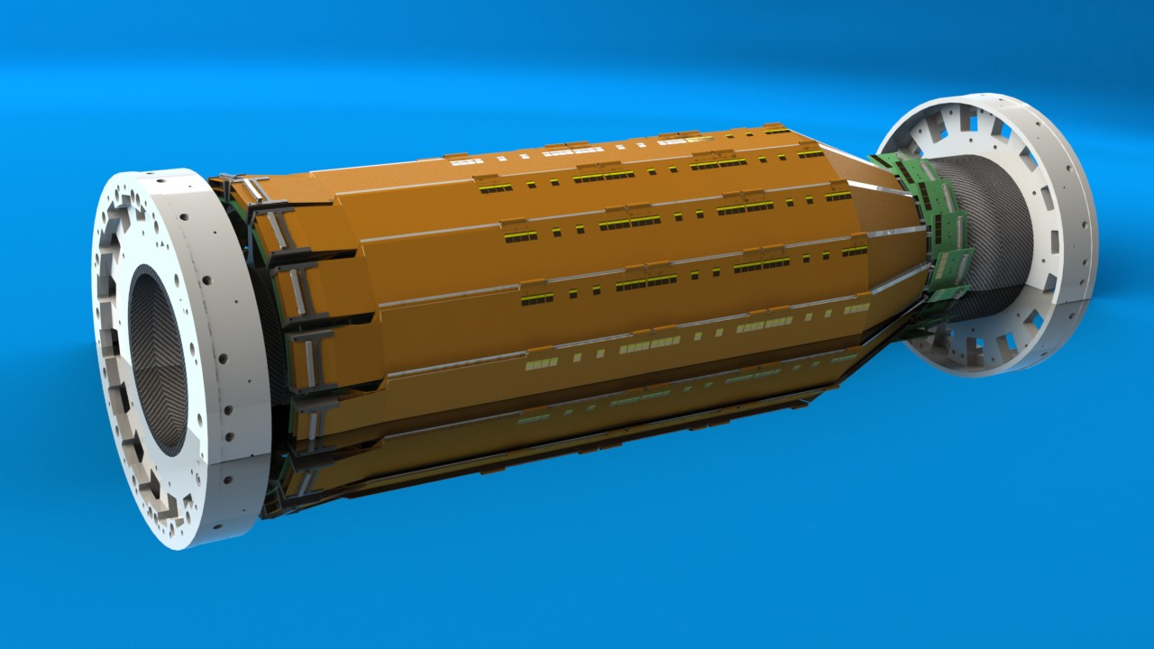
SVD Mechanical Status
PXD-SVD Meeting, Vienna

Slide 2
TDR Layout
The TDR version is no longer accurate
The windmill angle is mirrored
Mechanics had to be adapted to this change
Constraints from the CDC require a smaller radius in layer 5 and 6
Layer | Radius [mm] | Ladder # | Windmill ° | Overlap %
6 | 140 | 17 | 7 | 20.6
5 | 115 | 14 | 7 | 18.4
4 | 80 | 10 | 6 | 21.6
3 | 38 | 7 | 6 | 10.6

Slide 3
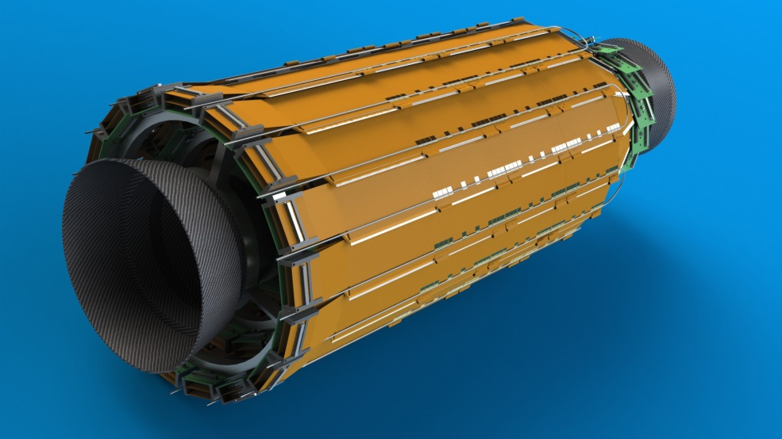
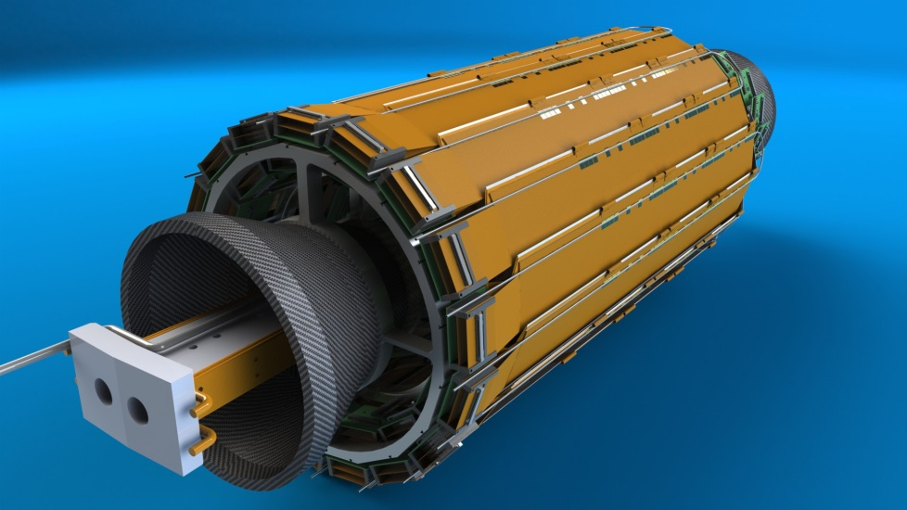
New Layout
End rings are mirrored
Hybrid boards had to switch position
Cooling tubes are merely shifted
Origamis and sensors are mirrored

Slide 4
Restrictions
KEK requests a dr of 20 mm between layer 5 and 6
Support shell max. radius = 155 mm (thickness 6 mm)
The reduction of the radii goes along with a reduction in ladders numbers
KEK requests an even number of ladders in each layer
Space restrictions require reevaluation of some components and concepts
The following studies show pros and cons of different radii configurations

Slide 5
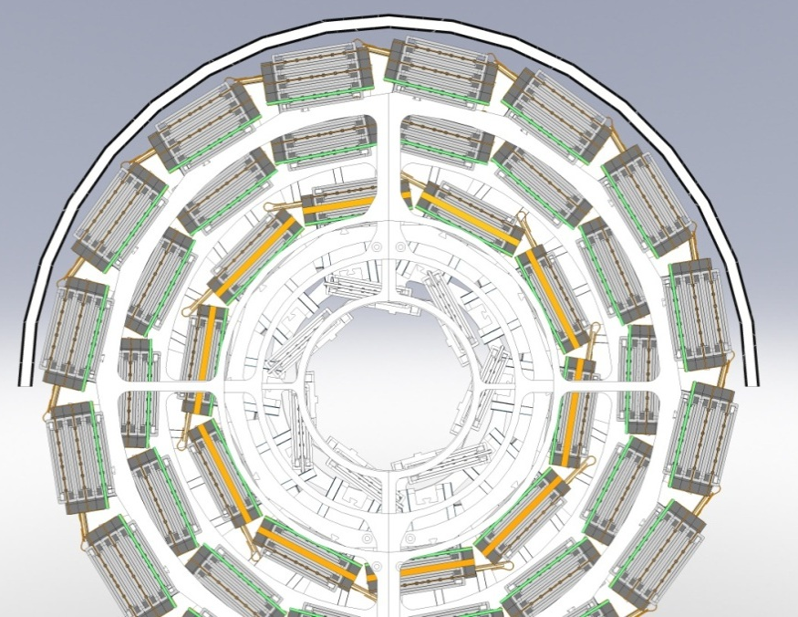
Iteration 1
Support shell Inner
radius: 155 → 149 mm
Layer 6 radius:
140 → 134 mm
Layer 5 radius:
115 → 110 mm
Too many ladders in layer 5
Layer 6 can be pushed outwards by 1 mm
Layer | Radius [mm] | Ladder # | Windmill ° | Overlap %
6 | 134 | 16 | 7 | 16.5
5 | 110 | 14 | 5 | 28.6

Slide 6
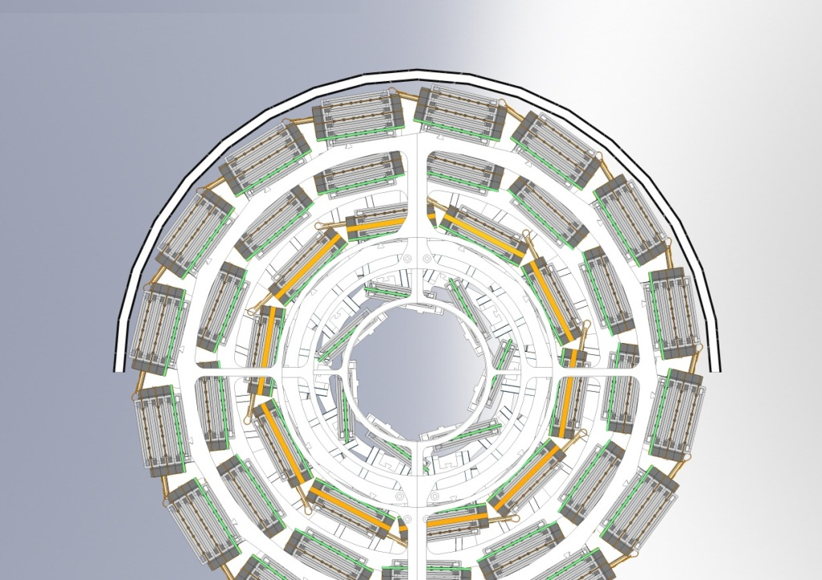
Iteration 2
Layer 6 radius increase
Layer 5 ladder count
reduced
Overlaps in layer 6 and 5 are
a bit high
Connectors in layer 5 are
difficult to access
Connectors overlap
endring
Layer | Radius [mm] | Ladder # | Windmill ° | Overlap %
6 | 135 | 16 | 7 | 15.2
5 | 110 | 13 | 5 | 14.7

Slide 7
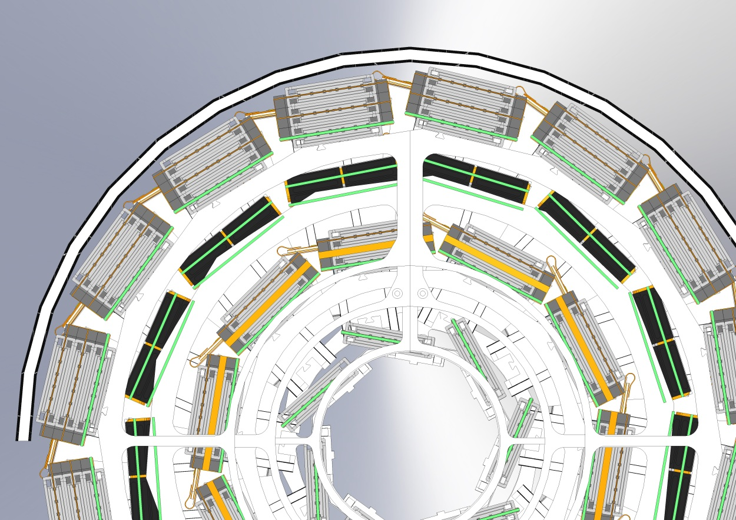
Iteration 3
Nanonics connectors
reduce overlap
Layer | Radius [mm] | Ladder # | Windmill ° | Overlap %
6 | 135 | 16 | 7 | 15.2
5 | 110 | 13 | 5 | 14.7

Slide 8
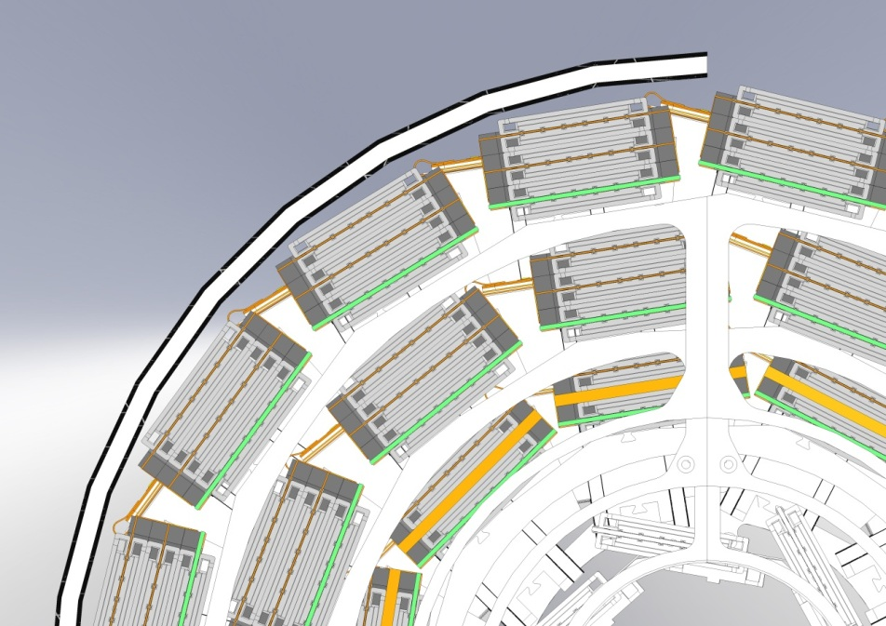
Iteration 4
Layer 5 radius reduced by 5 mm
Layer 5 ladder count reduced
Nice overlap in layer 5
Design does not require
Nanonics connectors
Interferences in the forward
region with layer 4
Layer | Radius [mm] | Ladder # | Windmill ° | Overlap %
6 | 135 | 16 | 7 | 15.2
5 | 105 | 12 | 5 | 7.8

Slide 9
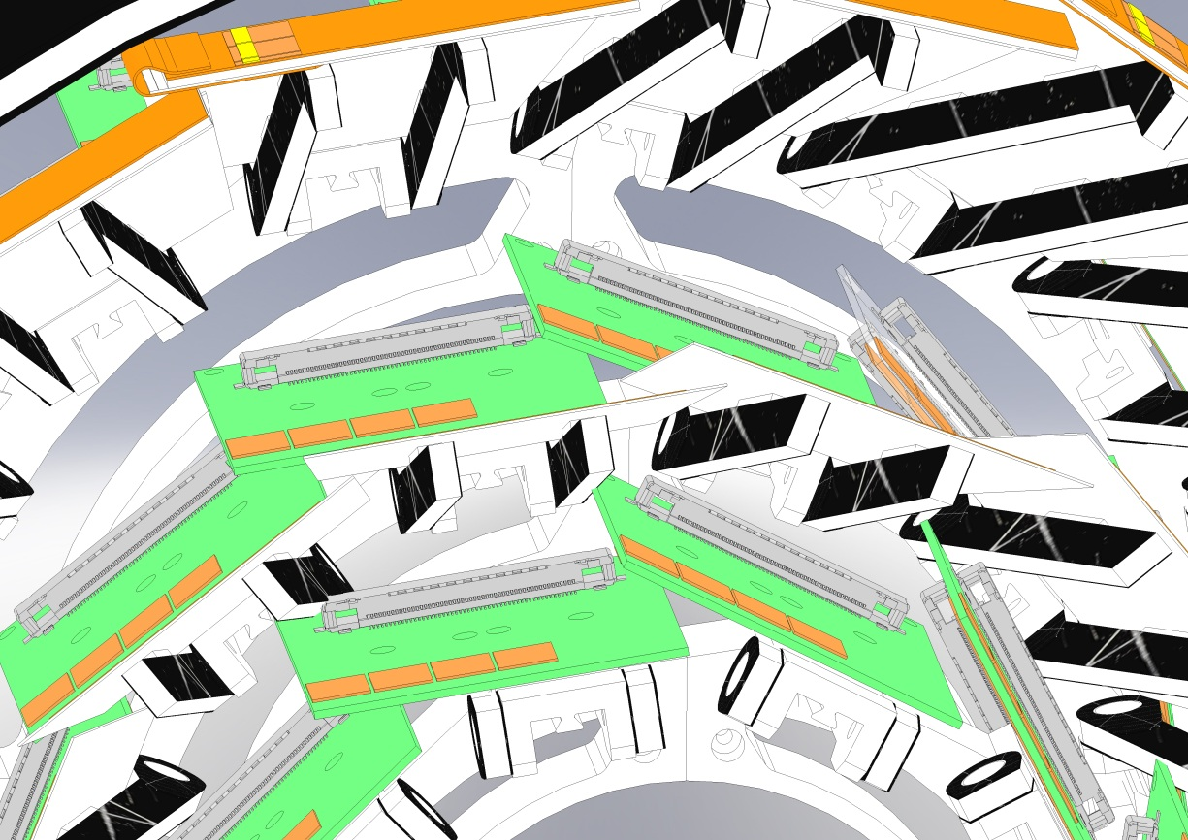
Iteration 4 Interferences
Interferences
Occurring interference between layer 4 and 5
Solution is pending

Slide 10
Comparison of Iterations
Iteration 1 has too much overlap in layer 5 and 6, the connectors are difficult to access
Iteration 2 has a better overlap in layer 6, connectors in layer 5 are still a problem
Iteration 3: Nanonics connectors solve the overlap problem - expensive solution
Iteration 2+3 have a odd number of ladders in layer 5
Iteration 4 is the cheapest solution but the interference between layer 4 and 5 has to be solved

Slide 11
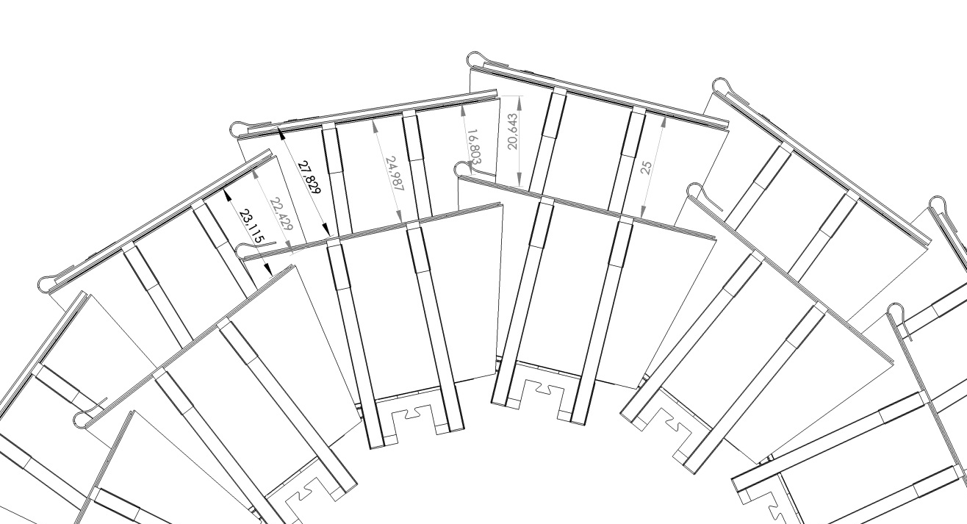
dr between layer 5 and 6
Note: discussions regarding the distance from layer 5 to layer 6 should include the consideration that this distance is highly variable
Thus a range should be defined, not a distance

Slide 12
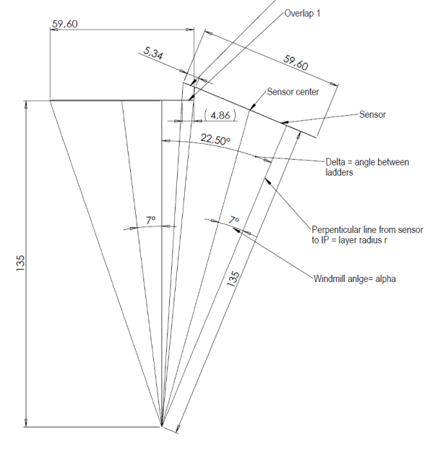
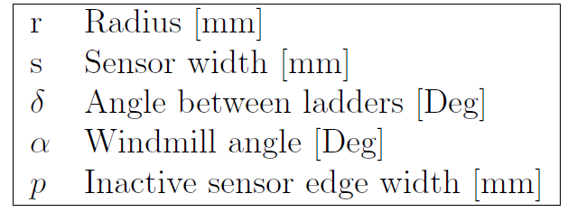
Analytical Method to Calculate Overlap
Due to many changes in geometry it was necessary to evaluate the overlap before drawing the actual configuration
Formula is not interference
sensitive

Slide 13
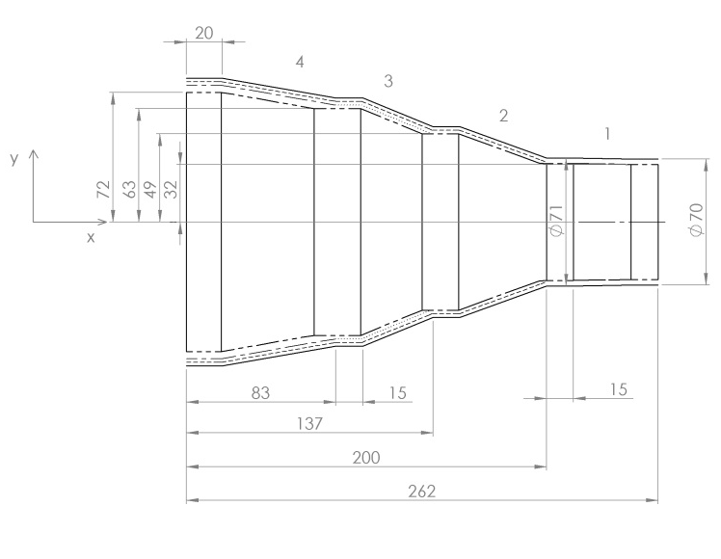
Backward Cone
Length and outer diameter is fixed
End ring connection points will only be changed if absolutely necessary
Inner diameter will
decrease a little
Flange attachment
point is designed

Slide 14
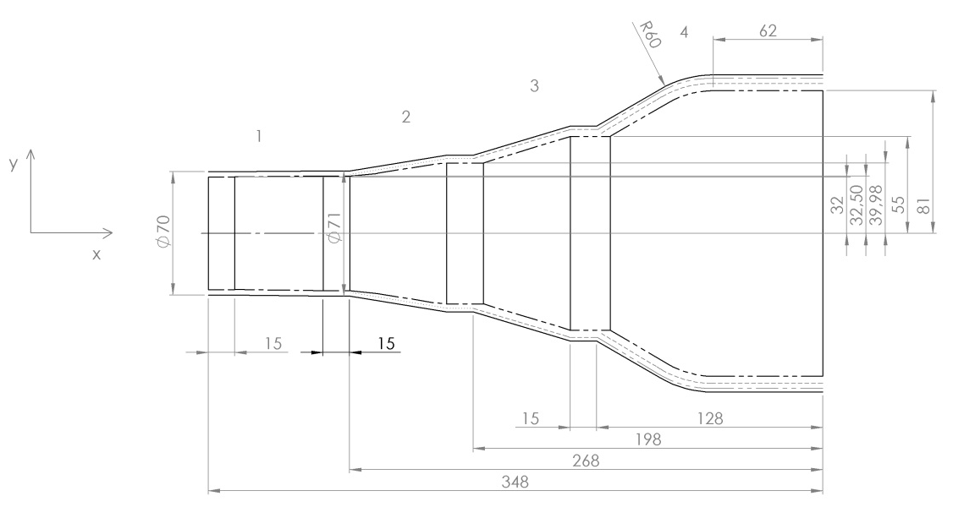
Forward Cone
Flange attachment area is stretched to accommodate PXD hardware
Inner diameter will be reduced
The shape is optimized for minimal deformation
The connecting
mechanism for the
cone halves will sit
on the end flange
and the layer 4/5 end
ring

Slide 15
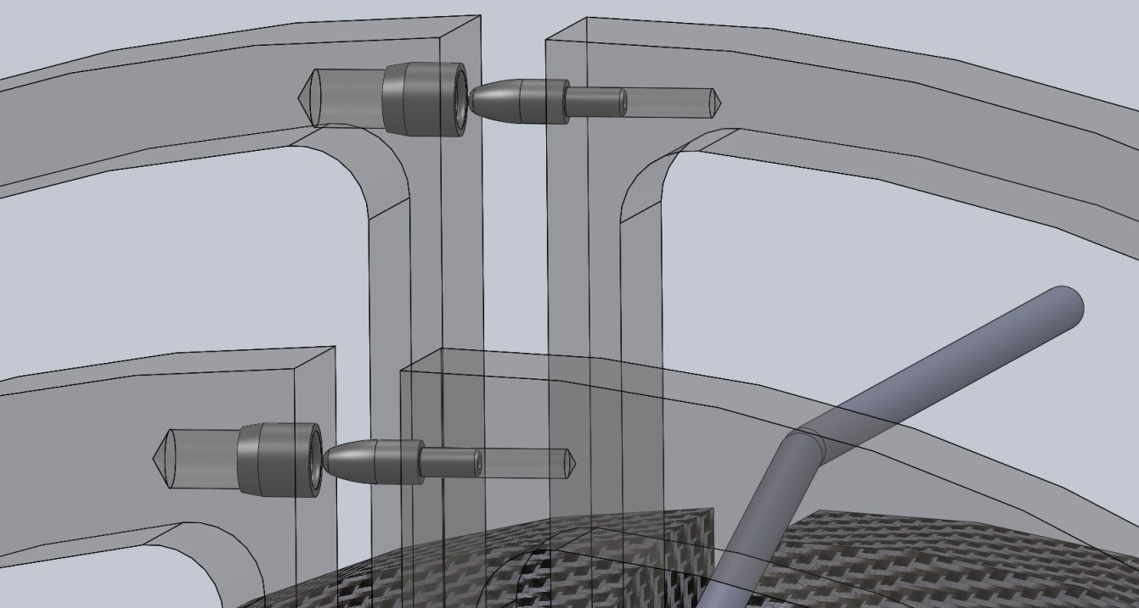
End Ring Separation/Positioning
Guide pins and bushings are included in every end ring
Used to provide mechanical alignment between the detector halves
Guide Pin
Bushing

Slide 16
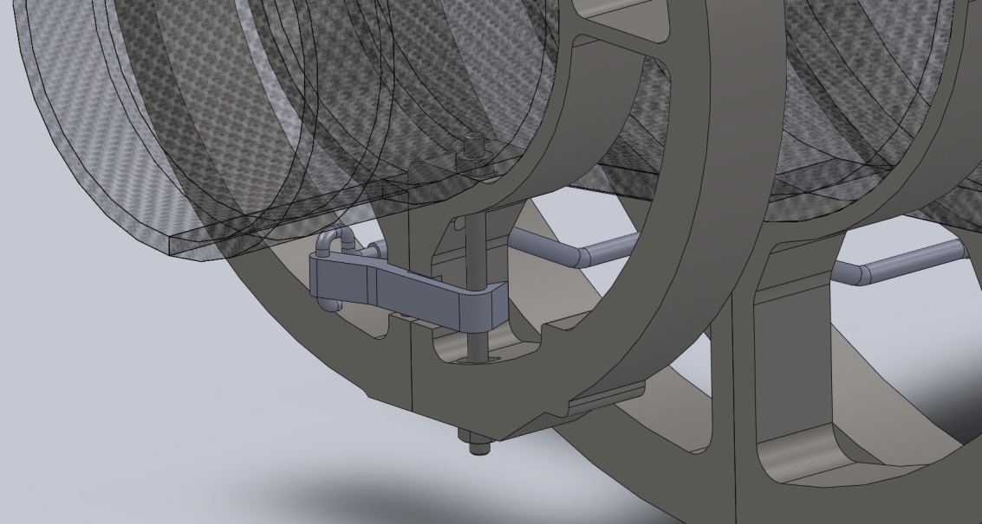
Closing Mechanism
Three types of remote locking mechanisms are under investigation
Mechanism is needed to provide stability along the cone
Can not be accessed directly
Remote operation
required
Operation needs to
be repeatable and
can not fail
Pushrod
Joint
“Snap-hook”

Slide 17
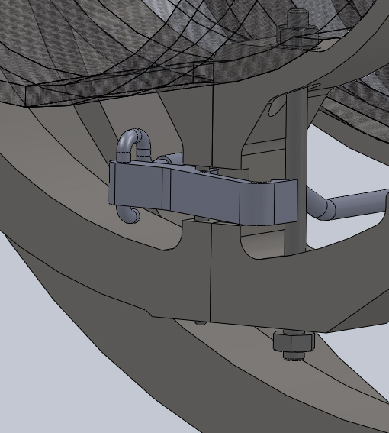
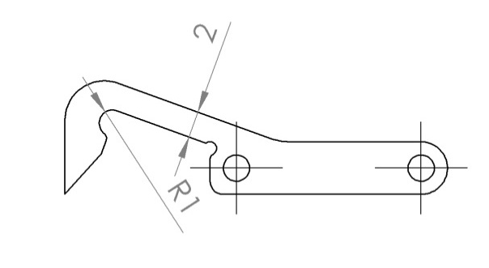
“Snap-hook” Disengaged View
Force required to lock the system can be varied easily by changing the cantilever length
Locking force is larger than the engaging force
Picture shows the experimental setup with a movable pin
Prototype is expected
to be finished until
March 2012
Disengaged Hook

Slide 18
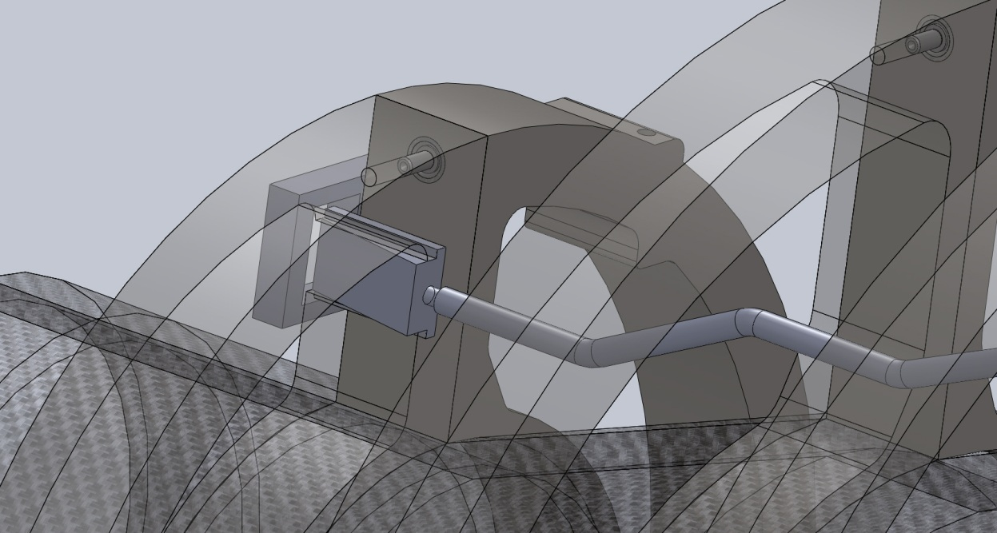
Wedge Design
Wedge design is simple and effective
Requires little space
Pushrod needs to be blocked to avoid accidental unlocking
Relatively large
force required
to lock the
mechanism
Wedge

Slide 19
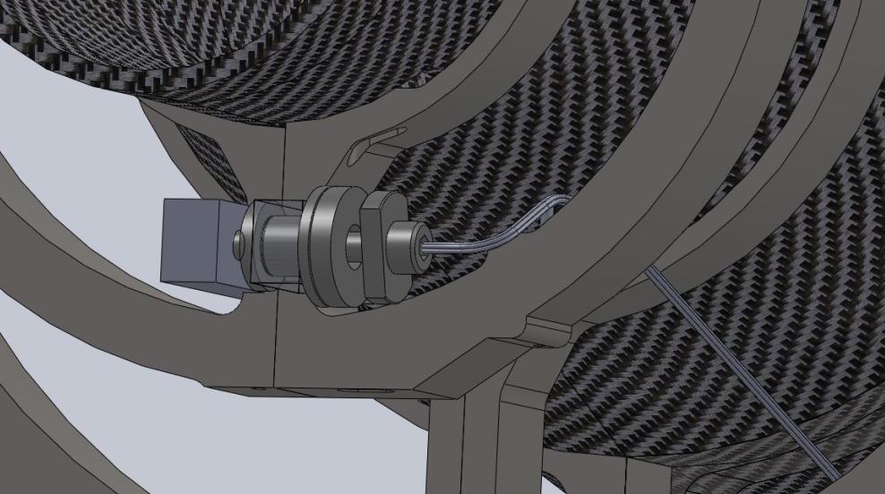
Rotation Lock
Most complex construction
Requires relatively low torque to lock up
The system is closed via a steel wire
Wire flexibility could cause the system to fail while unlocking
Mechanism is relatively
large
“Snap-hook” design is
currently preferred
Locking Mechanism
Sheathed Wire

Slide 20
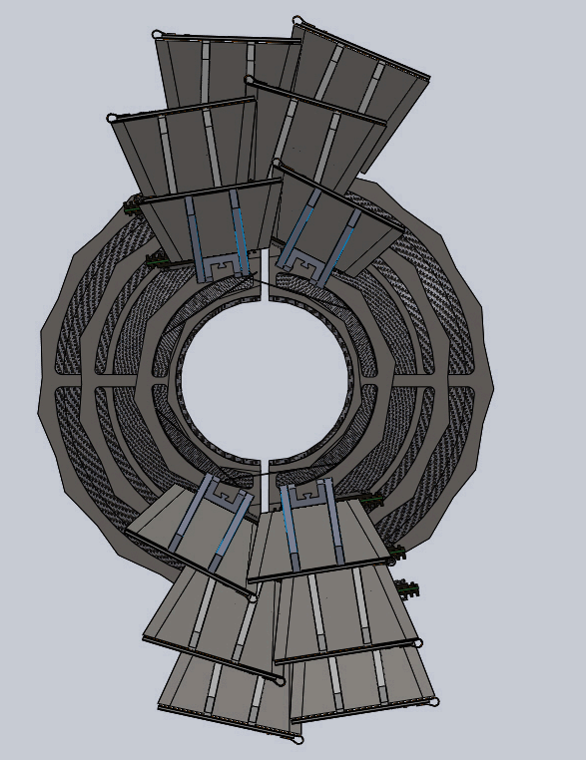
Separating the Halve Shells
The CAD drawing shows that it is possible to separate the halves without interferences
Interferences seen in the picture in layer 3 result from the dummy mechanics
representing the sensor as well
as the electronics
Mechanical mockup was built to
proof the concept
No interference discernible

Slide 21
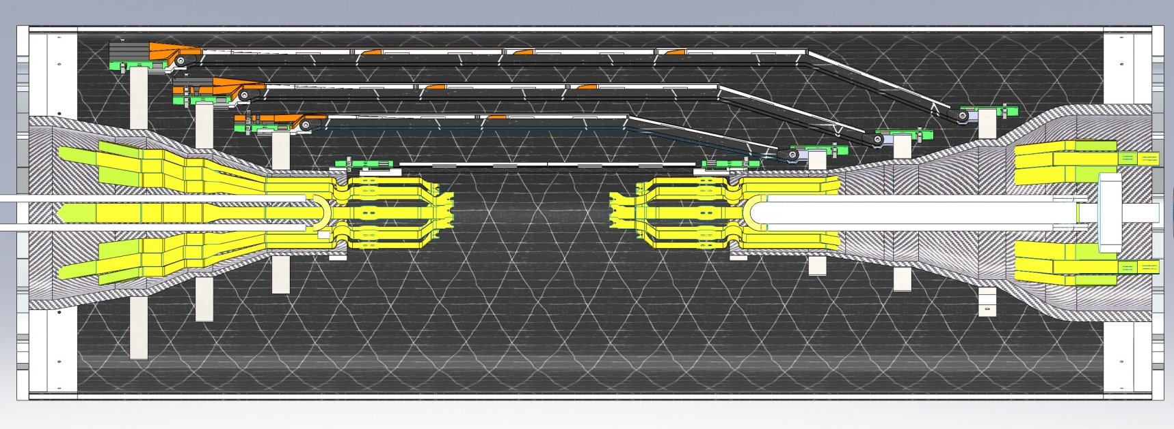
PXD Integration
Concerns about interferences in the narrow support cone part
Identified interferences only concern Kapton calbes
Unless a component sticks out further than the Kapton cables, there are no serious interferences
Area of Interest

Slide 22
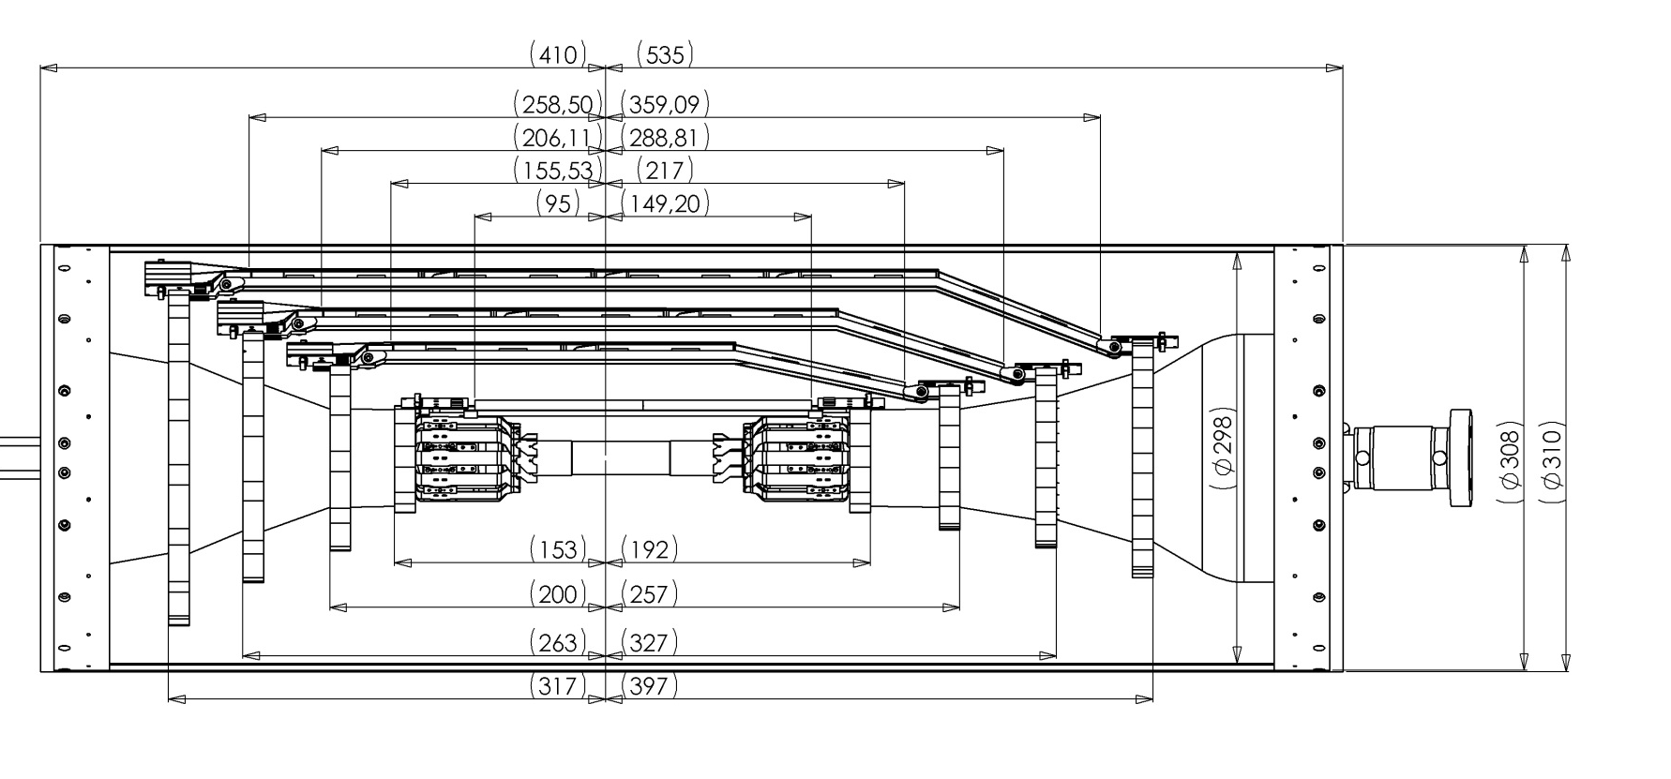
Ladder and End Ring Positions
Sensor edges are defined as distances from IP
Anchor point is not fixed due to rapid changes in the design

Slide 23
Discussion
Can we concur on a design to push onwards to prototyping?
Is KEK contributing to prototyping?
Which components can be manufactured at KEK?
Is manpower available at KEK for certain design details?
How much manpower/ budget is available for prototype production?

