Slide 1
Physics considerations
Christoph Schwanda
SVDPXD workshop, Vienna
Feb 6, 2012

Slide 2
Introduction
I have tried to quickly assess the impact on physics performance of a layer 6 radius reduction from 140 mm to 135 mm
If it is possible to build layer 6 with 140 mm radius my talk is obsolete

Slide 3
Proposed design
Layer | Radius TDR (mm) | Radius new (mm)
6 | 140 | 135
5 | 115 | 105
4 | 80 | 80
3 | 38 | 38

Slide 4
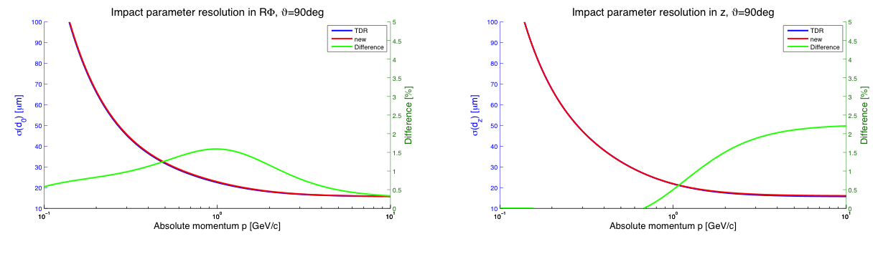
Impact parameter performance
Most important parameter for physics performance (vertexing)
Reduction of SVD L6 radius only deteriorates vertexing performance but can be recovered by a reduction of L5 radius (simulation by Manfred Valentan)
Difference TDR-new ~1%

Slide 5
TCPV in B → K^{*0}(K⁰_{S}π⁰)γ
Search for right-handed photons from b → sγ
Studied in 2004 LoI (KEK report 2004-4) and in the sBelle design report (KEK report 2008-7)
No charged tracks from CP-side vertex, only feasible if K_{S} daughters have hits in the SVD → location of SVD layers important
Hara-san studied the measurement of TCPV in B → K^{*0}(K⁰_{S}π⁰)γ as a function of layer 5 position

Slide 6
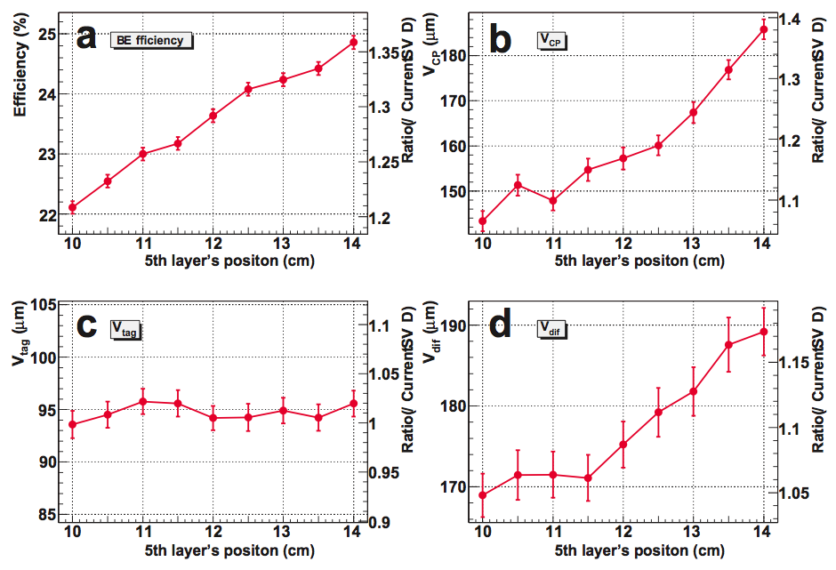
Plots from Hara-san’s simulation:
Δz resolution improves as layer 5 radius decreases.

Slide 7
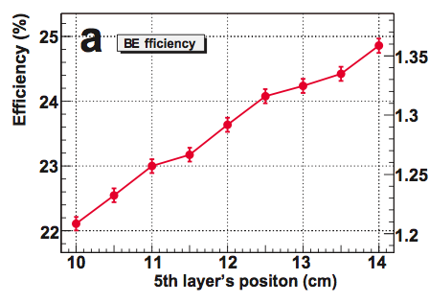
Plot from Hara-san’s simulation:
B → K^{*0}(K⁰_{S}π⁰)γ efficiency increases with increasing layer 5 radius as two SVD hits for each K_{S} daughter are required

Slide 8
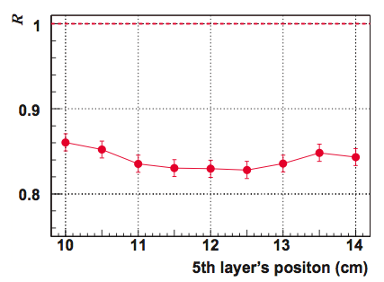
Figure-of-merit
Shallow optimum, virtually no difference in performance between a layer 5-6 difference of 2.5 cm (TDR) and 3 cm (new)
Plot from Hara-san’s simulation:
2.5 cm (TDR)
3 cm (new)

Slide 9
Summary
Reduction of SVD L6 radius has an impact on the vertexing performance but can be recovered by reducing L5 radius
According to the simulation done in 2008, TCPV in B → K^{*0}(K⁰_{S}π⁰)γ performance is virtually identical for TDR and modified design

