Slide 1


Accelerating Science and Innovation
News from CERN
R-D. Heuer Plenary ECFA , 24 Nov. 2011
Notes:
1

Slide 2
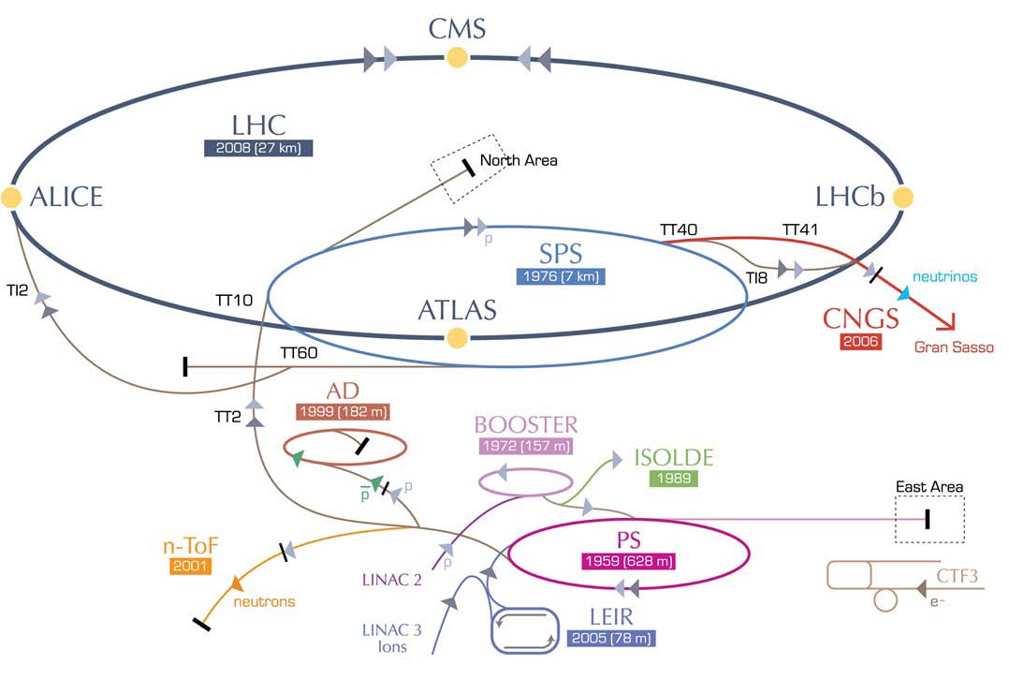
Accelerator Complex: Performance
Another excellent year
Efficiency 80%
PoT: 4.85 (4.8) x10¹⁹
Antiprotons 3.8 x10¹²
shifts: 370 (490)
PoT: 1.64 (1.6) x10¹⁹

Slide 3
Selected Highlights from fixed target experiments:
CLOUD: first results on influence of cosmic rays
on cloud formation
AD: storage of Antihydrogen atoms for 1000 s
OPERA: neutrino time of flight
Healthy and diverse physics program

Slide 4
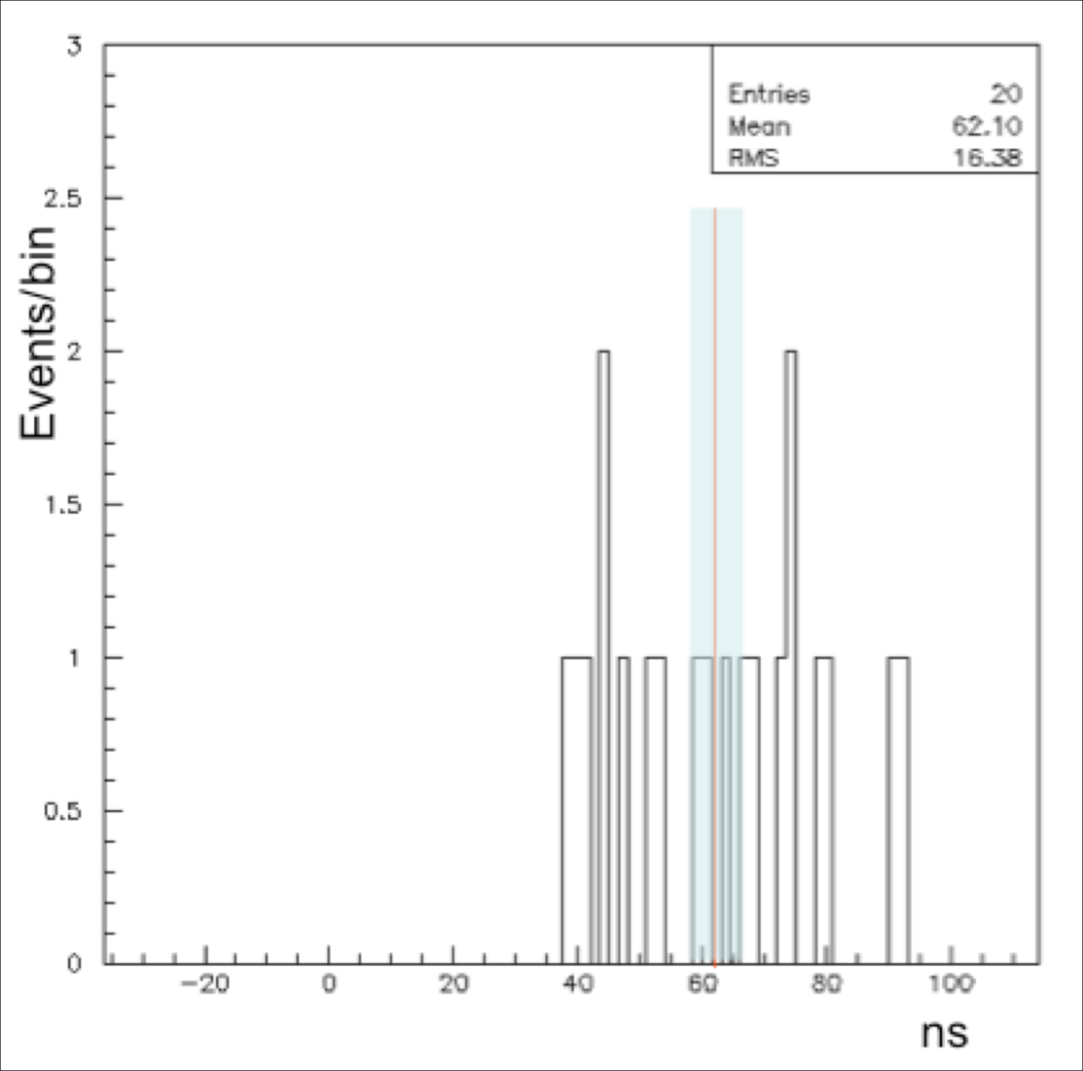

OPERA: neutrino time of flight
Check with bunched neutrino beam
Present result

Slide 5
Accelerating Science and Innovation
LHC
Notes:
5

Slide 6
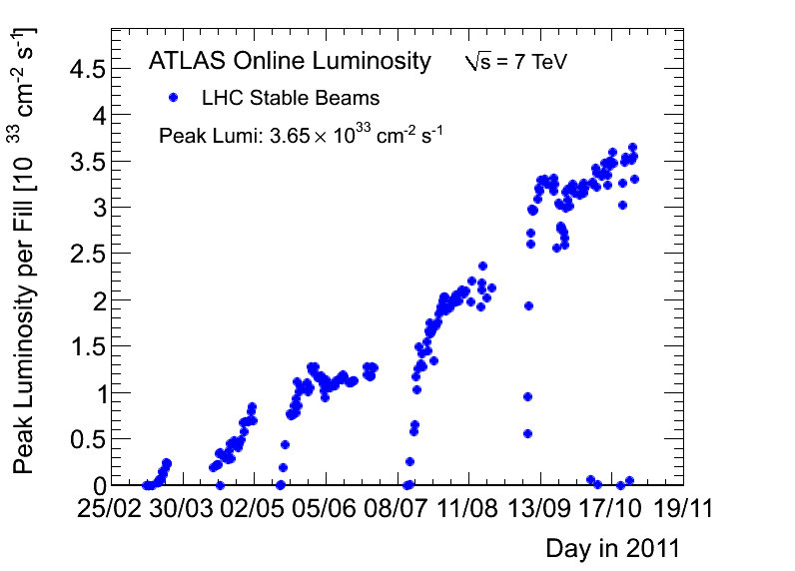
Peak luminosity 2011 - protons
3.65 x 10³³
2010

Slide 7
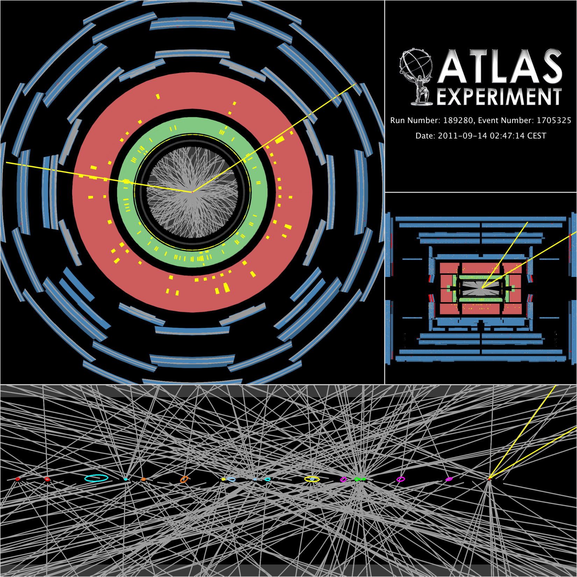
Pile-up
Experiment (trigger,
detector, reconstruction, ..)
is coping well with larger
than expected at this
stage and increasing
pile-up.
Today: average over a fill
is ~12 interactions/x-ing
(was ~ 6 in Spring),
with tails up to ~20
Pile-up could increase by up
to ~2 in 2012
Z → μμ event with 20
reconstructed vertices
(ellipses have 20 σ size
for visibility reasons)

Slide 8
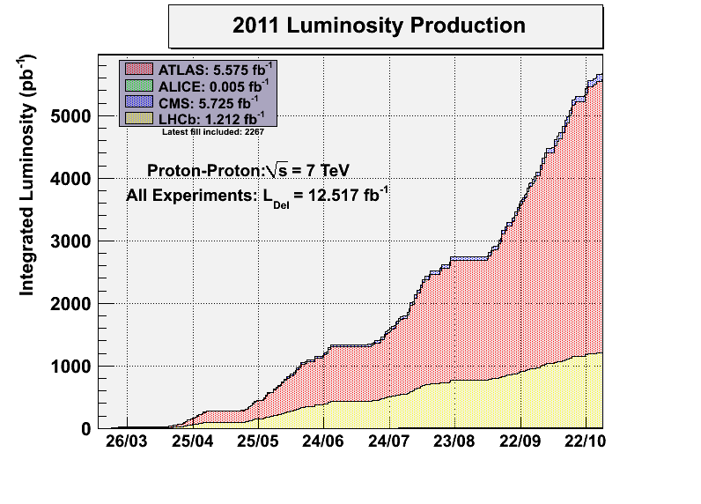
2011 Goal

Slide 9
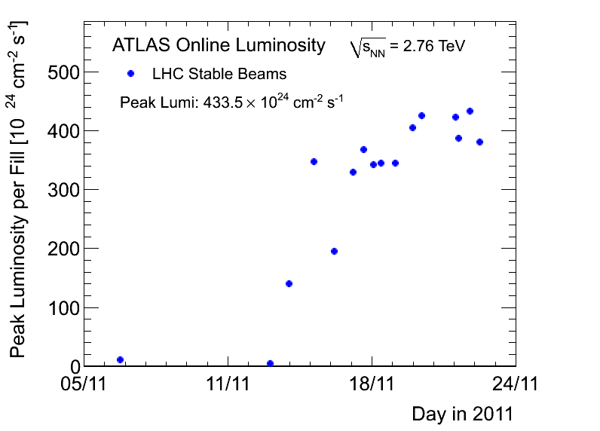
Peak luminosity 2011 – Pb ions
4.34 x 10²⁶
2010

Slide 10
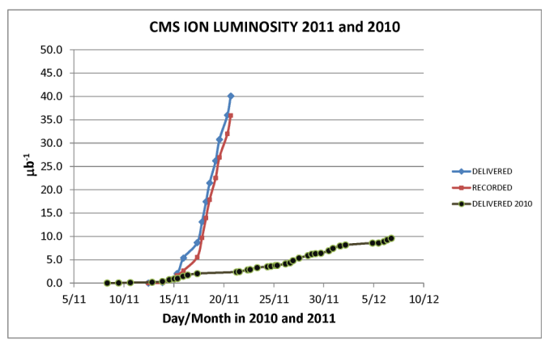
CMS comparison with 2011
Today: >65/μb

Slide 11
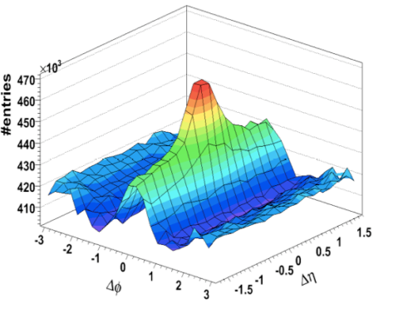
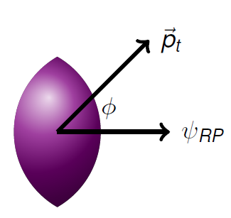
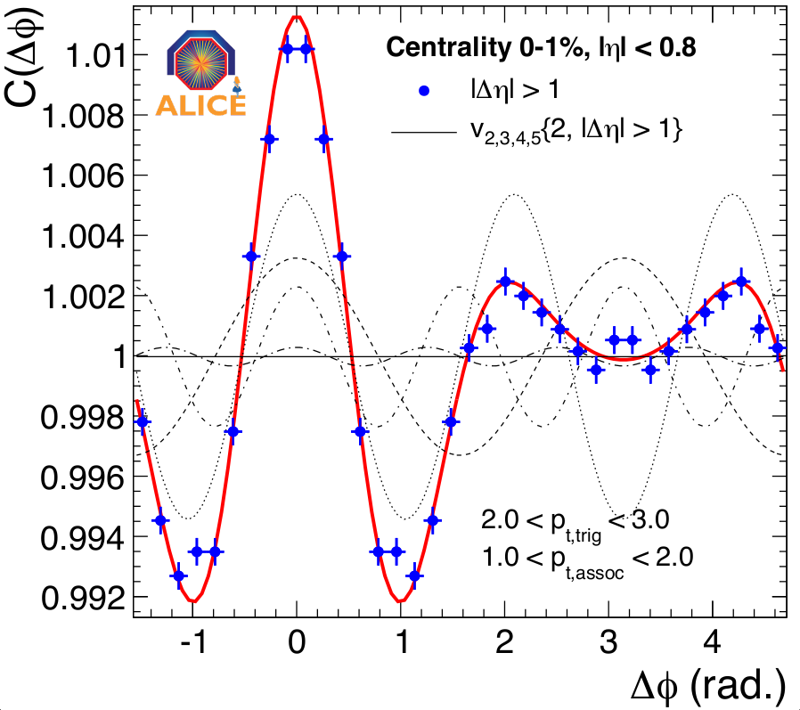
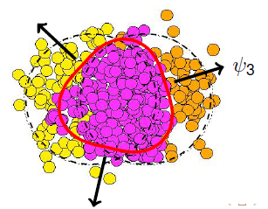
Collective Effects: Flow in Heavy Ion Collisions
Coordinate Space
Anisotropy
Momentum Space
Anisotropy
Interactions
y
z
x

Slide 12
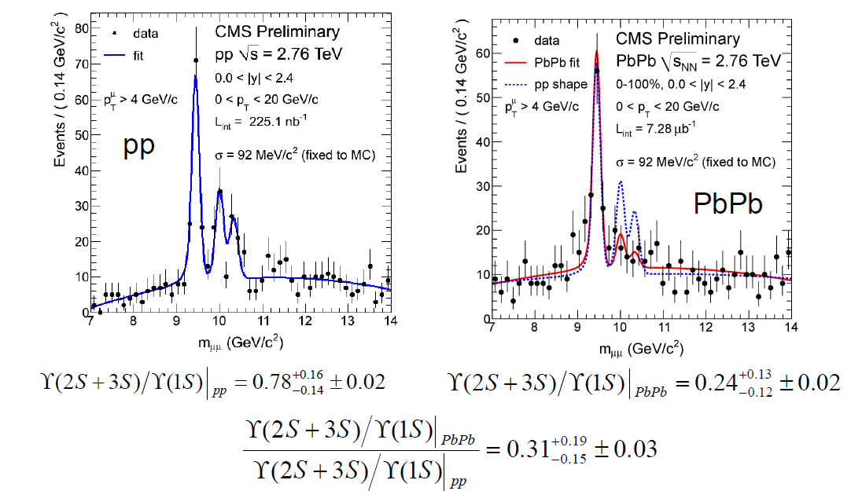
Deconfinement: Suppression in the Upsilon Family
CMS-PAS-HIN-10-006
L. Benhabib
R_{AA}(1S) = 0.6±0.15
Excited states ϒ(2S,3S) relative to ϒ(1S) are suppressed.
2.4σ effect

Slide 13
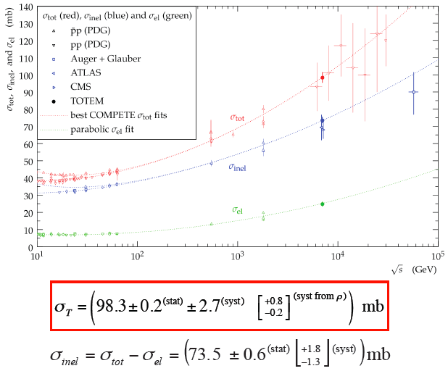

Total pp Cross-section at √s = 7 TeV
Earlier ATLAS and CMS measurements consistent

Slide 14
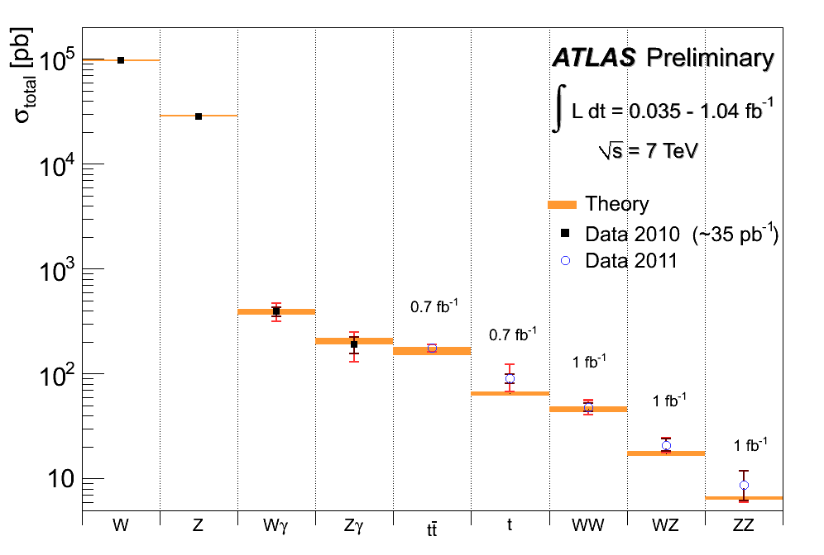
Summary of main electroweak and top cross-section measurements
Inner error: statistical
Outer error: total
~ 7%
σ (pp→ H) m_{H}=130 GeV
σxBR(ZZ→ 4l)
~ 40 fb
Good agreement with SM expectations (within present uncertainties)
Experimental precision starts to challenge theory for e.g. tt (background to most searches)
Measuring cross-sections down to few pb (~ 40 fb including leptonic branching ratios)

Slide 15
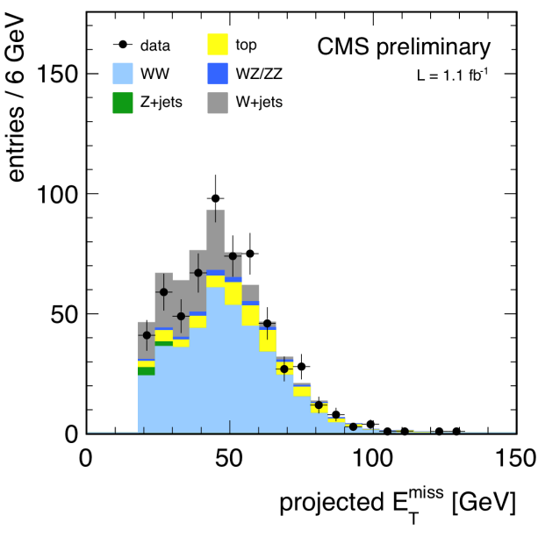
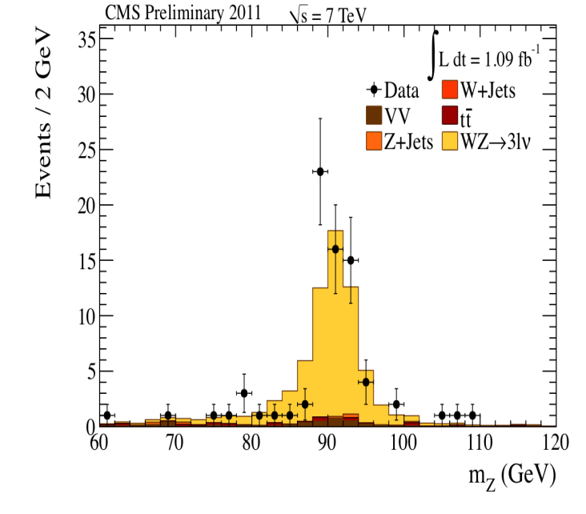
Di-bosons: WW, WZ, ZZ.
With 2011 data updated measurement of the W⁺ W⁻ cross section and first measurements of the WZ, ZZ production cross sections at 7TeV.
σ(pp → W⁺W⁻ + X) = 55.3 ± 3.3(stat.) ± 6.9 (syst.) ± 3.3 (lumi.) pb.
σ(pp →WZ + X) = 17.0 ± 2.4(stat.) ± 1.1 (syst.) ± 1.0 ( lumi.) pb.
σ(pp → ZZ + X) = 3.8 +1.5(stat.) ± 0.2 (syst.) ± 0.2 ( lumi.) pb.
All measured values are consistent with the standard model predictions.
Data driven methods are used to understand the background.
σ(NLO)=43±2pb
σ(NLO)=19.8±0.1pb
σ(NLO)=6.4±0.6pb
CMS PAS EWK-11-010

Slide 16
Principal goal for the 2011-2012 run:
Settle the question of the SM Higgs

Slide 17
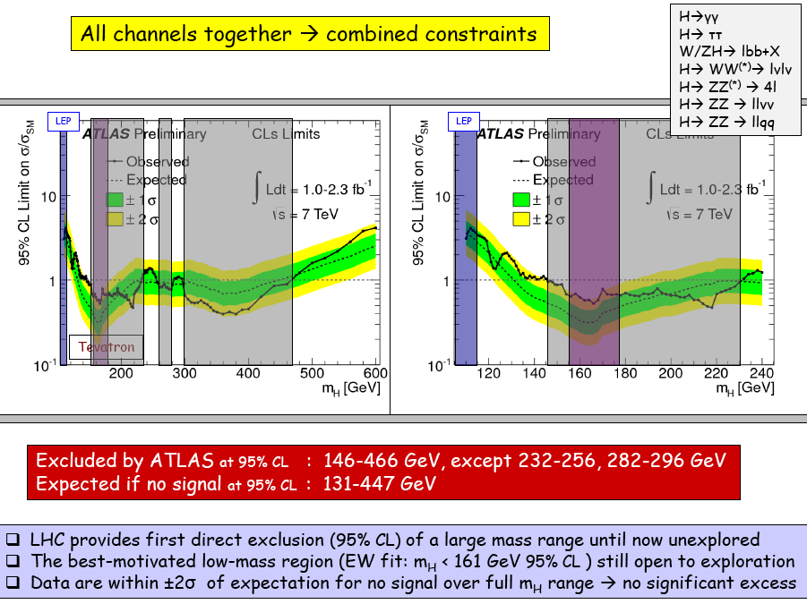

Slide 18
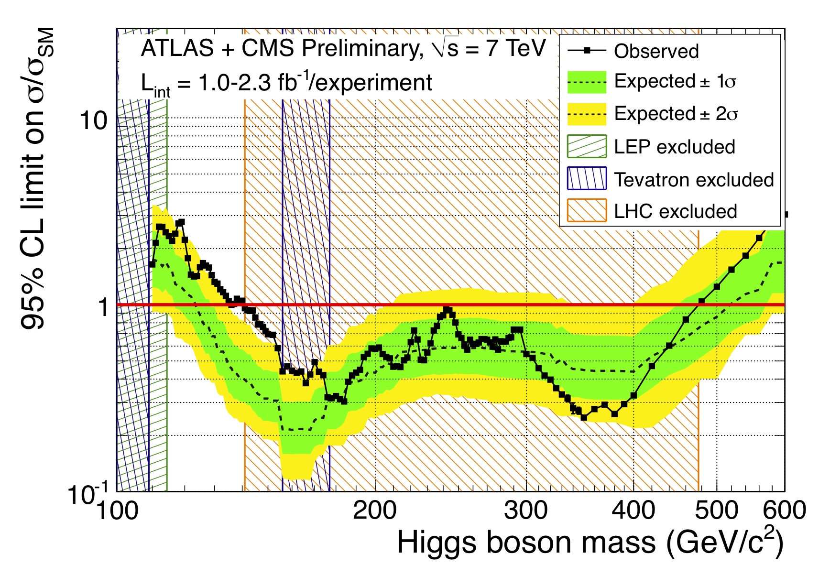
ATLAS and CMS first combined analysis on
the search for the Higgs boson

Slide 19
LHC and the Standard Model
Finding the Higgs: Discovery
Excluding the SM-Higgs: Discovery
Reminder:
LHC is poised to clarify mechanism of electroweak symmetry breaking

Slide 20
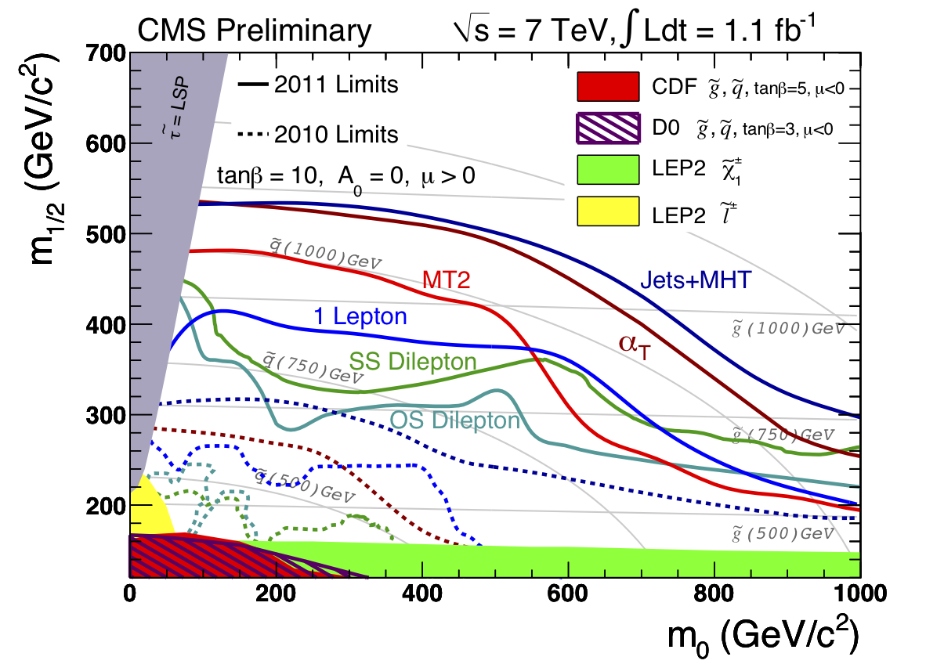
SUSY: new limits on CMSSM
Within the constrained MSSM models we have crossed the border of excluding gluinos and squarks up to 1TeV and beyond. The air is getting thin for constrained SUSY. More conclusive results for the winter conferences.
Notes:
Contours are envelopes of best sensitivity from different signal regions

Slide 21
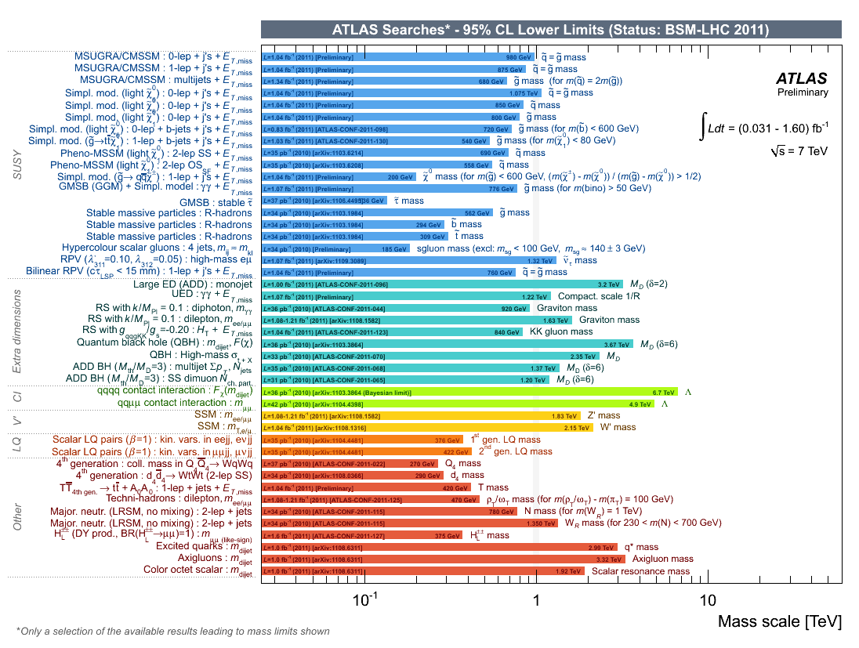
Results of main searches for New Physics
SUSY: mass limits
on in the range
0.5-1 TeV
(within constrained models)

Slide 22
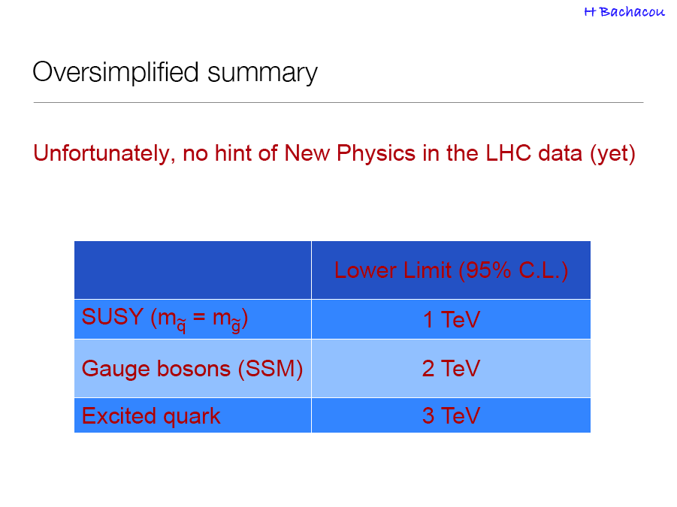

Slide 23
…not only searches
LHCb results show exciting prospects for 2012

Slide 24
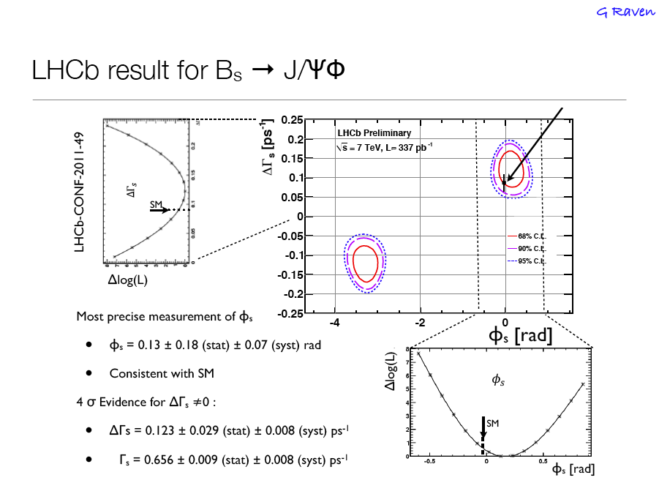

Slide 25
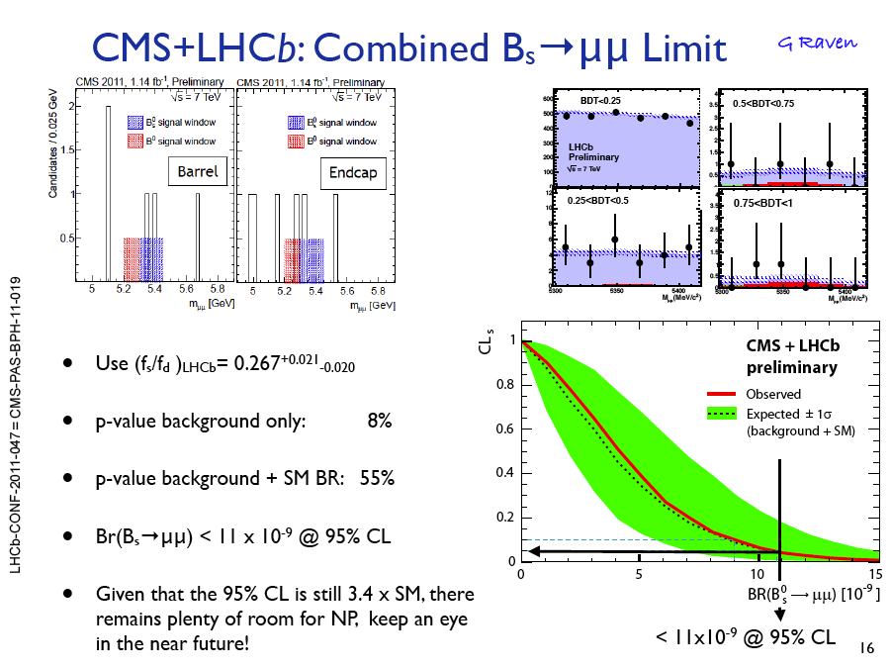

Slide 26
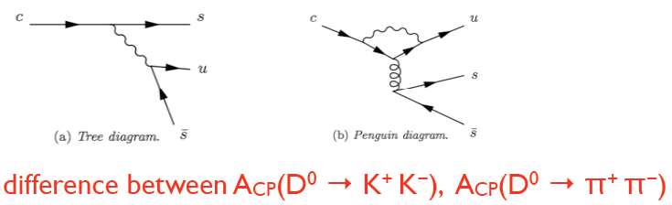
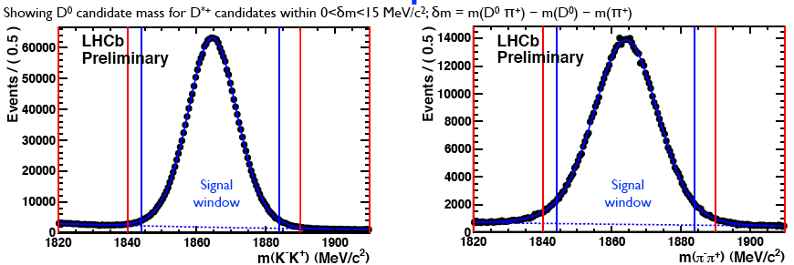
Direct CP Violation in the Charm Sector
M. Charles
-.82 +-.21+-.11 %

Slide 27
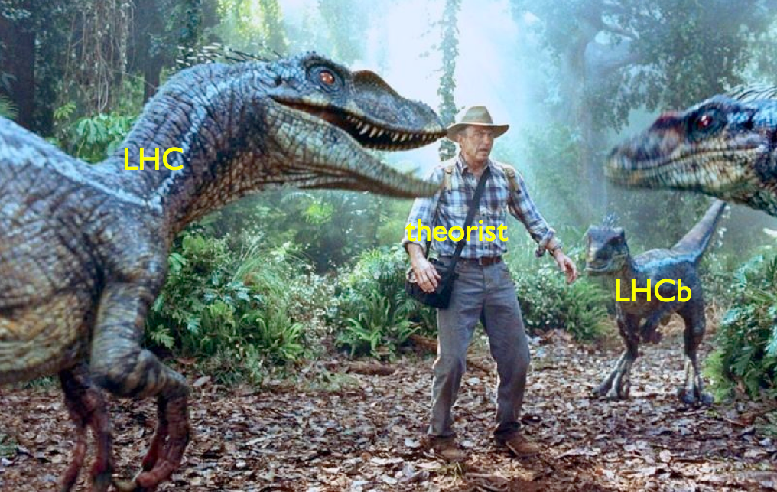
LHC and Theory…
Murayama, ICFA Seminar, 2011 CERN

Slide 28
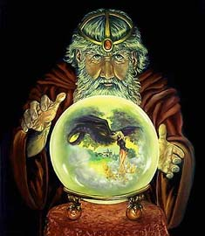
The predictable future: LHC Time-line
2009
Start of LHC
Run 1: 7 TeV centre of mass energy, luminosity ramping up to few 10³³ cm⁻² s⁻¹, few fb⁻¹ delivered
LHC shut-down to prepare machine for design energy and nominal luminosity
2013/14
Run 2: Ramp up luminosity to nominal (10³⁴ cm⁻² s⁻¹), ~50 to 100 fb⁻¹
2017 or 18
Injector and LHC Phase-I upgrades to go to ultimate luminosity
Run 3: Ramp up luminosity to 2.2 x nominal, reaching ~100 fb⁻¹ / year accumulate few hundred fb⁻¹
~2021/22
Phase-II: High-luminosity LHC. New focussing magnets and CRAB cavities for very high luminosity with levelling
Run 4: Collect data until > 3000 fb⁻¹
2030

Slide 29
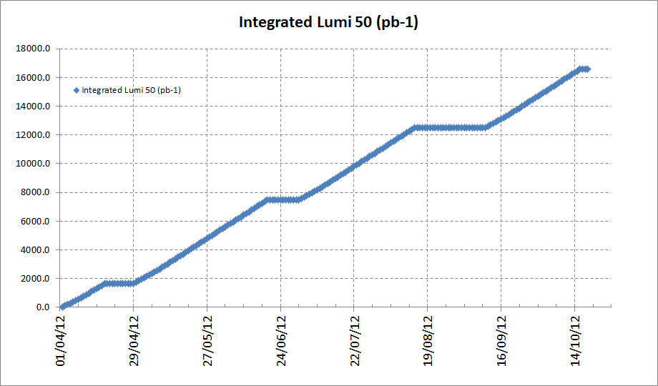
2012 Integrated with 50ns
Preliminary, final number after Chamonix 2012
E= 4TeV
Beta* = 0.7m
148 days of physics
Note on scaling
Energy: Peak, Integrated and µ scale linearly
β*: Peak, Integrated and µ to first order scale inversely but R depends on β*
µ : linearly with L_{peak}, inversely with n_{b}.

Slide 30
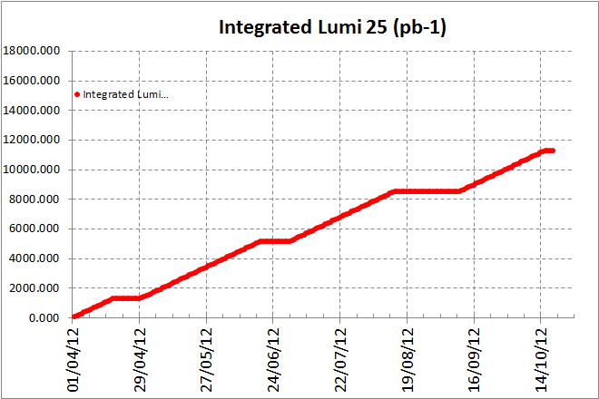
2012 Integrated with 25ns
E= 4TeV
Beta* = 0.7m
148 days of physics
Certainly optimistic
Possible intensity limitation
Possible limitation to β*
More scrubbing needed
Preliminary, final number after Chamonix 2012
Note on scaling
Energy: Peak, Integrated and µ scale linearly
β*: Peak, Integrated and µ to first order scale inversely but R depends on β*
µ : linearly with L_{peak}, inversely with n_{b}.

Slide 31


Summary for 2012
Preliminary, final number after Chamonix 2012
Assumptions
E=4TeV: beta* = 0.7m: 148 days of physics: no intensity limit for 25ns
Bunch Spacing | Peak Luminosity | Integrated Luminosity (fb-1) | Pile Up | N max
50ns | 5.80E+33 | ~16 | ~27 | 1.55E+11
25ns | 3.80E+33 | ~10 | ~9 | 1.15E+11
$$L_{peak}  { K}_{L}∙N_{total}∙B$$
${ K}_{L} = \frac{f_{rev}∙R∙γ}{4π∙β^{∗}}$
Note on scaling
Energy: Peak, Integrated and µ scale linearly
β*: Peak, Integrated and µ to first order scale inversely but R depends on β*, crossing angle and emittances
µ : linearly with L_{peak}, inversely with n_{b}.

Slide 32
CERN today….into the future
CLIC conceptual design report by 2012
Participation in all LC activities
LHeC conceptual design report 2011/early2012
R&D for high-field magnets (towards HE-LHC)
Generic R&D (high-power SPL, Plasma Acc)

Slide 33
CERN today….into the future
Romania in accession to membership
Israel now Associate Member in accession to Membership
Negotiation finished with Serbia concerning membership
First iteration of negotiations finished with Cyprus, Slovenia, and Turkey concerning membership
Several countries expressed interest in Associate Membership

