Slide 1
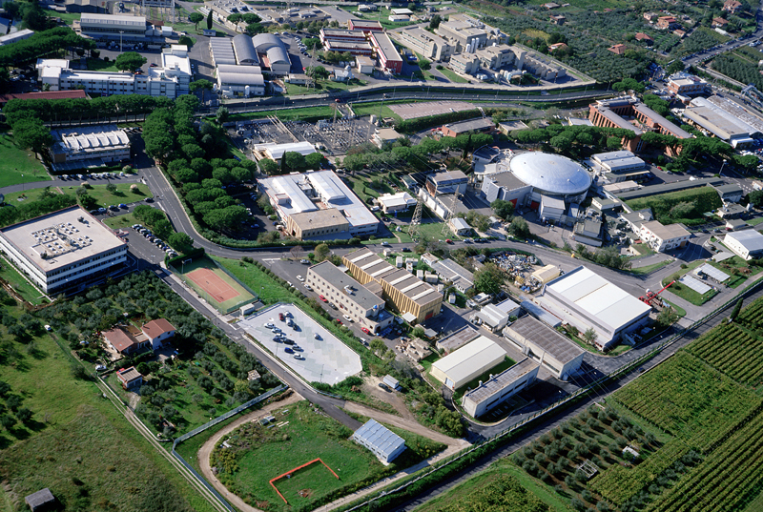
L.N.F. Status Report
Valeria Muccifora
INFN-LNF
SuperB → Tor Vergata
DAΦNE-light
LINAC
DAΦNE
BTF
SPARC
DAΦNE
KLOE-2
DAΦNE-light
SPARC-LAB
FLAME
Plenary ECFA meeting CERN 24-25 November 2011

Slide 2
DAΦNE in 2011
Many technical faults affected DAΦNE operations:
  Failure of injection septum of the positron ring.
  Cooling system of the KLOE magnet power supply.
  Injection system: D modulator fault.
  Injection system: LINAC gun cathode faults, last spare
  from SLAC worked until 25 May.
Solved..
  New coils delivered for all injection kickers, positron injection restored in April.
  Modification of the hydraulic circuit and cleaning the water cooling system, cooldown of the KLOE magnet completed in September.
  The ceramic window between the klystron of the D modulator, essential for e⁺ production, replaced in May.
  Several new cathodes ordered, the new one installed 24 October.

Slide 3

http://www.lnf.infn.it/acceleratori
DAΦNE Φ Factory
DAΦNE Timetable/Operation in 2011
Due to cathode fault the scheduled shutdown has been anticipated at 8 Jun, until 24 Th October
e- beam
down
standard operation
2011
Jan | Feb | Mar | Apr | May | Jun | Jul | Aug | Sep | Oct | Nov | Dec
shutdown
e+ septum
shielding KLOE
cathode
cathode delivery
Klystron D
septum coil e⁺
DAFNE-Light / BTF

Slide 4
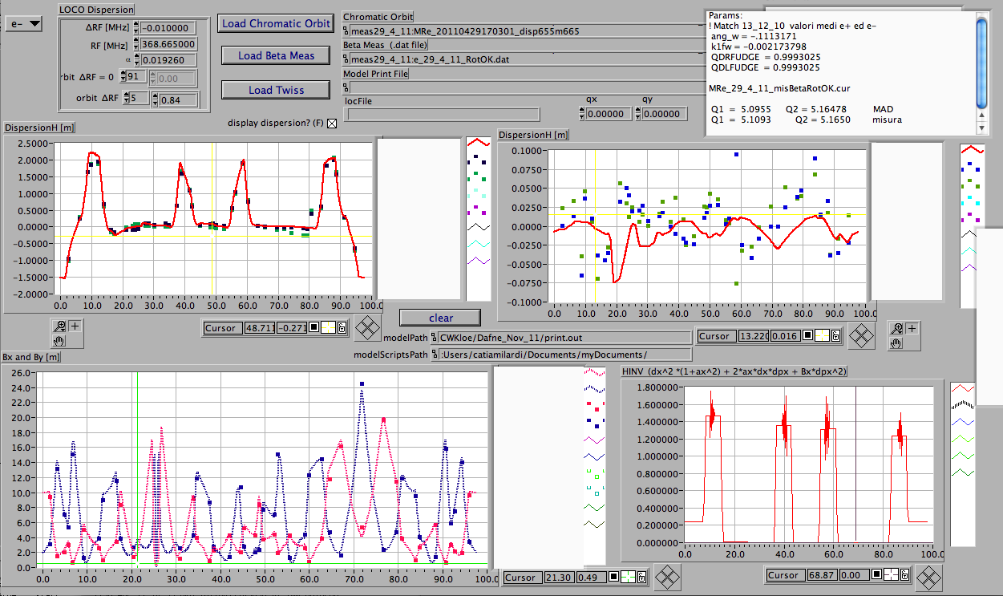
DAΦNE Low -Intensity Studies
Linear optics measurements (β₁, β₂, ν₁, ν₂, η_{x,} η_{x,} ξ_{x,} ξ_{y})
The optics is the one suitable for the Crab-Waist collision scheme
e-
IP
CW SXTs
IP
β₁^{IP} = 0.24 m
β₂^{IP} = 0.009 m
Good agreement between the theory and measurements

Slide 5
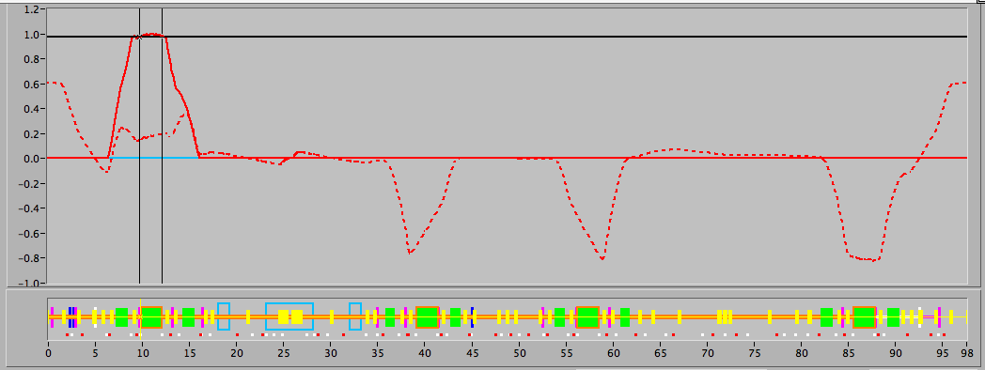
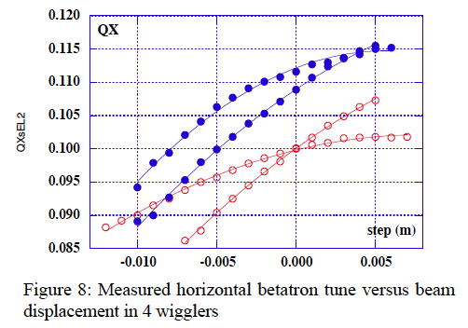
DAΦNE Low -Intensity Studies
Measurements of the non-linear
effects by displacing the orbit
in the wigglers.
Δν_{x} and Δν_{y} exhibit a linear behaviour excluding the presence of any octupole-like or higher component in the magnetic field
Published in 2004
K³ [m⁻³] | Year
800 | 2001
360 | 2004
0 | 2011
Published in 2004
Modifications made to the wiggler poles successfully eliminated most
of the undesirable multipole components.
Notes:
Measuring the tune shift DQx DQy.
Integrated strength of the octupole-like term derived from the horizontal betatron tune for 2 wiggles and electrons (empty dots ) and positron (full dots).

Slide 6
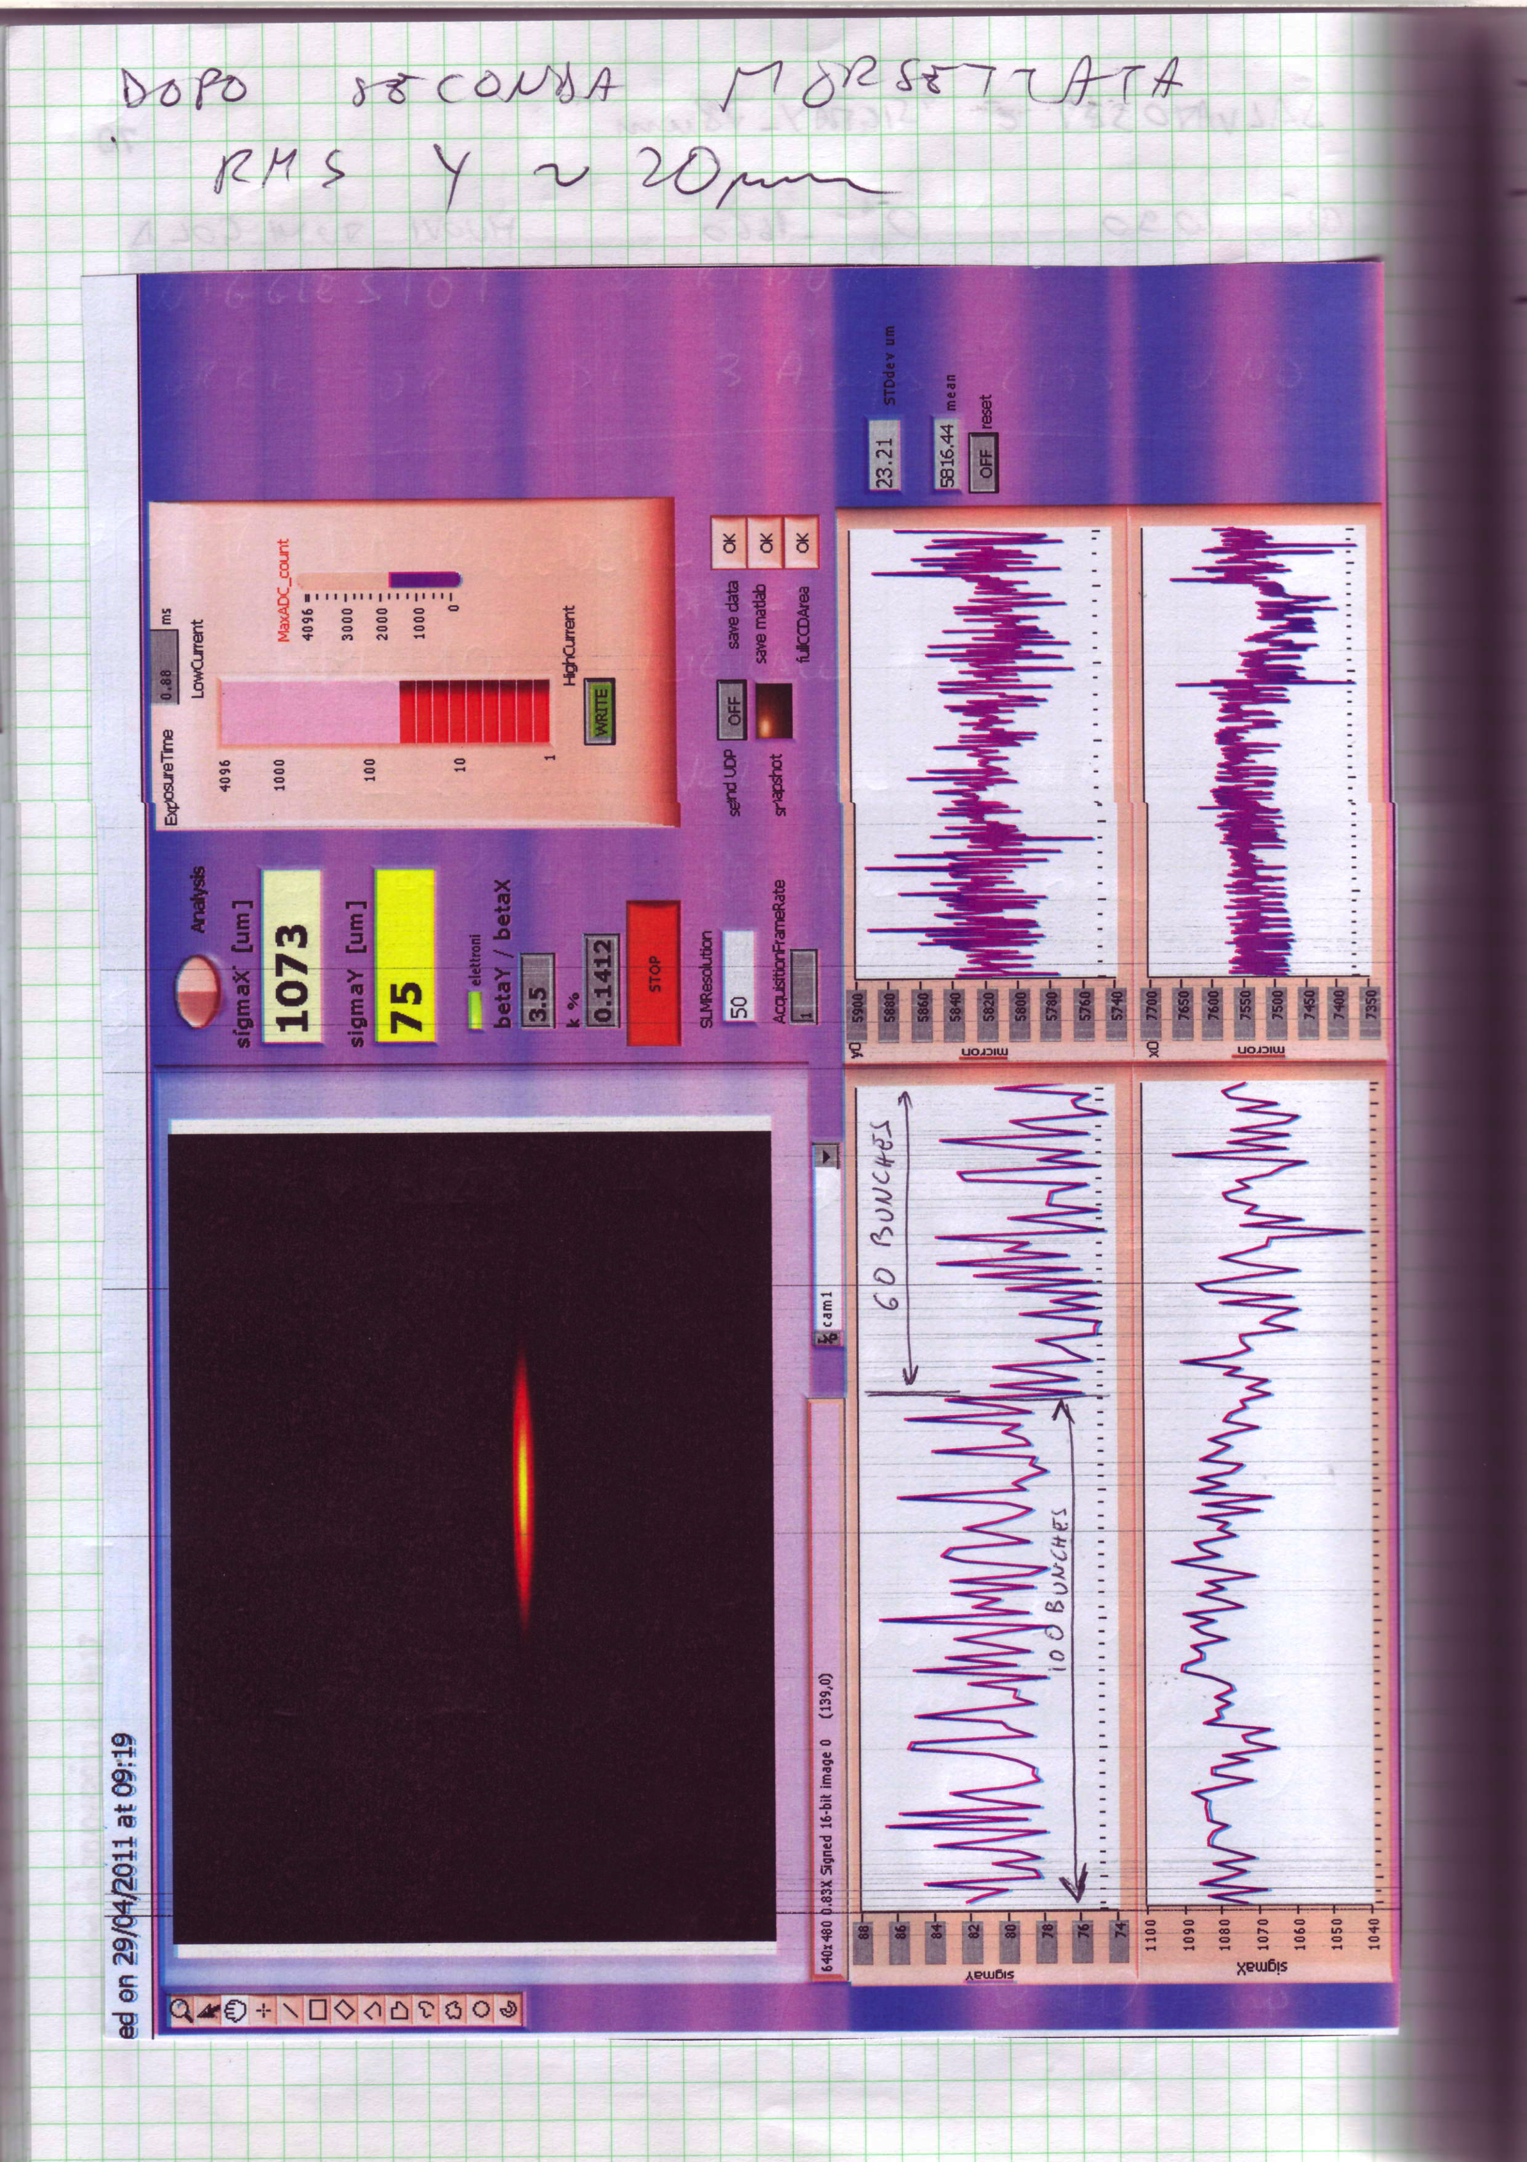
Collisions tuning: Betatron Coupling Corrections
σ_{y} = 75 μ at the Sync. Light Monitor
Single beam, 60 bunches
Best coupling κ ~ 0.14%
e⁻
  Better than the κ~ 0.2 ÷ 0.3 % best coupling obtained during the last KLOE run
Notes:
SLM sincrotron light monitor

Slide 7
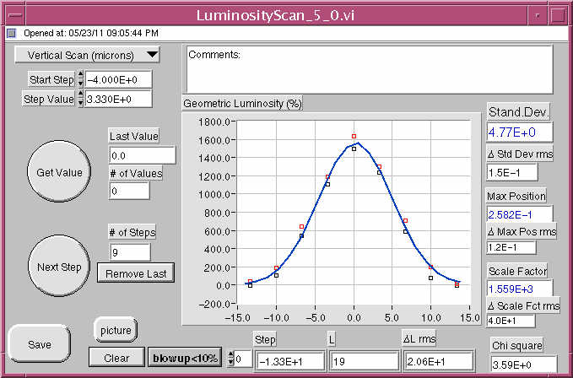
Collisions tuning:
Vertical beam-beam Luminosity scan
The convoluted vertical size measured by scanning a beam
through the other one looking the luminosity at IP.
Achieved a smaller vertical beam size with the KLOE solenoid than the best achieved without it, σ_{y}=3.5 μm ,during the SIDDHARTA run.

Slide 8
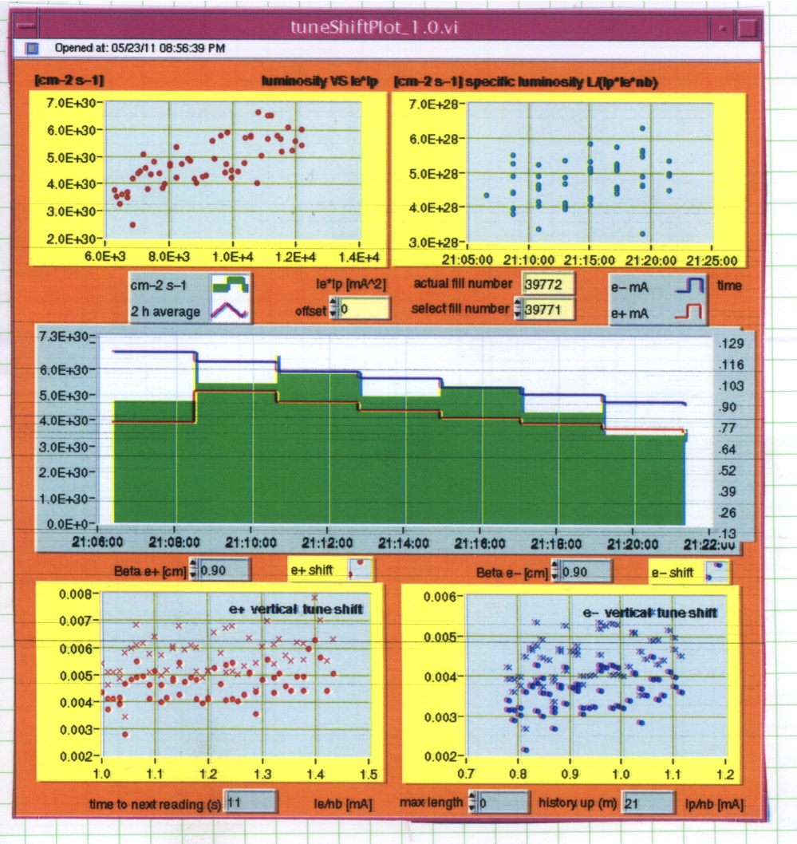
Collisions tuning: Specific Luminosity L_{sp}
At low currents L_{sp} = 4.5 10⁻²⁸ cm⁻² s⁻¹
L_{sp} comparable with the best SIDDHARTA run
L_{sp} exceeds by 4 times the best value measured during the past KLOE runs
SIDDHARTA run
Given the fragmented and limited time available so far,
we found promising and encouraging results.

Slide 9
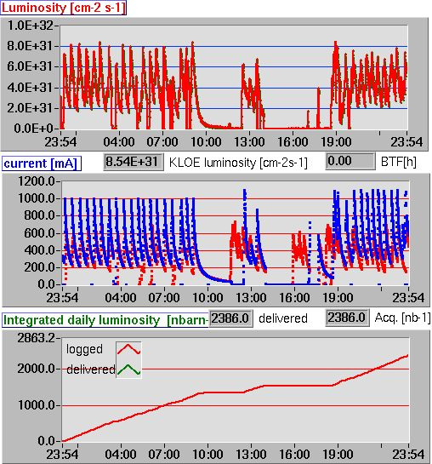
DAΦNE now…
DAFNE operation restarted on October 27 ^{th}.
Tuning-up the collider for the KLOE-2 data taking which is expected to be at regime in two months.

Slide 10
During the shutdown a big effort has been done in inspecting, repairing and refurbishing as far as possible to secure a frutiful data-taking to the KLOE-2 experiment .
Extra maintenance of LINAC modulator, klystron etc
LINAC gun system refurbishing and cathode
Vacuum LINAC review; pumps, valves and part of the load substitution
Power supply maintenance; all septum coil substitution
Cryogenic extra maintenance
Vibration noise study and attenuation
Controls, Diagnostic and RF system review, and maintenance

Slide 11
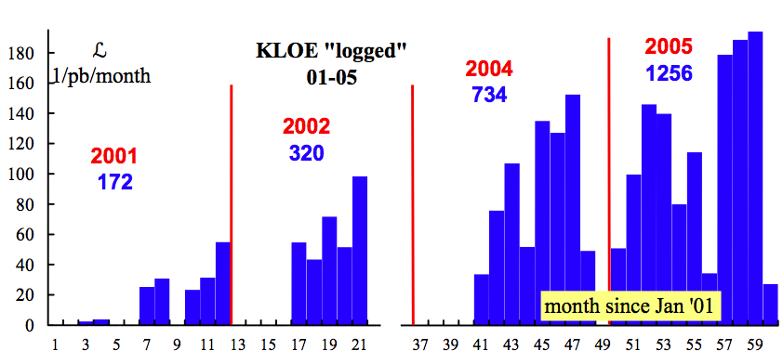
Between years 2000 and 2006 DAΦNE has delivered to KLOE 2.5 fb^{–1} of data at the Φ(1020) peak plus additional 250 pb^{–1} off-peak
L_{int}/ month (pb⁻¹)
Best day: 10 pb⁻¹
Best month: 194 pb⁻¹

Slide 12
Using these data, KLOE has published about 50 physics papers, addressing several fundamental topics in the fields of flavour and hadronic physics. Among our results one can list:
The complete set of measurement of neutral and charged kaon decay parameters to allow the precision measurement of V_{us} setting the best unitarity limit on the CKM matrix
A precise determination of the hadronic contribution to the g-2 of the muon
The best limit published so far on LFV in K_{e2} decays
The most detailed studies on the nature of scalar mesons
The measurement of some of the rarest branching ratios of the K_{s} and η mesons

Slide 13
KLOE-2 Physics Program
“Natural” extension of the KLOE program in the field of flavour and hadronic physics, with some additions, such as γγ interactions, or searches for new light gauge bosons. EPJC 68, 619-681 (2010)
Studies on CPT and QM violation with neutral kaons interferometry
Tests of Lepton Flavor Violation with K_{e2} decays
Studies on C, P, CP violation using rare η and K_{S} decays
Tests of Chiral Perturbation Theory with η, η’ , and K_{S} decays
Searches for signals of a Secluded Gauge Symmetry
Most of them involve decay processes at or very close the
interaction point 
Charged vertex efficiency near the IP
Acceptance for photons emitted at low polar angles

Slide 14
KLOE has already measured γ (assuming α = β = 0) obtaining
KLOE-2 becomes competive on γ and β with a few fb⁻¹ collected, and also on α with ≥ 20 fb⁻¹
The use of a inner tracker (blue points in figure) improves on the reachable limits by a factor ~ 3 (note the logarithmic scale!)
1
10
fb⁻¹

Slide 15
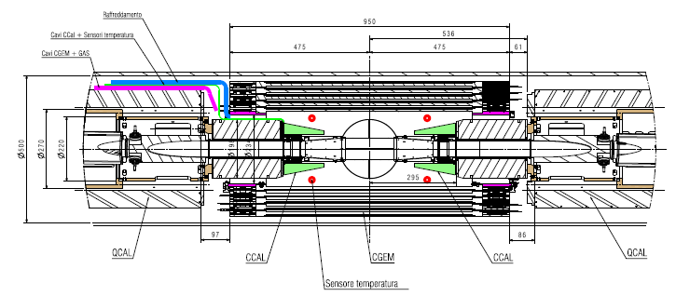
The upgraded interaction region
New sub-detectors will be installed around the interaction region
An inner tracker to improve on tracking resolution and acceptance
Forward calorimeters to increase acceptance for photons

Slide 16
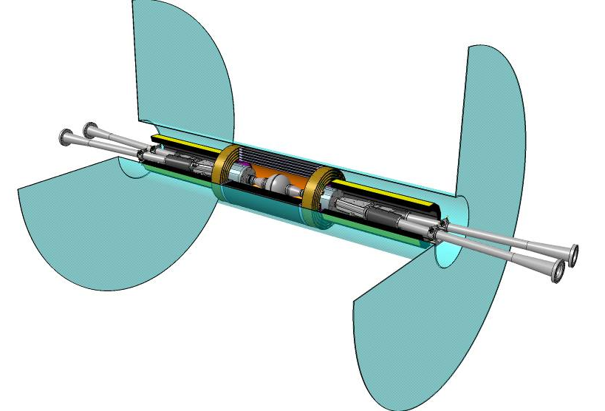
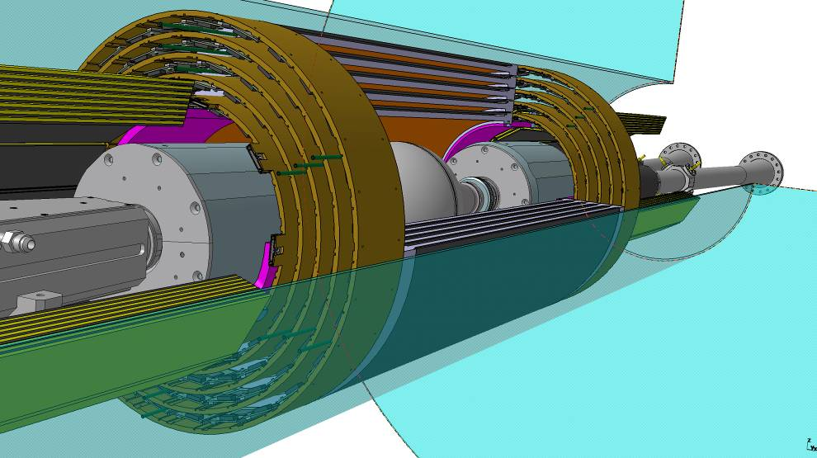
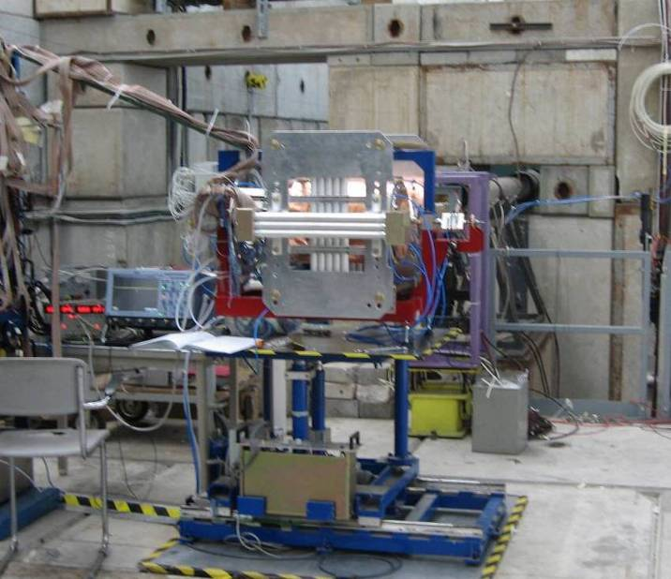
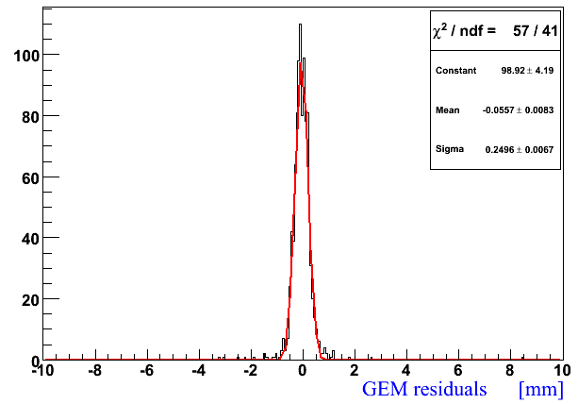
The KLOE-2 Inner Tracker
Four layers based on Cylindrical GEM technology
CGEM-IT
Drift Chamber
σ(global)² = σ(GEM)² + σ(tracker)²
σ(GEM) =√(250µm)² – (140µm)² ∼ 200µm

Slide 17
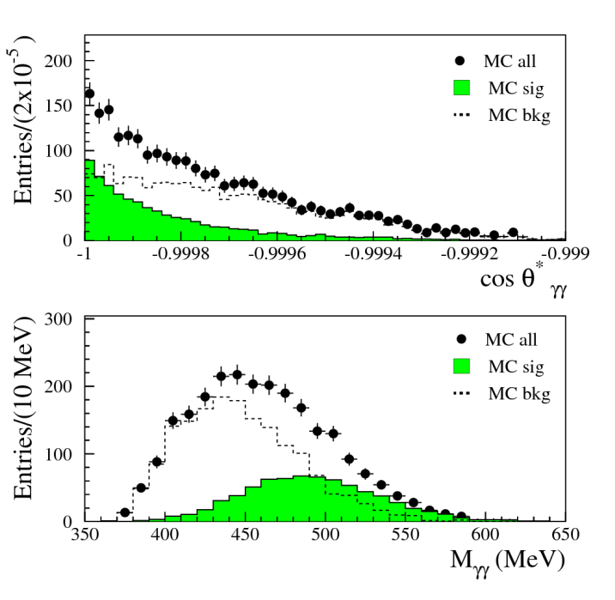
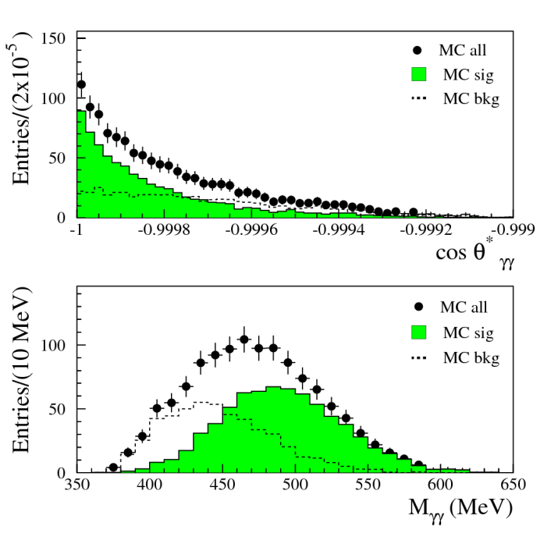
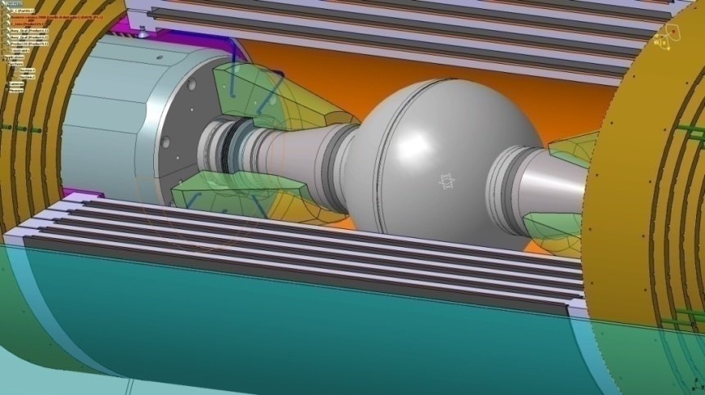
Forward calorimetry
The detector consists of two rings of 24 crystals of length of 10-13 cm and area from 1.5x1.5 to 2x2 cm²
W/O UPGRADE
It extends angular coverage down to 8°. Very useful for rare K_{S} decays
cristalli
WITH UPGRADE

Slide 18
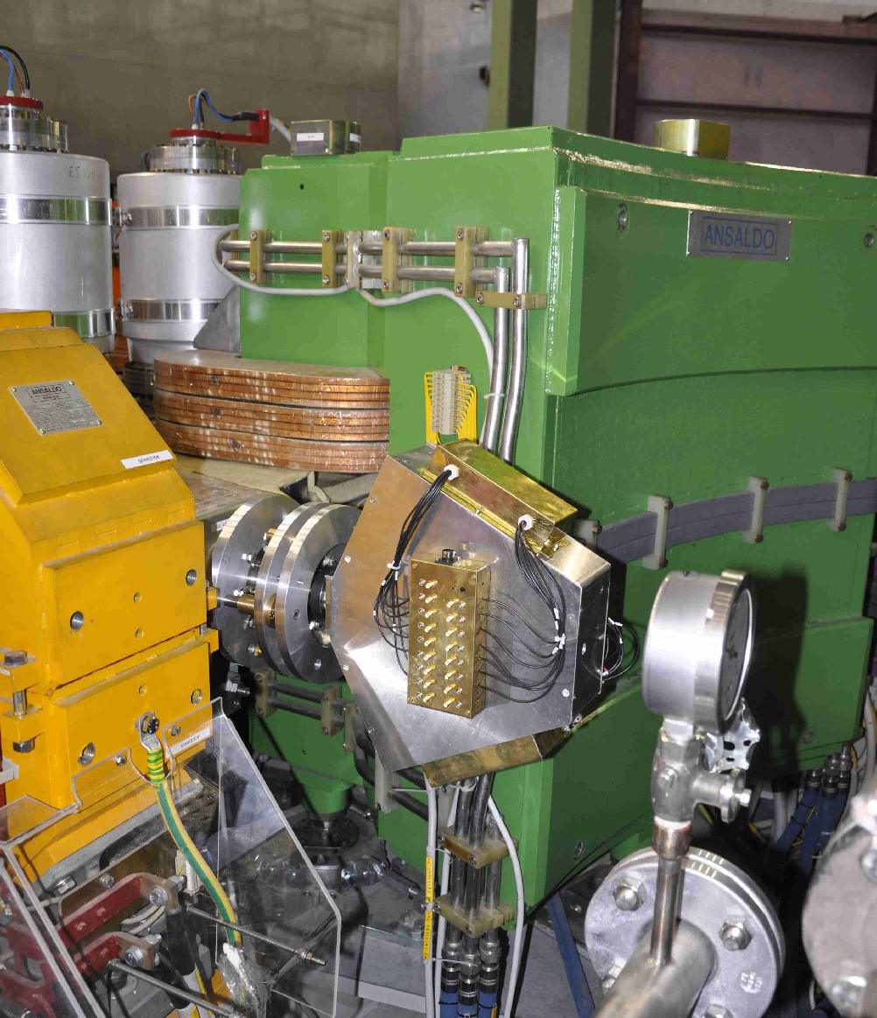
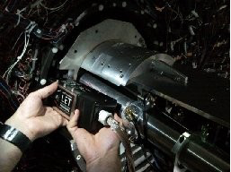
KLOE-2 Status
Taggers for γγ reactions installed.
High Energy Tagger installations
Low Energy Tagger installations
Starting commissioning phase

Slide 19
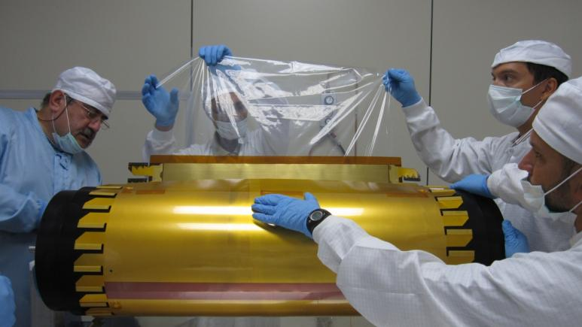
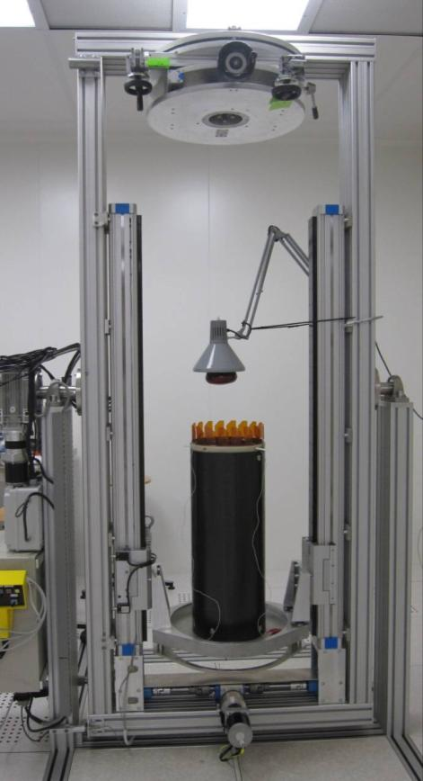
KLOE-2 Status
Inner Tracker : based on a well established technology, shaped in a totally innovative geometry, i.e. the cylindrical GEM (C-GEM) developped at LNF.
First layer (out of 4) almost completed.
Final insertion test of a real cylindrical GEM electrode inside a CF anode prototyope
Anode cylindrical gluing
Detector construction completion expected for summer 2012

Slide 20
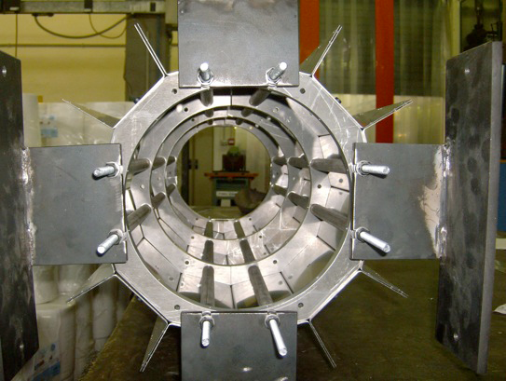
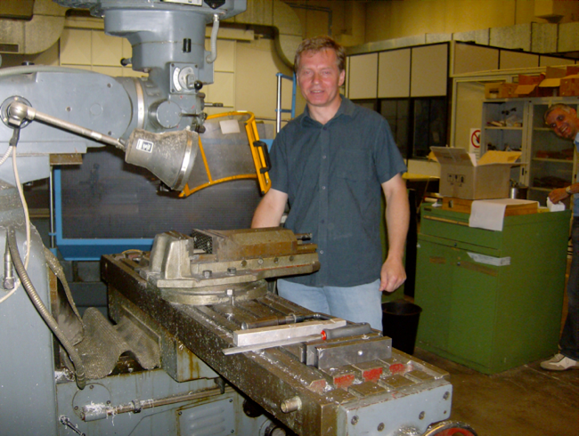
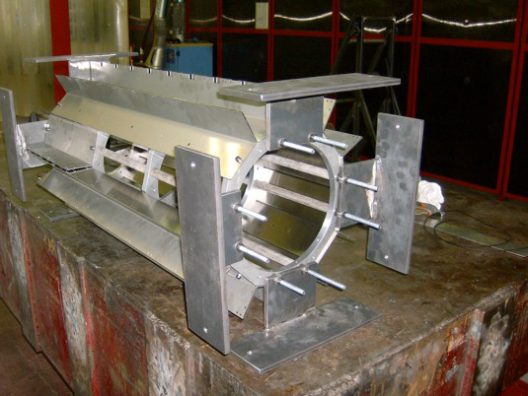
KLOE-2 Status
Quadrupole Calorimeter (QCALT) and Forward Calorimeter (CCALT) construction started.
Mechanical Structure
QCALT Tiles machining
Final detectors completion expected for spring 2012

Slide 21
http://www.lnf.infn.it/acceleratori
DAΦNE schedule
e- beam
down
standard operation
2011
Jan | Feb | Mar | Apr | May | Jun | Jul | Aug | Sep | Oct | Nov | Dec
LINAC vacuum, electronics and review; cathode inst.;
ordinary maintenance
2012
Jan | Feb | Mar | Apr | May | Jun | Jul | Aug | Sep | Oct | Nov | Dec
Inst. inner tracker KLOE
exceptional maintenance
cryogenic maintenance
2013
Jan | Feb | Mar | Apr | May | Jun | Jul | Aug | Sep | Oct | Nov | Dec
2014
Jan | Feb | Mar | Apr | May | Jun | Jul | Aug | Sep | Oct | Nov | Dec
ordinary maintenance

Slide 22
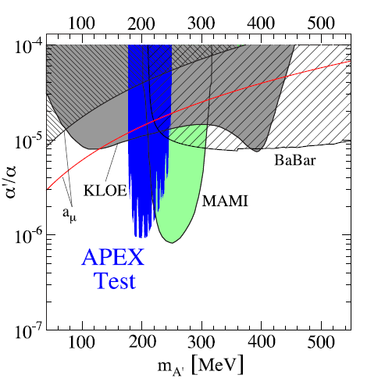
KLOE most recent results
Limit on “dark photon” production set using Φ → ηe⁺e⁻ decays. Best limit in the mass range 60 < M_{U} < 200 MeV
arXiv:1110.0411 (submitted to PLB)
Coupling of new force (normalized to α_{em})

Slide 23
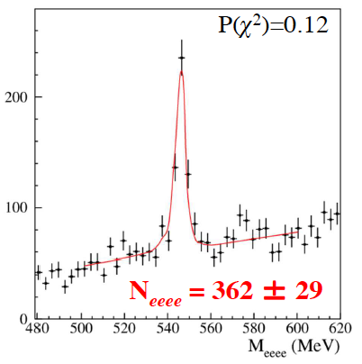
KLOE most recent results:
First observation of η→e⁺e⁺e⁻e⁻ decays
Theoretical predictions: BR ~ 2.4 – 2.6 ×10⁻⁵
BR < 6.9×10⁻⁵ @90%C.L. (CMD-2, 2001)
BR < 9.7×10⁻⁵ @90%C.L. (WASA, 2008)
(2 evts, with 1.3 bckg)
Data sample: 1.7 fb⁻¹
MC simulation according to
Bijnens and Persson [hep-ph/0106130]
e⁺e⁻ pairs from photon conversions in the
beam pipe and Drift Chamber wall rejected
Fit with signal + background from
continuum (e⁺e⁻→e⁺e⁻γ with γ conversion)
First observation
[PLB702(2011)324]

Slide 24
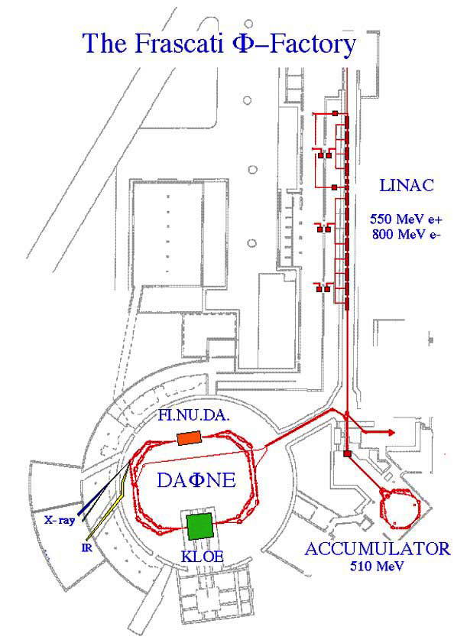
Beamlines @ DAΦNE
SINBAD - InfraRed beamline
DXR1 - Soft x-ray beamline (900eV-3000eV)
Open to Italian and EU users
DXR2 - UV beamline (2eV -10eV) new setup ready in 2012
2 new XUV beamlines
LEB-Low Energy Beamline (35eV -200eV) commissioning in 2011
HEB-High Energy Beamline (60eV -1000eV) commissioning in 2012
XUV
UV
Notes:
From Wiggler: DXR1 and DXR2
Froma Dafne magnet: IR, 2 XUV

Slide 25
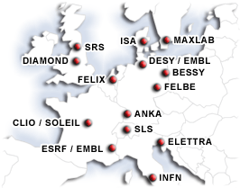
Beamtime for DAΦNE-light
2010 - 2011
186 days - 24 DAFNE dedicated days
20 different teams: 16 Italian 15 EU E.Li.S.A. users
All the E.Li.S.A (European LIght Sources Activities ) accepted proposals were successfully concluded in August
E.LI.S.A. is a program for research cooperation involving 17 laboratories and institutions throughout Europe.
This corresponds to the world largest network of synchrotron and FEL facilities.
2012 - A new proposal will be submitted in the Call opened inJuly 2011 –
If approved a new EU project C.A.LI.P.S.O. will start in May 2012.
Notes:
Calipso: utilizzera 5 linee e 600 ore

Slide 26
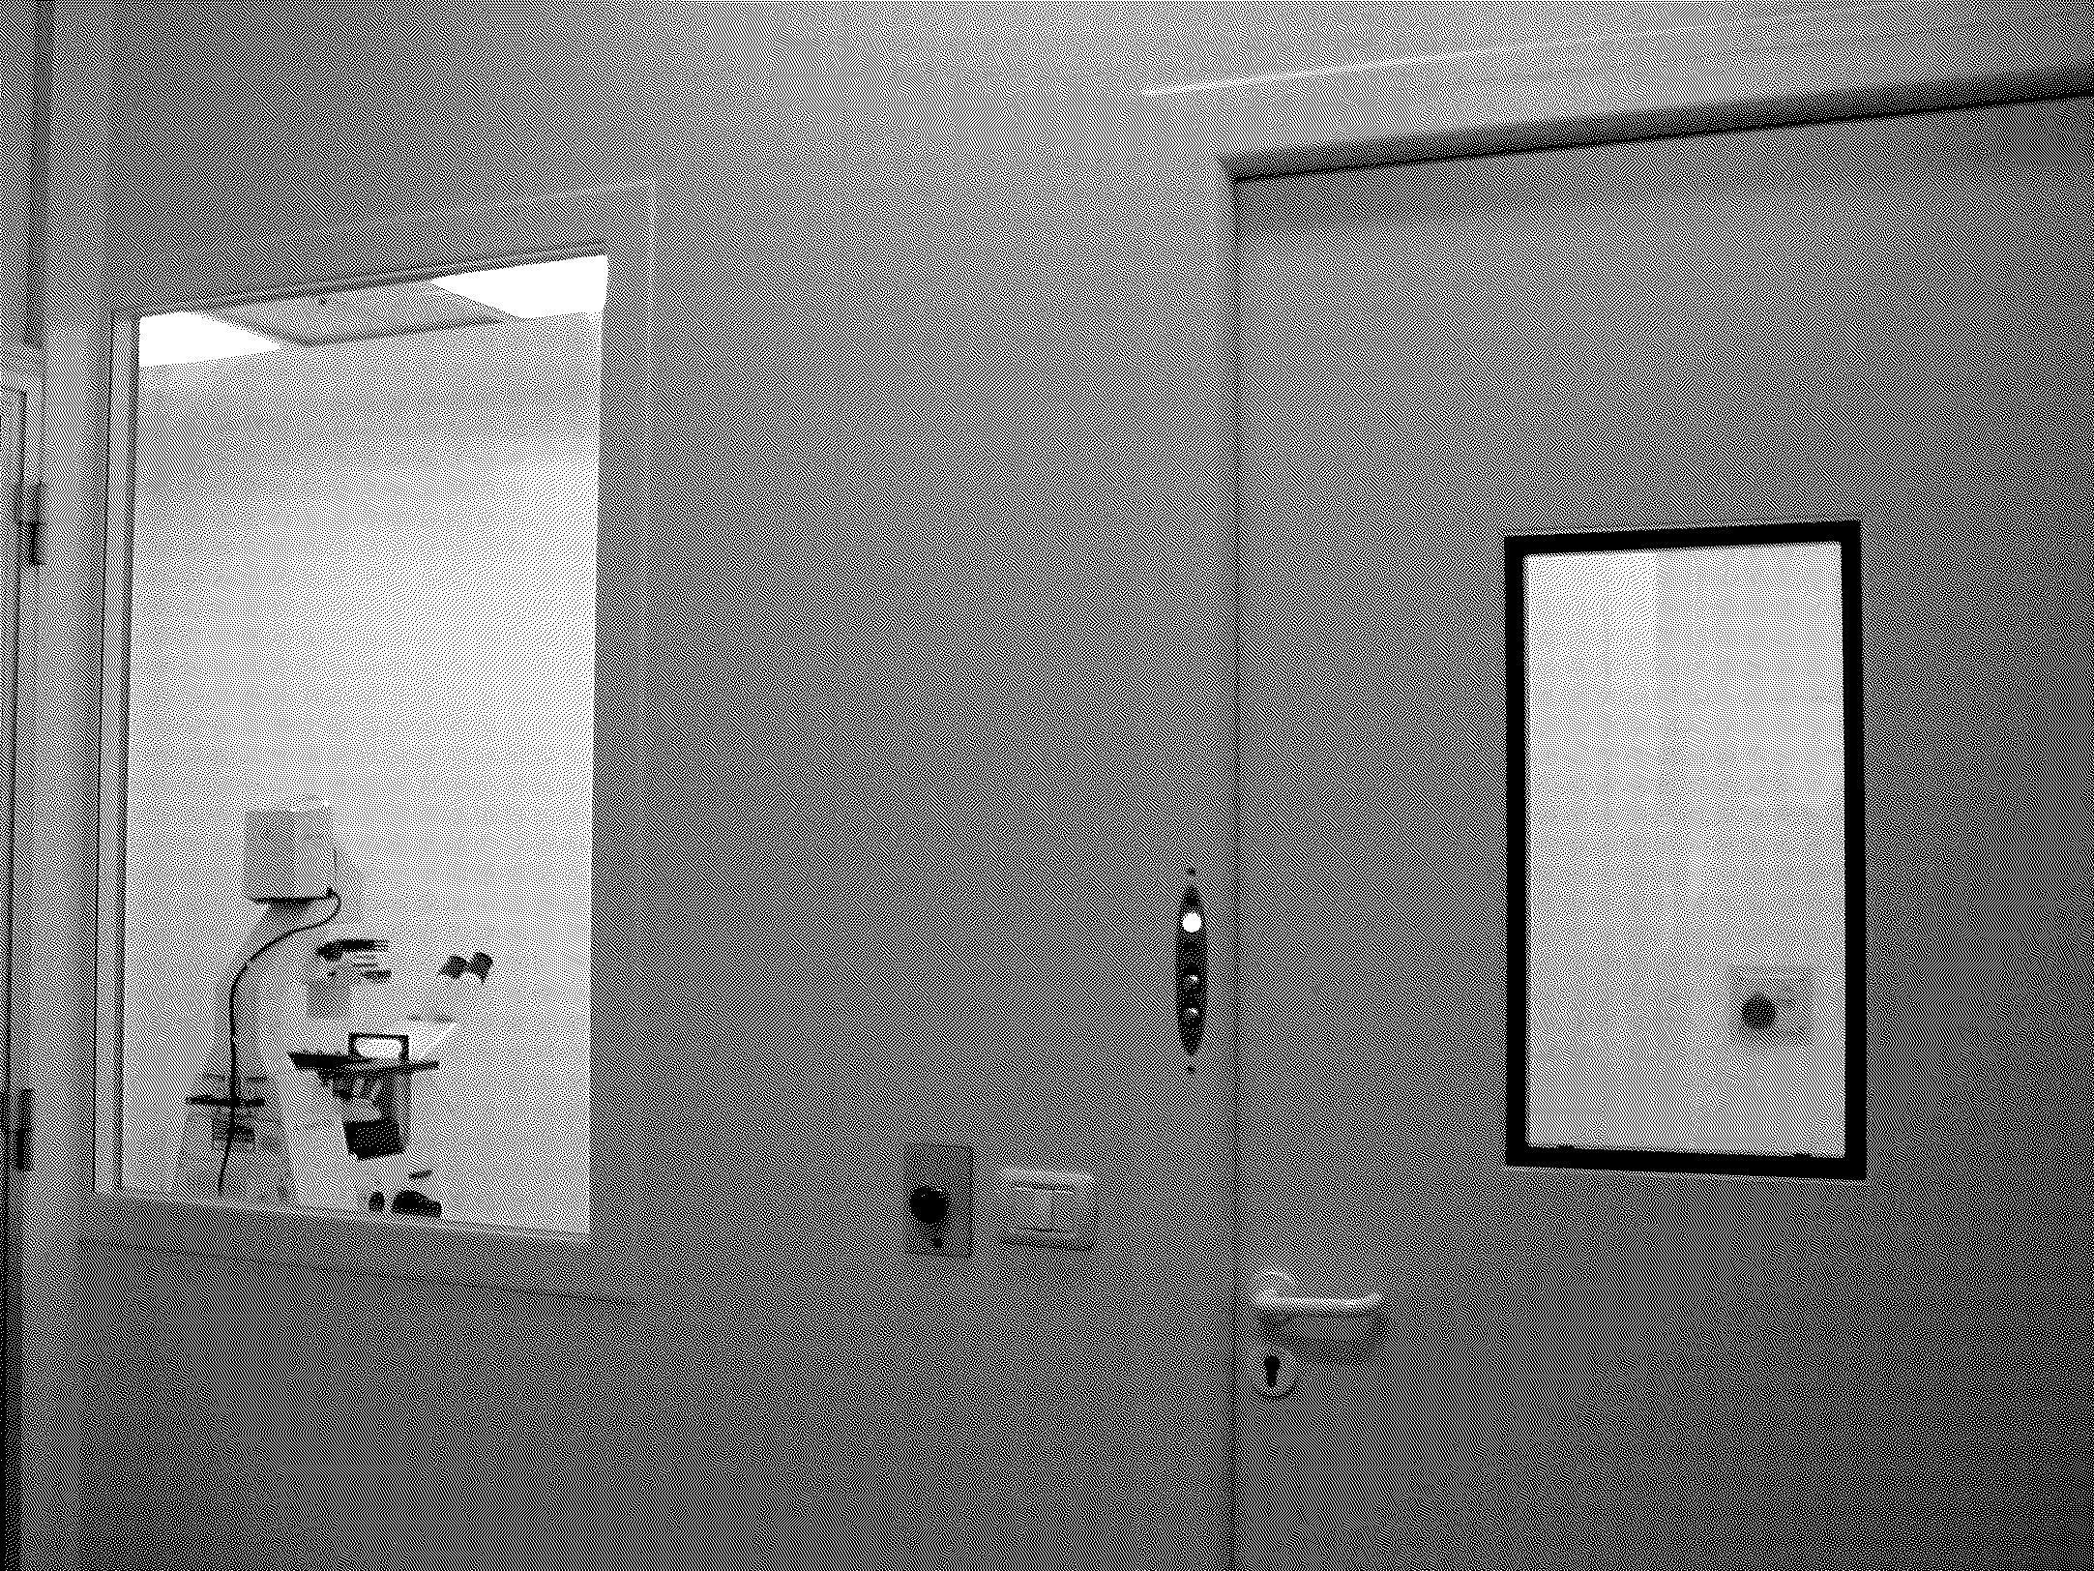
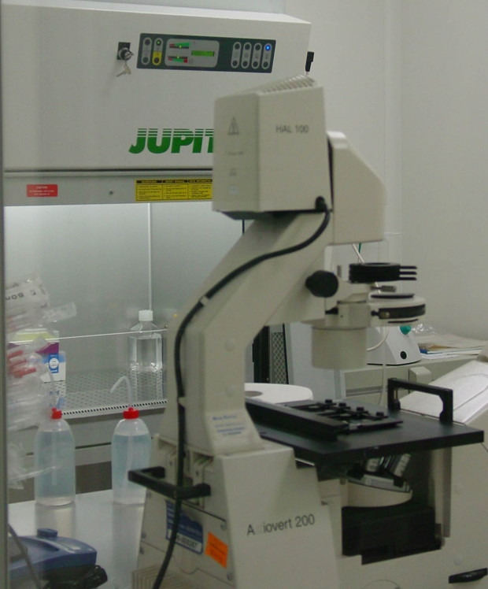
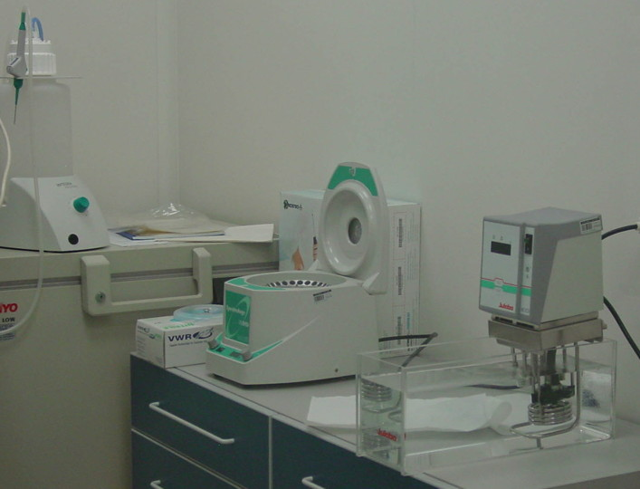
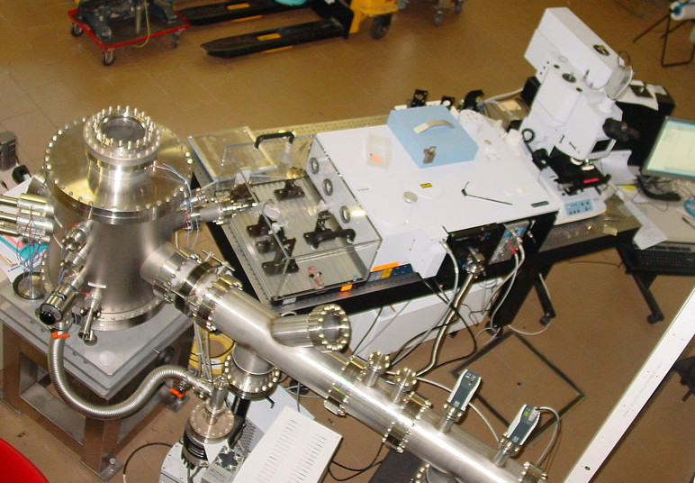
SINBAD-IR upgrade
NEW clean-room bio-laboratory for sample preparation available for users.
Dedicated instruments:
-cryo-microtome to allow thin tissues preparation (1 μm)
-freezer for cryo-conservation @ -85 °C
Imaging capabilities:
-Attenuated Total Reflection (ATR) microscope objective allowing cells growth
-Dedicated new IR spectrometer Vertex with unprecedented performances for vacuum micro-spectroscopy,
The complete setup installed at the end of 2011
operational in 2012 to perform first live cell experiments.

Slide 27
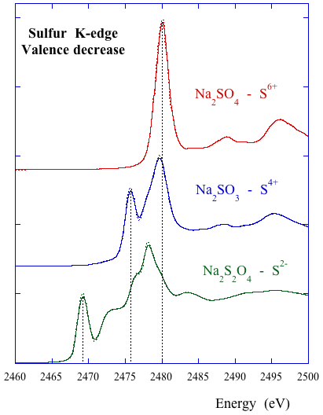
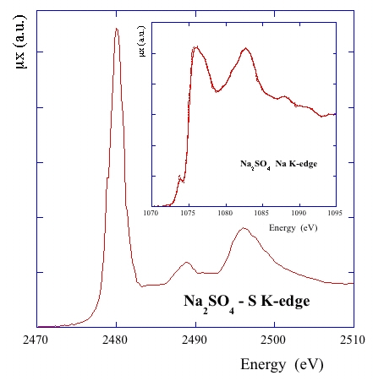
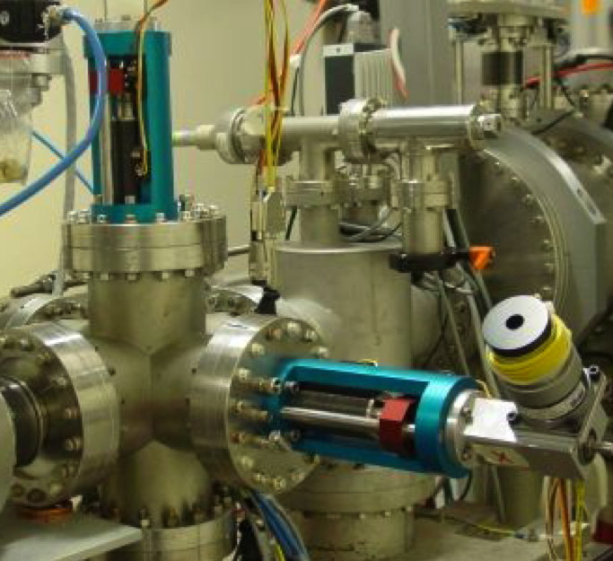
DXR1 Soft X-ray Beamline
- Wiggler soft x-ray beam line
- Critical energy E_{c} = 284 eV
Working range 0.9 - 3.0 keV
The monochromatic photon flux between 10⁷ and 10⁹ ph/s.
HIGH quality soft x-ray absorption data.
Dedicated instruments: double wire beam monitor, horizontal slit
NEW system to control, set and include the values of the pressures of the ionization chambers.
Beamline re-alignment ongoing.

Slide 28
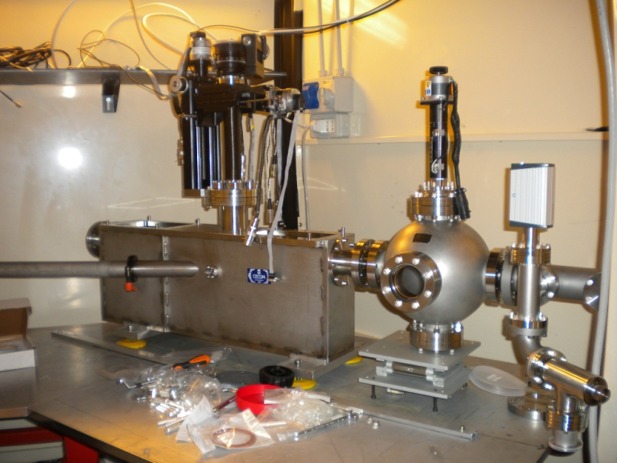

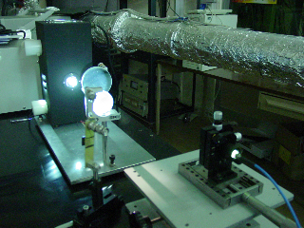
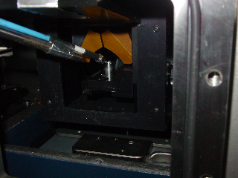
New DXR2 beamline
Wiggler UV branch line-deflection
UV beamline new setup 2 -10 eV (650nm - 120nm)
Branch line in a 1000-class clean room
Upgraded UV-VIS monochromatic radiation source (180-650 nm)
February 2011: First light on the new optical system of the UV-VIS beamline.
.
First tests on organic UV damaged samples, for space experiments
Notes:
VUV radiation source (D2 120-250 nm)
UV-VIS radiation source (Hg/Xe 200ﾖ650 nm)

Slide 29
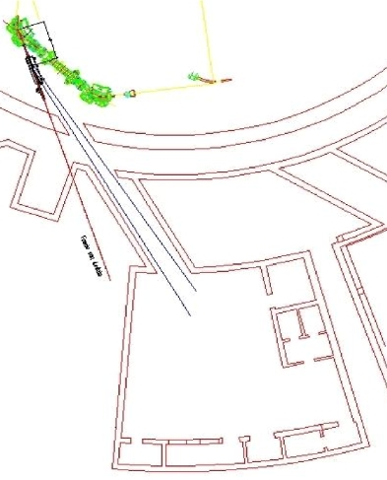
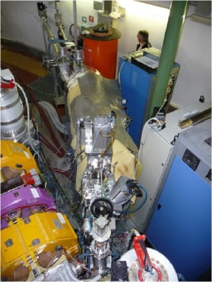
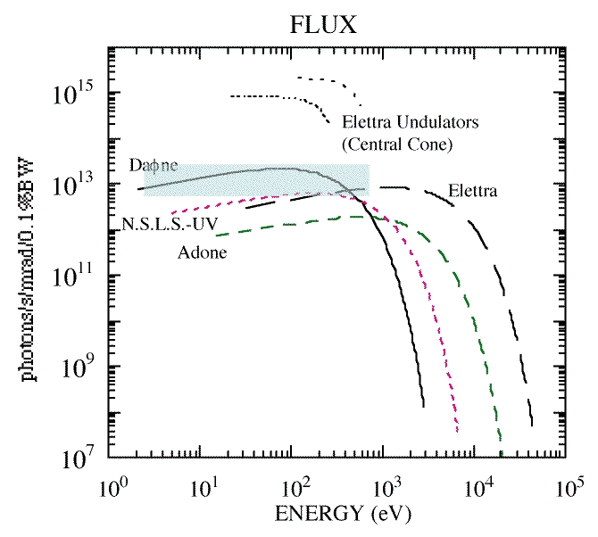
New XUV Beamlines
LEB (35-200 eV) commissioning in 2011
HEB (60-1000 eV) commissioning in 2012
Fields of interest & application:
Biology
Surface Science
Material Science
R&D studies of INFN interest
IMCA project: Innovative Materials and Coatings for Accelerators
R&D of new materials and thin films useful to minimize beam instabilities due to ‘e-cloud’.
Tests of relevance for e-cloud studies in collaborations with CERN, DESY (PETRA 3), Brookhaven (RICH) etc.
Notes:
NTA- Nuove Tecniche di Accelerazione

Slide 30
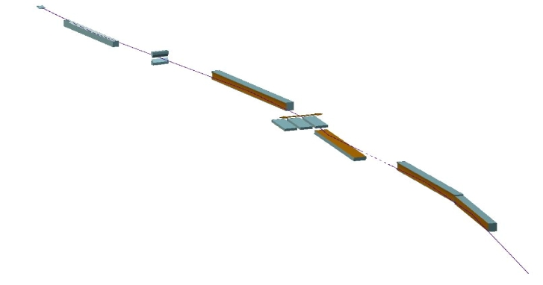
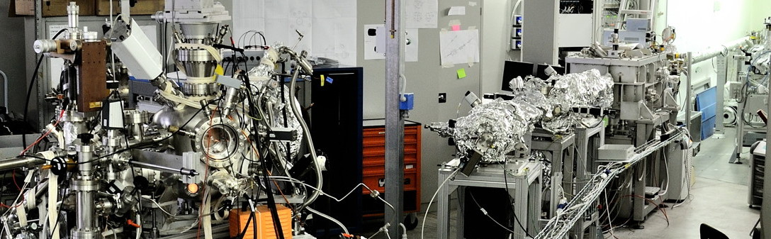
Status of the XUV HEB (60-1000 eV)
Exper.
chamber
Under study
Mono, slits, and other main optical elements
Refoc.
Mirror
Exit slits
HT₂
PG
HM₂
Energy range (eV) | Mono. | Resolving power | Flux (ph/s/0.1% bw)
60-1000 | PGM | 1000-5000 | 10¹³-10¹⁰
The optical elements and UHV vacuum chambers needed for the construction of the HEB have been mounted. The PGM monochromator was delivered by the end of 2010. Also for this beamline an experimental set-up to perform SR photoemission and absorption spectroscopy in UHV condition is under study.
Notes:
HT₁ and HT₂ - toroidal mirrors
HM - flat mirror,
PGM - plane gratings monochromator
Refoc. Mirror – toroidal mirror

Slide 31
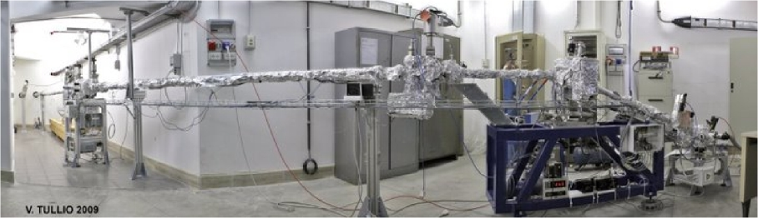
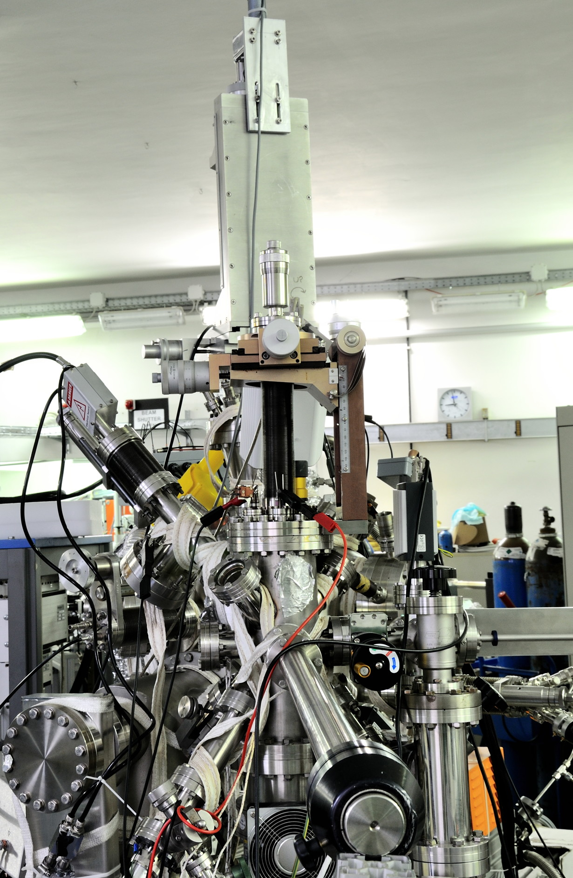
Status of the XUV LEB (35-200 eV)
All the optical and vacuum components of the LEB beamline available during 2008-2009, and the DAΦNE-L team worked to mount them in the foreseen positions.
2010 and 2011 have been devoted to the optimization of a ‘state of the art’ spectroscopic chamber, in order to be able to do angle resolved photoemission experiments, also at low temperature. This system has been tested at length during 2011 and a fast load-lock system has been implemented in order to be able to change samples to be studied with SR without breaking vacuum.

Slide 32
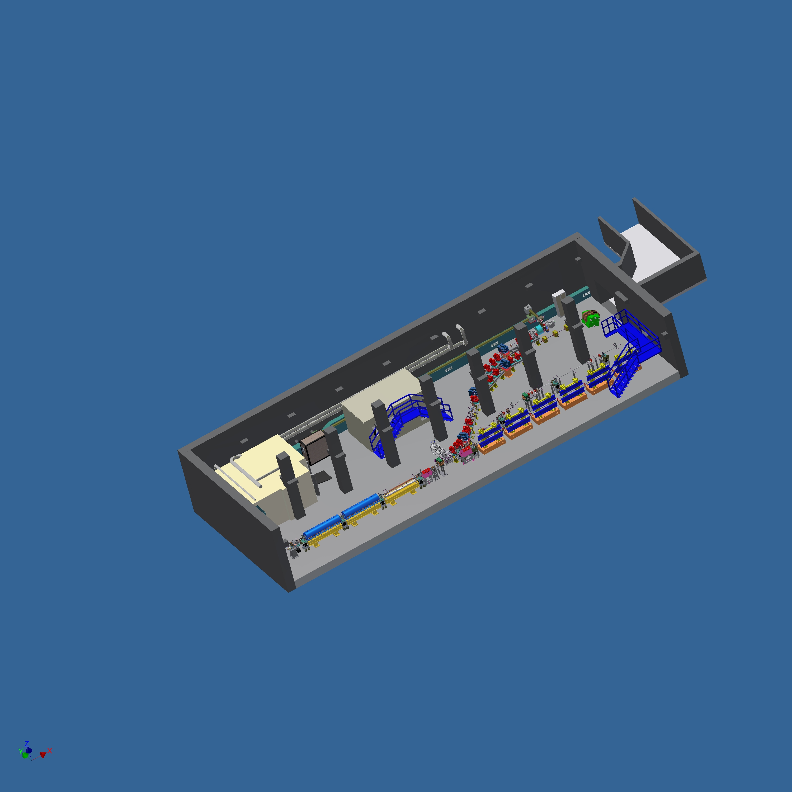
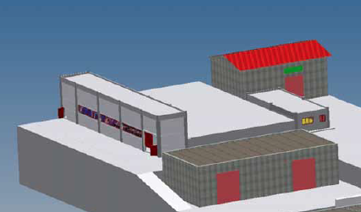

SPARC_LAB
Sources for Plasma Accelerators and Radiation Compton with Lasers And Beams
A facility based on
the unique combination of
high brightness electron beams with
high intensity ultra-short laser pulses
Notes:
to realise external injection into the plasma bubble. This requires extensive R&D work on the control and synchronization of electron beams on the few femtosecond scale.
To realize external injection into the plasma bubble requires extensive R&D work into the sincronization of the electron beam on the few femtosecond scale.

Slide 33
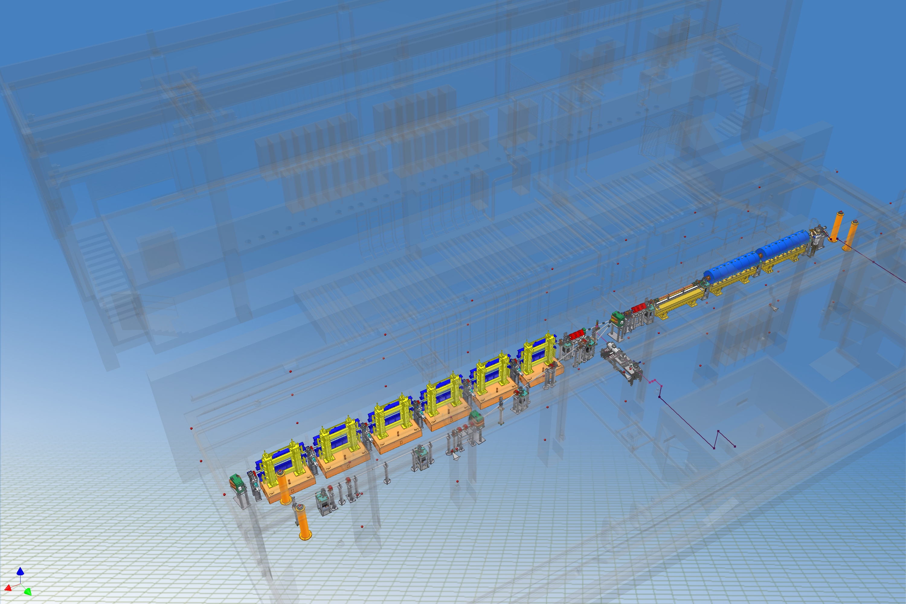
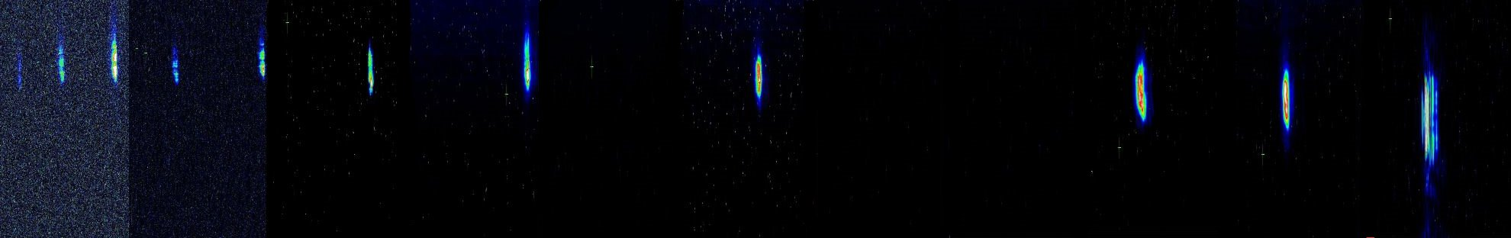
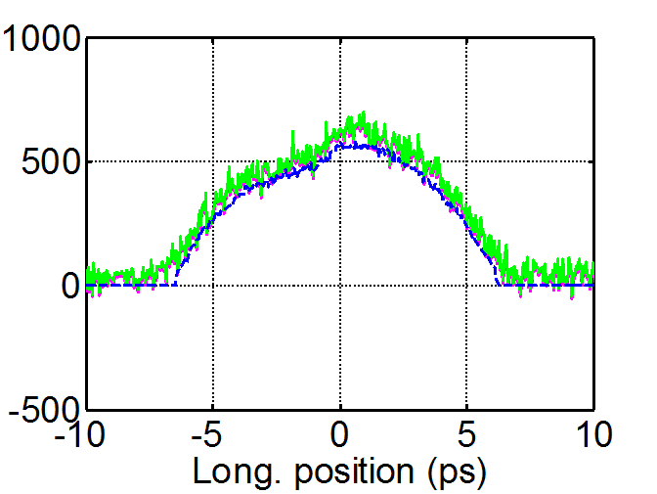





SPARC
150 MeV S-band linac
Velocity Bunching
Diagnostic and Matching
Undulators
λ_{u} = 2.8 cm
K_{max} = 2.2
λ_{r} = 500 nm
12 m
11h 10h 9h 8h 7h 6h 5h 4h 3h 2h 1h
11h 10h 9h 8h 7h 6h 5h 4h 3h 2h 1h
Long Solenoids
S-band Gun
15 m
Seeding
THz Source
Notes:
characterisation of the spontaneous and stimulated
radiation in the undulators.
The first spectum of coherent radiation was
observed at 500 nm on February 17th, 2009.
The generation of the higher harmonics for the FEL radiation. FEL
harmonic generation process of an input seed signal
obtained as higher order harmonics generated in gases
[16] and compare it with the single spike operation
described in [17] and [18].

Slide 34

FLAME:Frascati Laser for Acceleration
and Multidisciplinary Experiments
FLAME Laser, gas-jet target, beam transport fully commissioned in 2010.
-200 TW achieved.
-Beam focused into gas cell for plasma acceleration.

Slide 35

Target Area – Self-injection experiment

Slide 36


First laser accelerated electron bunches from self-injection
Electrons at LANEX screen
4 mm
Electron energies between 200 and 250 MeV
were achieved in the
self-injection mode.
The best laser-plasma acceleration results achieved worldwide

Slide 37

Plasma
Ext. Inj.
New installations
Investigation of different configurations of plasma accelerator.
Production of monochromatic ultra-fast X-rays by Thomson b-s driven by high-quality electron beam.
Back scattering
Thomson
THz
FEL
Notes:
Electron beamlines for thomson backscattering AND external injection into the plasma bubble are being installed in 2011.
In 2011 planned it’s planned to begin the backscattering program, generating X-ray pulses of unprecedenedt intensity.
External injection will come in 2013, it needs design of an interaction chamber. To realize external injection into the plasma bubble requires extensive R&D work into the sincronization of the electron beam on the few femtosecond scale.

Slide 38
Summary
DAΦNE operation restarted
KLOE-2 data taking expected to start in two months;
2012-2013-2014.
Required 8-12 month slot on DAΦNE in the 2012-2015 by SIDDHARTA-2 requiring the 2th interaction point.
DAΦNE-light: will operate with 2 new beamlines.
SPARC-LAB: 2 beamlines put LNF in a unique situation in terms of laser-plasma acceleration.
LHC EXPERIMENTS AND NA62
PHYSICS IN SPACE
DETECTOR TECHNOLOGY and APPLICATION
SuperB: based on the Crab-waist concept developed for DAΦNE

Slide 39

From ADA to SuperB
Fifty years ago, the first electron-positron storage ring in the world, the Anello di Accumulazione (AdA), started operating in Frascati.
Frascati National Laboratories
and
Laboratoire de l’Accélérateur Linéaire d’Orsay,
are jointly organizing a workshop:
"1961-2011 from AdA to SuperB ”
The workshop will be held in Frascati on December 1st.

Slide 40
Frascati National Labs (LNF)
Total Staff of which: 364 | Researchers 98 | Technologist/ Engineers 57 | Technicians 170 |  | Administration/ Services 39
External Users 546 | Italian 346 |  | Foreign 200
Visitors 3960 | Stages 310 | Conference Workshops 17 | Participants to Conf. / Work. 776 | Master Courses 1 (27 positions)

Slide 41
Backslides

Slide 42

Laser plasma acceleration

Slide 43
DAΦNE present achievements & perspectives
 | DAΦNE upgrade SIDDHARTA | DAΦNE KLOE | DAΦNE FINUDA
L_{peak} [cm⁻²s⁻¹] | 4.53•10³² (5.0•10³²) | 1.5•10³² | 1.6 •10³²
L_{∫day} [pb⁻¹] | 14.98 | 9.8 | 9.4
L_{∫1 hour} [pb⁻¹] | 1.033 | 0.44 | 0.5
I⁻_{MAX} in collision [A] | 1.52 | 1.4 | 1.5
I⁺_{MAX} in collision [A] | 1.0 | 1.2 | 1.1
N_{bunches} | 105 | 111 | 106
ξ_{y} | 0.0443 (0.074) | 0.025 | 0.029
Scaling the present data from the luminosity monitor:
  L_{∫day} ≥ 20. pb⁻¹ seems possible!
  Assuming 80% collider uptime ⇒ L_{∫month}~ .5 fb⁻¹
The Crab-Waist collision scheme has been widely recognized as a major advance in the field of the beam-beam interaction in lepton colliders.
(Courtesy of Catia Milardi)

Slide 44

V_{us} determination and CKM unitarity
Fit on
V_{us} from K_{l3}
V_{us}/V_{ud} from K_{μ2} /π_{μ2}
V_{ud} from 0⁺→0⁺ β decays
|V_{us} | = 0.2249 ± 0.0010
|V_{ud} | = 0.97418 ± 0.00026
1 – |V_{us} |² − |V_{ud} |² = 0.0004 ± 0.0007
was 0.0031 ± 0.0015 in PDG04

Slide 45


Hadronic contribution to muon g-2
Discrepancy between a_{μ}SM and a_{μ}^{EXP} at 3.2σ level
New KLOE analysis , with different selection criteria confirms KLOE08

Slide 46




GeV ACCELERATION WITH SELF INJECTION
Main set up parameters
See: L.A. Gizzi et al., EPJ-ST, 175, 3-10 (2009)

Slide 47


20 mrad
Electrons from
FLAME SELF INJECTION
2010 - FIRST ACCELERATION OF ELECTRONS AT 200MEV
Now:
1) Learn how to obtain stable beams and multiple accelerations
(10⁸ electrons/bunch in 100fs)
2) External injection
3) Electron beam self-acceleration with plasma waves

Slide 48




SPARC - FEL
Notes:
48

Slide 50


Slide 51


