Slide 1
Midtem Greece - Report
Theo Alexopoulos
NTU-Athens
P-ECFA @ CERN
25.11.2011
25/11/2011
TheoAlex, Greek Midterm, PECFA @ CERN
1

Slide 2

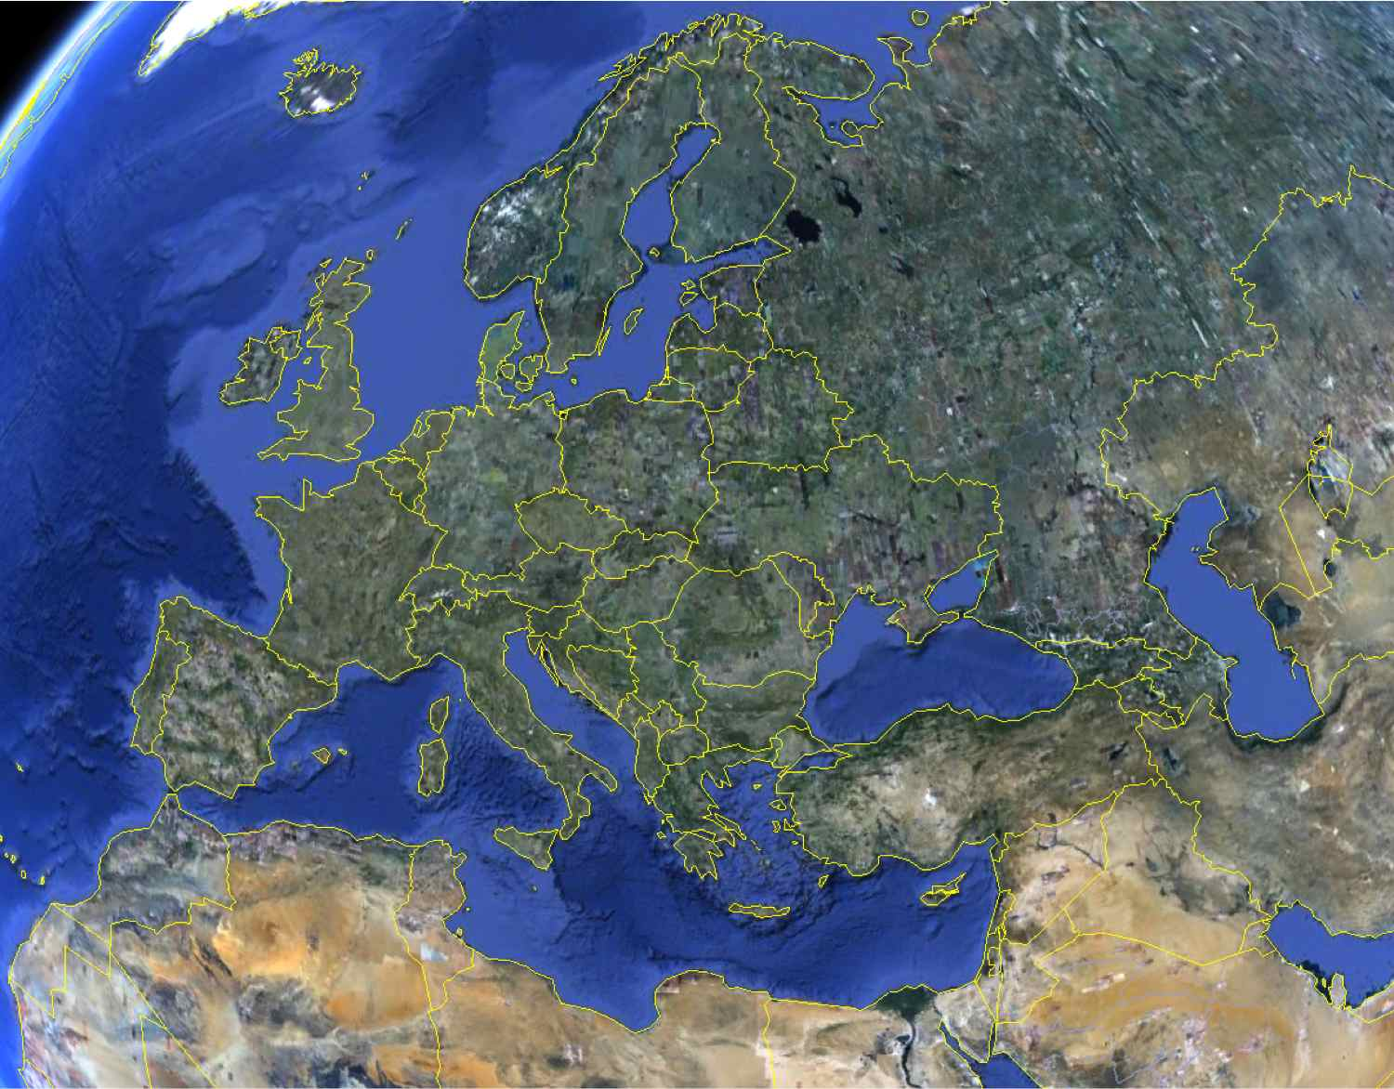
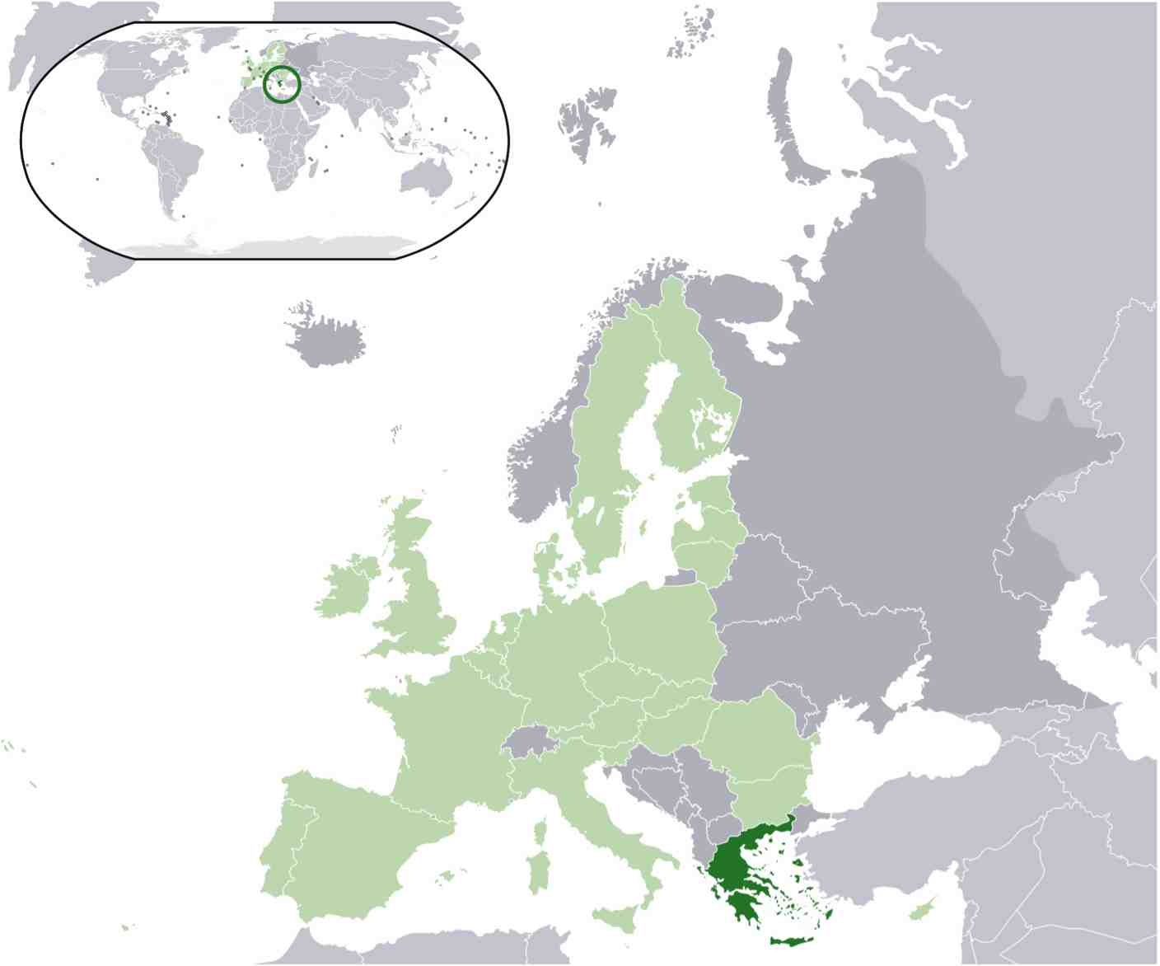
Geography/Logistics Data
some data:
Area: 131 990 km²
~1500/230 islands
80% mountains
Coastline: 13 700 km
Population: 10.8x10⁶
GDP: $305.4 billion
Per capita $27K
Unemployment: 17.6%!
Inflation rate: 3%
R&D expenditure:
0.56% of GDP!
Military expenditure:
4.3% of GDP! (nonR&D)
25/11/2011
TheoAlex, Greek Midterm, PECFA @ CERN
2

Slide 3
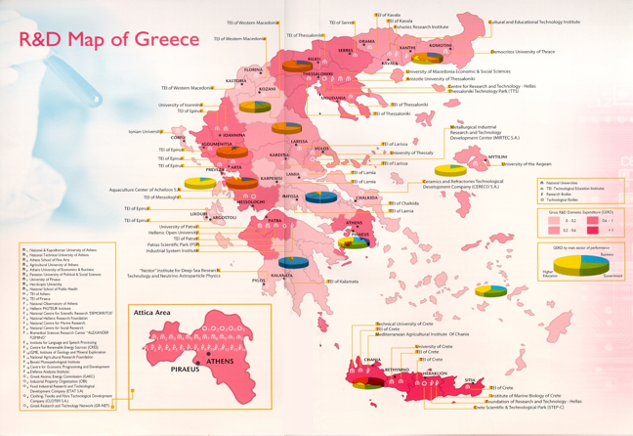
Higher Education
State funded; free education
Universities: 24 (5 established after 2000)
Teaching staff: 13,390
Education Expenditure: 4% of GDP
4-5y diploma+1.5y MSc+3-4y PhD
7 Universities offer Physics degrees
7 Universities offer HEP studies;71 PhD students
NCSR “Demokritos”/NTUA
University | # of Physics undergrad students
AUTh | 1100
U of Ioannina | 800
U of Patras, HOU | 800
U of A, NTUA U of Crete | 2300 600
total: 5.6K
25/11/2011
TheoAlex, Greek Midterm, PECFA @ CERN
3

Slide 4
HEP Funding
We’ve been trying (following ECFA’s recommendations) for many years to motivate the Greek government (General Secretariat of Research & Technology -- GSRT) to establish a funding body for HEP research, such as we could receive support for our research in a competitive basis, according to our efforts and achievements. This does not exist as yet.
Only very recently in which for the first time there are signs of establishing an international peer reviewing process for funding by the Ministry of Education. The results of the first research program “Thalis” have just been announced; 5 HEP teams (ATLAS, CMS, KM3NET) are funded for 3 years at the level of 600K each.
Other than that….
GSRT – provides
CERN contribution of 21.4MCHF (1.93% of CERN budget)
Ministry of Education, General Secretariat of Research & Technology – provides
LHC, nTOF, CAST experiments CF, M&O, etc. ~1.0 MCHF
University Basic Research Funding System of NTUA, AUTH, UoA, UoCrete, UoI
Ministry of Education programs for graduate students & Postdocs
EU FP6 (ARTEMIS), FP7 (AIDA, PATHWAYS, COSMOS, numerous theory networks…)
25/11/2011
TheoAlex, Greek Midterm, PECFA @ CERN
4

Slide 5
HEP Research projects
Accelerator based
CERN
LHC: ATLAS, CMS, ALICE
PS: n_TOF
Detector R&D: RD51
FNAL: CDF
DESY: H1
Non-accelerator based
CERN: CAST
Nestor, KM3NET
Theory
Phenomenology
Strings Theory
Astroparticle, Cosmology
…
Outreach
25/11/2011
TheoAlex, Greek Midterm, PECFA @ CERN
5

Slide 6
HEP Research Projects per Institution
Institution | Project
NTU-Athens | ATLAS, H1, RD51, Theory
U of Athens NCSR Demokritos | ATLAS, CMS, ALICE, CDF, RD51, KM3, Theory CMS, CAST, KM3, RD51, Theory
AU Thessaloniki | ATLAS, CAST, RD51, Theory
U of Ioannina | CMS, Theory
U of Patras | CAST, Theory
HOU | ATLAS, KM3
U of Crete U of Aegean Nestor Institute | Theory ATLAS, KM3 KM3
25/11/2011
TheoAlex, Greek Midterm, PECFA @ CERN
6

Slide 7
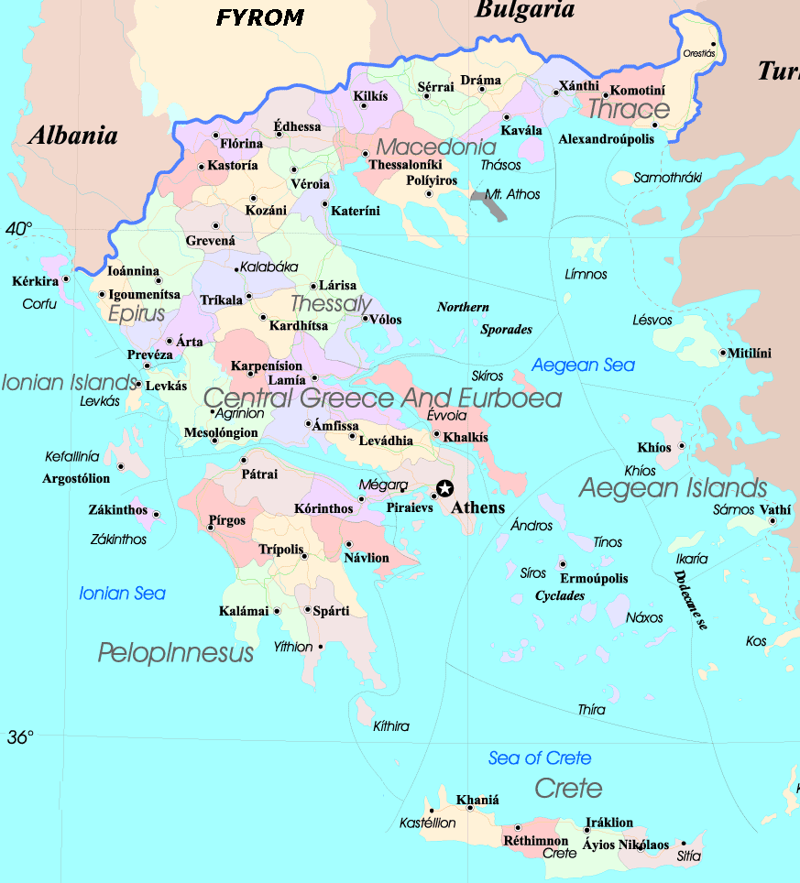
HEP Workforce
 | Staff |  | Postdocs |  | Students
 | exp | the | exp | the | exp | the
AUTH | 5 | 5 | 1 |  | 3 | 3
UoIoannina | 5 | 8 |  | 1 | 2 | 5
UoAegean | 2 |  |  |  | 1
UoPatras | 1 | 3 |  |  | 3 | 3
HOU | 3 |  | 2 |  | 3
NTUA | 7 | 8 | 1 | 2 | 8 | 8
UoA | 8 | 13 | 4 |  | 14 | 5
Demokritos | 9 | 3 | 1 | 1 | 2 | 5
Nestor | 4 |  |  |  | 2
UoCrete |  | 6 |  | 8 |  | 4
Total | 44 | 46 | 9 | 12 | 38 | 33
Experiment: Staff 44, Postdocs 9, Students 38
Theory: Staff 46, Postdocs 12, Students 33
Staff tenure & tenure-track numbers are being reduced
25/11/2011
TheoAlex, Greek Midterm, PECFA @ CERN
7

Slide 8






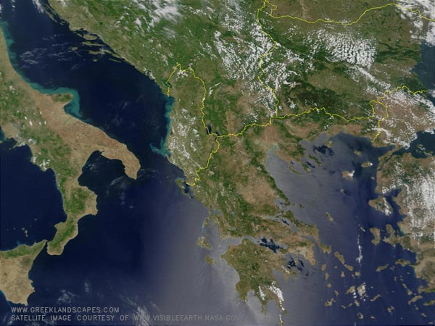
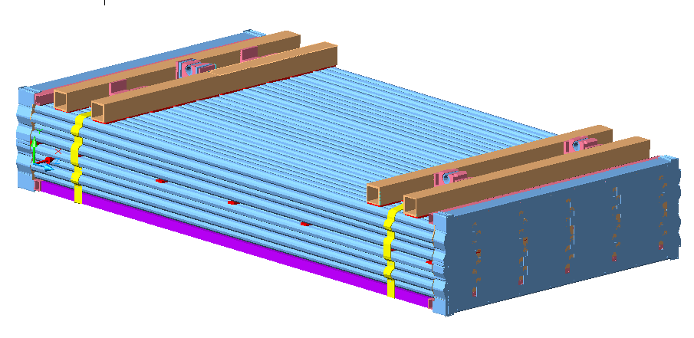
ATLAS
BIS-MDT
BIS-MDT production line
To CERN
AUTH
UoA
NTUA
25/11/2011
TheoAlex, Greek Midterm, PECFA @ CERN
8

Slide 9
ATLAS
Construction & Installation of the BIS muon chambers (Consortium of UoA, NTUA, AUTh)
Design, development and operation of the muon MDT & CSC HV, Elx DCS system (NTUA)
Physics studies:
  B-physics (NTUA, AUTh)
  Exotics (UoA, NTUA, AUTh)
  EW (AUTh)
  Higgs (UoA, NTUA)
  Top (UoA)
Upgrade – muon NSW, ATLAS MAMMA R&D group (UoA, NTUA, AUTh)
25/11/2011
TheoAlex, Greek Midterm, PECFA @ CERN
9

Slide 10

ATLAS & RD51 -Personel
University of ATHENS (UoA)
N. Giokaris, C. Kourkoumelis, D. Fassouliotis, P. Ioannou (ret.), A. Manousakis-Katsikakis
S. Angelidakis, A. Antonaki, G. Arabidze, K. Iordanidou, N. Tsirintanis, N. Vranjes (Phd Students)
V. Giakomopoulou (PostDoc)
C. Kourkoumelis: ATLAS muon speakers & pub. com. Chair 2009 – present
National Technical University of Athens (NTUA)
E. Gazis, T. Alexopoulos, S. Maltezos, T. Papadopoulou (ret.), G. Tsipolitis
S. Vlachos (Senior Scientist)
G. Iakovidis, K. Karakostas , E. Mountricha, C. Tsarouchas (Phd Students)
S. Vlachos: ATLAS muon run coordinator 2008 – 2010
S. Vlachos: ATLAS muon deputy Project Leader 2011 – present
G. Tsipolitis: RD51 Test Beam Coordinator 2008 – present
Aristotle University of Thessaloniki (AUTH)
C. Petridou, D. Sampsonidis, K. Kordas
U. of Aegean: I. Gkialas, K. Papageorgiou
  A. Petridis, I. Nomidis, D. Iliadis, V. Kouskoura, A. Ioannou,
  A. Kourkoumelis (PhD Students)
C. Petridou: ATLAS B-Physics co-convener 2008 – 2010
C. Petridou: ATLAS publication com. member 2008 – 2010
K. Kordas: ATLAS TDAQ speakers com. member 2009 – 2010
K. Kordas: ATLAS TDAQ speakers com. co-convener 2010 – 2011
 | Staff | PhD | Stud.
UoA (Tilecal+MDT) | 5 | 1 | 6
NTUA | 5 | 1 | 4
AUTh | 3+2 (Aegean Univ.) | - | 5+1
TOTAL | 14+2 | 2 | 16+1
Limited funding from Min. of Education & Min. of Development but not on regular base up to 2008. New prospects for funding starting 2012 through program “Thalis”.
Limited funding from Universities.
Some funding through EU (Artemis & AIDA projects)
25/11/2011
TheoAlex, Greek Midterm, PECFA @ CERN
10

Slide 11

RD51
Development on micromegas detectors (NTUA)
Design, development and operation of the HV DCS system for the test beams (NTUA)
Development and operation of the RD51 micromegas test beam telescope (NTUA, Demokritos)
Development and operation of the Neutron beam facility at Demokritos for testing micromegas detectors (NTUA, Demokritos)
Collaboration with the ATLAS-MAMMA project (UoA, NTUA, AUTh)
25/11/2011
TheoAlex, Greek Midterm, PECFA @ CERN
11

Slide 12
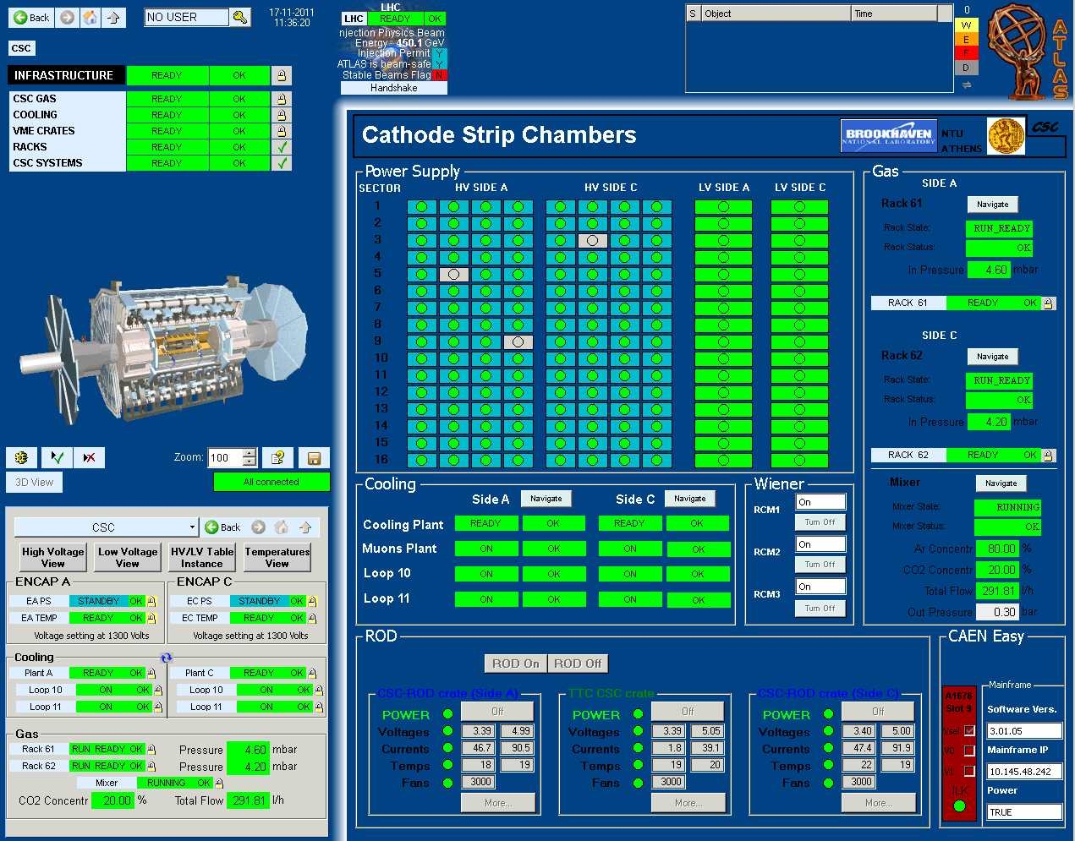
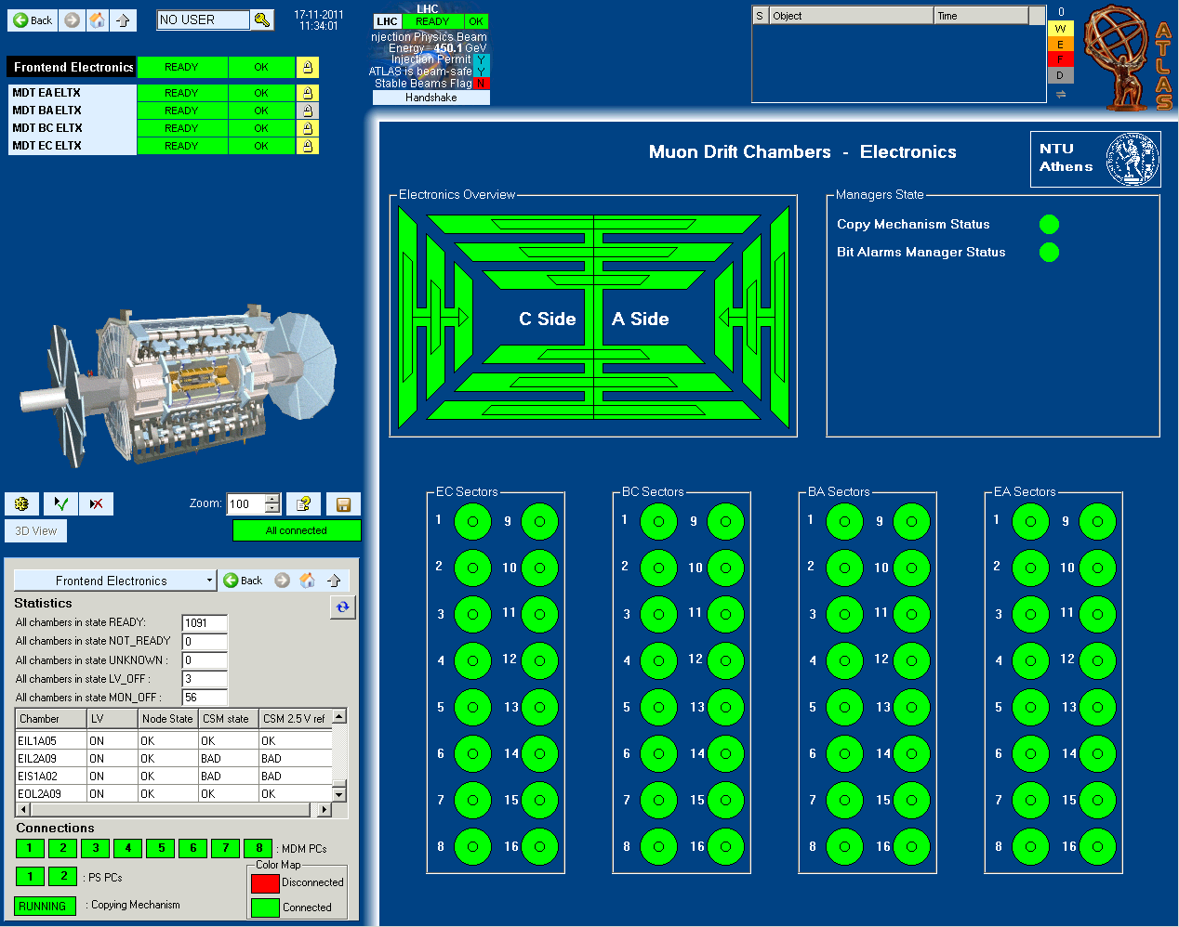
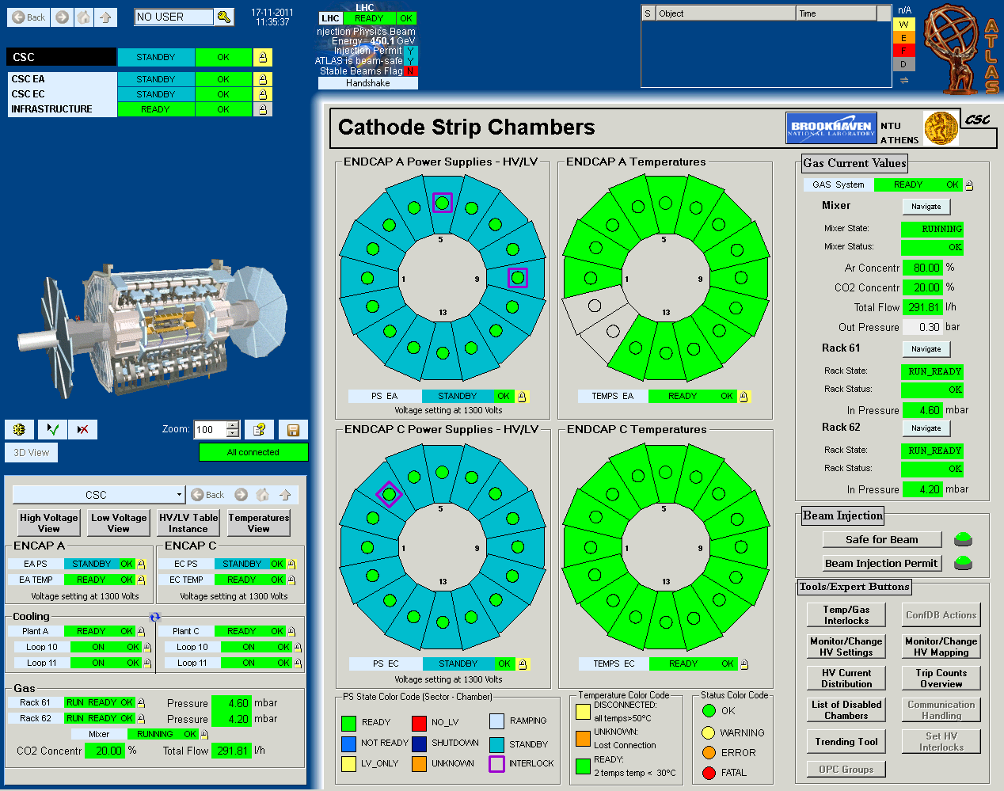
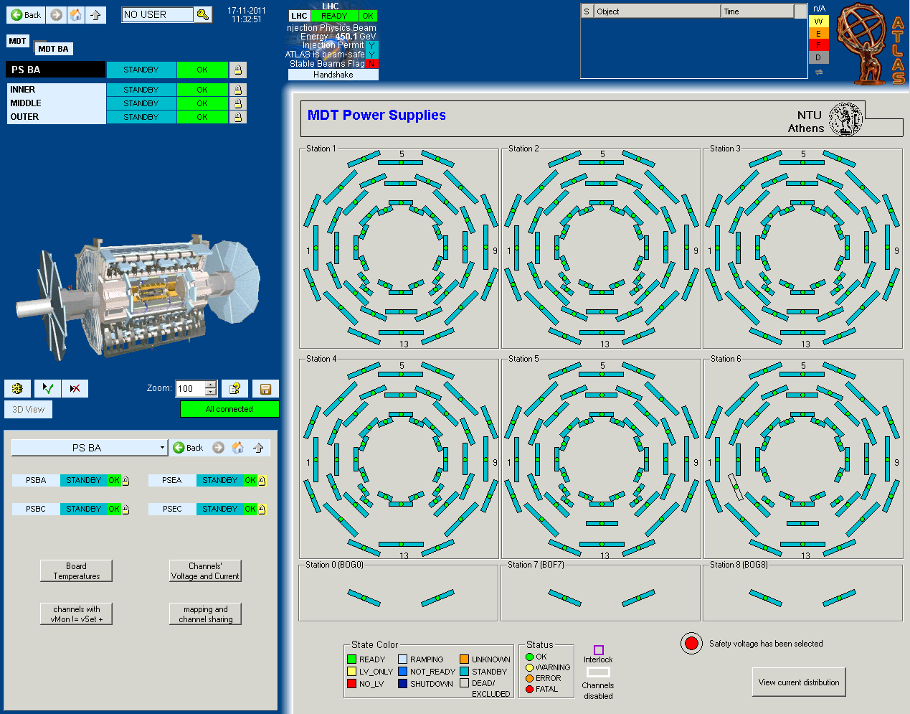
ATLAS MDT & CSC DCS SYSTEM
6 students have worked in the development of the MDT & CSC-DCS during the last 3 years
25/11/2011
TheoAlex, Greek Midterm, PECFA @ CERN
12

Slide 13
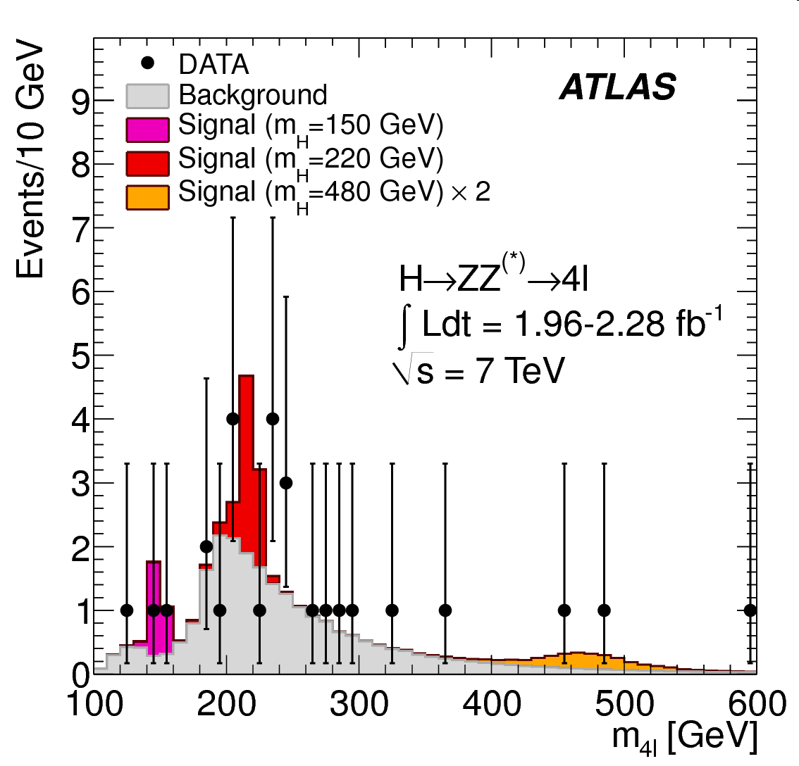
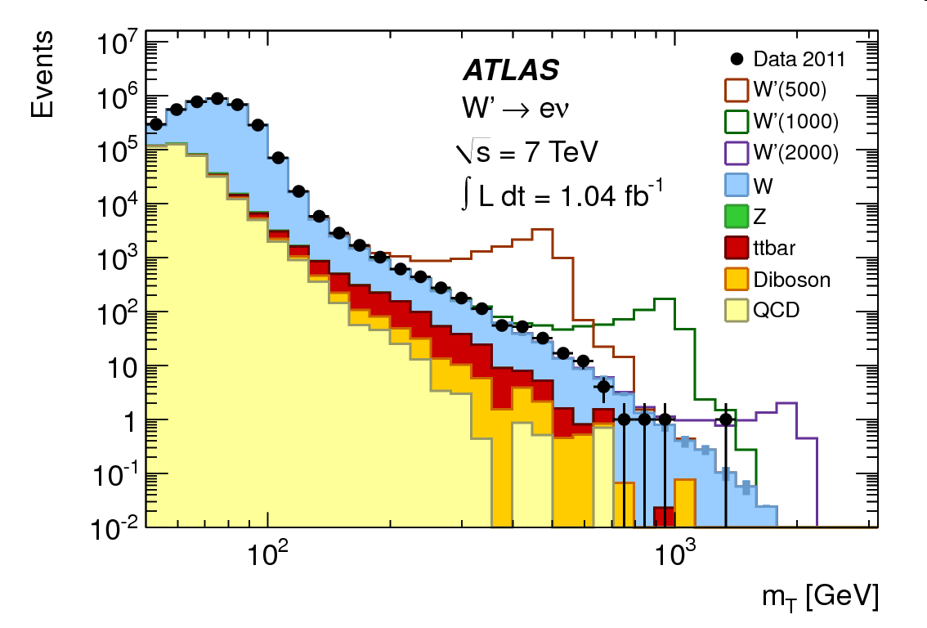
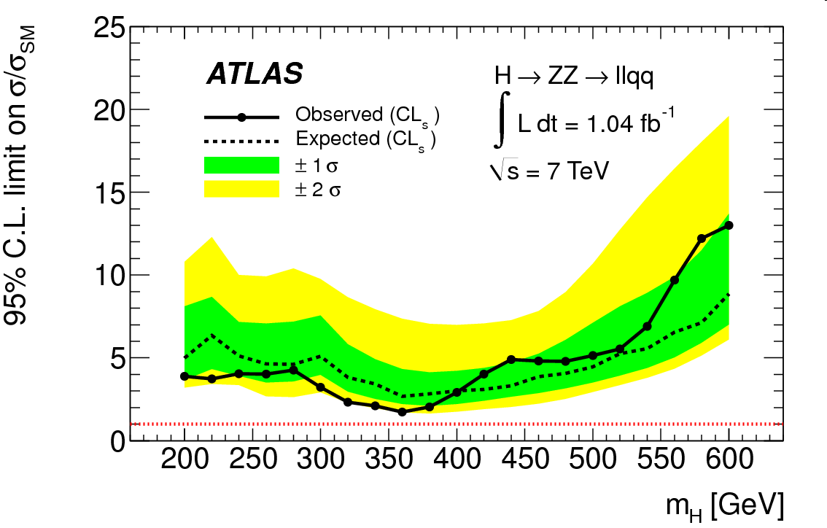
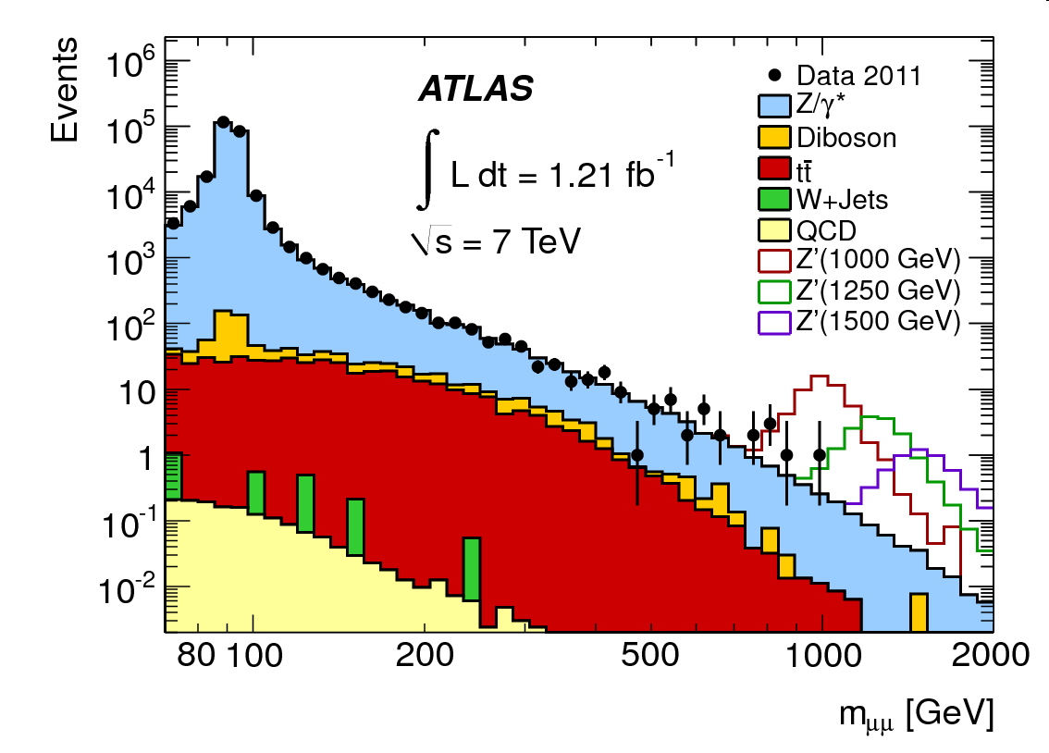
Search for the SM Higgs : H→ZZ(*)→4l
Search for heavy charged gauge bosons (W’→ lν)
Phd Theses: one comleted, two in progress
Phd Theses: one completed, one in progress
Search for the SM Higgs : H→ZZ(*)→l⁺l⁻qq
Search for heavy neutral gauge bosons (Z’→ l⁺l⁻)
Since 2008:
Major contribution to
14 ATLAS notes
6 ATLAS Public.
International Conferences
11 Talks
4 Invited talks
3 PhD thesis completed
3 PhD thesis in progress
1 MSc thesis
Phd Theses: one in progress
Phd Theses: one completed
25/11/2011
TheoAlex, Greek Midterm, PECFA @ CERN
13

Slide 14
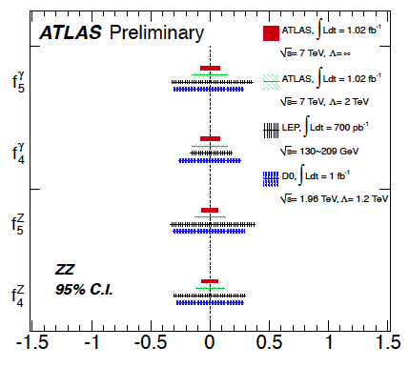
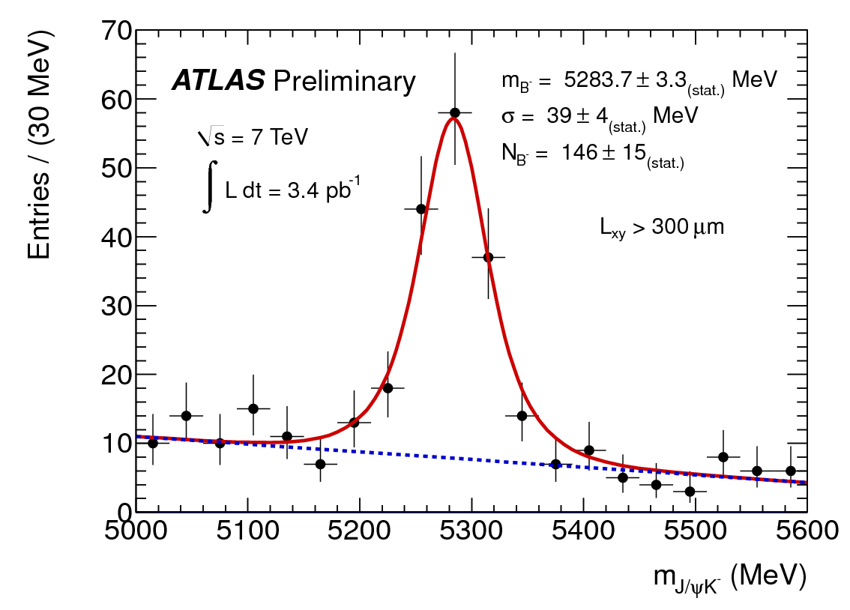
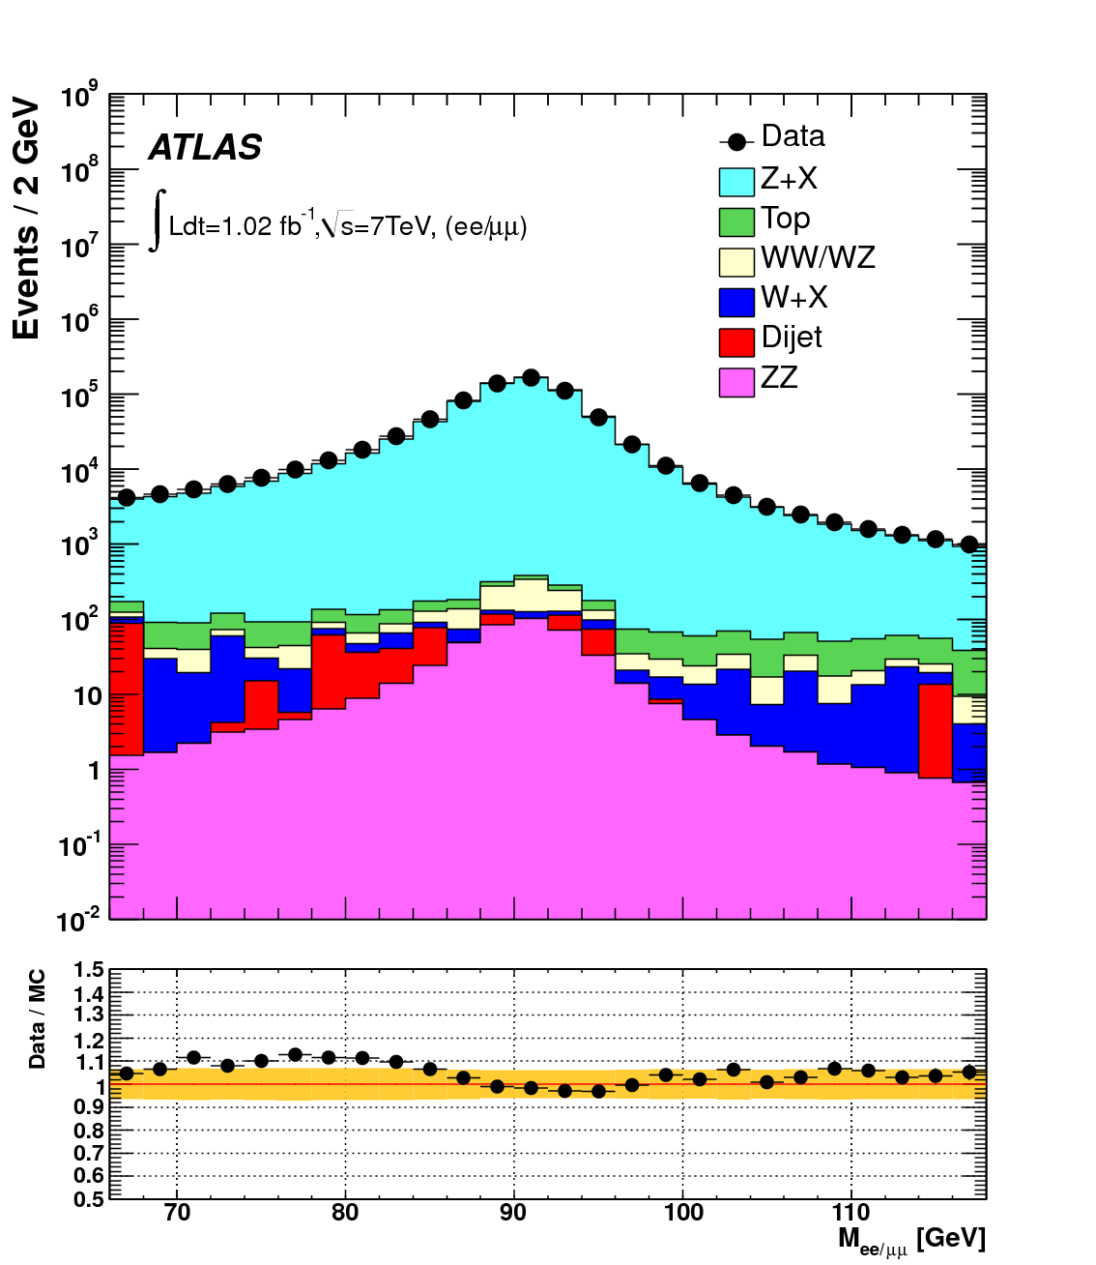
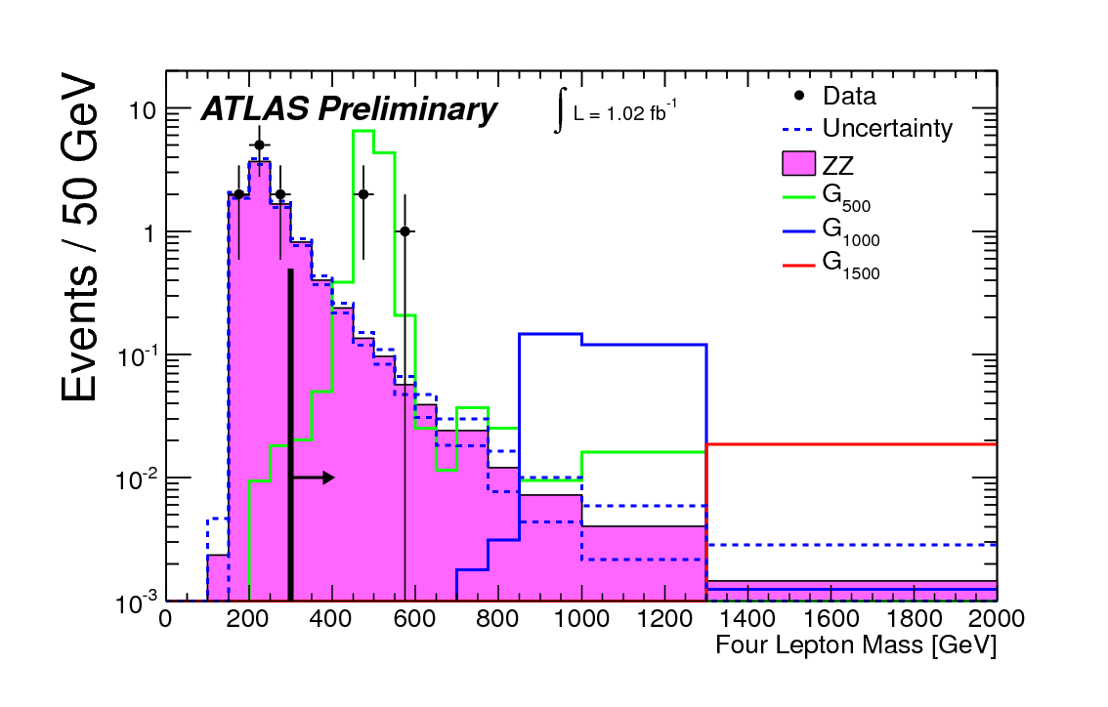
Search for TGC in ZZ → 4l
B±→J/ψK±
Phd Theses: one in progress
Phd Theses: one in progress
From ZZ → 4l production cross section (not enough to accomodate large aTGCs)
ZZ → 4 l
Graviton→ ZZ → 4 l
Distribution of four lepton invariant mass. Fake lepton background is not shown. Hypothetical graviton signal distribution are overlaid. The region with m_llll<300 GeV, to the left of the solid black line, serves as a ZZ control region; the signal region, indicated by the arrow, is m_llll>300 GeV. Overflow events are shown in the highest mass bin.
The invariant mass distributions of same-flavour opposite-sign lepton pairs selected using the ZZ->llll criteria including the trigger requirement, compared to simulation after applying all corrections. The different background sources are shown in different colours. The ratio of data to Monte Carlo is shown in the lower part of the histogram; the total uncertainty (statistical plus systematic) is indicated by the shaded band.
Phd Theses: one in progress
Phd Theses: one in progress
25/11/2011
TheoAlex, Greek Midterm, PECFA @ CERN
14

Slide 15
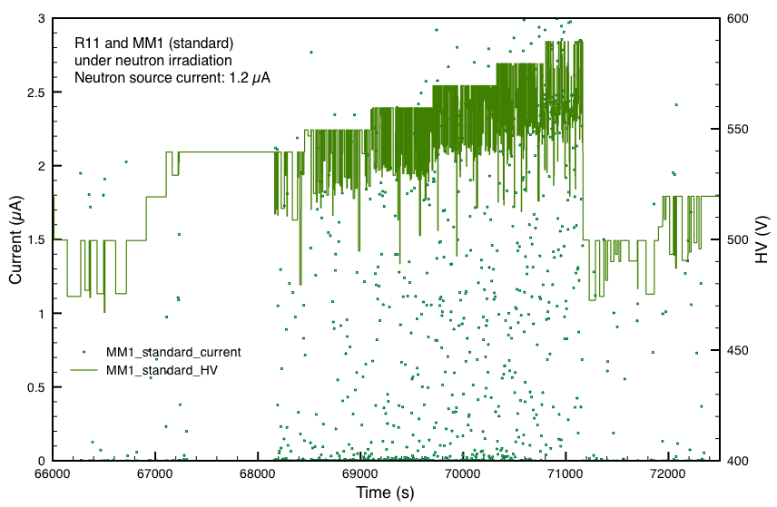
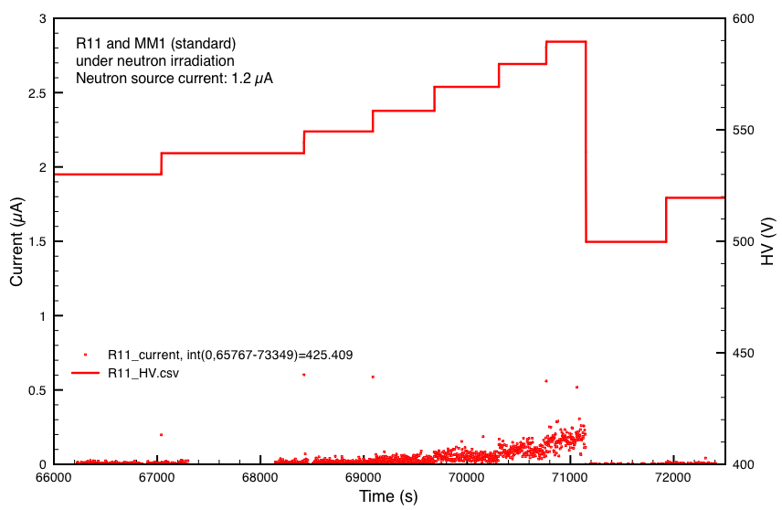
Micromegas – MAMMA R&D
Front view
Drift mesh - Anode
Drift mesh - Cathode
Charge track
Charged track
E_{drift}
5 mm
E_{drift}
5 mm
Mesh
Mesh
128 μm
E_{ampl}
Pillar
avalance
avalance
Pillar
avalance
128 μm
Pillar
E_{ampl}
Pillar
Insulating layer
avalance
PCB
Anode Readout Cu Strips
0.15 mm x 100 mm
Resistive Strips
0.5 – 5 MΩ/cm
Anode Strips
Gas: Ar:CO₂ (85:15) Neutron flux: ≈ 1.5x10⁶ n/cm²/s
Standard MM:
Large currents, Large HV drops, recovery time O(1s), Chamber could not be operated stably
Resistive MM:
Low currents despite discharges, but no HV drop, chamber operated stably up to max HV
25/11/2011
TheoAlex, Greek Midterm, PECFA @ CERN
15

Slide 16
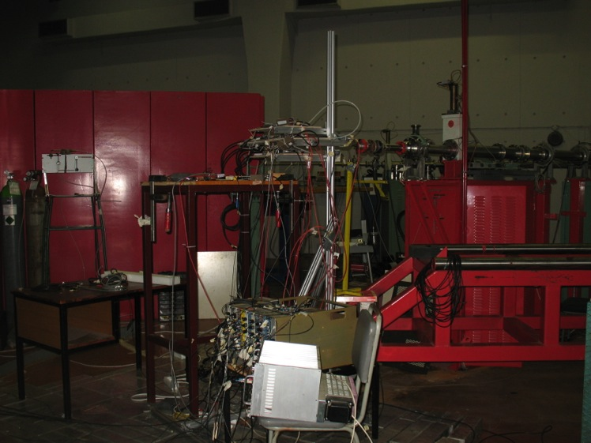
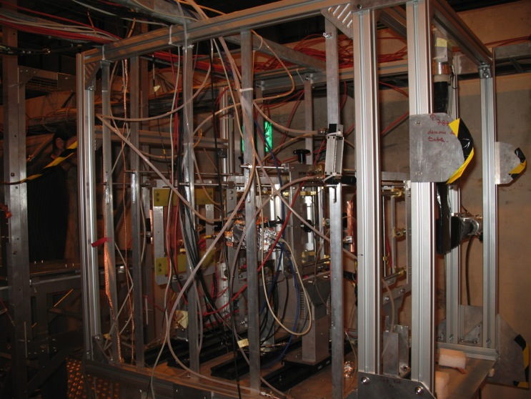
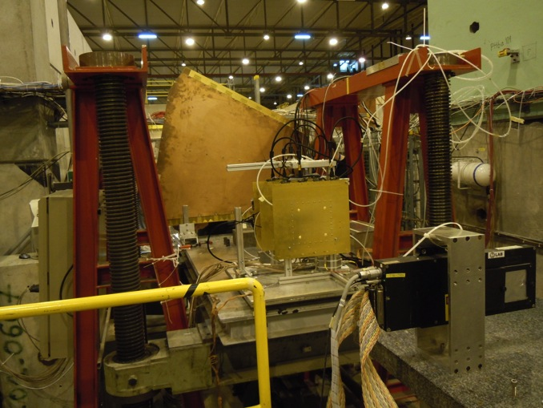
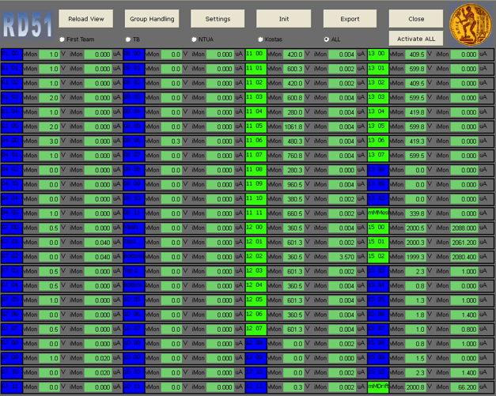
Micromegas activities
RD51 umegas telescope in SPS/H4
MAMMA neutron test in “Demokritos”
MAMMA test in SPS/H6
25/11/2011
TheoAlex, Greek Midterm, PECFA @ CERN
16

Slide 17


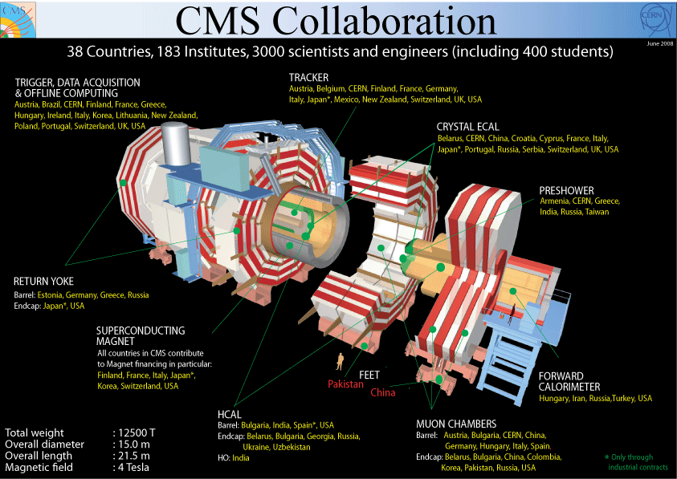
CMS: Univ. of Athens, NCSR Demokritos, Univ. of Ioannina
CASTOR
All three institutes participate in the CMS Trigger and DAQ Upgrade program (SuperLHC)
25/11/2011
TheoAlex, Greek Midterm, PECFA @ CERN
17

Slide 18
CMS
Construction & Installation of the CMS Preshower (Demokritos, UoI)
Design Construction & Installation of CASTOR (UoA)
Design Construction & Installation of key parts of the CMS Trigger and DAQ system (UoA, UoI, Demokritos)
Physics studies:
  SUSY (UoA, Demokritos)
  Higgs (UoA, Demokritos)
  Exotics (UoI, UoA)
  EW (Demokritos)
Upgrade project (Trigger-DAQ) (UoA, UoI, Demokritos)
25/11/2011
TheoAlex, Greek Midterm, PECFA @ CERN
18

Slide 19
CMS Greek Workforce
University of ATHENS
A. Panagiotou (ret), P. Sphicas, N. Saoulidou, E. Stiliaris.
L. Gouskos, A. Kalogeropoulos (Phd Students)
P. Shicas: CMS Physics Coord. 2007-2009, CPT PM 2005-2006
A. Panagiotou: CASTOR PM
NCSR ‘Demokritos’, Institute of Nuclear Physics
G. Daskalakis, Th. Geralis, A. Kyriakis, D. Loukas, A. Markou, Ch. Markou,
S. Kesisoglou (PostDoc)
I. Manolakos, E. Petrakou, E. Ntomari (Phd Students)
G. Daskalakis: CMS Electroweak group convener (2007-2009), Leader of the Vector
Boson Task Force 2010-2011, Editor of the “Inclusive W & Z cross section” papers
University of Ioannina, HEP Lab,
I. Evangelou, C. Foudas, P. Kokkas, N. Manthos, I. Papadopoulos, F. Triantis (ret).
I. Strologas (new faculty under appointment)
I. Flouris, E. Paradas, N. Loukas, D. Kolotouros (PhD Students)
C. Foudas: CMS Trigger Upgrades PM (2007-2011),
Global Calor. Trigger PM (2006-2010)
Greek CMS financial contribution (CMS M&O )
2010 : M&O A (14 PhD physicists) 1.2%
Funding: (1) New EU funding through ‘Thalis’
(2) Limited founding through AIDA
(3) Univ. of Ioann. Tier-2 center funded by Ioannina Univ.
14 PhD Physicists
9 Students
3 Data Taking Projects:
  Trigger/DAQ
  ECAL Pre-shower
  Castor
Physics Exploitation
  SUSY, Higgs, EW
  Exotics, Jets, QCD
25/11/2011
TheoAlex, Greek Midterm, PECFA @ CERN
19

Slide 20
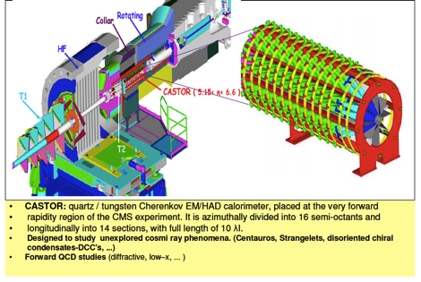
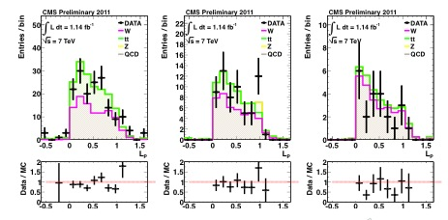
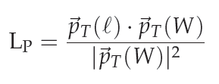
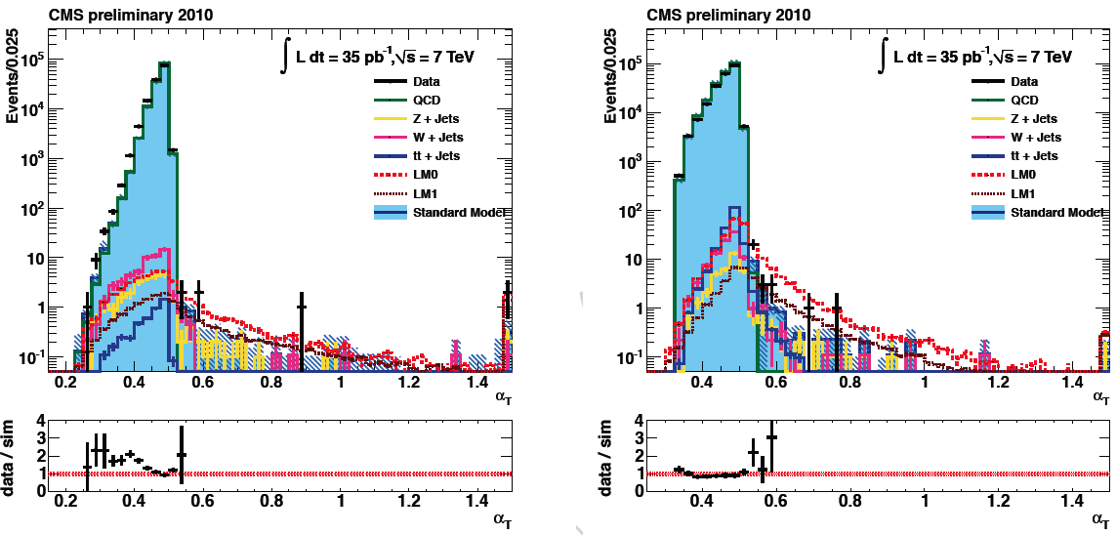
CMS-UoA activities
CMS Construction Effort:
  DAQ system (simulations and design)
  Castor Calorimeter (concept, design and construction)
  Physics reconstruction and selection
Physics: search for SUSY
  Zero-lepton, one-lepton and two-lepton channels
  Results from
    0-lepton (two publications)
    1-lepton (one “PAS” – i.e. public CMS result)
    2-lepton currently going through CMS approval system
UoA: search for SUSY in 1-lepton+jets+ME_{T}
UoA: search for SUSY in jets+ME_{T}
Using polarization in W+jets, t-tbar decays (lepton projection)
Use new kinematic variable, “α_{Τ}”:
α_{Τ} for 2 jets:
First SUSY results from the LHC (36 pb⁻¹)
Published in Phys.Lett. B698: 196-218, 2011 Most cited CMS paper
α_{Τ}=Ε_{Τ2}/Μ_{Τ}<0.5
Result presented at Lepton-Photon 2011
Currently updating for 4.6 fb⁻¹; publication right after
N_{jet}=2
N_{jet}≥3
With Imperial College, UCSB, CERN
25/11/2011
TheoAlex, Greek Midterm, PECFA @ CERN
20

Slide 21
CMS-University of Ioannina
The group is a founding member of CMS
Group Current activities
  Physics analysis
    The group is responsible for the measurement of the ratio of the 3 over 2 jet cross-sections using the first LHC data (P. Kokkas, C. Foudas and I. Flouris).
      Preliminary results shown at ICHEP 2010 (Paris)
      Published: Measurement of the Ratio of the 3-jet to 2-jet Cross Sections in pp Collisions at sqrt(s) = 7 TeV , Phys.Lett.B702:336-354,2011 . Presented in EPS 2011 (Grenoble) by P. Kokkas.
    New analysis on the same topic has started using the 2011-2012 data (PhD Thesis topic of I. Flouris)
    A new analysis has started in 2011 to search for signatures of new strong interactions (Axigluons, Colorons, hyperpions) using multi-jet final states with collaborations from CERN and Brown university (C. Foudas, P. Kokkas, E. Paradas)
  CMS Detector upgrades – Level-1 Trigger demonstrators
    Development of Level-1 trigger demonstrators using uTCA technology
    C. Foudas, N. Manthos, I Evangelou and I. Papadopoulos
    PhD Students: N. Loukas, D. Kolotouros
    Activities started on FPGA development cards
    In the process of ordering the first uTCA hardware
  Ioannina operates the first Greek Tier-2 center dedicated to CMS
    Designed, operated and maintained by I. Papadopoulos
25/11/2011
TheoAlex, Greek Midterm, PECFA @ CERN
21

Slide 22
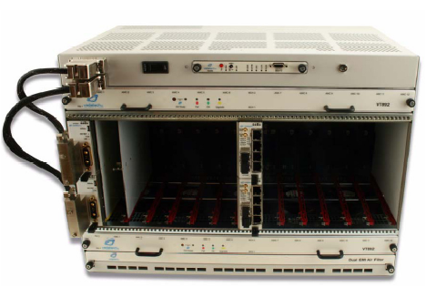
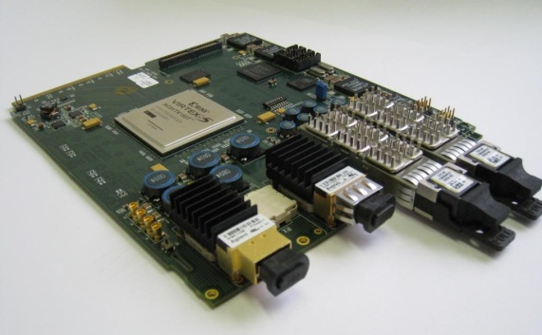
Upgrade Activities at U of Ioannina
uTCA Crate with MCH Controller
MiniT : Generic Level-1 Trigger uTCA Card developed at Imperial College (UK)
for the calorimeter trigger
A trigger platform is under development using the uTCA telecom standard and MiniT cards developed for the calorimeter trigger.
MiniT: Virtex5 FPGA and optical fibre I/O at 6 Gbps (24 Inputs, 24 Inputs and 8 Input/Output channels).
Development of trigger algorithms in VHDL for the Level-1 Trigger DT-Track Finder and hardware integration activities at Ioannina.
PhD thesis for N. Loukas and D. Kolotouros.
Collaborating with UoA-CMS (Sphicas, Stiliaris), NTUA-ATLAS (Gazis, Tsipolitis), Imperial College and Univ. of Wisconsin.
25/11/2011
TheoAlex, Greek Midterm, PECFA @ CERN
22

Slide 23
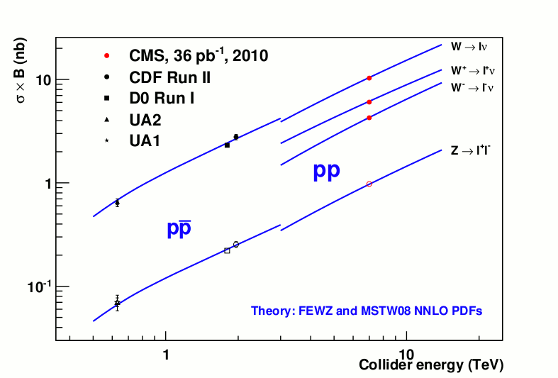
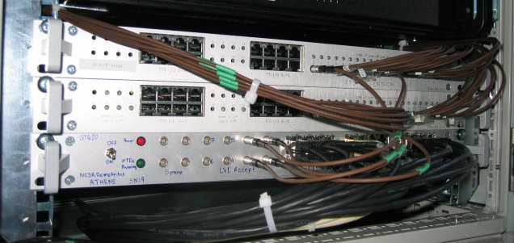
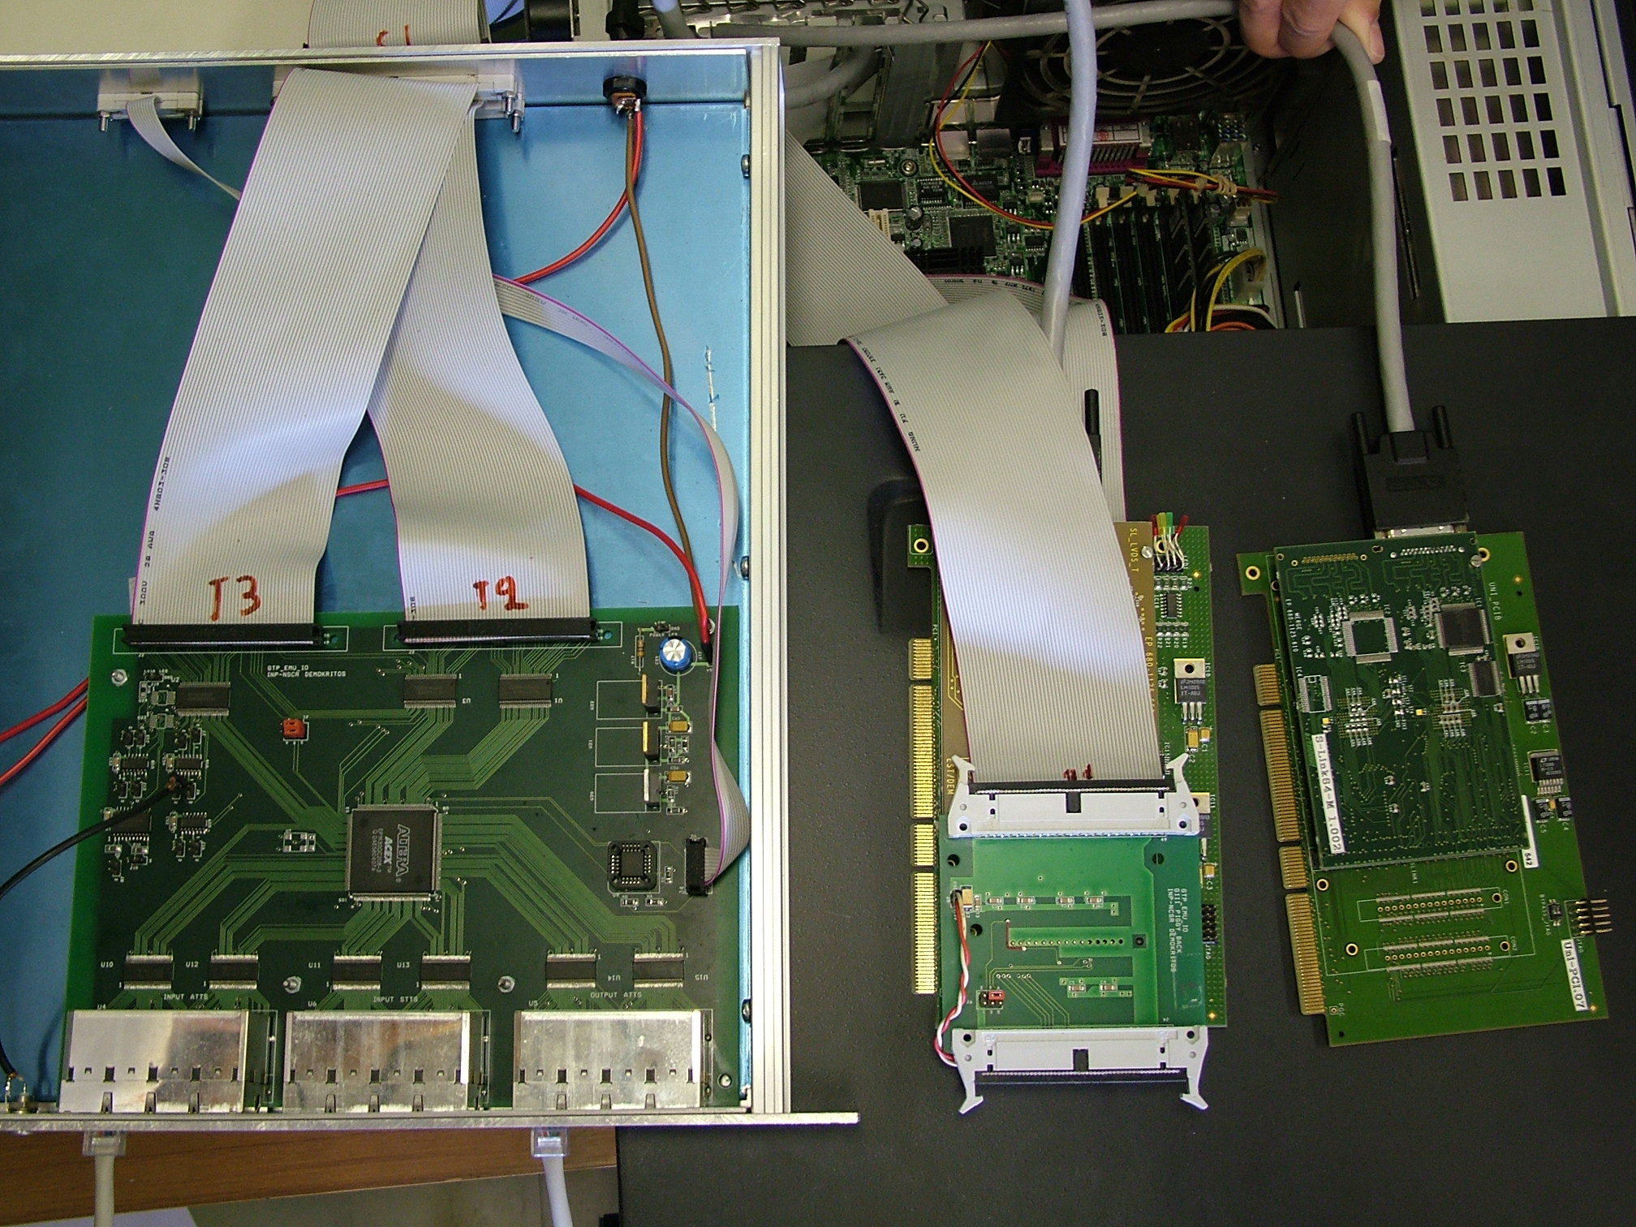
CMS - NCSR “Demokritos”
The group is a founding member of CMS
Group Current activities
  Physics analysis
    The group is participated in the measurements of inclusive W and Z production cross sections.
    Study of anomalous Trilinear Gauge Couplings in the pp→Zγ channel.
Global Trigger Processor Emulator – GTPe: 10 Full systems Designed, Built, tested at Demokritos. FPGA 400kGates (Mixed firmware VHDL and Handel-C) developed at Demokritos
Capabilities: Random Triggers up to 4 MHz (nominal 100kHz), Event Packaging, Communication to Event Manager, Backpressure signals from detectors and DAQ partitions
25/11/2011
TheoAlex, Greek Midterm, PECFA @ CERN
23

Slide 24


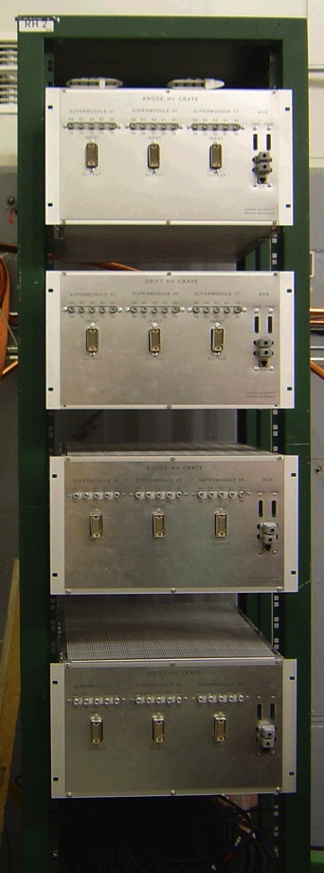
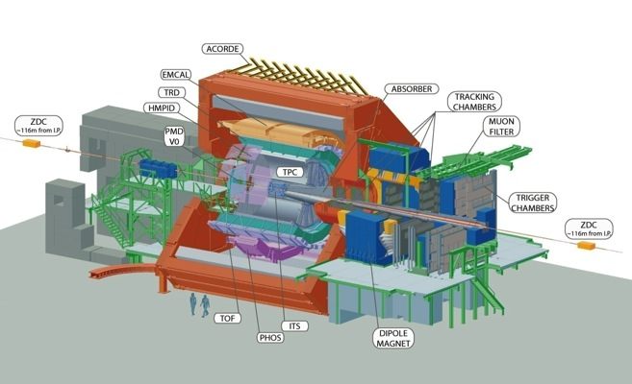
ALICE (1)
Design, construction, testing and commissioning of a High Voltage
Distribution System (HVDS) for the ALICE TRD.
Development and installation at CERN of the Control Software (DCS) for
the HVDS of the TRD
Development of Data Acquisition (DAQ) and monitoring system for the
ALICE Forward detectors (Τ0,V0,FMD)
Improvement of the software platform (MOOD) for the online
monitoring of the ALICE detectors
Design and development of a new platform (AMORE) for the on-line
monitoring of all the ALICE detectors
Contribution to the ALICE GRID
Responsibilities
Staff members: 3, Postdocs: 2, Students:5
Faculty: M. Vasiliou, M. Stasinaki, E. Floratos
Postdocs: A. Belogianni, P. Ganoti
Students: E. Cheiladakis, M. Fraguiadakis,
F. Roukoutakis, C. Tagridis, V. Tsoumaki
25/11/2011
TheoAlex, Greek Midterm, PECFA @ CERN
24

Slide 25
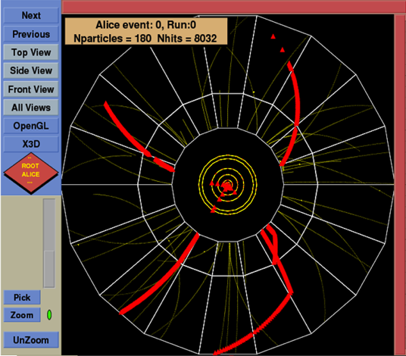
ALICE (2): Physics Analysis
Kaons identification from kink topology in p-p and Pb-Pb interactions
Study on central detectors’ PID efficiency and event-by-event particle ratios
Study of resonance production in p-p and Pb-Pb collisions
Kink Topology, Κ/π decay inside the TPC detector of ALICE
Current and Future Contribution
Participation in the ALICE data taking
Provided hardware and software maintenance
during data taking
Data analysis for physics purpose
Papers preparation
Students supervision for PhD, Master and Diploma thesis
25/11/2011
TheoAlex, Greek Midterm, PECFA @ CERN
25

Slide 26
Activities @ CLIC/CTF3 & Accelerator Technologies
Fruitful and essential participation in the CERN accelerator projects including:
Accelerators: Study, design, construction of modules, physics problems, instrumentation, data analysis (5 PhD students, 7 MSc students are involved under Prof. E. Gazis)
          SPS
          LHC
          CLIC
Applications & Transfer Technology, Outreach: Study, participation, education
          Radio-protection
          Proton Therapy
          TT-Network-Greek Industries
          Outreach
      SPS:
      Studies of longitudinal instabilities of the LHC proton beam in the SPS double RF system
      LHC:
      Design, Analysis & Performance for Nb₃Sn accelerator magnets
      Simulation studies for quench effect of the LHC magnets
      CLIC:
      Mechanical design, analysis and integration of pre-alignment systems for CLIC
      Optics design and optimization of the CLIC Pre-damping and Damping Rings
      Beam phase stability at CTF3
      Study and Fabrication of the prototype Supporting System for the CLIC Two-Beam Module
      Beam Loss Studies for CLIC
      Impedance budget and effect of chamber coating on CLIC DR beam stability
      Development and implementation of the Inventory Database for the components of the CLIC Two Beam Module
      Lattice loop design for the DR
      Medical Applications:
      Epidemiology of cancer and Design of a medical synchrotron
      Monte Carlo simulation for the ion beam absorption by human tissue and iron shield for the optimum shielding for the proton therapy
The Greek teams are cooperating under the coordination of NTUA as ONE group to the CLIC/CTF3 and other accelerator technology projects (Greek-CLIC/CTF3 MoU):
NTU-Athens
Democritus University of Thrace -- ECE dept.
University of Patras -- ECE dept.
25/11/2011
TheoAlex, Greek Midterm, PECFA @ CERN
26

Slide 27
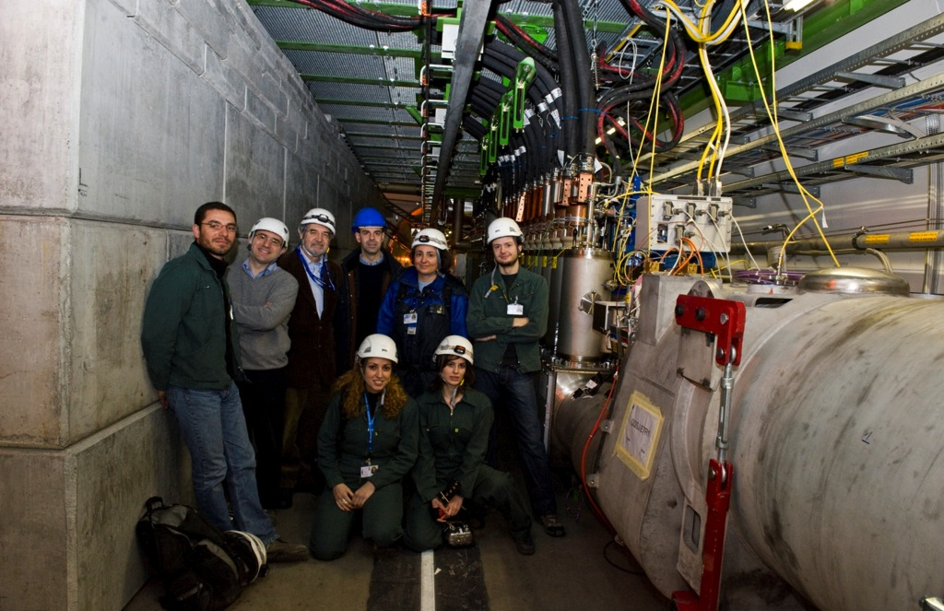
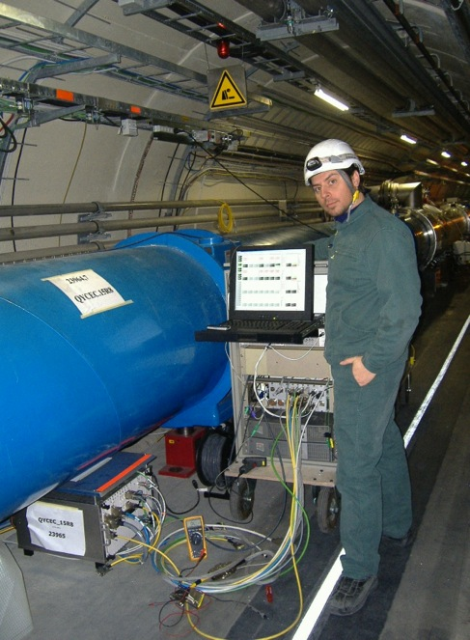
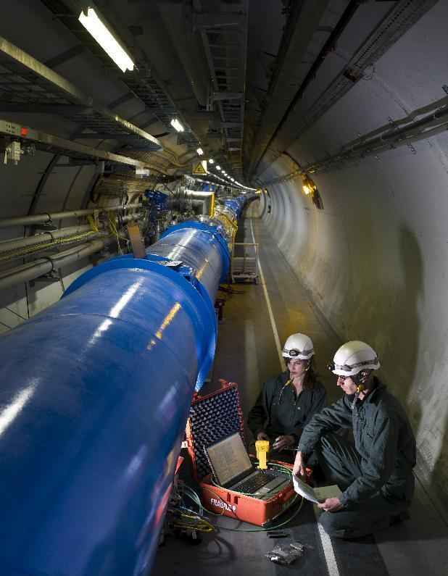
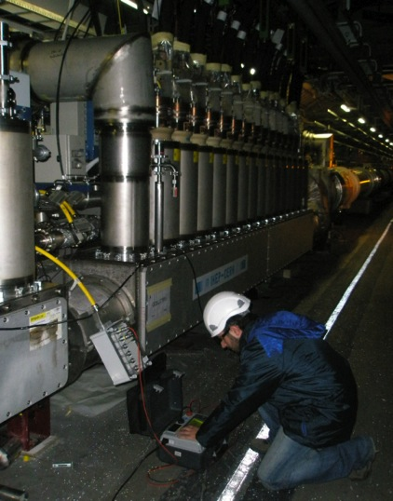
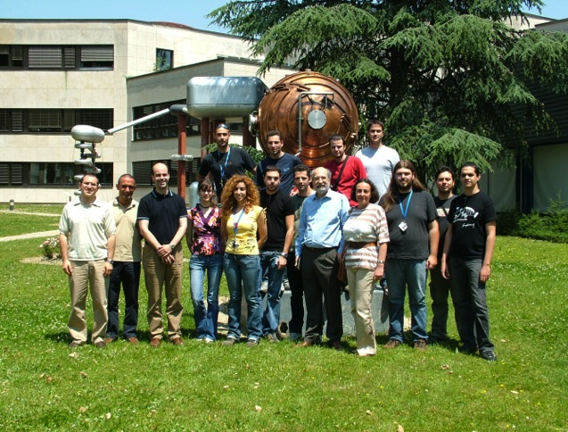
Greece @ LHC CRYOGENICS :
(NTUA, AUTH, TEI-ATHENS, TEI-PIRAEUS, 2006-2008
Collaboration agreement K1257/AT/LHC (2/2006-9/2008)
Accelerator Department in Cryogenics Instrumentation and Controls
Greek Coordination: NTU-Athens
New Collaboration Agreement under discussion for 10 NTUA Metallurgy Engineers students to wok at the LHC upgrade on 2013-2014!!
25/11/2011
TheoAlex, Greek Midterm, PECFA @ CERN
27

Slide 28
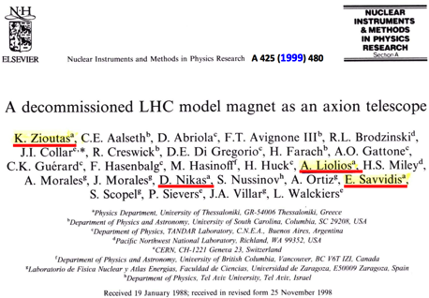
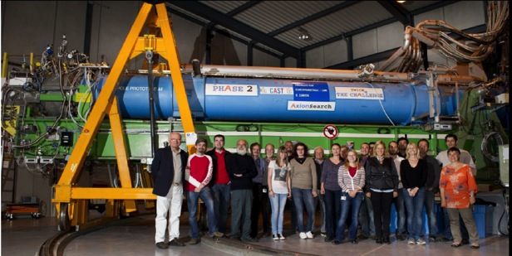
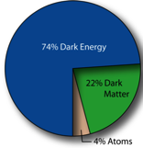
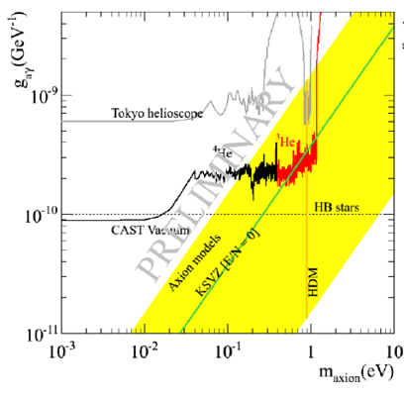
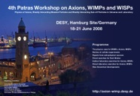
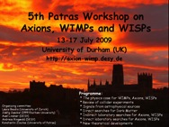
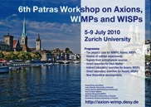
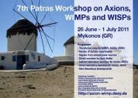
CAST – CERN Axion Solar Telesope
CAST is an experiment for the detection of axions emitted in the colar core by means of their conversion in photons inside a magnetic filed
Greece: UoP, NTUA, Demokritos
Canada: UoBritish Columbia
USA: UoChicago, LLNL
Spain: UoZaragoza
Germany: UoDarmstadt, UoFrankfurt, UoFreiburg, MPI
Russia: INR Moscow
France: CEA-DAPNIA
Italy: INFN Tieste
Institutions | Staff+Stu
NTU-Athens | 1+0
AUTh | 3+1
Demokritos | 2+0
U of Patras | 1+3
Motivation
Axions solve the strong-CP problem
Axions as Dark Matter candidates
Axions would be produced by the Sun
Axions helioscope concept
Experimental Goals
Explore QCD realistic axion models
Feasibility study of a new axions helioscope
Spokesperson – K. Zioutas (UoP)
D. Spokesperson – I. Giomataris(Saclay)
“PATRAS WORKSHOPS ON AXIONS,WIMPs & WISPs”
2012: 8th Patras WORKSHOP will
take place in Chicago.
2013: 9th Patras WORKSHOP
-> CERN?
Strong Greek contribution in the proposal & the creation of the collaboration
Contribution to Micromegas detectors simulations, He-3 system, upgrades and running of the Experiment, Analysis, Future CAST searches.
Talks in conferences
Initiated the “PATRAS Workshops on Axions, WIMPs & WISPs”
25/11/2011
TheoAlex, Greek Midterm, PECFA @ CERN
28

Slide 29

n_TOF collaboration
NTUA (2 staff members, 2 PhD students, 1 Post-Doc)
UoI (1 staff member)
Current activities:
Monte Carlo Simulations
Upgrade of the n_TOF DAQ system
Data analysis for ²³⁴U(n,f) and ²³⁷Np(n,f) with FIC detector
Data analysis for ^{240,242}Pu(n,f) with Micromegas detector
Micromegas for fission measurements
Radioactive target characterization
FIC
Publications:
Analysis of the FIC detector data at the n_TOF facility. D.Karadimos, R.Vlastou, et al. Nucl.Instr.Meth. B268(2010)2556).
The ²³⁷Np(n,f) cross section at the CERN n-TOF facility, D.Karadimos, R.Vlastou, M.Diakaki… and the nTOF collaboration, International Conference FINUSTAR-3, Rodos, August 2010, AIP Conference Proceedings, in press.
Micromegas
Funding sources:
National Budget : ~15.000 euros/year
25/11/2011
TheoAlex, Greek Midterm, PECFA @ CERN
29

Slide 30





Center of Excellence in Low-energy Ion-Beam Research and Applications
Development – Construction of a plunger device for MINIBALL @ ISOLDE
(budget 120 k€)
The MINIBALL γ-spectrometer
plunger device
PURPOSE: Access to measurements of transition probabilities in regions of the nuclear chart otherwise inaccessibly with Coulomb excitation (deep-inelastic /fusion-evaporation reactions).
The TANDEM Accelerator Group of “Demokritos”
(4 staff scientists, 4 PhD students, 2 Technicians)
Contact: Sotirios Harissopulos
sharisop@inp.demokritos.gr
25/11/2011
TheoAlex, Greek Midterm, PECFA @ CERN
30

Slide 31


CDF/FNAL
CDF Univ. of Athens team
N. Giokaris (PI)
A. Manousakis (Faculty)
C. Vellidis (Postdoc)
V. Giakoumopoulou (Postdoc)
Funding: 60K – FNAL. UoA
The CDF Collaboration
15 Countries
63 institutions
621 authors
Recent Highlights on Top Physics
Measurement of the Top Pair Production Cross Section in the Dilepton Decay Channel in p anti-p Collisions at s**(1/2) =1.96 TeV, T. Aaltonen et al., The CDF Collaboration, Phys. Rev. D82, 052002 (2010)
Measurement of the Top Quark Mass in the Lepton+Jets Channel Using the Lepton Transverse Momentum, T. Aaltonen et al., The CDF Collaboration, Phys. Lett. B, 698 (2011)
Search for High-Mass Resonances Decaying into ZZ in ppbar Collisions at sqrt(s)=1.96TeV,T. Aaltonen et al., The CDF Collaboration, cdf/pub/10614, Submitted to Phys. Rev. D, November 2011
C. Vellidis, “Top Physics group Convener”
H1/DESY
H1 NTU-Athens team
R. Papadopoulou (Emeritus Professor)
E. Panagoulias (Student)
Activities : Data Analysis on Leptoquark search
Data Analysis on LFV
Validation on new software releases
Data taking run shifts
Publications : 5 Conference papers & 1 PL-B
Support: Ministry of Education+DESY – 60K/3yrs
25/11/2011
TheoAlex, Greek Midterm, PECFA @ CERN
31

Slide 32

KM3NeT
Institutions | Staff+Postdocs+ Stu
UoA+Nestor | 4+1+1
Demokritos | 4+1+1
HOU+Aegean+UoP | 7+1+3
Tools and methods for simulation and evaluation of very large volume Cherenkov neutrino detectors ,A.G. Tsirigotis, A. Leisos, S.E. Tzamarias, NIM 639 (2011)
Using HOURS to evaluate very large volume undersea neutrino telescope configurations, A.G., A. Leisos, S.E. Tzamarias and On behalf of the KM3NeT Consortium, NIM 626 (2011)
Synchronous detection of extensive air showers by a HELYCON detector array and a deep sea underwater neutrino telescope: Statistical and systematic effects A. Leisos, G. Bourlis, A.G. Tsirigotis, S.E. Tzamarias , On behalf of the KM3NeT Consortium, NIM 639 (2011)
Calibration and optimization of a very large volume neutrino telescope using extensive air showers A. Leisos^{a, ,} , G. Bourlisª, N.A.B. Gizaniª, E.P. Christopoulou^{b}, A.G. Tsirigotisª, S.E. Tzamariasª and representing the KM3NeT Consortium, NIM 626-627 (2011)
HOU Reconstruction & Simulation (HOURS): A complete simulation and reconstruction package for very large volume underwater neutrino telescopes, A.G. Tsirigotis, A. Leisos, S.E. Tzamarias, NIM 6260627 (2010)
Reconstruction efficiency and discovery potential of a Mediterranean neutrino telescope: A simulation study using the Hellenic Open University Simulation & Reconstruction (HOURS) package, A. Tsirigotis, A. Leisos, S. Tzamarias, VLVnT 2011, to be published in NIM
A reconstruction method for neutrino induced muon tracks taking into account the apriori knowledge of the neutrino source, A. Tsirigotis, A. Leisos, S. Tzamarias, VLVnT 2011, to be published in NIM
Evaluation of the discovery potential of an underwater Mediterranean neutrino telescope taking into account the estimated directional resolution and energy of the reconstructed track, A. Leisos, A. Tsirigotis, S. Tzamarias, VLVnT 2011, to be published in NIM
A feasibility study for the detection of Super Nova explosions with an Underwater Neutrino Telescope, A. Leisos, A. Tsirigotis, S. Tzamarias, VLVnT 2011, to be published in NIM
25/11/2011
TheoAlex, Greek Midterm, PECFA @ CERN
32

Slide 33
Theory (1)
Rich theoretical program; Staff 46, Postdocs: 12, Students: 33
Research Activities by Topic
Standard Model Phenomenology: UoI, AUTH, Demokritos, UoP
Physics of Strong Interactions, NLO corrections: UoA, Demokritos
Monte Carlo Generators: Demokritos
Lattice Gauge Theories: NTU-Athens
Neutrinos: AUTH, UoA, UoP
Beyond the Standard Model Physics, SUSY: UoA, NTU-Athens, AUTH, UoI, UoP, Demokritos
Modern Aspects of Quantum Field Theory: UoA, UoC
String Theory: Athens, NTU-Athens, UoC, UoP, UoI, Demokritos
Holography: UoC, UoA
Physics of Extra Dimensions: UoA, NTU-Athens, UoI, UoC
Astroparticle Physics: UoA, AUTH, UoI
Cosmology: UoA, NTU-Athens, AUTH, UoC, UoI
General Relativity: UoA, UoI
Quantum Gravity: NTU-Athens
Neutrino physics: UoI, UoP
25/11/2011
TheoAlex, Greek Midterm, PECFA @ CERN
33

Slide 34
Theory (2)
Recent & Current Research Programs/Networks
CRETE-HEPCOSMO (REGPOT): E. Kiritsis, UoC; Nodes: UoC
HEPTOOLS: C. Papadopoulos, Demokritos; Nodes: UoI, AUTH, UoA
UNILHC (ITN): I. Antoniadis, CERN; Nodes: UoI, AUTH, UoA
UNIVERSENET: S. Sarkar, Oxford; UoI, AUTH, UoA, NTUA, Demokritos
QUEST for UNIFICATION: I. Antoniadis, CERN; Nodes: AUTH, UoI, NTUA, UoA
ENRAGE (RTN): R. Loll, Utrecht; Nodes: UoC, UoP, NTUA
CONSTITUENTS FUNDAMENTAL FORCES & SYMMETRIES of the UNIVERSE: D. Luest, Munich; Nodes: NTUA, UoP, UoC
Publications (inspires) in 2009-2010-now
Extra Funding for Postdocs,
Students, Travelling, Equipment:
Ministry of Education,
Ministry of Development,
University Basic Research Agencies
Institutions | Staff+Post+Stu | Publications
U of Athens | 13+0+5 | 31
NTU-Athens | 8+2+8 | 65
AUTh | 5+0+3 | 10
Demokritos | 3+1+5 | 29
U of Ioannina | 8+1+5 | 68
U of Patras | 3+0+3 | 40
U of Crete | 6+8+4 | 22
25/11/2011
TheoAlex, Greek Midterm, PECFA @ CERN
34

Slide 35





WLCG Tier-2 GRID at UOI
2007
  Deployment of the GR-07-UOI-HEPLAB GRID site
  at the HEP Laboratory of the University of Ioannina
  The site supports the CMS VO
  Size: 10 CPUs / storage element of ~5 TB
2008 - 2009
  Site certification → GR-07-UOI-HEPLAB in production status
  Member of the Tier-3 CMS GRID sites: T3_GR_Ioannina
  Middleware: gLite3.1/SLC4 & gLite3.2/SLC5
  Size: 28 CPUs / ~40 TB storage element
2010
  Limited funding received (50k€) → Major site upgrade (new CPUs and disk space)
  installation/configuration/testing of SLC5 CMSSW (32- and 64-bit)
  Middleware: gLite 3.2 / SLC5
  Size: 116 CPUs / ~200 TB storage element
2011
  Construction of a new room with air-conditioning for the site
  MoU signed between WLCG/CERN and the University of Ioannina → Tier-2
  (April 2011)
  Tier Country Federation Name Accounting Name
  Tier2 Greece HEP Laboratory, U. of Ioannina GR-Ioannina-HEP
    WLCG REBUS → http://gstat-wlcg.cern.ch/apps/topology/federation/281
  The site is upgraded/renamed for CMS: T2_GR_Ioannina (since 4 Nov 2011)
  Size: 135 CPUs / ~200 TB storage element
CPU time used for the LHC VOs in Greece during the last 8 months
Downtime: construction works
~10000 CMS jobs / month
~180 CMS users
0.5 FTE of CMS service work
Yearly pledged resources to WLCG
  CPU: 3040 HEP-SPEC06
  Disk: 200 Tbytes
  100% CMS VO
Pledge delivery on track
  51% delivered on the first 6 months
Completed jobs / month
25/11/2011
TheoAlex, Greek Midterm, PECFA @ CERN
35

Slide 36

IASA Grid (Inter)National activities
Institute of Accelerating Systems and Applications (IASA)
Belongs to University of Athens (UoA) and National Technical University of Athens (NTUA). Established in 1994. Head: P. Sphicas
Participation
EU-funded projects
  i.e. GRIDCC, EGEE I-II-III, EGI-InSPIRE, PRACE 1IP-2IP, etc.
National-level projects
  i.e. HellasGrid I-II, HellasHPC, etc.
Key roles and responsibilities
EGI: task leader for User Community Technical Services
EGI: deputy task leader for the global Unified Middleware Distribution (UMD) repository and support processes
HellasGrid: National Grid application porting team
Regional Coordinator for the operations in the South Eastern Europe (EGEE/2009)
Country representative/coordinator for HellasGrid (EGEE/2009)
25/11/2011
TheoAlex, Greek Midterm, PECFA @ CERN
36

Slide 37
Conferences, Schools, etc.
A series of international conferences/Schools has been organized in Greece during the past three years:
Neutrino2010, June 14-19, 2010, Athens
MPGD2009, 1st International Conference on Micro Gaseous Detectors, June 12-15 2009, Kolympari, Crete
TWEPP2008, Topical Workshop on Electronics for Particle Physics, September 15-19, 2008, Naxos Island
HEP08, XXVI Workshop on Recent Developments in High Energy & Cosmology, 16-19 April 2008, Ancient Olympia
6th Aegean Summer School: Quantum Gravity & Quantum Cosmology, 12-17 Sep 2011, Chora of Naxos, Naxos Island
2010 Workshop on Recent Advances in Particle Physics and Cosmology, 25-28 March 2010, Thessaloniki
XXIX Workshop on Recent Advances in Particle Physics & Cosmology, 14-16 April 2011, Patra
XXVII Workshop on recent Developments in High Energy Physics & Cosmology, 21-23 May 2009, Demokritos, Athens
International Conference FINUSTAR-3, Rhodos Island, August 2010
18th Hellenic Conference of Nuclear Physics, UoI, Ioannina 2009
19th Hellenic Conference of Nuclear Physics, AUTH, Thessaloniki 2010
20th Hellenic Conference of Nuclear Physics, NTUA, Athens 2011
ECAART-10 International Conference, Athens, September 2010
FLUKA Course, International School, NCRC “Demokritos, Athens 2009
Corfu2011: Workshop on Fields and Strings: Theory - Cosmology – Phenomenology September 14 - 18, 2011, Corfu Summer Institute, Corfu Island
1st Summer School of ITN: Unification in the LHC Era, 4-15 September 2011, Corfu Island
Workshop on Noncommutative Field Theory & Gravity, 7-11 September 2011, Corfu Island
School & Workshops on the Standard Model and Beyond – Cosmology, 29.08-5.11, Corfu Island
School and Workshops on Fields and Strings: Theory-Cosmology-Phenomenology, 5-12 September 2010, Corfu Island
ERG2010: 5th International Conference on the Exact Renormalization Group, 12-19 September 2010, Corfu
Satellite Workshop on Noncommutative Field Theory and Gravity, 8-12 September 2010, Corfu Island
School and Workshop on Standard Model and Beyond and Standard Cosmology, 30.08-6.11, 2009, Corfu Island
School and Workshop on Cosmology and Strings: Theory-Cosmology-Phenomenology, 6-13.09.2009, Corfu Island
2nd School and Workshop on Quantum Gravity and Quantum Geometry, 13-20.2009, Corfu Island
CERN Accelerator School, 18-30.09.2011, Chios Island
Workshop on Thermonuclear Reaction Rates for Astrophysics Applications, 24-25 November 2011, Athens, Greece
7th Patras Workhop on Axion, WIPs, WISPs, 26.06-01.07.2011, Mykonos Island
25/11/2011
TheoAlex, Greek Midterm, PECFA @ CERN
37

Slide 38




Greek
outreach
activities
coordination/participation in EU projects:
learning with ATLAS @ CERN
(an educational programme in EU transversal action, 2009-2010)
pathways to Inquiry Based Science Education
discover the COSMOS
(teachers and students through e-science, astronomy and hep,
2011-2013, 940 k€)
25/11/2011
TheoAlex, Greek Midterm, PECFA @ CERN
38

Slide 39











Talks to school students, teachers and open public (all around the country)
Visits of schools students to Universities and Research Centres
Talks to students and general public during local HEP conferences
enriching our web site (http://www.physics.ntua.gr/POPPHYS)
e.g. all CERN Press Releases on LHC translated
and circulated among journalists
cafe scientifique
Greek narration to ATLAS videos
Episode I:
The New Hope
Episode II:
The Particles
Strike Back
helping schools to
visit CERN, guiding extra
afternoon visits
translating books
CERN exhibitions in Athens
Thessaloniki, Alexandroupoli,
Chios
radio and TV interviews
articles in newspapers and
magazines
translating
brochures
25/11/2011
TheoAlex, Greek Midterm, PECFA @ CERN
39

Slide 40











International Master Classes (since 2005)
(http://www.physics.ntua.gr/~ntrac/POP/MASTERCLASSES/MC_2011/)
Participation (~450)
Athens: Univ. of Athens (60 st.), Democritus R.C. (40 st.),
Nat. Tech. Univ. (120 st. and 30 teachers).
Thessaloniki Univ. (180 st.) and Crete Univ. (60 st.)
and Aegean Univ. (since 2011)
MC_2011, LHC DATA, Z-peak
Greek translation of the packages used:
hands-on CERN, LEP data (2005-2010)
hands-on particle physics, LHC data (since 2011)
MC2010
The demand increases: in Athens ( for 220 st.) we had
in 2009, ~310 applications
in 2010, ~450 -"-
in 2011, ~460 -"-
HYPATIA- the software used for the Z-events
in the LHC data has been developed by
the University of Athens and Inst. Physics Belgrade
25/11/2011
TheoAlex, Greek Midterm, PECFA @ CERN
40

Slide 41






HELYCON: A project to Transfer New Knowledge to Education
Hellenic Lyceum Cosmic Observatory Network
Workshops for Physics Teachers
Data Presenter
and Shower Reconstruction
E-Lectures (webcasts)
www.helycon.gr/HELYCON/Tutorials.html
25/11/2011
TheoAlex, Greek Midterm, PECFA @ CERN
41

Slide 42
T. Alexopoulos (NTUA)
G. Fanourakis (NCSR “Demokritos”)
D. Fassouliotis (U of Athens)
T. Geralis (NCSR “Demokritos”)
G. Gialas (U of Aegean)
K. Kordas (AUTH)
C. Kourkoumelis (U of Athens) (**)
D. Loukas (NCSR “Demokritos”)
Ch. Petridou (AUTH)
D. Samsonidis (AUTH)
S. Sotiriou (Ellinogermaniki Agogi)(**)
N. Tracas (NTUA) (*)
N. Tsamis (U of Crete)
G. Tsipolitis (NTUA)
S. Tzamarias (HOU)
and many PhD students
Greek
outreach
activities
(*) EPS-HEP Outreach Prize 2003 (together with R. Landua-CERN)
(**)EPS-HEP Outreach Prize 2011
25/11/2011
TheoAlex, Greek Midterm, PECFA @ CERN
42

Slide 43
Acknowledgments
Many thanks to our colleagues who have helped for this midterm report:
E. Gazis, N. Tracas, R. Papadopoulou, G. Tsipolitis, R. Vlastou (NTU-Athens)
D. Fassouliotis, C. Kourkoumelis, P. Sphicas, N. Tetradis, M. Vasiliou (U of Athens)
A. Markou, G. Daskalakis (NCSR “Demokritos”)
C. Fountas, I. Papadopoulos (U of Ioannina)
K. Kordas, C. Petridou (AUTH)
K. Zioutas (U of Patras)
S. Tzamarias (HOU)
25/11/2011
TheoAlex, Greek Midterm, PECFA @ CERN
43

