Slide 1
Possible plan for moving forward

Slide 2
Current flow (WLCG perspective)
WSSA
Experiment accounting systems
Sites
MQ
APEL
WAU
API
CRIC
EGI portal repository and UI

Slide 3
Evolution (1). WLCG only
WSSA
Experiment accounting systems
Sites
MQ
APEL
WAU
API
API
CRIC
EGI portal repository and UI

Slide 4
Evolution (2). WLCG and EGI
WSSA
Experiment accounting systems
Sites
MQ
APEL
WAU is extended to include non LHC VOs
API
GocDB or any other topology system for non-LHC VOs
CRIC

Slide 5
Evolution (3). Towards final implementation
WSSA
Experiment accounting systems
Sites
APEL 2
New aggregation + WAU-like UI
MQ
GocDB or any other topology system for non-LHC VOs
APEL
CRIC

Slide 6
Evolution (4). Towards final implementation
WSSA
Experiment accounting systems
CRIC-like validation and API
Sites
APEL 2
New aggregation + WAU-like UI
MQ
GocDB or any other topology system for non-LHC VOs
APEL
CRIC

Slide 7
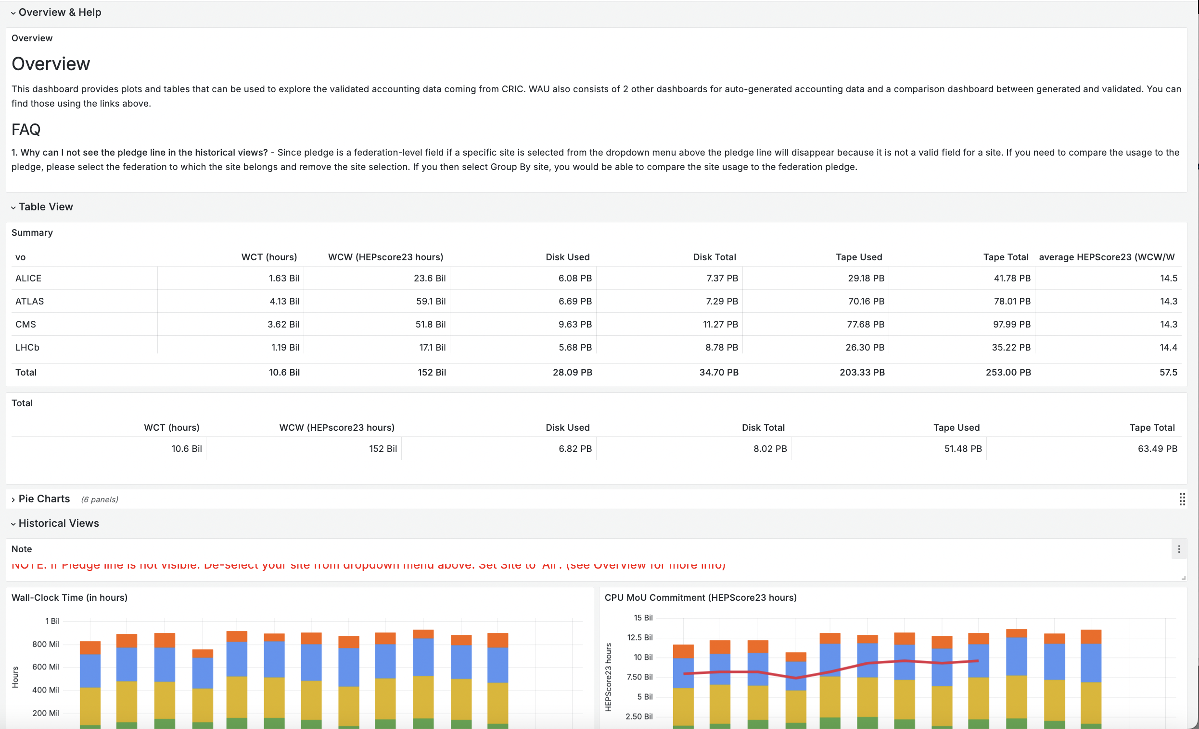
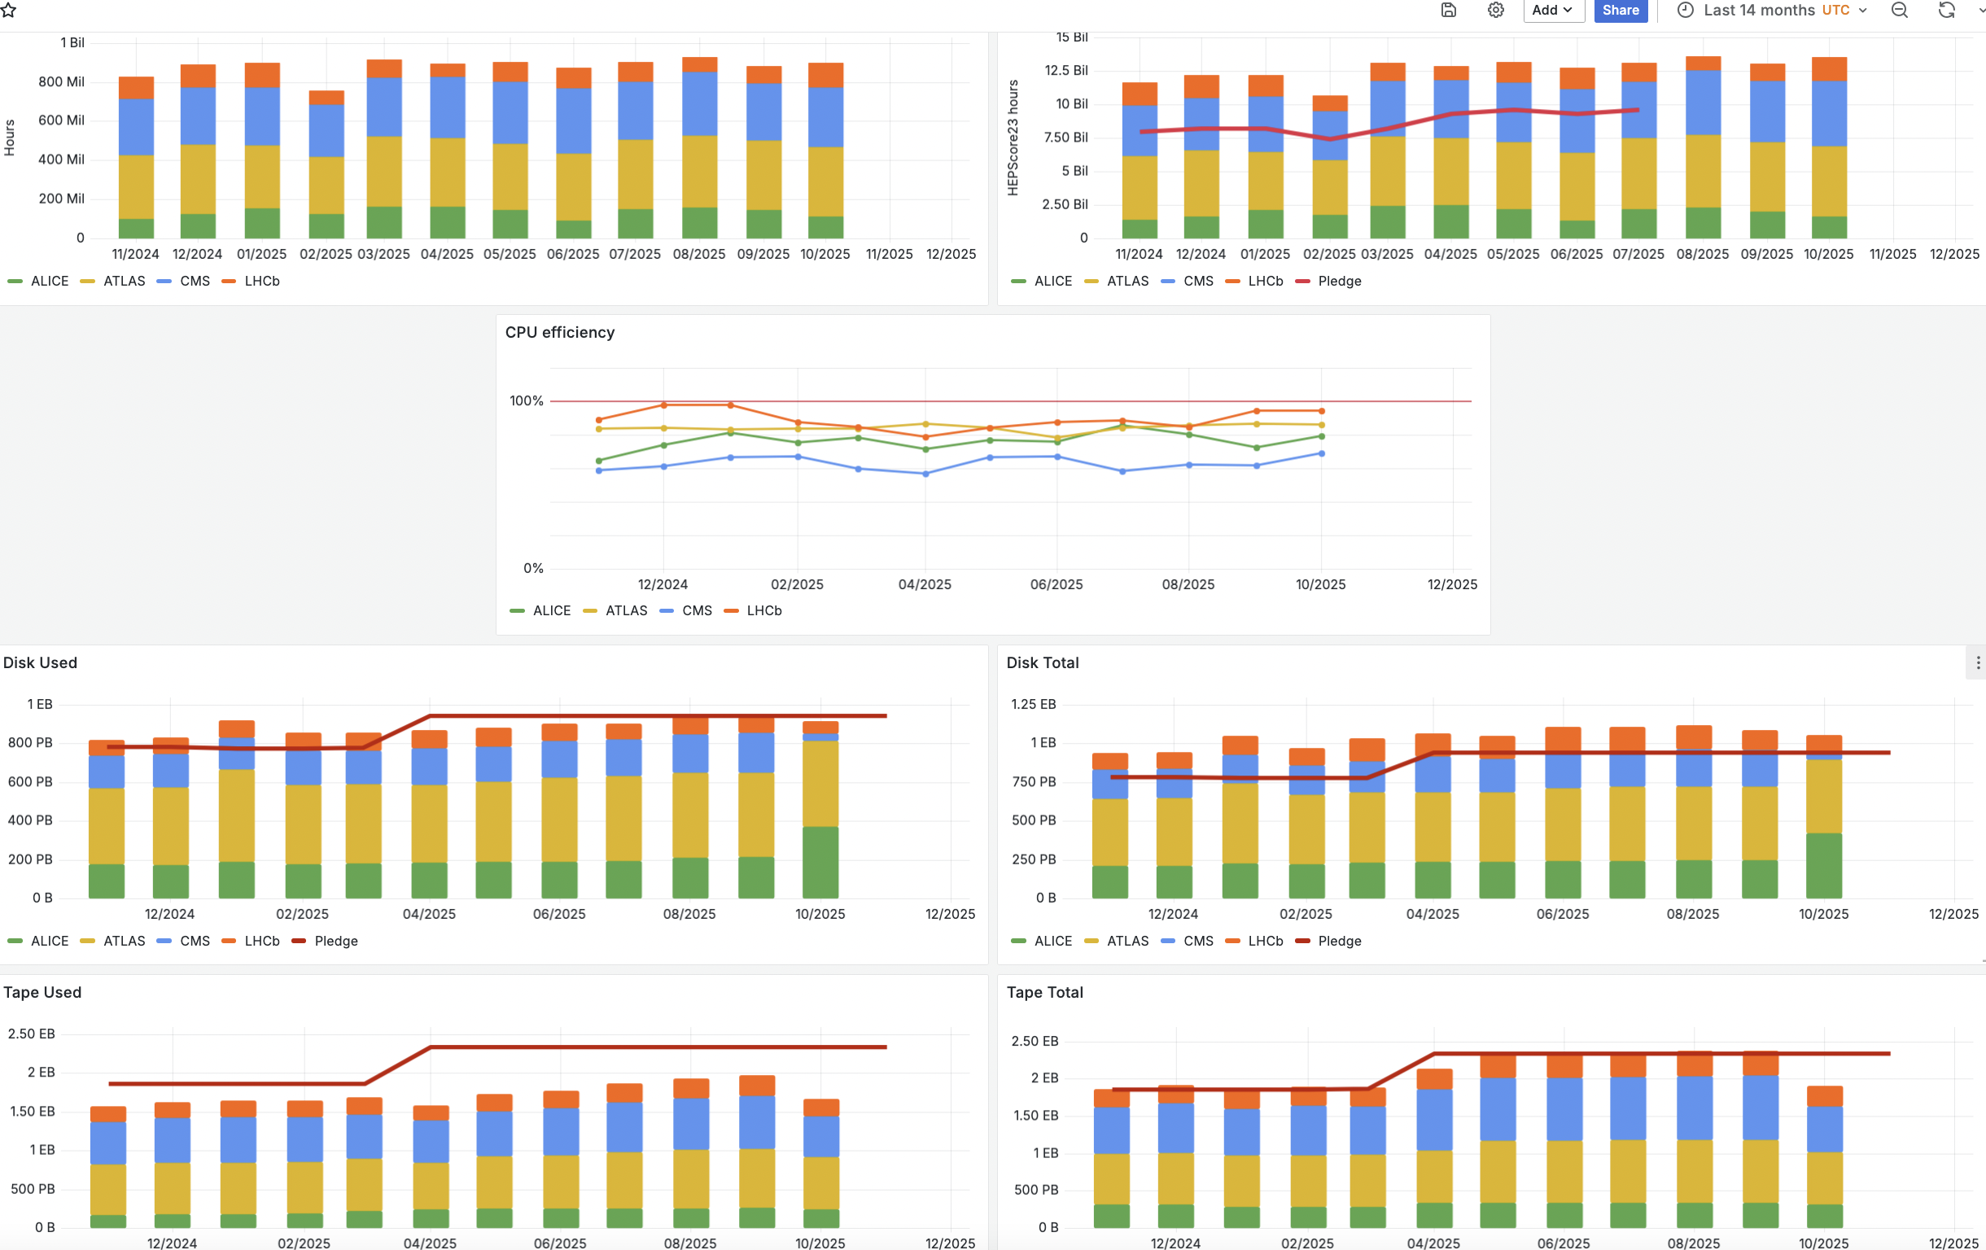
WAU UI
WAU screenshots
WAU link:
https://monit-grafana-open.cern.ch/d/6rLvYKhZl/central-wlcg-accounting-data?orgId=16

Slide 8
Who does what? Evolution (1 to 3)
We believe that APEL and CERN teams can work in parallel on the implementation.
CERN:
Update the WAU input source. Question: Can APEL provide an API instead of CERN consuming data from the message queue?
Extend WAU to support non-LHC VOs and include additional metrics that exist in APEL but not currently in WAU (e.g., number of jobs, etc.).
We propose using CERN infrastructure during development, followed by a migration to STFC.
Result of this development will be a new repository and UI. EGI portal can be retired after data validation
APEL Team:
Provide an API for retrieving data from the APEL database.
Implement data aggregation using the new technology stack.
Once this is in place, we will have the same functionality as the current implementation and will be able to validate the data easily by comparing it with the legacy system

Slide 9
Evolution (4) and points to consider
API & validation layer WAU currently lacks a proper API. We therefore need a lightweight service on top of WAU to provide APIs and to support CRIC-style validation so site administrators (including non-LHC VOs) can review and correct data. This validation/administration component can be implemented after the core functionality is in place. Flexibility for new metrics and metadata The new implementation must be extensible so that adding metrics or metadata takes days–weeks, not months. WAU already allows relatively fast additions today, but because it receives aggregated inputs, we should ensure flexibility across the entire data pipeline (not just at the WAU layer). Avoiding double counting and handling updates Closely related to flexibility is the need to prevent double counting when the data flow changes. We must plan carefully for both latest time bin updates and historical corrections so updates are applied idempotently.

