Slide 1

Spin Correlations in Dark Photon Searches
University of California, Irvine
Jonathan L. Feng, Miša Toman and Eli Welch arXiv:2508.18352

Slide 2
Talk Outline
Introduction
What are dark photons? How are they produced and detected?
Gap in the literature
Spin correlations and the narrow width approximation
Usual treatments of dark photon detection
What we did different
Analytic results and simulations
Impact on current experiments and outlook

Slide 3
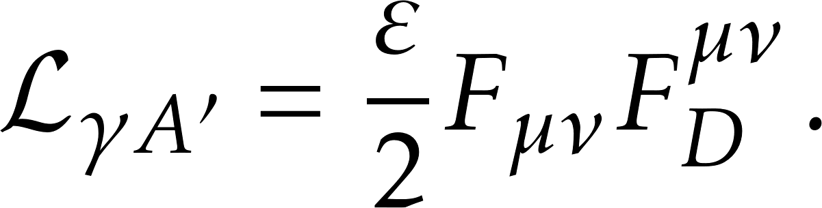
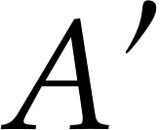

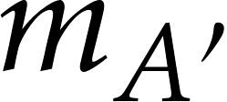



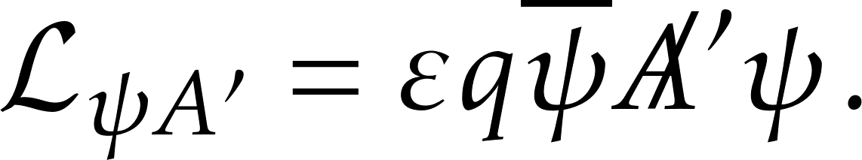
What are dark photons?
Gauge bosons, , of
Mass and coupling
The simplest renormalizable gauge portal.
This yields fermion couplings

Slide 4
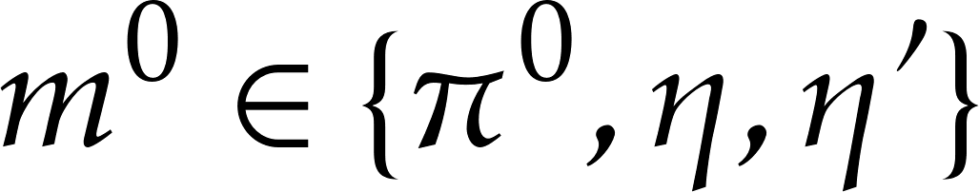
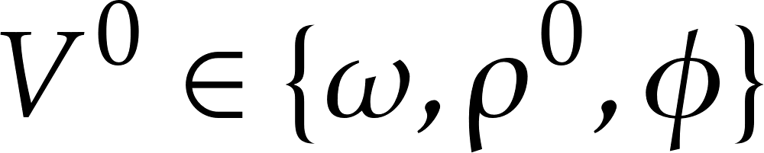
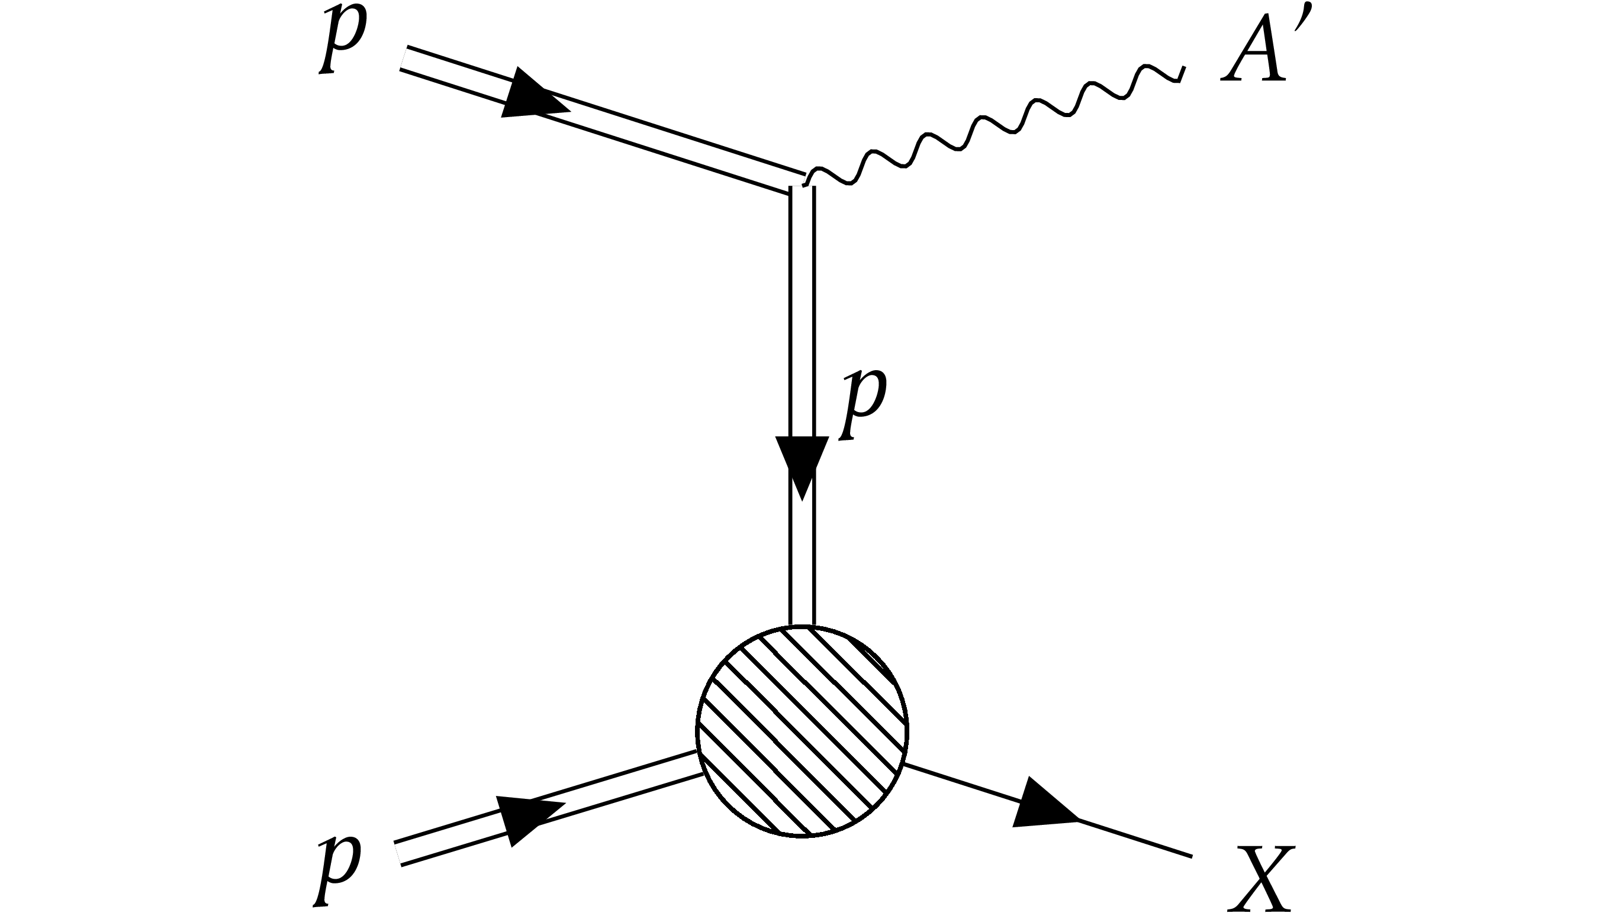
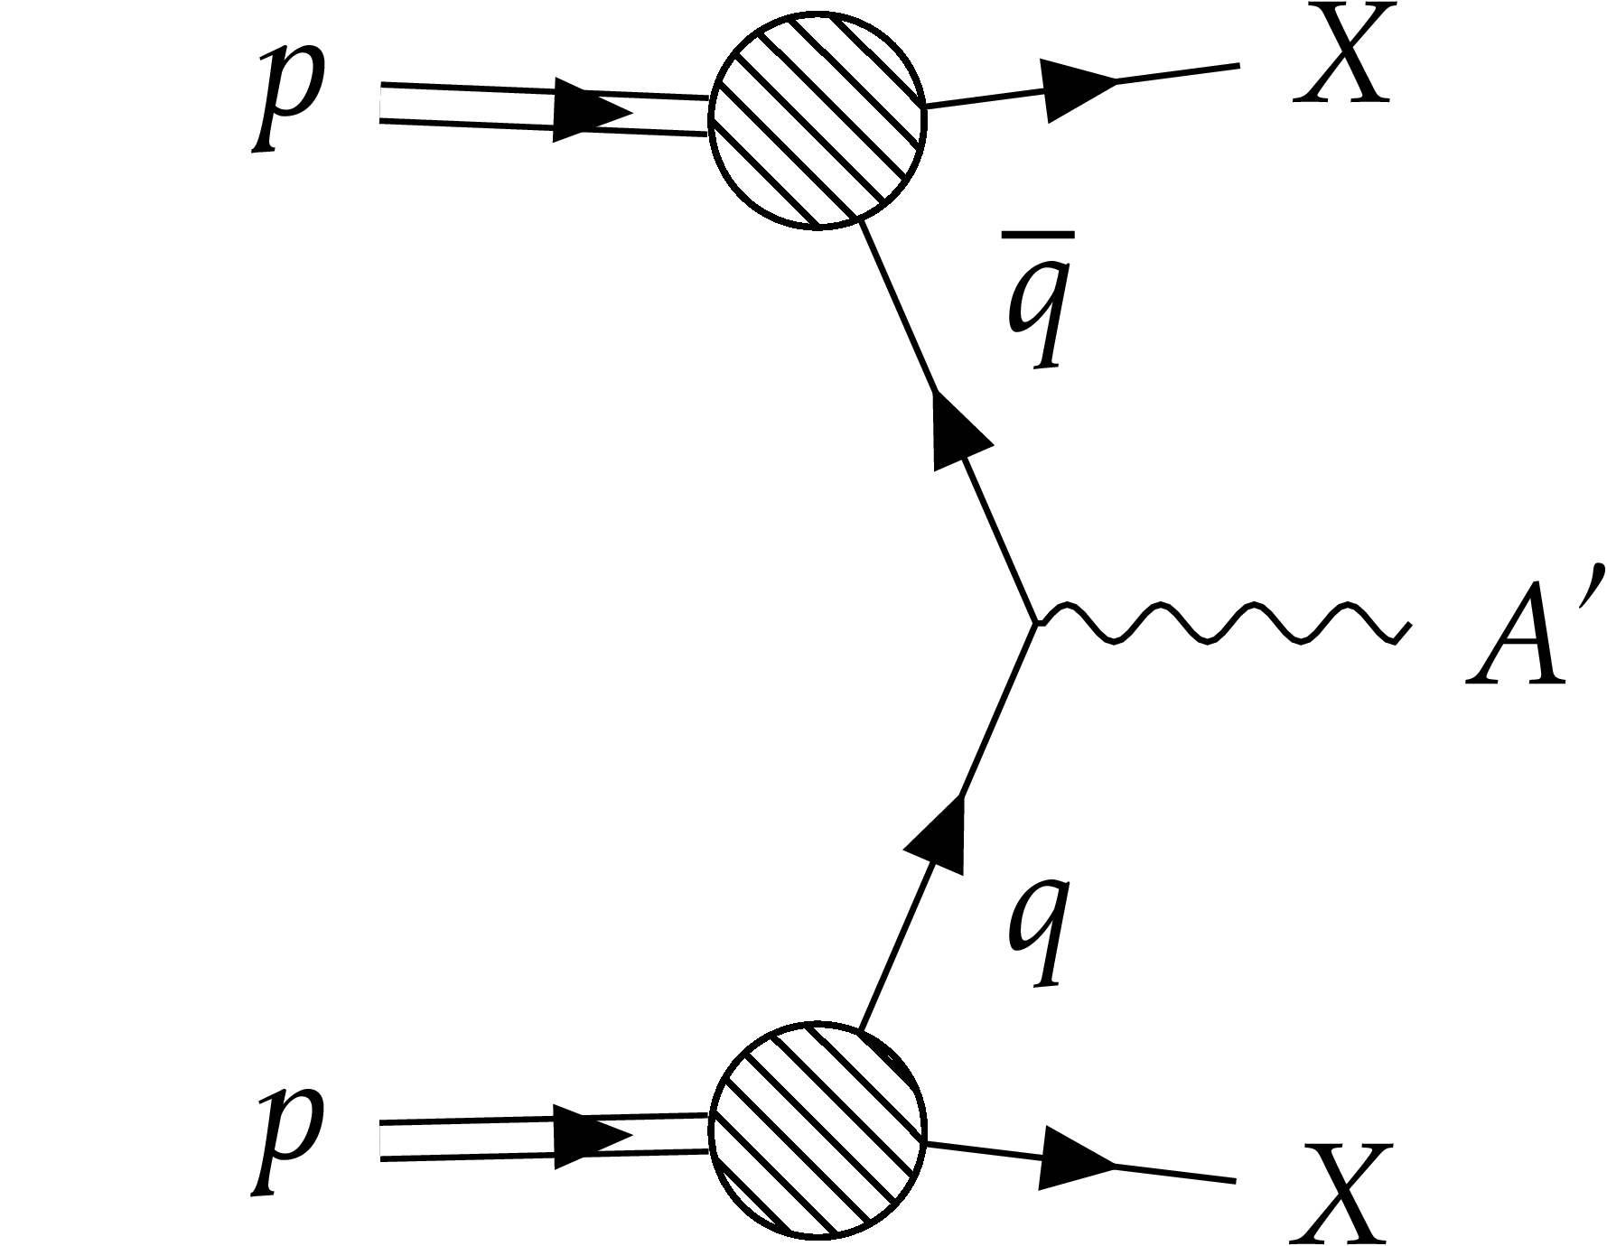
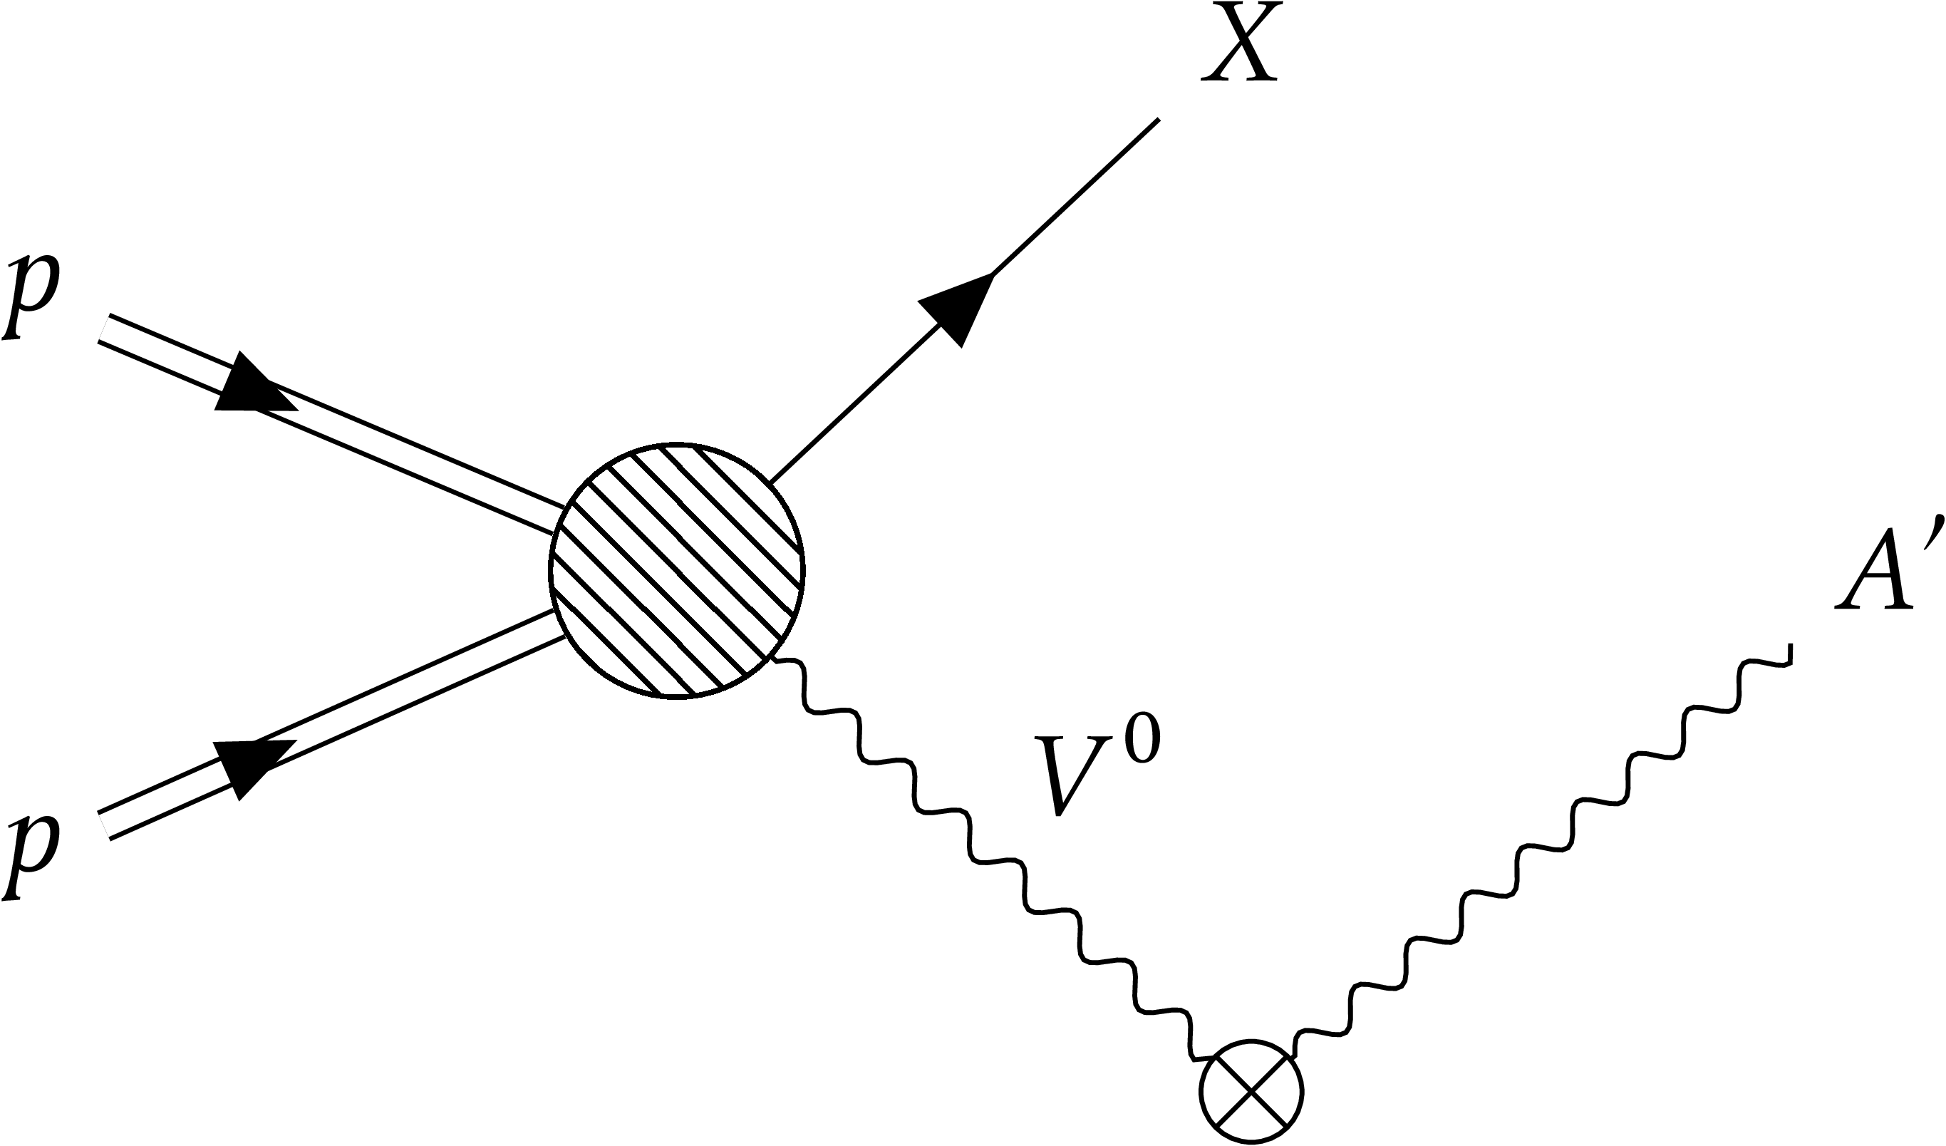
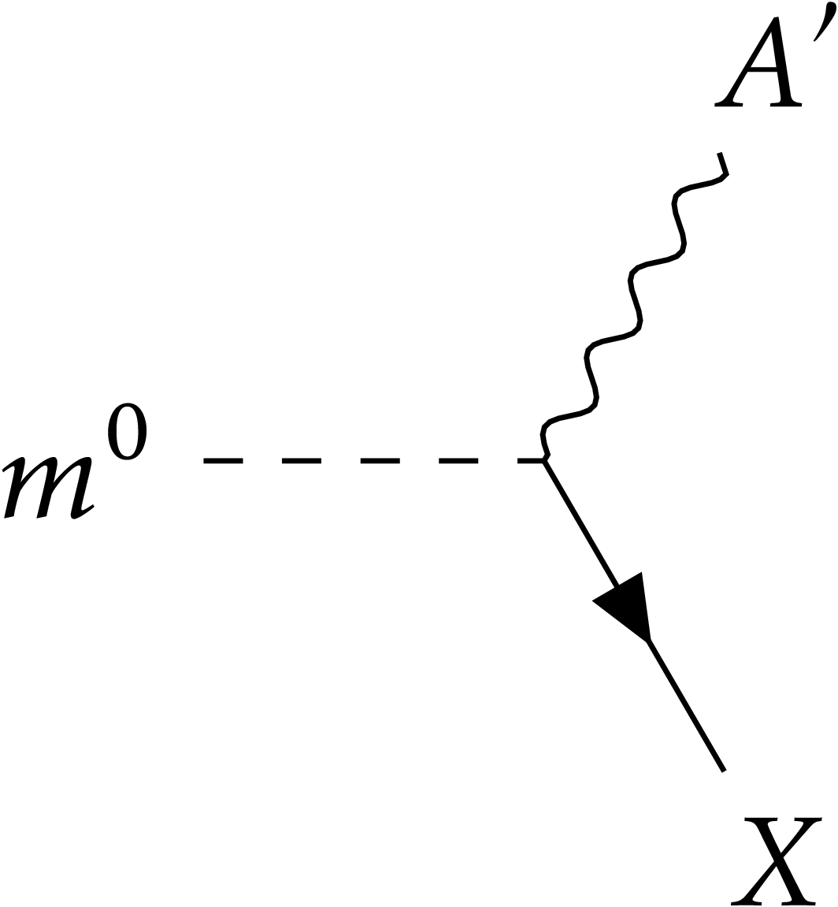
Dark photon production
Pseudoscalar meson decay
Proton Bremsstrahlung
Drell – Yan process
Vector meson mixing
arXiv:2409.11096 [hep-ph] Y. Kyselov and M. Ovchynnikov. Jan 2025

Slide 5
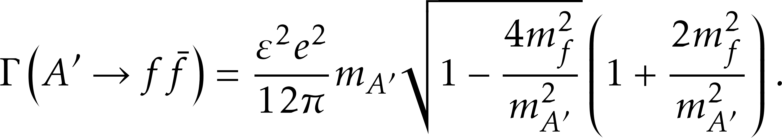
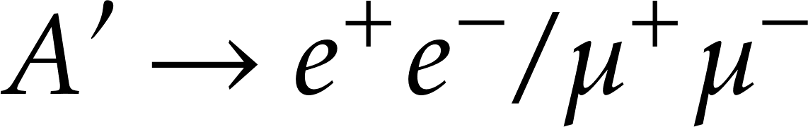
Dark photon searches
is expected to be a long-lived particle (LLP)
Existing searches: FASER, NA64, NA62, HPS.
And future searches such as SHiP, all look for the signs of decay.

Slide 6
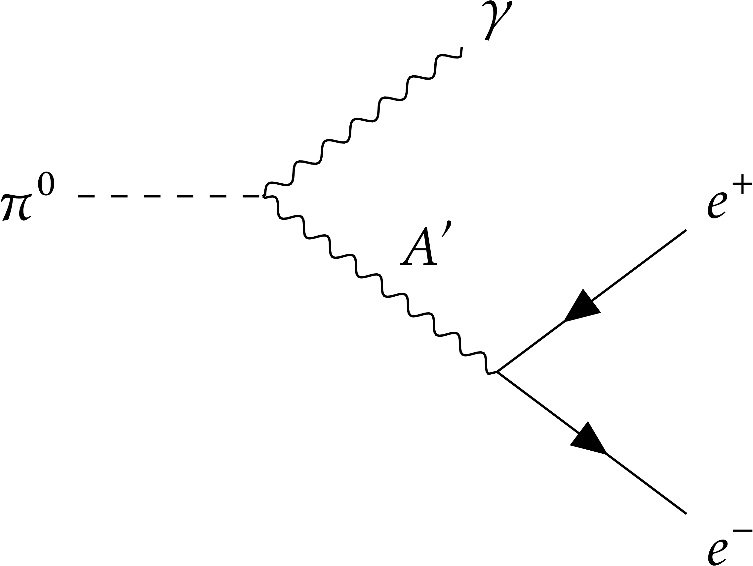
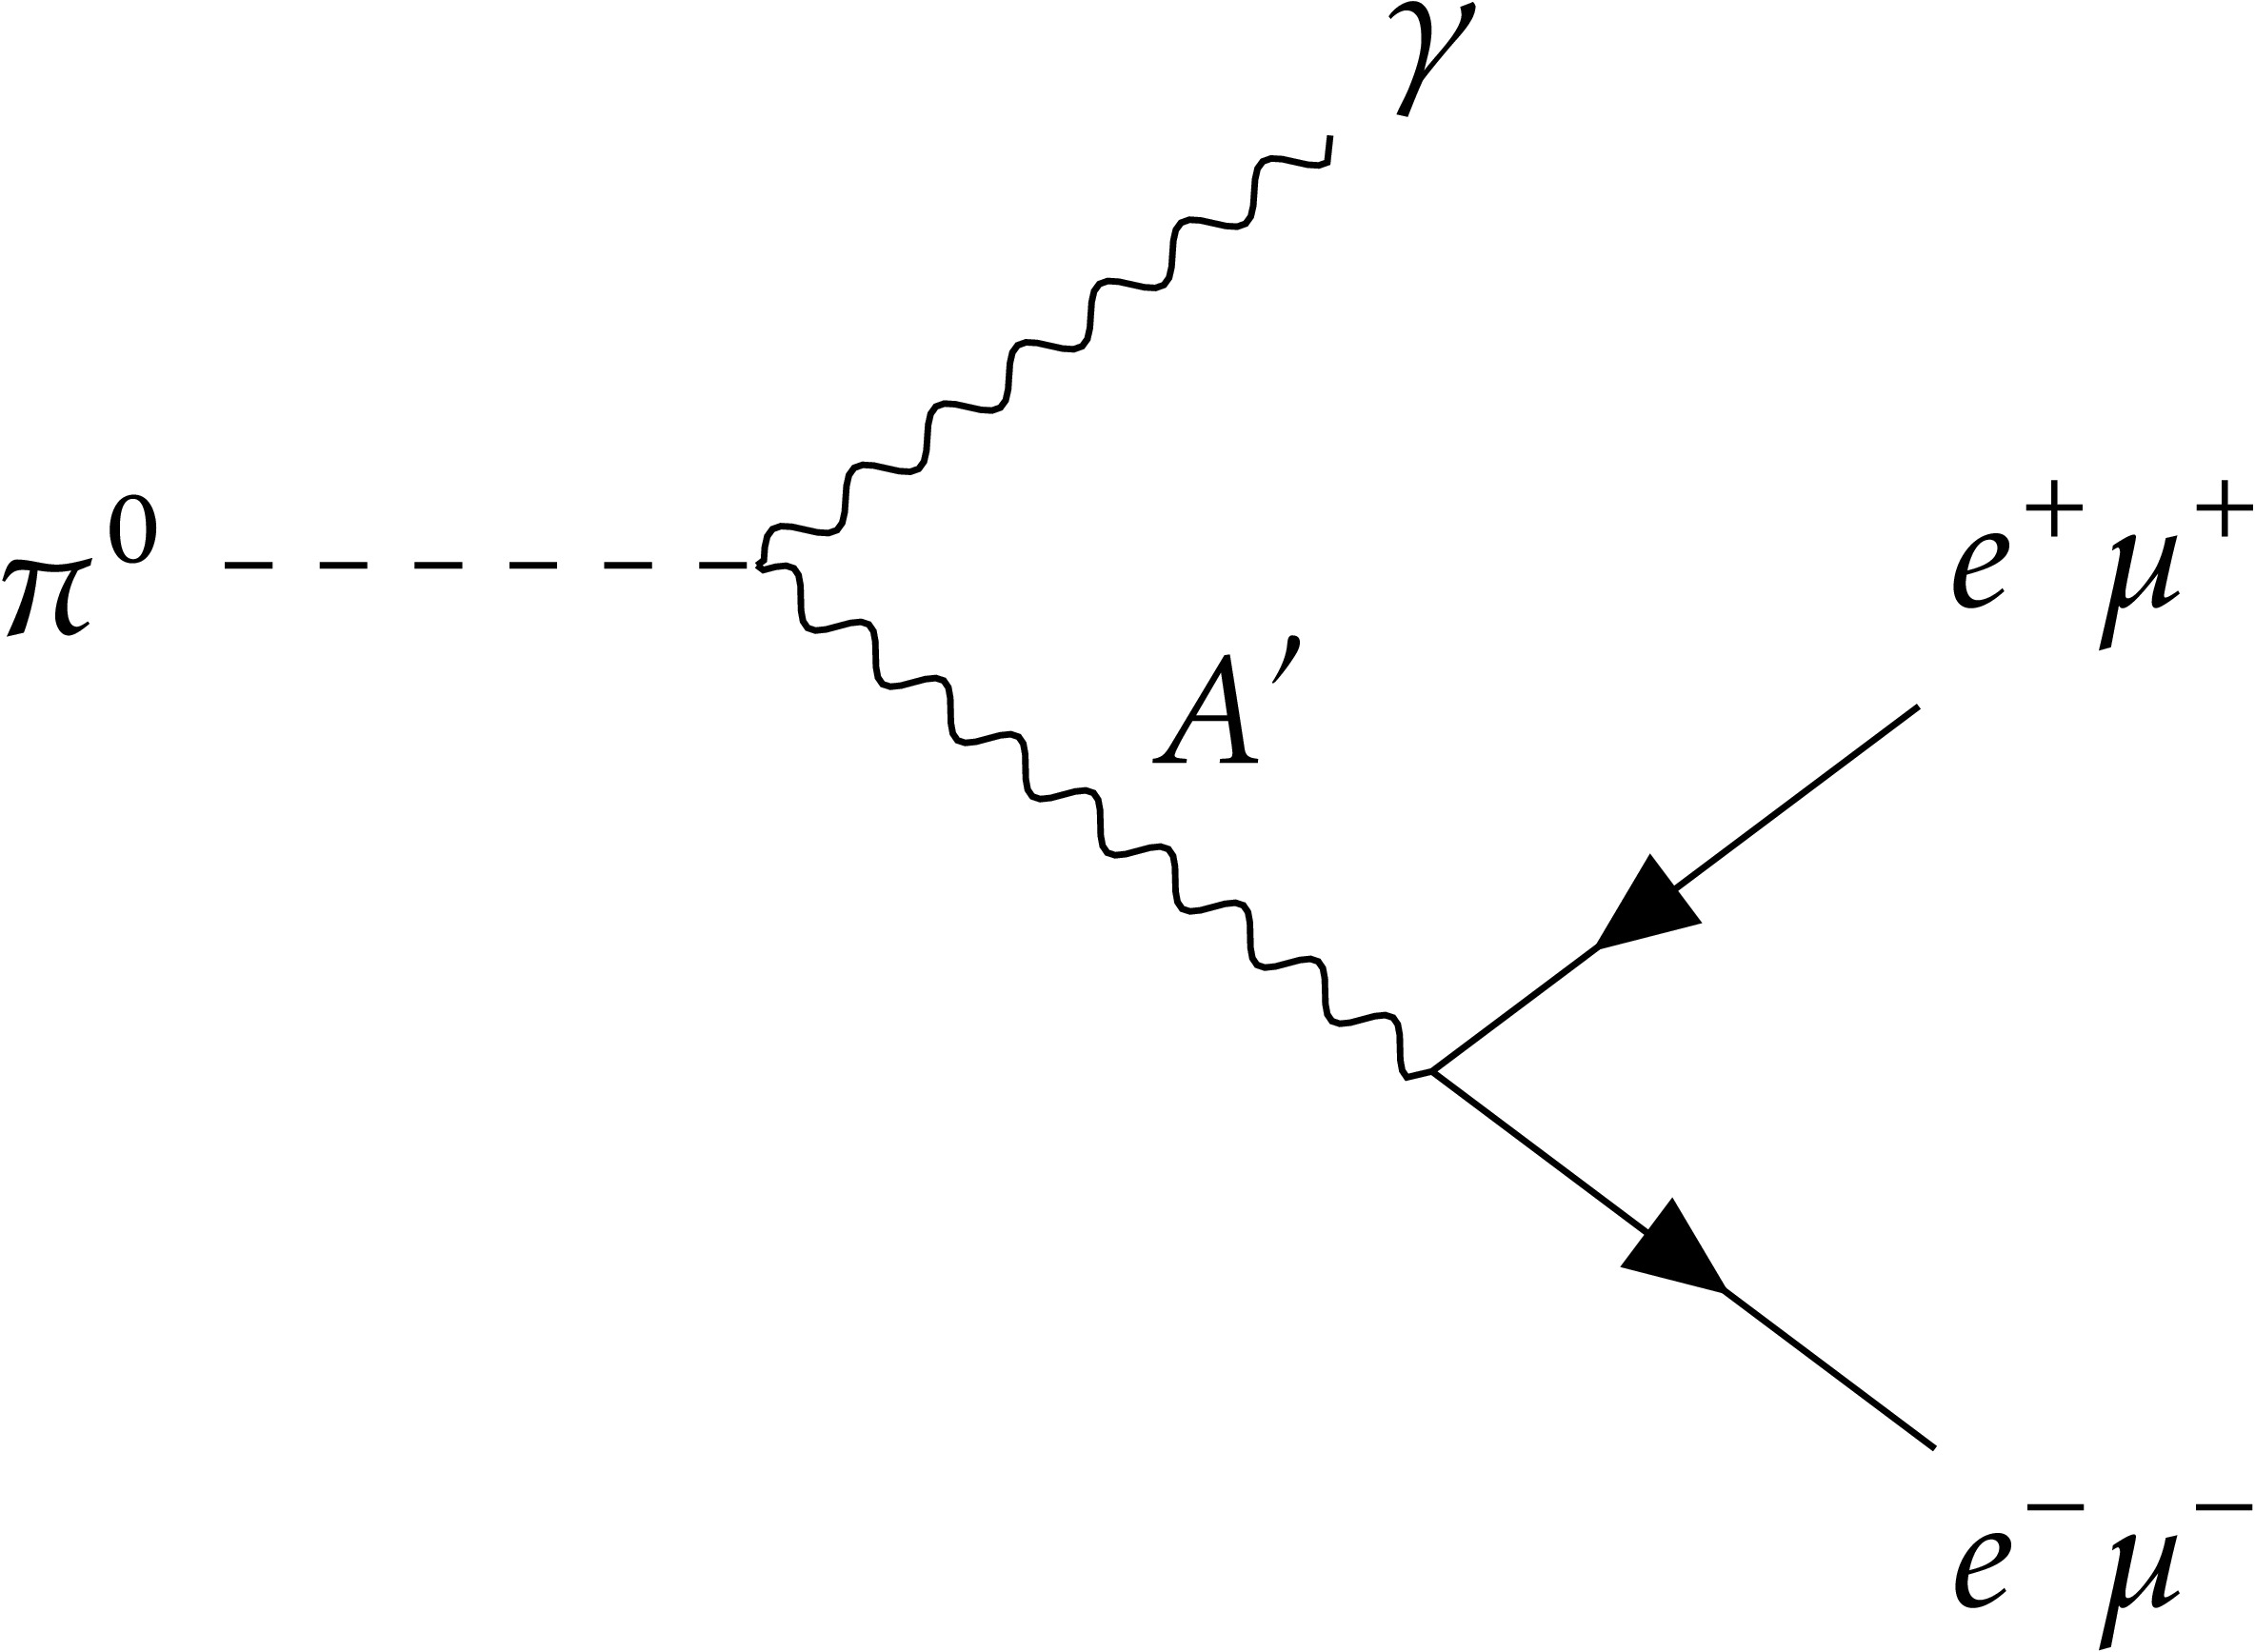
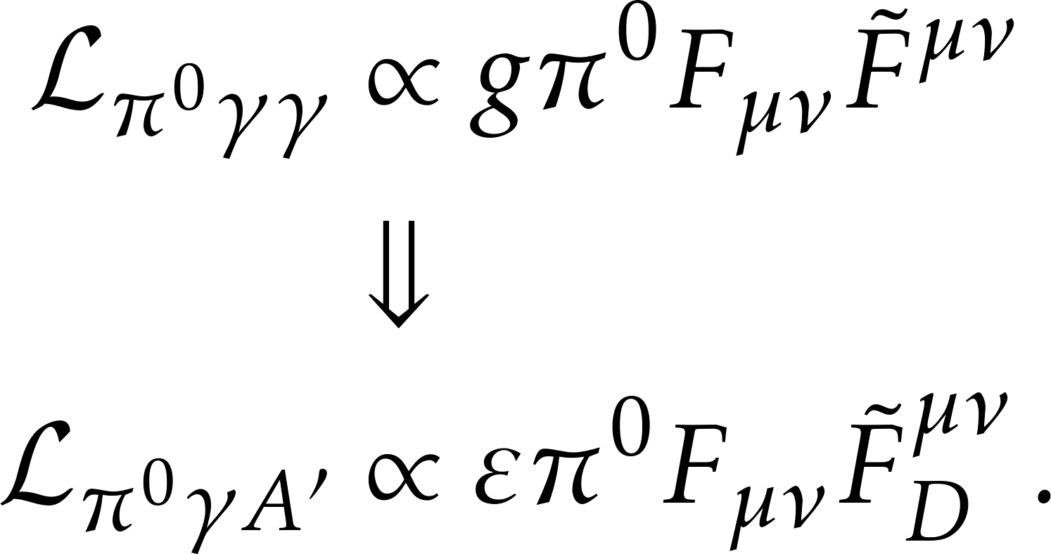
Pseudoscalar meson decay
How do mesons couple to the dark photon?
Inspiration from the chiral anomaly

Slide 7
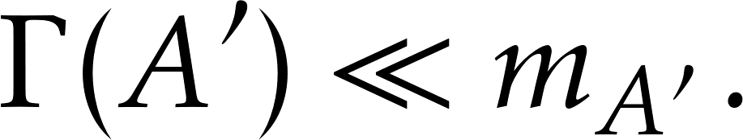
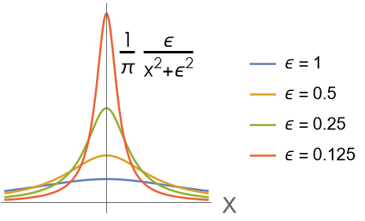
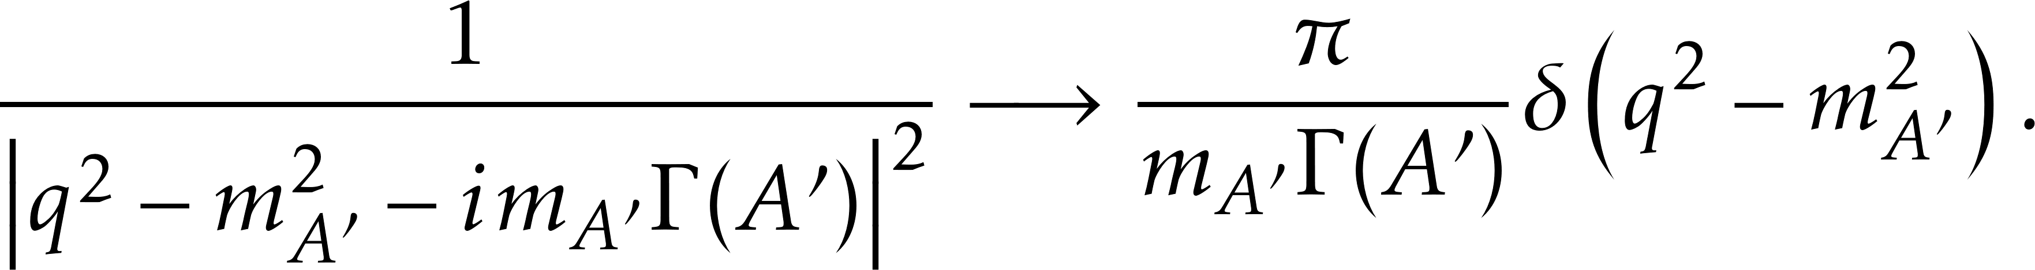
Gap in the literature
Two main approximations when it comes to LLPs:
Narrow width approximation. Valid when
Neglecting spin correlations.

Slide 8
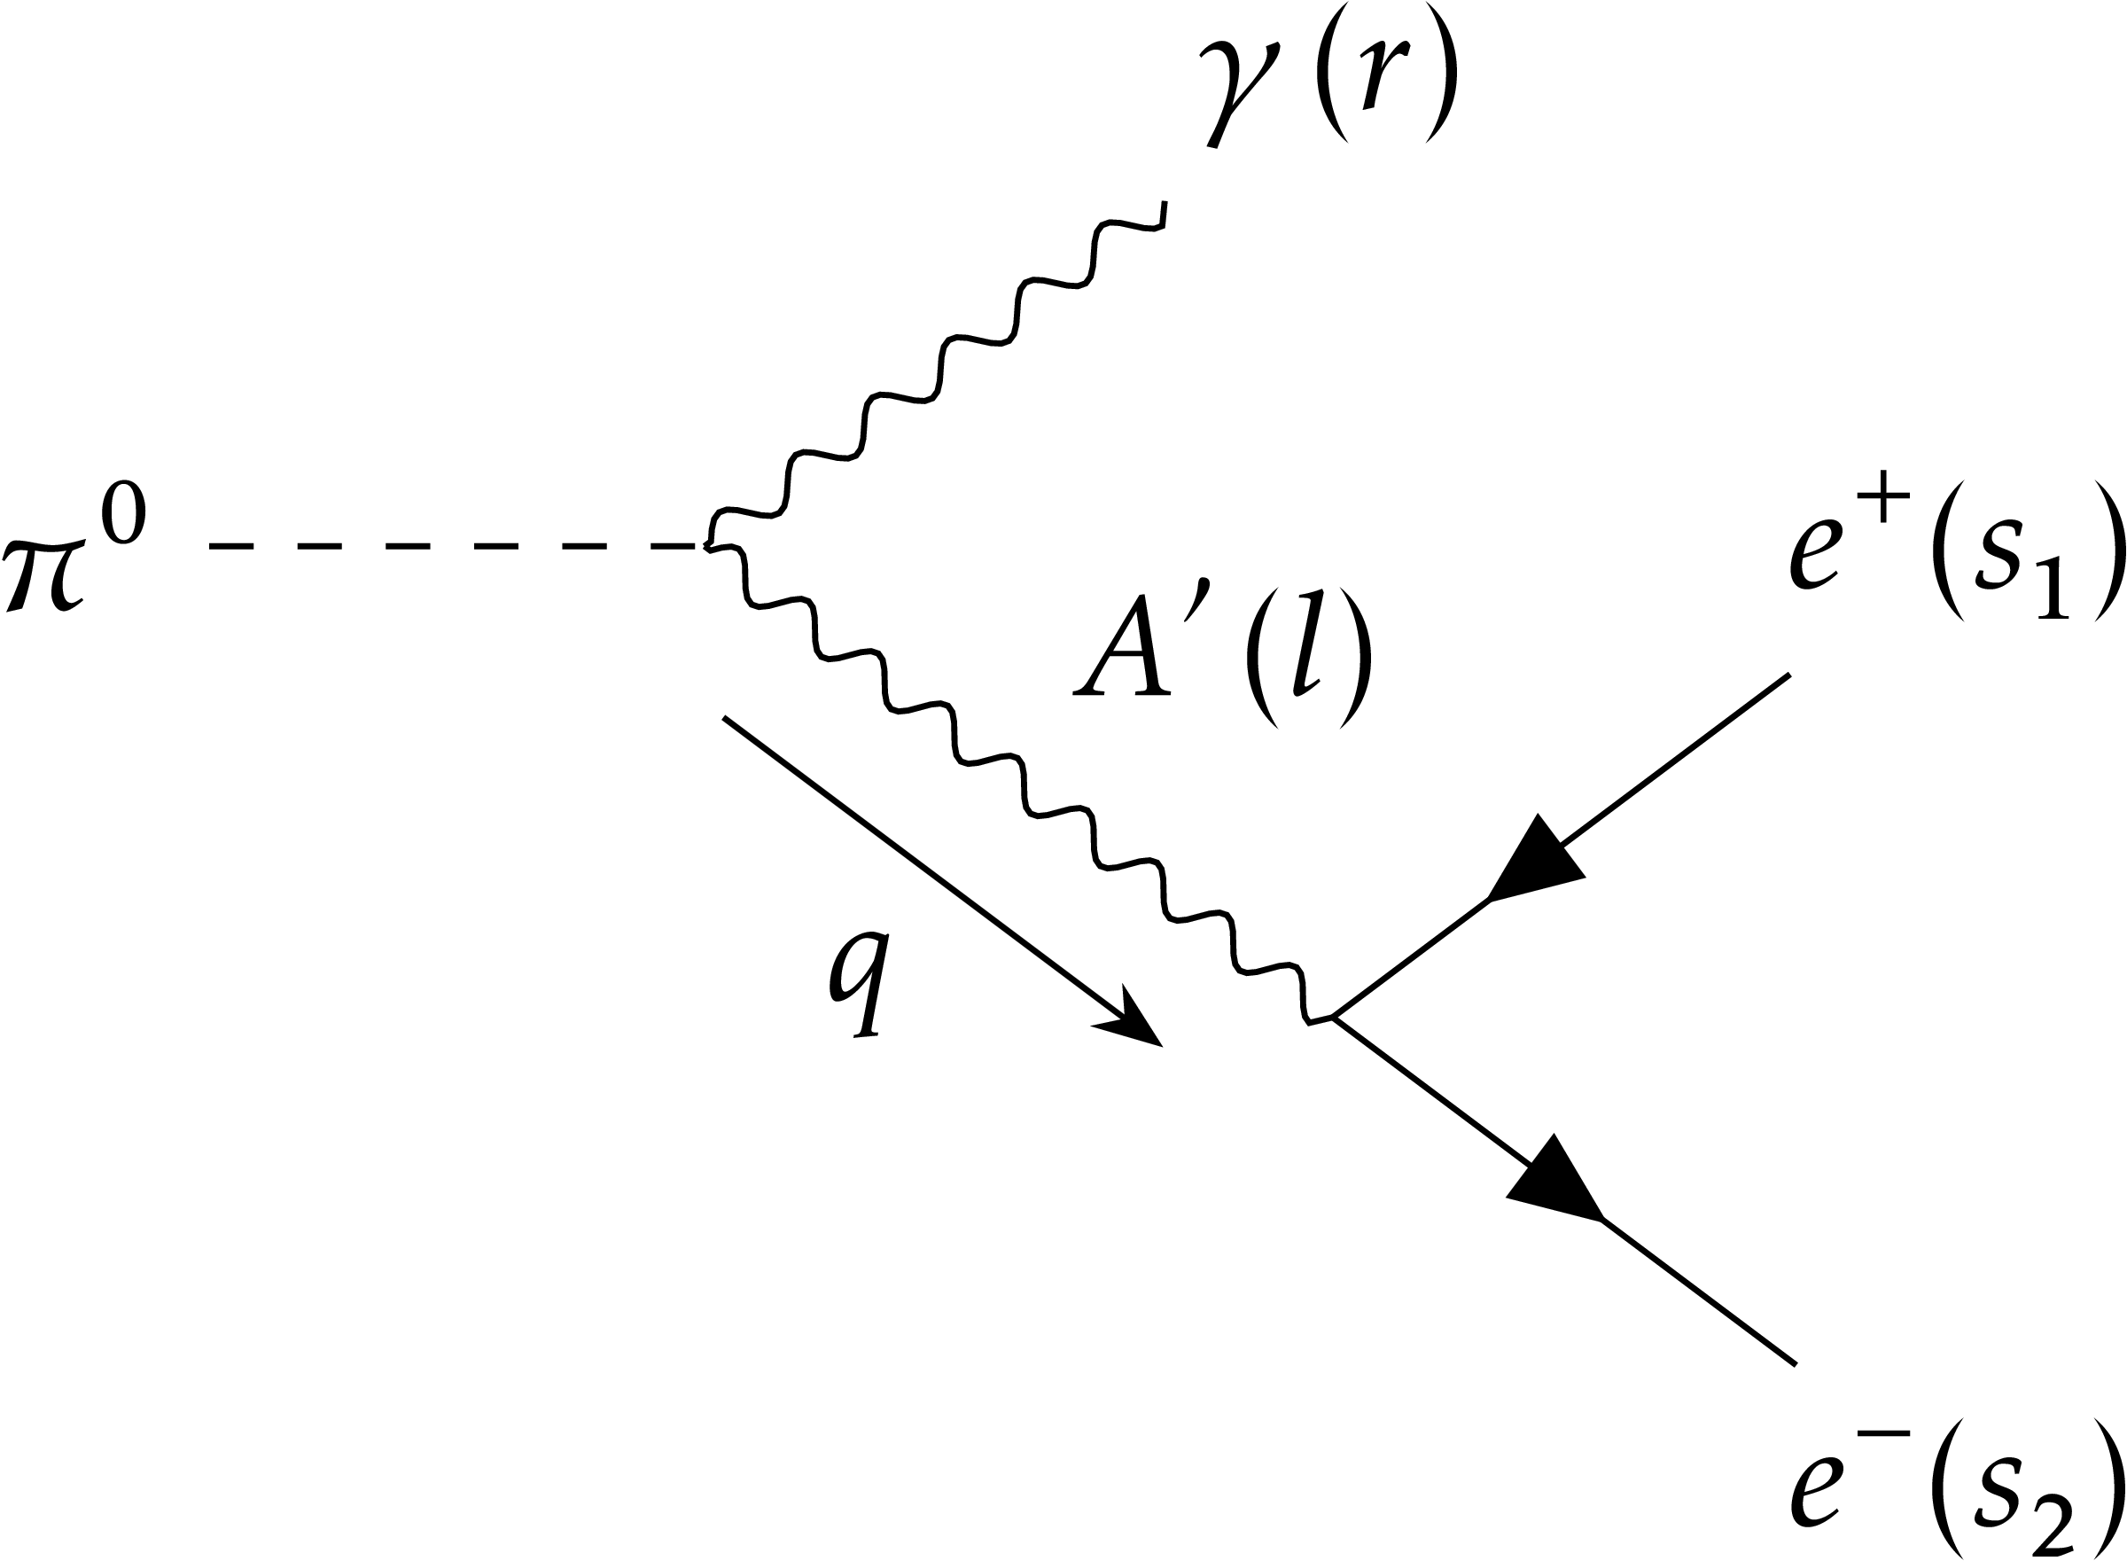
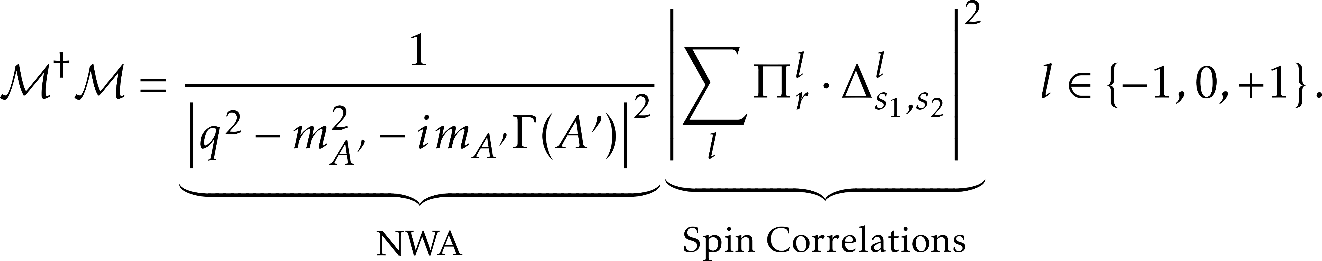

Spin correlations

Slide 9
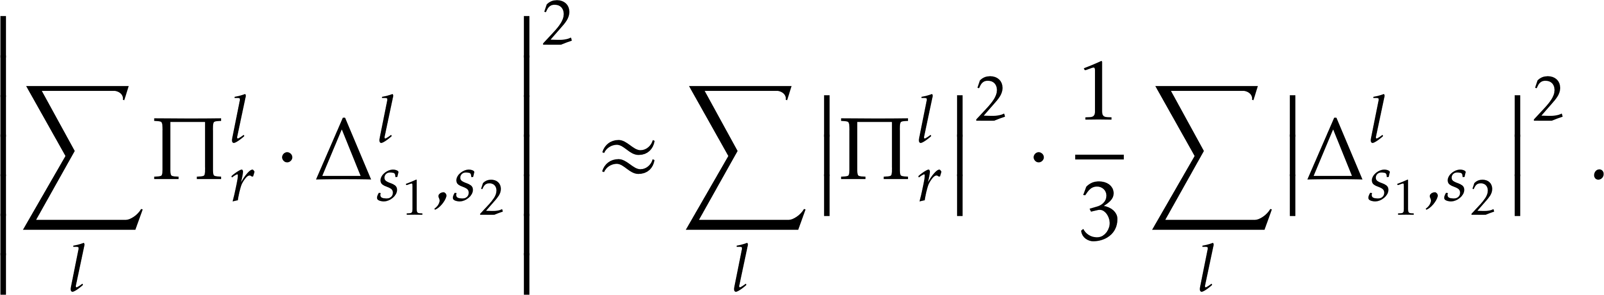

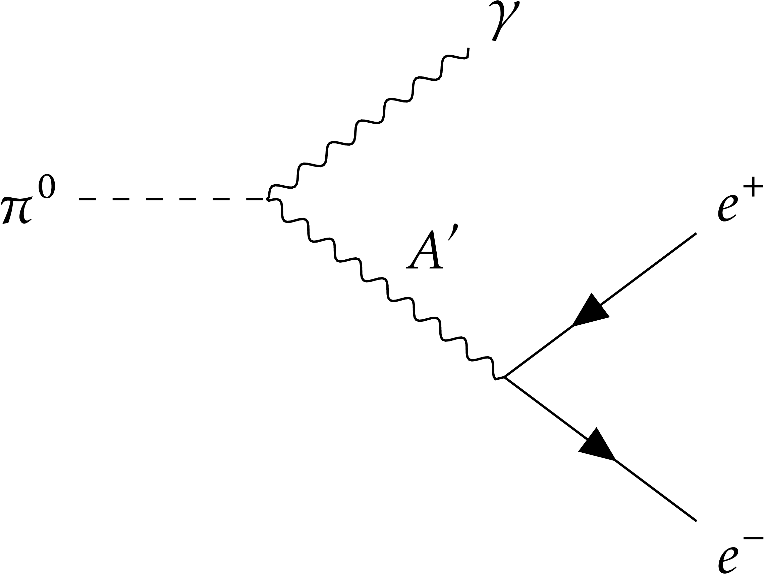
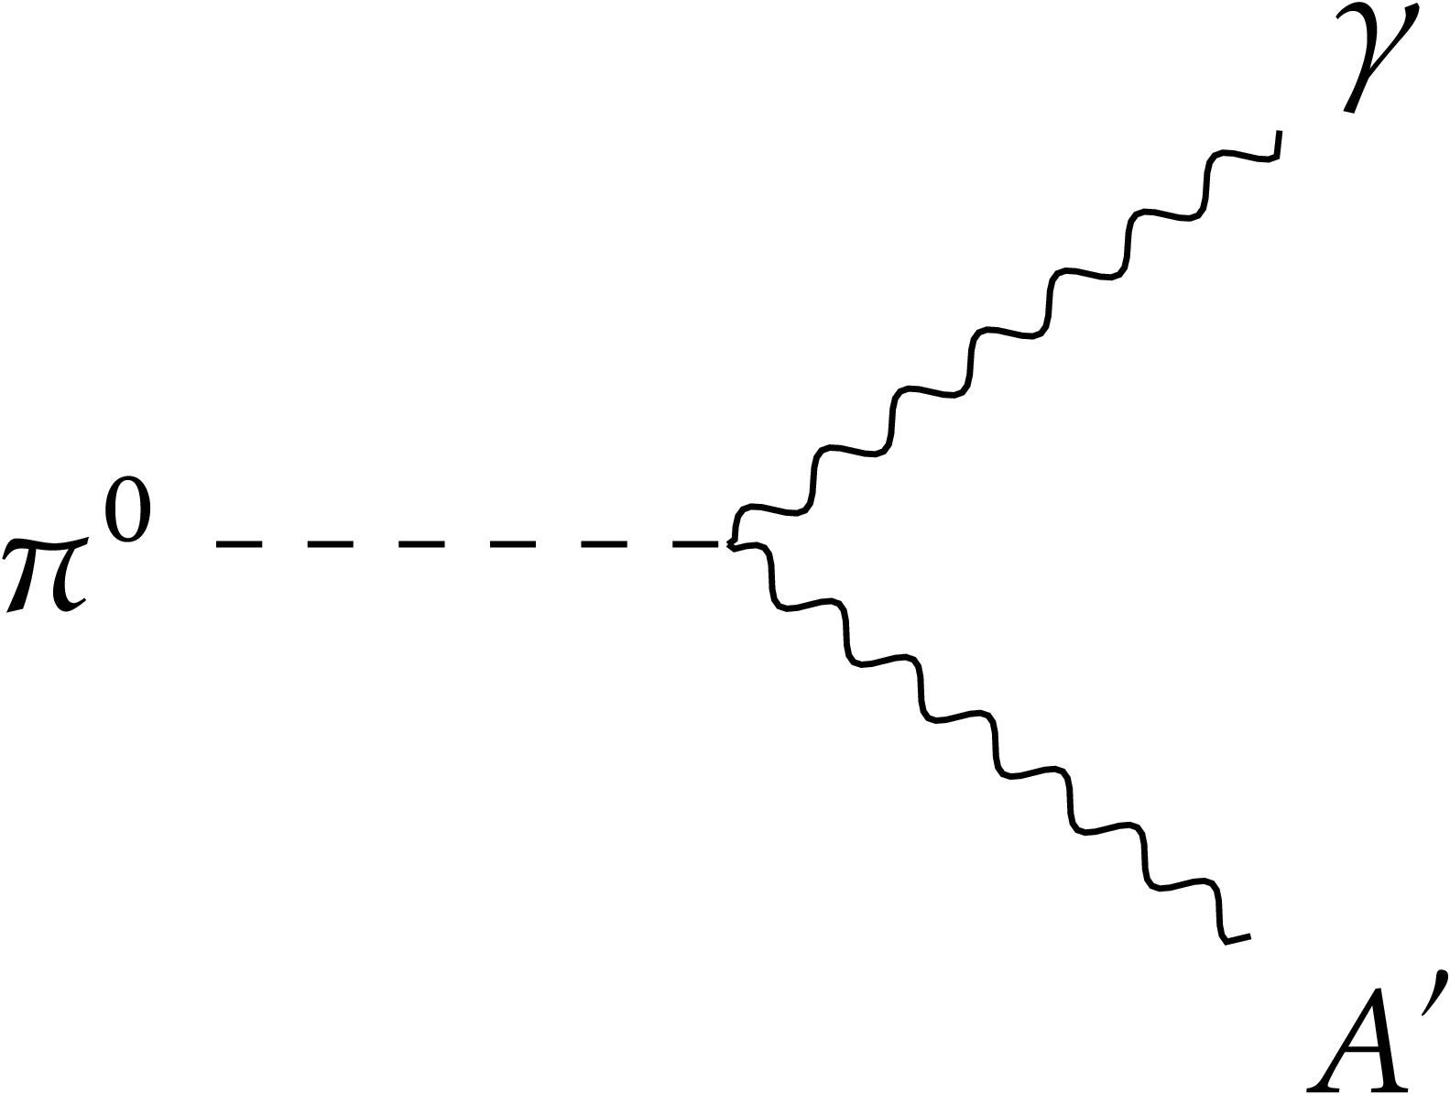
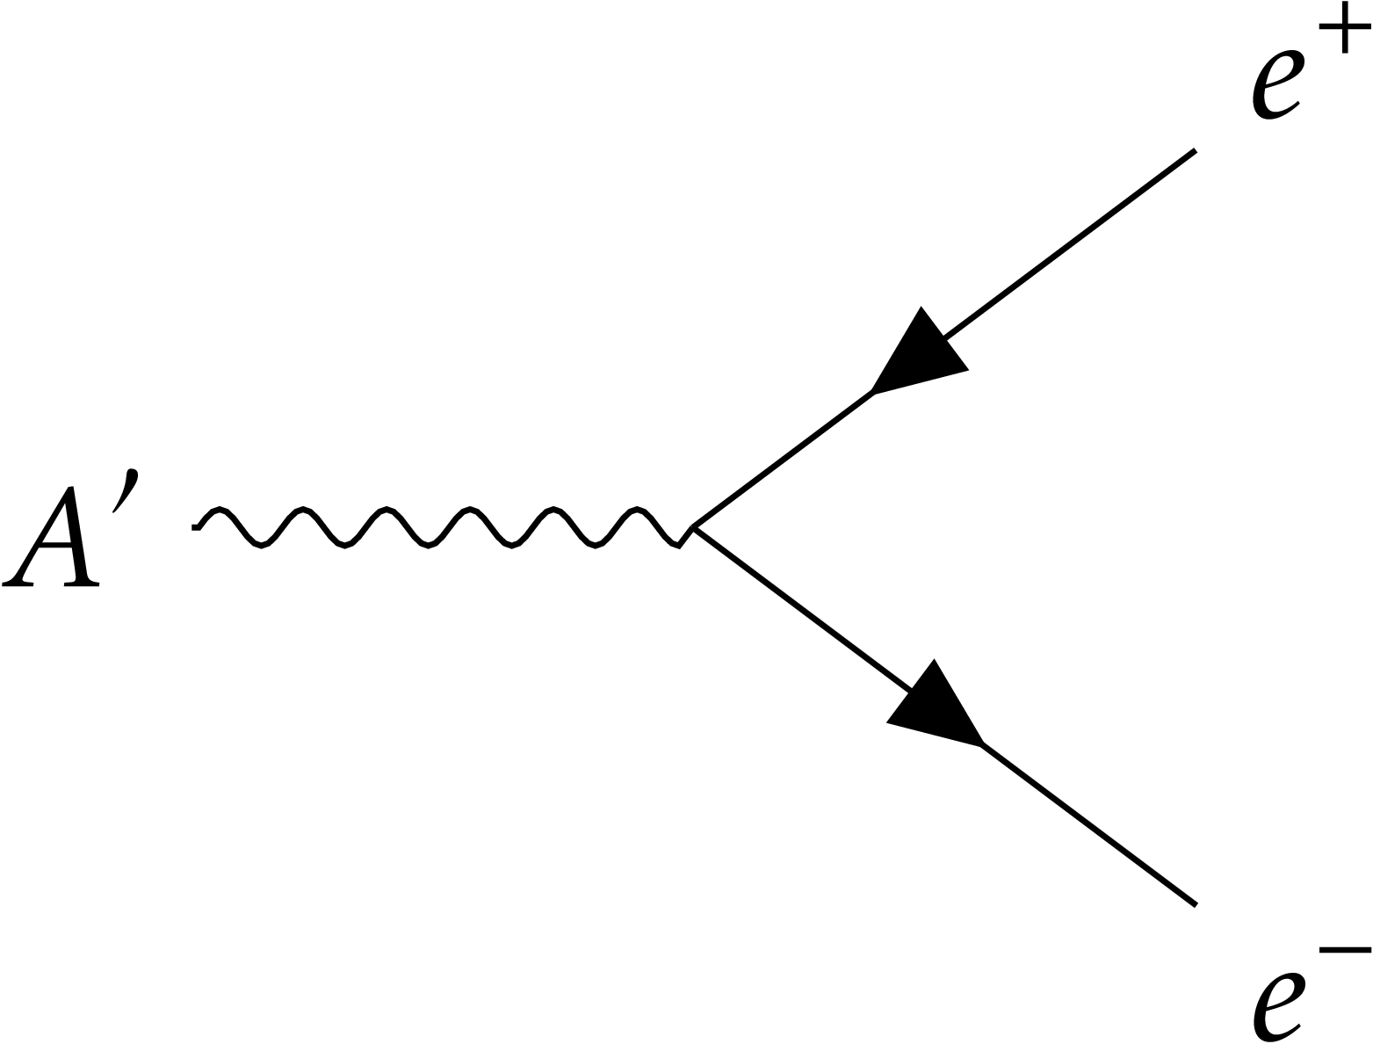

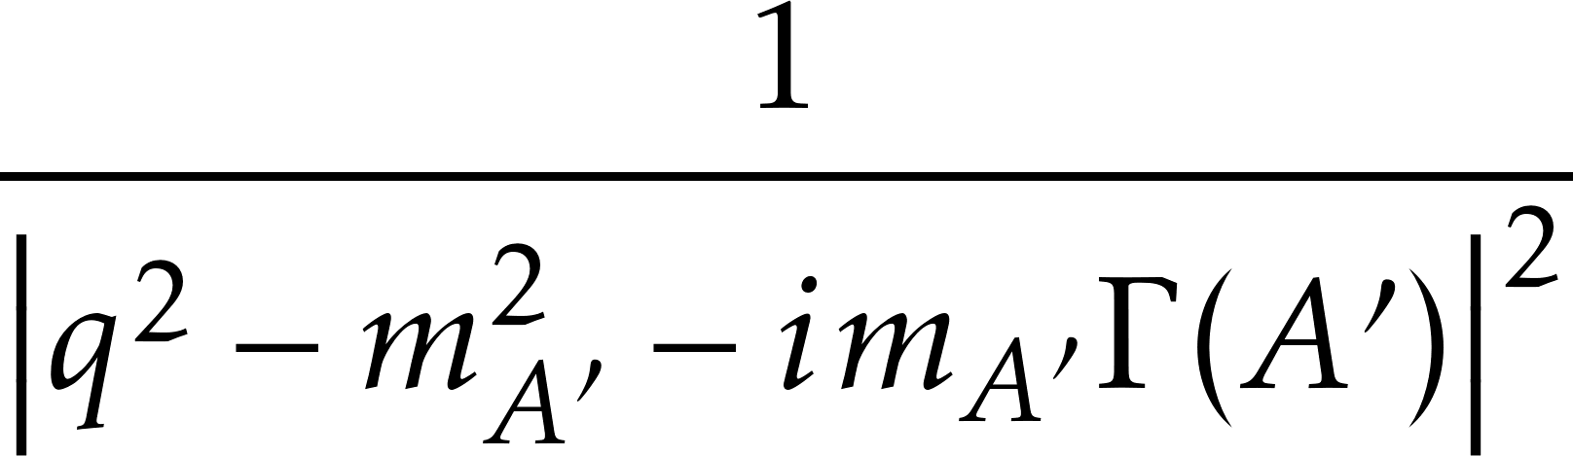
Spin correlations
To neglect spin correlations, approximate

Slide 10
Spin correlations
Convey information between production and decay.
Treating production and decay separately is wrong
Event generators like FORESEE have separate production and decay modules.

Slide 11
Results summary
Derived analytic expressions for:
Energy and angular distributions of dark photon decay products.
An experiment-independent parameter to quantify spin correlations.
Performed realistic experiment-specific analyses
Found 1-2% reduction in current FASER reach.
Found up to 10% reduction in SHiP’s projected reach in the meson decay channel.

Slide 12
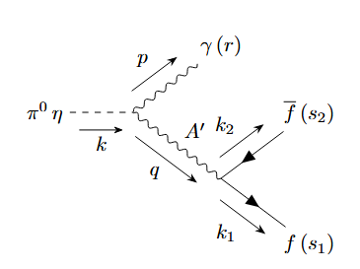
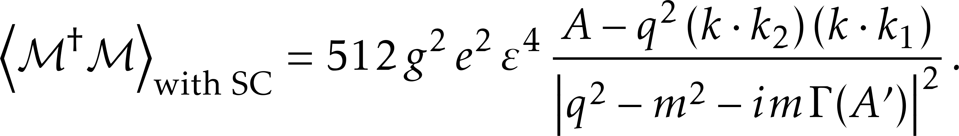
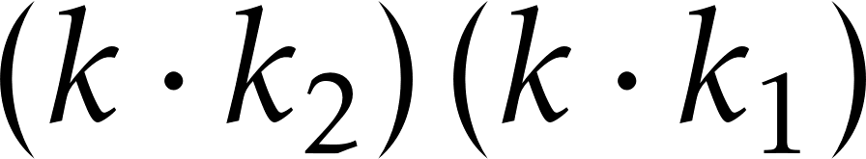
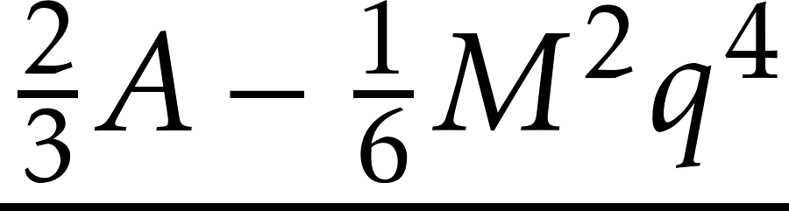
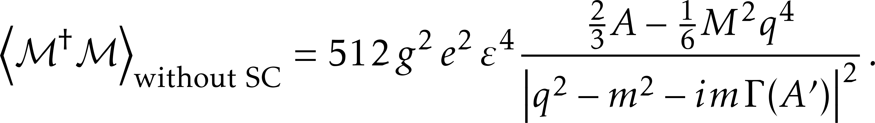
Results – averaged squared amplitudes

Slide 13
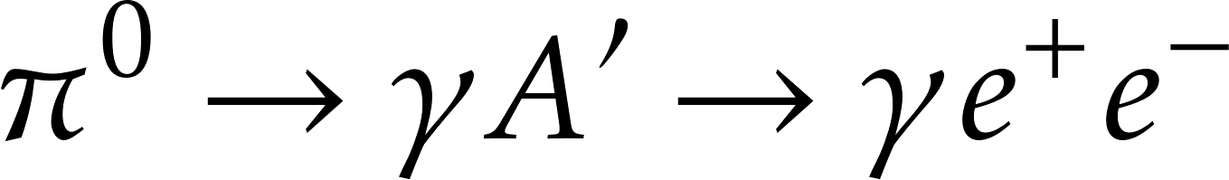
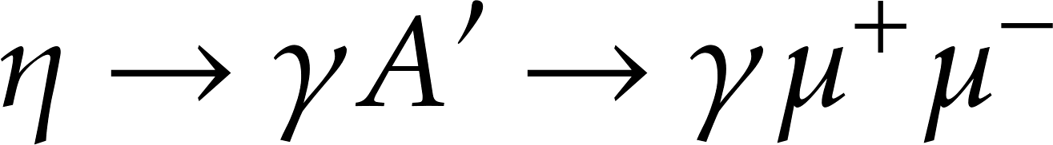
Results – fermion energy in the meson frame

Slide 14
Results – fermion energy spectrum in the lab frame
Non-relativistic pion decaying
Ultra-relativistic pion decaying

Slide 15

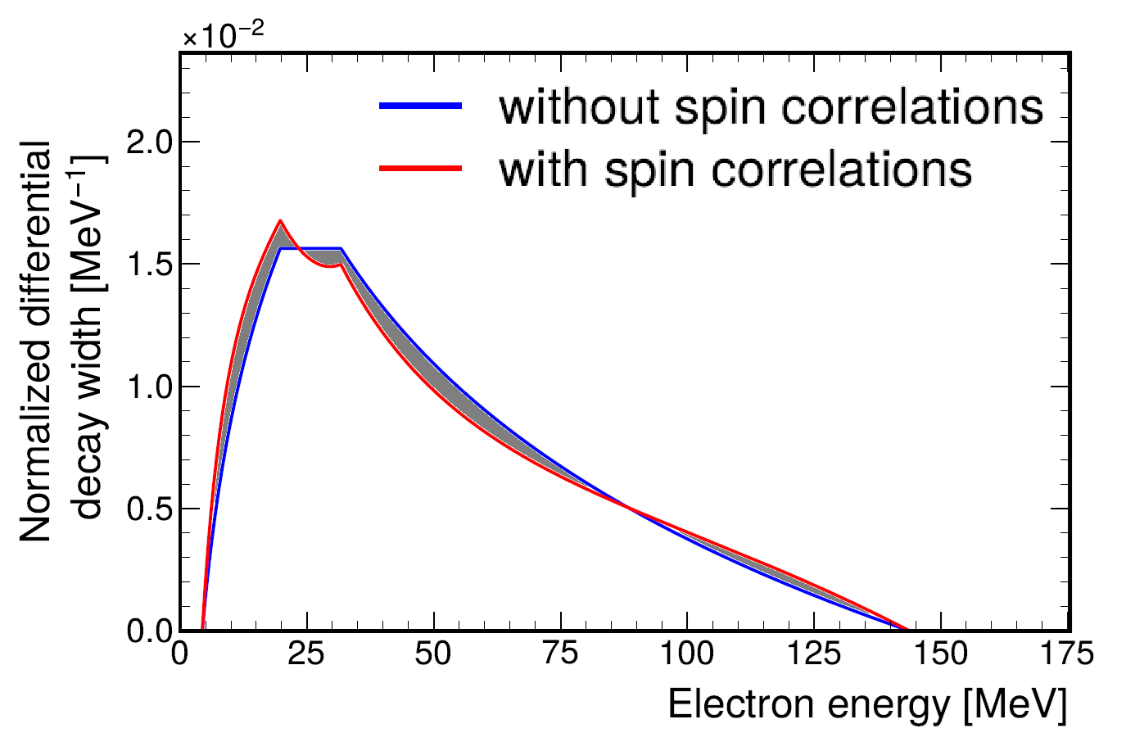
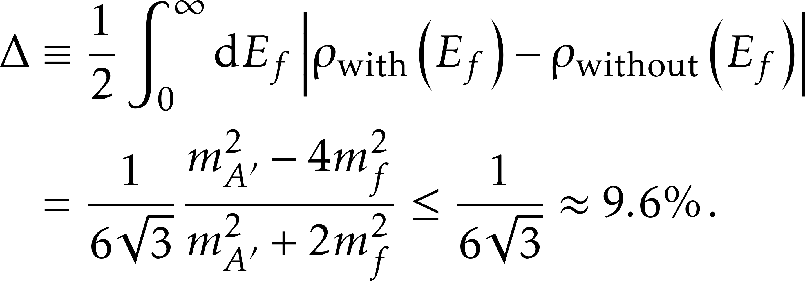
Results – discrepancy between spectra
We introduced a discrepancy parameter

Slide 16
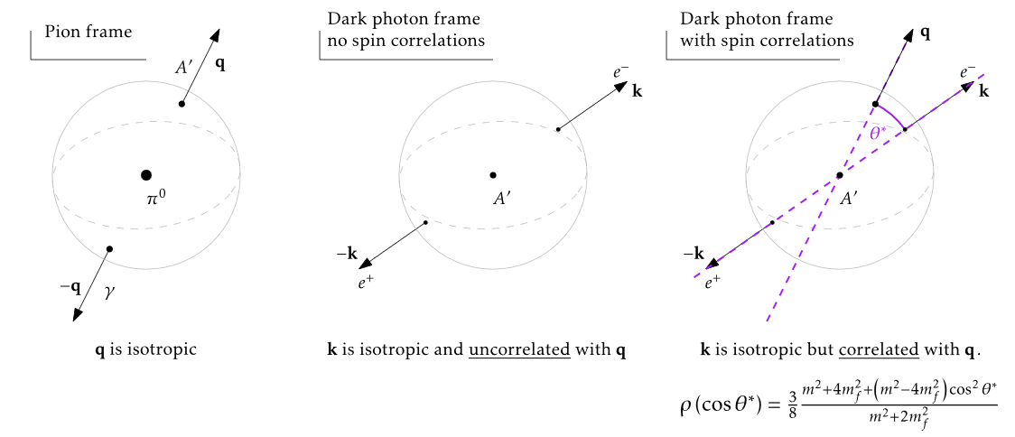
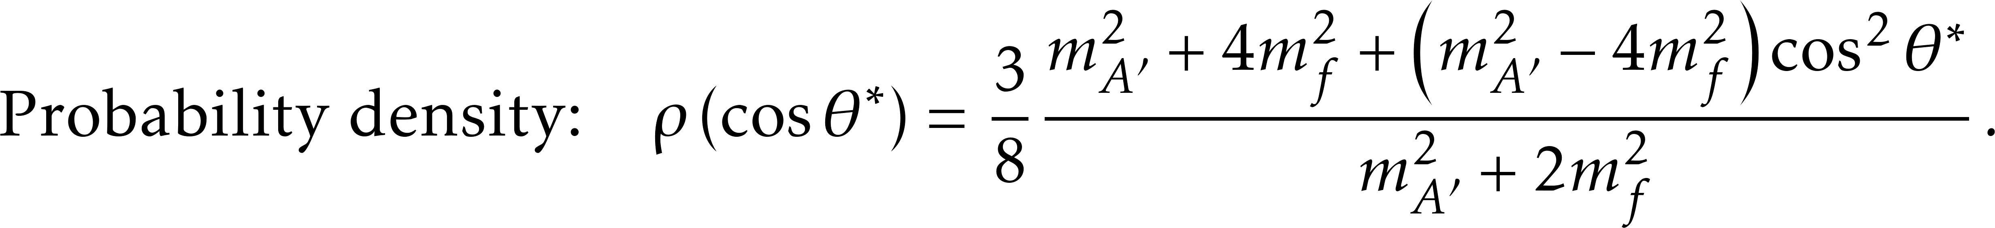
Results – decay products angular spectrum

Slide 17
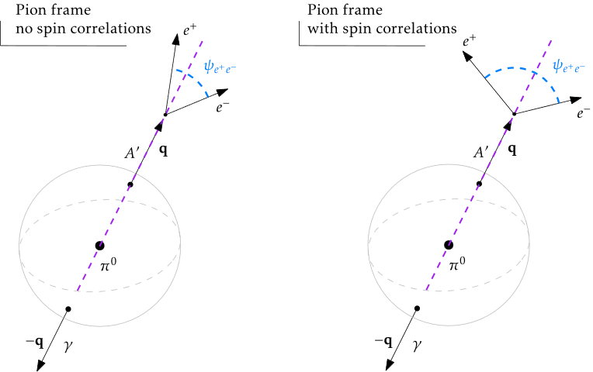
Results – decay products angular spectrum

Slide 18
Experiment specific analyses
Why FASER and SHiP?
FASER and SHiP represent two extremes; a high and a low boost system.
SC were thought to be negligible in FASER but without diligently checking – until our recent paper.

Slide 19
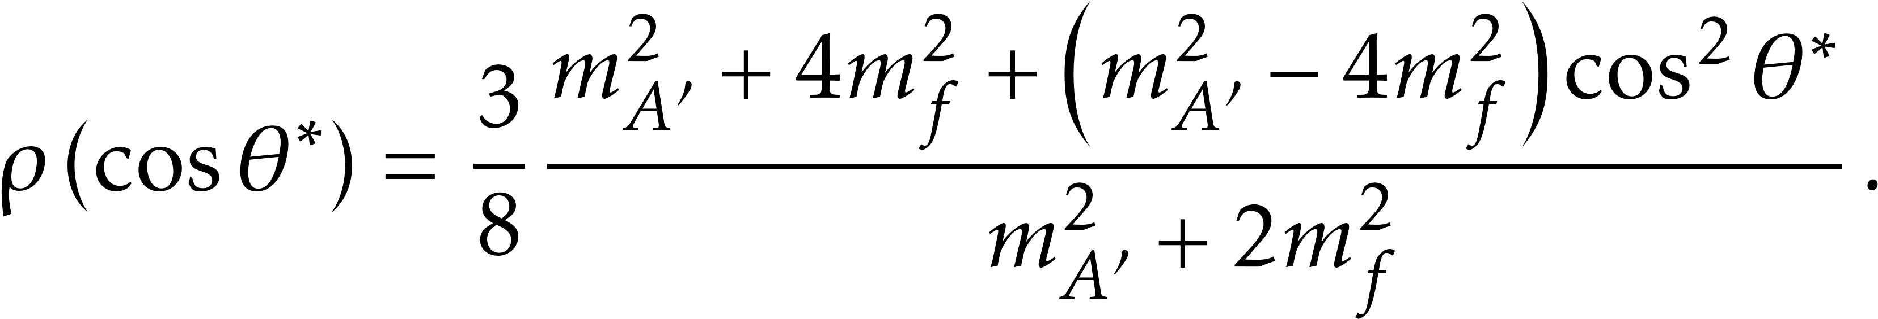
Experiment specific analyses
An Independent Signal Generator (ISG) was used to produce truth-level simulations of FASER & SHiP experiments.
Spin correlations were included with
Detector effects such as EM showers in the calorimeter were not incorporated.
CERN-FASER-NOTE-2022-011 FASER Collaboration E. Welch, et al., “Dark Photon Signal Validation and Systematic Uncertainties for LHC Run 3 in 2022”.

Slide 20
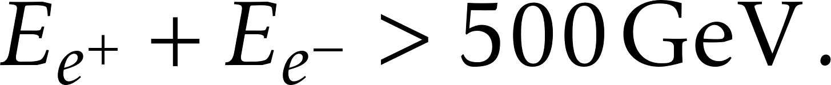
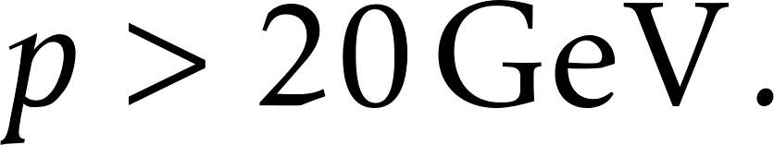
FASER analysis
Detector geometry
Total energy in the calorimeter
Two charged tracks with
Central tracks – tracks must remain within the cylinder.
Pion momentum distribution was taken from EPOS – LHC.
arXiv:2308.05587 [hep-ph] FASER Collaboration, Aug 10, 2023
arXiv:1306.0121 [hep-ph] T. Pierog, Iu. Karpenko et al. Jun 1, 2013

Slide 21
FASER analysis
Throughout parameter space with sensitivity 1-6% reduction.
However, just 1-2% reduction in unprobed region.

Slide 22
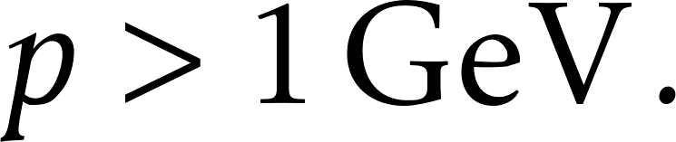
SHiP analysis
Detector geometry
Impact parameter of dark photon decay.
Two charged tracks with
Eta meson momentum distribution was sourced from FairShip.
arXiv:2010.11057 [hep-ex] Sensitivity of the SHiP experiment to light dark matter SHiP Collaboration. Apr 2021
https://cds.cern.ch/record/2878604 BDF/SHiP at the ECN3 high-intensity beam facility, Oct 2023

Slide 23
SHiP analysis
In meson channel only
With SHiP’s proposed cuts
arXiv:2011.05115 [hep-ex] - Sensitivity of the SHiP experiment to dark photons decaying to a pair of charged particles, SHiP Collaboration, May 2021.

Slide 24
Conclusion
Spin correlations are generically relevant to fixed target experiments
enhance energy asymmetry
enhance fermion opening angle
lighter fermions get a generically larger correction
Spin correlations impact experimental cuts and acceptances
Both projected SHiP and future FASER search stand to benefit from reassessing cuts in the light of spin correlations effects

Slide 25
Thank you!

Slide 26
Event generation for FASER

Slide 27
Event generation for SHiP
Notes:
All energy spectra are after the impact parameter cut!

Slide 28
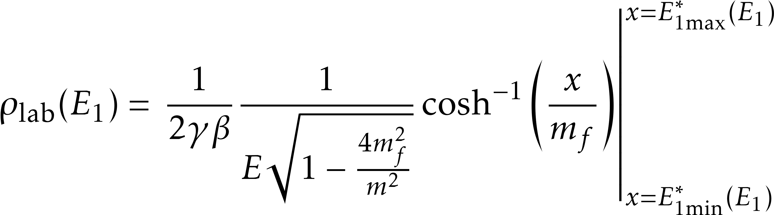
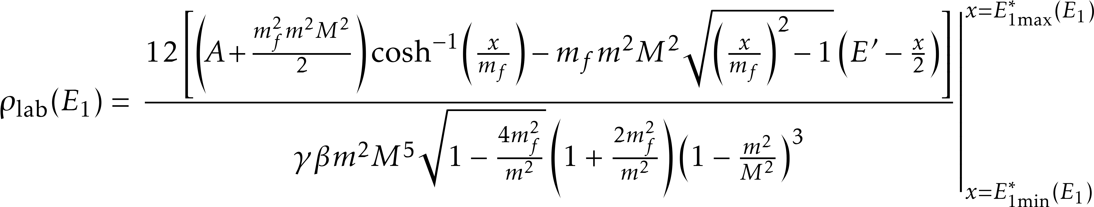
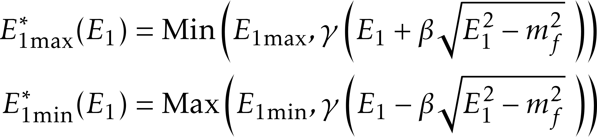
Results – more analytic expressions

