Slide 1
SR1 ITk IS Data Transmission Updates
RCE Test Stand Meeting
December 16th, 2025
Austin Mullins, Martin Kocian

Slide 2
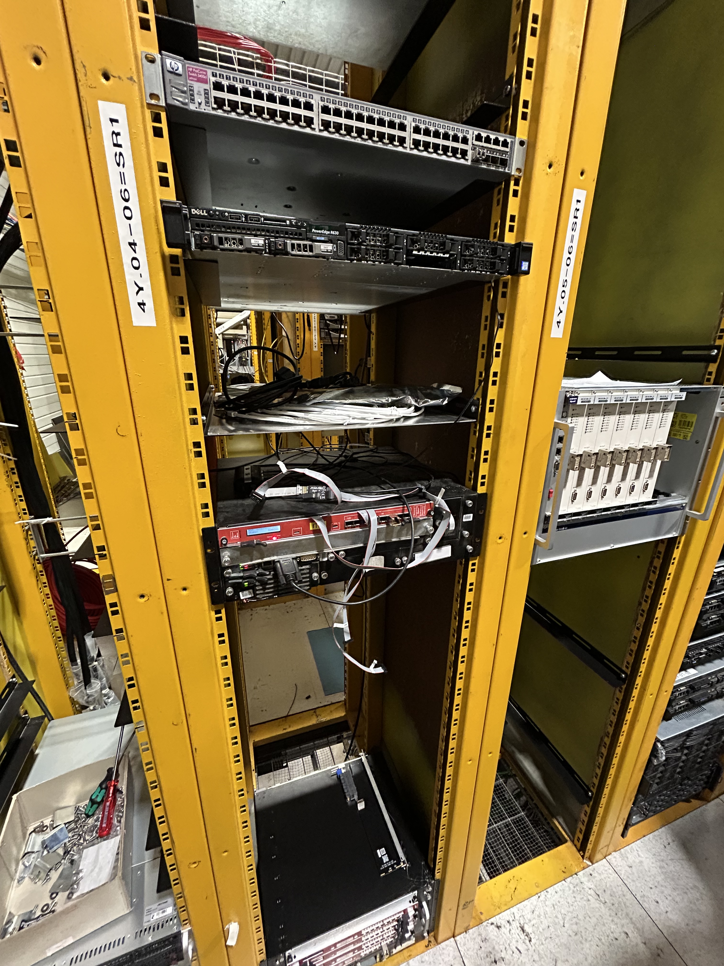
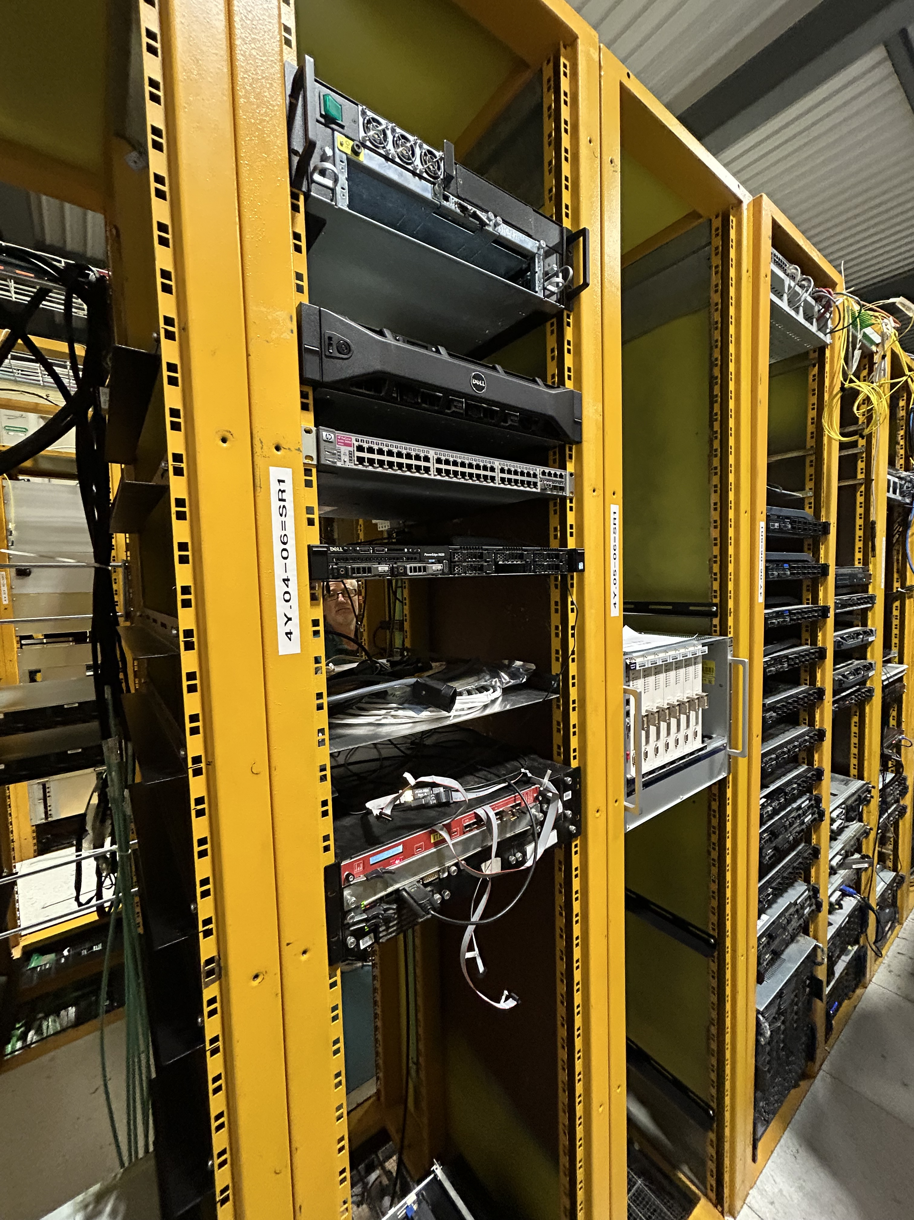
NEW Test Stand Location
The RCE test stand has been moved to the 4Y_04-06=SR1 rack.
Crate with COB
Second available crate

Slide 3
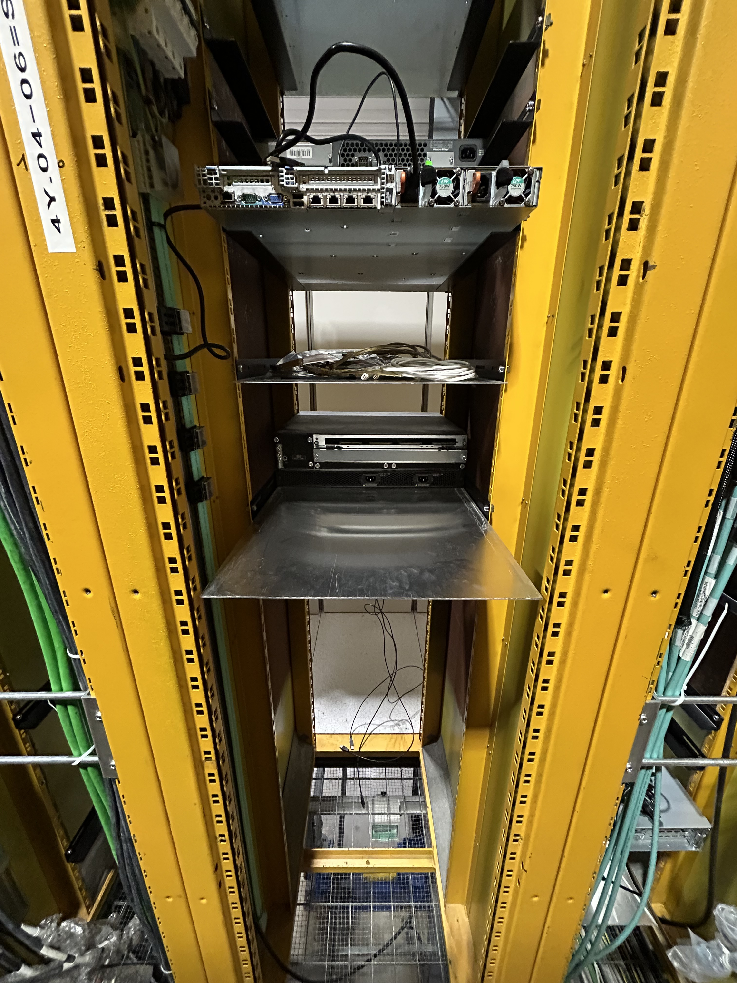
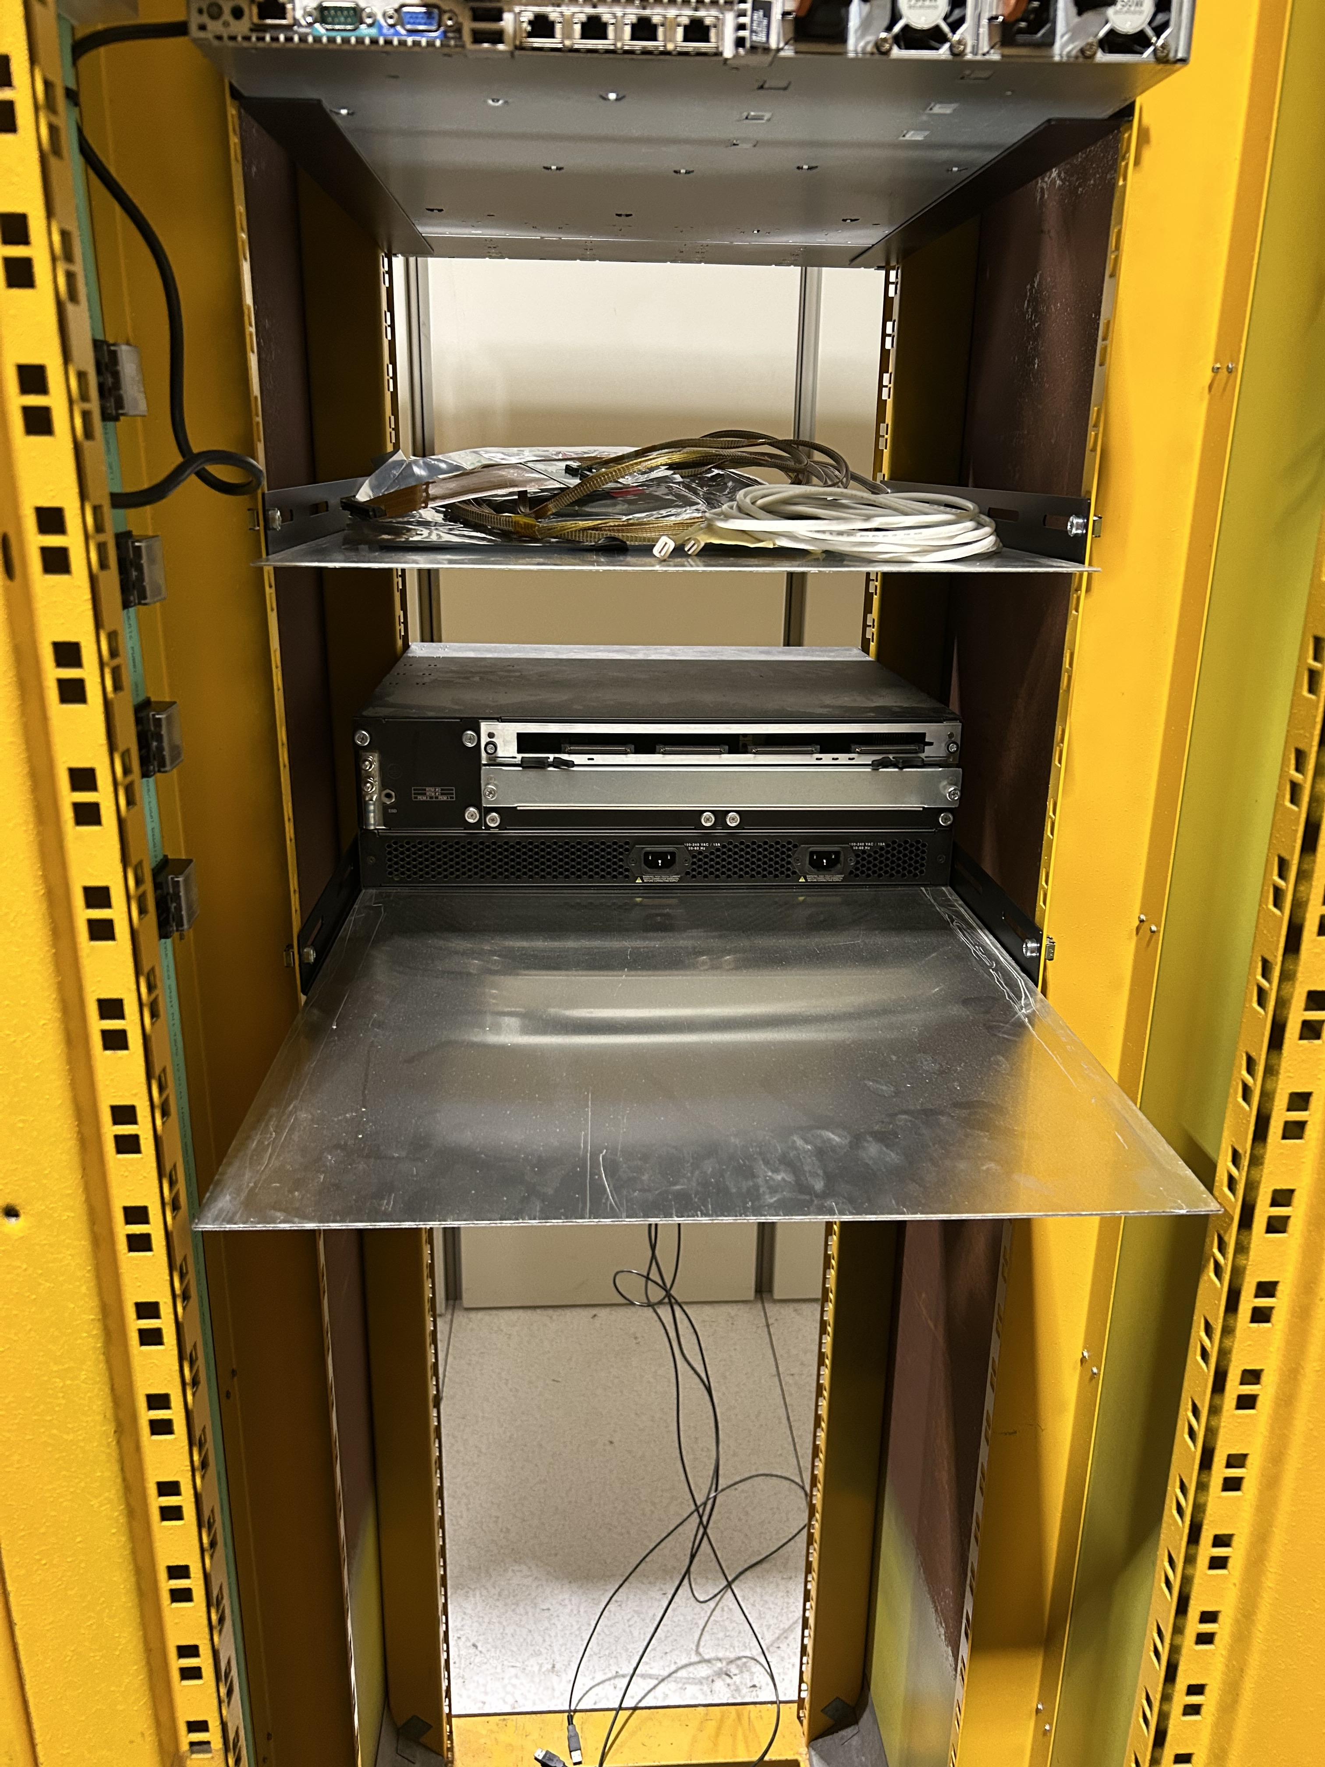
NEW Test Stand Location
Crate position has been optimized for easy access and cable storage.
Cable
storage
Bundle landing zone

