Slide 1
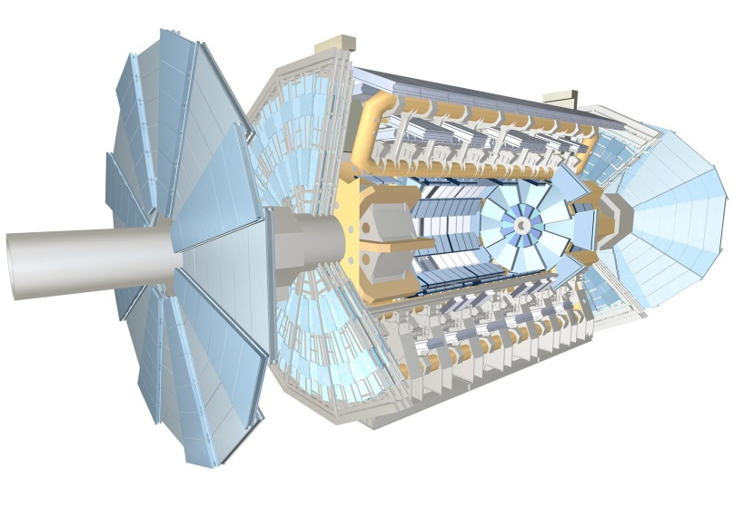
Muon Operation
A. Polini
(on behalf of the Muon Group)
Outline
Detector Status
  CSC, MDT, RPC, TGC
Operation:
  Data taking, Data Taking Efficiency
  Data Quality, Detector Alignment
Shutdown Plans
Manpower
Shift Organization
RPC
CSC
MDT
TGC
Many thanks to all who provided material and information

Slide 2
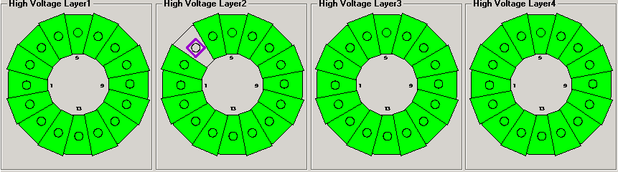
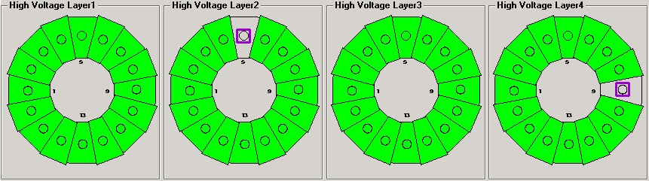
CSC Detector Status
CSC
SideC
SideA
CSC detector is working fine
Dead channels stable:
  total of 3 wire planes (out of 128) without HV due to trips
  2 since the start of Atlas operations
  1 additional dead layer since August (possibly broken wire)
  Dead layers are in different sectors: → no degradation of reconstructions efficiency
Operation-wise: system very stable, almost no hiccups
Mentioned in previous Atlas/Muon Weeks:
  CSC ROD (failed to configure) this summer
  Few cases of “CSC link lost” during a physics run
  Either fixed or understood

Slide 3
CSC ROD Status (i)
CSC
The CSC system has been running reliably during 2011 and has not caused operational loss during data taking. During this period, two CSC ROD firmware releases have been deployed at P1:
  V07-05-00 : addressed a misconfiguration problem that resulted in the inability to absorb bursts of more than 4 L1s Accepts.
  V07-06-03: provided a fix for the so-called lock-up problem, in which a ROD could assert busy permanently. Note that this behaviour has only been observed during testing with high trigger rates and high data occupancy and never during data taking.
During the winter shutdown we aim at deploying a new release that removes internal status words that may degrade performance. The performance gain will depend on the event size distribution, which we will understand better when running with collisions. This release also improves reliability by adding ROD status checks during the Start-Of-Run and the End-Of-Run transitions.

Slide 4
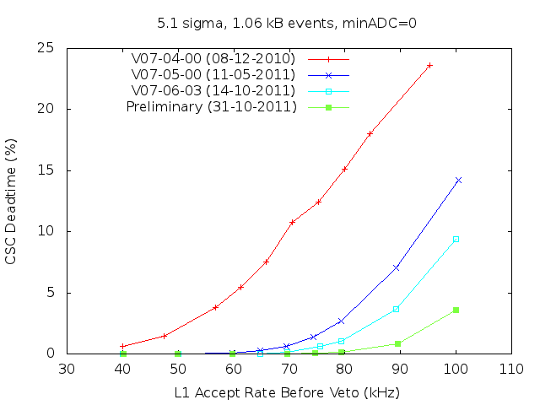
CSC ROD Status (ii)
CSC
The performance of various CSC ROD firmware releases is shown below. The random trigger pattern used to obtain these results is more stringent than that used during data taking to insure that the CSC ROD meets all the ATLAS requirements. Actual observed performance (dead-time) is typically better by ~2%.

Slide 5
CSC ROD Status (iii)
CSC
Since December 2010 we have been in maintenance mode.
After deployment of the current candidate release there are no scheduled plans for performance improvement.
The CSC dead-time could be further reduced by increasing the thresholds and by reducing the number of samples from 4 to 2. The latter option does however affect the off-line reconstruction software. The actual impact is currently being evaluated.
For the future (13th down), a new design of the CSC ROD is under consideration by the CSC ROD steering group (Vinnie Polychronakos, Frank Taylor, Andy Lankford, Jim Bensinger, Mike Huffer and Su Dong). Building a new ROD will be based on both ATLAS needs and requirements as well as finding the necessary resources.

Slide 6
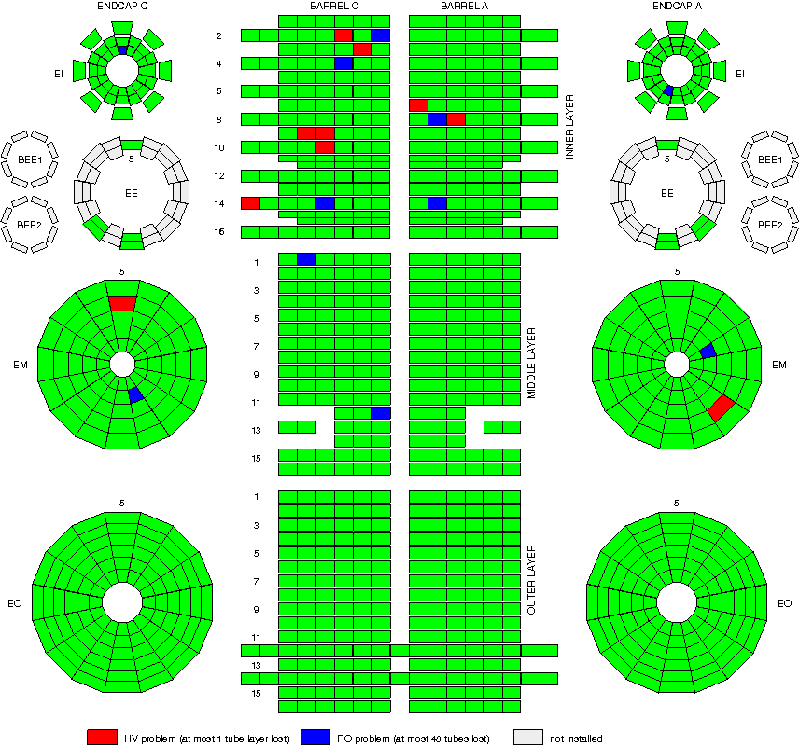
MDT Detector Status
MDT
Working channels: 99.72% (0.10% can be fixed if we get access, 0.18% are lost). This correspond to 968 of 341568 channels not working. This number is quite stable, as we can fix most of the problems during the Technical Stops, the minimum this year was 99.67%, the maximum 99.74%.
Only single tube layers (of 6 or 8) or single mezzanine cards (24 channels in 1 ML) or less missing in each of the affected chambers.
There are two exceptions: EMS2C12 is missing 2 mezzanines in different ML which actually create a tiny loss in acceptance a few tubes wide and BIS8C14 where 1 of 3 tube layers is missing (but the chamber is very small).

Slide 7
MDT Operation and Plans
MDT
Operation:
MDT: Very stable both DAQ and DCS wise
Stopless recovery has been improved to handle the following cases:
  A mezzanine is dropped
  A chamber is dropped
  LHC clock has a jump or a glitch and the TIM module goes busy.
  A ROD goes busy (still deserves some debugging).
Plans for the shutdown:
EE chambers installation (Complete installation of missing EES and EEL chambers of side C; side A will follow in 2013/2014)
➔ see Lulu Liu's and Jorg Dubbert’s presentations
Gas System:
  Fix of EO gas leaks. So far at least we know of 45 channels with leaks (8 large, 14 medium, 23 small leaks). Each channel serves one Multilayer of 6 chambers. From January to July we had 15 new leaks, 14 leaks got worse, 16 stayed the same class.
  Full leak test of all channels (barrel + endcap) over Christmas as usual, then early January ML by ML search on EO, then fixing of EO gas leaks.
The usual small repairs on the front-end electronics

Slide 8
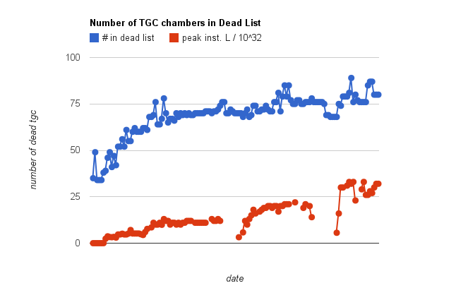
TGC Detector Status
TGC
TGC units not holding HV:
  Now 80 out of 3588
  affected detector fraction is 2.2%
  Affected region w.r.t. to primary muon L1 trigger is 0.08% (only if same units in multiple layers affected)
  Need of careful monitoring of the development
During Christmas shutdown operate
TGCs on pure CO₂: try to burn off
deposits on wires by allowing
temporarily high currents
LV, threshold, readout 100% operational
Technical Stop:
Recovery of few units with
trip problems due to power
supply
You are here
Mar ‘11
Nov ‘11

Slide 9
TGC Operation and Plans
TGC
Operation:
ROD: big improvement in the recovery procedure; now automatic fast recovery when a ROD goes busy or a star switch is dropped. If does not work, manual on the fly full reconfiguration
Front-End: stable with a few recent hiccups. Rare and difficult to address. This will be done during the shutdown.
GNAM: improvements in 2011 but still room for work in 2012
Shutdown Plans:
Replacement of chambers ( less than 10 ) is planned
Data recording scheme of the stand-alone partiton is modified
  ROD local recording to ROD → ROS → Muon Event Builder → Castor
Change four VME power supplies which currently have no monitoring

Slide 10
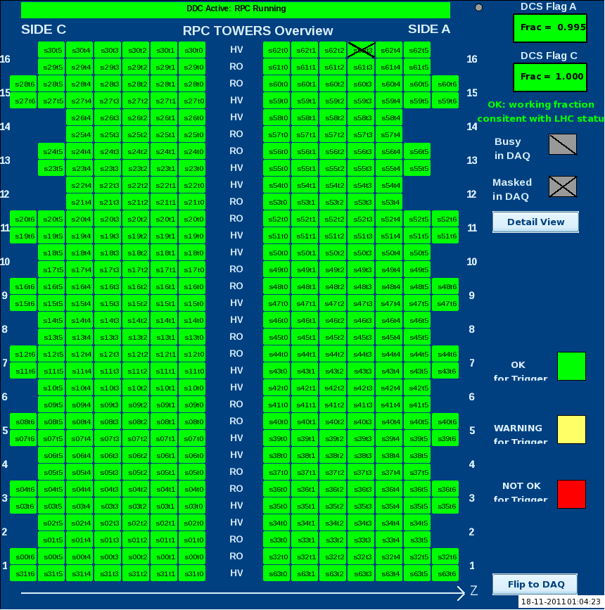
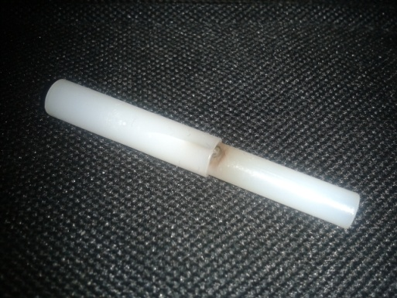
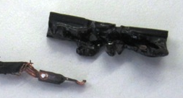
RPC Detector Status
RPC
Generally running with
active readout channels: 97%
active trigger towers: 99.0 - 99.5% (0~3 off out of 404)
Disconnected Gas Gaps
47 (out of 3592) gaps disconnected from HV,
mostly on BOL chambers (broken gas inlets)
23 gaps on HV Recovery channels
Detector usually very stable
Some issues with:
HV connectors:
  4 failures in 2011
  (1 failure/week before the replacement of all the rack side connectors) ➔
  Easy replacement (Cavern Rack side). Will continue monitoring.
48V power failure:
  Traced in all cases to a 48V connection having developed an increase of electrical resistivity leading to a connector to melt down ➔
Reduced impact due to prompt request for access
Since August: added DCS monitoring in order to spot potential problems before failure

Slide 11
Long List of Shutdown Activities
RPC
Gas standard repair
Most of the detected leaks are due to broken gas inlets on chamber which can be fixed in most of cases, providing sufficient access
Gas impedance installation
Replacement of the present impedances on gas distribution with higher values to obtain a more uniform gas flow and a general decrease of the gas leak
Flow re-adjustment to control leak rate and compensate high background
Gas BOL repair
In about 45 cases accumulated up to now the standard repair is not applicable due to lack of access on the broken inlet. Alternative methods are under study
Re-building of 48V distribution to HS crates
Replace cables, replace daisy-chain with star distribution, exploit redundancy on input/output connectors on back of crates, install new fastening blocks, use single connector for +/-ve pole pair, monitor current flow between service and power lines
Grounding improvement
About 230 thresholds over 3000 have been set to harder values due to e.m. radio-frequency pickup noise concentrated on the early installed chambers
Cable-stops installation to enhance Faraday cage

Slide 12
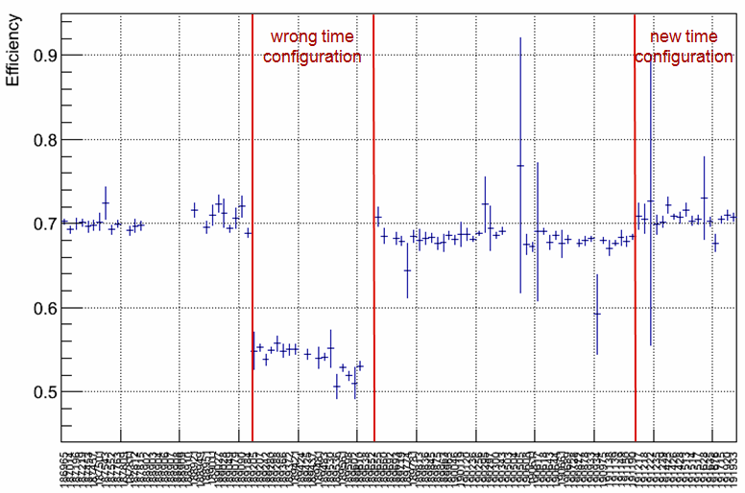
Barrel Level 1 Status
RPC
Level1 trigger in the barrel has shown good stability over the year:
Trigger tower hardware failure: towers have to be manually masked out from the DAQ, and fixed/replaced during the first available cavern access (16 Pads replaced during 2011 + some cables/fibers). Total inefficiency caused by killed/masked towers and out of sync towers/SL/ROD is about 0.6%
New Trigger Tower Recovery: malfunctioning towers are automatically killed in the Sector Logic. Muon shifter can manually detect and recover the trigger tower holding the trigger and running a resync procedure.
BCID/L1ID loss of sync of a ROD or a SL (rare): can be caused by a clock distribution problem, noise induced from HV failures, ... New DQ tools in place to spot the problem. Run stop and reconfiguring the RPC usually solves the problem.
Trigger efficiency: a wrong timing configuration from September 12th to 22th caused a drop on barrel trigger efficiency by a factor around 15%. A new (improved) configuration on October 17th (run 191215) increased the efficiency by around 4%. Now we are around the nominal efficiency value, some small improvements can still be applied next year

Slide 13
DAQ Status and Plans
RPC
RPC:
  Develop an automatic recovery within the DAQ for killed trigger towers and for out of sync trigger sectors/RODs
  Begin to work on the upgrade of the level1 barrel trigger using additional RPC stations in the feet region. The plan is to equip at least a couple of new trigger towers (a total of 16 new trigger towers will be fully equipped during the 2013 shutdown)
Common to all technologies:
  TDAQ migration during the shut down
    Need to agree on target date: either 2nd week of December or 2nd week of January (to be agreed)
  Concerns:
    A better follow up of day-to-day problems by on call experts.
    Need of new long term experts
    Documentation

Slide 14
Muon Alignment
Status:
Barrel and Endcap alignment very system stable routinely providing an updated alignment automatically every 2 hours, which is used at Tier-0 for prompt reconstruction.
Occasionally (~1 case every couple of months) a problem with an entire chamber becoming unresponsive, either temporarily (for up to a few days) or permanently. In most but not all cases the issue is a repeater which sits on the outside of the wheel and is accessible in a short access or a shutdown, and which we replaced whenever possible. In some cases the problem seems to be rather a severely malfunctioning device on the chamber, or the multiplexer on the chamber, and in both cases there is nothing we can do unless we get access to the wheel surface, i.e. only in the winter shutdown. At this moment we have some 4 chambers in this category, two of which are permanent, two are intermittently unresponsive.
Plans:
For upgrades there is of course the EE chamber installation upcoming, which we are preparing for. In addition we are planning to put alignment sensors on the BEE chambers. The latter is foreseen for the 2013/14 shutdown but we will try to manage to equip one sector (as a prototype) in this shutdown already.
Alignment Run (Toroid Off)
alignment in 2011 March 21-22 (Run nr 177986 and 178019-178026)
alignment in 2011 September 7th (188902-188910)
We still need those 30pb⁻¹ of toroid-off data (minus the ~9 we already got), to be taken at a good occasion next year.

Slide 15
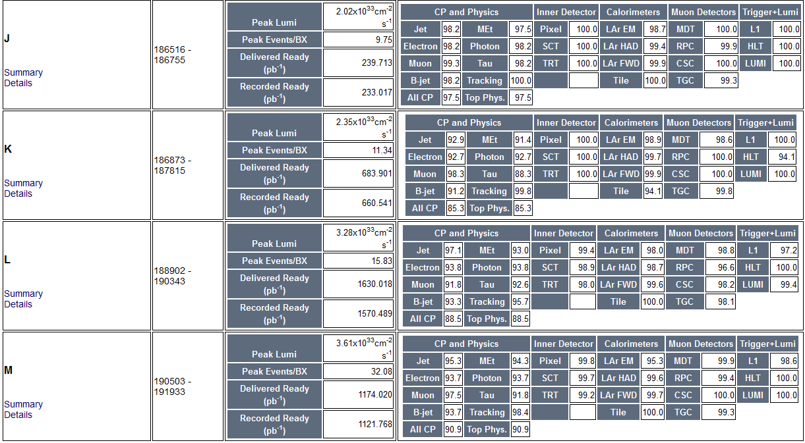
Data Taking and Data Quality
Sat Jul 30
Muon running ‘overall’ smooth in general....
With unchanged fraction close to 100% of “good DQ’” flags
Includes special runs with toroid magnets OFF for straight track alignment → Flagged as “bad” for standard physics
Thu Aug 04
Thu Aug 04
Technical
Stop
Mon Aug 22
Wed Sep 07
Tue Oct 04
Thu Oct 06
Sun Oct 30

Slide 16
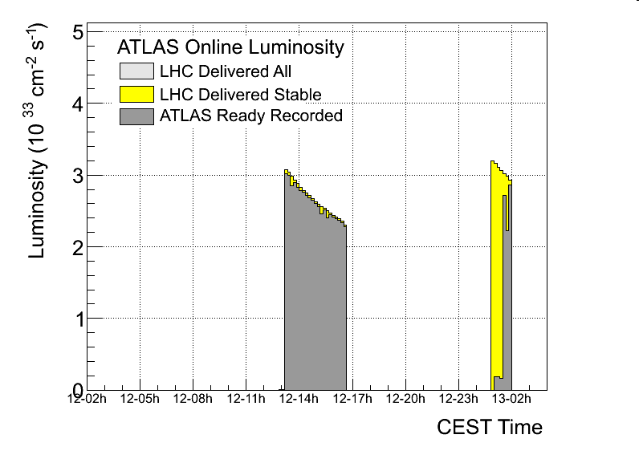
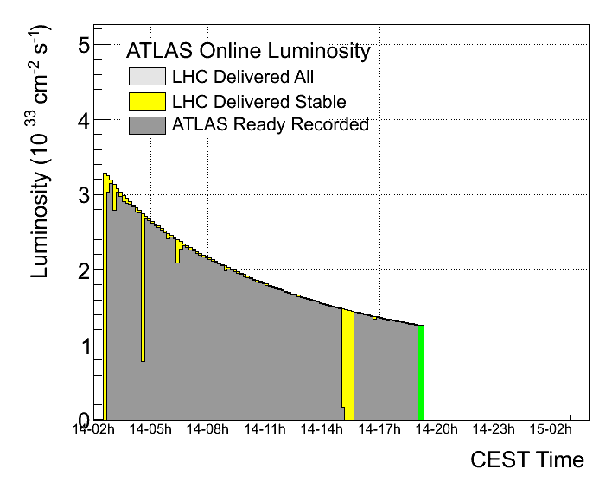
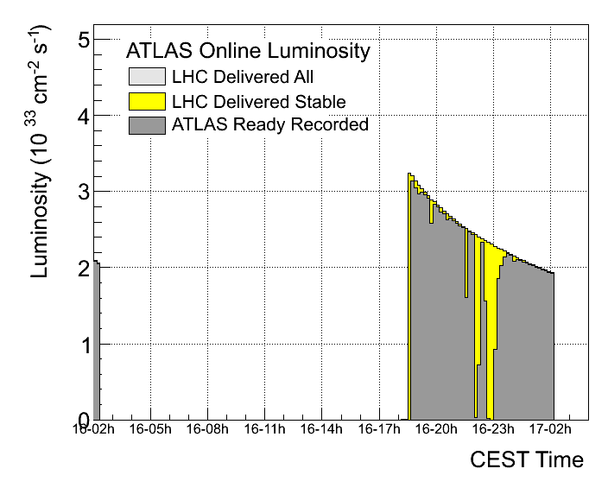
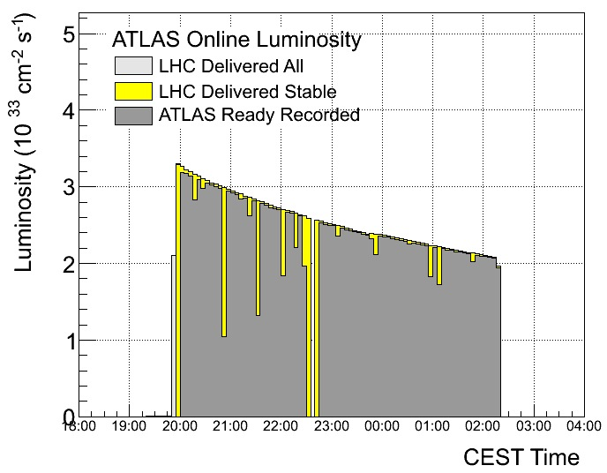
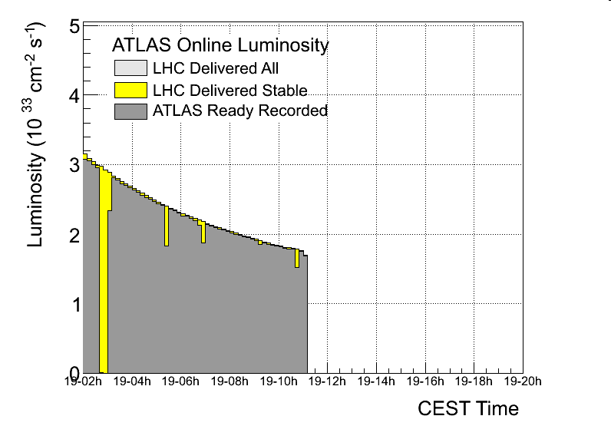
…Not always smooth running
Muon “Black Week” Sep 12 to 19:
Sep 12
Sep 14
Sep 15
MDT
TGC
CSC
Sep 16
Sep 19
RPC
MDT
The good news: very few weeks like the one above
Almost all understood and solved !

Slide 17
Muon Shifts

Slide 18
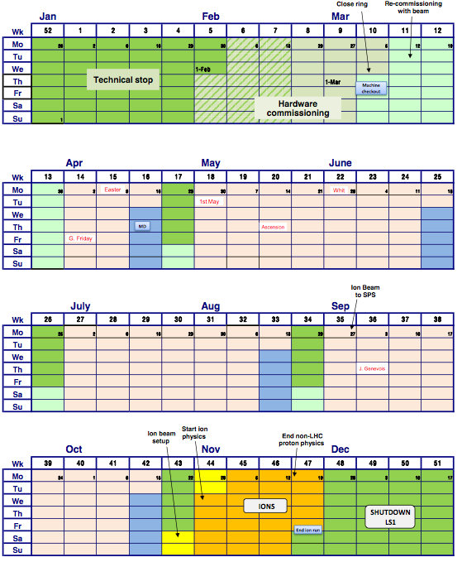
2012 Operations Planning, Shifts and Shift Booking, Muon Experts Situation, (Shutdown) Manpower Situation
2012 Atlas Operations:
LHC operations ~March 9 to Nov 23
Atlas full shift crew from March 1st on
ACR shift crew will be 10 people/shift (4 detector shifters, 6 common tasks: run control, shift leader, trigger, … shift merging has been completed also for other sub-detectors)
Total of 8440 Atlas shifts needed in 2012 (incl. SLIMOS full year)
2471 “Atlas authors” (OTs) →
3.4 shifts/”person”
~800 muon ACR shifts to be covered
~270 offline muon DQ shifts + class 2
calibration center shifts.

Slide 19
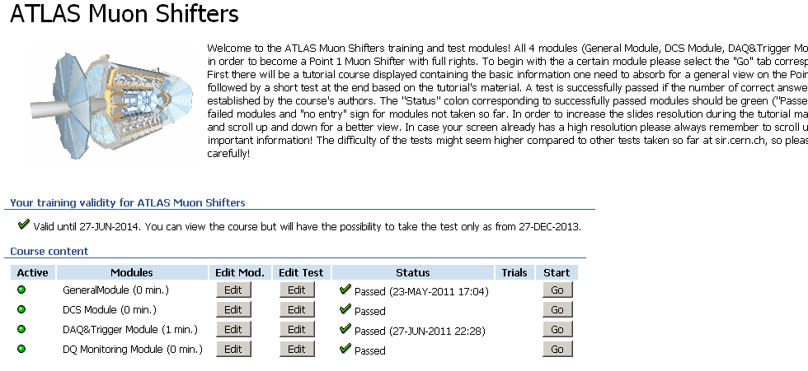
New Web Based Course
After the Feb. session we abandoned the (bi)monthly shift training day with overview talks and tutorials, due to too few participants.
NEW (work of Dan Vladoiu from LMU Munich): web based training course → sir.cern.ch → Course: Atlas Muon Shifters
You are all encouraged to use it (more instructions on how to see also on the shift manual twiki)
Comments, feedback, problems: report to Muon Run Coords + Dan

Slide 20
Muon Shifts in 2011 and Shift Booking Procedure …
Recap of 2011:
Collaborators doing muon operations shifts required to at least 12 shifts within 3 months
Shift call in autumn 2010 done in 2 steps
  asked institutes (team leaders) to provide a short list of 2-4 people from their group who should do muon shifts
  2 weeks later opened shift booking in OTP for the full year for the ‘nominated’ people
  Allowed people to BOOK shifts before they had completed the shift training, with the requirement to complete shift qualification before the actual shifts (different from many other systems)
From muon run coordinators point of view worked reasonably well, in particular compared to 2009 did not have the situation with many shifters doing a single or widely spaced apart shift blocks which proved very counter-productive to efficient operations …
Some complaints from institutes
  not being able to get their fair quota of shifts since booked out already
  some complaints that some institutes ‘grabbed’ a far large share of shifts then their ‘quota’ in muons but did not contribute to other non-muon shifts …

Slide 21
Shift Booking for 2012
(From IB) Would like to apply a similar scheme as last year
Keep the requirement that muon shifters must do at least 12 shifts within a 3 months period
Ask institutes to provide list of max. 3 people/institute to do muon shifts in 2012 by December 1st
Institutes not having managed to do any muon shifts in 2011 can ask for preferred booking for 2012 … stating so before 1st when providing the list of shifter candidates
Preferred shift booking for institutes not having done muon shifts in 2011 from Dec 5 to Dec 8
Open OTP shift booking for all other listed shift candidates on Dec 12.
(Review shift booking situation in spring 2012, if needed ask general muon community to volunteer for shifts …)

Slide 22
Experts Situation
Experts situation and long-term prospects are becoming a real problem:
Several expert on call tasks are (still) covered by very few (2-4) individuals all year round, this is not sustainable for the future!
Not easy to find new people willing to become primary on-call experts, in particular if it involves weekends etc., and given it needs quite a bit if effort to get to the level of ‘being an expert’ …
Phase a lack in particular for CSC/MDT already this summer
Increasing problem on how to train new experts and pass information from one generation to the next:
  People doing on-call duty as qualification work too often disappear from the activity after the qualification phase is complete ☹ ☹ ☹
  People after their qualification phase may be willing to continue as on call ☺, but do not want to/are not in the position to in turn train new people and bring them to expert level ☹
  Many expert tasks currently still depend largely on original long-year experts to train any newcomer, with long-term people leaving (or finally wanting to do something else), will and is having in some areas already an adverse impact on operations and data taking quite soon if not solved !
PLEASE HELP !!

Slide 23
Conclusions
All muons subsystems are running well: lot’s of progress for improving stability and monitoring of the system
Also true is that smooth and good running still require
careful and continuous monitoring and expert’s presence: the coming shutdown is an opportunity to solve the remaining glitches and further improve the stability
Detector-wise a busy schedule for the coming shutdown but, from the detector side, there are a few points to watch but no major worries
Missing experts and loss of expertise is becoming a real issue and might soon impact adversely on data taking if we do not find a solution

