Slide 1
ATLAS Muon PL Election 17-Nov-11
The Candidates for Term 01-Mar-12 to 28-Feb-14
  Tatsuo Kawamoto (University of Tokyo (JP))
    Seeking 1st 2-year term
  Ludovico Pontecorvo (Universita e INFN, Roma I (IT))
    Seeking 3° 2-year term
Election rules will follow those for the ATLAS Spokesperson
  https://atlas.web.cern.ch/Atlas/private/ATLAS_CB/CB_Approved_Documents/

Slide 2
Voting Procedure (Outgoing Spokesperson Standing for Re-election)
Under rules of the collaboration he/she must obtain a 2/3 majority for election to an additional term. All candidates, including the outgoing spokesperson (OS), should be put to a vote. [To vote for the OS alone would be unfair to him as some voters might switch their votes to him if their candidate were defeated.] If someone has an overall majority, or the OS has a 2/3 majority, from all the institutions represented then they are elected. Abstentions count against at this stage.
If this is not the case, then the candidates with the two highest numbers of votes are retained. If after the next vote a candidate, other than the OS, has a simple majority, not counting abstentions, then they are elected.
If the OS has less than 2/3 of the total vote, with abstentions counted against, then he is eliminated. Given that the OS's supporters might now prefer to vote for a person who had been eliminated at the earlier round, all remaining candidates are brought back and the voting is repeated without the OS according to the previous rules.
In the case that there are only two candidates initially, one of whom is the OS, and neither achieves the necessary majority (>2/3 for the OS, >1/2 for the other candidate) then the OS is eliminated and a vote is taken for the other candidate with a simple majority required for election, not counting abstentions.
If the required majority is not achieved, the search committee will seek new candidates.

Slide 3
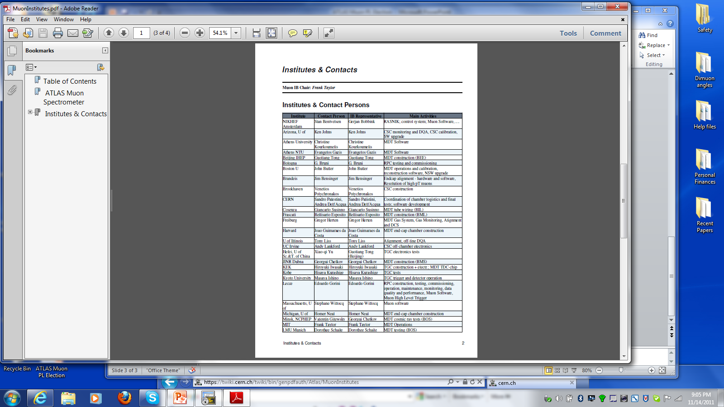
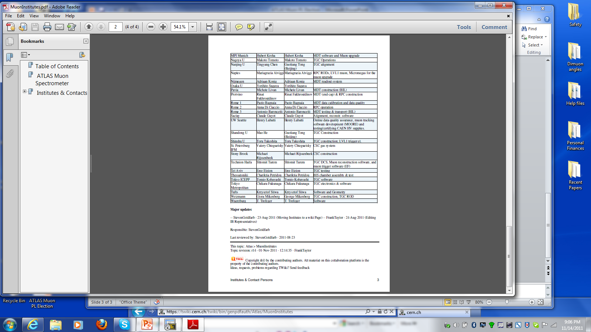
52 Institutes => Simple majority = 27 must participate for election to be valid

